Slide 1



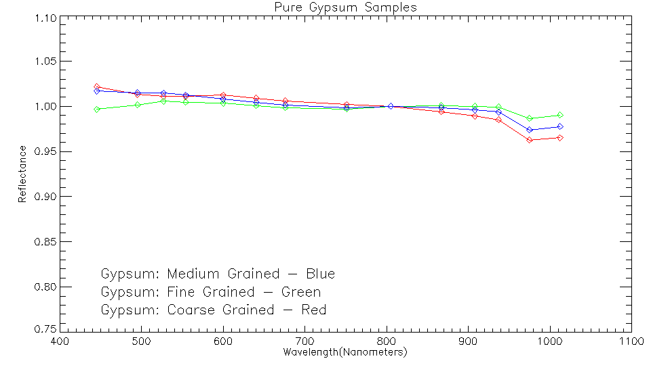
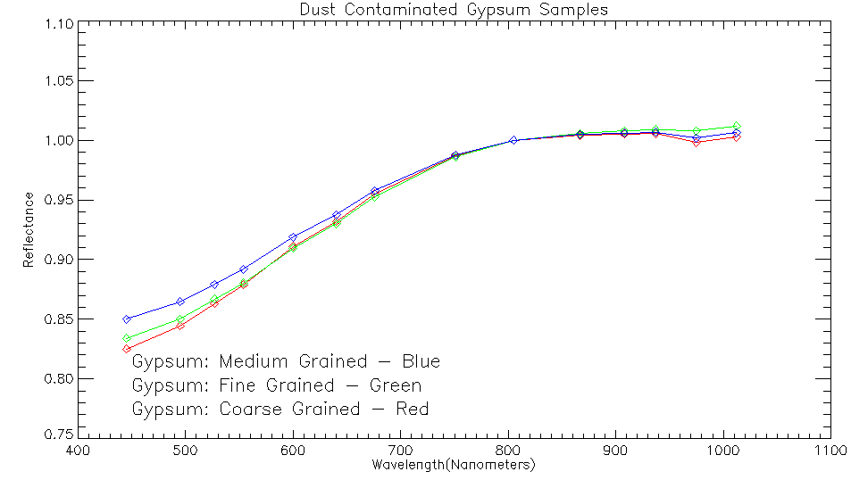
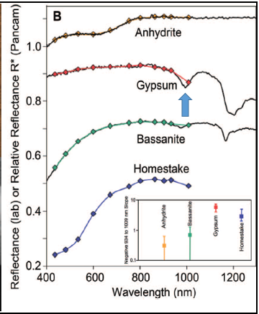
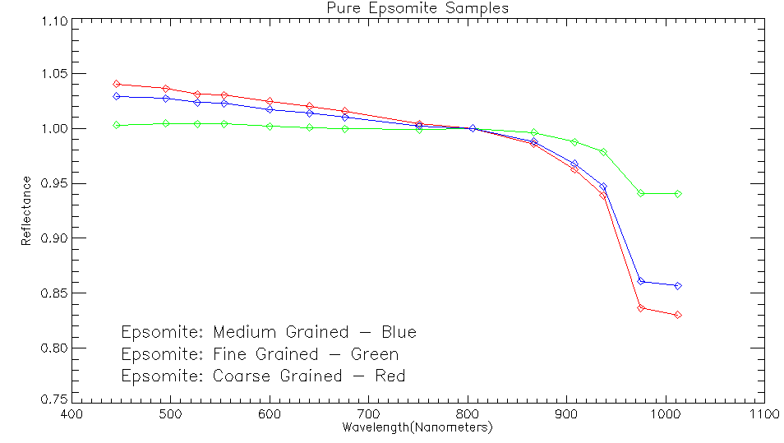
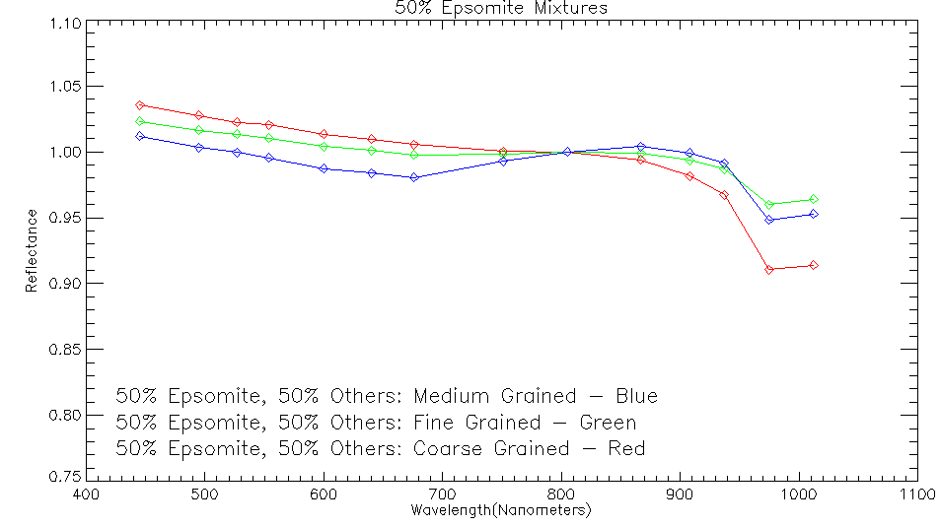
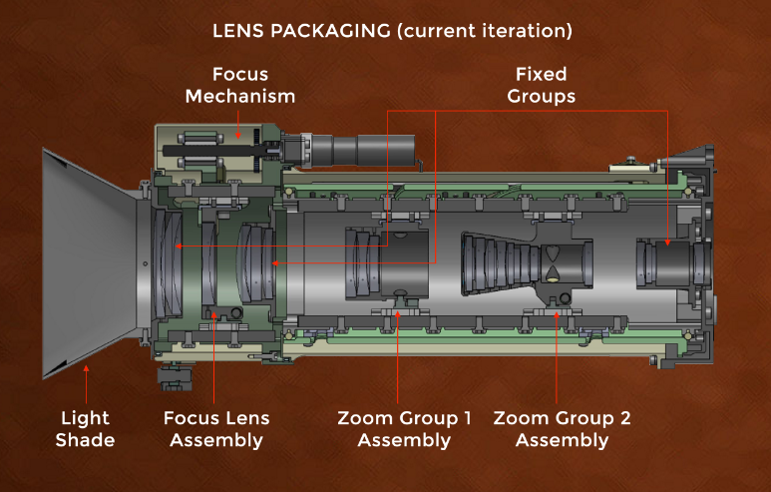
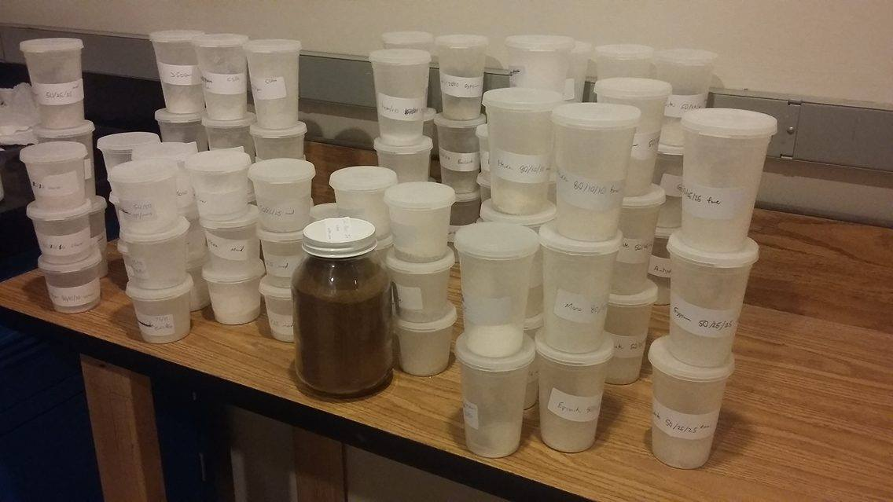
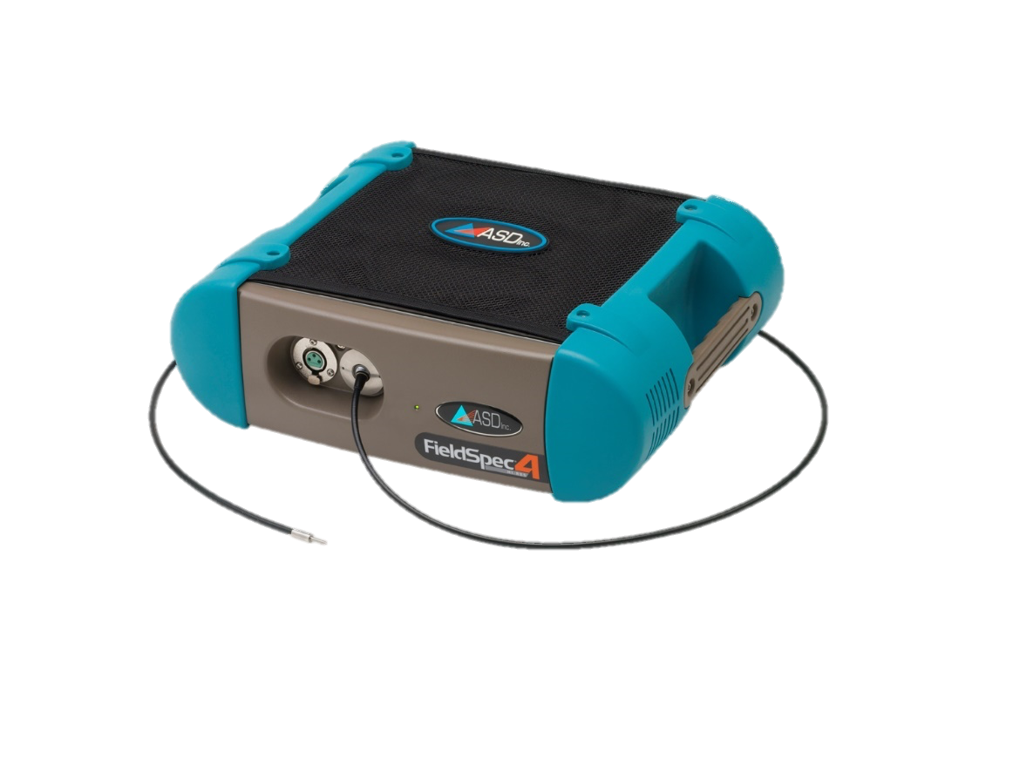
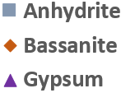
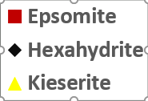
Hydrated Sulfates on Mars: Characterizing Visible To Near-Infrared Spectra and Implications for Rover-Based Imagers
Darian Dixon, Western Washington University • Dr. Melissa Rice, Western Washington University • Dr. Edward Cloutis, University of Winnipeg
1. Key Questions:
Observed Spectral Trends:
4. Conclusions:
What hydrated sulfate minerals will be detectable to the Mars2020 Mastcam-Z instrument?
What effects will grain size, dust cover, and mineral mixtures have on Mastcam-Z’s ability to detect hydrated sulfates?
The 950-1000nm hydration feature may be especially difficult for Mastcam-Z to detect in calcium sulfates (at these grain sizes)
Only pure, dust-free gypsum offers reasonable detectability (>1% band depth)
Bassanite hydration band may be undetectable to Mastcam-Z
Anhydrite undetectable to Mastcam-Z
Polyhydrated magnesium sulfate (hexahydrite and epsomite) hydration bands may be detectable with Mastcam-Z
Band depths for pure, pure dust-contaminated, mixed, and mixed dust-contaminated samples show sufficient band depths to allow detection; especially in larger grain sizes
Kieserite, a monohydrated magnesium sulfate, displays <1% band depths unless mixed with other phases and may be difficult to detect
Band depth generally increases with grain size for all sulfates
Very fine, dust-like accumulates of some sulfate minerals could present significant challenges to Mastcam-Z
Minerals in lithified outcrop may be more detectable
Fig 5a and 5b: mixing of 5% by sample volume Mars dust simulant to epsomite powder decreases the hydration feature band depth
Hydration Feature Band Depth Reduced
2. Background:
Hydrated sulfates have been detected across widespread regions of the Martian surface [1-7].
The Mars Exploration Rover and Mars Science Laboratory missions are equipped with multispectral visible to near-infrared cameras (VNIR), Pancam and Mastcam, that have some sensitivity to hydration in sulfate minerals.
Their low spectral resolution has made characterizing these narrow hydration bands difficult [8-9] .
Mars 2020’s Mastcam-Z is a stereoscopic, multispectral imaging system with a zoom capability, a Bayer pattern CCD, and 13 unique narrowband filter positions from 440-1100nm.
Mastcam-Z will include a new filter position near 975nm to better constrain the these hydration features that occur in the 950-1000nm range [10].
To aid investigations of Mars’ surface with these cameras, we have analyzed VNIR reflectance spectra of Ca- and Mg-sulfates.
Figure 6a and 6b: Hydration feature band depth decreases in 50% epsomite, 25% hexahydrate, 25% kiesierite multiphase mixture.
Hydration Feature Band Depth Reduced
Figure 1: Lab and Mastcam simulated spectra of Ca-sulfates compared to spectra of the Homestake gypsum vein observed by Opportunity Pancam in Meridiani Planum
Mastcam vs. Mastcam-Z Spectral Comparison:
Figure 7: Addition of the new ~975nm filter resolves the weak hydration band in the 950-1000nm region in epsomite in Mastcam-Z spectra, whereas this band is more difficult to resolve in Mastcam
Mastcam-Z ~975nm filter location
Figure 2: Schematic of proposed Mastcam-Z lens packaging
3. Methods:
Mastcam-Z Detection Thresholds:
5. Future Work:
Pure Calcium Sulfates
Dust Contaminated Pure Ca Sulfates
Calcium Sulfate Mixtures
Pure Magnesium Sulfates
Dust Contaminated Pure Mg Sulfates
Magnesium Sulfate Mixtures
Dust Contaminated Mg Sulfate Mixtures
Experiments to be repeated for other percentages of multiphase mixtures.
A broader suite of minerals will undergo spectral analysis in a Mars Environment Simulation Chamber at University of Winnipeg.
All spectra will be included in Western Washington University’s currently in development interactive online spectral database to assist mission scientists.
Ca-sulfates: Gypsum, Bassanite, Anhydrite
Mg-Sulfates: Epsomite, Hexahydrite, Kieserite
Samples were created separating each pure mineral into three grain size fractions and also mixing samples by volume to 50/25/25% mixtures.
JSC Mars-1, a martian dust simulant was also introduced to each sample at 5% by sample volume.
Grain size ranges: <63ųm, 63-500ųm, >500ųm
Lab spectra were digitally convolved to Mastcam-Z filter resolution to demonstrate how these spectra would appear to the Mastcam-Z instrument and determine Mastcam-Z’s ability to detect hydration features in these minerals.
Percent Band Depth
Figure 3: Mars JSC-1 dust contaminant (center) and sulfate samples in the WWU mineral spectroscopy lab
F
M
C
F
M
C
F
M
C
F
M
C
F
M
C
F
M
C
F
M
C
Figure 8a-8g: Percent band depths for the ~975nm filter position in Mastcam-Z simulated spectra. Green region may be detectable by Mastcam-Z. Dust contaminated samples mixed with 5% by volume of sample Mars JSC-1. Sulfate mixtures include 50% of a dominating sulfate, 25% of remaining two sulfates in each series. Grain size is indicated on the bottom axis as F = Fine (<63ųm); M = Medium (63-500ųm); C = Coarse (>500ųm)
Hydration Feature Detectable
Hydration Feature Not Detectable
Acknowledgements:
Gypsum: Fine and medium grained pure samples
Epsomite: Pure and dust contaminated at all sizes and in medium and coarse grained mixtures
Hexahydrite: Pure samples at all sizes, medium and coarse grained dust contaminated samples and in medium and coarse grained mixtures
Kieserite: Pure samples at all sizes
Gypsum: Fine grained pure samples, dust contaminated at all sizes, and in mixtures
Bassanite: All tested scenarios
Anhydrite: All tested scenarios
Epsomite: Fine grained samples in mixtures
Hexahydrite: Fine grained dust contaminated samples and fine grained samples in mixtures
Kieserite: Dust contaminated at all sizes and in mixtures
ASD, Inc – Goetz Instrument Support Program
Geological Society of America
NASA Jet Propulsion Laboratory
Western Washington University
Figure 4: An ASD Fieldspec 4 was used to acquire all laboratory spectra in this study
References:
1. Carter, J., Poulet, F., 2012. Icarus 219, 250–253.
2. Cloutis, E.A., et al., 2006. Icarus 184, 121–157.
3. Farrand, W.H., et al., 2009. Icarus 204, 478–488.
4. Kounaves, S.P., et al., 2010. Geophys. Res. Lett. 37, L09201
5. Vaniman, D.T., Chipera, S.J., 2006. Mineral. 91, 1628–1642.
6. Wang, A., et al., 2005. J. Geophys. Res. Planets 111, E02S17.
7. Wray, J.J., et al., 2010. Icarus 209, 416–421.
8. Squyres, S.W., et al., 2012. Science 336, 570–576.
9. Rice, M.S., et al., 2010. Icarus 205, 375–395.
10. Hunt, G.R., 1977. Geophysics 42, 501–513.

