Slide 1
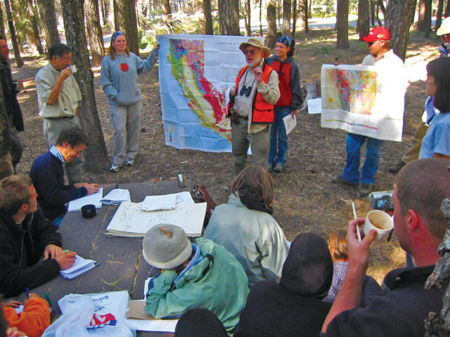
Honoring Eldridge Moores’ Geoscience Education Contributions
Michael Wysession
Department of Earth and Planetary Sciences
Washington University, St. Louis, MO
michael@seismo.wustl.edu

Slide 2

www.earthscienceliteracy.org

Slide 3
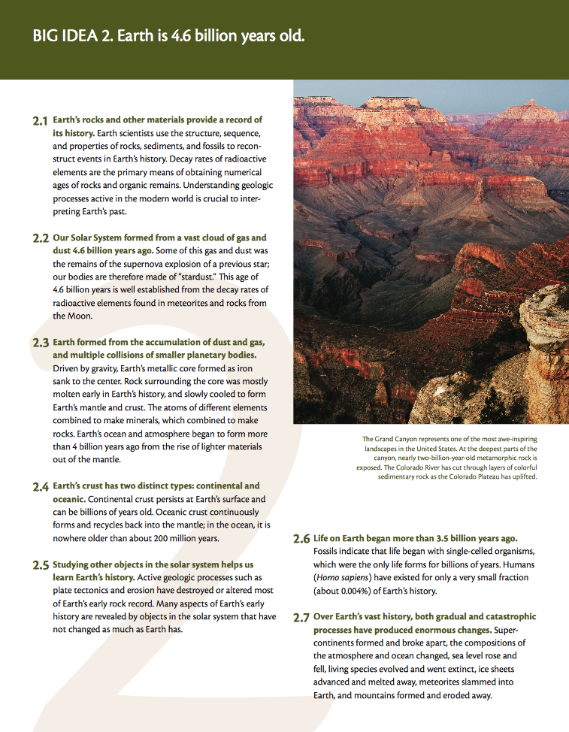
www.earthscienceliteracy.org
Free copies of the brochure available

Slide 4
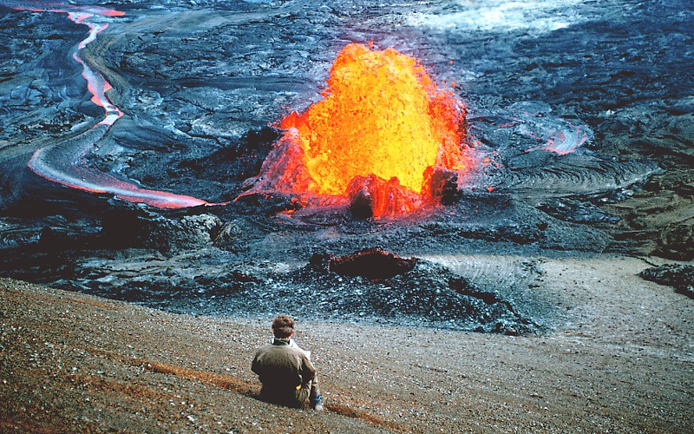
Big Idea #1: Earth scientists use repeatable observations and testable ideas to understand and explain our planet.

Slide 5
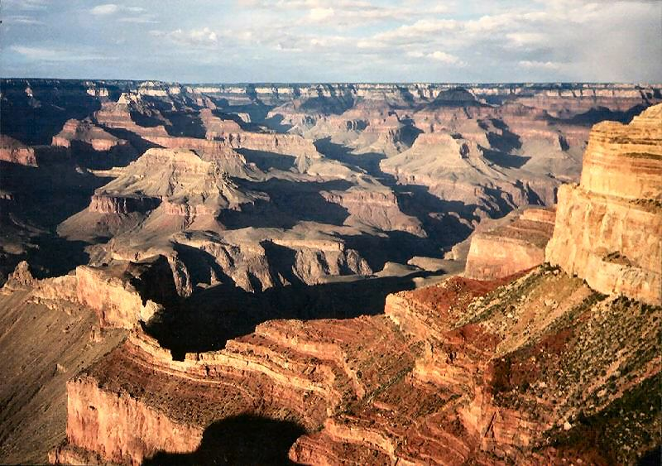
Big Idea #2: Earth is 4.6 billion years old.

Slide 6
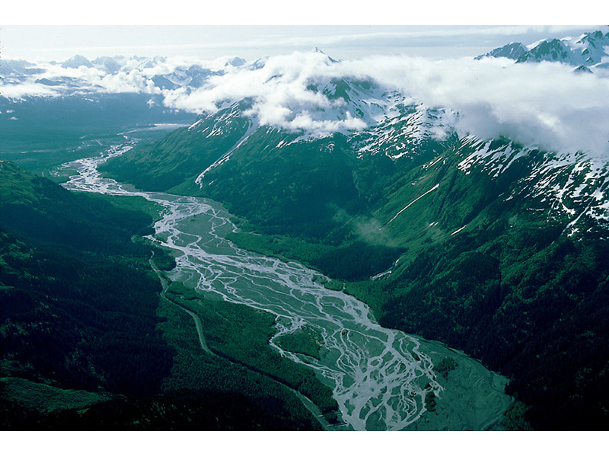
Big Idea #3: Earth is a complex system of interacting rock, water, air and life.

Slide 7
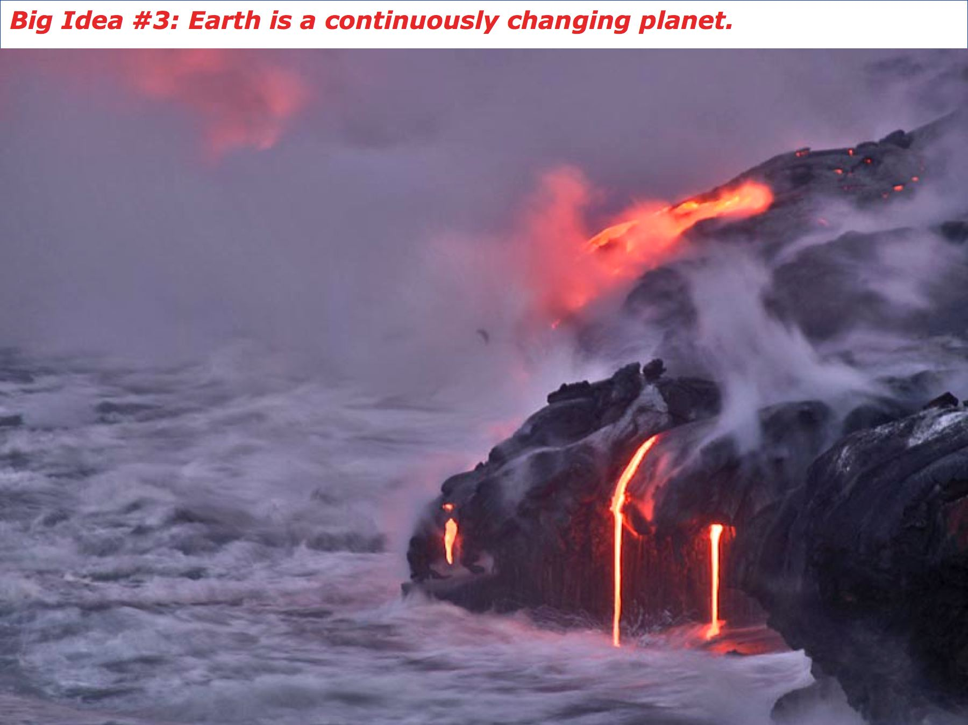
Big Idea #4: Earth continuously changing.

Slide 8
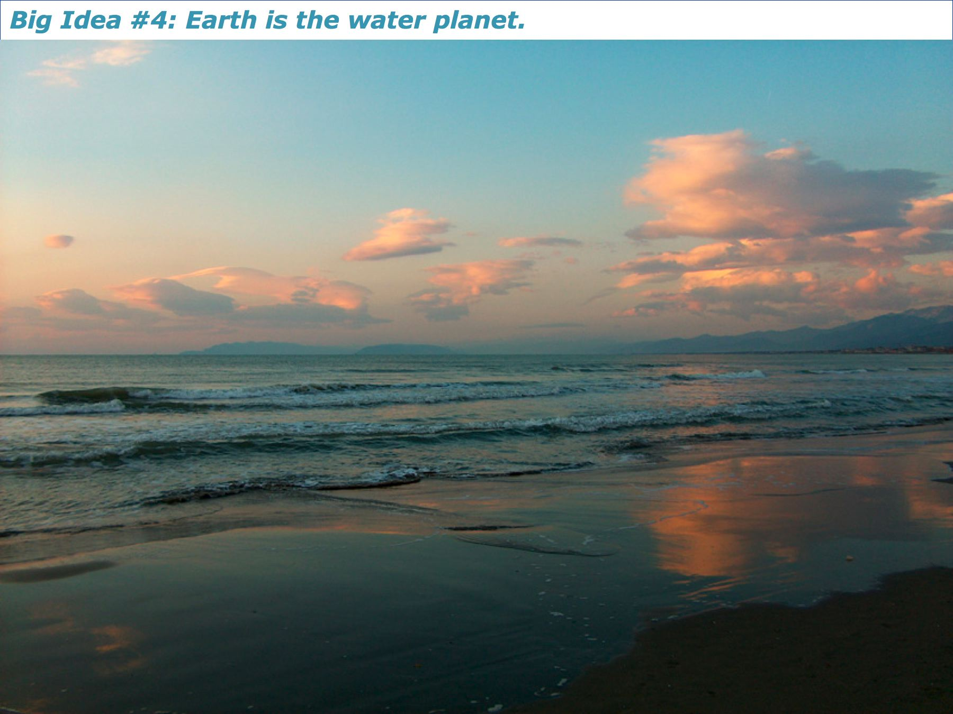
Big Idea #5: Earth is the water planet.

Slide 9
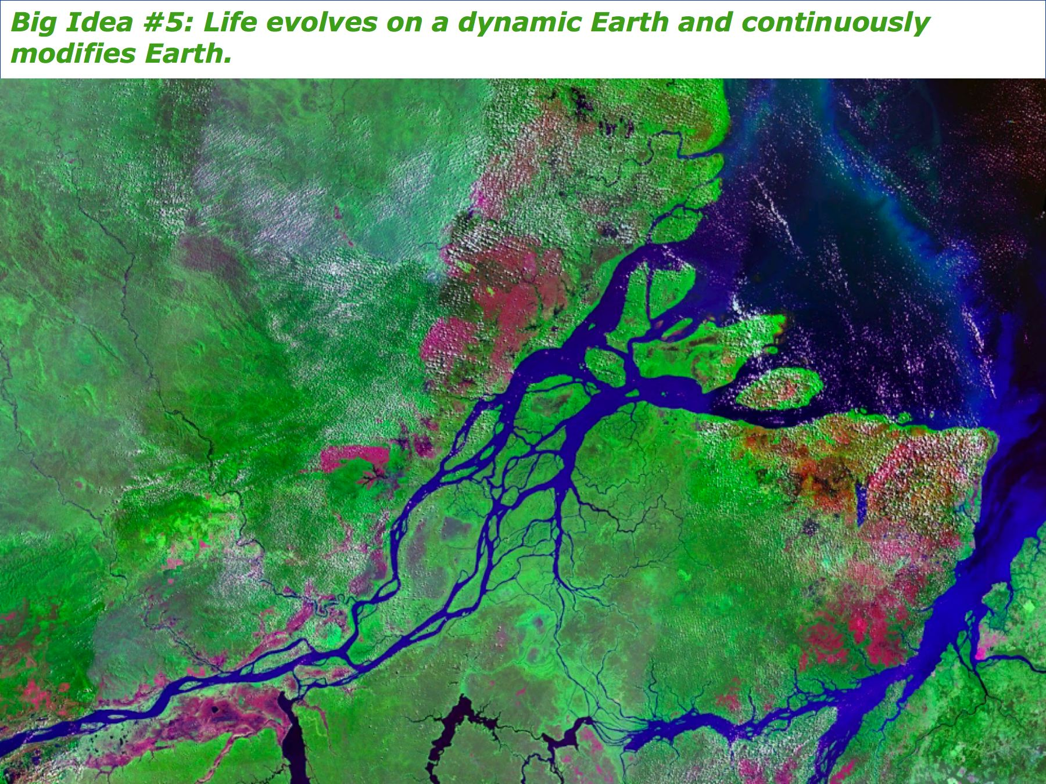
Big Idea #6: Life evolves on a dynamic Earth and continuously modifies Earth.

Slide 10
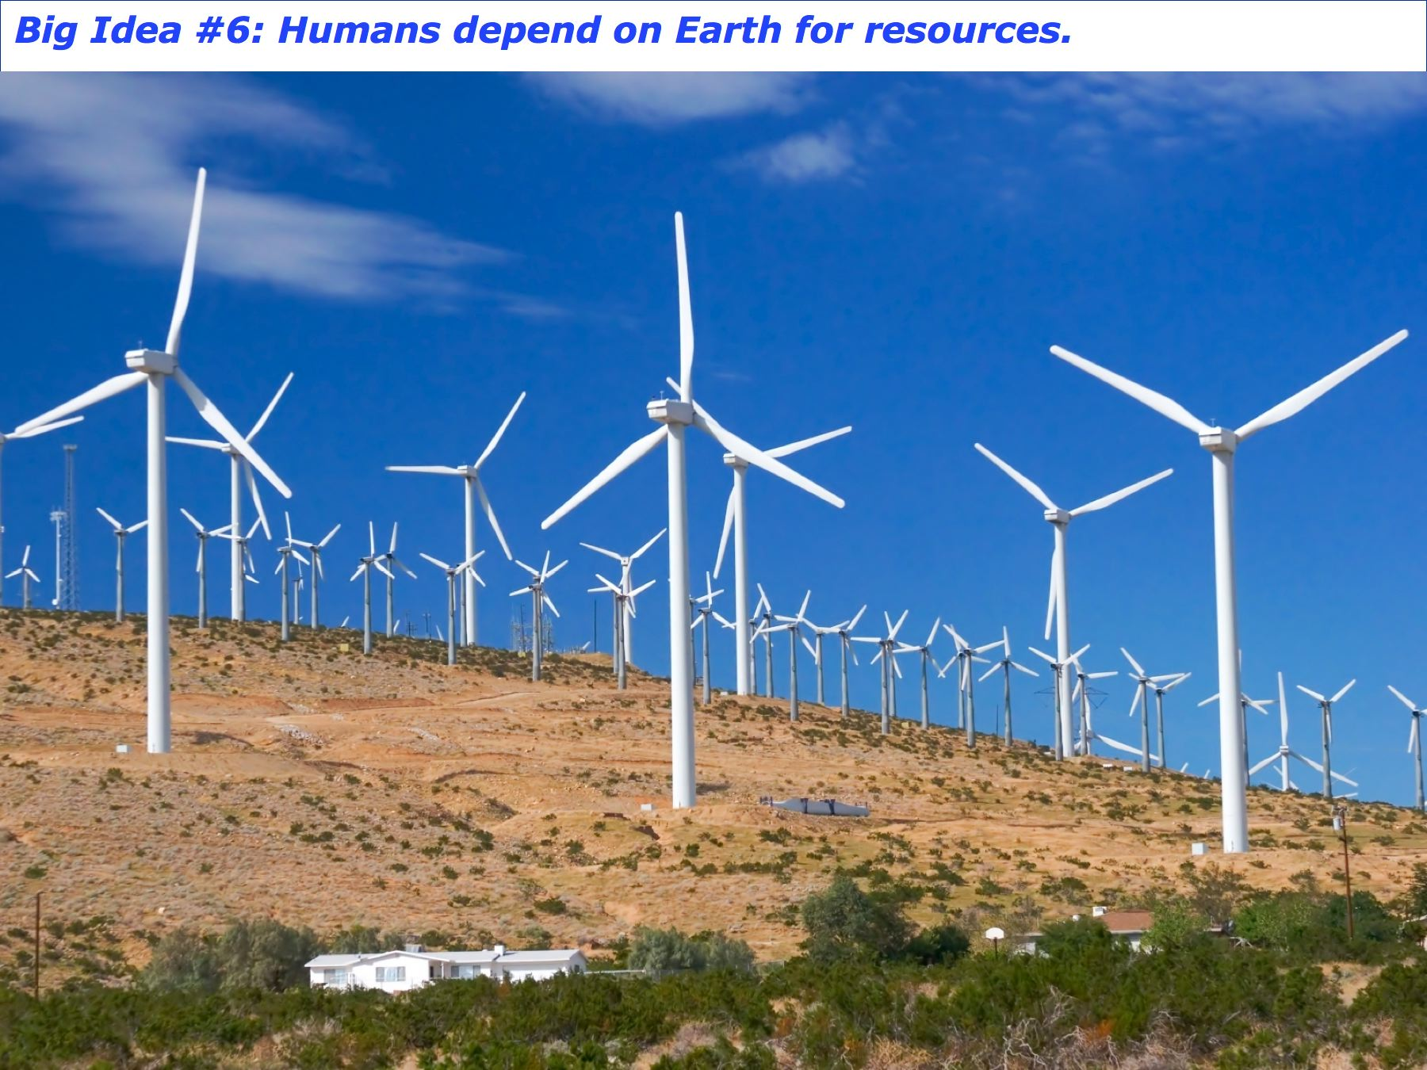
Big Idea #7: Humans depend on Earth for resources.

Slide 11
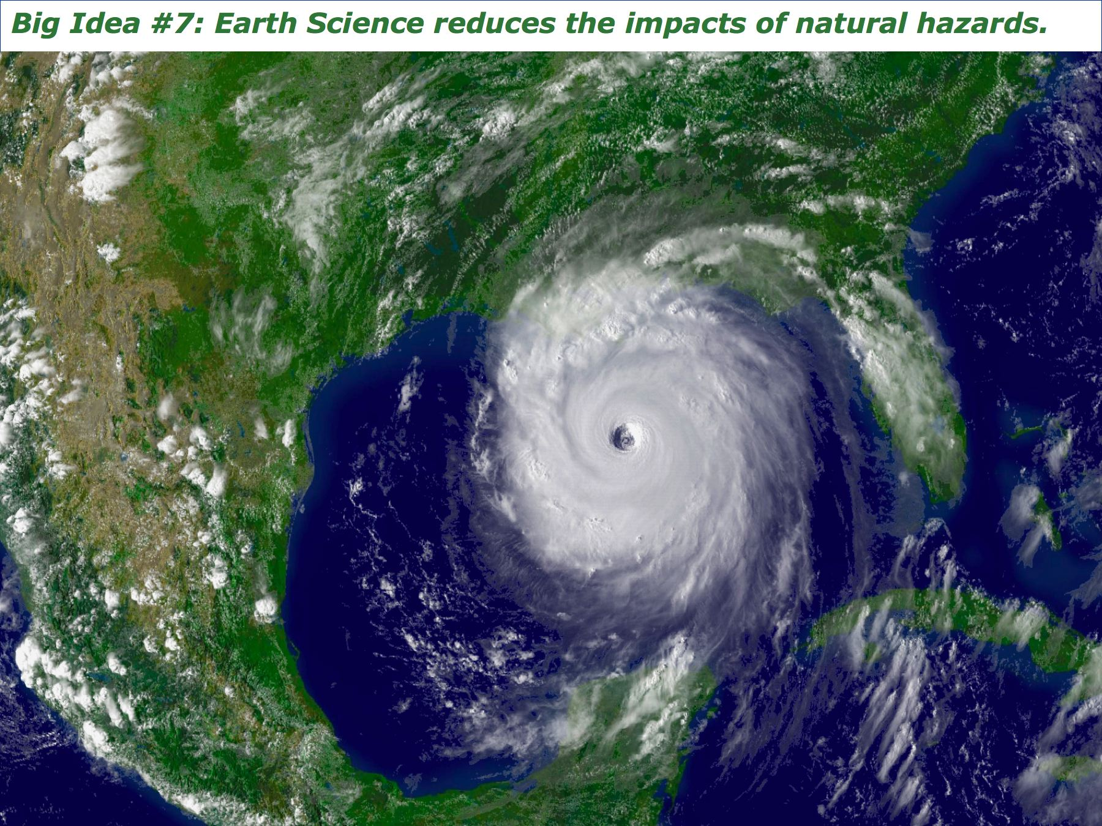
Big Idea #8: Natural hazards pose risks to humans.

Slide 12

Big Idea #9: Humans significantly alter the Earth.

Slide 13

NRC Framework: Three Dimensions of
Disciplinary Core Ideas (DCIs),
(2) Science and Engineering Practices (SEPs), and
(3) Crosscutting Concepts (CCCs)
Completed 2011
Published 2012

Slide 14
NRC Framework: The Content of Science (“Disciplinary Core Ideas”) is Organized into Three Areas

Slide 15
NRC Framework: Three Dimensions of
Disciplinary Core Ideas (DCIs),
(2) Science and Engineering Practices (SEPs), and
(3) Crosscutting Concepts (CCCs)
Organized around disciplinary core ideas
Central role of science and engineering practices
Coherence: building and applying ideas across time, building storylines of understanding

Slide 16
The Practices of
Science and Engineering
1. Asking questions (for science) and defining problems (for engineering)
2. Developing and using models
3. Planning and carrying out investigations
4. Analyzing and interpreting data
5. Using mathematics and computational thinking
6. Constructing explanations (for science) and designing solutions (for engineering)
7. Engaging in argument from evidence
8. Obtaining, evaluating, and communicating information

Slide 17
The Crosscutting Concepts
1. Patterns
2. Cause and effect
3. Scale, proportion, and quantity
4. Systems and system models
5. Energy and matter
6. Structure and function
7. Stability and change

Slide 18

The Next Generation Science Standards

Slide 19
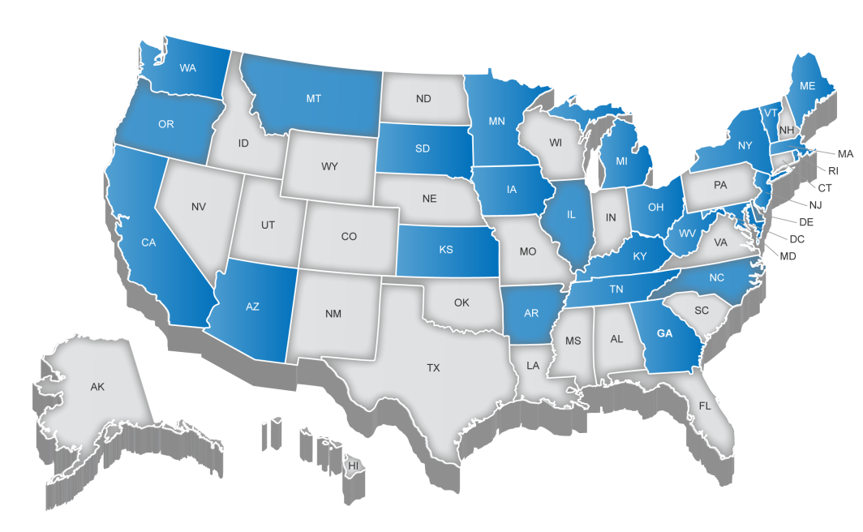
The NGSS were a “states-led” process
States that participated in writing the NGSS:

Slide 20
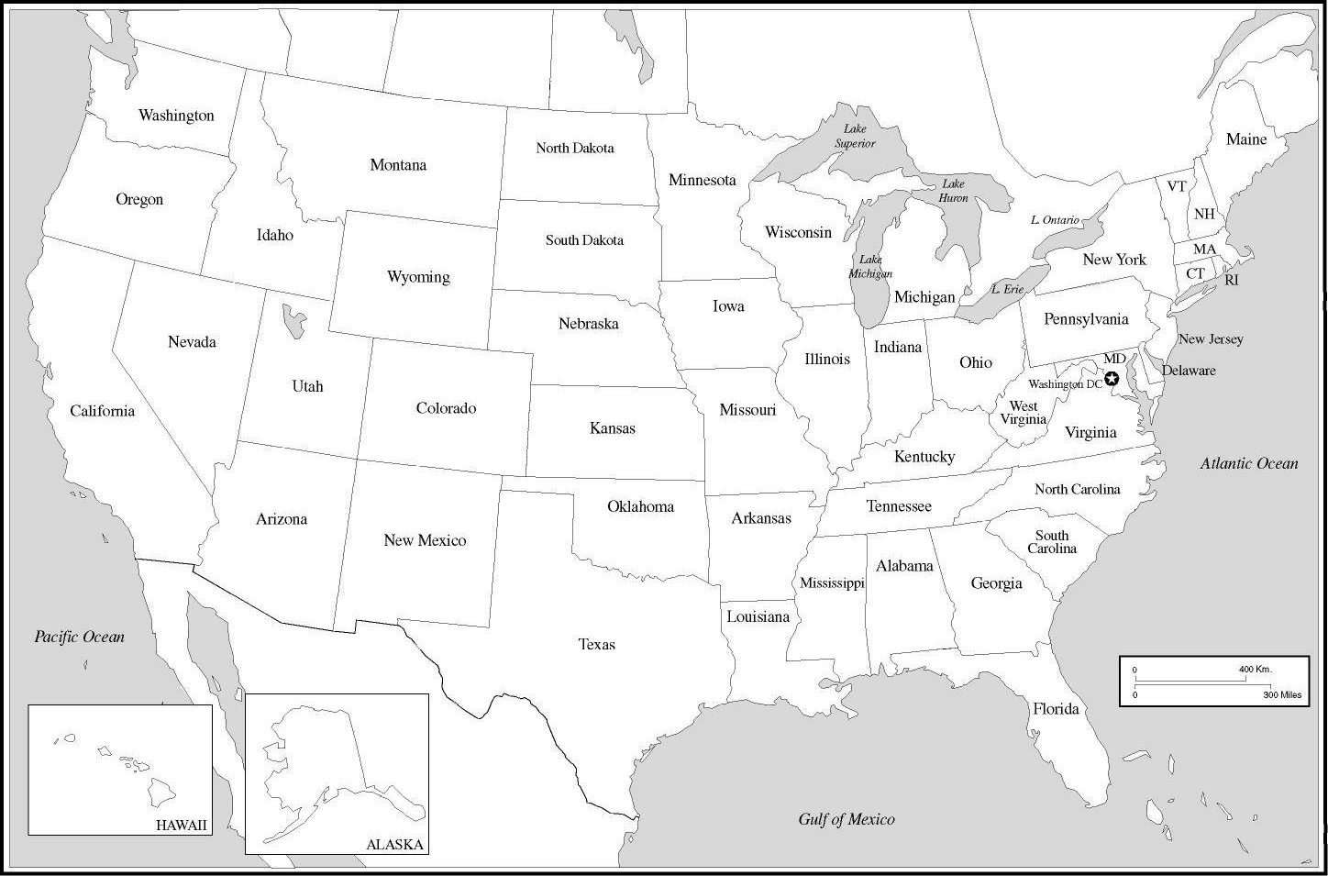
NGSS State-wise Adoption
Adopting
States:
Arkansas
California
Connecticut
Delaware
Hawaii
Illinois
Iowa
Kansas
Kentucky
Maryland
Michigan
Nevada
New Jersey
Oregon
Rhode Isl.
Vermont
Washington
(and DC)
Adopting/Adapting States: >40% of US Children
Additional Districts/Schools: ~35% of US Children
So Far: >80% of US Children are being impacted by the NGSS
(In process of adapting the NGSS: Alabama, Massachusetts, Missouri, Oklahoma, South Carolina, South Dakota, West Virginia, …..)
Notes:
But maybe 60% are being substantially impacted (Sep, 2016 – Aneesha Badrinarayan)

Slide 21
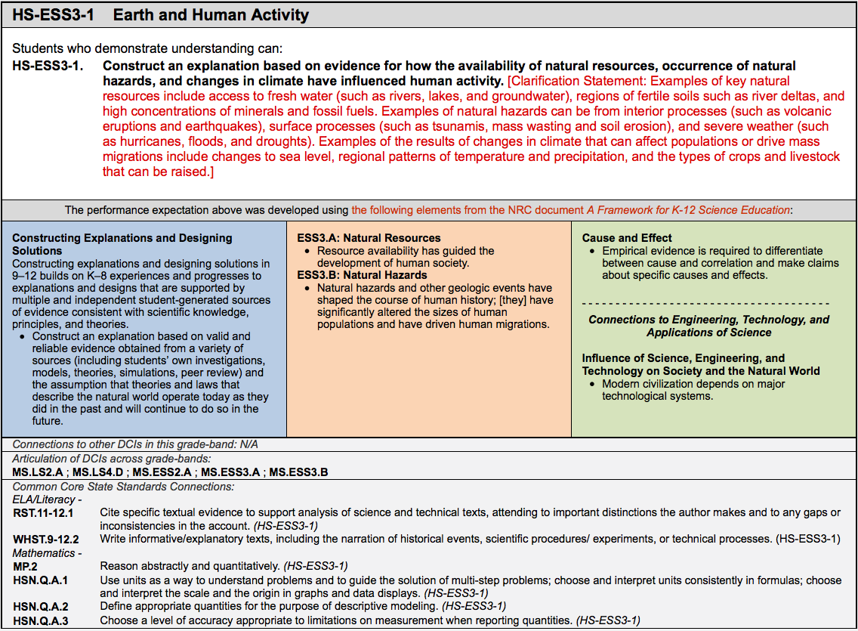


How do you Teach Earth and Space Science with the NGSS?
PRACTICES CONTENT X-CUTTING CONCEPTS

Slide 22
How would you design a curriculum to teach kids to play baseball or softball?
Notes:
Johnson’ Elementary and Secondary Education Act “War on Poverty”

Slide 23

How would you design a curriculum to teach kids to play baseball or softball?
Notes:
Johnson’ Elementary and Secondary Education Act “War on Poverty”

Slide 24
How would you design a curriculum to teach kids to play baseball or softball?
The U.S. leads countries in “boredom” in schools
Notes:
Johnson’ Elementary and Secondary Education Act “War on Poverty”

Slide 25

How would you design a curriculum to teach kids to play baseball or softball?
Notes:
Johnson’ Elementary and Secondary Education Act “War on Poverty”

Slide 26
Notes:
Johnson’ Elementary and Secondary Education Act “War on Poverty”

Slide 27
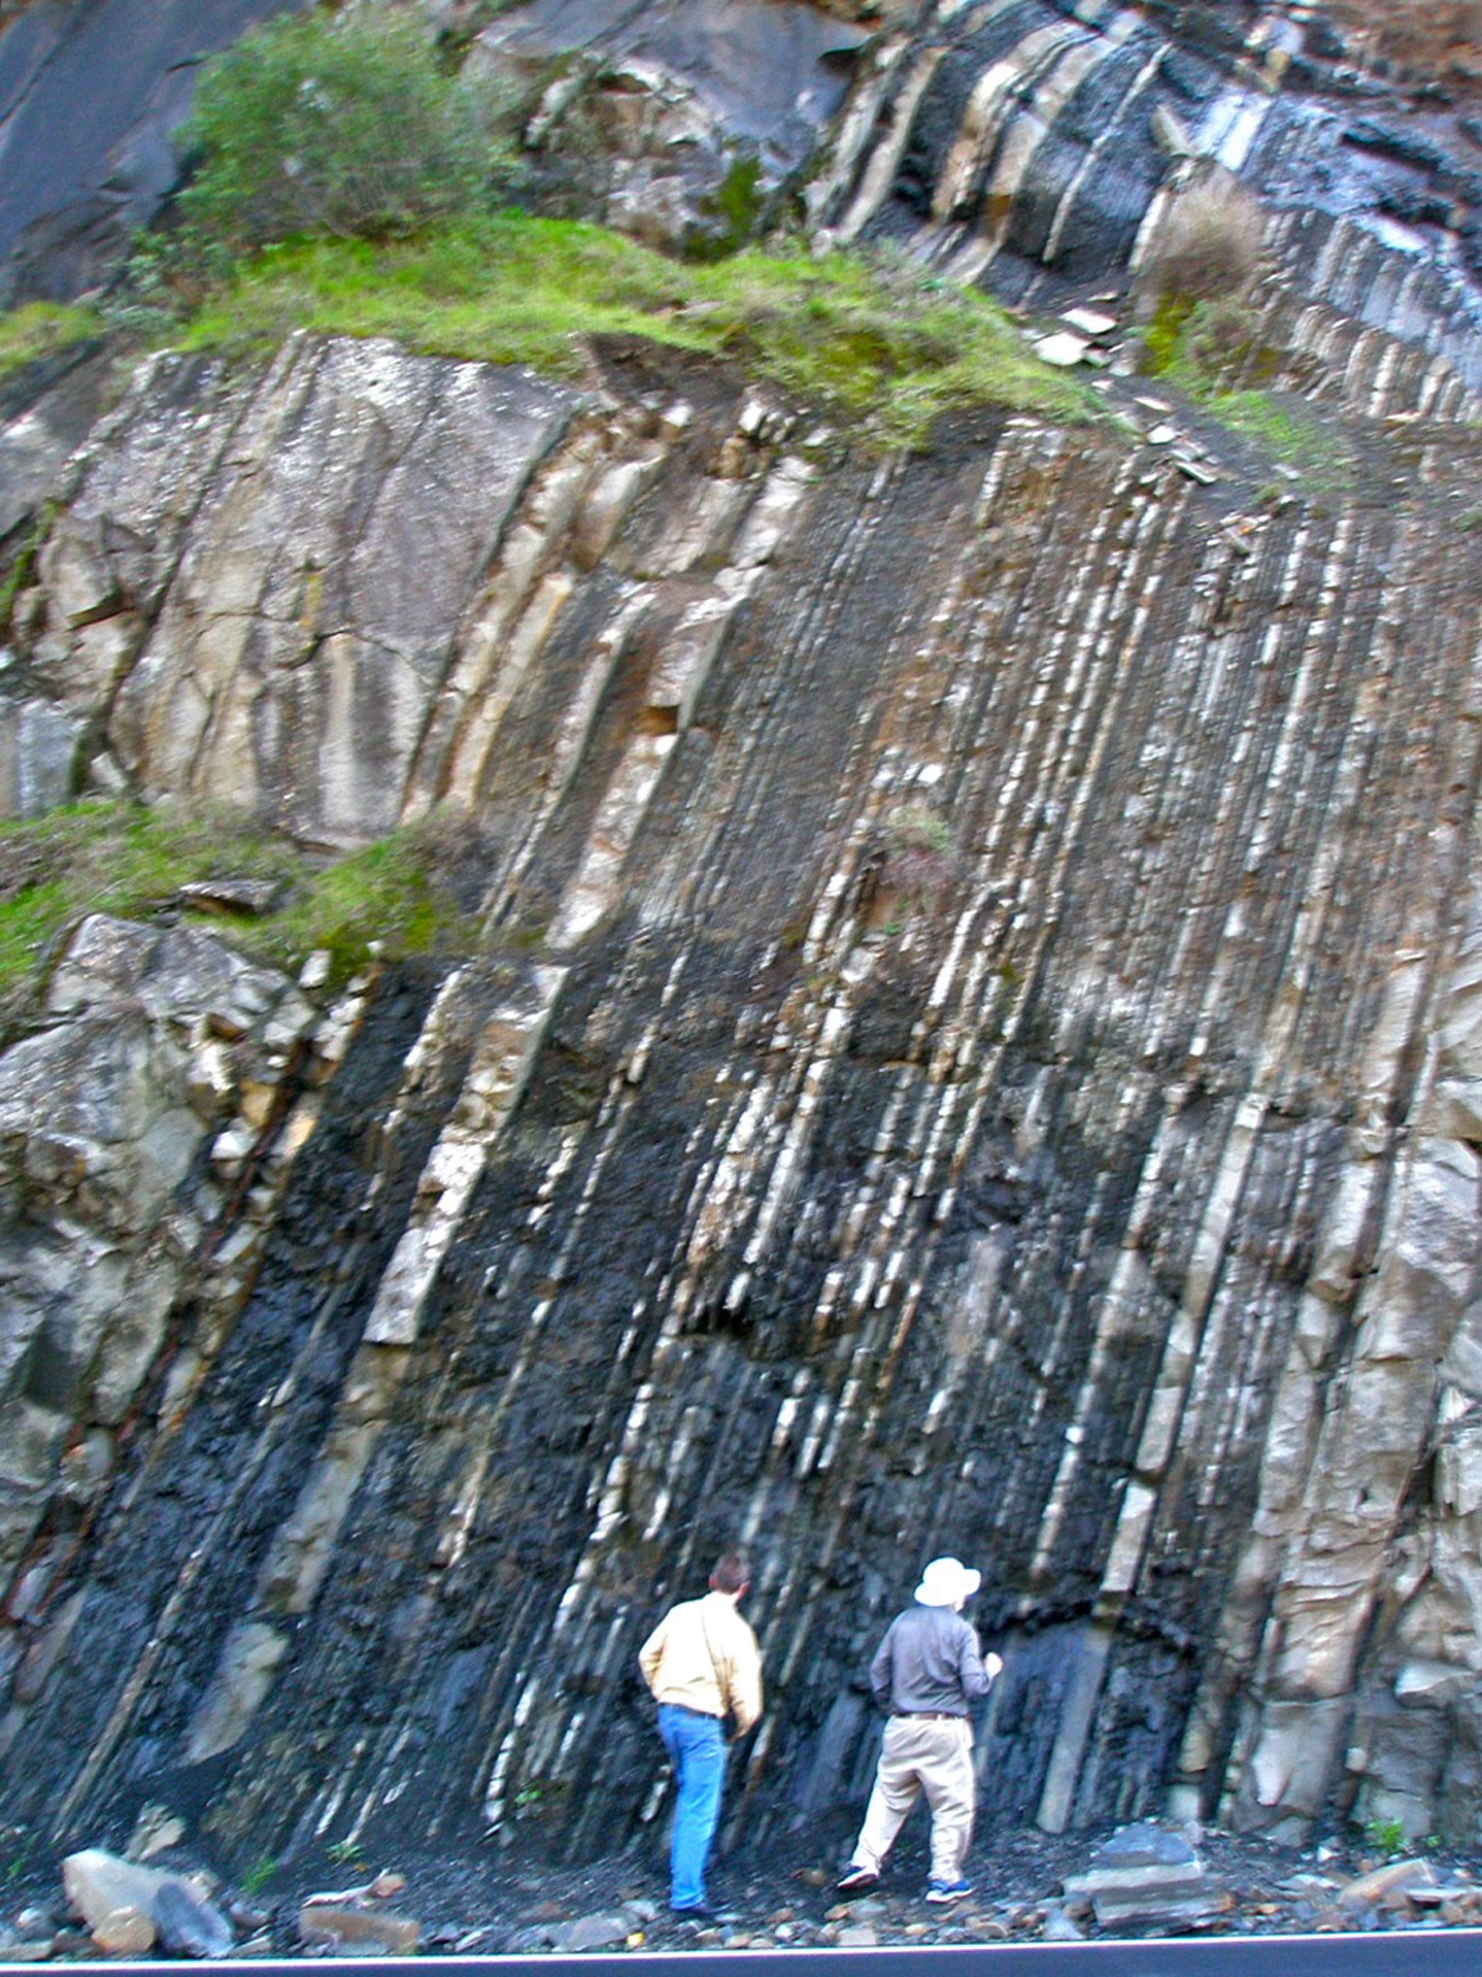
Notes:
Johnson’ Elementary and Secondary Education Act “War on Poverty”

Slide 28

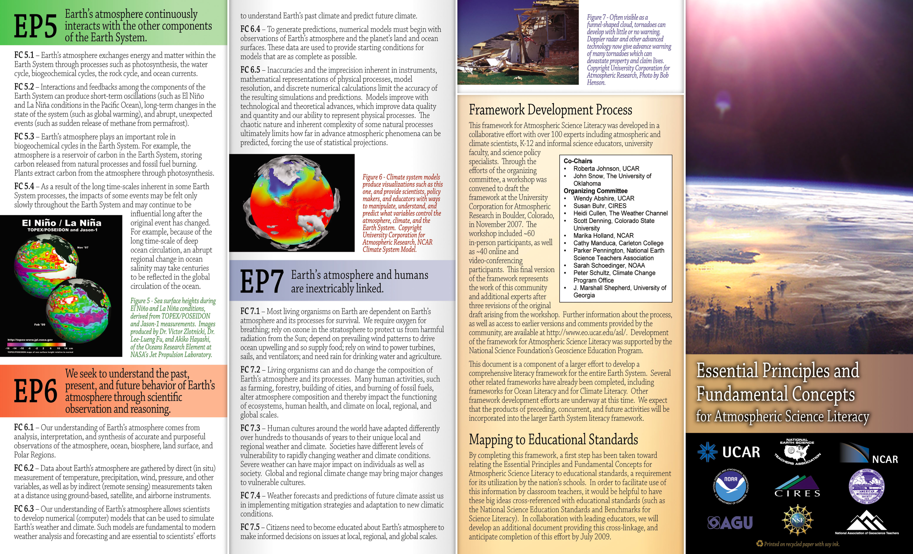

Geoscience content informed by recent
community-based literacy efforts

Slide 29
Performance Expectations
Elementary School: Grade-Level Standards, K-5
Middle School: Grade-Banded Standards, 6-8
1 year of Life Science
1 year of Physical Science (Chemistry & Physics)
1 year of Earth and Space Science
High School: Grade-Banded Standards, 9-12
1 year of Life Science
1 year of Physical Science (Chemistry & Physics)
1 year of Earth and Space Science

Slide 30
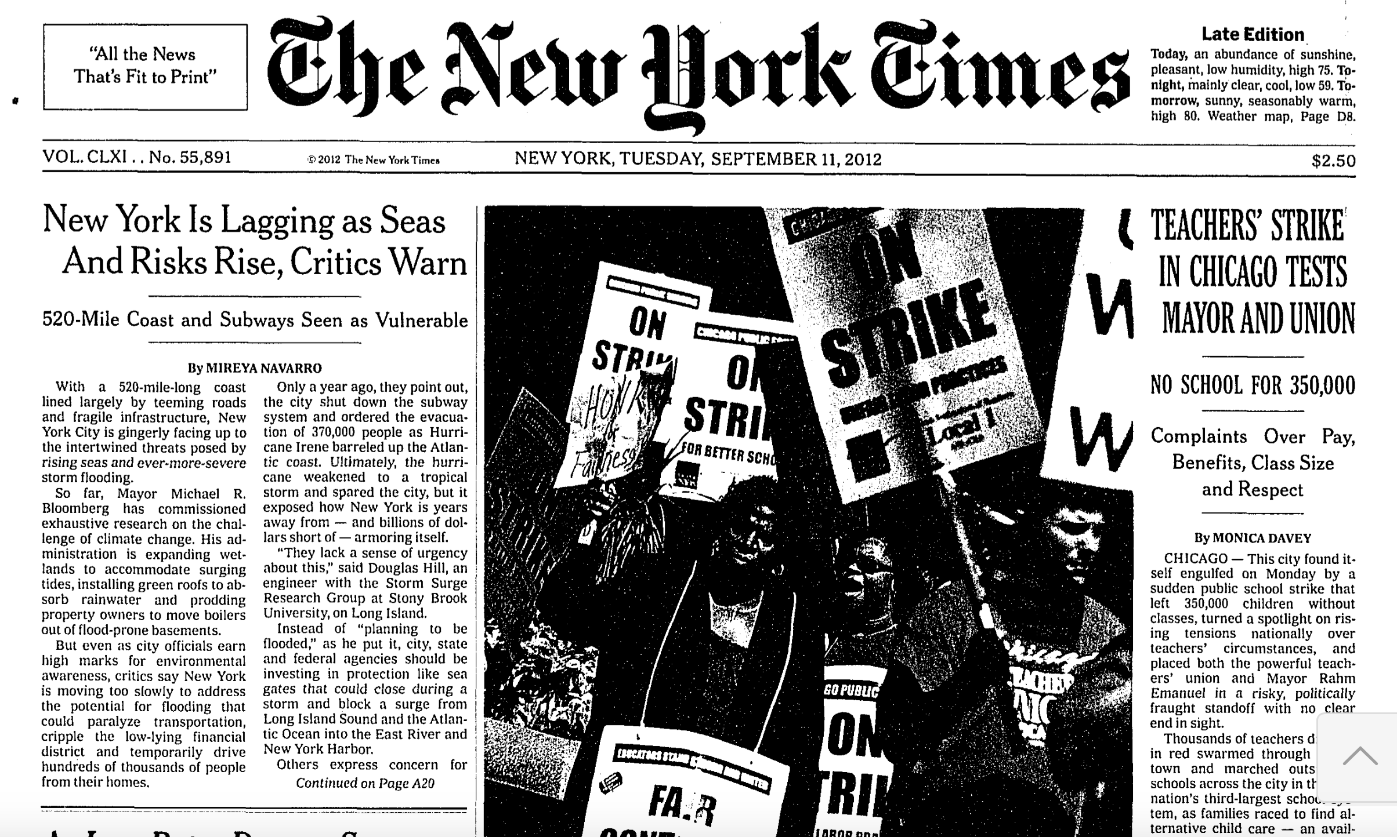
Study of how science, as presented in the media (i.e., New York Times) aligns with the NGSS, using the year 2012 as an example.
Notes:
Democrats don’t like some implications of standards. Republicans don’t like “National” (state’s rights)

Slide 31
Study of how science, as presented in the media (i.e., New York Times) aligns with the NGSS, using the year 2012 as an example.
→ A total of 1702 articles, taken from the daily front page and the weekly “Science Times” section.
Notes:
Democrats don’t like some implications of standards. Republicans don’t like “National” (state’s rights)

Slide 32
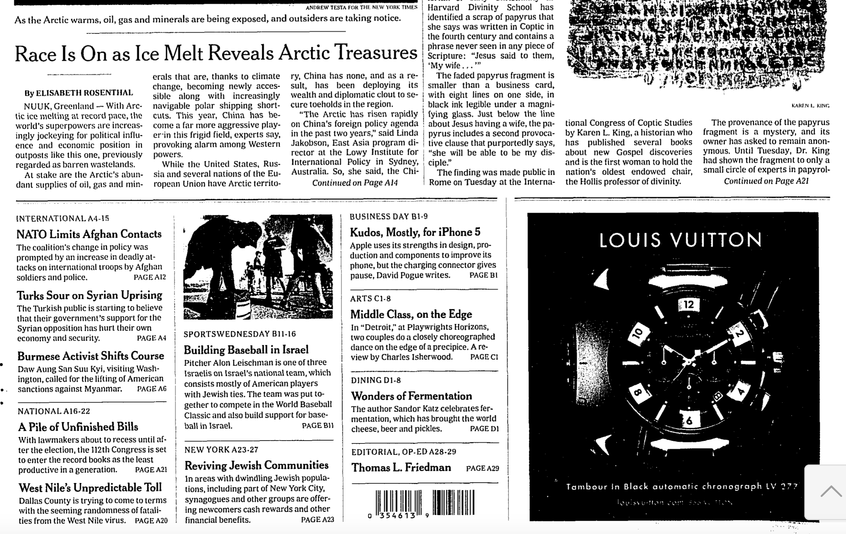
The front page articles come in two forms:
Notes:
Democrats don’t like some implications of standards. Republicans don’t like “National” (state’s rights)

Slide 33
The front page articles come in two forms: (A) The starts of articles,
Notes:
Democrats don’t like some implications of standards. Republicans don’t like “National” (state’s rights)

Slide 34
The front page articles come in two forms: (A) The starts of articles, and (B) call-outs to articles later in the paper
Notes:
Democrats don’t like some implications of standards. Republicans don’t like “National” (state’s rights)

Slide 35
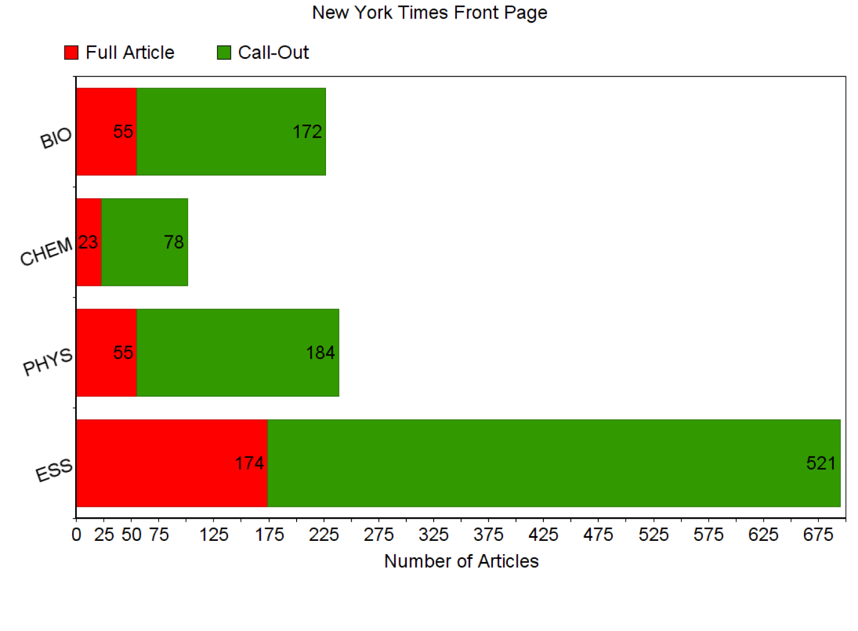
Notes:
Democrats don’t like some implications of standards. Republicans don’t like “National” (state’s rights)

Slide 36
Daily Weather
Notes:
Democrats don’t like some implications of standards. Republicans don’t like “National” (state’s rights)

Slide 37
Study of how science, as presented in the media (i.e., New York Times) aligns with the NGSS, using the year 2012 as an example.
Notes:
Democrats don’t like some implications of standards. Republicans don’t like “National” (state’s rights)

Slide 38
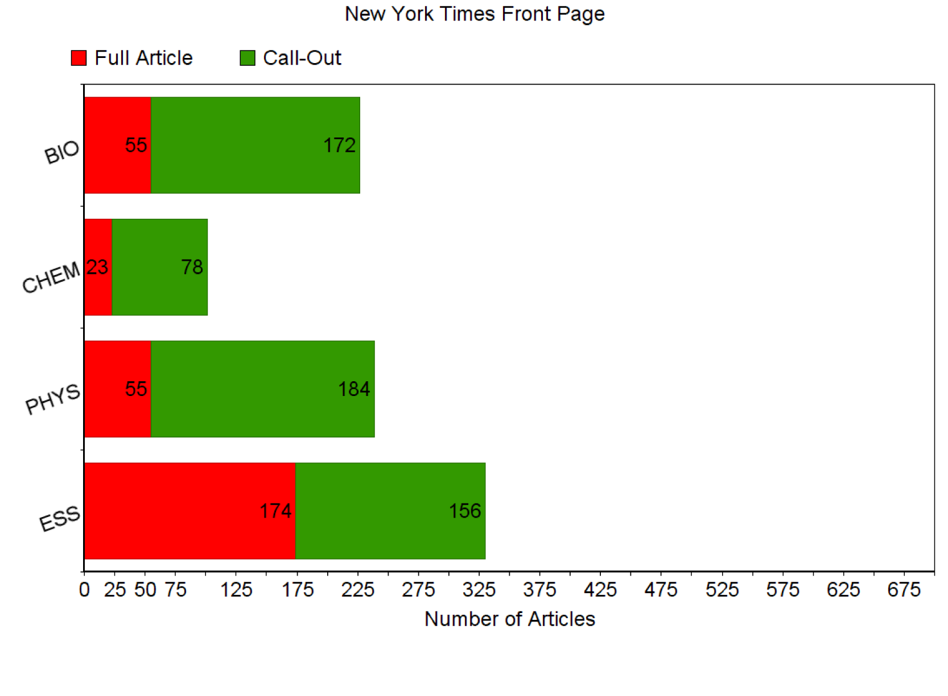
Notes:
Democrats don’t like some implications of standards. Republicans don’t like “National” (state’s rights)

Slide 39
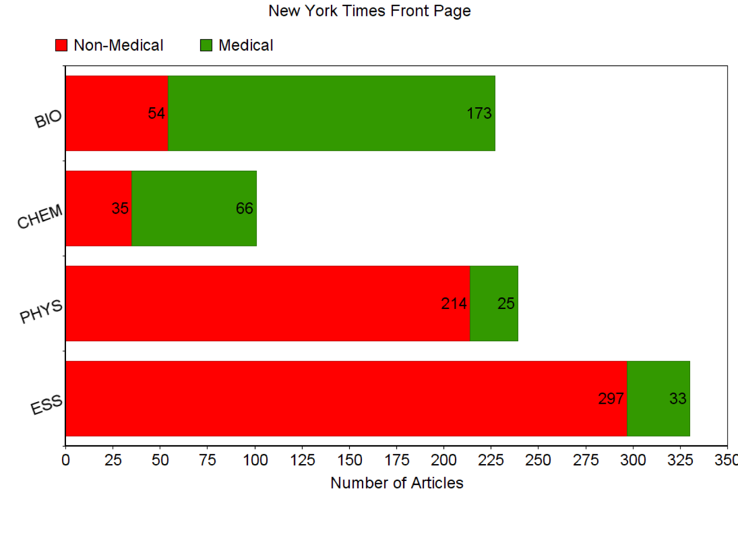
Notes:
Democrats don’t like some implications of standards. Republicans don’t like “National” (state’s rights)

Slide 40
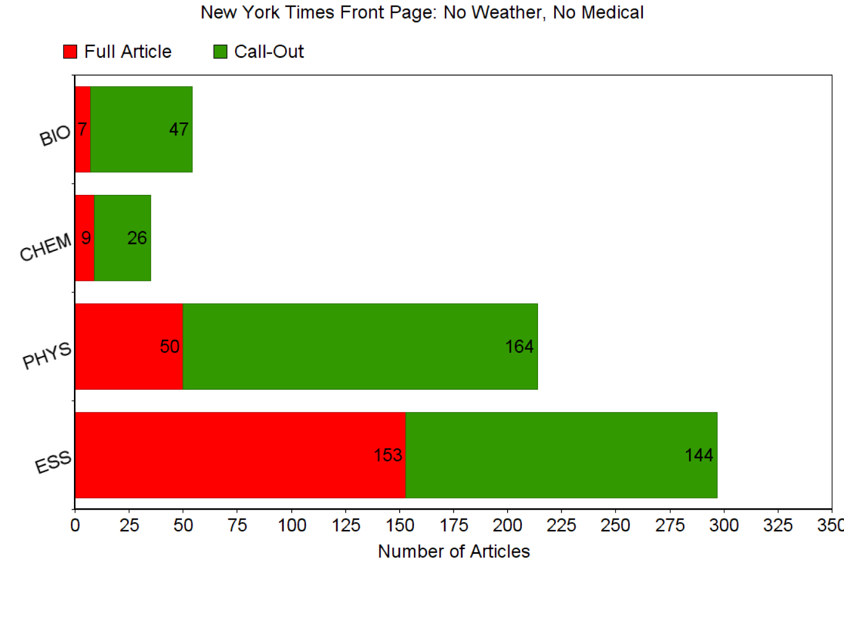
Notes:
Democrats don’t like some implications of standards. Republicans don’t like “National” (state’s rights)

Slide 41
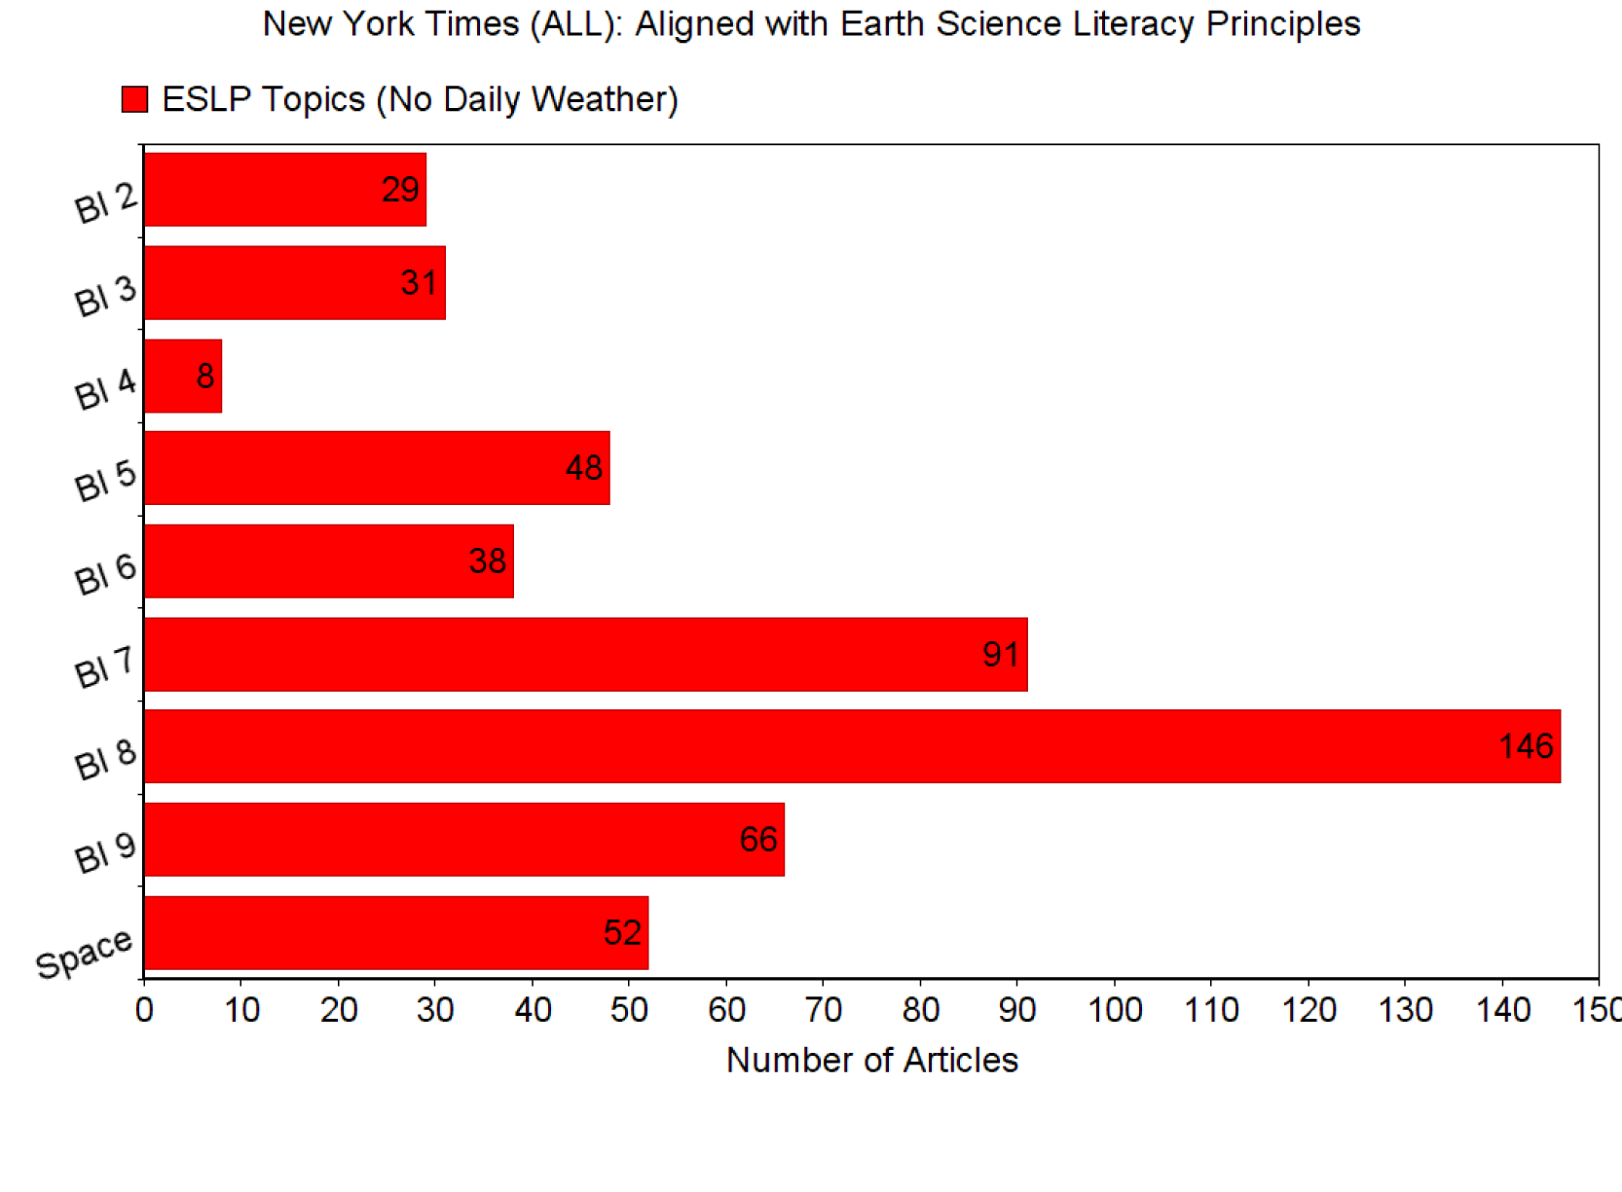
Geologic Time
Earth Systems
Changing Earth Systems
Hydrosphere
Biosphere
Natural Resources
Natural Hazards
Human Impacts
Space and Planetary Science
Notes:
Democrats don’t like some implications of standards. Republicans don’t like “National” (state’s rights)

Slide 42
