Slide 1


Deep Earthquakes Spatial Distribution: Numerical Modeling of Stresses within the Subducting Lithosphere
Prasanna Gunawardana
Gabriele Morra
Department of Physics
University of Louisiana at Lafayette

Slide 2
Earthquake Distribution with depth
Earthquakes hypocenters have been detected from the surface to the maximum depth of 650km to 700km
Hypocenters form a 2D surface zone (“Wadati-Benioff”) within subducting slabs (Isacks & Molnar 1971)
It appears that there are no earthquakes in the lower mantle (Stark & Frohlich 1985)

Slide 3
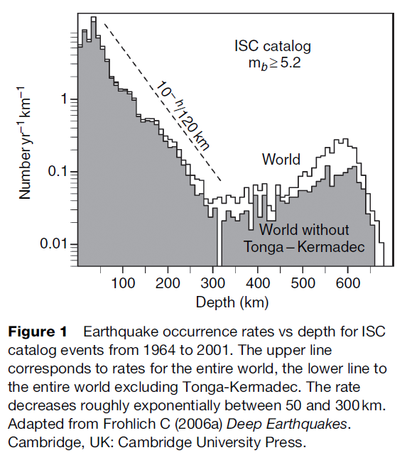
Bi-model Nature of the earthquake Distribution
Long-time interest in the bi-model distribution of earthquake hypocenter depth
Frequency vs depth :
  50 to 300 km -> exponential decay
  300 to 450 km -> low level plateau (Heidi Houston, 2007)
  450 to 650 km -> increase (Frohlich, 2006)
(Houston H. 2007)

Slide 4

Visco-Elastic Nature of the lithosphere
Solid materials are generally "visco-elastic.“
Transition time (“Maxwell Time”, $T_{m}$) = Shear Viscosity/Shear Modulus.
$T_{m}(upper mantle)= {{10}^{21}}/{{10}^{11}}={10}^{10}$ seconds ~ 300 years.
$T_{m}\left(lithosphere\right)=30Kyrs to 300Kyrs$
On geological timescales subduction process takes~10 Myrs >> $T_{m}$ (Morra et al., 2008)
Viscous approximation holds.

Slide 5

Why we look at the stresses and the Elastic energy
Elastic
Viscous
Released Elastic Energy
Earthquake activity: a source of stress and a material that can experience unstable strain localization.
Explore stress and stored elastic energy distribution in subducting lithosphere and compare it with the earthquake distribution

Slide 6


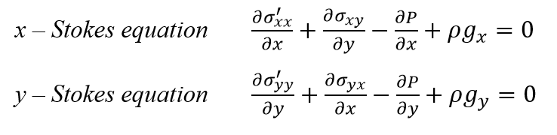


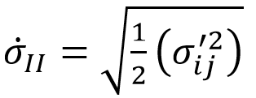

Governing equations
Incompressibility continuity equation
Stokes Equation for slow flow(2D)
Strain rate, stress, Second invariant of the Stress and energy

Slide 7
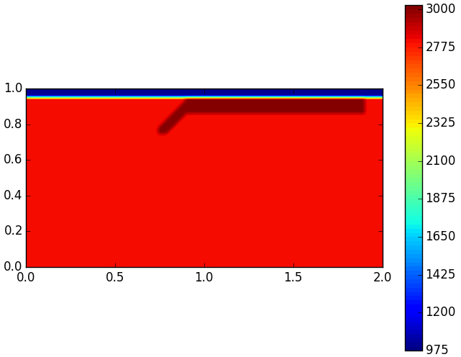
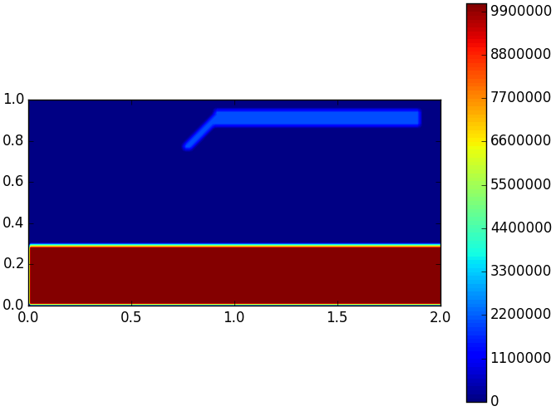
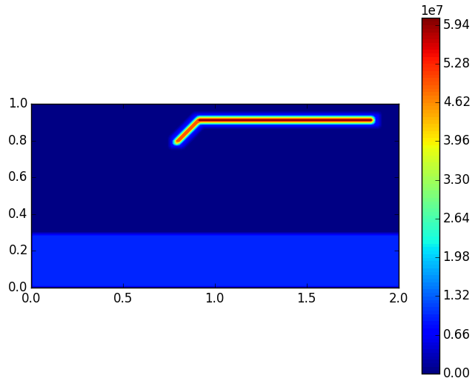


Initial conditions
#Viscosity
$$ɳ_{OceanicLayer}=1×{10}^{20}Pas$$
$$ɳ_{UpperMantle}=1×{10}^{21}Pas$$
$$ɳ_{LowerMantle}=1×{10}^{24}Pas$$
#Density
$$ρ_{Mantle}=2800.0 kg/m^{3}$$
$$ρ_{Lithosphere}=3000.0kg/m^{3}$$
$$ρ_{OceanicLayer}=1000.0kg/m^{3}$$
Density Distribution
Viscosity Distribution
ISO - Viscous
Layered - Viscous
Spontaneous Subduction

Slide 8
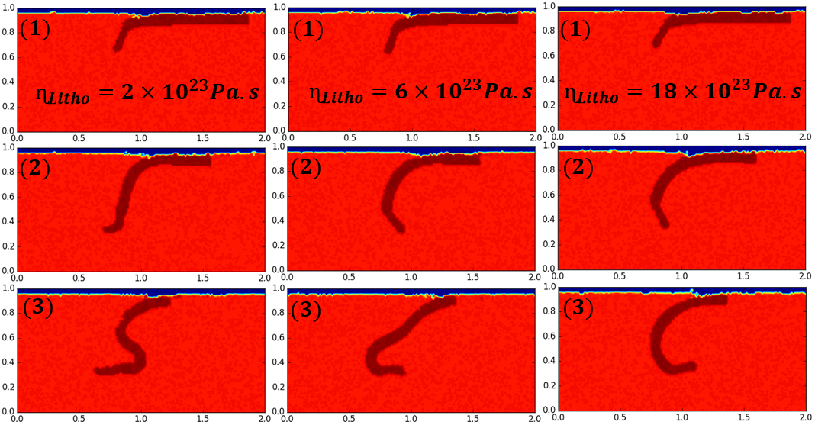
Layered Viscous models - Density
Low viscous slab
Intermediate viscous slab
High viscous slab

Slide 9
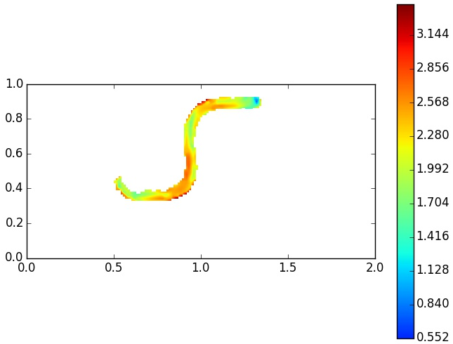
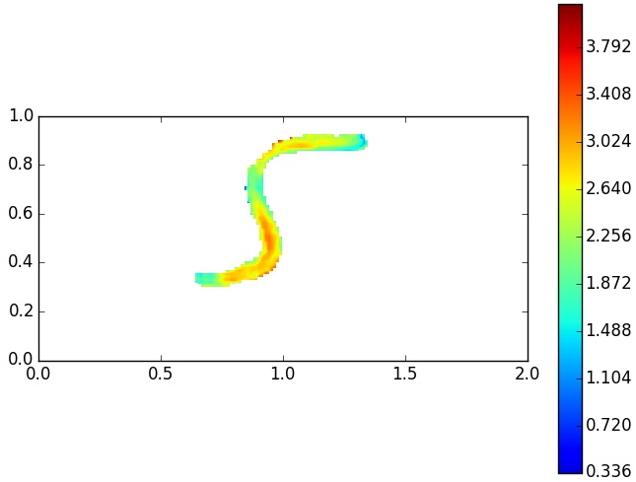
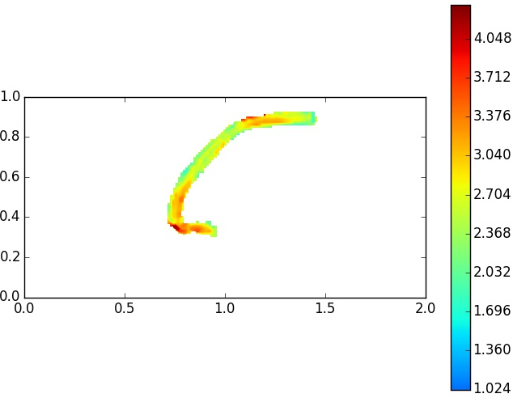
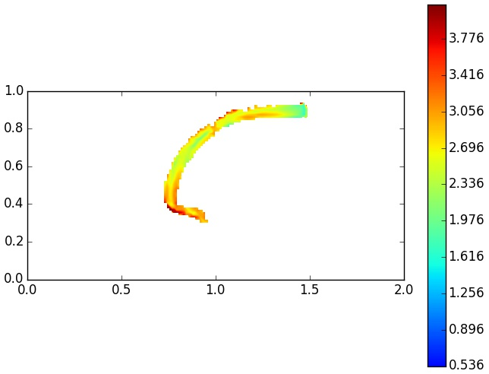








Stress inside the slab
$$ɳ_{Litho}=18×{10}^{23}Pa.s$$
$$ɳ_{Litho}=2×{10}^{23}Pa.s$$
$$Iso−viscous$$
$$ɳ_{Litho}=2×{10}^{23}Pa.s$$
$$ɳ_{Litho}=6×{10}^{23}Pa.s$$
$$ɳ_{Litho}=18×{10}^{23}Pa.s$$
$$Layered−viscous$$
$$Layered−viscous$$
$$Iso−viscous$$

Slide 10
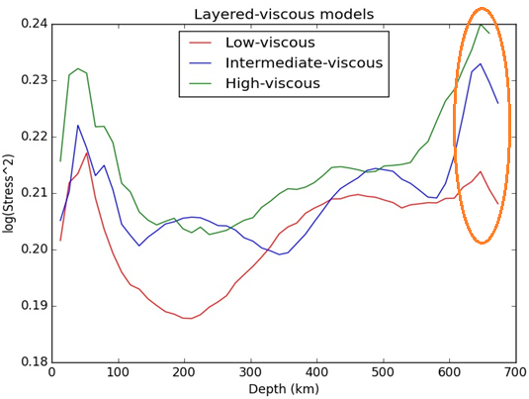
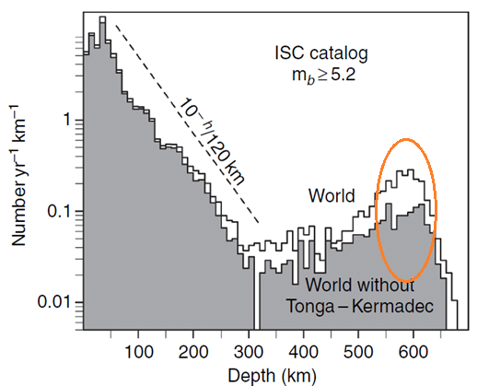
Stored Elastic Energy Distribution VS Earthquake Distribution

Slide 11
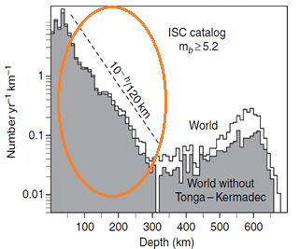
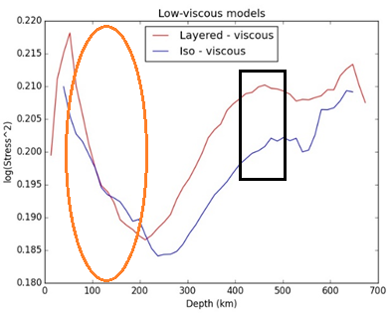
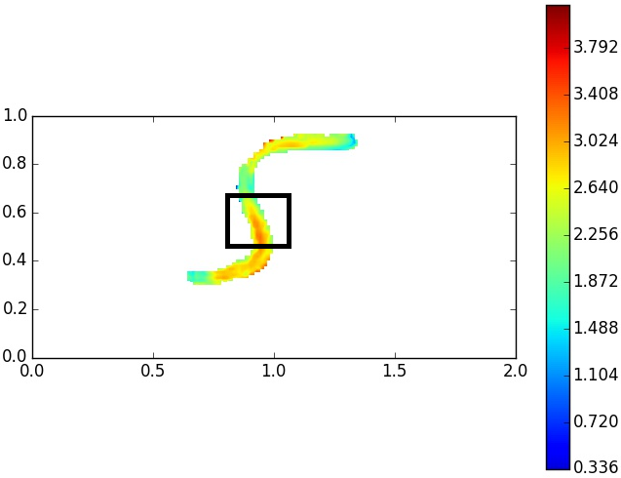
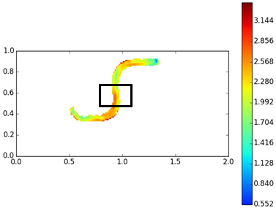

High Energy region at 400km depth
$$Layered−viscous$$
$$Iso−viscous$$

Slide 12
Future works
Mid Continental Rift modeling using the Geodynamic techniques under the supervision of Professor Robert Moucha, Earth Science Department, Syracuse University.

Slide 13
Conclusions
New numerical model to calculate the stored elastic energy in the subducting lithosphere
Slab bending at the upper lower mantle transition zone causes the deeper peak of the earthquake frequency-depth distribution.
The decay of earthquake frequency-depth distribution at the intermediate depth is closer to exponential for a high viscous stiff core inside the slab.
Bending of the slab creates a “minor peak” at the 400km depth for all the models with the layered-viscous lithospheric models.

Slide 14

Acknowledgement
Professor Robert Moucha, Earth Science Department, Syracuse University

Slide 15
References
Frohlich C (2006a)., Deep Earthquakes. Cambridge, UK: Cambridge University Press.
Houston, H., 2007. Deep earthquakes. In: Schubert, G. (Ed.), Treatise on Geophysics, vol.4. Elsevier, pp.321–350.
Isacks, B. & Molnar, P., 1971. Distribution of stresses in the descending lithosphere from a global survey of focal-mechanism solutions of mantleearthquakes, Rev. geophys. Space Phys., 9, 103–174.
Morra, G., Goes, S., Fabio A. C., 2008. Evidence of lower-mantle slab penetration phases in plate motions, Nature 451, 981-984.
Myhill R. 2012., Slab buckling and its effect on the distributions and focal mechanisms of deep-focus earthquakes Schemling H., Kaus B. J. P., Morra G., Schmalholz S. M., 2008, A benchmark comparison of spontaneous subduction models - Towards a free surface.
Stark, P.B.& Frohlich, C., 1985. The depths of the deepest deep earthquakes, J. geophys. Res., 90, 1859–1870.
Taras V. Gerya , David A. Yuen, 2003, Characteristics-based marker-in-cell method with conservative finite-differences schemes for modeling geological flows with strongly variable transport properties. Physics of the Earth and Planetary Interiors 140 (2003) 293–318

Slide 16
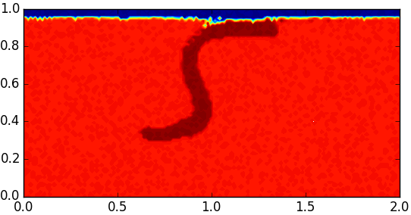
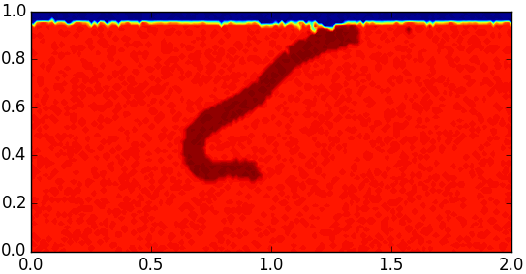
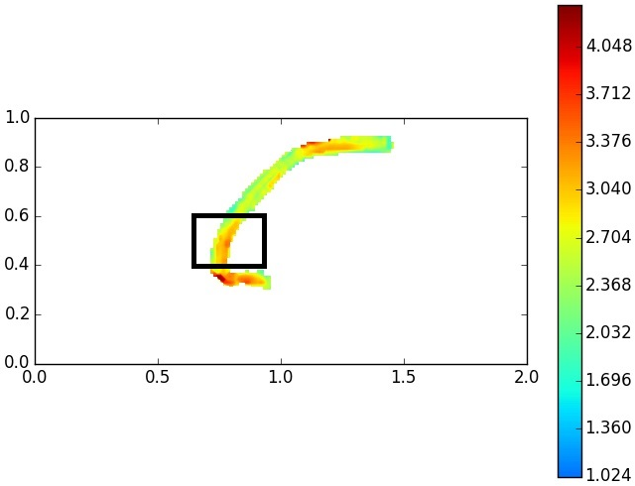
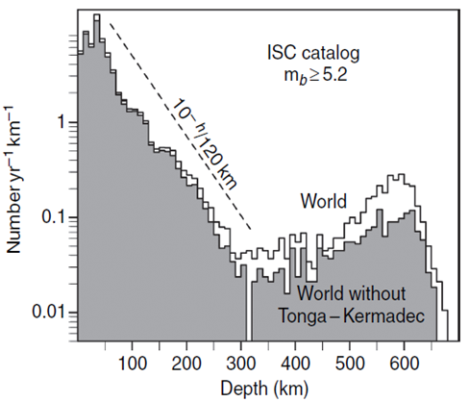
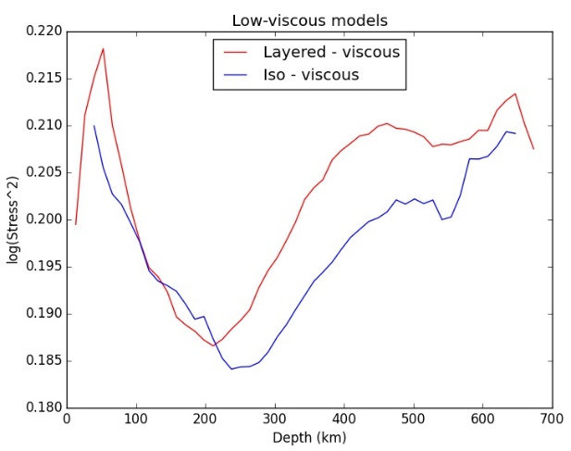
Thank you & Questions?

