Slide 1
ANDRAGOGY IN EARTH SCIENCE TEACHER PREPARATION
Session T72: Advances in In-Service and Pre-Service K-12
Earth Sciences Teacher Preparation and Professional Development
Suzanne Metlay, Ph.D.
Geoscience Education, Teachers College
Western Governors University
Geological Society of America Annual Meeting
Denver, CO
25 September 2016
AUTHOR’S NAME HERE

Slide 2
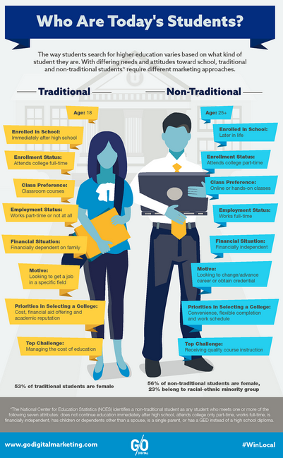

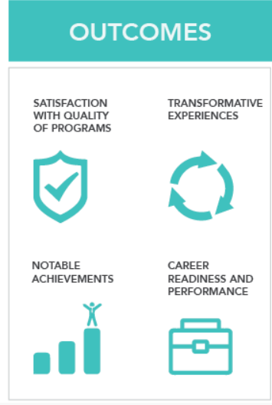
Andragogy: Study of Adult learners
Adult education grew out of human resources development concerns during1950s-1980s
Since 2000, adults transformed how colleges and universities provide courses and professional credentials
http://eric.ed.gov/?id=ED084368
http://www.godigitalmarketing.com/learn/infographic/marketing-strategies-for-traditional-and-non-traditional-students
http://www.eduventures.com/2015/04/defining-educational-outcomes/

Slide 3
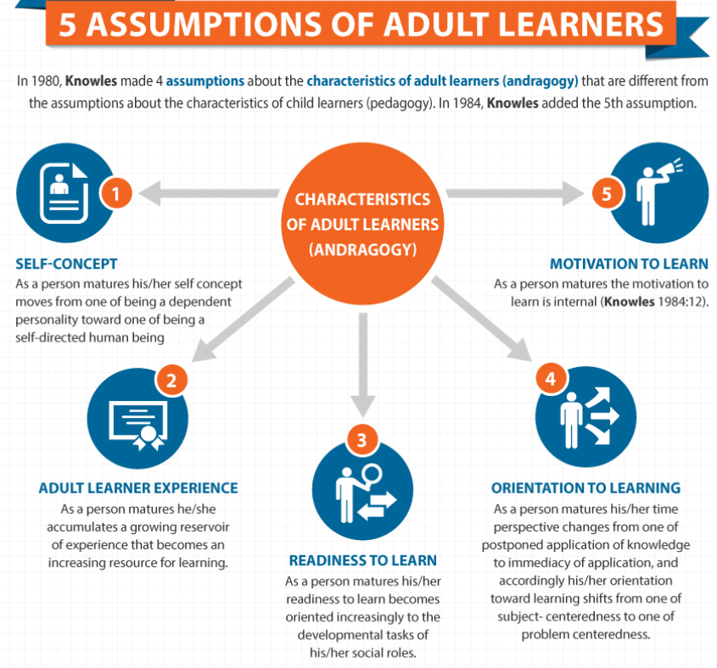
Andragogy Assumptions
http://elearninginfographics.com/adult-learning-theory-andragogy-infographic/

Slide 4
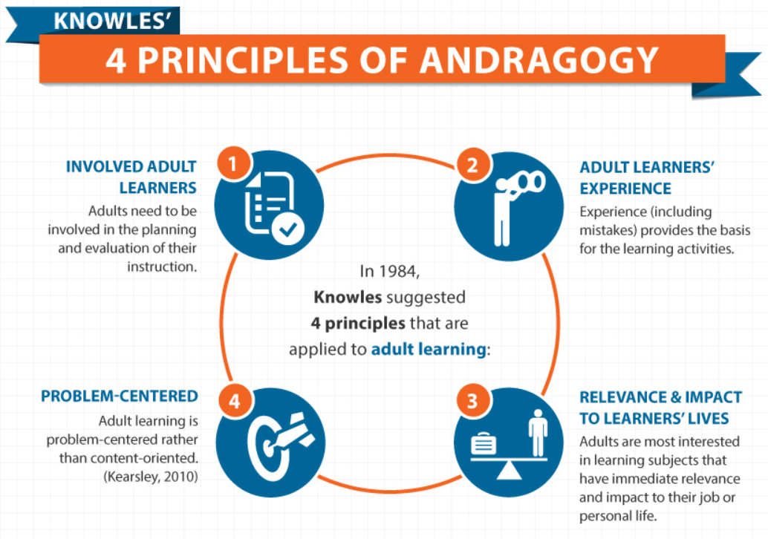
Teaching adult Learners
http://elearninginfographics.com/adult-learning-theory-andragogy-infographic/

Slide 5
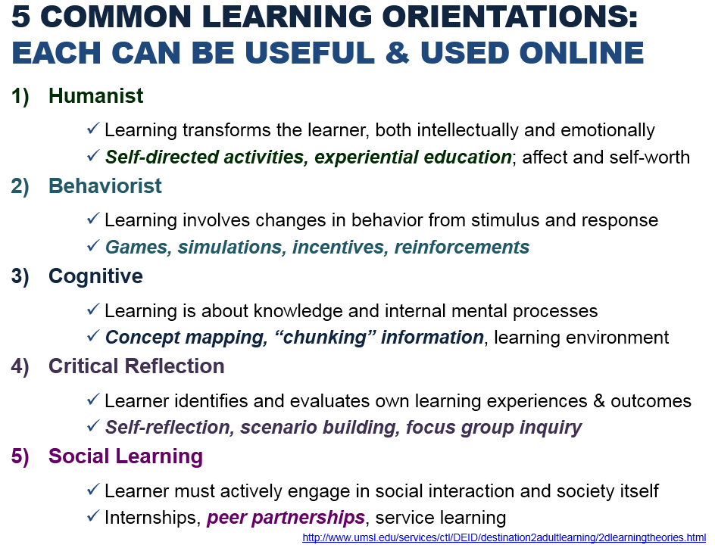
5 Common Learning Orientations
Formerly slide 3 from handout accompanying https://gsa.confex.com/gsa/2012AM/webprogram/Paper210635.html

Slide 6

Geoscientists learn best by doing
Earth sciences teacher preparation is particularly well-suited to adapting and implementing andragogy in the classroom because of our emphasis on practical education:
Field work
Laboratory work
Identification/classification activities
Math skills, including introductory statistics or data visualizations (charts/graphs)
Technology use, like mobile devices for mapping or data collection, analysis, & communication
Extreme Citizen Science in Congo basin:
https://www.ucl.ac.uk/excites

Slide 7

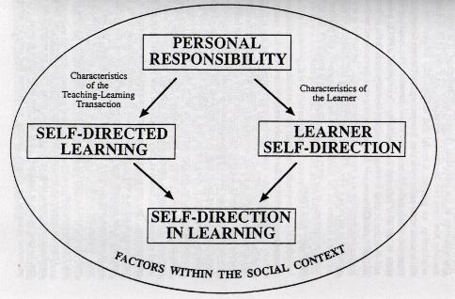
Embracing Failure
Lifelong learning involves changing your mind or
admitting prior knowledge was incomplete
For example:
As climate change models improve, student engagement with and understanding of datasets must also evolve
New discoveries within and outside our solar system require
on-going re-assessment of prior knowledge and existing paradigms
Adult learners are particularly challenged by new ways of thinking about their physical environment
Pluto – NASA/JHUAPL/SwRI/New Horizons
Students struggle with allowing themselves to make or admit mistakes
Vital to experiential learning
Starts with personal responsibility
http://infed.org/archives/e-texts/hiemstra_self_direction.htm

Slide 8

Andragogy Influences Pedagogy
Next Generation Science Standards
are moving K-12 pedagogy toward modern views of andragogy
Kids are encouraged to think more like adults
More self-direction
More empowerment through experience, relevance, ownership
Performance Expectations
are what students should know and be able to do.
Parsed by grade bands, and
grades, with progressions for
Science & Engineering Practices, Disciplinary Core Ideas, and Crosscutting Concepts.
HS-ESS2-4. Use a model to
describe how variations in the flow of energy into and out of Earth’s systems result in changes in climate.
“what
students
do”
“what
students
know”
(1) Problem-centered
(2) Learners involved in own education
(3) Mistakes as part of learning process
(4) Immediately relevant to learners’ lives
“how
students
think”
Achieve, Inc.
Peter A’Hearn, Palm Springs Unified School District Eric Pyle, James Madison University

Slide 9
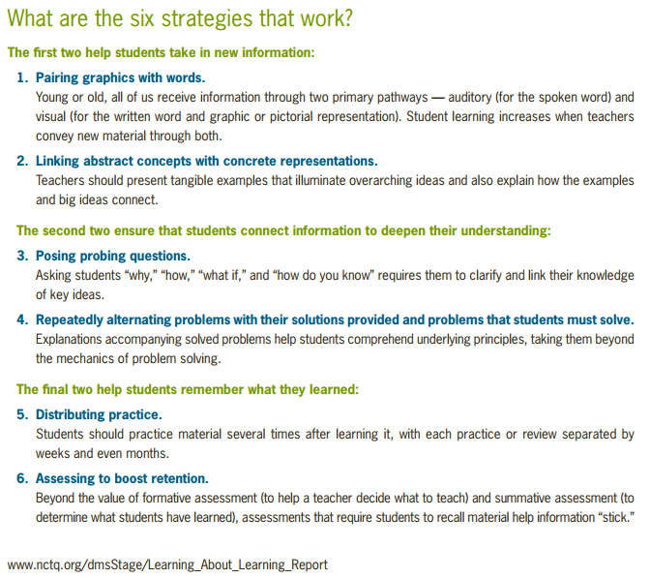
NCTQ’s 6 Strategies that Work:
National Council on Teacher Quality: Learning About Learning Report, January 2016
“how
students
think”
“what
students
know”
“what
students
do”

Slide 10
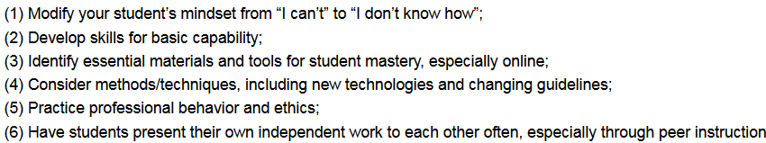
Applications in our Classrooms:
https://gsa.confex.com/gsa/2012AM/webprogram/Paper210635.html
Incorporate key principles of andragogy into
Earth sciences teacher education:
(1) Involvement – Adult learners must be partners in their own education
(2) Experience – Doing, including making mistakes, is essential
(3) Relevance – Work must have immediate impact on their grades
or on their lives outside school
(4) Problem-Focus – Learning centers on problem design & resolution
rather than content memorization

Slide 11
References:
Achieve, Inc. (2013). Next Generation Science Standards: For States, By States. Washington, DC: The National Academies Press.
Brockett, R. G. & Hiemstra, R. (1991). A Conceptual Framework for Understanding Self-Direction in Adult Learning. Self-Direction in Adult Learning: Perspectives on Theory, Research, and Practice. Personal Responsibility Orientation (PRO) model graphic retrieved on 18 May 2016 from http://www.infed.org/archives/e-texts/hiemstra_self_direction.htm
Conlan, J., Grabowski, S., & Smith, K. (2003). Adult Learning. In M. Orey (Ed.), Emerging perspectives on learning, teaching, and technology. Retrieved 18 May 2016 from http://epltt.coe.uga.edu/index.php?title=Adult_Learning
Extreme Citizen Science (2015). Graphic of women mapping on cellphones in Congo basin retrieved on 10 October 2015 from ExCiteS website at https://www.ucl.ac.uk/excites
Fleming, B. (2015). Defining Educational Outcomes, Measuring Impact. Retrieved on 23 September 2016 from Eduventures blog at http://www.eduventures.com/2015/04/defining-educational-outcomes/
Knowles, M. (1984). The Adult Learner: A Neglected Species. Full text retrieved 18 May 2016 from http://eric.ed.gov/?id=ED084368
Metlay, S. (2012). Learner-Directed Learning in Online Geoscience Education. Geological Society of America Abstracts with Programs. Vol. 44, No. 7, page 150. Abstract and PowerPoint (handout) retrieved 18 May 2016 from https://gsa.confex.com/gsa/2012AM/webprogram/Paper210635.html
NASA (2015). Image of Pluto taken by New Horizons spacecraft on 14 July 2015 retrieved on 15 July 2015 from Johns Hopkins University Applied Physics Lab website at http://pluto.jhuapl.edu/
NCTQ (2016). Learning About Learning Report. “Six strategies” retrieved from page vi on 15 September 2016 from National Council on Teacher Quality website at http://www.nctq.org/dmsStage/Learning_About_Learning_Report
Pappas, C. (2013). The Adult Learning Theory – Andragogy – of Malcolm Knowles. Infographics retrieved on 18 May 2016 from http://elearningindustry.com/the-adult-learning-theory-andragogy-of-malcolm-knowles
“Who are Today’s Students” (n.d.) Infographic retrieved on 23 September 2016 from GoDigitalMarketing website at http://www.godigitalmarketing.com/learn/infographic/marketing-strategies-for-traditional-and-non-traditional-students

Slide 12
Questions?
Contact me at:
suzanne.metlay@wgu.edu
Western Governors University

