Slide 1
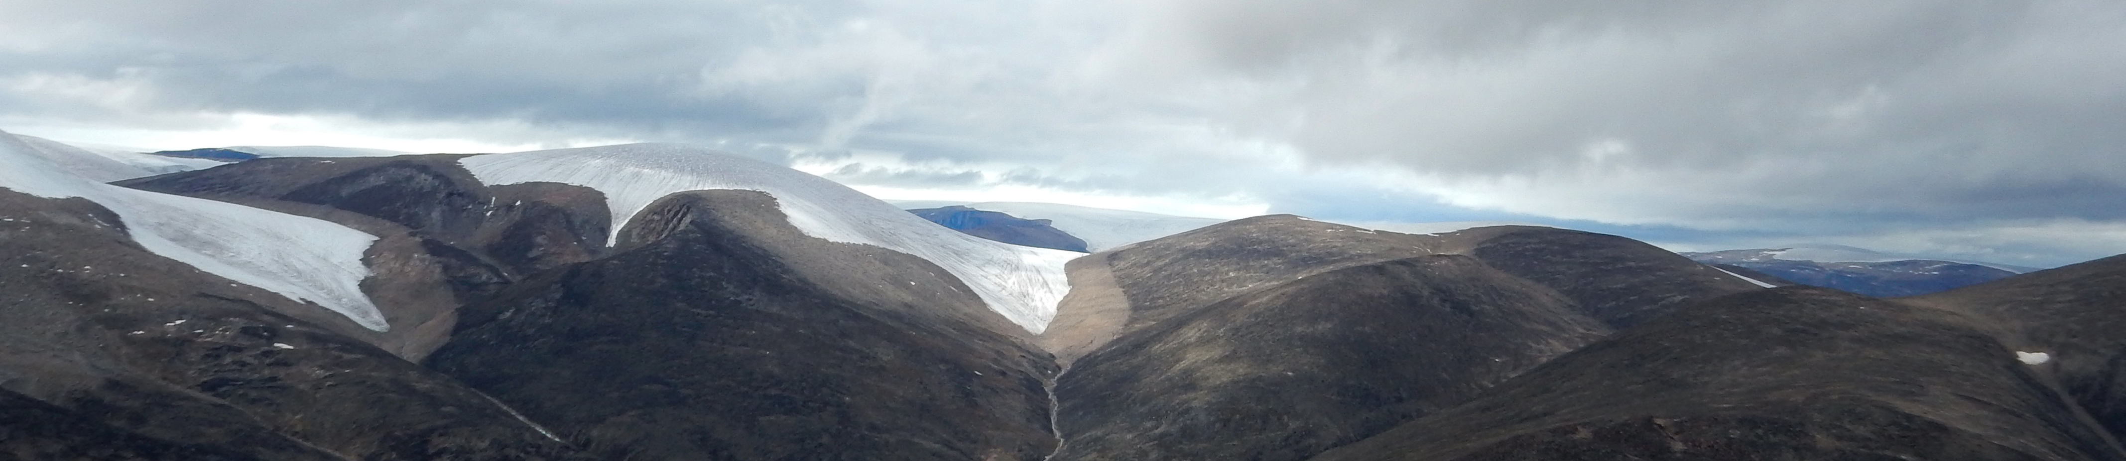
Constraining latest Holocene expansion and 20th century retreat of a small Canadian Arctic ice cap using entombed vegetation
Simon Pendleton, Gifford Miller, Robert Anderson, Sarah Crump
28 September 2016
INSTAAR/Dept. of Geological Sciences
University of Colorado Boulder

Slide 2
Reconstructing Holocene Glacial Activity
Holocene Climate in the Northern Hemisphere
Growth of glaciers and ice caps during Neoglacial period (6ka – Little Ice Age)
Reconstruction of Neoglacial activity:
  Glaciers
    Moraine preservation bias
    Moraine dating methods can be fraught with uncertainties (lichenometry, ¹⁰Be, etc.)
    Climate – glacier dynamics
Direct records of continuous ice margin activity are hard to come by…
LIA
Marcott et al., 2013

Slide 3
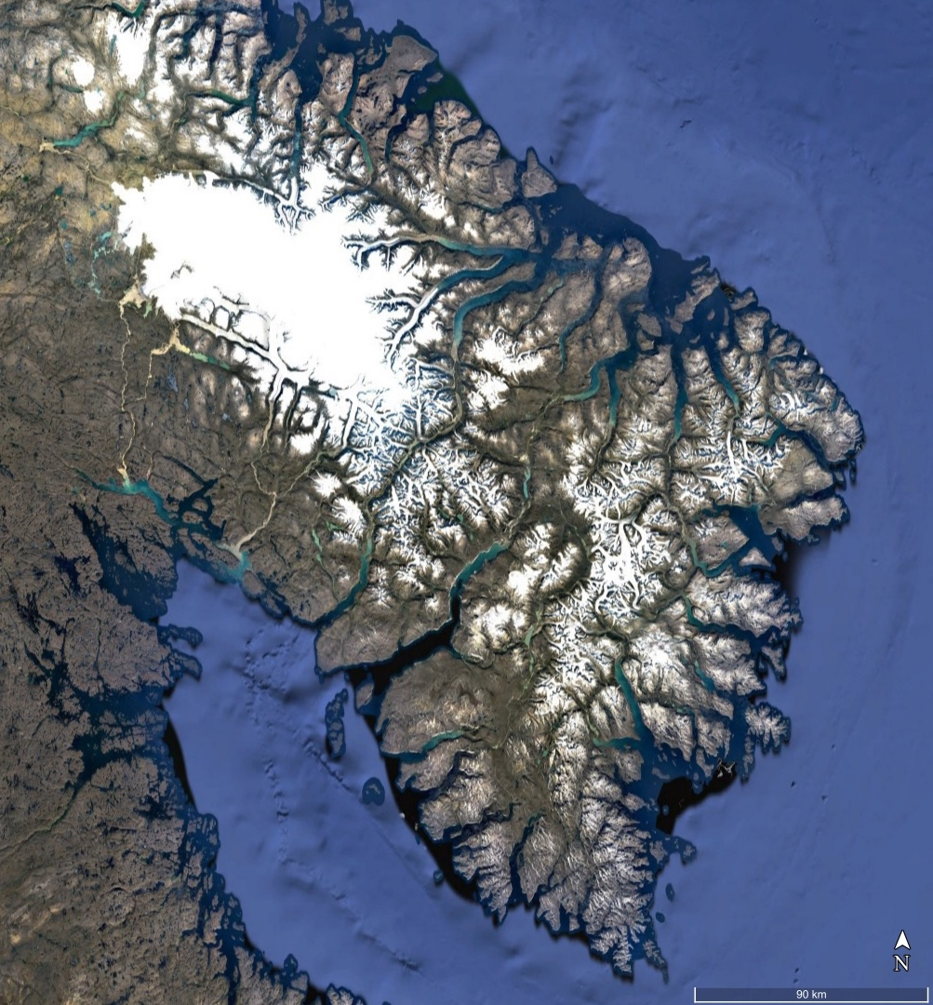
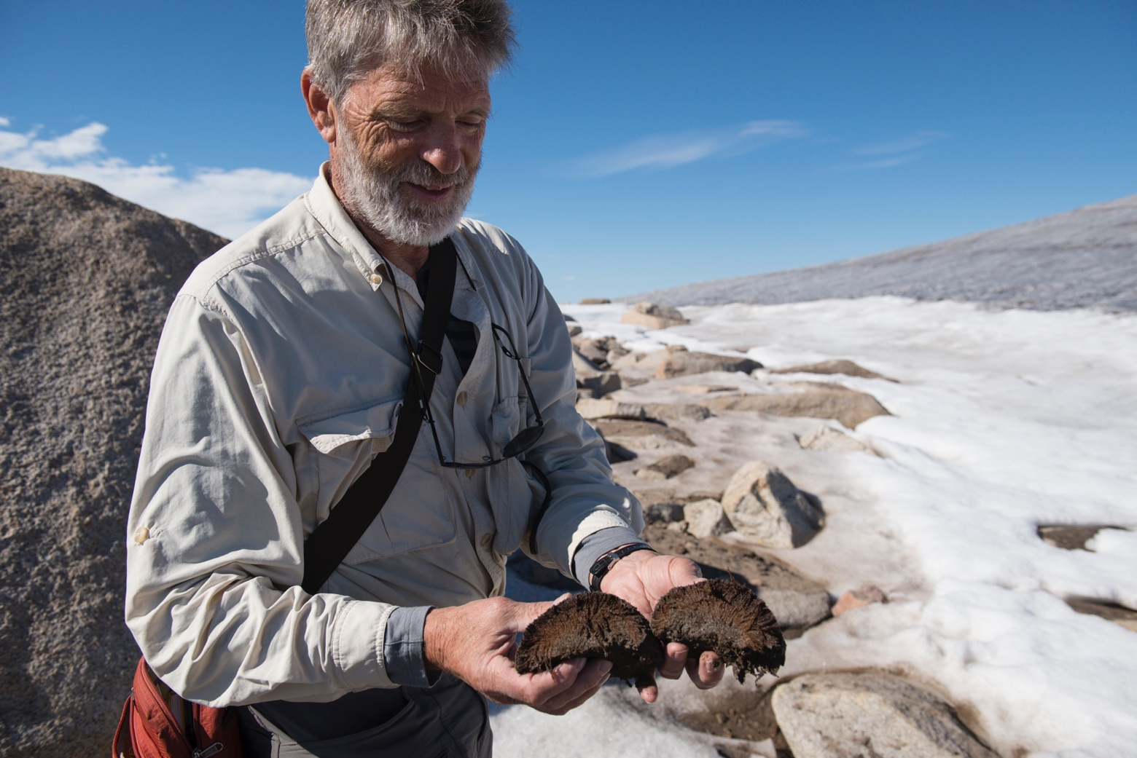
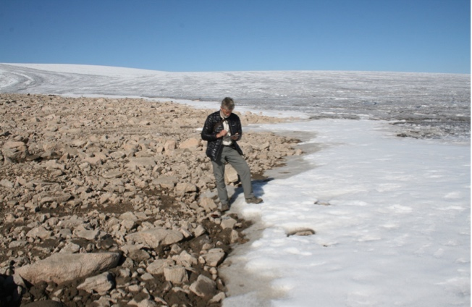
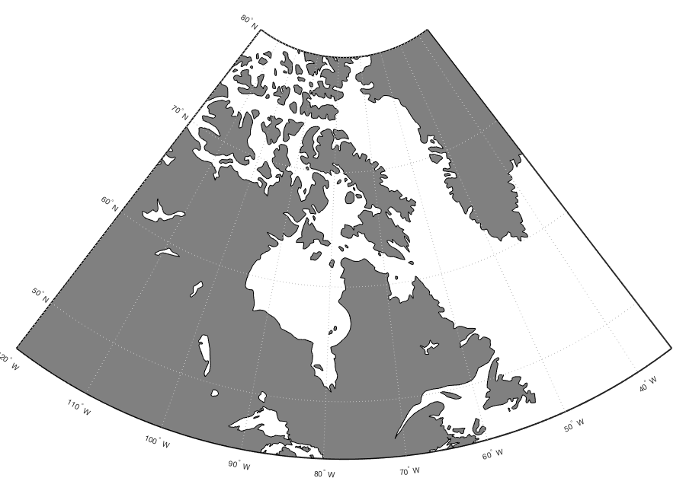
Cumberland Peninsula, Baffin Island
65-68°N, 61-68°W
Penny Ice Cap, small local ice caps, valley glaciers
Cold based ice – high degree of land surface preservation
Increasing ice margin retreat over last century
Penny Ice Cap

Slide 4
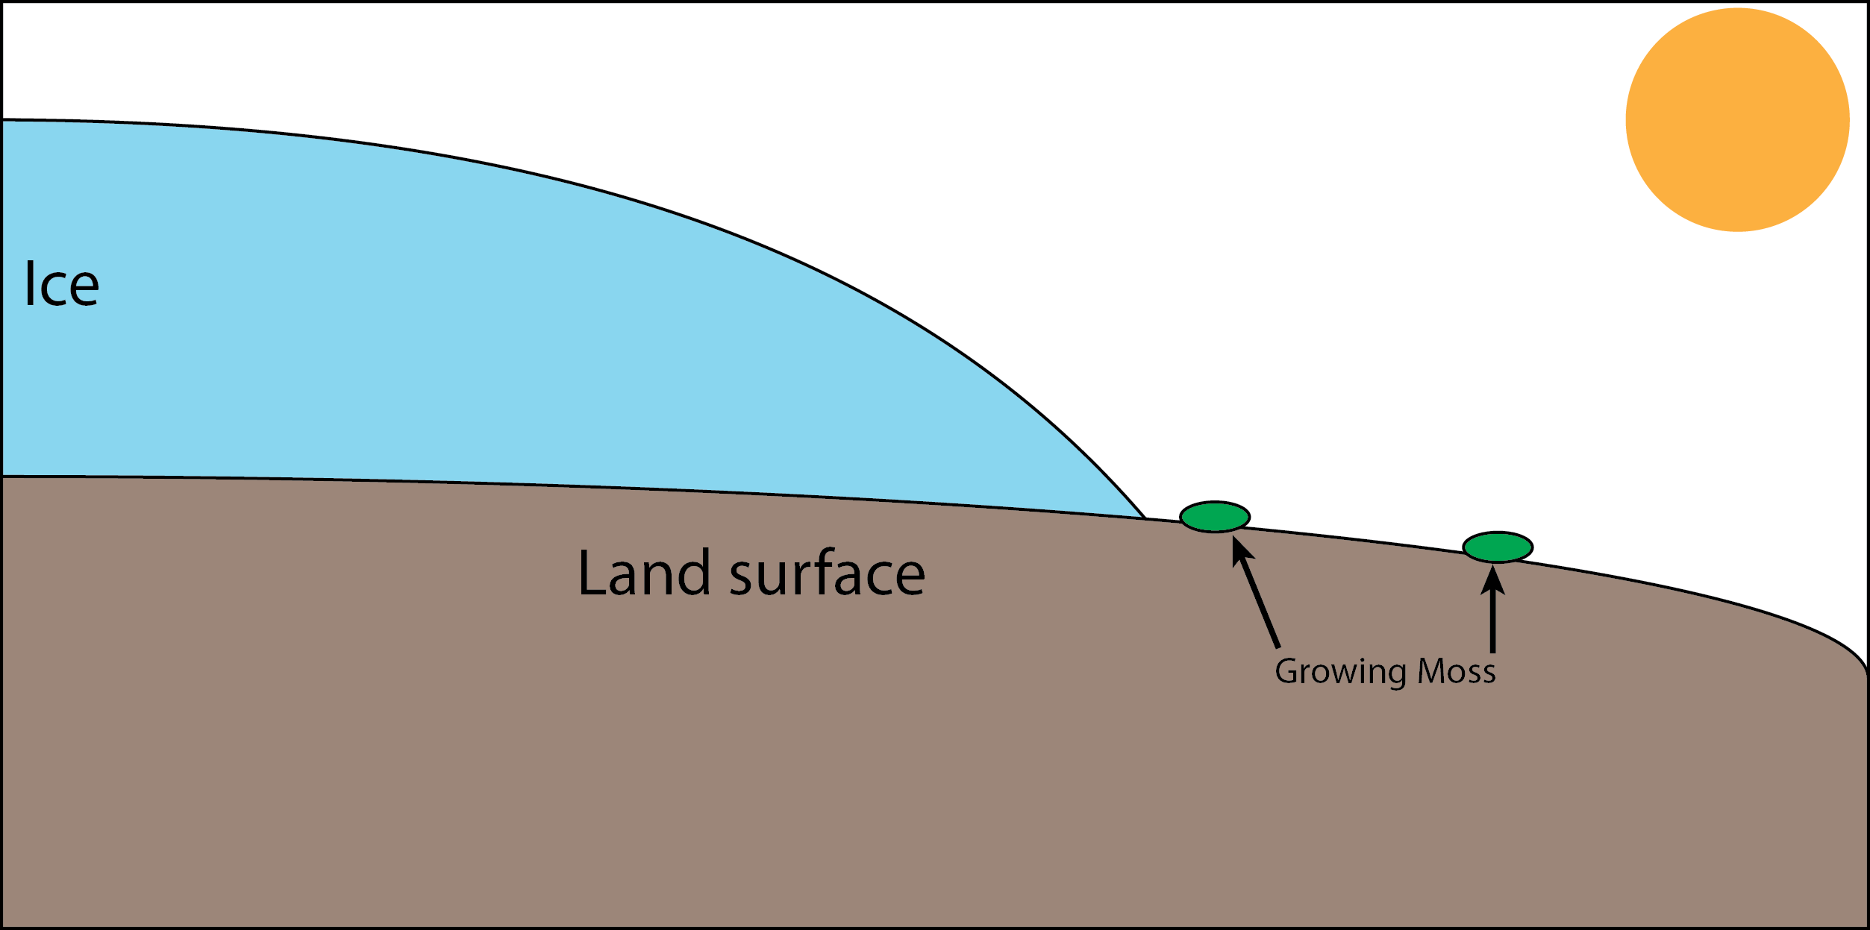
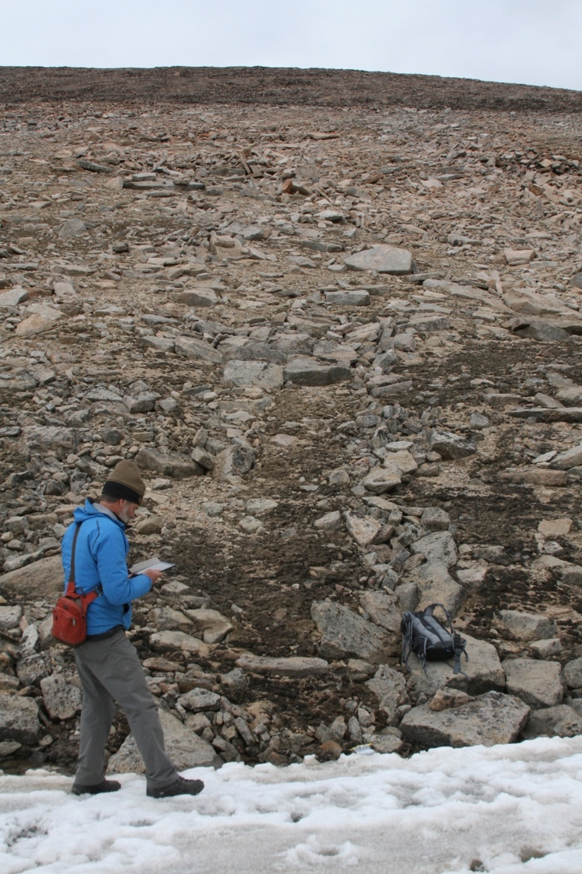
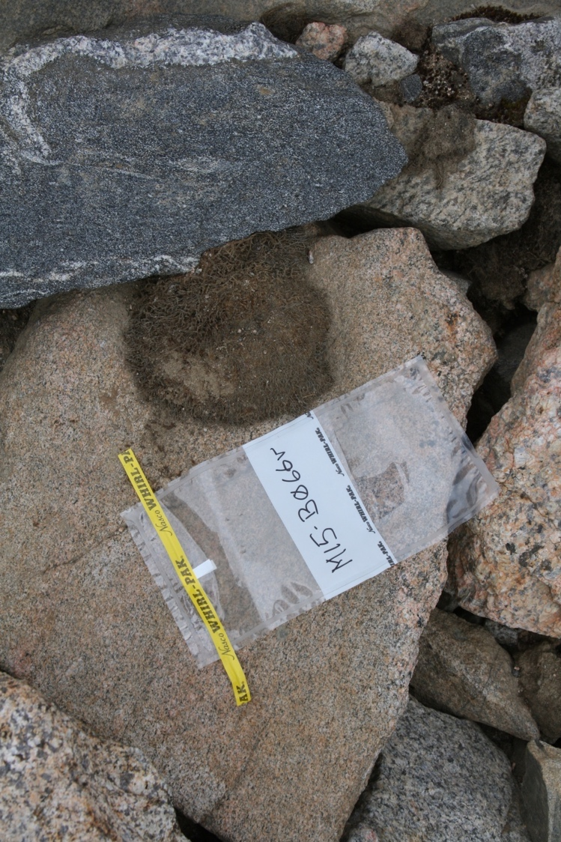
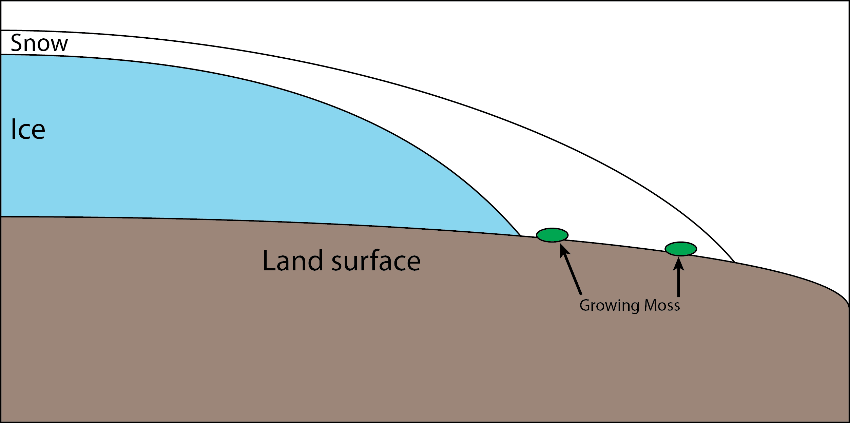

Entombed Dead Vegetation

Slide 5
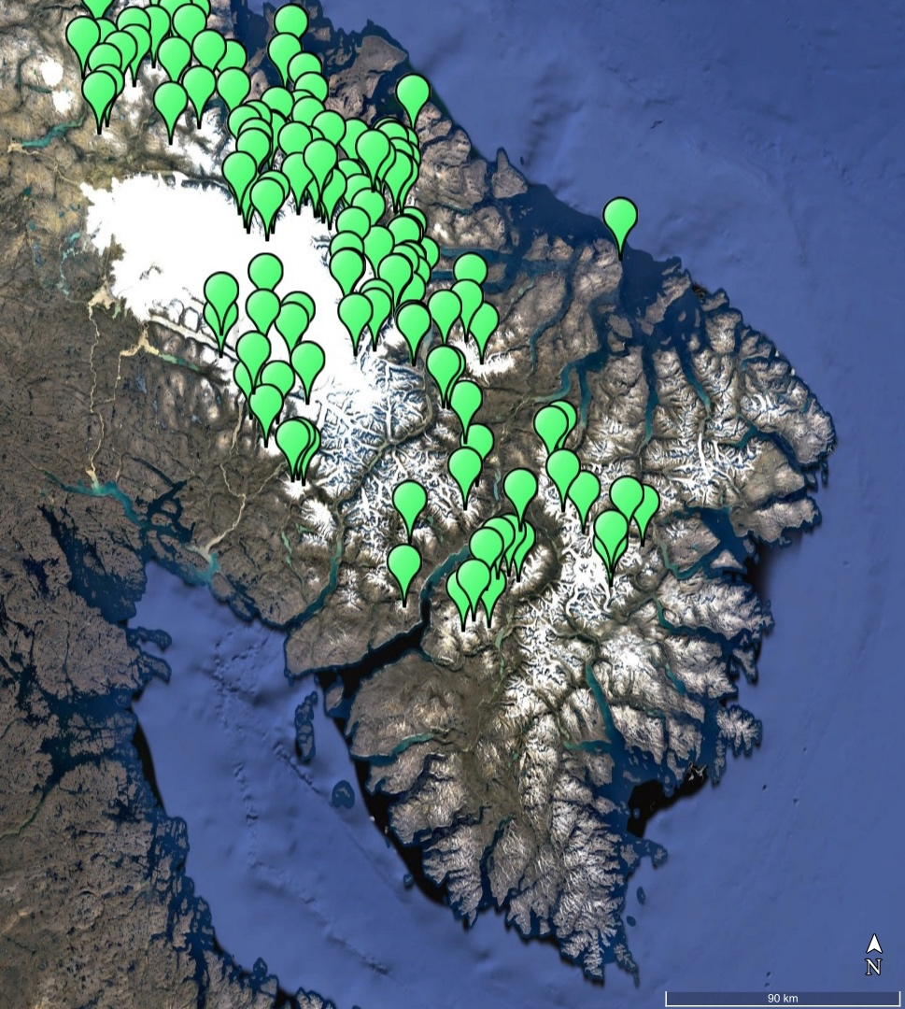
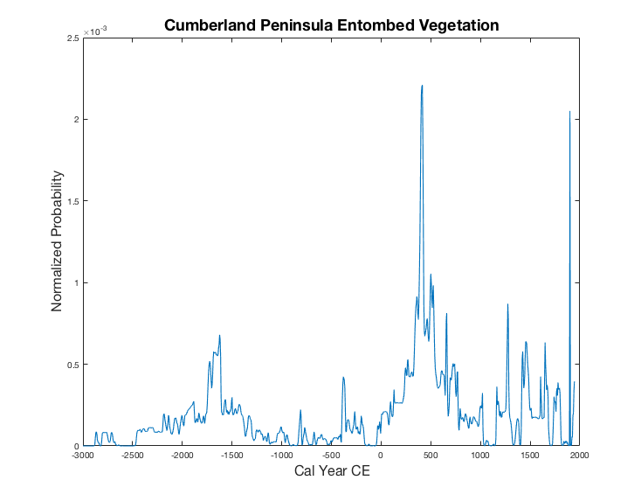
Entombed Dead Vegetation
If One sample from many ice caps = Regional History of ice margin Advance
What information would many Samples from one Ice cap provide?

Slide 6
Research Questions
Can the rapid modern ice cap retreat and exposure of entombed vegetation provide a continuous chronology of ice margin advance?
What climate inferences can be extrapolated from a simplified modeling of the observed ice margin activity over the the latest Holocene?

Slide 7
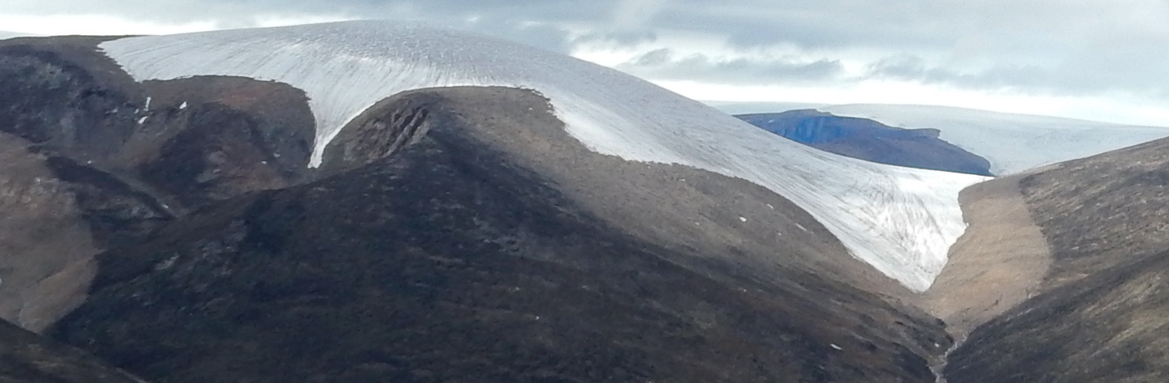
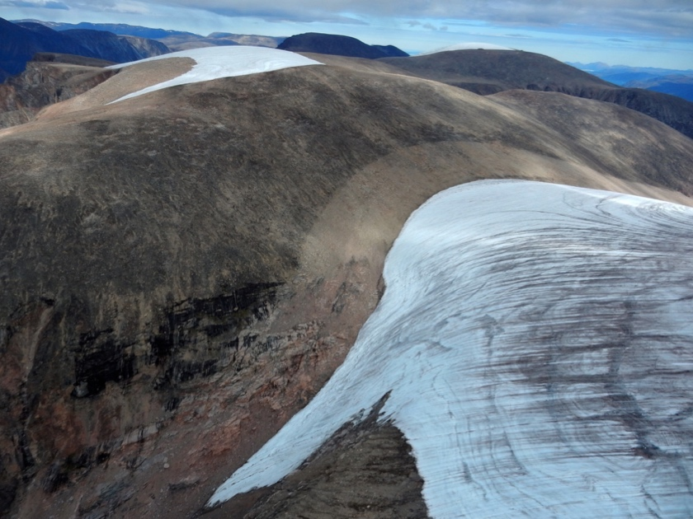
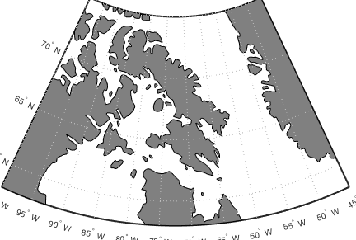
Case Study: Divide Ice Cap
7 km²
Thin (<100m), cold based
Obvious Holocene maximum extent trimline

Slide 8
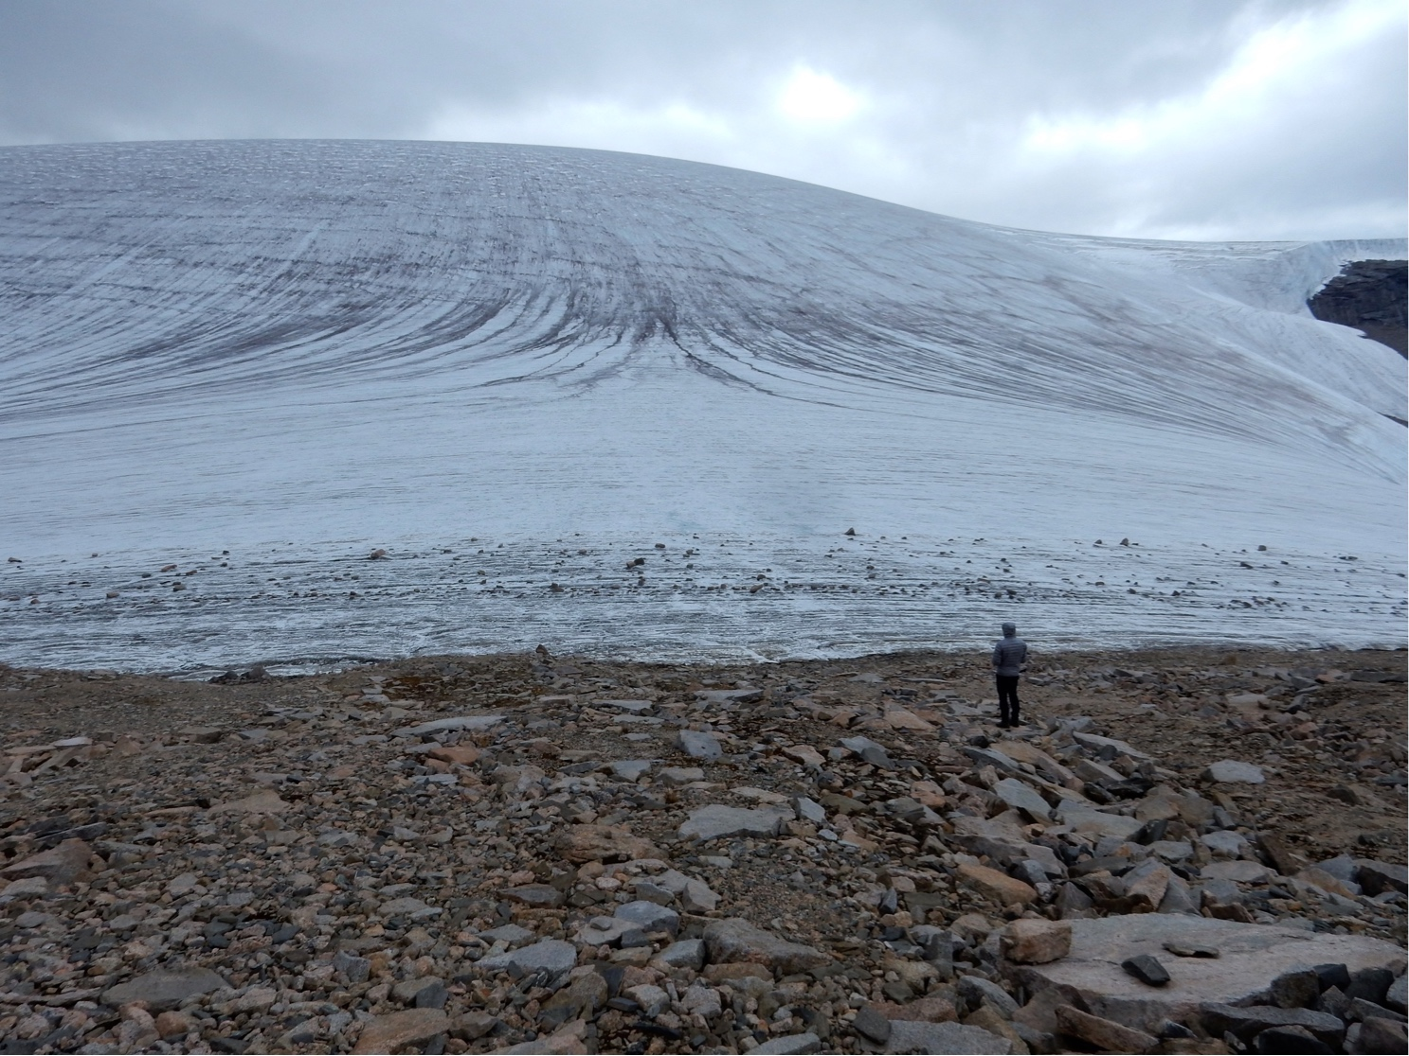
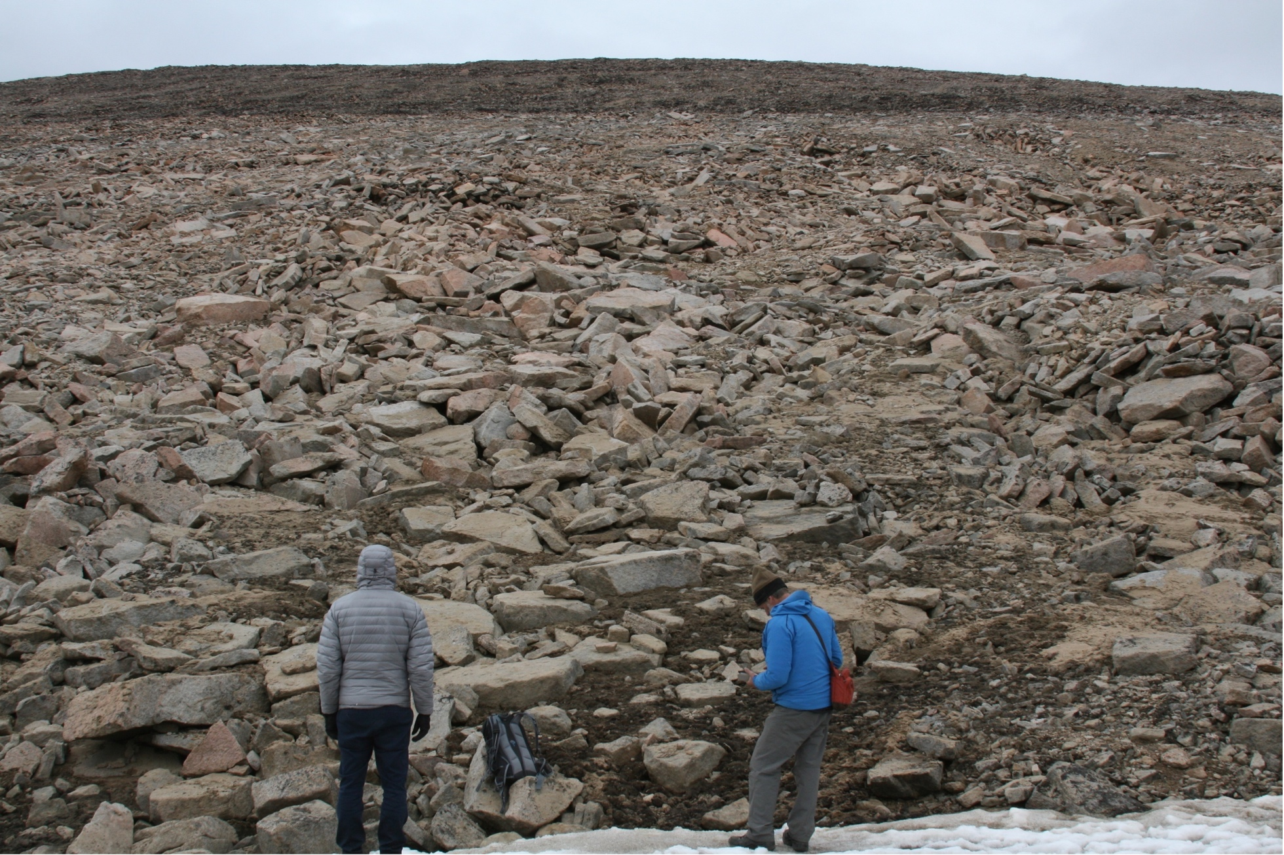
Ice Margin and Trimline

Slide 9
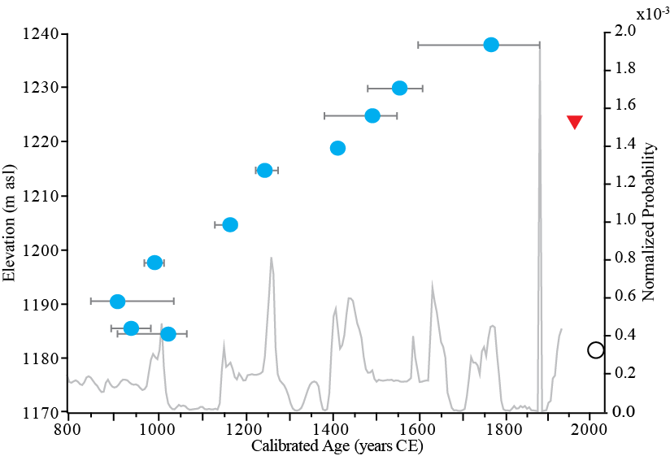
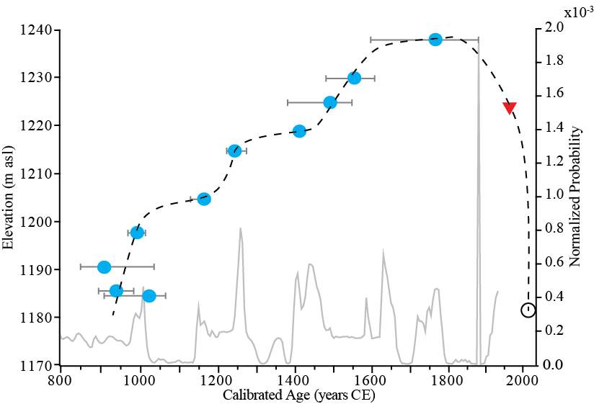
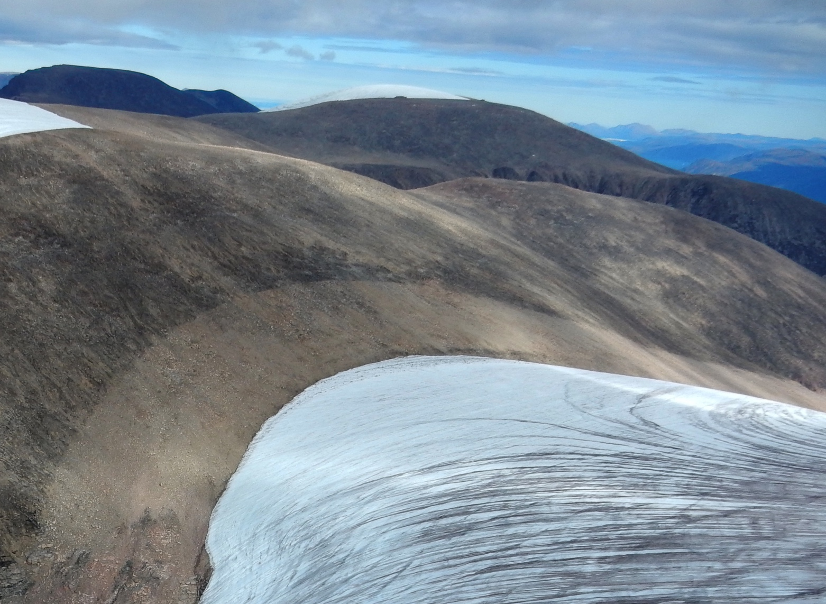
Ice Margin Chronology
10 sample transect
  ~950-1900 CE
Aerial Imagery
Trimlines

Slide 10
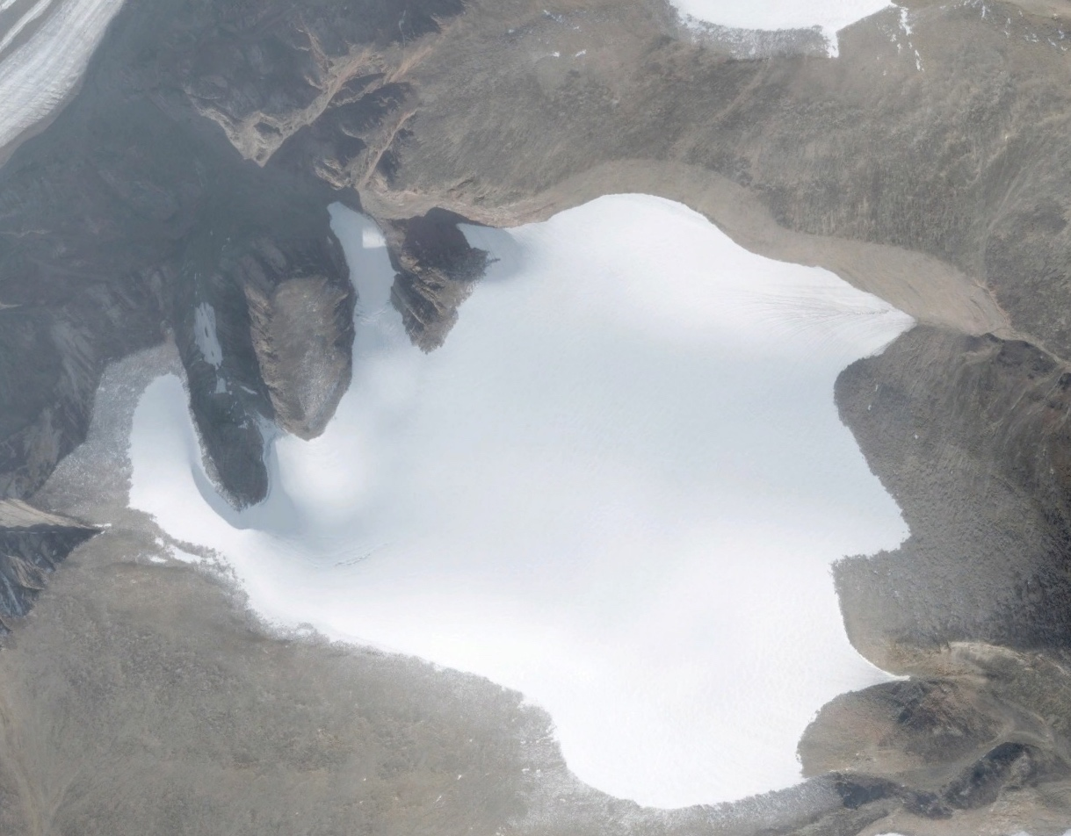
Ice Cap Modeling: Spatial-Temporal Constraints
Knowns:
  Where the advancing ice margin was at ~0, 1000, 1910 CE
Unknowns:
  What climate history is required to match the observed chronology?
What can model simulations tell us?
~1600-1910 CE
~1000 CE
~0 CE

Slide 11
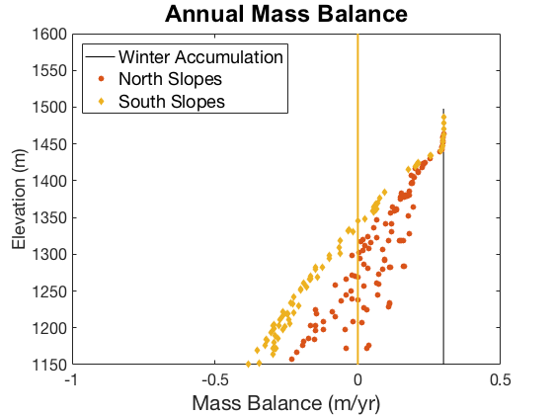
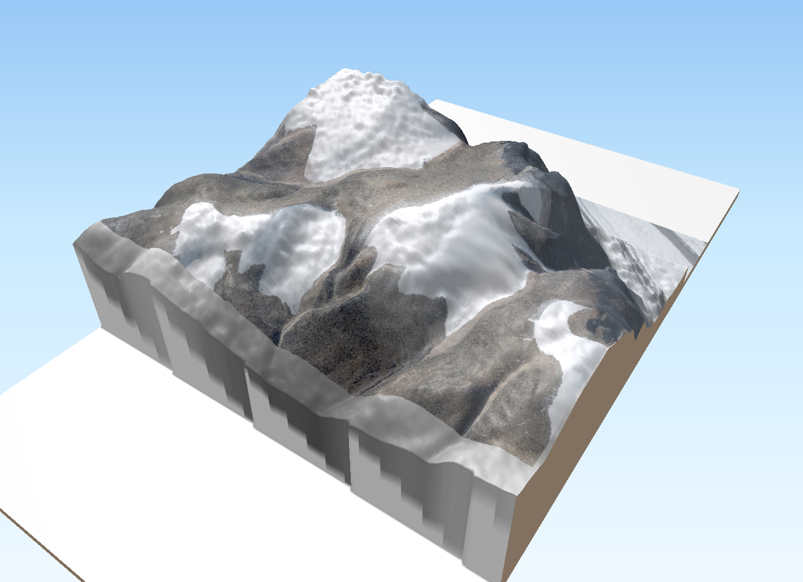
Ice Cap Modeling: Set up
2D Finite Difference model (e.g. Kessler et al., 2006)
  Shallow ice approximation
  No basal sliding
Mass Balance
  Prescribed accumulation
  Melt
    Positive Degree Day model
      Derived from annual temperature cycle (Braithwaite, 1995)
    Solar melt (e.g., Hock et al., 2003, 2005)
      Length of melt period, slope, aspect (Kumar et al., 1997)
Notes:
$$M= f_{m}PDD+aQ_{s}$$
mm [=] (mm C-1 day-1)*(C day) + (mm day[W m-2]-1)*(W m-2)

Slide 12
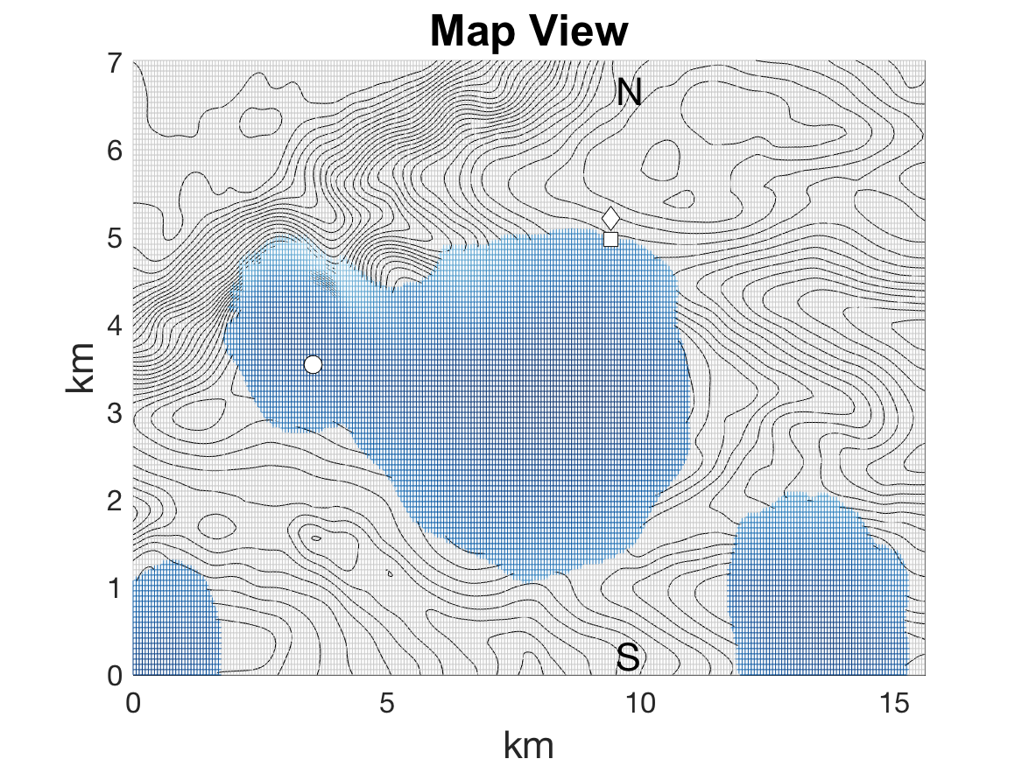
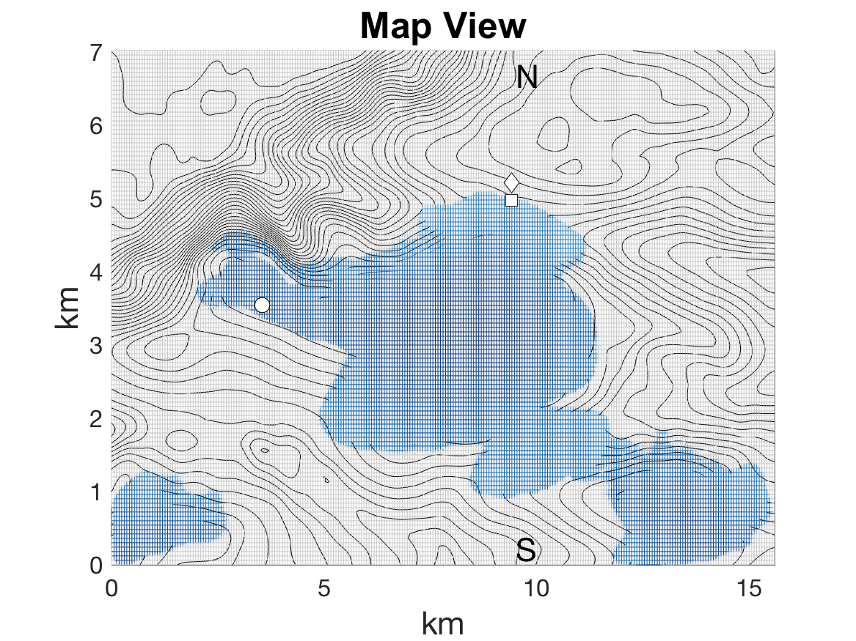
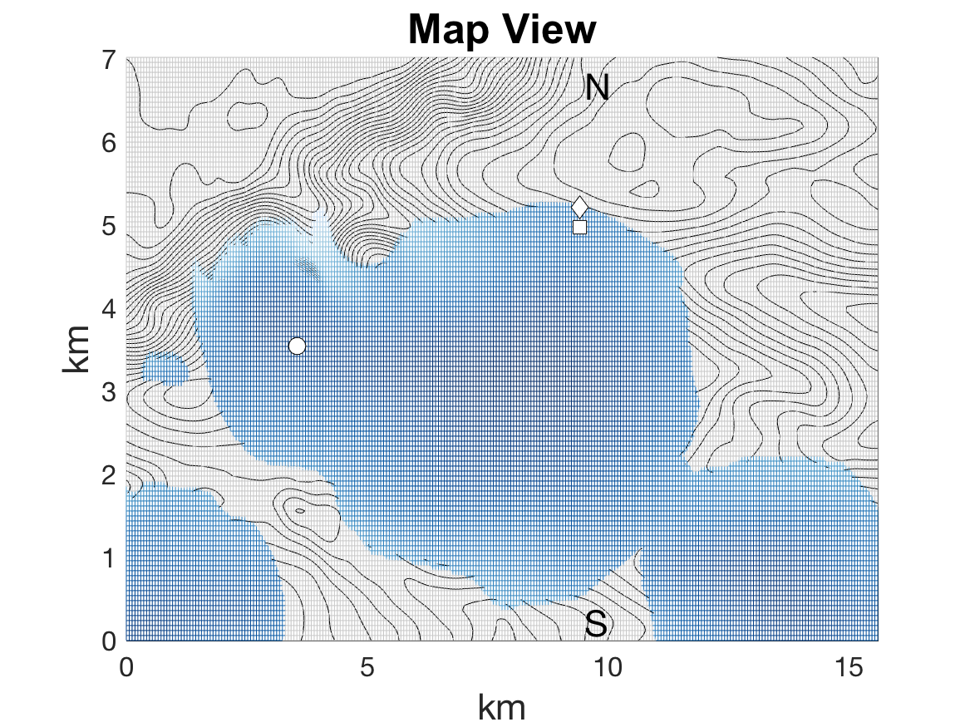
Ice Cap Modeling: Results
Minimum cooling over last 2000 years: ~0.4°C
  Second millennium CE ~0.25°C cooler than First
Warming (since 1910)
    Cumulative warming: ~2.8 °C
Ice cap disappearance in ~85 years
Notes:
Solar melt factor: 0.036 – 0.042 mm day⁻¹ [W m⁻²]
Dewar Lakes (1959-2015): 0.014°C yr⁻¹
Qik (1995-2009): 0.0867 °C yr⁻¹
Model Optimized: 0.026°C yr⁻¹

Slide 13
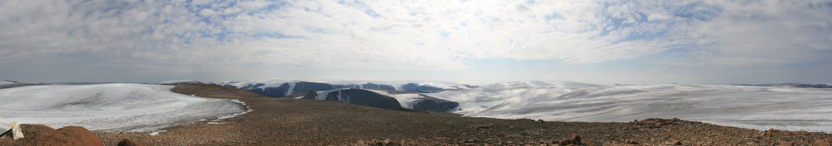
Conclusions
Direct record of ice margin advance during latest Holocene
Minimum of ~0.4°C of cooling in last 2ka
2nd millennium CE was ~0.25°C cooler than 1st millennium CE
Holocene advances likely episodic
Modeled modern retreat fall within observational data
Ice cap disappearance in ~85 years (or less)
Model could be improved by in situ temperature, solar, and mass balance observations.

Slide 14
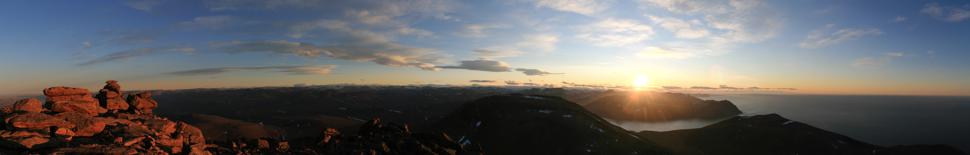
Acknowledgements
NSF Award #1204096, Scott Lehman and NSRL for ¹⁴C processing, Chris Florian for sample prep assistance, Nicolás Young for field assistance, William Armstrong and Eric Winchell for thoughts on modeling, Polar Continental Shelf for logistical support and Universal Helicopters for transportation and Gordie Audlakiak Mina Kunilusia guiding and field support.

Slide 15
References
Benn, D.I., and Lehmkuhl, F., 2000, Mass balance and equilibrium-line altitudes of glaciers in high-mountain environments: Quaternary International, v. 65–66p.15–29, doi:10.1016/S1040-6182(99)00034-8.
Braithwaite, R.J., 1995, Positive degree-day factors for ablation on the Greenland Ice-sheet studied by energy balance modeling: Journal of Glaciology, v. 41, no. 137, p.153–160.
Hock, R., 2003, Temperature index melt modelling in mountain areas: Journal of Hydrology, v. 282, no. 1–4, p.104–115, doi:10.1016/S0022-1694(03)00257-9.
Hock, R., 2005, Glacier melt: a review of processes and their modelling: Progress in Physical Geography, v. 29, no. 3, p.362–391, doi:10.1191/0309133305pp453ra.
Kumar, L., Skidmore, A.K., and Knowles, E., 1997, Modelling topographic variation in solar radiation in a GIS environment: International Journal of Geographical Information Science, v. 11, no. 5, p.475–497, doi:10.1080/136588197242266.
Miller, G.H., Lehman, S.J., Refsnider, K.A., Southon, J.R., and Zhong, Y., 2013, Unprecedented recent summer warmth in Arctic Canada: Geophysical Research Letters, v. 40, no. 21, p.5745–5751.
Marcott, S.A., Shakun, J.D., Clark, P.U., and Mix, A.C., 2013, A Reconstruction of Regional and Global Temperature for the Past 11,300 Years: Science (New York, N.Y.), v. 339, no. 6124, p.1198–1201, doi:10.1126/science.1228026.
Raper, S.C.B., and Braithwaite, R.J., 2009, Glacier volume response time and its links to climate and topography based on a conceptual model of glacier hypsometry: The Cryosphere, v. 3p.183–194, doi:10.5194/tcd-3-243-2009.
Young, N.E., Schweinsberg, A.D., Briner, J.P., and Schaefer, J.M., 2015, Glacier maxima in Baffin Bay during the Medieval Warm Period coeval with Norse settlement: , no. December, , doi:10.1126/sciadv.1500806.

