Slide 1
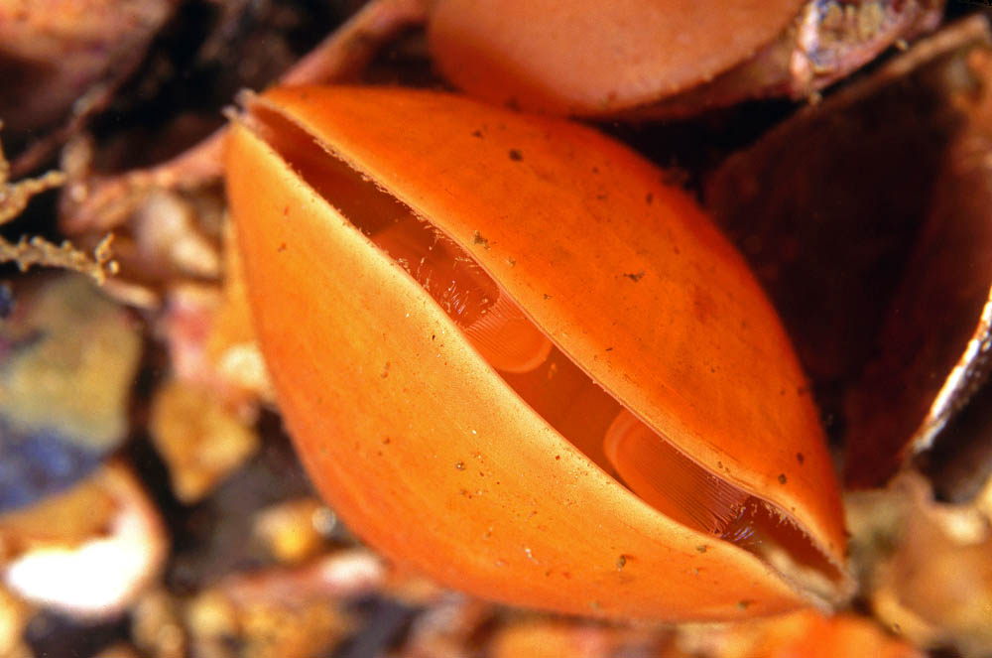
Substrate Preference and Mid-Mesozoic Brachiopod Decline
Marko Manojlovic
UC Santa Cruz

Slide 2
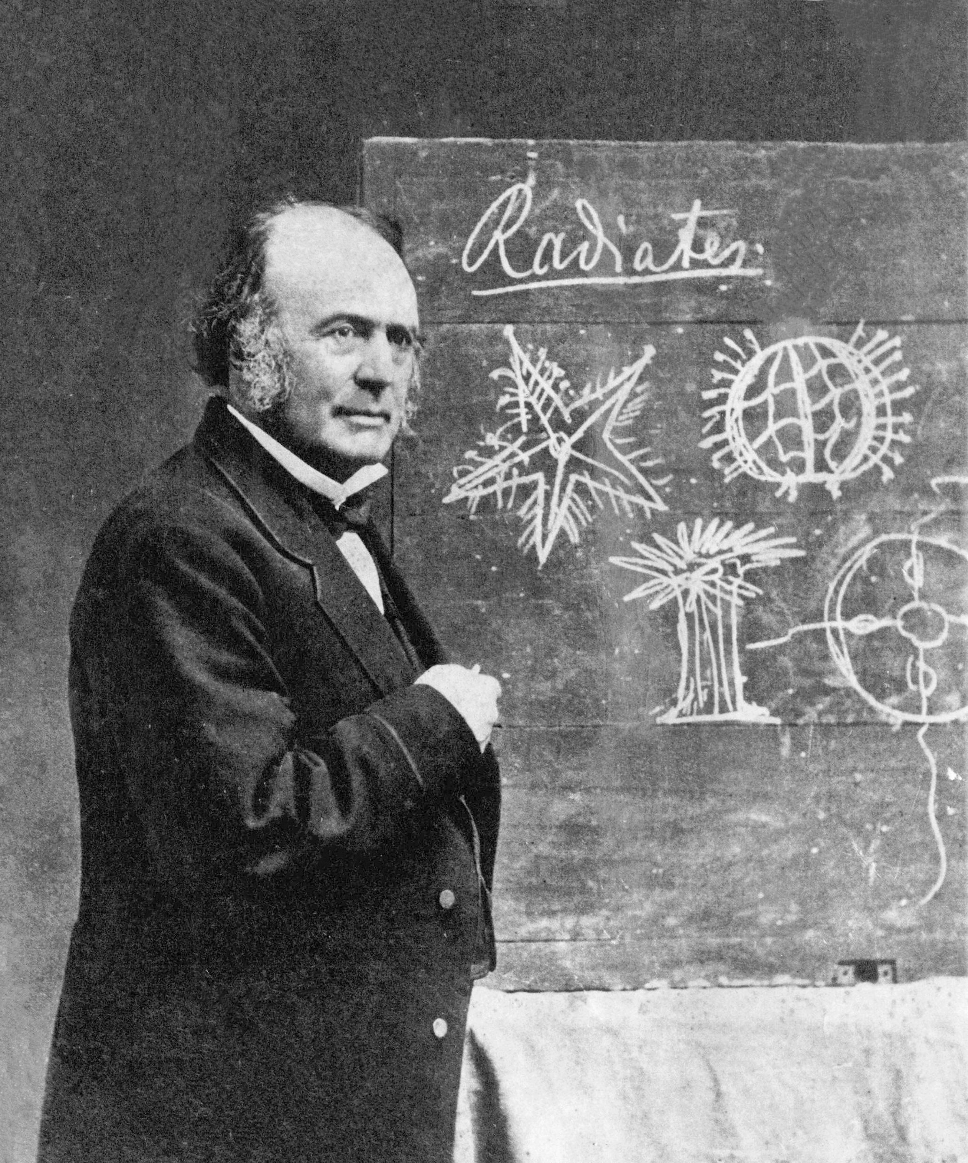
Brachiopods vs Bivalves
“Every zoologist acknowledges the inferiority of the Bryozoa and the Brachiopods when compared with the [Bivalves]….Now if any fact is well established in Paleontology, it is the earlier appearance and prevalence of the Bryozoa and Brachiopoda in the oldest geological formations, until [Bivalves] assume the ascendancy which they maintain to the fullest extent at present”
Louis Agassiz 1857
Notes:
Had good ideas, at least outside of human biology

Slide 3
Brachiopods vs Bivalves
In 1980 Gould and Calloway argued that brachiopods did not decline due to competition with bivalves
Instead they point to the much larger effect of the Permian-Triassic extinction on the brachiopods compared to bivalves
“Ships passing in the night”
Recently it has been argued that bivalves were always metabolically dominant and that superior metabolism led to their post-P/T dominance
Notes:
Emphasize that this is about the Mesozoic, not P-T

Slide 4
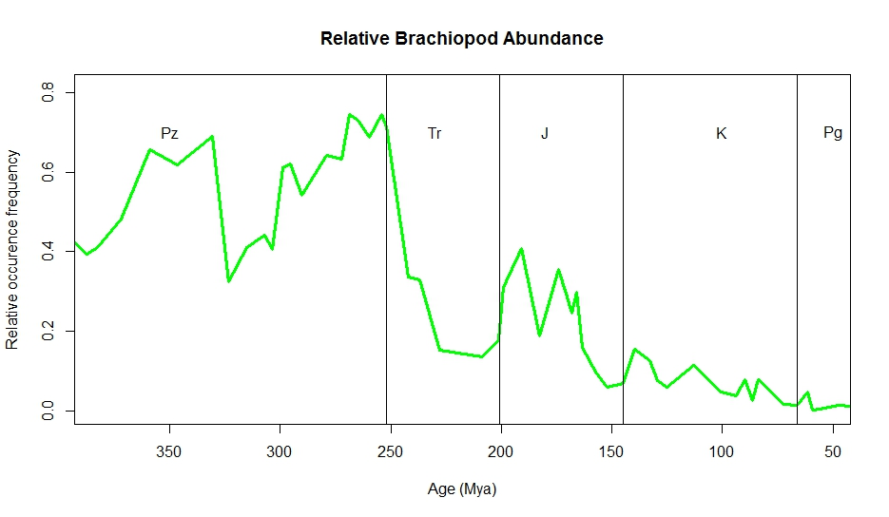
Brachiopods vs Bivalves
The Jurassic represents the last “golden age” of brachiopods as the group recovered from the P-T extinction
Notes:
Relative to bivalves, gastropods, echinoderms etc..

Slide 5
Modern Brachiopod Distribution
Restricted to hard substrates and deep, low nutrient environments
Associated with carbonate substrates in studies of large living communities off Brazil and New Zealand
Notes:
Focus on hard substrate because it is possible to examine in the record

Slide 6
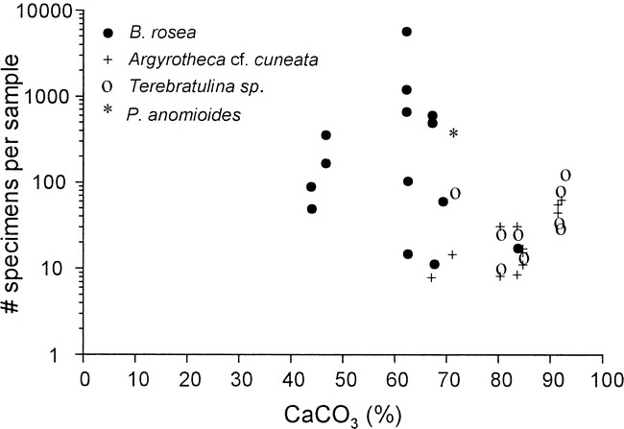
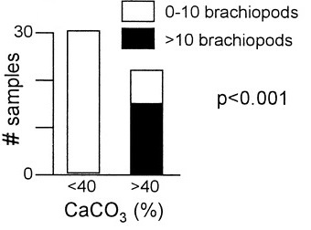
Brazil (Kowalewski et al. 2002)
Brachiopods only present in >40% CaCO³ samples, unlike mollusks
*
*Fisher’s Exact Test
Notes:
Large high abundance, low diversity, brachiopod communites off Brazil associated with carbonate substrates

Slide 7
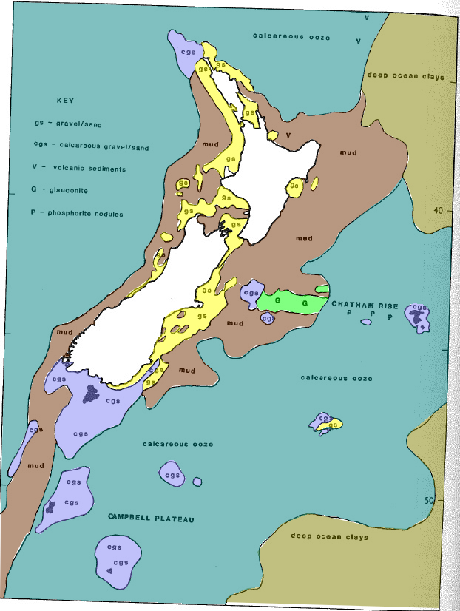
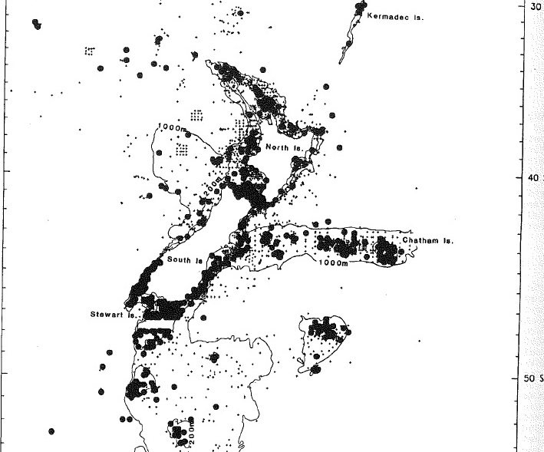
Adapted from Lee 1990

Slide 8
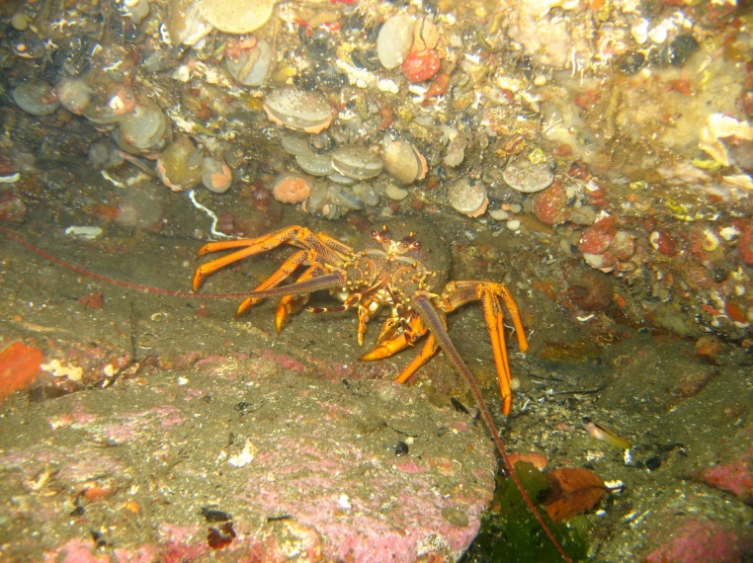
Substrate
Brachiopods much more reliant on hard substrate than bivalves
Can’t recover if buried by burrowers and almost never able to reattach if dislodged from substrate
Restricted to harder substrates and marginal environments by burrowing and grazing organisms

Slide 9
The Brachiopod and the Bulldozer
“deposit feeders as villains…immobile suspension feeders occupying soft substrate (ISSOS) as victims and…mud bottoms as the scene of the crime” (Thayer 1983)
The brachiopod world dramatically contracted with increasing bioturbation in the Mesozoic, compared to vast available unconsolidated sediments in the Paleozoic
Could the increase in burrowing and grazing by other organisms account for the brachiopod shift to harder substrates?
Notes:
Bioturbation dramatically shrank the world of the brachiopods from the Paleozoic, where their inferior reproduction

Slide 10
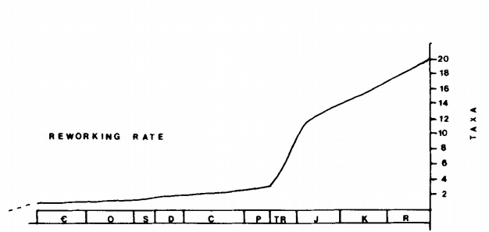
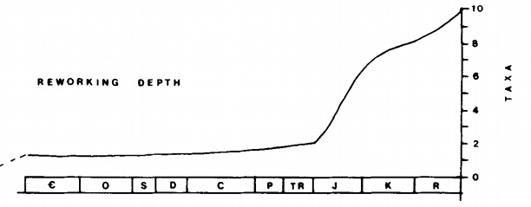
Increasing Bioturbation?
- Increasing thickness of preserved event beds (Sepkoski 1991)
-increasing reworking rate and depth
Notes:
Namedrop MMR?

Slide 11
Methods
Examined brachiopod/bivalve substrate preference by lumping the lithology of fossil collections into two broad categories:
Carbonate: limestone (various subtypes), chalk, lime mudstone etc…
Proxy for a hard substrate
Siliciclastic: sandstone, mudstone, siltstone, shale etc…
Proxy for a soft substrate
Carbonate environments generally offer harder attachment surfaces and usually lithify more rapidly, offering new attachment opportunities
Siliciclastic environments represent primarily soft bottoms with few attachment opportunities and more intense burrowing activity
Notes:
Substrate islands impossible to see in the fossil record (deep discinids on shark teeth, other immobile suspension feeders on glass bottles)

Slide 12

Methods
Examined brachiopod, bivalve and gastropod abundance counts
from occurrences with:
>30 specimens total per collection
Paleoecological counts of all species from each group
Excluded silicified collections
Notes:
And tagged for future analysis in the PBDB

Slide 13
Abundance
Percent abundance used as a proxy for ecological dominance (Clapham 2006)
% bivalve, % brachiopod and % gastropod determined for each collection
Data was then binned to the epoch level and mean % abundances in carbonate and siliciclastic collections were calculated
Notes:
Paleoecological collections as those that don’t focus on only one of the groups

Slide 14
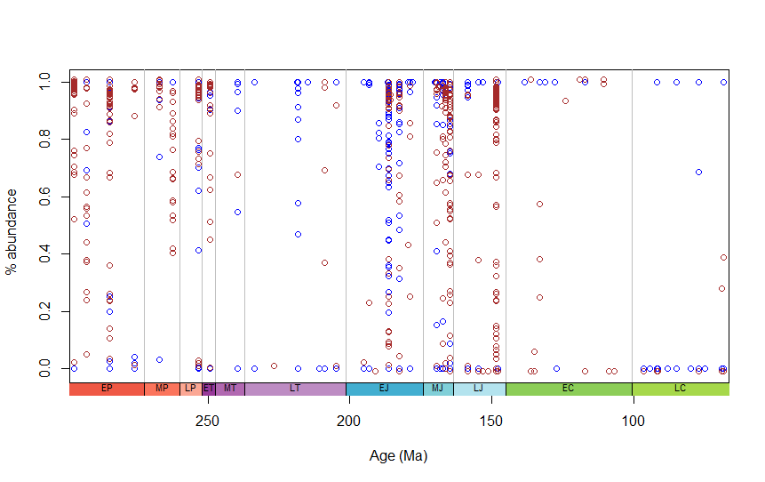
Notes:
Here’s the collections

Slide 15
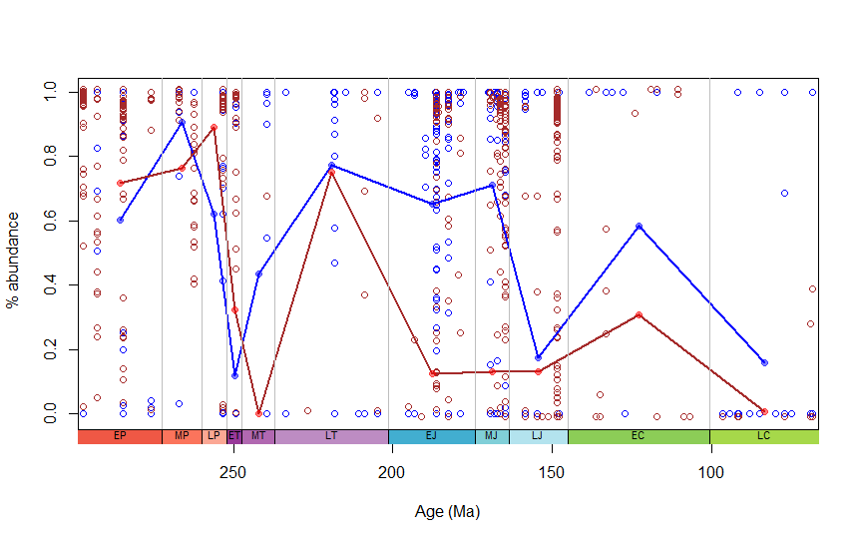
Notes:
Note: Cretaceous siliciclastic brachiopod occur WITH hard substrate indicators such as ferruginous or phosphatic. Lots of siliciclastics with 0% brachiopods in the late Cretaceous

Slide 16
Results
Higher median % abundance of brachiopods in carbonates after the Early Triassic, pointing to a post P-T brachiopod recovery mostly occurring on carbonates
Agrees with earlier work with examining brachiopod/bivalve presence absence in carbonates and siliciclastics, showing increasing preference for carbonates

Slide 17
Lithology Adjectives
Also investigated association between brachiopod occurrence and PBDB lithological adjectives that could also serve as proxies for firmer substrate conditions, such as “glauconitic”, “ferruginous” etc... or softer substrate conditions such as “muddy”
Data binned by epoch from the Permian to the Cretaceous and mean % of brachiopods and bivalves associated with adjective plotted
Notes:
Main lithology is the noun, this is an adjective. Emphasize that this is presence/absence, not counts based.

Slide 18
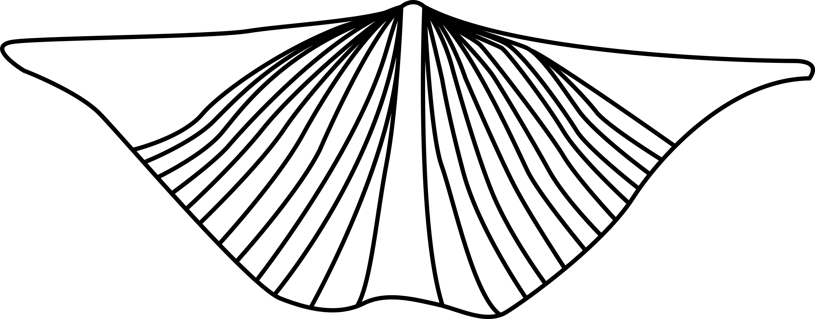

Lithology Adjectives
2x2 contingency tables constructed for brachiopods and bivalves and Fisher’s Exact Test performed
Glauconite | Non-glauconite
323 | 14503
3786 | 39234
Notes:
Main lithology is the noun, this is an adjective. Emphasize that this is presence/absence, not counts based.

Slide 19
Lithology Adjectives
Bivalves actually have a statistically significant association with glauconitic and ferruginous occurrences, even when limiting data to the Mesozoic, contrary to assumptions
Brachiopods do have a statistically significant negative association with non-carbonate lithologies characterized as silty, muddy, argillaceous or sandy
Notes:
NOT non-carbonate lithologies

Slide 20
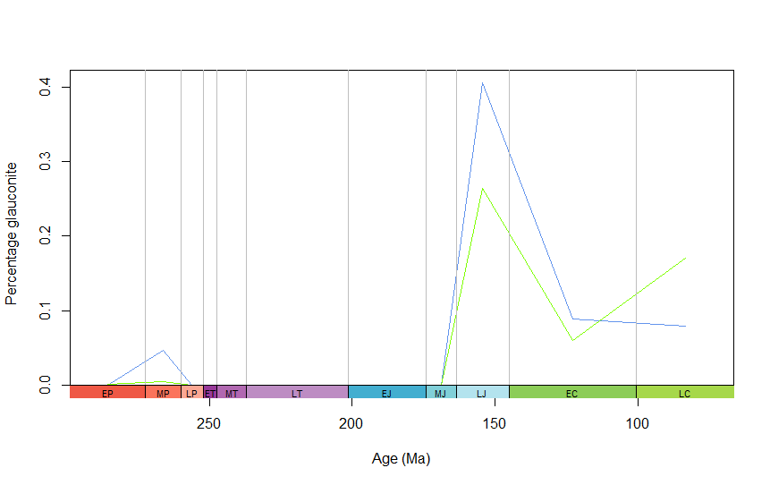
Glauconite

Slide 21
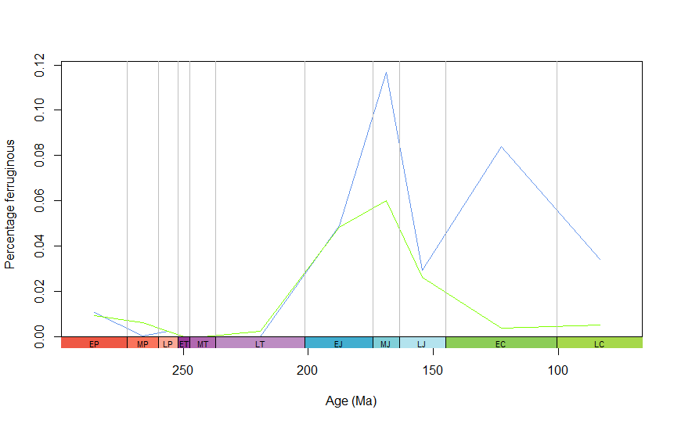
Ferruginous

Slide 22
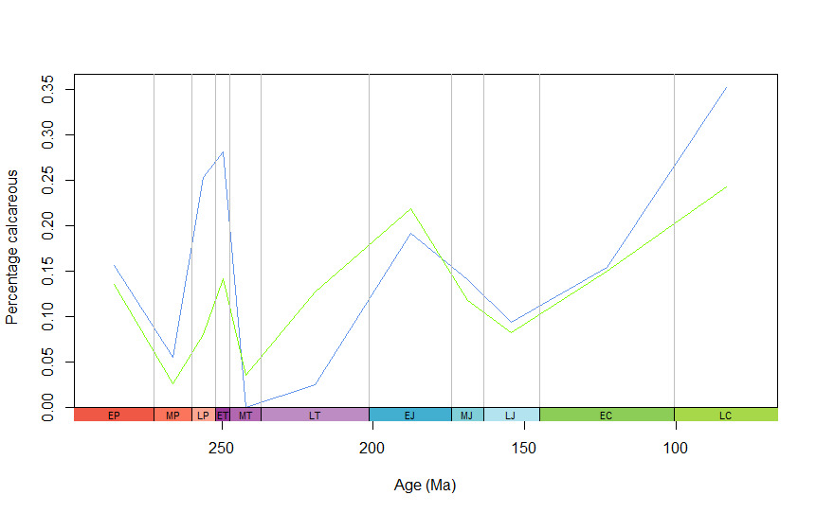
Calcareous

Slide 23
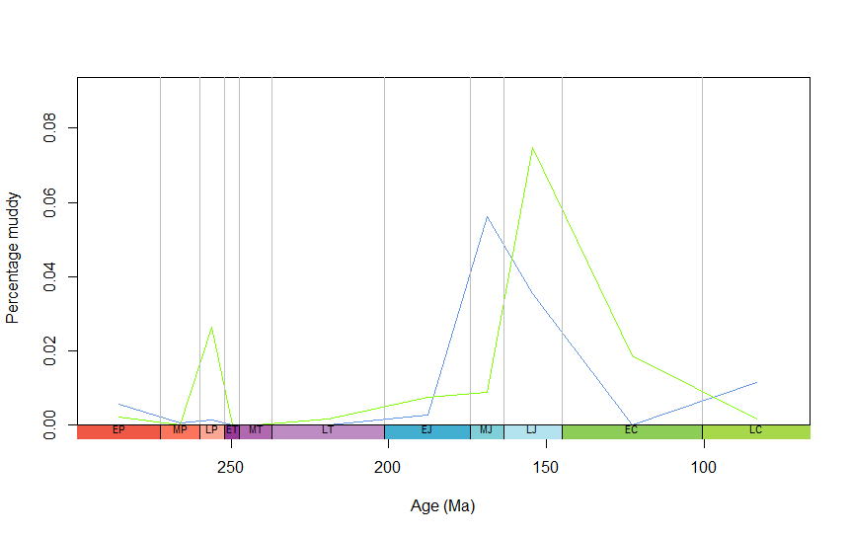
Muddy

Slide 24
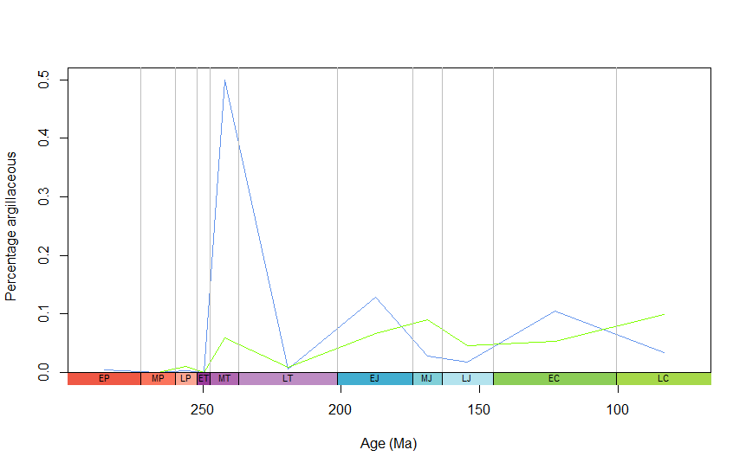
Argillaceous

Slide 25
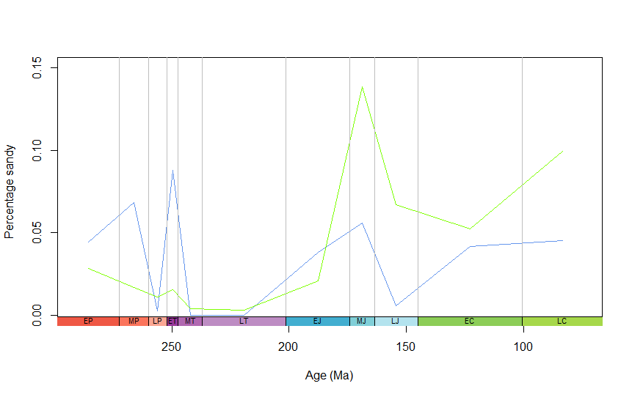
Sandy

Slide 26
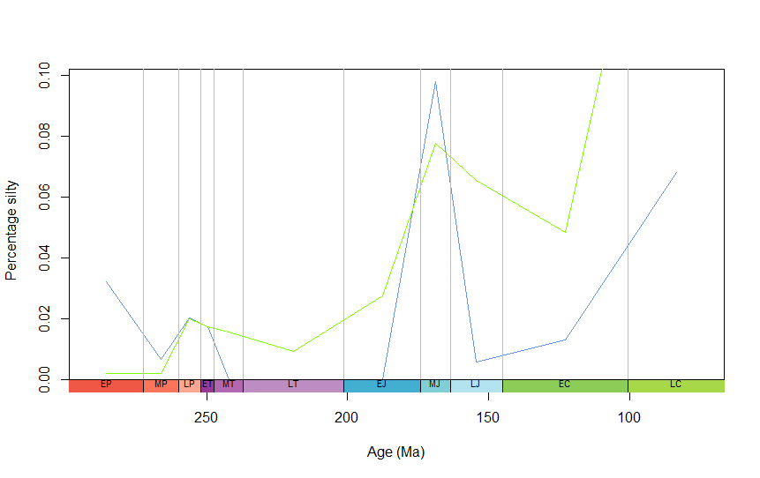
Silty

Slide 27
Conclusion
Modern brachiopods restricted to hard, often carbonate substrates compared to widespread bivalves
Analysis of abundance data shows brachiopod preference for carbonates (which are a proxy for hard substrate)
Analysis of occurrence lithology adjectives shows a negative association between brachiopods and soft substrate indicators, but also a negative association with ferruginous and glauconitic sediments
Substrate firmness was an important factor in post P-T brachiopod decline

Slide 28


Acknowledgments
Matthew Clapham and EPS
The Paleobiology Database and all its contributors
Paleontological Society

Slide 29
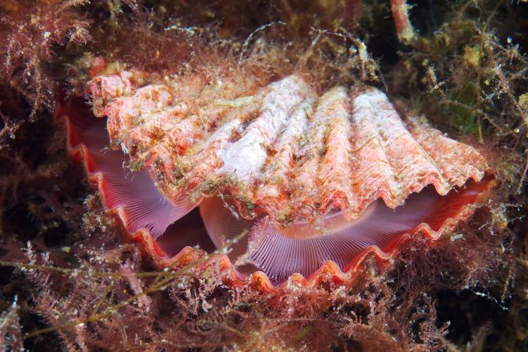
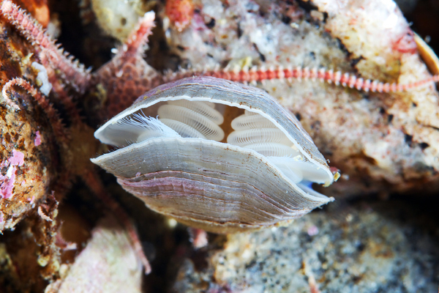
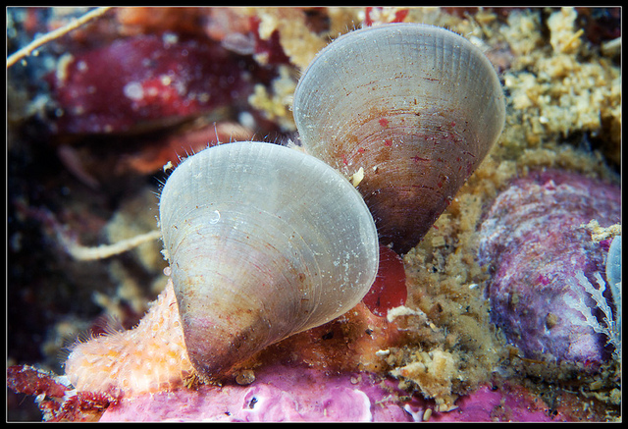
Questions?

