Slide 1

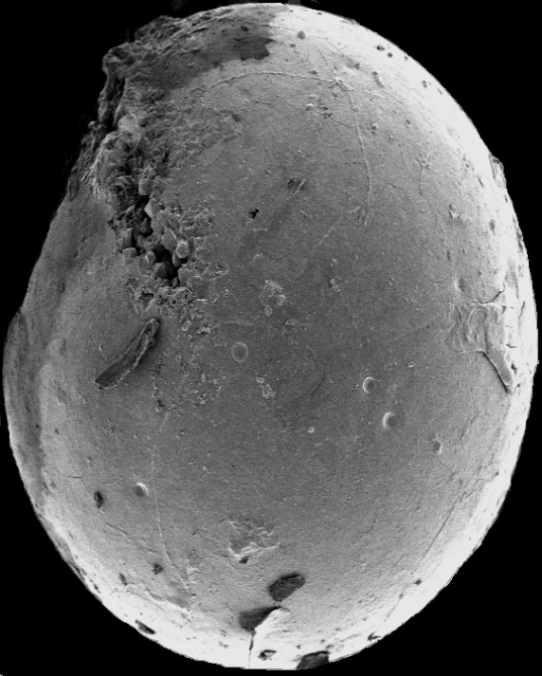
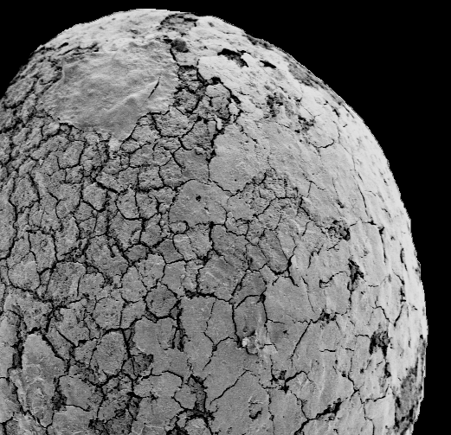
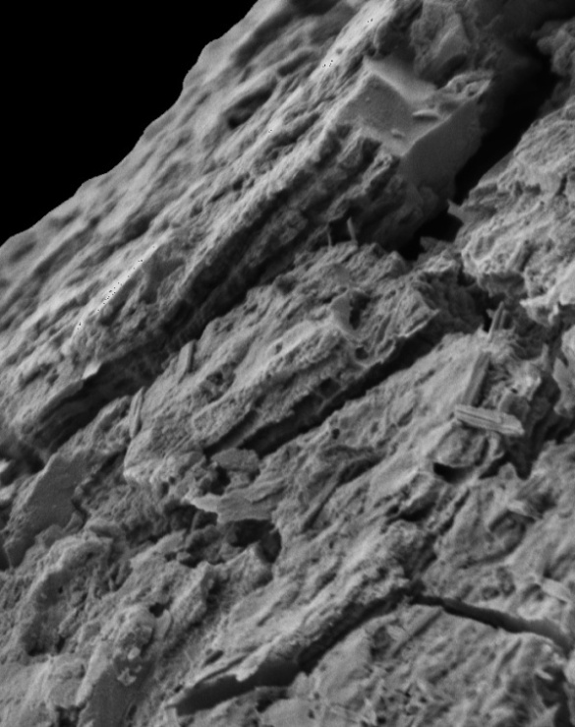
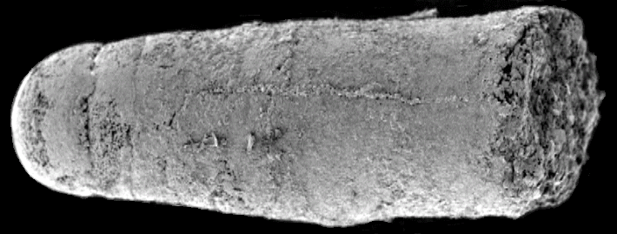
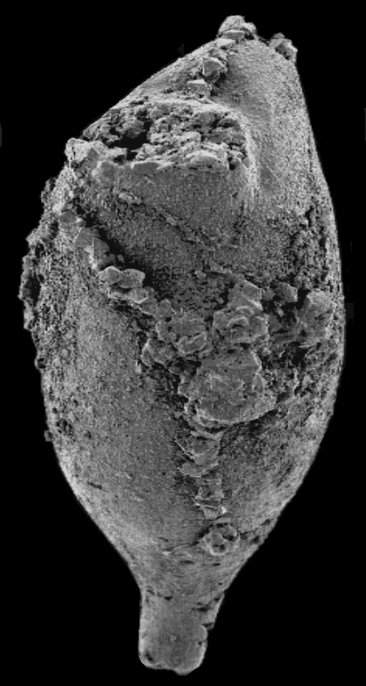
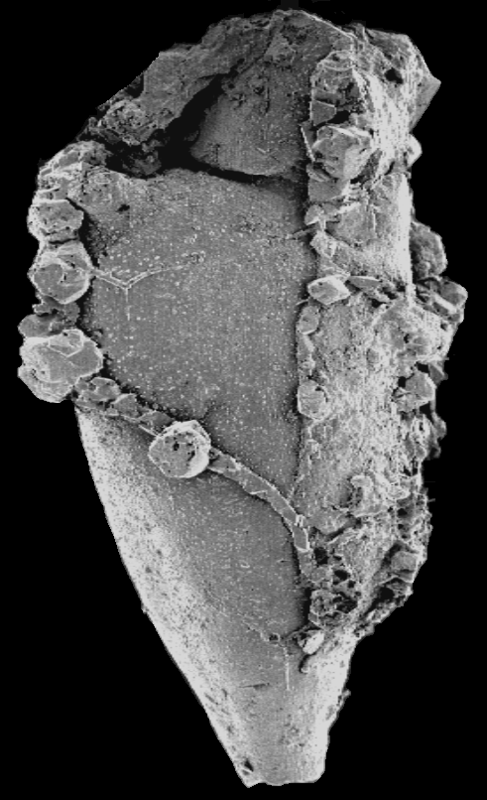
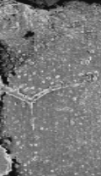
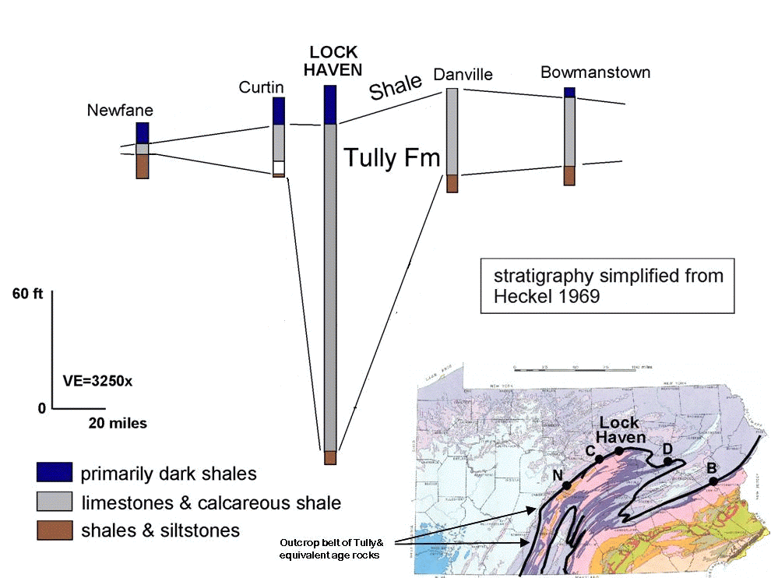
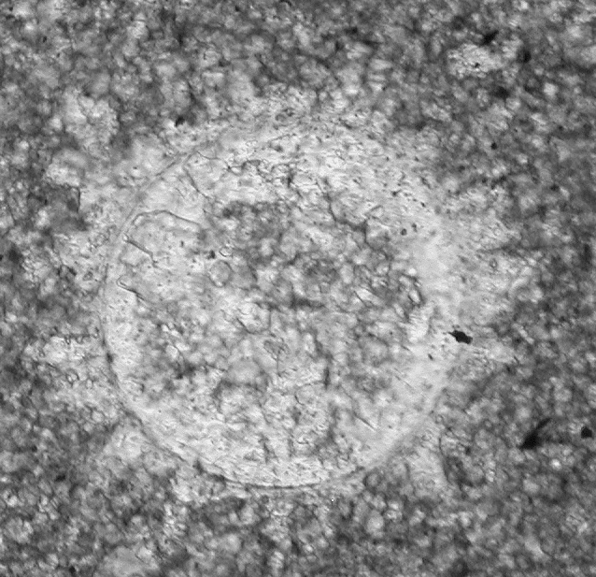
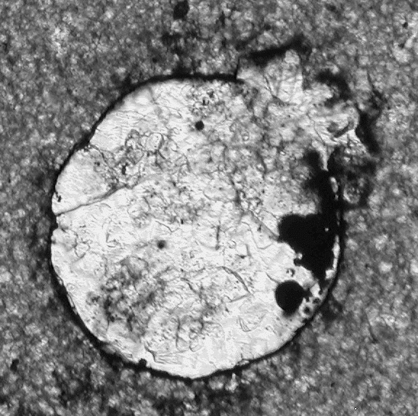
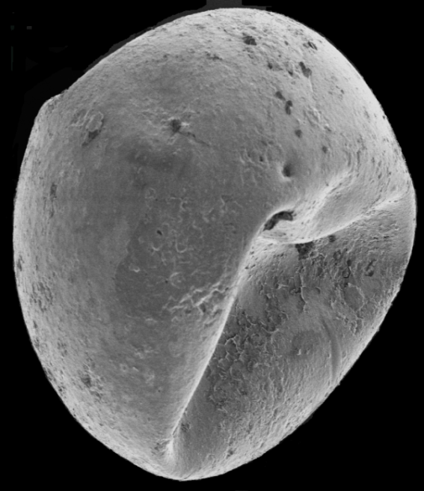
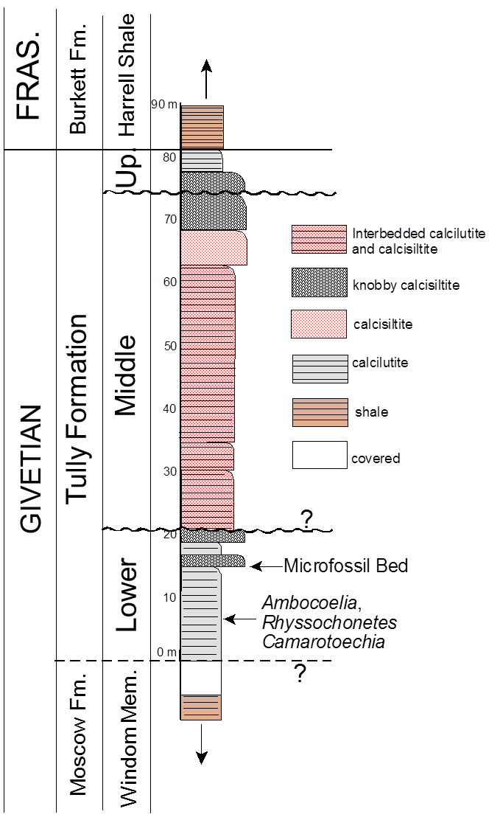
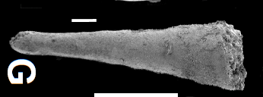
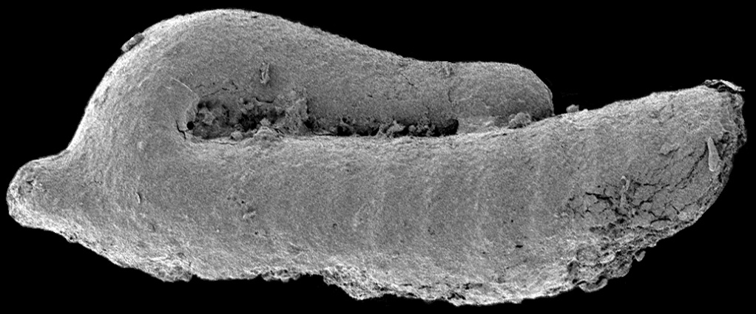
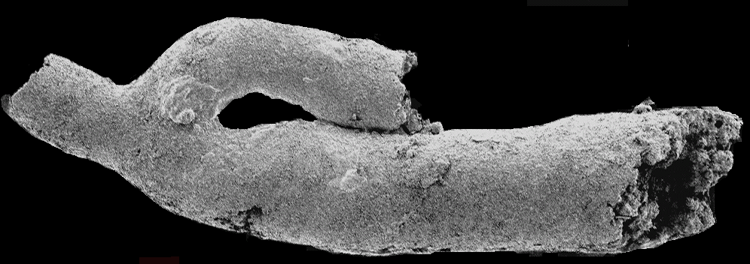
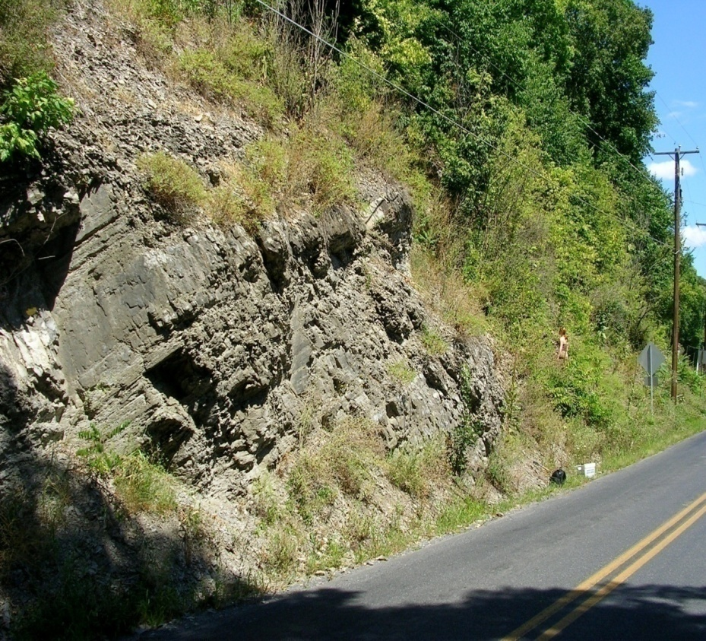
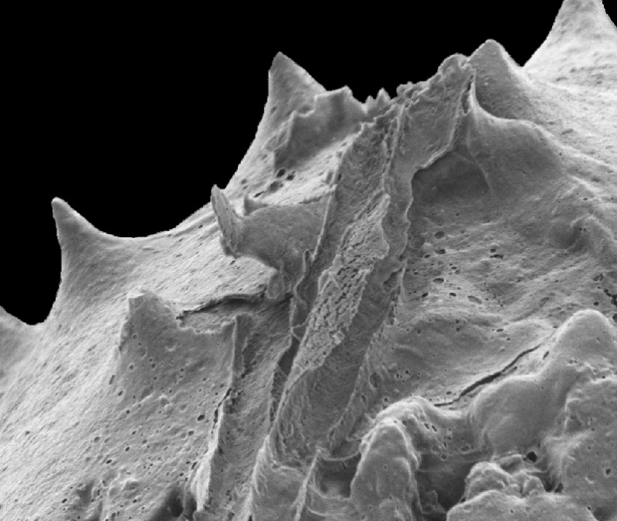
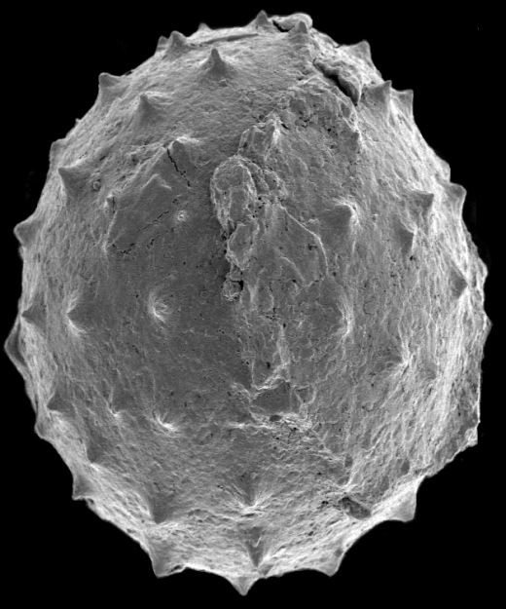
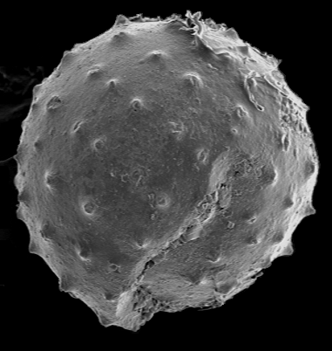
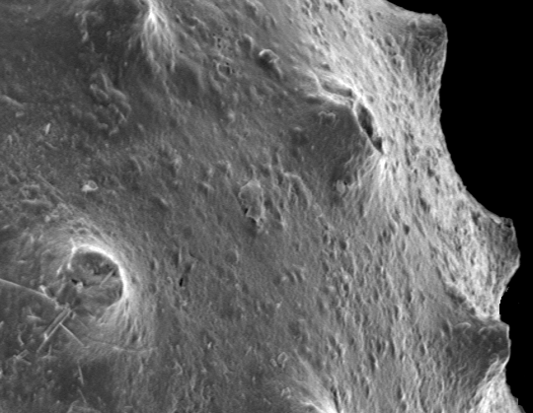
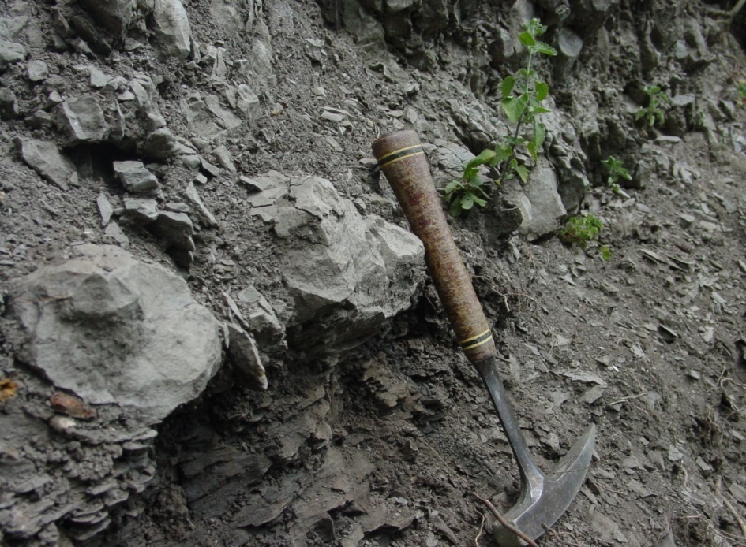
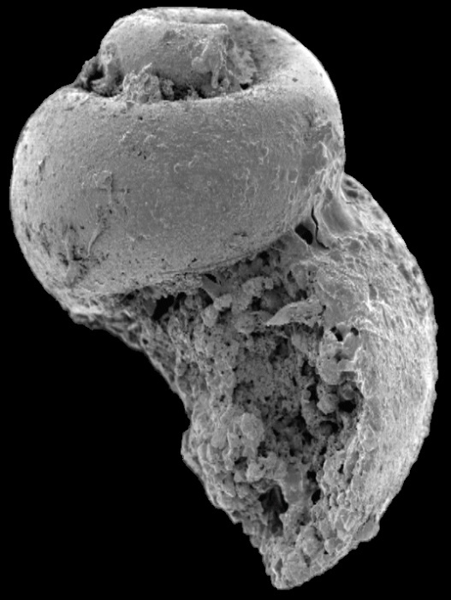
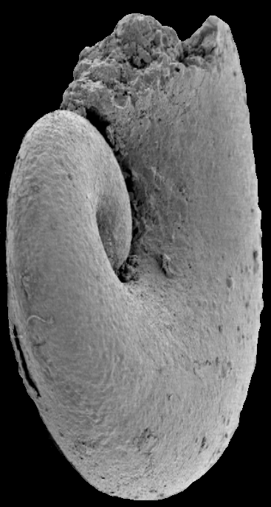
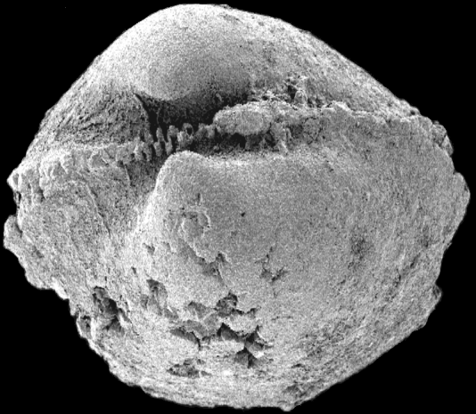
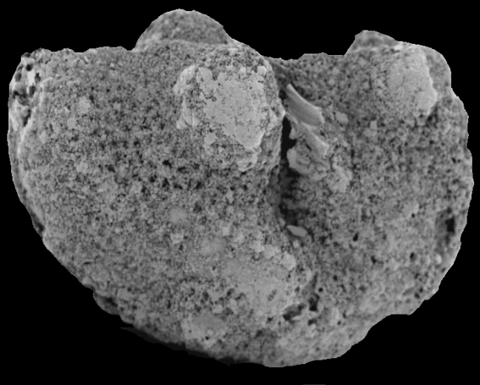
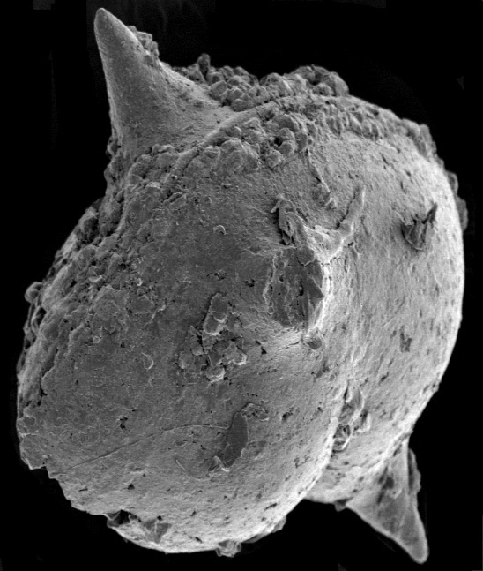
A MINERALIZED ALGA AND ACRITARCH DOMINATED MICROBIOTA FROM THE TULLY FORMATION (GIVETIAN) OF PENNSYLVANIA
JOHN A. CHAMBERLAIN, JR., Dept. of Earth & Environmental Sciences, Brooklyn College, Brooklyn, NY 11210, johnc@brooklyn.cuny.edu
REBECCA B. CHAMBERLAIN, Dept. of Biology, College of Staten Island, Staten Island, NY 10314, chamberlain@mail.csi.cuny.edu
TULLY FORMATION
The Tully Fm is a prominent member of the Middle Devonian (Givetian) sequence of New York and Pennsylvania. It is composed primarily of limestone and shaley limestone and is the only significant carbonate unit within the otherwise siliciclastic Hamilton Group. In Pennsylvania the Tully Formation is exposed in a long, sinuous outcrop belt (FIGURE 1) produced by the combined effects of Late Paleozoic Appalachian tectonism and subsequent erosion. Our specimens come from Lock Haven, PA, in the center of this exposure belt.
Baird and Brett (2003; 2008) recognize a three-fold division of the Tully Fm (FIGURE 2). The upper unit is richly fossiliferous with a typical Hamilton fauna. Below this at Lock Haven is a poorly fossiliferous sequence of carbonates subdivided into two different depositional sequences by a discontinuity that Baird and Brett (2003; 2008) interpret as a maximum flooding surface.
The occurrence near the base of the Lock Haven outcrop of such index fossils as Ambocoelia umbonata indicate that at least part of Baird and Brett’s (2003) New Lisbon interval of their lower Tully depositional sequence is present at Lock Haven. The microalgae, acritarchs, and other microfossils we describe here derive from a thin horizon at the base of the lowermost ledge-forming, knobby calcilutite bed in the Tully exposure (FIGURES 3 & 4). This bed probably lines near the top of the Lower Tully Fm (FIGURE. 2). Macrofossils do not occur in this bed although elongate, non-bifurcating burrows up to 1 cm in diameter and inclined to the bedding are present.
The fossils described here were involved in the lower Tully Bioevent of the Global Taghanic Biocrisis (Baird and Brett, 2003, 2008; Zambito et al., 2012) which re-structured the biotic composition of the ocean both regionally in the Northern Appalachian Basin and globally.
MICROFOSSIL OCCURRENCE
MICROBIOTA - ALGAE
C
MICROBIOTA - MOLLUSCS
A
B
A
B
2
3
4
5
6
bv
1
FIGURE 13: SEM of a protoconch of a pyritized longiconic nautiloid cephalopod, probably Michelinoceras or Casteroceras. Numbers identify the positions of the first 6 septa. The specimen is unlikely to be a bactritid because the protoconch is not globular is the case in bactritids. Scale bar = 100 µm.
al
al
bv
1 mm
0.75 mm
FIGURE 9: SEMs of Tasmanites. cf. T. sommeri Winslow 1962. A: specimen showing a few punctation pits and excystment split.. B: specimen with vesicle wall cracked during diagenesis. C: close-up of specimen in B showing laminae in vesicle wall typical of this species of Tasmanites. Scale bars in A, B = 50 µm, Scale bar in C = 5 µm.
C
MICROBIOTA - BRYOZOANS
FIGURE 5: Thin sections showing: A: micritic texture of the limestone, and calcitic microfossils, al – algal cyst; bv – bivalve shell fragment. Black, opaque grains are pyrite grains. B: pyrite concentrated in burrow
C
C
S
FIGURE 14: SEMs of two pyritized stoloniferan ctenostome bryozoan zooids partly enclosed by strings and clusters of superficial pyrite crystals adhering to their surfaces (A , B). s – stolon; c – collar. C: enlargement of area at base of lateral stolon in B showing micropores now infilled with pyrite that originally extended into the outer skeleton surrounding the zooid Scale bars in A, B = 100 µm. Scale bar in C = 40 µm. These specimens probably represent a new species of the genus Ropalonaria because the zooids are more inflated than the elongated, fusiform zooecial pits commonly preserved among species of this genus. The collars preserved here indicate, these specimens are zooecia. They are the oldest ctenostome zooecia known from North America, and are only slightly younger than the recently described zooecia from Lockhovian age Podoliapora doroshivi from the eastern Ukraine
MICROFOSSIL PRESERVATION
A
B
C
A
B
C
S
A
S
B
100 µm
100 µm
100 µm
FIGURE 10: Thin sections and SEM of Tasmanites. cf. T. sinuosus Winslow 1962. A: calcitic specimen. B: specimen filled with sparry calcite and with a pyritized vesicle wall. C: deformed specimen showing a few punctation pits. All scale bars = 100µm. The small size of these specimens indicates T. sinuosus.
MICROBIOTA - PROBLEMATICA
FIGURE 1:Tully Fm in Pennsylvania
FIGURE 6: microfossil mineralogy. A: algal cyst composed of calcite; B: calcitic algal cyst with grains of pyrite in the interior. C: algal cyst composed entirely of pyrite. Note halo of sparry calcite crystals adhering to periphery of specimens
A
B
C
A
B
A
MICROBIOTA - ACRITARCHS
B
C
FIGURE 15: SEMs of specimens of uncertain affinity. All scale bars = 100 µm. A: Jinonicella kolebabi, ribbed morph; rare in Tully assemblage, unknown elsewhere. B: Jinonicella kolebabi, smooth morph; known from eastern Europe. C: Dacryoconarids; Viriatellina sp., common in Tully assemblage.
DEPOSITIONAL ENVIRONMENT & TAPHONOMY
Environment
Offshore (100’s kms)
Deep water >100m
O₂ in water column
Dysoxic bottom sediment
Taphonomy
FIGURE 7: evidence for rapid mineralization (weeks to months). A: deformed algal cysts indicate that cysts were still soft and flexible when they were mineralized. Scale bar = 100 µm. B: Acanthomorphic acritarchs show “frothy” surface material that probably represents a mineralized mucilaginous sheath originally surrounding the live organism. Scale bar = 10 µm.
FIGURE 11: SEMs of Solisphaeridium cf. S. laevagatum Wicander & Wood1997. A & B: Two specimens showing arrangement and form of spines; B has an excystment split. C: some spines (arrow) are hollow – probably the original condition. Scale bars in A, B = 50µm. Scale bar in C = 10µm.
Live algae ( ), acritarchs ( ), planktonic
molluscan larva ( ) and dacryoconarids ( )
in photic zone
FIGURE 3: Lower Tully exposure showing microfossil horizon (red star)
Offshore, deep env’t indicated by:
a) restricted algal assemblage
b) absence of land plant spores
c) Lower Tully is in part turbiditic
Cysts and dead oranisms settle through water column, and begin to rapidly mineralize as they sink. Molluscs transform into shell-bearing neonates that are asphyxiated when they settle to the substrate.
MICROBIOTA - MOLLUSCS
MICROBIOTA - OSTRACODES
A
B
C
Acceptable levels of O₂ in water:
a) presence of planktonic
microfossils and burrow-makers
b) O₂ probably was reduced with
depth, thus promoting
mineralization as the dead
microorganisms sank downwards
A
B
B
FIGURE 2: Stratigraphic column for the Tully Formation at Lock Haven, Pennsylvania. The microfossils described here derive from the lowermost knobby calcisiltite bed in the Lower Tully sequence. They lie just above the contact
the with the calcilutites below.
Mineralization continues syndepositionally in substrate. Specimens falling into intensely dysoxic patches become fully pyritized. Those falling into less dysoxic patches remain primarily calcitic.
A
Dysoxic conditions in substrate:
a) presence of pyrite
b) dysoxia was patchy (Fig. 5),
thus providing a basis for both
calcitic and pyritic preservation
FIGURE 4: Contact between lower calcilutites (A) and lowermost knobby bed (B) containing microfossils.
FIGURE 8: SEMs of pyritized ostracodes. A: ostracode, probably Ulrichia sp., B: spiny ostracode, probably belonging to either to the Aechminidae or Aechminellidae. Scale bars = 100µm.
FIGURE 12: SEMs of gastropods and bivalves. A: highspired loxonematacean gastropod, possibly Palaeozygopleura sp. B: Euomphalacean gastropod, possibly Euomphalus sp. C: paleotaxodont bivalve, probably Nuculoidea corbuliformis. All scale bars = 100µm.
Intensely dysoxic
Lightly dysoxic
FIGURE 16: Tully Deposition &Taphonomy
Presented at the 2016 annual meeting of the Northeastern Geological Society of America. Albany, NY. March 23, 2016

