Slide 1
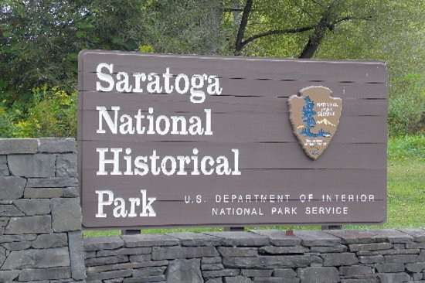
Surficial & Bedrock Maps of the Saratoga National Historical Park Generated for Archaeological & Educational Purposes
David J. DeSimone, DeSimone Geoscience Investigations, NY
Tim Connors, National Park Service, CO

Slide 2
The Back Story
2007 meeting with NPS geologists Bruce Heise & Tim Connors at U Mass to discuss geologic maps of several regional park properties
My comment was much of SNHP had already been mapped by students of Bob LaFleur - Eric Hanson, Jack Dahl & me
May 2013 - Tim & Bruce reach out and request existing maps
November 2014 - we discuss a plan to generate a park map
May 2015 - we go forward

Slide 3
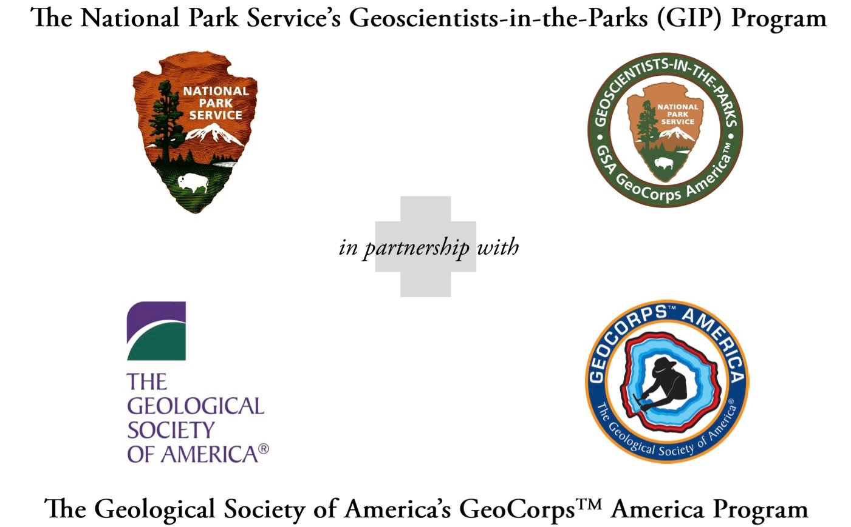
Goals
Compile existing map data, edit, interpret & fill in gaps
&
Generate 1:24,000 surficial map for SNHP’s 4 quads
Compile existing bedrock data & generate 1:62,500 bedrock map for the 4 quads

Slide 4
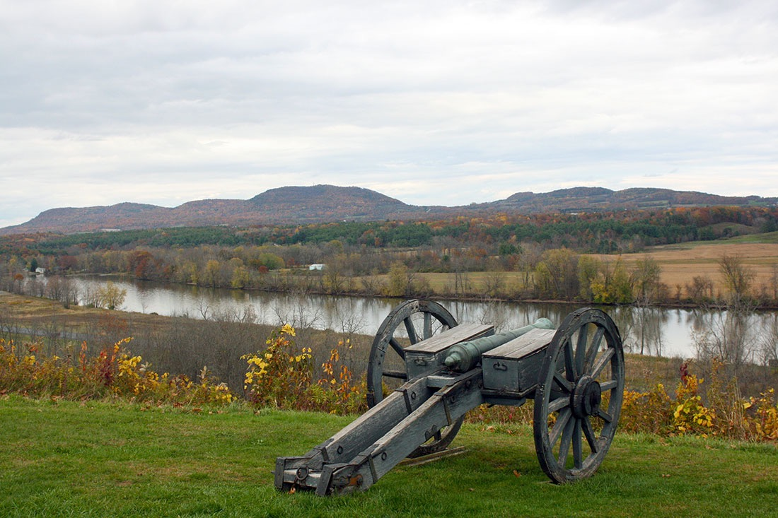
Role of Geomorphology in the Battles of Saratoga, Sep-Oct,1777
Bemis Heights has commanding view of Hudson River & River Road (Rte 4)
How did this geomorphology develop? What are the underlying bedrock & glacial features that made this location so strategically important?

Slide 5

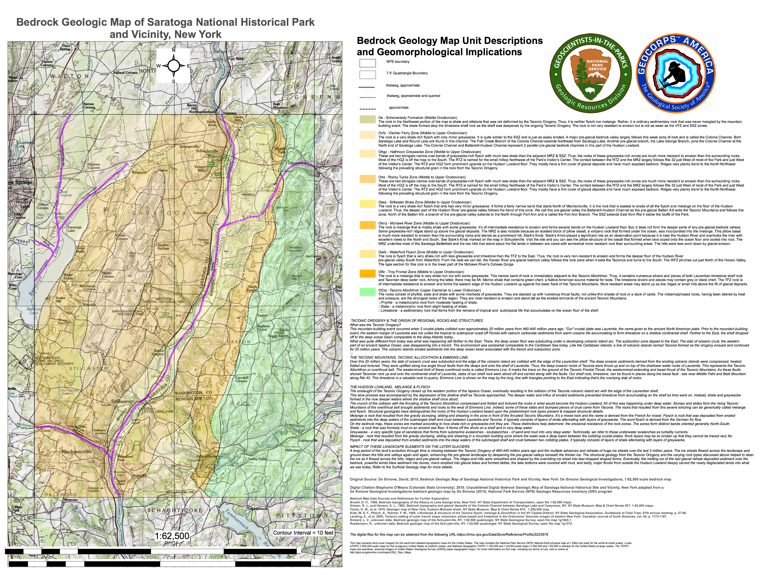
Vischer Ferry Zone Shale-Rich Flysch
< Fort Ann Channel
Schenectady Shale
Stillwater Zone Shale-Rich Flysch
< Emmons Line TFT
< Colonie Channel
Rocky Tucks Zone Graywacke-Rich Flysch
< Battenkill-Hudson Channel
< Troy Frontal Zone Melange
Mohawk River Zone Melange
Taconic Allochthon Phyllite-Slate
Waterford Flysch Zone

Slide 6
Bedrock Geomorphology Features
Taconic Allochthon rocks are most resistant to erosion - phyllite & slate mostly
Emmons Line is the trace of the Taconic Frontal Thrust & follows Rte 40; nick points along the Tomhannock, Hoosic & Batten Kill; limestone slivers along the TFT enhance resistance at a few nick points; Emmons Line marks the boundary between uplands & lowlands
Hudson Valley topography determined by whether melange or flysch is shale-rich or greywacke-rich; zones are nearly N-S
Rocky Tucks & Halfmoon Greywacke Zones form the low divide between the Battenkill Hudson & Colonie Channels
Bedrock channels formed in weaker shale-rich zones, especially the Stillwater Shale Zone & Vischer Ferry Zone

Slide 7
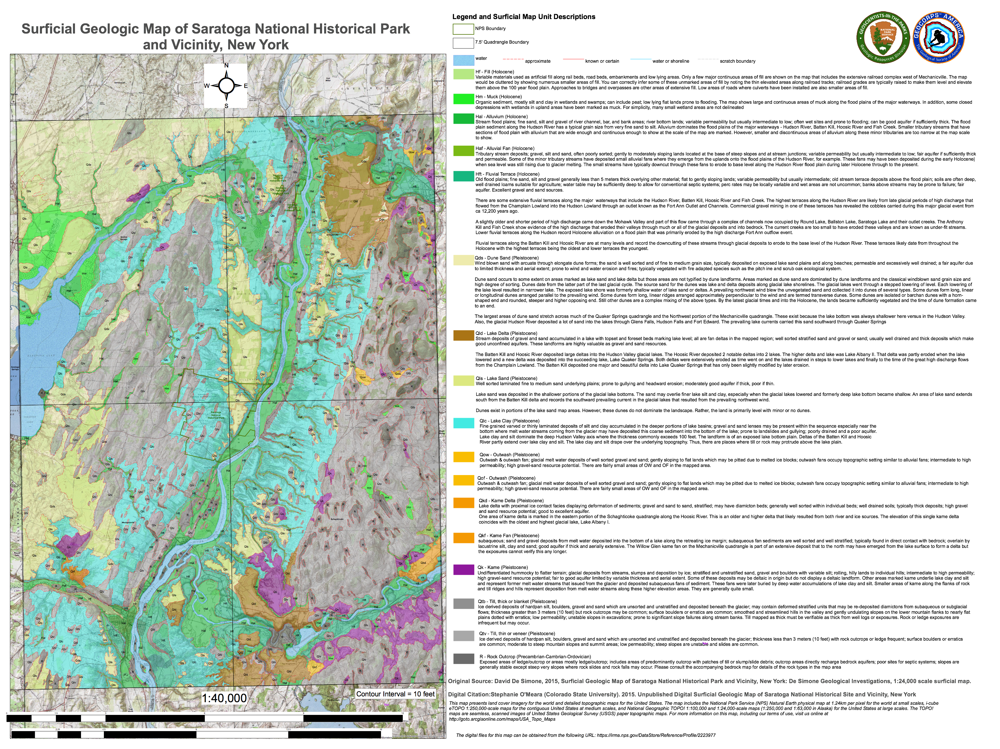
LS
FT
DS
LD
LS
< Tb
Tv
LC
R
Tv
LS
AL
DS
KF
K
KD
LD

Slide 8
Glacial Geomorphology Features
Shades of grey - rock, till veneer & till blanket; outcrop and veneer dominate the Taconic highlands & Rocky Tucks hills
Depositional Forms
Lake deltas of the Batten Kill & Hoosic River (brown)
Lake silt-clay infilled deeper Battenkill Hudson Channel (blue)
Lake sand deposited in shallow water especially down current from deltas (yellow)
Dune sand accumulated atop lake sand & deltas (yellow)

Slide 9
Glacial Geomorphology Features
Erosional Forms
Iro-Mohawk River discharge followed distributary channels - pre-glacial channels in bedrock topography
Initially, sand deposition occurred over eroded lake silt-clay into Lake Quaker Springs along Colonie Channel
Later erosion of glacial deposits along Fish Creek & Anthony Kill channels emptied into Lake Coveville
Lake Fort Ann discharge exhumed Battenkill-Hudson Channel & Fort Ann Branch
Late Pleistocene high discharges established topographic lows for later Holocene erosion & deposition
Holocene dissection of glacial lake bottom sediments by headward erosion along tributaries to the Hudson set the landscape for the battles

Slide 10
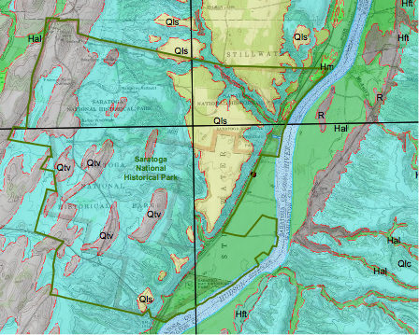
Implications for the Battles
< 1. Battenkill-Hudson Channel exhumed & eroded by Fort Ann outflow.
< 2. Drumlins were high ground & where isolated farmhouses were sited. Lake bottom clays were routes for troop movements. Tributary ravines hindered troop movements.
< 3. Bluffs block floodplain
< 4. Bemis Heights controls the river road and river.

Slide 11
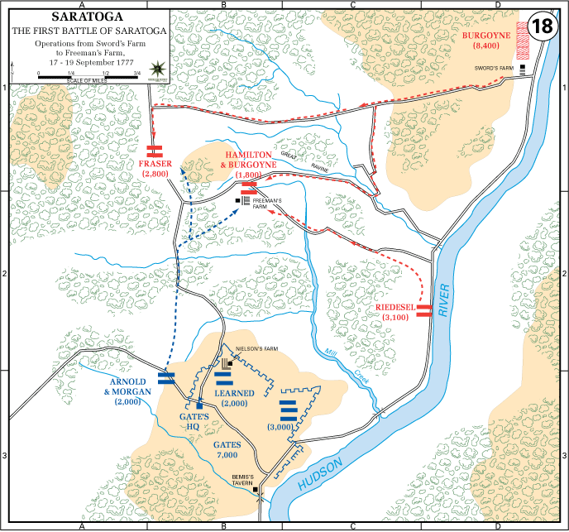
1st Battle, 17-19 Sep 1777
Kroma Kill
Ravines control troop movement.
Arnold and American forces retreat from Freeman’s Farm.
No river & road access farther south.
Mill Creek
Gen Gates - control of river and river road

Slide 12
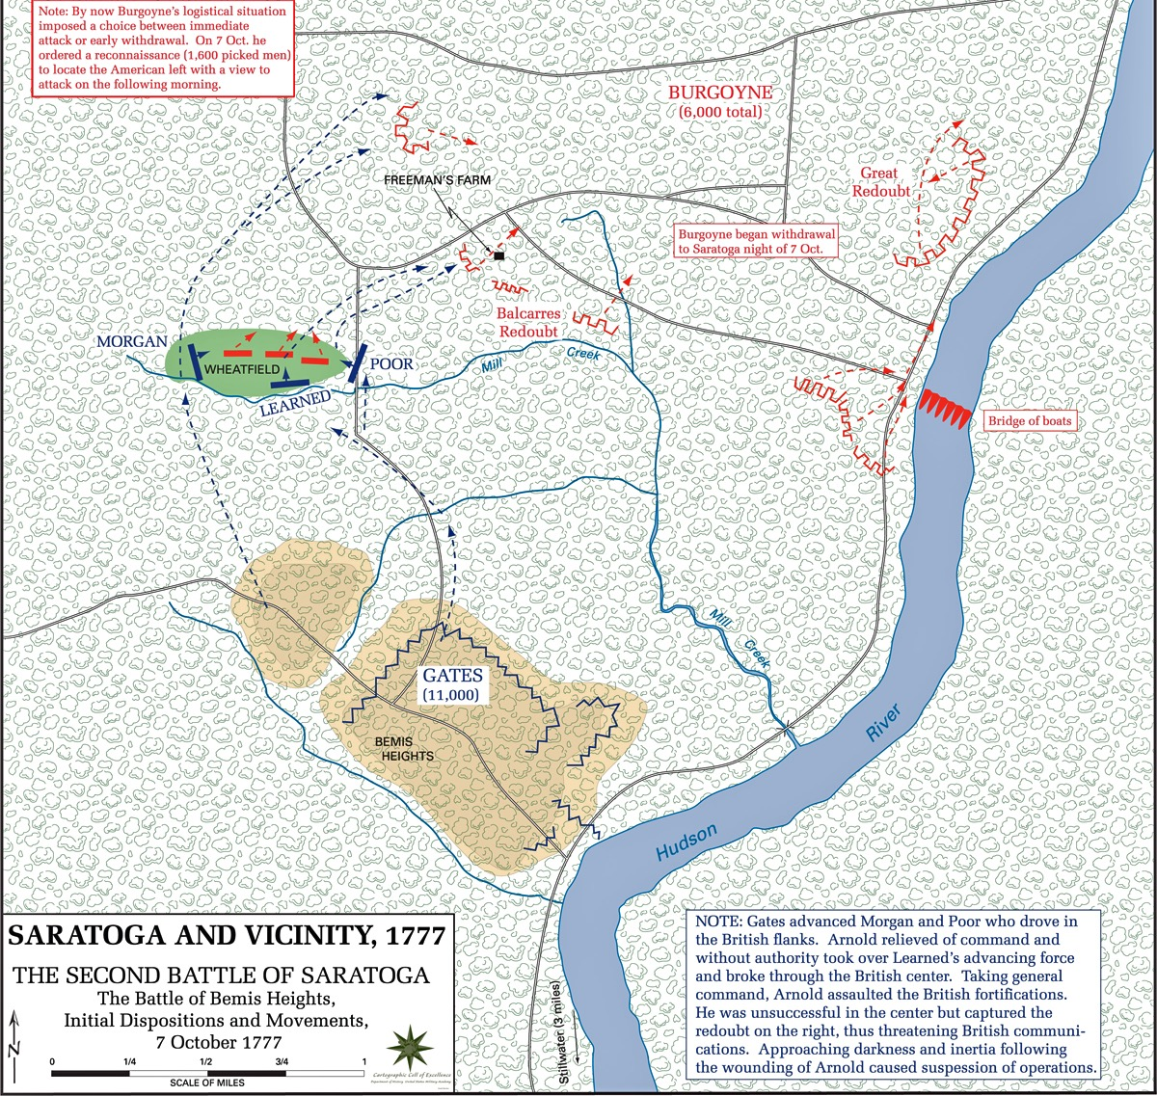
2nd Battle, 7 Oct 1777
Arnold assumed command & captured the British right, threatening to cut off Freeman’s Farm & British communications. That evening, Burgoyne began a retreat to the north.

Slide 13
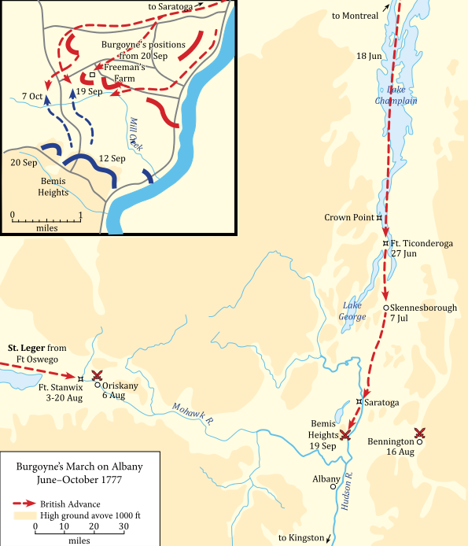
Role of Geomorphology in Archaeological Investigations
We geomorphologists have a place in the trenches with the archaeologists.
We also can provide insights into the history of landscape elements that can assist archaeological investigations.
Our role in mapping & understanding the history of landform & sediment origins can be critical and our knowledge of regional glacial history can be decisive in the successful completion of an archaeological study.

