Slide 1
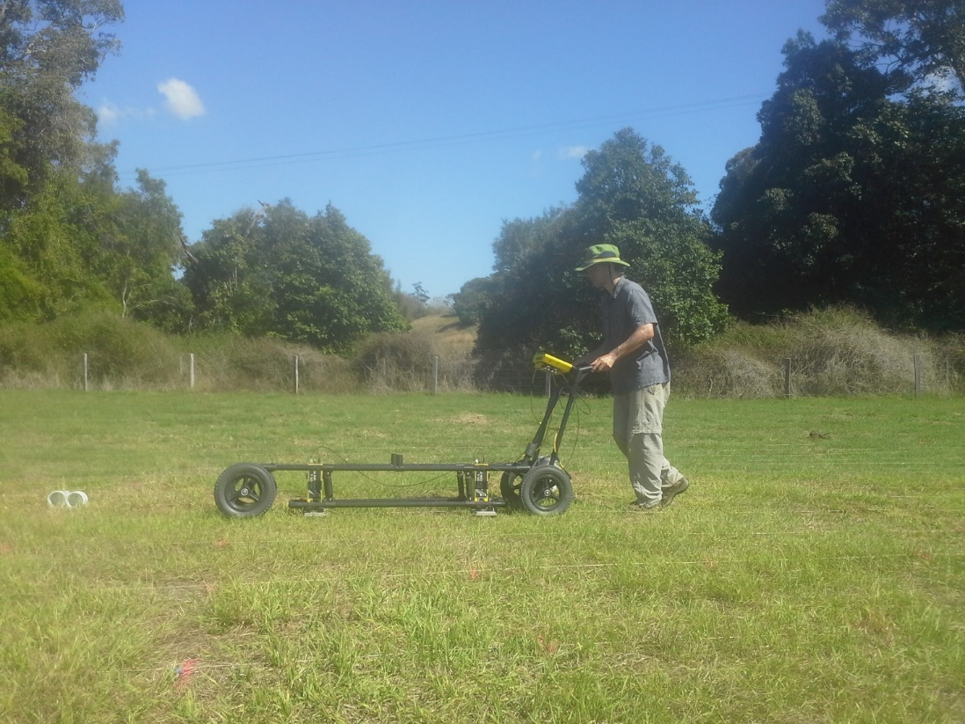



Using early time GPR to map spatial variation in soil water content in response to irrigation in clay soils
Jonathan Algeo
Remke Van Dam
Lee Slater

Slide 2

Topics of Discussion
What is GPR? What is it used for?
What is the early time methodology?
Field study in Australia

Slide 3
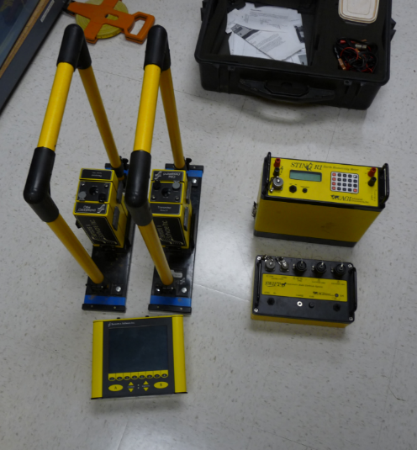
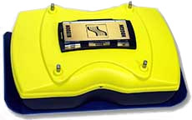
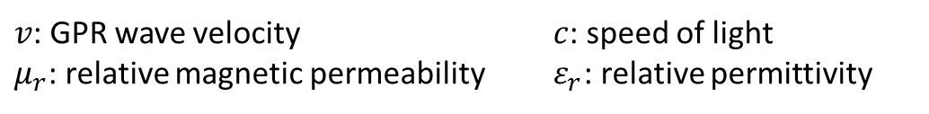

Ground Penetrating Radar
Electromagnetic pulse
Velocity controlled by the relative permittivity of the subsurface:
$$v=\frac{c}{√(μ_{r}ε_{r})}$$
$v$: GPR wave velocity $c$: speed of light
$μ_{r}$: relative magnetic permeability $ε_{r}$: relative permittivity

Slide 4
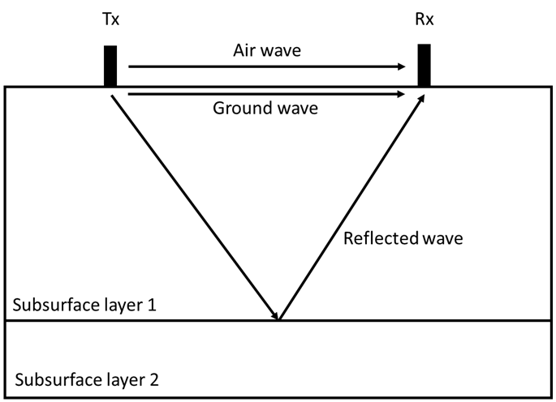

Ground Penetrating Radar
$$v=\frac{c}{√(μ_{r}ε_{r})}$$
Schematic of a GPR survey

Slide 5


Primary GPR application
Soil vs Water relative permittivity
Can estimate and monitor soil water content
Drawback:
$$a= 1.69\frac{σ}{{ε_{r}}^{\frac{1}{2}}}$$
Model from Topp et al, 1980, showing the relationship between soil water content and relative permittivity
$a$: attenuation
$σ$: conductivity
$ε_{r}$: dielectric permittivity

Slide 6
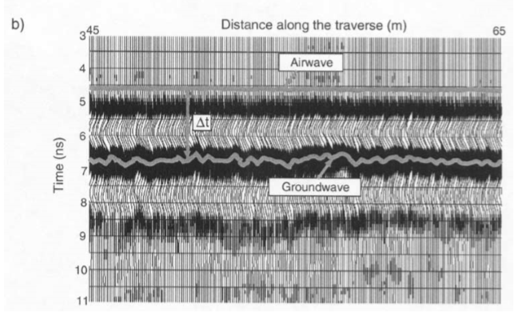

Classic GPR methodology for SWC estimation
Distance along traverse
Airwave
Time
Groundwave
Schematic of a GPR survey
Figure from (Grote et al, 2003) showing the groundwave measurements they used to map changes in SWC
$$v=\frac{c}{√(μ_{r}ε_{r})}$$

Slide 7
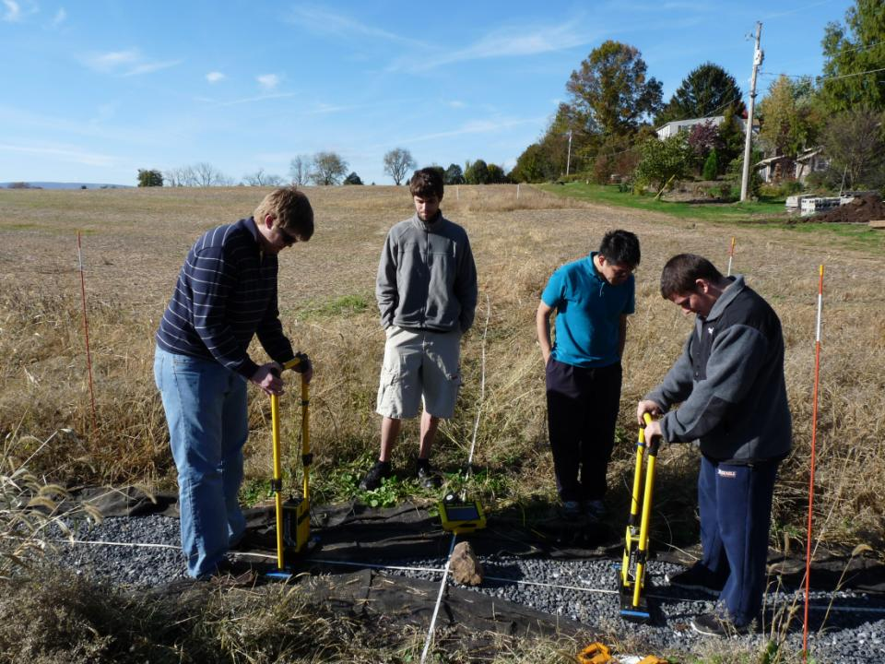
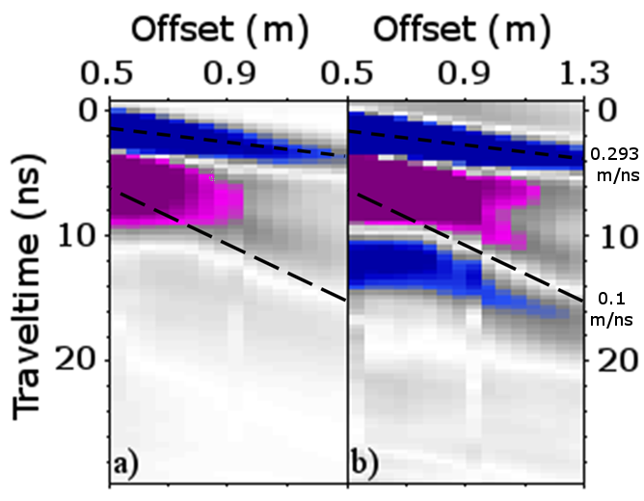
Why We Encounter Problems in Clay
Carrying out a common midpoint sounding
Common midpoint radargram from SERF

Slide 8
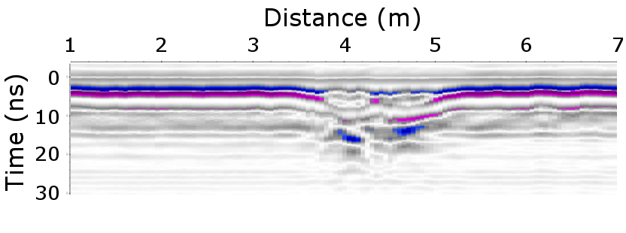
GPR early-time amplitude analysis
Relatively new methodology developed by Petinelli et al, 2007.
Looks at the combined air/ground wave
Common offset radargram of a GPR line collected over a wetted area of the field site at SERF

Slide 9
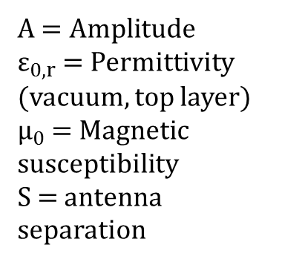
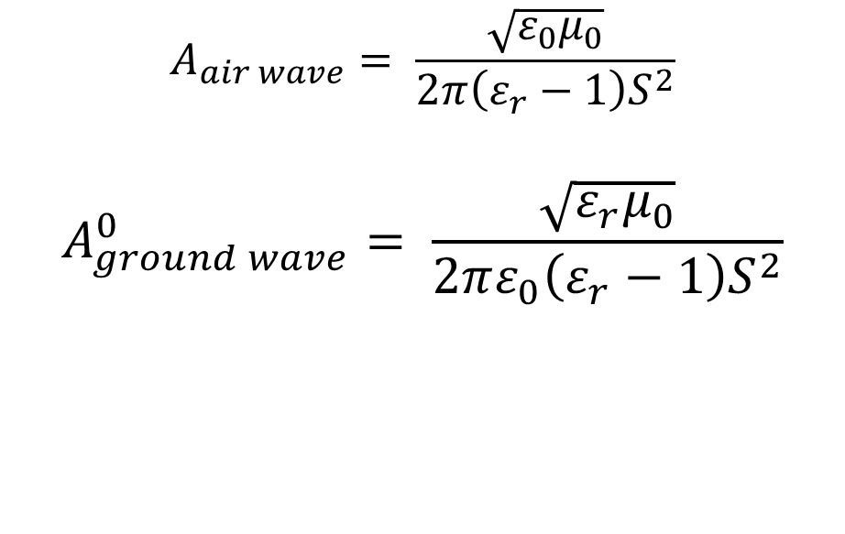
GPR early-time amplitude analysis
$$A_{air wave}= \frac{\sqrt{ε_{0}μ_{0}}}{2π\left(ε_{r}−1\right)S^{2}}$$
$$A_{ground wave}^{0}= \frac{\sqrt{ε_{r}μ_{0}}}{2πε_{0}\left(ε_{r}−1\right)S^{2}}$$
A $=Amplitude$
$ε_{0,r}$ = Permittivity (vacuum, top layer)
$μ_{0}$ = Magnetic susceptibility
S = antenna separation
Di Matteo et al, 2013

Slide 10
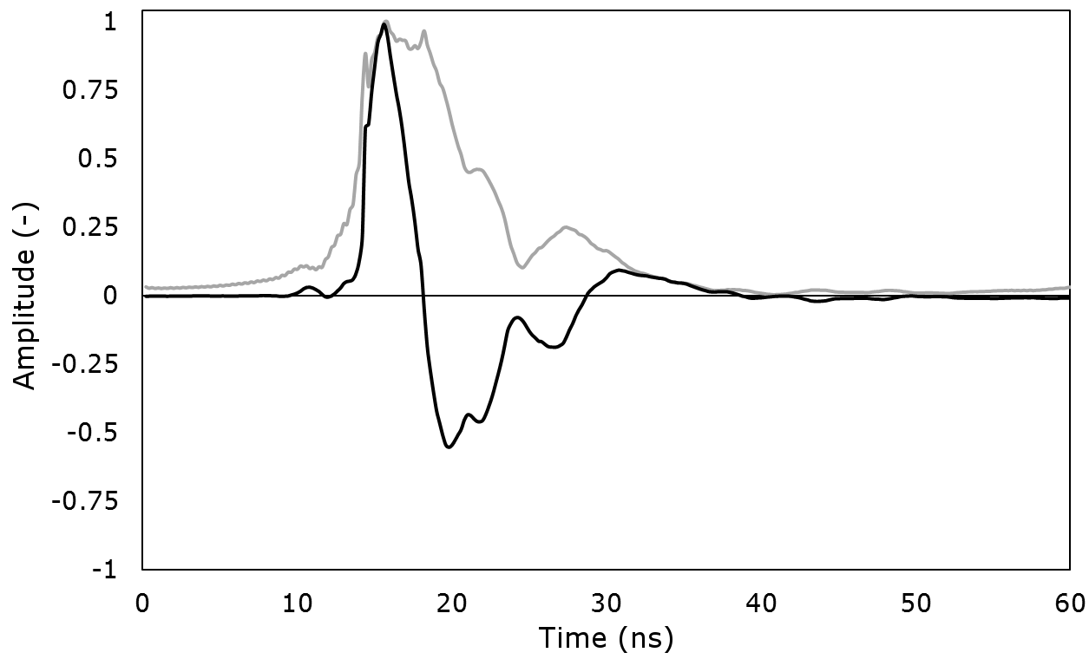
How do we do early time analysis?
Early time processing steps:
Start with GPR trace
Perform Hilbert transform on the trace
Take the absolute value (envelope)
Measure desired statistic on first positive half cycle (shaded)
Gray: Envelope
Black: Real trace

Slide 11
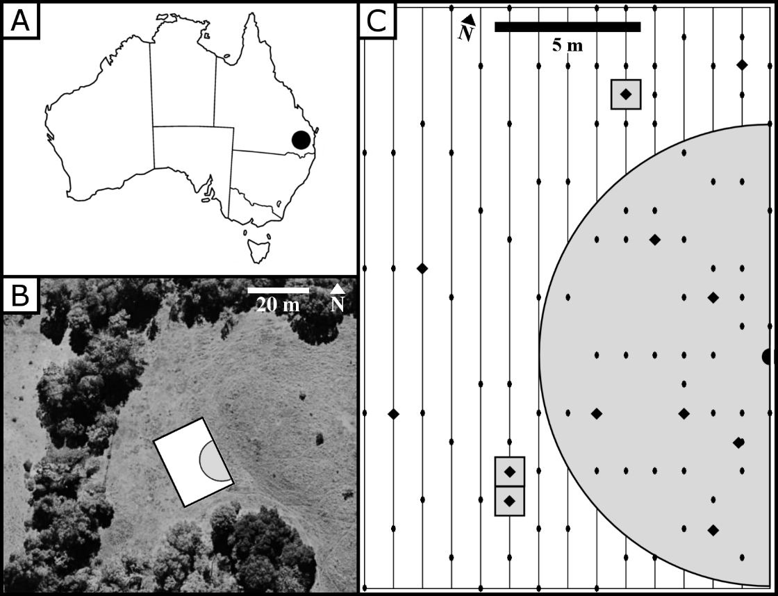
Project Background
NSF EAPSI grant
Research in Queensland, Australia with the Institute for Future Environments at QUT
Samford Ecological Research Facility (SERF), high clay content grassland (>30%)
Field site and survey layout

Slide 12
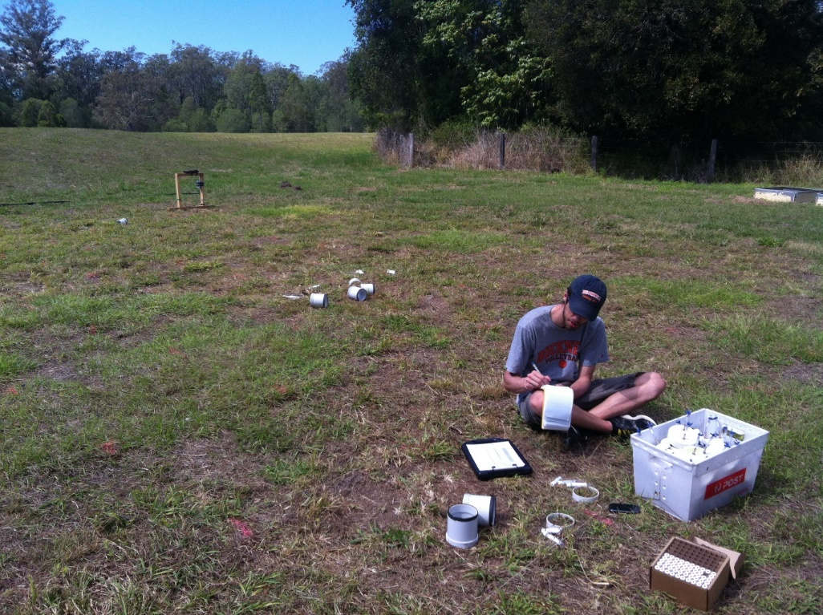
Hypothesis
The early-time GPR methodology can be used to map and monitor spatial variations in soil water content (SWC) in clay soils, where GPR traditionally fails

Slide 13
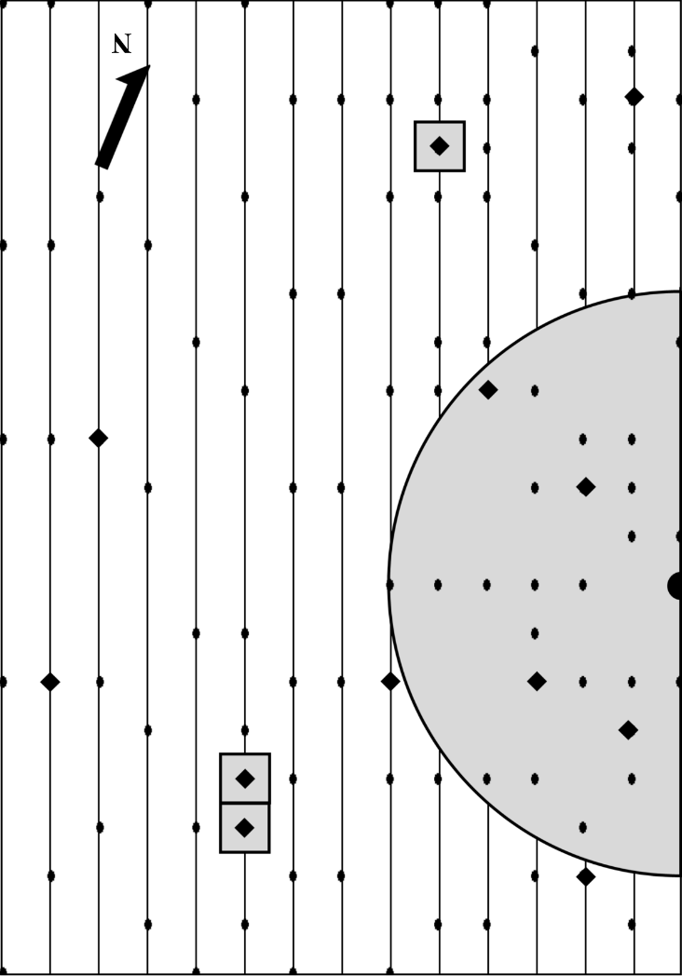
Experiment design
20x14 m plot
Sprinkler and box irrigation performed night of Day 1
Geophysics collected for 5 days
101 time-domain reflectometry (TDR) data points
15 GPR common offset lines
12 soil sample locations
Lines: GPR
Ovals: TDR
Diamonds: Soil sample locations
Shaded area: Irrigation

Slide 14
SERF traditional measurements
Common offset GPR survey carried out at SERF. 1 meter area in center was irrigated.

Slide 15
SERF traditional measurements

Slide 16
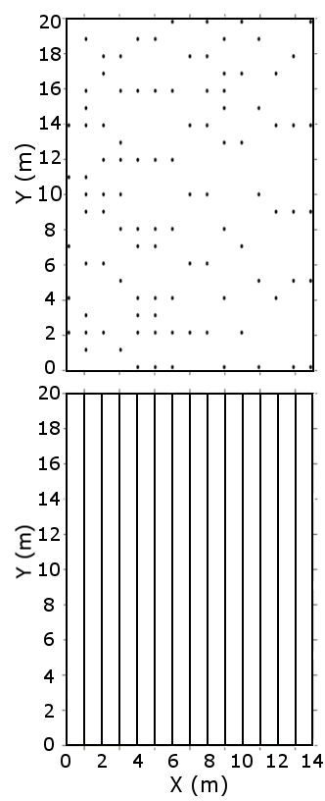
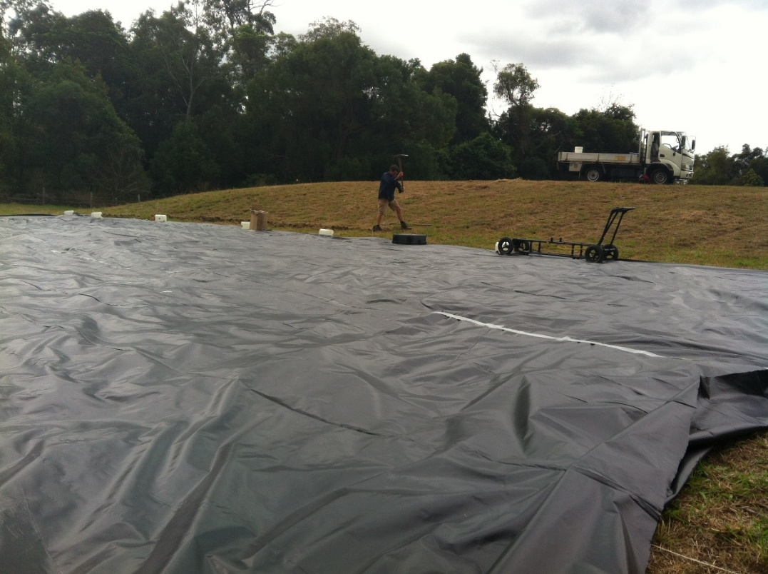
TDR & GPR Results
TDR
GPR
Tarp setup in preparation for rain prior to experiment

Slide 17
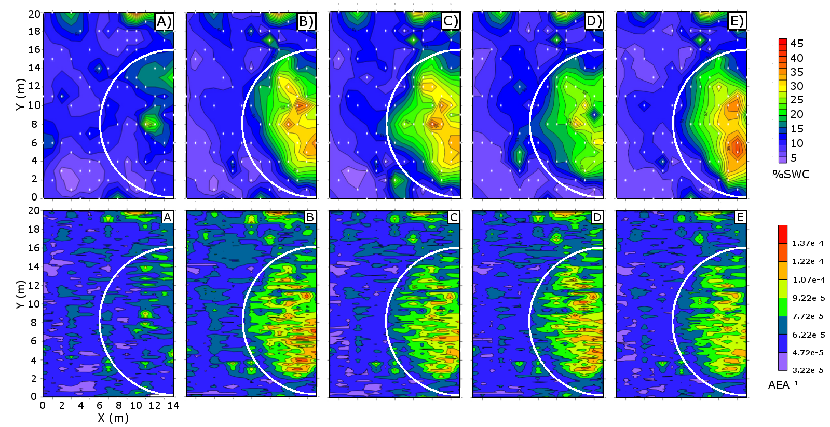

TDR Results
Day 1
Day 2
Day 3
Day 4
Day 5
20
10
0
45
35
25
15
5
SWC %
10
0
1.5e-4
9.2e-5
3.2e-5
0 7 14
Amplitude (-)
GPR Results

Slide 18
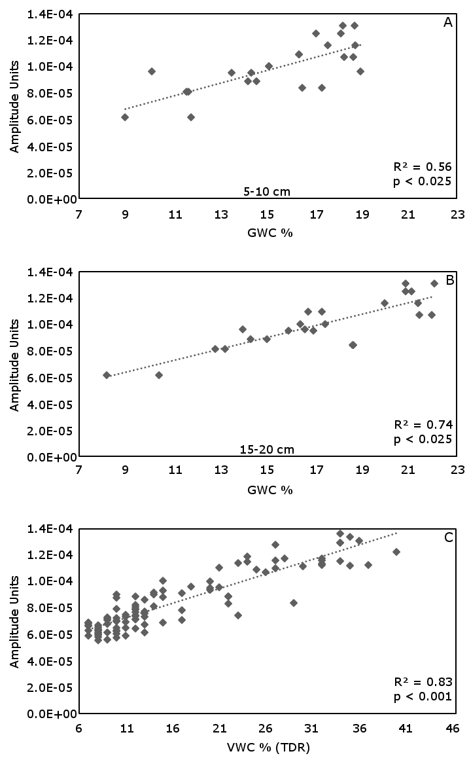
GPR
vs
5-10 cm Soil Samples
GPR
vs
15-20 cm Soil Samples
GPR
vs
TDR

Slide 19
Discussion
We see the expected inverse relationship between GPR amplitude and water content
Slow drying post-irrigation evident in GPR dataset
GPR and direct measurement of soil water via gravimetric analysis correlate well

Slide 20
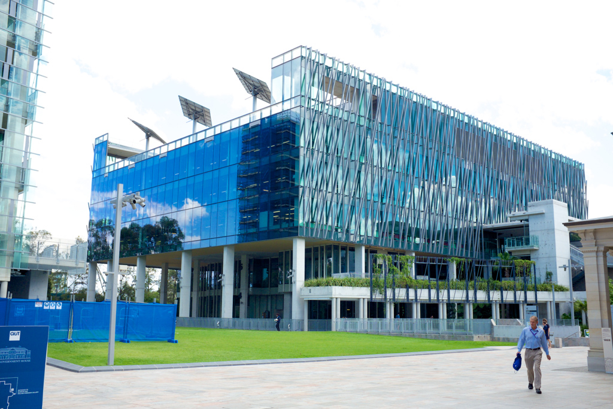
Conclusions
The GPR early-time methodology shows promise for allowing GPR to be used at clay field sites
Future research:
  Get an absolute measurement of SWC (Hislop et al 2015)
  Potential alternate to Hilbert transform – Fourier transform (Comite et al 2016)
P Block on QUT Campus – home of Institute for Future Environments

Slide 21


Acknowledgements
NSF & Australian Academy of Science
Queensland University of Technology

Slide 22
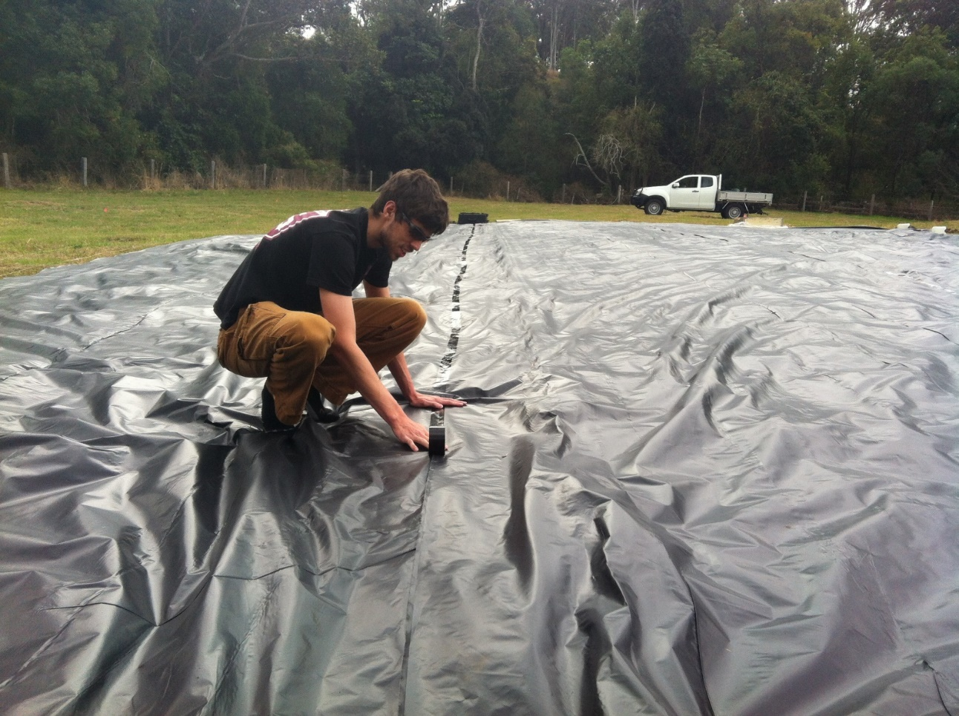
Thank you for your attention!

