Slide 1
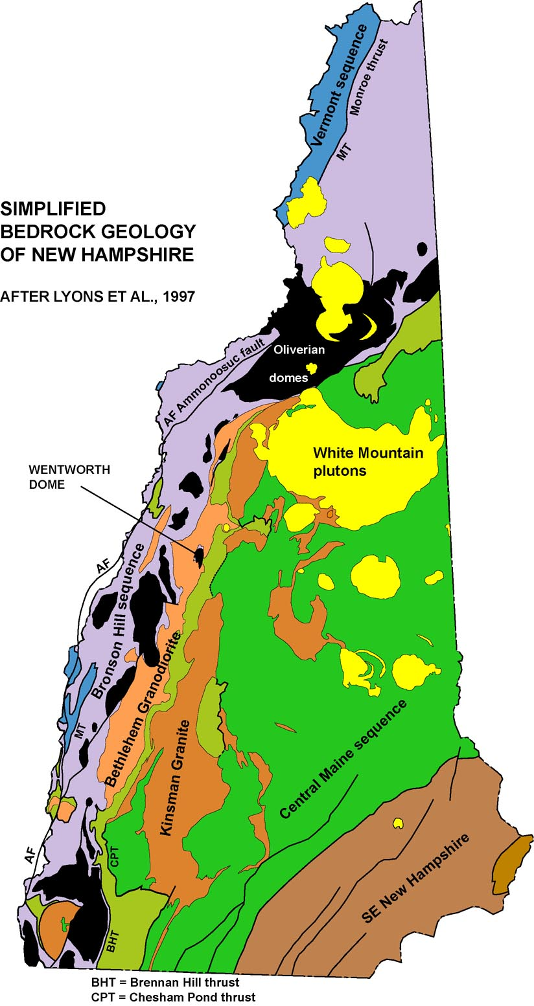
NORTHEY HILL “LINE”, WESTERN NEW HAMPSHIRE:
SINISTRAL SHEAR ZONE DUE TO LATE PALEOZOIC JOSTLING
OF DEEP-SEATED LAURENTIA-GANDER SUTURE?
Peter J. Thompson
Work supported by Statemap projects, 2012-present,
USGS and New Hampshire Geological Survey
Simplified Bedrock Geology of New Hampshire
after Lyons et al., 1997
Northey Hill “line”
Acadian thrust nappes:
Central Maine sequence
Monadnock sequence
Bronson Hill sequence
Vermont sequence
Notes:
The main objective of this talk is to present evidence for a high-strain zone along the so-called Northey Hill Line in western New Hampshire, and briefly to speculate on the implications for structure in the underlying basement.

Slide 2
Context for the Northey Hill line:
1. Acadian thrust nappes set up conditions for
inverted metamorphic isograds.
Central Maine sequence and Kinsman granite
Monadnock sequence and Bethlehem gneiss
Bronson Hill sequence and Oliverian domes
Vermont sequence
Chesham Pond thrust
Brennan Hill thrust/Fall Mtn. nappe
Monroe thrust
Notes:
The regional geology involves a sequence of thrust nappes that transported rocks westward and thickened the crust during the Acadian Orogeny. Bronson Hill rocks, in purple, were displaced west over the Vermont sequence, in blue; above that the Monadnock sequence and Bethlehem gneiss were displaced westward along the Brennan Hill thrust, Fall Mtn nappe, and Piermont allochthon. And finally the Central Maine sequence and Kinsman granite were emplaced above all that. This stacking of hot rocks onto cooler rocks resulted in an inverted metamorphic sequence.

Slide 3
2. Oliverian domes rose in the latest Acadian,
deforming the overlying thrust nappes and isograds.
Central Maine sequence and Kinsman granite
Monadnock sequence and Bethlehem gneiss
Bronson Hill sequence and Oliverian domes
Vermont sequence
Chesham Pond thrust
Brennan Hill thrust/Fall Mtn. nappe
Monroe thrust
Notes:
All of that was arched by the movement of pre-existing Ordovician domes (shown in black) in the latest Acadian, with attendant folds and foliation superposed on the nappe-stage structures.

Slide 4
3. Mesozoic normal faults
further disrupted the map pattern.
Ammonoosuc fault
Grantham fault
Notes:
Mesozoic normal faults further disrupted the map pattern.

Slide 5
What about the Northey Hill “line”?
Younger than the domes, older than the Mesozoic faults.
First proposed in Moosilauke 15’ Quad (Billings, 1937)
Followed south through Mt. Cube and Mascoma 15’
Quads (Hadley, 1938 and Chapman, 1939)
Shown continuing SW on the state map (Billings, 1955)
Notes:
What can we say about the Northey Hill line? * It is younger than the domes, and older than the Mesozoic faults. Perhaps “Northfieldian”?
Its type locality is here in the north. * It was mapped out to the south along the Silurian unconformity, and shown * on Billings’ state map going all the way to the CT River.
* Yet Lyons et al’s state map shows it only in the north.

Slide 6
What about the Northey Hill “line”?
Younger than the domes, older than the Mesozoic faults.
First proposed in Moosilauke 15’ Quad (Billings, 1937)
Followed south through Mt. Cube and Mascoma 15’
Quads (Hadley, 1938 and Chapman, 1939)
Shown continuing SW on the state map (Billings, 1955)
Shown only at Northey Hill on the state map by
Lyons et al. (1997)
Notes:
* Yet Lyons et al’s state map shows it only in the north.

Slide 7
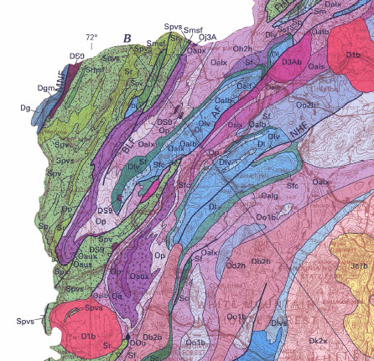
Littleton
Monroe
Northey Hill
Woodsville
Lyons et al., 1997
Notes:
So let’s look first at the Northey Hill area, south of Littleton, NH. Here is the fault, bisecting an area of Littleton Formation (in blue).

Slide 8
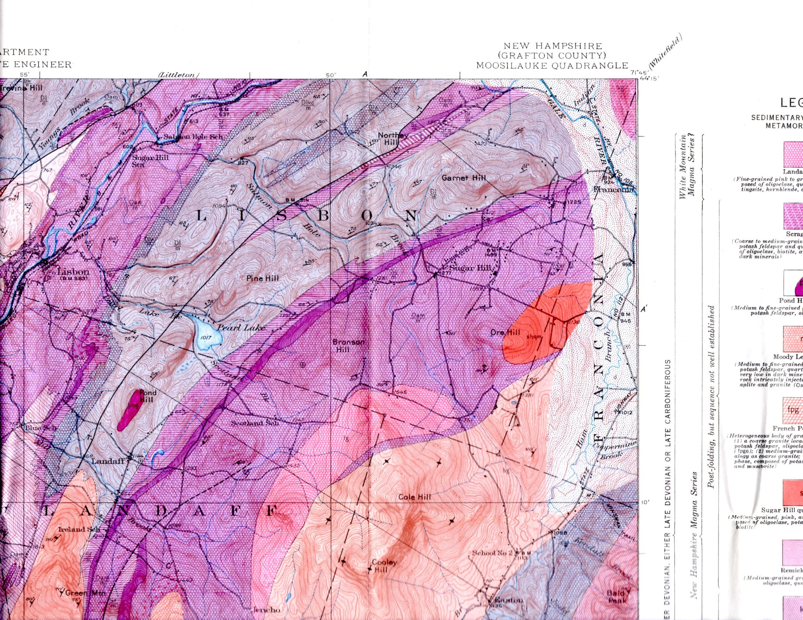
Northey Hill
Salmon Hole Brook “syncline”
Garnet Hill “syncline”
Billings, 1935
Notes:
Here is Billings’ 1935 map, showing the Northey Hill fault displacing a stratigraphic syncline, with Littleton Formation in the center. Rocks are older both to the west and to the east. The Garnet Hill structure continues at least 70 miles SW. The Salmon Hill Brook structure plunges SW. * If these are truly synclines, they should plunge NE toward the younger rocks. * Let’s look at Billings’ line of cross section.

Slide 9
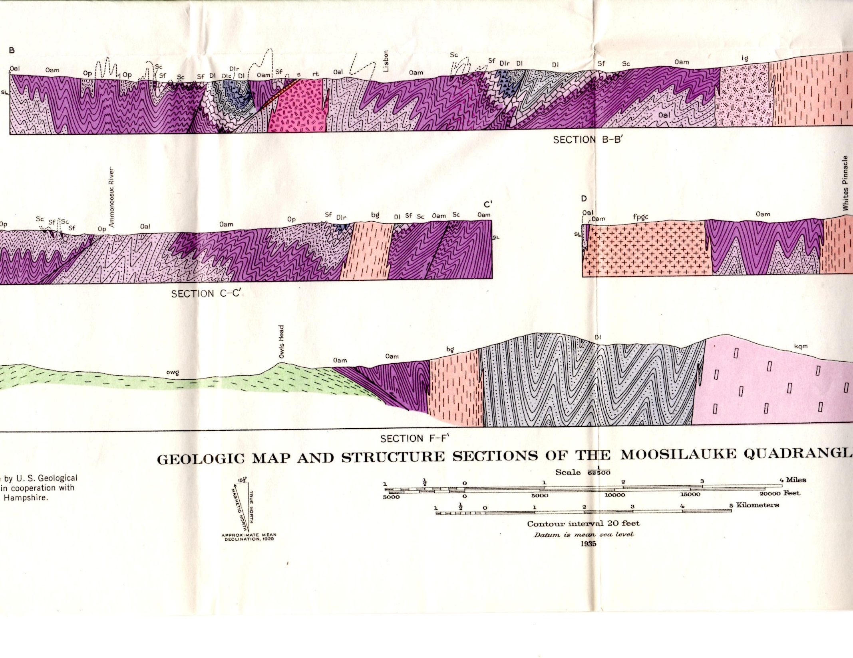
Billings XC
Billings, 1935
Notes:
We’ll zoom in on the cross section through Northey Hill. *

Slide 10
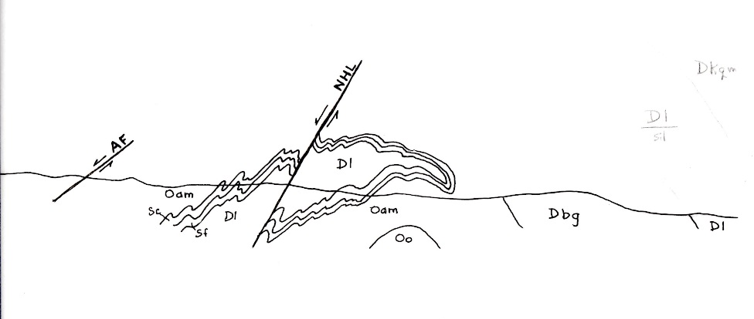
NHL
AF
Dl
Dbg
Oam
Oam
Sc
Dl
Oo
Sf
Billings, 1935
Notes:
Billings shows the fold as a syncline, which means the west side of the NHL had to have moved up. Note that he shows Dl on top of older units on the west limb.
In fact, if the folds plunge SW, older units must be above Dl in the overturned limb of an early fold. The stratigraphic syncline must be antiformal. * This also means that the west side of the NHL moved down, not upwards as Billings showed it.

Slide 11
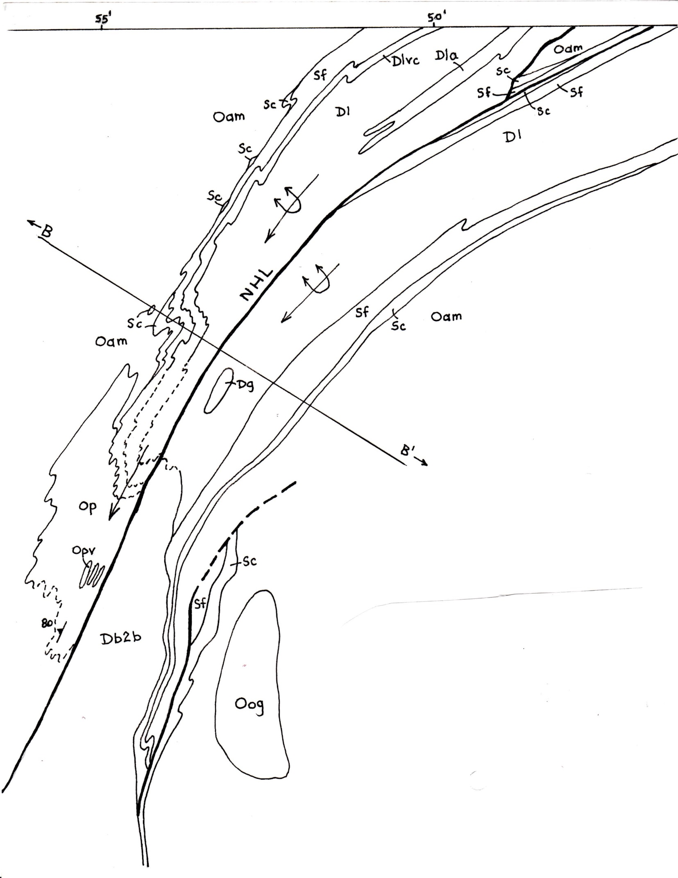
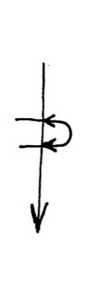
Notes:
* Here is my interpretation of the map, showing the antiformal synclines plunging SW. At this latitude rocks on both sides of the fault are at staurolite grade.

Slide 12
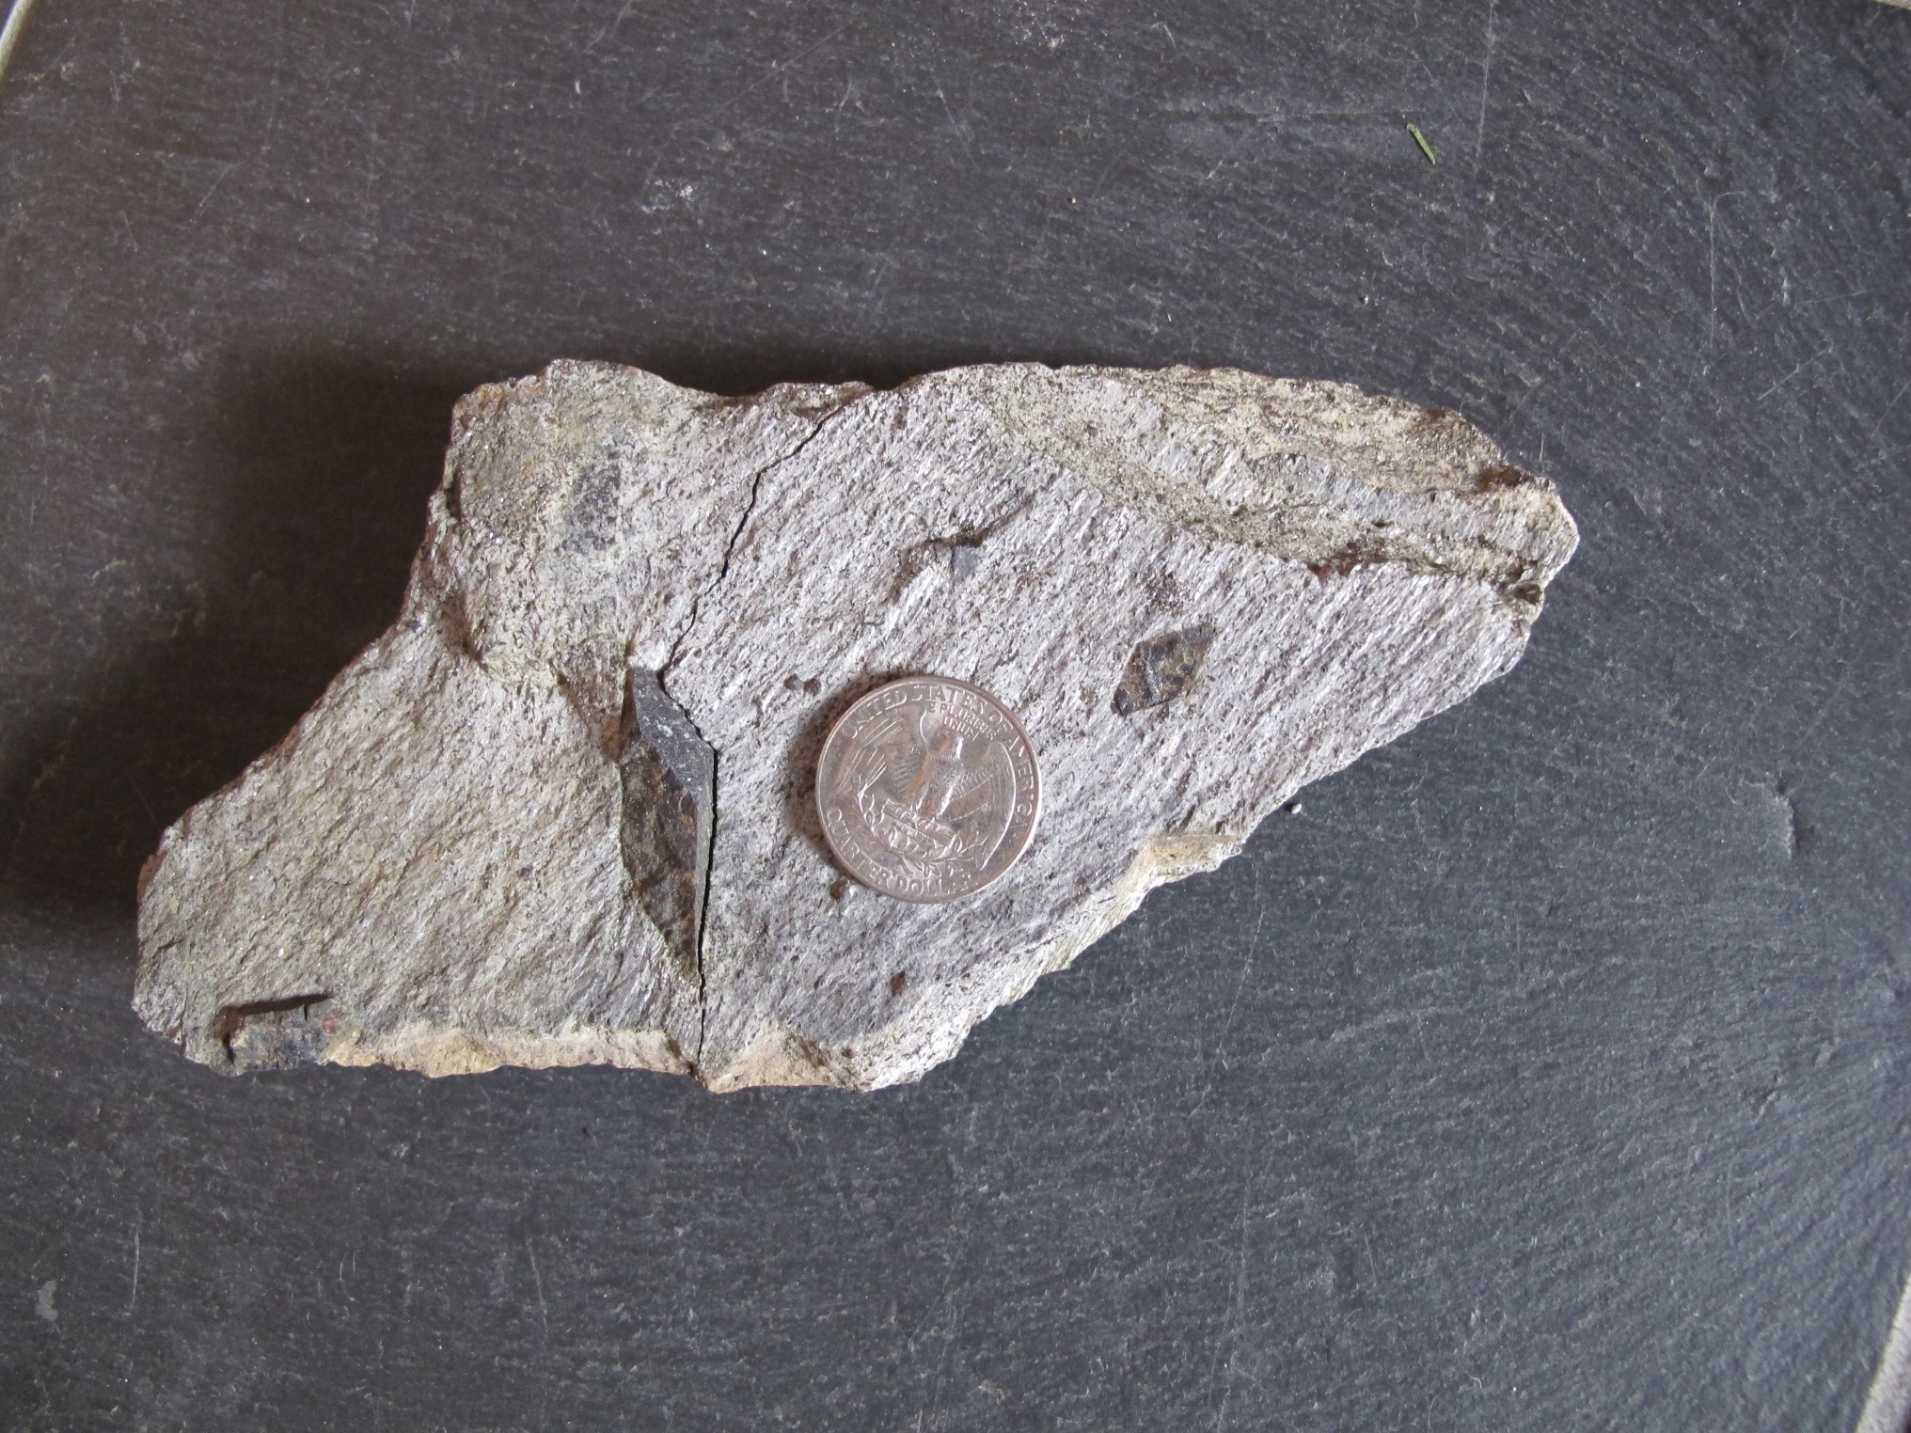
Staurolite schist
Littleton Formation
Northey Hill, NH
(coin diameter 25mm)
Notes:
Here is a typical sample of Littleton schist from Northey Hill.

Slide 13
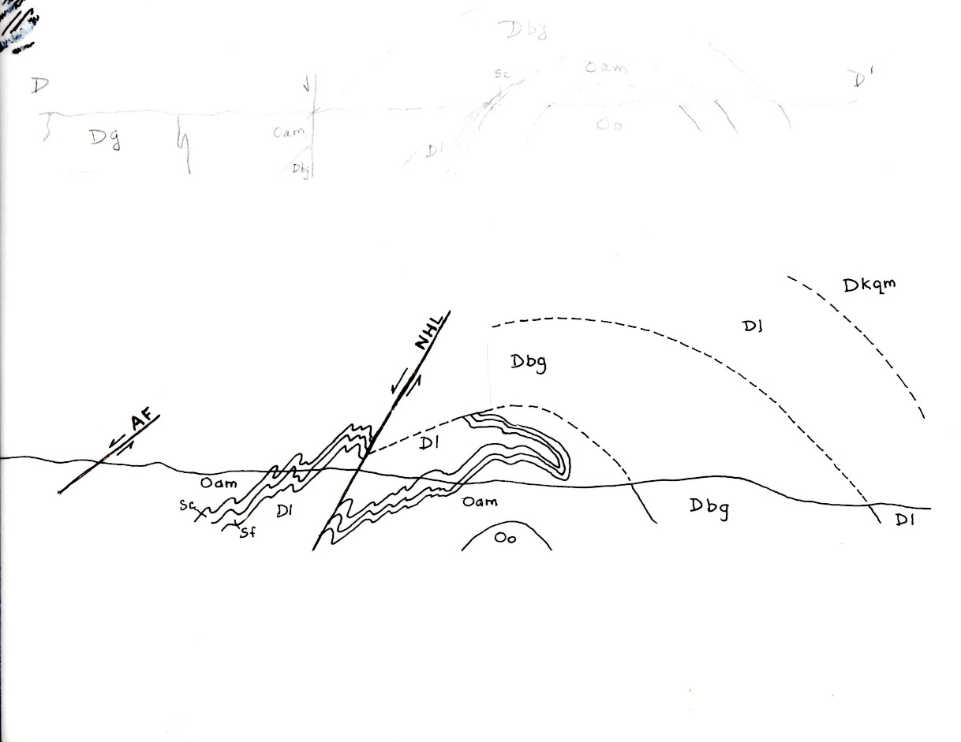
Dkqm
Dl
sillimanite
NHL
Dbg
(+/- Fall Mountain thrust nappe)
AF
Dl
staurolite
staurolite
Oam
Dbg
Oam
Sc
Dl
Oo
Sf
Notes:
Prior to displacement on the NHL the Garnet Hill structure had been intruded by the Bethlehem gneiss, perhaps in conjunction with the Fall Mountain nappe, bringing hotter rocks in from the east.

Slide 14
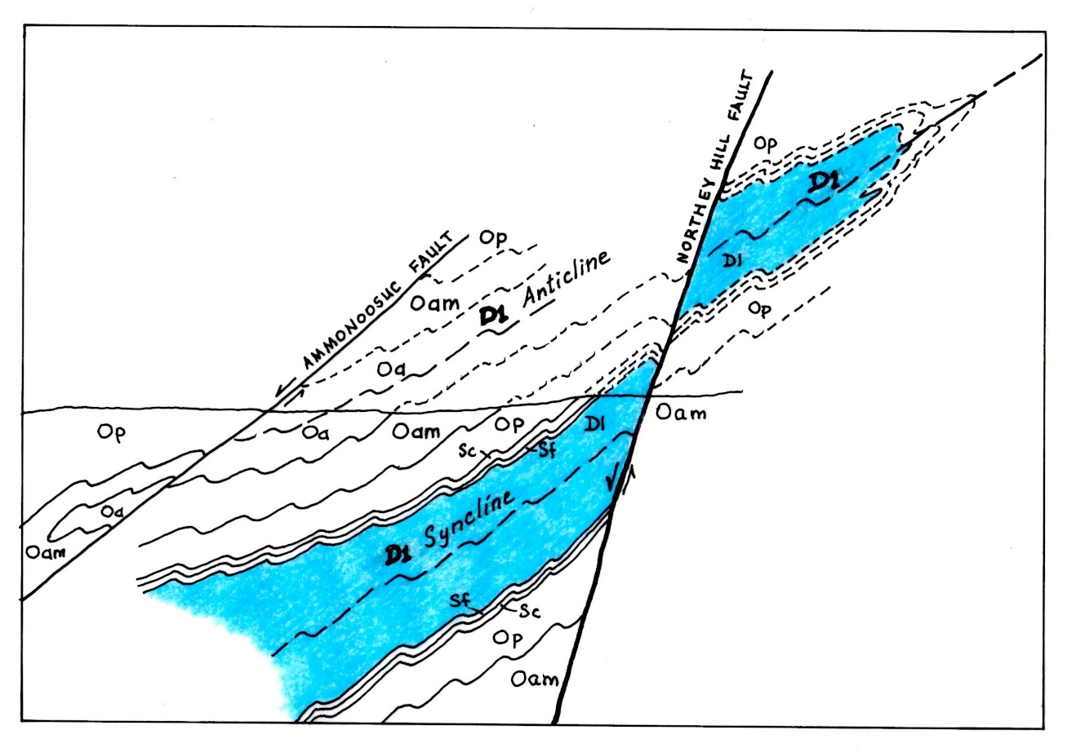
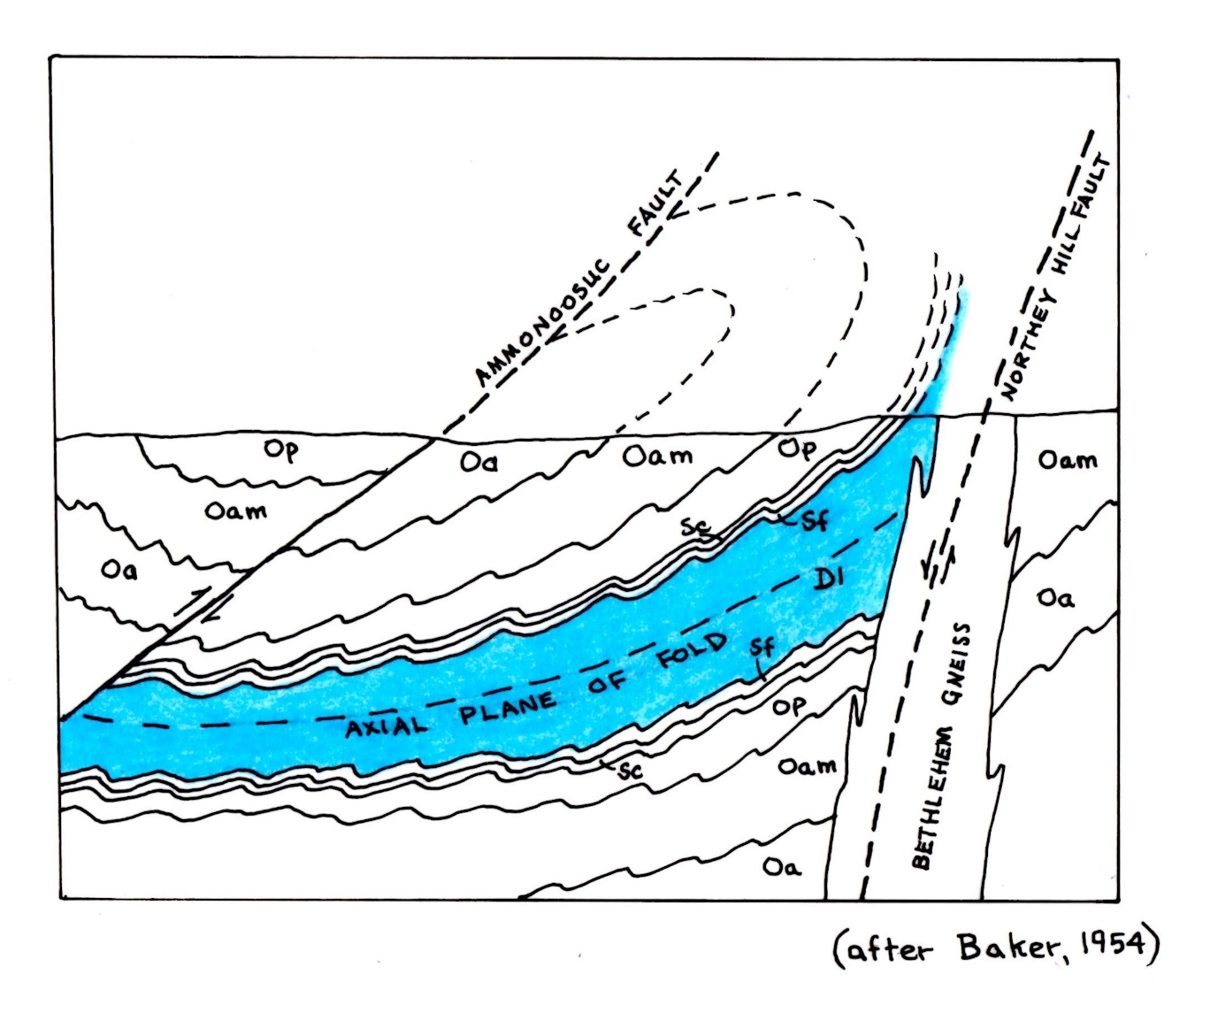
D1 Anticline
Cornish nappe
D1 Syncline
East-verging D1 folds (Baker, 1954).
West-verging D1 folds (this lecture).
Notes:
Back in 1954, Baker had proposed the idea of the overturned limb of an early fold in his Masters thesis at Dartmouth. * The east-verging transport sense is at odds with Jim Thompson’s west-verging nappes in southern New Hampshire. I’m proposing that the Garnet Hill syncline lies below a west-verging nappe, * with the syncline opening downwards toward the west. The core of the anticline can be traced to the Cornish nappe farther south. * Note that in this new interpretation, both faults - - the Mesozoic Ammonoosuc fault and the NHL - - are W side down.

Slide 15
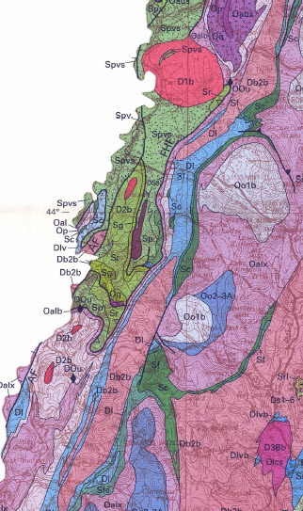
Woodsville
Sunday Mountain cleavage belt (Rumble, 1969)
BRONSON HILL ANTICLINORIUM
Piermont
allochthon
3 miles
Sunday Mountain
CORNISH NAPPE
Lyons et al., 1997
Notes:
Now we’ll follow the NHL south. Here is the Garnet Hill antiform, cored by Littleton Formation and Bethlehem gneiss. The NHL was mapped by Billings and Hadley more or less along the western contact of the Littleton, the Silurian unconformity, which is highly attenuated, I think because we are on the overturned limb of the Cornish nappe - - and as Don Wise taught us to say, “overturned limbs catch hell”. But a zone of late, vertical foliation * up to a mile or more wide parallels the line. Rumble called this the Sunday Mountain cleavage belt. It overprints nappe-stage and dome-stage foliations.

Slide 16
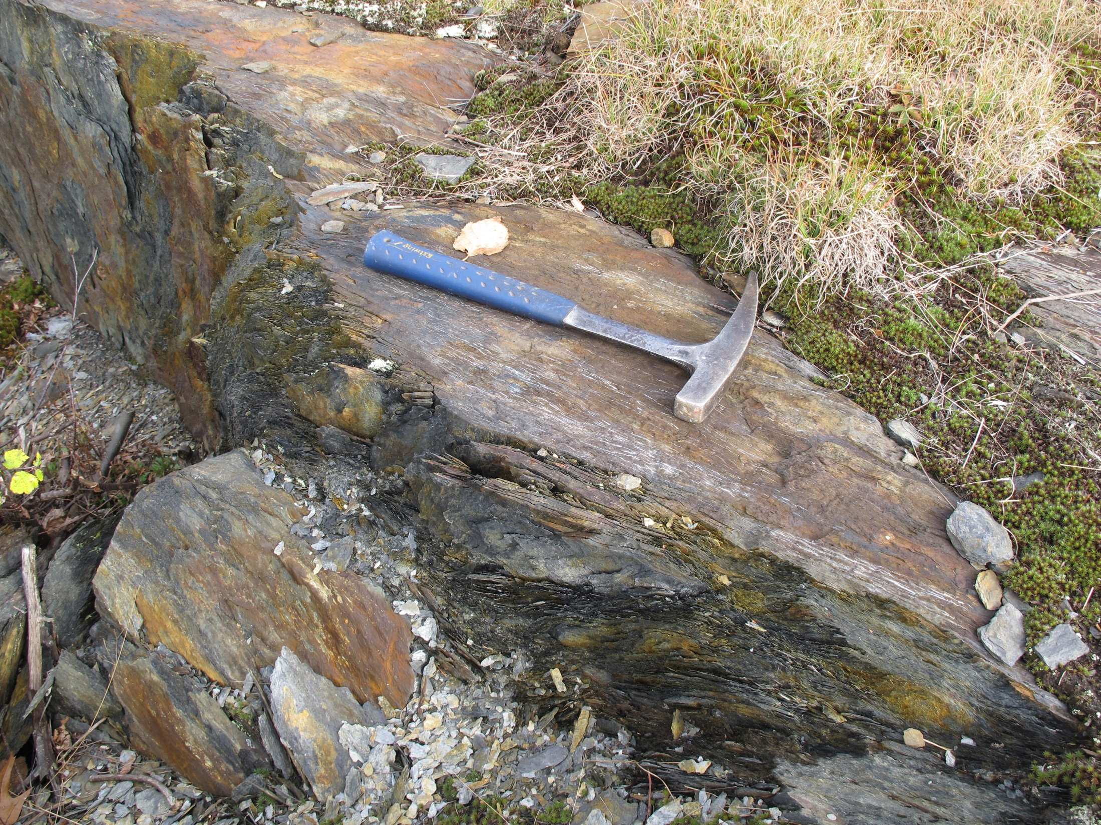
Notes:
The late foliation is typically a pervasive, fine-grained cleavage that strikes NNE, with very steep to vertical dips. It transposes and locally obliterates older foliations.

Slide 17
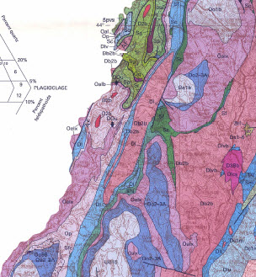
Piermont
allochthon
Orfordville
Sunday Mountain
BRONSON HILL ANTICLINORIUM
CORNISH NAPPE
3 miles
Lyons et al., 1997
Notes:
We move now a bit south to the area of Orfordville, still between the Cornish nappe and the Bronson Hill anticlinorium. The next slide shows a map by Dan Orange of the area inside this box.

Slide 18
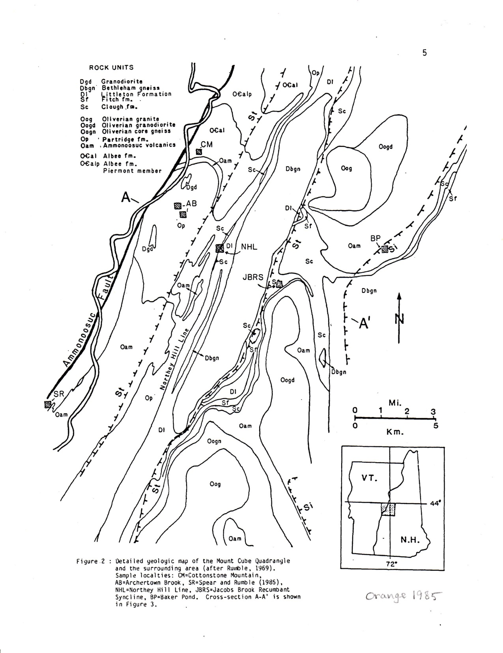
Piermont
allochthon
Orfordville
Bethlehem gneiss
BRONSON HILL ANTICLINORIUM
CORNISH NAPPE
Bethlehem gneiss
Sunday Mountain cleavage belt
Sunday Mountain cleavage belt
Sunday Mountain cleavage belt
After Orange, 1985
After Orange, 1985
After Orange, 1985
Notes:
Orange made a detailed petrologic study of mineral assemblages across this part of the orogen for his Master’s thesis at MIT, working with Frank Spear. The NHL follows along the contact between Partridge and Littleton Formations, with a few lenses of Fitch or Clough along the way. The Sunday Mtn cleavage belt is shown again in yellow, where dominant foliation is nearly vertical.

Slide 19
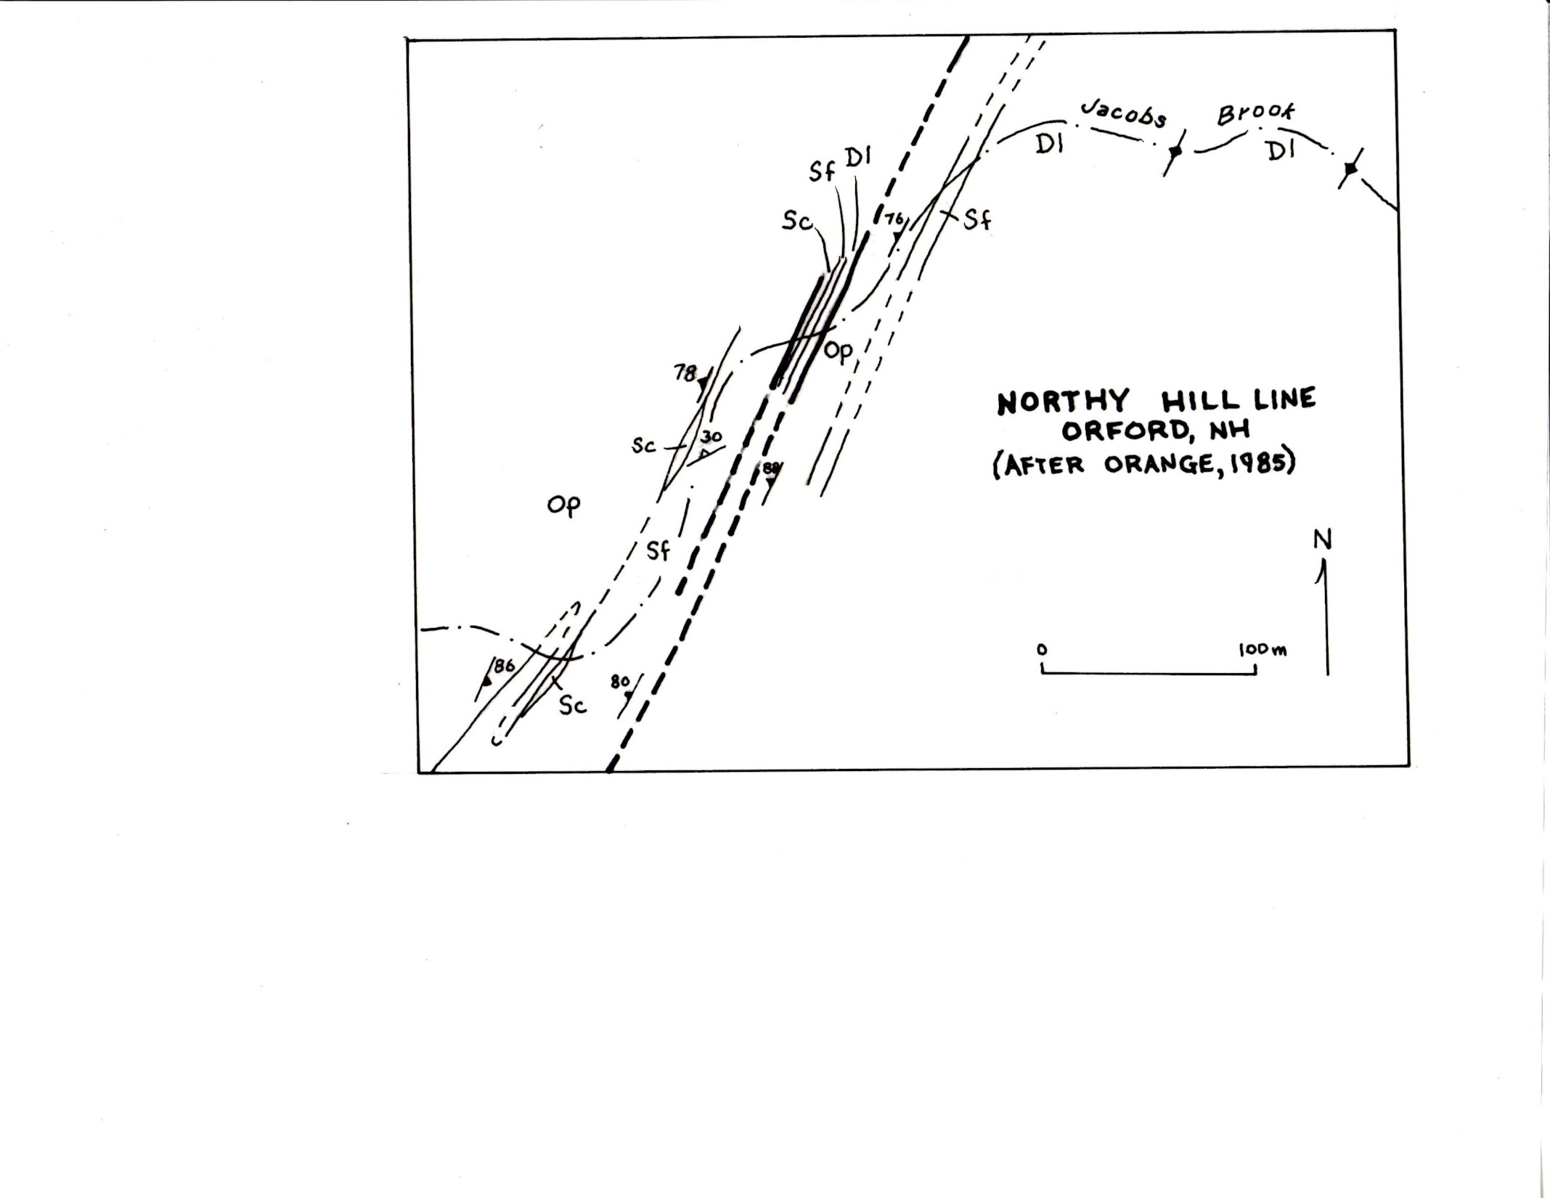
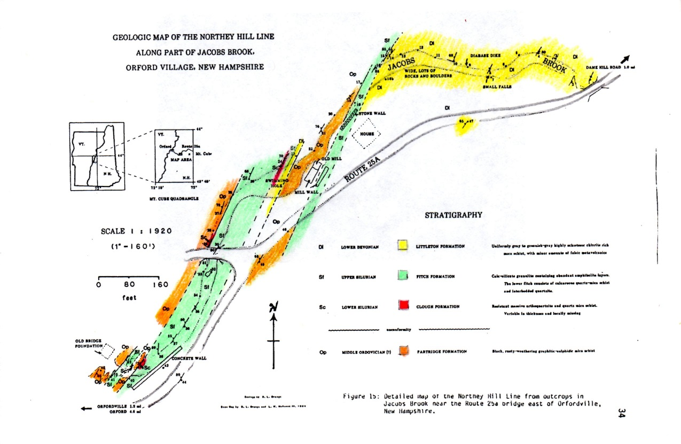
Northey Hill “line”
Orfordville, NH
(after Orange, 1985)
Notes:
Orange mapped details of the NHL where it is well exposed near Orfordville. * Here is an overlay showing just the map units. Note the repetition of units in an east-facing stratigraphy: Partridge, Clough, Fitch; Clough, Fitch, Littleton; Partridge, Fitch, Littleton. So we have repetitions of stratigraphy and discrete fault surfaces within this zone - - it’s not simply a matter of an attenuated Silurian unconformity. Rumble noted rotated garnets in the Littleton at this locality, with sinistral shear sense (W side down).

Slide 20
Staurolite
Garnet
Sillimanite
Staurolite
Sunday Mountain cleavage belt
Orange, 1985
Notes:
Now back to Orange’s bigger map. In the late cleavage belt * pelitic rocks may contain garnet, although where the cleavage is best developed the rocks are very fine-grained, and almost slaty. * On either side the rocks may also have staurolite. * Farther east they are at sillimanite grade. Orange made detailed petrologic studies of mineral assemblages from six locations across the area, shown here as red squares, one right from the NHL, 3 locations to the W and 2 to the E.

Slide 21
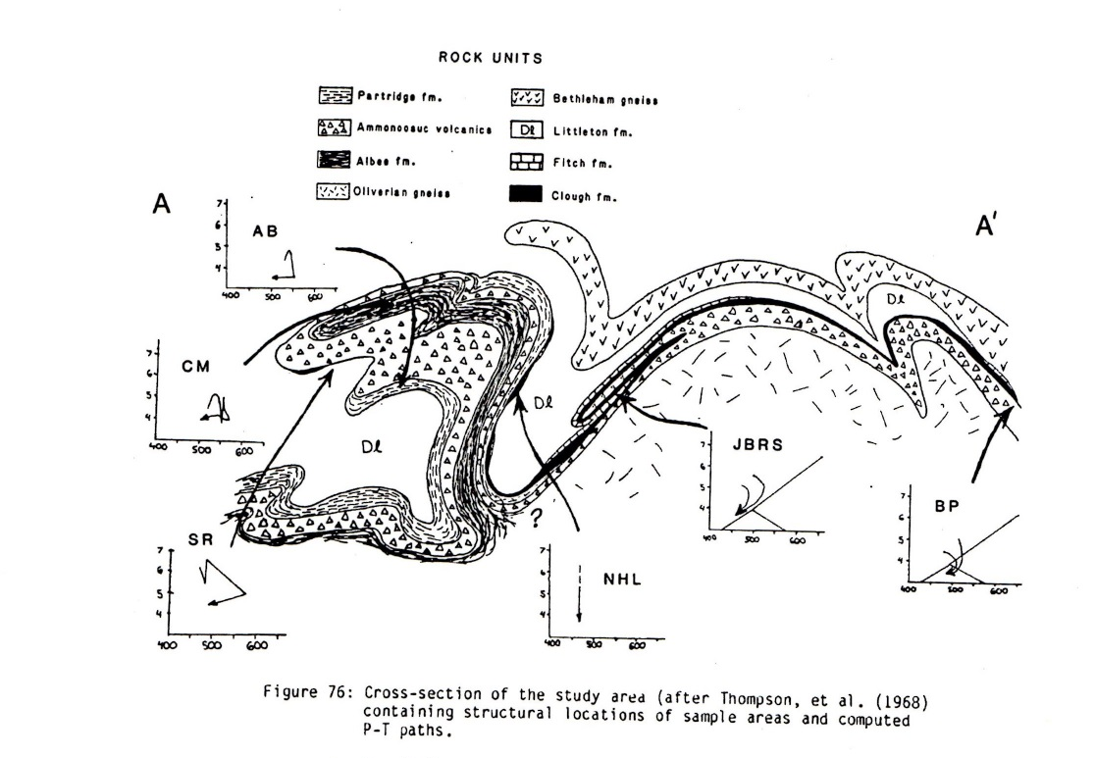
Orange, 1985
Notes:
Here he has plotted each sample location with a corresponding PTt path diagram on a cross section. (More about the cross section in a moment.) Note that PTt paths in the west are clockwise, initially moving toward higher P and moving toward hotter T, presumably due to loading of hot rocks above, and then toward lower pressures and temperatures. Those to the E are also clockwise, but lack the initial P increase. In contrast, the NHL sample shows only decompression. Orange concluded that the NHL “may be a zone of intense ductile deformation with a large normal component”.

Slide 22
Garnet Hill “syncline”
Cornish nappe
BHA
Orange, 1985
Notes:
Now consider the cross section. Note the Garnet Hill syncline shown opening upwards. I think this dragon’s head for the Cornish nappe is incorrect * and I think the Littleton must connect through here *.

Slide 23
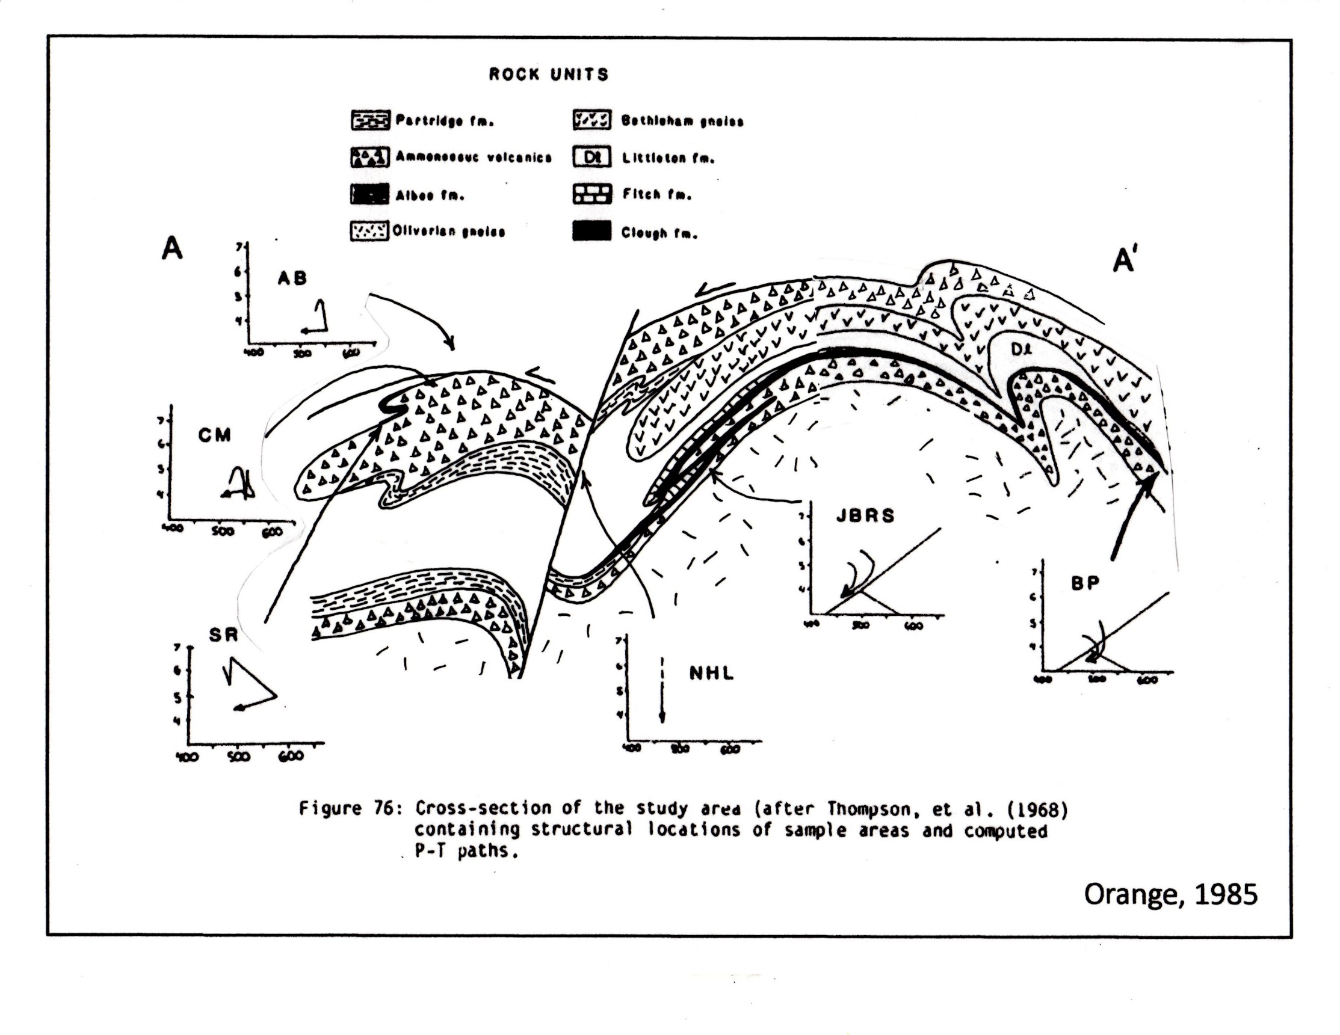
Fall Mountain thrust nappe
NHL
Piermont allochthon
Cornish nappe
BHA
syncline
Garnet
Hill
Notes:
A more reasonable cross section would have the Cornish nappe rooted above the Garnet Hill syncline, not below. It is exposed at the earth’s surface because the west side of the NHL dropped down.

Slide 24
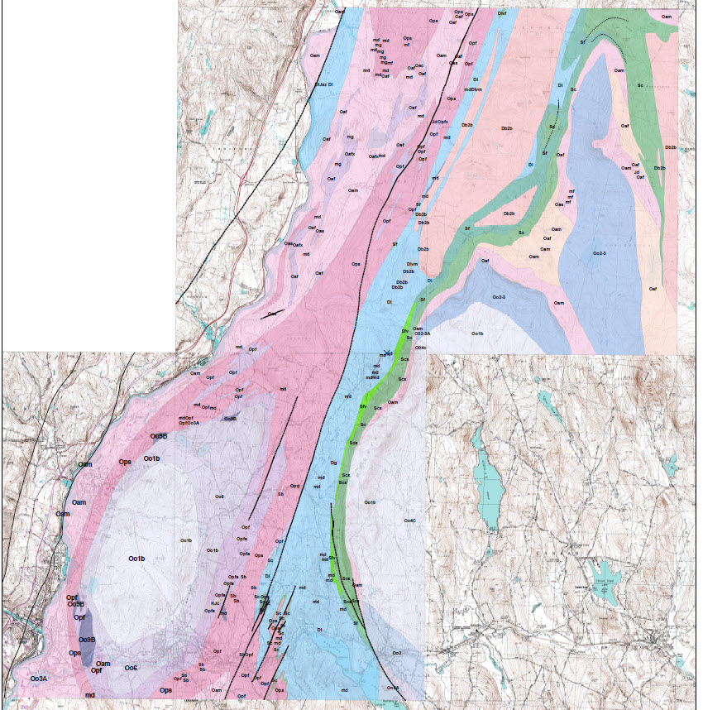
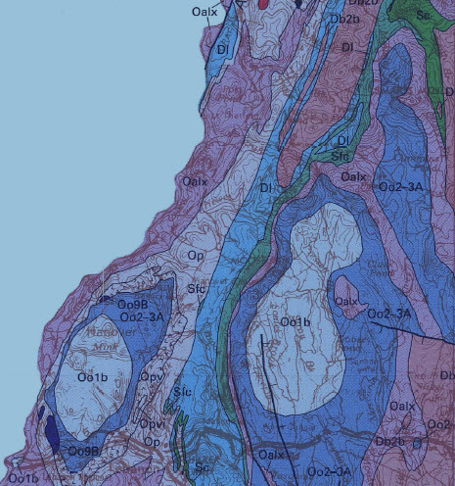
Post
Pond
Smarts
Mtn
Ammonoosuc fault
CORNISH NAPPE
Northey Hill line
MASCOMA DOME
LEBANON DOME
Hardy
Hill
Notes:
Still farther south, this is the area of Lyons’ map that I have been remapping in recent years. * Here is my map at the same scale - - thanks to Greg Barker at the NH Survey for digitizing the results. Here is the Lebanon dome, draped by the overturned limb of the Cornish nappe, and here is the upper limb, one of Orange’s sample sites. The staurolite isograd trends diagonally across the area, staying west of the Lebanon dome. It does not encircle the dome, as shown by Lyons et al (1997) and has nothing to do with contact metamorphism against the igneous rocks of the dome. Sinistral shear along the Northey Hill line is indicated by en echelon stepping of faults, for example here south across Hardy Hill.

Slide 25
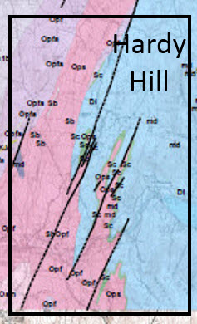
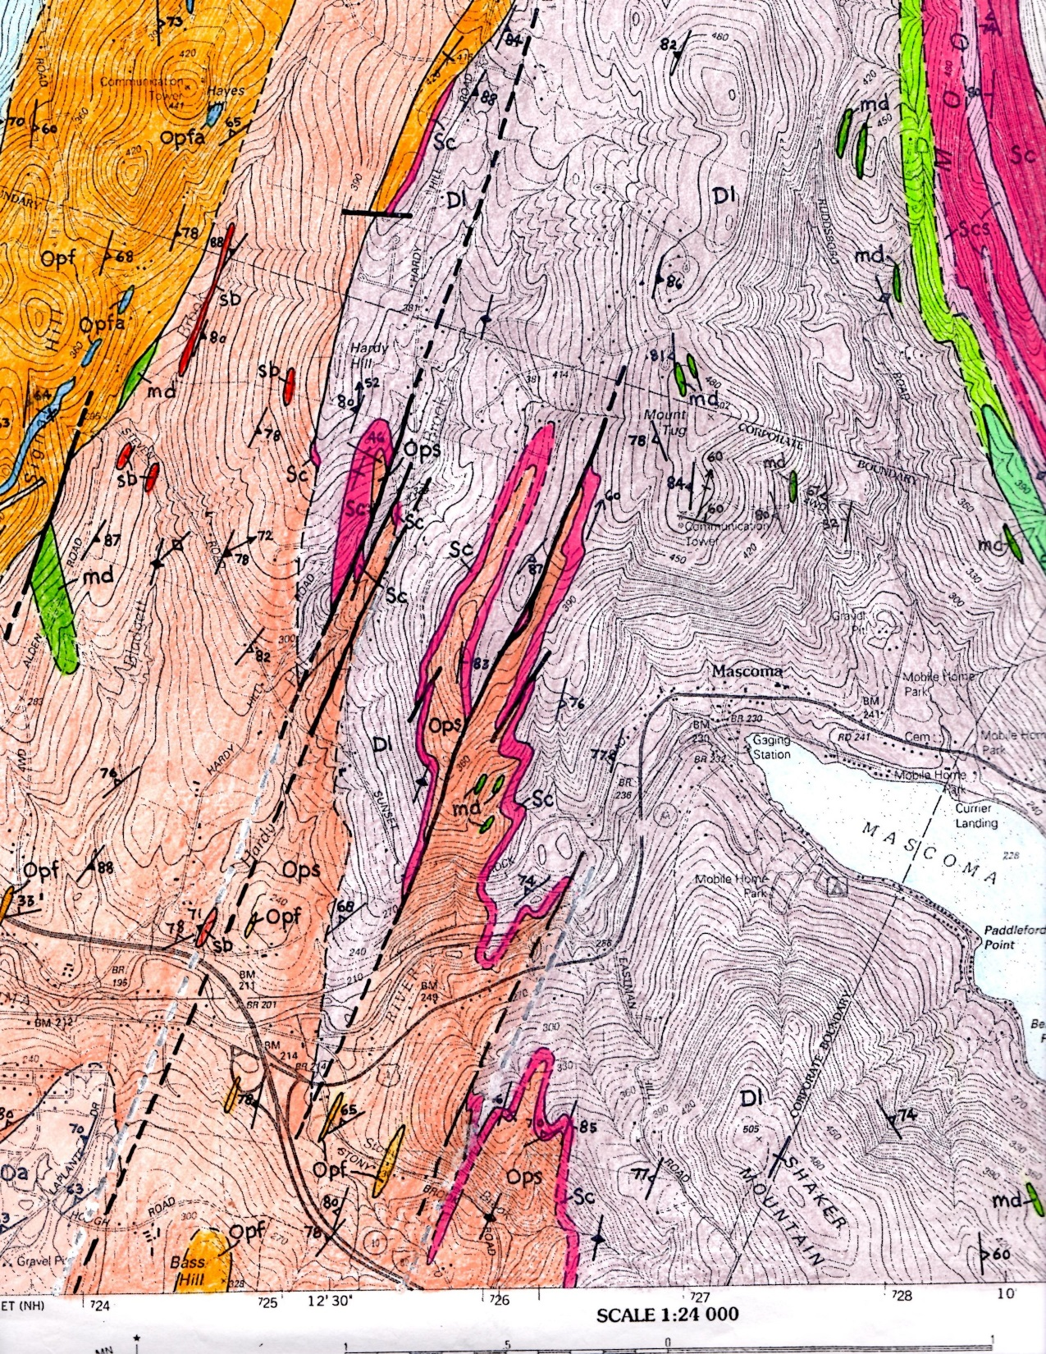
D
U
Notes:
Here is a blow-up of that area, and my drafted map with yet another color scheme. The Clough Quartzite, in red, outlines a nappe-stage isoclinal fold, deformed by dextral dome-stage folds, and offset by a series of sinistral faults. The rocks on the west moved relatively down and to the south .

Slide 26
Post
Pond
Smarts
Mtn
Ammonoosuc fault
CORNISH NAPPE
Northey Hill line
MASCOMA DOME
LEBANON DOME
Notes:
Next we’ll zoom in to a small area in Lyme.

Slide 27
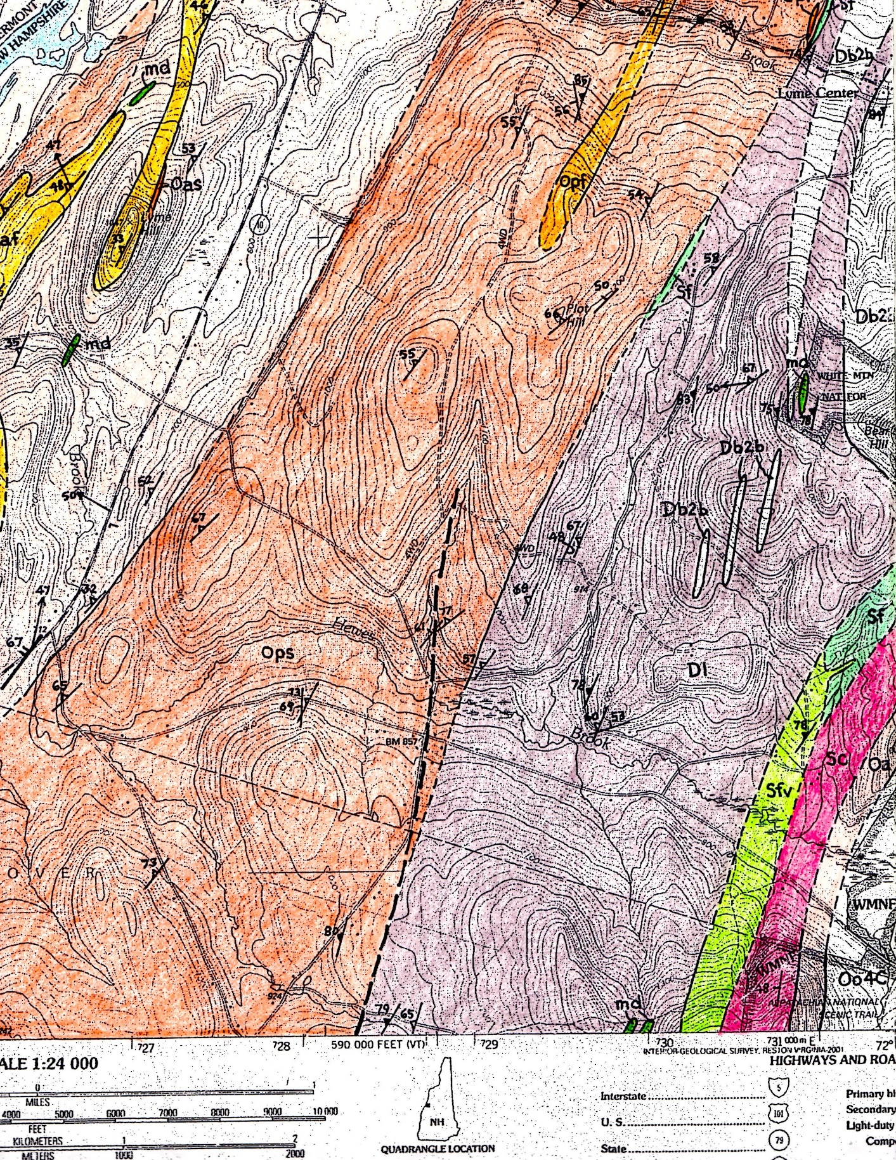
67
48
u
67
70
Garnet Hill antiformal syncline
Notes:
On the west limb of the Garnet Hill syncline, we see that foliation is steeper than overturned bedding, whereas on the east limb bedding is steeper than foliation. This is in fact where I first got the idea that the syncline closes upwards,

Slide 28
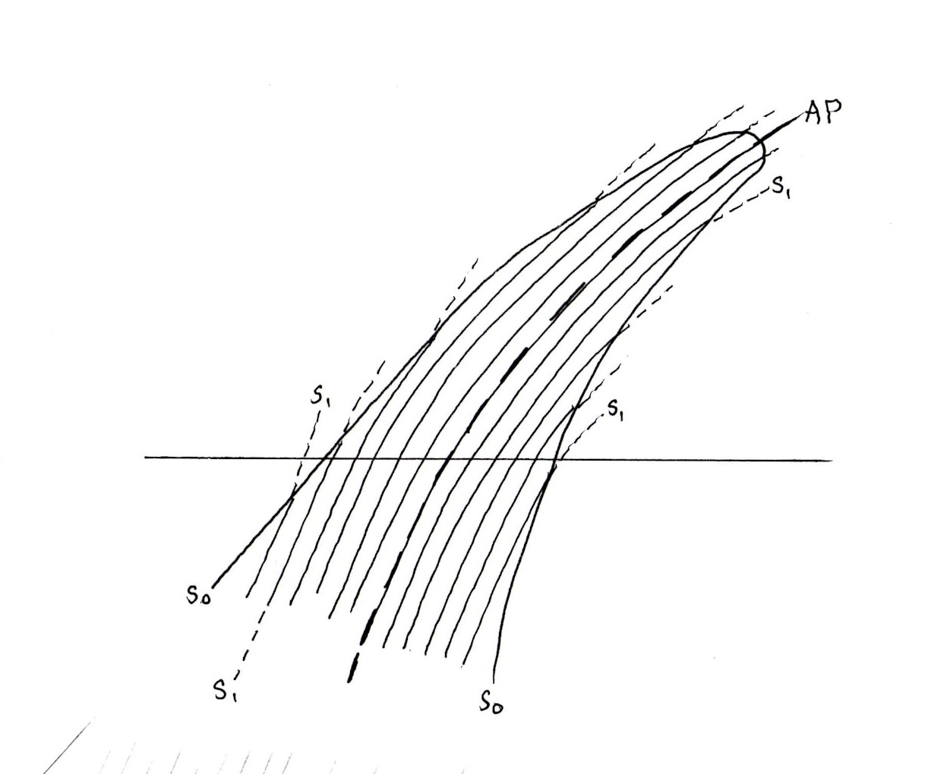
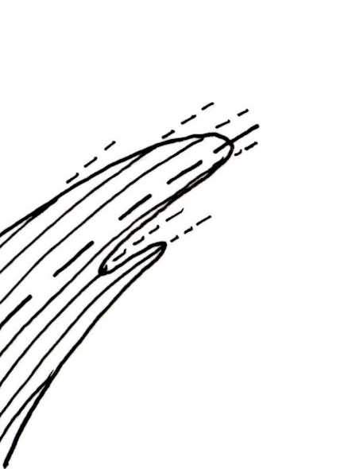
Notes:
because if you look at the cross section view, if the foliation formed axial planar to the fold, the fold has to be an antiform. * This is consistent with the rotation sense of the Jacobs Brook syncline that Rumble mapped farther north.

Slide 29
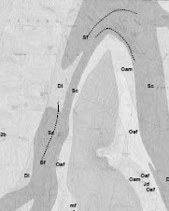

Post
Pond
Smarts
Mtn
NW
Sc
Ammonoosuc fault
Dl
SE
Sc
CORNISH NAPPE
Garnet Hill antiformal syncline
Northey Hill line
MASCOMA DOME
LEBANON DOME
Dl
NW
SE
Notes:
We’ll zoom in now to the area of that fold near Smarts Mountain. The Littleton-Clough contact is folded in a minor recumbent fold. If we draw a cross-section here, it appears to be a minor fold on the lower limb of an antiform.

Slide 30
Simplified Bedrock Geology of New Hampshire
after Lyons et al., 1997
Notes:
Back to the bigger picture. * It seems likely that the NHL continues SW somehow along the dome-stage Meriden antiform, but the details need to be reconciled with recent mapping in that area.

Slide 31
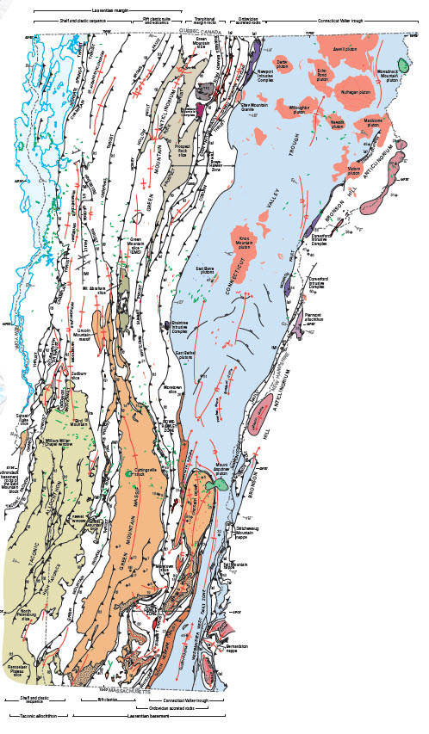
SOUTHERN VERMONT
What age?
Is it a continuation of the Westminster West fault system?
~300 Ma
(McWilliams et al., 2014)
Ratcliffe et al., 2011
Notes:
Does the Northey Hill line continue into southern Vermont as the Westminster West fault system? * I think it may. Both are sinistral, with late, steep foliation. * Late muscovite from the foliation in Vermont has been dated at about 300 Ma. Maybe it’s time for some Ar/Ar work along the Northey Hill line in NH?

Slide 32
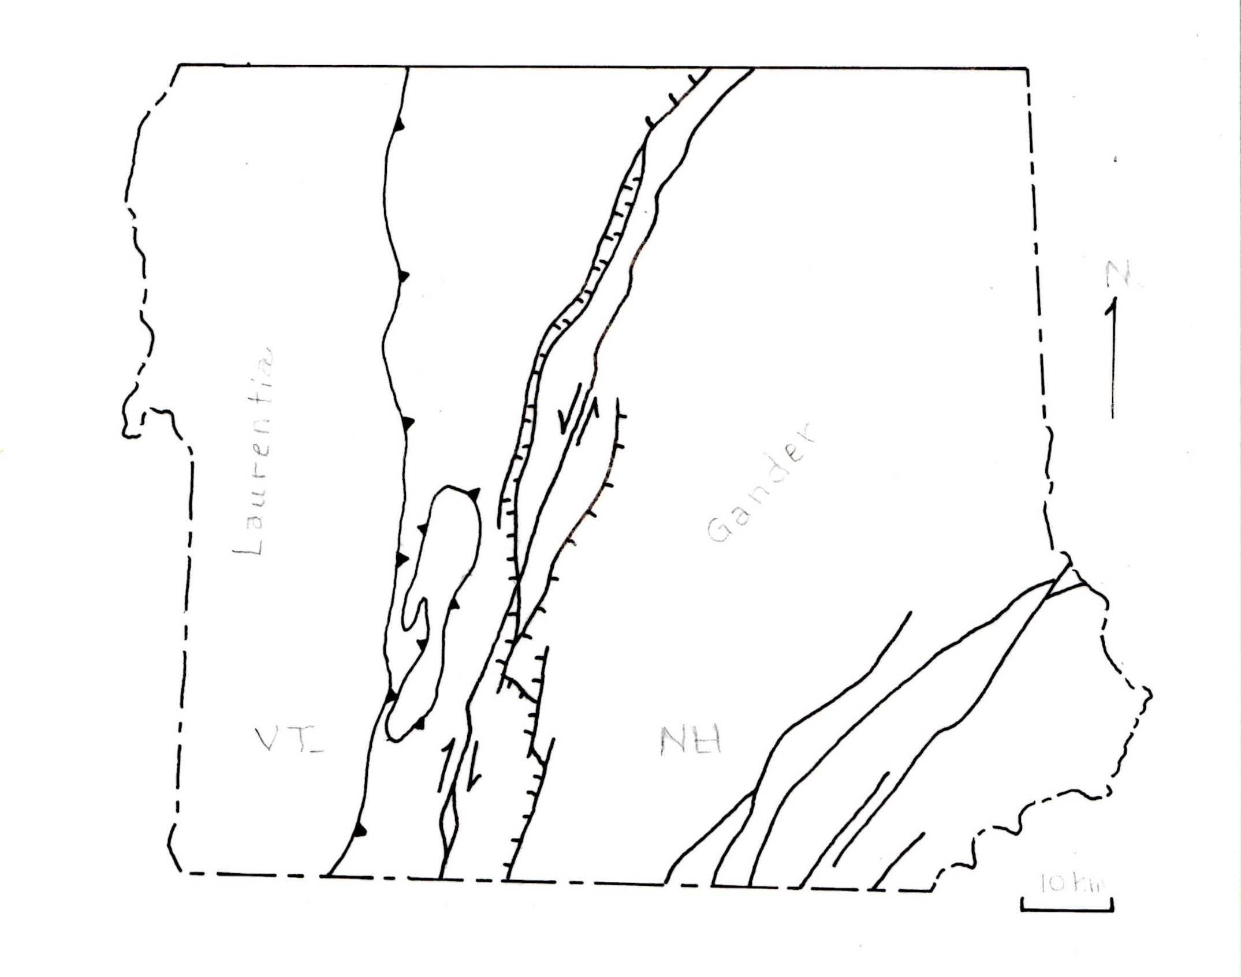
Western limit of Gondwanan detrital zircons (Ryan-Davis et al., 2013)
N
Laurentia
Gander
Chester
dome
VT
NH
10 Km
Notes:
And finally, what do these structures suggest about the suture between Laurentia and Gander? Although the Red Indian line * may well be at the earth’s surface along the west edge of the Moretown slice, I think we need to pay attention to the concentration of late Paleozoic and Mesozoic faults * along the Connecticut River as an indication of the deep-seated suture between Laurentian and Gondwanan basement.

Slide 33
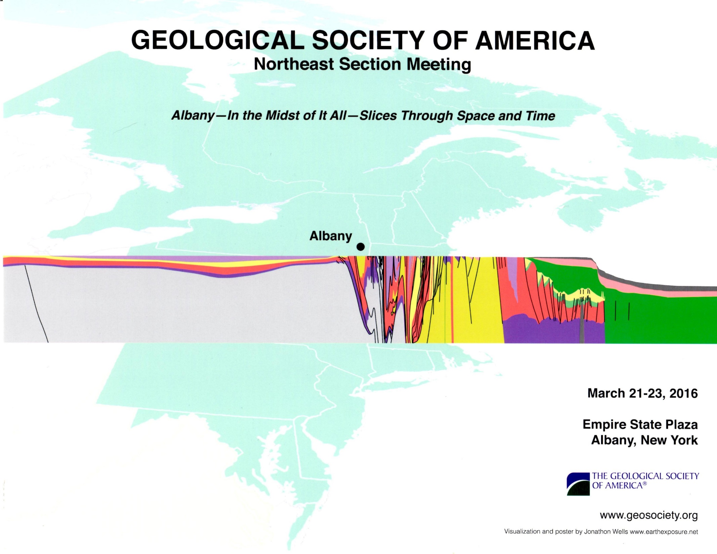
Laurentian basement
Gander
Avalon
Poster by Jonathon Wells www.earthexposure.net
Notes:
The poster for this meeting portrays this idea very nicely!

Slide 34
Red Indian Line ?
Laurentia
Gander
Avalon
Notes:
The Red Indian Line at depth would be here, east of the Chester dome. * Its position at the surface is likely to the west in Vermont, but that’s a topic for others to address. Thank you.

