Slide 1
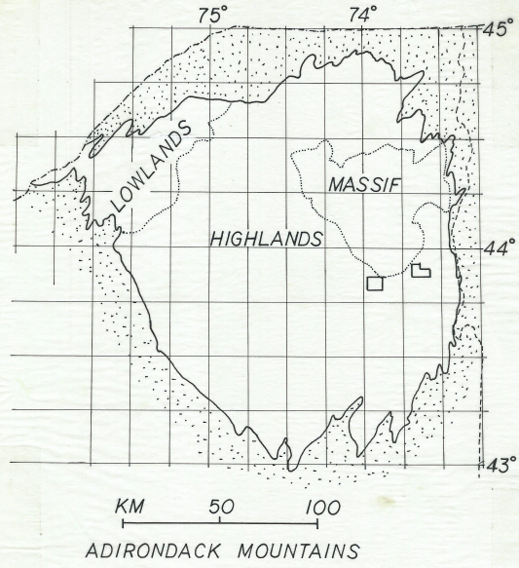
Turner – Skiff Mountain Tectonic Unit

Slide 2
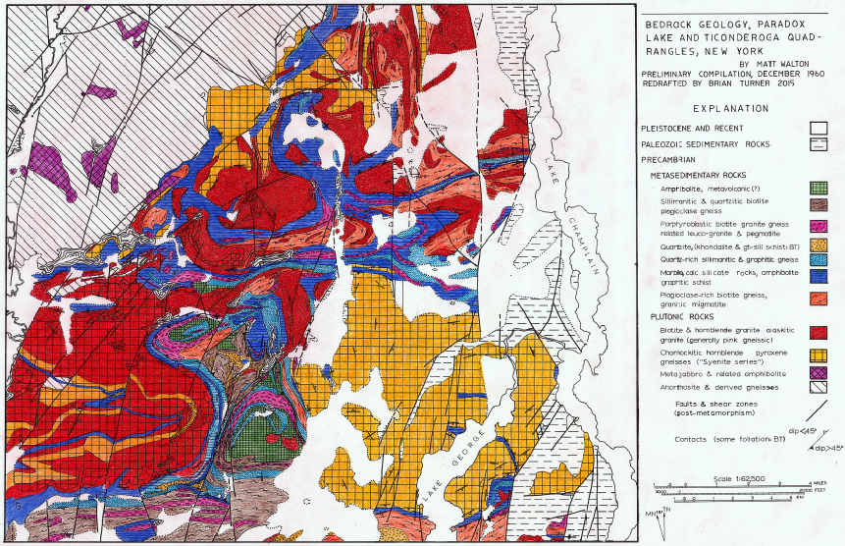
Turner – Skiff Mountain Tectonic Unit

Slide 3
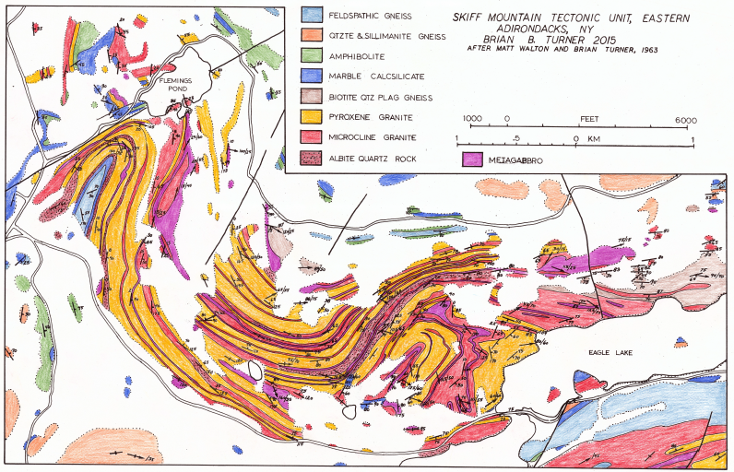
Turner – Skiff Mountain Tectonic Unit

Slide 4
Turner – Skiff Mountain Tectonic Unit
Background
Walton and deWaard, basement hypothesis, 1962,
now discredited.
Turner - Field assistant to Walton, 1962.
Walton recognized Skiff Mtn has complex structure.
Assigned me to 6 weeks mapping at 1:10,000.
Mapping was field checked by Walton.
Some rocks have pyroxene, so called “charnockite” by Walton – I now disagree with that identification.

Slide 5
Turner – Skiff Mountain Tectonic Unit
Description of Rock Types in Skiff Mtn
Layered granite gneisses, mappable*.
Low Ti-magnetite ore bodies (3 mines, several pits).
Pervasive partial melting and anatexis; paragneisses locally grade into granite gneiss.
Pervasive retrograde metamorphism, hydrous minerals as alteration products of primary anhydrous minerals (sericite, uralite, chlorite).
Many thin metagabbro sills, mappable.
Feldspars changed by local metasomatism – replacement textures in many rocks, see isochrons.
Similar to Lyon Mtn gneiss of Whitney and Olmsted

Slide 6
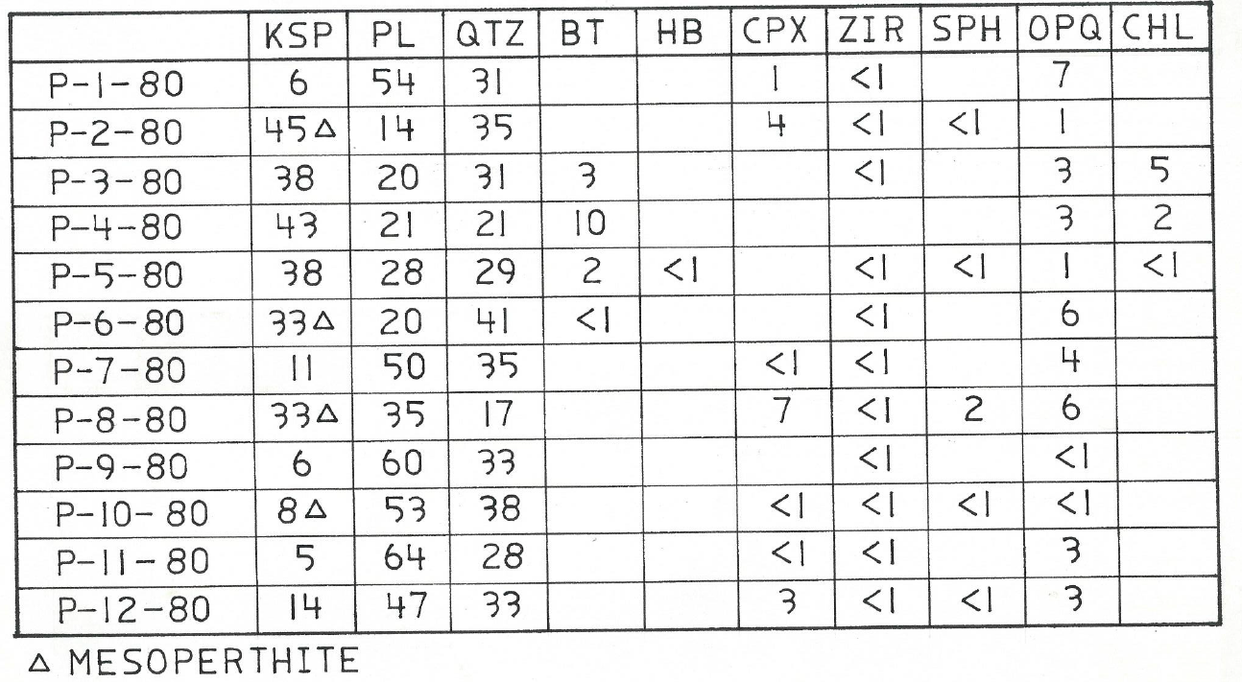
Turner – Skiff Mountain Tectonic Unit

Slide 7
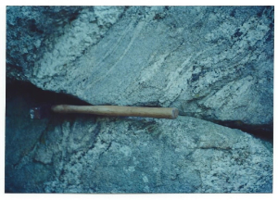
Turner – Skiff Mountain Tectonic Unit
Leucosome and migmatite,
Skiff Mtn near Arnold Pond.

Slide 8
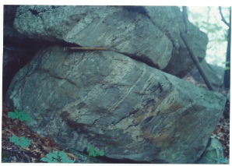
Turner – Skiff Mountain Tectonic Unit
Leucosome and migmatite
Skiff Mtn near Arnold Pond

Slide 9
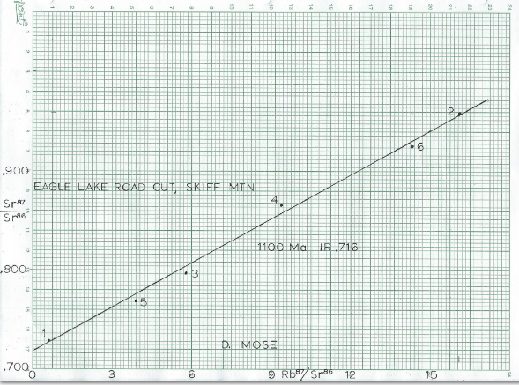
Turner – Skiff Mountain Tectonic Unit
Whole rock Rb/Sr isochron by Doug Mose, 1980
“K- metasomatism” – Mose note
1100 Ma, IR = 0.716

Slide 10
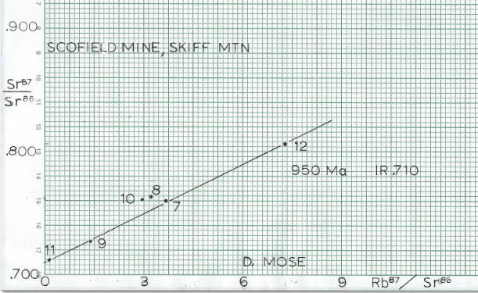
Turner – Skiff Mountain Tectonic Unit
Whole Rock Rb/Sr Isochron by Doug Mose, 1980
#11, 2-4 m over ore, no replacement texture
#9, 1 m over ore, no replacement
#7, 2 m over ore, some rplcmnt
#12, 2-4 m over ore, some rplcmnt
#10, ½ m over ore, some rplcmnt
#8, 1 m over ore, much rplcmnt
#8 and #10 clearly open systems
compared to other samples further
from ore layer.
950 Ma, IR = 0.710

Slide 11
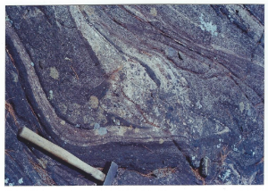
Turner – Skiff Mountain Tectonic Unit
Refolded isocline, near Arnold Pond

Slide 12
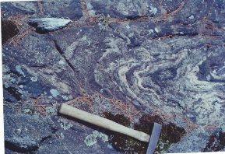
Turner – Skiff Mountain Tectonic Unit
Refolded isocline near Arnold Pond

Slide 13
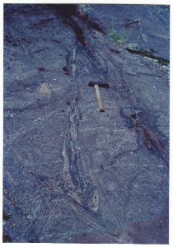
Turner – Skiff Mountain Tectonic Unit
Refolded isocline near
Arnold Pond

Slide 14
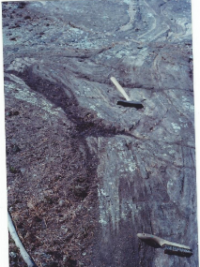
Turner – Skiff Mountain Tectonic Unit
Refolded isocline near
Arnold Pond

Slide 15
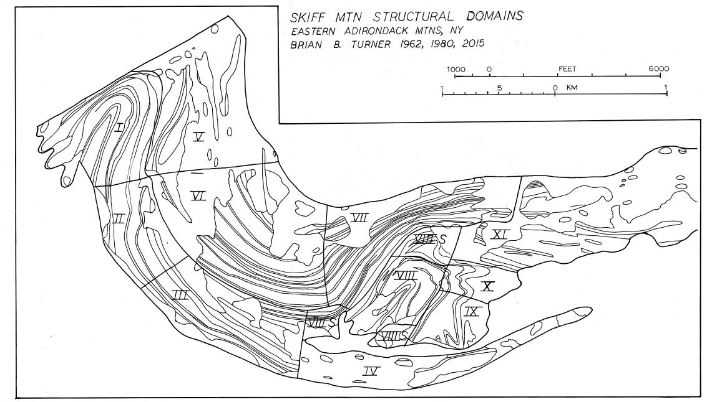
Turner – Skiff Mountain Tectonic Unit
Skiff Mtn Domain Map

Slide 16
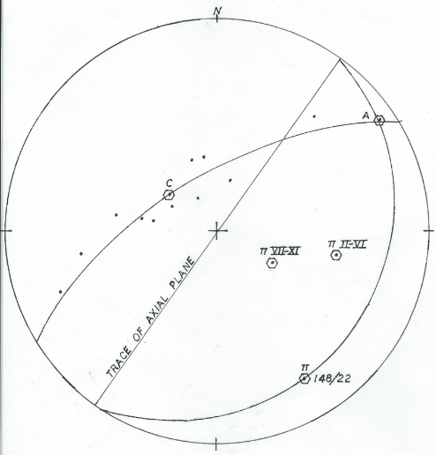
Turner – Skiff Mountain Tectonic Unit
Stereonet of poles to
foliation, fold at W
end of Skiff Mtn
Pi pole of fold at
148/22
Pi poles for domains
2-6 and 7-11 plotted for
reference
Axial plane plotted
for analysis

Slide 17
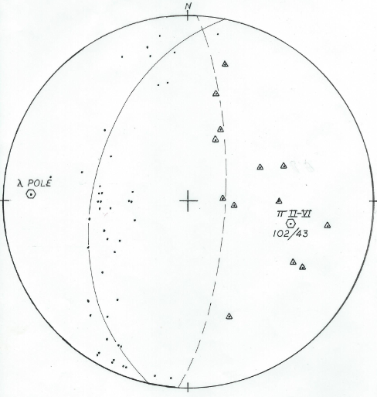
Turner – Skiff Mountain Tectonic Unit
Stereonet of poles
to foliation, domains
2-6 (mid-mountain)
Pi pole at 102/43,
least squares best fit
Some lineations
(triangles) on a great
Circle
Pole to lineation
circle at 272/12 (for
future reference

Slide 18
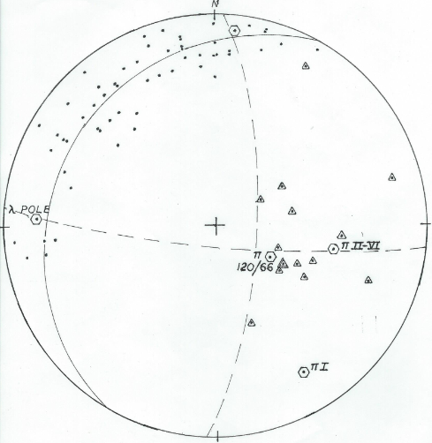
Turner – Skiff Mountain Tectonic Unit
Stereonet of Poles
to foliation, Domains
7-11
Pi pole at 120/66,
eyeball fit
Pi poles for Domains
1 and 2-6 for reference
Pole for lineation
great circle for reference
N.B. 90 degree inter-
sections

Slide 19
Turner – Skiff Mountain Tectonic Unit
Discussion of Structure
All pi-poles, thus presumably fold axes, plunge at much steeper angles than an entire terrane just 2 km to the south where late F-2 folds predominate.
Major E-W trending belts of marble lay just N and S of Skiff Mtn.
Structural fabric of the area around Skiff is different from the structural fabric to the south and southwest.
All granite bodies near Skiff Mtn plunge to the E.
Are these granite bodies allochthonous or synformal?
Are the refolded isoclines refolded F-1 folds?

Slide 20
Turner – Skiff Mountain Tectonic Unit

Slide 21
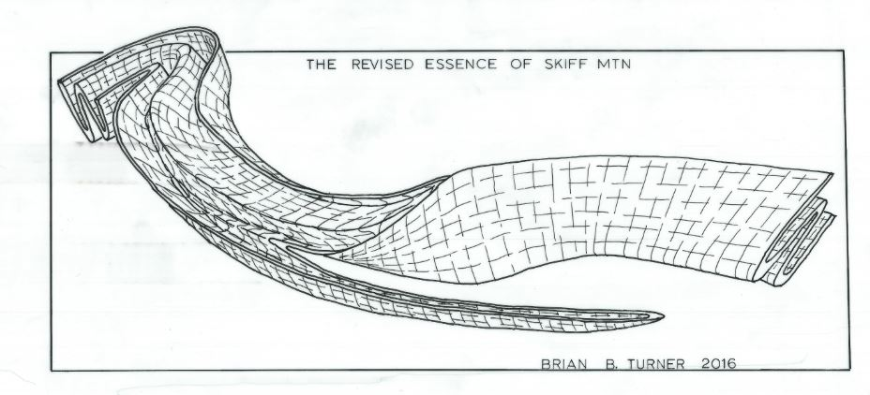
Turner – Skiff Mountain Tectonic Unit
The Revised Essence of Skiff Mountain

Slide 22
Turner – Skiff Mountain Tectonic Unit
Evolving Concepts:
Should the essence of Skiff Mtn be detached?
Should the essence be inverted?
Should it be bounded underneath by a thrust plane/ductile shear?

Slide 23
Turner – Skiff Mountain Tectonic Unit
Conclusions:
A Shawinigan original age of host gneisses is indicated by:
Paragneiss (ca. 1200 Ma) with leucosome grading into granitic gneiss.
Mappable layers of granitic gneiss (layered prehistory).
Refolded F-1 isoclines within the gneissic body.
Isoclinal interfolding of gneisses with metasedimentary rocks.
Fold axes totally different than F-2 and F-3 axes elsewhere in region.
Not incompatible with Whitney and Olmsted vision of a layered metavolcanic sequence above other metasedimentary rocks.
Magnetite ore introduced later with alteration of host rock and
alkali metal metasomatism, ca. 950 Ma?

Slide 24
Turner – Skiff Mountain Tectonic Unit

Slide 25
Turner – Skiff Mountain Tectonic Unit

