Slide 1
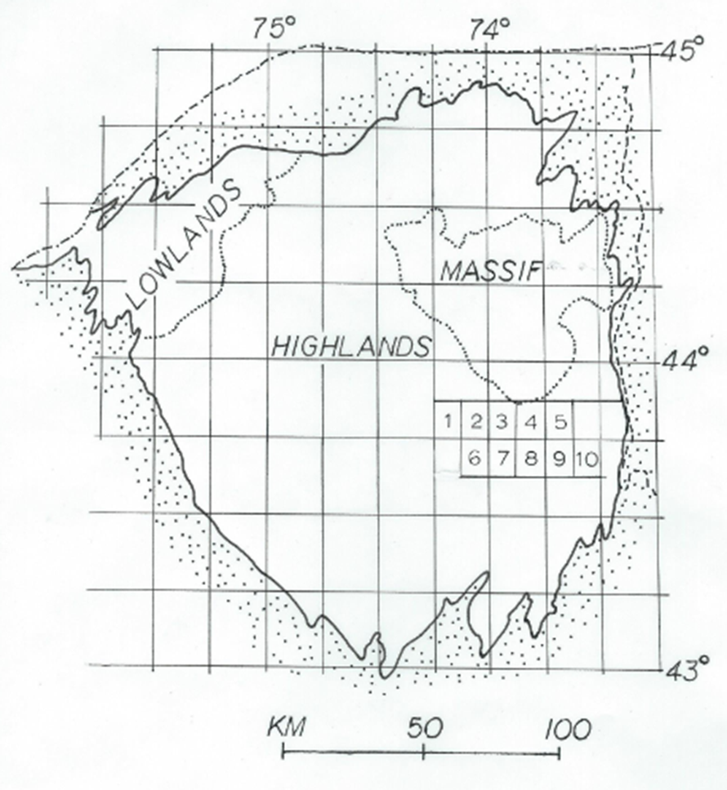
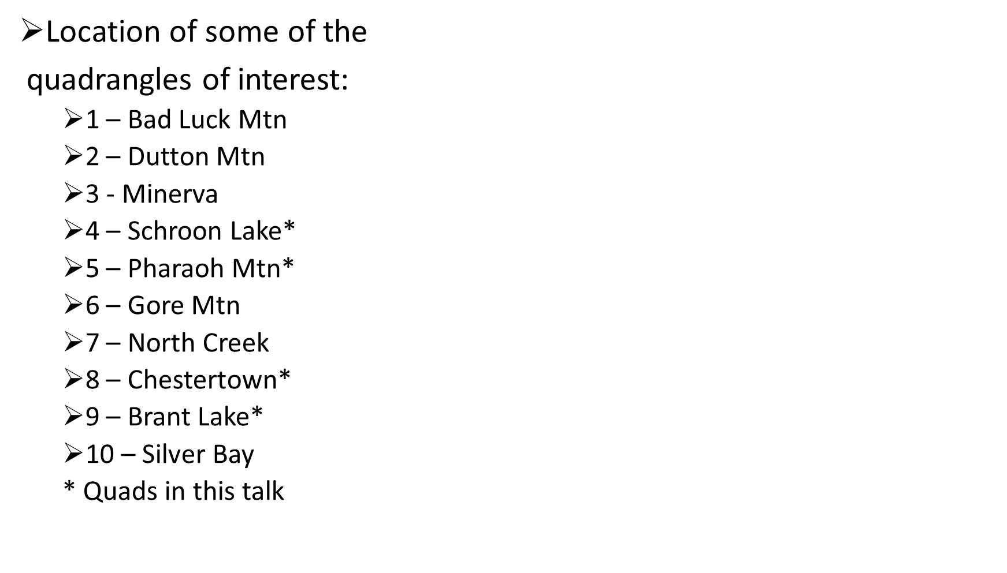
B. B. Turner – Poster Session 2016 NE GSA

Slide 2
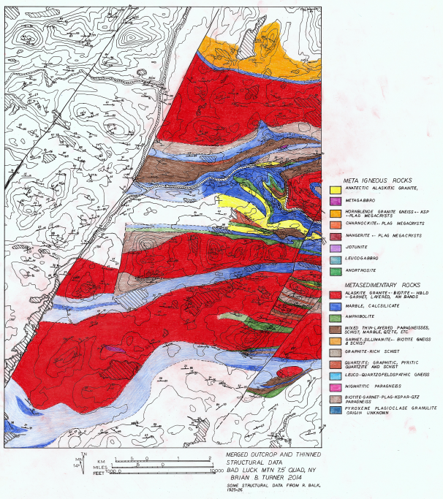
B. B. Turner – Poster Session 2016 NE GSA
Bad Luck Mtn quad

Slide 3
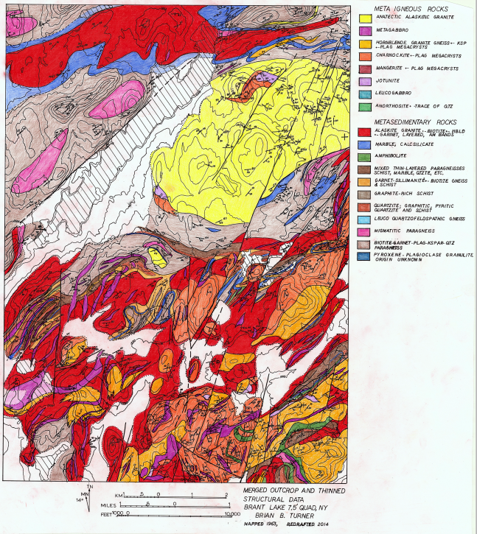
B. B. Turner – Poster Session 2016 NE GSA
Brant Lake quad

Slide 4
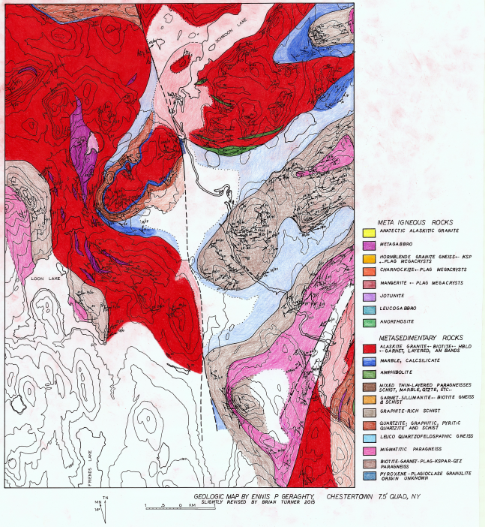
B. B. Turner – Poster Session 2016 NE GSA
Chestertown quad

Slide 5
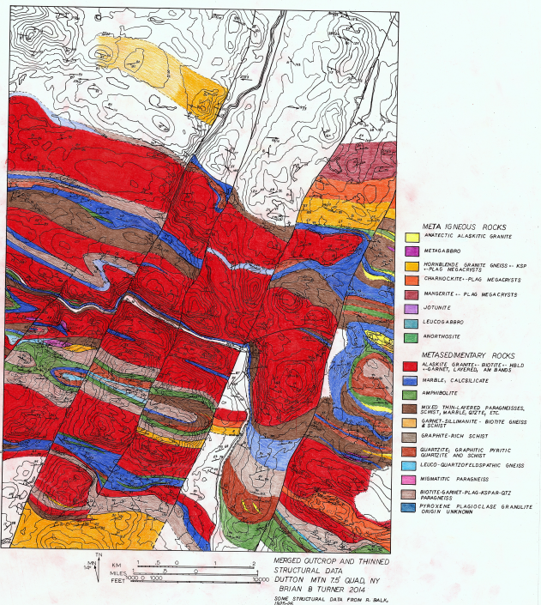
B. B. Turner – Poster Session 2016 NE GSA
Dutton Mtn quad

Slide 6
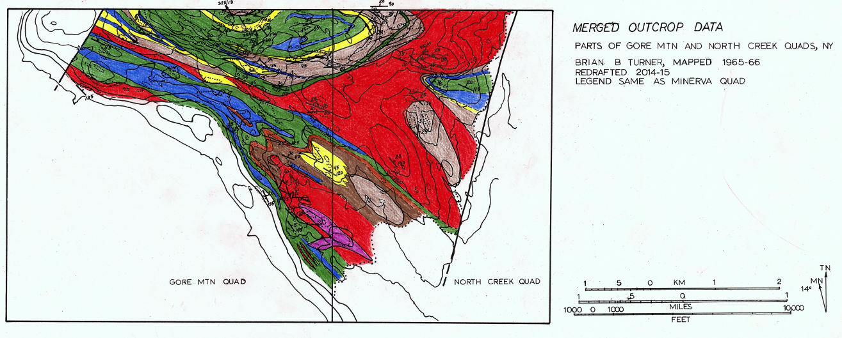
B. B. Turner – Poster Session 2016 NE GSA
Gore Mtn-North Creek partial quads

Slide 7
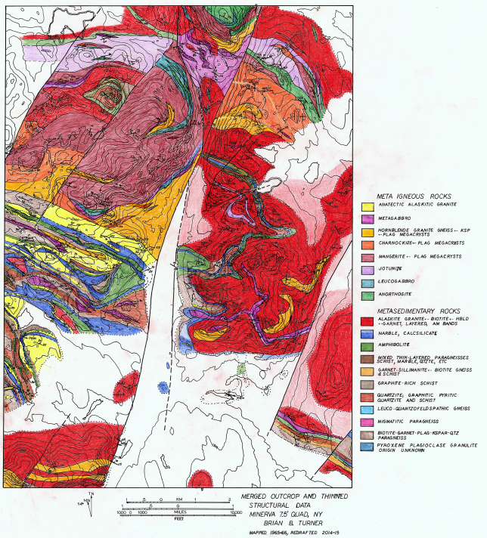
B. B. Turner – Poster Session 2016 NE GSA
Minerva quad

Slide 8
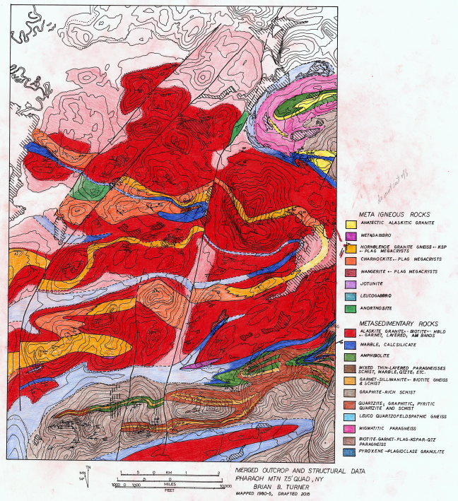
B. B. Turner – Poster Session 2016 NE GSA
Pharaoh Mtn quad

Slide 9
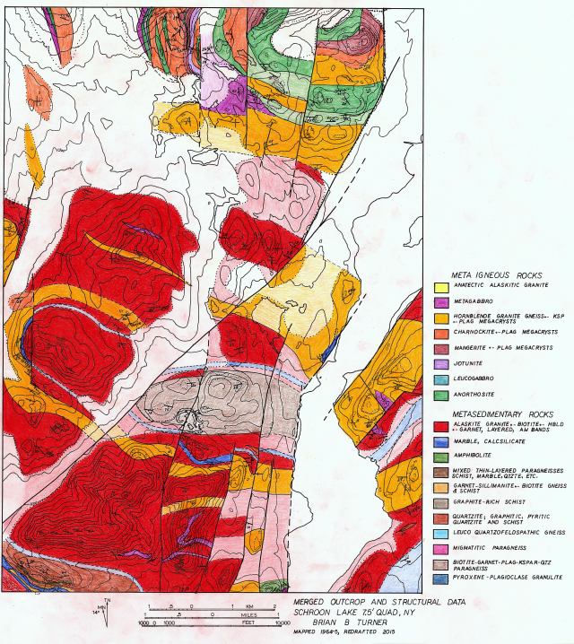
B. B. Turner – Poster Session 2016 NE GSA
Schroon Lake quad

Slide 10
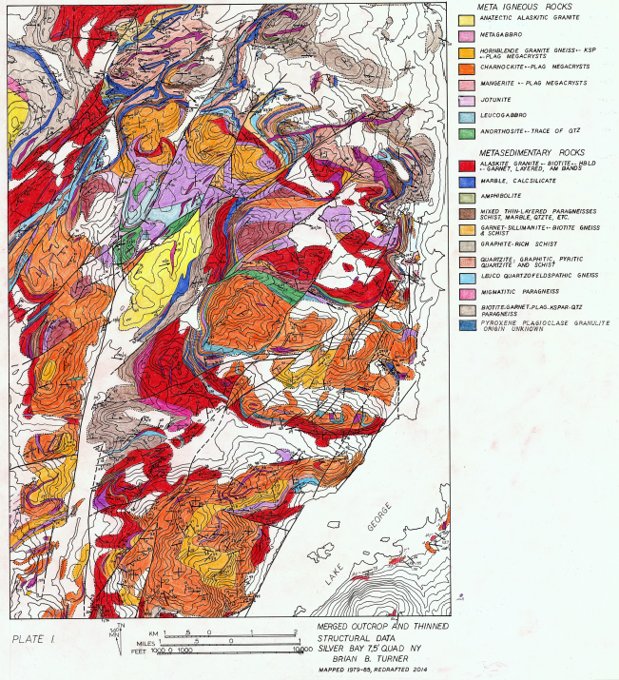
B. B. Turner – Poster Session 2016 NE GSA
Silver Bay quad

Slide 11
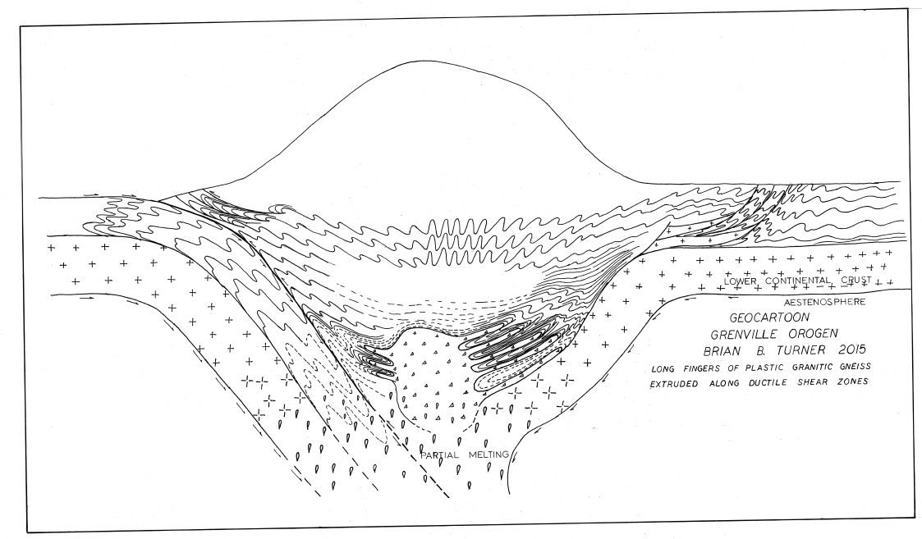
B. B. Turner – Poster Session 2016 NE GSA
Grenville Orogen cartoon

Slide 12
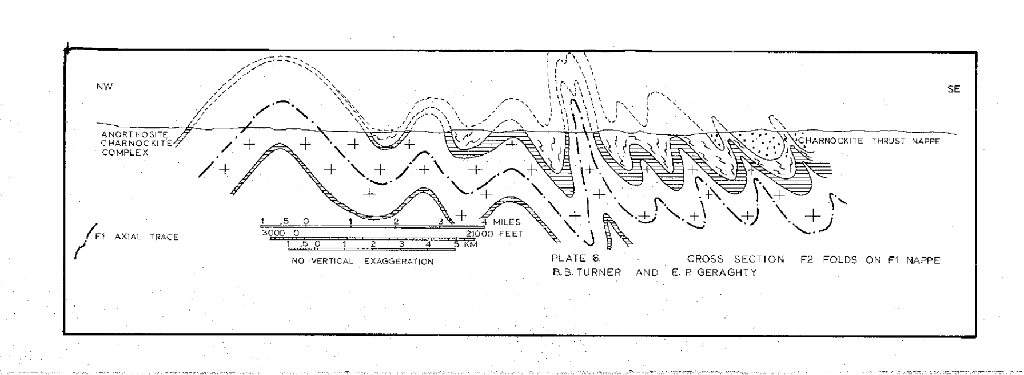
B. B. Turner – Poster Session 2016 NE GSA

Slide 13
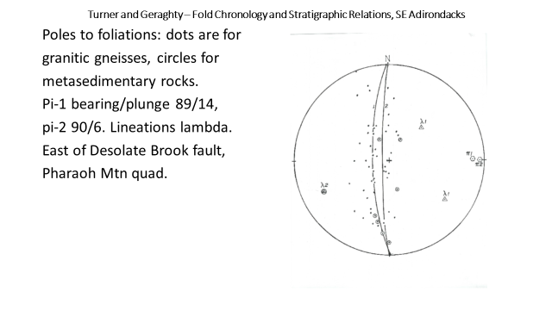
B. B. Turner – Poster Session 2016 NE GSA

Slide 14
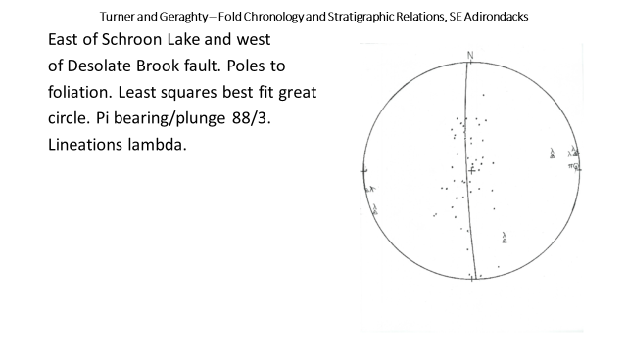
B. B. Turner – Poster Session 2016 NE GSA

Slide 15
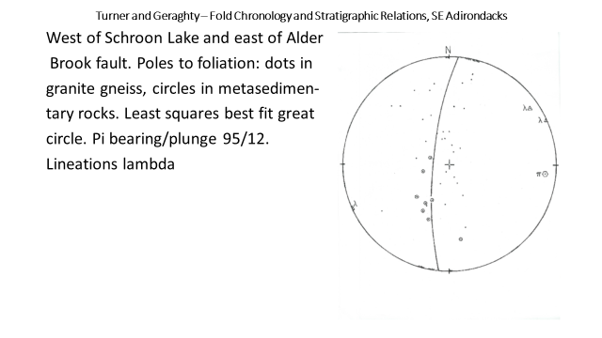
B. B. Turner – Poster Session 2016 NE GSA

Slide 16
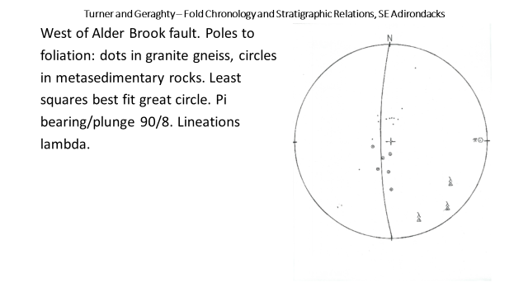
B. B. Turner – Poster Session 2016 NE GSA

Slide 17
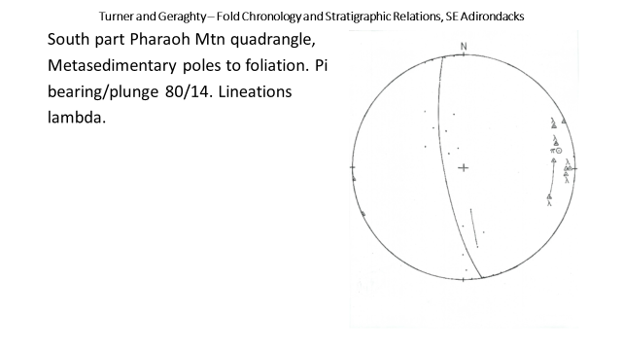
B. B. Turner – Poster Session 2016 NE GSA

Slide 18
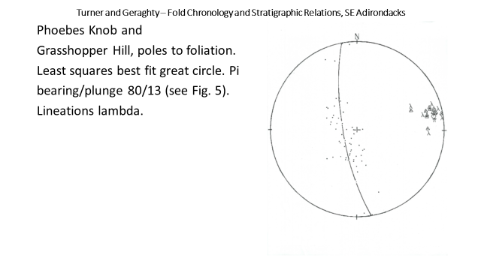
B. B. Turner – Poster Session 2016 NE GSA

Slide 19
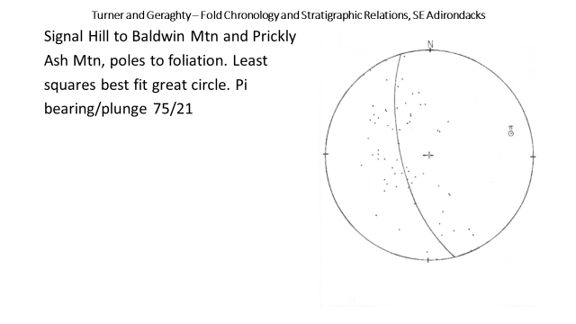
B. B. Turner – Poster Session 2016 NE GSA

Slide 20
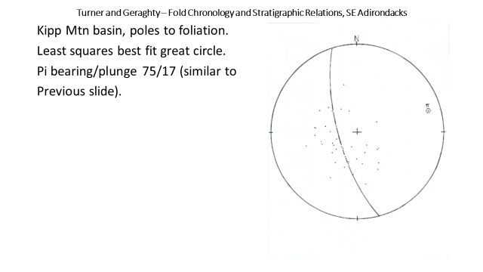
B. B. Turner – Poster Session 2016 NE GSA

Slide 21
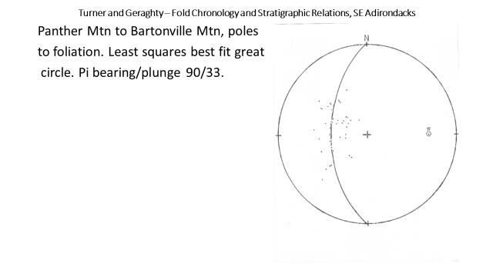
B. B. Turner – Poster Session 2016 NE GSA

Slide 22
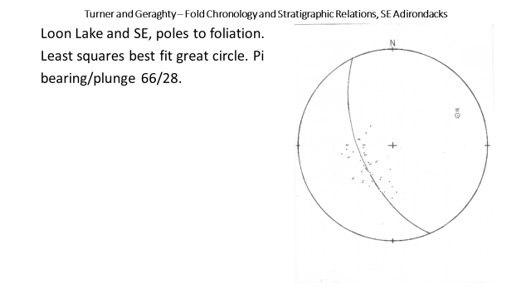
B. B. Turner – Poster Session 2016 NE GSA

Slide 23
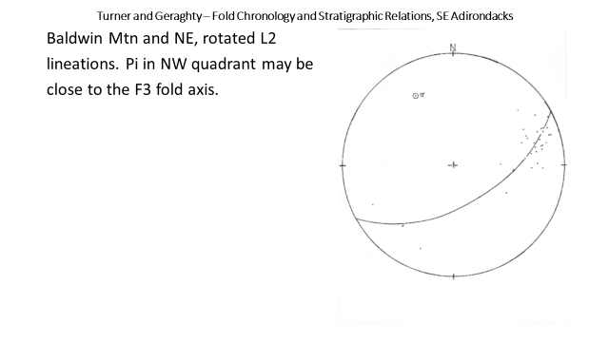
B. B. Turner – Poster Session 2016 NE GSA

Slide 24
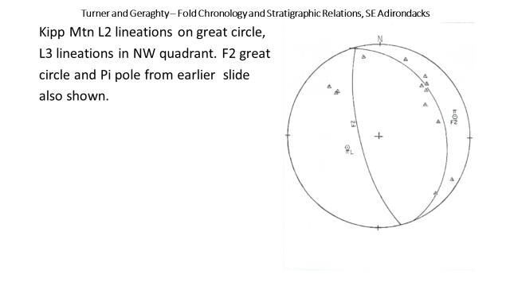
B. B. Turner – Poster Session 2016 NE GSA

Slide 25
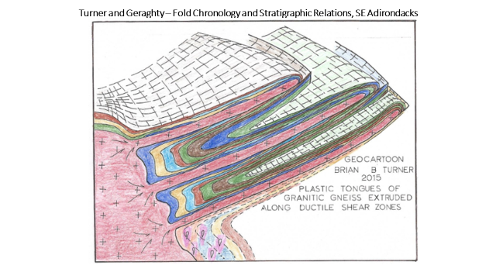
B. B. Turner – Poster Session 2016 NE GSA

Slide 26
B. B. Turner – Poster Session 2016 NE GSA

Slide 27
B. B. Turner – Poster Session 2016 NE GSA

