Slide 1
A late holocene Paleoclimate reconstruction from puerto rico based on a cave speleothem
Heather Roman-Stork
Boston College
Jeremy D. Shakun, Stephen J. Burns, Hai Cheng, R. Lawrence Edwards

Slide 2
Outline
Motivation
Background
Methodology
Results and Interpretation
Summary

Slide 3
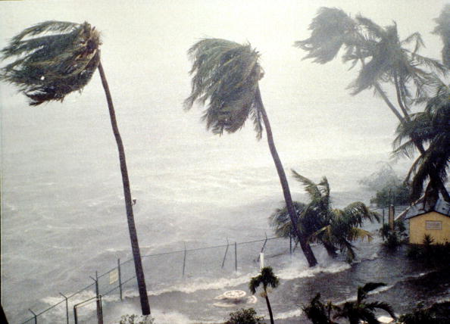
Motivation
Why Puerto Rico?
Source:
mentalfloss.com

Slide 4
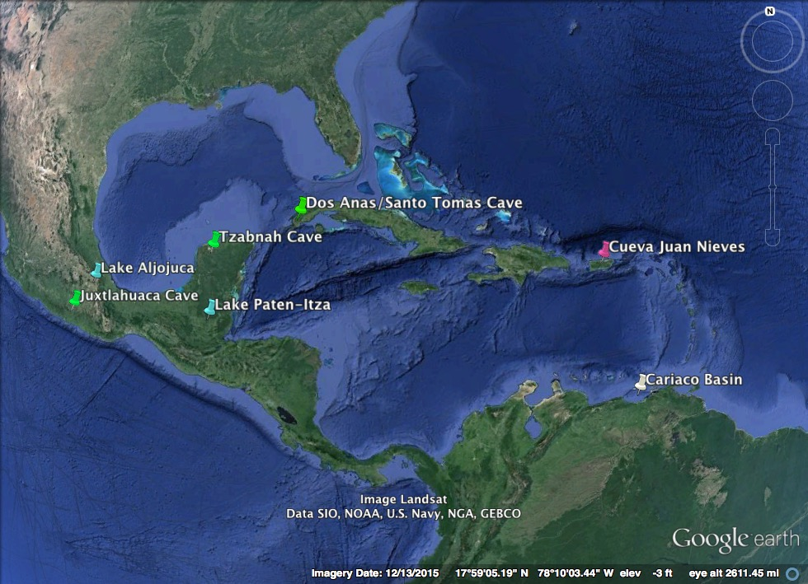
Notes:
***I’ll go in and fix this later

Slide 5
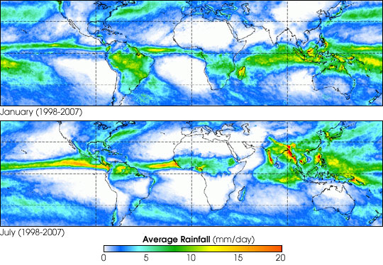
Puerto Rico
Source: NASA
Notes:
NAH = North Atlantic High
“In the Caribbean region, the rainy season occurs during the northern summer half-year when the ITCZ moves north, displacing the NA subtropical high and weakening the eastern trade winds. Meteorological studies of interannual variability of rainfall in the tropical Atlantic sector during the 20th century have found a strong correlation between precip anomalies and intensity of the annual cycle.” – Hodell et al., 1991
Dominant influence on climate in the region is the North Atlantic subtropical High
Topography and elevation are important
Dominant oscillations are decadal – tri-pole pattern of SST and upper zonal winds that involved shifts in Hadley circulation and subtropical jet stream every 11 years
ENSO also comes into play – becomes drier during ENSO years, but can lead to more rainfall during the summer of El Nino years
What ENSO does to the Caribbean has to do with what the NAO is doing at the time
****Show winter vs. summer picture of the Caribbean
****replace words with pictures
Sources: PR state of the climate, Hodell et al., 1991, Penn State (https://courseware.e-education.psu.edu/courses/meteo241/Section04p03.html)

Slide 6
Data source:
Worldweatheronline
Notes:
Average monthly temperature in Florida, PR (deg. C)

Slide 7
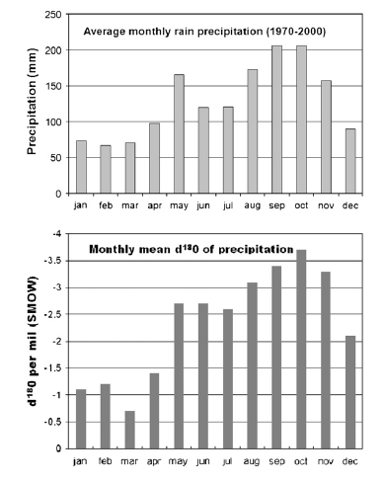
Source:
Winter et al, 2011
Notes:
Add in a slide showing why we’re interpreting this in terms of wet and dry – relation between O18 and rainfall amounts
Amount effect
“The amount effect in rainfall from Panama for monthly averages (filled circles), all months (open circles), and annual d18O values with mean annual precipiration divided by 12 for plotting with monthly data (open squares). The amount effect gradient is -1.6 to -2.85% per 100 mm of monthly rain. From Lachniet and Petterson (2006).”
“The amount effect is the observed decrease in rainfall d values with increased rainfall amount and is dominant in tropical regions where deep vertical convetion is common. Such conditions are also present in tropical cyclones, thus allowing some possibility for reconstruction of paleotempestology using speleothems…IN Panama, a humid tropical region within the heart of the ITCZ, averaged monthly d18O values are inversely correlated to rainfall amount and weight-averaged annual d18O values show a similar inverse relationship….The amount effect has also been demonstrated in the d18O values of rainfall in Barbados…and in the Southern Oman.”
Use the Lachinet Panama amount effect graph

Slide 8

Methodology
Notes:
https://www.youtube.com/watch?v=pZ65BztF874

Slide 9
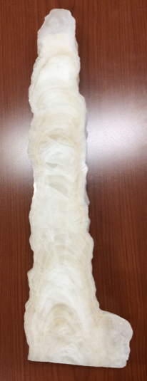
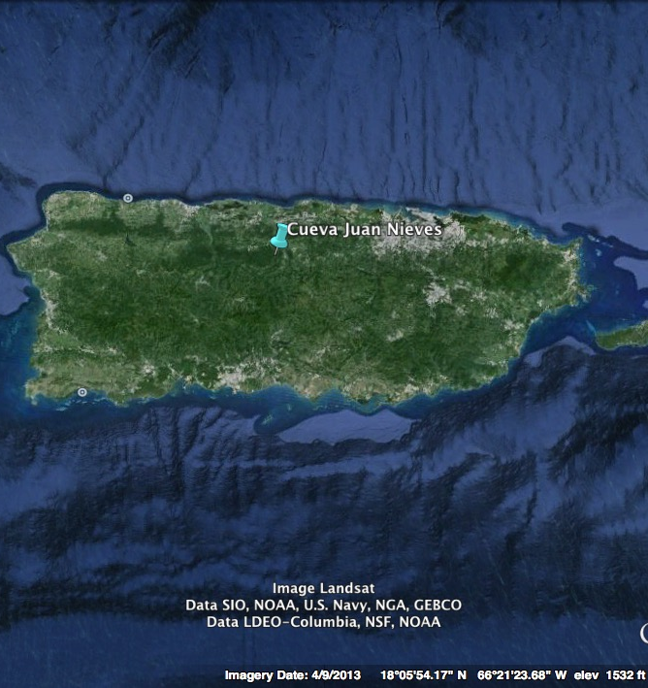
Methodology
47 cm
Samples drilled at UMass, run on a mass spec by Dr. Steve J. Burns at UMass
Notes:
Facts about the cave, thanks entirely to Damian Weyand
One might say that it would be a deadly descent to try and go through it

Slide 10
Notes:
Mention that the error bars are there, they’re just super tiny

Slide 11
wet
dry
Notes:
MWP: 1320 to 1462 AD = 630 to 488 years BP (that’s the latest spike)
Drought 1400-1000 BP
Overall trend of increased rainfall
***write in wet vs dry/time running from r to l

Slide 12
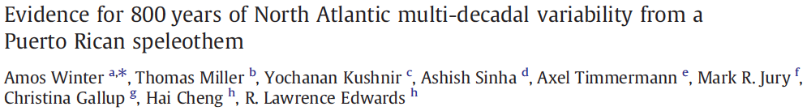
Cueva Juan Nieves
Perdida Cave
Notes:
Winter cave = 350 m

Slide 13
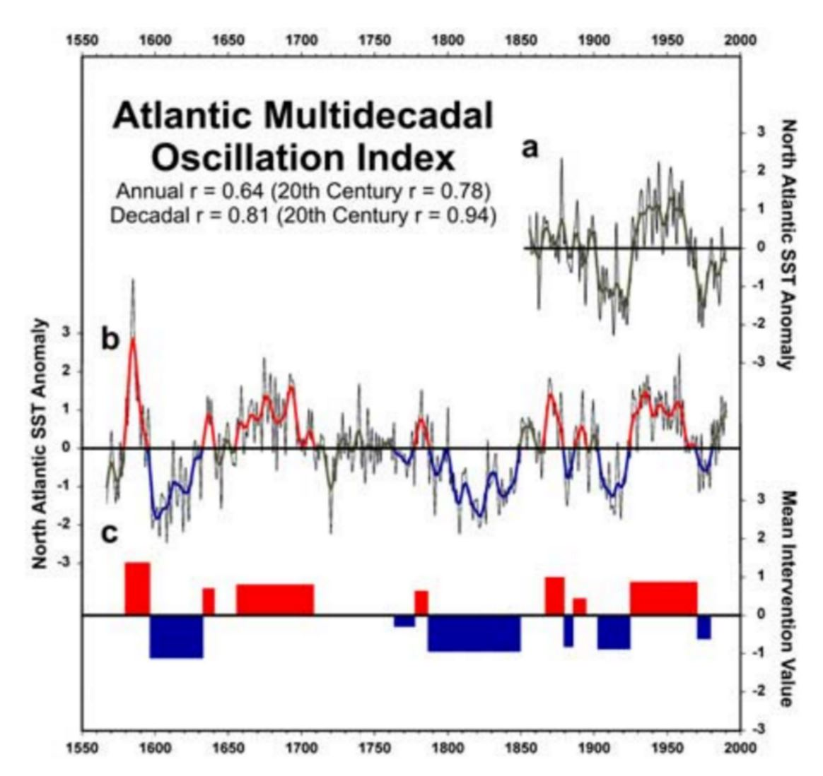
Atlantic Multidecadal Oscillation (AMO)
Source:
Grey et al., 2004
Source:
Realclimate
.org
Notes:
Source: http://www.realclimate.org/images/Amo_fig2.jpg

Slide 14
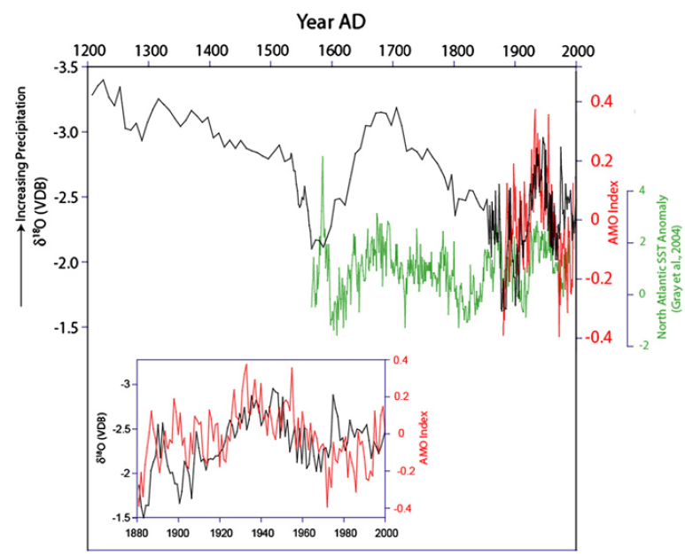
Perdida Cave
Source:
Winter et al., 2011
Notes:
AMO defined: how warm is the North Atlantic Ocean relative to the rest of the globe → positive when N Atlantic especially warm

Slide 15
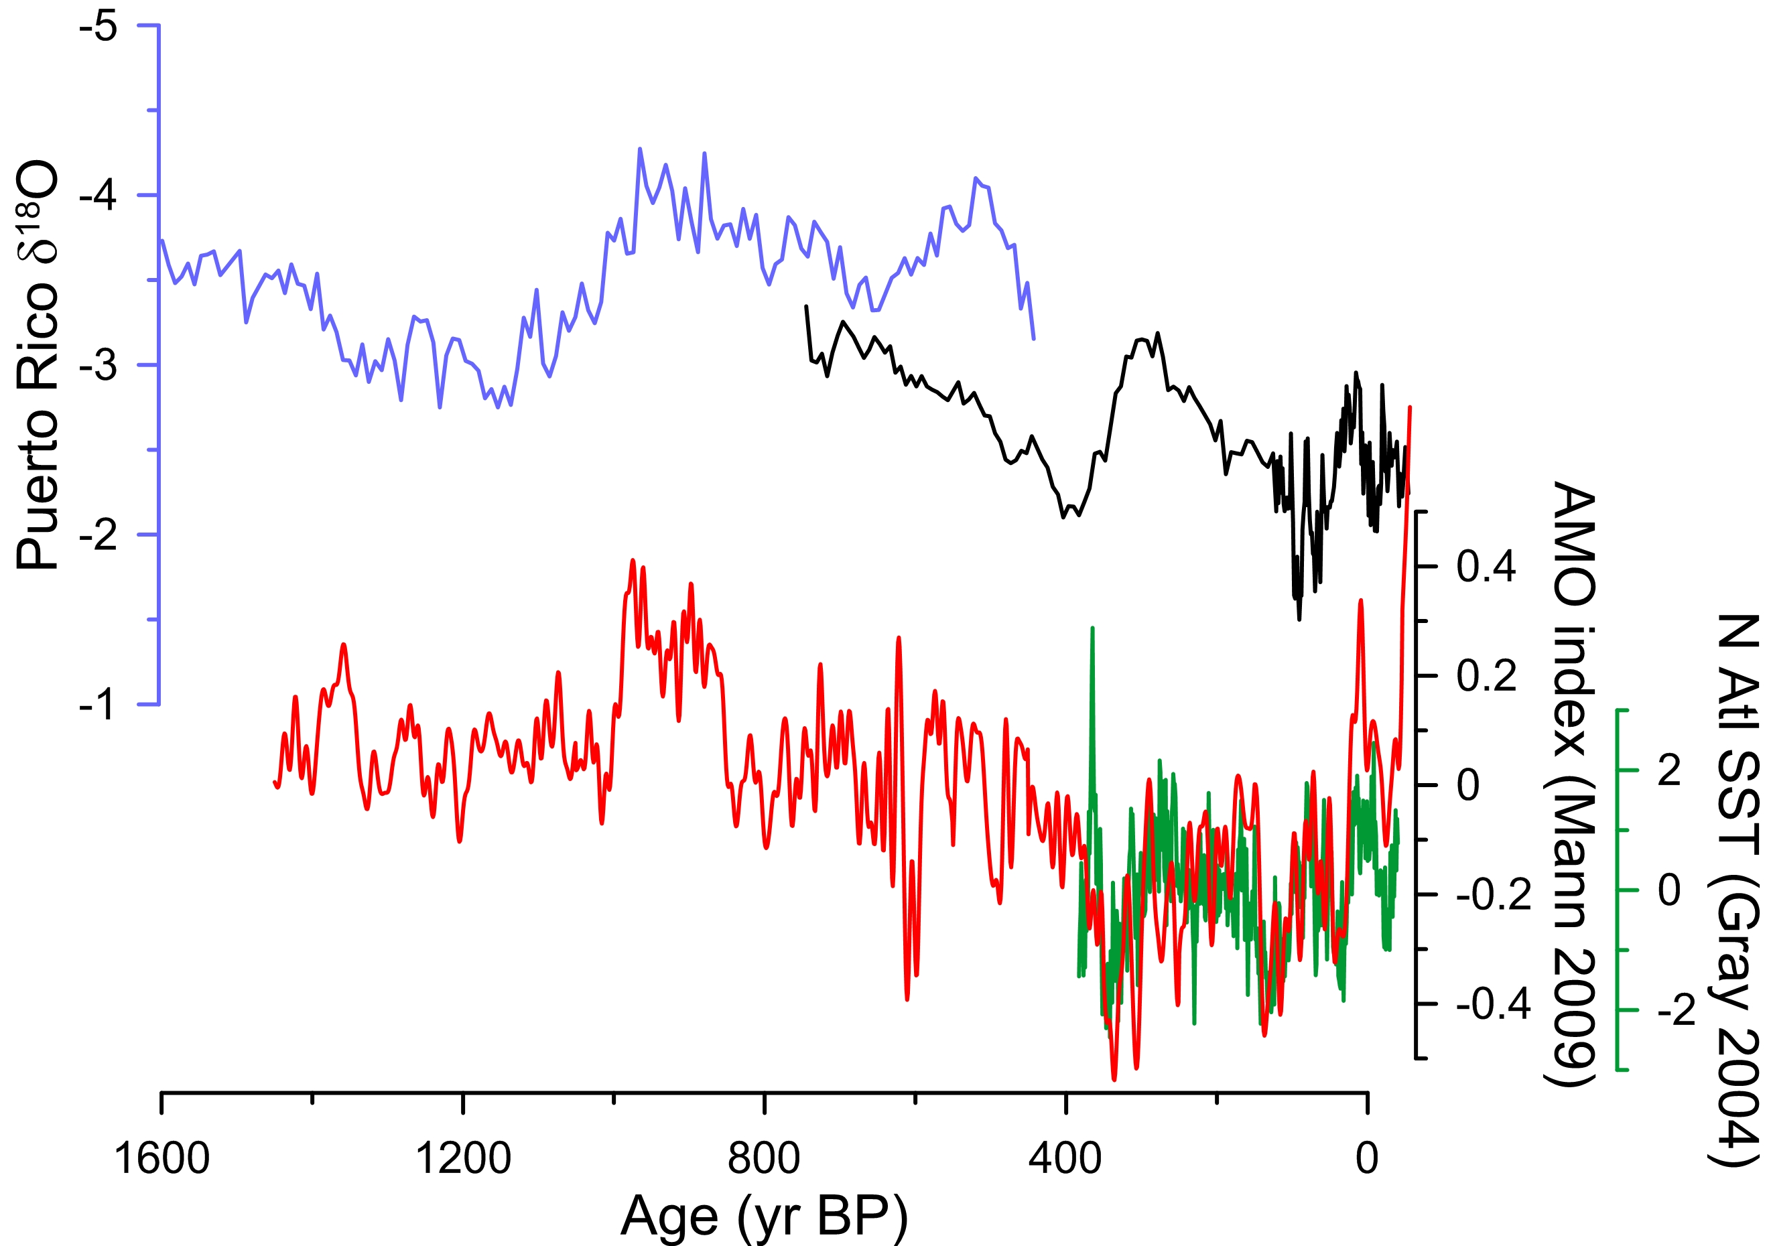
Cueva Juan Nieves
Perdida Cave
Notes:
Source: Jeremy
Perdida Cave record probably is different b/c it’s at a different elevation/might not be in a jungle, etc.
Perdida Cave said to be related to the AMO, N Atl SSTs
You can see that the AMO kind of lines up with my record in terms of overall trends for the short time that they overlap, but a) are we sure the AMO is even real and b) you don’t really see the same drastic change and drought that we see in my record, so at the very least you can’t explain that with the AMO

Slide 16
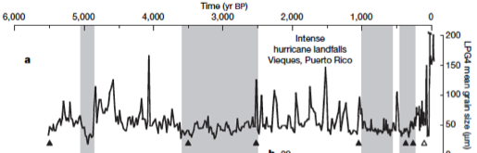
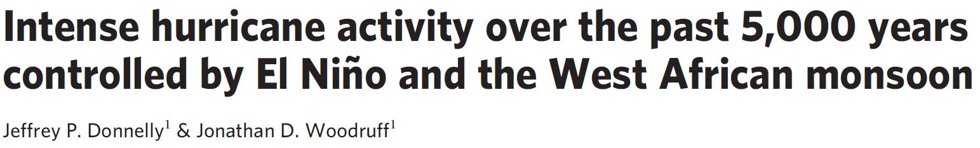
wet
dry
Notes:
Paleohurricane record from Puerto Rico, Donnelly and Woodruff, 2007 (Intense Hurricane Activity over the past 5,000 Years Controlled by El Nino and the West African Monsoon”
There’s really no pattern here, if anything they show MORE hurricanes during my big period of drought

Slide 17
Notes:
***I’ll go in and fix this later

Slide 18
Dos Anas/Santo Tomas Cave
Notes:
Should I maybe bracket the parts that I want people to notice?

Slide 19
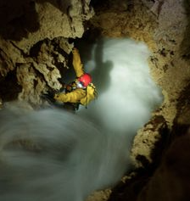
summary
Cave speleothem from Puerto Rico produced a δ18O record from 450 to 5050 years BP that is a paleorainfall proxy
Major drought from 1400 to 1000 years BP
Early trend of increased rainfall

Slide 20

Thank You!

Slide 21
References
Tripti Bhattacharya, Roger Byrne, Harald Bohnel, Kurt Wogau, Ulrike Kienel, B. Lynn Ingram, and Susan Zimmerman. 2015. Cultural implications of late Holocene climate change in the Cuenca Oriental, Mexico. Proceedings of the National Academy of Sciences. doi: 10.1073/pnas.1405653112
Burgman, Robert, Richard Seager, Amy Clement, and Celine Herweijer. "Role of Tropical Pacific SSTs in Global Medieval Hydroclimate: A Modeling Study." Geophys. Res. Lett. Geophysical Research Letters 37.6 (2010): n. pag. Web.
Canals, Miguel, Jorge Capella, Jorge Corredor, David Cuevas, Pedro Diaz, Mark Jury, Glenn Landers, Katherine Hayhoe, Odalys Martinez, Melissa Melendez, Pablo Mendez, Aurelio Mercado, Julio Morell, and Adam Terando. Working Group 1: Geophysical and Chemical Scientific Knowledge: Observed Trends and Future Projections. Rep. N.p., n.d.
Curtis, J.H.. 1998. A multi-proxy study of Holocene environmental change in the Maya lowlands of Peten, Guatemala. Journal of Paleolimnology Vol. 19, pp. 139-159
Discovery Channel. "Discovery Press Web Asia-Pacific." Deadly Descent : Programs : Discovery Science : Discovery Press Web. Discovery Channel, n.d. Web. 18 Nov. 2015.
Donnelly, Jeffrey P., and Jonathan D. Woodruff. "Intense Hurricane Activity over the past 5,000 Years Controlled by El Niño and the West African Monsoon." Nature 447.7143 (2007): 465-68. Web.
Fensterer, Claudia, Denis Scholz, Dirk L. Hoffmann, Christoph Spötl, Andrea Schröder-Ritzrau, Christian Horn, Jesus M. Pajón, and Augusto Mangini. "Millennial-scale Climate Variability during the Last 12.5ka Recorded in a Caribbean Speleothem." Earth and Planetary Science Letters 361 (2013): 143-51. Web.
Gregory, Braden R.b., Matthew Peros, Eduard G. Reinhardt, and Jeffrey P. Donnelly. "Middle–late Holocene Caribbean Aridity Inferred from Foraminifera and Elemental Data in Sediment Cores from Two Cuban Lagoons." Palaeogeography, Palaeoclimatology, Palaeoecology 426 (2015): 229-41.
Grey, Stephen T., Lisa J. Graumlich, Julio L. Betancourt, and Gregory T. Pederson. A tree-ring based reconstruction of the Atlantic Mutlidecadal Oscillation since 1567 AD. Geophys Res Lett. Geophysical Research Letters. 31 (2004). Web. doi:10.1029/2004GL019932,

Slide 22
References
Grinsted, A., Moore, J.C., Jevrejeva, S. (2004) Application of the cross wavelet transform and wavelet coherence to geophysical time series, Nonlin. Processes Geophys., 11, 561–566, doi:10.5194/npg-11-561-2004
Haug, G.H., Hughen, K.A., Peterson, L.C., Sigman, D.M., and Röhl, U., 2001, Southward migration of the Intertropical Convergence Zone through the Holocene. Science 293, 1304-1308 (2001).
Hodell, David A., Jason H. Curtis, Glenn A. Jones, Antonia Higuera-Gundy, Mark Brenner, Michael W. Binford, and Kathleen T. Dorsey. "Reconstruction of Caribbean Climate Change over the past 10,500 Years." Nature 352.6338 (1991): 790-93.
Lachniet, Matthew S. “Climatic and Environmental Controls on Speleothem Oxygen-isotope Values.” Quaternary Science Reviews 28.5-6 (2009): 412-32.
Lachniet, M.S., J.P. Bernal, Y. Asmerom, V. Polyak, and D. Piperno. 2012. A 2400 yr Mesoamerican rainfall reconstruction links climate and cultural change. Geology, Vol. 40, No. 3, pp259 - 262, March 2012. doi:10.1130/G32471.1
Medina-Elizalde, M., S.J. Burns, D.W. Lea, Y. Asmerom, L. von Gunten, V. Polyak, M. Vuille, and A. Karmalkar. 2010. High resolution stalagmite climate record from the Yucatán Peninsula spanning the Maya terminal classic period. Earth Planet. Sci. Lett. doi:10.1016/j.epsl.2010.08.016
Wanner, Heinz, Jürg Beer, Jonathan Bütikofer, Thomas J. Crowley, Ulrich Cubasch, Jacqueline Flückiger, Hugues Goosse, Martin Grosjean, Fortunat Joos, Jed O. Kaplan, Marcel Küttel, Simon A. Müller, I. Colin Prentice, Olga Solomina, Thomas F. Stocker, Pavel Tarasov, Mayke Wagner, and Martin Widmann. "Mid- to Late Holocene Climate Change: An Overview." Quaternary Science Reviews 27.19-20 (2008): 1791-828.
Winter, Amos, Thomas Miller, Yochanan Kushnir, Ashish Sinha, Axel Timmermann, Mark R. Jury, Christina Gallup, Hai Cheng, and R. Lawrence Edwards. "Evidence for 800years of North Atlantic Multi-decadal Variability from a Puerto Rican Speleothem." Earth and Planetary Science Letters 308.1-2 (2011): 23-28.

