Slide 1

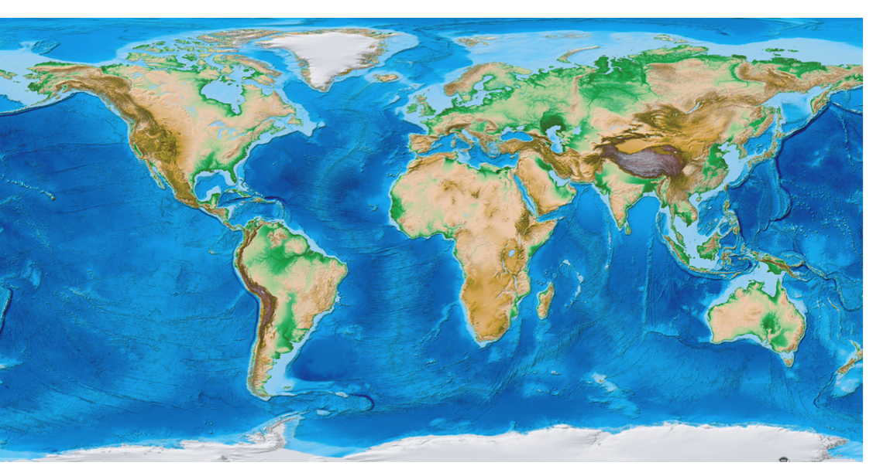
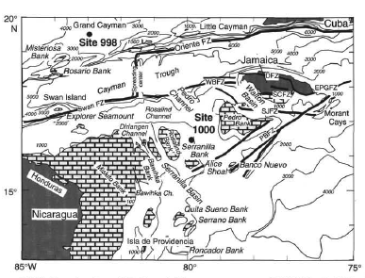
A POSSIBLE EPHEMERAL SHOALING OF THE CENTRAL AMERICAN SEAWAY DURING THE LATE MIOCENE (12.0 - 9.5 MA)?
HIGH-RESOLUTION STABLE ISOTOPIC EVIDENCE FROM ODP SITE 1000
Kwiatkowski, B. S.^{1, 2}, Turetcaia, A.¹, Pekar, S. F.^{1, 2, 3},
¹ School of Earth and Environmental Science, Queens College, City University of New York
² Graduate Center, City University of New York
³ Lamont Doherty Earth Observatory, Columbia University, NY
CU
NY
The City
University
of
New York
Abstract
High-resolution (4 kyr) benthic foraminiferal δ¹⁸O and δ¹³C records were developed from ODP Site 1000 to investigate the relationship of the Caribbean carbonate crash events (12.0 – 9.5 Ma) to the possible shoaling of the Panamanian Isthmus and the start-up of global thermohaline circulation. Site 1000 is located in the Pedro Channel on the Nicaragua Ridge between the Yucatan Peninsula and the island of Jamaica at 927 m below sea level, making it ideally located to monitor the development of the Caribbean Current as it contributed the development of the Gulf Steam and the onset of North Atlantic Deep Water circulation. Both δ¹³C and δ¹⁸O records from Site 1000 follow some of the broad global trends as seen from other high-resolution records (e.g., South China Sea Site 1146 and North Atlantic Site 982). This suggests that Site 1000 is a good register of global deep-water changes even though this site is bathed by intermediate waters. Superimposed over these global trends are the long (400 kyr) and short (100 kyr) eccentricity cycles that appear to dominate the both isotopic records. In addition, both isotopic records from Site 1000 contain differences from the global trends that can only be ascribed to regional circulation changes owing to possible changes in Central America Seaway (CAS). The increase in δ¹³C values from 11.6 Ma represents a decrease in North Pacific Intermediate Waters entering into the western Caribbean, concomitant with enhanced contribution of AAIW into the Caribbean Basin. We speculate this change may be due to shoaling of the CAS.
Results and Interpretations
Site 1000
Oxygen Stable Isotopes
Carbon Stable Isotopes
Calcium Carbonate
9.5
Site 1146
Site 982
Site 1000
Site 1146
Site 982
Site 1000
10.0
10.5
Age (Ma)
11.0
11.5
NPIW
AAIW
d13C
NPIW
Shoaling of CAS?
12.0
0.5
1.0
1.5
2.0
2.5
3.0
2.0
2.5
NPIW
0.5
AAIW
-1.0
δ¹⁸O (‰)
1.0
1.5
-0.5
0.0
0.5
1.0
1.0
1.5
0
20
40
60
80
100
δ¹⁸O (‰)
δ¹⁸O (‰)
δ¹³C (‰)
δ¹³C (‰)
δ¹³C (‰)
CaCO₃ %
Background
Figure 4. Summary figure of stable isotope and calcium carbonate data comparing Site 1000 to other isotopic records.
The δ¹⁸O and δ¹³C isotopic records are from Site 1000 (this study), the South China Sea Site 1146 (Holbourn et al., 2013) and from the North Atlantic Site 982 (Andersson and Jansen, 2003). The blue shaded box in the δ¹³C record for Site 1000 represents the range in isotopic values for AAIW and the green shaded box shows the highest range (full range is -0.5 - 0.0‰) for North Pacific Intermediate Water (NPIW) (Bostock et al., 2010). Both isotopic records show cyclicity that can be related to the long (405 kyr) and short (100 kyr) eccentricity cycles and contain trends similar to Site 1146 that has been interpreted to represent the global signal. In addition, differences seen at Site 1000 suggest that regional changes in water masses have affected the isotopic records. For example, a long-term increase in δ¹³C between 11.7 and 11.2 Ma is interpreted to represent a decrease in North Pacific Intermediate water and increase in Antarctic Intermediate Water. This can be explained by a shoaling of the Central American Seaway. Note: all δ¹⁸O values have been converted to calcite.
Site 982
δ¹⁸O (‰)
Site 1000
Site 1146
FO Discoaster
berggrenii
Summary and Conclusions
22.0m/Ma
High-resolution stable isotope records were developed from Site 1000 for the Late Miocene and are compared to two high-resolution isotopic records from different ocean basins for this interval.
As at Site 1146, short (100 kyr) and long (400 kyr) Milankovitch cycles are identified in the stable isotope data at Sites 1000.
Both δ¹⁸O and δ¹³C records at Site 1000 provide evidence that in the Caribbean Basin, North Pacific Intermediate Waters (Newkirk and Martin, 2009) decreased between 12.0 and 11.2 Ma, concomitant with a strengthening of AAIW (Roth et al., 2000). We interpret this to represent a potential shoaling of the Central American Seaway. This supports the hypotheses of Montes et al. (2012) and Sepulchre et al. (2013) that the Central American Seaway shoaled earlier than than previous studies have suggested.
55.3m/Ma
LO Discoaster
hamatus
Figure 1. Global map showing locations of sites in this study. From mapsonline.com
22.2m/Ma
FO Discoaster
hamatus
FO Catinaster coalitus
References
50.8m/Ma
Andersson, C., & Jansen, E. 2003. A Miocene (8-12 Ma) intermediate water benthic stable isotope record from the northeastern Atlantic, ODP Site 982. Paleoceanography, 18(1): 1013, doi:10.1029/2001PA000657
Bostock, H.C., Opdyke, B.N. & Williams, M. J. M. 2010. Characterising the intermediate depth waters of the Pacific Ocean using δ13C and other geochemical tracers. Deep-Sea Research 157: 847 – 859
Gradstein, F.M., Ogg, J.G., Schmitz, M.D. & Ogg, G.M. 2012. The Geologic Time Scale 2012. Vol. 1 & 2. Elsevier, NY
Holbourn, A., Kuhnt, W., Clemens, S., Prell, W., & Andersen, N. 2013. Middle to late Miocene stepwise climate cooling: Evidence from a high-resolution deep water isotope curve spanning 8 million years. Paleoceanography, 28(4): 688–699. doi:10.1002/2013PA002538
Montes, C., Cardona, A., McFadden, R., Moron, S. E., Silva, C. A., Restrepo-Moreno, S., Ramirez, D.A., Hoyos, N., Wilson, J., Farris, D., Bayona, G.A., Jaramillo, C.A., Valencia, V., Bryan, J. and Flores, J.A. 2012. Evidence for middle Eocene and younger land emergence in central Panama: Implications for Isthmus closure. Geological Society of America Bulletin, 124(5-6): 780–799. doi:10.1130/B30528.1
Newkirk, D. R., & Martin, E. E. 2009. Circulation through the Central American Seaway during the Miocene carbonate crash. Geology, 37(1): 87–90. doi:10.1130/G25193A.1
Roth, J. M., Droxler, A. W., & Kameo, K. 2000. The Caribbean Carbonate Crash at the Middle to Late Miocene Transition: Linkage to the Establishment of the Modern Global Ocean Conveyor. In: Leckie, R.M., Sigurdson, J. Acton, G.D. & Draper, G. (Eds). Proceedings of the Ocean Drilling Program, Scientific Results, Vol. 165, 249-273
Sepulchre, P., Arsouze, T., Donnadieu, Y., Dutay, J.-C., Jaramillo, C., Le Bras, J., Martin, E., Montes, C., and Waite, A.J. 2013. Consequences of shoaling of the Central American Seaway determined from modeling Nd isotopes, Paleoceanography, 29: 1-14 doi:10.1002/2013PA002501
Sigurdsson, H., Lekie, R.M., Acton, G.D. et al. 1997, Proceedings of the Ocean Drilling Program, Initial Repts., Vol. 165, 231-288
B acme Discoaster kugleri
52.4m/Ma
T Sphenolithus heteromorphus
Figure 3. Age model for Site 1000 for the study interval between 250 and 550 mbsf.
Nannofossil data were used to construct the age model. All age data were converted to the Gradstein et al. (2012) timescale. Reductive diagenesis in the cores prevented the development of the paleomagnetostratigraphy for this interval. This may have resulted in some uncertainty in the age model and could explain some of the isotopic offsets between Site 1000 and Site 1146. We will attempt to tune the records using spectral analysis in the near future.
Acknowledgements
Figure 2. Base map of western Caribbean Sea showing the location of ODP Site 1000.
Bathymetric map (1000-m contour interval) showing the location of Site 1000 and the major physiographic features of the area. From Sigurdsson et al. (1997).
This research obtained samples from the Ocean Drilling Project. Funding came from the overhead account of S. Pekar.

