Slide 1
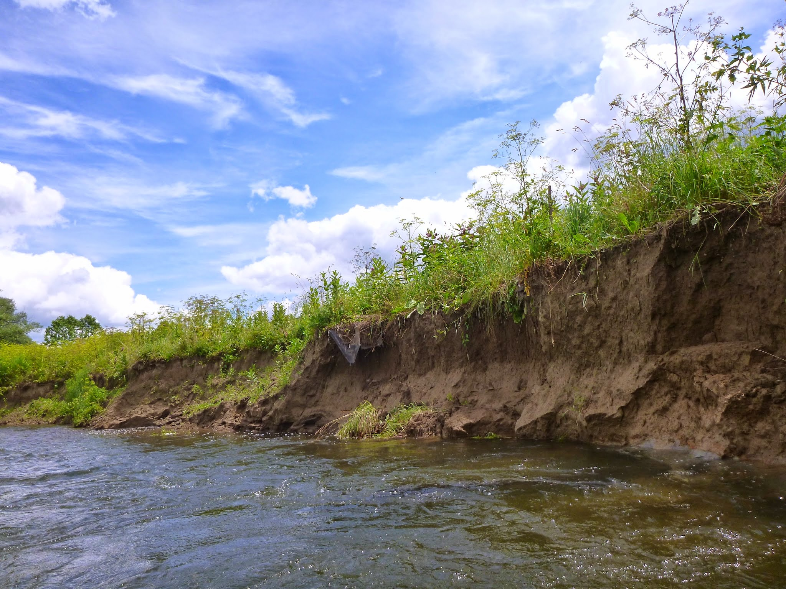


Flood records, bank erosion mechanisms and meander migration in Butternut Creek, New York
Les Hasbargen, Earth & Atmospheric Sciences, SUNY Oneonta
Peter T. Booth, Geography, SUNY Oneonta
Derek Walling, Earth & Atmospheric Sciences, SUNY Oneonta
David Busby, Environmental Science, SUNY Oneonta
Session No. 12 titled “T19. Applications of Geologic Mapping to Address Geologic Hazards, Natural Resources, and Natural History Studies”
Date: Monday, 21 March 2016
Location: Empire State Plaza Convention Center, Meeting Room 5
Session Start Time: 10:00 AM
Presentation Start Time: 11:00 AM

Slide 2
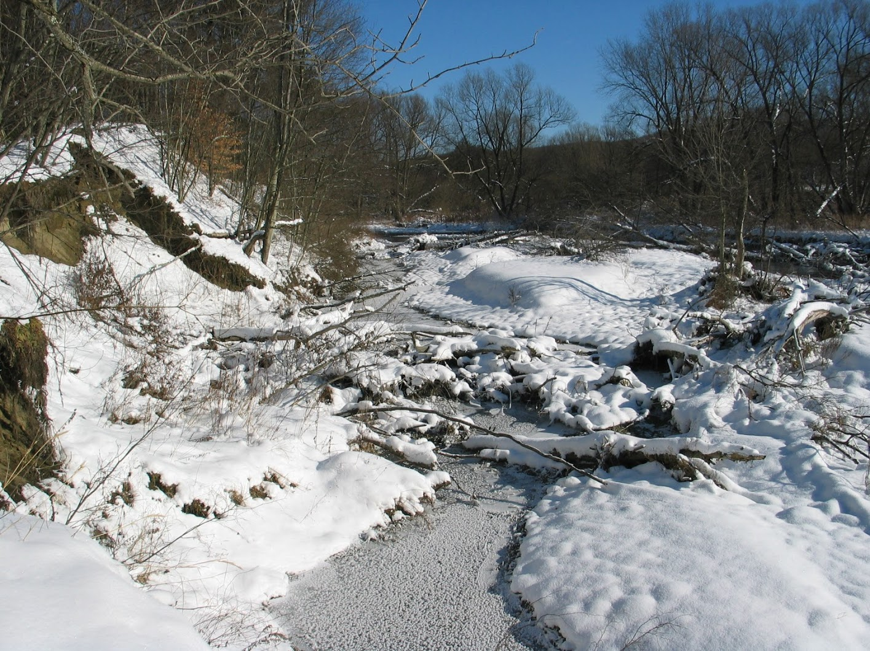
Acknowledgements
Robert and Blevyn Wheeler, owners of the cutbank (some of them!)
The Research Foundation of SUNY for faculty research grant to Hasbargen
Biological Field Station, SUNY Oneonta for summer internships, research fellowship, and logistical support (including a UAV)

Slide 3
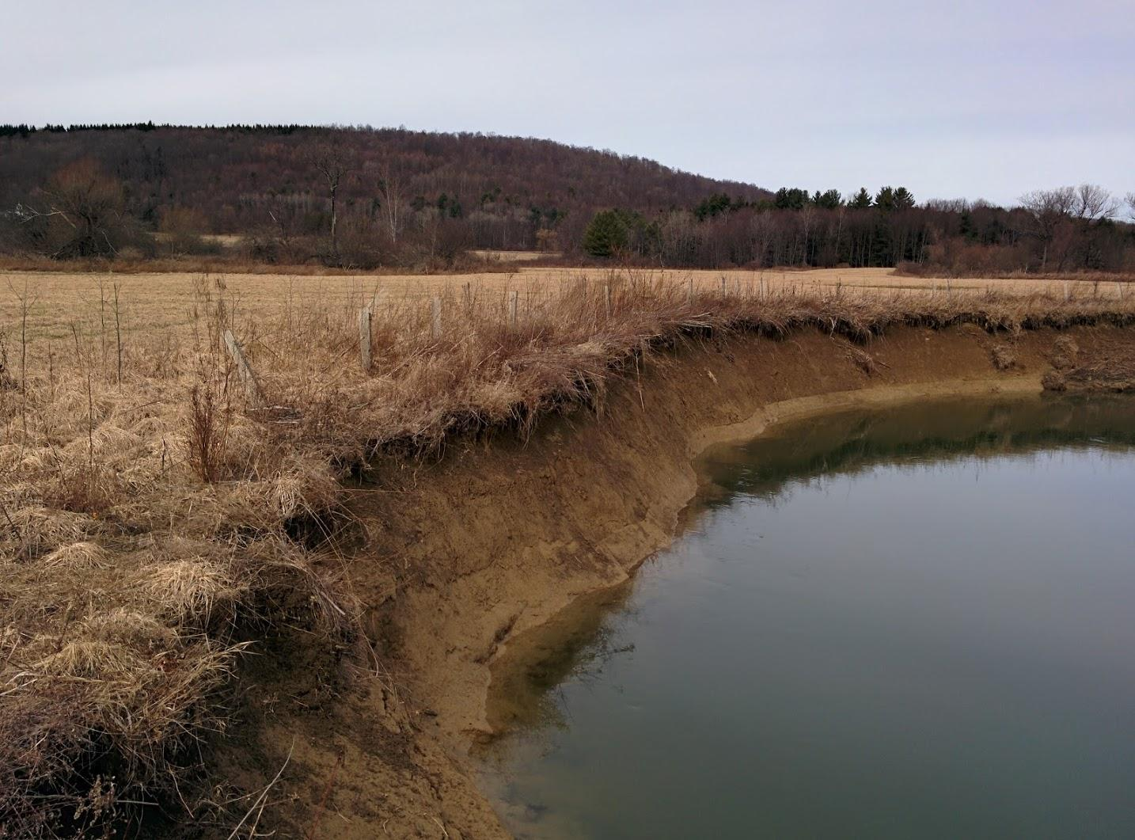
Talking Points...
Testing geologic “rules of thumb”
Erosion Processes and Hypotheses
  Larger flows erode more (bank shear stress)
  Medium size flows erode more (undermine cutbanks→ bank collapse)
  Freeze-thaw days erode more
Comparing one bend to the next is problematic…
    Geometric variation
    Bank materials vary
Stream records
  Flow percentiles, flow proxies
Daily climate records
  Freeze-thaw erosion events are complex!
  And effective
  And time-varying
Bank monitoring: Structure from motion

Slide 4
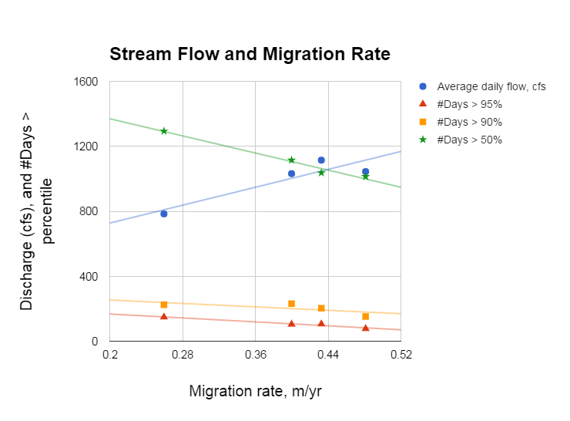
First up: a revision
Slide presented at GSA 2015, Baltimore
And the basis for abstract submitted to NE GSA 2016
I can’t replicate this!!!!!
So what’s going on here??!!
More high flow days appear to stymie migration.
Do they suppress undercutting and bank collapse?
We could use more close range observations of processes...
More on this later...

Slide 5
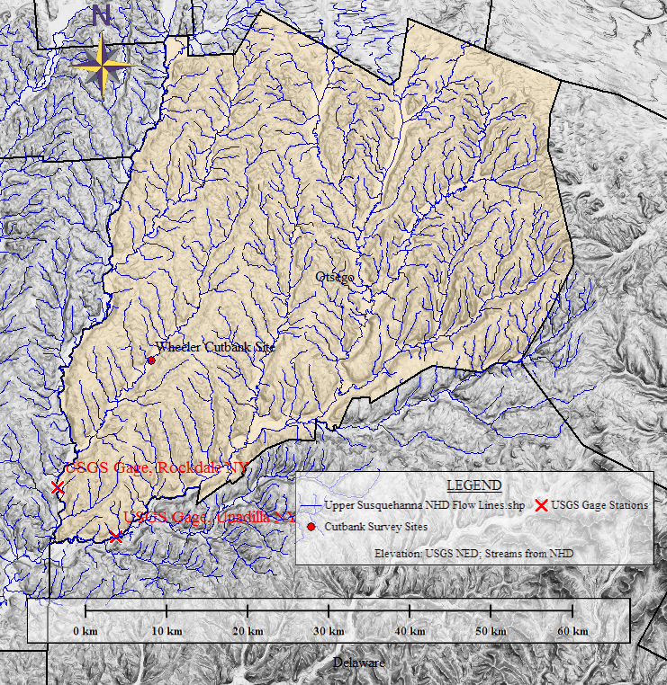
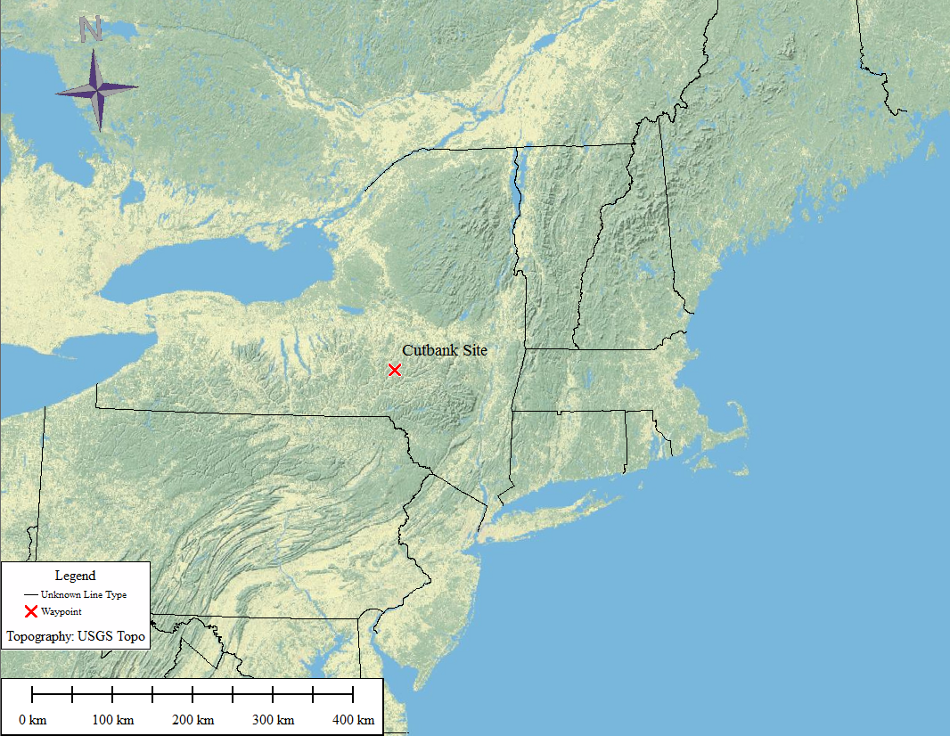
Field Sites:
Butternut Creek, a tributary to Susquehanna River
Climate data location

Slide 6
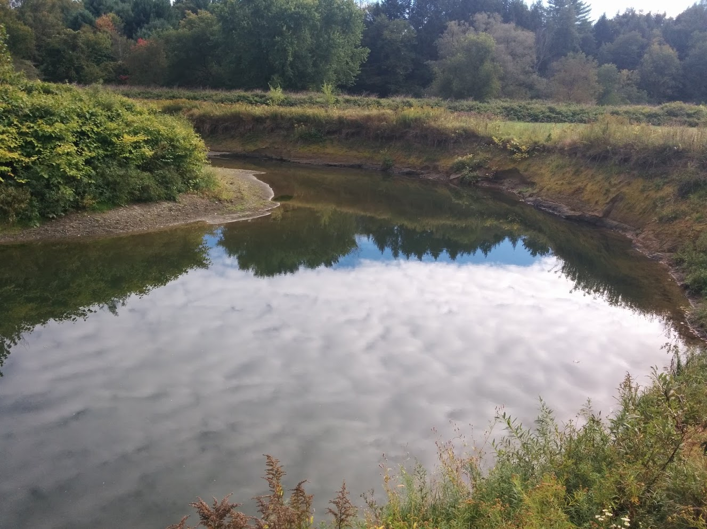
Which processes are most responsible for bank migration?
Frost action?
Bank scour via fluid shear stress?
Bank collapse via undercutting?
Local mass movements (particle and debris flow, etc)
Note: All of these are threshold dependent

Slide 7
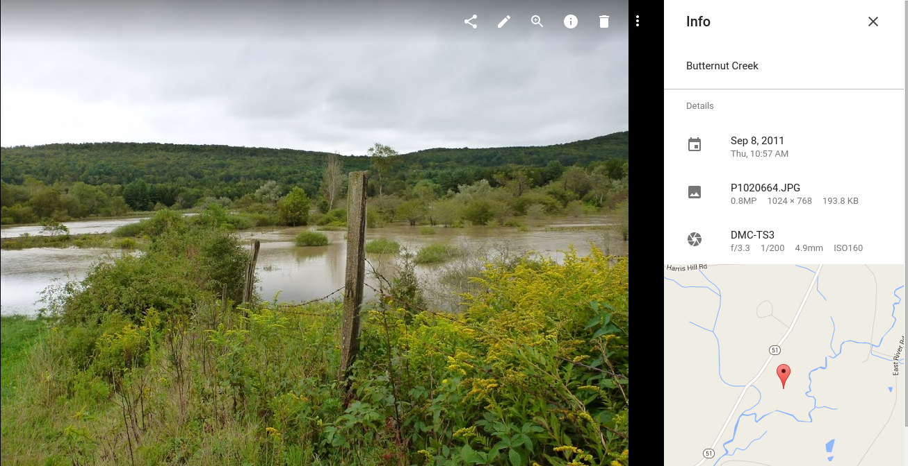
Hypothesis: Larger flows drive more migration
9/8/2011 (TS Lee), clearly overbank
> 99.99 percentile flow (flood of record since 1929)
What processes are active at the cutbank?
Does it matter once the river goes over the bank?

Slide 8
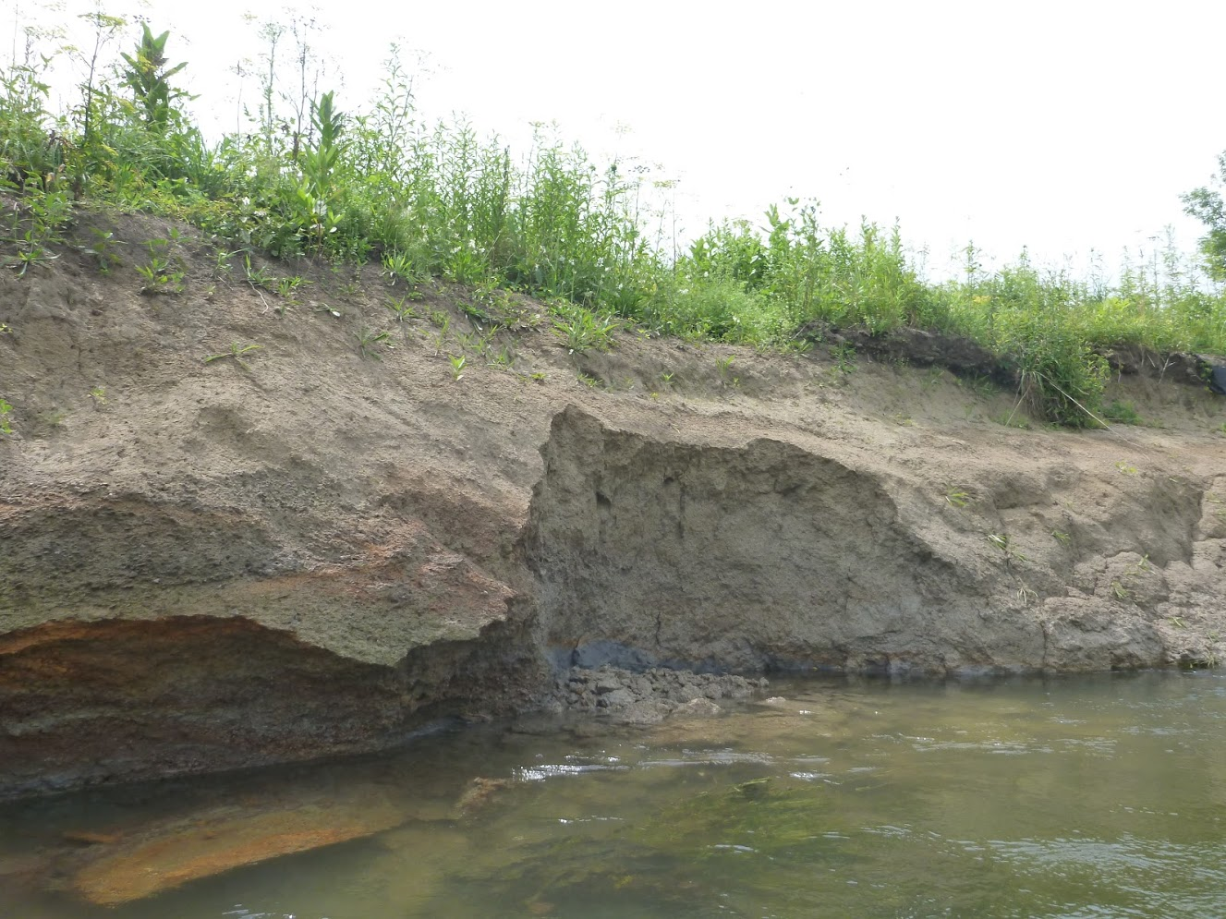
Undercut and collapse
Photo taken: 9/18/2011
Current water level =72 percentile
Next several slides reveal bank conditions and erosional processes, after a major flood
Smooth bank: eroded by fluid shear stress on the bank

Slide 9
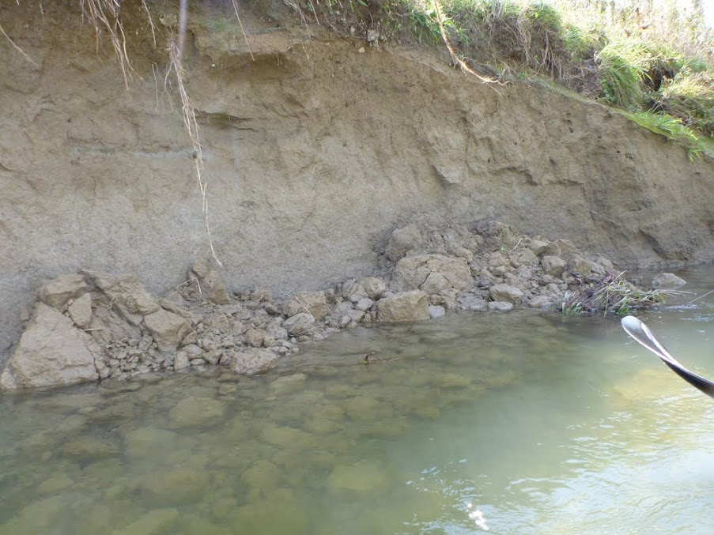
Bank collapse
9/18/2011;
Current flow is 72 percentile
After Tropical Storm Lee

Slide 10
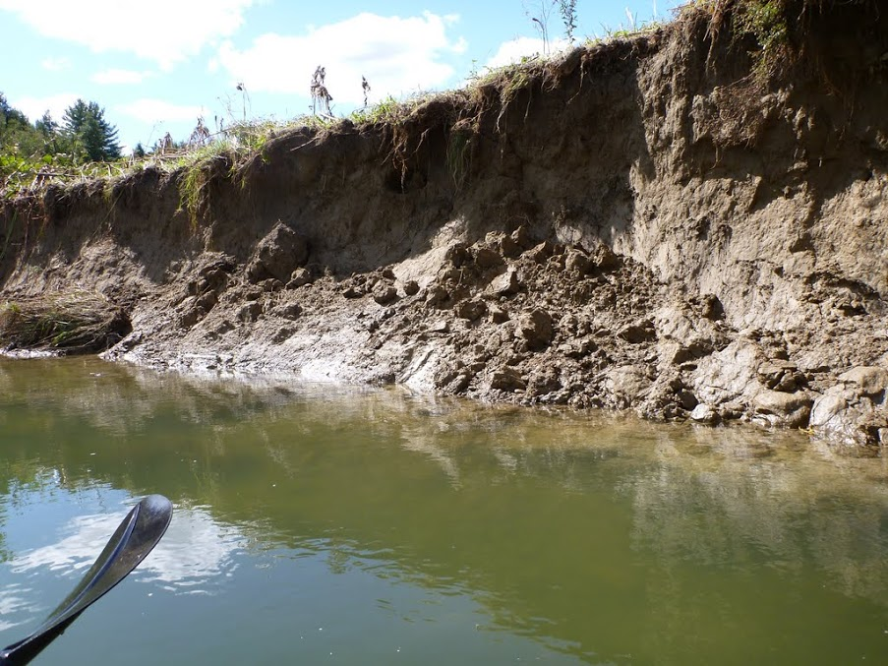
Undercut and collapse
9/18/2011;
Current flow is 72 percentile
After Tropical Storm Lee
Zone of maximum erosion

Slide 11
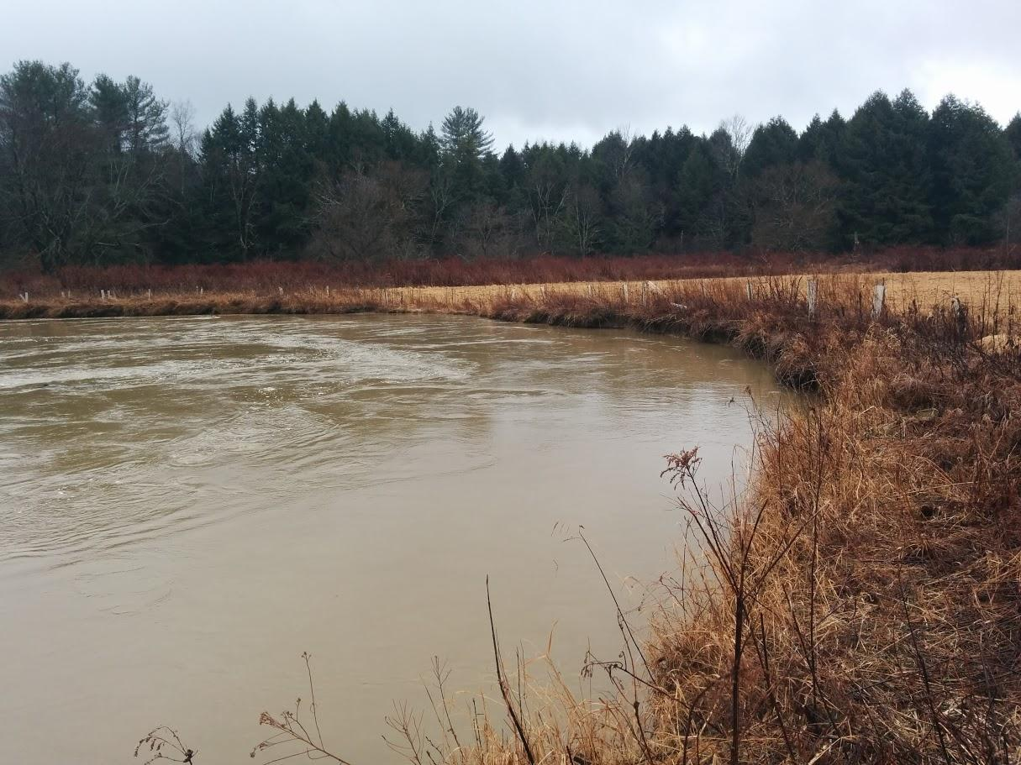
Near bankfull
~99th percentile flow day
2/25/2016

Slide 12
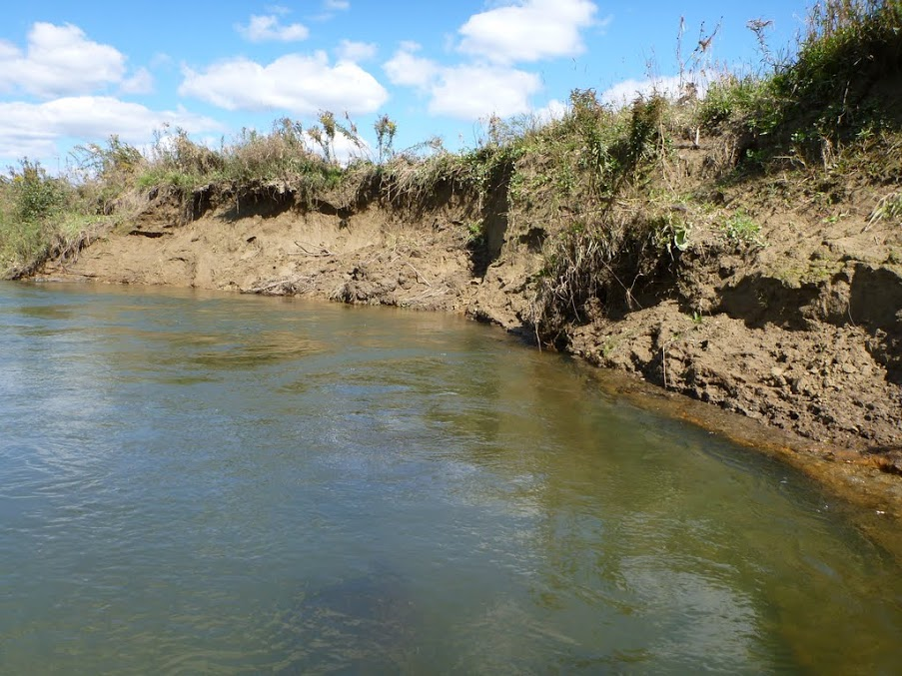
Bank collapse and undercutting
9/18/2011;
Current flow is 72 percentile
After Tropical Storm Lee

Slide 13
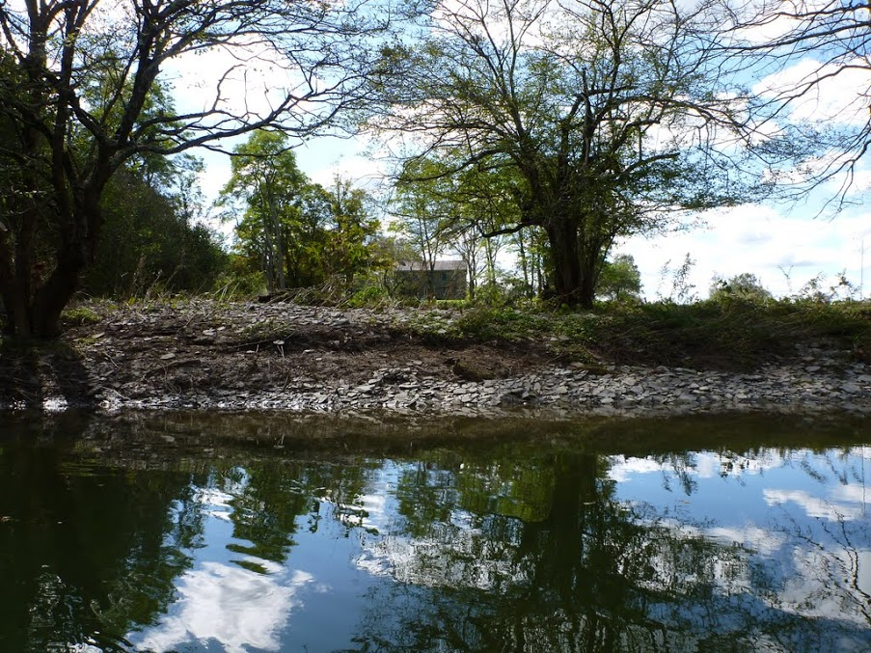
Platy cobbles draped over the bank
Scoured then armored
9/18/2011;
Current flow is 72 percentile
After Tropical Storm Lee

Slide 14
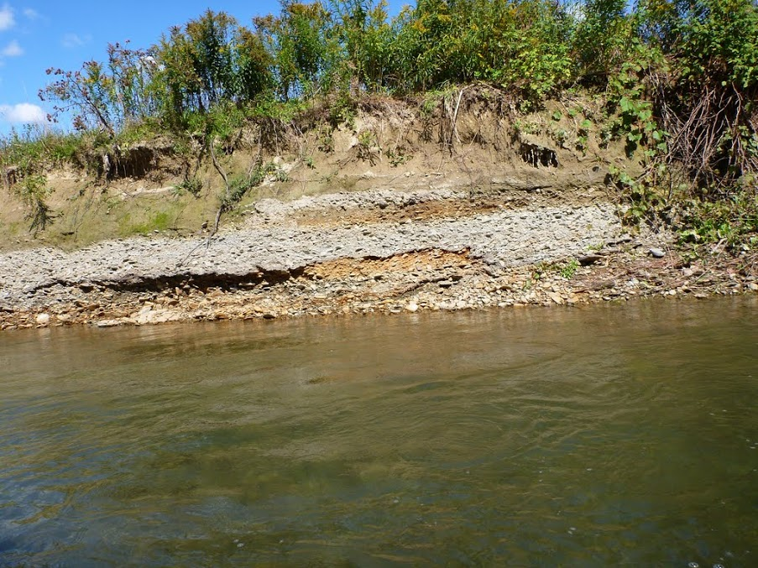
9/18/2011;
Current flow is 72 percentile
Bank materials vary
Old gravel bars

Slide 15
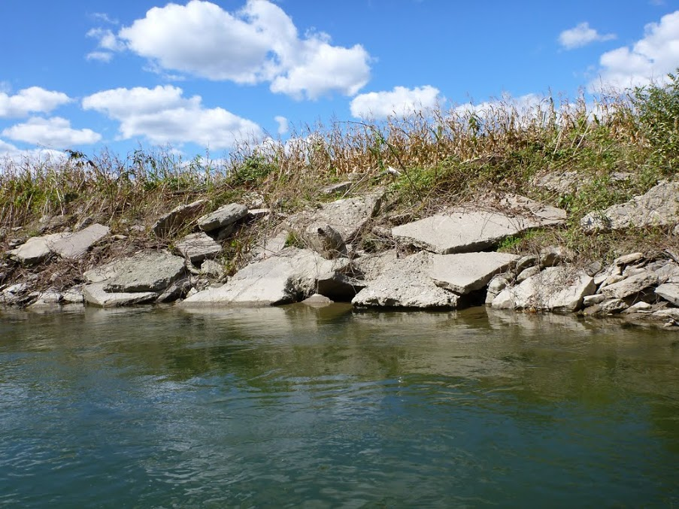
No erosion (has not moved since 1995 aerial image)
9/18/2011
Current flow is 72 percentile
Bank Conditions:
armored outside bend

Slide 16
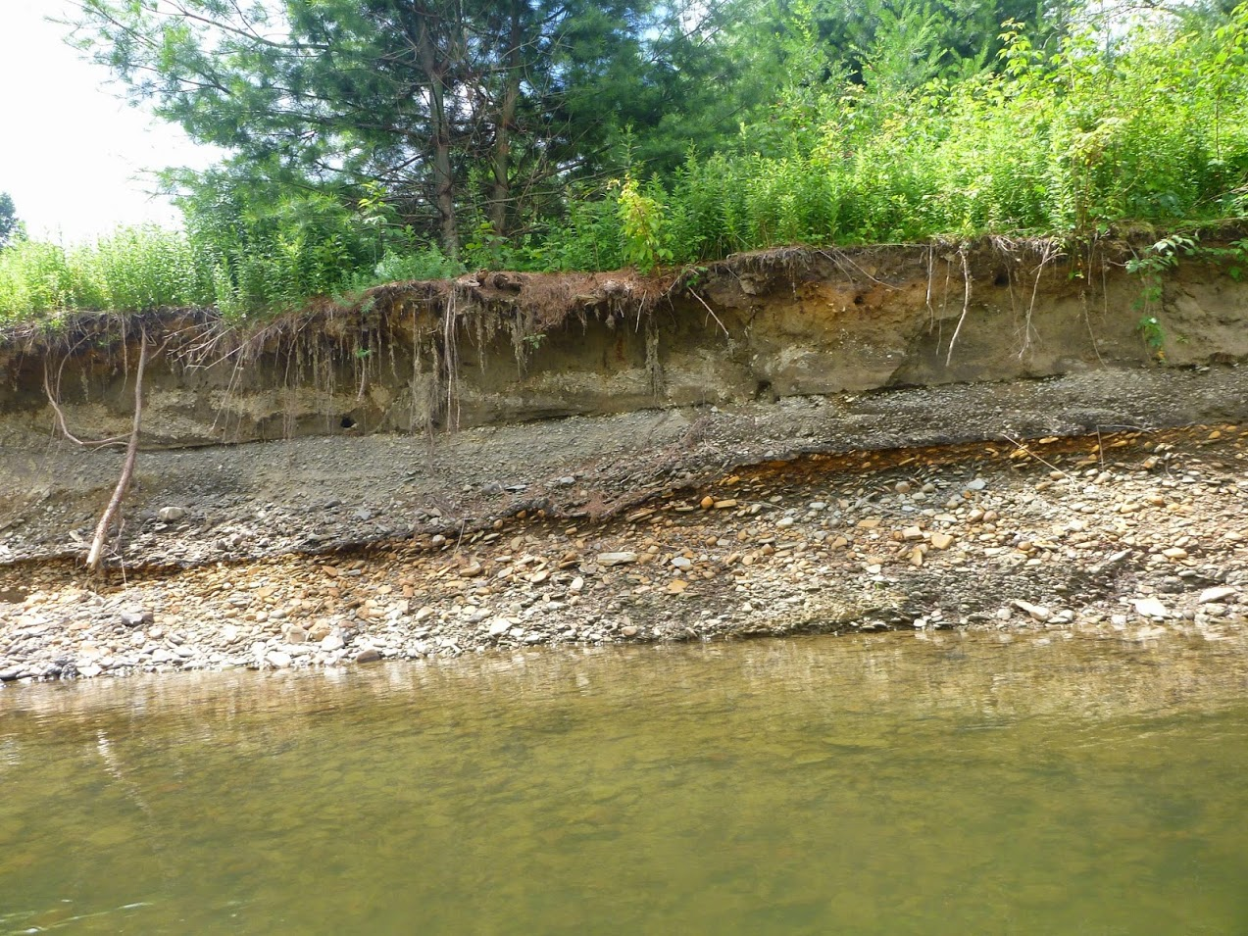
Variation in bank materials limits processes (threshold)
7/16/2014
~59th percentile flow day

Slide 17
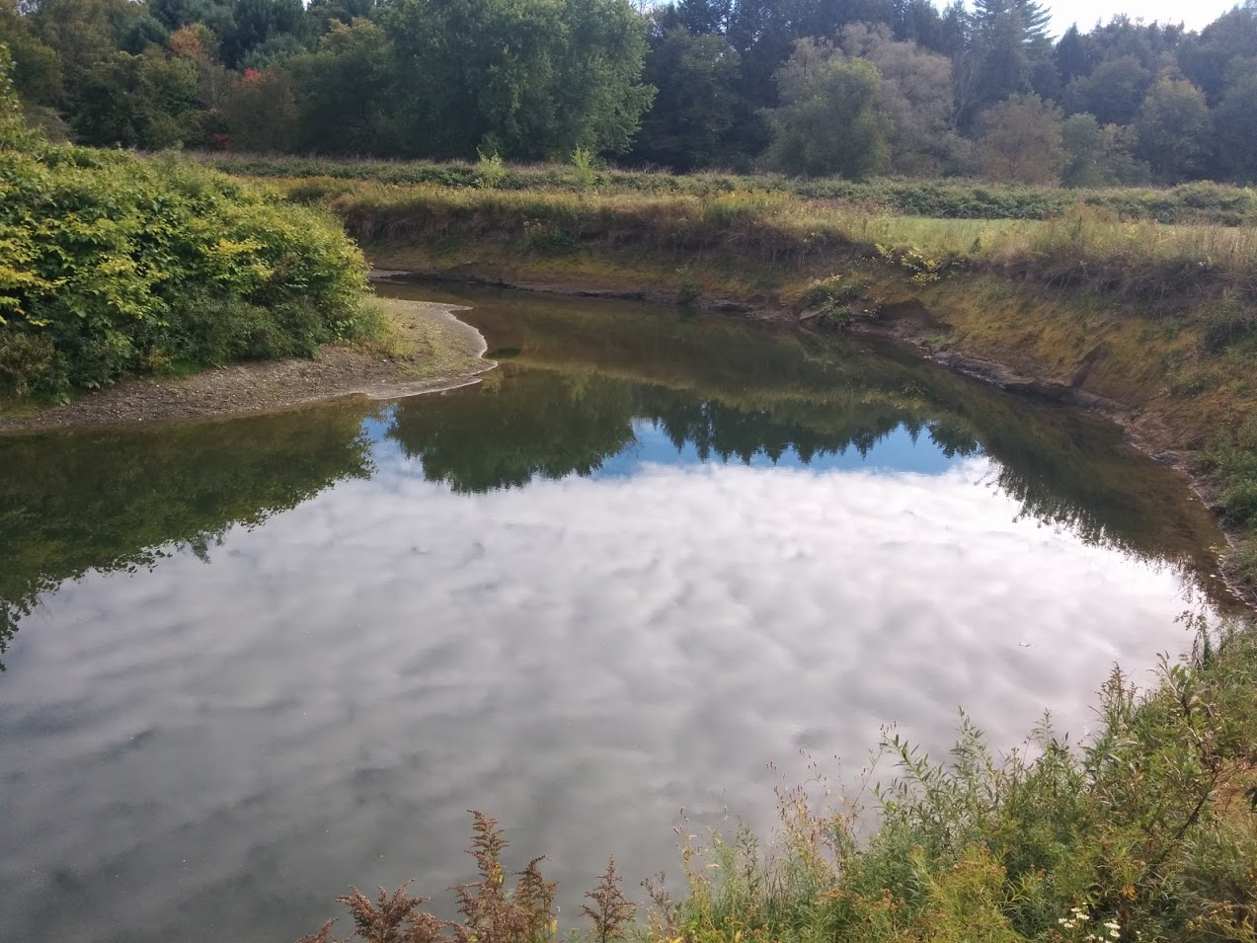
~99th percentile
~59th percentile
Low Flow Day
~12th percentile
9/22/2015
~93rd percentile

Slide 18
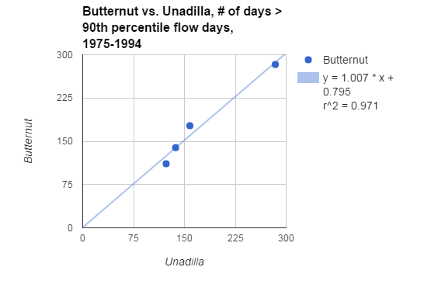
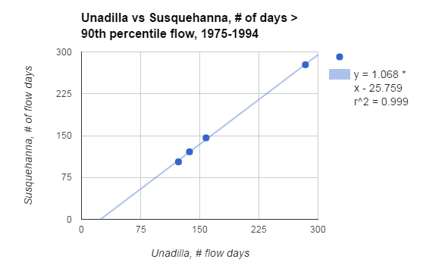
About those percentiles and proxies…
Butternut Creek was monitored by USGS until 1996
Two other gaging stations have overlapping data with the Butternut
I compared the number of flow days at a given percentile for the gages for overlapping time periods
Bottom line: the number of flow days on one stream can serve as a predictor of the number of flow days for a given time period on a nearby stream
I selected 4 periods of the same length, counted the #days exceeding 90th percentile, and the charts show the comparison between streams

Slide 19
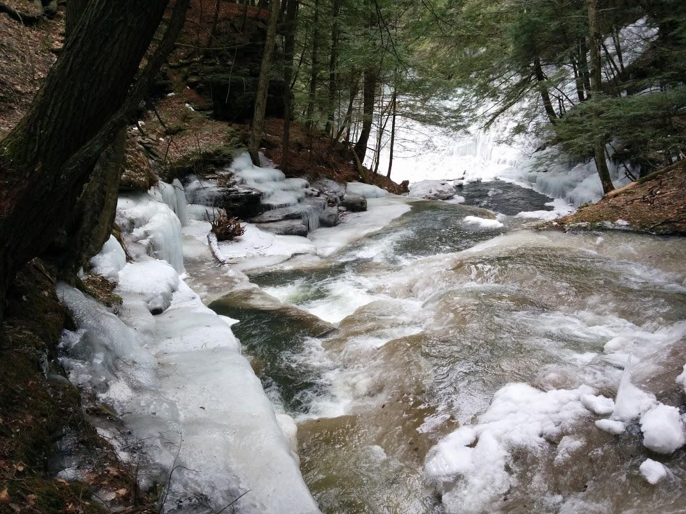
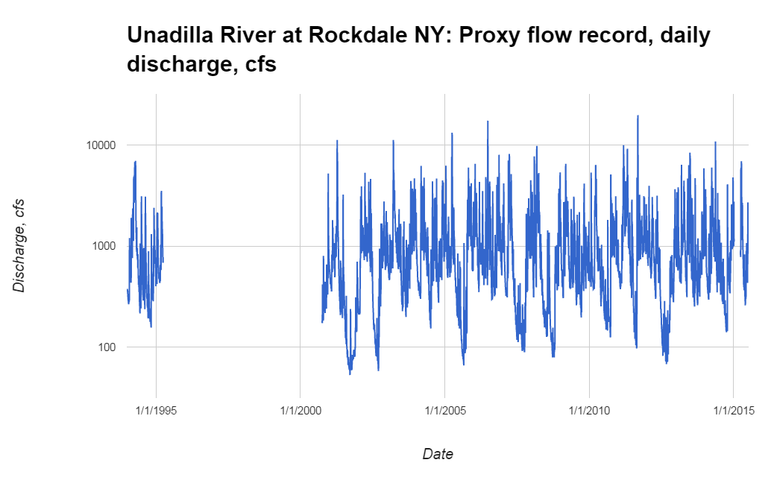
Flood of Record, Tropical Storm Lee
Threshold for erosional activity at 95th percentile?
Or (70th percentile)?
Gage not recording for this interval…
And there is aerial imagery for this time period

Slide 20
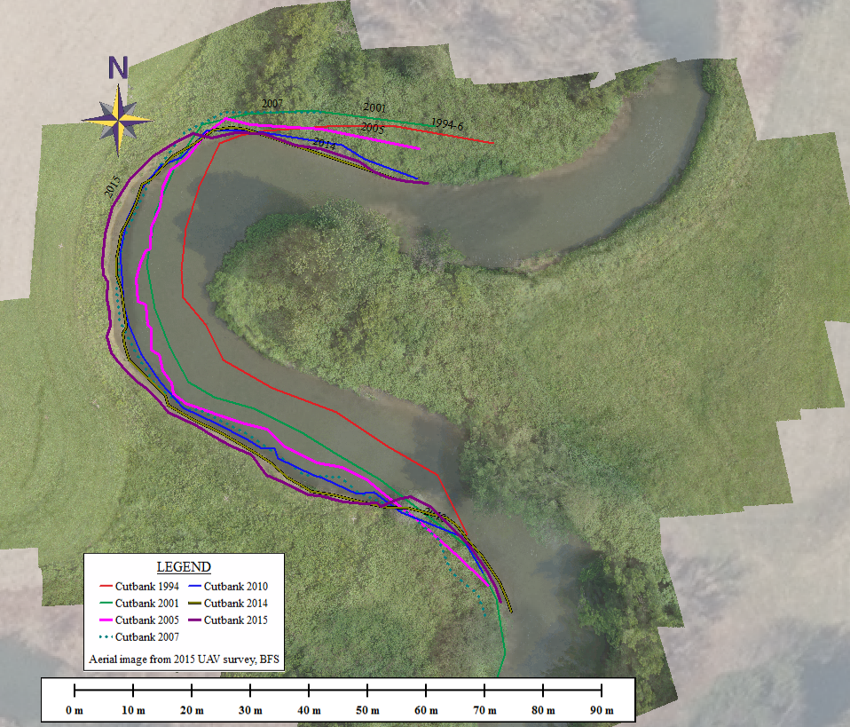
Meander migration rates,
6 active sites
(out of 10)
Rates vary from 0 to ~2 m/yr
Rates based on time series of orthoimagery from New York State GIS Clearinghouse, Lidar in 2007+UAV in 2015
Average migration distance = Area / Perimeter x 2
Top overaly is orthomosaic from UAV

Slide 21
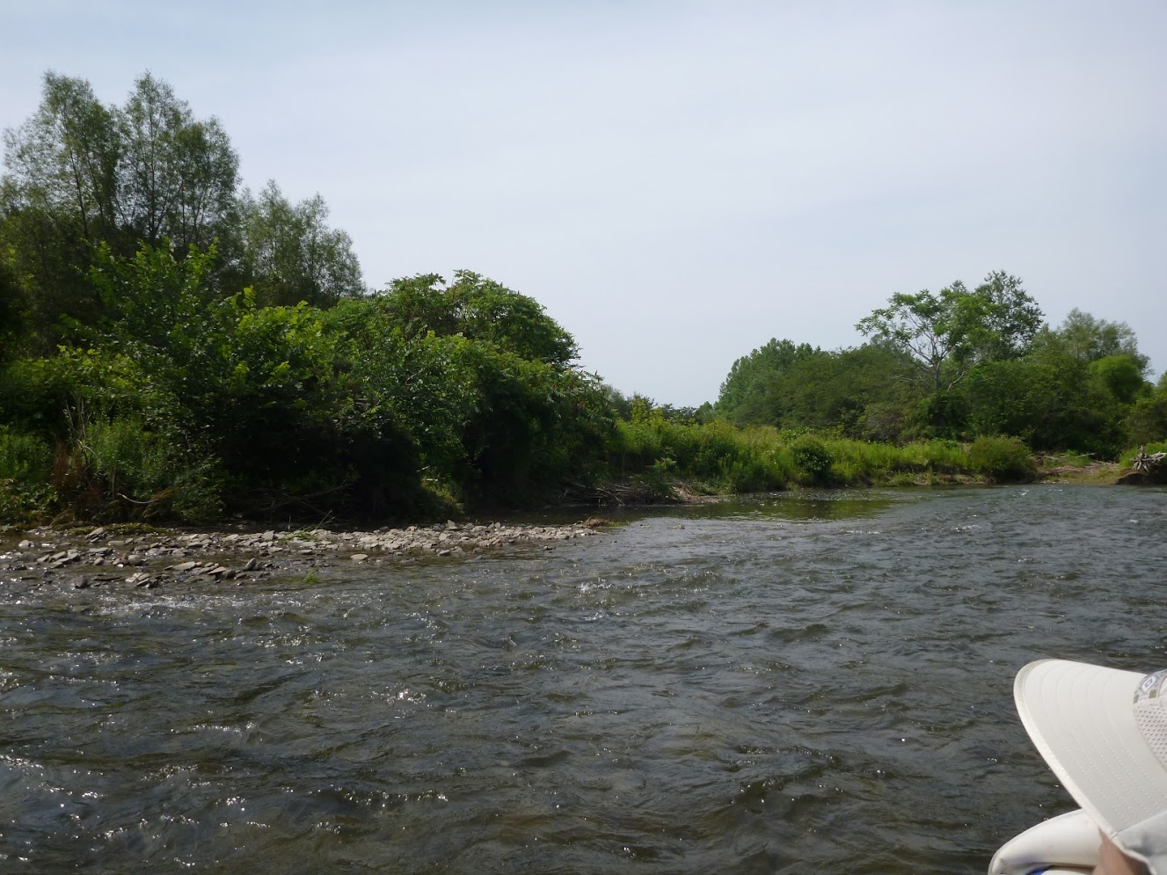
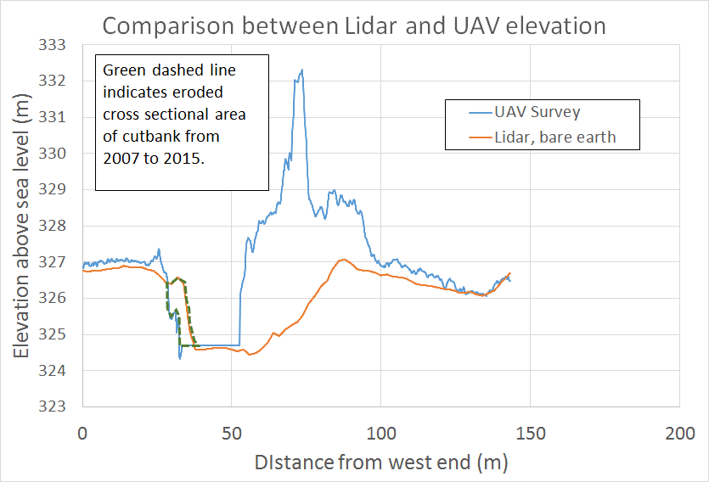
Comparing Lidar and UAV

Slide 22
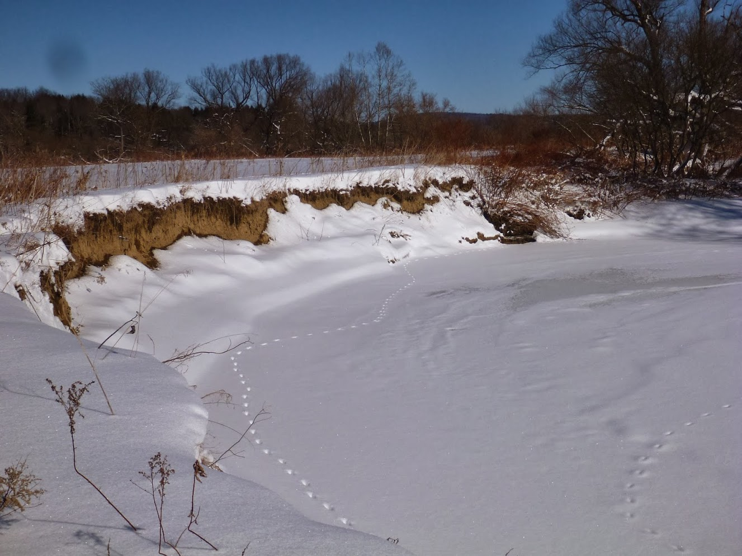
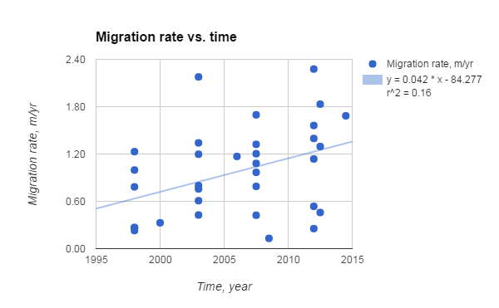
Migration rates since 1994
Very weak relationship between migration rate and time

Slide 23
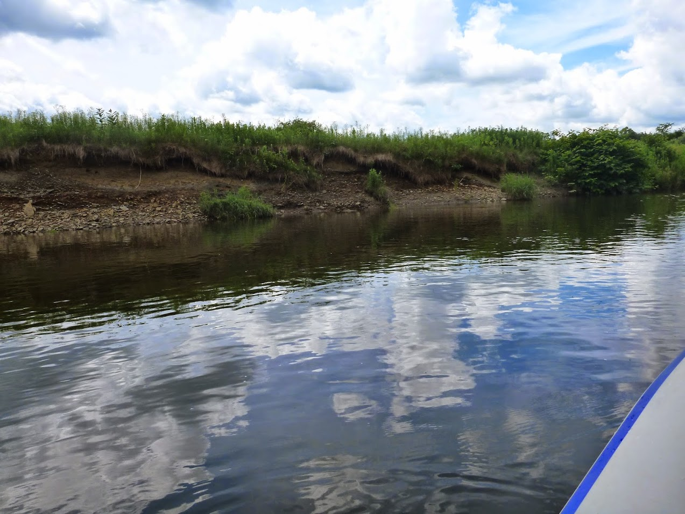
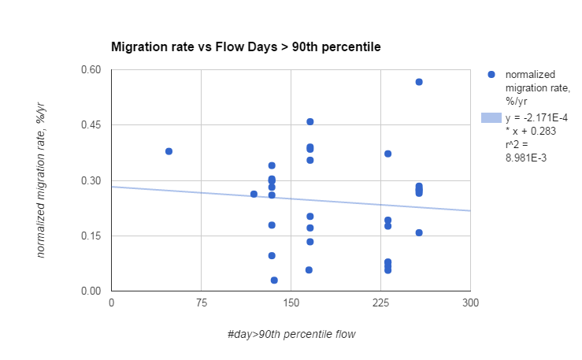
Migration rates vs # days > 90th percentile
No relationship between more flow days and migration rate
6 Cutbanks with measurable erosion on aerial imagery
Time periods: 1994-2001; 2001-2005; 2005-2010; 2010-2014
Each cutbank eroded distance is normalized to the total local eroded distance

Slide 24
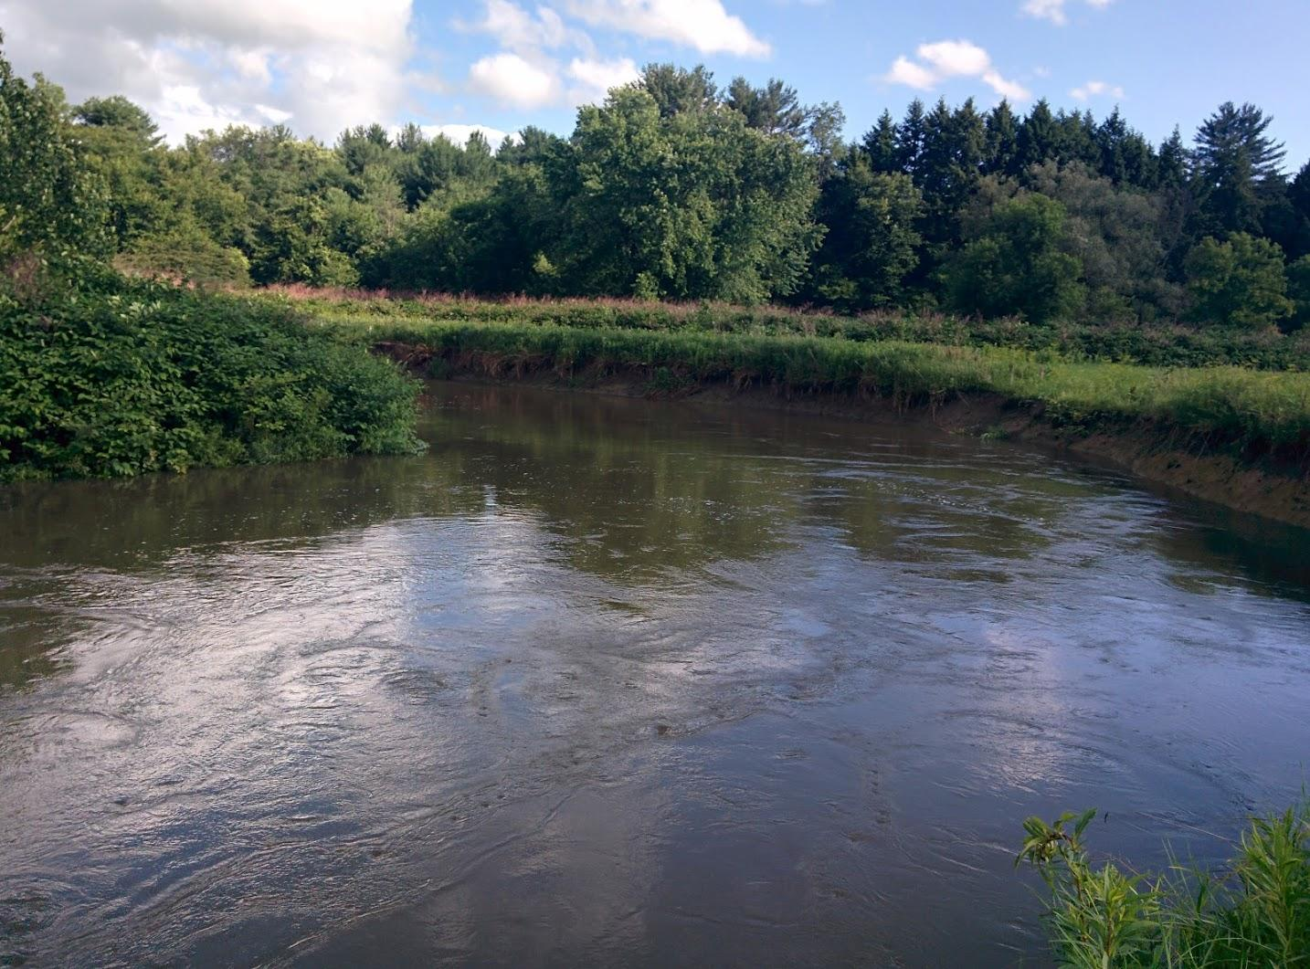
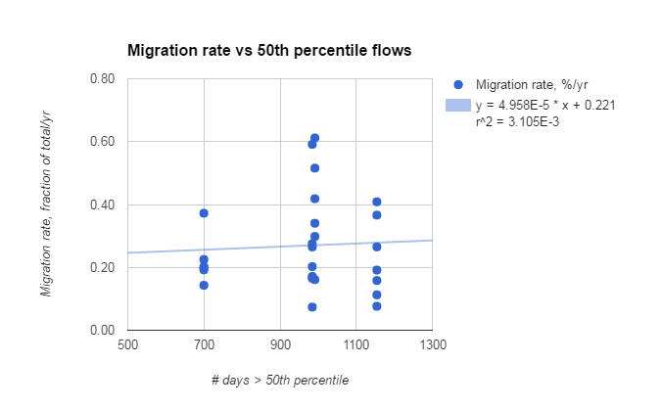
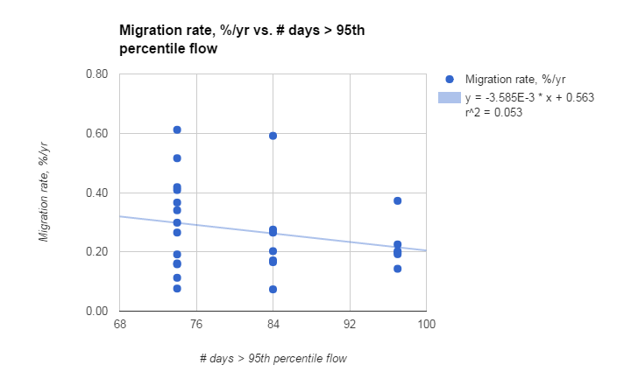
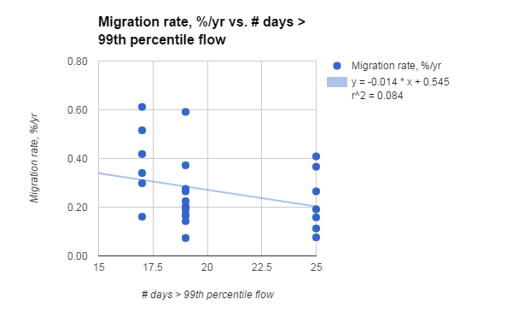
No relationship between very high or moderate flows and migration rate

Slide 25
Freeze-thaw activates cutbanks

Slide 26
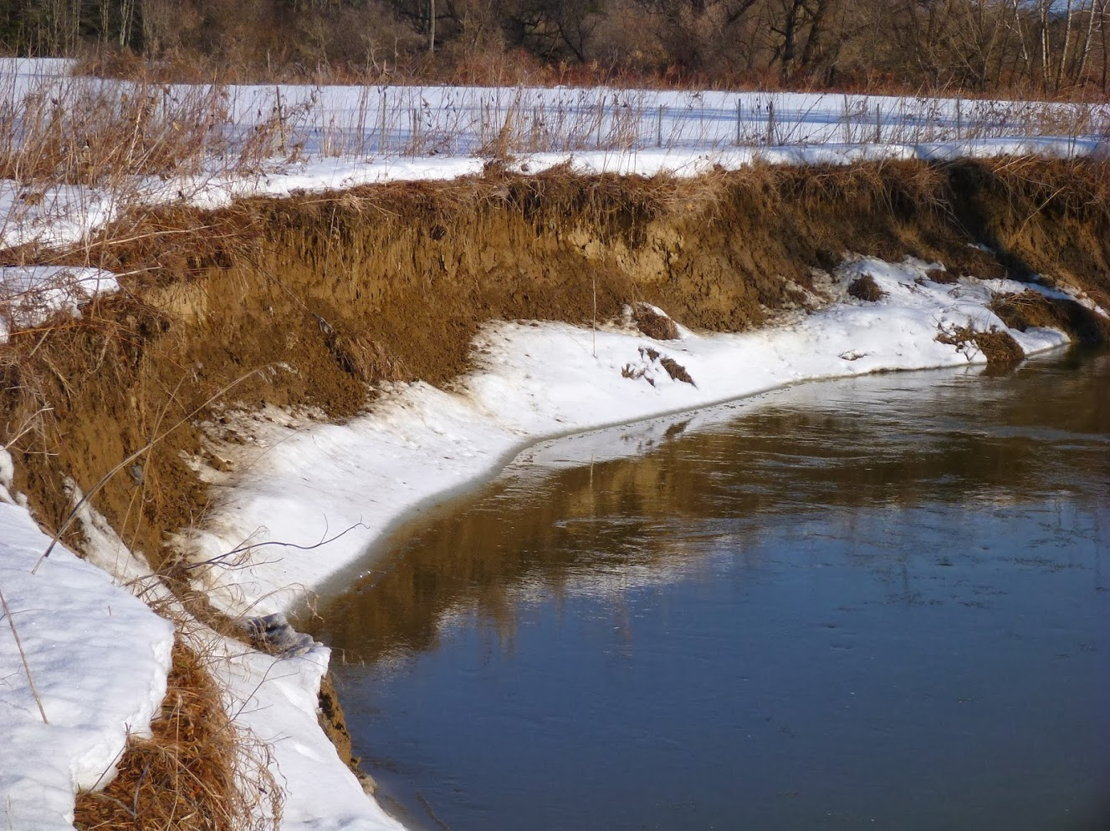
Freeze-thaw of cutbanks
Small grain flows/avalanches
Feb. 22, 2014: 77th Percentile flow

Slide 27
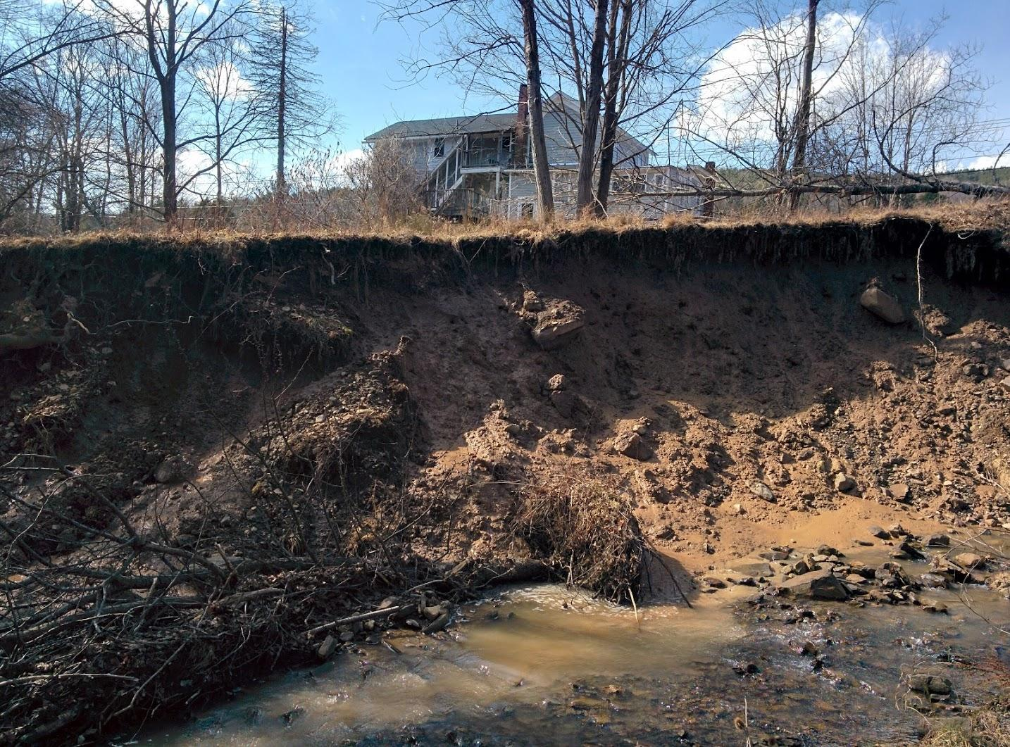
Freeze-thaw of cutbanks
Debris flows, slumps
March 9, 2016, Oneonta
A single event can remove 1-10+ cm from a cutbank

Slide 28
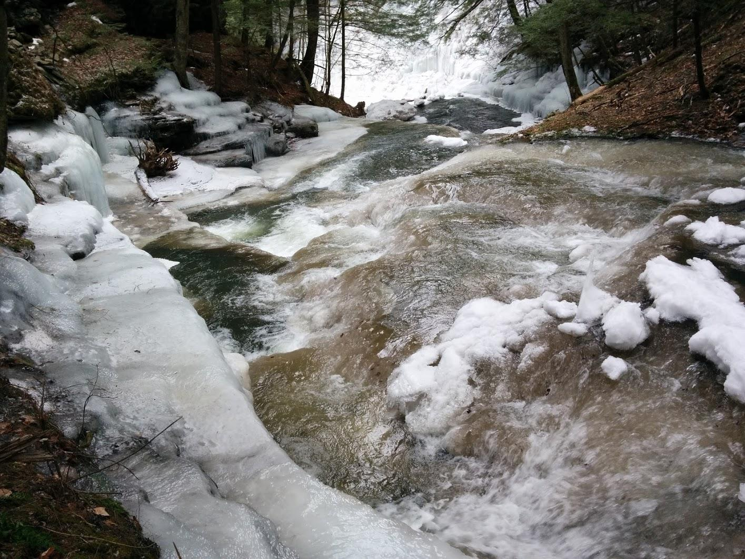
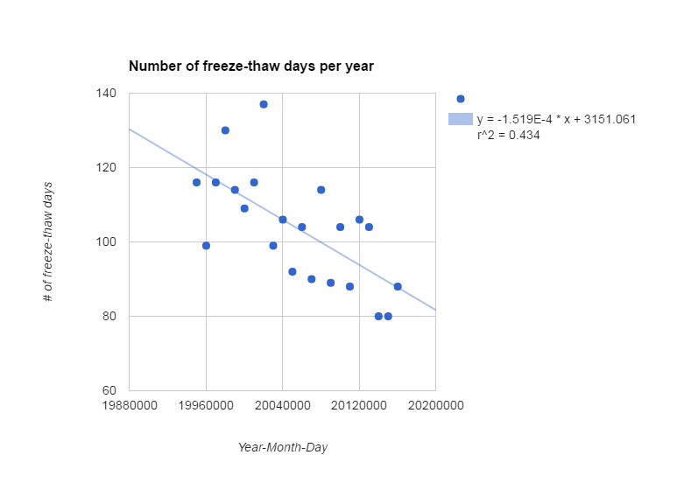
Freeze-thaw activated processes
80 to 120 f-t events per year
5 to 20 per yr for > 5C and < -5C
The number of freeze-thaw days appears to be declining

Slide 29
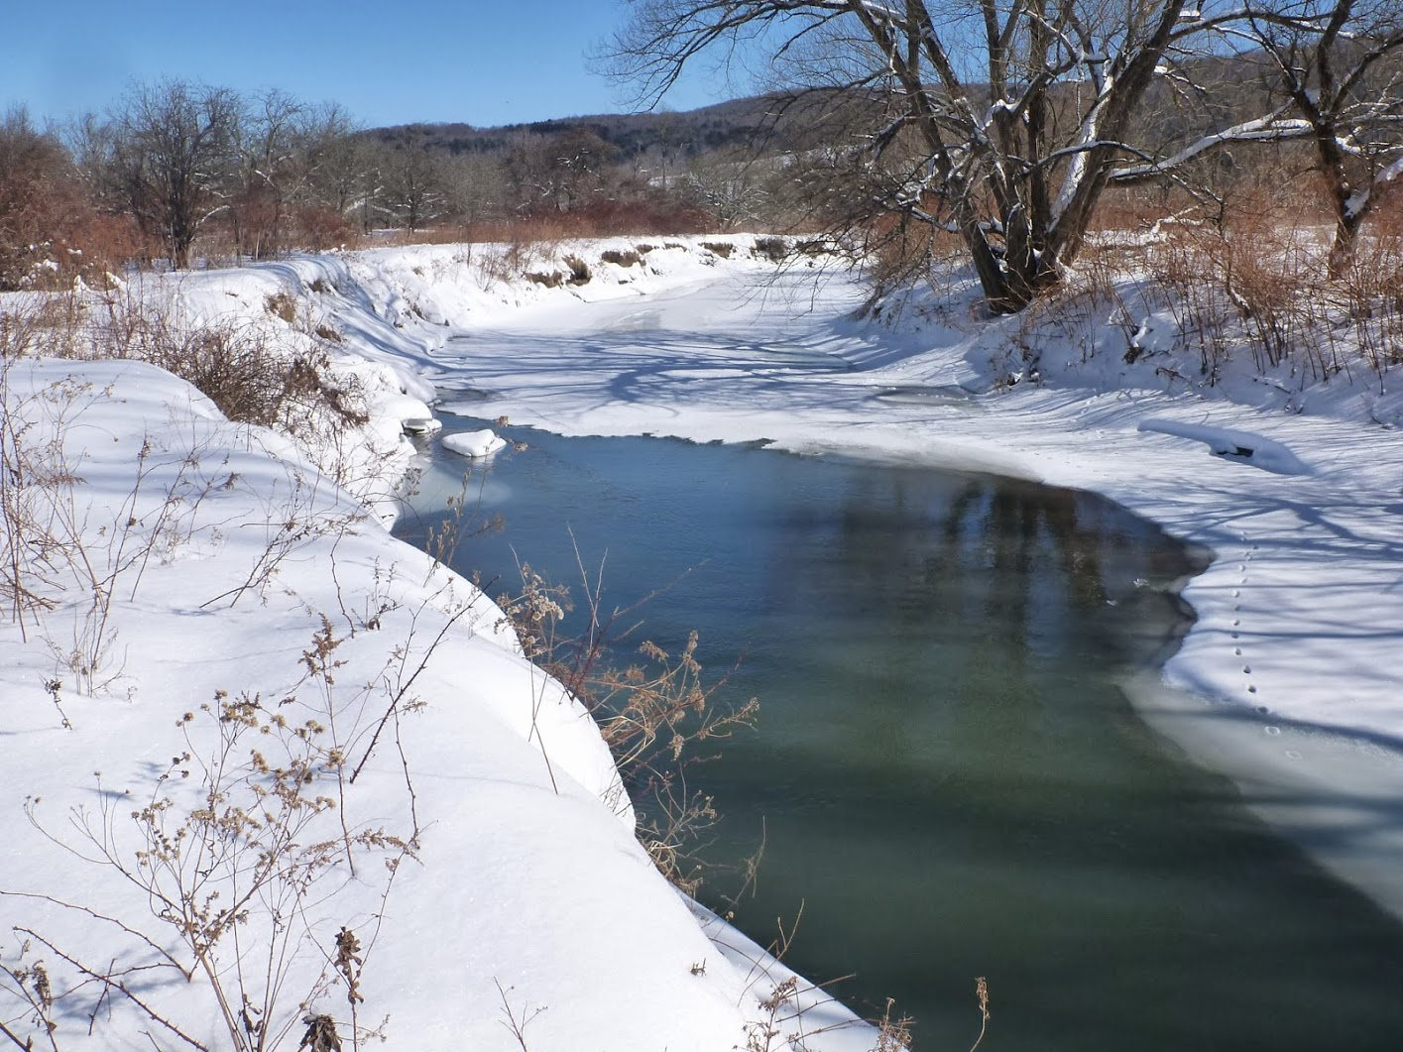
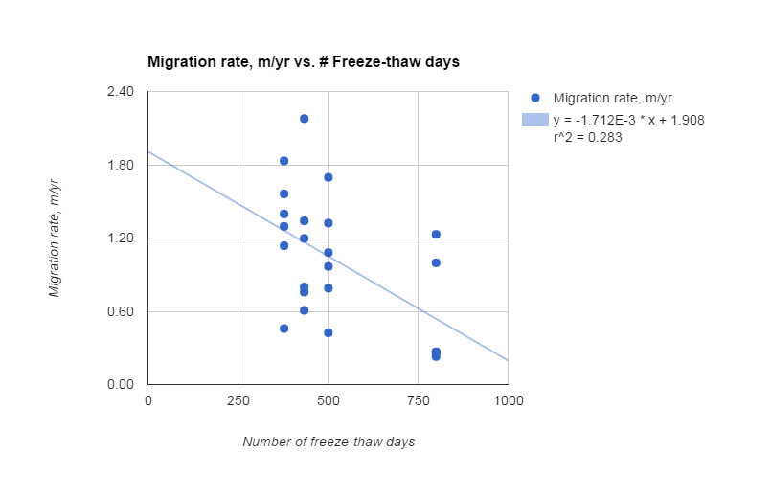
Migration rate vs freeze-thaw days
There is a weak inverse relation between the # of freeze-thaw events and migration rates!
This could be from the averaging interval effect...

Slide 30
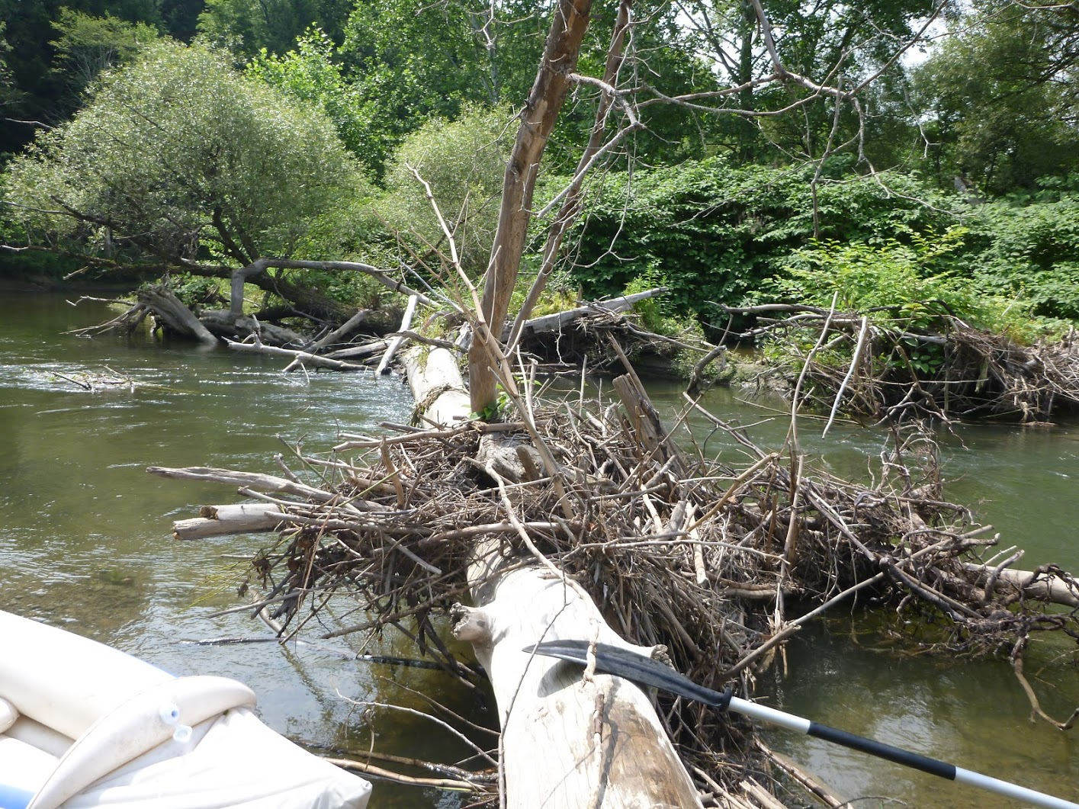
Conclusions
More floods = more migration doesn’t hold
More freeze-thaw = more migration doesn’t hold
Migration rate of cutbanks appears to be:
  insensitive to mid-size and larger flows
  Inversely related to freeze-thaw events
Rate interval may be too long to elucidate process control (shorter interval = higher rates?)
We need higher resolution measurements to get around this logjam! UAVs are an affordable monitoring tool
More info on Flow field? Bank stiffness? Soil water?

Slide 31
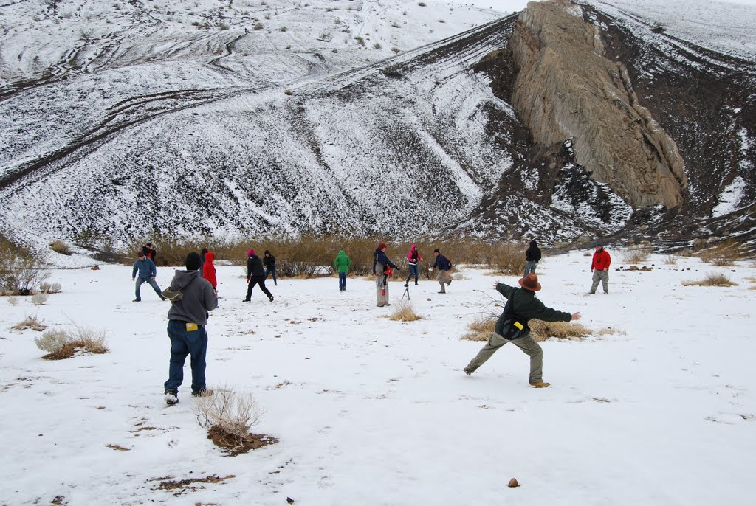
I’ll take your questions!

Slide 32
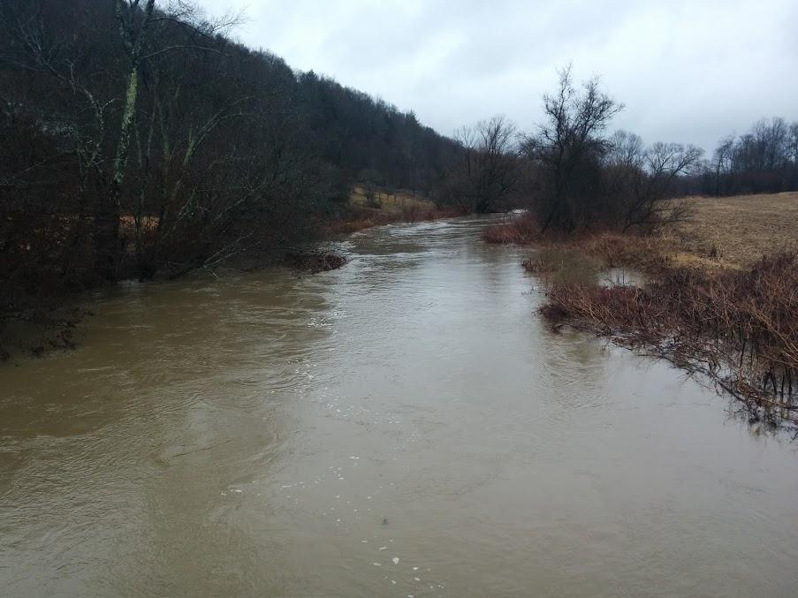
Bankfull flows
2/25/2016
(~99th percentile daily flow)
Abstract
Several natural processes erode stream cutbanks including bank collapse, fluid bank shear stress during high flows, burrowing and bioturbation, and freeze-thaw events. Which of these contribute most to meander migration rate? If fluid bank shear dominates, one might expect a direct correlation with the number of days of flows exceeding a given size and migration rate. If bank collapse dominates, perhaps smaller flows are more effective at creating undercut banks, which could increase migration rate at lower flows. We develop a test for these hypotheses by determining bank migration rate at a site along Butternut Creek, a tributary to the Susquehanna River in upstate New York, which has a well-developed Holocene floodplain nestled into glacial deposits. The cutbank is ~2 m high, extends for ~100 m, and exhibits signs of recent erosion. Several floods in the last decade have overtopped the banks here. Aerial imagery from New York State GIS warehouse shows the cutbank has migrated several meters since 1994. We extracted USGS stream gage records for nearby rivers, and determined the number of days for flows exceeding the 50, 90, and 95 percentile daily flow for the time period between aerial images. The migration rate appears to be inversely related to the number of exceedance days, suggesting that higher flows stymie migration. We hypothesize that higher bank shear stress may remove a more uniform thickness from the bank, causing a reduction in bank collapse frequency, whereas lower flows may tend to undercut more effectively. We captured overlapping photographs of the stream banks on the ground, from a canoe, and from an unmanned aerial vehicle (UAV). PhotoScan, a structure-from-motion software by Agisoft, was used to construct three dimensional topographic models of the cutbank that compare favorably with aerial based Lidar surveys. We intend to monitor the bank more closely from the river’s view with these new tools to identify the dominant erosion process.

Slide 33
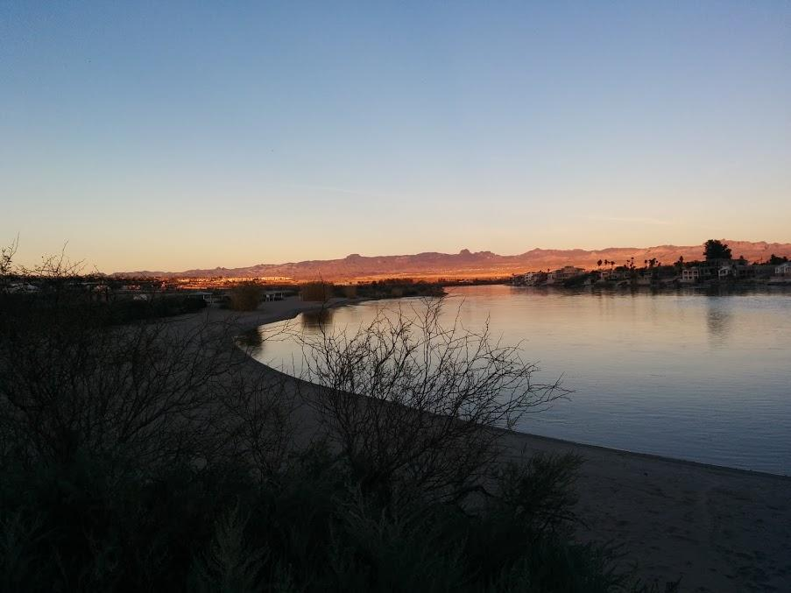
Links to data and software for this project
River flow data: http://waterdata.usgs.gov/ny/nwis/uv?site_no=01502500
Daily climate data, NOAA National Center for Environmental Information (site is GHCND:USC00305113): http://www.ncdc.noaa.gov/cdo-web/search?datasetid=GHCND
Aerial imagery and lidar: http://www.orthos.dhses.ny.gov/
Agisoft PhotoScan: http://www.agisoft.com/
Visual Structure from Motion (open source): http://ccwu.me/vsfm/
RTK set up for UAVs: http://store.swiftnav.com/s.nl/it.A/id.4216/.f
Iris 3DR UAV: https://3drobotics.com/kb/iris/
UAV Control Software (open source): http://copter.ardupilot.com/

Slide 34
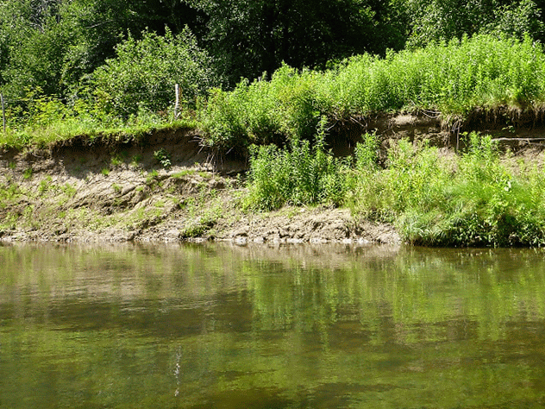
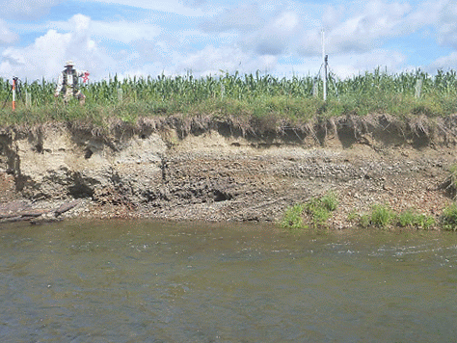
Measuring cutbanks with SfM: Take overlapping photos
The software (PhotoScan, by Agisoft):
  Aligns photos
  Finds common points in photos
  Calculates 3D coordinates of each point
  Colors the point
  Rectifies the coordinates, if ground control points are known

