Slide 1



THE RITES PATH TO FORMING K-12 & HIGHER EDUCATION PARTNERSHIPS
Geological Society of America
Northeast Section
Albany, NY
March 21, 2016
Presented by:
Daniel Murray, Principal Investigator
Howard Dooley, Project Manager
Donna Casanova, Co-Principal Investigator
This material is based upon work supported by the National Science Foundation under Grants No. MSP 0831974, CSE 0831974, and STEM+C 1542892.
Notes:
1

Slide 2
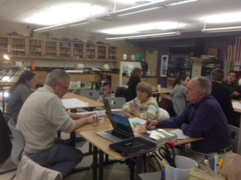
Plan of Talk
WHAT IS RITES?
WHAT IS THE RITES
PARTNERSHIP?
IS THE PARTNERSHIP
SUCCESSFUL?
WHY IS THE PARTNERSHIP
SUCCESSFUL?

Slide 3
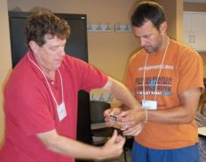
What is RITES?
A Partnership between higher education, school districts, middle & high school science teachers and RI’s state Department of Education designed to support the transformative work already underway by the partners to reform science education throughout RI
An NSF STEM initiative funded by a 5+year, Math Science Partnership Grant
Inquiry-rich, content-deep and technology-enhanced professional development opportunities and on-line investigations
A professional learning community
Learning Science…
By Doing Science…
Notes:
GOAL
Systemic growth of STEM literacy throughout RI
Application to elsewhere in the country
IMPLEMENTATION PROJECT
Inclusive, “open-ended” experiment
Why RI?
Petri dish analogy
COMPONENTS OF RITES
PARTNERSHIP
PROFESSIONAL DEVELOPMENT
TECHNOLOGY
EVALUATION
DISSEMINATION

Slide 4
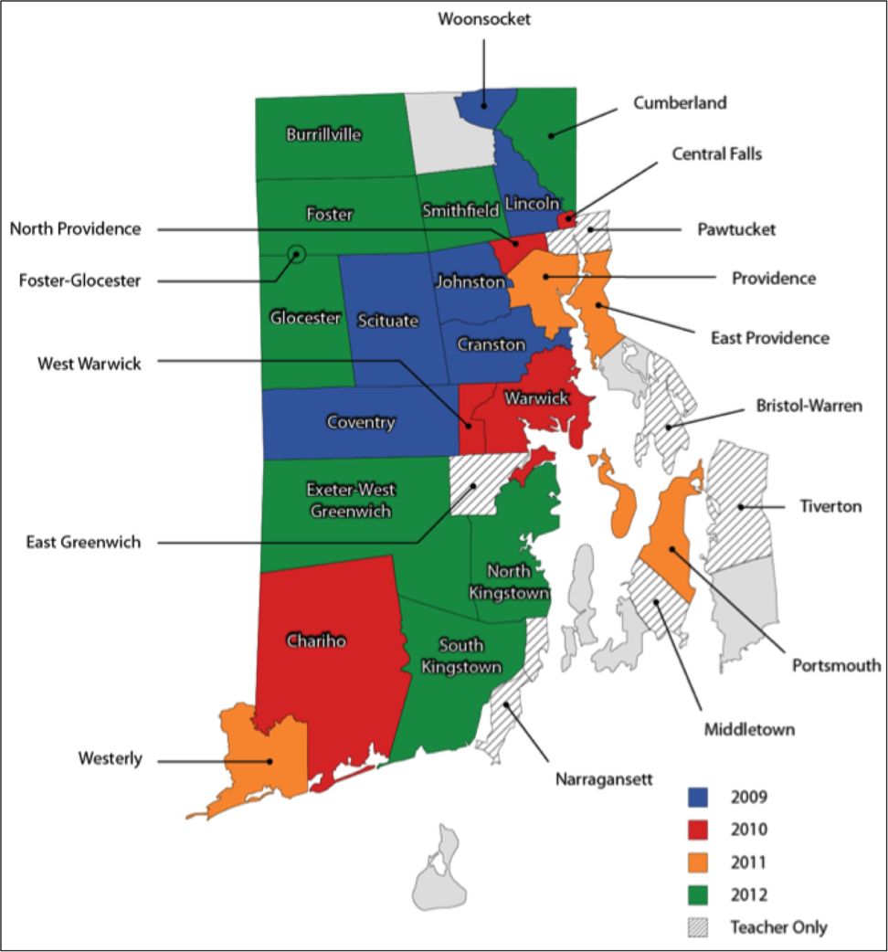
What is RITES?
DESIGN
5 year MSP Target project
Supplemental PD
Premise: Teacher gains => Student gains
Statewide effort
RESULTS
75% science teacher participation
~40,000 student involvement / yr
Robust partnership
Student gains in science inquiry component of state exam
Teacher gains in
science content
technology literacy
best science practices
reformed teaching practices
Notes:
RITES is now moving towards RITES+C, moving strategies to include computing and computer science domains

Slide 5
What is the RITES Partnership?
Leadership Team
Monthly meetings bring together decision makers from all partners
Resource Teams as Professional Development
Product design and development brings together K12 and HE faculties as collaborators
RITES staff
Individualize to district-specific needs, learning environments and pedagogies
Notes:
Multiple layers of participation
These groups are the work-horses. They do not constitute all the partners.

Slide 6
Leadership Team
Team Members
Higher Education - University of RI, RI College
Public School Districts - Chariho, Cranston, Johnston,
Providence, South Kingstown, Westerly, Woonsocket
Supporting partners – include the Community College of RI, Brown University, the RI Department of Education and The Concord Consortium.
Notes:
Leadership Team members throughout the 8 year history. Johnston is the original district in the grant proposal. All others joined in year 2, except South Kingstown which joined in year 4.

Slide 7
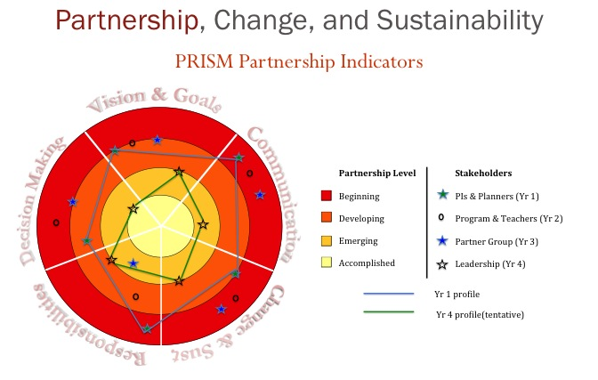
PRISM Leadership Team (2007).
Partnership Rubric. Retrieved from
http:hub.mspnet.org/index.cfm/14308?
Notes:
The PRISM Rubric - The lower right figure shows how the RITES partnership has matured and deepened over the course of the grant, through 2012. A third data set will be collected and analyzed this spring (2016). The lines show a clear movement towards a level of “Accomplished” in all five aspects measured: shared vision & goals; decision making; communication; responsibilities; and sustainability. Early results show that the deepening of the partnership has continued, as more cohorts (districts and teachers) have risen to leadership roles in RITES. Note: RITES used the PRISM rubric for this, as it was developed by another MSP. See MSPnet http://hub.mspnet.org/index.cfm/14308?
Increasingly K12 has taken leadership and are beginning to own RITES, making decisions about direction, design, and funding.

Slide 8
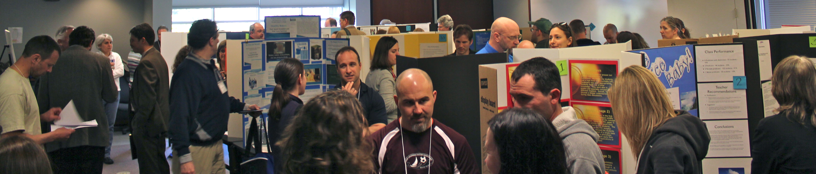
Professional Development Model
Resource Teams pair master teachers with content specialists
investigations built on deeper content knowledge, scientific practices,
processes and tools
Short Courses model best teaching and learning practices
Action Research fosters reflection on teaching strategies
Classroom data improves teacher actions and student outcomes
Spring Conferences provides a platform for teachers showcasing and
sharing their learning
Notes:
PD has two purposes - to create the materials and to generate an authentic partnership.

Slide 9
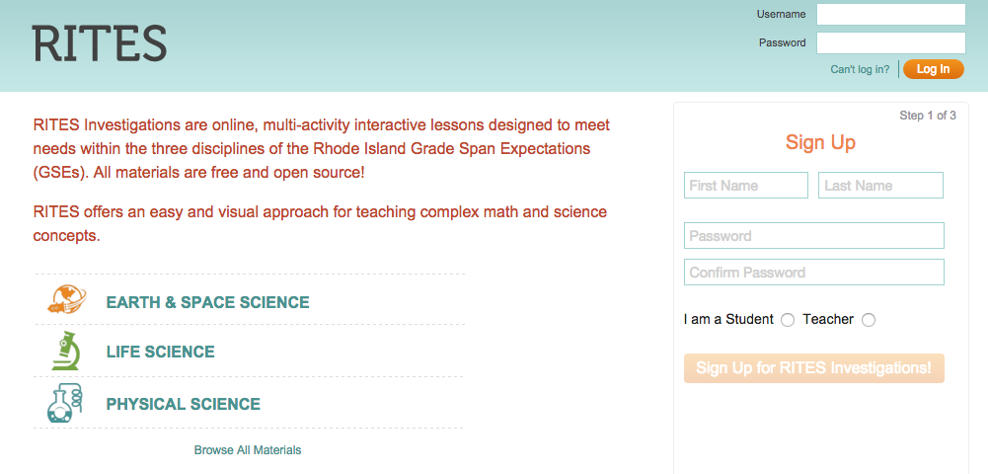
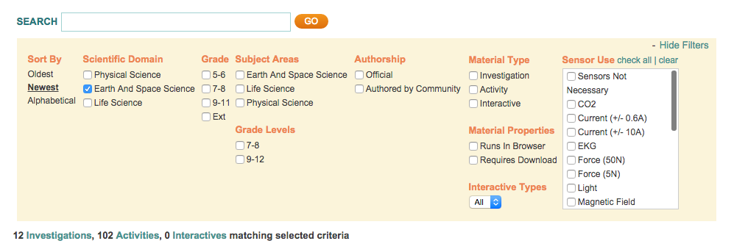
RITES Investigations
Northeast GSA
Notes:
Shows how to access investigations through the portal
We will select out one to look at closely – Earthquakes.
9

Slide 10
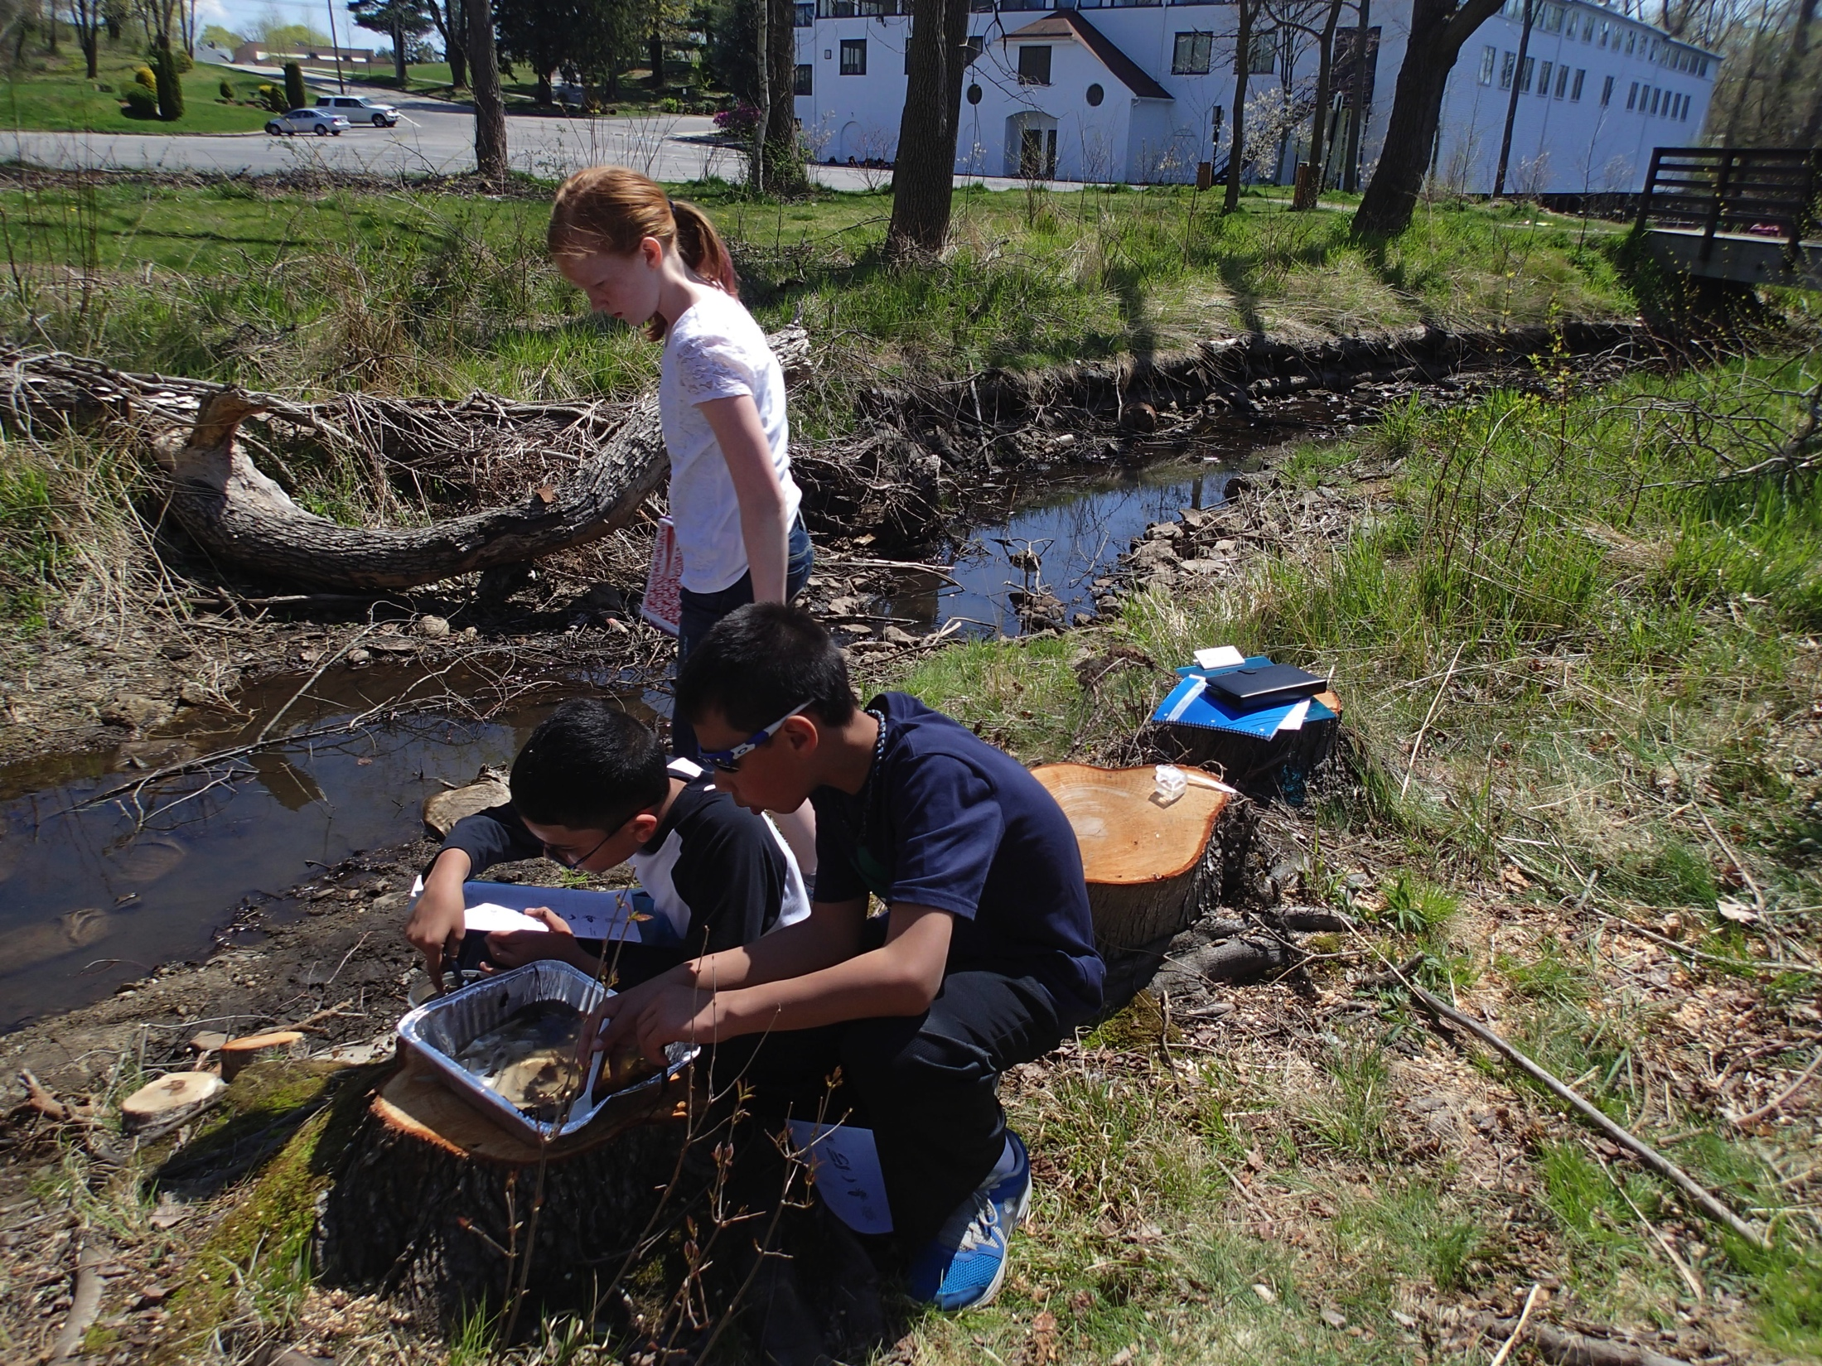
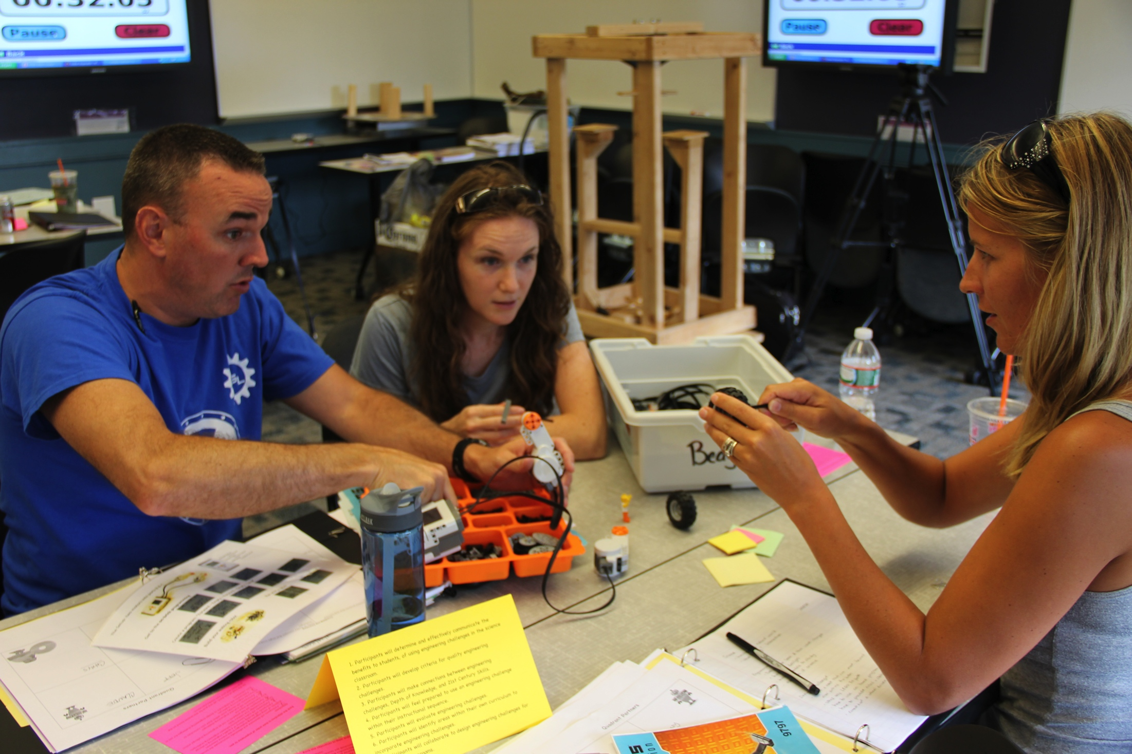
Professional Development
Short Course Design
2 ½ Days in a 2 week Summer Institute
Developed by Gr6-12/HE Resource Teams
Organized around RITES Investigations
High Expectations & Incentives
Short Course Outputs
40 Short Courses: PS, LS, ESS
500+ Teachers (Grades 5-12 )
27 of 36 Districts
Foundation for growth of RITES partnership
21 March 2016
Northeast GSA
10
Notes:
The PD which the Resource Teams were responsible for designing and implementing.

Slide 11
Lessons Learned from PD
A minimum of 70 contact hours of PD is estimated as the necessary amount for significant impact to be reached. Impact became significant after a complete cycle (2 years).
A critical mass of teacher participation is also necessary. Higher level of participation contributes to faster impact.
Punctuated experiences (average of twice annually) is sufficient for students to reap benefits.
21 March 2016
Northeast GSA
11

Slide 12
Lessons Learned from PD
Starting the PD from the standards is effective. It makes alignment with appropriate curricula possible. It enhances the likelihood of buy in/adoption.
Technology-based investigations provide appropriate inquiry opportunities to affect students’ analytical skills.
A focus on inquiry will help students develop skills transferrable to new contexts.
21 March 2016
Northeast GSA
12

Slide 13
Impacts of Resource Team Model
Either Add a slide for
Knowlton et al. (2015). Higher Education Collaboration
with K-12 Teachers as a Professional Development
Activity for Faculty. Journal of College Science Teaching. 44(4), 46-53.

Slide 14
Is the Partnership a Success?
Sustainability
Initially HE directed, but has evolved to be a true peer partnership, driven by the K12 community
Partnership has remained even as original NSF funding has ended
Seeing changes in the cultures
Greater recognition of having educators in tenured faculty positions
Greater use of inquiry based science activities in middle and high school science classes
Data sharing at a deep level
Notes:
Most of the people on the State Council which pushed the adoption were RITES participants, and the effort was nurtured by the RITES partnership.
Data sharing includes student level data that is often not shared with temporary research grants. Results of data has been shared in other presentations.

Slide 15
Is the Partnership a Success?
RITES adds self-determined value to districts and their
teachers
Materials support existing curriculum reforms, not initiate reform
Materials punctuate the curriculum, does not provide a curriculum per se
Materials are modular, flexible
Materials provided in different formats (paper, whole-class projection, student-group, one-to-one) to match existing tech environments
Notes:
These points are not necessarily found in these types of partnerships. They came out of many discussions, taking ideas and concerns from higher ed faculty and administrators; LEA teachers and administrators; local science education experts.

Slide 16
Is the Partnership a Success?
RI the first state to adopt the Next Generation Science Standards
RITES partners have committed to expanding work to computing and computer science
have won more funding for this, and are working towards making this a reality
CT and CS Literacy efforts built on a foundation of RITES
Notes:
Most of the people on the State Council for NGSS which pushed the adoption were RITES participants, and that effort was nurtured by the RITES partnership.
This was not coincidental. The RT’s designs took NGSS ideas into account; for example,
Two important consequences re NGSS: RI was receptive to NGSS in part because of what was happening in RITES.
RITES investigations and materials are more easily aligned to NGSS.
The RITES partnership and PD provide the ideal foundation to develop statewide gains in CT and CS.
RITES MSP is growing into RITES+C through STEM+C = new PIs, new districts, new teachers, new partners.

Slide 17
Why is the Partnership a Success?
Teacher-centric
Bottom up approach
Peer Collaboration on processes and products
on Design, Content, Pedagogy, Technology
on Development
Eye to systemic change
“going to scale” was part of RITES’ plan from Day One
Notes:
Systemic change – Led to quicker acceptance across state. Led to teacher leader development in districts.

Slide 18
Why is the Partnership a Success?
T R U S T
L I S T E N
E Q U A L
Notes:
ULTIMATELY – The partnership is succeeding, because it is built on TRUST amongst the partners; because we listen to each other, at all levels; and because we see each other as equals in all we undertake. Never lose sight of these three!
And these 3 relate to the PRISM rubric categories - Communication, &c

Slide 19
Lessons Learned
How was the Partnership successful?
The partnership provided the platform to hear and involve teachers and faculty in expressing their needs and assisting in designing and participating in their PD.
Resource Teams were the beginning of the partnership, with both sides talking and working together. These relationships were deepened in the professional development program and program implementation.
From these relationships, trust and value grew at the institutional levels
Why Are Partnerships between K12 & Higher Education Important?
Partnership is the bridge between K12 and higher education. We need that bridge to develop new earth scientists and teachers.
Both sides need to understand each other’s culture and needs to be successful.
The greatest needs in K12 science is in the Earth & Space Sciences.
Notes:
“We will describe our current efforts to determine how best to include lead teachers, higher education faculty and participating classroom teachers in discussions about the meaning of the NGSS standards and how best to foster students' computational thinking through the design of our next generation of investigations.” – Abstract
The purpose of this talk is to share with you a successful model to develop materials to improve STEM literacy statewide. We will focus on examples in ESS and explain how they can be remodeled to NGSS.
And finally, CT and ??? are of great interest to the ed community, and we have begun to blend these into our investigations, and we will provide our ideas on that.

Slide 20
Acknowledgments
Though there are too many individuals to thank here for the constant support and hard work which formed and continues to support the Partnership, there are a few we would note ~
Dr. Glênisson de Oliveira Peter McLaren Dr. Dawn Cardace Dr. Jay Fogleman Donna Casanova Jane Daly Amber & Joshua Caulkins Frieda Reischmann Sean Dacey | PRINCIPAL INVESTIGATORS Dr. Daniel Murray Higher Education Dr. Karen Kortz Dr. Sarah Knowlton Local Education Judith Lundsten Heather Taylor RITES Staff & Support William Day Robert Tinker | Dr. Anne Veeger Alicia Storey Dr. Victor Fay-Wolfe Dr. Rob Pockalny Arthur Petrosinelli Timothy McGee Amy O’Donnell Henry Wladkowski Lori Jacolucci

Slide 21
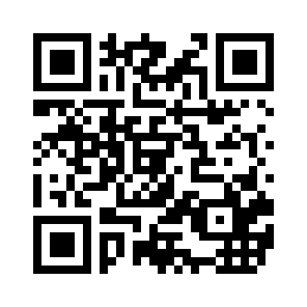
Resources
Presenters
Dr. Daniel Murray dpmurray@uri.edu Geosciences emeritus, URI
Howard Dooley, Jr. hdooley@uri.edu Project Manager
Donna Casanova Donna.Casanova@ppsd.org K12 Science Coordinator,
Providence Public School
Insert
Any opinions, findings, and conclusions or recommendations expressed in this material are those of the authors and do not necessarily reflect the views of the National Science Foundation.
This material is based upon work supported by the National Science Foundation under Grants No. MSP 0831974, CSE 0831974, and STEM+C 1542892.
Notes:
Hand-outs –
* 3 slides / page
*

