Slide 1


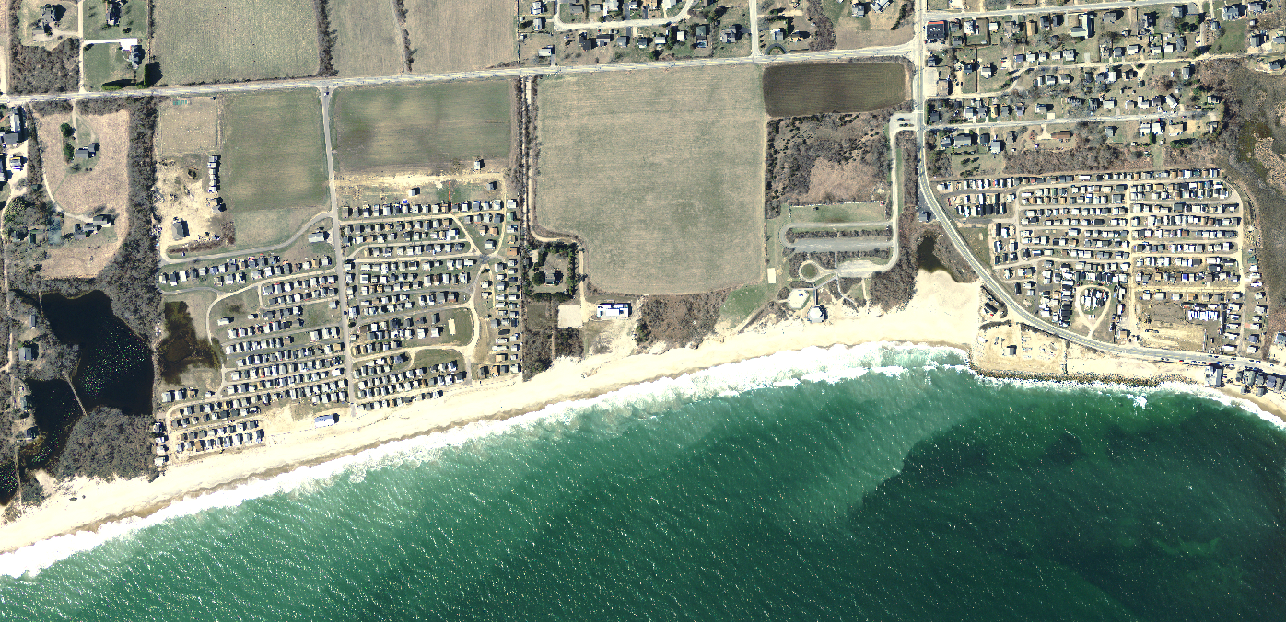
Variable Rates Of Shoreline Change Along The Rhode Island South Shore: A Closer Look At Processes And Methods
Hollis R. J. ^{1, 2} , Oakley B. A. ^{1,3} and Jon C. Boothroyd^{1,2}*
Rhode Island Geological Survey ( * deceased) (2) Department of Geosciences, University of Rhode Island, Kingston RI 02881
3) Environmental Earth Science Department, Eastern Connecticut State University, Willimantic, CT 06226

Slide 2
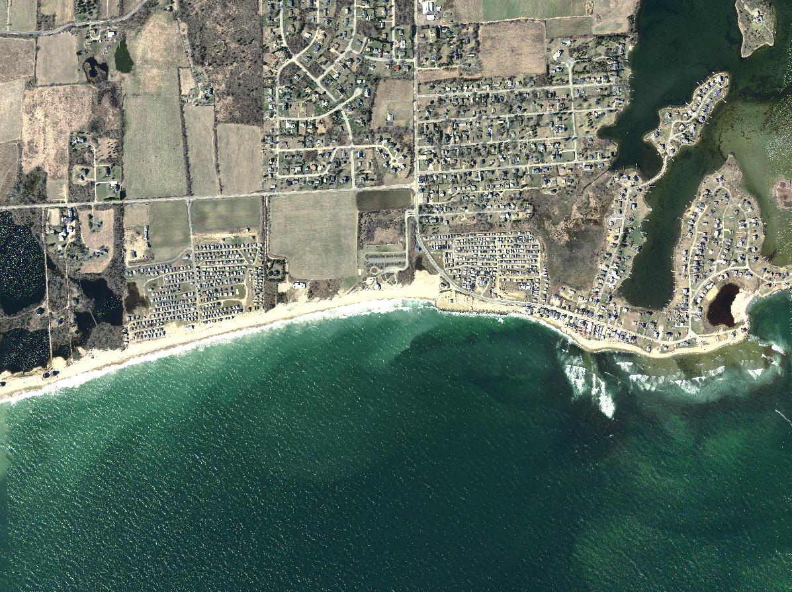
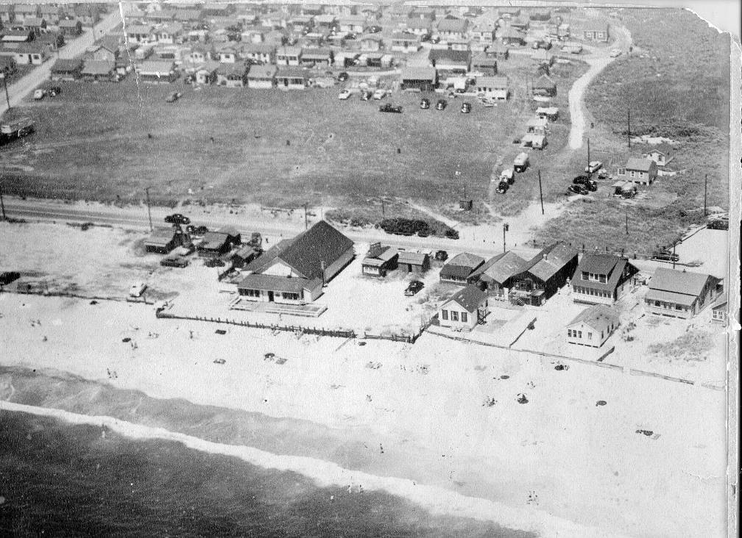
What’s the issue? Why is it important?
1950’s- CRMC Archive

Slide 3
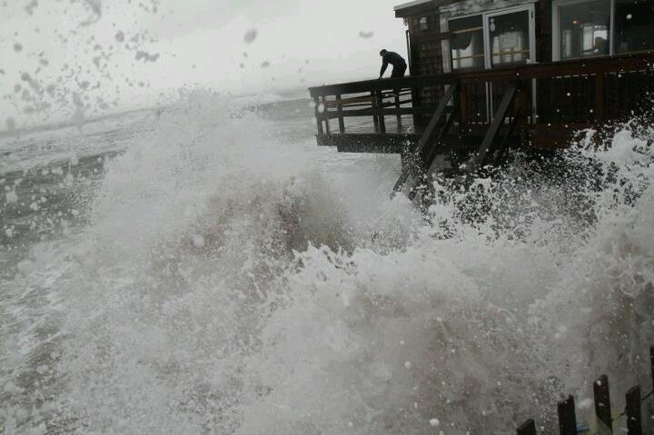
What’s the issue? Why is it important?
2012- Independent RI

Slide 4
Matunuck Beach Rd.

Slide 5
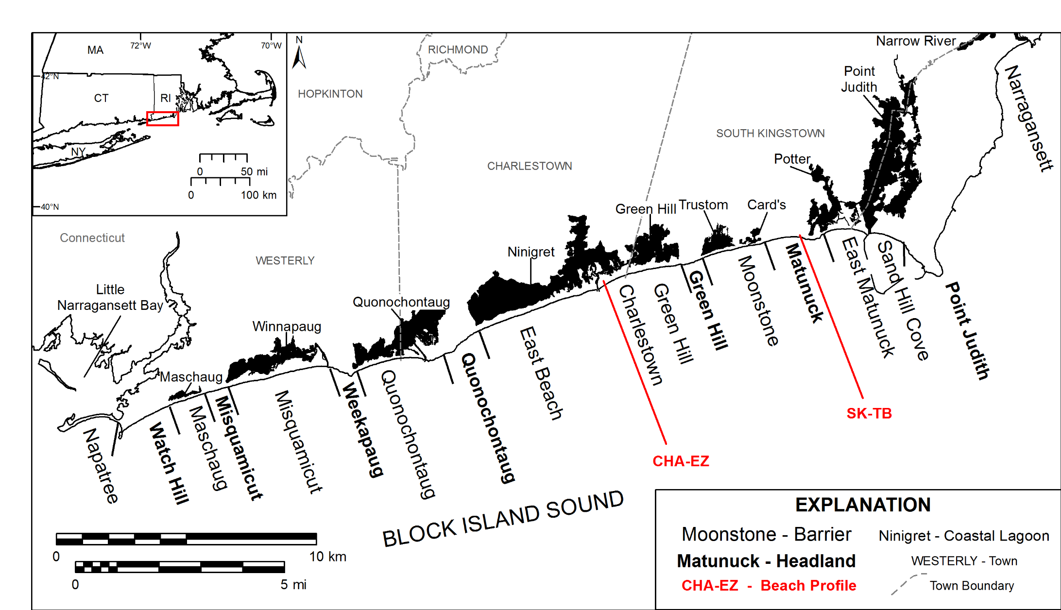
Rhode Island South Shore

Slide 6
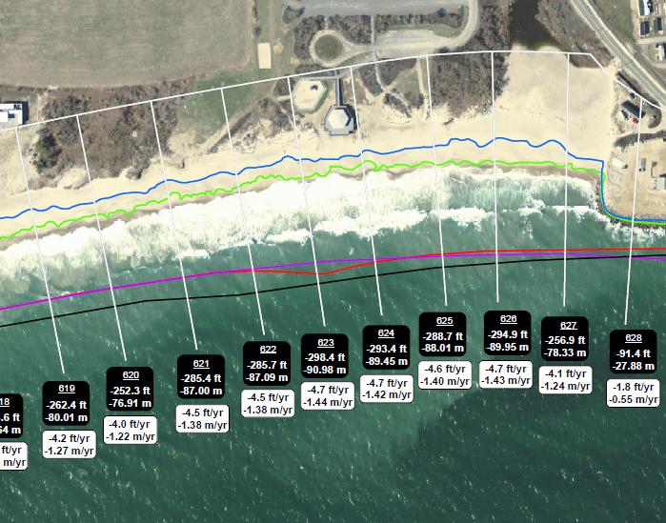
Shoreline Change Mapping and Beach Profiling
SK-TB
Shoreline Proxies(LHTS)
digitized from multiple aerial imagery sets
Good Spatial Coverage
Poor Temporal resolution
Good for overall trends
Modified Emery Method
(Two Sticks and a String)
Poor Spatial Coverage
Good Temporal resolution
Good for short term trends

Slide 7
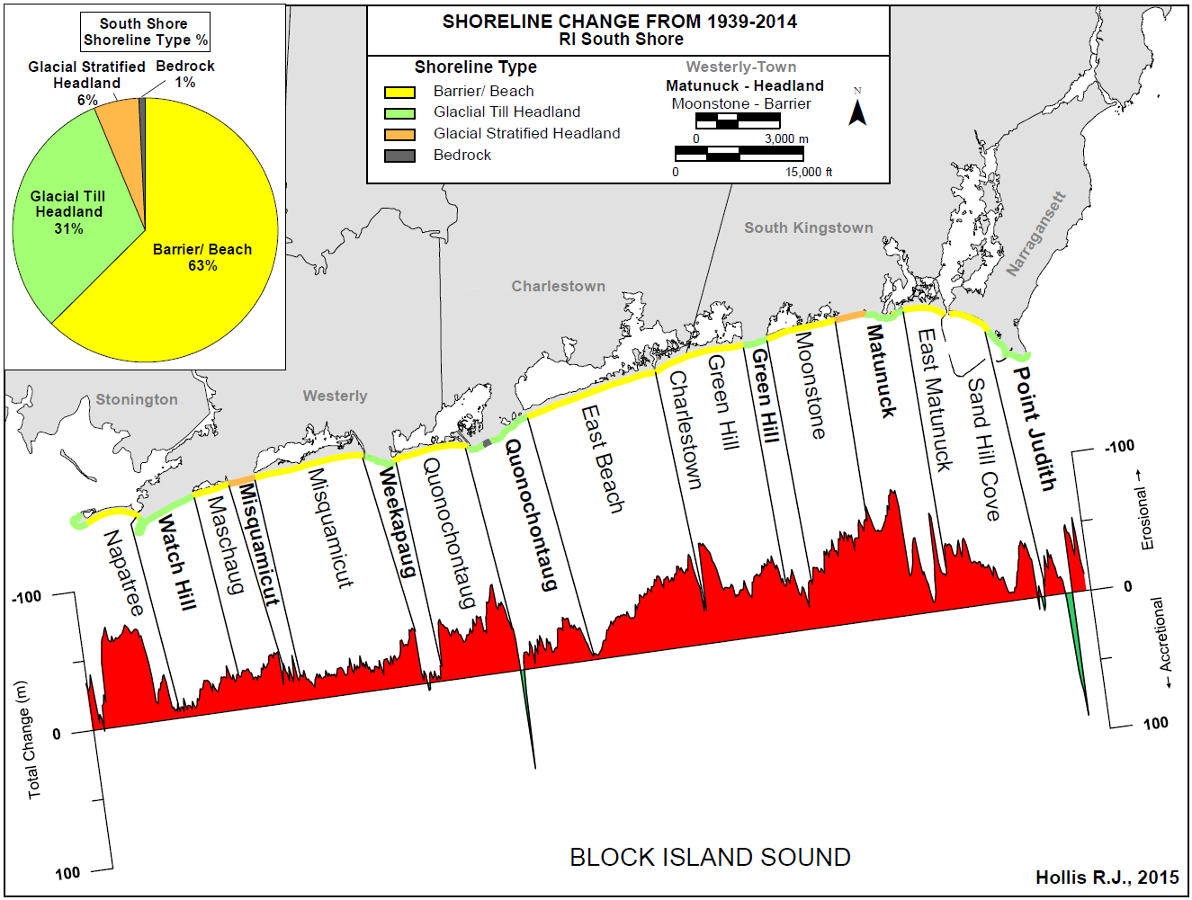
Shoreline Change Alongshore Trends

Slide 8
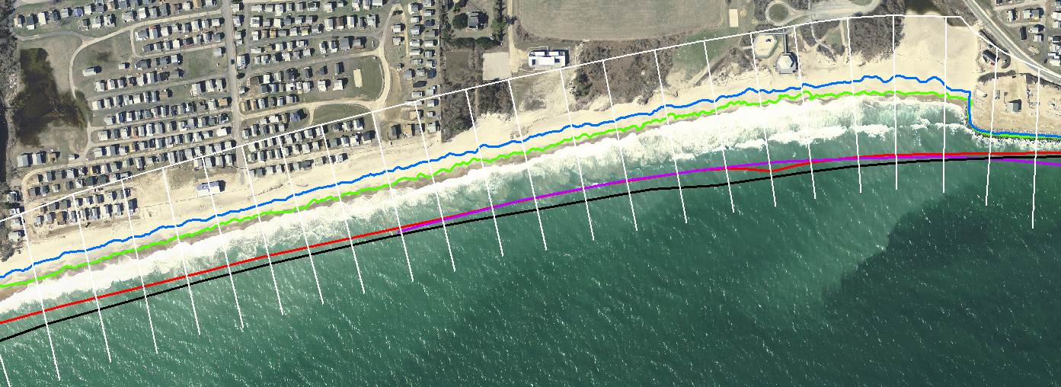
Glacial Stratified has Highest Shoreline Change Rates
Shoreline Type | Average Shoreline Change Distance (m) | Average Shoreline Change Rate (m*yr⁻¹) | Percent of South Shore Shoreline
Glacial Stratified | -49.27 | -0.76 | 6%
Barrier | -35.89 | -0.57 | 63%
Glacial Till | -18.41 | -0.31 | 31%
Bedrock | -12.22 | -0.25 | >1%
2014
-91 m
-1.44m*yr⁻¹
1951

Slide 9
Traits of Matunuck Headland contributing to erosion
Varied storm response of barrier and headland beaches (specifically Matunuck Headland)
Beach Morphology
Bluff Elevation
Bluff composition
Beach Slope
Beach Width
Shoreface
Wave Refraction
Sediment transport

Slide 10
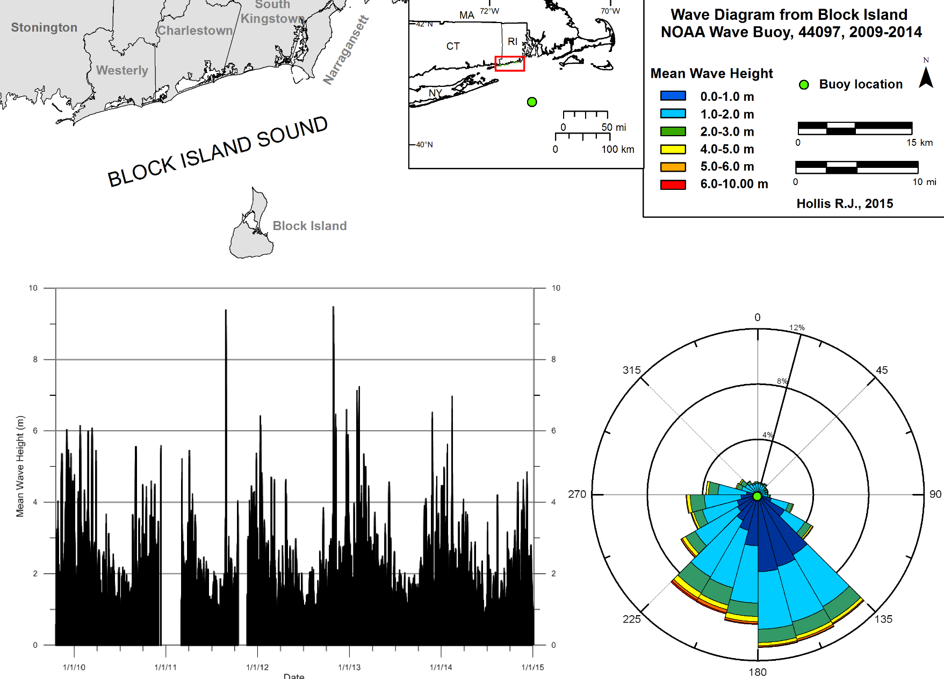
Highest Percent of Large Waves SE/SW Approach
Irene H_{s} = 4.1 m
H_{max} = 6.8 m
10
Significant Wave Height (m)
Irene H_{s} 9.39 m
221 ̊
Sandy H_{s} 9.48 m
164 ̊
0 ̊
0 ̊
8
6
4
2
0
2010
2011
2012
2013
2014
2015

Slide 11
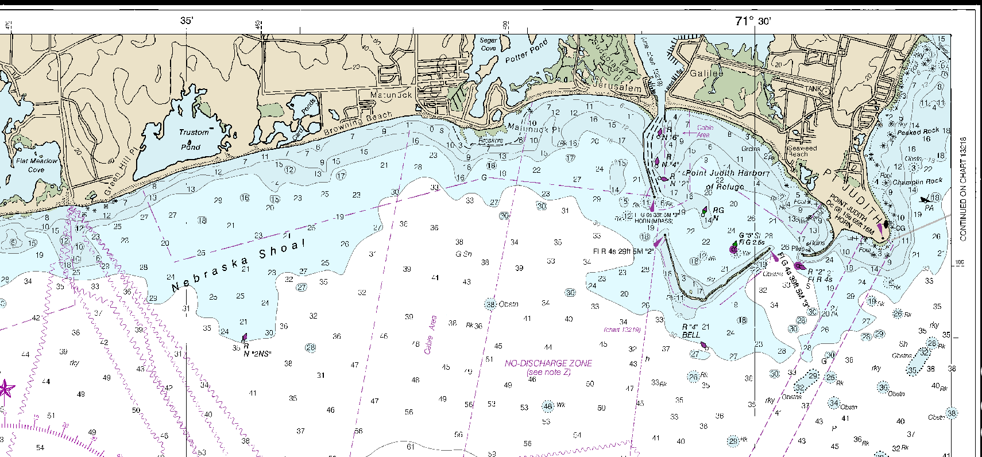
Bathymetric Differences Cause Wave Refraction
SK-TB
NOAA Chart 13215

Slide 12
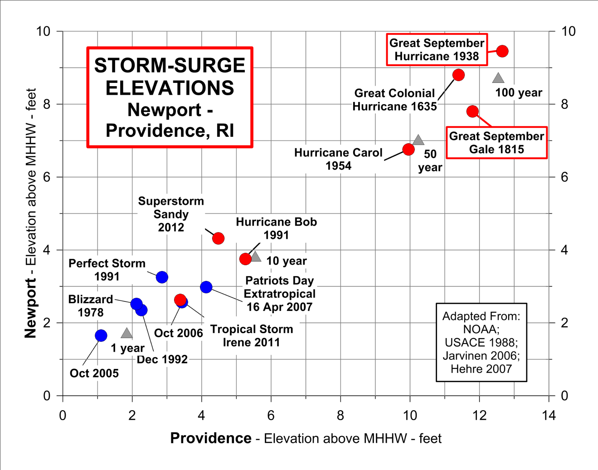
Storms frequency and surge elevations
Boothroyd

Slide 13
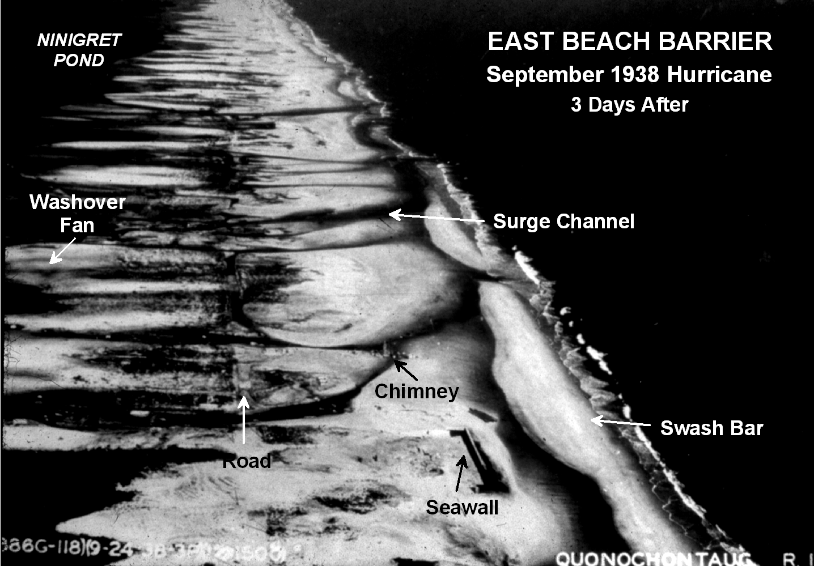
Barrier Roll Over Affects Barrier Position
View East
Boothroyd

Slide 14
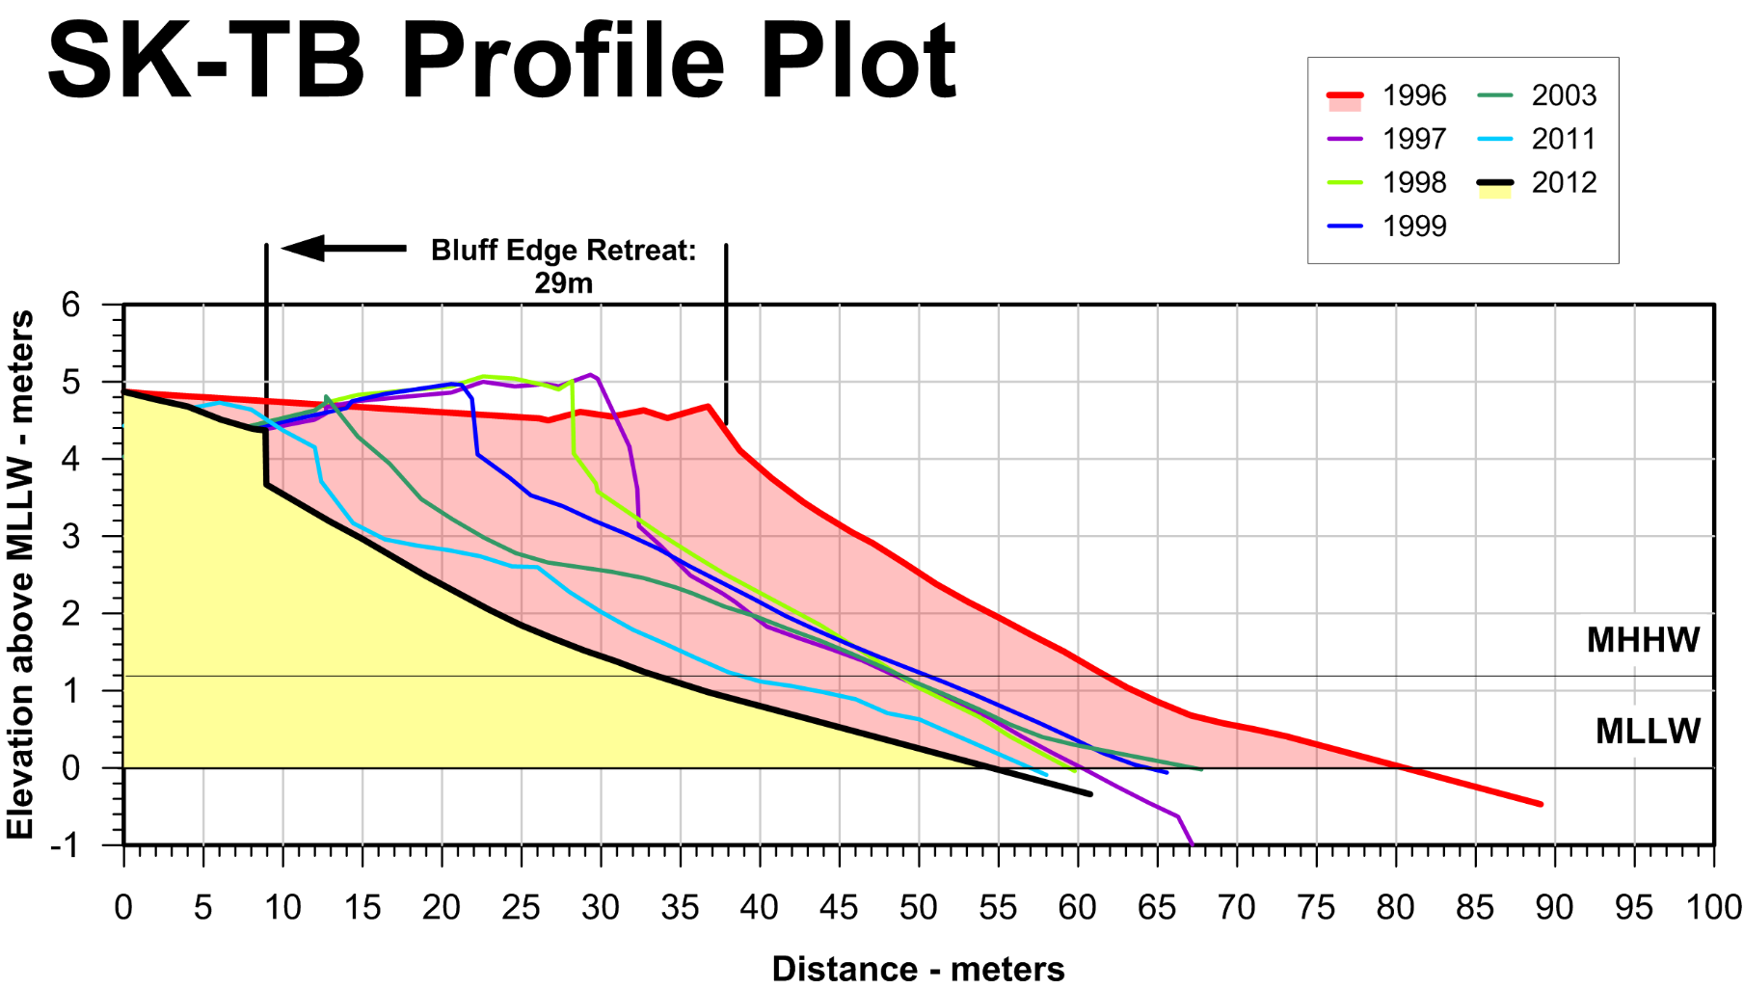
Glacial Bluff Retreat = Not Coming Back
MHW

Slide 15
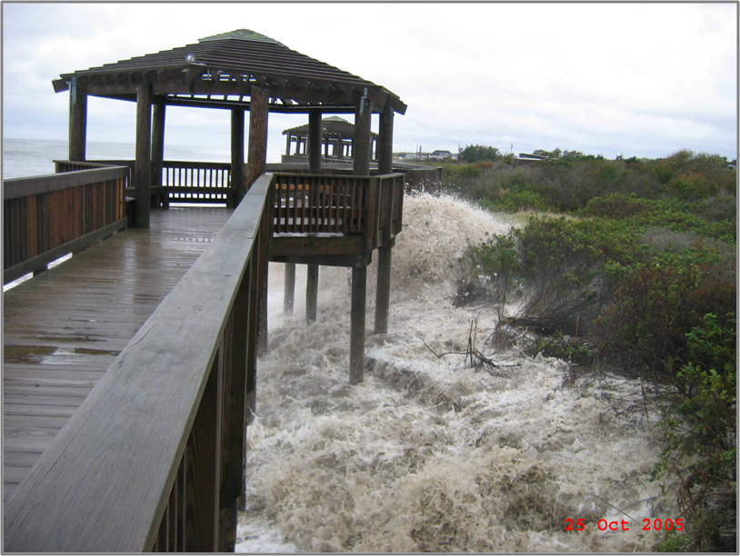
(Former) Boardwalk at SK-TB atop Glacial Bluff
Oct 2005
Oakley

Slide 16
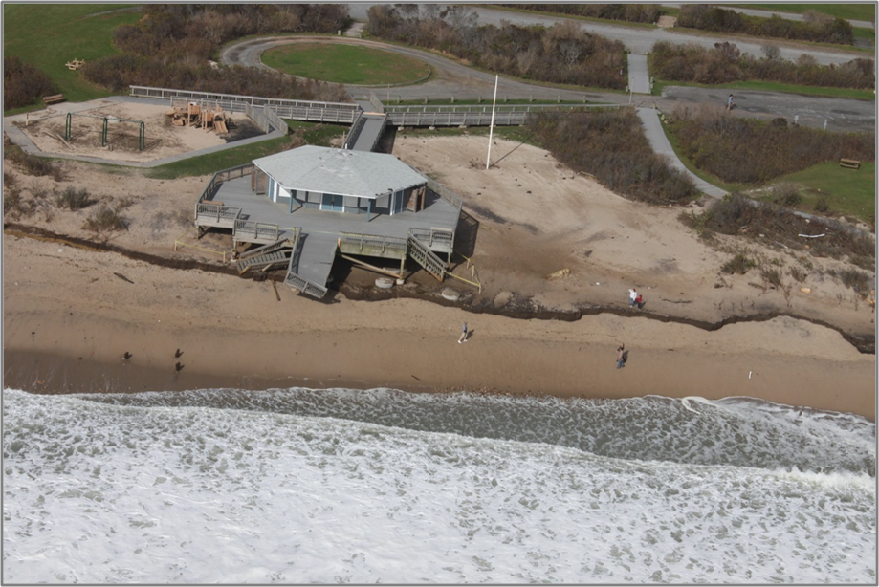
Glacial Bluff at SK-TB Post Sandy
Boardwalk Pilings
Oct 2012
RIDOT

Slide 17
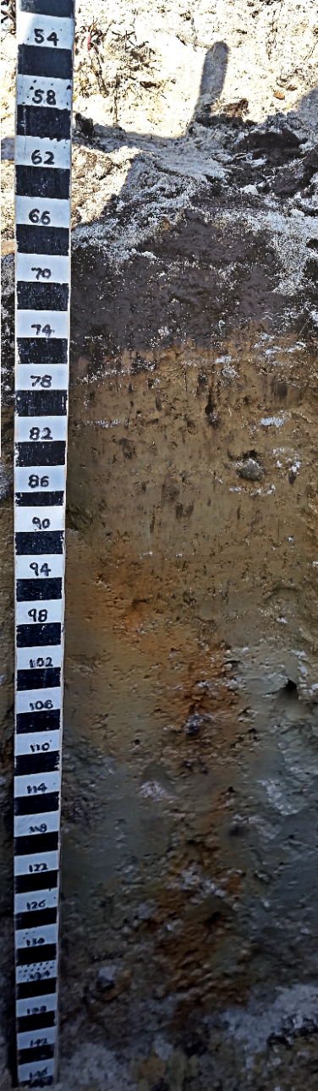
Size Composition of Glacial Bluff
0 cm
Washover
Plow Zone
Eolian
Mantle
120
Stratified
Deposits

Slide 18
44 % of Plow Zone and Eolian Mantle Lost in Storms
0 cm
Washover
Plow Zone
44%
Eolian
Mantle
120
Stratified
Deposits

Slide 19
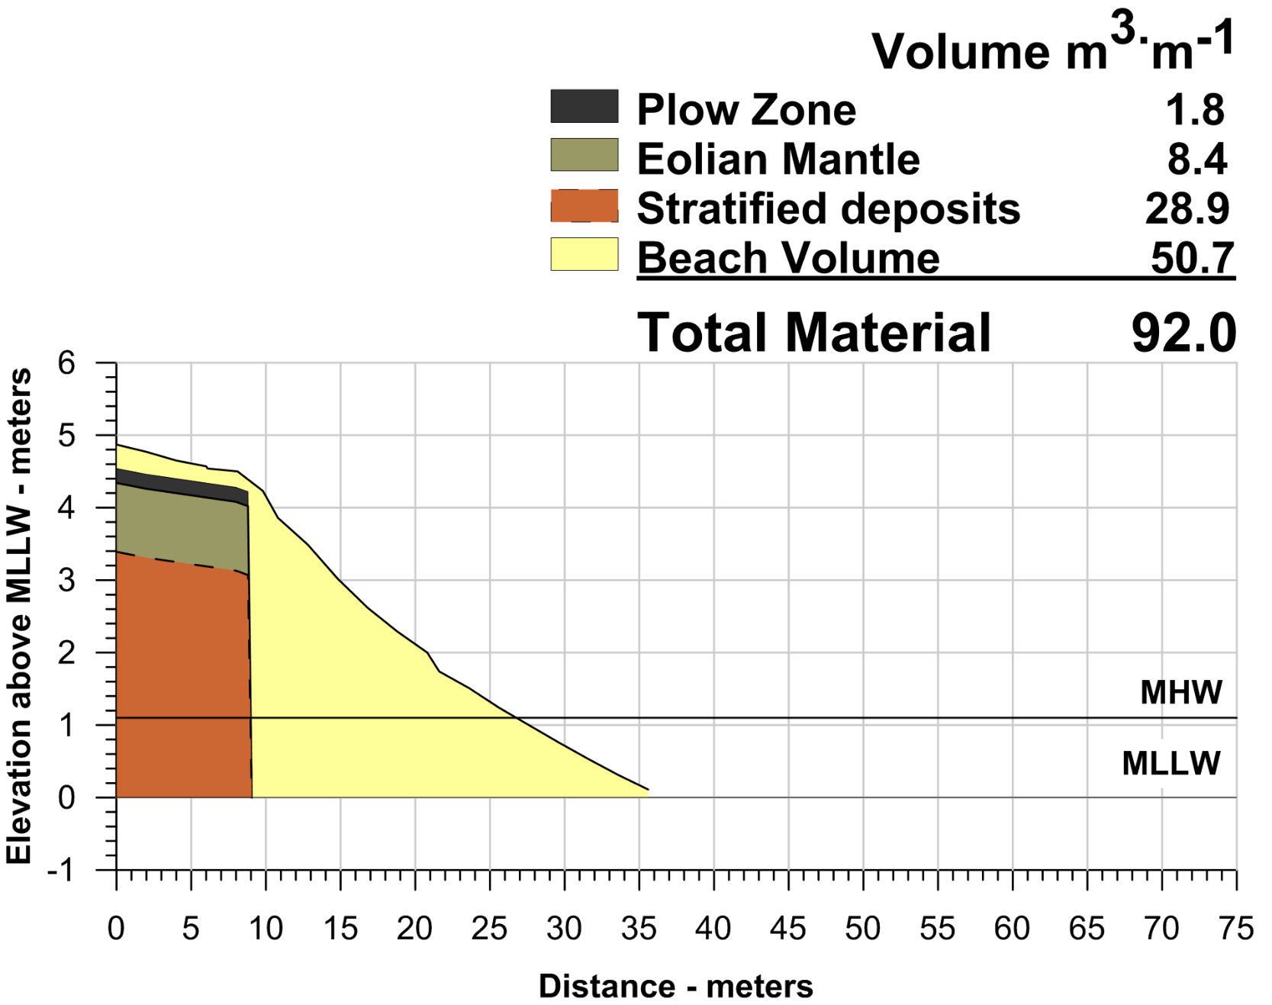
SK-TB 28 February 2016 Glacial Bluff

Slide 20
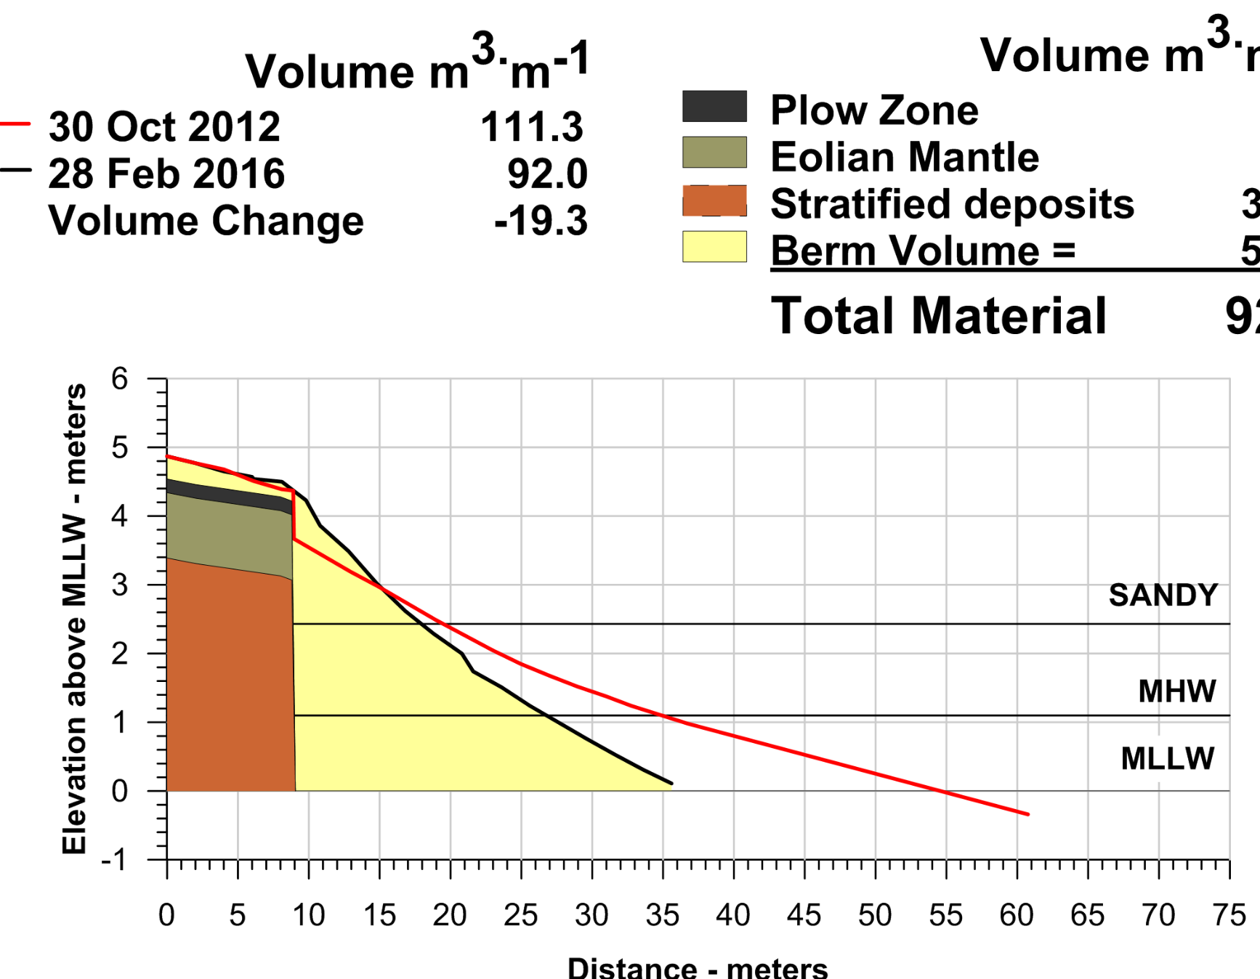
SK-TB 28 February 2016 Glacial Bluff

Slide 21
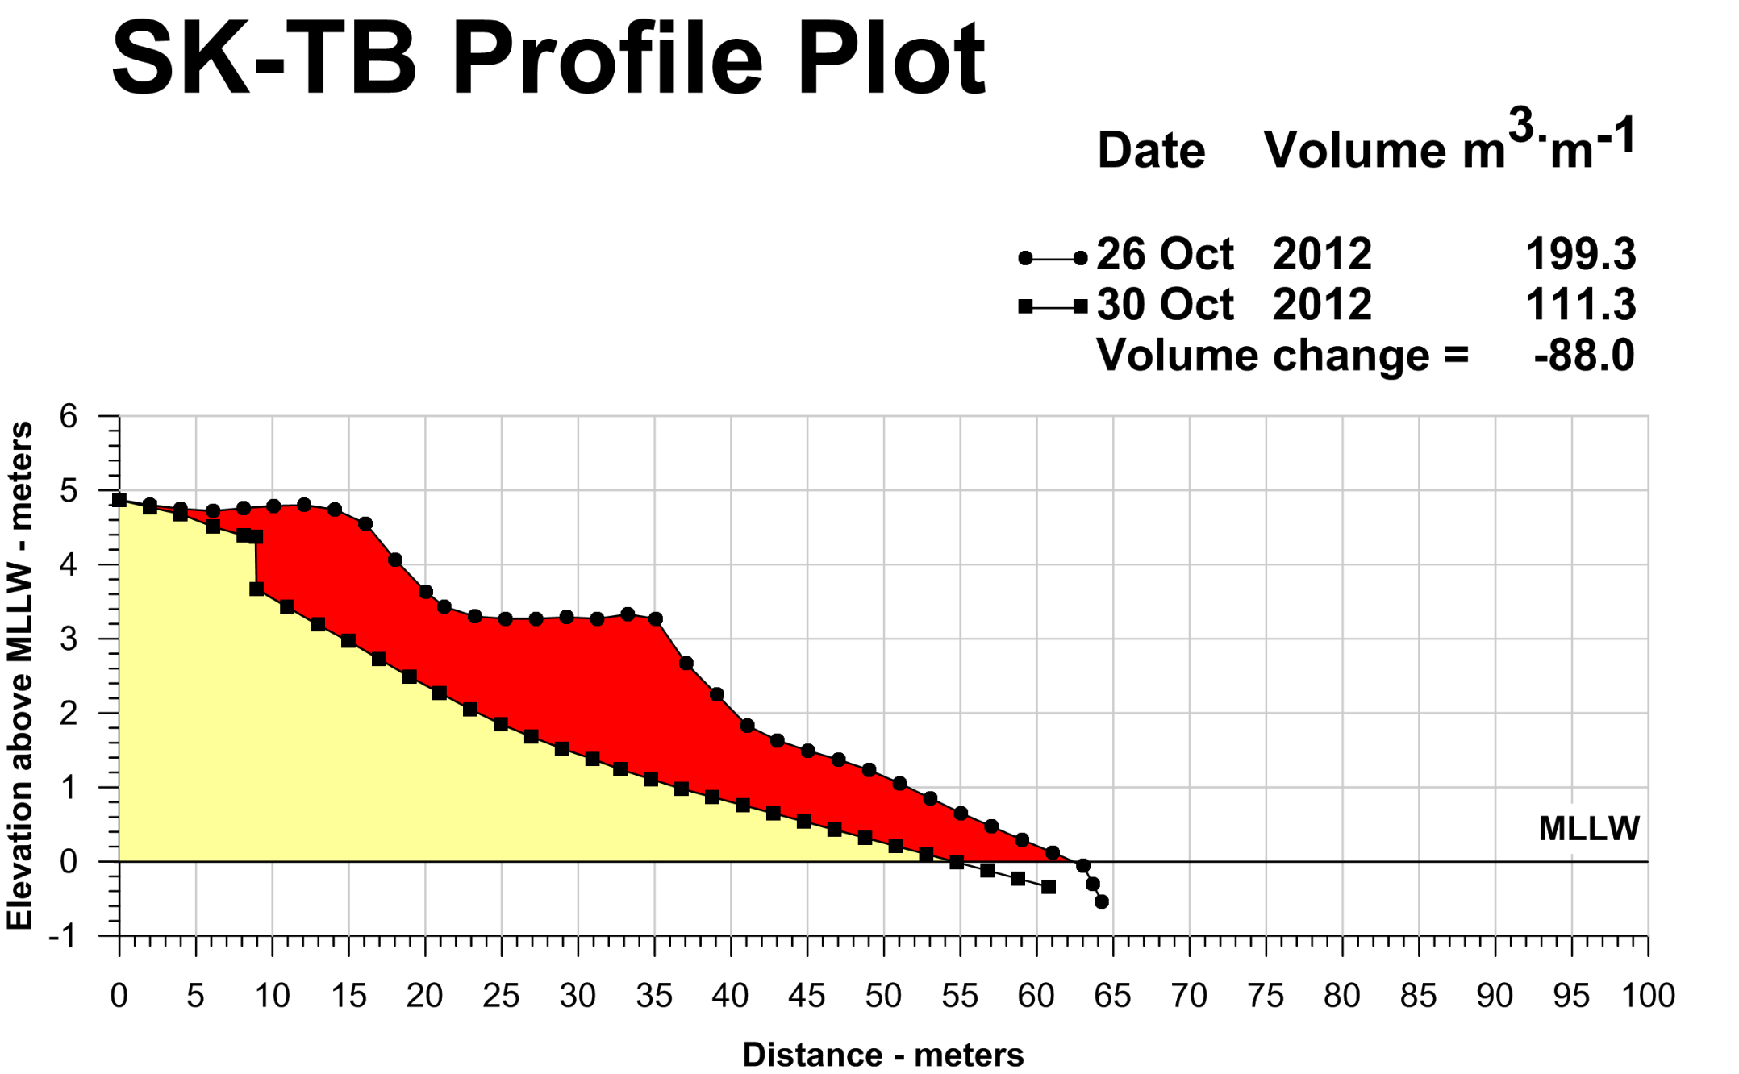
SK-TB Pre and Post Sandy
Post Sandy
Pre Sandy

Slide 22
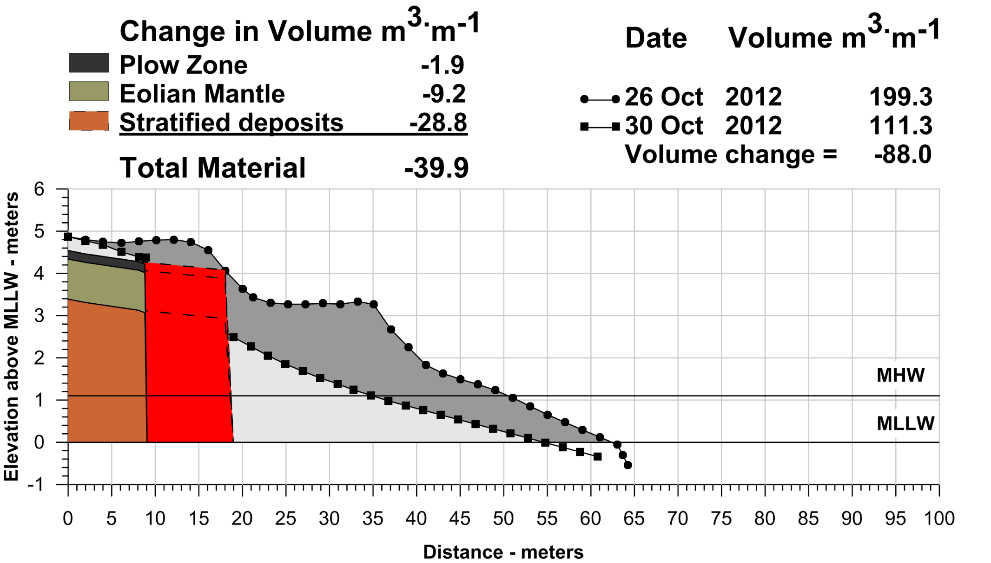
~9 Meter Bluff Retreat in Sandy
12% is silt and will not be redeposited onshore

Slide 23
Summary
Waves from SW-SE directions are focused to this portion of the headland
Even a 1 year event can cause shoreline migration and larger storms cause severe bluff retreat
Narrow reflective beach increases likelihood of bluff retreat
Silt portion of bluff composition is lost to the offshore environment

Slide 24
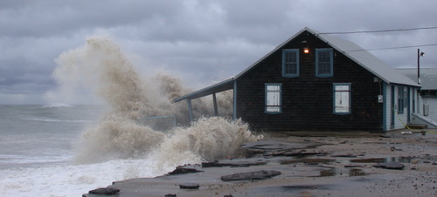
How’s the beach doing? When do I get that view!?
MMCK Oct 2005

Slide 25
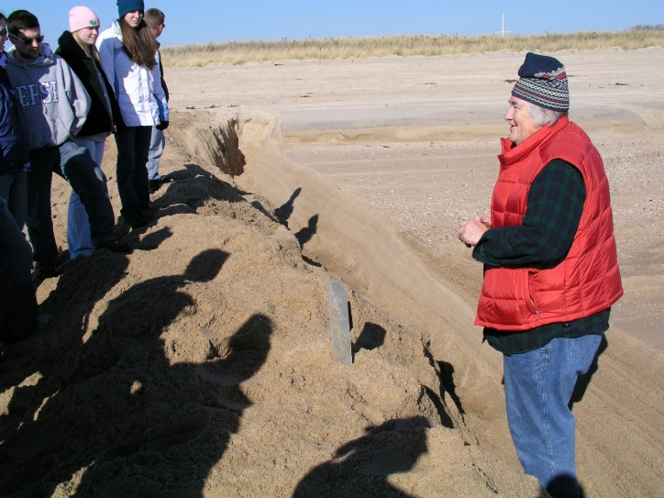
Thank you! Questions?
Acknowledgements
URI
Undergraduate Research Assistants:
Allen Tevyaw, Charlie Lindner, Christopher Wallace, Kevin Ormerod, Paige McLaughlin, Samantha Noone

