Slide 1
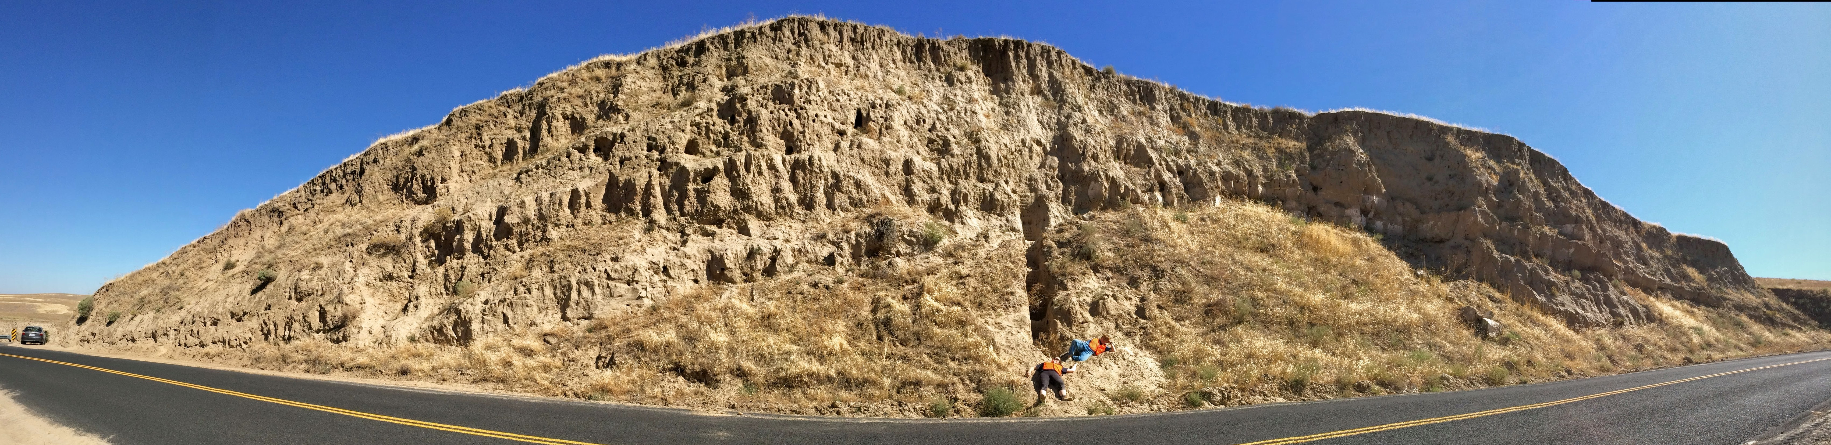
Magnetic Susceptibility of the Palouse Loess: Paleoclimate Proxy?
By: Gabby McGann
Whitman College Geology: Loess Division
Photo from Nick Bader
Notes:
I’m here to talk to you today about this picture, distorted by Powerpoint, of a pile of windblow dust that has been accumulating through the Pleistocene epoch

Slide 2
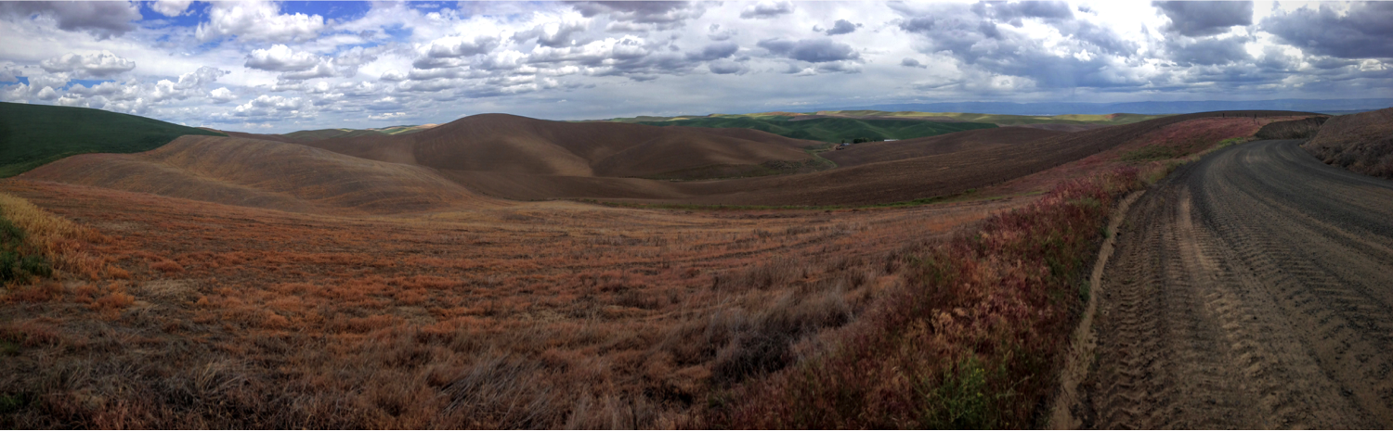
Research Goals
Overall Goal: Gather magnetic susceptibility data to find trends and relate these trends to the paleoclimate of the Palouse area
My Goal: (1) Investigate abundance and distribution of iron in loess, and (2) See if any changes correlate with magnetic susceptibility
Photo from Nick Bader
Notes:
Before getting into my presentation, what is loess? Loess is wind-blown silt-sized sediment
Within the Palouse Hills of Eastern Washington there are outcroppings of loess in the region
And from this abundance of loess within the Palouse, this project has an overall goal of gathering magnetic susceptibility data to find trends and relate these trends to the paleoclimate of the Palouse area
Specifically, my goal was to (1) Investigate abundance and distribution of iron in loess, and (2) See if any changes correlate with magnetic susceptibility

Slide 3
Overview
Palouse loess
Magnetic susceptibility and background of Clyde site
Field work, magnetic susceptibility, and microscopy
Microscopy data
Trends between microscopy and magnetic suscptibility, as well as future research
Notes:
Microscopy just being the microscope work I did

Slide 4
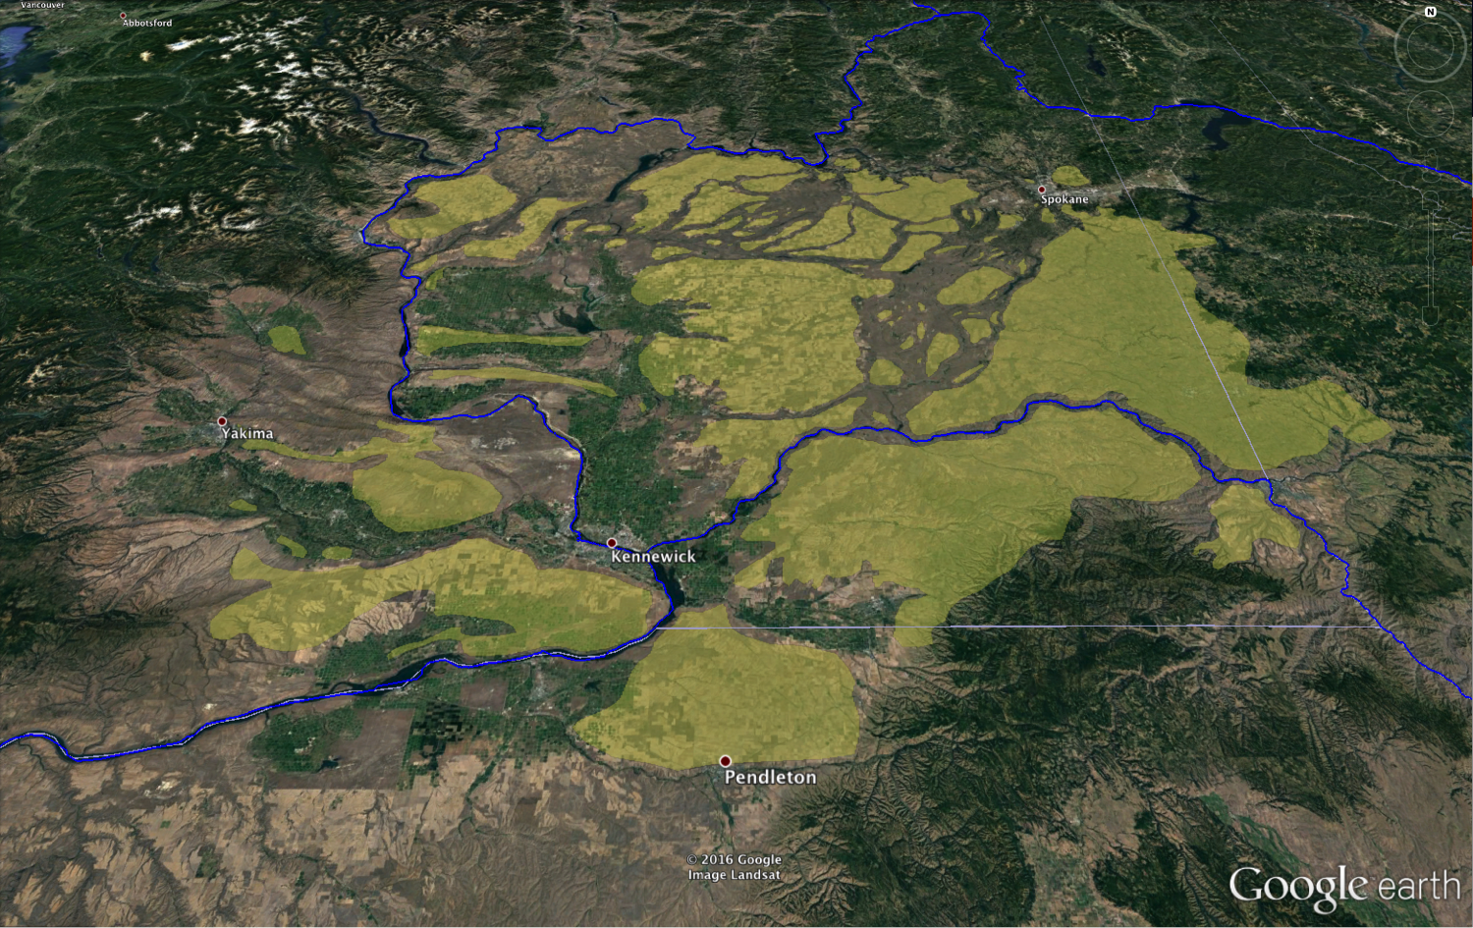
Palouse Loess History
Photo from Nick Bader
Notes:
What we are looking at is a picture of Washington and parts of Oregon and Idaho. To help orient us, you can see the Columbia River and the Snake River. North is the top of the picture
The yellow patches on this map are areas where loess has accumulated in the Palouse
Loess within the Palouse covers up to 50,000km of southeastern WA, along with parts of Oregon and Idaho
Loess has been accumulating throughout the Quaternary period, with a maximum age of 2 million years old and maximum thickness of 75m
The Clyde site is within the Palouse and contains 12 loess paleosol sequences

Slide 5
Magnetic Susceptibility
Research on other loess paleosol sequences has examined trends in magnetic susceptibility as a proxy for paleoclimate
Magnetic Susceptibility: degree to which a sample responds to an external magnetic field
FD (frequency dependent): percentage of magnetic susceptibility based on the smallest size range
Notes:
Research has been performed on other loess plateaus around the world
This research has examined if trends in magnetic susceptibility can be used as a proxy for paleoclimate, but this research hasn’t been applied to the Palouse – we are trying to figure out what does magnetic susceptibility mean for the Palouse?
Magnetic susceptibility is the degree to which a sample responds to an external magnetic field
Magnetic susceptibility can mean a lot of things, For example, higher magnetic susceptibility within the Chinese loess correlated to higher rainfall
Within the Palouse, we are trying to see if a high magnetic susceptibility means a higher concentration of Fe-bearing particles and what are those Fe-particles
FD stands for frequency dependent and that is the percentage of magnetic susceptibility based on the smallest size range
A low FD means that there are fewer of these very small particles

Slide 6
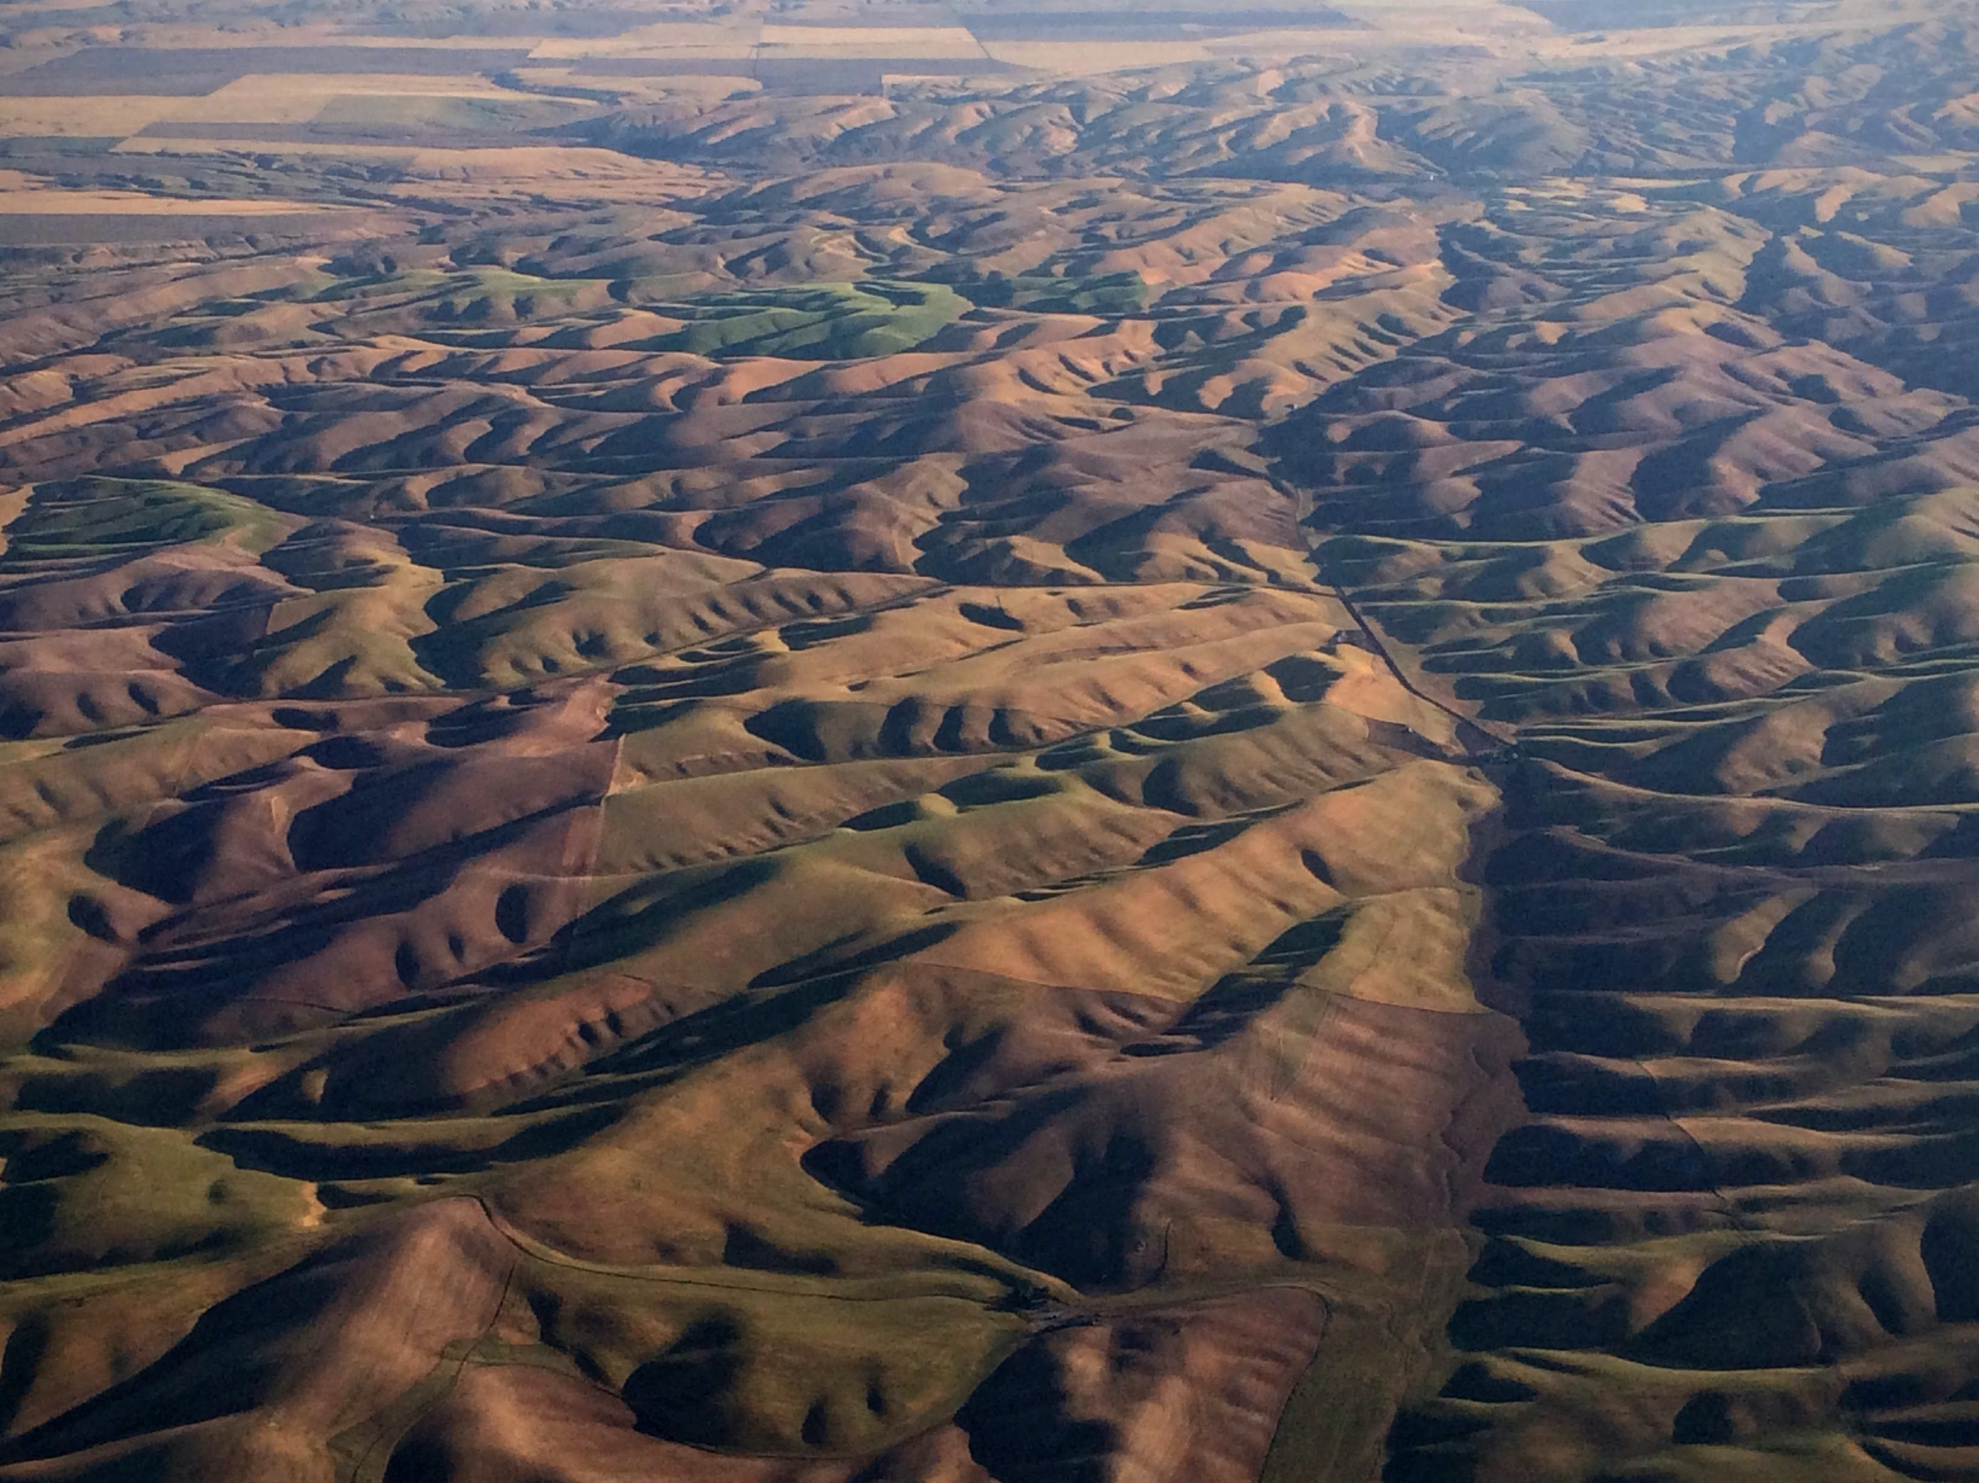
Clyde Site Loess Characteristics
Clyde site made of quartzofeldspathic loess
Contains tephras and aggregates
Fe-bearing particles?
Photo from Nick Bader
Notes:
The Clyde site is composed of quartzofeldspathic loess; loess being the name given to windblown silt, with silt being the grain size between sand and clay
Our site also contains tephras, which are made of shards of volcanic ash and aggregates, which is soil that is clumped together
With my research I am hoping to confirm the presence of Fe-bearing particles within the loess paleosol sequences at the Clyde site

Slide 7
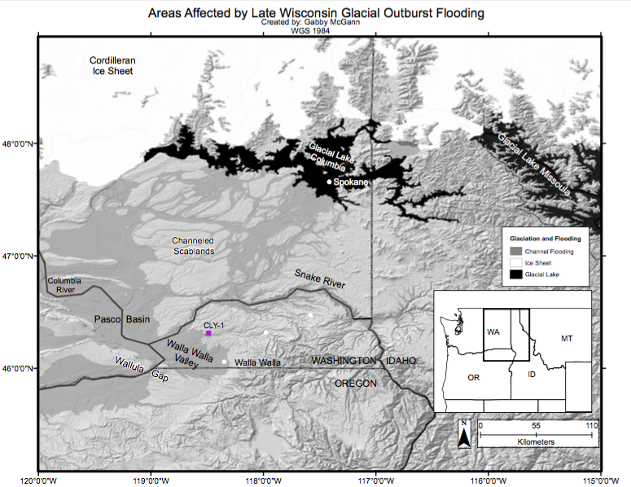
Clyde Site Background
Notes:
Quick background on how the loess came to be deposited at the Clyde site:
Ice age floods swept acros Northeastern Washington and were channeled by the Columbia River
Then all the particles the floods were holding were deposited in Pasco Basin and Walla Walla Valley due to backflooding
Finally these sediments were reworked by winds coming from the Southwest and deposited within the Palouse and at the Clyde site

Slide 8
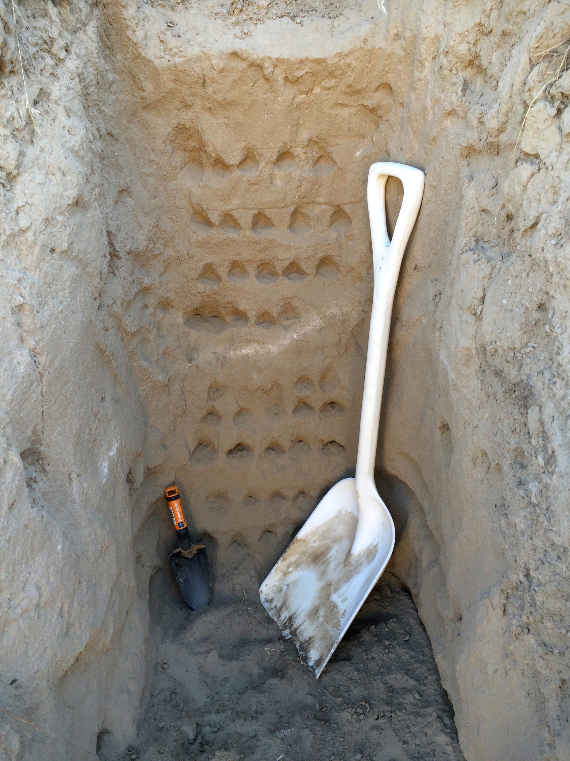
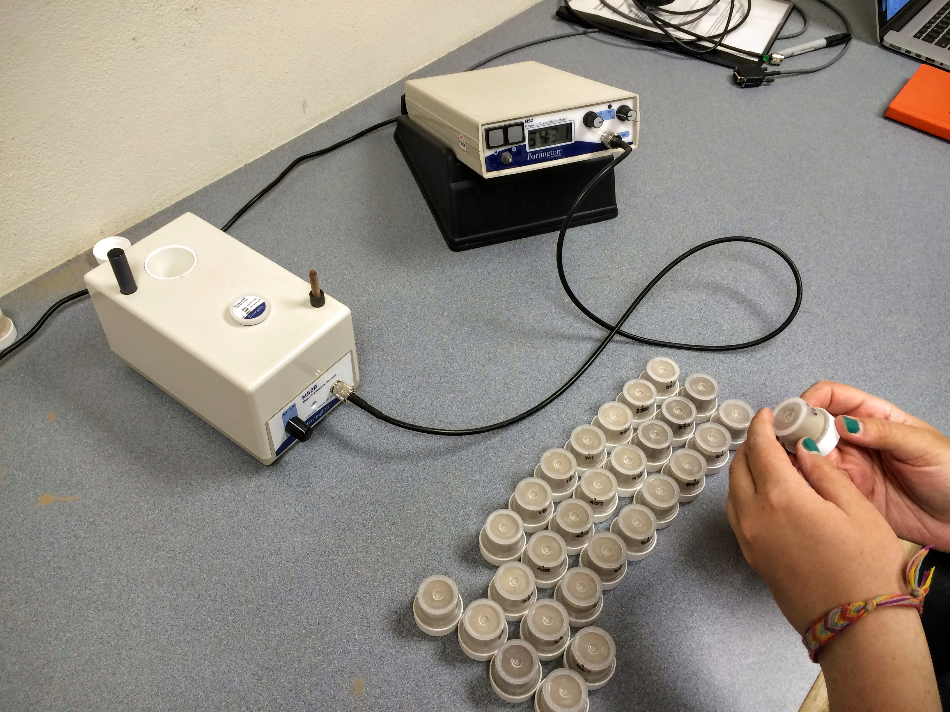
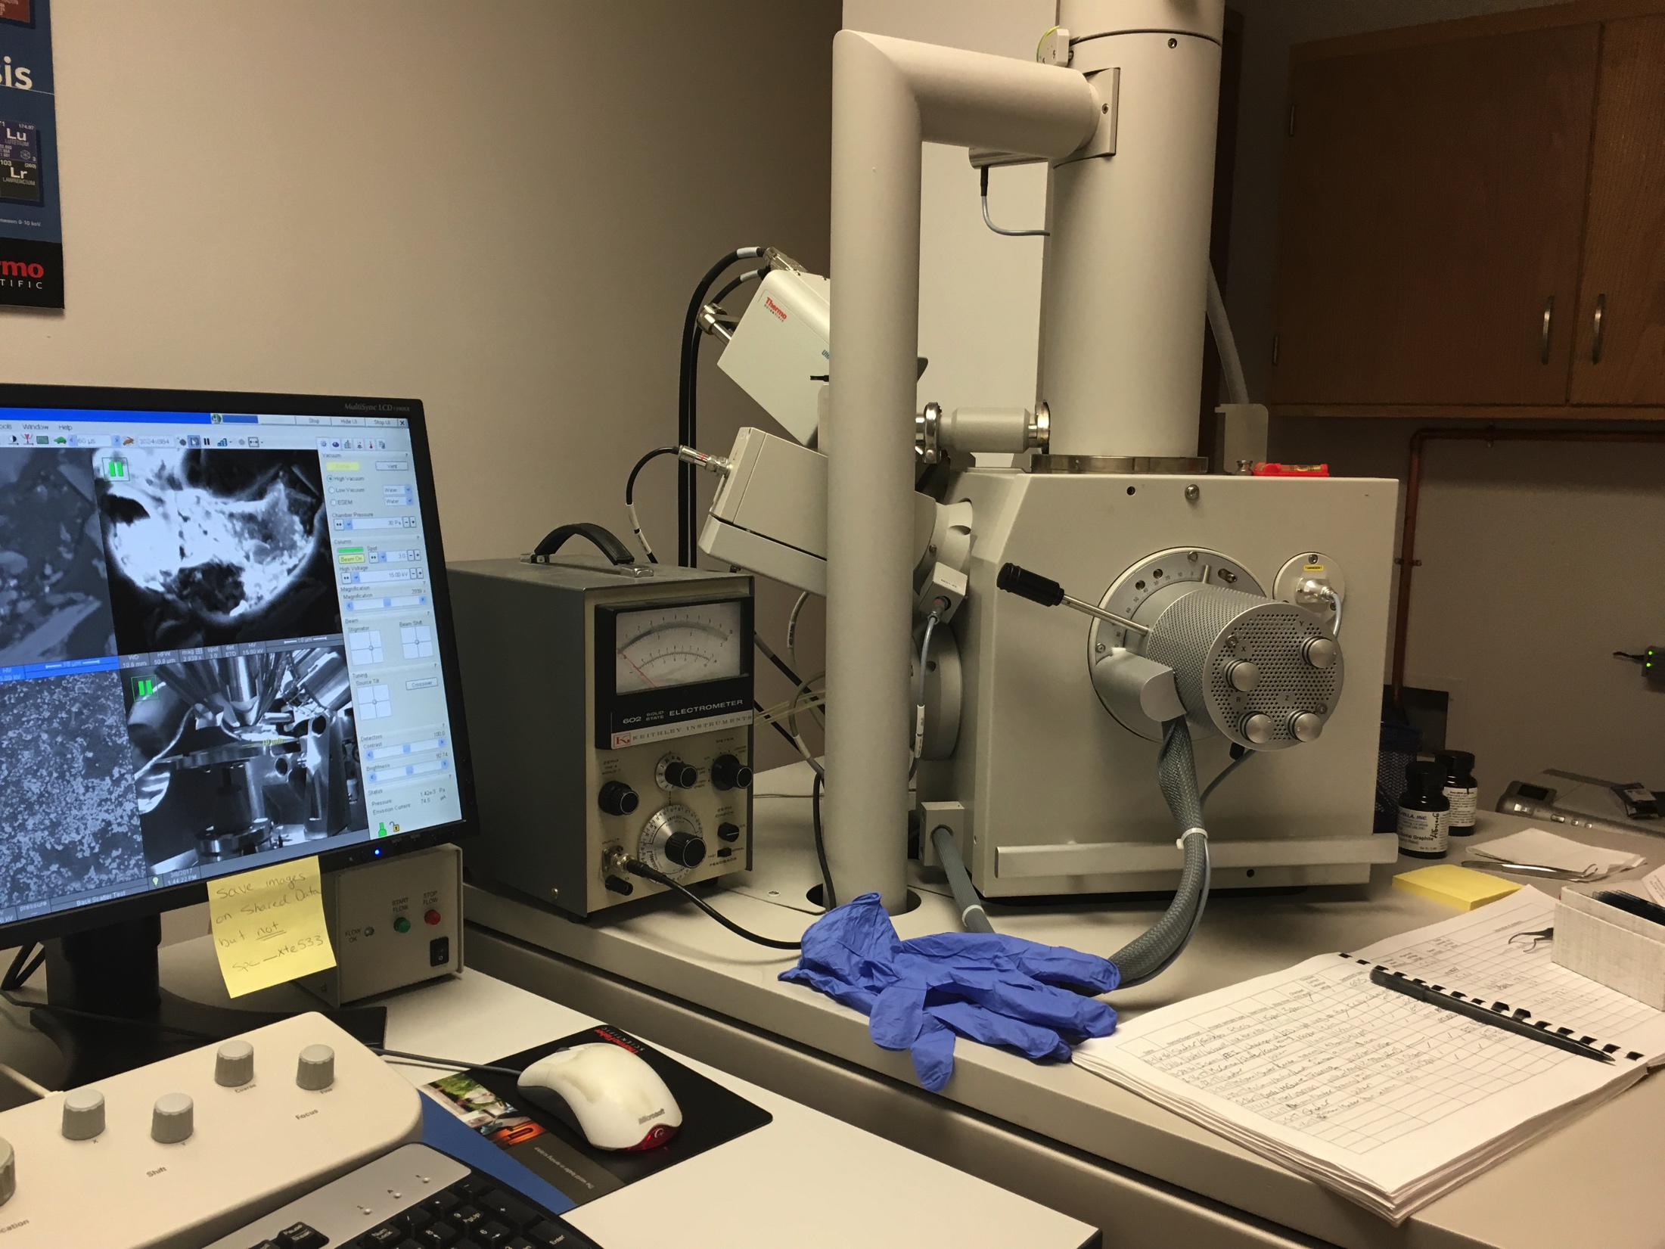
Methods
Photo from Nick Bader
Left: Trench dug at Clyde site
Top Right: Magnetic susceptibility
Bottom Right: SEM work on thin sections
Photo from Nick Bader
Notes:
A quick overview of our methods
In the field we dug trenches with plastic trowels and shovels to collect our samples, which we then took back to the lab to measure their magnetic susceptibility at a low frequency and a high frequency.
I then examined 7 thin sections, chosen due to their magnetic susceptibility values, and examined them with a petrographic microscope
I also examined them with a Scanning Electron Microscope (also known as SEM), which provided me a very clear picture of the grains
Through SEM I was able to use Energy-Dispersive X-ray Spectroscopy (also known as EDS), which allows me to measure the elemental composition of the grains

Slide 9
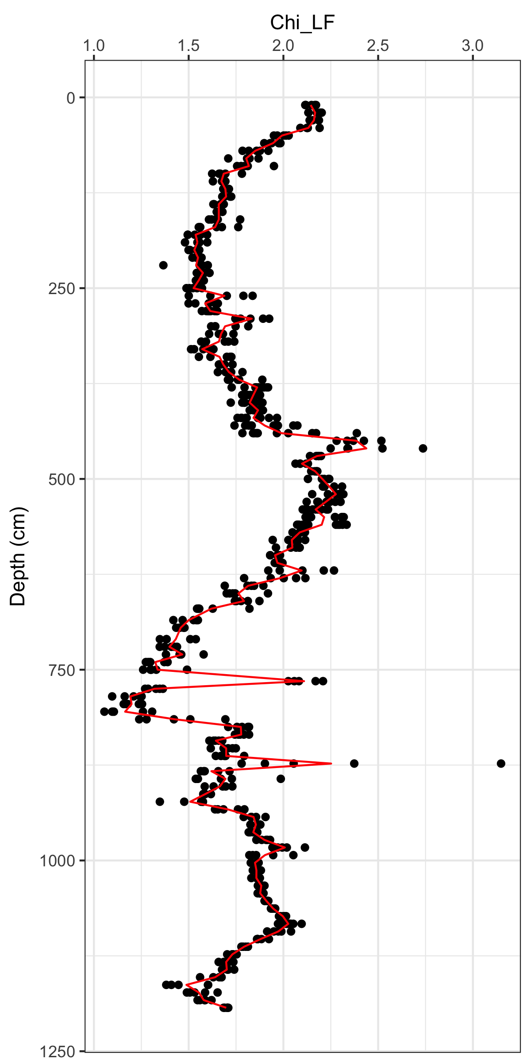
Results – Magnetic Susceptibility
Magnetic Susceptibility varied with depth and between the paleosols
Higher variance occurred around 875cm depth due to presence of nail
Notes:
The graph on the right with the Chi_LF axis is the measurement of magnetic susceptibility at low frequency
Our study site has been previously studied and those scientists left behind a nail at the site to mark the presence of a tephra, but this nail influenced the Magnetic susceptibility data

Slide 10
Results - Microscopy
NBC16-3: high MS + FD
MCC16-1: local MS + FD minimum
4 x 0.10 magnification PPL
4 x 0.10 magnification PPL
Notes:
This is a picture of a very thin slice of intact soil that has been filled in with resin, under a petrographic microscope
With these thin sections you are able to see the individual grains and also some of the specific details of larger structures within soil not as easily visible to the eye
For example, on left is a thin section that contains a very visible aggreagte, which is just soil clumped together; while you can see aggregates in the field, you do not get as clear of a view on its composition as you do under the microscope
Within the yellow circles are opaques, which are grains that stay black when looking at them under a microscope, and within the red circles are red grains, which I believed to be hematite. Both opaques and hemtatite are Fe-bearing particles
These two thin section were chosen to show the differences between samples of high magnetic susceptibility (the TS on the left) and samples of low magnetic susceptibility (the TS on the right)
The thin sections with a high magnetic susceptibility contain more opaques and red grains than thin sections with low magnetic susceptibility

Slide 11
Results - SEM
MCC16-1: local MS + FD minimum
NBC16-3: high MS + FD
Notes:
These next two slides contain SEM and EDS data on the Fe-bearing particles
When using SEM, I used the Backscatter Detector (BSE) dector, which will make grains with a higher atomic number appear lighter in color than grains with a lower atomic number
As I moved around in SEM, I would focus in on these light grains and use EDS to get an elemental map of the grains to gather the composition of the grains
When moving around in SEM, I also noticed that in the TS of high magnetic susceptibility, there were more white colored grains compared to the TS of low magnetic susceptibility

Slide 12
Results - EDS
Notes:
This image shows the grains overlaid with the EDS map, which display the elemental analysis of the grain
In the image on the left, the green areas are Calcium, the purple areas are Titanium, and the red areas are Iron
In the image on the right, the red area represents Iron
The grains in each thin section ranged in composition across every sample, no matter the magnetic susceptibility
All of them contained high percentages of Fe, but sometimes the grain would also contain Al, Ti, or Mg
This EDS data confirmed the presence of Fe-bearing particles within the loess paleosol sequences at Clyde
When calculating the Fe/O ratio, many of these iron-bearing particles were confirmed to be Goethite (1.8), Hematite (1.5), and Magnetite (1.3). Many of the values fell between Goethite and Hematite because the two can be converted from one to another during the soil formation process.
The Fe/O ratio values did not always fall between the expected values because the Fe/O percentages were not close to 100%

Slide 13
Results - SEM
GMC16-1: high MS + FD minimum
NBC16-4: LF peak
NBC16-5: local FD peak + moderate MS
Notes:
This image demonstrates the interesting pattern within some of the aggreagates of high magnetic susceptibility compared to the average aggregate of low magnetic susceptibility
The image on the left is from a TS with high magnetic susceptibility and it demonstrates a criss cross pattern within an aggregate, with Fe-bearing particles included within, that did not appear in TS with low magnetic susceptibility
In comparison, the image on the right, from a TS with low magnetic susceptibility, does not contain this interesting pattern and this pattern was not found within the low magnetic susceptibility TSs

Slide 14
Results - EDS
Notes:
The image on the left, overlaid with EDS, shows that the grains contain Fe in red and Ti in purple within the aggregate while
The image on the left, overlaid with EDS, shows high amounts of Ca in the green and Al in the red within the aggregates
This was an interesting trend within the aggreagates that was unique to thin sections of high magnetic susceptibility
Clays or small micas

Slide 15
Conclusion
Findings: (1) Small amounts of iron-bearing particles within loess, and (2) Positive correlation between magnetic susceptibility and presence of iron-bearing particles
Future research: Create magnetic acquisition curves from samples to understand what phases of iron-bearing particles are present
Notes:
I started this project looking to see if there were Fe-bearing particles within the loess and if there were any trends between magnetic susceptibility and Fe-bearing minerals
I found that yes there are Fe-bearing particles within the loess and that with a high magnetic susceptibility, there is a greater presence of Fe-bearing particles
The future research for this project is to create magnetic acquisition curves from the samples to understand more specifcally what phases of Fe-bearing particles are present
The future research will allow for a more complete understanding of the Fe-bearing minerals present and what environmental processes would have lead to their acummulation within the soil providing a proxy for paleoclimate

Slide 16

Thank you!
Loess Division:
Prof. Nick Bader
Molly Coates (Jr.)
Photo from Nick Bader

