Slide 1
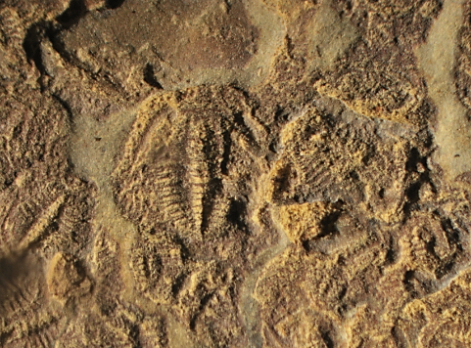

A Cambrian meraspid cluster : evidence of trilobite egg deposition
David R. Schwimmer
and
William M. Montante

Slide 2
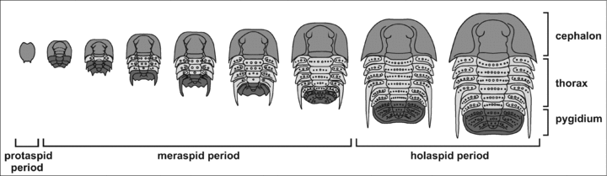
Trilobite reproduction has been considered for over 150 years (e.g. Barrande, 1852),
and the ontogenetic sequences have long been recognized for many clades.
Generalized postembryonic trilobite ontogeny
(Fusco, et al., Evolution 66-2, 2011)

Slide 3
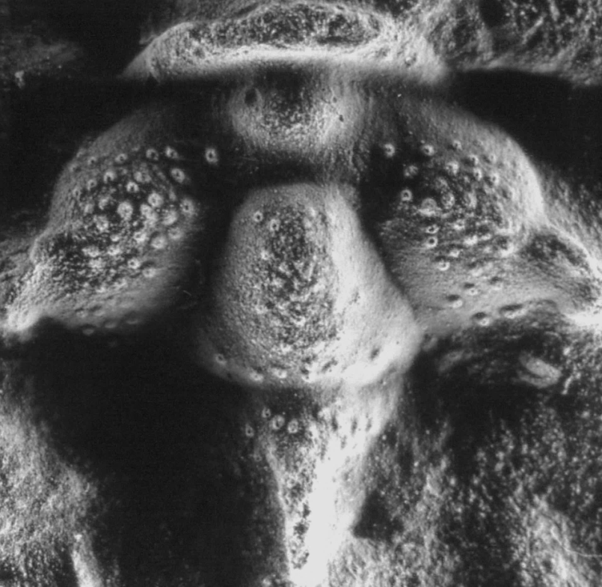
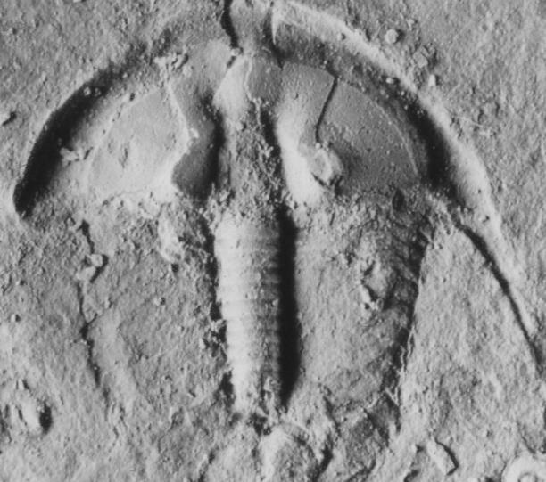
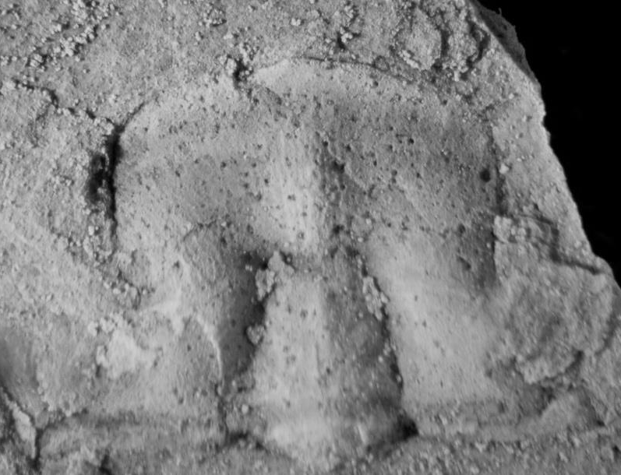
It has also been assumed (but only recently proven) that trilobites were oviparous,
possibly brooding eggs in preglabellar pouches in some species
Examples of Cambrian trilobites with preglabellar swellings
argued as brood pouches, fide Fortey and Hughes, 1998)
Bolaspis labrosa
Meagher Fm. MT
Alokistocare americanum,
Conasauga Fm., GA

Slide 4
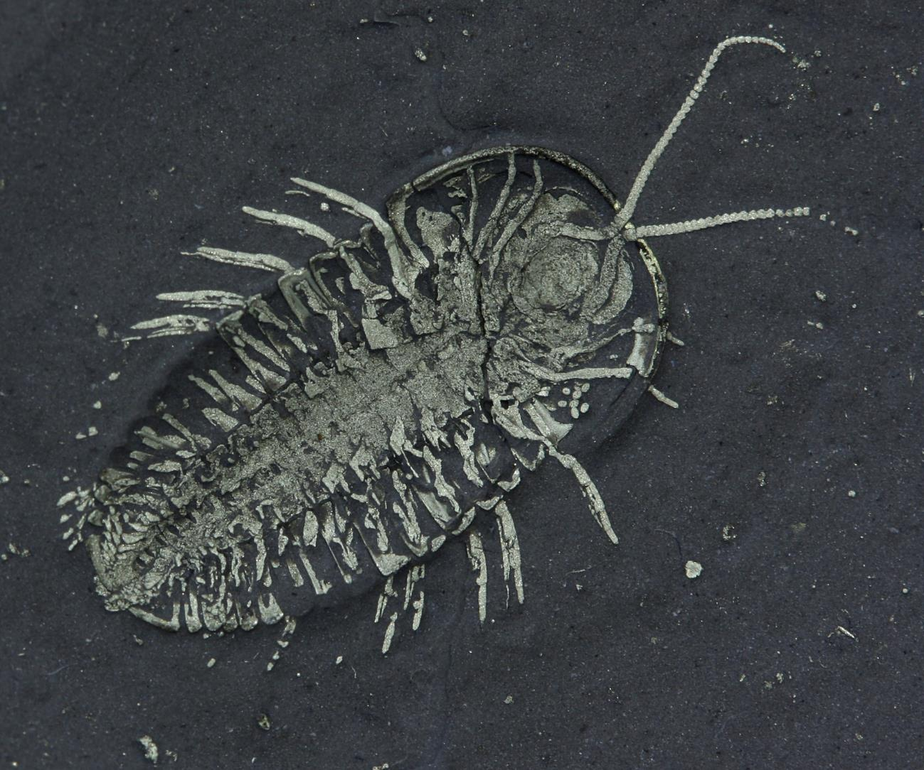
2017 Positive evidence of trilobite oviparity
Hegna et al. , Geology 45(3)
Trilobite eggs(Geology article))
eggs
Triarthrus eatoni
Whetstone Gulf. Fm.,
Ordovician, NY, showing eggs (arrow)
(from Hegna, et al. 2017, reproduced courtesy of the authors and GSA)

Slide 5
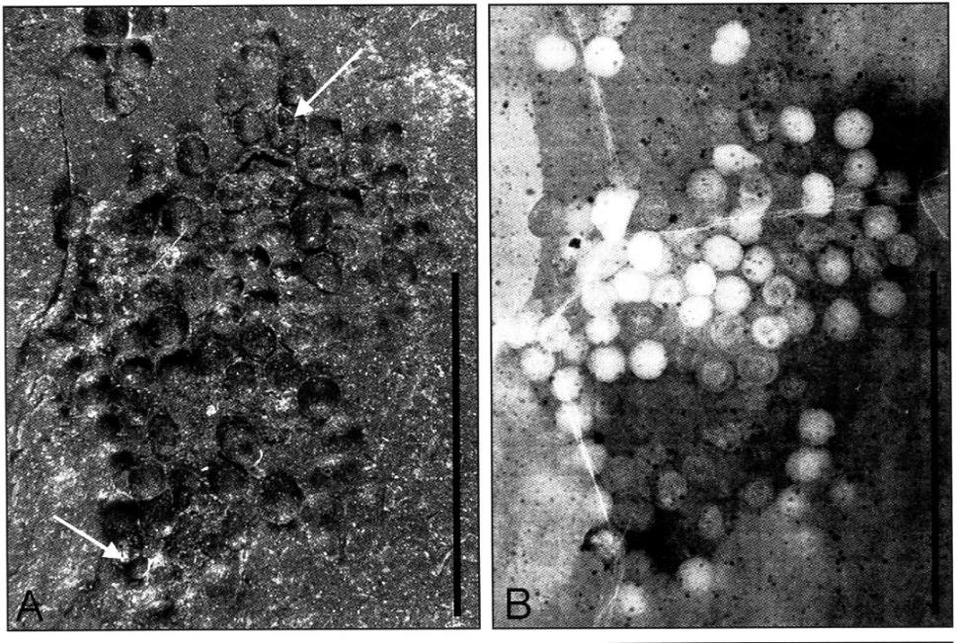
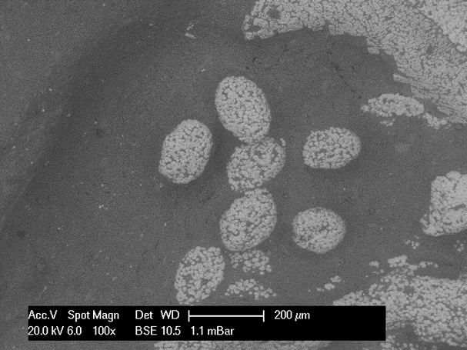
Prior evidence of Middle Cambrian egg clusters
From unidentified source resemble the Ordovician
trilobite eggs, however they are ~0.33 size
Silicified Middle Cambrian egg cluster
Guizhou, south China
200 µm
1 mm
modified from Lin, et al, 2006, Geology 34(12)

Slide 6
Questions on trilobite oviparity and ontogeny possibly addressed
by the specimen in study:
Did trilobites deposit eggs in masses at discrete nesting sites?
Did trilobite larvae exhibit homing behavior at those nesting sites?
Are xiphosurians good analogs for trilobite brooding behavior ?

Slide 7
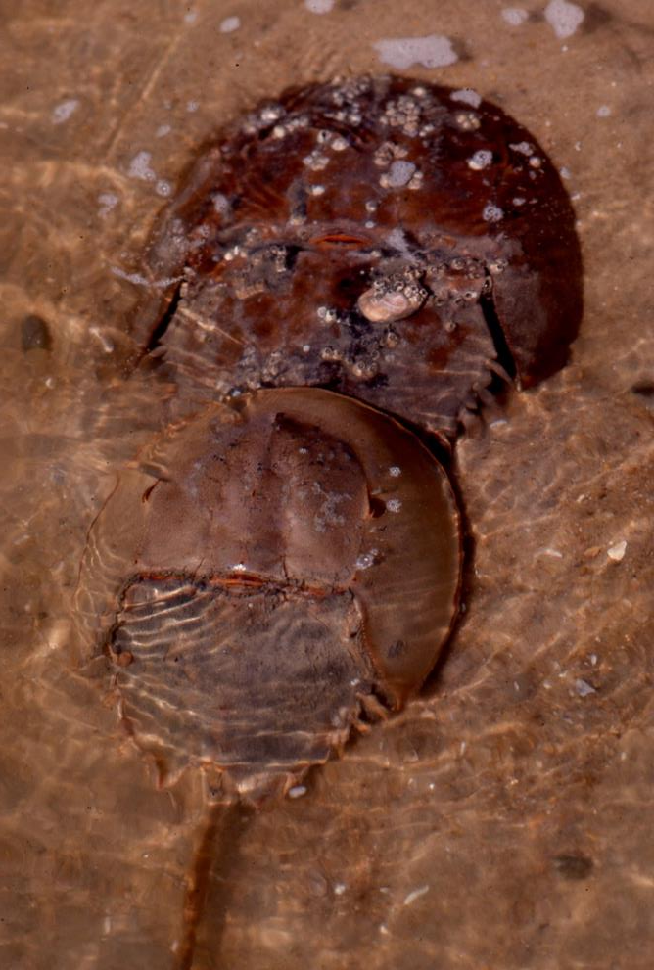
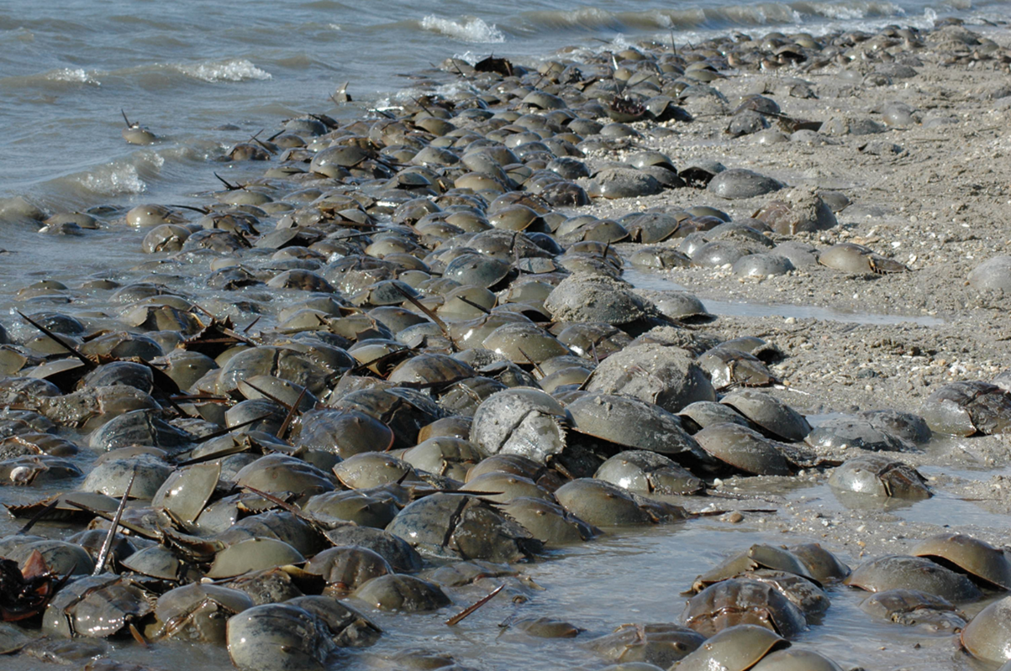
Horseshoe crab reproduction as a model for trilobites?

Slide 8
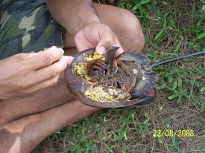
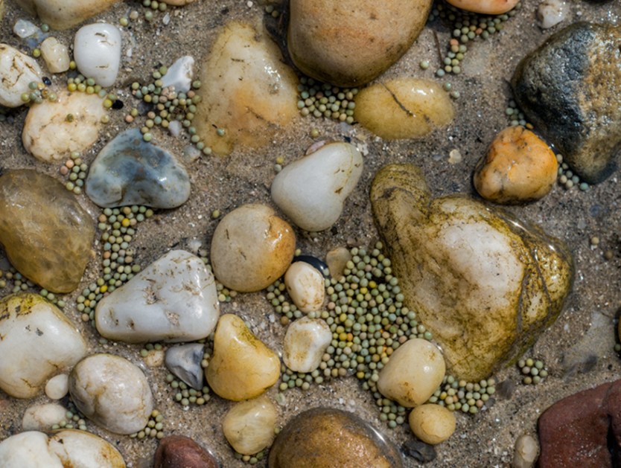
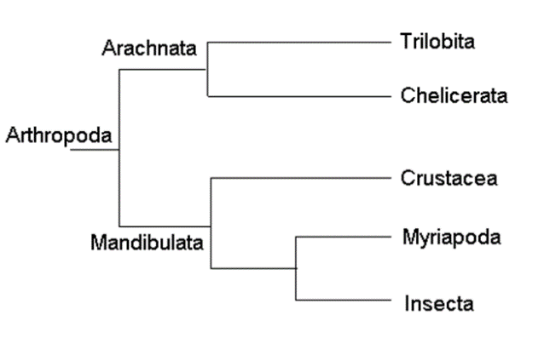
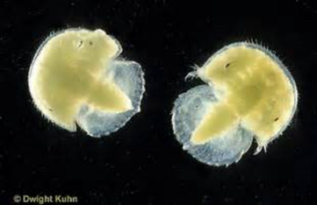
Note xiphosurian eggs
deposited in sandy,
shallow subtidal
environment
gravid Limulus polyphemus
Xiphosurian chelicerates
are generally assumed the
closest living relatives
(not necessarily analogs)
of trilobites.
“trilobite” larval stage

Slide 9
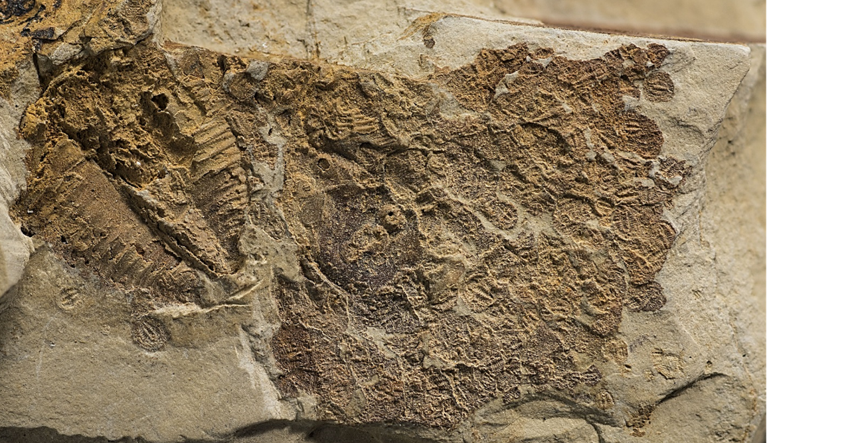

Specimen in the present study
28 mm
Claystone fragment with
>183 Aphelaspis meraspids
Conasauga Fm., Paibian,
Northwest GA
32 mm

Slide 10
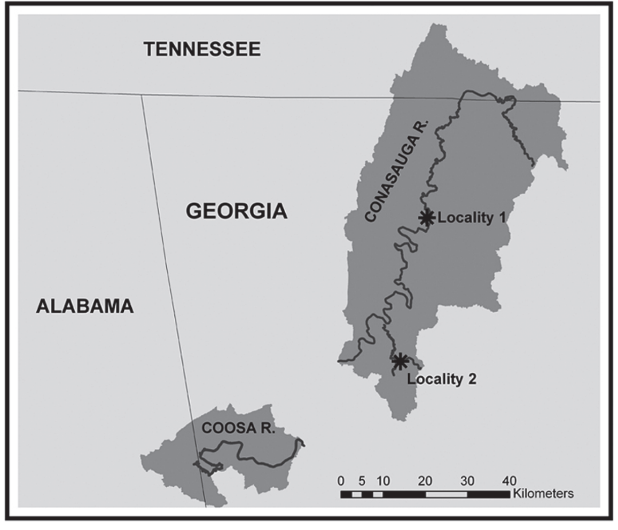
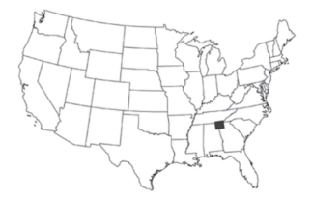

Slide 11
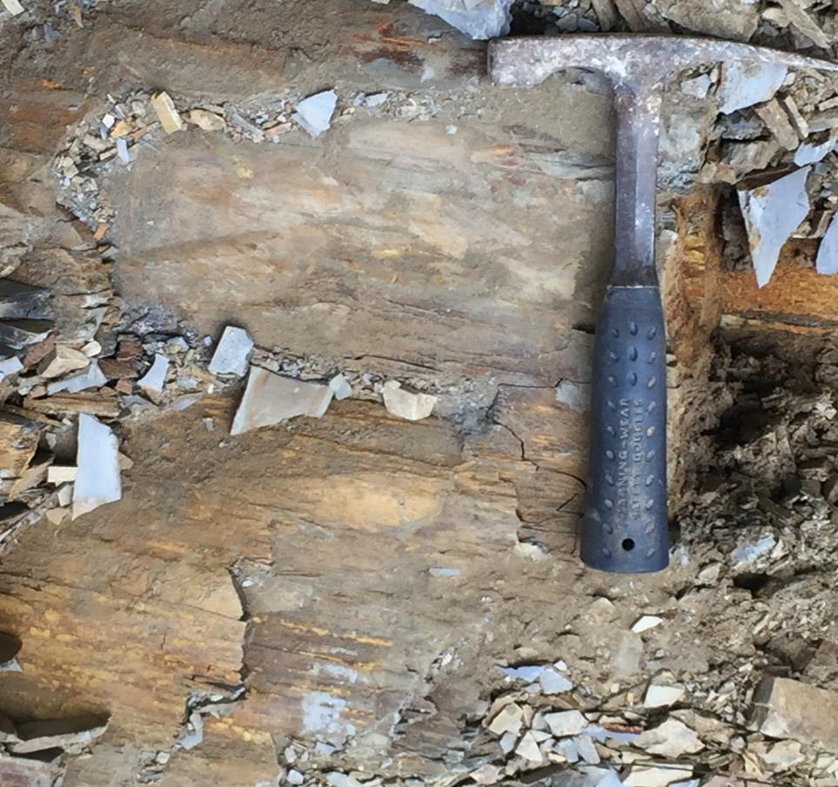
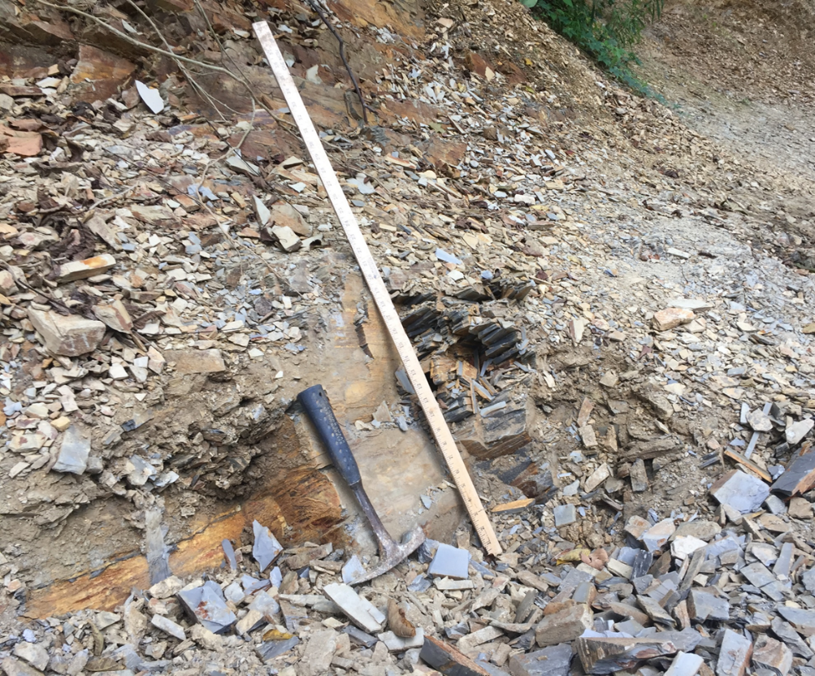
Outcrop of Conasauga Fm. claystones at Tibbs Bridge site, Murray Co. GA

Slide 12
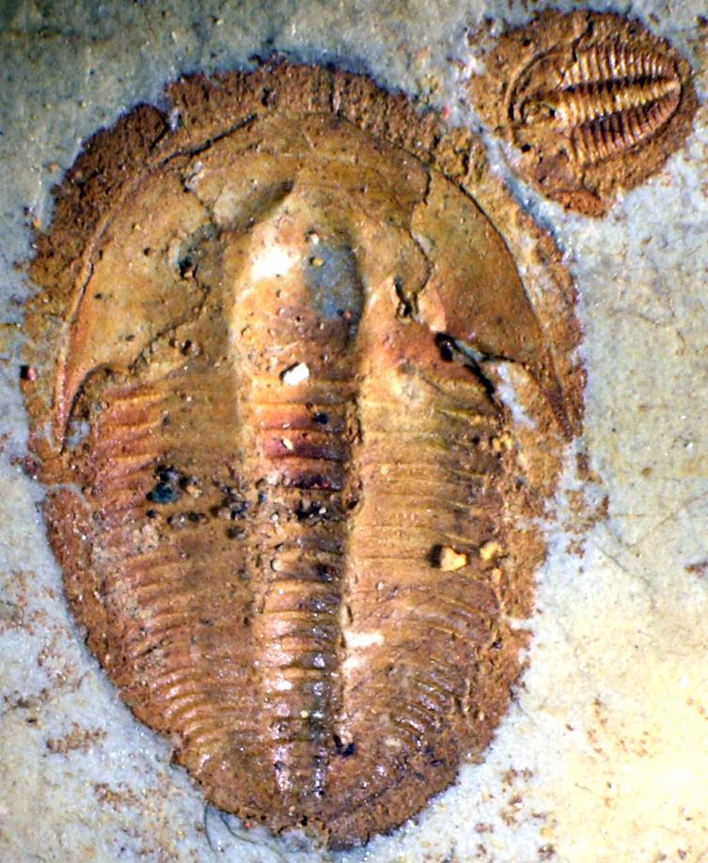
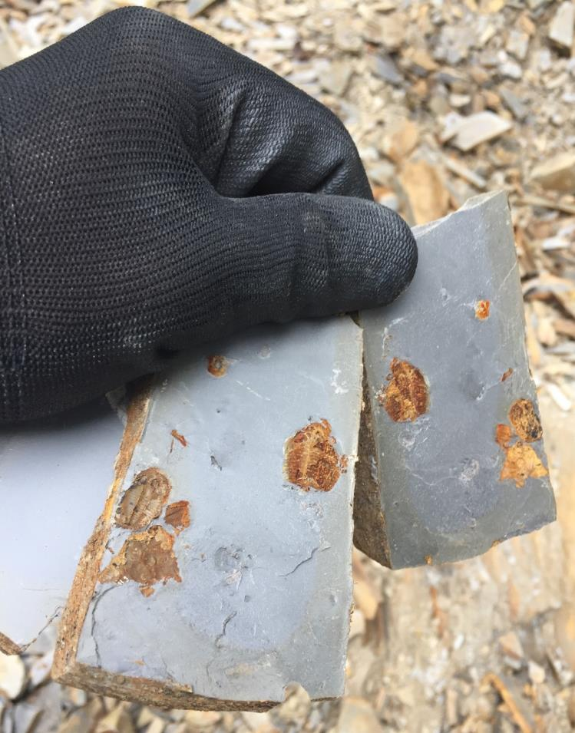
1 cm
Aphelaspis brachyphasis, comprising >95% of polymeroid trilobites,
superabundant at the Tibbs Bridge site, Conasauga Fm.

Slide 13
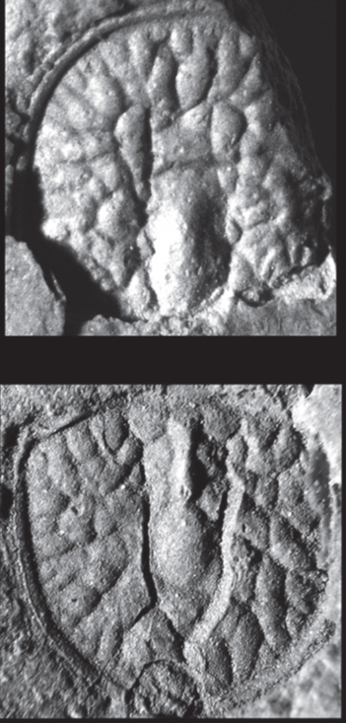
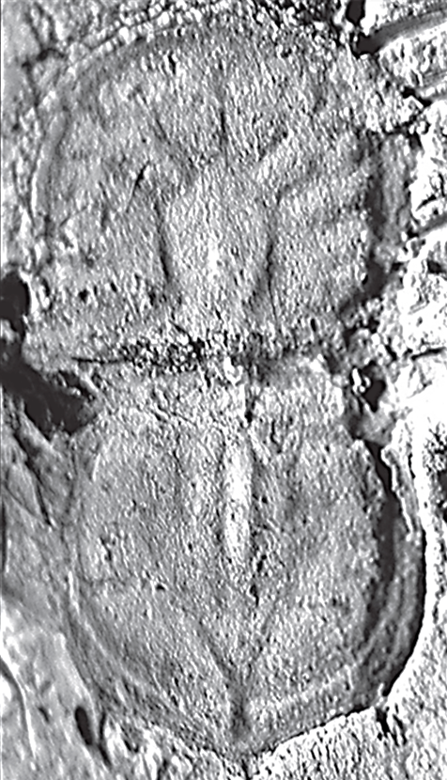
Agnostines associated with the meraspid site, all common
in the global Glyptagnostus reticulatus biozone
Agnostus inexpectans
Aspidagnostus rugosus
Glyptagnostus reticulatus
from Schwimmer and Montante, 2012, Southeastern Geology v. 40(1)

Slide 14
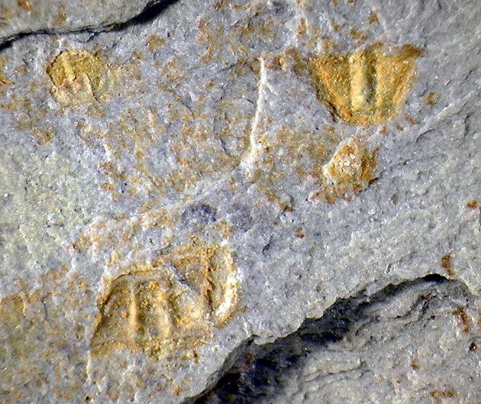
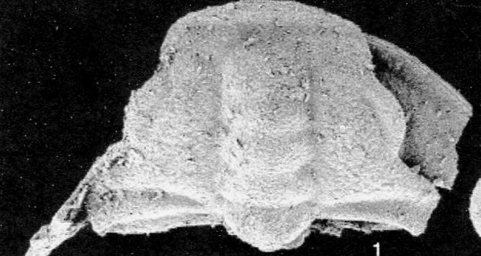
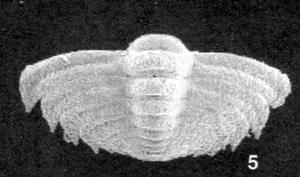
Meraspids of Aphelaspis brachyphasis Palmer, 1962
Aphelaspis brachyphasis
meraspid cranidium and pygidium
From Lee and Chatterton, 2005,
Palaeontology 48(6)
Aphelaspis meraspid cranidia in Conasauga Fm.

Slide 15
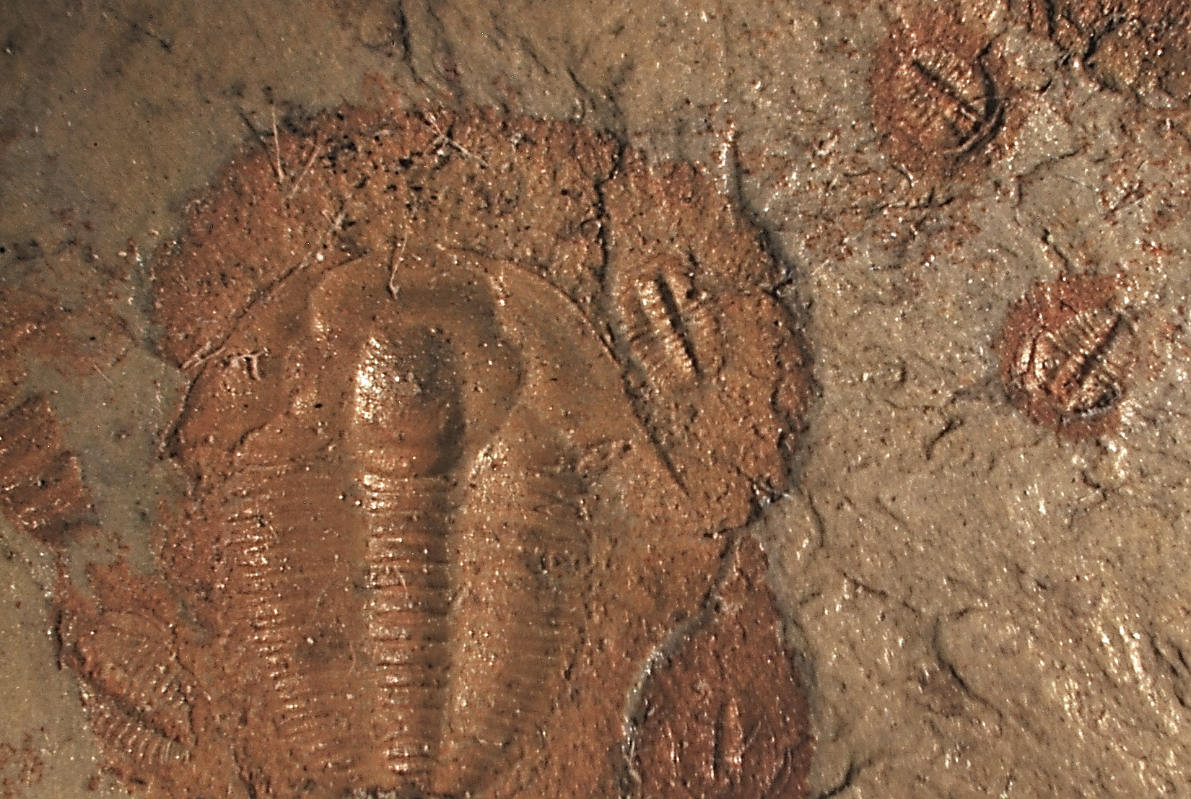
The Tibbs Bridge Sites has almost all complete adult and juvenile specimens, suggesting death and preservation by
Bioimurration on soft sediment
Note nearly all Aphelaspis holaspids and meraspids at site are
complete individuals, thus dead trilobites.
2 mm

Slide 16
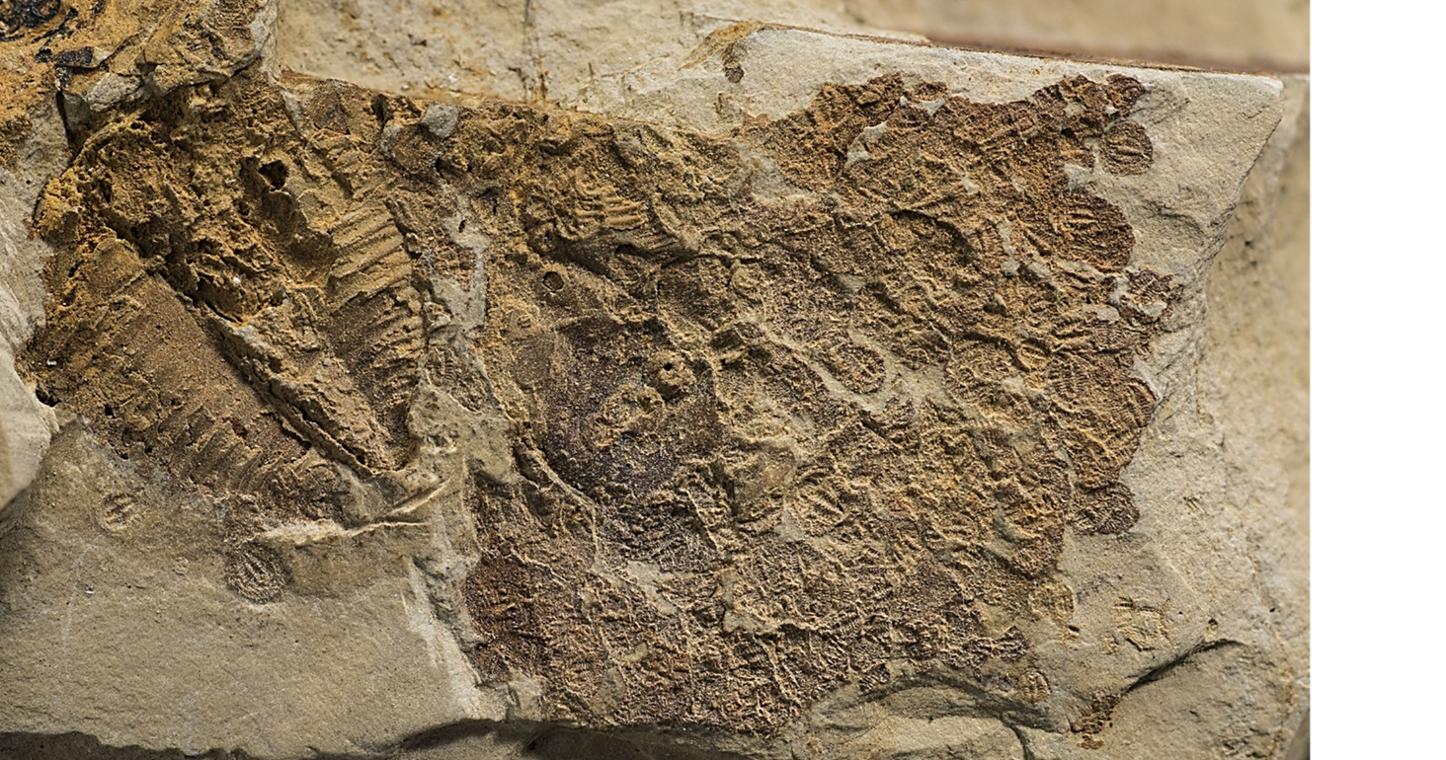


Slide 17
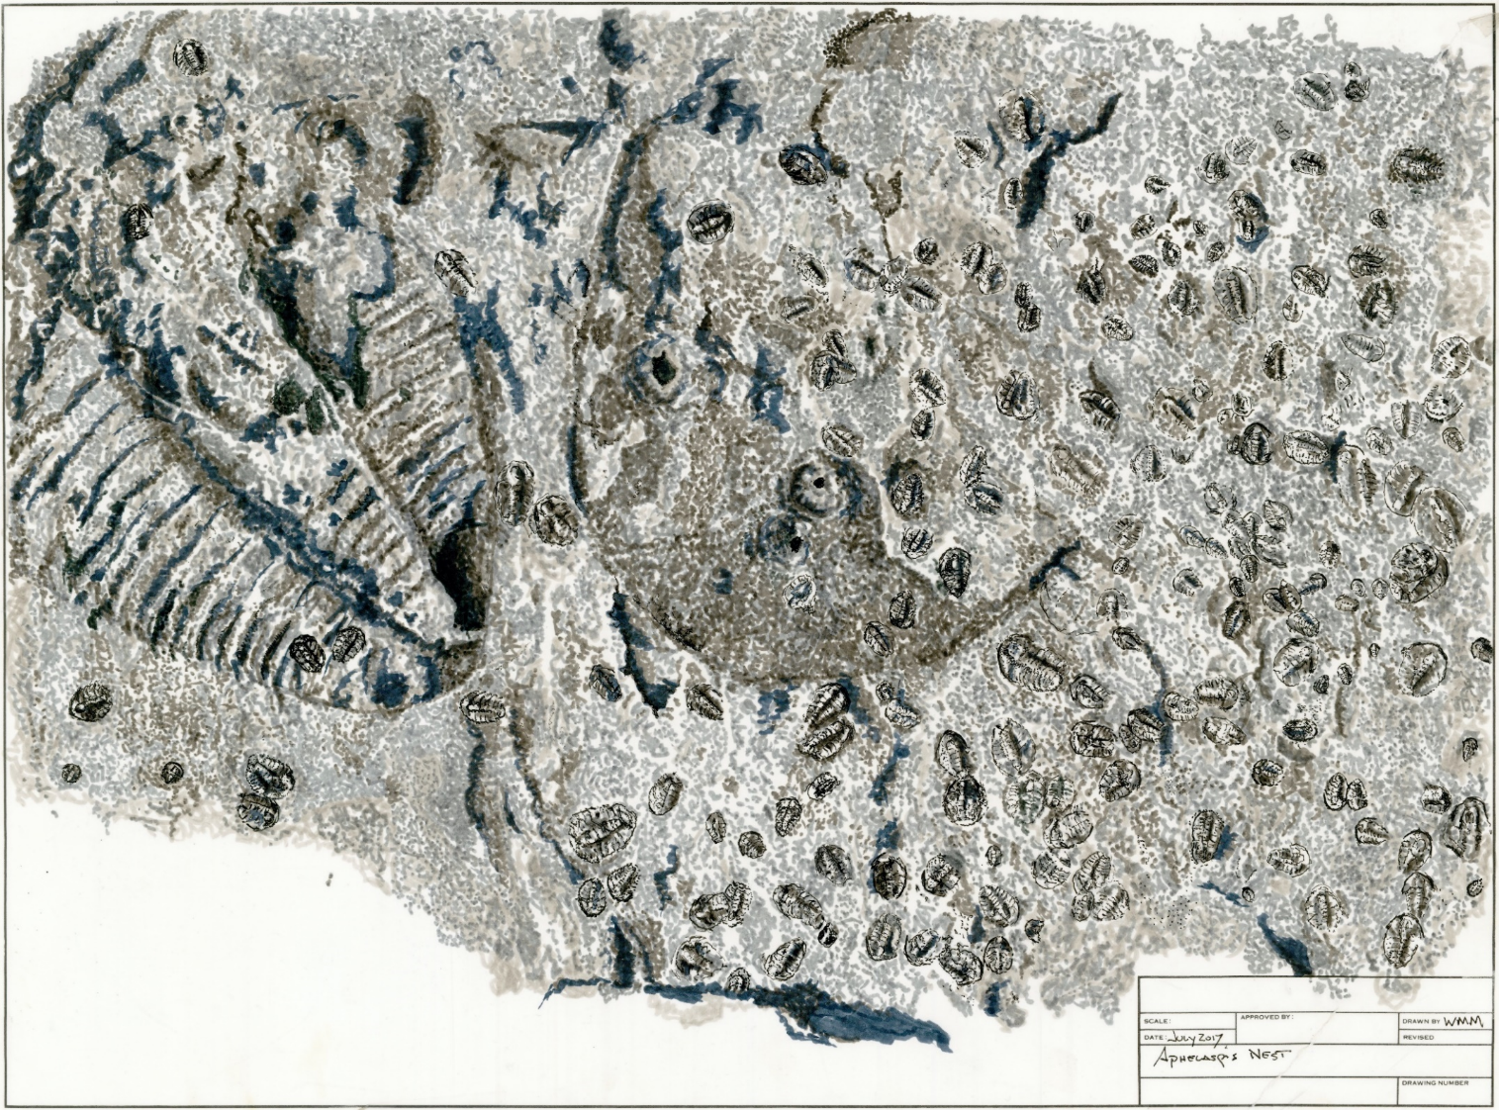
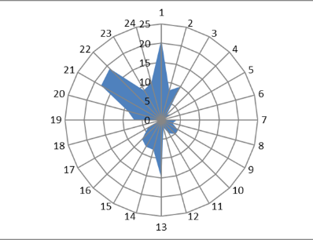
Orientation Diagram

Slide 18
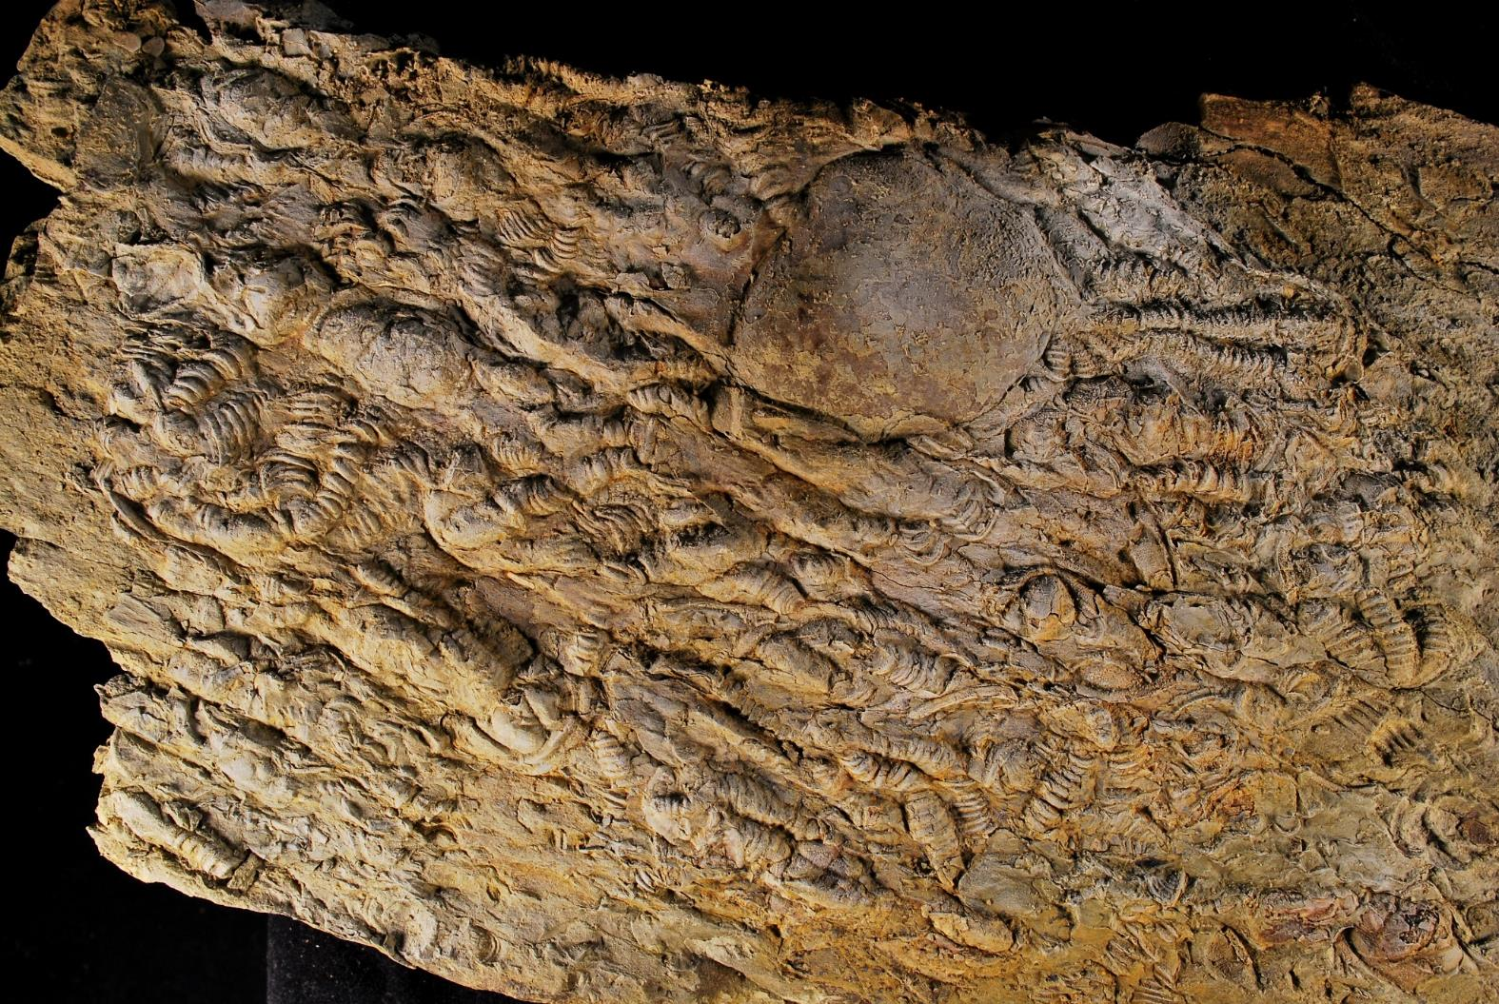
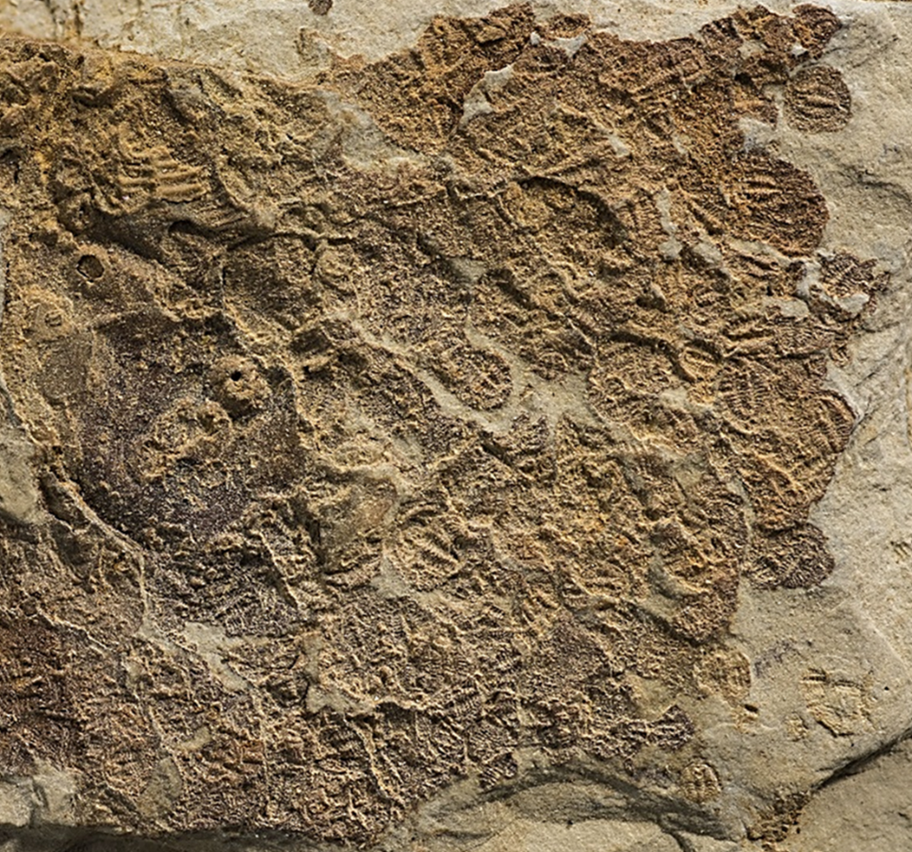
Contrast: Current –sorted
accumulation
Cluster of holaspid exuviae
in middle Cambrian beds,
Conasauga Fm., showing
evident accumulation by
unidirectional currents.
Note that these are molted
sclerites, evident by separated
librigenae and other parts.
All identifiable specimens are Elrathia antiquata

Slide 19
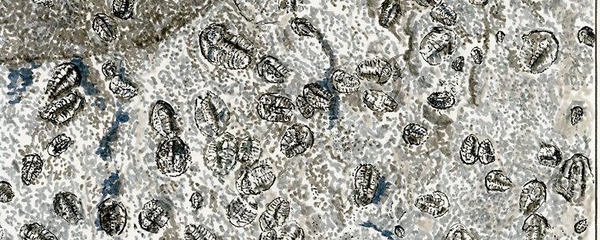
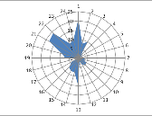
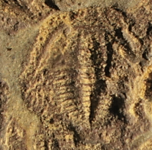
Evidence for egg deposition site and voluntary meraspid clustering behavior,
based on Conasauga specimen:
Multiple orientations of long axes contradicts
current sorting: association not random,
leaving assumption of voluntary clustering
Intact cephala with librigenae indicates these
are dead individuals (i.e. biocoenosis)
rather than exuviae, indicating meraspids alive
prior to burial
3. Coeqaual meraspid stages of 183 individuals suggests hatching from a single event.

Slide 20

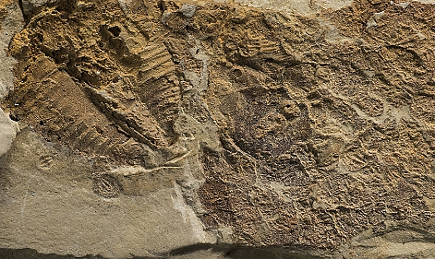
Conclusions
Some trilobite larvae cluster, as least through meraspid stage 5, possibly for
protection or as homing behavior at the egg deposition site;
2. Ptychopariid trilobites, perhaps among others, deposit their eggs in or on
low-energy subtidal surfaces, including clay bottoms;
3. The xiphosurian analog for trilobite egg deposition in sandy, high subtidal
environments may not apply to trilobites, given this mudstone specimen.

Slide 21

Acknowledgements
Clinton I. Barineau, Columbus State University
Thomas A. Hegna, Western Illinois University
Diana Ortega-Ariza, Columbus State University
Jeff Scovil, Scovill Photography.com
Tellus Science Museum, White, Georgia

