Slide 1
Did Plate tectonics start with a big bang?
David Moerdyk
Notes:
First of all I would like to thank the organizers for letting me come and present my ideas.

Slide 2
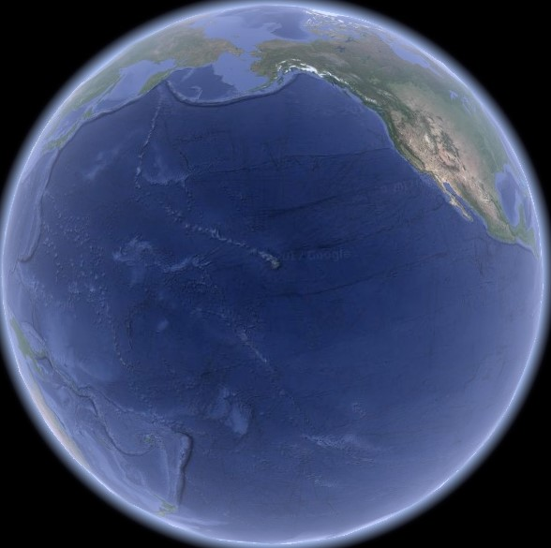
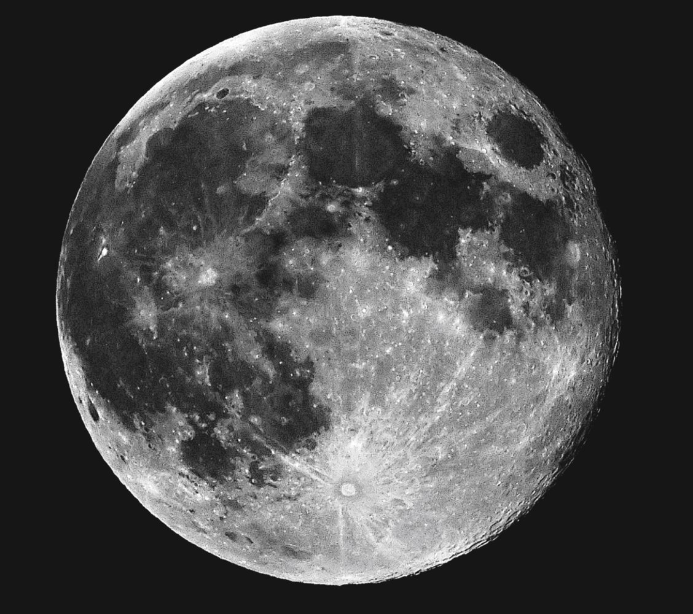
Inspiration
Notes:
In the 1970’s I saw a picture similar to this that was supposed to illustrate how the Moon could have been extracted from the Pacific basin.

Slide 3
Target Earth
Notes:
But I saw a target.

Slide 4
Unlikely Coincidence
Notes:
With the Hawaiian Hotspot as the bull’s eye. I thought that it was an unlikely coincidence that the Hawaiian Hotspot lay in the middle of the Pacific Basin. Maybe the formation of the Hawaiian Hotspot and the Pacific Basin were linked. What better linkage than the Moon, or other large bolide hitting the Earth and forming both the hotspot and the basin. Since then, I have been reading research articles on the evolution of the Earth’s geology trying to find convincing evidence that this unconventional idea was definitely false. Instead I found supporting evidence.

Slide 5
Another Unlikely Coincidence
Permian-Triassic | Extinctions | Cretaceous-Tertiary
252 Ma | Age | 65 Ma
Siberian Traps | Large Lava Eruptions | Deccan Traps
Notes:
I found another unlikely coincidence. Two of the largest eruptions of lava in the Earth’s history occurred simultaneously with the two largest extinction events. If this is not a coincidence, then either the eruptions caused the extinctions or what caused the extinctions also caused the eruption of the lava.

Slide 6
Main Cause
Permian-Triassic | Extinctions | Cretaceous-Tertiary
252 Ma | Age | 65 Ma
Siberian Traps | Large Lava Eruptions | Deccan Traps
 | Bolide Impact | Chicxulub
Notes:
There is good evidence and general acceptance that a bolide impact caused the CT extinction. If it is not a coincidence that these were simultaneous, then the bolide impact must have caused the eruption of the lava.

Slide 7
Impact Causes Lava Eruptions
Permian-Triassic | Extinctions | Cretaceous-Tertiary
252 Ma | Age | 65 Ma
Siberian Traps | Antipodal Eruptions | Deccan Traps
 | Bolide Impact | Chicxulub
Notes:
The Deccan Traps would thus be the antipodal outpouring caused by the bolide impact. And by symmetry, the Siberian Traps would also be an antipodal outpouring. But, so far no impact has been identified for the PT extinction. The proposed Hawaiian impact could have caused both the extinction and the eruption of the Siberian Traps.

Slide 8
PT Impact
Permian-Triassic | Extinctions | Cretaceous-Tertiary
252 Ma | Age | 65 Ma
Siberian Traps | Antipodal Eruptions | Deccan Traps
Pacific | Bolide Impact | Chicxulub
Hawaiian | Hotspot
Notes:
The Hawaiian impact brings along the Hawaiian Hotspot. For symmetry, the CT impact should also have formed a hotspot.

Slide 9
CT Hotspot
Permian-Triassic | Extinctions | Cretaceous-Tertiary
252 Ma | Age | 65 Ma
Siberian Traps | Antipodal Eruptions | Deccan Traps
Central Pacific | Bolide Impact | Pacific NW
Hawaiian | Hotspot | Yellowstone
Notes:
The only hotspot that is similar to the Hawaiian Hotspot is the Yellowstone Hotspot. This entire senerio sounds like speculation but there is some evidence that supports it.

Slide 10
Making of a
Hotspot
Notes:
First, could bolide impacts have formed the Hawaiian and Yellowstone Hotspots. A bolide hitting the Earth would melt a column of magma underneath it. The heated magma would begin to rise. A heat source is required for magma to continuously rise over millions of years.

Slide 11
Tube Above 660 km,
Ball Below
B. Schmandt
EPSL May 2012
Notes:
If the bolide impact was large enough to melt a column of magma down to the 660 km depth, it may have found such a heat source. Material rising through this boundary undergoes a exothermic phase transition. The added heat could perpetuate the rising magma column. Seismic imagery of the Yellowstone Hotspot shows a column of magma above the 660 km boundary but a circular structure exists below the boundary, as if magma is being sucked up through the boundary and other magma is flowing in from all sides to fill the space.

Slide 12
CT Hotspot
Permian-Triassic | Extinctions | Cretaceous-Tertiary
252 Ma | Age | 65 Ma
Siberian Traps | Antipodal Eruptions | Deccan Traps
Central Pacific | Bolide Impact | Pacific NW
Hawaiian | Hotspot | Yellowstone
 | Impact-Eruption Relative Position | 170°
 | Type of Impact | Near Vertical
 | Result | Bolide Destroyed
 | Residual | Iridium Rich Layer
Notes:
The geometry of the impacts is also a supportive indication. The Yellowstone Hotspot is almost directly opposite where the Deccan Traps were located 65 Ma. This indicates a nearly vertical impact that would have destroyed the bolide and generated an iridium rich layer. The rich layer at the CT boundary is the main evidence that a bolide impact caused the CT extinction.

Slide 13
PT Hotspot
Permian-Triassic | Extinctions | Cretaceous-Tertiary
252 Ma | Age | 65 Ma
Siberian Traps | Antipodal Eruptions | Deccan Traps
Central Pacific | Bolide Impact | Pacific NW
Hawaiian | Hotspot | Yellowstone
~120° | Impact-Eruption Relative Position | 170°
Grazing | Type of Impact | Near Vertical
Most of Bolide Escapes to Space | Result | Bolide Destroyed
No Iridium Rich Layer | Residual | Iridium Rich Layer
Notes:
The angle between the Hawaiian Hotspot and the Siberian Traps is less. This would indicate a very shallow angle of impact. In this case, most of the bolide would escape back to space and not leave a iridium rich layer. This is also what has been observed.

Slide 14
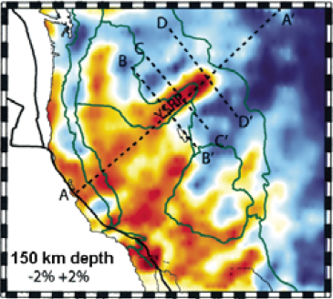
Hotspot Thermal Path Extends to Coast
M. Obrebski
Geophys. J. Int 2011
Notes:
This proposal would set the age of the Yellowstone Hotspot at 65 Myr. 65 Ma the hotspot would have been located well off the western coast of North America. It would then have come onshore as the North American plate moved over it. Seismic imagery shows that the thermal trace does extend to the coast. The large outpourings of lava would have been generated when the rise associated with the hotspot was broken open as it encountered the continental plate.

Slide 15
Cordilleran Volcanic Activity Begins 61 Ma
J.K. Madsen
Geosphere, Feb. 2006
Notes:
A large bolide impact off the coast of North America could have broken up crust to form the Cordilleran. Another coincidence is that the oldest volcanic activity in the Cordilleran is dated at 61 Ma which is close to the proposed impact date.

Slide 16
PT Hotspot
Permian-Triassic | Extinctions | Cretaceous-Tertiary
252 Ma | Age | 65 Ma
Siberian Traps | Antipodal Eruptions | Deccan Traps
Central Pacific | Bolide Impact | Pacific NW
Hawaiian | Hotspot | Yellowstone
~120° | Impact-Eruption Relative Position | 170°
Grazing | Type of Impact | Near Vertical
Most of Bolide Escapes to Space | Result | Bolide Destroyed
No Iridium Rich Layer | Residual | Iridium Rich Layer
Jurassic Quiet Zone Ontong Java Plateau Breakup of Pangea | Geologic Evidence | Cordilleran Volcanism 61 Ma
Notes:
Supportive evidence for the PT impact is more scant. The Jurassic Quiet Zone lacks magnetic striping as would be expected of crust that was formed at the same time. The Ontang-Java Plateau could be a sunken portion of the continental crust destroyed by the impact. However, the overlying lava on these two sites is much younger than the proposed impact date.
If the Hawaiian impact formed the Pacific Basin, it may have destroyed 2/3 of the Earth’s crust and could be associated with the breakup of Pangea.

Slide 17
Global Crustal Model Timeline
Global Crust Formation:
Constant Generation
Pliable Crust
Formation of Keels
Intraplate Tectonics:
Global Continental Crust
Crust Hardens
Small Plate Movement
Cooling Period:
New Oceanic Crust Becomes Negatively Buoyant
Subduction Plate Tectonics:
4.5 Ga
3.9 Ga
0.25 Ga
0.2 Ga
0.0 Ga
Pangea
Breakup
Hawaiian Impact
“Big Bang”
Notes:
This implies a radical new model for the evolution of geology on Earth. For the first 600 Myr of Earth’s history the crust was pliable and new crust was constantly being formed. About 3.9 Ga, the Earth had cooled enough to have a solid crust where generation of new crust was periodic. For the next 3.8 Gyr the Earth had a global continental crust that was dominated by inter-plate tectonics. There was little movement of the plates. Then 250 Ma a bolide impact, a “Big Bang”, occurred as was proposed earlier and destroyed 2/3 of the continental crust. 50 Myr later, after the new oceanic crust had cooled enough to become negatively buoyant, it began to subduct and pull Pangea apart. This was the start of modern subduction plate tectonics.

Slide 18
Evidence From Zircons
Episodic Generation Indicates Rigid Crust
Continuous Generation
Mixing from Diverse Sources Indicates Pliable Crust
A.I.S. Kemp
EPSL 2010
Notes:
Zircons provide evidence of the early pliable continental crust. Their existence indicates continental crust. The continuous age distribution indicates continuous generation of continental crust. The wide chemistry variation indicates mixing of multiple sources. Continuous generation ends when the continental crust becomes solid.

Slide 19
Keel Structure Formed by Differentiation
Low Melt Temperature Interior
High Melt Temperature Thermal Boundary
Notes:
The keel structure of the cratons indicates formation by differentiation, not subduction plate tectonics. The interior is low melt temperature material as indicated by the rapid rise of kimberlites through it. The exterior, therefore must be a high melt thermal barrier. This structure could have been formed when mafic eruptions at the surface sunk as they cooled and then differentiated. The mafic restite sunk to the bottom to form the thermal barrier.

Slide 20
Subduction Generated Geologic Structures Are Not Older than 1 Ga
See:
W.B. Hamilton, GSA Today 2003
R.J. Stern, Geology 2005
Notes:
I refer you to two articles that detail the case for a lack of subduction generated geologic structures prior to at least 1 Ga.

Slide 21
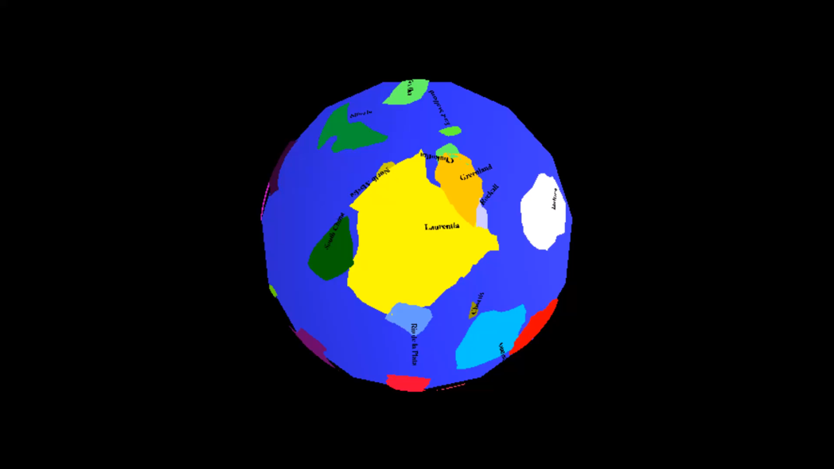
Paleomagnetism Shows Little Movement Between the Best Measured Cratons
Based on Z.X. Li
Precambrian Research 2008
Notes:
The paleomagnetic data from the best surveyed continents indicate little relative movement.

Slide 22
Keel Structure is Fragile
Longevity indicates little stress.
Lack of kimberlites older than 200 Ma indicates little stress until the breakup of Pangea.
Allowed widespread destruction of crust.
Notes:
The keel structure of cratons is fragile. If the exterior thermal barrier is cracked, magma will seep in and melt the interior. Small cracks produce kimberlites. No kimberlites are older than 200 Ma. This indicates little stress and no collisions prior to the breakup of Pangea. Its fragility could have allowed a bolide impact to destroy 2/3 of the Earth’s crust.

Slide 23
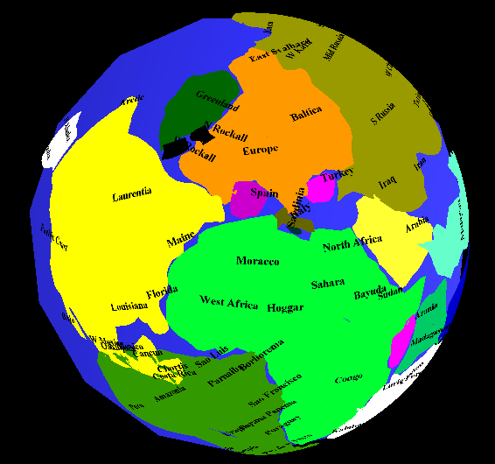
Reconstruction of Pangea
Different Edge of Baltica Connected to Laurentia
Notes:
In the reconstruction of Pangea, if the eastern face of Baltica abuts Laurentia instead of Greenland abutting Laurentia, Eurasia is rotated and shrinks the Tethys Sea.

Slide 24
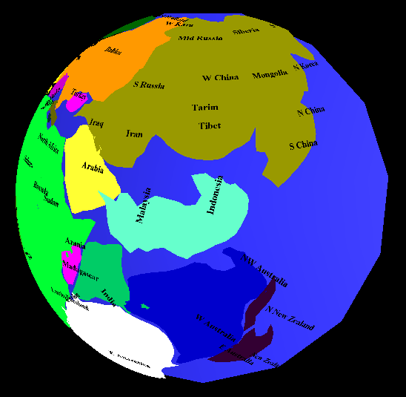
Result: Circular Pangea Landmass
Tethys Sea filled with Southeast Asia Landmass and extension of Tibet
Notes:
The area left can be filled with the Southeast Asia landmass and extension of the Tebetan Plateau. Pangea is now a circular landmass as expected by a remnant of a bolide impact.

Slide 25
Other Planets Have Been Hit
Mars’ Terrain Dichotomy Attributed to Bolide Impact
Venus resurfaced 300-500 Ma. Could a bolide impact caused this?
1,300 km Caloris Basin on Mercury
Notes:
Other planets have had large bolide impacts.

Slide 26
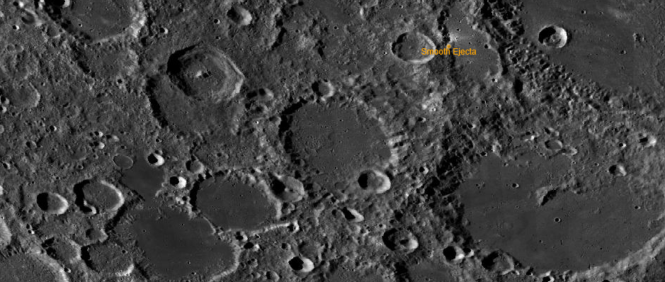
Moon is Bolide?
Requires South Pole-Aitken Basin to be formed by impact.
QuickMap : NASA/GSFC/Arizona State University 2016
Notes:
Where did such a large bolide come from? The Moon could have been the bolide but it would require making the South Pole-Aitken Basin into the impact point. Many of its craters do have young surfaces.

Slide 27
Bolide from Outer Solar System?
~10 Dwarf Planets have been discovered in Kupier Belt
400-1700 Dwarf Planets estimated in Oort Cloud
Notes:
The bolide could have come from the outer solar system. As more dwarf planets are discovered, the probability of this source increases.

Slide 28
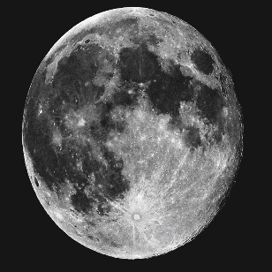
Reality
Notes:
A bolide impact destroying 2/3 of the Earth’s continental crust seems infeasible. It especially seems infeasible when the Moon is drawn in real proportion to the Earth. However, circumstantial evidence indicates that this did happen. A final confirmation will require a better understanding of the craton’s keel structure and modeling of whether the compression wave from a bolide impact could have destroyed the keels of 2/3 of the Earth’s continental crust.
Thank you.
Earth Diameter = 12.7 km
Moon Diameter = 2.159 km

