Slide 1
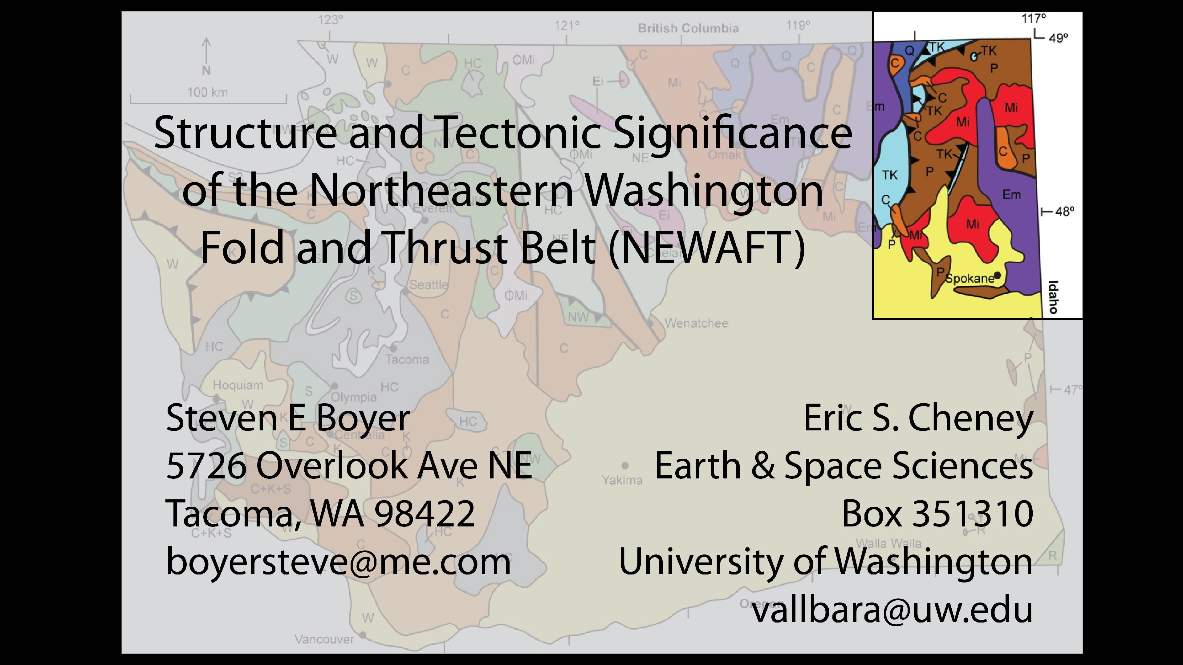

Slide 2
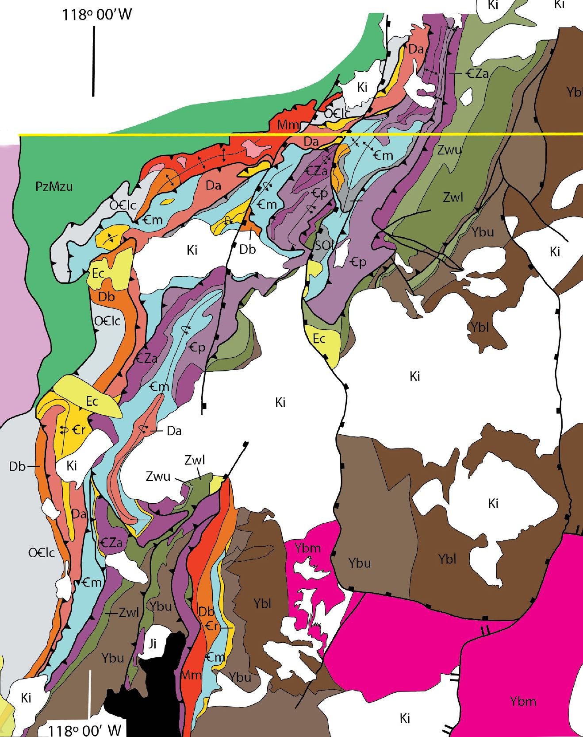
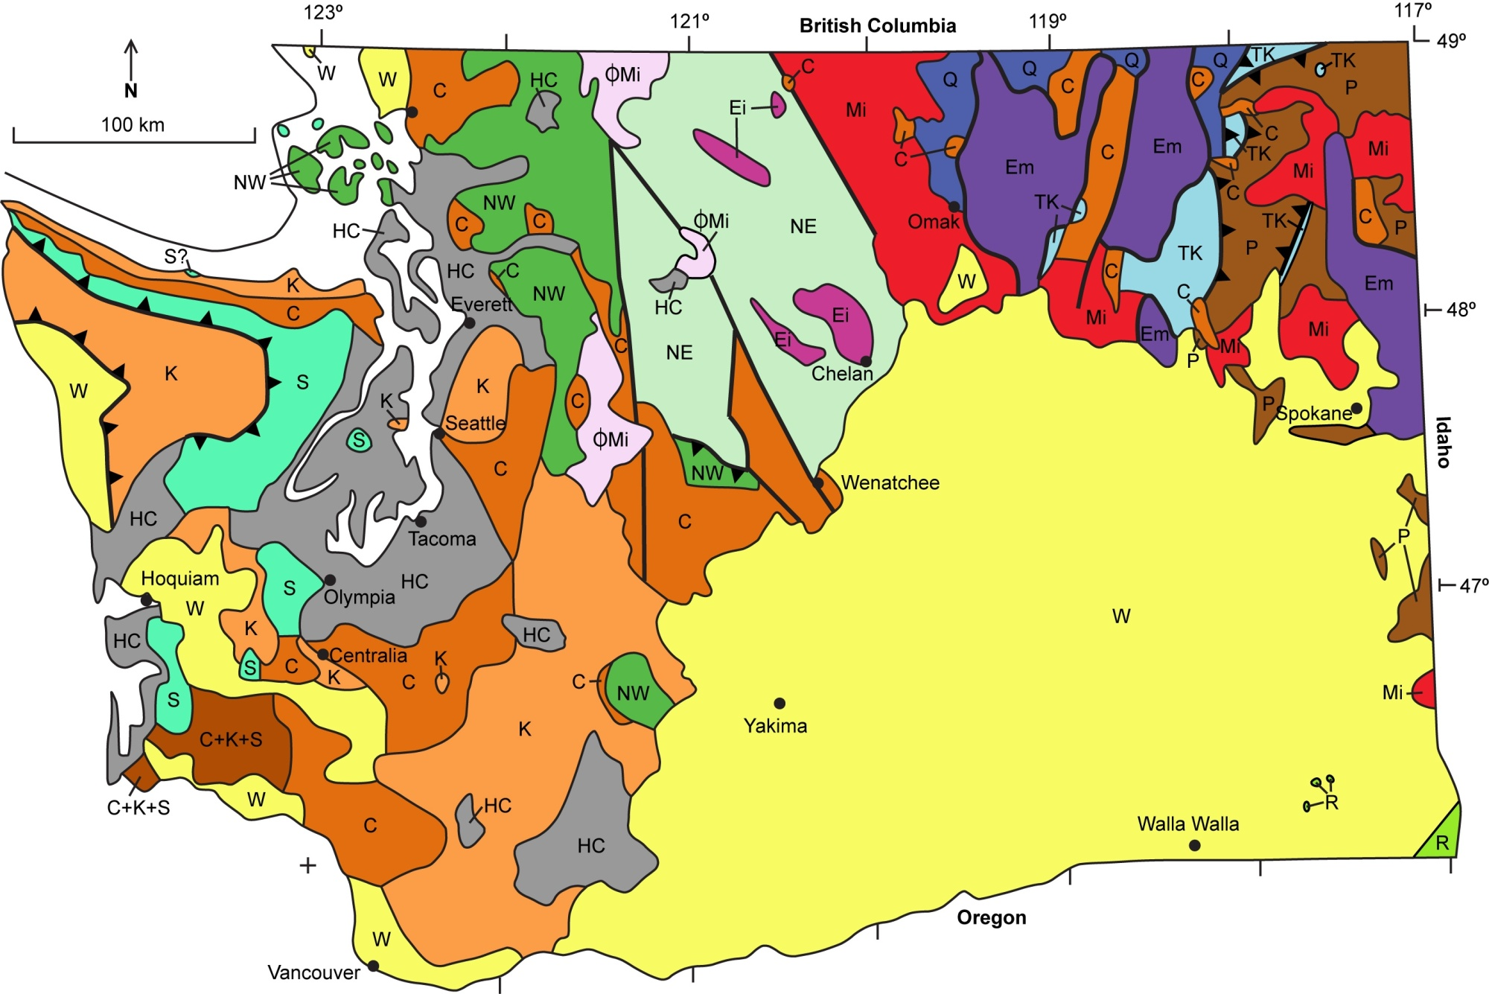

Northeast Washington Fold & Thrust Belt
after Cheney & Zieg (2016)
Notes:
Eric Cheney introduced Steve Boyer to the Northeast Washington thrust belt a few years ago and suggested that he & Steve collaborate on some balanced cross sections. For various reasons, Steve & Eric never got around to constructing balanced sections, but we did have some interesting discussions which led to this talk. Tucked away in the northeast corner of the state of Washington, and adjacent Idaho, Montana & British Columbia, is an underappreciated thrust belt.

Slide 3

Northeastern Washington Fold and Thrust Belt (NEWAFT)
1. Regional context
2. Architecture of the thrust belt
3. Relationship between the thrust belt &
the Neoproterozoic rift margin of Laurentia
Notes:
We will place this thrust belt in its regional context & share some details of its structural configuration. Throughout the talk we will note the probable influence that the Neoproterozoic rift margin had on the evolution of this thrust belt.

Slide 4
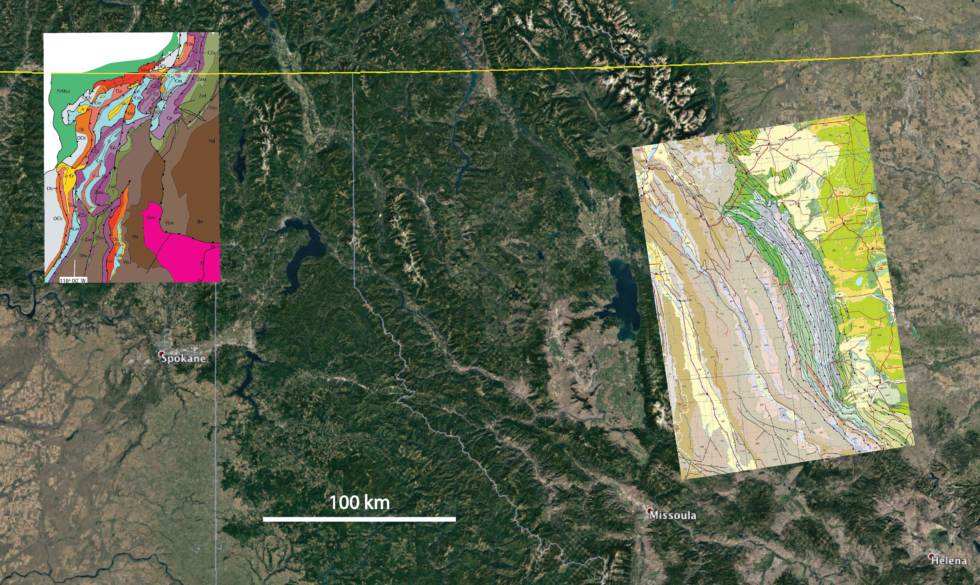
Regional Context
Sawtooths
NEWAFT
Spokane
Missoula
Helena
Notes:
The Northeast Washington thrust salient is similar in size to the Sawtooth thrust salient of Montana. However, the Northeast Washington Fold and thrust belt (NEWAFT) is mostly northwest-vergent & thought to be of middle to late Jurassic age, whersas the Sawtooth thrust salient is east-northeast-vergent and initiated in the Late Cretaceous with deformation continuing into the Paleocene.

Slide 5
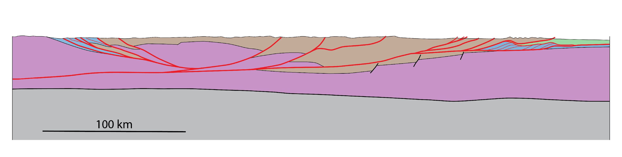
NE Washington
Fold & Thrust Belt
Priest River
Complex
Purcell Anticlinorium
Libby Thrust Belt
Front Ranges (AB)
Sawtooth Range (MT)
Mesoproterozoic Belt / Purcell Supergroup
Archean
basement
MOHO
Generalized regional transect
after Yoos et al. (1991), Cowan & Potter (1986),
Price (1981) & Harrison et al. (1980)
Notes:
The two thrust belts lie on the fringes of a much larger regional thrust belt dominated by super thrust sheets of Mesoproterozoic Belt / Purcell Supergroup rocks. The geometry of supersheets was controlled primarily by configuration of the Belt-Purcell basin. On the eastern margins of this regional thrust belt, the geometry of the Paleozoic basins controlled geometry of the Sawtooths. And in the west the geometry of the Neoproterozoic rift margin controlled the evolution of the NE Wa thrust belt.

Slide 6
Lund, K. 2008
Geometry of the Neoproterozoic and Paleozoic rift margin of western Laurentia . . . Geosphere
Notes:
The Neoproterozoic and early Paleozoic rift margin may have looked something like this –– a series rift basins offset by by transform faults and associated promontories or structural highs. One of these transform systems and its associated arch, “Montania”, pass through the NEWAFT. The structural & stratigraphic changes across this transform undoubtedly had an influence on the structural evolution of the subsequent thrust belt. Figure from Lund (2008).

Slide 7
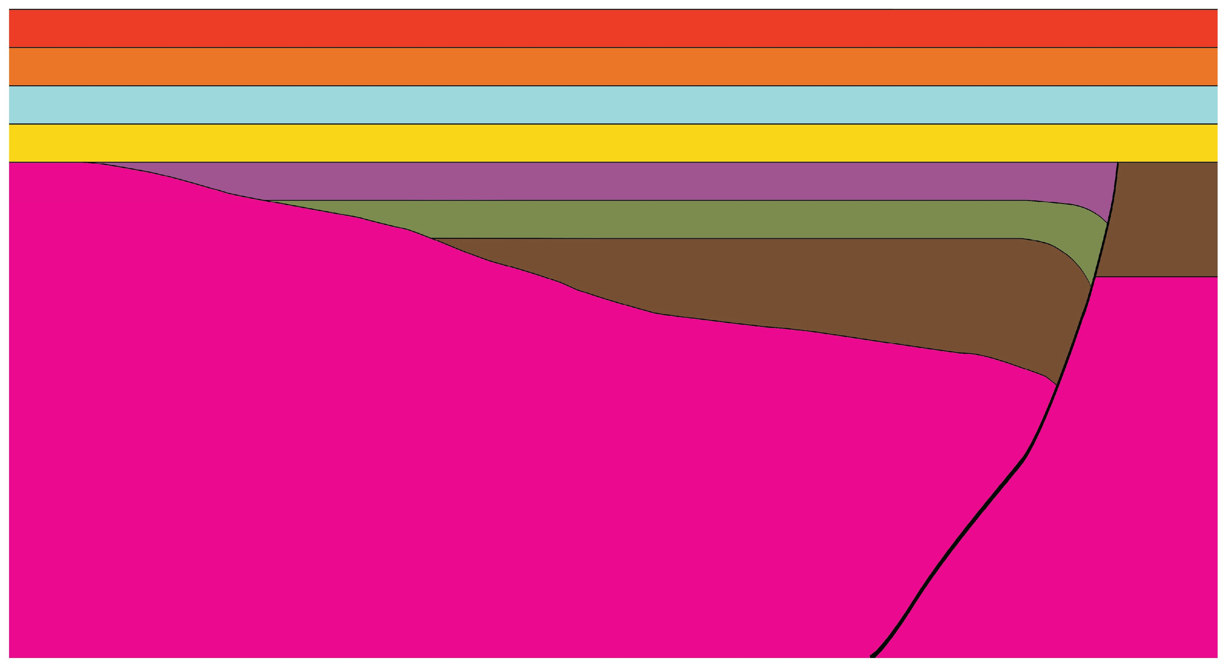
Paleozoics – undifferentiated
Post-rift Middle Cambrian quartzites (Salmo & Chewelah)
Upper Proterozoic to Lower Cambrian Addy quartzite
Upper Proterozoic Windermere
Middle Proterozoic Belt
/ Purcell Supergroup
Montania
NW
Stratigraphy schematic
not to scale
SE
see Lund & Cheney and Cheney & Zieg
in Cheney (ed.) 2016
The Geology of Washington and Beyond:
From Laurentia to Cascadia
Notes:
This is a carton of the stratigraphy in the vicinity of the step-over zone. For a detailed discussion of the stratigraphy, see the papers by Lund & Cheney and Cheney & Zieg in Eric’s recent book The Geology of Washington and Beyond.

Slide 8
Post-rift Middle Cambrian quartzites (Salmo & Chewelah)
Late Proterozoic / Early Cambrian
Windermere / Addy rift basin
Montania
Notes:
We have stripped away most of the annotation in order to focus on the strata and structures associated with the early rift margin. These are the structures that appear to have controlled the geometry of the NEWAFT. In subsequent maps, pay special attention to the brown, green & purple units, as we think these exerted control over the geometry of the thrust salient. These are Middle Proterozoic Belt / Purcell (brown), Upper Proterozoic Windermere Group rocks (green) & Upper Proterozoic to Lower Cambrian quartzites that include the Addy (purple).The Windermere & Addy appear to have been deposited in a rift basin. These upper Proterozoic rocks are not present in the SE part of the study area, where Middle Cambrian quartzites lie directly upon Belt strata.

Slide 9
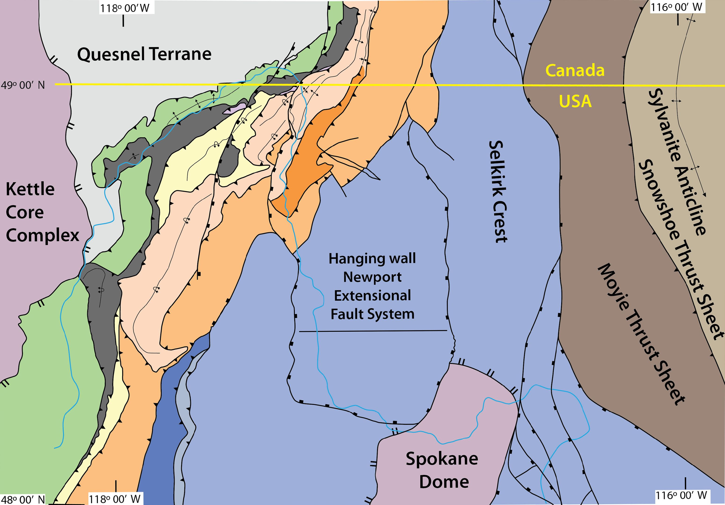
1
11
5
4
2
6
10
3
1
9
5
6
9
4
8
7
1
Notes:
The NEWAFT lies east of the Kettle core complex. This thrust belt is thought to have fromed in the Middle Jurassic during the accetion of the Quesnel terrane. There are at least 6 sheets in the north, with two additional sheets in the south, # 7 & 8. To the east are the Moyie thrust sheet and the Snowshoe thrust sheet and associated Sylvanite anticline of the Libby thrust belt. Between the these west-vergent & east-vergent thrust belts is an extensional regime with metamorphic core complexes. Omitted on this figure are the extensive Cretaceous intrusions, which are shown in the next figure.

Slide 10
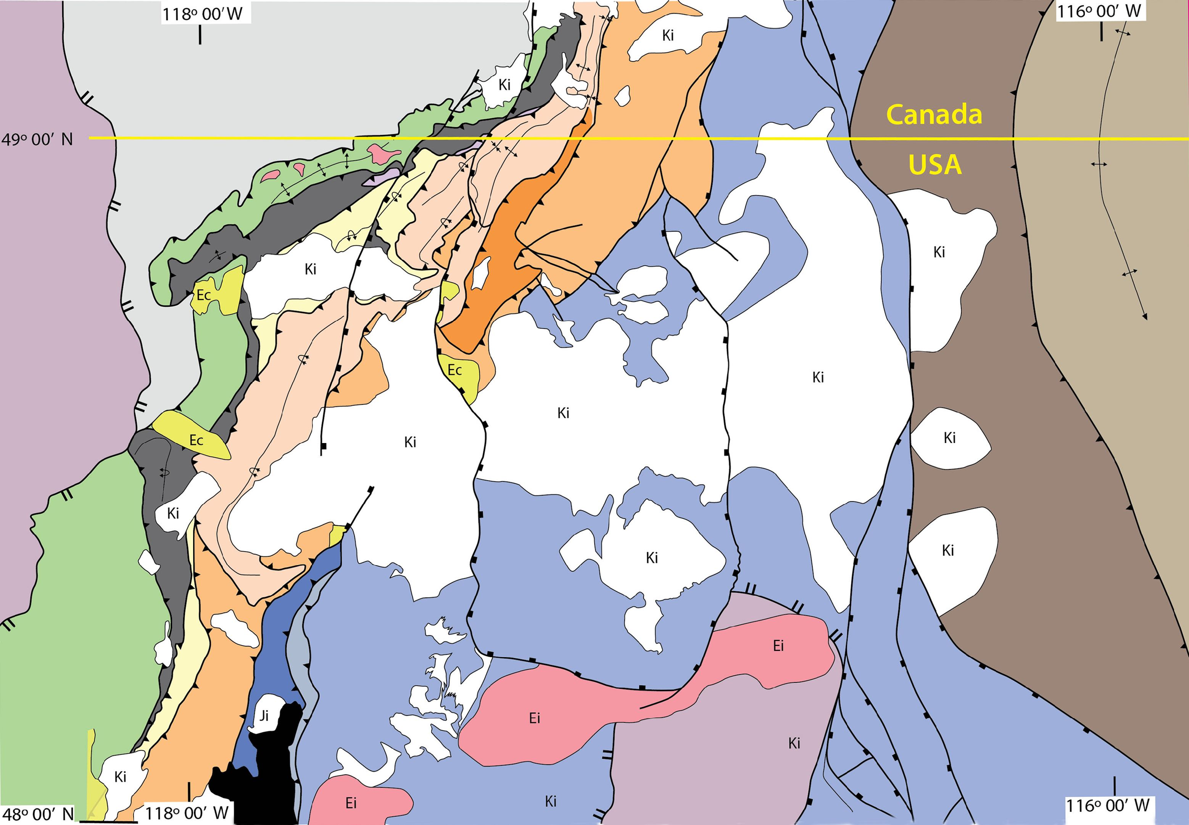
Granitic intrusions ~90 ±10 Ma
Notes:
These Cretaceous instrusions are dated at approximately 80 - 100 Ma. These intrusions postdate the thrust deformation, cutting across all thrusts and related folds. In the next few slides the intrusions will be omitted so that the thrust structures can be more clearly depicted. We will return to a discussion of the tectonic and structural significance of the instrusions near the end of the talk.

Slide 11
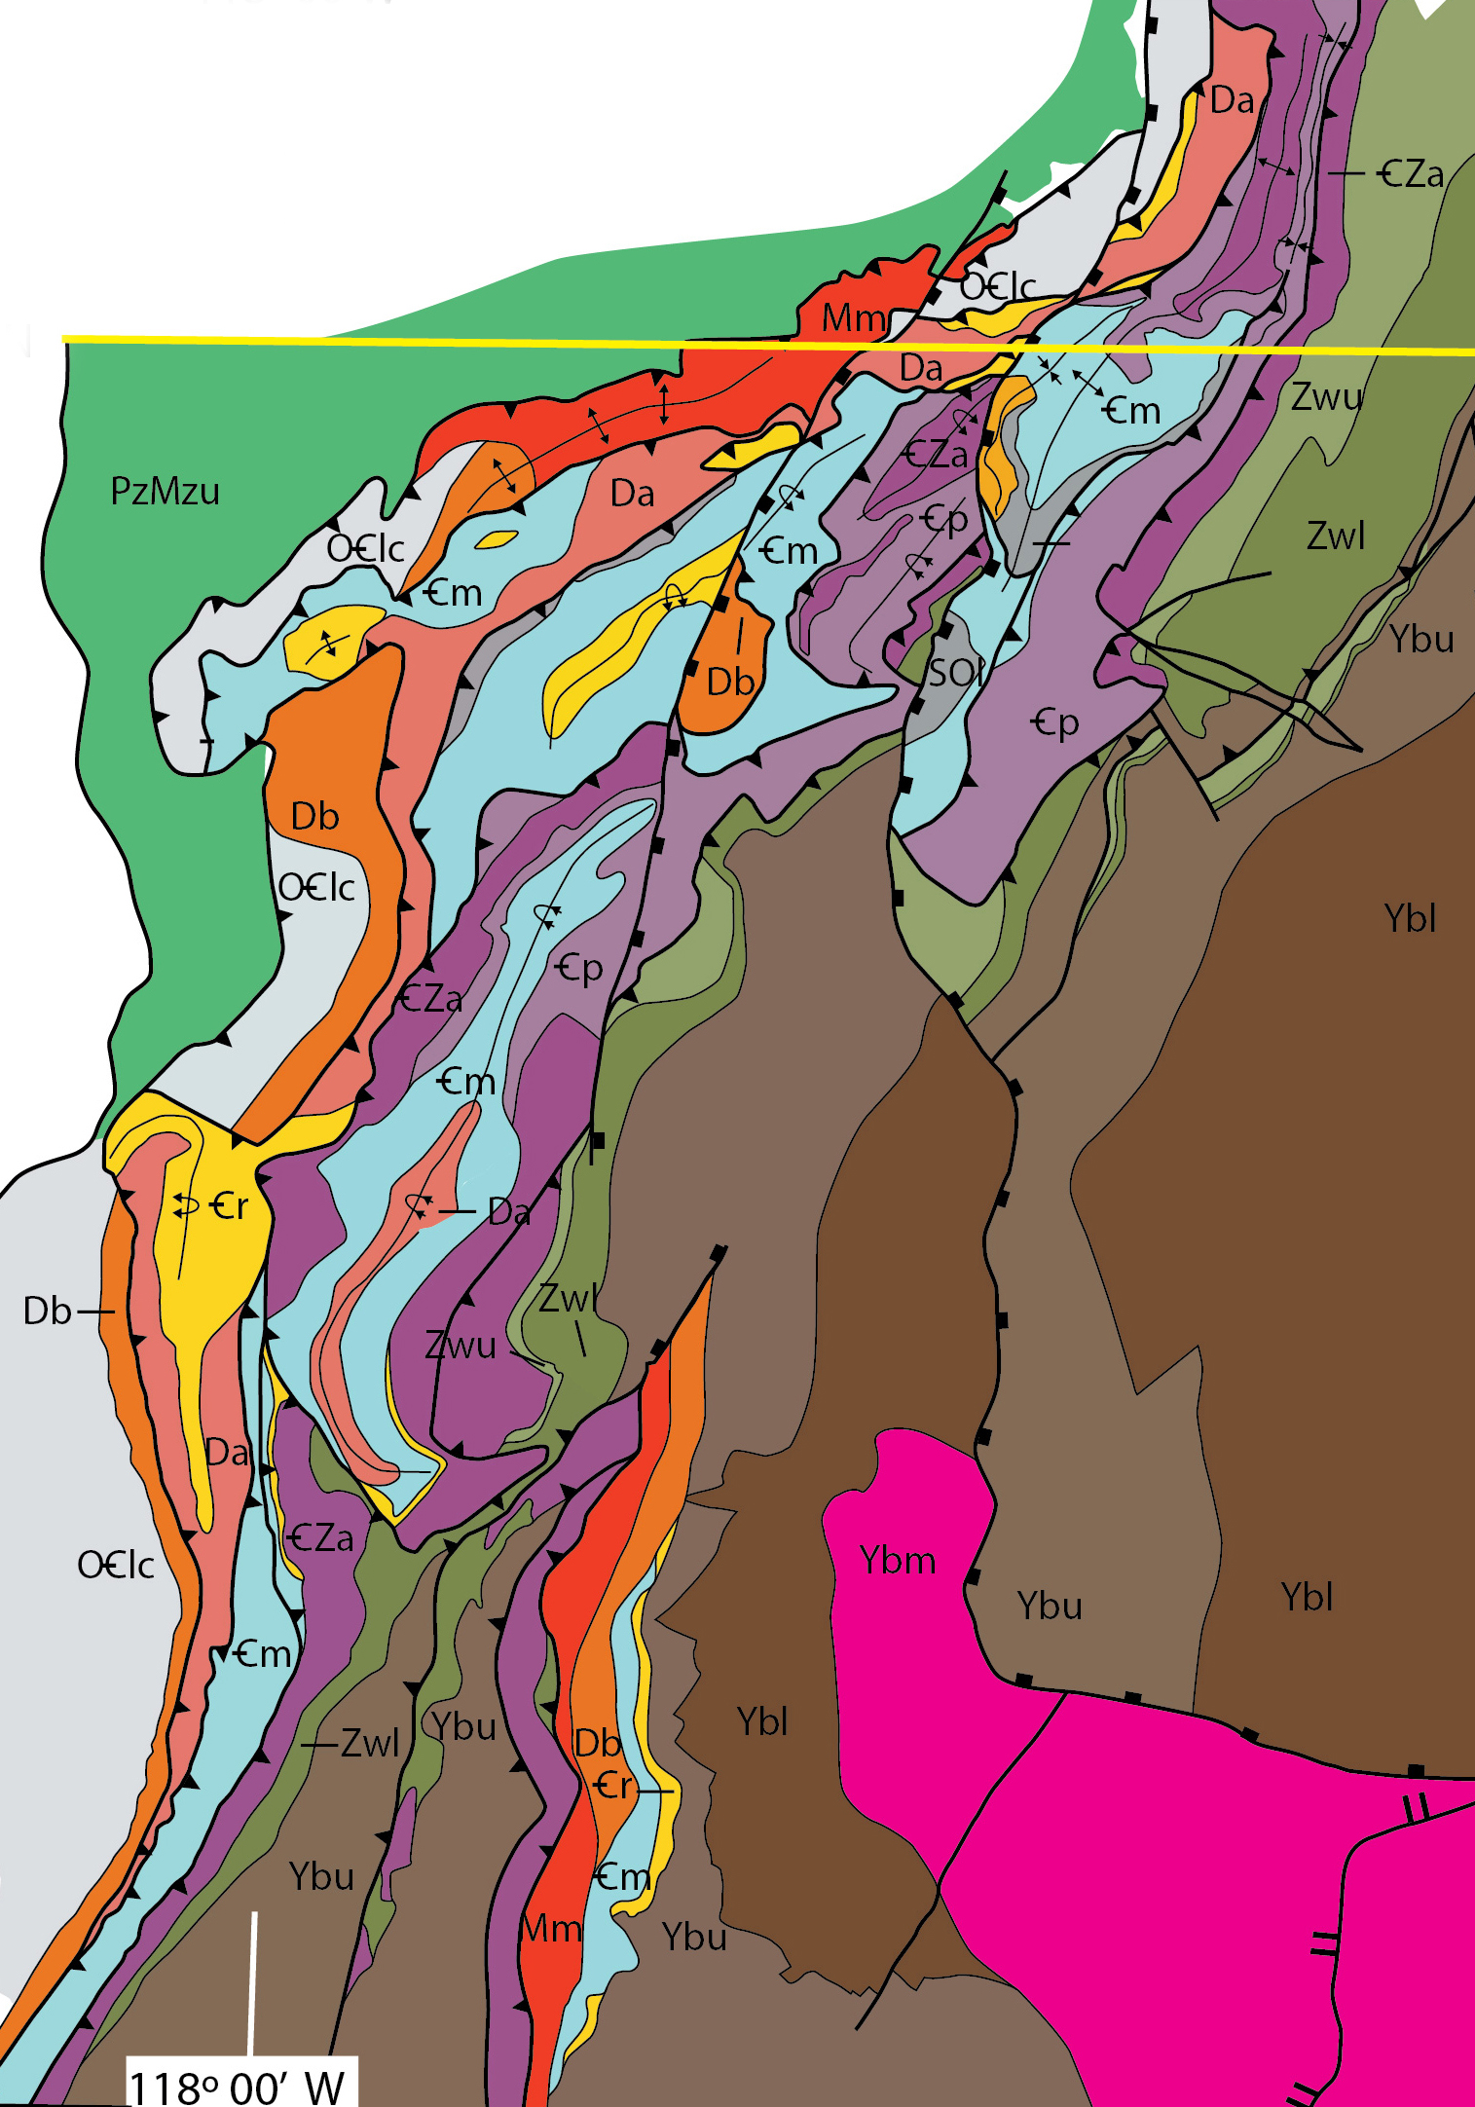
W-vergent salient – Pend Oreille River Fold-Thrust Belt (PORFT)
E-vergent Colville River Fold-Thrust Belt (CRFT)
S-plunging, W-vergent Bald Mtn anticline (BMA)
1
3
2
Notes:
There are 3 distinct structural regimes that constitute the NEWAFT. The most prominant feature is the west- to northwest-vergent Pend Oreille River thrust salient (PORFT), which lies to the north near the Canadian border. To the south is what Eric Cheney has called the Colville River fold & thrust belt (CRFT), which is mainly east-vergent. And to the east of the CRFT lies a 3rd feature that has previously not received much attention, a south plunging antiform, which we call the Bald Mtn anticline.

Slide 12
after Cheney 2010
& Cheney & Zieg 2016
Pend Oreille River thrust belt (PORFT)
NW-vergent, large sheets
Cambrian, Devonian, & Mississippian rocks in leading sheets
Windermere & Cambrian rocks in trailing sheets
1
11
5
4
2
6
10
3
1
9
5
6
9
4
8
7
1
Notes:
The NEWAFT can be divided into two domains. To the north is what Eric has called the Pend Oreille River fold and thrust belt. It is a prominent salient with 6 major NW-vergent thrust sheets of Paleozoic strata. The trailing sheets along the eastern margin of the salient contain Windermere & Cambrian strata. The Windermere is in shades of green & the Addy is deep purple. Belt / Purcell rocks (brown) comprise the hinterland of this thrust salient.

Slide 13
after Cheney 2010
& Cheney & Zieg 2016
1
11
5
4
2
6
10
3
1
9
5
Colville River thrust belt CRFT
ESE-vergence dominant
Upper Belt-equivalent rocks & lower Windermere in E-vergent sheets
Cambrian, Devonian & Ordovician strata in 2 small W-vergent sheets
6
9
Montania
4
8
7
1
Notes:
The Colville River thrust belt appears is a two-sided system with the greatest shortening and main sense of vergence toward the ESE. The two dominant eat-directed sheets are composed primarily of the upper Belt-equivalent rocks (brown), the lower part of the Windermere (green) and the upper Precambrian to lower Cambrian Addy. The western boundary of the Colville River thrust belt is defined by two thin west-directed thrust sheets.

Slide 14
after Cheney 2010
& Cheney & Zieg 2016
1
11
Pend Oreille River thrust belt (PORFT)
5
4
2
6
10
Transition zone with lateral ramps
(evidence: stratigraphic separation diagrams)
3
1
9
5
6
9
4
8
Colville River thrust belt CRFT
7
1
Notes:
Between the mainly E-vergent thrust system in the south & the NW vergent salient in the north, is a transition zone. This transition zone is marked by lateral ramps, which are evident on stratigraphic separation diagrams . . .

Slide 15
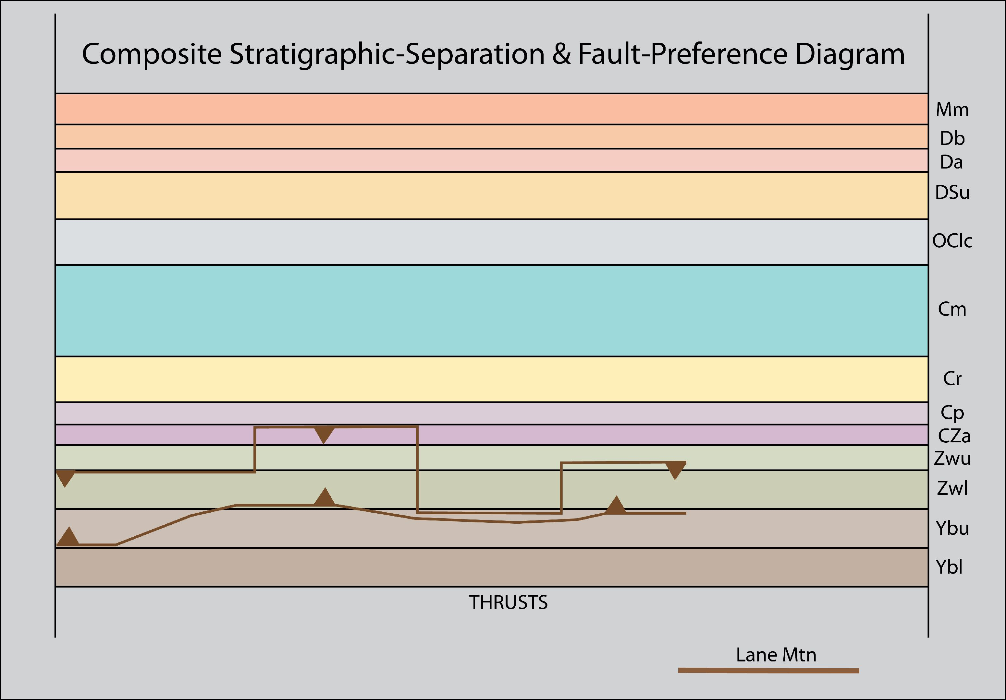
Addy
Windermere
Footwall
Hanging wall
Belt / Purcell
Lane Mtn thrust
stratigraphic separation diagram
Notes:
This is a stratigraphic separation diagram of the Lane Mtn thrust, one of the easternmost thrusts of the Colville River fold & thrust belt in the south. Stratigraphic separation diagrams are usually constructed from geologic maps. They depict the vertical stratigraphic separation between rocks of the footwall and rocks of the hangingwall of a thrust. Thrusts usually place older rocks on top of younger. So the upper line depicts the position of the thrust relative to the footwall and the lower line is the trace of the thrust relative to the hanging wall.

Slide 16
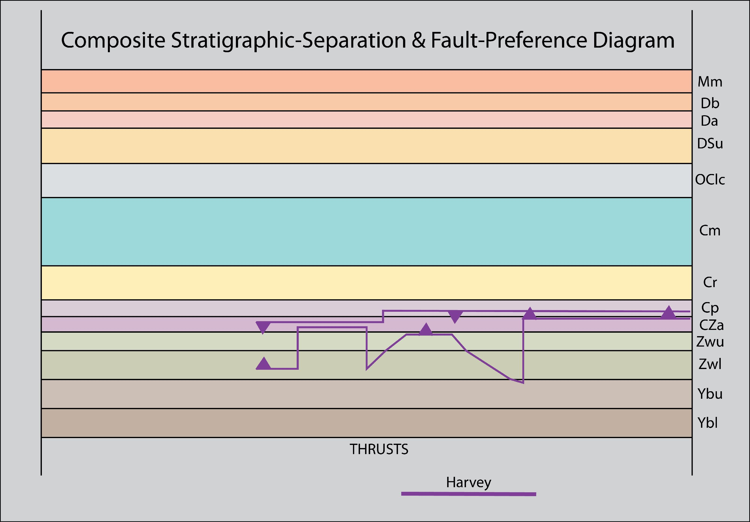
Footwall
Hanging wall
Harvey thrust
stratigraphic separation diagram
Notes:
As we move toward the west and examine SSDs for the other thrusts, we see that they also have lateral ramps . . .

Slide 17
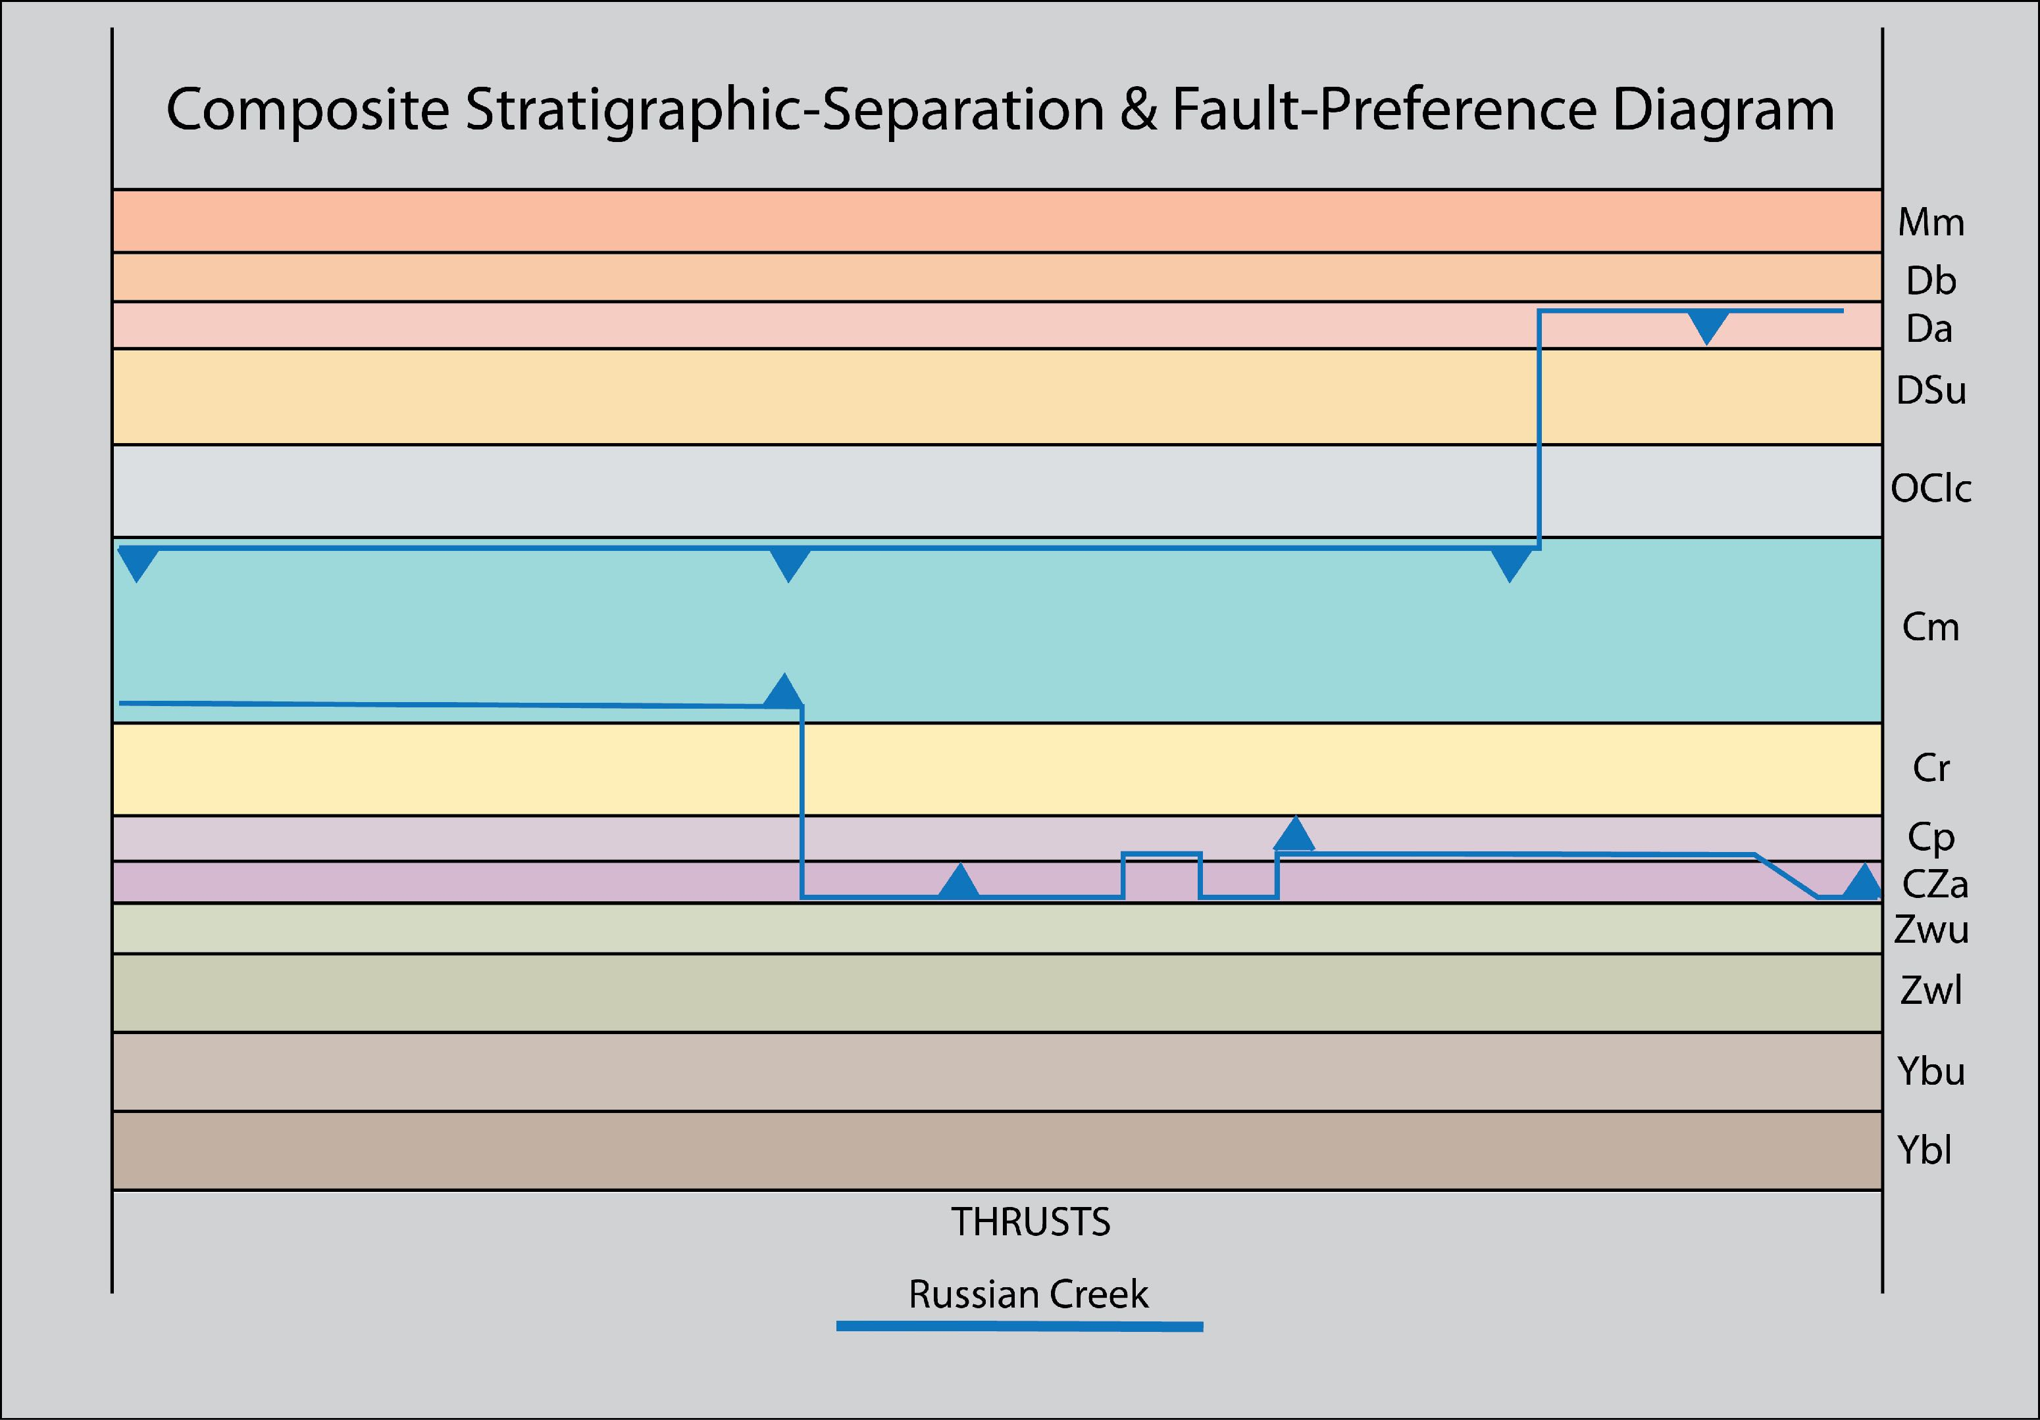
Footwall
Hanging wall
Addy
Windermere
Belt / Purcell
Russian Creek thrust
stratigraphic separation diagram
Notes:
Farther west in the belt lies the Russian Creek thrust. Note the lateral change in the positions of both the hanging wall & footwall thrust traces. These are lateral ramps. Note that hanging wall & footwall lateral ramps need not correpond due to large thrust displacement.

Slide 18
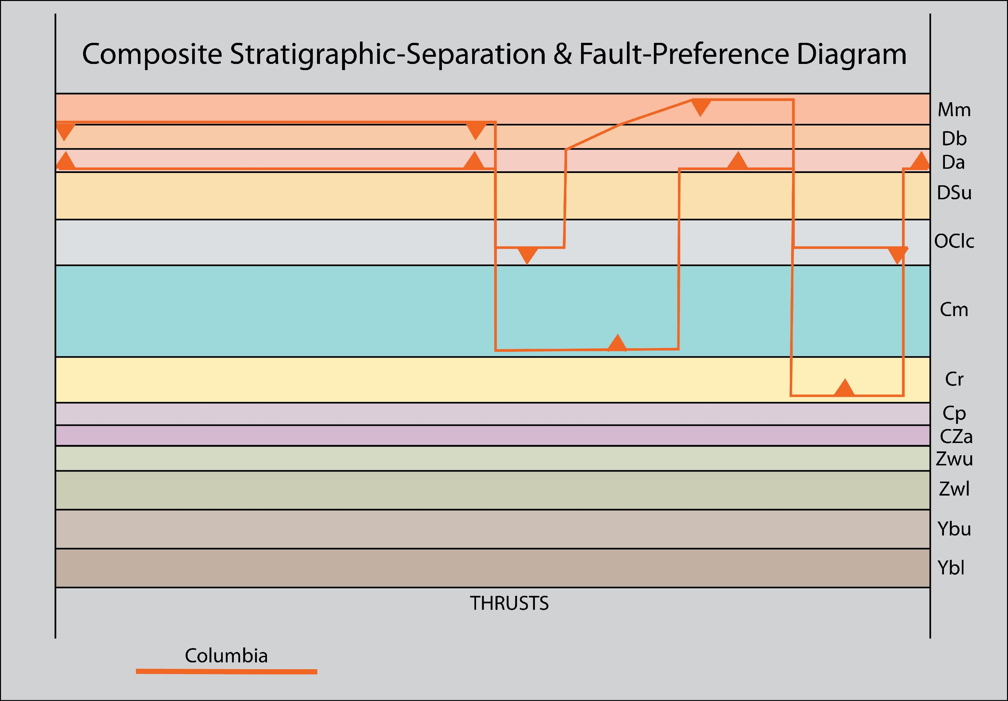
Footwall
Hanging wall
Addy
Windermere
Belt / Purcell
Columbia thrust
stratigraphic separation diagram
Notes:
However, farther west on the Columbia thrust, the footwall & hangingwall lateral ramps do correspond.

Slide 19
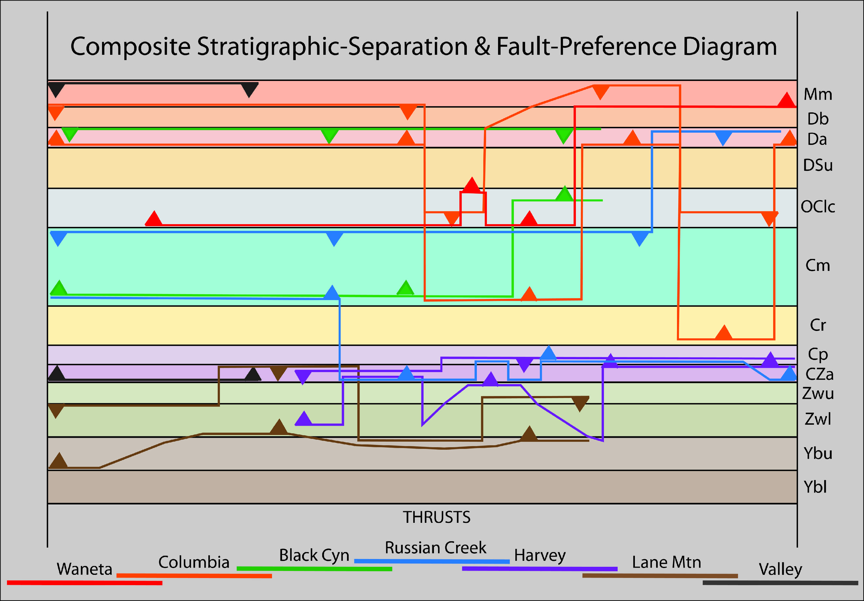
Stratigraphic Separation Diagram
of All Thrusts
Addy
Windermere
Belt / Purcell
Notes:
And here is a composite stratigraphic separation diagram for all the thrusts. The thrust sheets carrying Belt / Purcell, Windermere and Addy strata, lie in the easternmost thrust sheets of the north & in the east-vergent Colville River thrust belt in the south. The lateral ramps at this level lie farther south. In the prominent thrust salient of the Pend Oreille River thrust belt, the thrusts are all within the Paleozoic sequence and the lateral ramps have shifted farther north.

Slide 20
Lund 2008
fig 3
Lateral ramps
Notes:
The details are uncertain, but it appears that these lateral ramps and the north to south change in thrust vergence & structural style may be in response to stratigraphic variations associated with the Late Proterozoic, early Paleozoic rift margin, Montania. The figure at right from Lund (2008).

Slide 21
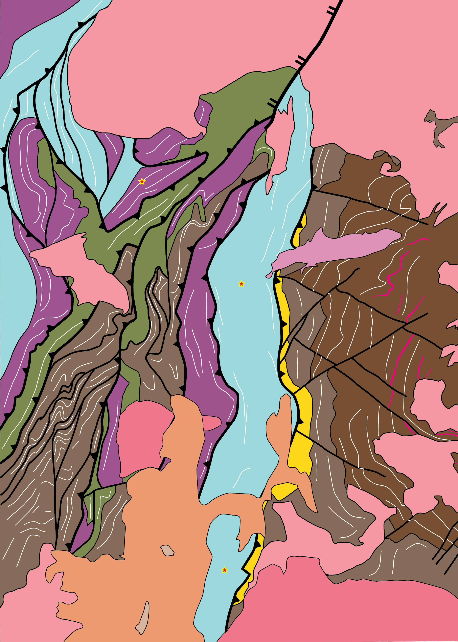
Windermere
Duplexes
in
E-vergent
sheets of
CRFT
?
Addy
after
Miller 2000
USGS
MF-2354
Belt
(Deer Trail)
Notes:
Let’s look at some interesting details of the east-vergent Colville River fold and thrust belt. The map at right is a blow-up of the east-vergent CRFT. Of special interest are two structures that look like duplexes. If these are duplexes what are their significance & how do they fit into the bigger picture?

Slide 22
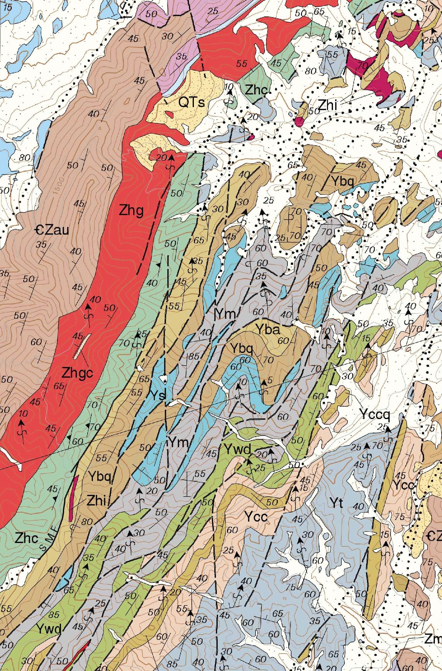
Miller 2000
USGS
MF-2354
Notes:
We will examine two areas of interest, beginning with the structures in the west, indicated by the red arrow at right. The map shows detail of Miller’s Chewelah map sheet.

Slide 23
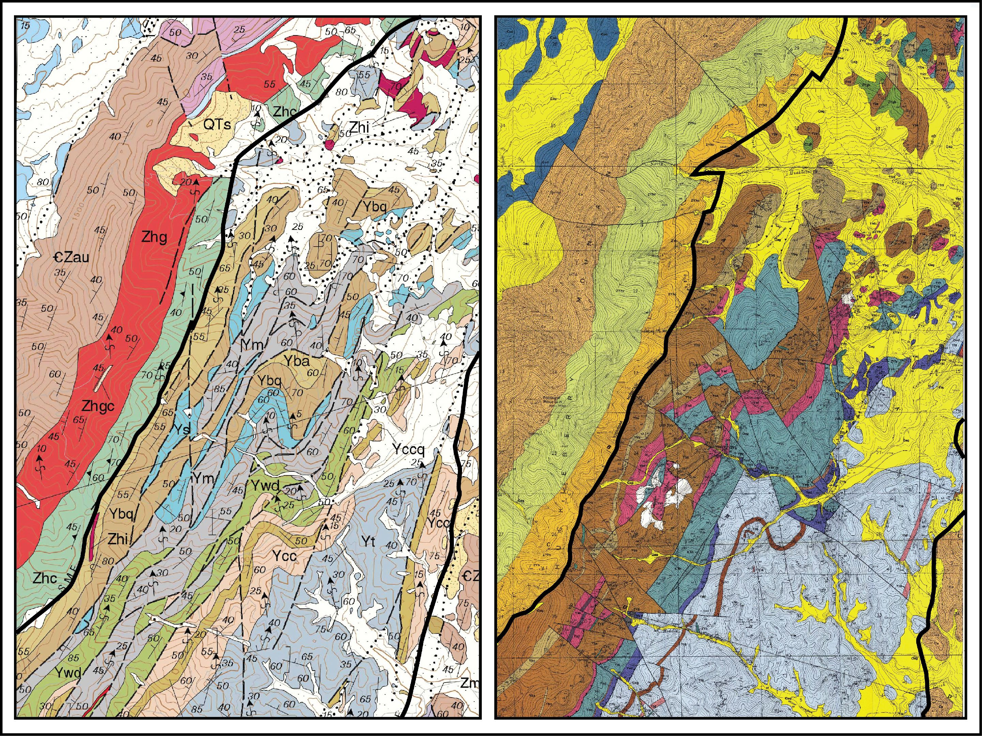
Addy quartzite
& Upper Proterozoic
Windermere Group
Miller 2000
USGS
MF-2354
Middle Proterozoic
Deer Trail Group
(Upper Belt Supergroup)
Evans 1987
USGS
Bulletin 1679
Stensgar Mtn fault
Stensgar Mtn thrust
Lane Mtn fault
Lane Mtn thrust
Notes:
Here are two maps covering the same area. At right is a 1987 map from Evans. Both maps show a complex area of faulting between two prominant through-going faults, the Stensgar Mtn fault to the west and the Lane Mtn fault to the east. WNW-dipping Windermere group comprises the hangingwall. Middle Proterozoic Deer Trail Group, equivalent to the Upper Belt, comprise the body of the fault zone, sandwiched between the Stensgar Mtn & Lane Mtn faults.

Slide 24
Miller 2000
USGS
MF-2354
Evans 1987
USGS
Bulletin 1679
Stensgar Mtn fault
Stensgar Mtn thrust
DUPLEX
Lane Mtn fault
Lane Mtn thrust
Notes:
Evans interpreted this structure as a duplex with the Stensgar Mtn thrust as the roof and the Lane Mtn thrust as the floor.

Slide 25
Miller 2000
USGS
MF-2354
Evans 1987
USGS
Bulletin 1679
NOT
a
DUPLEX
Stensgar Mtn extensional fault
Stensgar Mtn thrust
DUPLEX
Lane Mtn reverse fault
Lane Mtn thrust
Notes:
However, Miller countered that this could not be a duplex (map at left). He presented convincing arguments that the Stensgar Mtn fault is extensional, downdropping less deformed hanging wall rocks against ductile, highly deformed footwall rocks. But we know that this area has been overprinted by Paleogene extension. So perhaps the roof thrust has been reactivated as an extensional fault.

Slide 26
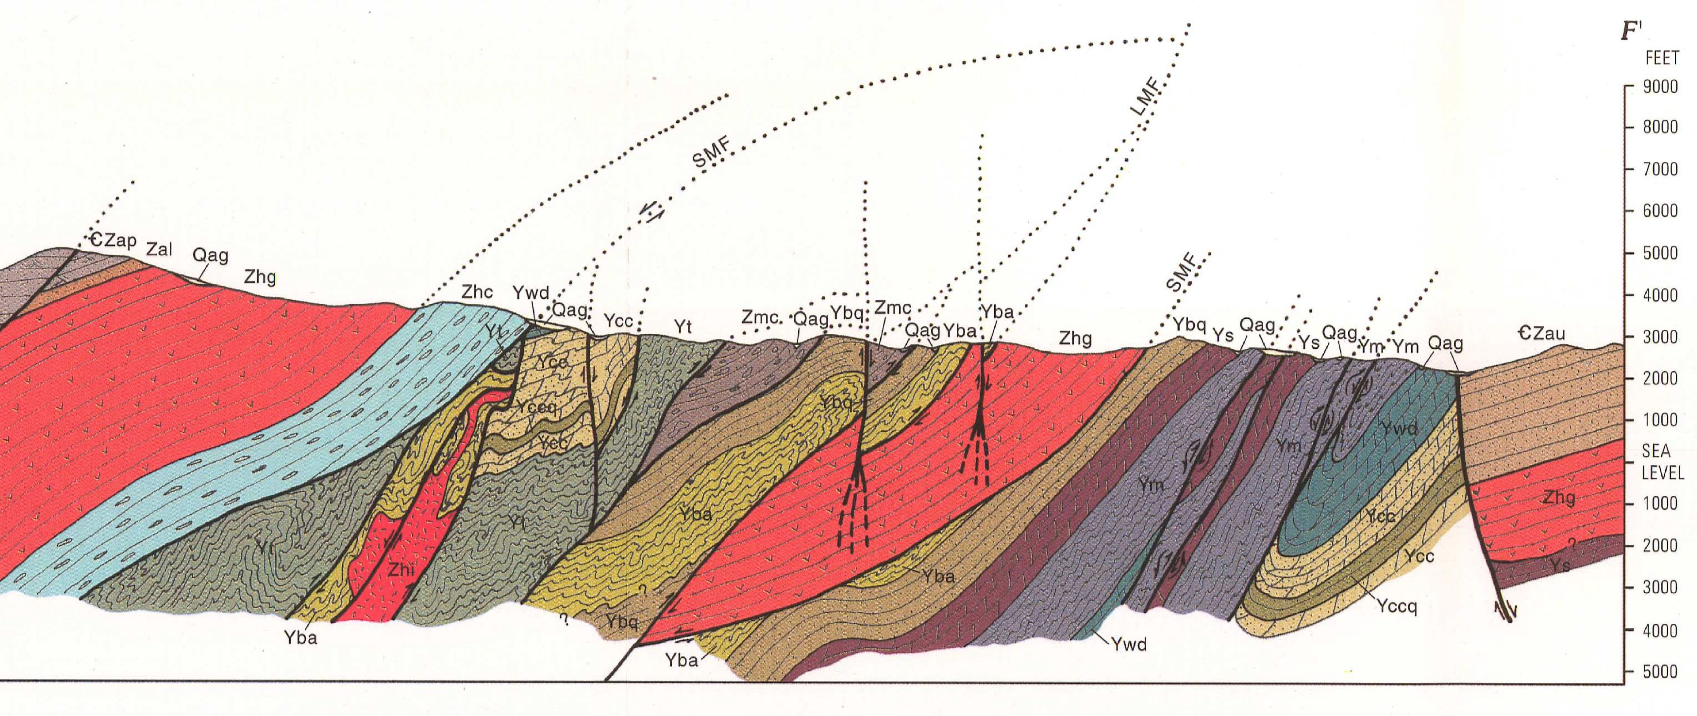
Cross section from geologic map of Addy area
Miller (1996) – USGS Map I-2492
Notes:
In any case, the geometry of this structure, as viewed in both map & cross-section, sure appears to be a duplex . . .

Slide 27
East-vergent Duplex
Roof thrust
Floor thrust
Cross section from geologic map of Addy area
Miller (1996) – USGS Map I-2492
Notes:
A duplex with east vergence. Here we have interpreted the Stensgar Mtn fault as the roof thrust of the duplex and the Lane Mtn fault as the floor thrust.

Slide 28
Notes:
And just to the north is another structure that looks very much like a duplex.

Slide 29
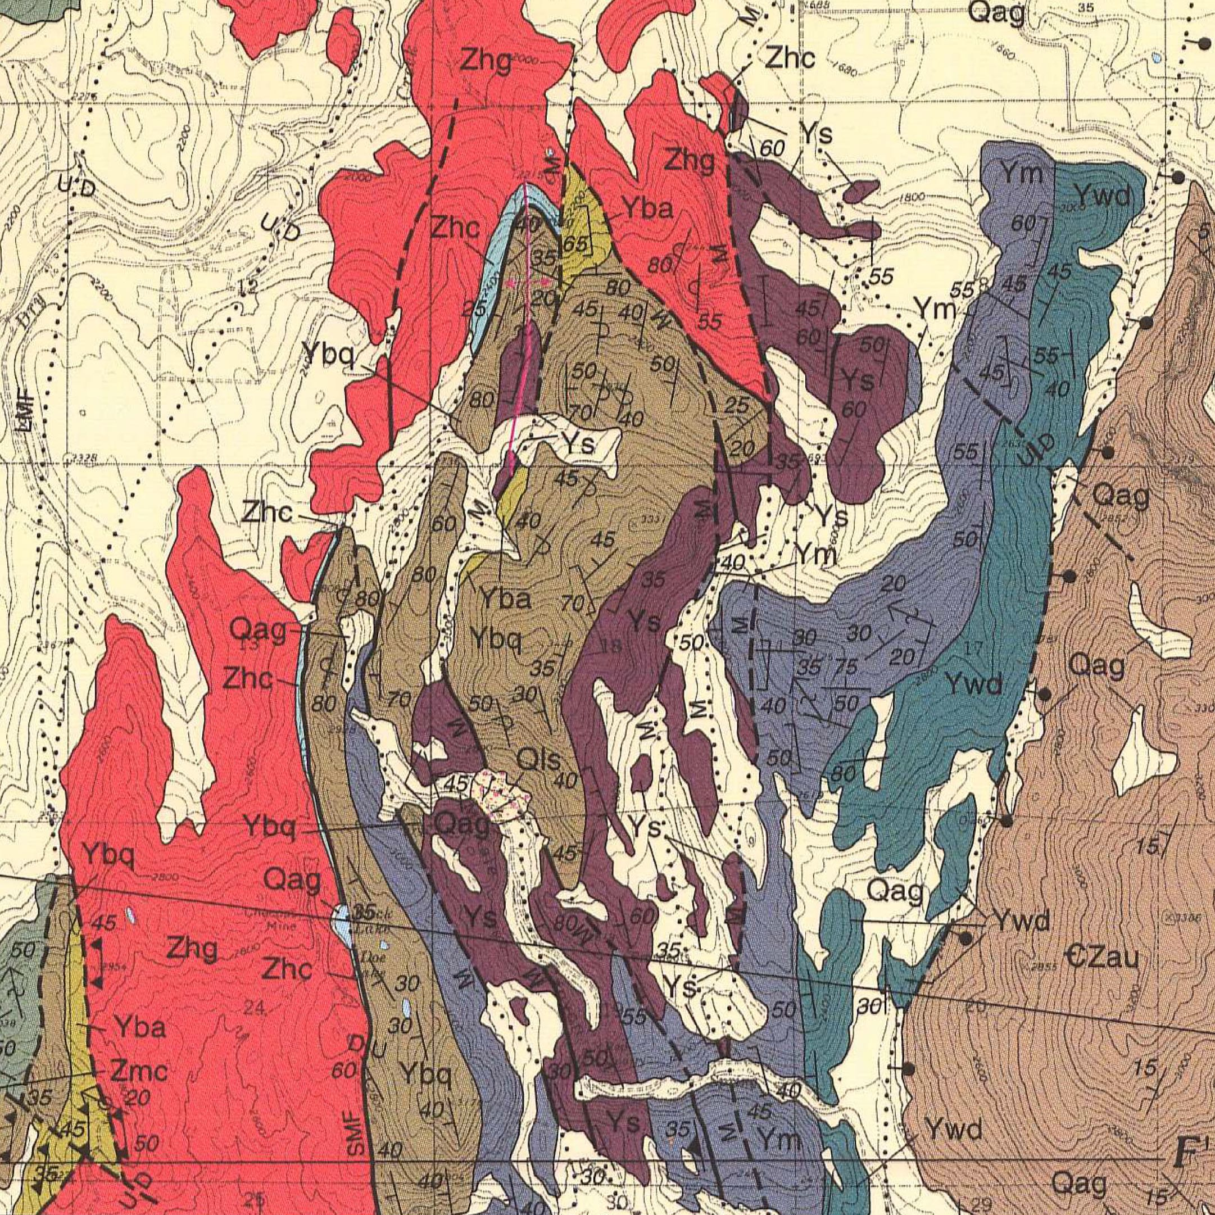
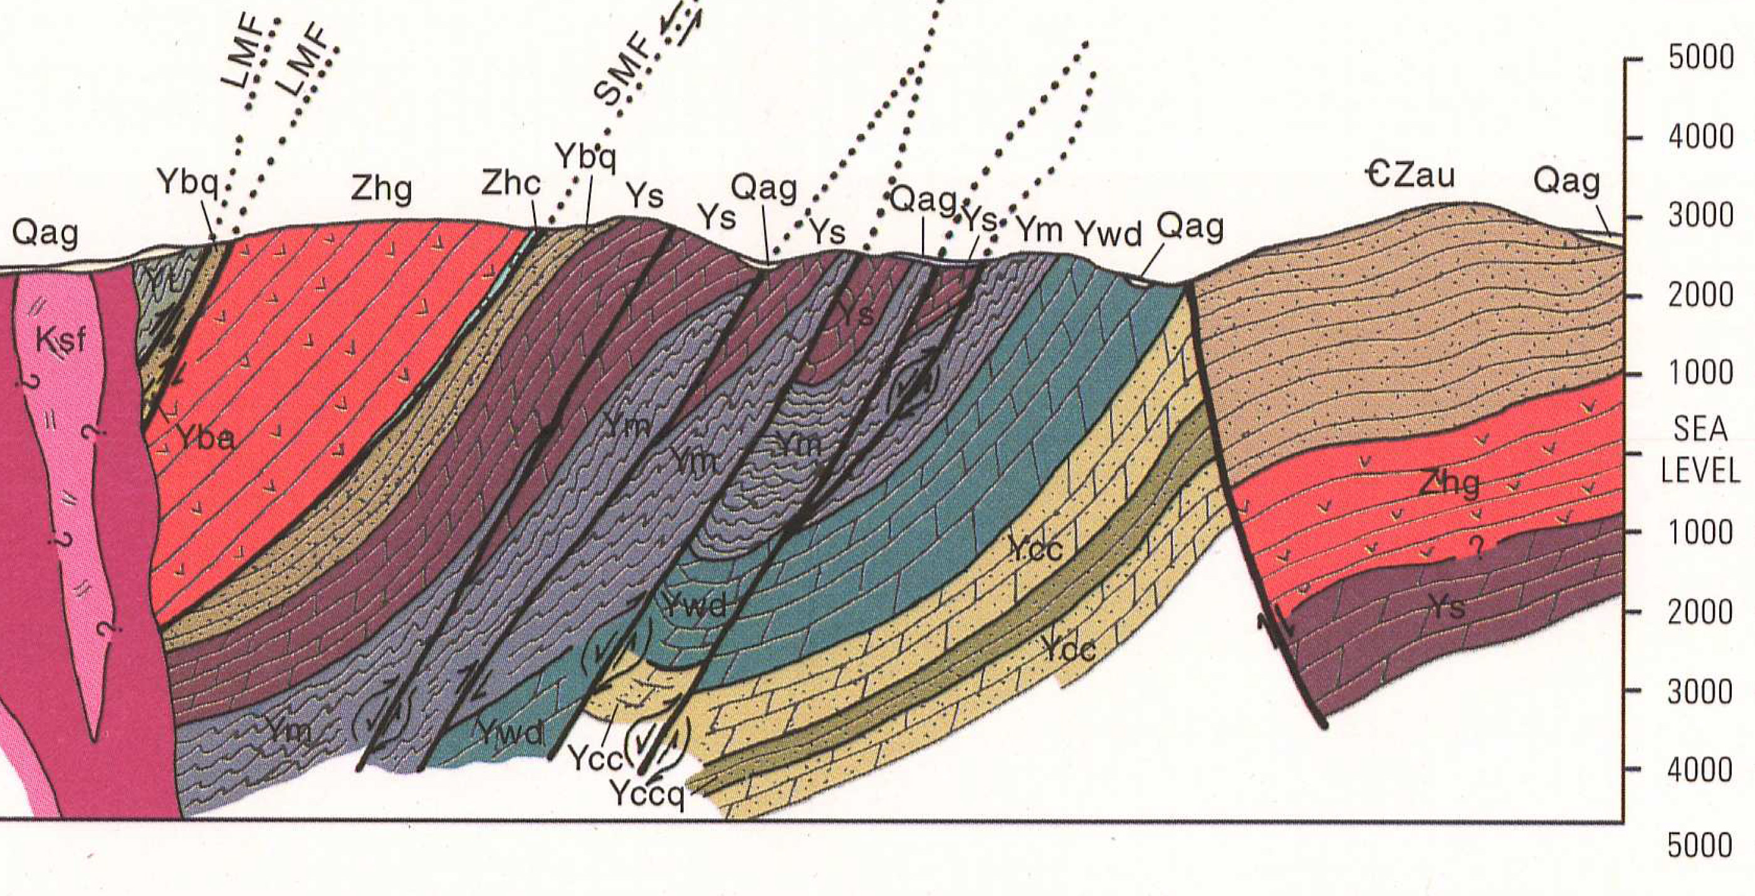
Notes:
The white line shows the line of section across this second proposed duplex.

Slide 30
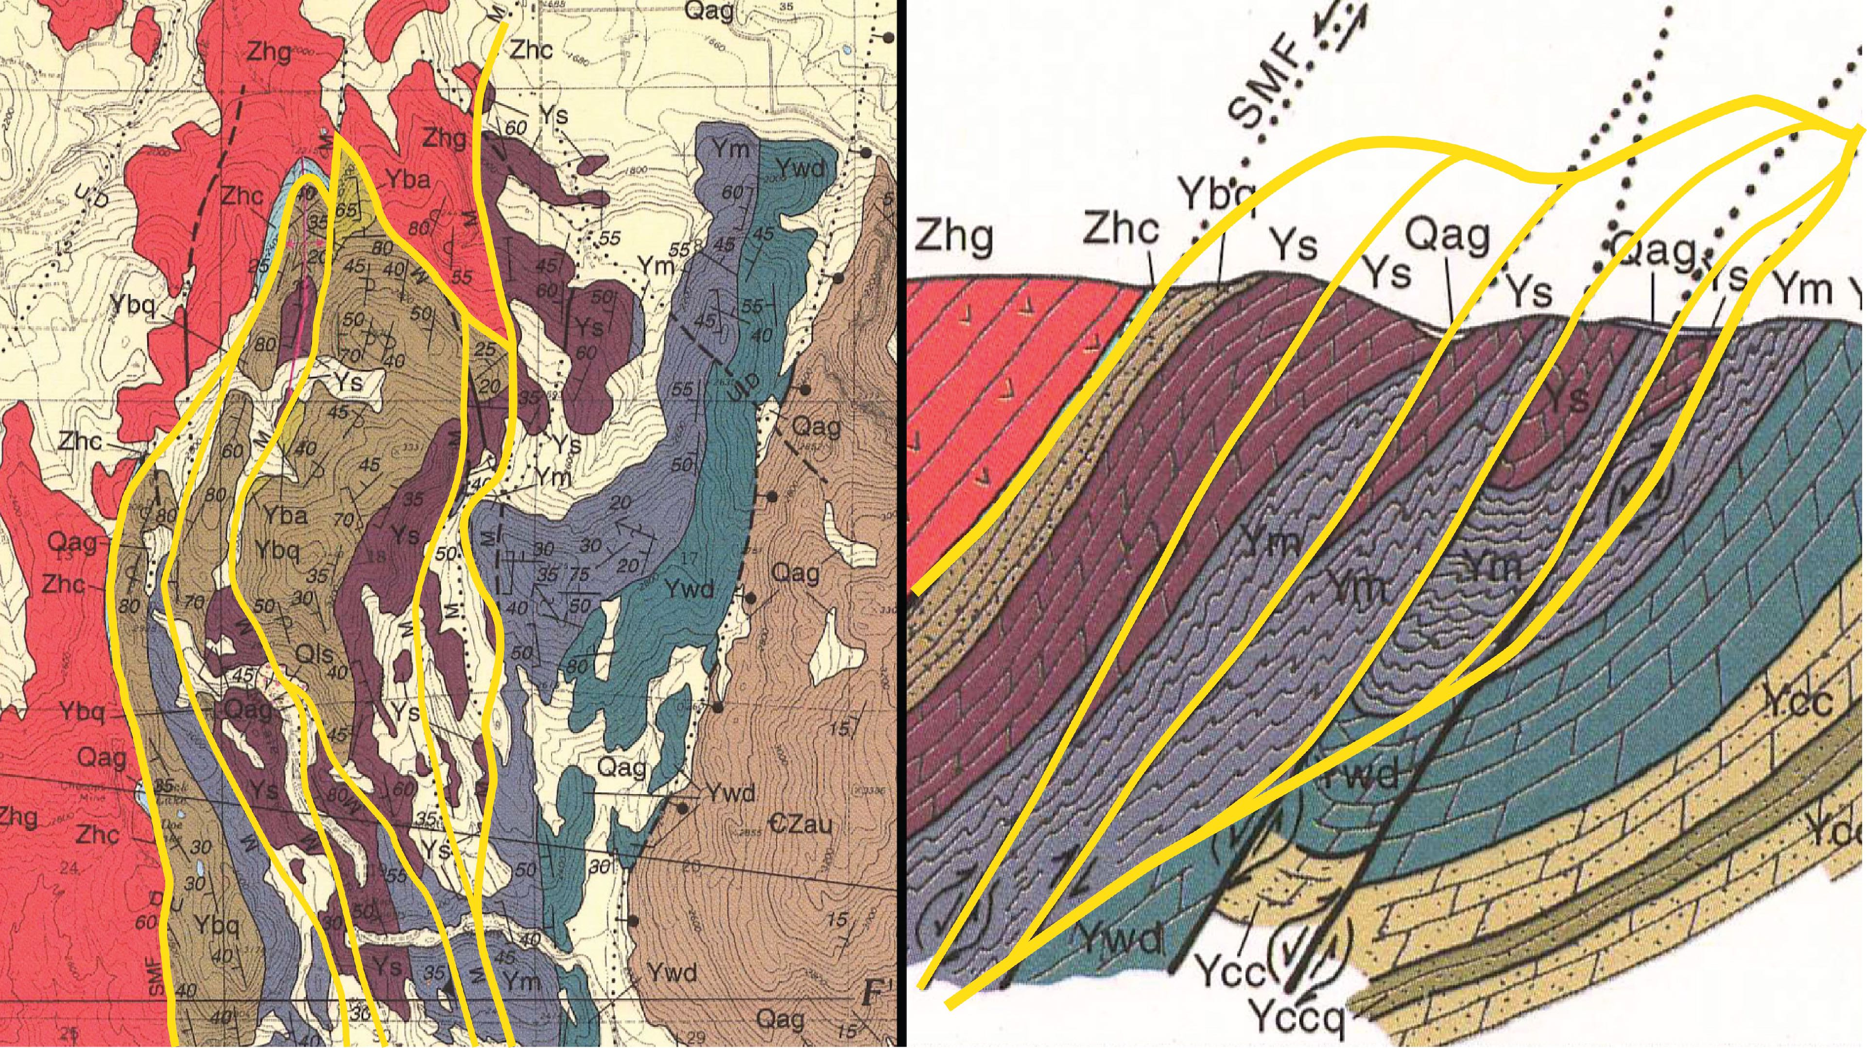
East-vergent
Duplex
Roof thrust
Roof thrust
Floor thrust
Floor thrust
Notes:
And this is the interpretation of the structure as a duplex. The core of the duplex is made up of Deer Trail Mtn rocks, equivalent to Upper Belt. The roof Windermere. So the roof thrust is essentially a bedding-parallel detachment between the Upper Belt & Windermere. Let’s now put these duplexes of the E-vergent Colville River thrust system within the context of the greater NE WA fold & thrust belt . . .

Slide 31
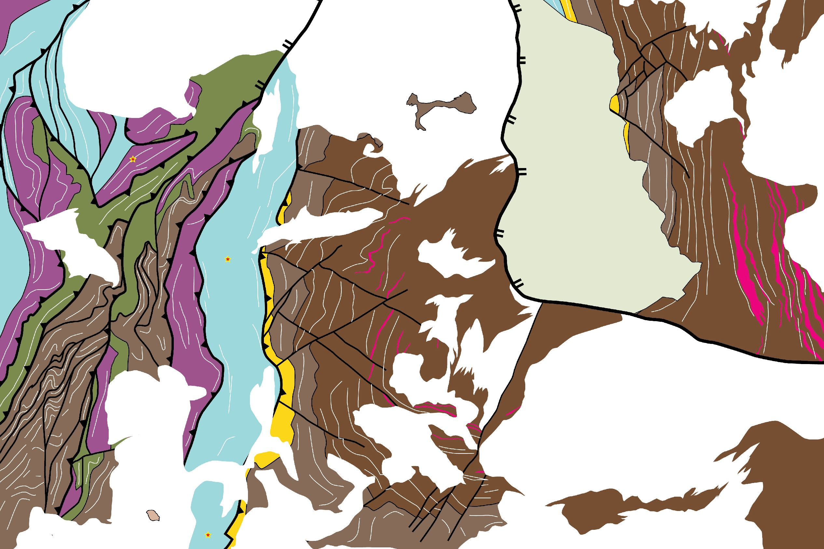
≈
Triangle Zone
comprised of
east-vergent duplexes @ leading edge
west-vergent Bald Mtn anticline @ trailing edge
Notes:
In this map the two duplexes that we have just discussed are show by the blue and yellow stars. These duplexes comprise the majority of the east-vergent CRFT. Another feature of significance is the a south-plunging anticline that lies to the east of the CRFT. We have termed this the Bald Mtn anticline. It is west-vergent with an overturned west limb that may or may not be broken by a thrust fault. We propose that the east-vergent duplexes of the CRFT and the Bald Mtn anticline constitute a triangle zone.

Slide 32
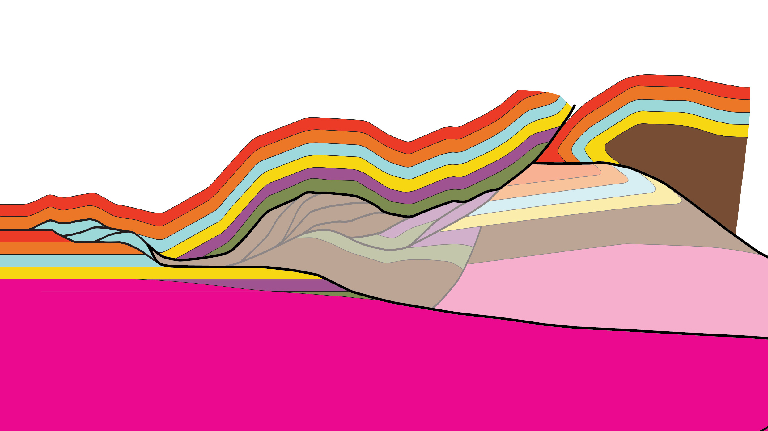
Triangle Zone
Bald Mtn
anticline
east-vergent duplex
Colville River thrust belt
bounded by
– roof of E-vergent CRFT duplexes
– W-vergent Bald Mtn anticline &
– a regional sole thrust
sole thrust – base of triangle zone
Notes:
The east-vergent Colville River thrust belt may be the leading edge of this triangle zone, bounded beneath by a regional sole thrust and to the east by the thrusted Bald Mountain anticline.

Slide 33
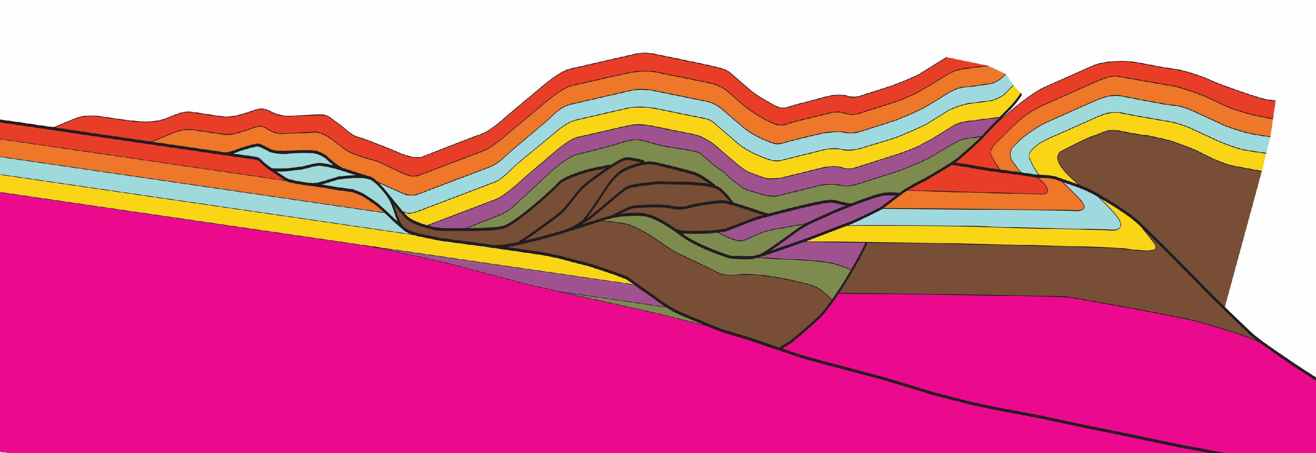
Triangle Zone
east-vergent duplex
Colville River thrust belt
Bald Mtn
anticline
bounded by
– roof of E-vergent CRFT duplexes
– W-vergent Bald Mtn anticline &
– a regional sole thrust
sole thrust – base of triangle zone

Slide 34
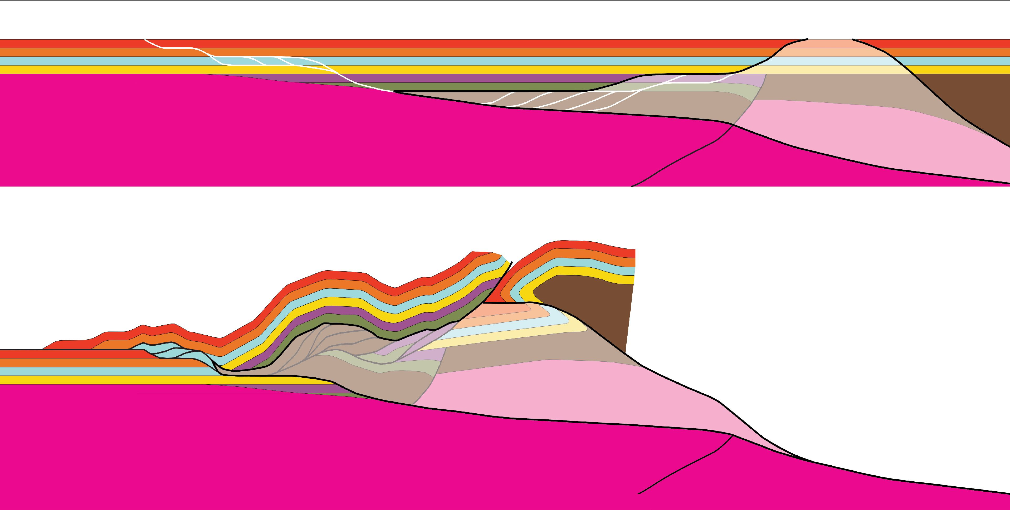
future
Bald Mtn anticline
wedge
sole thrust
Bald Mtn
anticline
CRFT
Notes:
The triangle zone formed as the regional sole thrust propagated westward, carrying with it a wedge of rock that included the Belt & Windermere strata of the rift basin. This wedge drove itself westward, peeling up the overlying lower Paleozoic strata. As the wedge advanced, its leading edge imbricated to form the east-vergent Colville River thrust belt.

Slide 35

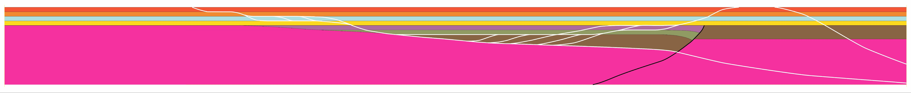
Paleozoics – undifferentiated
Post-rift Middle Cambrian quartzites (Salmo & Chewelah)
Upper Proterozoic to Lower Cambrian Addy quartzite
Upper Proterozoic Windermere
Middle Proterozoic Belt
/ Purcell Supergroup
Thrust trajectories of
Triangle Zone
Notes:
This figure depicts the hypothesis that the geometry of the Windermere / Addy basin controlled the thrust architecture of the Colville River thrust belt. This is similar to backstop models previously put forward to by Eric Cheney in several invited talks.

Slide 36
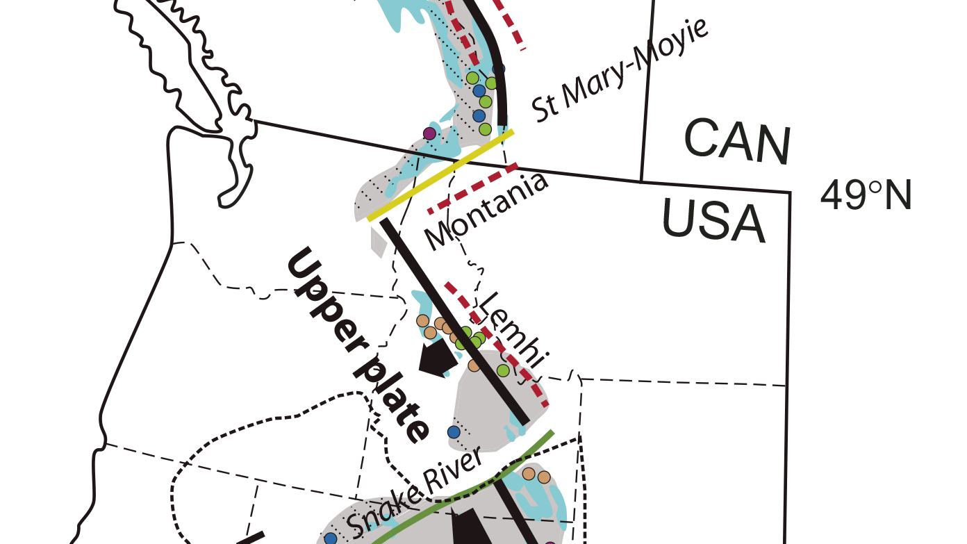
Structural architecture of NEWAFT
influenced by geometry of
Late Proterozoic-Early Paleozoic
rifted margin & “Montania”
?
Lund 2008
fig 3
Montania
Notes:
And perhaps the trajectory of faults within the NE Wa thrust belt were controlled by the configuration of the Late Proterozoic - Early Paleozoic rifted margin & the orientation of a transform fault and related “Montania” arch.

Slide 37
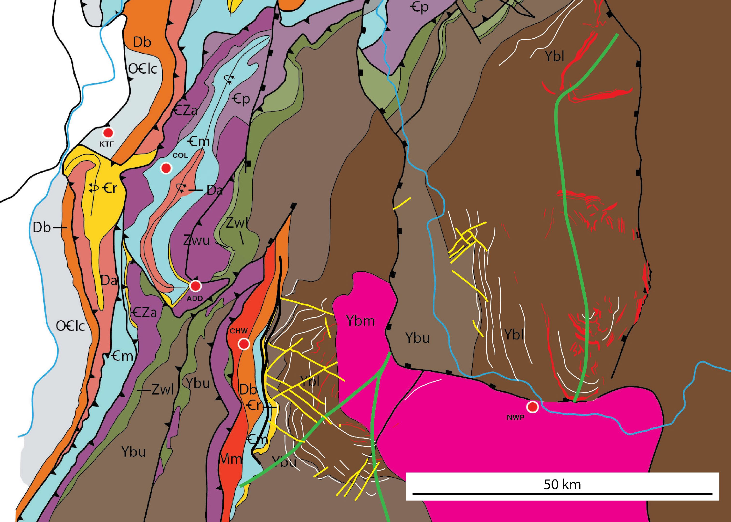
Offset
W-vergent
anticlines
SVA
Newport
fault
SVA
Snow Valley
Anticline
(Schroeder 1952;
Miller et al., 1999)
BMA
Bald Mtn
Anticline
(after Miller, 2000)
BMA
Notes:
One last piece to the puzzle with regard to the Bald Mtn anticline, which forms the eastern boundary of the hypothesized triangle zone. The Bald Mtn anticline is truncated by the low-angle, east-dipping Newport fault shown in yellow. In 1952 Schroeder mapped the Snow Valley anticline. These two anticlines appear to be the same structure.

Slide 38
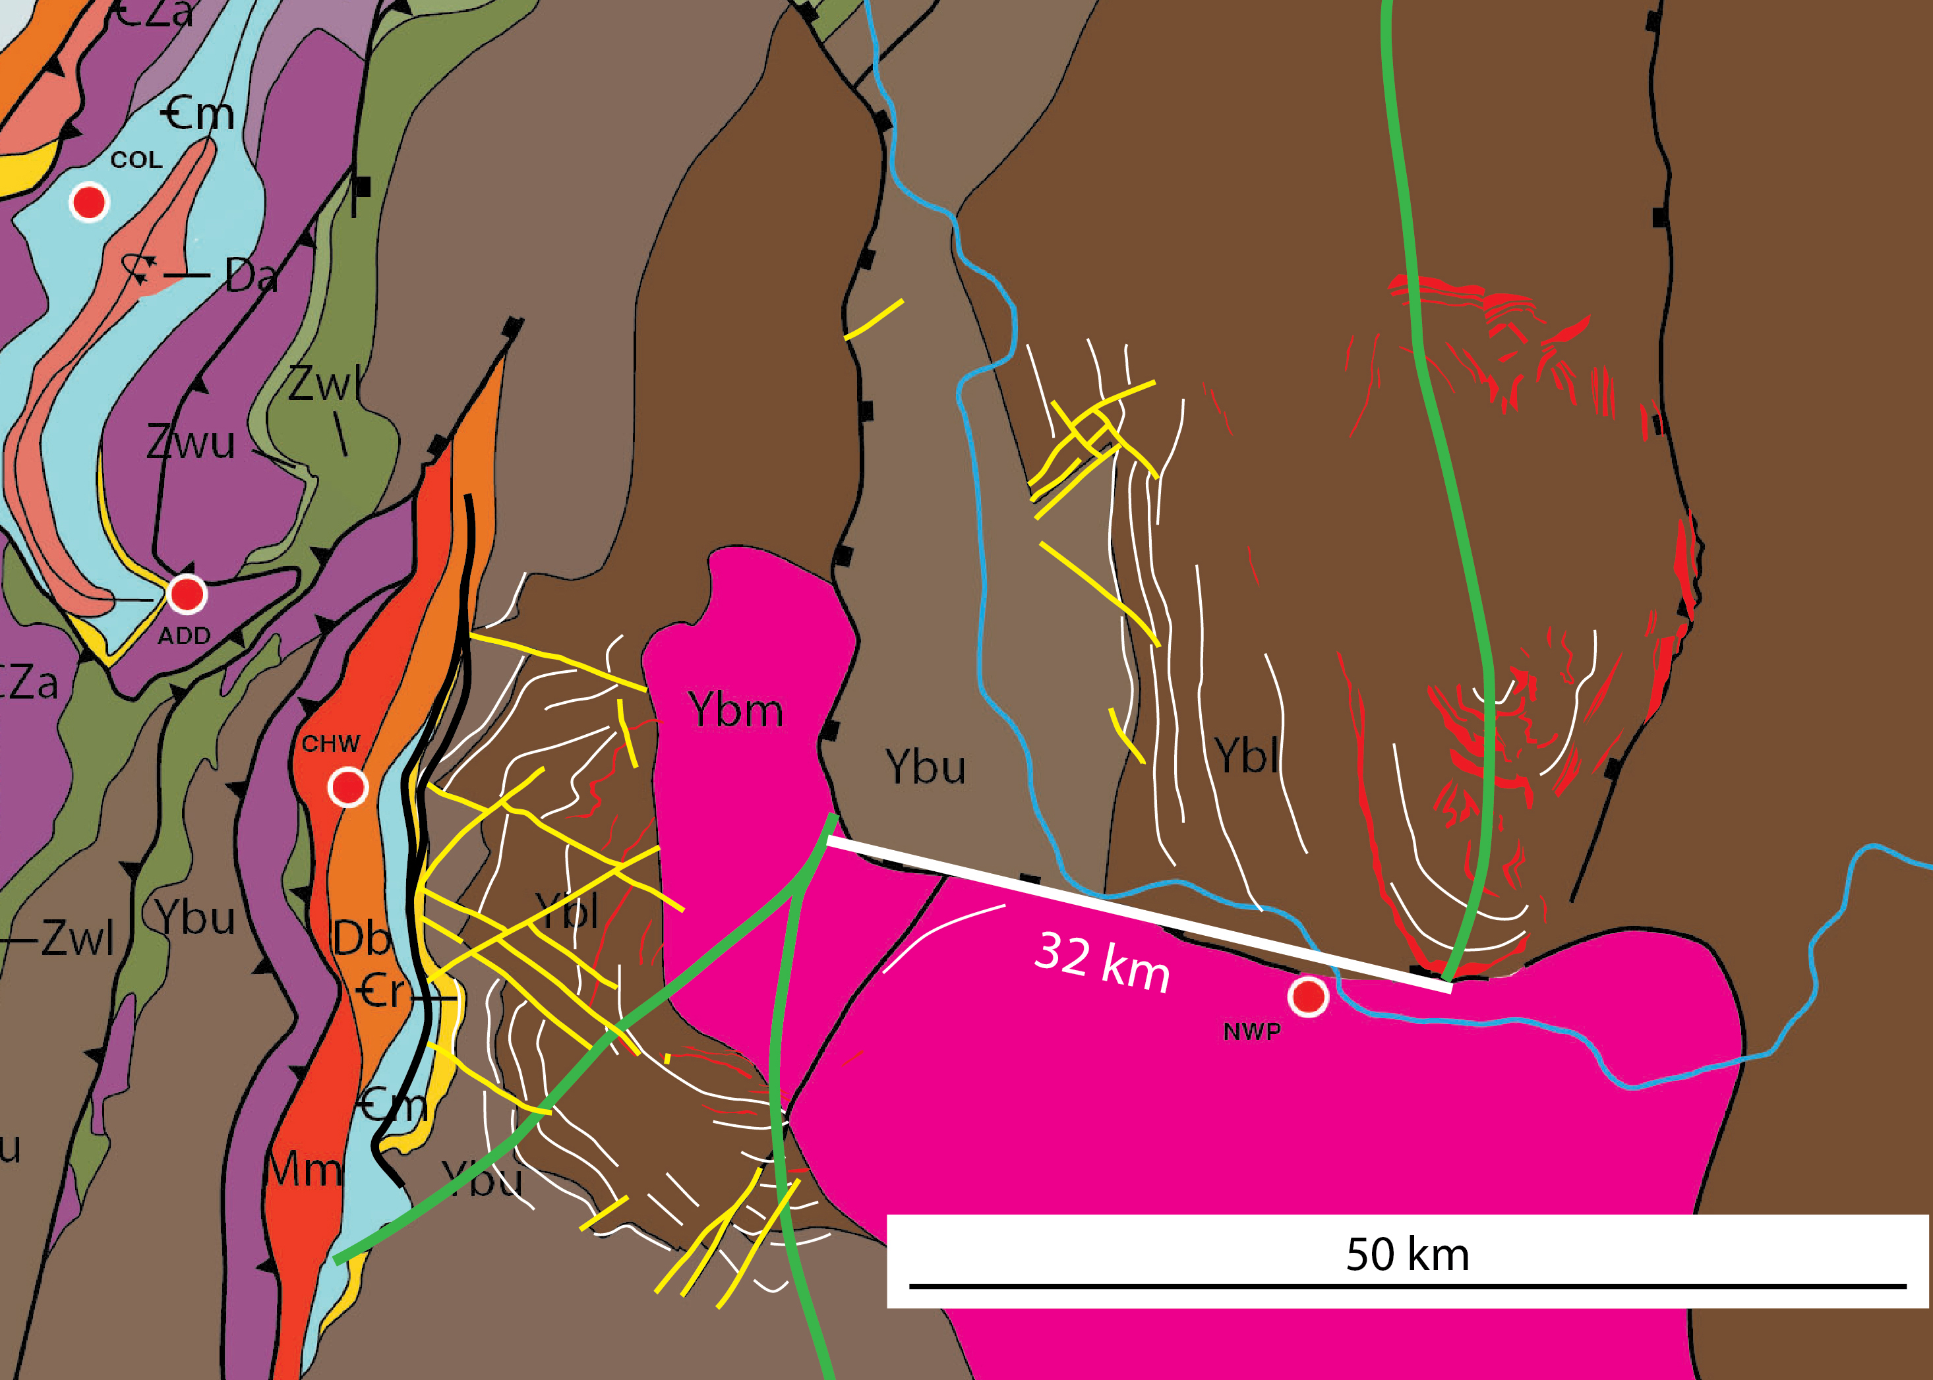
SVA
32 km
offset
BMA
Notes:
If these two anticlines are indeed the same, they have been offset by ~32 km displacement on the Newport extensional fault.

Slide 39
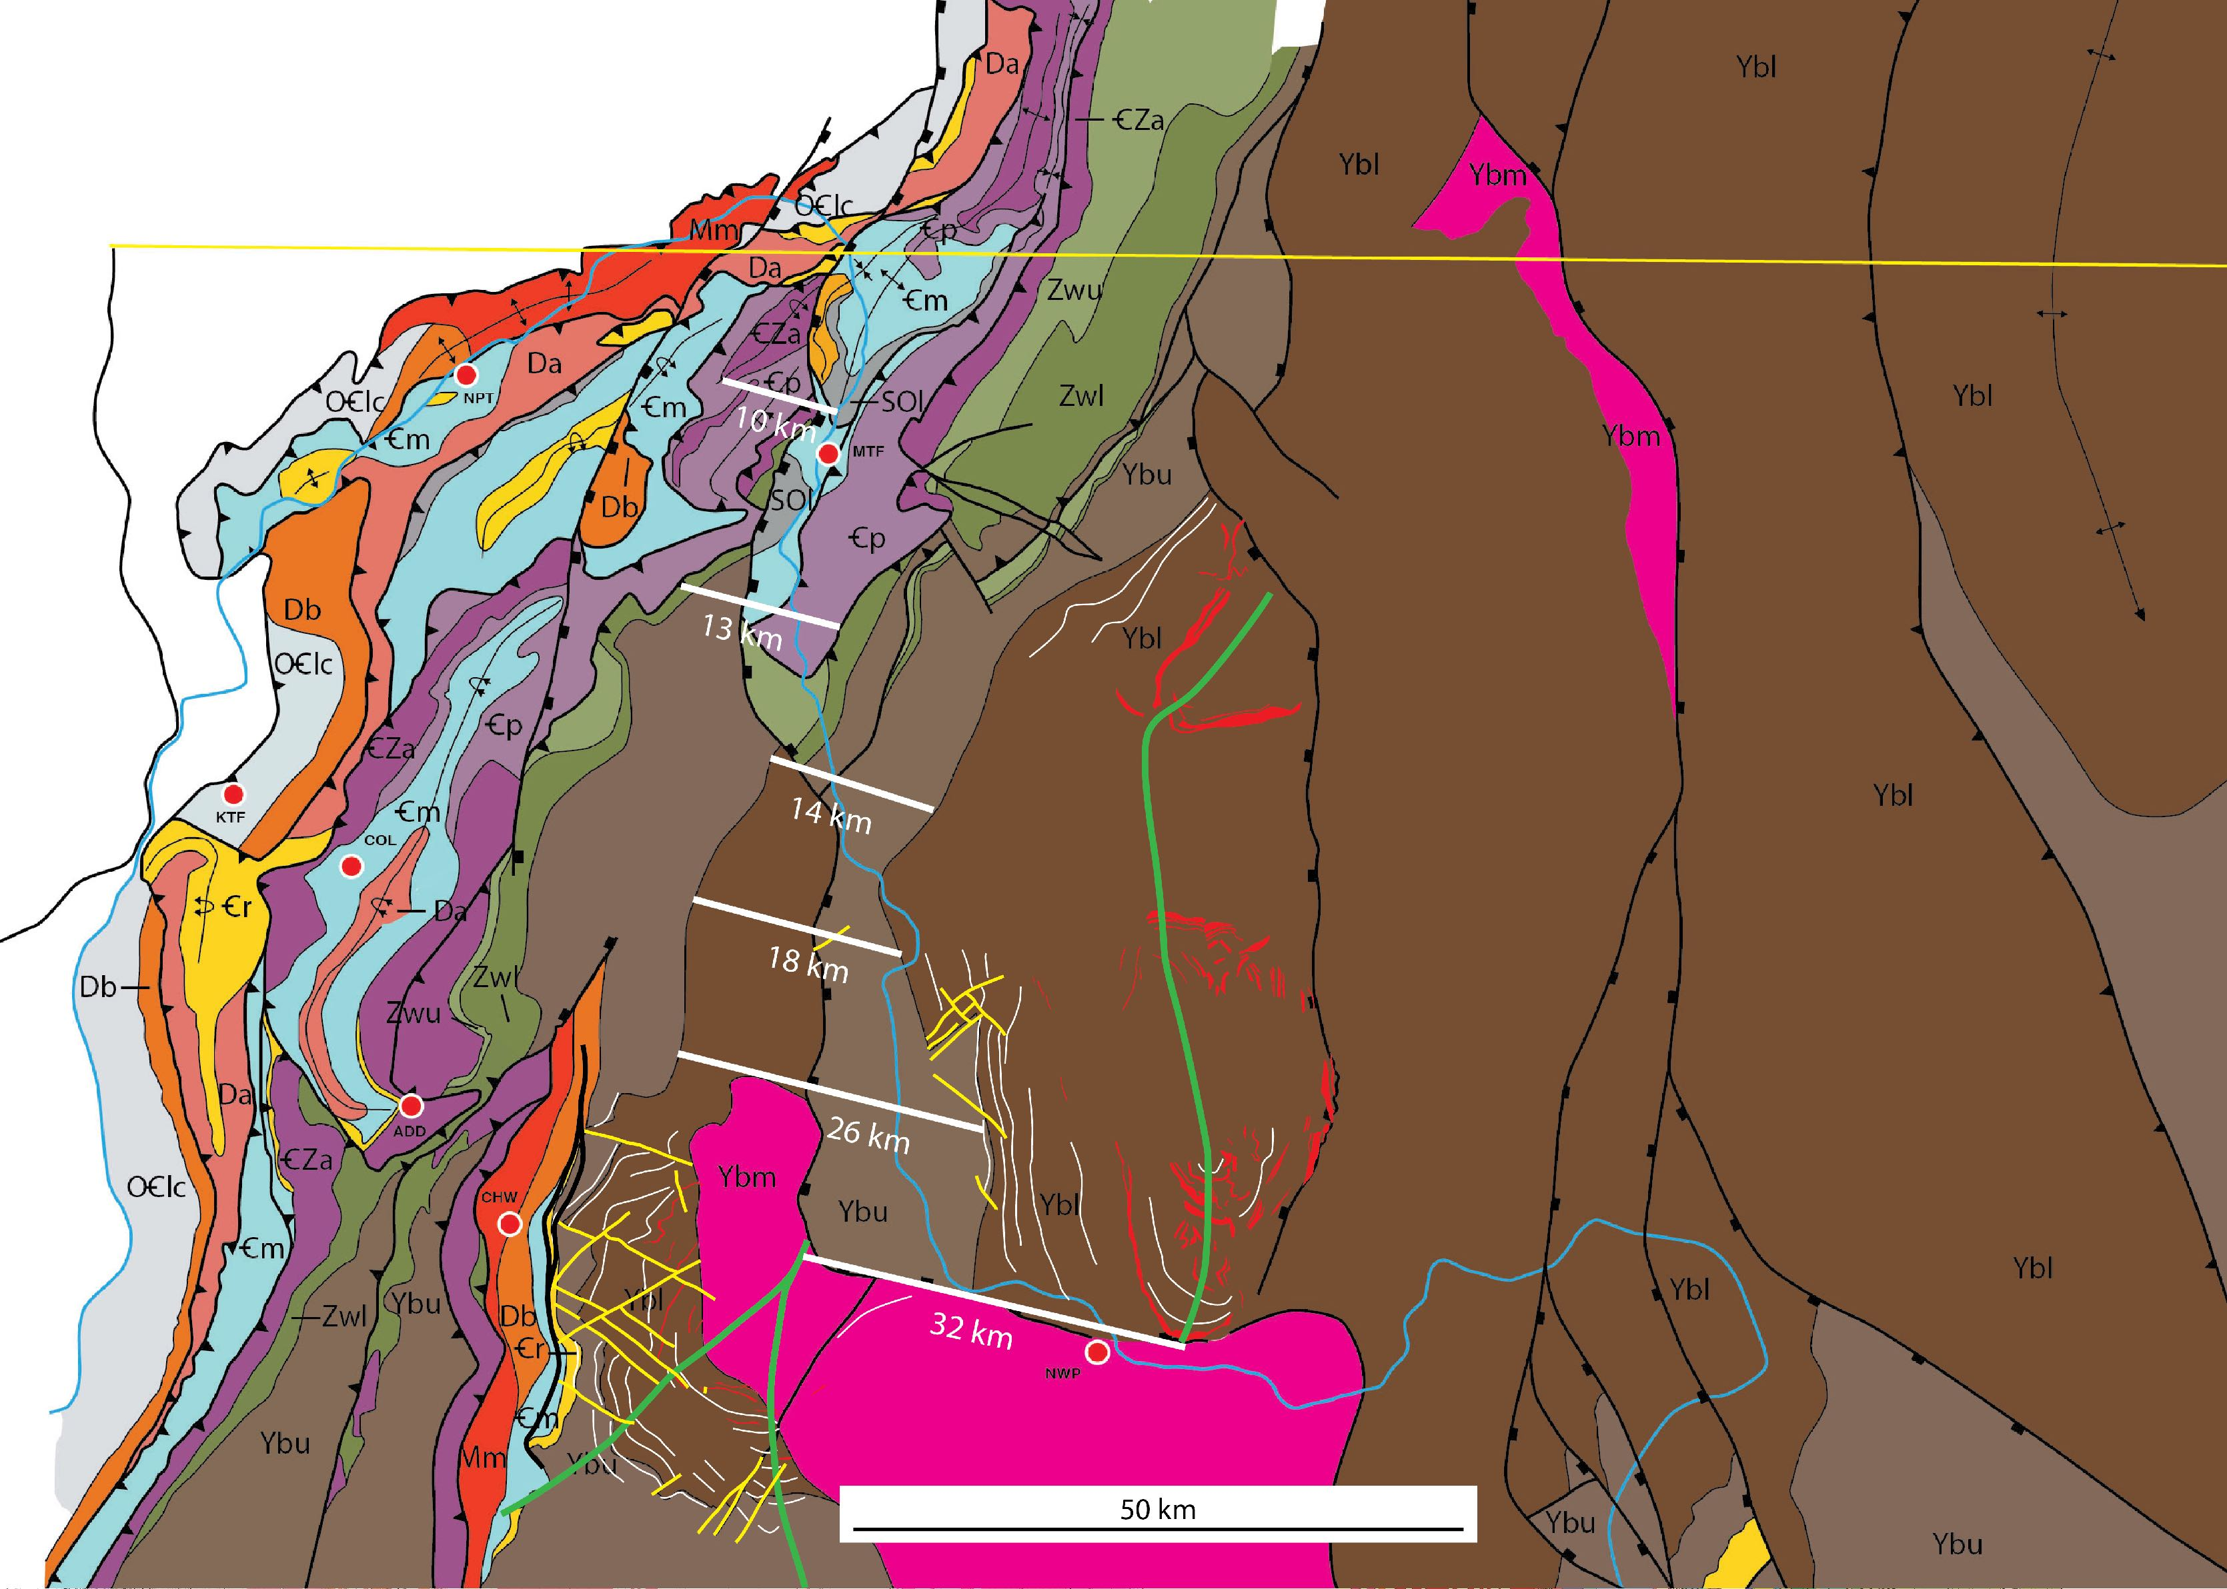
10 km offset on fold axes
13 km offset of 3 thrust sheets
14-26 km offset on Upper (Ybu)
& Lower (Ybl) Belt contact
32 km offset of Snow Valley (SVA)
& Bald Mtn (BMA) anticlines
Notes:
The Newport extensional fault appears to lose displacement northward toward the Canadian border. The estimates are based on apparent offsets of fold axes and formational contacts within the Belt Supergroup.

Slide 40
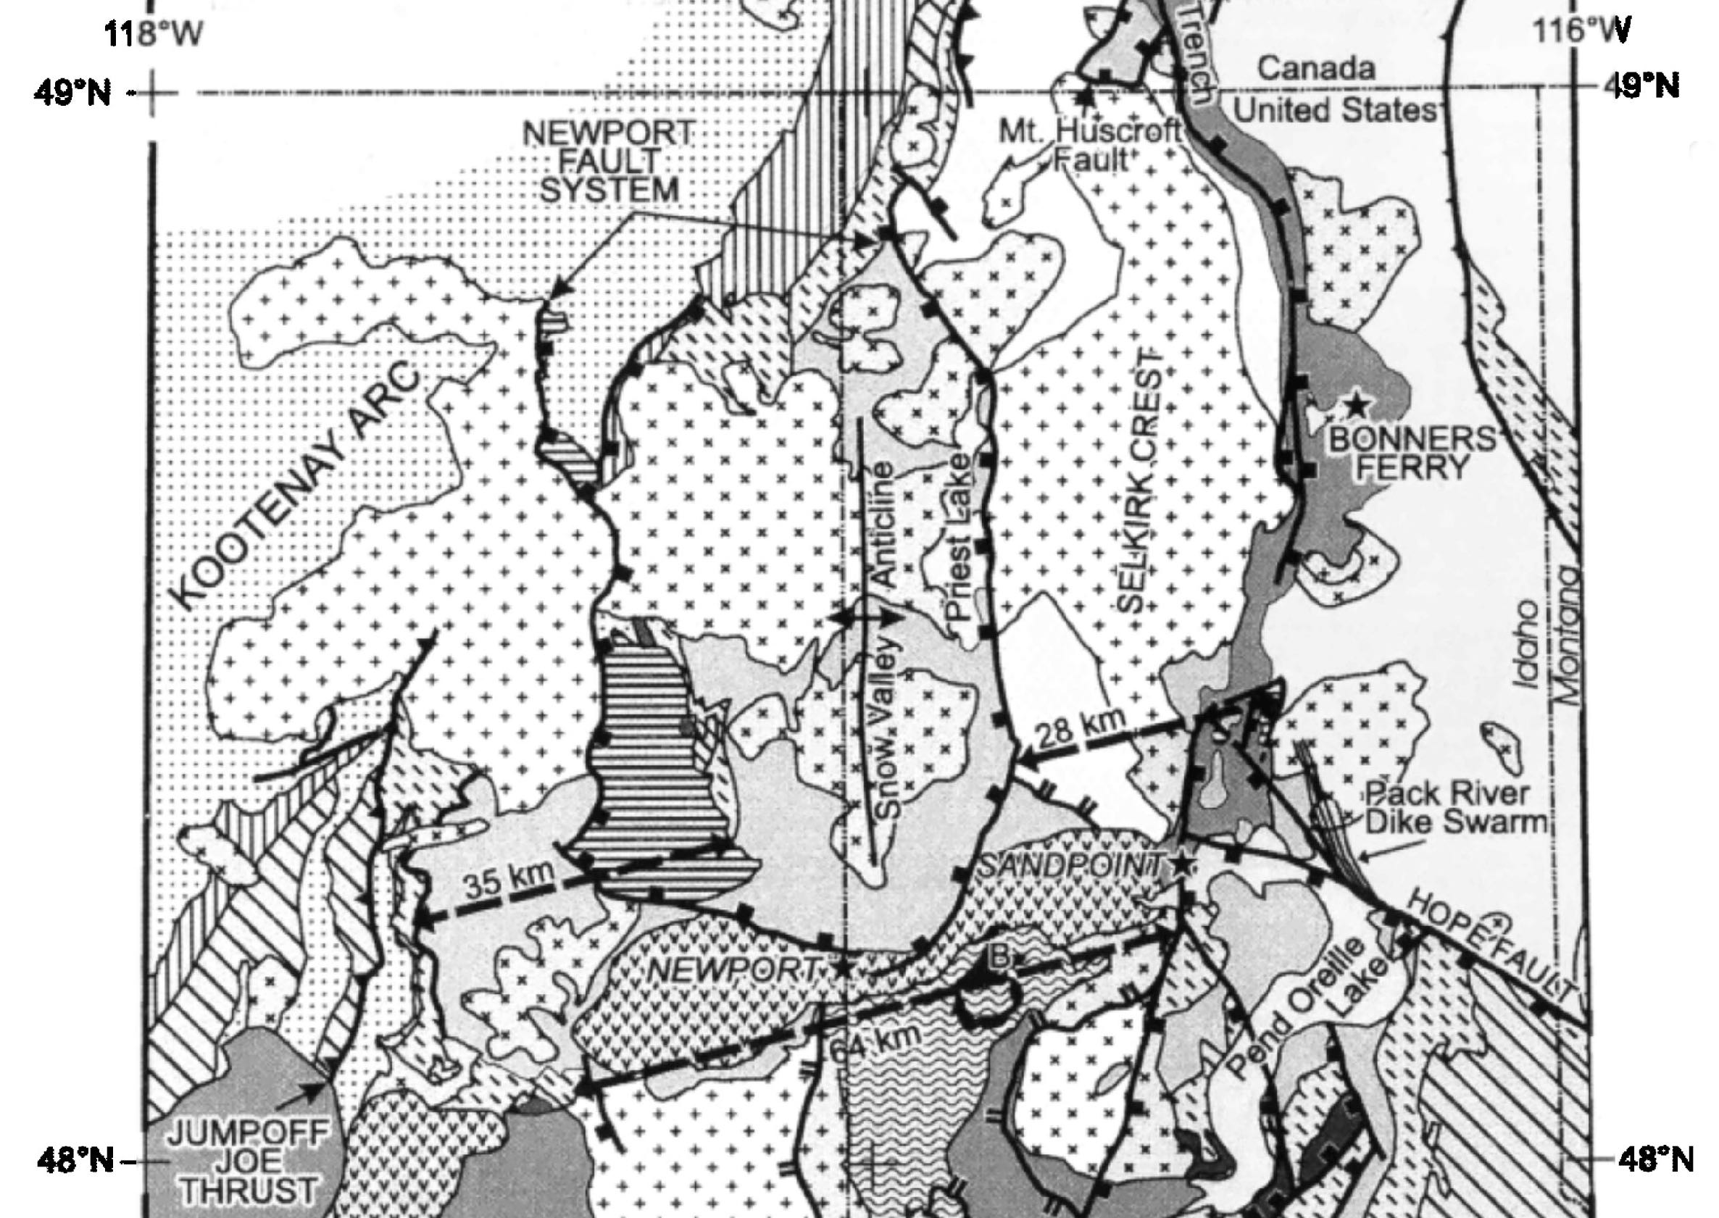
35 km
offset across
western
Newport fault
28 km
offset over
Selkirk Crest
64 km
extension
over
Spokane Dome
Doughty & Price
1999
fig. 3
Notes:
Doughty & Price (1999) arrived at a similar figure, 35 km, for the offset on the Newport fault. They also computed 28 km over the Selkirk Crest & a total of 64 km extension over the Spokane Dome.

Slide 41
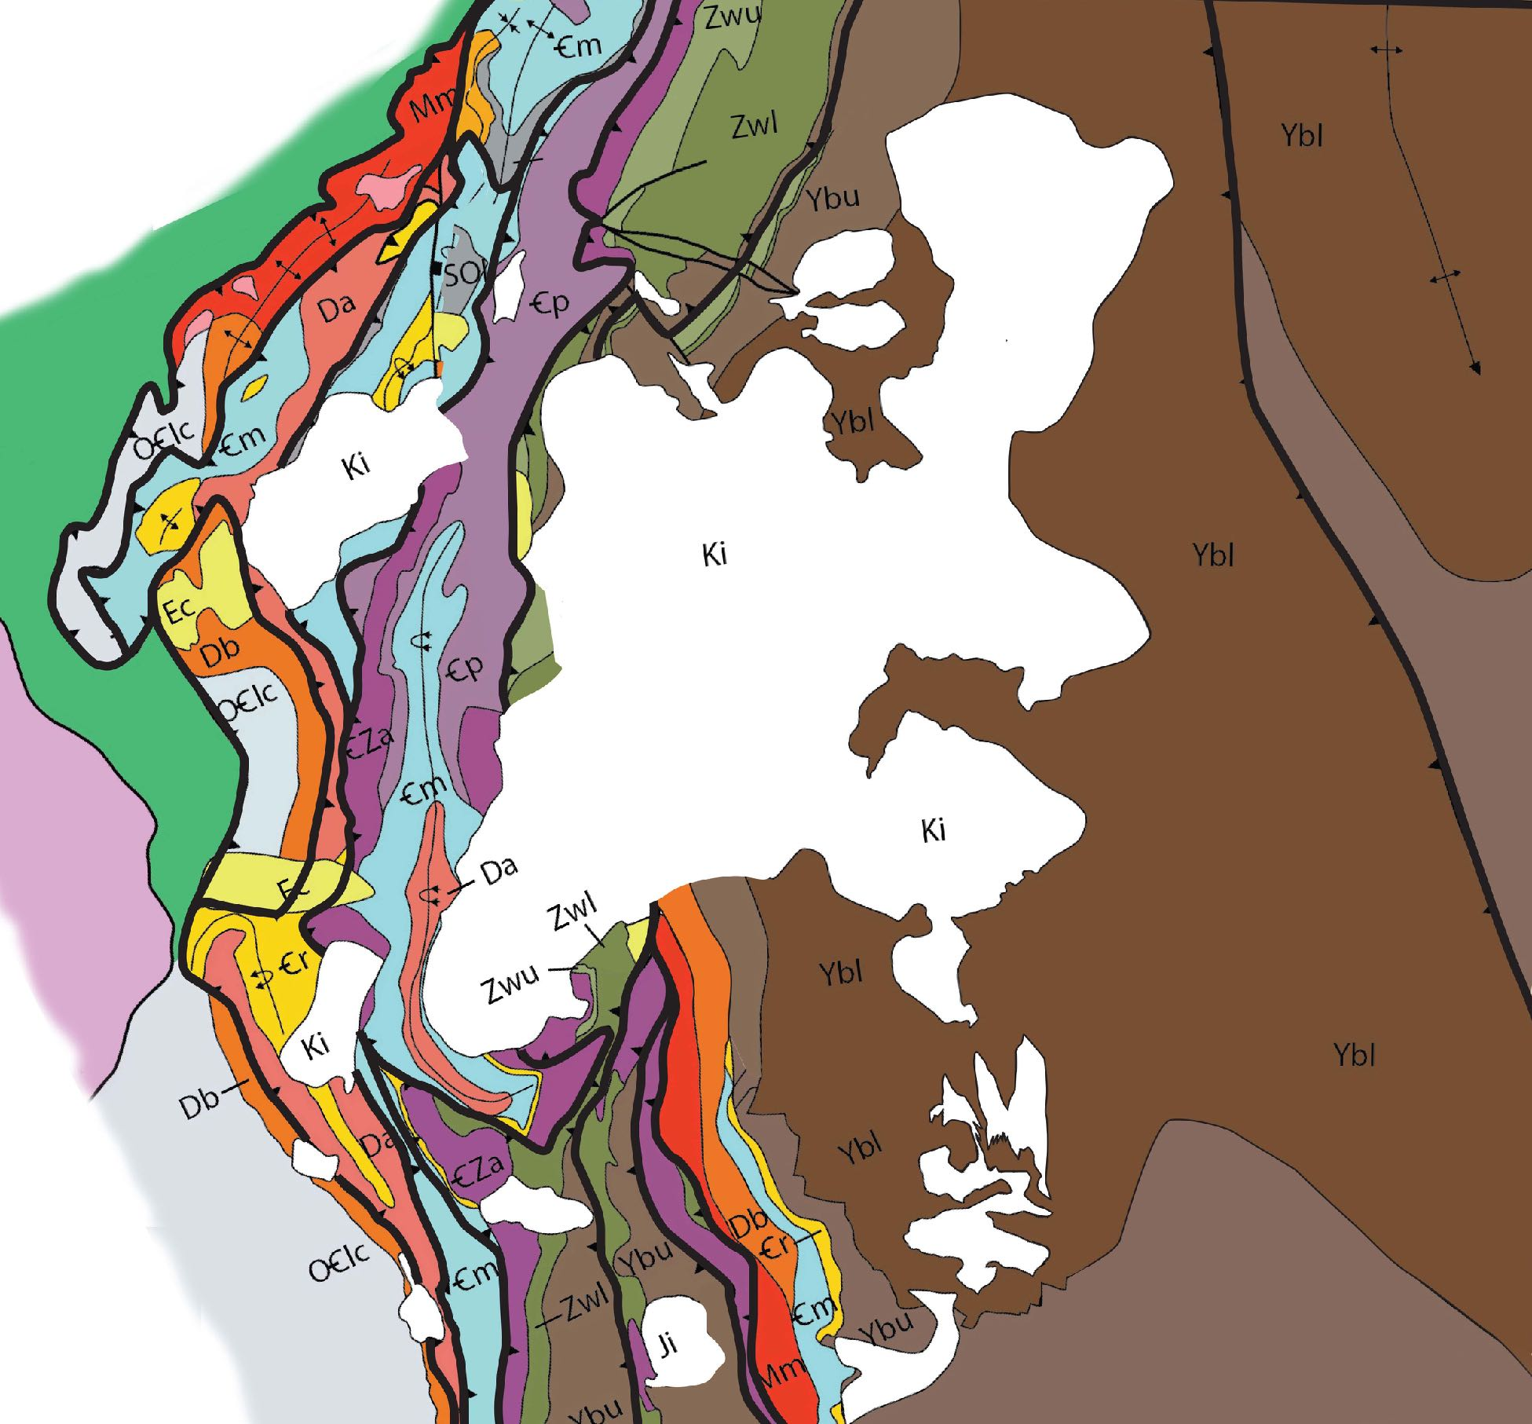
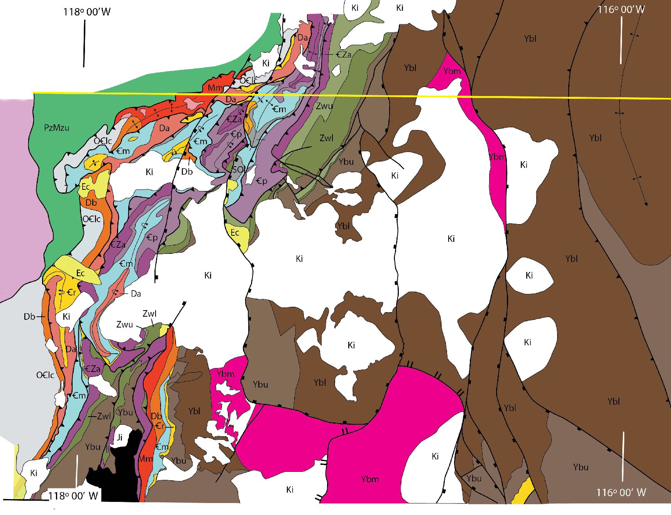
Removal of 64 km Paleogene extension
consolidates middle Cretaceous
instrusions at center of thrust salient
Notes:
The map at left shows the Cretaceous instrusions that occur across the NEWAFT. If we remove the extensional deformation, the Cretaceous instrusions consolidate at the core of the NEWAFT. It is likely that the structures of the Late Proterozoic rift margin and subsequent thrusts guided the intrusion of these magmas into the thrust salient.

Slide 42
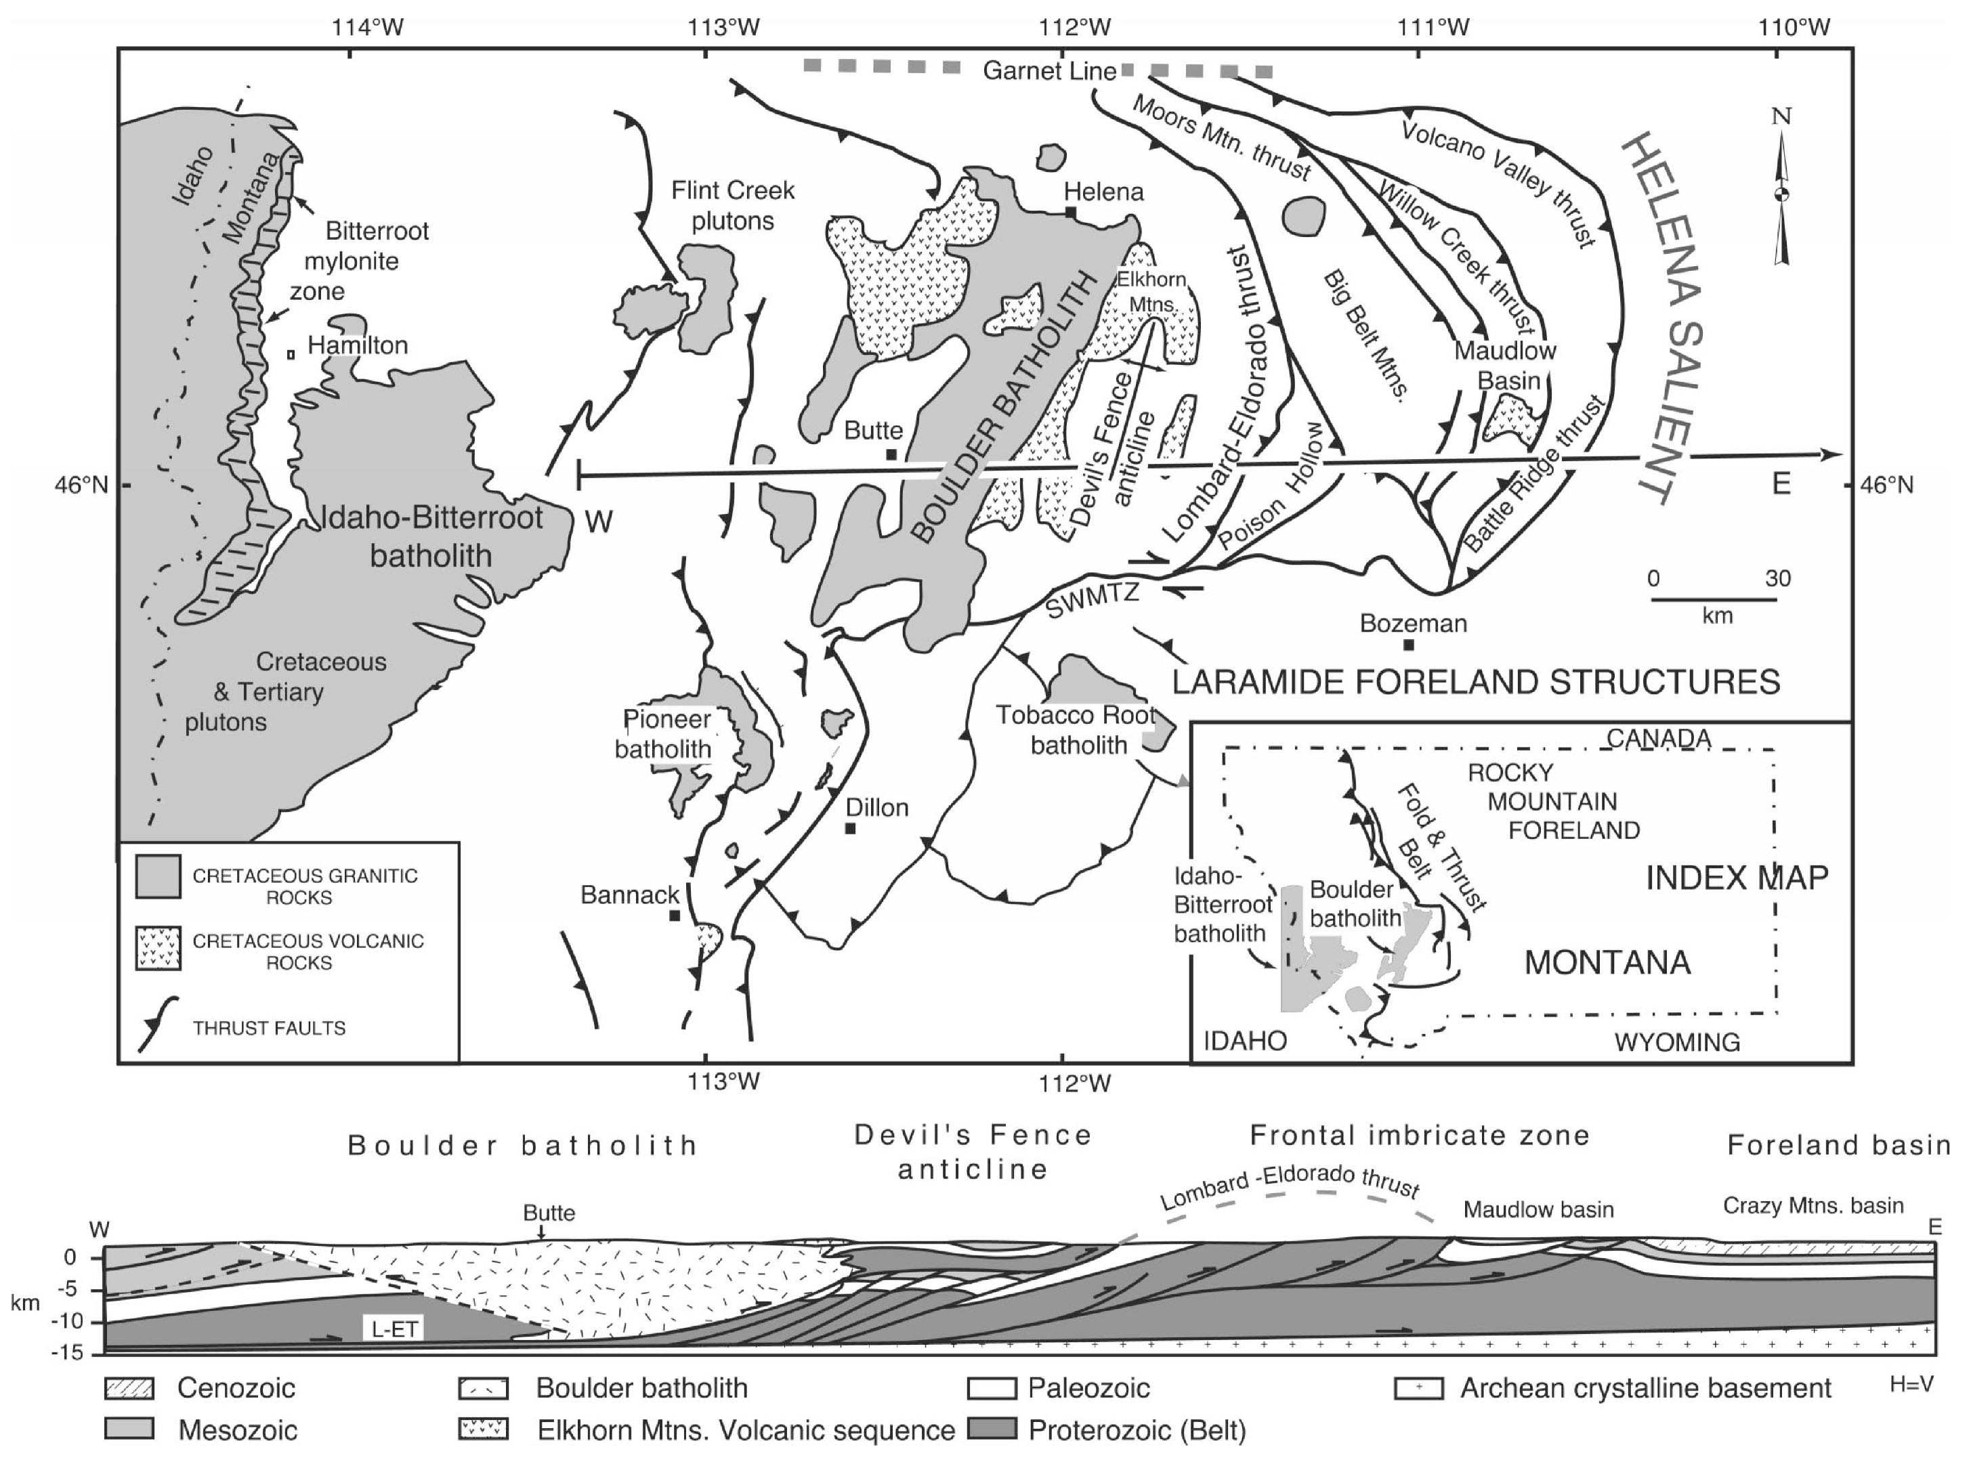
Boulder Batholith
in
Helena Salient
Pioneer Batholith
in
McCartney Mtn Salient
Lageson et al. 2001
fig 1
Notes:
A similar relationship among intrusive centers, Mesozoic thrust salients, & older Precambrian structures has been noted for the Helena & McCartney Mtn salients . . .

Slide 43
Spatial & Temporal Relationships Among Mesozoic Intrusive Centers, Thrust Salients & Precambrian Faults & Basins
Robinson, Klepper & Obradovich 1968. Overlapping plutonism, volcanism, and tectonism in the Boulder batholith region, western Montana. In GSA Memoir 116: 557-576.
Hamilton, W., & W. B. Myers 1974. Nature of the Boulder Batholith of Montana. GSA Bulletin 85: 365-378.
Geiger, B.C. 1980. Ductile strain in the overlap zone between the Cordilleran thrust belt and the Rocky Mountain foreland . . . MS Thesis, U of Montana.
Schmidt, Smedes & O’Neill 1990. Syncompressional emplacement of the Boulder and Tobacco Root Batholiths . . . Geological Journal 25 (3-4): 305-318.
Lageson, D. R. et al. 2001. Influence of Late Cretaceous magmatism on the Sevier orogenic wedge . . . Geology 29 (8): 723-726.
Kalakay, John & Lageson 2001. Fault controlled pluton emplacement in the Sevier fold-and-thrust belt of southwest Montana, USA. Journal of Structural Geology 23: 1151-1165.
Berger, Hildenbrand & O’Neill 2011. Control of Precambrian basement deformation zones on emplacement of the Laramide Boulder batholith . . . USGS SI Report 2011-5016.
Notes:
by numerous authors over the past 50 years.

Slide 44
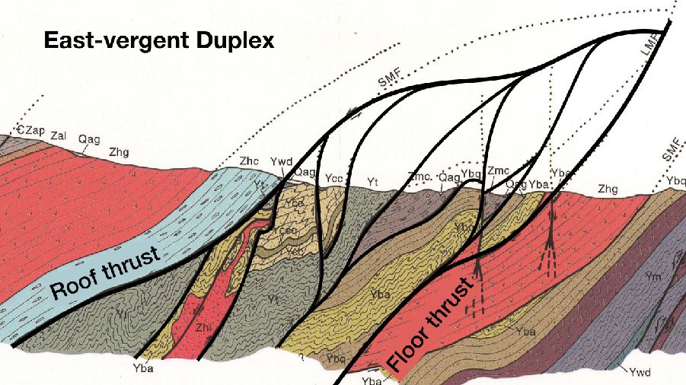
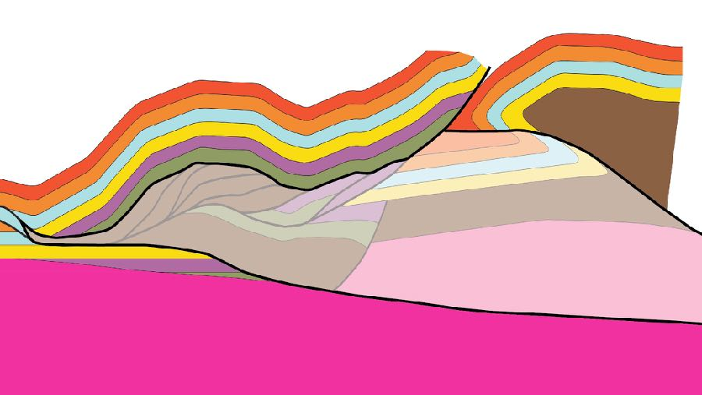
NE WA Thrust Belt
Hypotheses / Conclusions
1. NEWAFT: “typical” thrust belt
• duplexes
• lateral ramps
• triangle zones
2. Neoproterozoic / Early Paleozoic rift margin
controlled Mesozoic thrust-belt architecture
3. Thrust faults: conduits for Cretaceous (~90
- 100 Ma) magma emplacement
1. NEWAFT is “typical” thrust belt with
• duplexes
• lateral ramps
• triangle zones
Notes:
The conclusions are more hypotheses than conclusions. These “conclusions” suggest topics for future study. We propose that the NEWAFT is a ”typical” thrust belt with duplexes, lateral ramps and triangle zones.

Slide 45
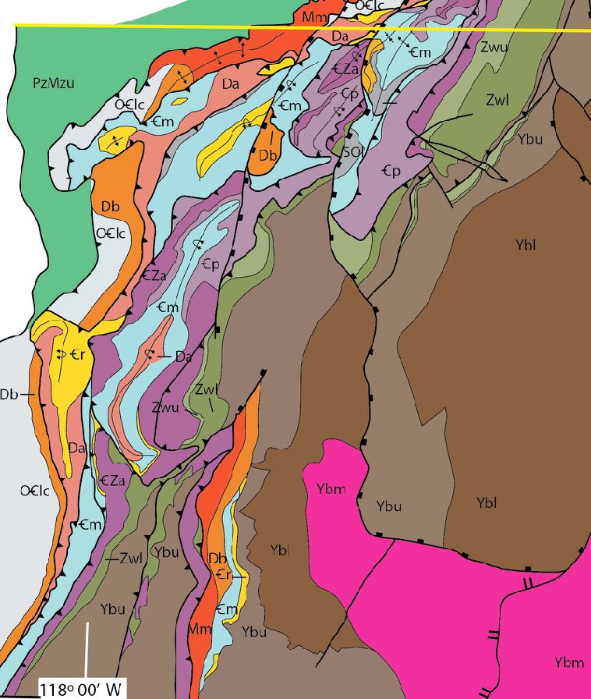
NE WA Thrust Belt
Hypotheses / Conclusions
1. NEWAFT: “typical” thrust belt
• duplexes
• lateral ramps
• triangle zones
2. Neoproterozoic / Early Paleozoic rift margin
controlled Mesozoic thrust-belt architecture
3. Thrust faults: conduits for Cretaceous (~90
- 100 Ma) magma emplacement
1. NEWAFT is “typical” thrust belt with
• duplexes
• lateral ramps
• triangle zones
2. NEWAFT has two domains
• northern PORFT salient of NW vergence
• SE-vergent CRFT
Notes:
And that the NEWAFT has two domains. To the north is the northwest-vergent thrust salient, the Pend Oreille River Fold and Thrust Belt (PORFT). And to the south is the southeast-vergent Colville River Fold and Thrust Belt (CRFT).

Slide 46
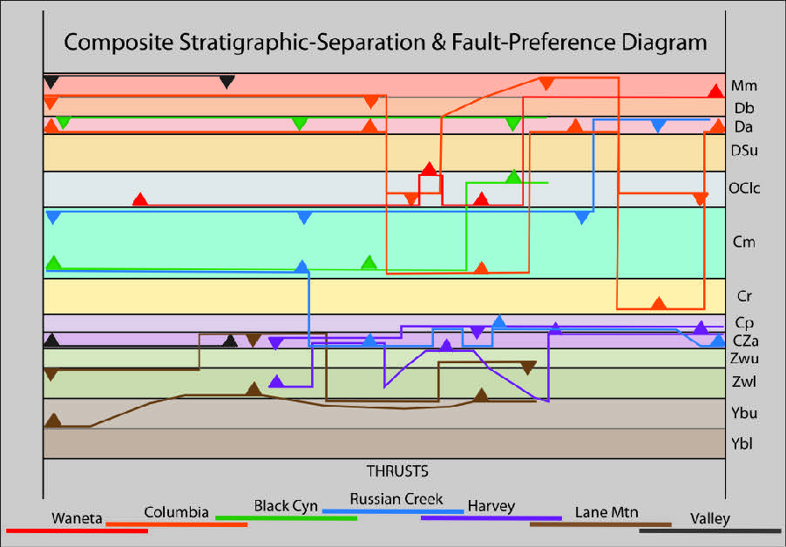
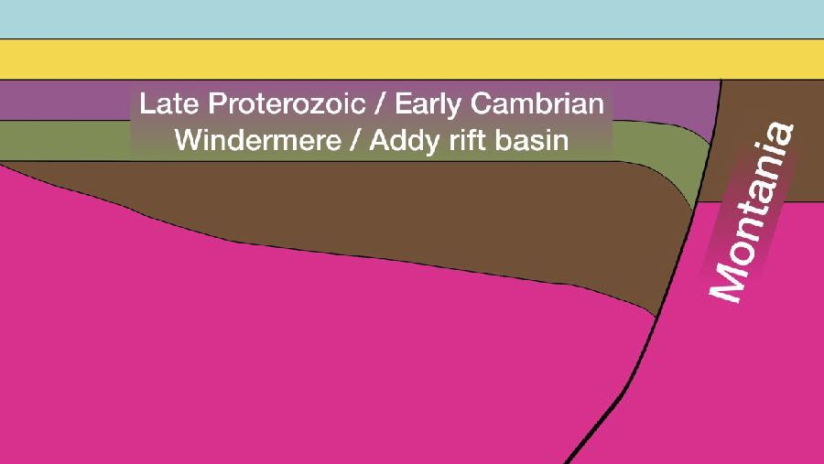
NE WA Thrust Belt
Hypotheses / Conclusions
1. NEWAFT is “typical” thrust belt with
• duplexes
• lateral ramps
• triangle zones
2. NEWAFT has two domains
• northern PORFT salient of NW vergence
• SE-vergent CRFT
3. Neoproterozoic / Early Paleozoic rift margin
controlled Mesozoic thrust-belt architecture
Notes:
The geometry of the Neoproterozoic to early Paleozoic rift margin may have controlled the location and kinematic evolution of the NEWAFT.

Slide 47

NE WA Thrust Belt
Hypotheses / Conclusions
1. NEWAFT is “typical” thrust belt with
• duplexes
• lateral ramps
• triangle zones
2. NEWAFT has two domains
• northern PORFT salient of NW vergence
• SE-vergent CRFT
3. Neoproterozoic / Early Paleozoic rift margin
controlled Mesozoic thrust-belt architecture
4. Thrust faults were conduits for Cretaceous
(~90 - 100 Ma) magma emplacement
Notes:
And the thrust faults later served as conduits for the intrusion of synkinematic to post-thrust instrusions.

Slide 48
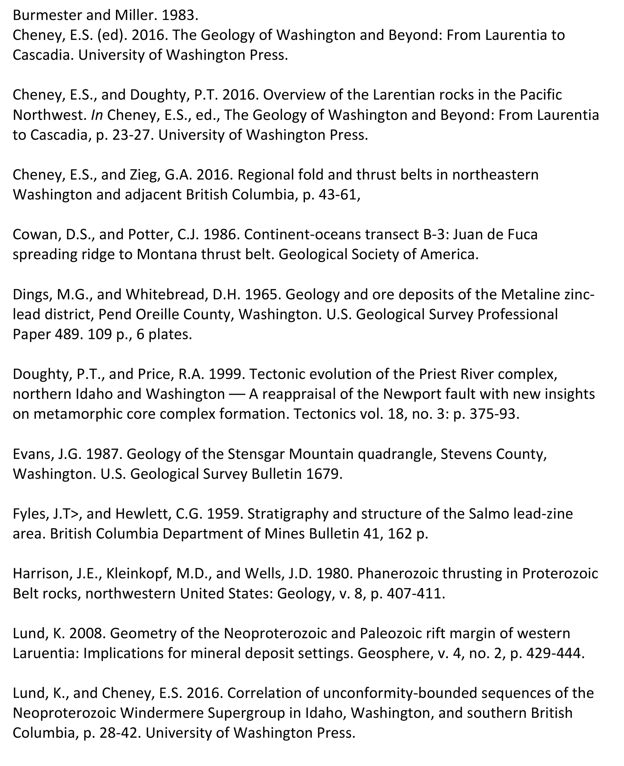
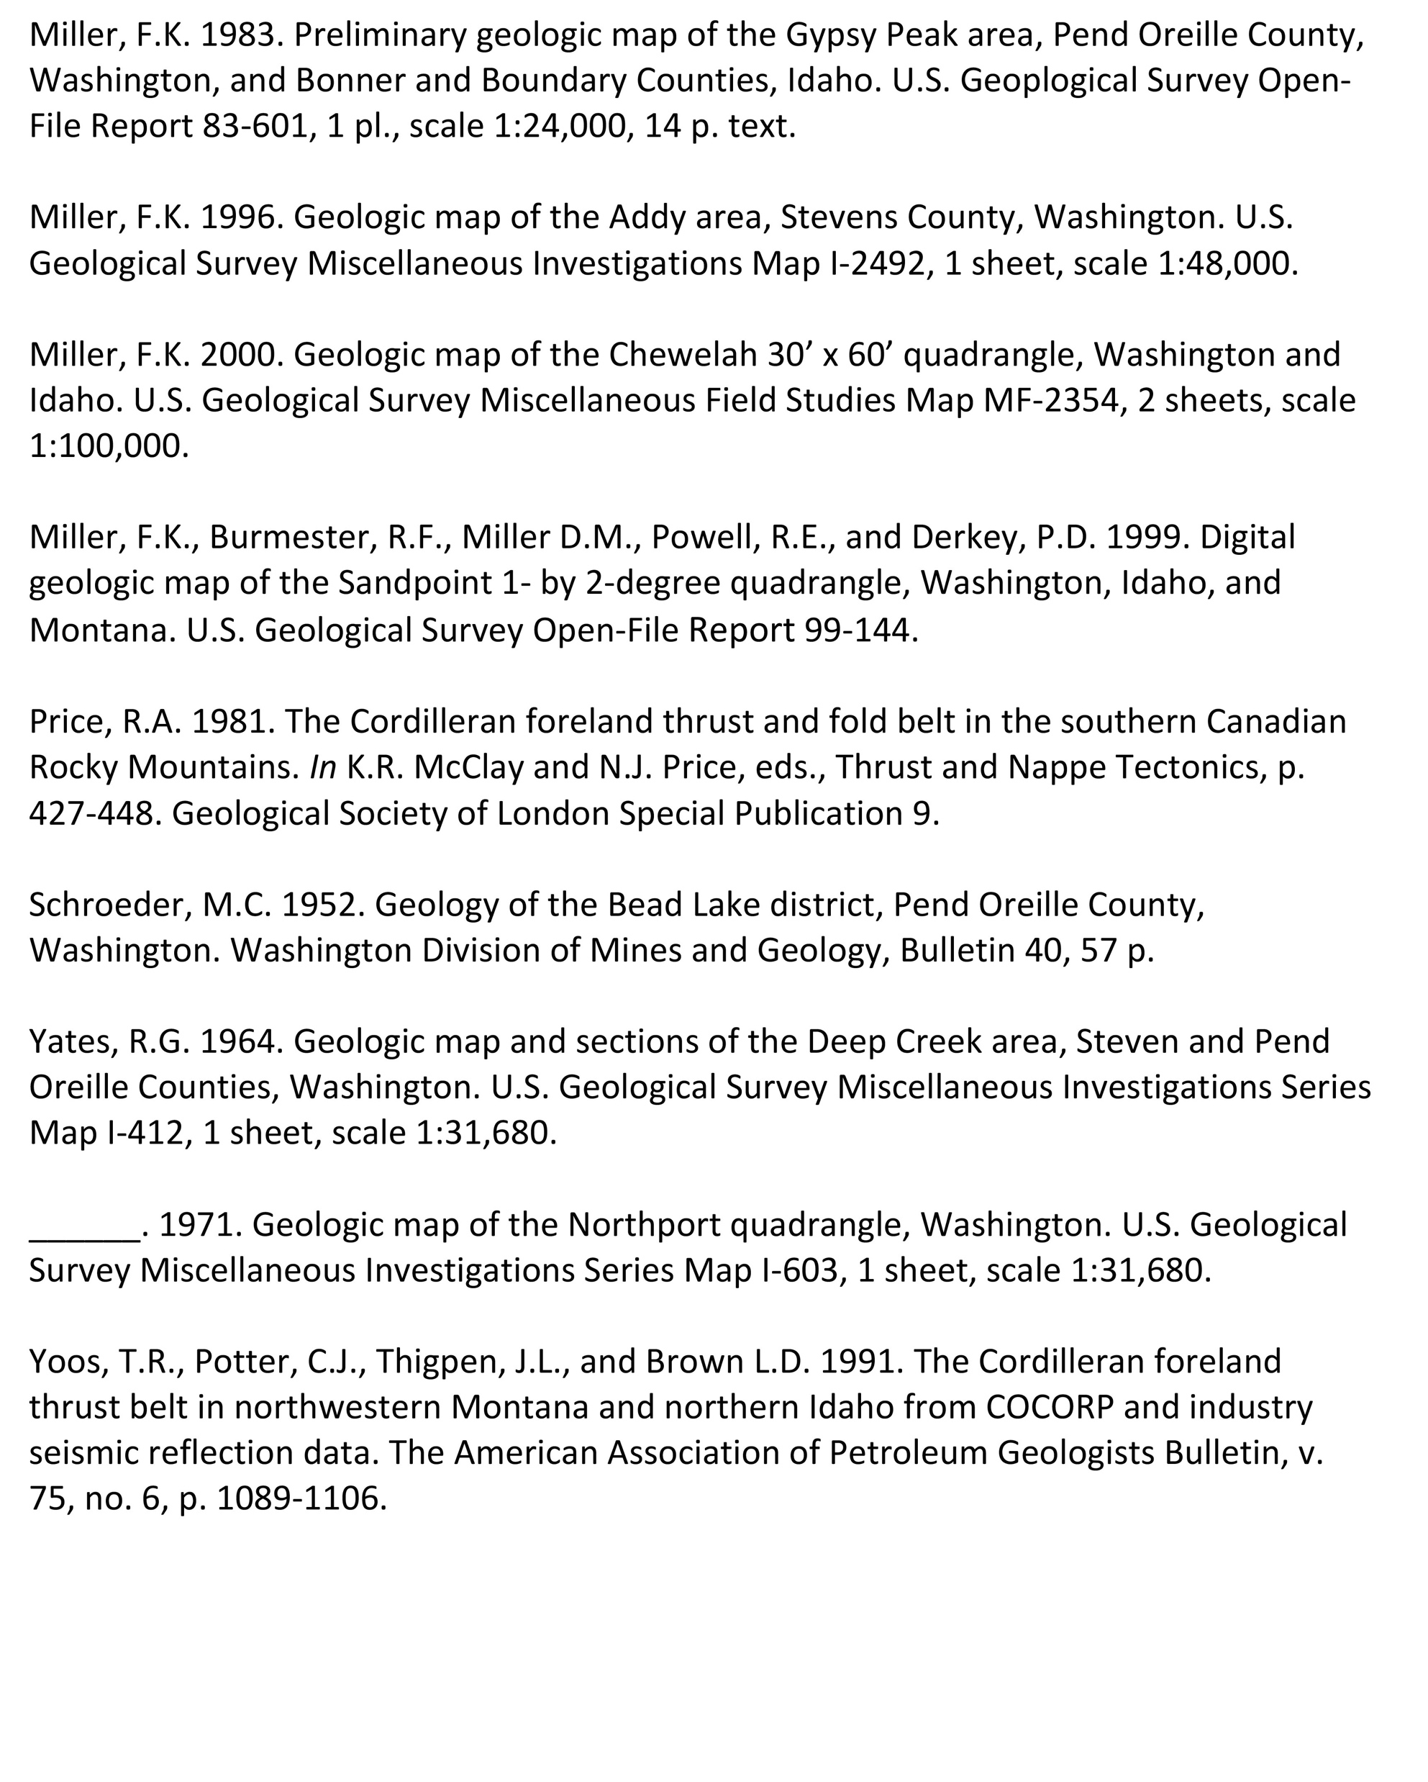
References Cited
& Other Resources of Interest

