Slide 1
Improving Precision and Accuracy for Trace Elements in EPMA
J. J. Donovan University of Oregon, CAMCOR, Eugene, OR 97403-1253

Slide 2
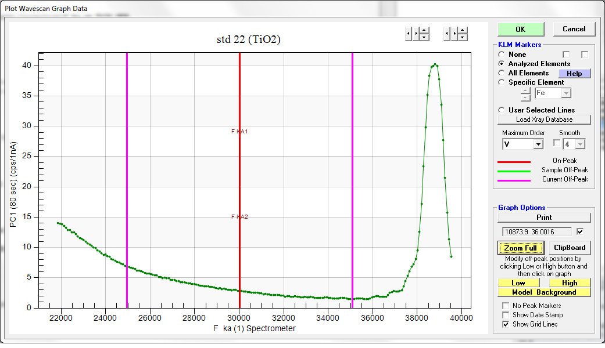
Traditional Off-Peak Methods
Bgd “low”
Bgd “high”

Slide 3
Two solutions: MAN and MPB
MAN (mean atomic number)
Measure the “on-peak” background in (standard) materials that do not contain the element of interest
Correct for continuum absorption and fit to average Z
MPB (multi point background)
Measure the off-peak background at more than two positions
Fit to polynomial or exponential expression

Slide 4
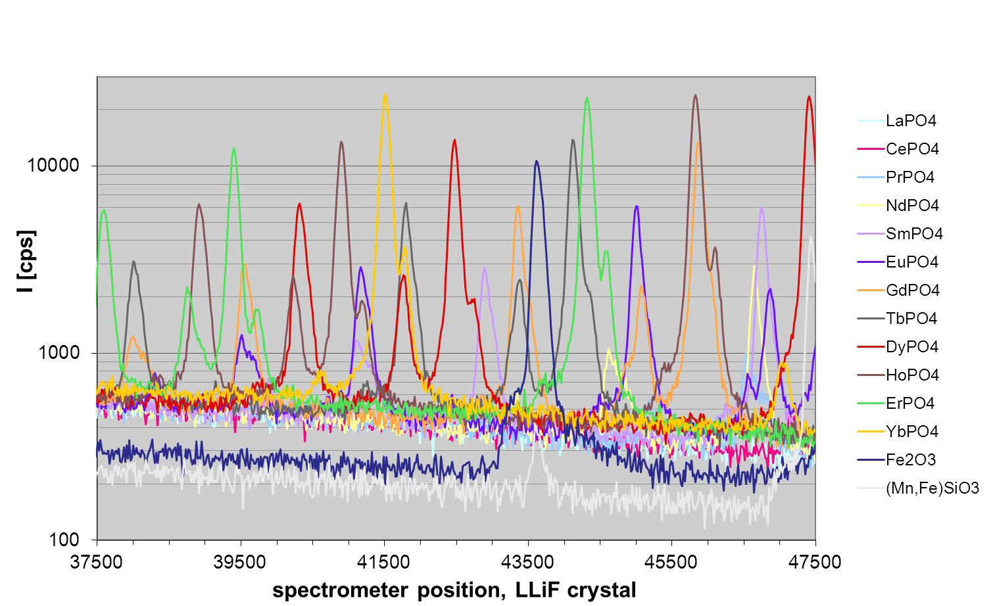
MPB (multi-point backgrounds) provide accurate trace analysis background measurement, especially in complex systems
DyLβ₁ peak
FeKβ
Jercinovic et al. 2012, Mater. Sci. Eng. 32, 012012

Slide 5
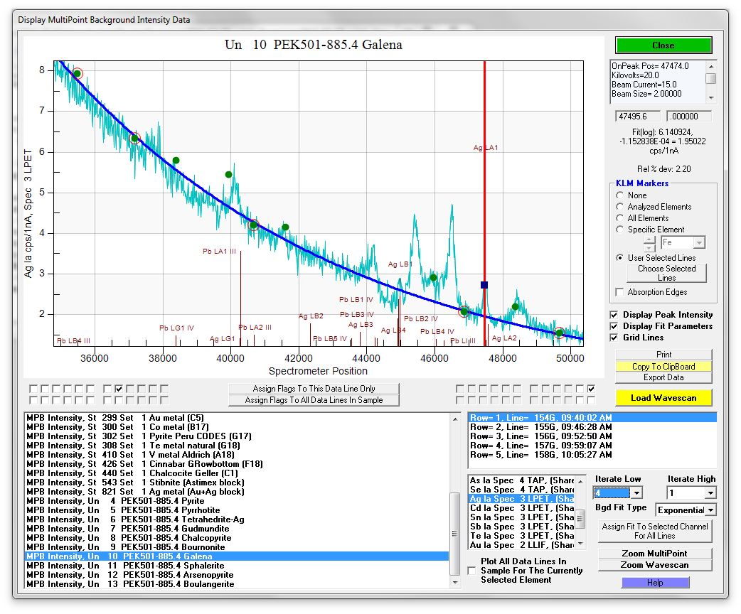
Manual or automatic optimization, with many useful features for trace element evaluation
background interference
peak intensity
x-ray line markers
background intensities (circled – currently used for fitting)
List of datasets
wavescan overlay
data rows in dataset
Measured elements, Ag Lα selected

Slide 6
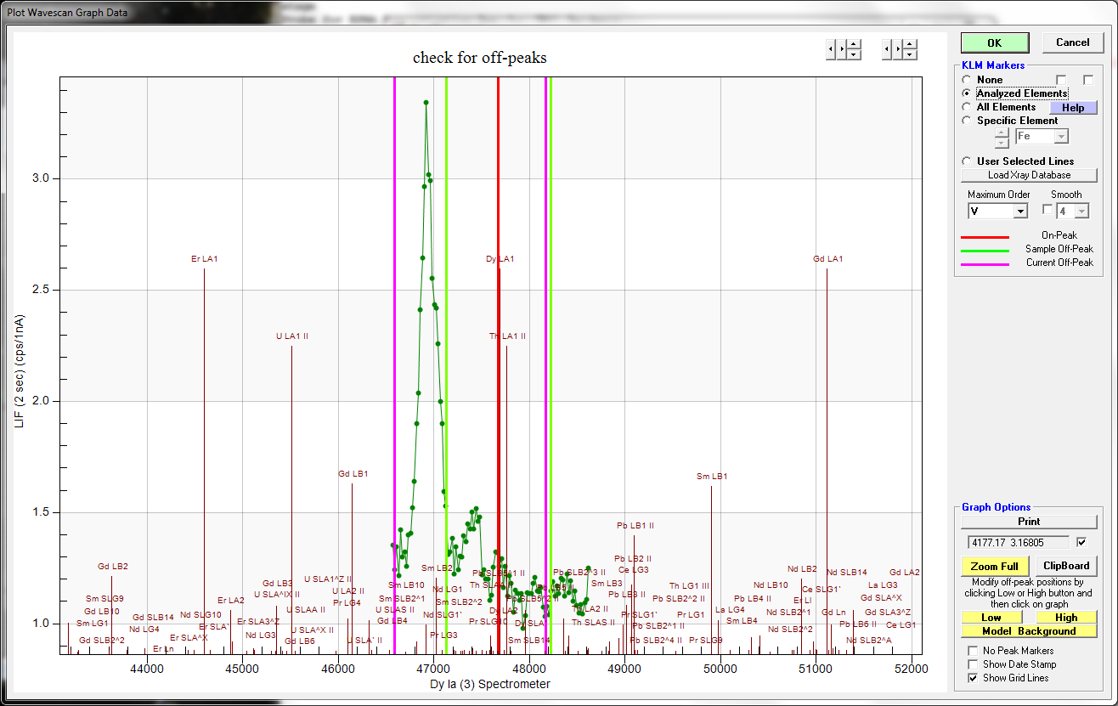
”Shared” MPB
?
?
?
?

Slide 7
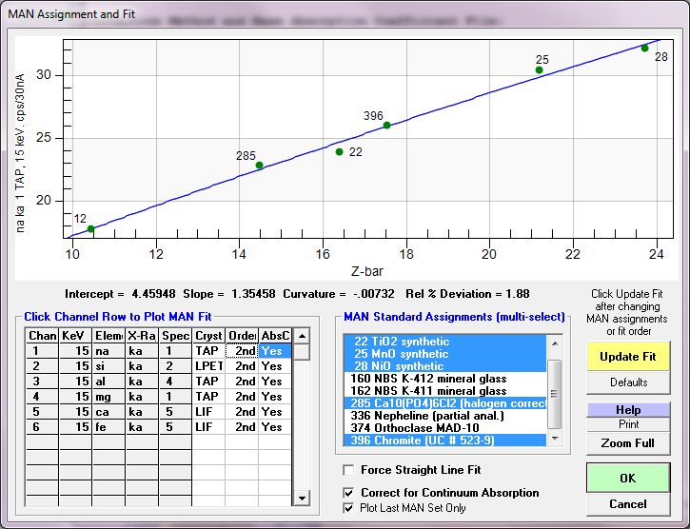
MAN (mean atomic number) background calibration
By prior determination of continuum intensities in a variety of materials (over a range of average atomic number) that do not contain the element of interest, the matrix iteration can quantitatively calculate the background intensity from the unknown specimen composition.
Since no off-peak measurements are utilized, time is saved resulting in less sample damage and elimination of possible off-peak interferences.
This is a significant acquisition time advantage for major and minor elements.
… and also results in improved trace element sensitivity…
Donovan, et al., Amer. Min., 2016

Slide 8
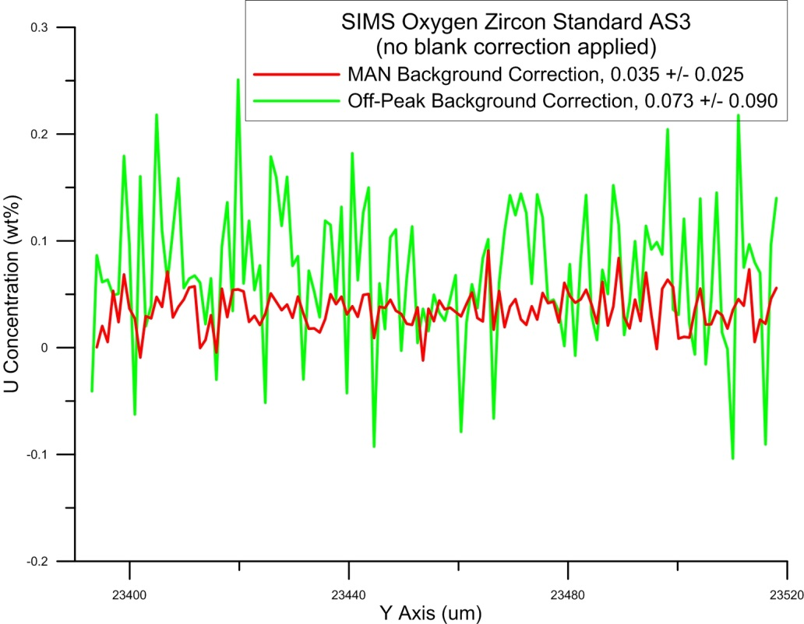
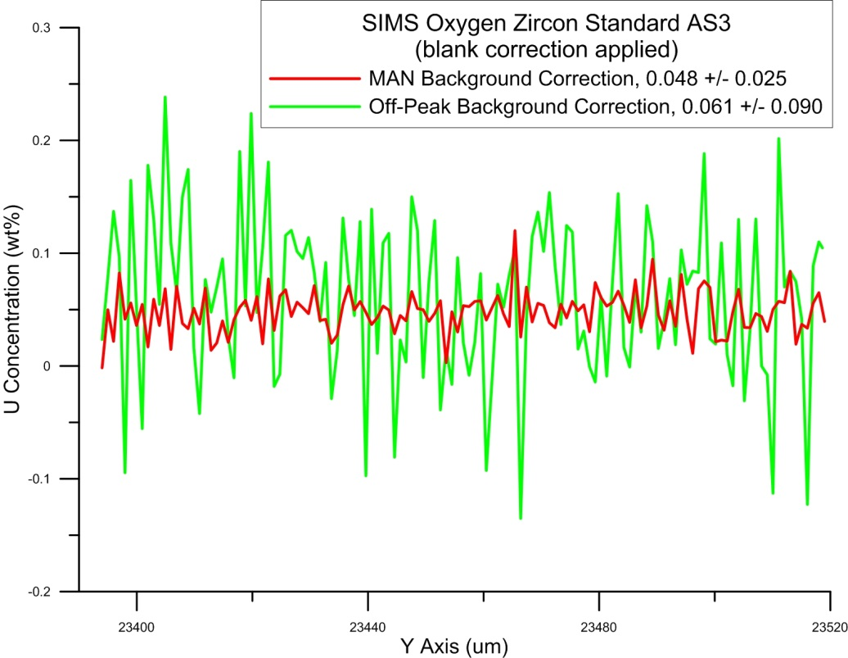
Comparing MAN and Off-peak Measurements (same dataset)
No Blank Correction
Blank Correction

Slide 9
On and off peak variances add in quadrature!
When we directly measure the background intensities, we introduce additional imprecision to the net intensity calculation.
If only there was a method to determine the continuum background intensities *without* a direct measurement…
How about the MAN background method?

Slide 10
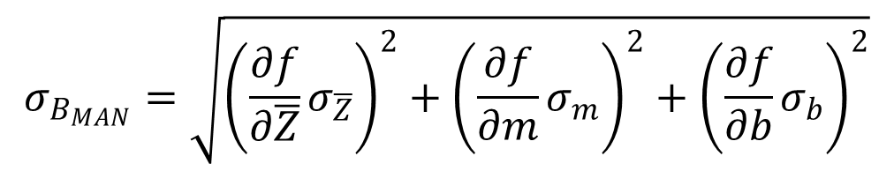

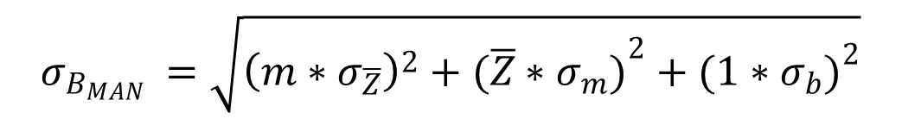
Modeling Precision (Sensitivity) with the MAN Background Method
MAN background intensity is correlated with Z-bar (the average atomic number) in the form of a line with slope (m) and intercept (b)
$$B_{MAN}\left(\overline{Z}, m, b\right)=m∗\overline{Z}+b$$
The MAN background variance is therefore
$$σ_{B_{MAN}}=\sqrt{{\left(\frac{∂f}{∂\overline{Z}}σ_{\overline{Z}}\right)}^{2}+{\left(\frac{∂f}{∂m}σ_{m}\right)}^{2}+{\left(\frac{∂f}{∂b}σ_{b}\right)}^{2}}$$
For the linear case, the partial derivatives can be combined to yield:
$$σ_{B_{MAN} }=\sqrt{{{\left(m∗σ_{\overline{Z}}\right)}^{2}+(\overline{Z}∗σ_{m})}^{2}+{(1∗σ_{b})}^{2}}$$

Slide 11
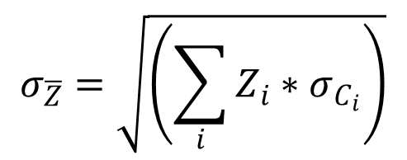
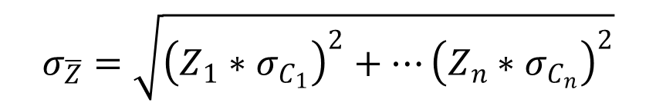
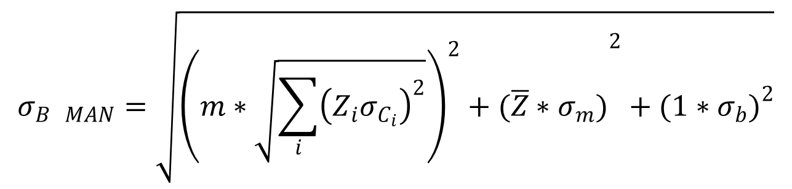
Calculating the variance of the average atomic number, Z-bar:
$$σ_{\overline{Z}}=\sqrt{{\left(Z_{1}∗σ_{C_{1}}\right)}^{2}+…{\left(Z_{n}∗σ_{C_{n}}\right)}^{2}}$$
or
$$σ_{\overline{Z}}=\sqrt{\left(\sum_{i}{Z_{i}∗σ_{C_{i}}}\right)}$$
The total MAN variance is therefore the average Z variance (for measured elements) plus the regression variance, correct?
$$σ_{B MAN}=\sqrt{{{\left(m∗\sqrt{\sum_{i}{{\left(Z_{i}σ_{C_{i}}\right)}^{2}}}\right)}^{2}+(\overline{Z}∗σ_{m})}^{2}+{(1∗σ_{b})}^{2}}$$
“Model A”

Slide 12
Off-Peak Background Correction (calculated background pixels)
 | Th | Hf | U | P | Y
Average | .226061 | 2.02225 | .611455 | .320043 | .113804
Std Deviation | .028376 | .142604 | .128880 | .037488 | .021821
Cps/nA
Off-peak Model | .027325 | .081837 | .044766 | .032520 | .019335
MAN Background Correction (fixed ZrSiO4 matrix)
 | Th | Hf | U | P | Y
Average | .254557 | 2.04241 | .630875 | .280978 | .113875
Std Deviation | .000348 | .001509 | .002499 | .000904 | .000156
MAN Model (A) | .025887 | .076575 | .026831 | .017200 | .006861
MAN Model (B) | .000328 | .001510 | .000612 | .000265 | .000095
MAN Background Correction (measured ZrSiO4 matrix)
 | Th | Hf | U | P | Y
Average | .254586 | 2.04253 | .630940 | .281020 | .113894
Std Deviation | .000812 | .002682 | .002897 | .001754 | .000683
MAN Model (A) | .027446 | .083754 | .029741 | .018462 | .007315
MAN Model (B) | .001886 | .008685 | .003521 | .001526 | .000549

Slide 13
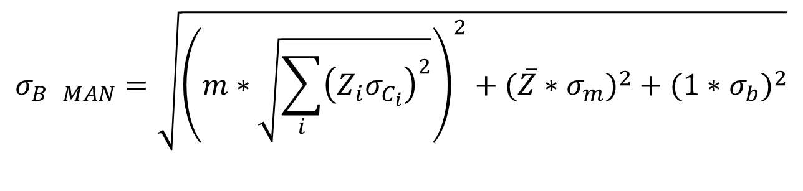
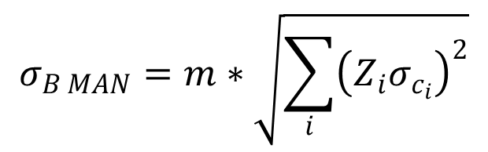
MAN Variance Models
$$σ_{B MAN}=\sqrt{{{\left(m∗\sqrt{\sum_{i}{{\left(Z_{i}σ_{C_{i}}\right)}^{2}}}\right)}^{2}+(\overline{Z}∗σ_{m})}^{2}+{(1∗σ_{b})}^{2}}$$
“Model A”
MAN regression precision is actually an accuracy issue!*
Unless we remeasure our MAN curve for *every* point or pixel!
$$σ_{B MAN}=m∗\sqrt{\sum_{i}{{\left(Z_{i}σ_{c_{i}}\right)}^{2}}}$$
“Model B”

Slide 14
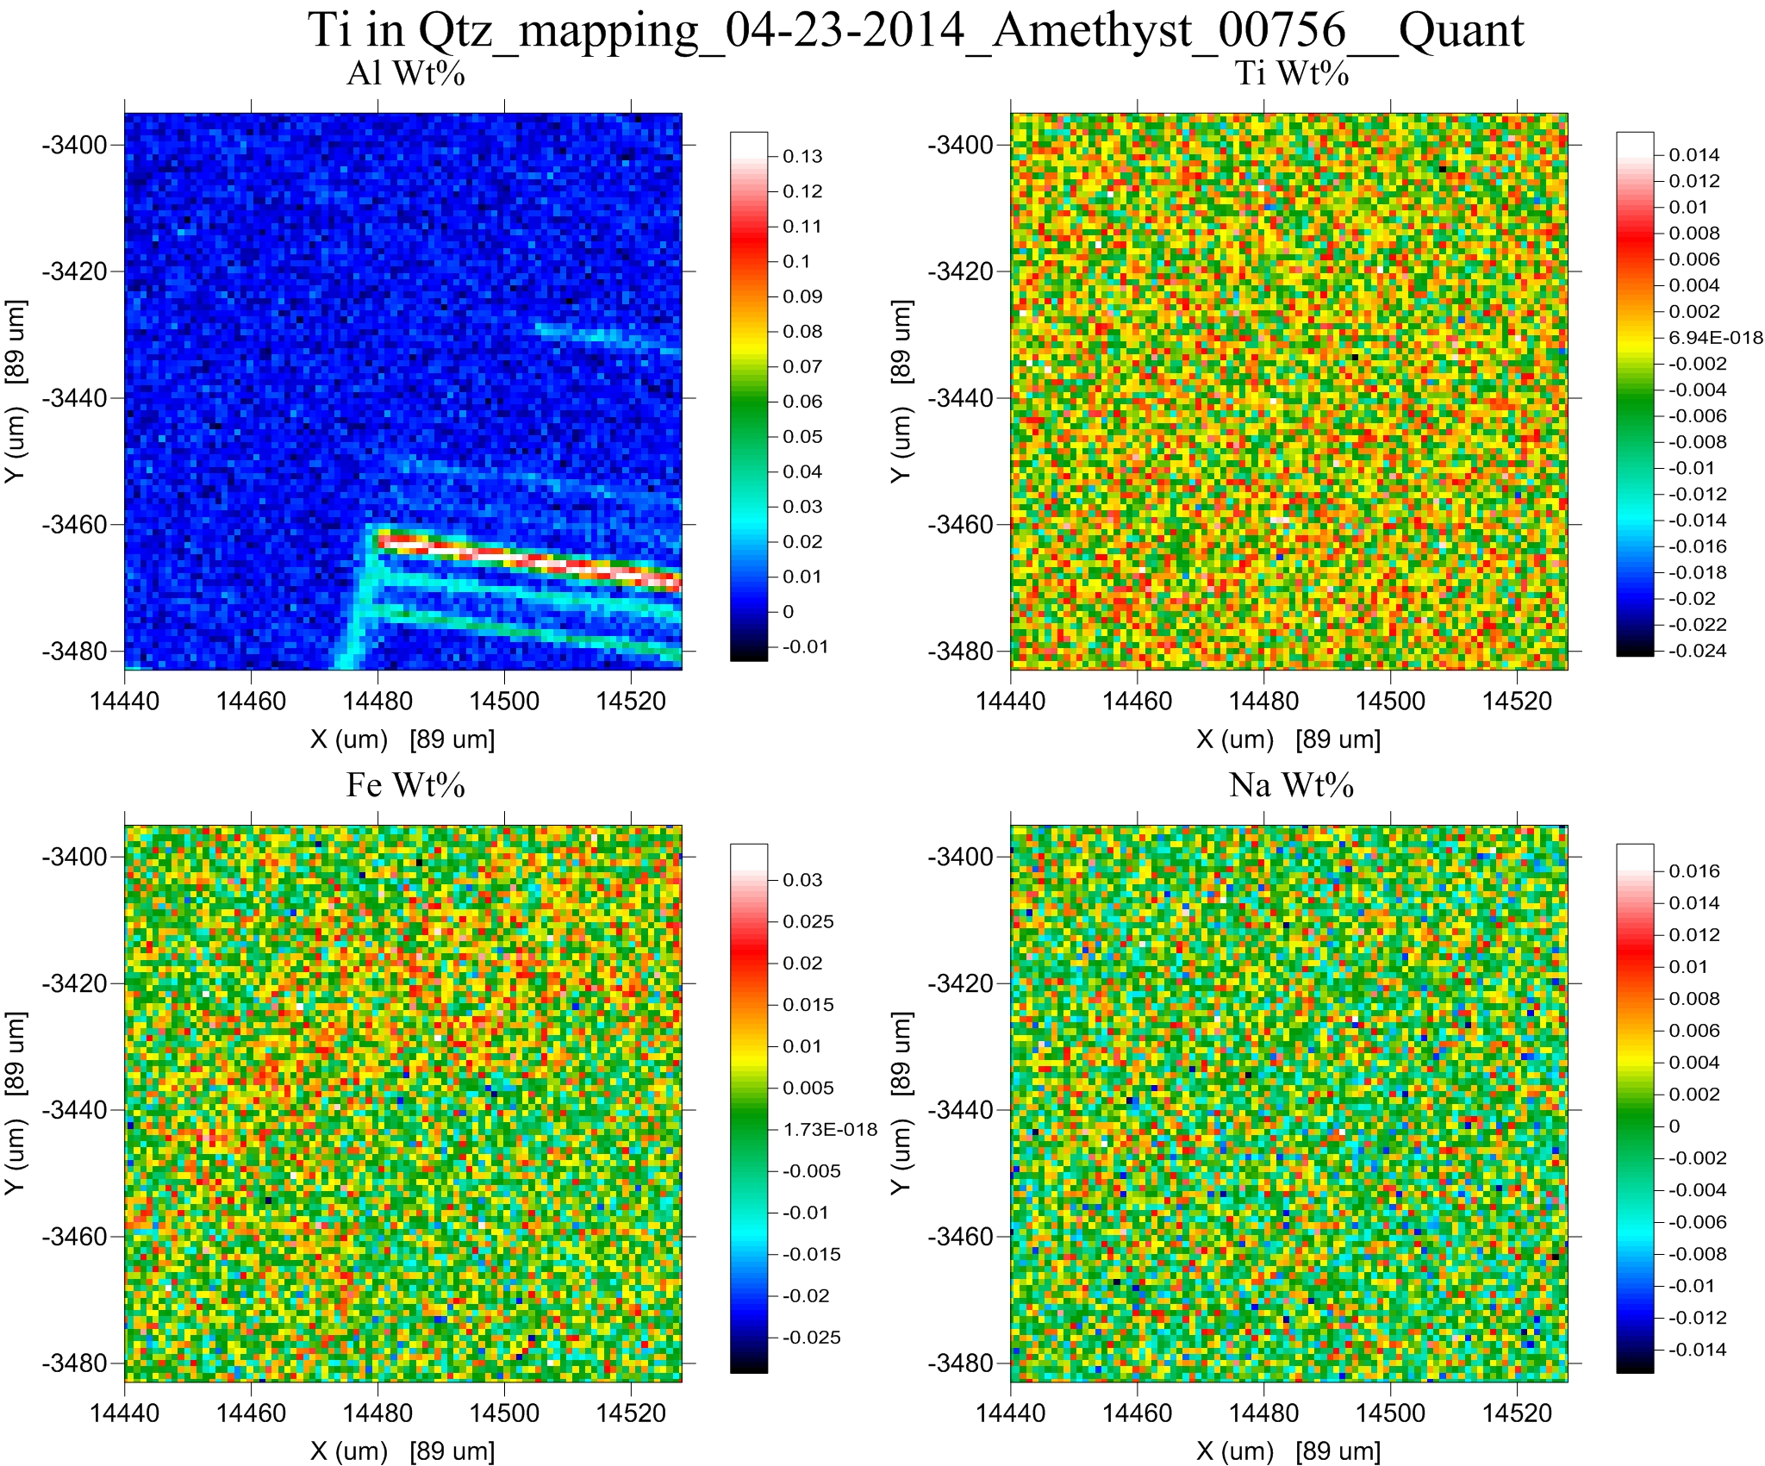
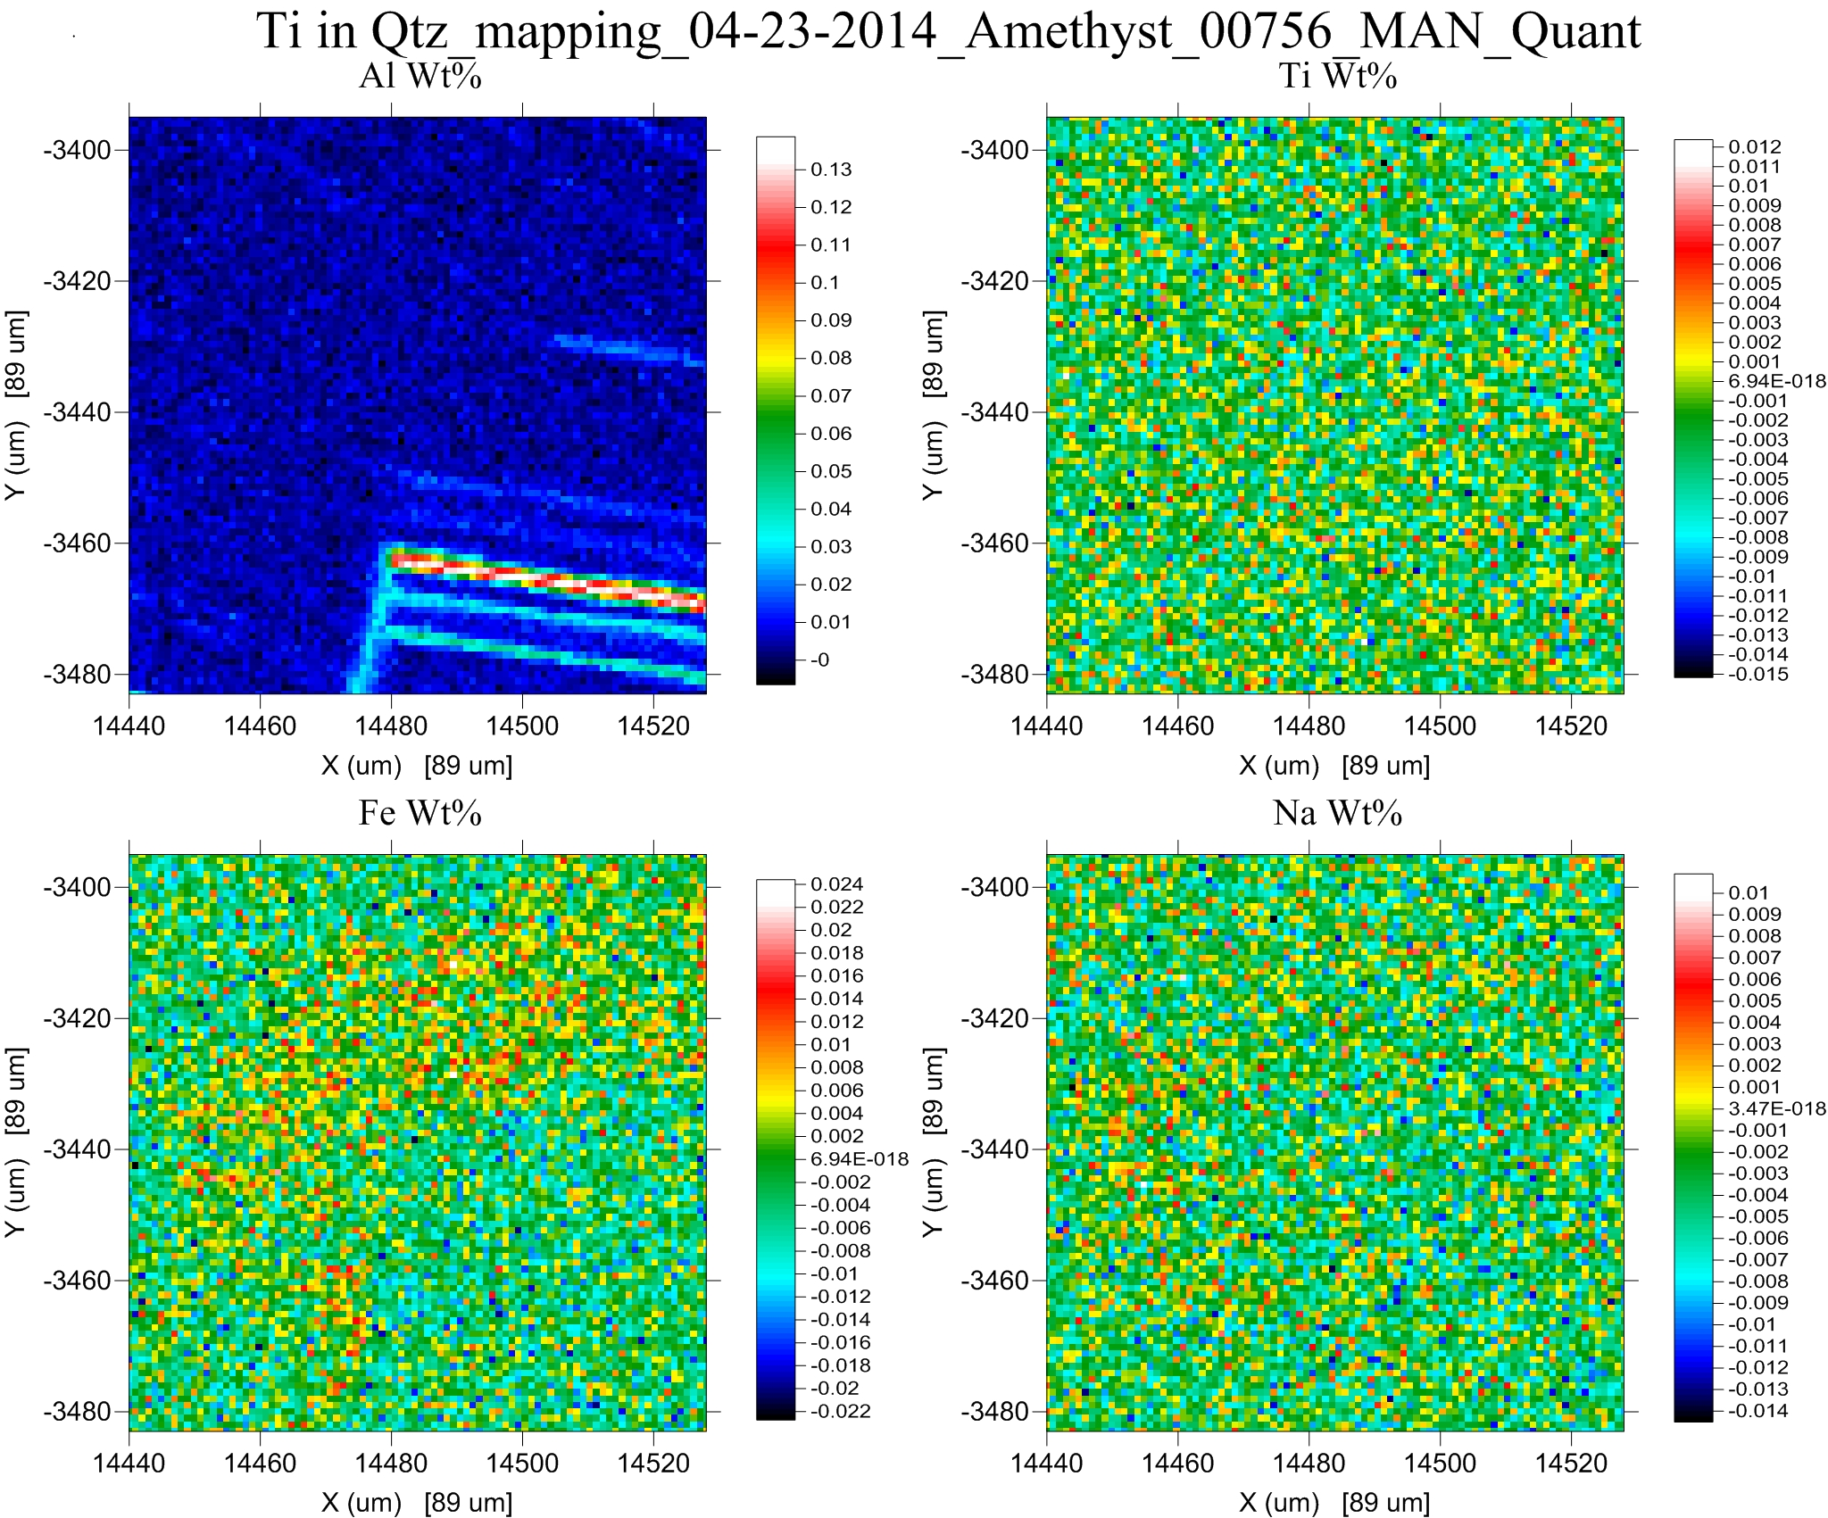
Natural Quartz
Quant mapping

Slide 15
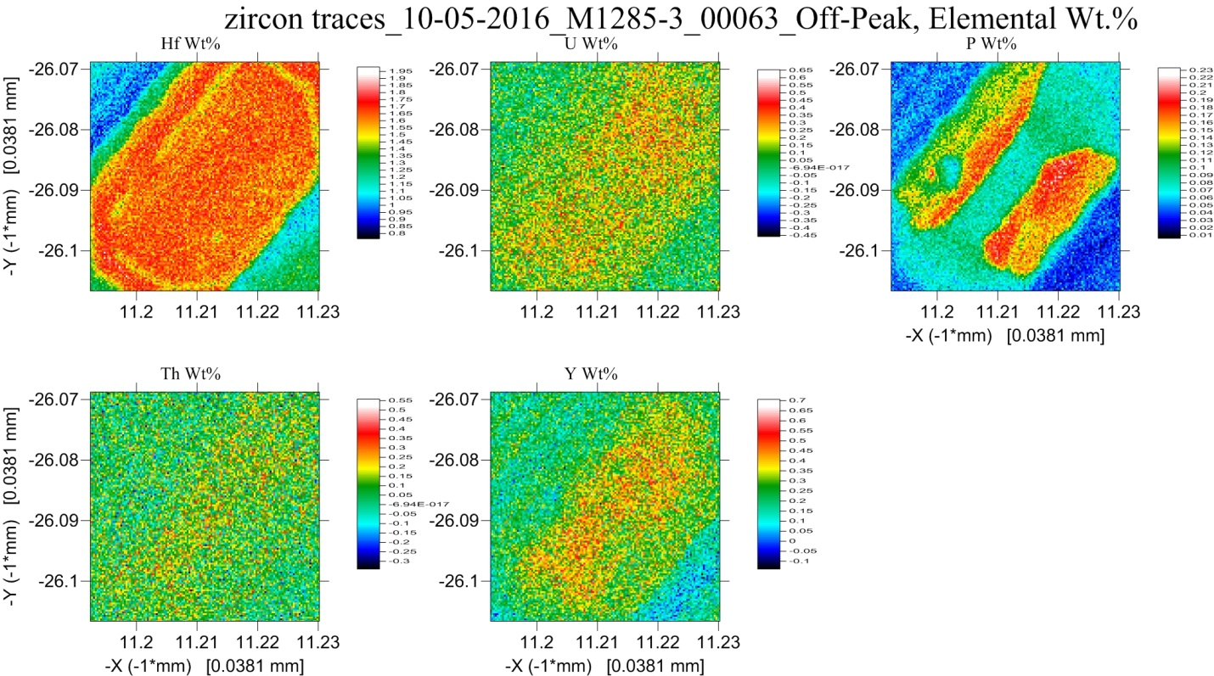
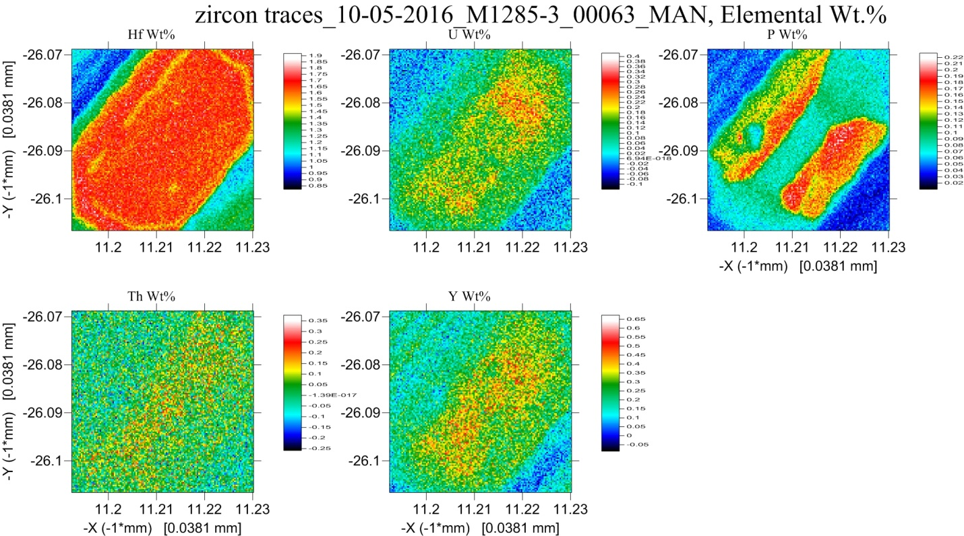
Natural (Toba) Zircon
~20 hours
~10 hours

Slide 16

Off-peak measurements =
worse sensitivity in twice the time!

Slide 17
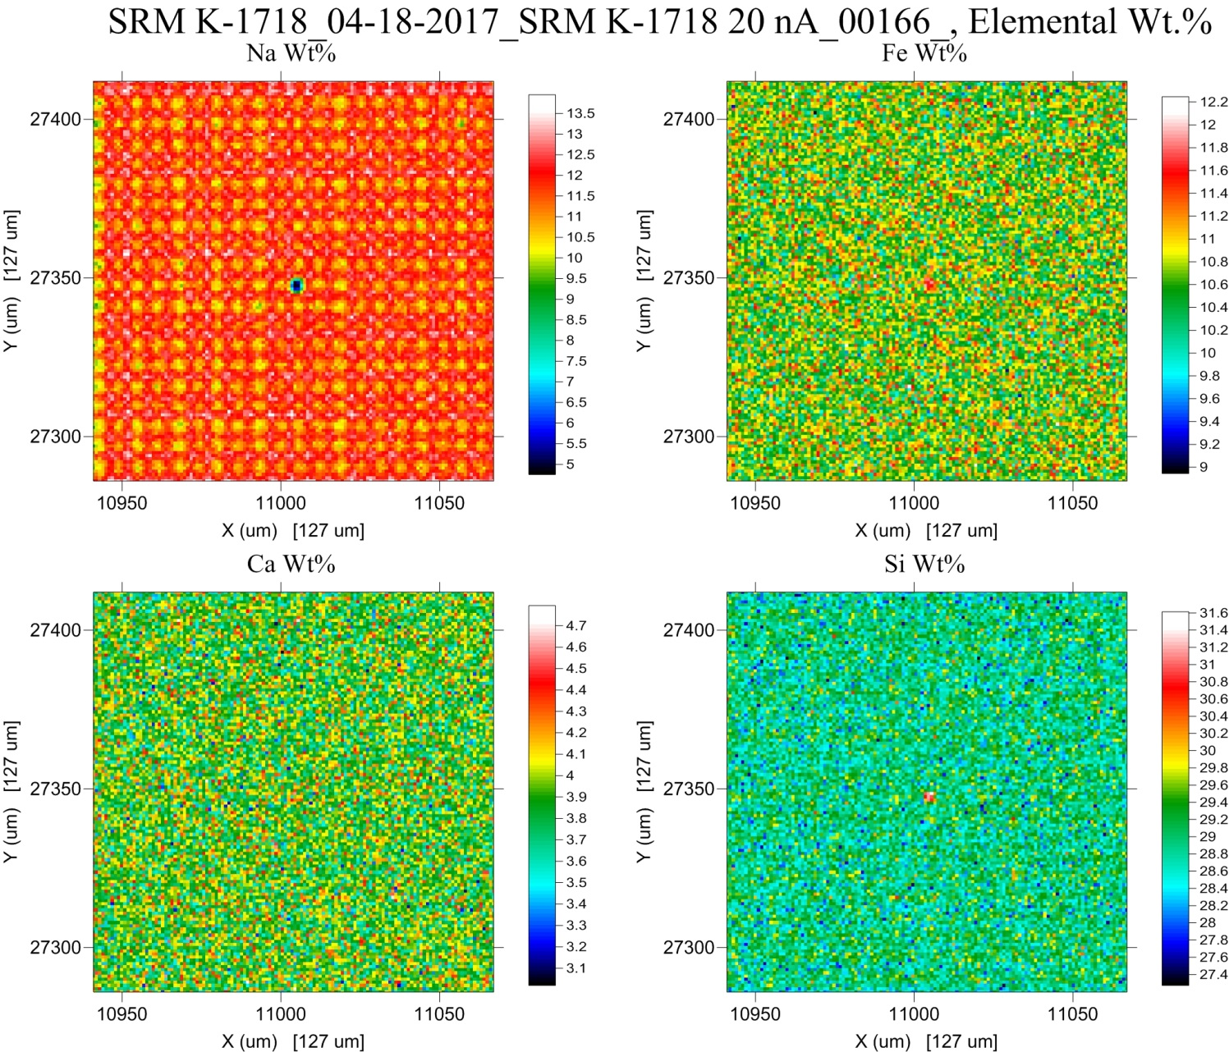
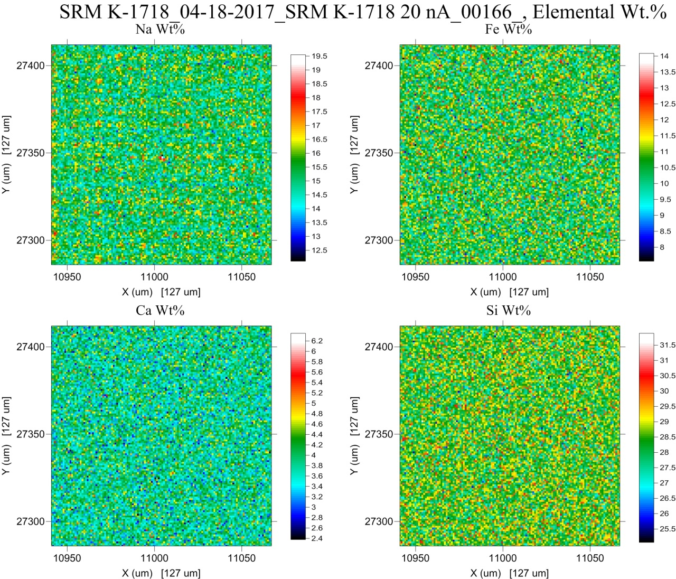
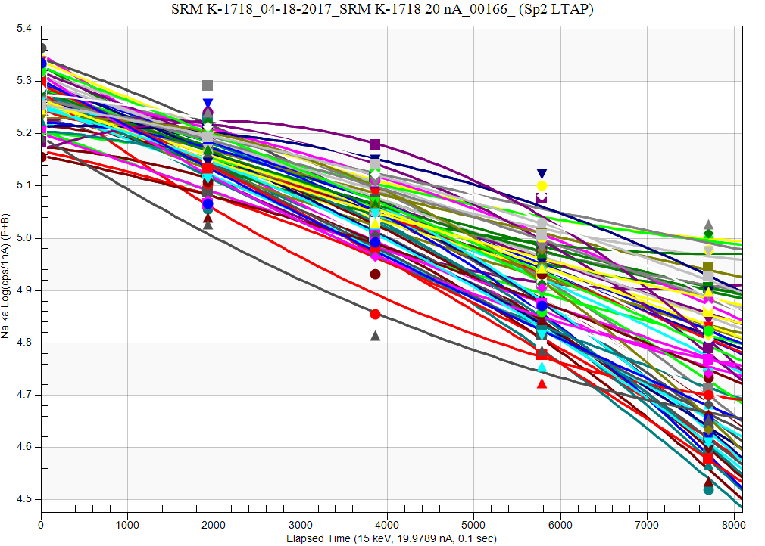
20 nA, 0.5 sec per pixel
14.8 wt% (publ.)

