Slide 1
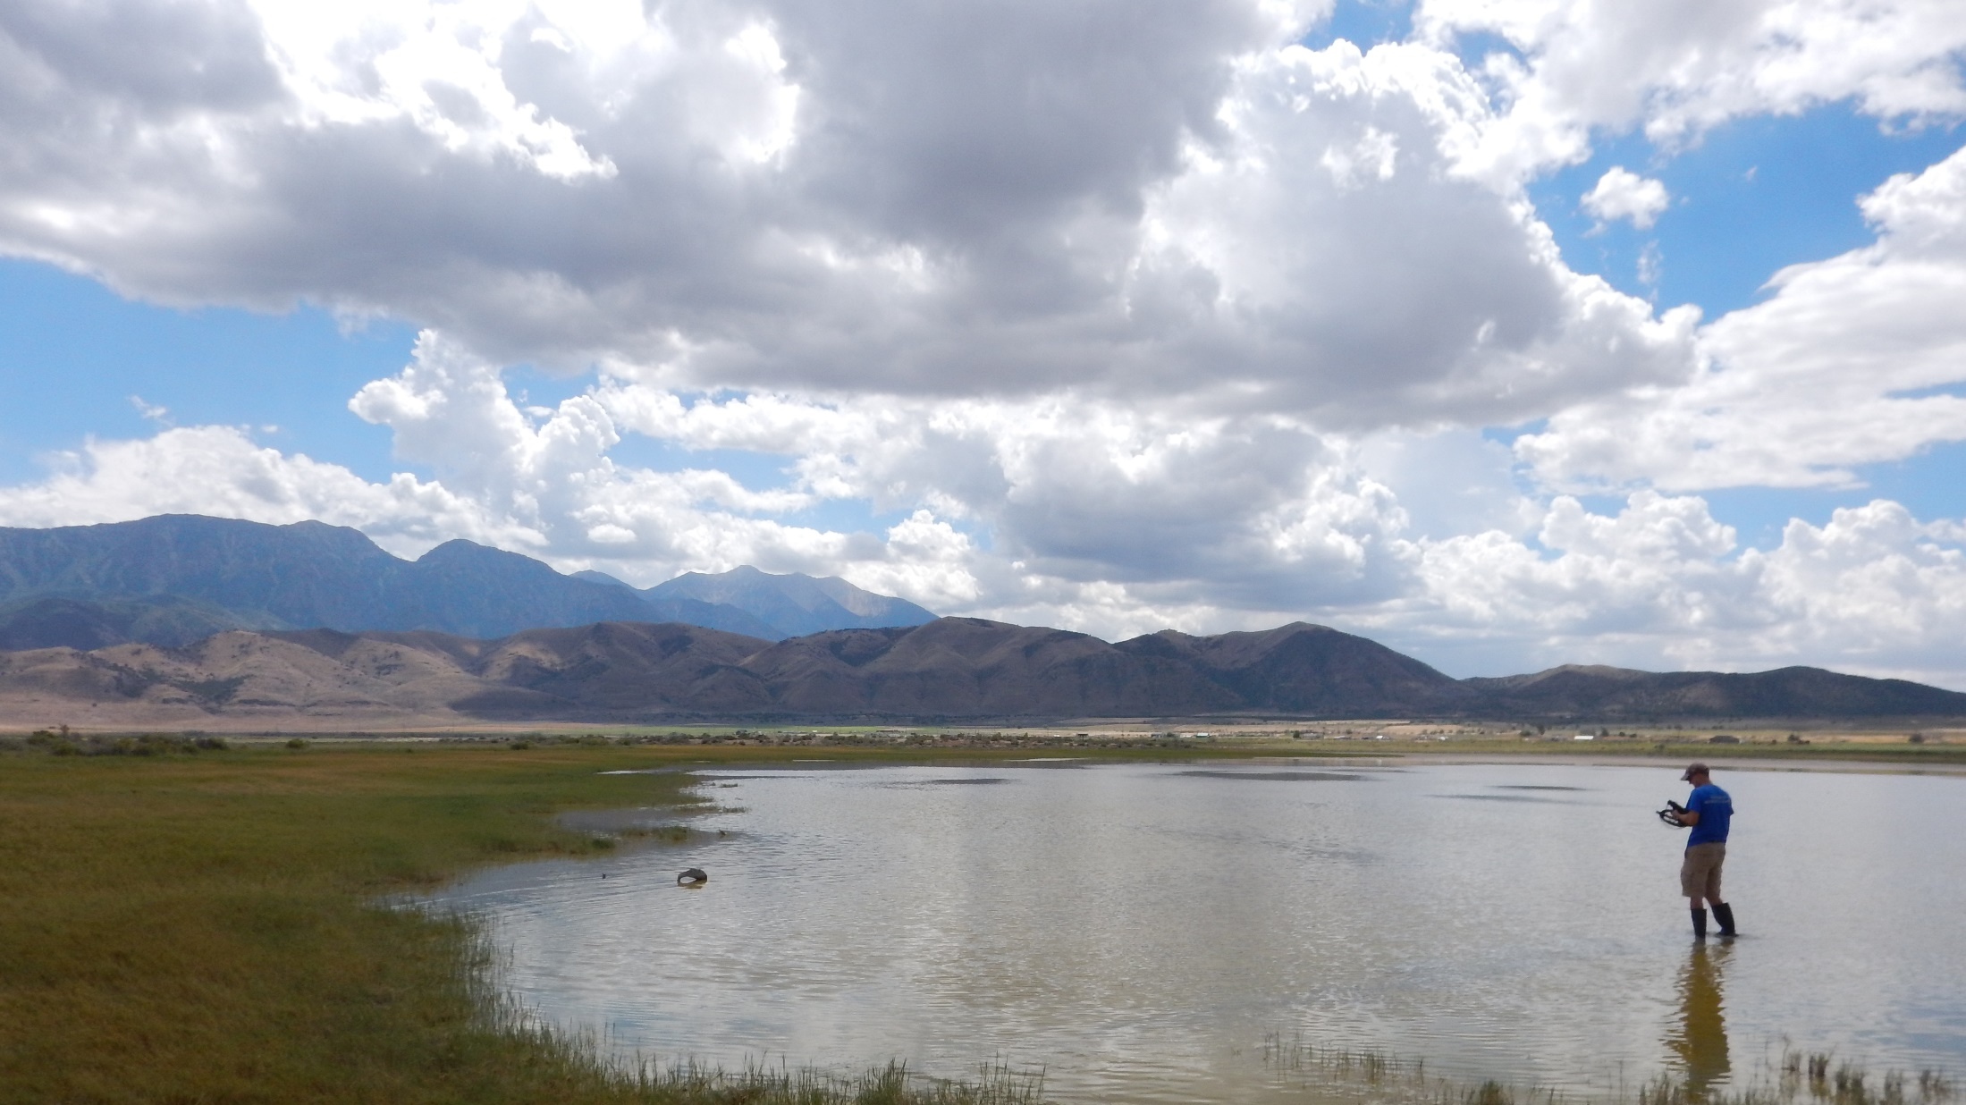


Natural and anthropogenic sources of arsenic and nitrate in a semi-arid alluvial basin; Goshen Valley, Utah, USA
G. Carling, B. Selck, S. Kirby, N. Hansen, B. Bickmore, K. Rey, D. Tingey, J. Wallace, and L. Jordan

Slide 2
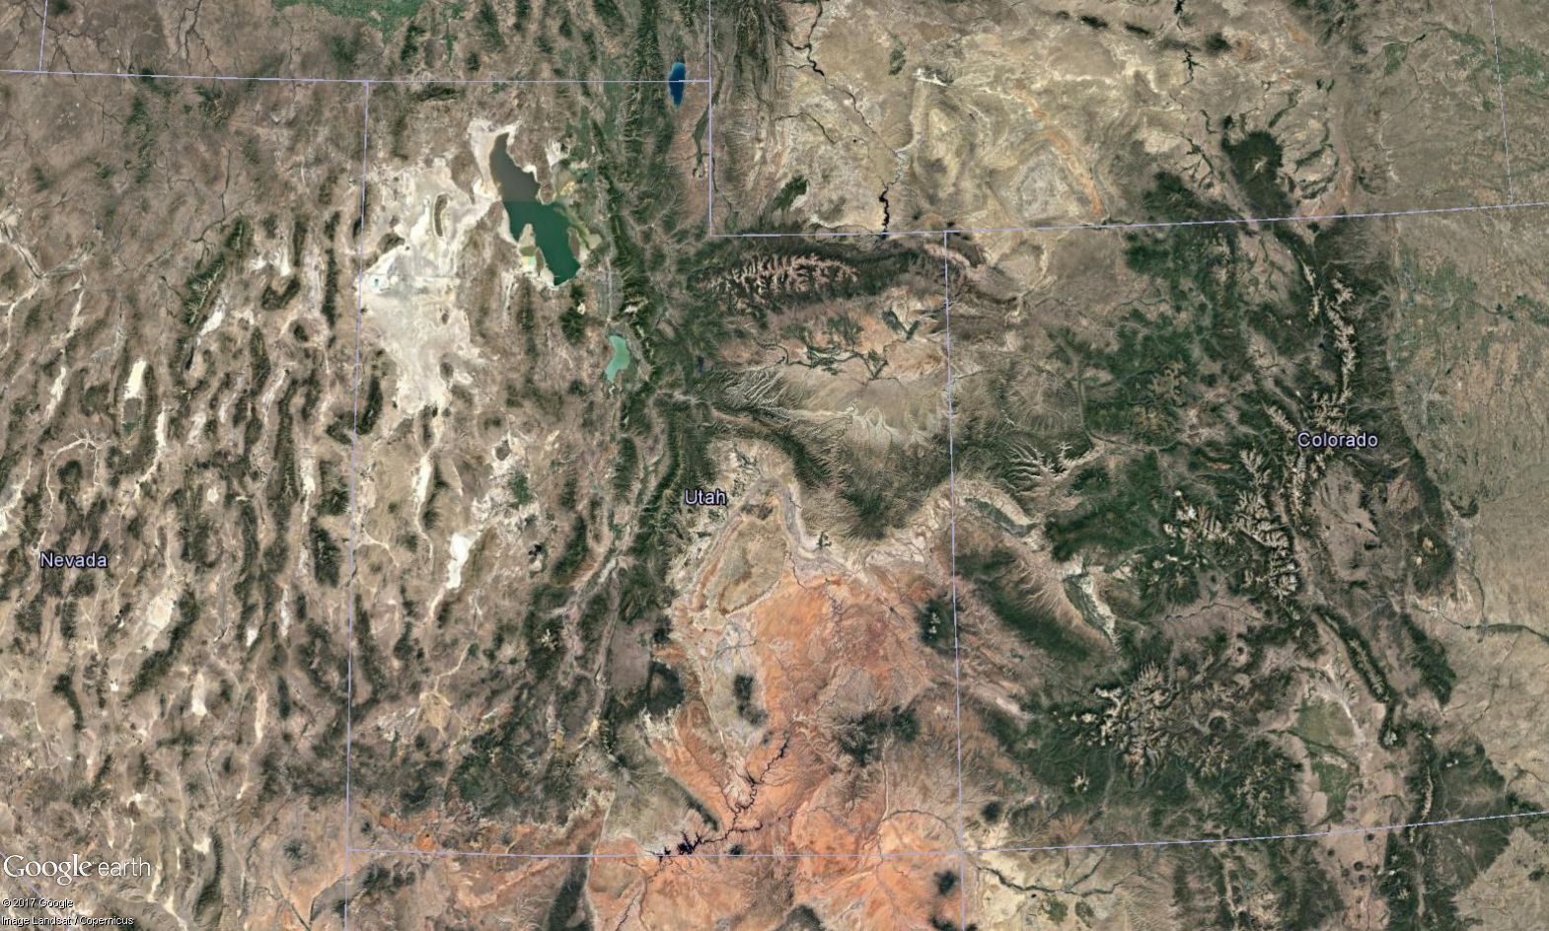

Slide 3
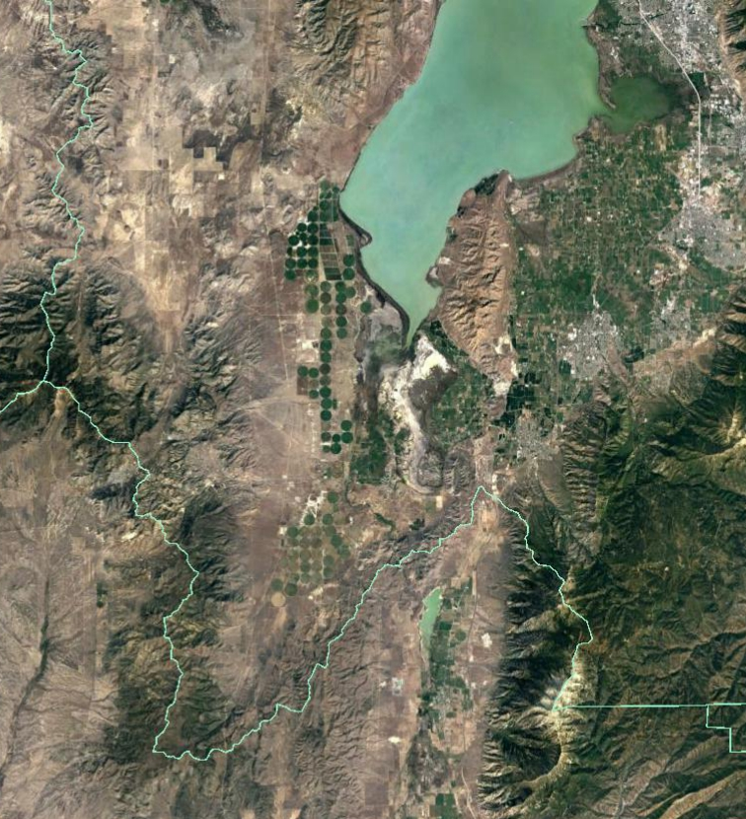
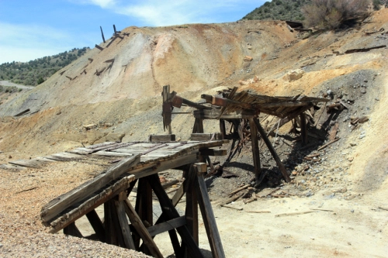
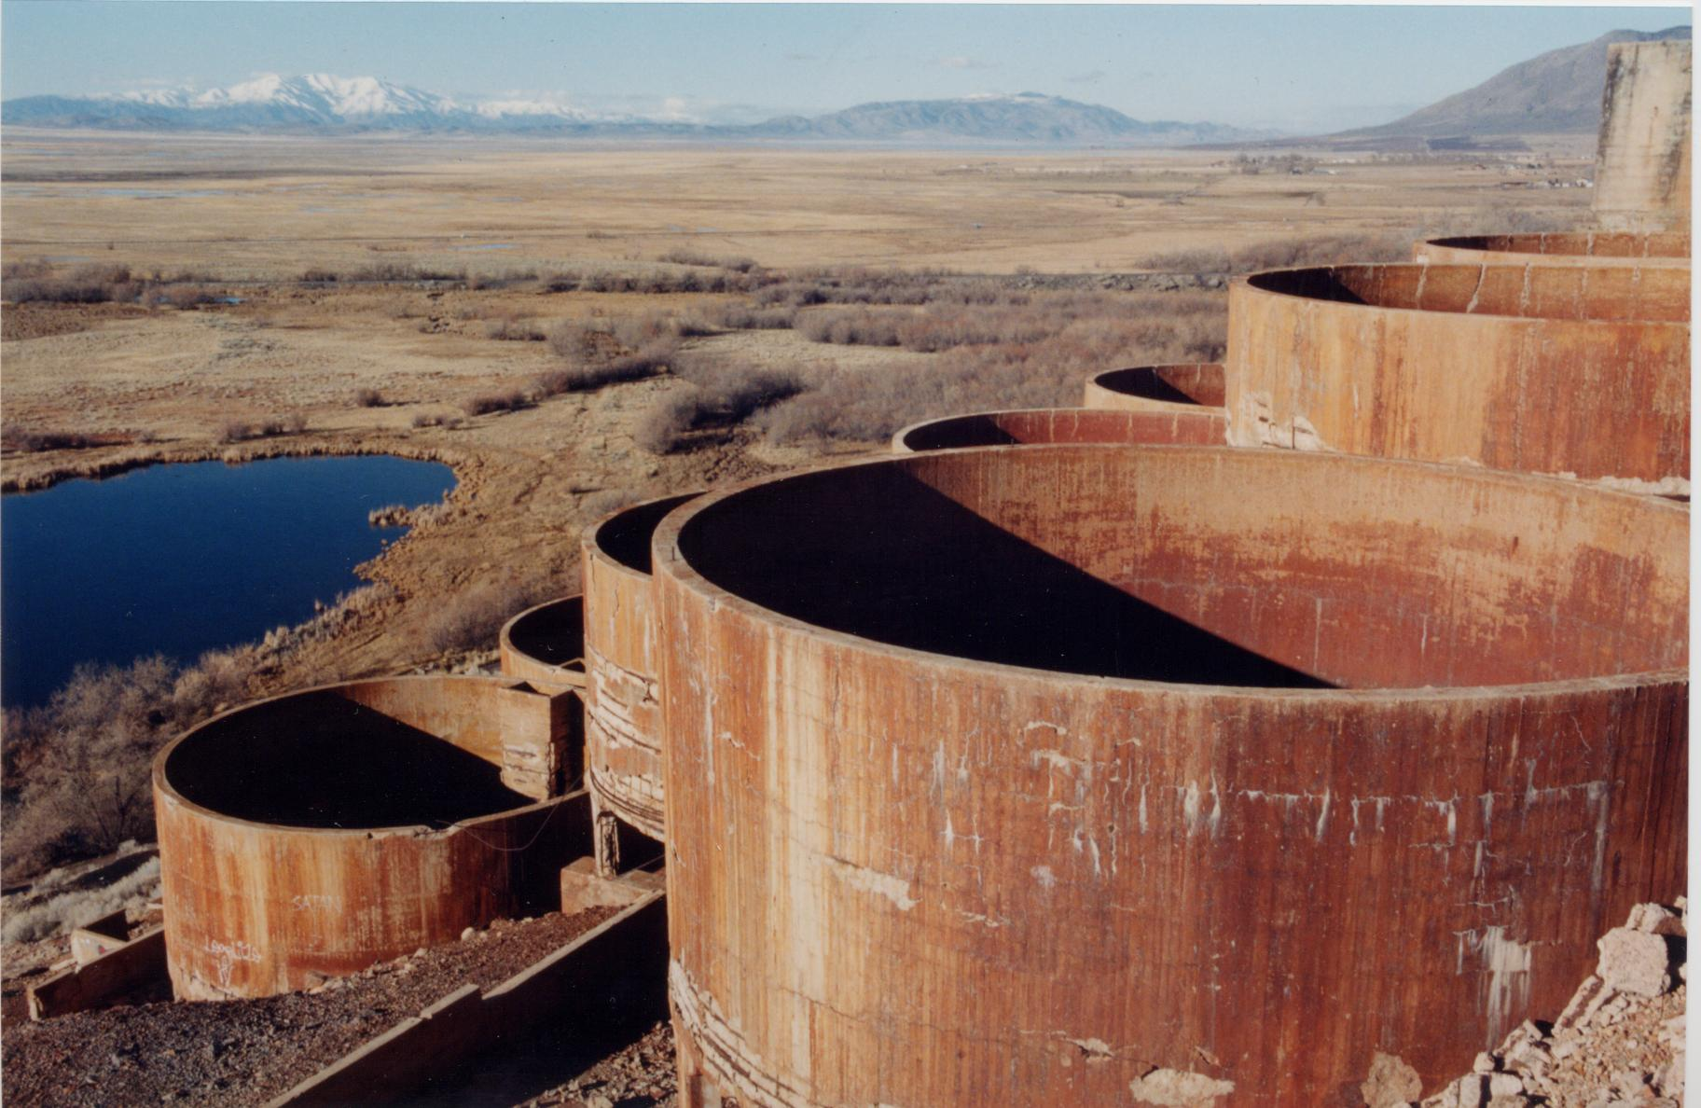
Nitrate and arsenic concentrations exceed drinking water standards
geothermal waters
playa soils
www.elementsunearthed.com
Tintic Mining District
historic ore processing
dairy farms
agriculture
www.clui.org

Slide 4
What is the source of elevated nitrate and arsenic in Goshen Valley groundwater?
Nitrate from agriculture
Arsenic from geogenic sources

Slide 5
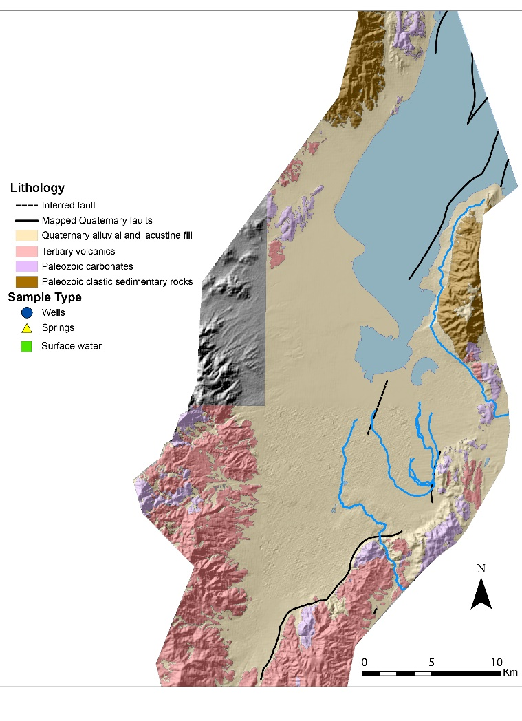
Quaternary alluvial and lacustrine fill
Paleozoic clastic sedimentary rocks
Paleozoic carbonate rocks
Tertiary volcanic rocks

Slide 6
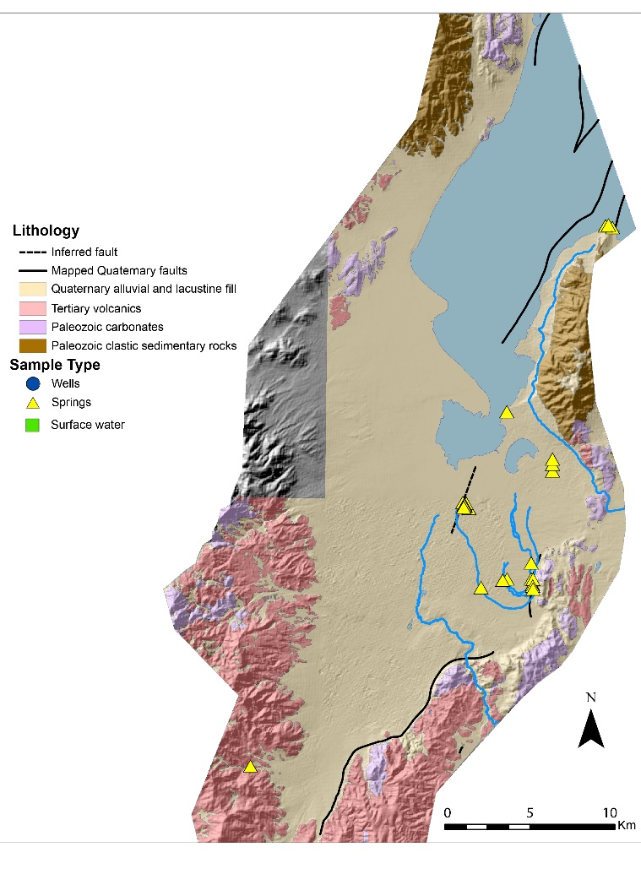
spring samples
→Several fault-related springs

Slide 7
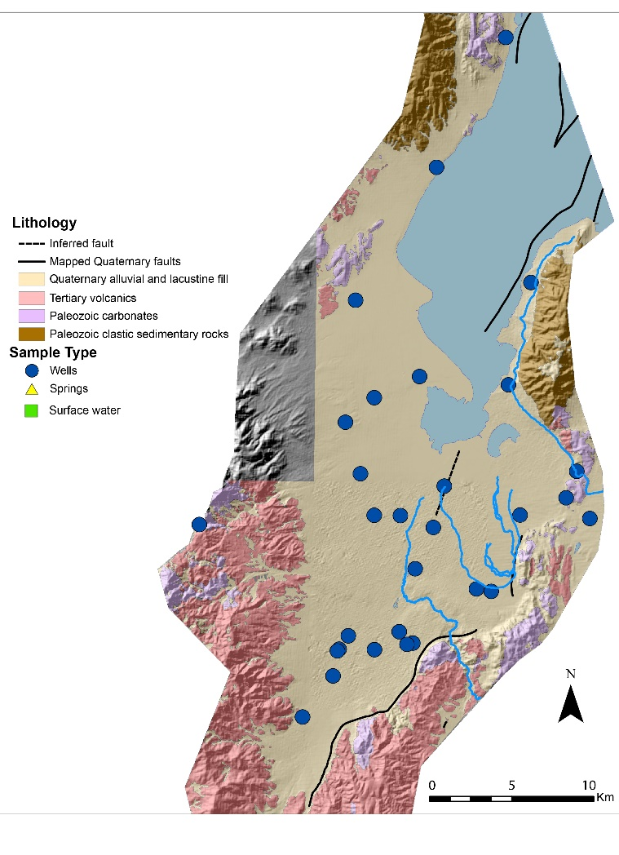
well samples
→Deep agricultural supply wells

Slide 8

surface water samples
→Canals carry irrigation water

Slide 9
Nitrate concentrations
Nitrate (mg/L)
EPA MCL
Background
Springs
Wells
Surface
water

Slide 10
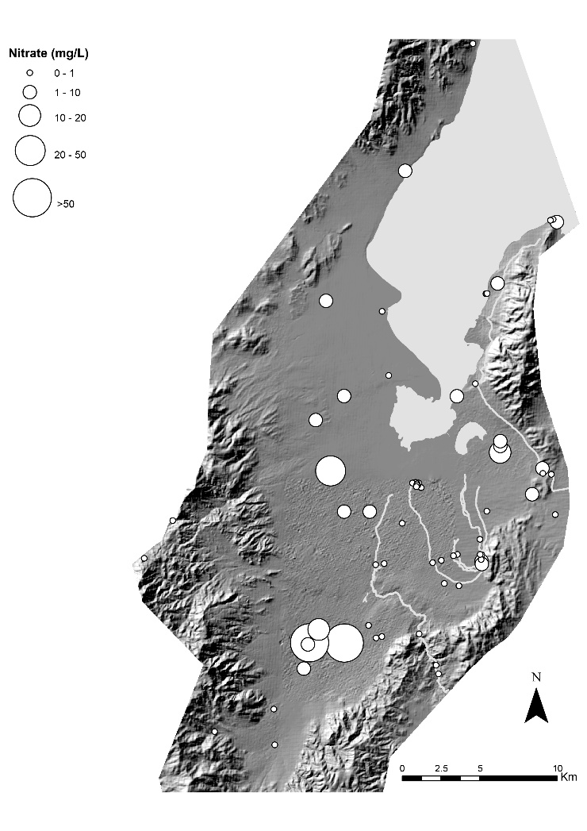
Nitrate concentrations (mg/L)
0-1
1-10
10-20
20-50
>50

Slide 11
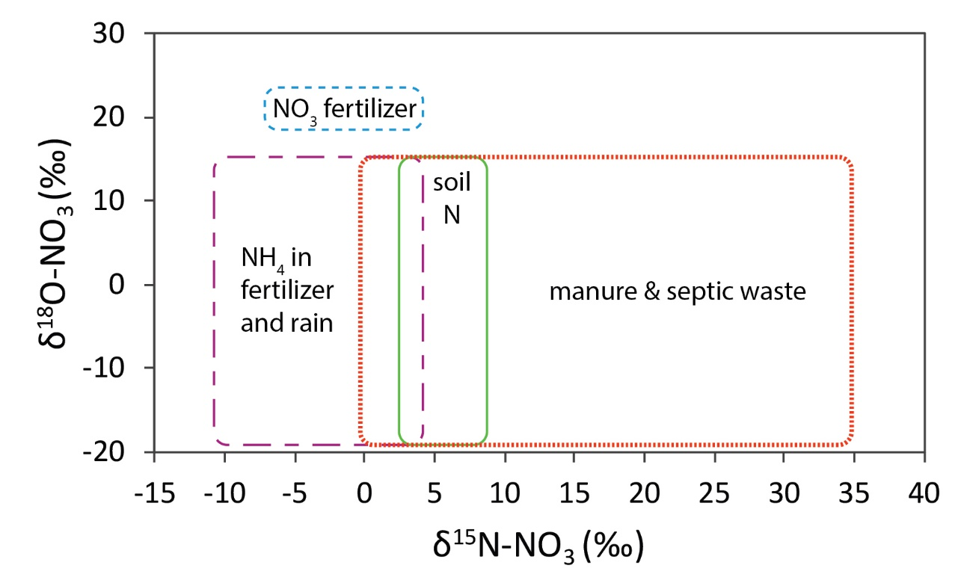
Kendall et al. (2014)

Slide 12
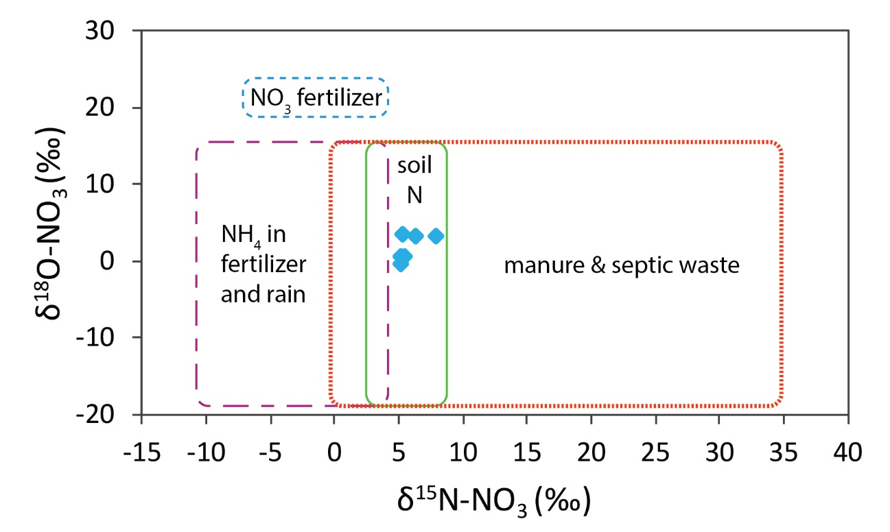
Kendall et al. (2014)

Slide 13
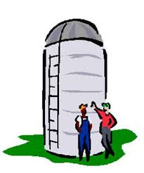

But how does nitrate enter deep aquifers?
nitrate
aquitard

Slide 14
Arsenic concentrations
Arsenic (µg/L)
EPA MCL
Background
Springs
Wells
Surface
water

Slide 15
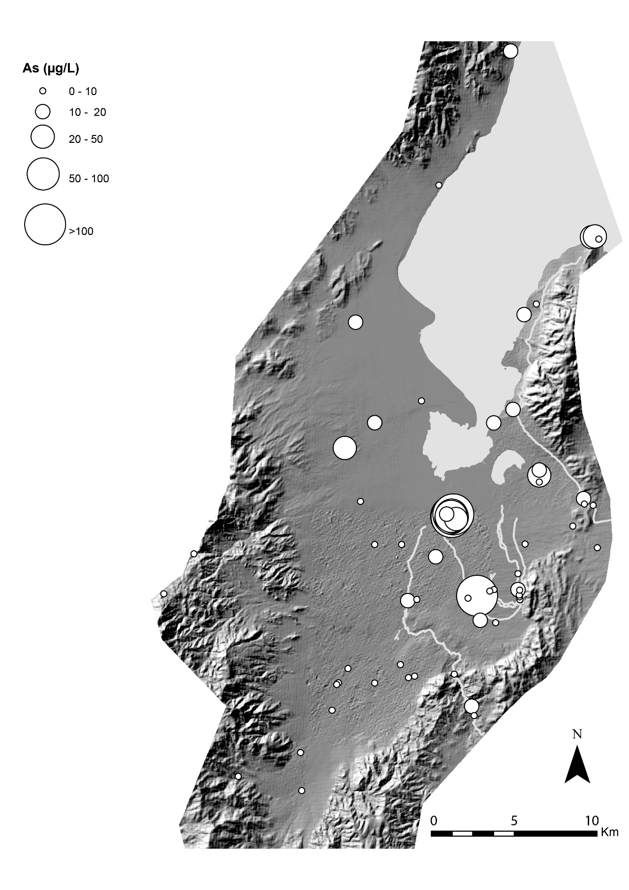
Arsenic concentrations (µg/L)
0-10
10-20
20-50
50-100
>100

Slide 16
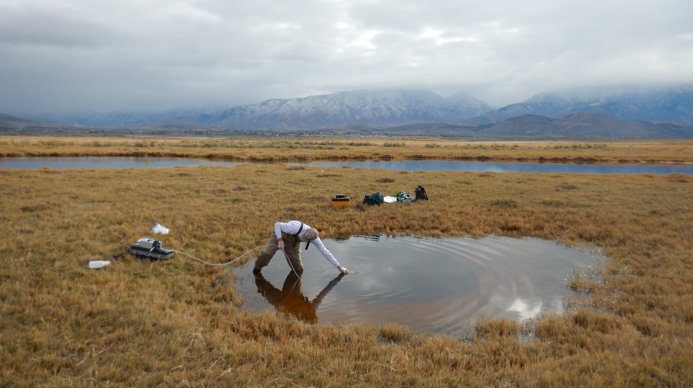

Slide 17
NMS ordination

Slide 18
⁸⁷Sr/⁸⁶Sr
δ³⁴S (‰)

Slide 19
⁸⁷Sr/⁸⁶Sr
δ³⁴S-SO₄ (‰)

Slide 20
Arsenic in deeply circulating groundwater
arsenic-rich spring
halite
gypsum
dolomite
calcite
geothermal waters (?)

Slide 21
Conclusions
Nitrate contamination in agricultural wells related to dairy farming
Nitrogen isotopes indicate manure as a source
High nitrate in deep wells below dairy farms
Nitrate enters aquifer through poorly completed wells
Arsenic contamination in springs from geogenic sources
Arsenic correlated with Sr, Li, B, Na, Cl, SO₄
Sr and S isotopes indicate mineral source of these elements
No evidence for As contamination from mining

Slide 22
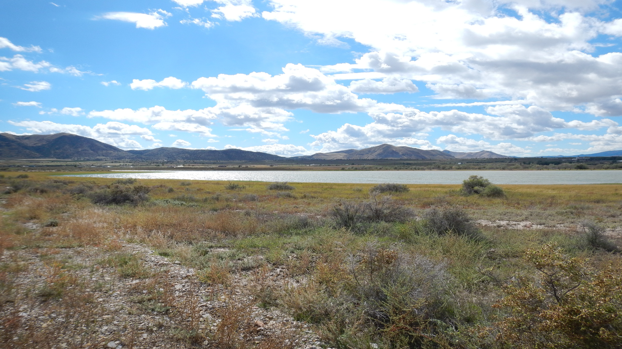
Thank you!

Slide 26
