Slide 1

Extending InTeGrate Materials Across the University of Texas at El Paso (UTEP) Science and Engineering Curriculum
Diane I. Doser, Musa Hussein, Lin Ma, Lixin Jin, Brenda Barnes, Maryam Zarei

Slide 2
Student Profile, UTEP
80%-95% Hispanic
70% do not speak English at home
40-50% first generation college students
Educational “closed loop”

Slide 3
InTeGrate Materials
Connect to grand challenges
Address interdisciplinary problems
Develop geoscientific thinking
Use authentic data
Foster systems thinking

Slide 4
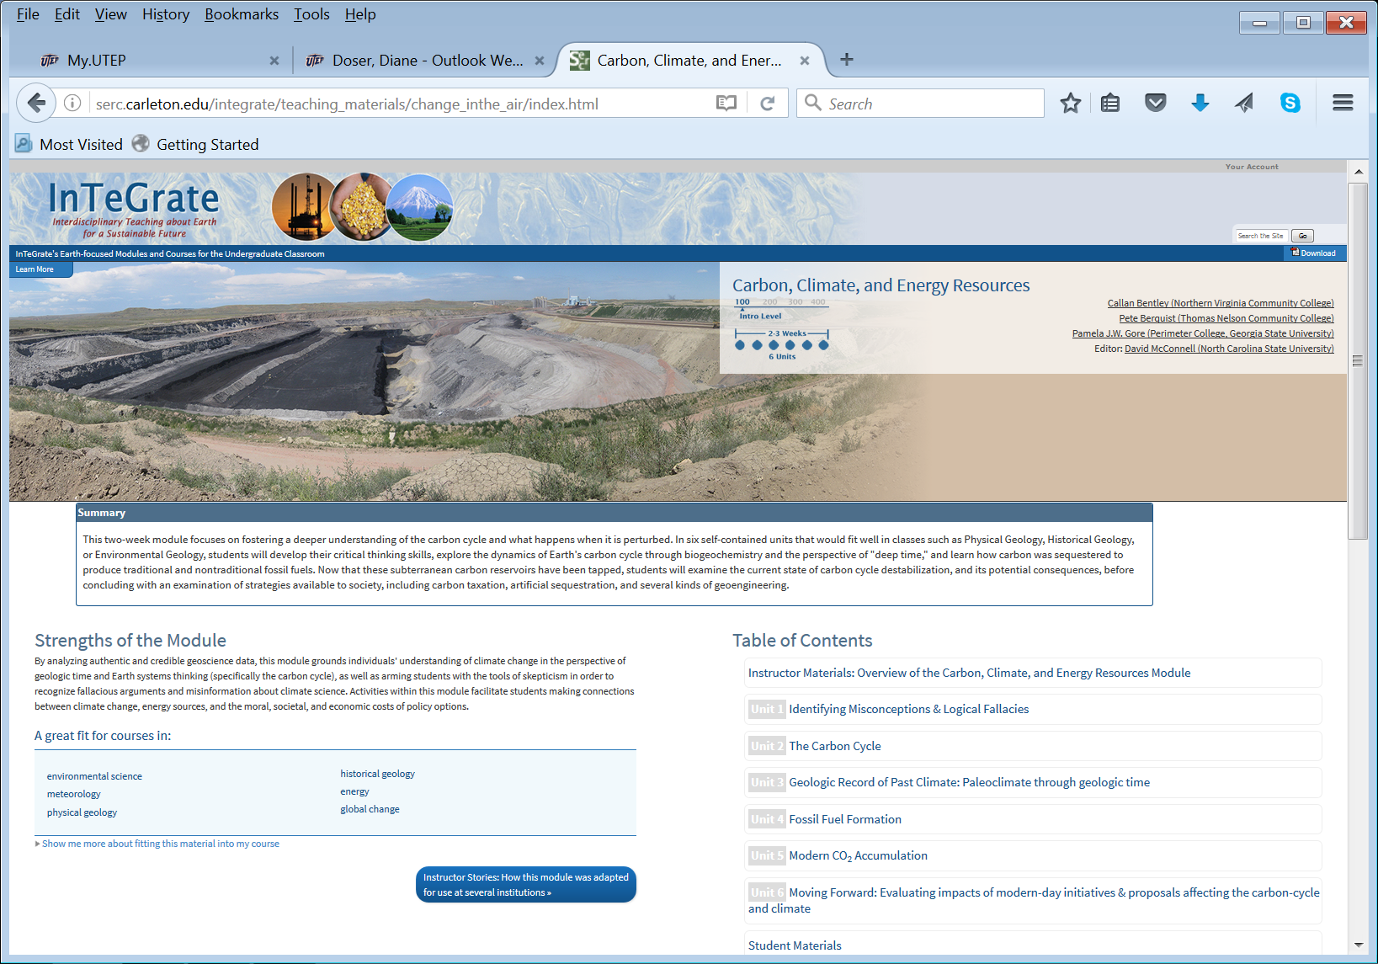
Example of materials
https://serc.carleton.edu/integrate/teaching_materials/modules_courses.html

Slide 5
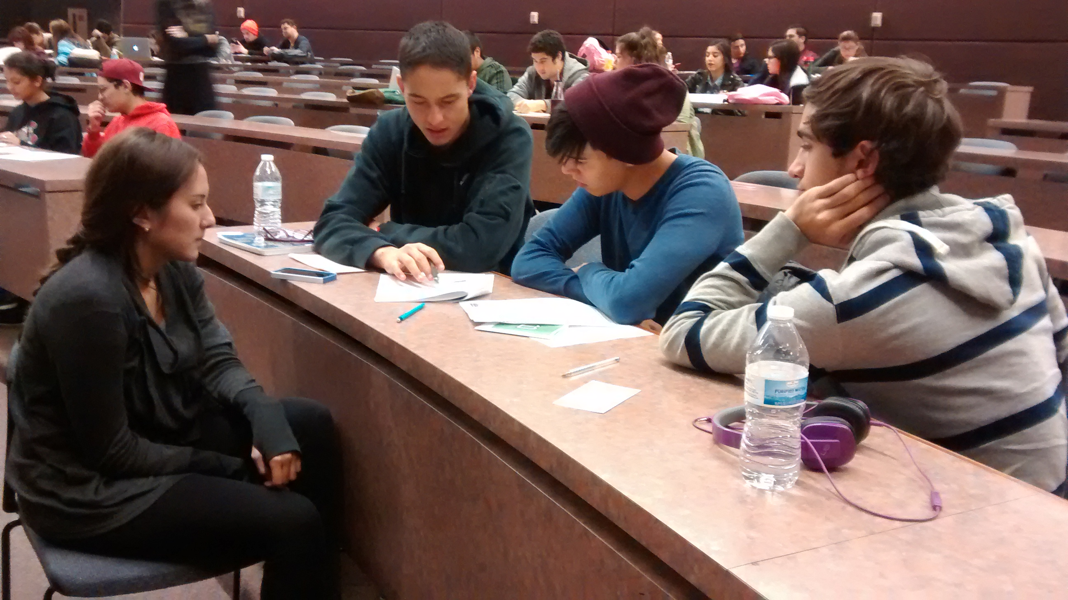
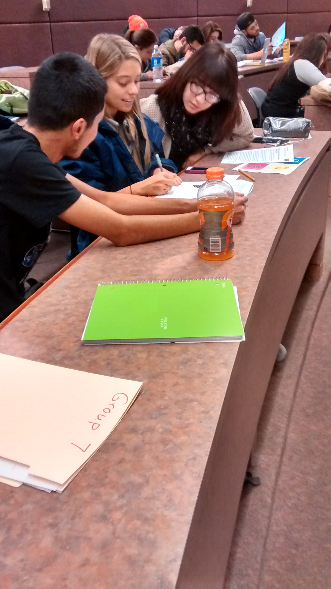
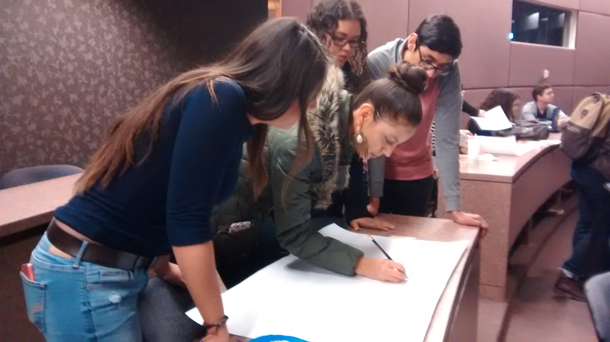

Slide 6
Adoption of InTeGrate
Would it appeal to our student body?
How easy would it be for UTEP instructors (from full professors to TA’s) to use materials?
Could we extend use across the El Paso higher education community (community colleges, early college high schools, dual credit programs)?

Slide 7
How was InTeGrate introduced?
Fall 2014
Spring 2015
Fall 2015
Piloted activity in 4 classes with 2 other classes for control
On-line survey of available modules
Hands-on workshops that used materials
One-on-one consulting
Class visits
Spring 2016
Fall 2016
Fall 2017
Workshop for teaching assistants
Workshop highlighting new modules
Class for teaching assistants, piloting new physical geology labs (60% InTeGrate content)

Slide 10
Who Used InTeGrate?
Notes:
43% senior faculty came to first workshop but did not use materials

Slide 11
Which Courses Used InTeGrate?

Slide 12
What Type of Course Delivery?

Slide 13
Which Modules Were Used?

Slide 14
How Many Modules Per Class?

Slide 15
Positive Student Feedback:
Excited to come to class, time flew
Group participation helped those fearful of math/science
Made new friends
Relevance to El Paso and daily lives
Appealed to visual learners
Popular activities included: water footprint, climate gallery walk, environmental justice

Slide 16
Negative Student Feedback:
Had to come to class every day, couldn’t just show up to take exams
Too much reading
Problems with group dynamics
Dislike of interacting with others

Slide 17
Instructor Feedback:
Positives
Got to know the individual students better
Students more comfortable asking questions and coming to instructors for help
Students came to talk to instructors in later semesters
Lots more fun to teach!
Negatives
Learning curve can be steep
Takes commitment to change teaching style

Slide 18
Conclusions:
Built core faculty who slowly encourage others to use
Teaching assistants highly involved and learning best pedagogy
Structure of materials helpful for teaching assistants and for students whose first language is not English
Senior faculty less likely to adopt
Add material relevant to the local community to increase appeal

