Slide 1





Crustal structure and vertical movements of the Upper Mississippi Embayment and Ozark Uplift
Lin Liu, Stephen S. Gao, and Kelly H. Liu (Missouri University of Science and Technology)
Kevin Mickus (Missouri State University)
Jianguo Song (China University of Petroleum, Qingdao)
Youqiang Yu (Tongji University)

Slide 2
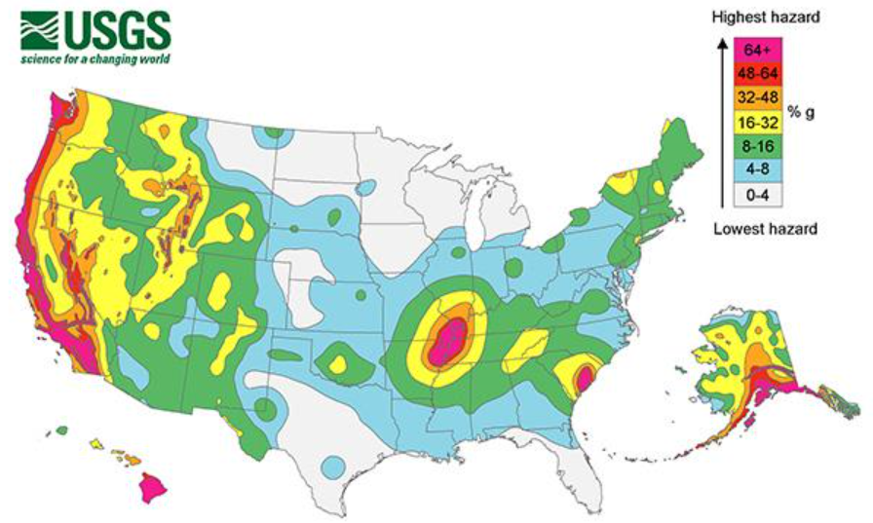
The New Madrid Seismic Zone (NMSZ)
It is the archetype of intra-plate earthquake zones, but the causes of the quakes are not clear
Three of the largest historical earthquakes in the contiguous United States occurred about 200 years ago in the NMSZ, probably with long-lasting aftershocks (till today)
The occurrence interval of the large quakes is debated.
NMSZ

Slide 3
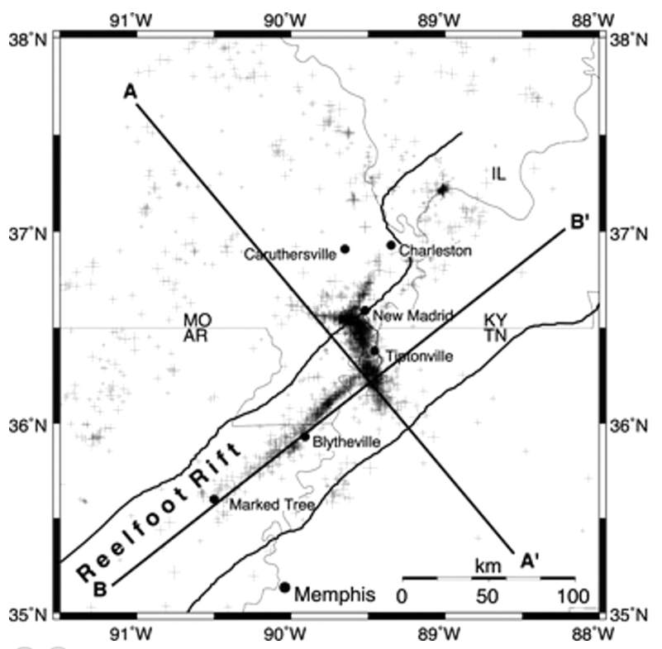
The Reelfoot Rift
The New Madrid Seismic Zone is located inside the Reelfoot Rift
The first period of subsidence of the Reelfoot and surrounding areas took place between 600 to 340 million years ago
The second period of subsidence started around 144 million years ago, and probably lasts to the present time
There was a 200 million year relative tectonic inactivity between the two periods of subsidence
There was a 2-km uplift shortly before the second period of subsidence
A typical continental rift has only one dominant period of subsidence
The question to be addressed by this study: What was the most likely cause of the second phase of subsidence？
Grollimund and Zoback, 2001

Slide 4
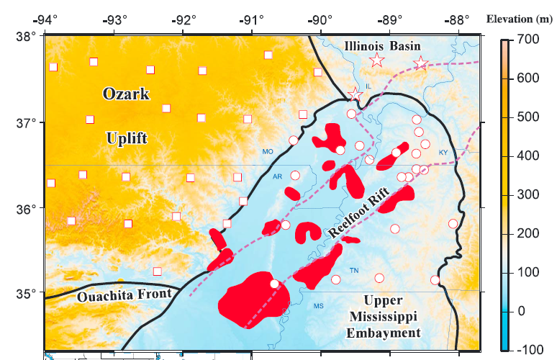
The Upper Mississippi Embayment
The Reelfoot Rift occupies the axial area of the Upper Mississippi Embayment
The Embayment formed during Late Triassic (220 Ma)
It is the northward extension of the Gulf of Mexico
Widespread igneous intrusives formed during the second period of subsidence
Liu et al., 2017 JGR

Slide 5
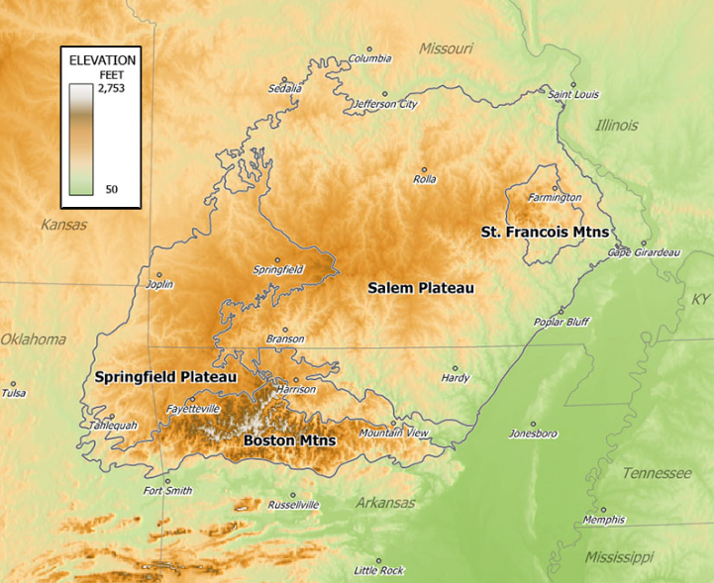
To the west of the Upper Mississippi Embayment is the Ozark Plateau
https://en.wikipedia.org/wiki/Ozarks#/media/File:OzarkRelief.jpg

Slide 6
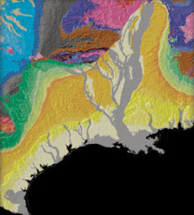
Proposed mechanisms for the second phase of subsidence
Hypothesis No.1 :
Extensional stress regime associated with the opening of the Gulf of Mexico [Ervin and McGinnis, 1975; Kane et al., 1981].
However, this model has been questioned because the subsidence did not start until about 80 Ma after the cessation of the rifting of the Gulf margin [Cox and Van Arsdale, 1997].
墨西哥湾

Slide 7
Hypothesis No. 2:
The second model postulates that the second phase of subsidence represents isostatic adjustment of a high-density, mafic lower crustal layer during a period of decreased lithospheric viscosity owing to increased geothermal gradient [DeRito et al., 1983; Braile et al., 1986].
This model has difficulties in explaining the pre-subsidence 2-km uplift of the area. Also the origin of the mantle heat source is unclear.

Slide 8
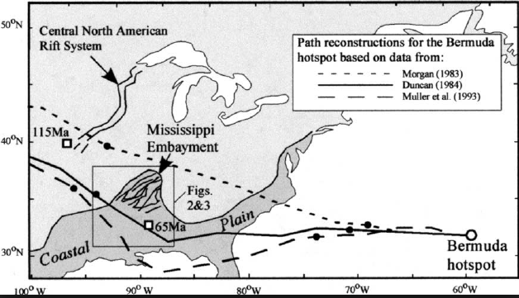
Hypothesis No. 3:
The third model advocates the role that the proposed Bermuda mantle plume played during its passage over the previously rifted area [Cox and Van Arsdale, 1997], leading to uplift, intrusion of high-density igneous rocks into the crust, erosion of the uplifted axial area of the UME, and subsidence due to thermal contraction and loading of both the sediments and dense intrusions [Cox and Van Arsdale, 1997].

Slide 9
Seismic and gravity data used for the study
Obtained from the IRIS (Incorporated Research Institutions for Seismology) Data Management Center.
Recording period: 9/1989 to 4/2015
Epicentral distance range: Greater than 30 degrees
Total number of broadband seismic stations: 49, distributed in 3 tectonic regions: the Upper Mississippi Embayment, Ozark Plateau, and Illinois Basin.
Gravity data were obtained from the National Geophysical Data Center

Slide 10
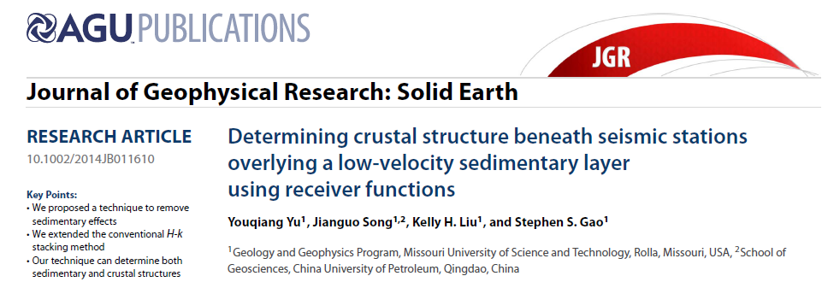
Methods
Receiver function calculation using the water-level deconvolution method (Clayton and Wiggins, 1977)
Removal of multiple reverberations caused by the loose sedimentary layer (Yu et al. 2015）
H-k stacking (Zhu and Kanamori, 2000)
Gravity modeling

Slide 11
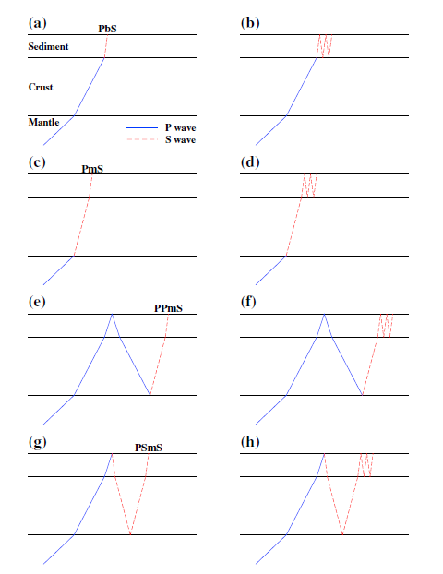
Moho (left panels) and sedimentary layer related seismic arrivals
(Yu et al., 2015)

Slide 12
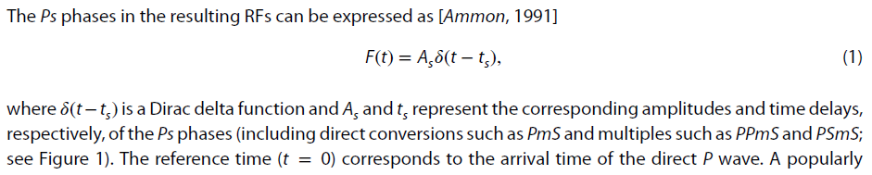
The primary arrivals in time domain

Slide 13
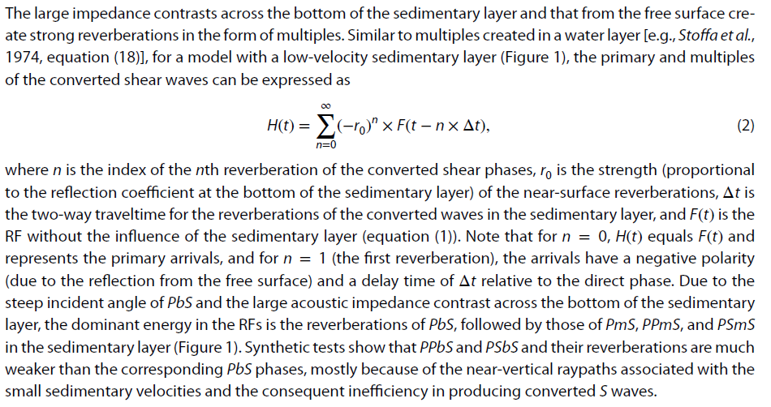
The multiples in time domain

Slide 14
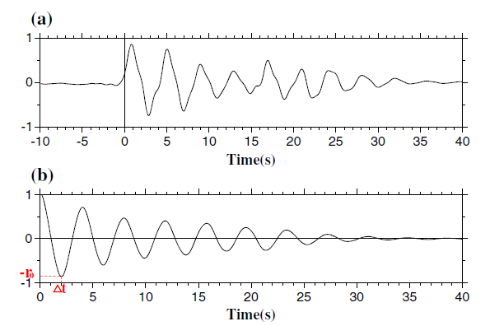
A synthetic receiver function with a Moho and a sedimentary layer： r₀=0.8, Δt=2.0s
The autocorrelation of the receiver function: To measure r₀ and Δt

Slide 15
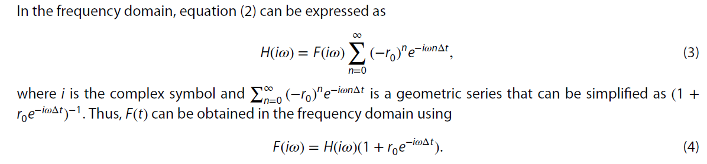
The frequency domain expression of the multiples (Eq. 3) and the removal of the multiples (Eq. 4)

Slide 16
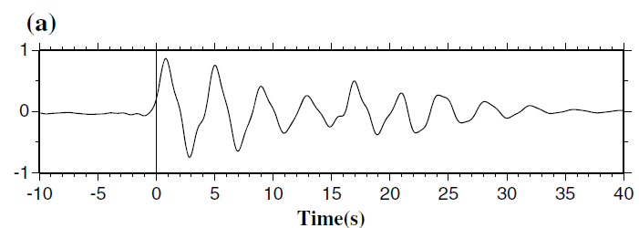
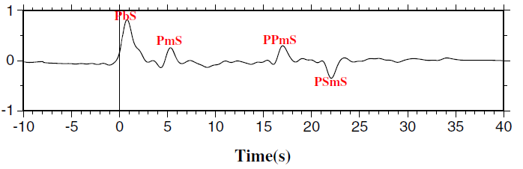
Original receiver function: H(t)
The receiver function after the removal of the multiples: F(t)

Slide 17
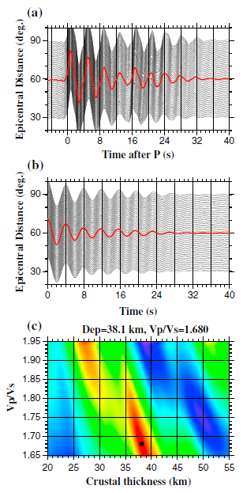
H-k stacking using the original receiver functions: The results are wrong
The true parameters used for the synthetics:
For the sedimentary layer, the thickness, VP, VS, VP∕VS are 0.7 km, 2.1 km/s, 0.7 km/s, and 3.0；
For the subsediment crustal layer, the corresponding values are 35 km, 6.1 km/s, 3.49 km/s, and 1.75;

Slide 18
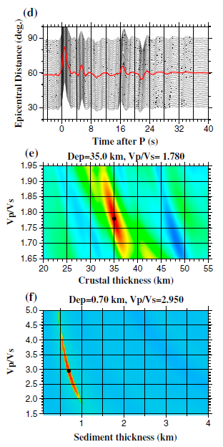
Correct results from stacking of reverberation-removed RFs: The results are almost the same as the parameters used for generating the synthetic RFs.
For the sedimentary layer, the thickness, VP, VS, VP∕VS are 0.7 km, 2.1 km/s, 0.7 km/s, and 3.0；
For the subsediment crustal layer, the corresponding values are 35 km, 6.1 km/s, 3.49 km/s, and 1.75

Slide 19
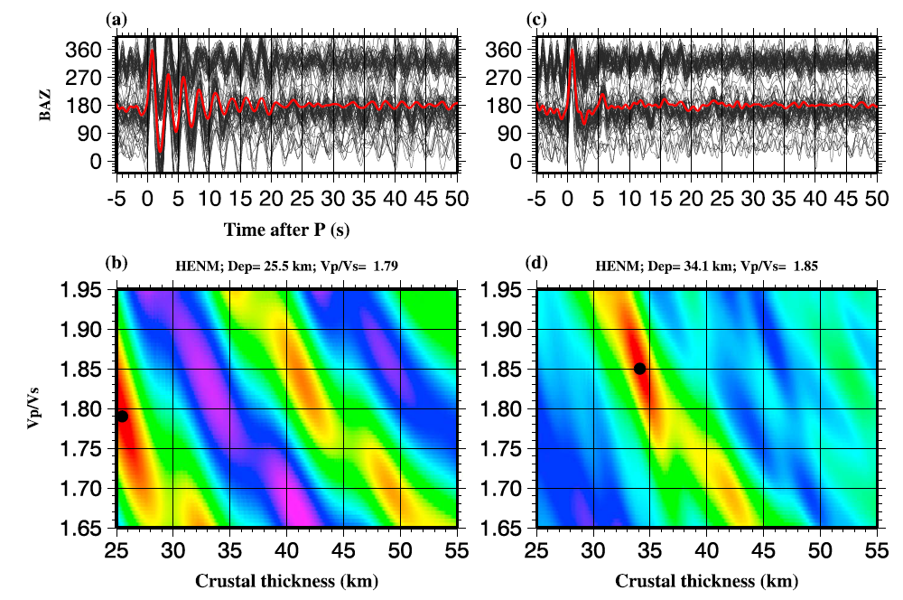
Station HENM in the Embayment:
Original RFs and the wrong H-k plot (left plots)
Reverberation-removed RFs and the resulting H-k plot (right plots).

Slide 20
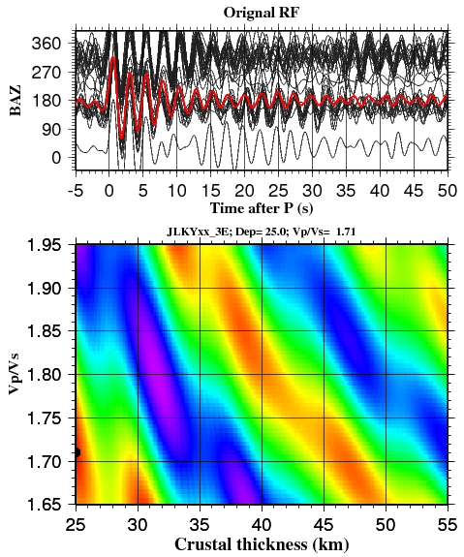
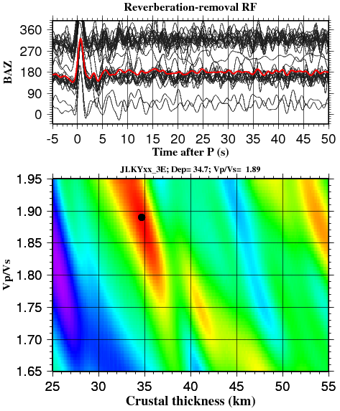
Station JLKY in the Embayment:
Original RFs and the wrong H-k plot (left plots)
Reverberation-removed RFs and the resulting H-k plot (right plots).

Slide 21
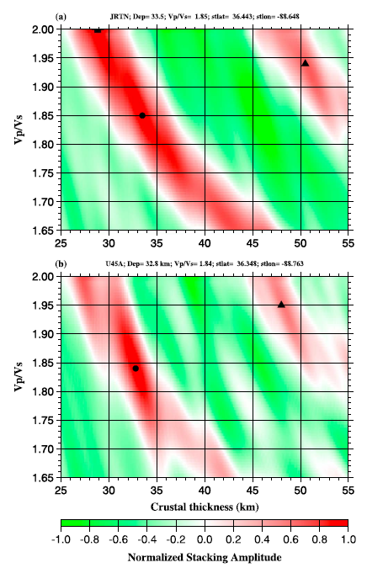
Two arrivals are found at most stations in the Embayment.

Slide 22
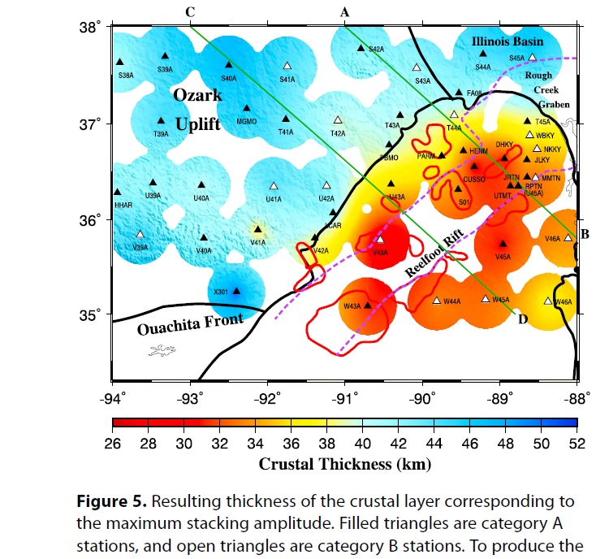
“Crustal” thickness corresponding to the maximum stacking amplitude. For Embayment stations, the thickness is that of the upper crustal layer.

Slide 23
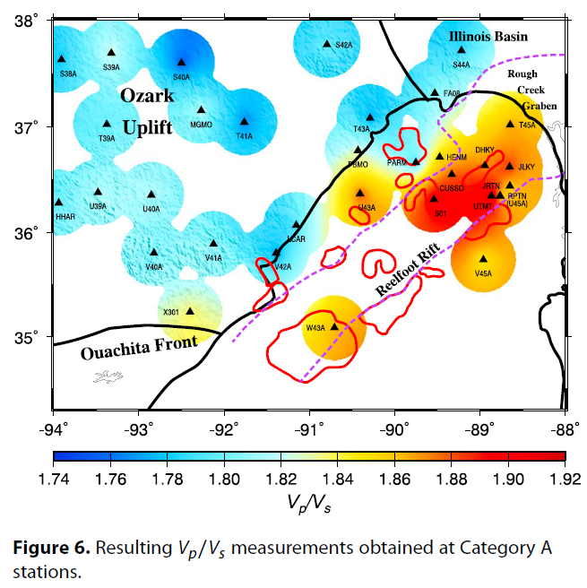
Very high Vp/Vs for the upper crustal layer beneath the Embayment

Slide 24
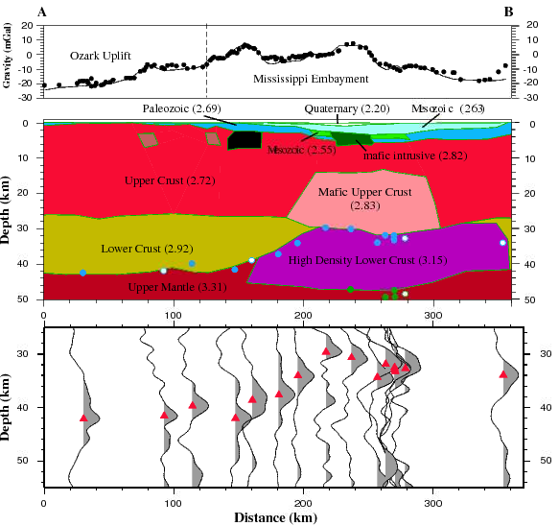
High density upper and lower crustal layers are needed to fit the gravity data.
The whole crust beneath the entire area is about 50 km thick, while the upper crust is only about 30 km.

Slide 25
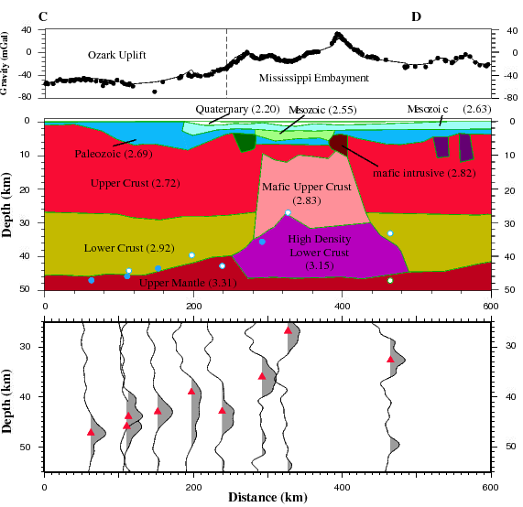
Gravity modeling results along profile C-D

Slide 26
Crustal composition
The normal upper crust is mostly composed of felsic rocks, and thus the Vp/Vs is low (about 1.74)
The normal lower crust is mostly basaltic rocks and thus the Vp/Vs is high (about 1.81).
The average crustal Vp/Vs is about 1.78
The crustal Vp/Vs for the Ozark Plateau is normal.
The very high upper crustal Vp/Vs (~1.88) relative to the normal value of 1.74 indicates mafic intrusion.

Slide 27
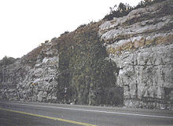
Diking of mantle material leads to high Vp/Vs
Mantle rocks are ultra-mafic and have very high Vp/Vs (>=1.85) under crustal conditions. If some of the crust is replaced by mantle rocks, the Vp/Vs will increase
Liu and Gao, 2010.

Slide 28
Summary
A high density, mafic upper crust has been revealed beneath the Upper Mississippi Embayment
The results are most consistent with the third hypothesis: A passing mantle plume produced uplift, led to intrusion of mafic mantle materials to both the upper and lower crust
When the area drifted away from the plume, thermal contraction caused the second phase of subsidence
The plume had little influence on crustal composition beneath the Ozark Plateau, probably due to the strong lithosphere

