Slide 1

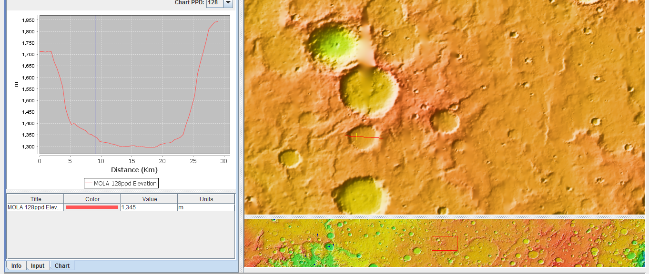
-9 km
-6 km
-3 km
0 km
3 km
6 km
9 km
12 km
15 km
18 km
21 km
Can Slope-Dependent Transport Explain Martian Crater Profiles
Sara Goldenbaum and Les Hasbargen
Dept. of Earth and Atmospheric Sciences , SUNY Oneonta, NY, 13820
Saragoldenbaum@gmail.com
Session 227 : “T206. Geomorphology and Landscape Evolution of Mars : The GK Gilbert Award Session (Posters)”
Tuesday, 24 October 2017
9 AM – 6:30 PM
Booth Number : 353
Martian impact craters have rims and walls that have been modified by surface processes. Indeed, the craters on Mars vary drastically in age as well as size and degree of degradation. Of the many mechanisms of mass transport, we chose a simple model of downslope gravity driven transport as a testable hypothesis. We constructed a numerical model in a spreadsheet of how a crater profile would change over time. We assume that sediment transport rate varies according to slope magnitude, and this results in a diffusive-like model. The mathematical elevation profile evolves through time based on spatial changes of sediment transport rate.The model has seven variables that must be specified including initial elevation; diffusivity; time step size; spacing between nodes in the solution; two boundary flux conditions; and duration of a simulation. We performed sensitivity tests in order to see how each variable affected the mathematical profile. We found a moderate range in forms can develop in the model, with the dominant control exerted by boundary flux conditions. Old craters, if they evolve according to a slope-dependent transport model, should smoothly fill from the edges inward, relief and slope should decline over time, and the point on the profile which divides the eroding section from the depositing section should very slowly migrate toward the crater center over time. The profile evolves toward a constant boundary between erosion-deposition areas early in the evolution, coincident with ~0.5 crater relief. Thus, no bedrock should be visible below that height. We test these predictions against a cohort of Martian crater profiles extracted from Mars Orbiter Laser Altimeter data that range in degree of degradation. Relief and slope covary for the craters, with lower slope coinciding with lower crater relief, consistent with the model. We are initiating a search of HiRise imagery to test the erosion-deposition transition location.
Conclusions
The main sediment transportation process that our model takes into account is gravity driven transport.
The older craters are less steep and have lower slopes then younger ones
Older craters show less relief
Parabolic crater floors are not obvious in old craters in our data set
Example of the crater selection process in the JMARS interface. Individual profiles can be exported to csv files and compiled in a spreadsheet (see below).
Acknowledgements
We thank NASA, Arizona State University and JMARS team for providing access to Mars elevation data in a very user friendly software
Attendance at the conference was made possible in part by a grant from the D’Antonio Travel for Excellence Fund, SUNY Oneonta
At left is a numeric evolution of a Mars crater profile showing how it evolves over time.
The crater slopes decrease in steepness
Crater relief declines
Crater floors aggrade in a parabolic form
The boundary between erosion and deposition remains constant over time
At left we plot several profiles of Mars craters. Each of these craters are of different ages but approximately the same size. We chose craters that were between 10 and 40 km wide. It appears older profiles are less steep with lower relief and possibly the valley floors became more rounded overtime in Martian craters.

