Slide 1

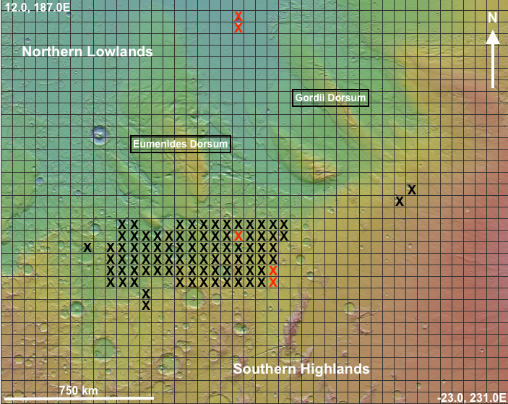
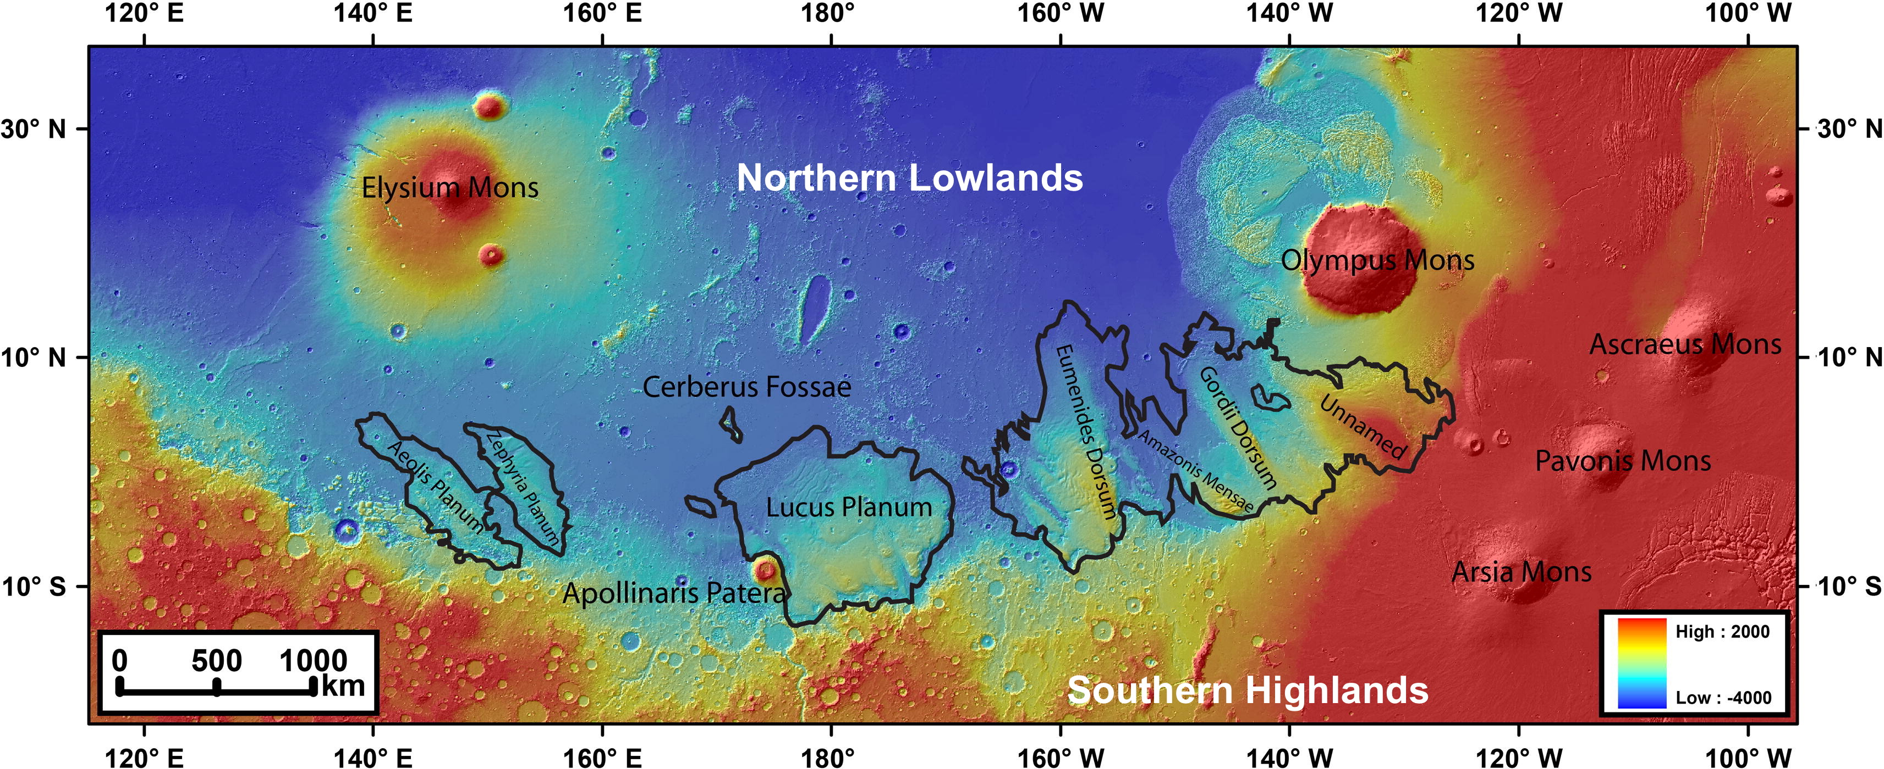
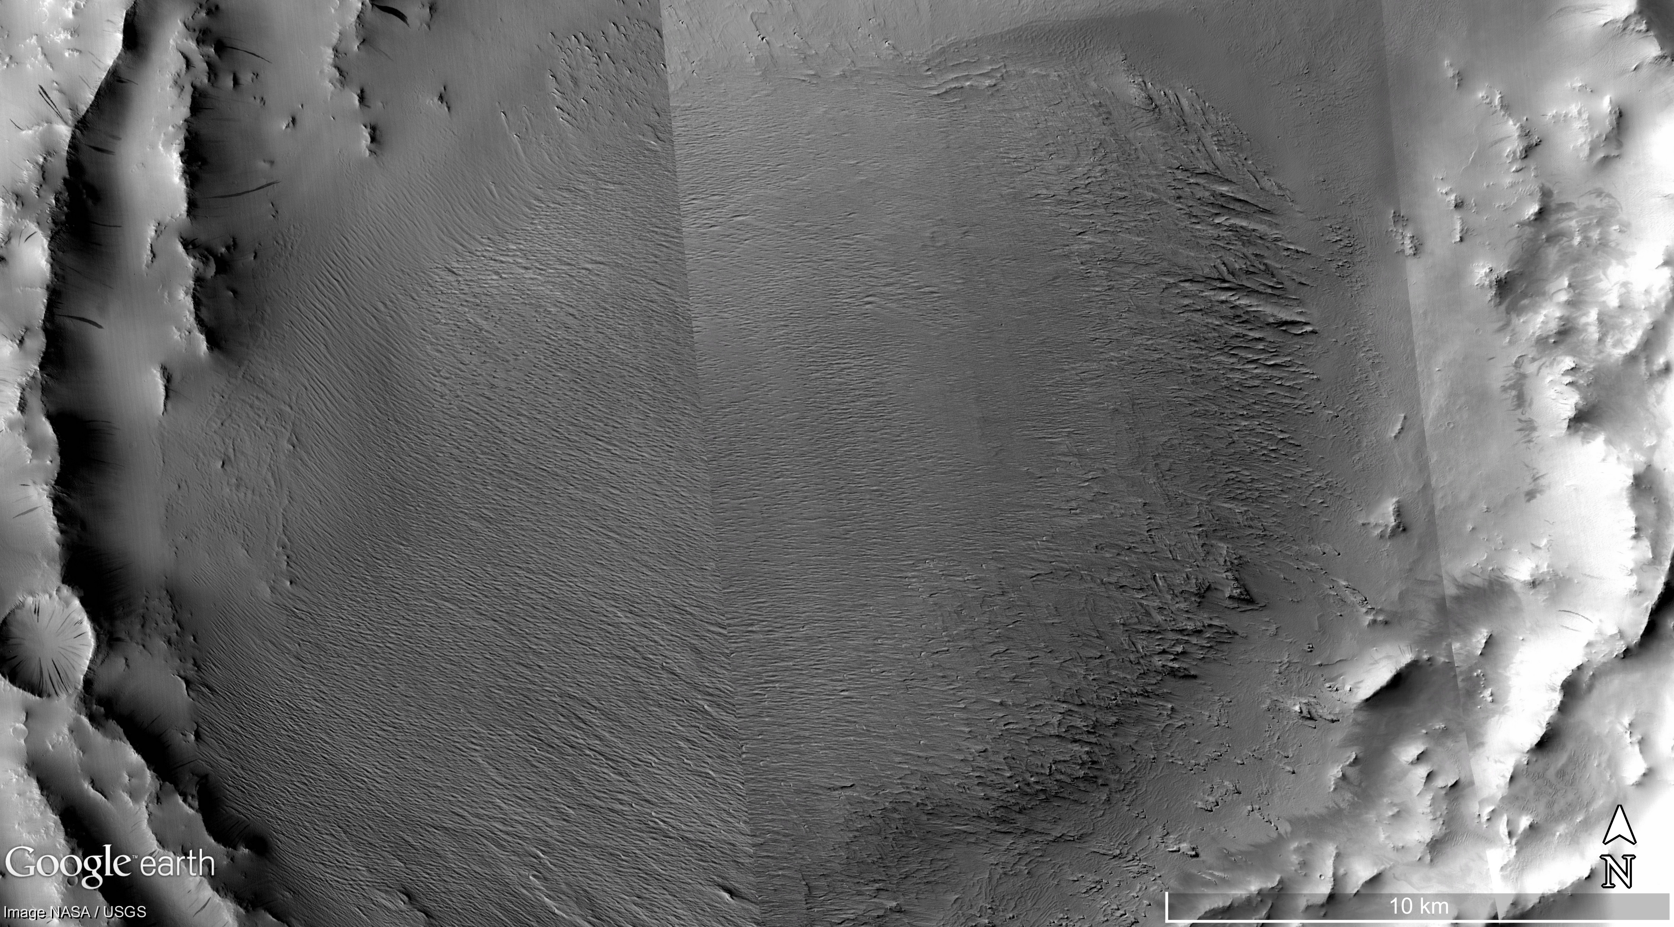
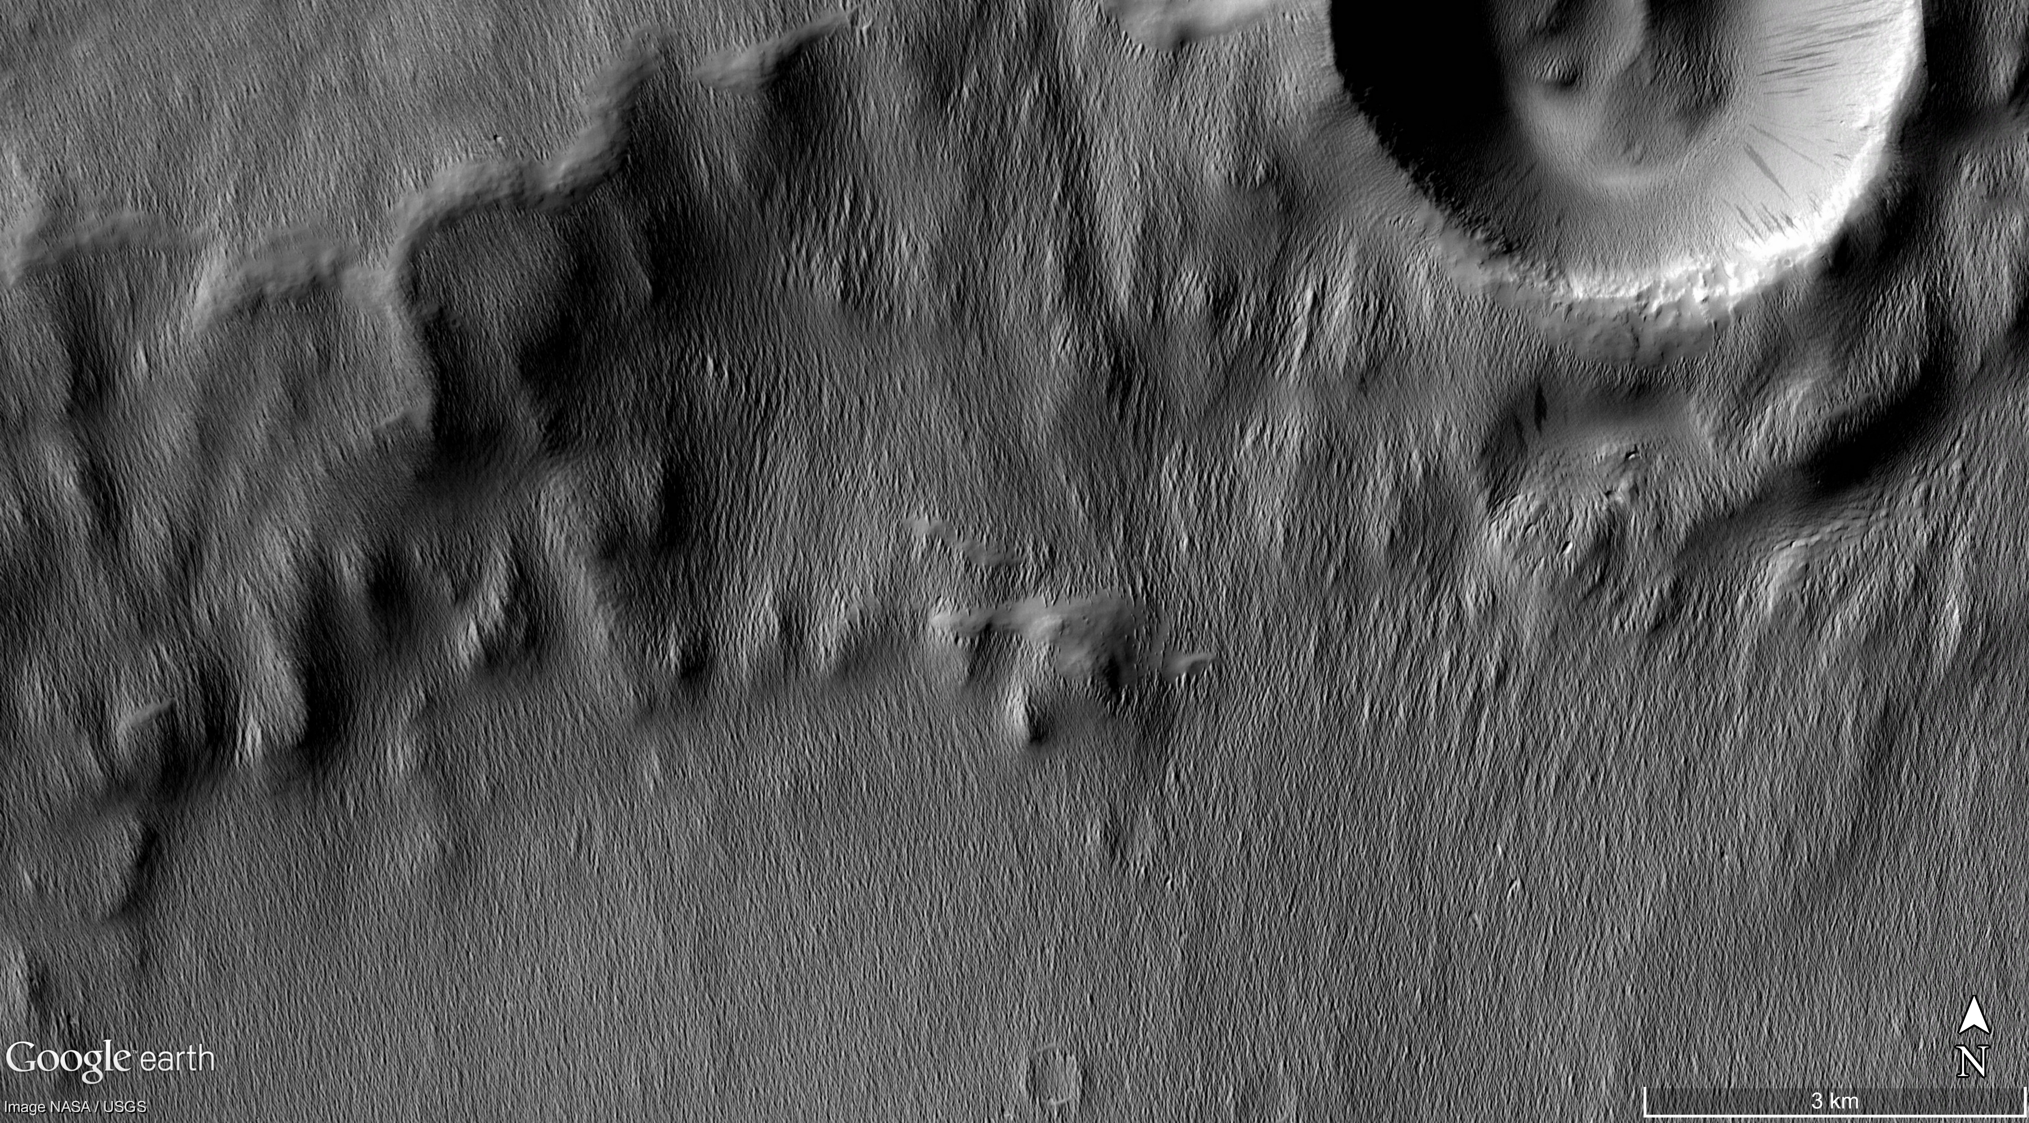
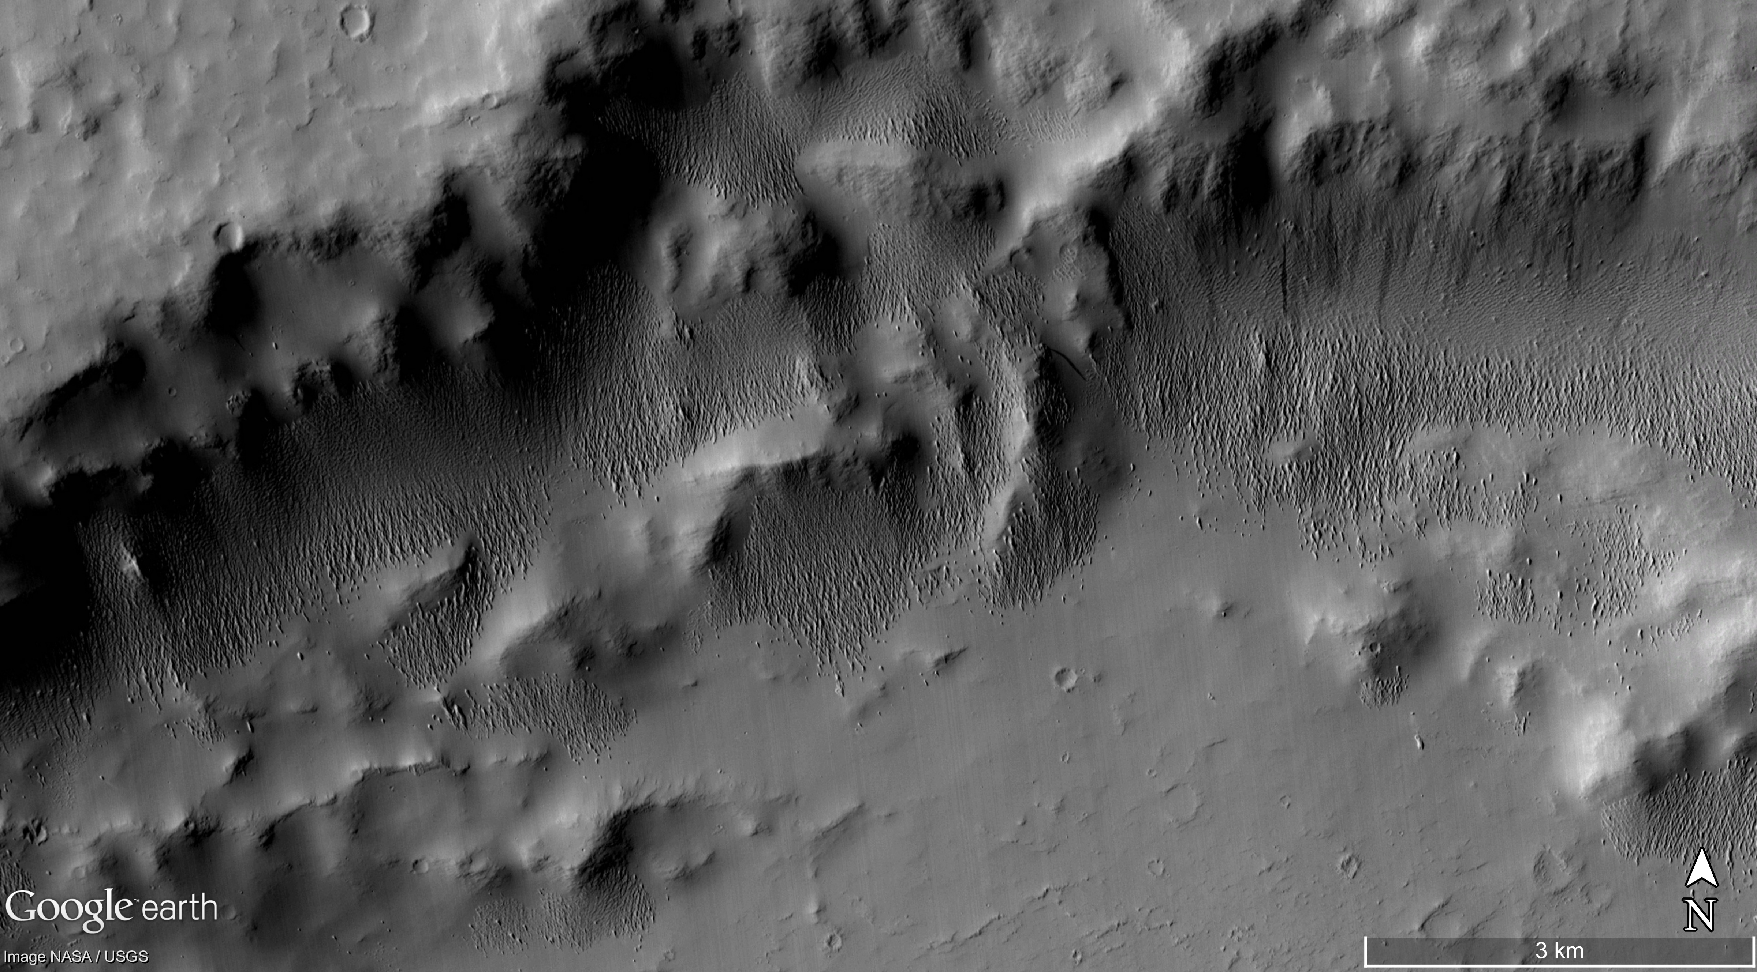
Mapping the Previous Extent of the Medusae Fossae Formation, Mars
Ian T. Dunning¹, Dr. Tracy K. P. Gregg¹, and Dr. Jim Zimbelman²
¹University at Buffalo, SUNY, Department of Geology, 126 Cooke Hall, Buffalo, NY 14260
²Smithsonian National Air and Space Museum, Center for Earth and Planetary Studies, Independence Ave at 6th St, SW, Washington, DC 20560
Purpose:
Map outlier outcrops of the Medusae Fossae Formation (MFF), Mars (Mandt et al., 2008)
Determine the previous extent of the MFF
Estimate erosion rates for the Martian surface based on the approximate area removed over time
Erosion rate estimates for the MFF might shed some light on the conditions at the Martian surface, in addition to the physical properties of the MFF itself
Conclusions:
Preliminary findings suggest that the MFF covered an area ≥2x its currently mapped extent (Tanaka et al., 2014)
MFF deposits can be observed in the Southern Highlands
MFF deposits found in the Highlands appear to preferentially fill topographic lows
yardangs
different yardang orientations
Key
X = MFF outcrops present
X = MFF present but too small to
map (<25% areal coverage)
= ~ 4km in elevation
= ~ -2km in elevation
(Kerber et al., 2011)
aligned grooves and troughs
Methods:
1 degree grid overlain onto a colorized MOLA image (Christensen et al., 2009)
Using Context Camera (CTX) (Malin et al., 2007) imagery, outlier outcrops of MFF material mapped based on the qualifying characteristics given in Table 1
MFF can be confidently identified with:
  1 strong characteristic
  2 medium and 1 weak
  1 medium and 2 weak
  ≥ 4 weak
aligned grooves and troughs
Table 1. Characteristics used to map the Medusae Fossae Formation.
Strong Characteristic | Medium Characteristic | Weak Characteristic
Superposed layered materials displaying different yardang orientations | Yardangs | Deposit mantling underlying terrain
 | Crenulated margins | Consistent surface texture
 | Layered materials | Geographic continuity with known MFF deposits
 |  | Proximal to known MFF deposits
 |  | Aligned topographic depressions, such as grooves or troughs, suggesting removal of material
crater rim
deposit mantles underlying terrain
aligned grooves and troughs
References: (1) Christensen, P.R.; Engle, E.; Anwar, S.; Dickenshied, S.; Noss, D.; Gorelick, N.; Weiss-Malik, M.; JMARS – A Planetary GIS, http://adsabs.harvard.edu/abs/2009AGUFMIN22A..06C. (2) Kerber, L., Head, J. W., Madeleine, J. B., Forget, F., and Wilson, L., 2011, The dispersal of pyroclasts from Apollinaris Patera, Mars: Implications for the origin of the Medusae Fossae Formation: Icarus, v. 216, no. 1, p. 212-220. (3) Malin, M.C., Bell, J.F., Cantor, B.A., Caplinger, M.A., Calvin, W.M., Clancy, R.T., Edgett, K.S., Edwards, L., Haberle, R.M., James, P.B., Lee, S.W., Ravine, M.A., Thomas, P.C., and Wolff, M.J., 2007, Context Camera Investigation on board the Mars Reconnaissance Orbiter: Journal of Geophysical Research: Planets, v. 112, p. n/a-n/a, doi: 10.1029/2006JE002808. (4) Mandt, K. E., de Silva, S. L., Zimbelman, J. R., and Crown, D. A., 2008, Origin of the Medusae Fossae Formation, Mars: Insights from a synoptic approach: Journal of Geophysical Research-Planets, v. 113, no. E12. (5) Tanaka, K.L., Robbins, S.J., Fortezzo, C.M., Skinner Jr., J.A., and Hare, T.M., 2014, The digital global geologic map of Mars: Chronostratigraphic ages, topographic and crater morphologic characteristics, and updated resurfacing history: Planetary and Space Science, v. 95, p. 11-24, doi: https://doi.org/10.1016/j.pss.2013.03.006.
crenulated margin
deposit mantles underlying terrain

