Slide 1
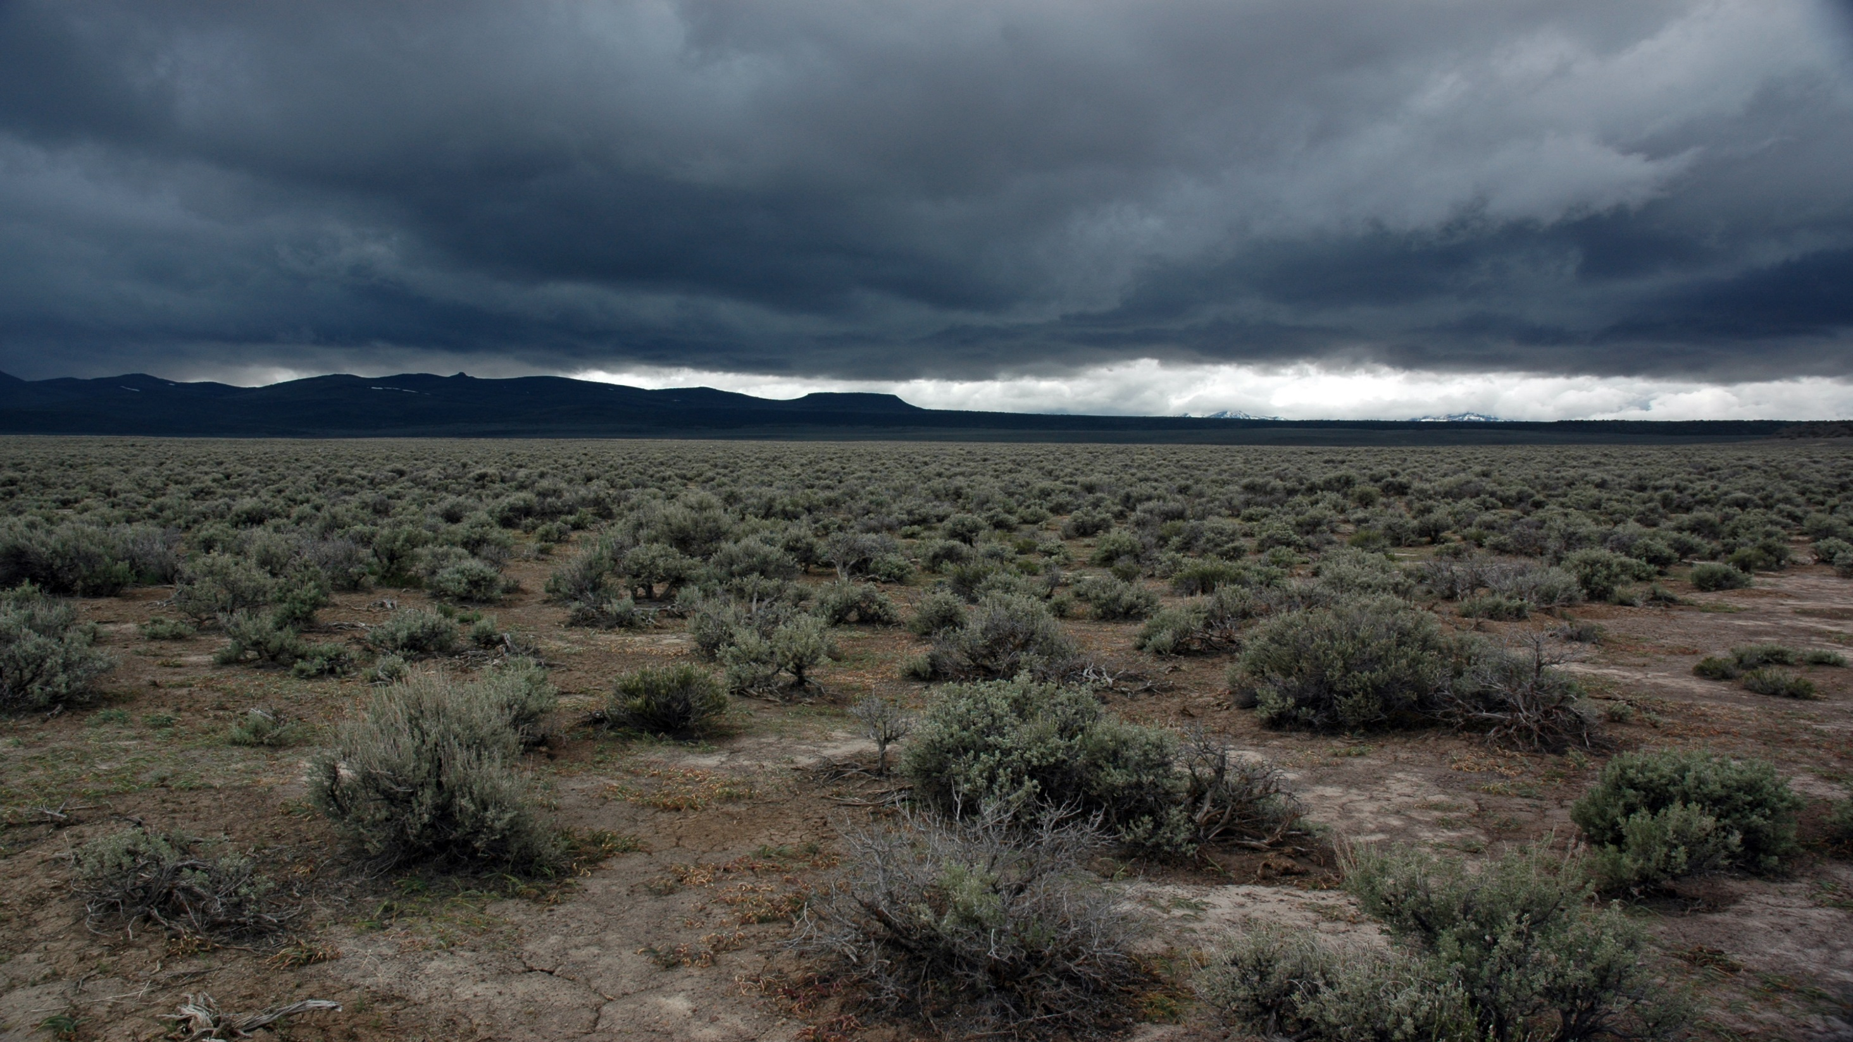
FARALLON SLAB UPLIFT AND BACK-ARC VOLCANISM ALONG
THE YELLOWSTONE ADAKITE HOT SPOT TRACK
Victor Camp, Martin Ross, Robert Duncan, and David Kimbrough
Notes:
This talk is an attempt to summarize a paper that was just published in JGR.

Slide 2
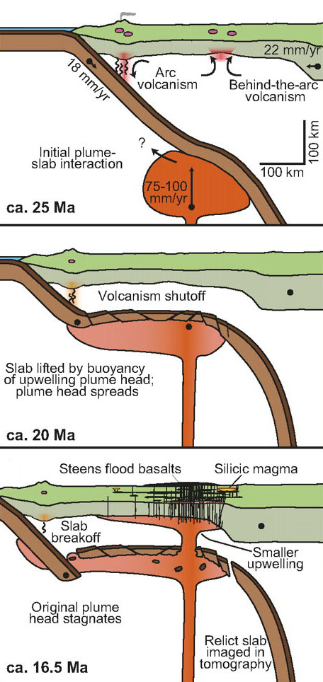
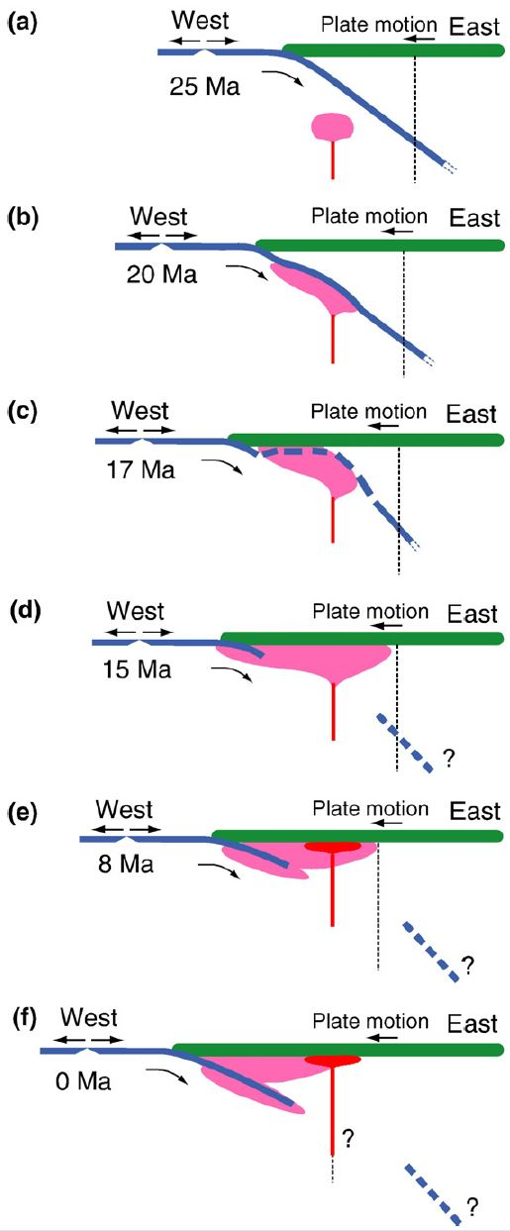
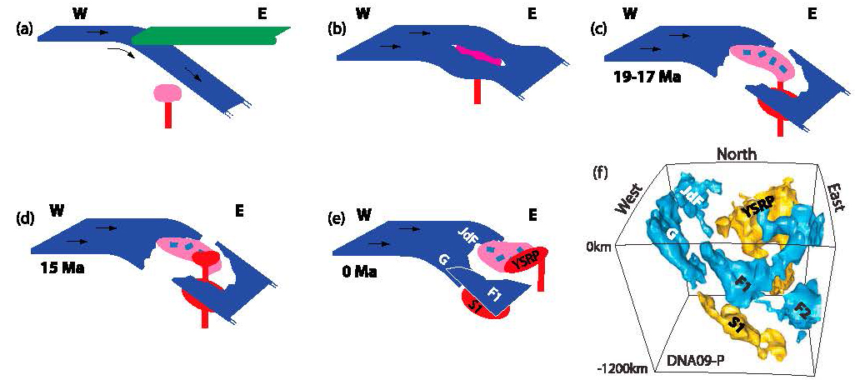
Seismic hole in eastern Oregon
Present
time
Obrebski et al. (2010)
Juan de Fuca slab terminates in eastern Oregon at
shallow depths between 400-160 km, consistent with
subduction after ~17 Ma.
Slab termination
<400 km depth
Coble and Mahood (2012)
Xue and Allen (2007)
Notes:
Seismic studies have identified a slab hole beneath eastern Oregon, where the Juan de Fuca plate terminates at shallow depths that vary from 400 to 160 km depth. This can be seen in this 3-dimensional representation of Obrebski et al. (2010) where the Gorda plate descends to 400 km beneath NW Nevada and the JdF plate to still shallower depths beneath eastern Oregon. Slab termination at these depths is consistent with subduction no older than about 17 Ma.
Several workers have attributed this seismic hole to interaction with the Yellowstone mantle plume. If true, significant disruption of the Farallon plate or changes in slab dip should be reflected in volcanic perturbations in the arc and back-arc regions but these have not been recognized or thoroughly explored.

Slide 3
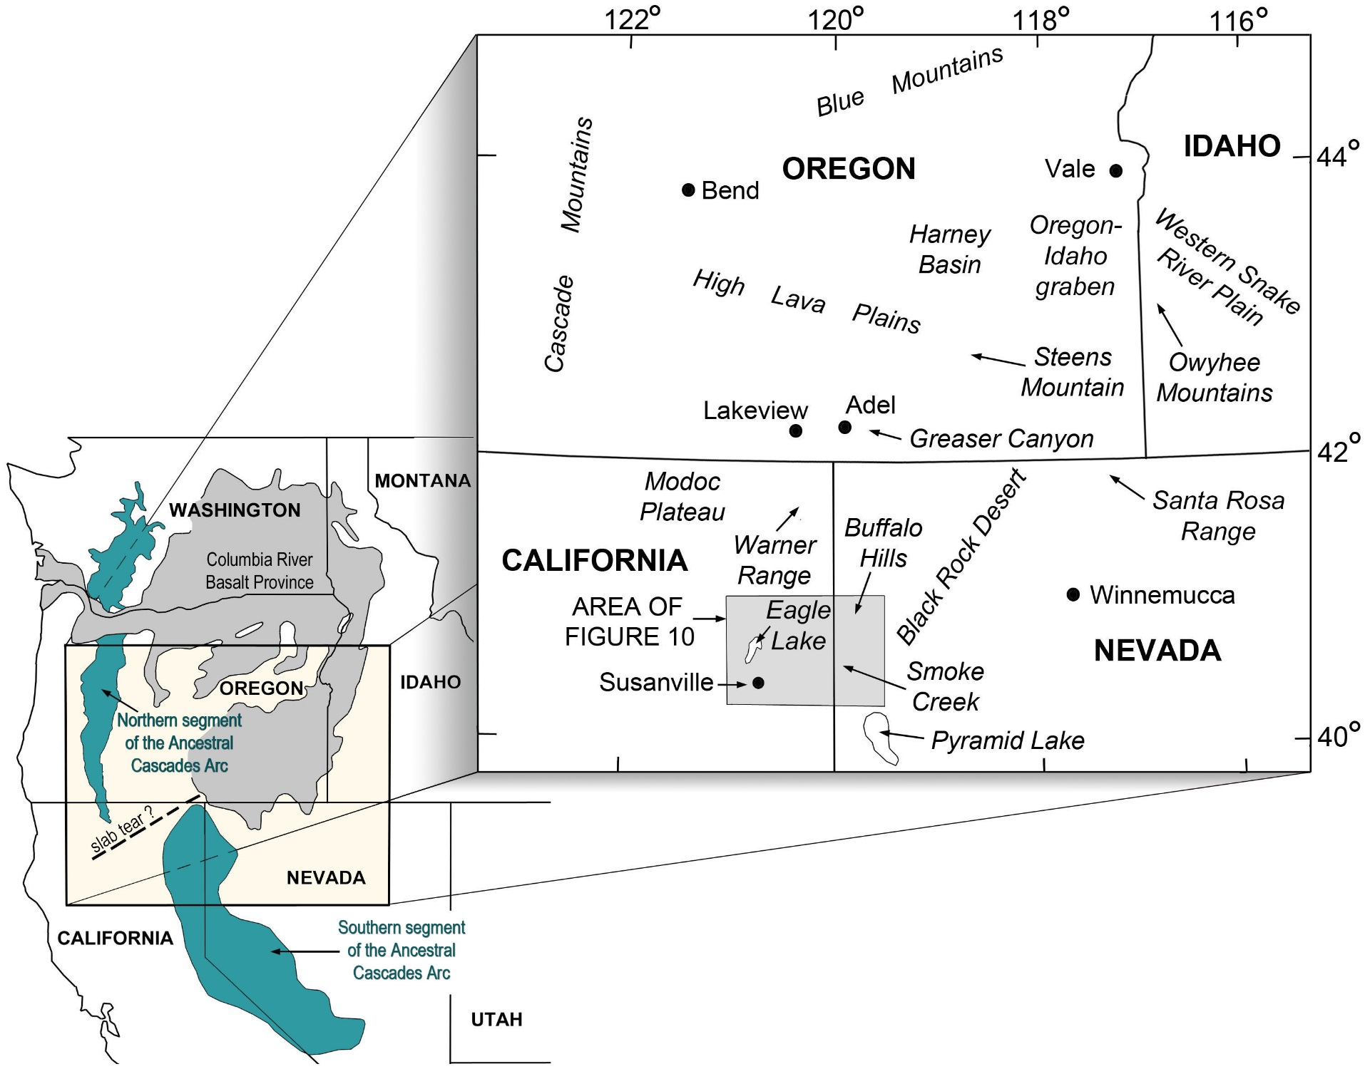
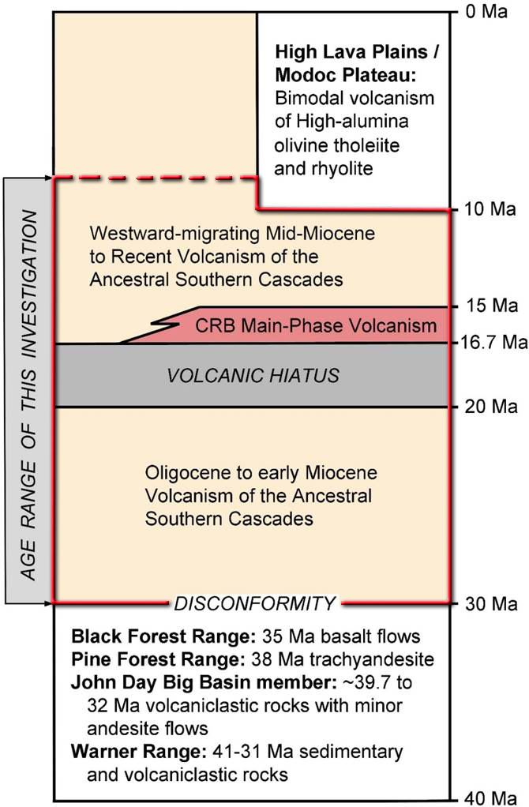
Notes:
So, this forms the basis of our own study. Note in the inset that subduction-related melting is evident in the northern and southern segments of the ancestral Cascades. Our area of interest is in the highlighted box that contains both as well as volcanic rocks in the back-arc region which is our main focus.
Click . We are specifically interested in volcanic rocks that erupted between 30 to 8 Ma. In a very general way, we can be subdivide these into three main groups:
Oligocene to Early Miocene calc-alkaline rocks from 30-20 Ma, followed by a 3-5 m.y. hiatus,
the main-phase eruptions of the CRBG from 16.7-15 Ma, and
partly contemporaneous calc-alkaline rocks of the southern segment of the ancestral Cascades.

Slide 4
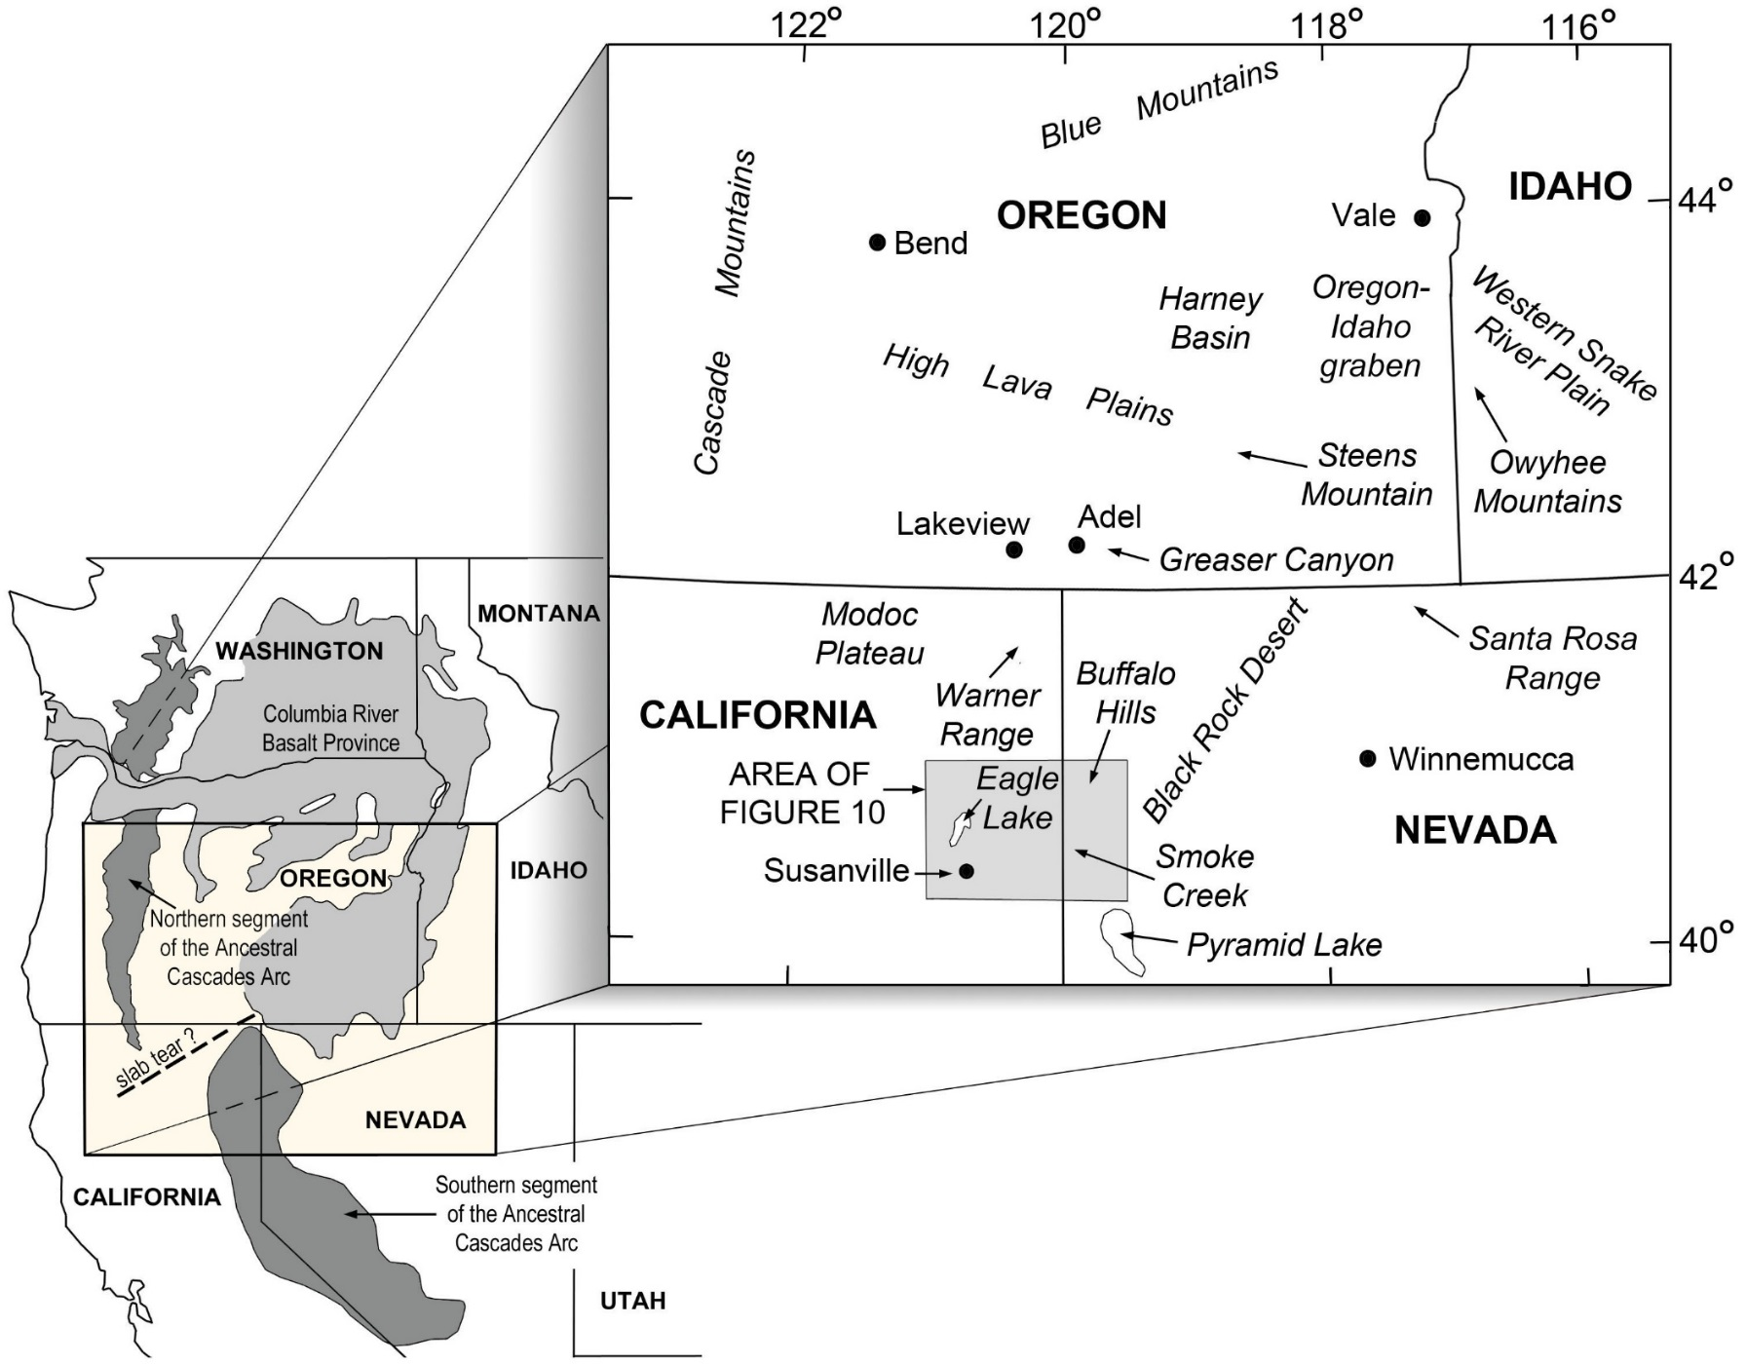
Compiled Data:
Geochronological data on several hundred samples and geochemical data on over 2600:
Oligocene to early Miocene outcrops (~30-20 Ma): Norman and Leeman, 1990; Langer, 1991; Mathis, 1993; Camp et al., 2003; Carmichael et al., 2006; Colgan et al., 2006, 2011; Scarberry et al., 2007, 2010; Iademarco, 2009; Lerch et al., 2008.
Northern and Southern segments of the Ancestral Cascades (~30-8 Ma): du Bray and John, 2011; du Bray et al., 2006, 2014, NAVDAT, 2016.
Columbia River flood-basalt main phase, northern Nevada rift, and related rocks of northern Nevada (~16.5-15 Ma): Hooper, 2000; John et al., 2000; Camp et al., 2013, NAVDAT, 2016.
New EarthChem Analytical Datasets (~30- 8 Ma):
Camp et al. (2017): Chemical data (299 analyses)
Duncan et al. (2017): ⁴⁰Ar/³⁹Ar age data (15 analyses)
Kimbrough et al. (2017): zircon ablation age data (5 analyses)
Notes:
We’ve collected a large amount of geochemical data on 299 samples and age data on 20 samples.
In addition, we have compiled data from numerous published sources shown here, and these include chemical analyses of over 2600 samples, and age data on several hundred samples.

Slide 5
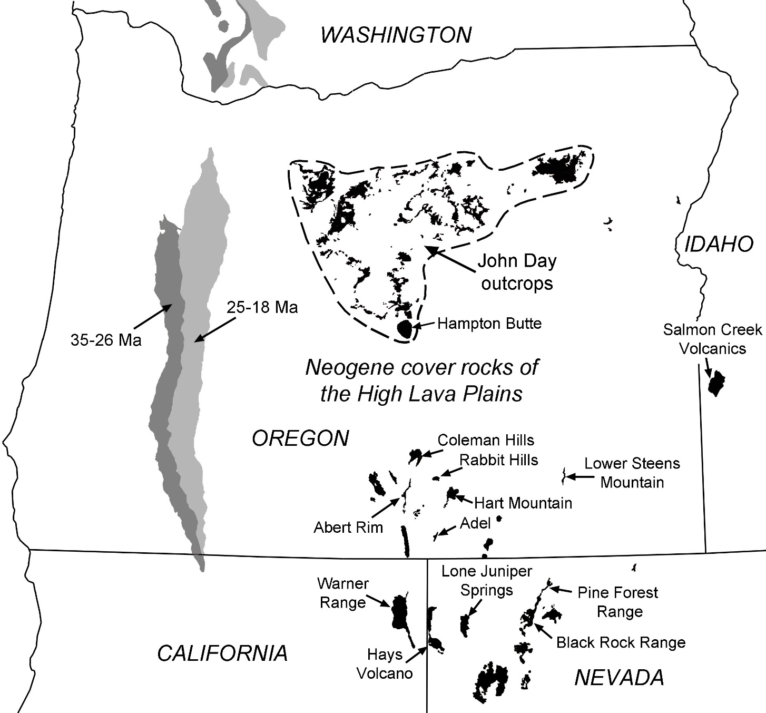
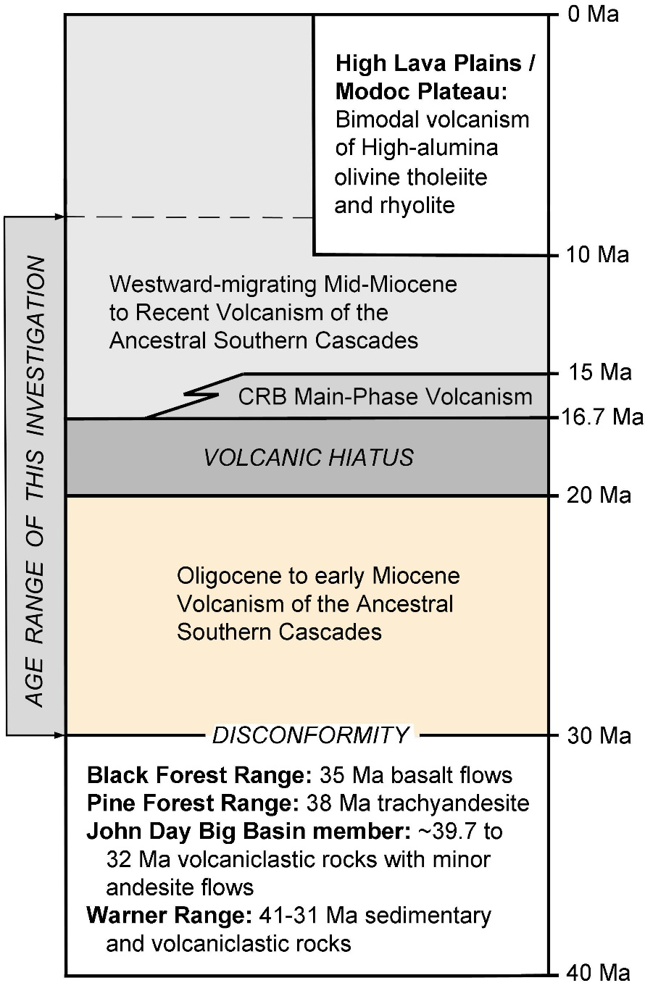
~30-20 Ma volcanic rocks
Notes:
The 30-20 Ma volcanic rocks in the Oregon back-arc region are largely covered by younger rocks, but they are widely distributed across eastern Oregon and adjacent NV and CA, extending into northern Oregon to include the John Day outcrops shown here.

Slide 6
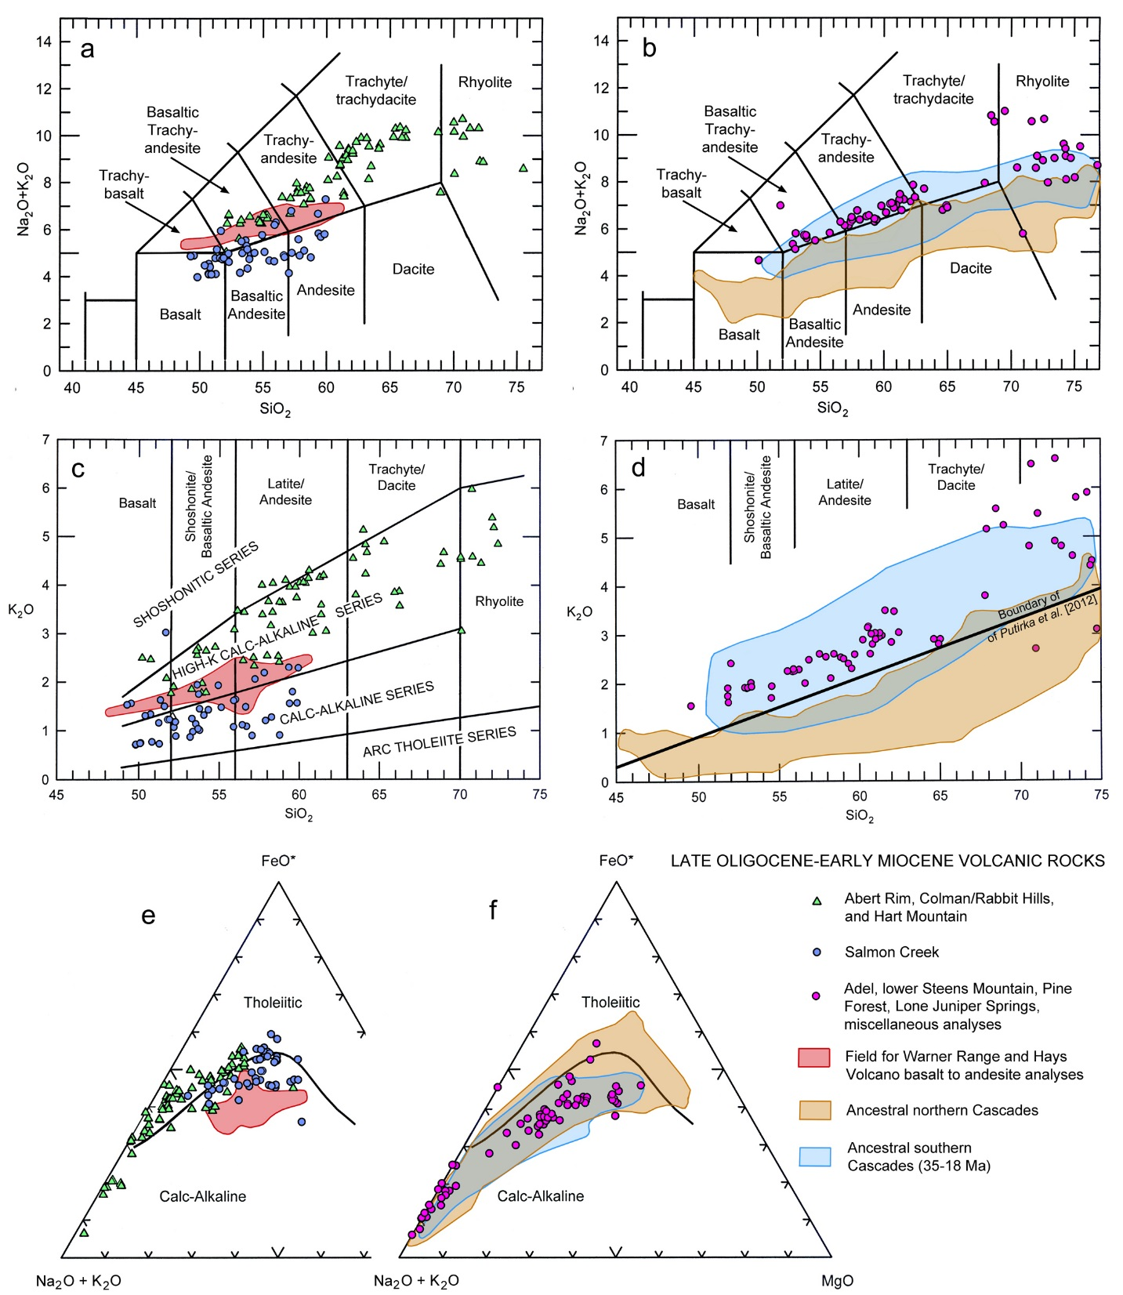
~30-20 Ma volcanic rocks
~30-20 Ma volcanic rocks
Notes:
Compare the overall chemistry of these rocks to contemporaneous rocks of the ancestral Cascades on these very simple major-element plots. The most striking difference between the southern and northern segments of the ASCs is the high-K nature of the southern Cascades rocks (shown in blue on the silica-K2O diagram) compared with the northern segment (in Brown).
Data points on all of these these diagrams are color-coded for the various 30-20 Ma outcrops areas in the back-arc region. These areas are consistent in their resemblance to the high-K composition of the ancestral southern Cascades, and both arc- AND back-arc lavas have the same Fe-depletion trends typical of calc-alkaline differentiation.

Slide 7
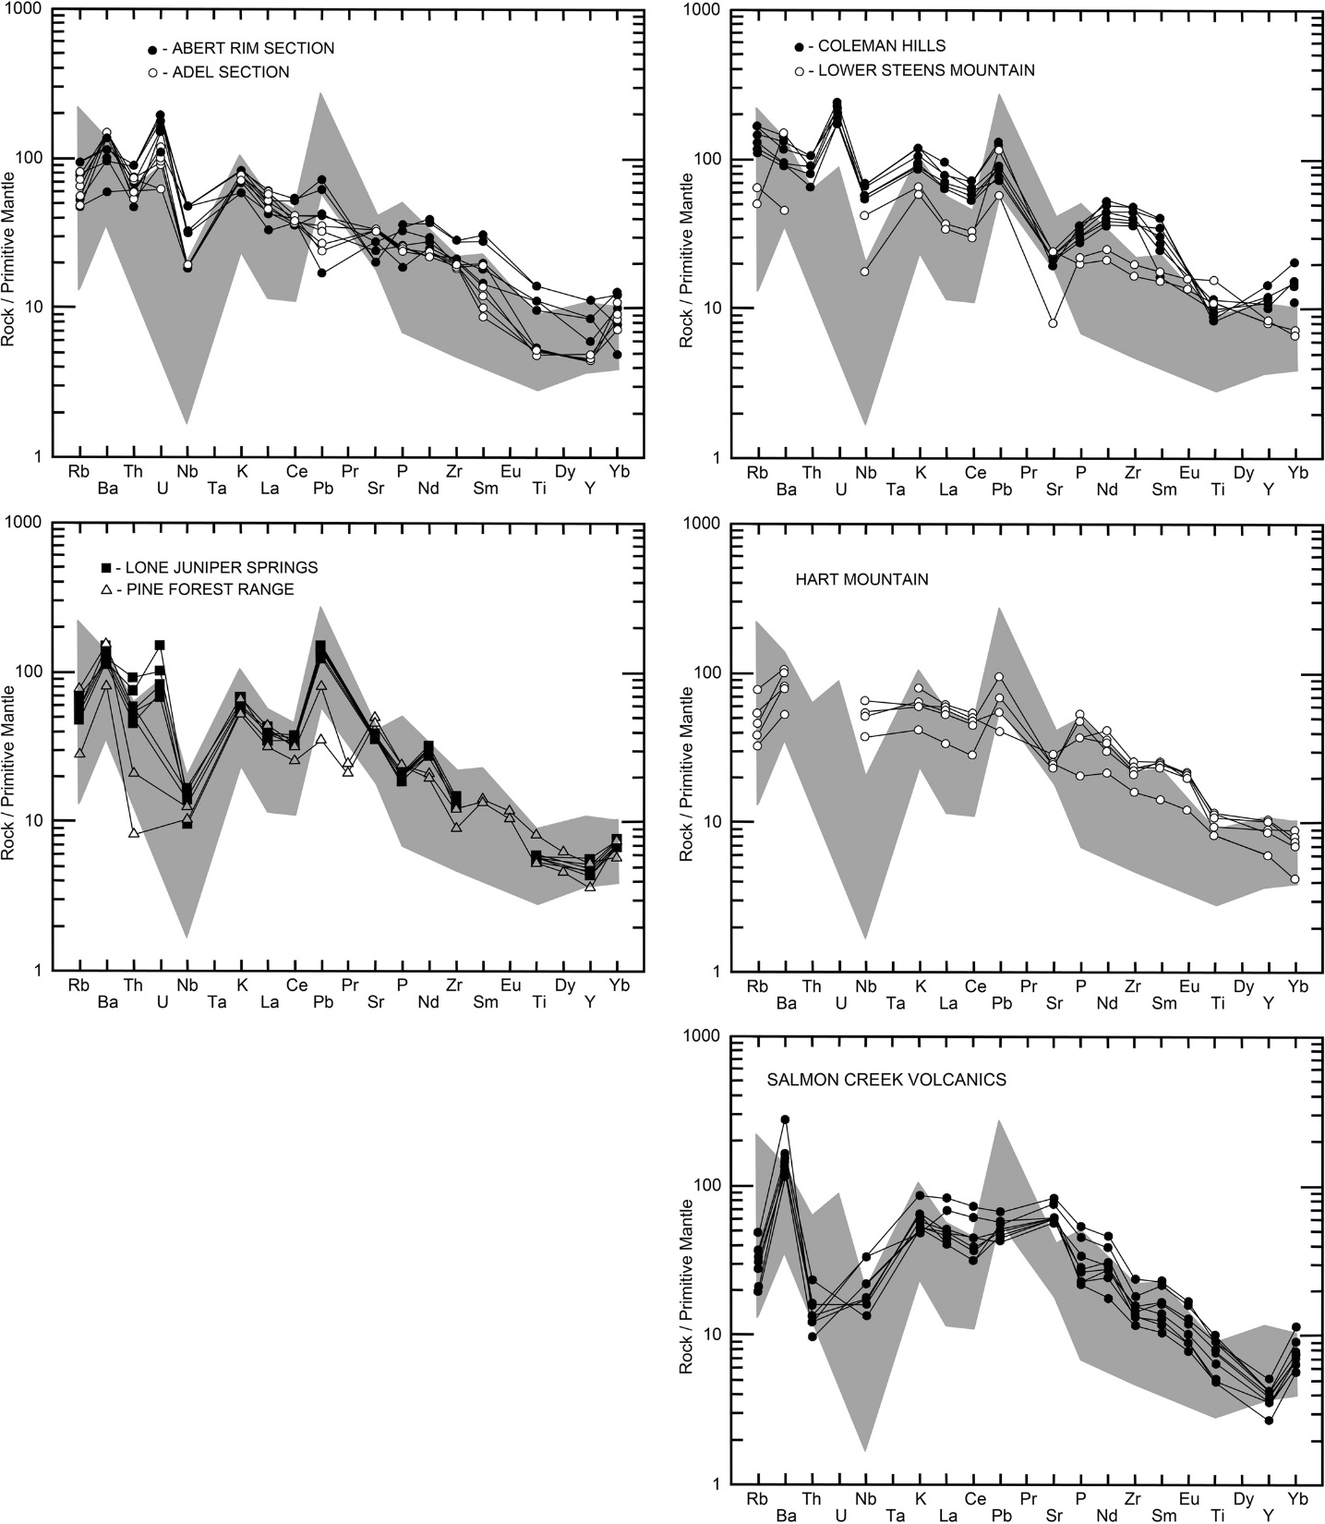
Ancestral southern Cascades in Warner Range
Trace-elements normalized to Primitive mantle of Sun and McDonough (1989)
~30-20 Ma volcanic rocks
~30-20 Ma volcanic rocks
Notes:
There is some variability in the range of trace-elements that are shown here normalized to primitive mantle; but, as a general rule, most locations show enrichment in the water-soluble elements Rb, Ba, K and Pb, and depletions in Nb, all of which are typical of the range in TEs for the ASCs, shown in gray pattern.

Slide 8
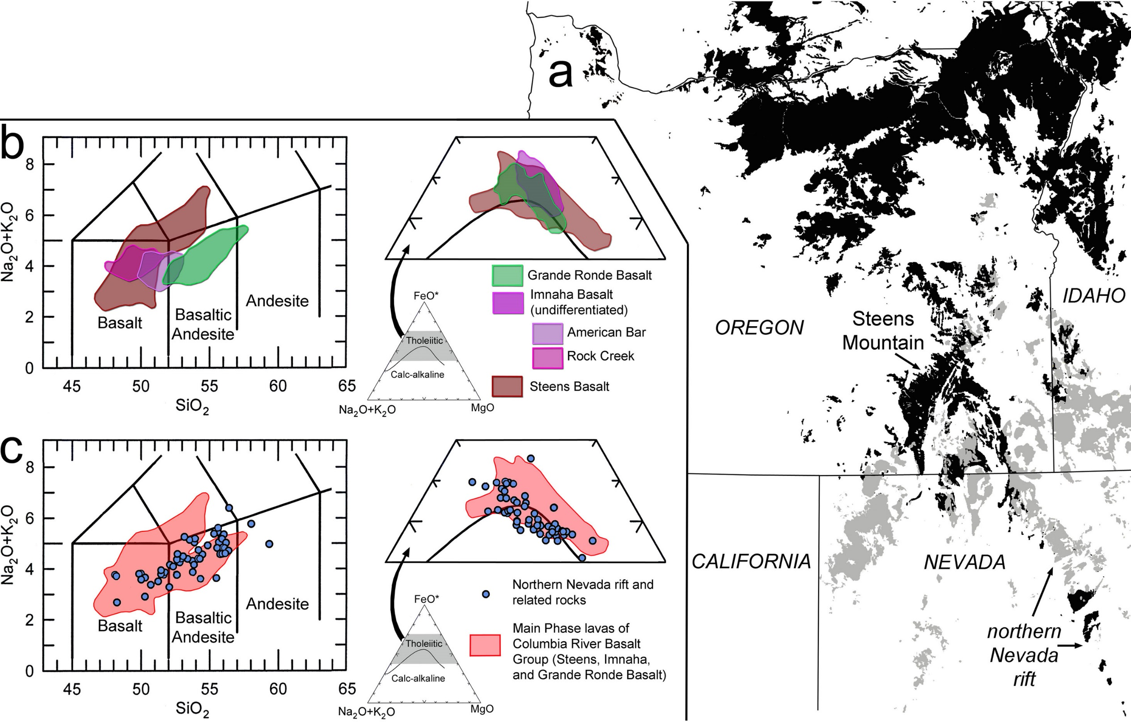
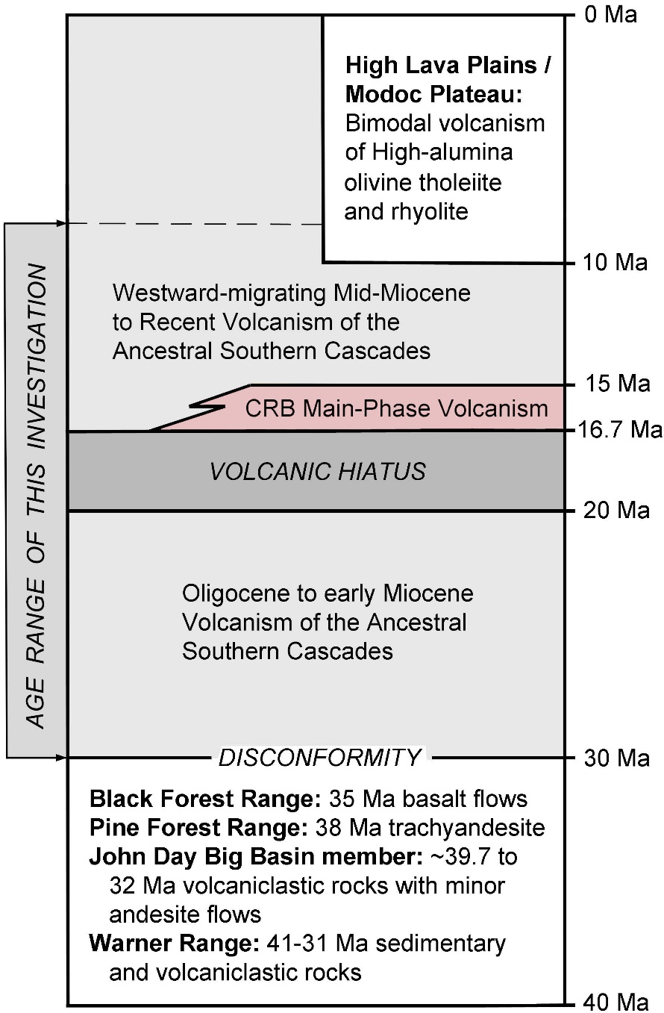

Columbia River Basalt Main Phase and related rhyolites (16.7-15 Ma)
Notes:
High-K calc-alkaline volcanism began to wane at 22-20 Ma followed by a volcanic hiatus that was terminated abruptly at 16.7 Ma with bimodal volcanism of basalt and rhyolite associated with main-phase eruptions of the CRBG.

Slide 9
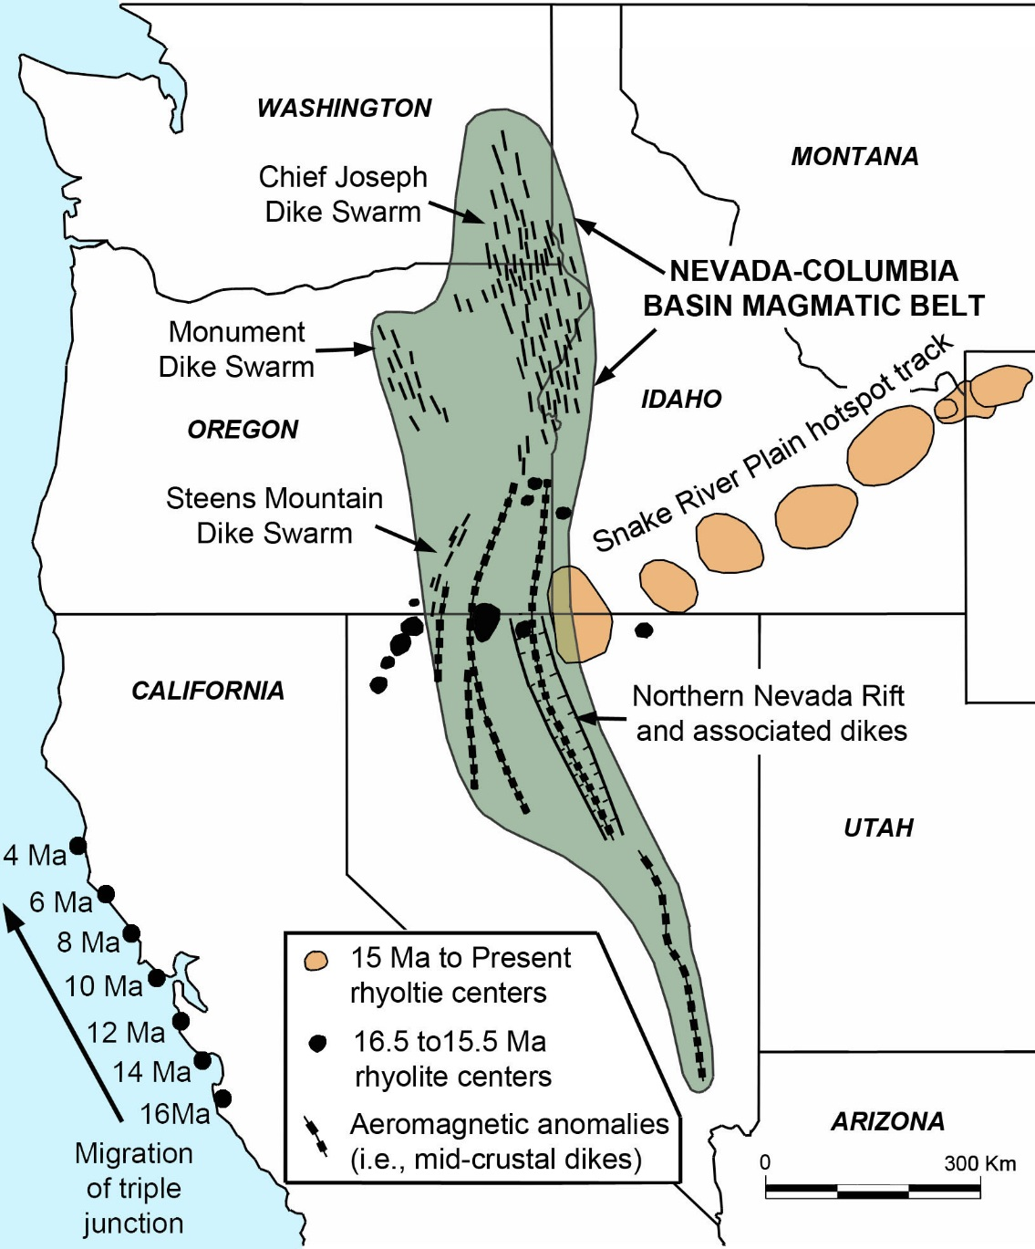
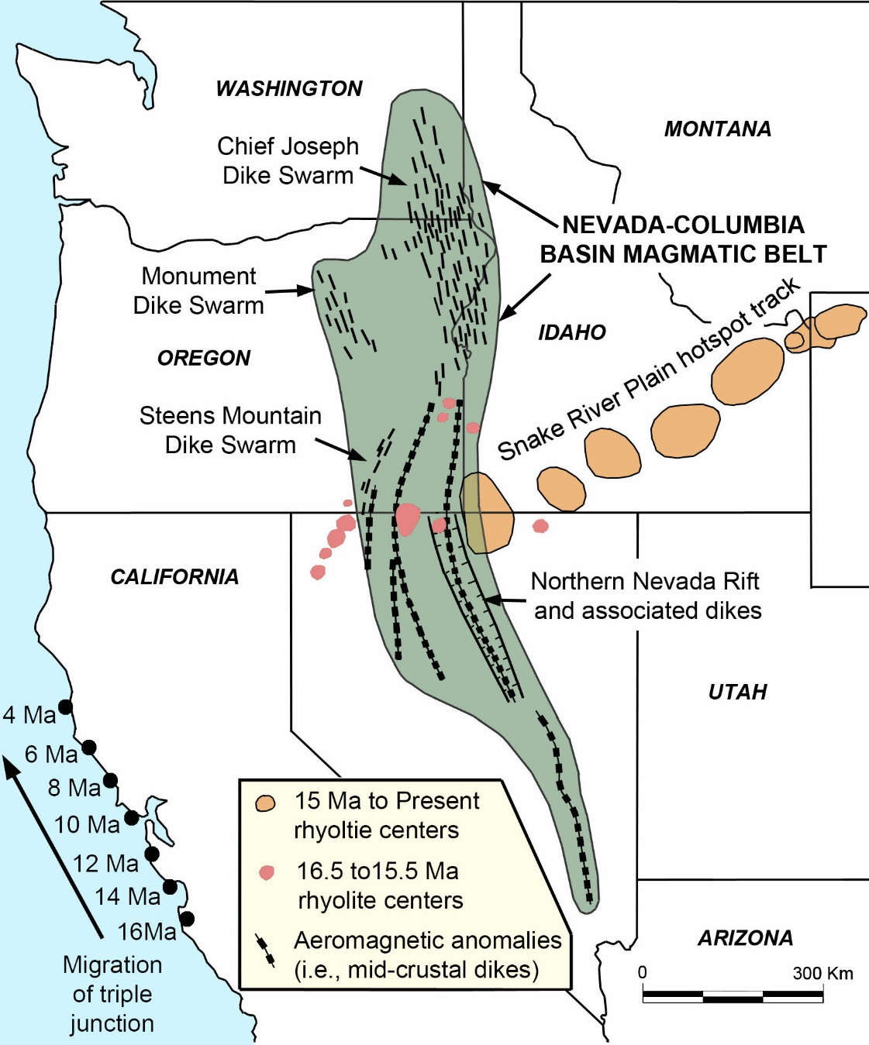
Nevada-Columbia Basin Magmatic Belt (16.7-15 Ma)
Notes:
These eruptions were associated with an extensive system of dikes extending from southern Oregon through SE Washington, together with large mid-crustal intrusions identified as prominent aeromagnetic anomalies associated in part with the NNR system which might extend even father to south into southern Nevada. We refer to refer to this short-live belt of 16.7-15 Ma magmatism as the Nevada-Columbia Basin magmatic belt.

Slide 10
~16.7-15 Ma tholeiitic rocks
Notes:
Although Steens Basalt displays a differentiation trend toward mildly alkaline rock types, all of the main-phase basalts display Fe-enrichment trends consistent with tholeiitic basalts derived from a dry mantle source. The data points in the two lower diagrams are from the NNR and related areas. They straddle the CA-TH boundary on the AFM diagram, but as a group, they also display a clear tholeiitic trend of Fe-enrichment. In some ways, these rocks are very similar to the main-phase eruptions of Grande Ronde Basalt.

Slide 11
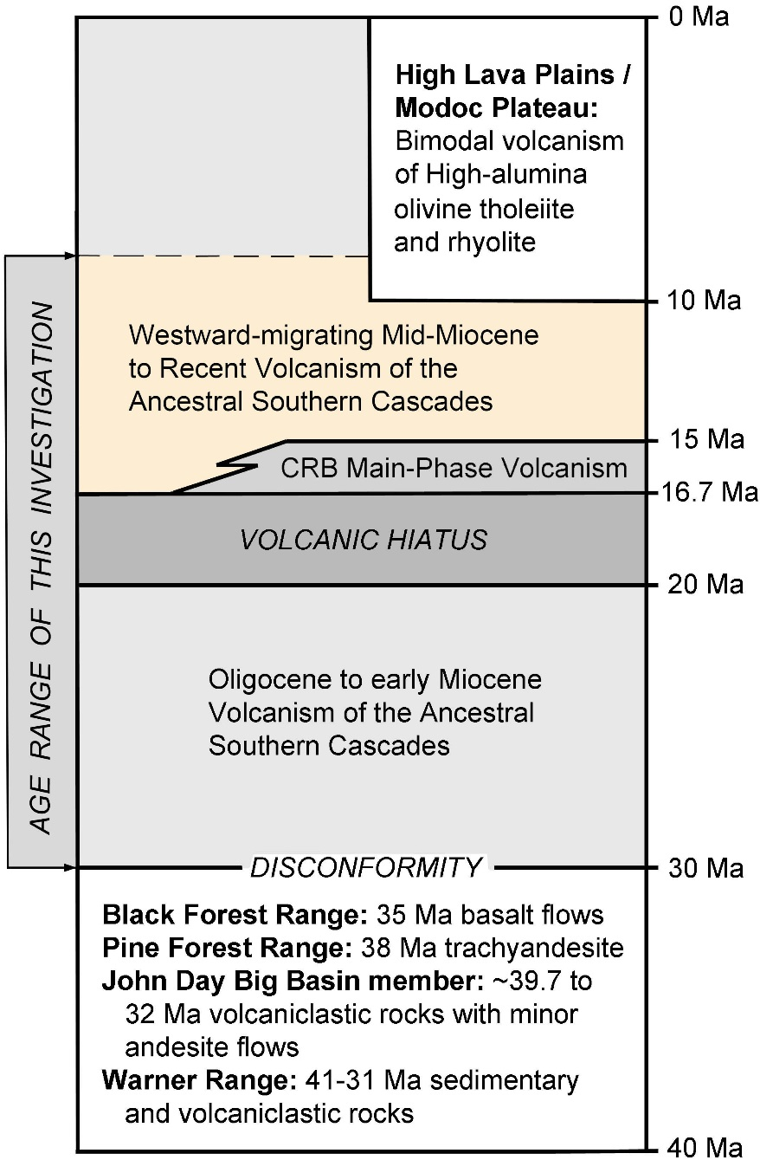
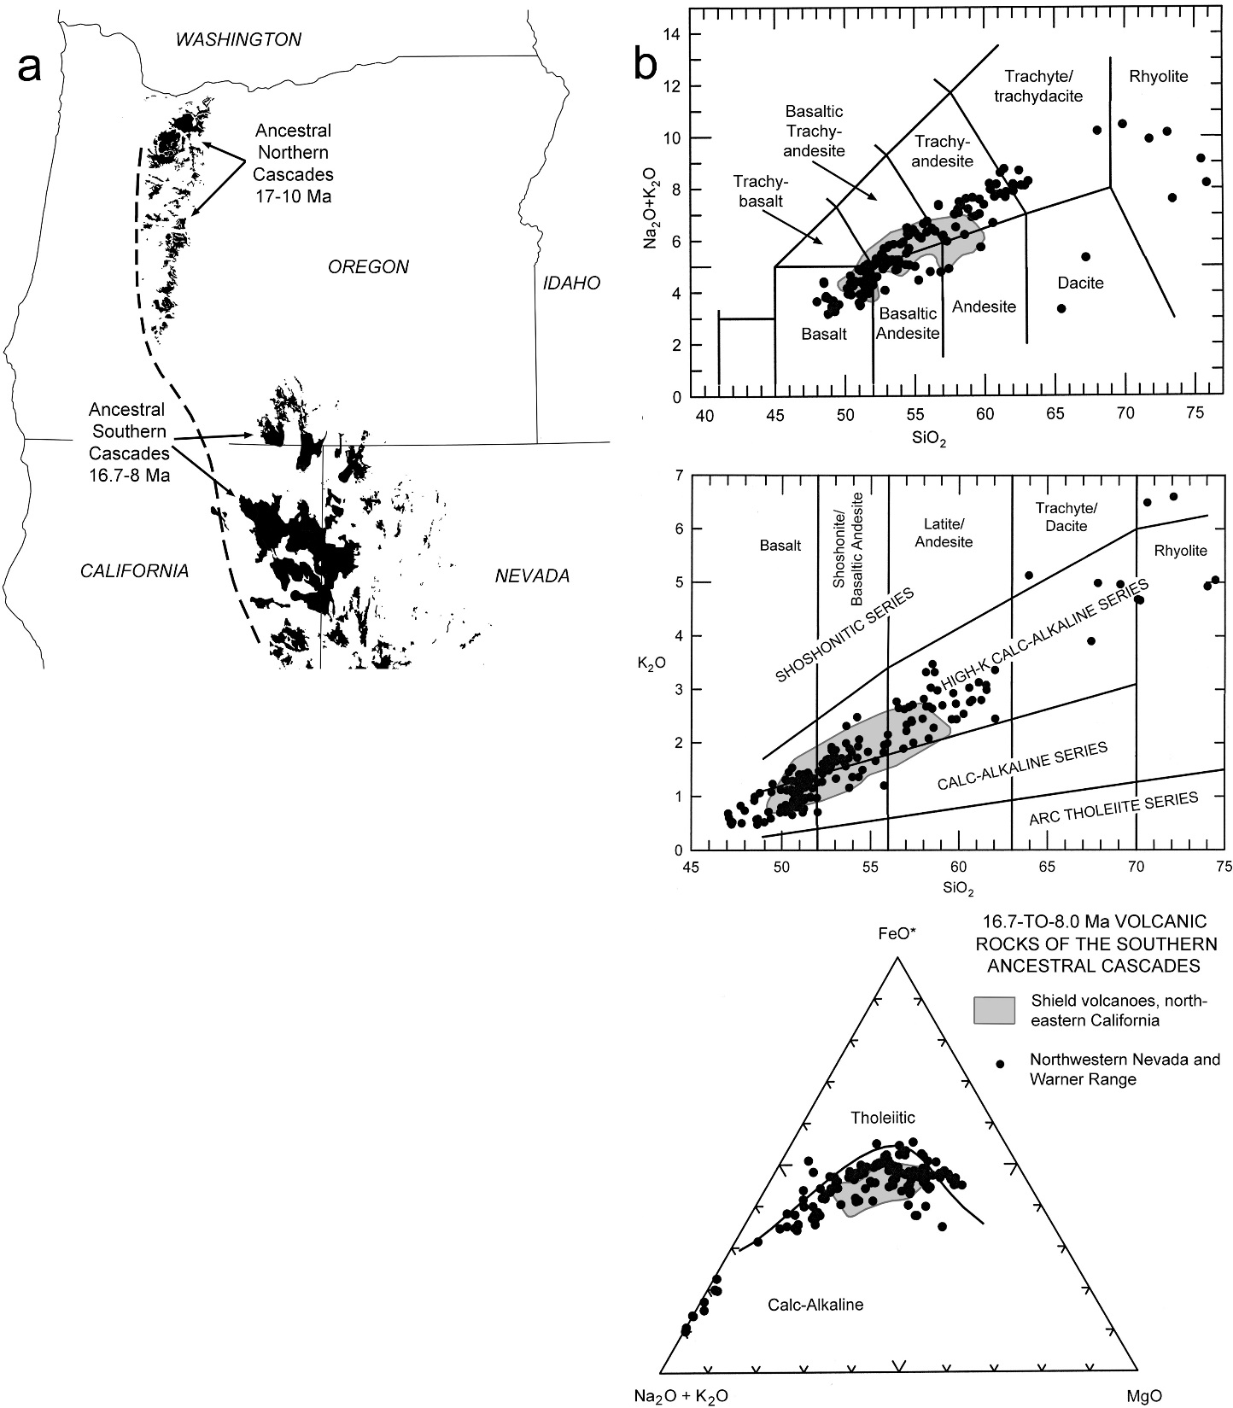
Oldest ⁴⁰Ar/³⁹Ar ages:
16.23 ± 0.17 Ma
16.64 ± 0.14 Ma
16.81 ± 0.13 Ma
Ancestral Southern
Cascades (16.7-8.0 Ma)
Notes:
The outcrop areas are shown here are for both the northern and southern Cascades after 17 Ma. A dramatic change is evident in the distribution of calc-alkaline volcanism following the volcanic hiatus. CA volcanism extended well into northern Oregon before the hiatus, but when it reemerged after the hiatus, it was largely restricted to the Nevada-California border region.
Field evidence, together with new Ar-Ar ages, indicate that arc volcanism in the southern Oregon border region was re-initiated at 16.7 Ma, contemporaneous with initiation of the CRBG to the east.
The chemistry of these younger arc eruptions is nearly identical to the high-K chemistry of the 30-20 Ma rocks of eastern Oregon.

Slide 12
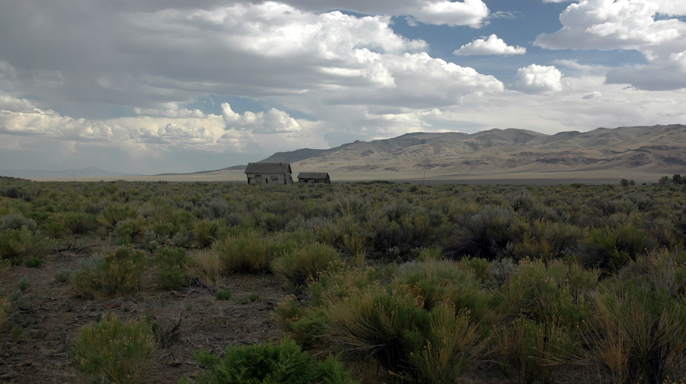
Volcanic perturbations:
Ancestral arc/back-arc (30-20 Ma): wet mantle source
Hiatus (20-16.7 Ma)
CRB main phase (16.7-15 Ma): dry mantle source
Ancestral arc (16.7-8 Ma): wet mantle source
Notes:
The younger and older periods of high-K calc-alkaline volcanism with enrichment in LILE suggests the involvement of a hydrated and metasomatized mantle source. In contrast, the 16.7-15 Ma period of main-phase tholeiitic flood-basalt volcanism suggests the involvement of a relatively dry mantle source.
These surface changes in the style, distribution and composition of volcanism cannot readily be attributed to changes in tectonic environment. Instead, we believe that they reflect sublithospheric changes in mantle source that we attribute to slab disturbance and dismemberment.

Slide 13
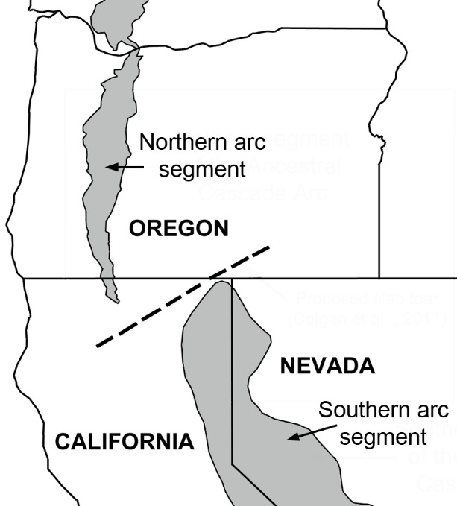
Calc-alkaline volcanism: ~30-20 Ma
Wells et al. (2014)
Notes:
Several workers have suggested that the southern segment of the ancestral Cascades arc terminates at the Oregon border, where its axis must be offset from the northern segment by a fracture in the subducting plate. Click.

Slide 14
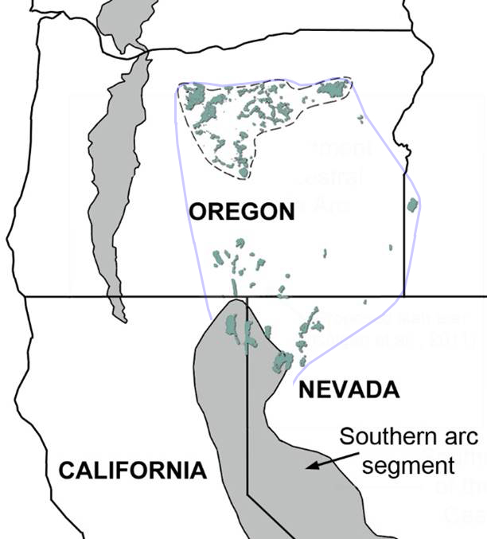
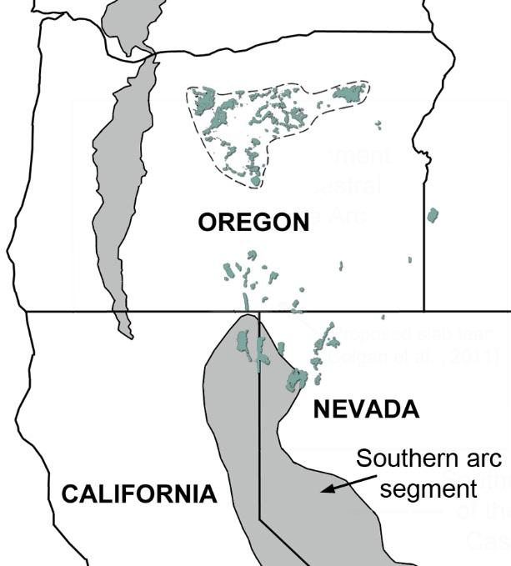
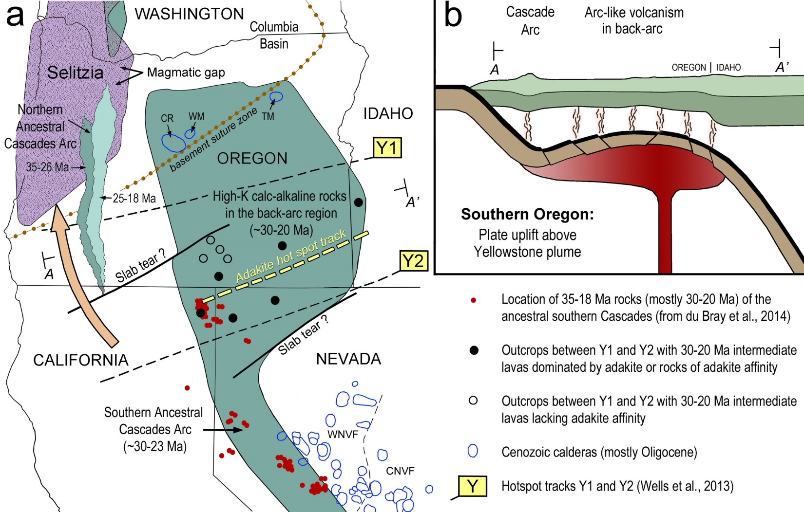
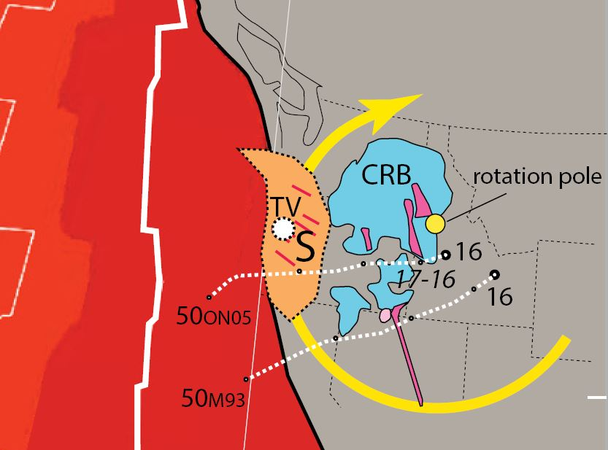
Wells et al. (2014)
Siletzia
~30-20 Ma
Notes:
However, the high-K calc-alkaline character and trace-element patterns for the majority of 30-20 Ma outcrops in the southern Oregon border region closely match those for the southern segment of the ancestral arc. This suggests that the southern ancestral arc transitions into the back-arc region of the northern arc segment from 30 to 20 Ma.

Slide 15
Siletzia
Southern Oregon:
Plate uplift above the Yellowstone plume
Effects of slab uplift and heating:
Liberated H₂O into mantle wedge, thus promoting partial melting and calc-alkaline volcanism from 30-20 Ma.
2. Decreased slab strength, leading to
dismemberment that began ca. 20-17 Ma.
~30-20 Ma
Notes:
We attribute this to slab uplift and heating as it interacted with the Yellowstone mantle plume. Slab decompression and heating had two significant effects:
It liberated H2O into the mantle wedge, thus promoting partial melting and calc-alkaline volcanism from 30-20 Ma, while
It decreased slab strength, eventually leading to dismemberment of the slab from 20-17 Ma.
Slab uplift also resulted in an eastward shift of the northern Cascades at about 25 Ma.

Slide 16
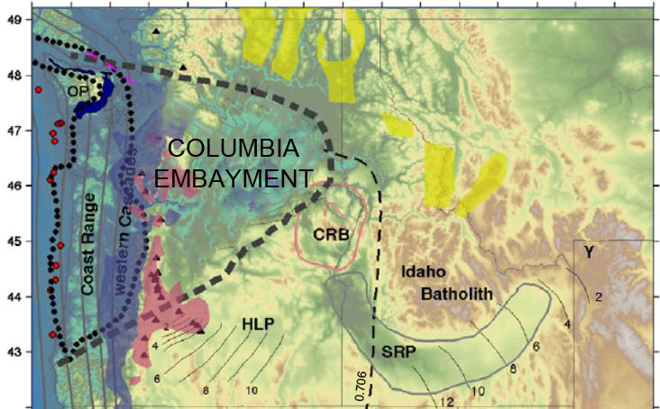
Wells et al. (2014)
Siletzia
Gao et al. (2011)
~30-20 Ma
Notes:
Recent studies add credence to the idea that the Yellowstone plume is a long-lived feature that provided the source for the Siletzia oceanic plateau. According to Wells et al. (2014), the accretion of Siletzia was complete by 50 Ma, and the hotspot itself was overridden by the North American plate by about 42 Ma. Since that time, Selitzia has rotated to the north by about 250 km.
Wells et al. (2014) used a plate reconstruction model to estimate two potential hotspot tracks for the Yellowstone plume, which we have reproduced in the figure to the left as tracks Y1 and Y2, based on two separate hot-spot reference frames. (click)

Slide 17
Siletzia
~30-20 Ma
Notes:
Wells et al. (2014) used a plate reconstruction model to estimate two potential hotspot tracks for the Yellowstone plume, which we have reproduced in the figure to the left as tracks Y1 and Y2. (click).
Mid-way between these two hotspot tracks we have identified a broad zone of volcanic rocks (shown filled circles) that have the characteristic features of adakites. Such rocks were originally defined as andesitic to dacitic magmas derived from the melting of oceanic crust in a subducting slab. It seems reasonable to assume that the low solidus temperature of basaltic crust would make it particularly susceptible to melting in an environment of plume uplift with elevated mantle temperatures.

Slide 18
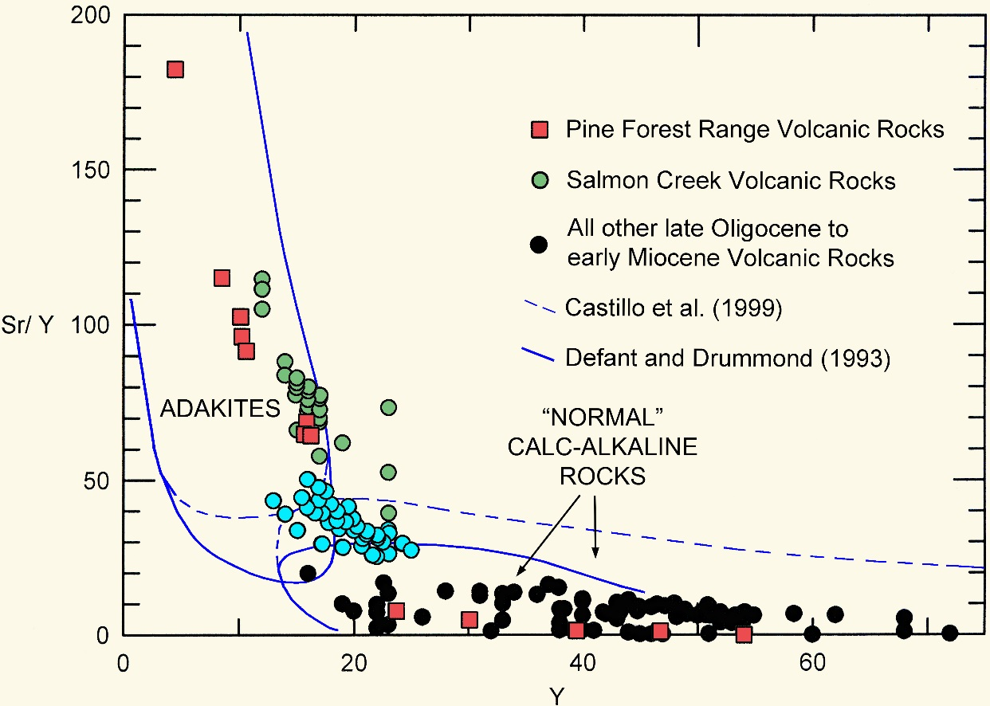
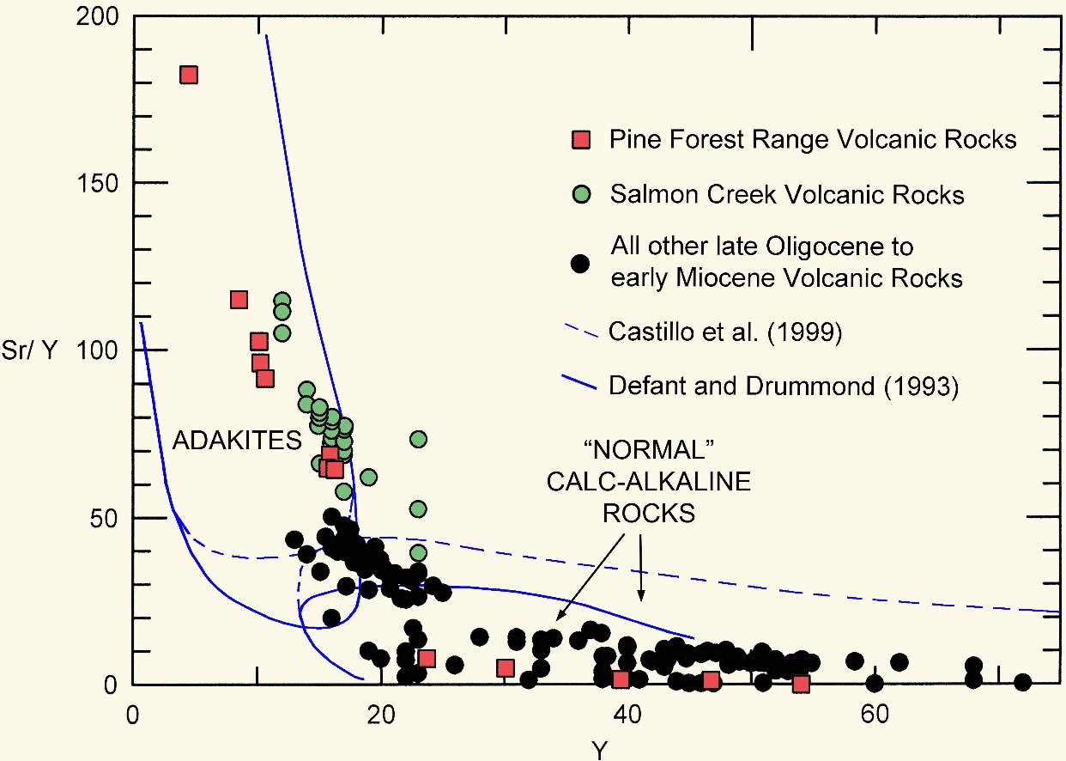
Lavas ≥ 55% SiO₂ (30-20 Ma)
~30-20 Ma
Notes:
Adakites are thought to form at depths below the stability of plagioclase, where Sr will behaves as an incompatible element during partial melting and Y remains in the bulk solid because of its compatibility in garnet or amphibole. The Sr/Y ratio is opposite to that found in periditite partial melts and is widely used to discriminate adakites from normal calc-alkaline rocks. These normal calc-alkaline signatures are shown for the outcrops shown in open circles.
On the binary plot to the right, a large, but fairly isolate group of analyses have moderate Sr/Y ratios between 25 and 50 (click; shown here in light blue) that fall either in the adakite field or in an area transitional between adakite and normal calc-alkaline andesite. We suggest that these could be derived from variable mixtures of pure adakite with differentiated melts from a calc-alkaline source. However, those with the strongest adakite signatures are from the Pine Forest Range of northern Nevada and from the Salmon Creek volcanics of SW Idaho.
This broad zone of partial melting has an overall ENE trend that we refer to as the Yellowstone adakite hot spot track, and we suggest that it may represent the older continuation of the Y-SRP hot spot track of similar trend to the east.

Slide 19
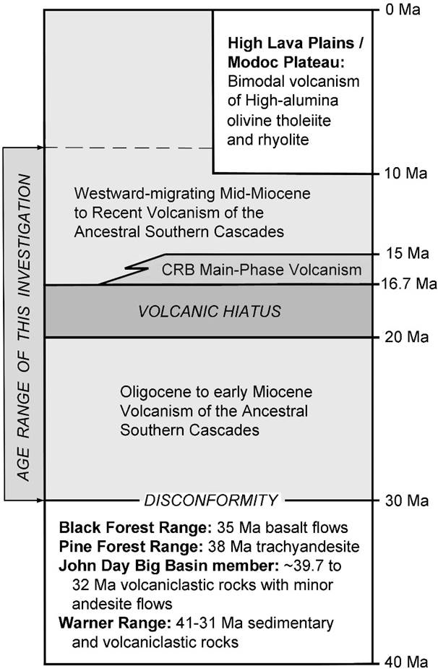
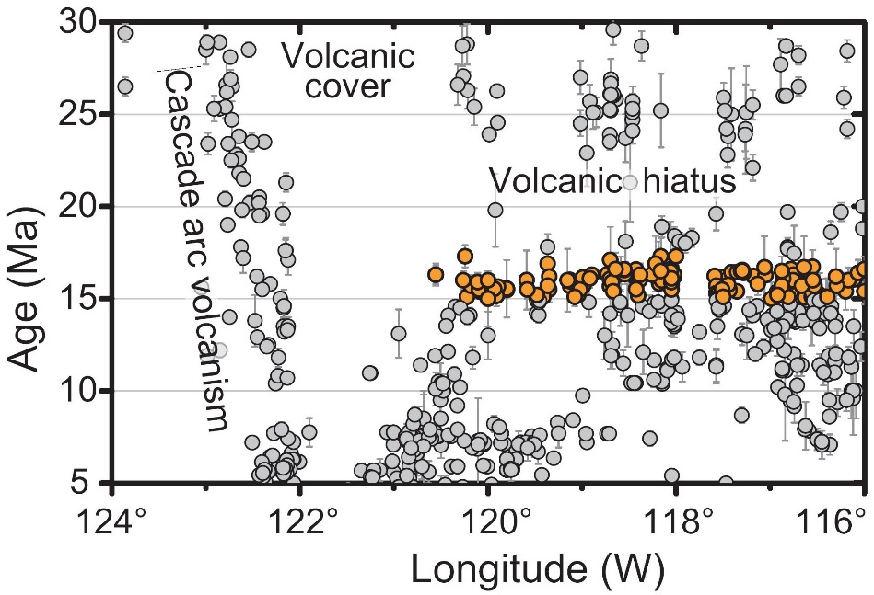
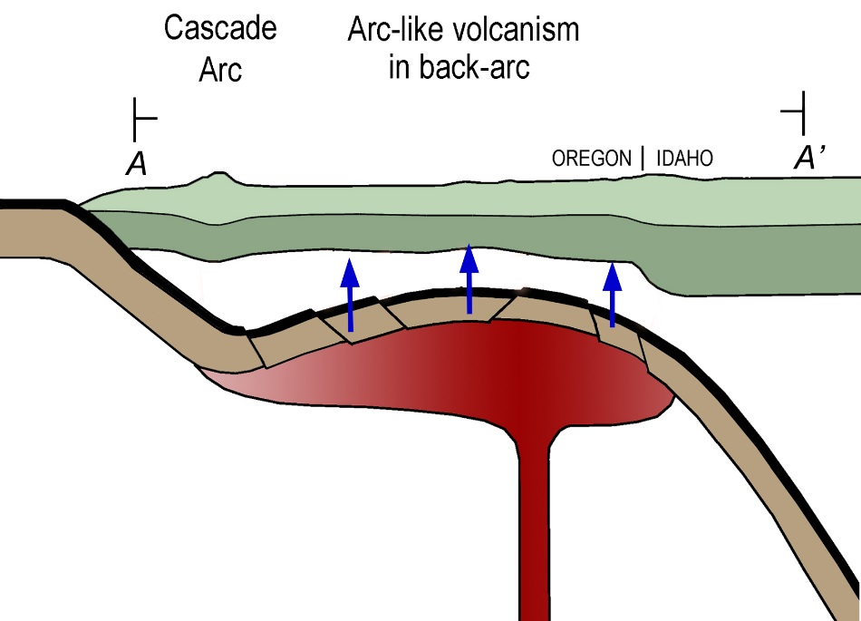
Volcanic Hiatus
Coble and Mahood (2012). Geochronology from eastern Oregon and northern Nevada, from NAVDAT. Orange dots from 16.7-15 Ma.
Hiatus: Continued uplift; cessation of counter-flow.
Notes:
Volcanism began to wane at 22 Ma and largely stopped by about 20 Ma. We follow the suggestion of Coble and Mahood (2012) that this volcanic hiatus was the result of continued uplift leading to the cessation of corner flow in the mantle wedge. In fact, it may have resulted in the juxtaposition of the entire slab against the overlying lithosphere at this time.

Slide 20
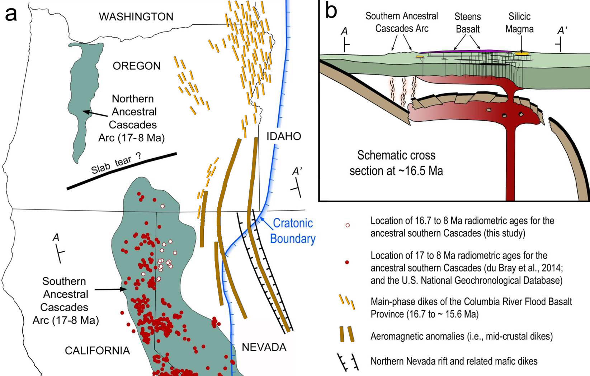
Modified from Coble and Mahood (2012)
16.7-15 Ma
Notes:
The volcanic hiatus ended abruptly with slab rupture in two separate places at 16.7 Ma. The eastern rupture allowed for plume rise through the slab, where decompressional partial melting of a dry mantle source generated dike intrusions and the initial flood-basalt eruptions. The contemporaneous western rupture resulted from subduction-related tearing of the uplifted slab, thus allowing for the contemporaneous rejuvenation of subduction that began at 16.7 Ma.

Slide 21
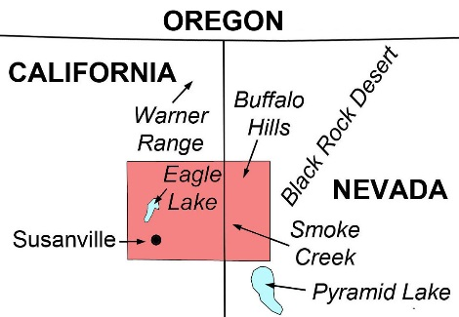
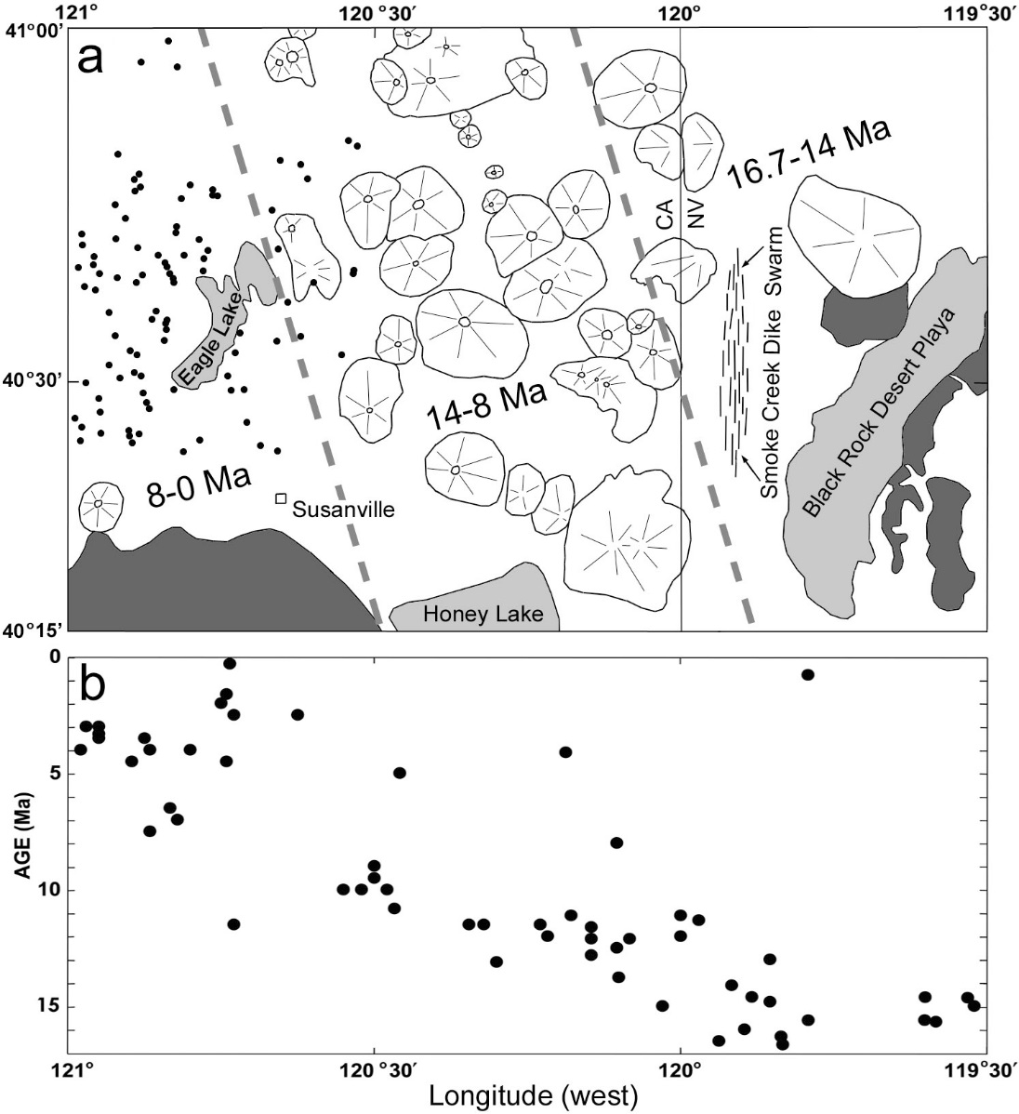
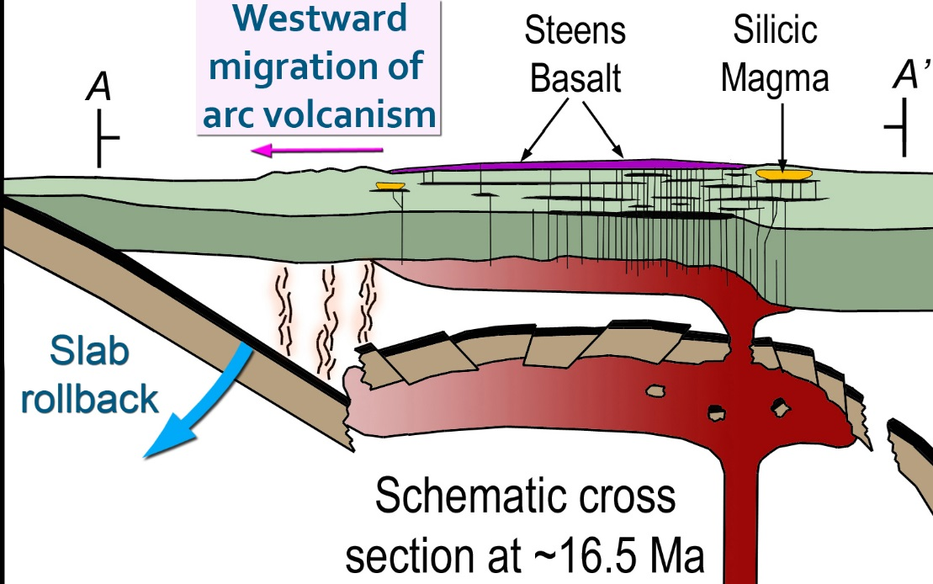
SLAB ROLLBACK (16.7-8.0 Ma)
Location map
~7.8 km/m.y.
Notes:
This re-initiation of subduction was associated with slab rollback which is evident in the westward migration of arc volcanism across the CA-NV border region at a rate of 7.8 km/m.y.
The oldest ages for these arc rocks are derived from the Smoke Creek dike swarm, just west of the Black Rock Desert region, where they range from 16.7 to 14 Ma. West of the CA-NV border the style of volcanism changes from dike intrusion to the development of spectacularly well-developed shield volcanism with ages that range from 14 to 8 Ma. Click .
- Here, a few of the Smoke Creek dikes are visible in the lower two diagrams, some of which are relatively small and others that are much thicker and over a km in length. The younger, well-preserved shield volcanoes in the upper diagram lie immediately in NE CA. Still farther west in the Susansville-Eagle Lake region, the style of volcanism changes once more to smaller shield volcanoes and abundant scoria cones with ages less than 8 Ma.

Slide 22
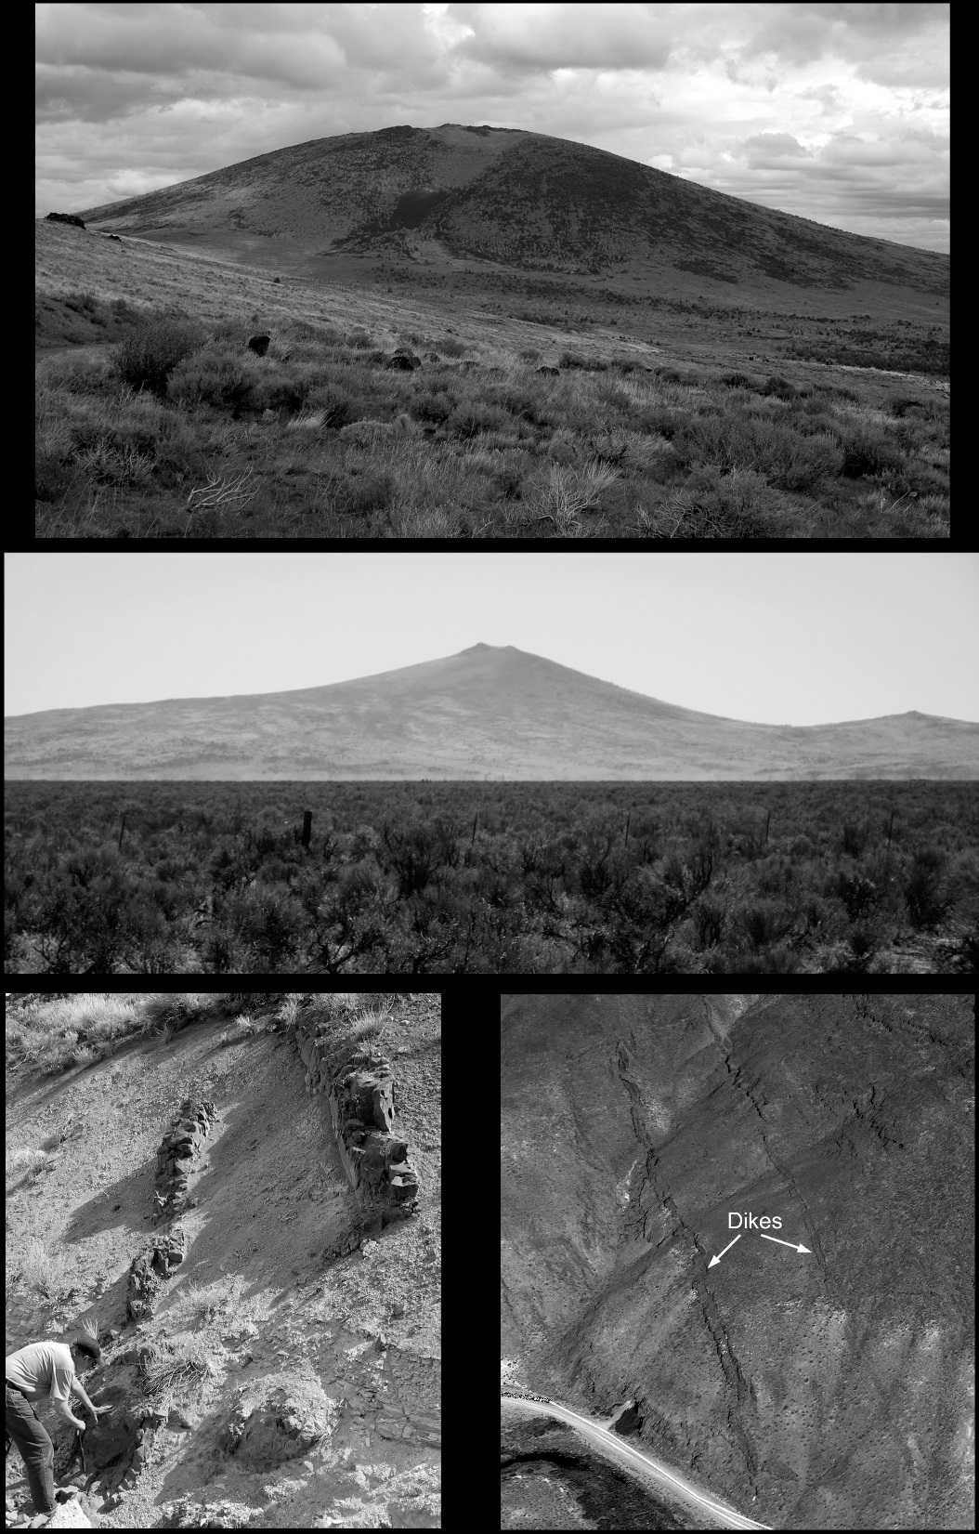
~7.8 km/m.y.
Notes:
This re-initiation of subduction was associated with slab rollback which is evident in the westward migration of arc volcanism in the CA-NV border region at a rate of 7.8 km/m.y.
The oldest ages for these arc rocks are derived from the Smoke Creek dike swarm, just west of the Black Rock Desert region, where they range from 16.7 to 14 Ma. West of the CA-NV border the style of volcanism changes from dike intrusion to the development of spectacularly well-developed shield volcanism with ages that range from 14 to 8 Ma.
Click - Here, a few of the Smoke Creek dikes are visible in the lower two diagrams, some of which are relatively small and others that are much thicker and over a km in length. The younger, well-preserved shield volcanoes in the upper diagram lie immediately in NE CA. Still farther west in the Susansville-Eagle Lake region, the style of volcanism changes once more to smaller shield volcanoes and abundant scoria cones with ages less than 8 Ma.

Slide 23
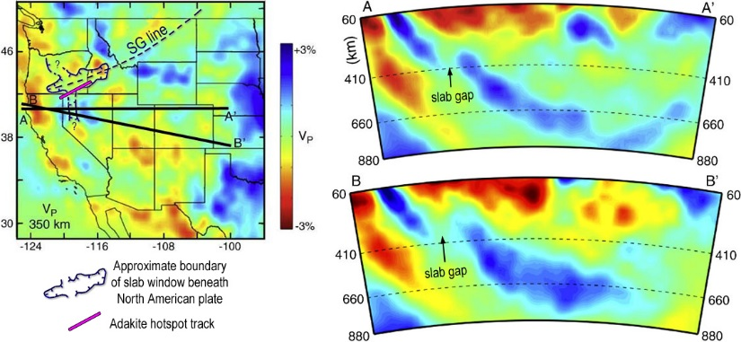
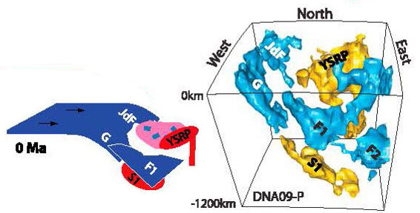
Schmandt and Humphreys (2010)
Obrebski et al. (2010)
Notes:
Today, the roll-backed slab of the Gorda plate is evident in the seismic tomography of Schmandt and Humphreys (2010), and the previously uplifted slab is still present, but in Nevada it has now descended into the mantle transitions zone. This is mantle relic is referred to as the F1 remnant slab in the model of Obrebski et al. (2010).

Slide 24
Schmandt and Humphreys (2010)
Estimated from Sigloch et al. (2008)
Notes:
Today, the roll-backed slab of the Gorda plate is evident in the seismic tomography of Schmandt and Humphreys (2010), and the previously uplifted slab is still present, but in Nevada it has now descended into the mantle transitions zone. This is mantle relic is referred to as the F1 remnant slab in the model of Obrebski et al. (2010).
However, when you cross the border into Oregon, the uplifted remnant is entirely missing, replaced instead by the seismic hole whose southern edge is bounded by the Yellowstone adakite hotspot track. We suggest that demise of the Farallon slab and creation of the seismic hole in this region is the combined result of a long-lived sequence of plume-triggered thermal erosion, rapid tearing, and the foundering of slab segments from 30-10 Ma.

Slide 26
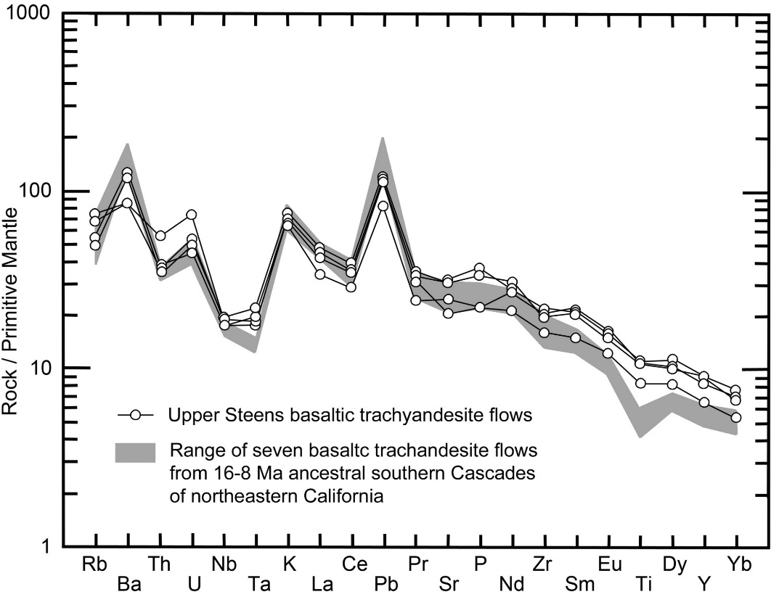
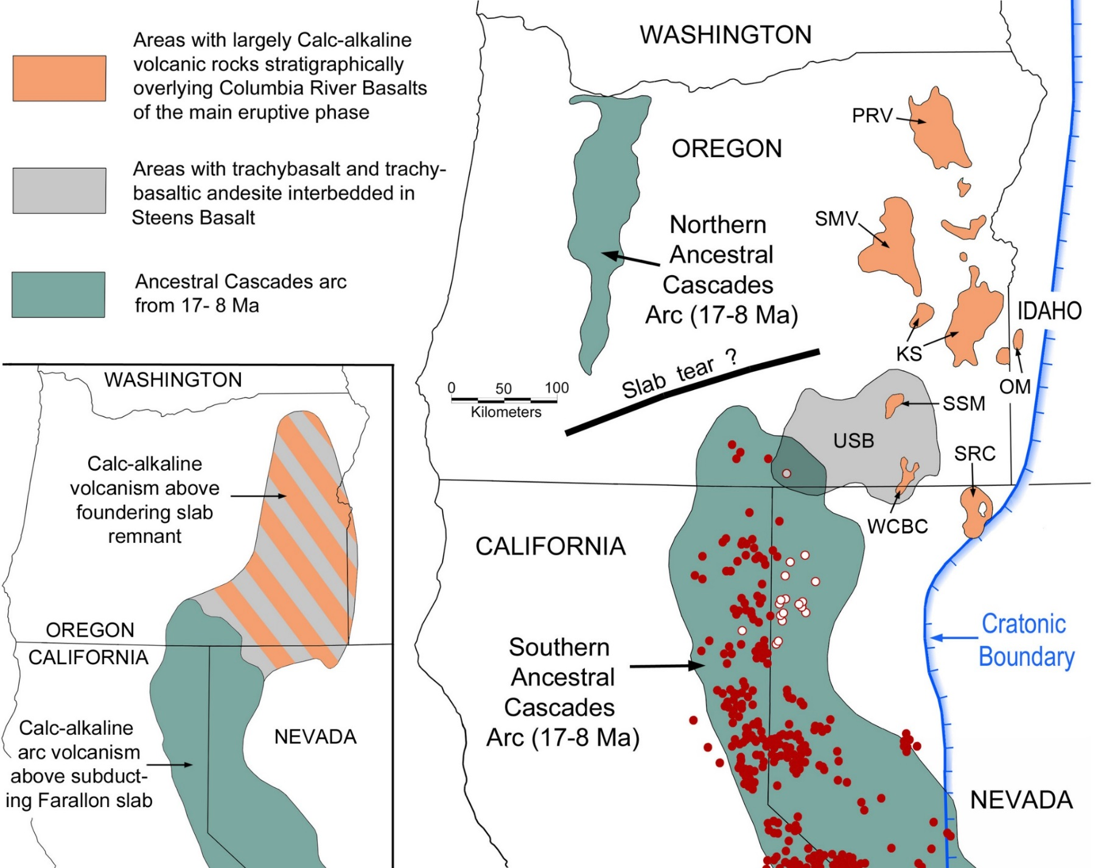
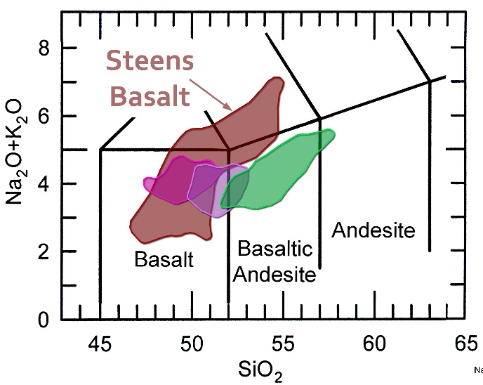
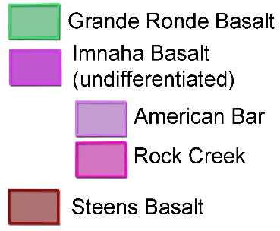
~16.7-8 Ma

