Slide 1
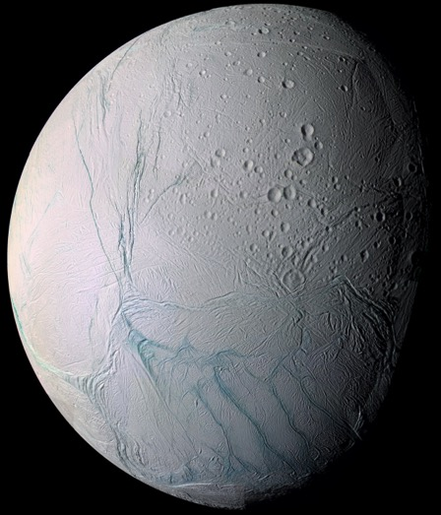
Investigating Crater Island Formation on Enceladus
Erin J. Leonard^{1,2}
An Yin¹
Robert T. Pappalardo²
¹University of California Los Angeles
²Jet Propulsion Laboratory
GSA October 23rd, 2017
Image Credit: NASA/JPL/SSI

Slide 2
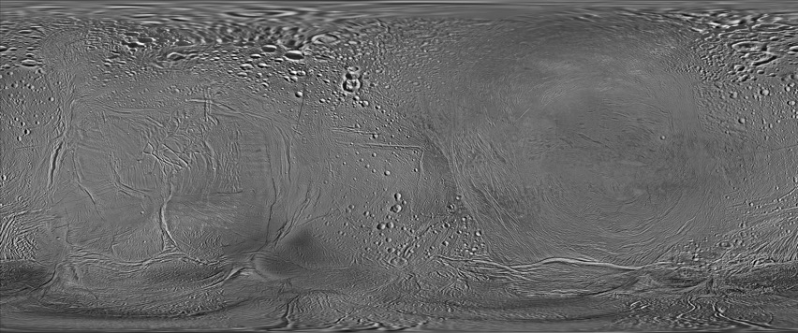
90º N
0º
90º S
0º
90º E
180º E
270º E
360º
Trailing Hemisphere
Leading Hemisphere
USGS Global Mosaic

Slide 3
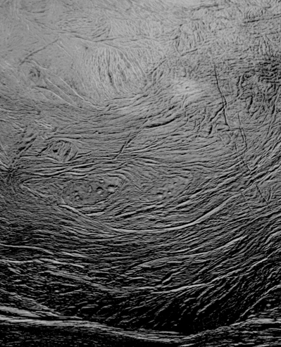
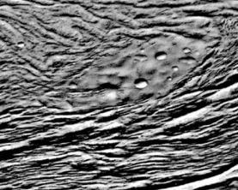
30º S
20 km
270º E

Slide 4
Structural Map

Slide 5


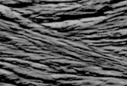

Structural Map
Scale bars = 5 km

Slide 6
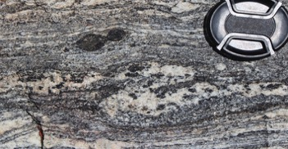
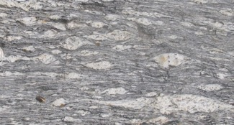
Clast Rotation on Earth
Image Credit: Monash University (Brazil)
2 cm
Image Credit: Jena Structural Geology (JST)
Notes:
Cite pics and add scale

Slide 7
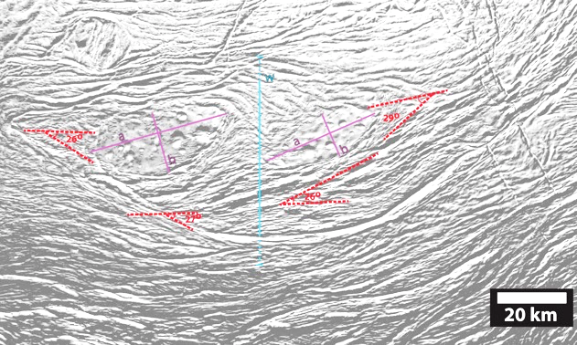

Estimating Shear Strain from Rotation
α~ 27°
ε~ 2

Slide 8
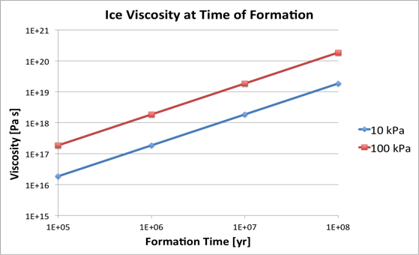

Estimating Surface Ice Viscosity
σ ~ 10-100 kPa
ε~ 2/(10⁶-10⁷ yr)
Crow-Willard and Pappalardo (2015)
η ~ 10¹⁷-10¹⁹ Pa s

Slide 9
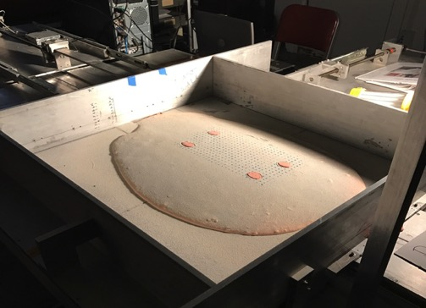
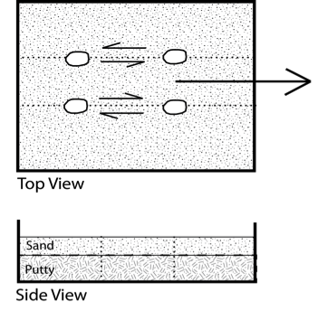
Analogue Model Set-up
~0.2 cm
2 cm
Not to scale
Scale: 1 cm in model = ~10 km on Enceladus
6 hours = ~10⁶ years on Enceladus
Leonard et al. (GSA 2017)

Slide 10
Analogue Model Set-up
~0.2 cm
2 cm
Not to scale
Scale: 1 cm in model = ~10 km on Enceladus
6 hours = ~10⁶ years on Enceladus
Leonard et al. (GSA 2017)

Slide 11
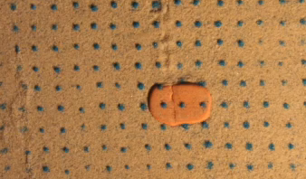
Experiment Example
- 0.2 cm sand
(2 km on Enceladus)
- 2 cm putty
- 1 x 1 cm grid
Left-lateral Shear Zone

Slide 12
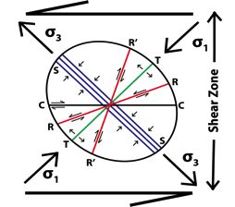
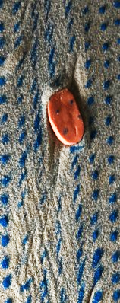
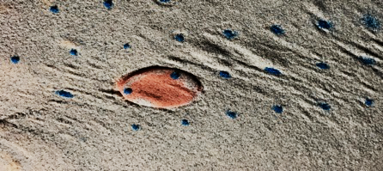
illumination
1 cm x 1 cm grid
R Shears?
illumination
2 cm x 2 cm grid
Folds?

Slide 13

ρ = 920 kg/m³
g = 0.113 m/s²
μ = 0.4
(Schulson et al., 2012)
η ~ 10¹⁷-10¹⁹ Pa s
z = 1.6 km
Notes:
Set the frictional force equal to the shear stress → failure!

Slide 14
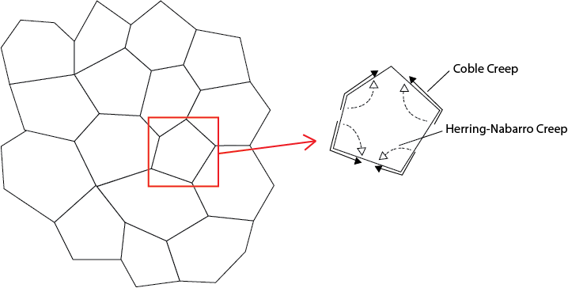
Ice Grain Size
Coble Creep (boundary diffusion)
Implies grain size ~100 μm
Herring-Nabbaro Creep (lattice diffusion)
Implies grain size ~1 μm
Observed at SPT by Cassini
(Porco et al., 2006; Brown et al., 2006; Jaumann et al., 2008)
Ice Grains
Notes:
Nice, bc it provides a good argument for us that this is the dominant mechanism near the surface, in the brittle layer, on Enceladus (important implications for tectonic calculations/interpretations). Not well confirmed before, mostly theoretical as lab experiments don’t go out to these conditions.

Slide 15
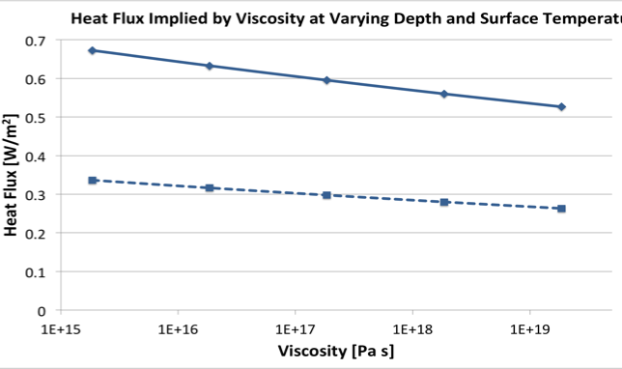

Heat Flux at Time of Formation
z = 1 km
k = 651 W/m
z = 2 km
T_{surf} = 70 K
Viscosity ~ 10¹⁸ Pa s
z ~ 1.5 km
Heat Flux: 0.4-0.5 W/m²
Notes:
Add SPT line
Add our viscosity
Put on Bland
Add Emily numbers

Slide 16
Heat Flux at Time of Formation
z = 1 km
k = 651 W/m
z = 2 km
T_{surf} = 70 K
Viscosity ~ 10¹⁸ Pa s
z ~ 1.5 km
Heat Flux: 0.4-0.5 W/m²
Other Heat Fluxes (Calculated/Observed)
0.15 - 0.24 W/m²: SPT average flux (Spencer and Nimmo, 2013)
Notes:
Add SPT line
Add our viscosity
Put on Bland
Add Emily numbers

Slide 17
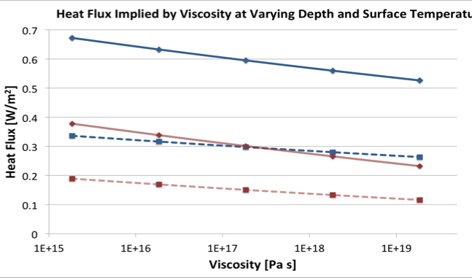
Heat Flux at Time of Formation
z = 1 km
k = 651 W/m
z = 1 km
z = 2 km
T_{surf} = 70 K
T_{surf} = 110 K
z = 2 km
Viscosity ~ 10¹⁸ Pa s
z ~ 1.5 km
Heat Flux ~ 0.2 W/m²
Other Heat Fluxes (Calculated/Observed)
0.15 - 0.24 W/m²: SPT average flux (Spencer and Nimmo, 2013)
Notes:
Add SPT line
Add our viscosity
Put on Bland
Add Emily numbers

Slide 18
Heat Flux at Time of Formation
z = 1 km
k = 651 W/m
z = 1 km
z = 2 km
T_{surf} = 70 K
T_{surf} = 110 K
z = 2 km
Viscosity ~ 10¹⁸ Pa s
z ~ 1.5 km
Heat Flux ~ 0.2 W/m²
Other Heat Fluxes (Calculated/Observed)
0.15 - 0.24 W/m²: SPT average flux (Spencer and Nimmo, 2013)
0.2 - 0.27 W/m²: Features at 130º E (Giese et al., 2008)
Notes:
Add SPT line
Add our viscosity
Put on Bland
Add Emily numbers

Slide 19
Heat Flux at Time of Formation
z = 1 km
k = 651 W/m
z = 1 km
z = 2 km
T_{surf} = 70 K
T_{surf} = 110 K
z = 2 km
Viscosity ~ 10¹⁸ Pa s
z ~ 1.5 km
Heat Flux ~ 0.2 W/m²
Other Heat Fluxes (Calculated/Observed)
0.15 - 0.24 W/m²: SPT average flux (Spencer and Nimmo, 2013)
0.2 - 0.27 W/m²: Features at 130º E (Giese et al., 2008)
0.11 - 0.22 W/m²: Trailing Hemisphere Structures (Bland et al., 2007)
Notes:
Add SPT line
Add our viscosity
Put on Bland
Add Emily numbers

Slide 20
Heat Flux at Time of Formation
z = 1 km
k = 651 W/m
z = 1 km
z = 2 km
T_{surf} = 70 K
T_{surf} = 110 K
z = 2 km
Viscosity ~ 10¹⁸ Pa s
z ~ 1.5 km
Heat Flux ~ 0.2 W/m²
Other Heat Fluxes (Calculated/Observed)
0.15 - 0.24 W/m²: SPT average flux (Spencer and Nimmo, 2013)
0.2 - 0.27 W/m²: Features at 130º E (Giese et al., 2008)
0.11 - 0.22 W/m²: Trailing Hemisphere Structures (Bland et al., 2007)
> 0.15 W/m²: Cratered Terrain (Bland et al., 2012)
Notes:
Add SPT line
Add our viscosity
Put on Bland
Add Emily numbers

Slide 21
Heat Flux at Time of Formation
z = 1 km
k = 651 W/m
z = 1 km
z = 2 km
T_{surf} = 70 K
T_{surf} = 110 K
z = 2 km
Viscosity ~ 10¹⁸ Pa s
z ~ 1.5 km
Heat Flux ~ 0.2 W/m²
Other Heat Fluxes (Calculated/Observed)
0.15 - 0.24 W/m²: SPT average flux (Spencer and Nimmo, 2013)
0.2 - 0.27 W/m²: Features at 130º E (Giese et al., 2008)
0.11 - 0.22 W/m²: Trailing Hemisphere Structures (Bland et al., 2007)
> 0.15 W/m²: Cratered Terrain (Bland et al., 2012)
0.007 W/m²: Current Global Average (Spencer and Nimmo, 2013)
Notes:
Add SPT line
Add our viscosity
Put on Bland
Add Emily numbers

Slide 22
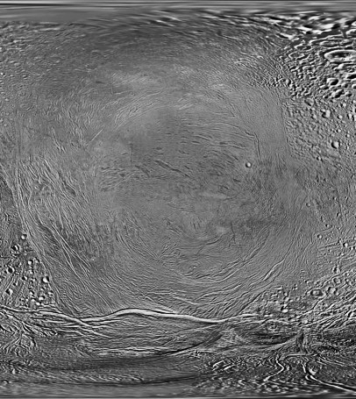
Conclusions
Analogue experiment qualitatively supports left-lateral shear zone hypothesis
At the time of formation:
Viscosity ~ 10¹⁸ Pa s;
z ~ 1.5 km;
Heat flux ~ 0.2 W/m²
Grain size ~100 um (upper limit)
Indicates Coble Creep is dominant
Insulating layer needed to raise effective surface temperature (1-10 m)
Supports Bland et al. (2012, 2015); Martin et al. (2017)
0º
270º E

Slide 23
New Questions
Why did the crater islands survive?
Stronger?
Radiation? Composition? Porosity? Strain Localization? Grain Size? Geologic History?
Boudinage?
Shear zone formation
Episodic resurfacing? (e.g. O’Neill and Nimmo, 2010)
Sluggish Lid Convection? (e.g. Barr and Hammond, 2014)
Uplift? (Janes and Melosh, 1990; Crow-Willard and Pappalardo, 2015)
Rotation/Shear Zone?
0º
270º E

