Slide 1


Climate Change Inquiry: Technology Applications in the High School Classroom
Taormina (Tara) Lepore, M.S.
The Webb Schools and
Raymond M. Alf Museum of Paleontology

Slide 2
Objectives
Why is citizen science important in a K-12 classroom?
How do we involve students in citizen science, through inquiry-based learning – questions of their own design?
What kinds of technology can bridge students with real-time data collection and bioinformatics?
Anthropogenic climate change: Helping students remain invested in the future of investigating weather patterns, climate science trends, and human “creature comforts” through urban green spaces

Slide 3
Why Citizen Science?
Citizen science allows students to work with ongoing data collection – large scale!
Investment in local communities and the science that can help people – promoting compassion.
Students are faced with real scientific problems, and the celebrations and frustrations of the scientific process.
Networking with other students and fellow scientists across the globe.

Slide 4
Inquiry-Based Learning
Students are involved in generating questions to solve real problems.
Student-driven procedures that engage and inspire.
Not your standard cookbook lab!

Slide 5
3-Dimensional Learning
3D Learning and the Next Generation Science Standards (NGSS): Increasing push to shift from simply teaching science ideas, to helping students explain phenomena and design solutions to problems (Krajcik, 2015).
Incorporating all “three dimensions” of standards:
1. Cross-Cutting Concepts (CCC) – Connecting subjects
2. Disciplinary Core Ideas (DCI) – What topics?
3. Science and Engineering Practices (SEP) – How to design
Not just learning content, but solving problems.

Slide 6
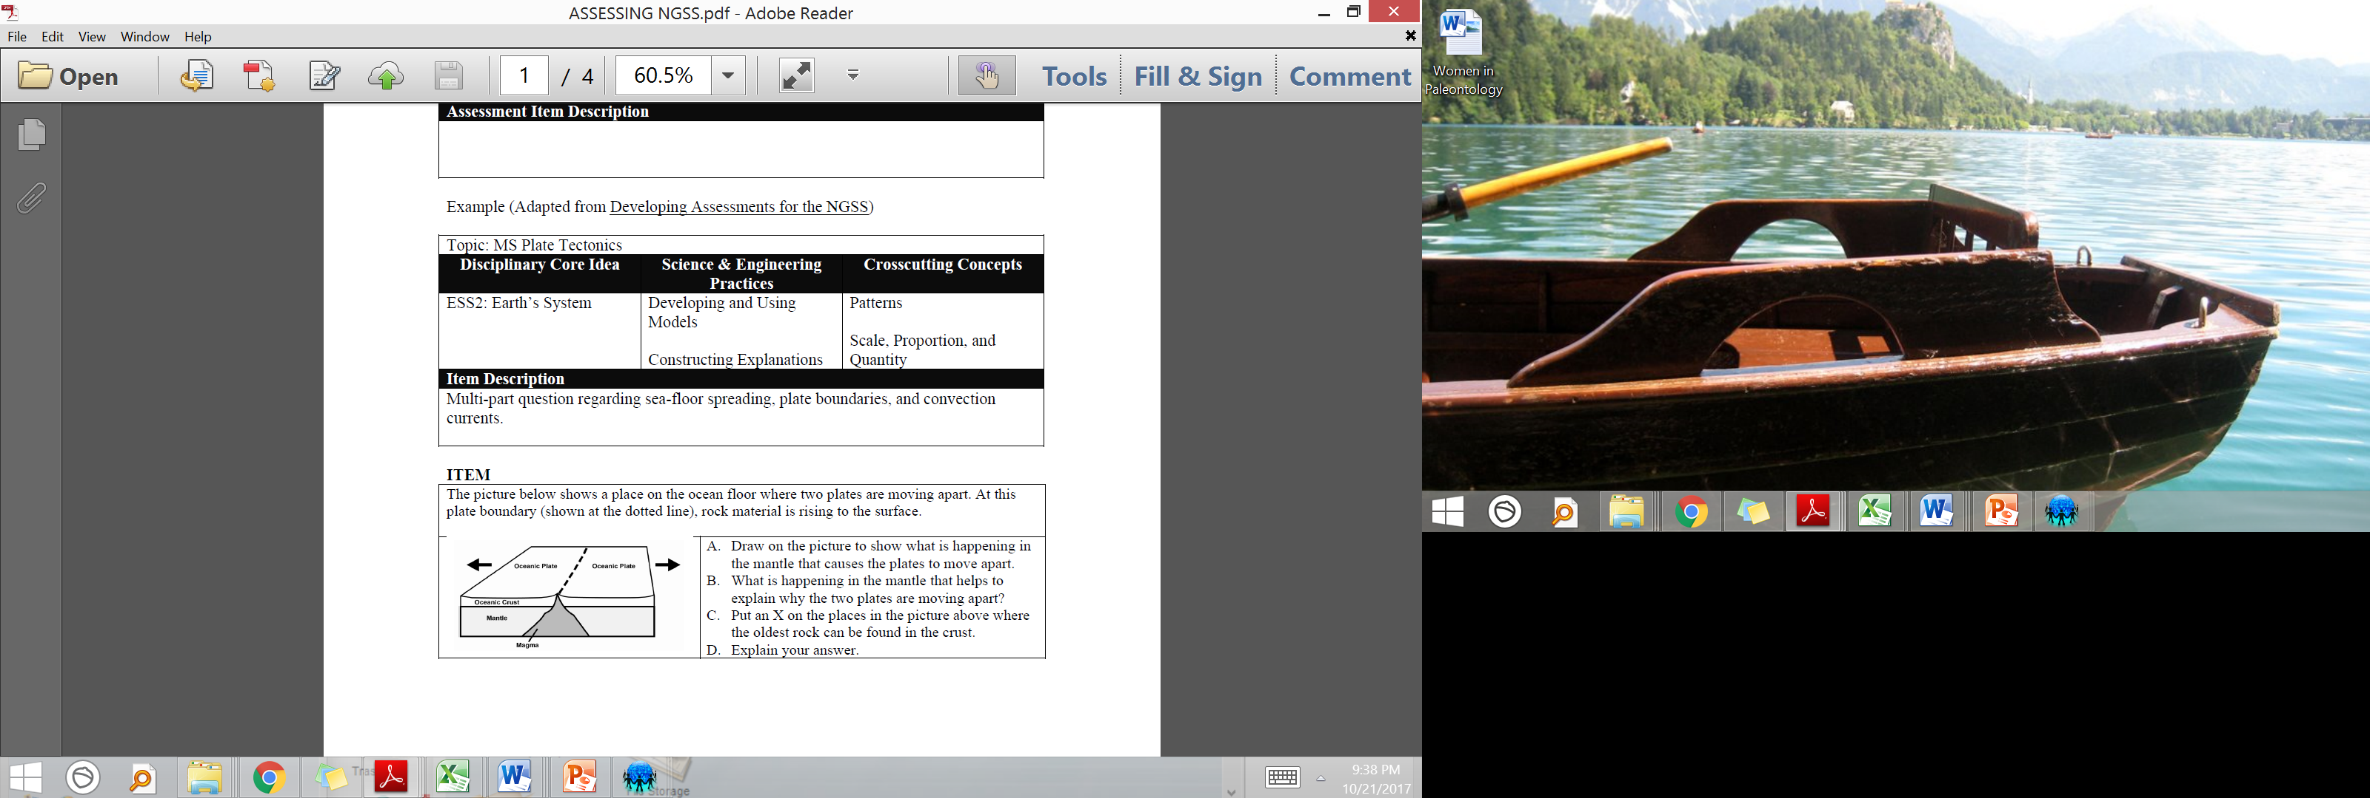
3-Dimensional Learning

Slide 7
The Webb Schools
Approximately 400 students, 9-12
Two schools: Webb School of California and Vivian Webb School; Claremont, CA
Day and boarding students, 70% boarding, 30% day student
Raymond M. Alf Museum of Paleontology on campus – the only nationally accredited paleontology museum (American Association of Museums) on a high school campus
Blending of experiential education and core content

Slide 8
Setting the Stage
Earthwatch Institute, Chino Basin Water District, and University of California – Riverside
Over 100 sensors (“iButtons”) placed around greater Los Angeles area, measuring temperature every 30 min.
How to involve local communities, schools, and interested citizens in this broad initiative?
Mark Chandler – Education Director at Earthwatch Institute, Maynard, MA

Slide 9
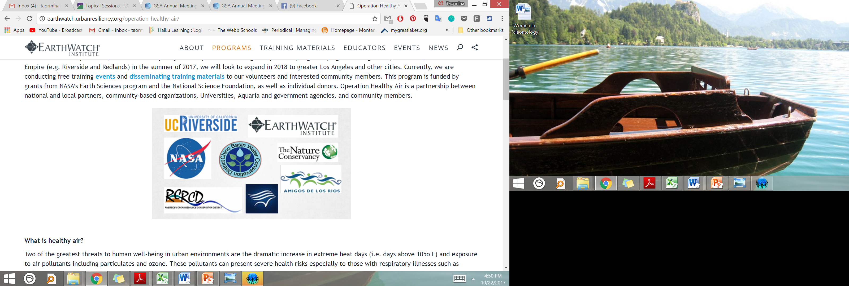
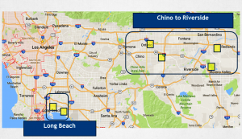
Setting the Stage

Slide 10
Big Ideas
Overarching questions:
Can urban green spaces improve quality of life for those at risk from excessive heat exposure?
How can schools, businesses, and other entities make sound decisions to improve landscape quality and human comfort level?
What is the long-term trend? Over time, can we build a data set that teases out the impact of trees, buildings, pavement, landscaping – on climate change?

Slide 11
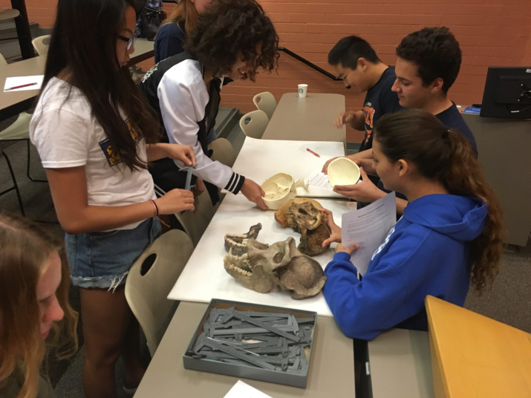
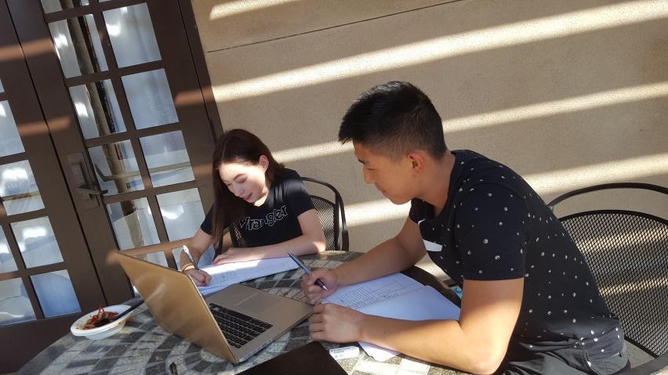
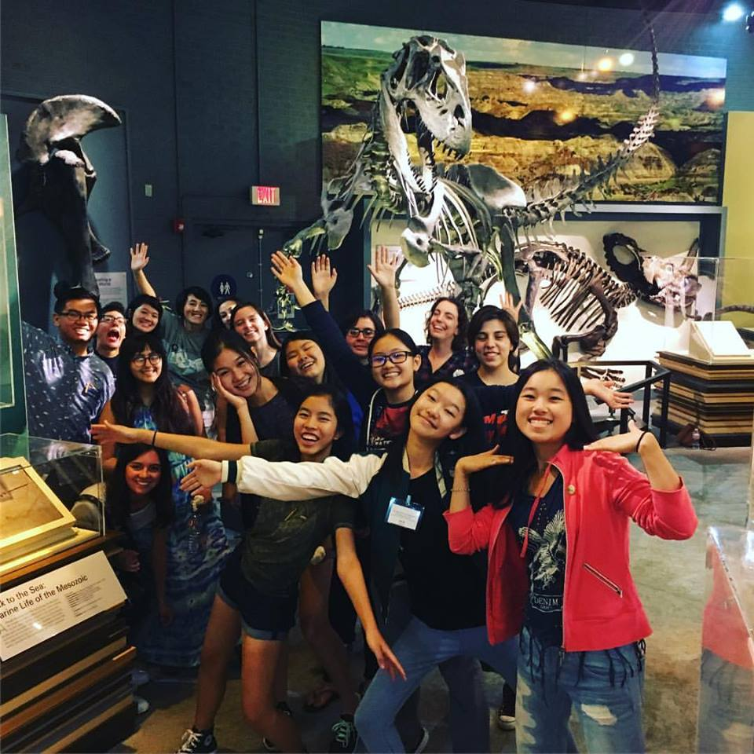
Cast of Characters

Slide 12
The Quest: Climate Change Inquiry
Engaging students, particularly high school students, with the realities of climate change can be an unexpected challenge for instructors.
Climate science, our daily perceptions of climate and weather, and a barrage of news media can all affect how students conceptualize climate change and how it applies to their daily lives.

Slide 13
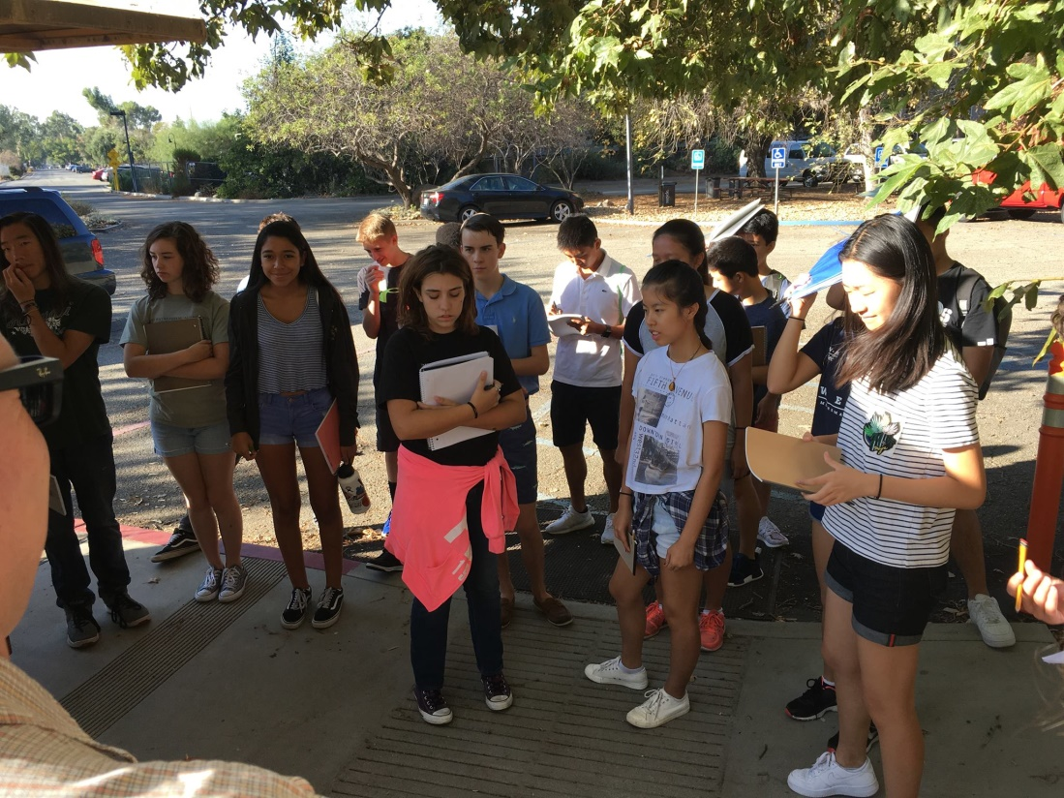
Where does climate inquiry fit in?

Slide 14
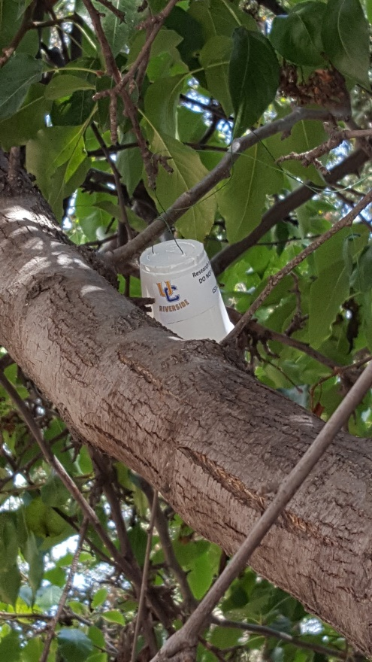
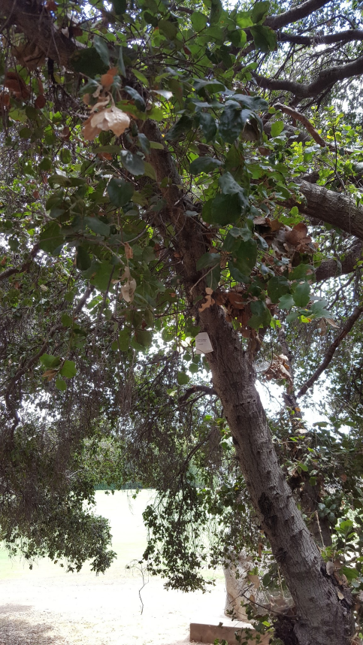
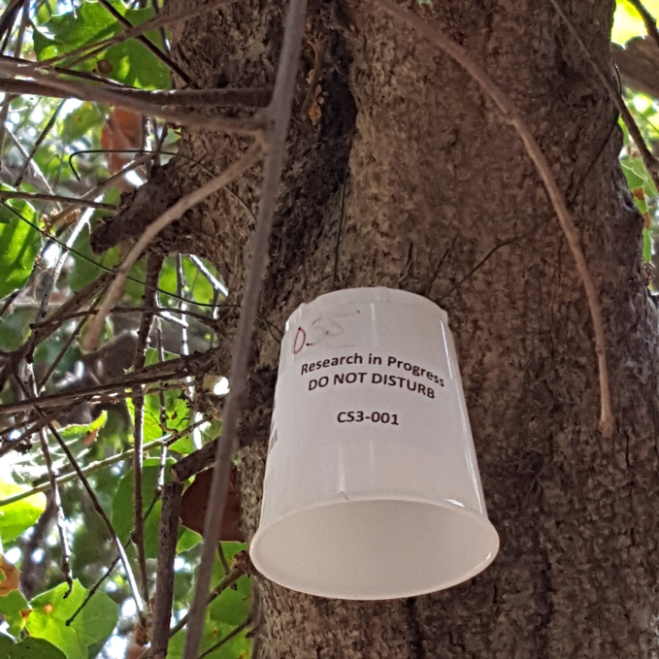
iButton Temperature Sensors

Slide 15
Student Data Analysis
Can we map the entire school, and determine how much hotter it is over pavement vs. under a big tree vs. in the courtyard?
Predict times of day / parts of campus that could affect overall health?
And, what data would you need to collect and analyze to answer these questions?
How is this going to be communicated in a way that is relevant and understandable?

Slide 16
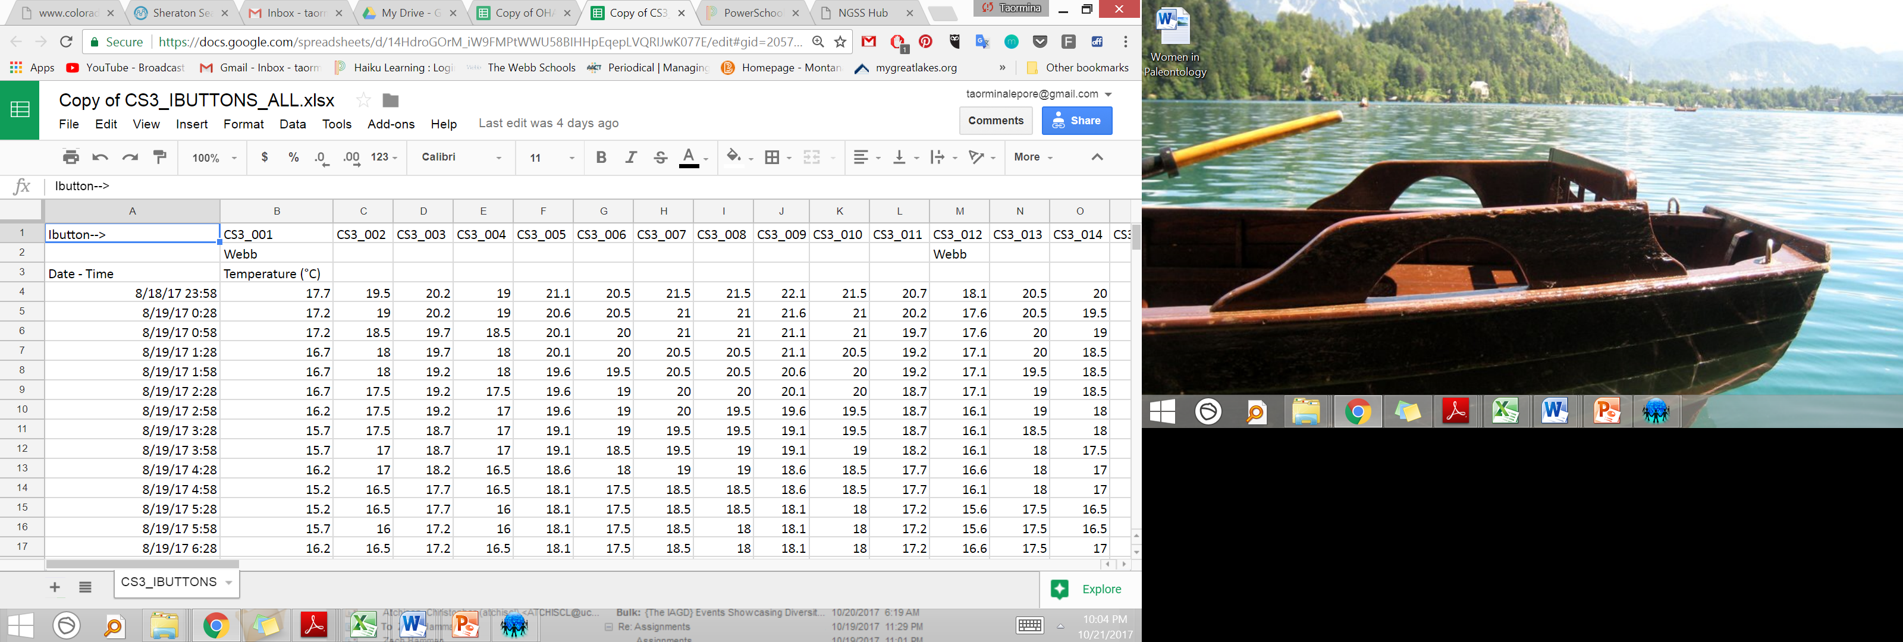
Student Data Analysis

Slide 17
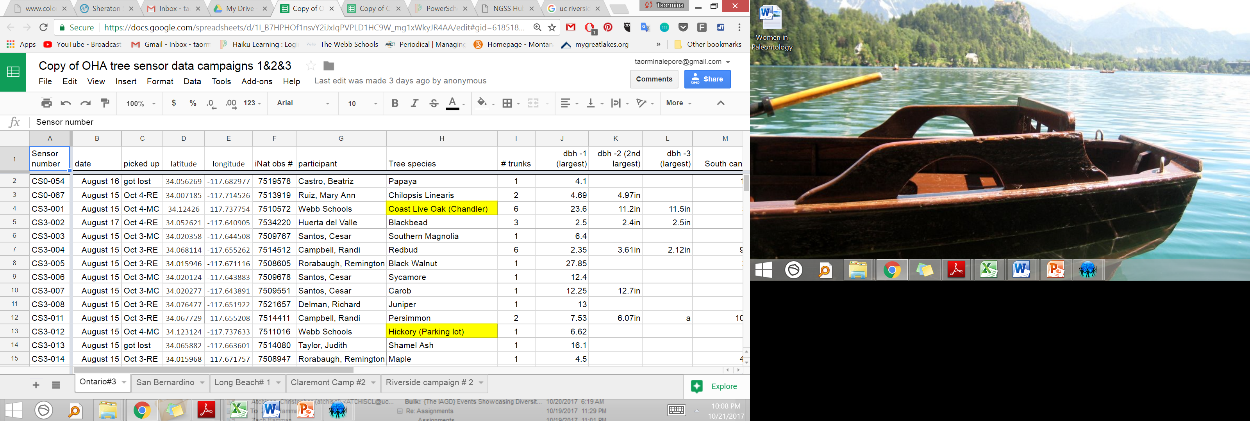
Student Data Analysis

Slide 18
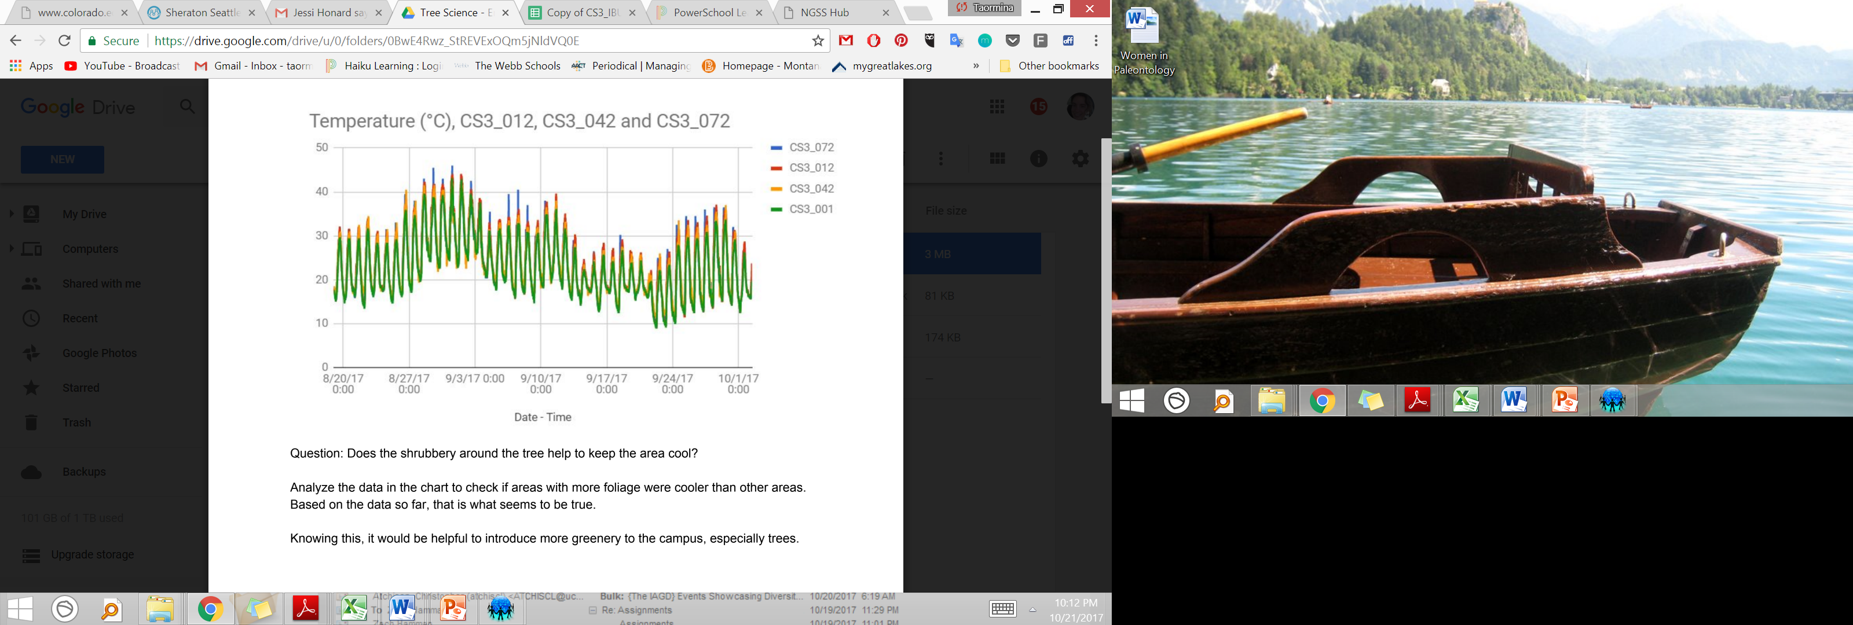
Student Data Analysis

Slide 19
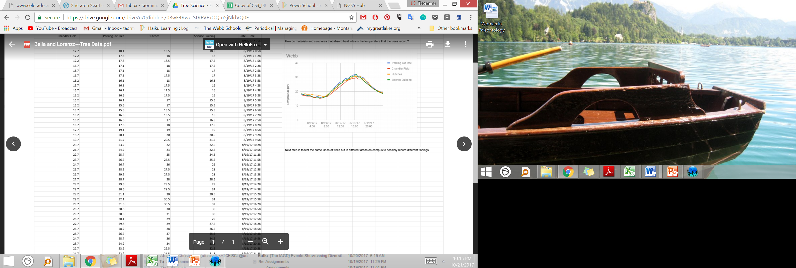
Student Data Analysis

Slide 20
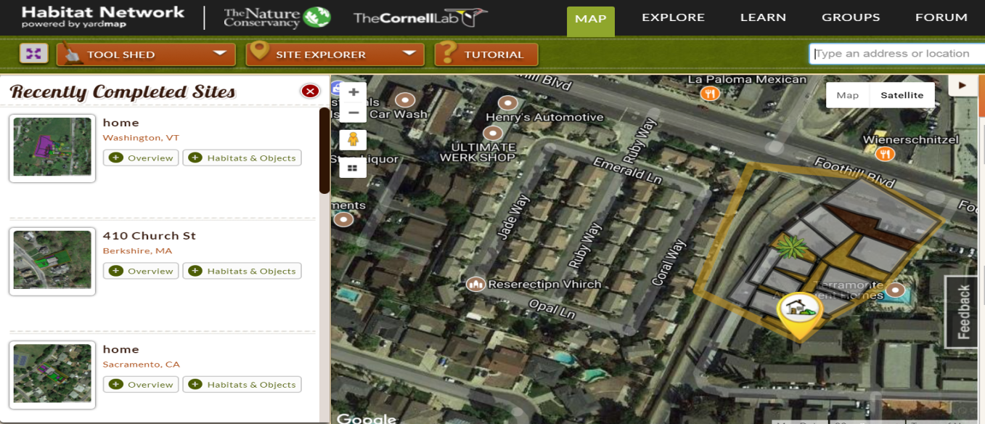
Habitat Network
Proportion of land cover within a certain radius around a sensor.
Can we predict temperature?

Slide 21
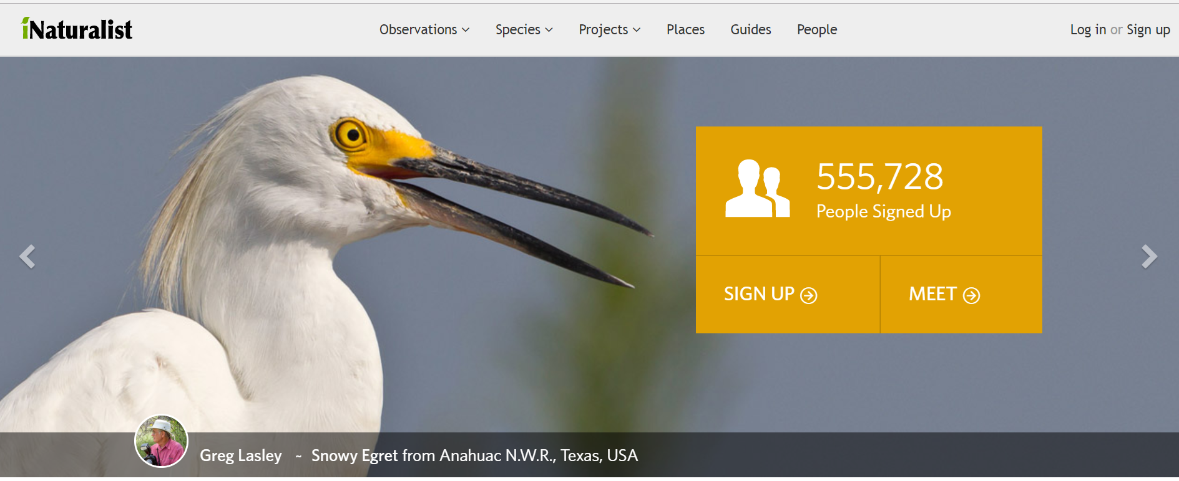
iNaturalist

Slide 22
Common Tools
How to use Habitat Network and map habitats digitally? Using Weather Underground to track coarse wind data, using the closest station to the school: https://www.wunderground.com/
MODIS Data Collection https://modis.gsfc.nasa.gov/
NASA Earth Observations https://neo.sci.gsfc.nasa.gov/view.php?datasetId=MOD11C1_M_LSTDA
University of Iowa Real-Time Temperature Data http://esmc.uiowa.edu:3838/ozone_series_ca_all_data/

Slide 23
Future Directions
Increased peer-to-peer collaboration with citizen science data
Presentation of data at academic conferences
Student-directed research: “It’s okay to fail!”
Ultimately, how can we increase green spaces?
Are our green spaces helping human quality of life?
Will climate change cause a spike in urban heat islands?

Slide 24
Acknowledgements
My students for their enthusiasm and dedication!
Many thanks to Mark Chandler and his team at Earthwatch Institute for productive discussion and collaboration
UC-Riverside urban green spaces research group
The Webb Schools and Raymond M. Alf Museum for support and guidance – Theresa Smith, Tracy Miller, Gabe Santos, Andy Farke, John Lawrence
Montana State University – Science Education Dept.
GSA and Paleontological Society for travel support

Slide 25

Questions?
Contact: tlepore@webb.org
Open call for collaborators!
@taorminalepore

