Slide 1
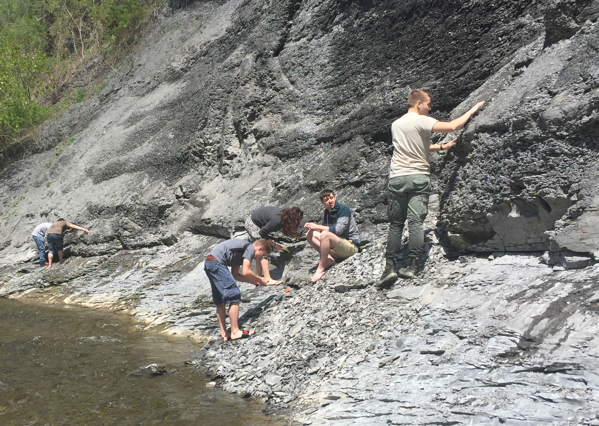

Increased Completion Rates Following Course Redesign in a 2YC Physical Geology Course
Amanda Colosimo
Monroe Community College, Rochester, NY

Slide 2
Background
July 2015: Week-long Xerox- STEM Institute on Course Redesign
Participants were taught mini-lectures, engaged in active learning, small group and individual coaching
Goal: redesign 1 unit of an existing course
Fall 2015: follow- up with monthly cohort meetings for encouragement and trouble shooting
Summer/ fall stipend

Slide 3
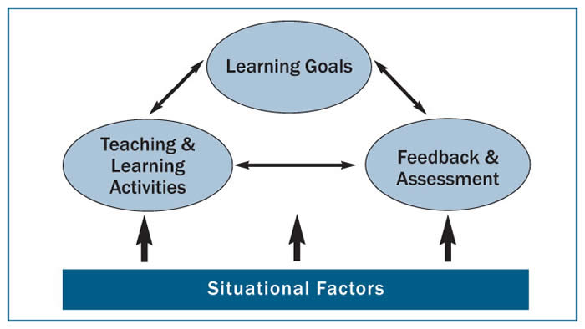
Fink, 2007

Slide 4
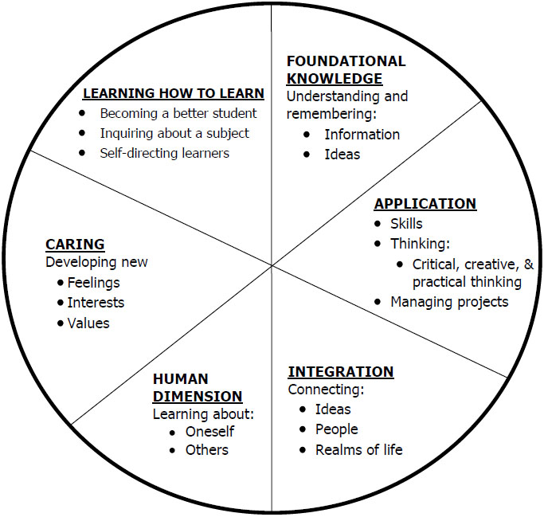
Taxonomy of Significant Learning

Slide 5
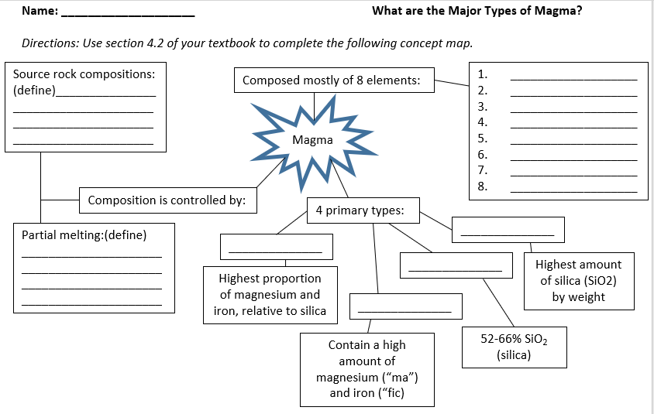
Active Engagement Techniques

Slide 6
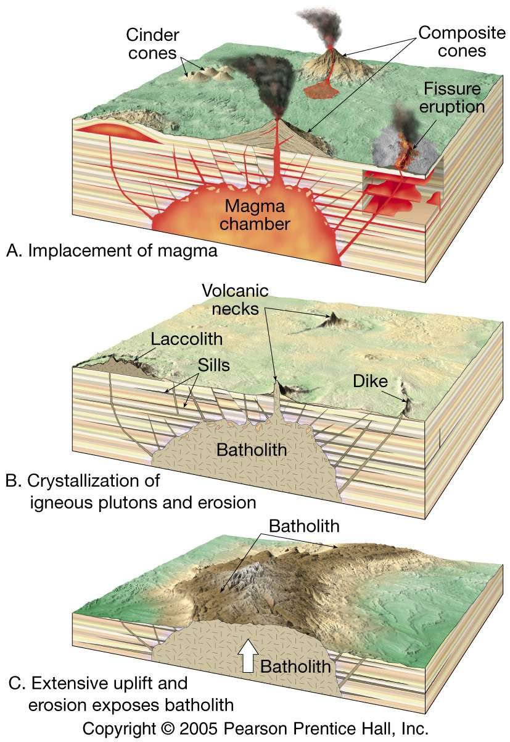
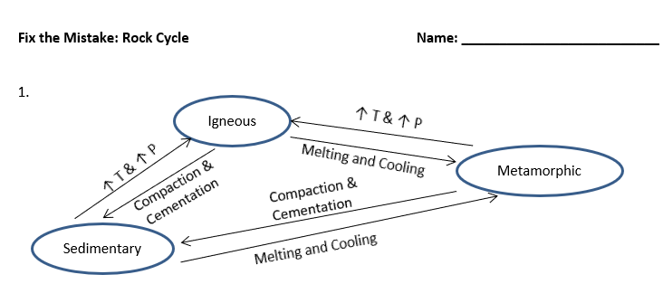
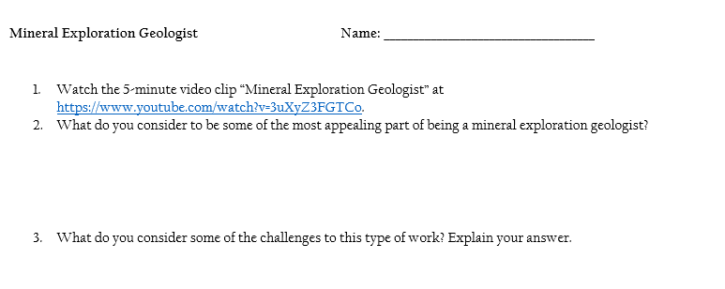

Slide 7
Sylvite, KCl
Magnetite, Fe₃O₄
Chalcopyrite, CuFeS₂
Garnet, Fe₃Al₂Si₃O₁₂
Calcite, CaCO₃
Quartz, SiO₂
Galena, PbS
Dolomite, CaMg(CO₃)₂
Corundum, Al₂O₃
Hematite, Fe₂O₃
Sphalerite, ZnS
Pyrite, FeS₂

Slide 8
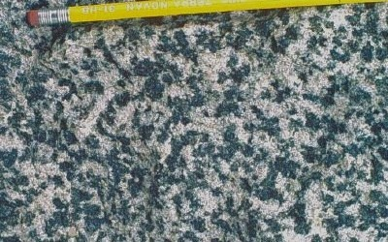
A
B
C
D

Slide 9
Methodology
Analyzed course outcomes 4 semesters prior to and following redesign for F’s and W’s
Coded students as students of color, female, and combined as “underrepresented groups”
Analyzed results for statistical significance

Slide 10
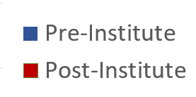
Results: Overall Course Changes

Slide 11
Results: Students of Color

Slide 12
Results: Females
21.7

Slide 13
Results: All Under-Represented Students

Slide 14
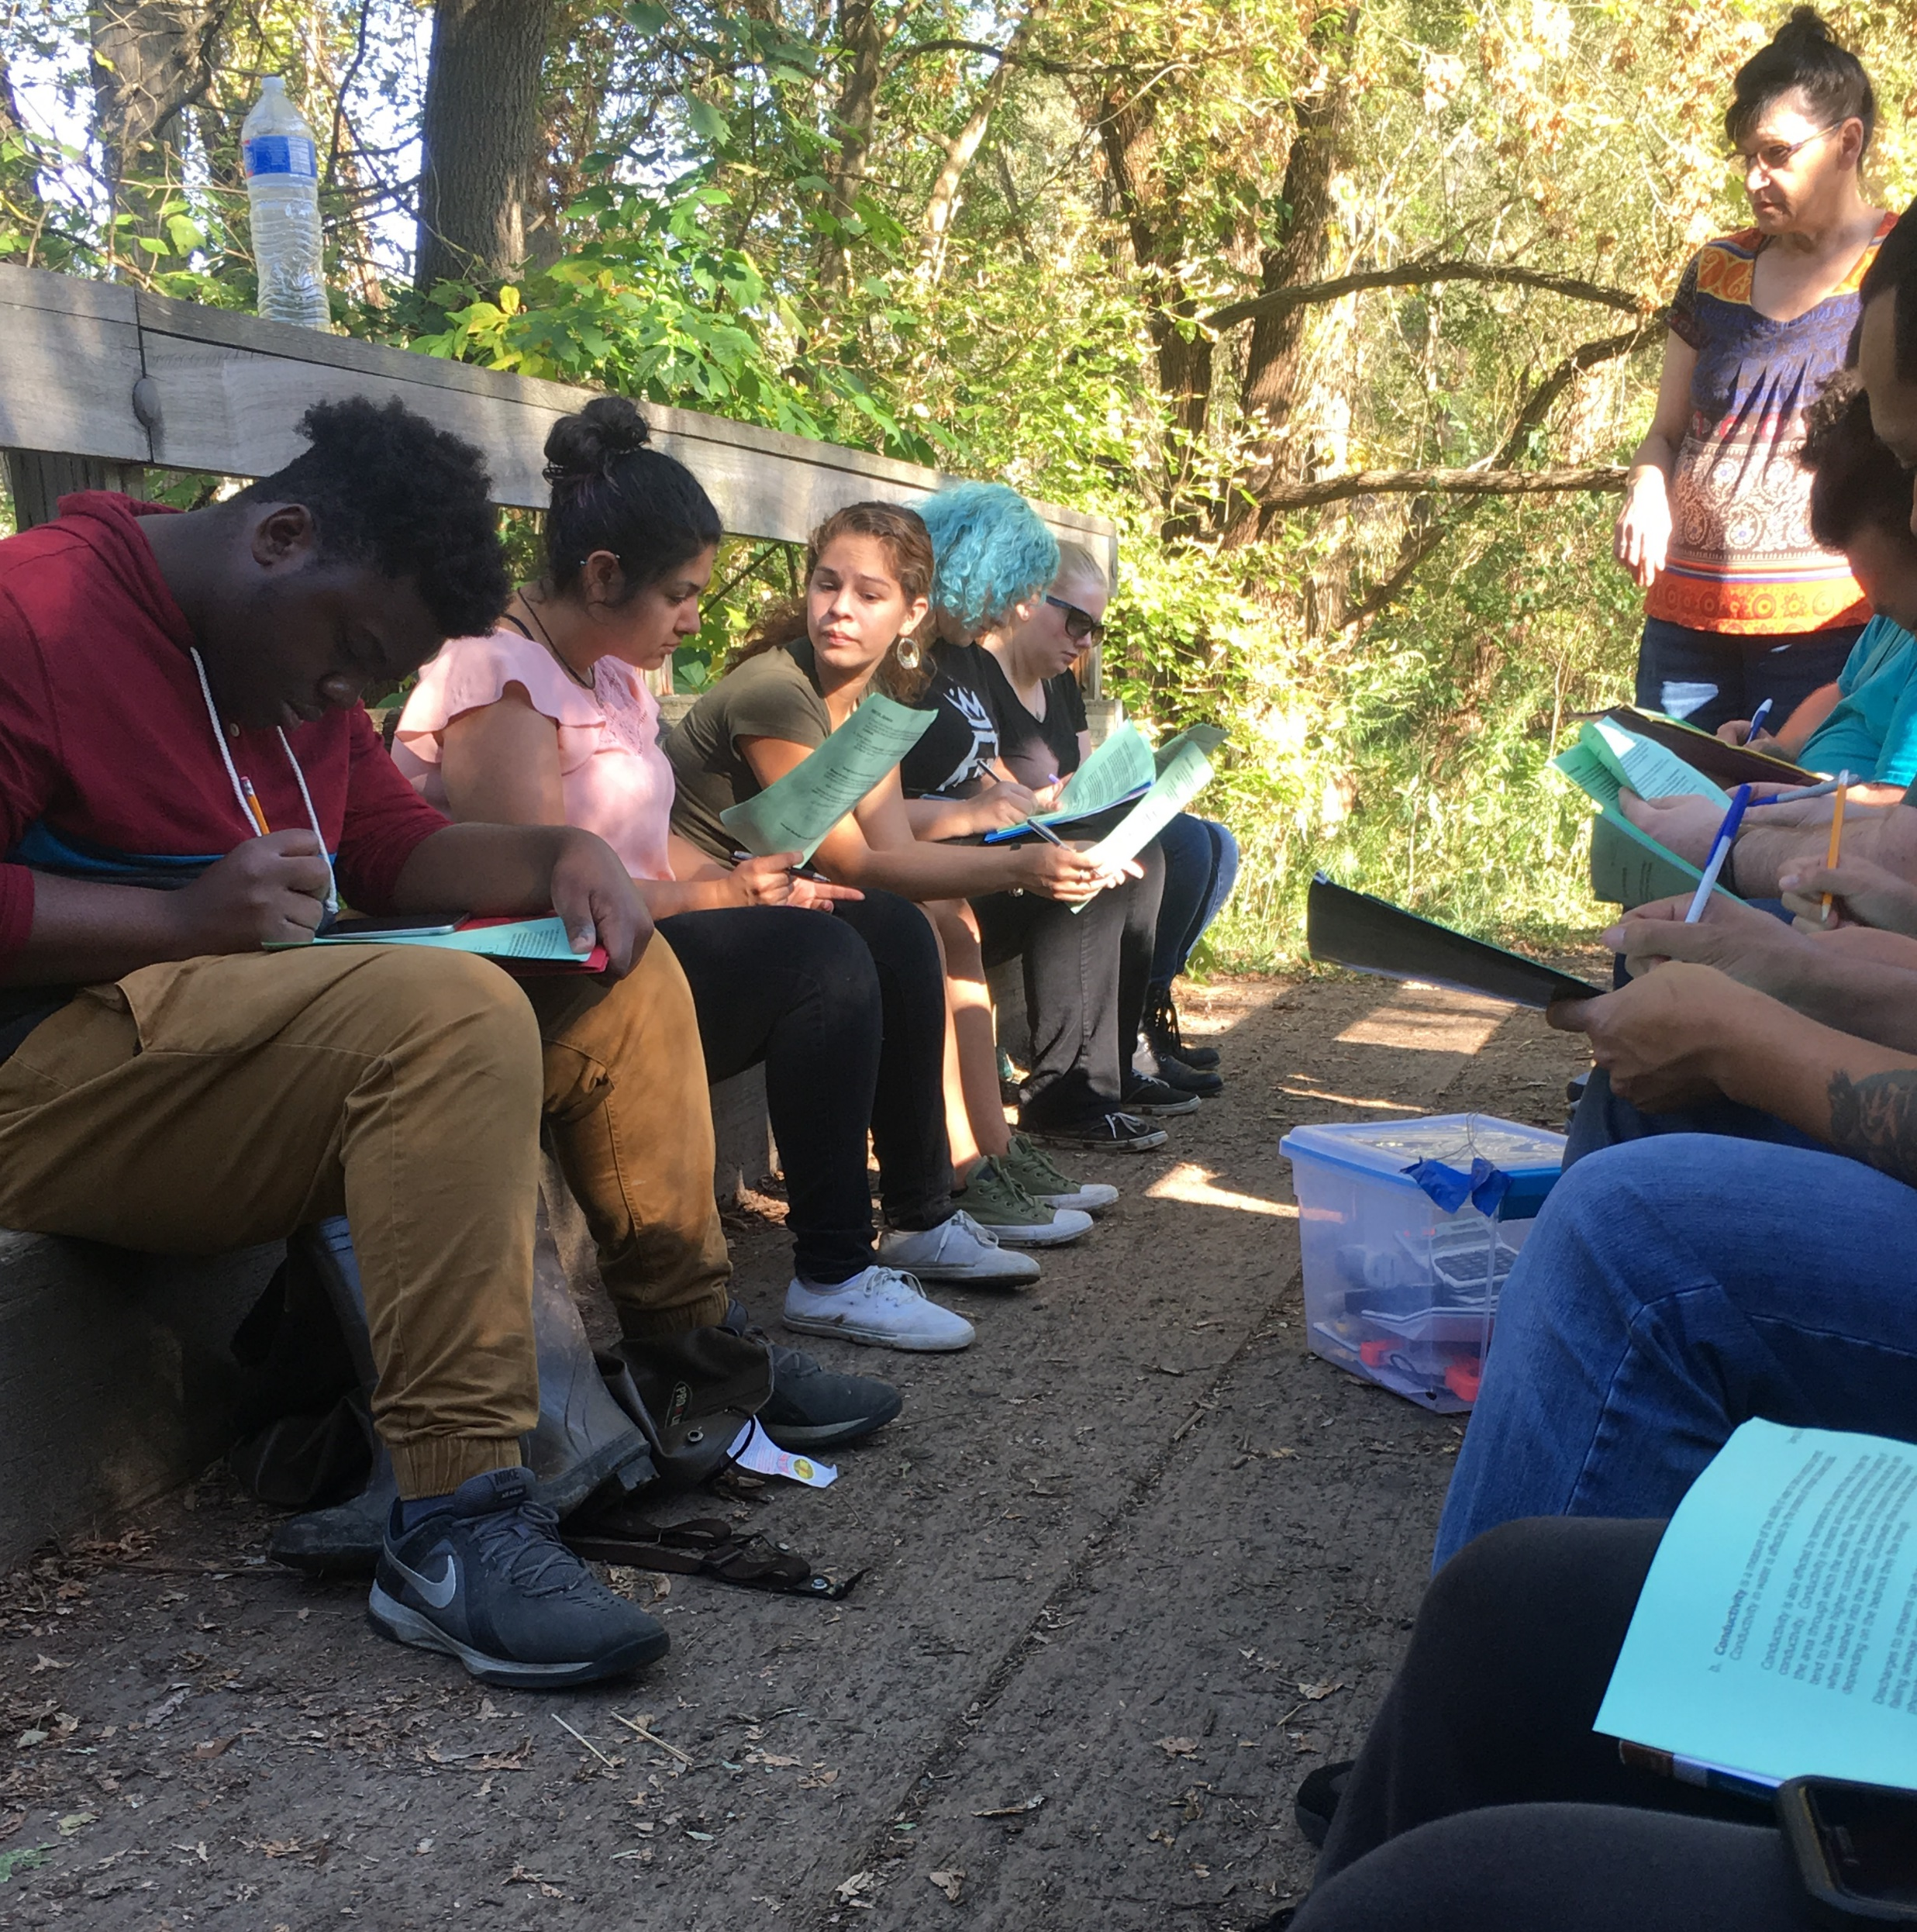
Summary
Results support existing literature on benefits of active learning strategies
  Specifically for females!
Illustrates need for financial support for faculty for meaningful course redesign

