Slide 1


The Social Network and Geoscience Education: Why Who You Know Is Just as Important as What You Know When It Comes To Innovative Teaching
Jonathan Tomkin
Dept. of Geology, University of Illinois
T128. Teaching about the Earth Online
GSA Annual Meeting, Seattle 2017

Slide 2
Thanks to
Alison Anders
Geoffrey Herman
Shufeng Ma
Jason Morphew
Jose Mestre
Rachel Oien
Matthew West

Slide 3
What are some evidence-based instructional practices?

Slide 4
What gets us to use evidence based instructional practices?

Slide 5
Correlated Variables†
Variable | Know | Tried | Continue
READ (teaching-related journals) | * | *
NFW (New Faculty Workshop) | ***** | ***
ATND (talks/workshops) | **
MORE (interest in using more RBIS) |  | * | *
GEN (gender) |  |  | *
SATF (satisfied with meeting goals) | *
PSTN (full-time, permanent vs. other) | *
RSH2 (research publications)
SIZE (class size)
INST (type of institution)
CRSE (alg- or calc-based course)
DGRE (highest degree)
ENC (departmental encouragement for teaching)
GOAL (instructional goals)
JOB (% of job related to teaching)
PEER (frequency of talk w/ peers about teaching)
RANK (academic rank)
RSH1 (research presentations)
RSH3 (research grants)
YEAR (years of teaching experience)
†Controlling for other study variables using a logistic regression model. *Strength of effect is based on size of odds ratios (each * ~ odds ratio of 2).
Borrego, M., & Henderson, C. (2014). Increasing the use of evidence‐based teaching in STEM higher education: A comparison of eight change strategies. Journal of Engineering Education, 103(2), 220-252.

Slide 6
Correlated Variables†
Variable | Know | Tried | Continue
READ (teaching-related journals) | * | *
NFW (New Faculty Workshop) | ***** | ***
ATND (talks/workshops) | **
MORE (interest in using more RBIS) |  | * | *
GEN (gender) |  |  | *
SATF (satisfied with meeting goals) | *
PSTN (full-time, permanent vs. other) | *
RSH2 (research publications)
SIZE (class size)
INST (type of institution)
CRSE (alg- or calc-based course)
DGRE (highest degree)
ENC (departmental encouragement for teaching)
GOAL (instructional goals)
JOB (% of job related to teaching)
PEER (frequency of talk w/ peers about teaching)
RANK (academic rank)
RSH1 (research presentations)
RSH3 (research grants)
YEAR (years of teaching experience)
†Controlling for other study variables using a logistic regression model. *Strength of effect is based on size of odds ratios (each * ~ odds ratio of 2).
Borrego, M., & Henderson, C. (2014). Increasing the use of evidence‐based teaching in STEM higher education: A comparison of eight change strategies. Journal of Engineering Education, 103(2), 220-252.

Slide 7
Correlated Variables†
Variable | Know | Tried | Continue
READ (teaching-related journals) | * | *
NFW (New Faculty Workshop) | ***** | ***
ATND (talks/workshops) | **
MORE (interest in using more RBIS) |  | * | *
GEN (gender) |  |  | *
SATF (satisfied with meeting goals) | *
PSTN (full-time, permanent vs. other) | *
RSH2 (research publications)
SIZE (class size)
INST (type of institution)
CRSE (alg- or calc-based course)
DGRE (highest degree)
ENC (departmental encouragement for teaching)
GOAL (instructional goals)
JOB (% of job related to teaching)
PEER (frequency of talk w/ peers about teaching)
RANK (academic rank)
RSH1 (research presentations)
RSH3 (research grants)
YEAR (years of teaching experience)
†Controlling for other study variables using a logistic regression model. *Strength of effect is based on size of odds ratios (each * ~ odds ratio of 2).
Borrego, M., & Henderson, C. (2014). Increasing the use of evidence‐based teaching in STEM higher education: A comparison of eight change strategies. Journal of Engineering Education, 103(2), 220-252.

Slide 8
Correlated Variables†
Variable | Know | Tried | Continue
READ (teaching-related journals) | * | *
NFW (New Faculty Workshop) | ***** | ***
ATND (talks/workshops) | **
MORE (interest in using more RBIS) |  | * | *
GEN (gender) |  |  | *
SATF (satisfied with meeting goals) | *
PSTN (full-time, permanent vs. other) | *
RSH2 (research publications)
SIZE (class size)
INST (type of institution)
CRSE (alg- or calc-based course)
DGRE (highest degree)
ENC (departmental encouragement for teaching)
GOAL (instructional goals)
JOB (% of job related to teaching)
PEER (frequency of talk w/ peers about teaching)
RANK (academic rank)
RSH1 (research presentations)
RSH3 (research grants)
YEAR (years of teaching experience)
†Controlling for other study variables using a logistic regression model. *Strength of effect is based on size of odds ratios (each * ~ odds ratio of 2).
Borrego, M., & Henderson, C. (2014). Increasing the use of evidence‐based teaching in STEM higher education: A comparison of eight change strategies. Journal of Engineering Education, 103(2), 220-252.

Slide 9
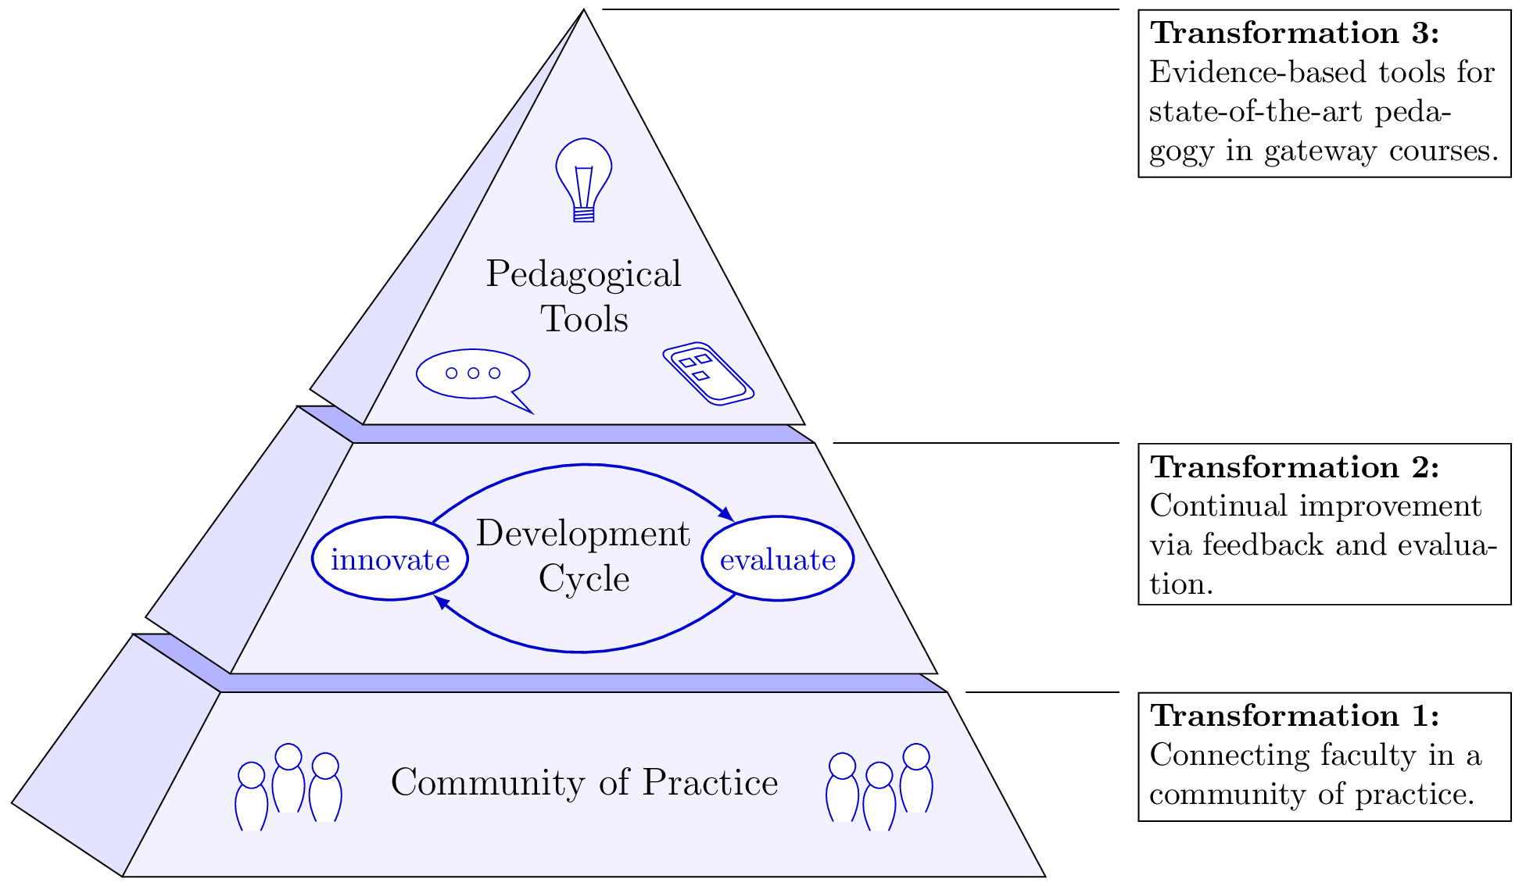

Slide 10
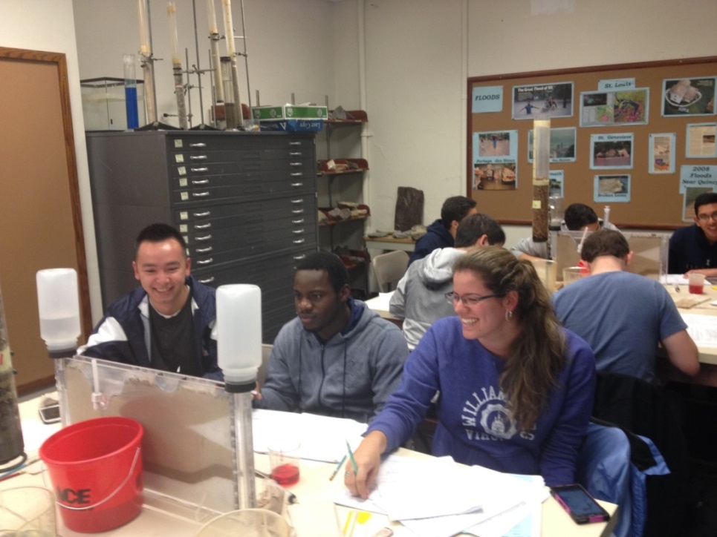
Geology Lab Reform

Slide 11
Did you learn in this lab?
***
*
*
**
***
Average Score
Oien et al., in review

Slide 12
Did you enjoy this lab?
*
*
**
**
***
***
***
Average Score
Oien et al., in review

Slide 14

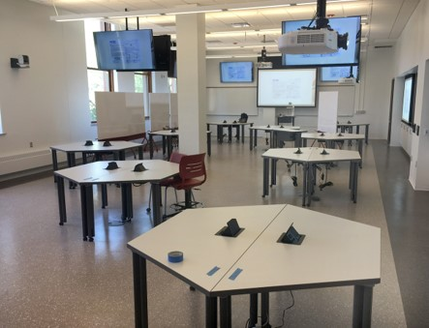

Slide 15
What do profs and students do in lectures?
Tomkin et al., in prep.

Slide 16
What do profs and students do in lectures?
No CoP? Professors TALK
CoP? Professors TEACH
Tomkin et al., in prep.

Slide 17
What do profs and students do in lectures?
No CoP? Students LISTEN
CoP? Students WORK
Tomkin et al., in prep.

Slide 18
Students in CoP classes WORK
Traditional
Reformed
Tomkin et al., in prep.

Slide 19
Students in CoP classes WORK
No CoP
CoP
Traditional
Reformed
Tomkin et al., in prep.

Slide 20
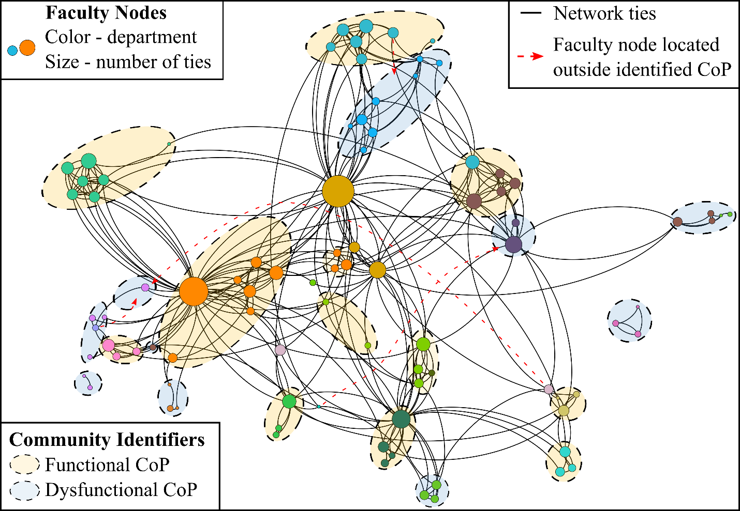
Ma et al., in review

Slide 21
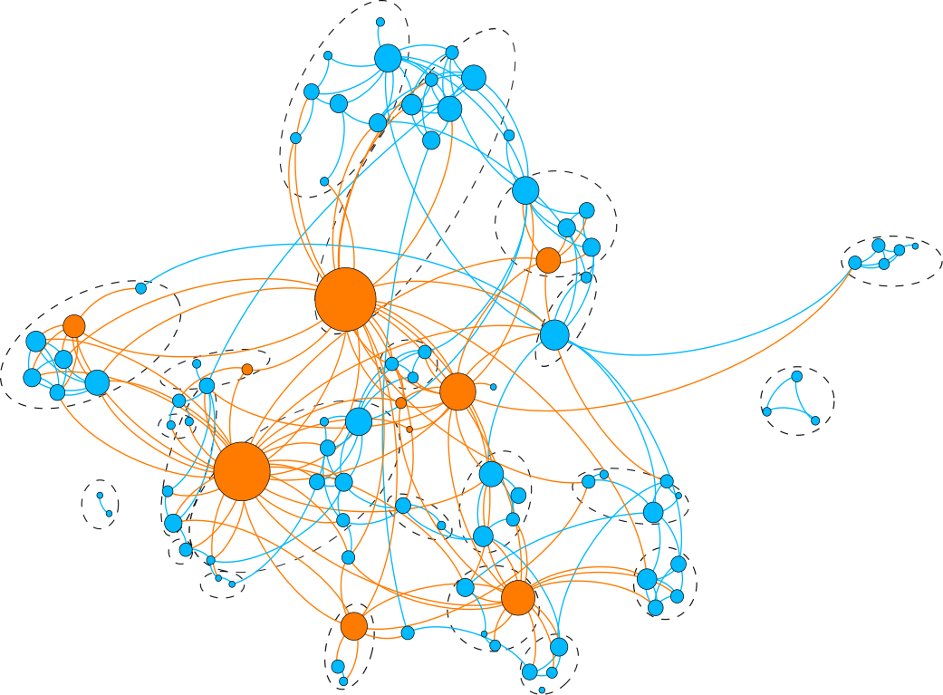
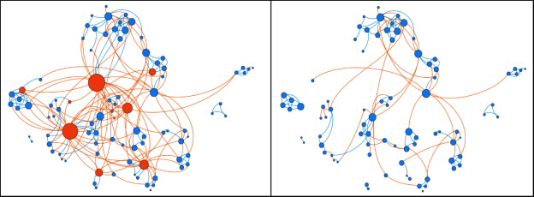
Mentors form bridges
Ma et al., in review

Slide 22
Does not promote
bridging ties
Promotes
bridging ties
Does not promote strong ties
Traditional teaching structures
Promotes
strong ties

Slide 23
Does not promote
bridging ties
Promotes
bridging ties
Does not promote strong ties
Traditional teaching structures
Center for teaching and learning
Promotes
strong ties

Slide 24
Does not promote
bridging ties
Promotes
bridging ties
Does not promote strong ties
Traditional teaching structures
Center for teaching and learning
Promotes
strong ties
Discipline-based education researchers

Slide 25
Does not promote
bridging ties
Promotes
bridging ties
Does not promote strong ties
Traditional teaching structures
Center for teaching and learning
Promotes
strong ties
Discipline-based education researchers
Course-centric CoPs connected by mentors

Slide 26
Does not promote
bridging ties
Promotes
bridging ties
Does not promote strong ties
Traditional teaching structures
Center for teaching and learning
Promotes
strong ties
Discipline-based education researchers
Course-centric CoPs connected by mentors

Slide 27
Community of Practice

Slide 28
Community of Practice

Slide 29
Questions?
Thank You!

Slide 31
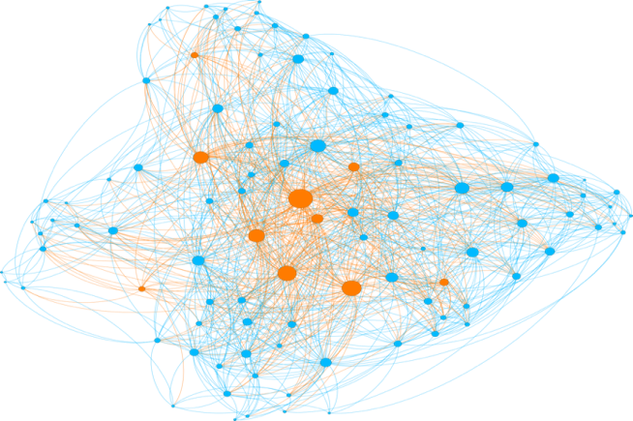


Slide 32
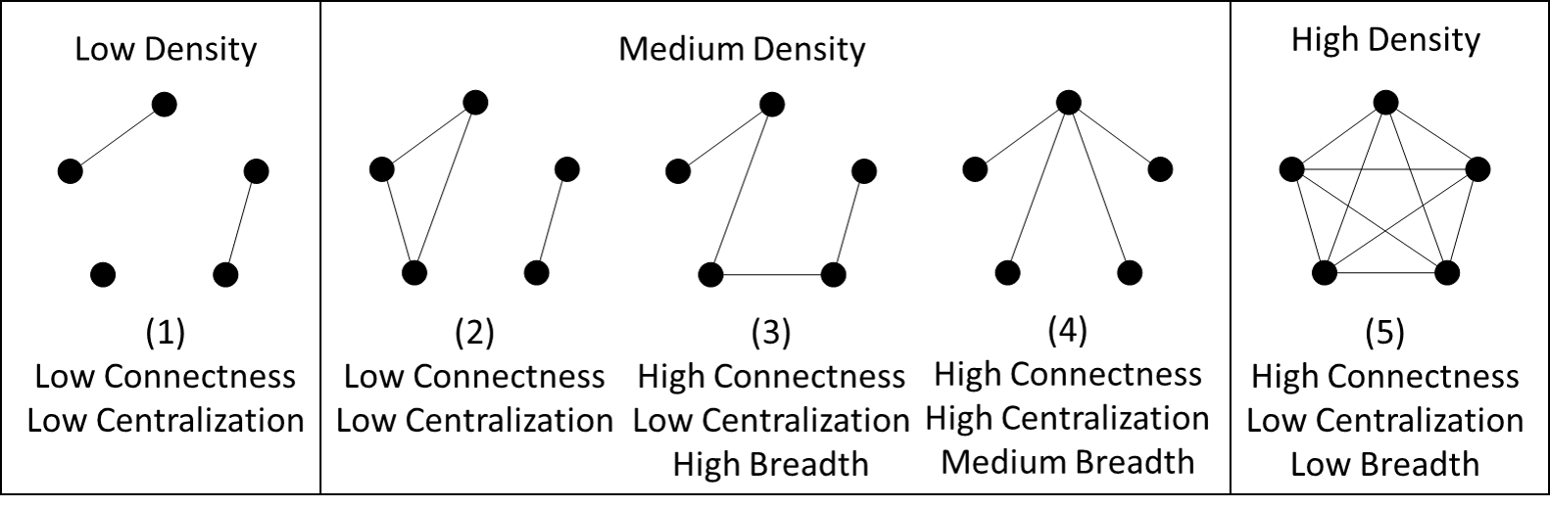

Slide 33
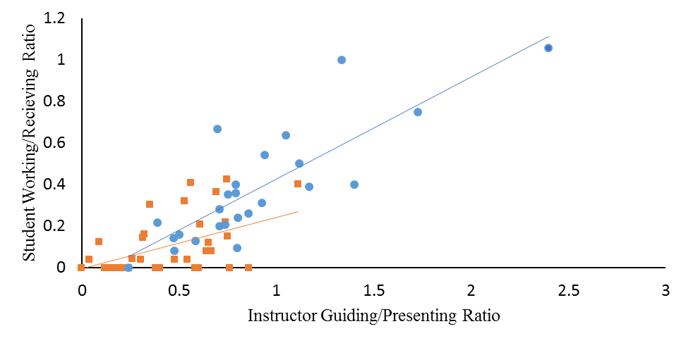
Classroom observations
Tomkin et al., in prep.

Slide 35
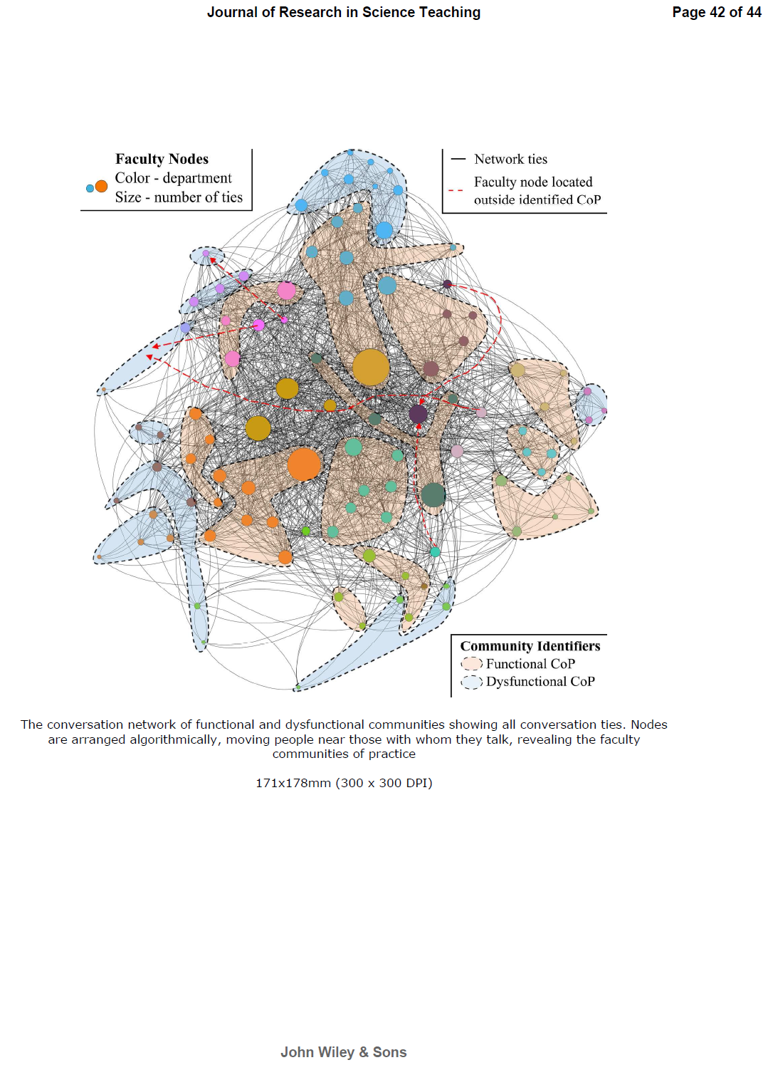
Ma et al., in review

