Slide 1
PRESENTATION
TITLE HERE
Session T128: Teaching about the Earth Online
Redeveloping Online
(Geo)Science Pedagogy at
Western Governors University
  Suzanne T. Metlay, Western Governors University, Salt Lake City, UT
  Rachel L. Sims, Western Governors University, Salt Lake City, UT
Geological Society of America Annual Meeting
Seattle, WA
22 October 2017
AUTHOR’S NAME HERE

Slide 2

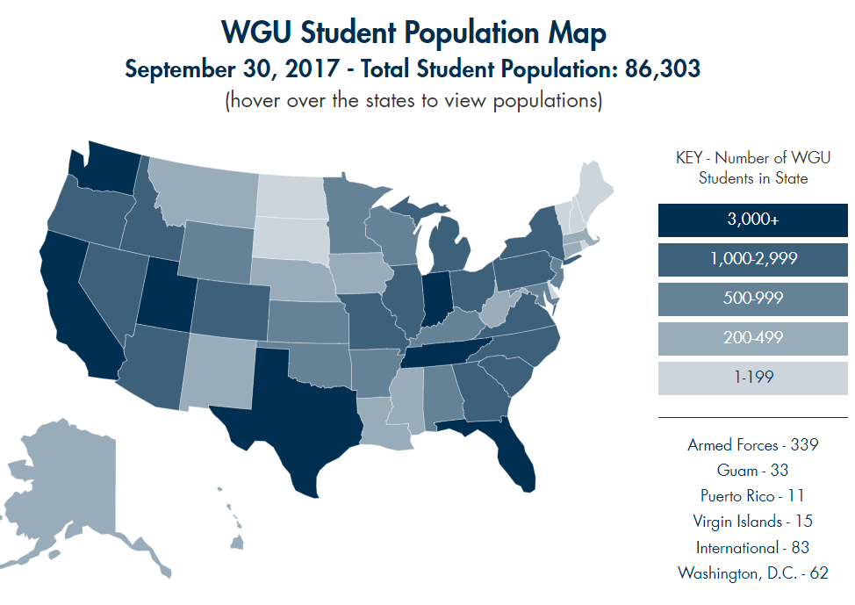
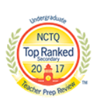
WGU Overview
Western Governors University, Teachers College
  Competency-Based Learning
    Bachelors & Masters degrees in Education
  Completely online until Field Placement
    Students observe & teach in actual classrooms
    Licensure/endorsement & Praxis exams are graduation requirements
  Students in all 50 states, DC, US territories, & US military bases
    WGU accommodates changes in state science standards, education reforms
WGU Teachers College
Current enrollment: ~20,000 students
in all programs
(undergrad + graduate)

Slide 3
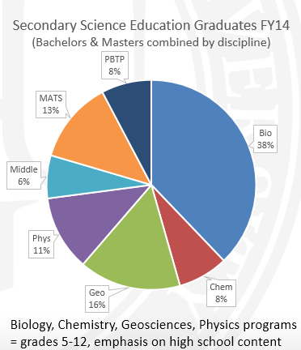
New courses rolling out in Fall 2017
Science Pedagogy – New courses launched Sept 2017
Geosciences programs – New courses: Nov 2017
Geosciences Education
Middle School Science Education
For those who already have degrees in science,
initial licensure programs:
  Master of Arts in Teaching Science
  Post-Baccalaureate Teacher Preparation

Slide 4
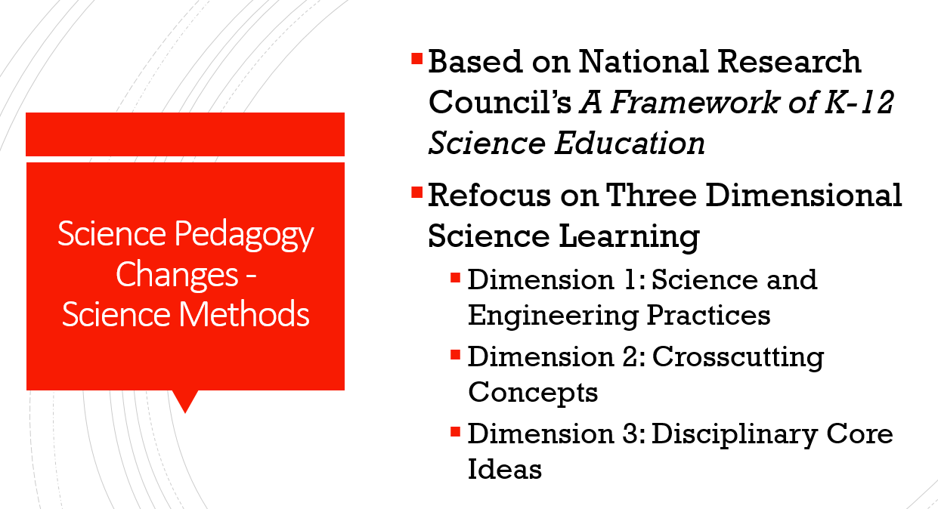
What are we doing?
Why are we doing it?
State licensure requirements are changing as more states adopt or adapt to
Framework, NGSS, edTPA, and CAEP recommendations

Slide 5

Improvements in Science pedagogy at WGU include:
Science Methods Course
Increased emphasis on three-dimensional science
Science-specific lesson planning and lesson evaluation
Science laboratory safety
Pre-clinical Experience in the classroom
  From 60 hours required
    45 hours observed, 15 hours engaged
  To 75 hours required
    60 hours observed, 15 hours engaged
Concepts in Science course – coming in January 2018
Introductory course before science sequence
Fundamentals such as scientific notation, unit conversion, etc.

Slide 6
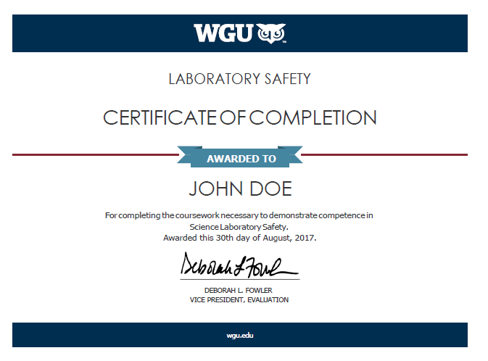
Lab Safety certificate
Issued to students who successfully complete four performance assessments including a lab safety assignment.
Includes:
  Safety Contract
  Safety Equipment
  Science Equipment
  Common Chemicals
    Safe storage and disposal
  Safety and Ethics with the use of
  living organisms and dissections.

Slide 7
Science Teacher Professional Standards & Ethics
WGU Teachers College is a School of Education
Teacher Success Support Staff
Science professional development focus
Code of Ethics, Professional Behaviors and Dispositions
This evaluation analyzes the following dispositions:
  Caring and considerate
  Affirming of diversity and cross-culturally competent
  Reflective practitioner
  Equitable and fair
  Committed to the belief that all students can learn
  Collaborative
  Technologically proficient
  Professional leadership

Slide 8
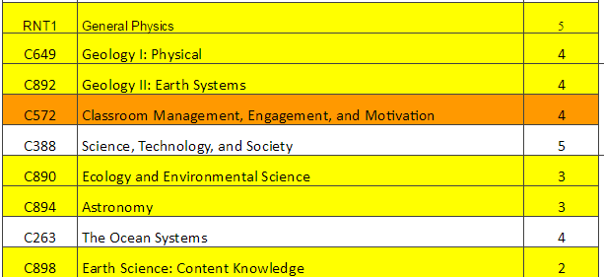
follow the standard path
Instructional sequence is pre-determined
No electives
WGU Secondary Science Courses build upon each other.
Need to know content before applying by teaching that content.
Learn how to write assessments and lesson plans before applying those concepts to teaching science.

Slide 9
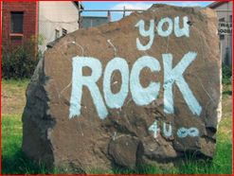
Improvements to Geoscience Education Programs at WGU:
4 new courses
Deeper dive into disciplinary content
Geology I: Physical
Geology II: Earth Systems
  Includes meteorology and hydrology
  Emphasis on critical zone science
Ecology & Environmental Science
  Shared with Biology Education and Middle School Science programs
Astronomy
  Shared with Middle School Science programs

Slide 10
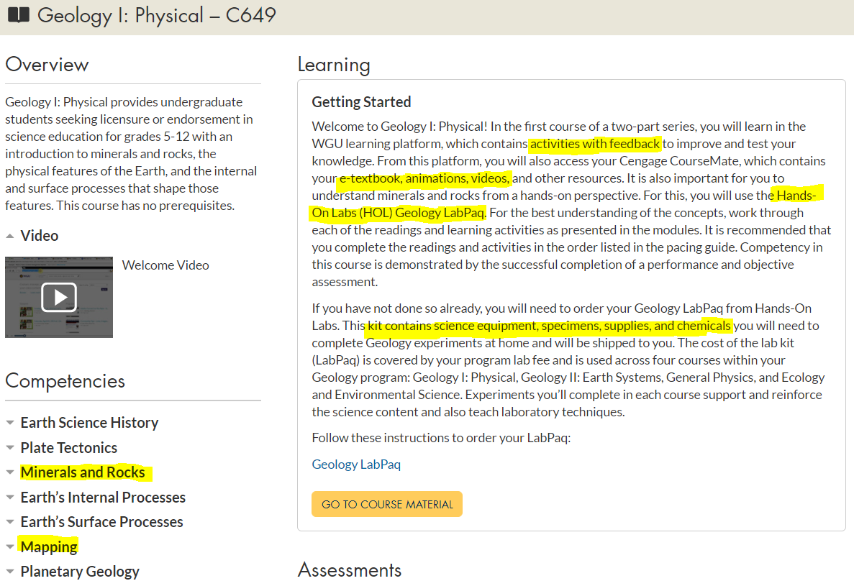
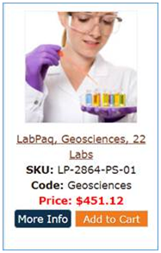

Slide 11
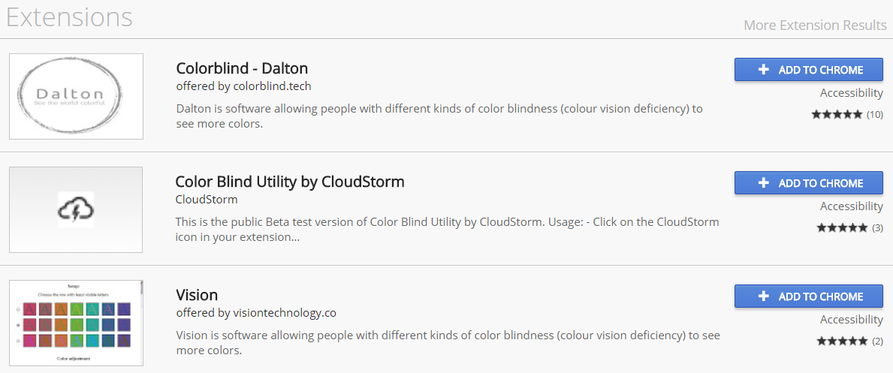
Mapping task
No virtual field trips allowed - Students must explore their own environment
  Within reasonable safety and accommodation constraints per the Americans with Disabilities Act
Nearly 10% students are color vision deficient or otherwise visually impaired
Apply hatching, filtering, or hue saturation to online geologic maps or images
  Visolve: http://www.ryobi-sol.co.jp/visolve/en/visolve.html
  EyePilot: http://www.eyepilot.com/
  FirefoxAddOn: https://addons.mozilla.org/en-US/firefox/addon/colorblindext/

Slide 12
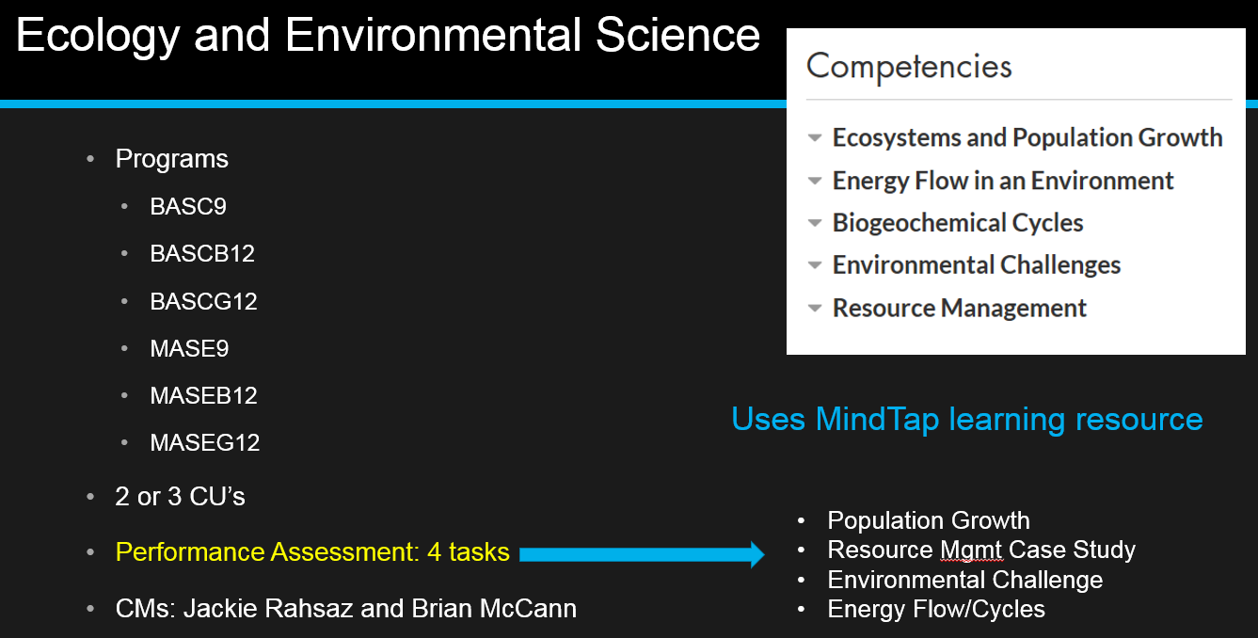
Place-Based Learning:
Students identify and consider local environmental challenges
- Whenever possible, go local on resource management case studies

Slide 13
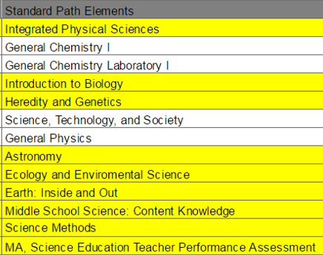
Improvements to Middle School Science Education programs
Physics first
Replaced single geoscience course with:
Astronomy
Ecology & Environment
Earth: Inside & Out
  American Museum of Natural History (AMNH) Seminar on Science

Slide 14
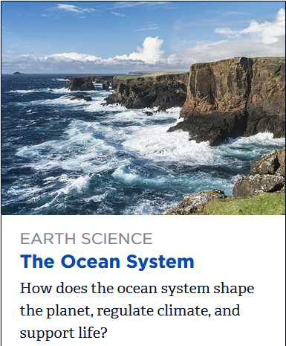
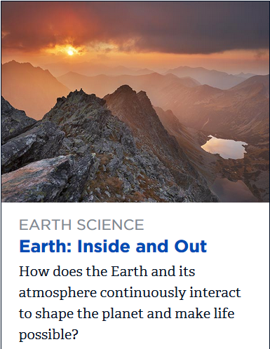
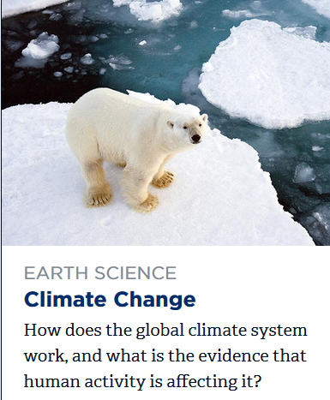
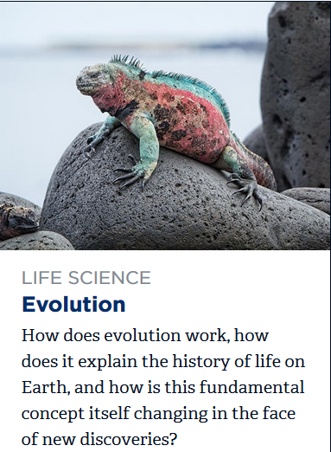
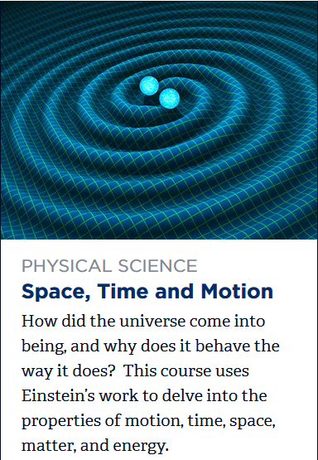
AMNH Seminars on Science now required for WGU Secondary Education science

Slide 15

Contact Us
Rachel L. Sims, Ed.D.
Teacher Education: Science Pedagogy
Western Governors University
4001 South 700 East, Suite 700
Salt Lake City, UT 84107
385-428-7212
rachel.sims@wgu.edu
pedagogy@wgu.edu
Suzanne T. Metlay, Ph.D.
Teacher Education: Geosciences
Western Governors University
4001 South 700 East, Suite 700
Salt Lake City, UT 84107
385-428-4961
suzanne.metlay@wgu.edu
geosciences@wgu.edu

Slide 16
References –
AccessIQ (2015). “Accessibility Tips: Making maps Accessible”. Obtained from http://www.accessiq.org/news/news/2015/03/accessibility-tip-making-maps-accessible
American Museum of Natural History Seminars on Science graphics obtained from
http://www.amnh.org/learn-teach/seminars-on-science/courses
Chrome extensions graphic obtained on 14 October 2017 from https://chrome.google.com/webstore/search/color%20blind?utm_source=chrome-ntp-icon
De Paor, D., et al. (2017). “Color Vision Deficiency and the Geosciences”. GSA Today, Volume 27, Issue 6, pages 42-43.
EyePilot: http://www.eyepilot.com/
Firefox AddOns: https://addons.mozilla.org/en-US/firefox/addon/colorblindext/
Geology I front page obtained from https://my.wgu.edu/courses/course/4240099
Visolve: http://www.ryobi-sol.co.jp/visolve/en/visolve.html
WGU accreditation and population graphics obtained from https://www.wgu.edu/about_WGU/accreditation and
https://www.wgu.edu/about_WGU/students_alumni

