Slide 1

Organo-Mineral Structures, Organominerals, and Exceptional Fossil Preservation: A Microcosm of the Influence of Iron-Oxidizing Bacteria on the Fossil Record
M. A. STRANGE¹, J. D. SCHIFFBAUER², M. REN¹, AND S. M. ROWLAND¹
¹Department of Geoscience, University of Nevada, Las Vegas, NV, USA
²Department of Geological Sciences, University of Missouri, Columbia, MO, USA

Slide 2
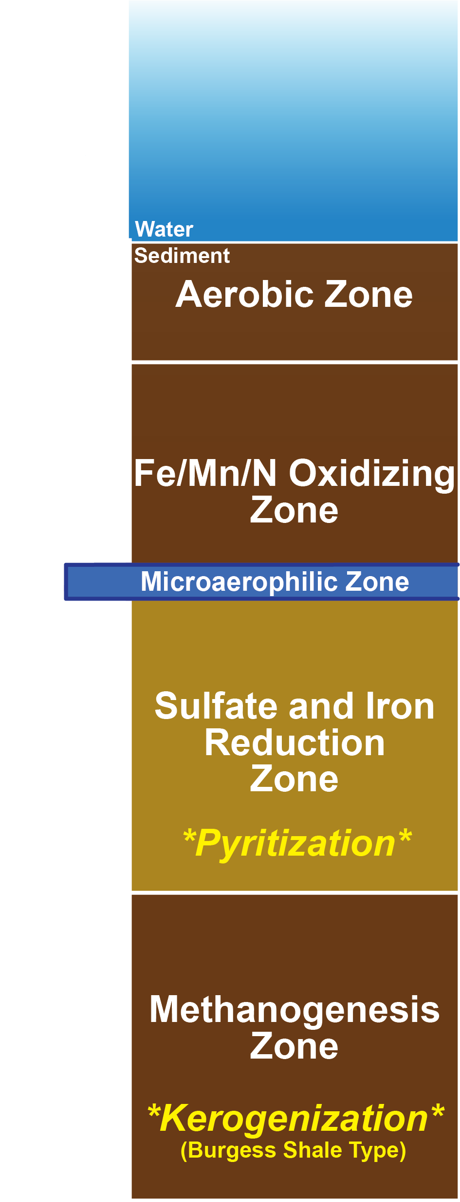
Taphonomic Modes
Sediment Microbial/Redox Zonation Model (Schiffbauer et al. 2014)
Sulfate Reducing metabolism = Pyritization
Methane Reducing metabolism = Kerogenization
Project Goal: Integrate Deep Spring tube fossils into taphonomic model

Slide 3

Deep Spring
Tube Fossils- the Wormworld Fauna
Latest Ediacaran
Tubicolous vermiforms
Shale unit between microbialite reefs
Generalized tubicolous vermiform reconstruction
Smith et al. 2016

Slide 4
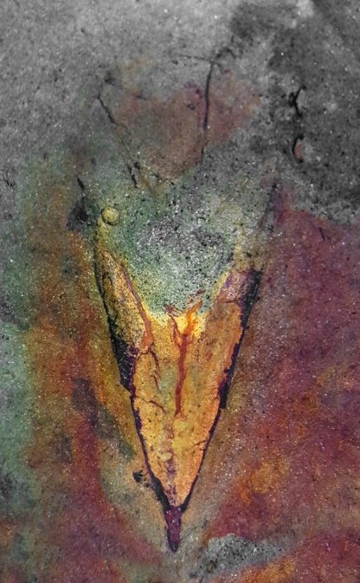
Methods
Deep Spring Tube Fossils
Three specimens
  2 Deep Spring Formation tube fossils
  1 Spence Shale (Langston Formation) Hyolith
Electron Probe MicroAnalysis (EPMA) of authigenic minerals
  Non-Metric Multidimensional Scaling (NMDS)
Raman Spectroscopy
Scanning Electron Microscopy
  Backscatter electron imaging
DSM-200
DSM-300
Spence Shale
Hyolith

Slide 5
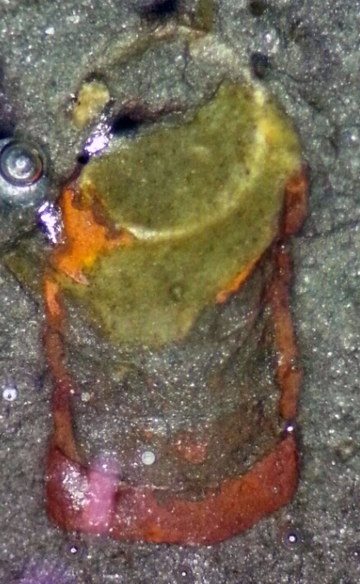
Results:
DSM-200
C
Clays of variable Fe content dominant
Lesser amount of Fe Oxyhydroxides
e
Iron-Rich Clay
Iron Oxyhydroxide

Slide 6
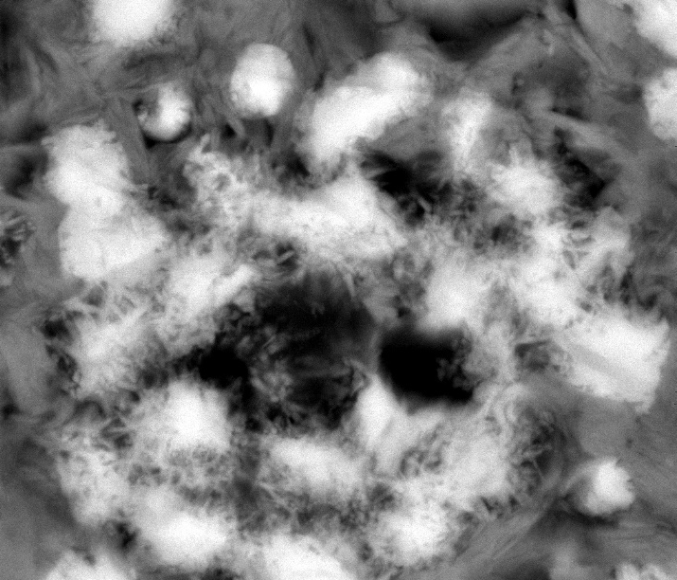
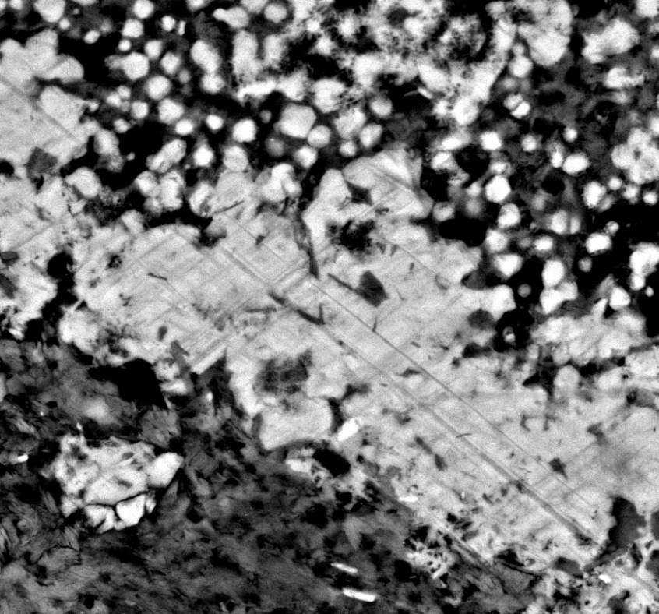
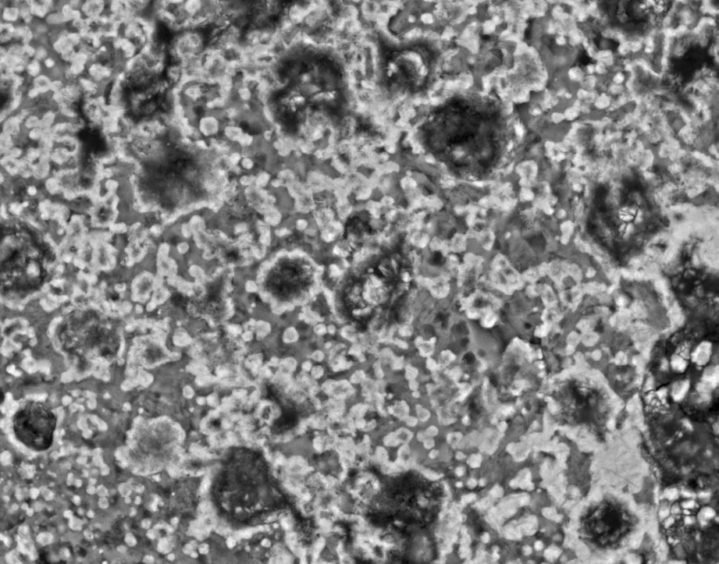
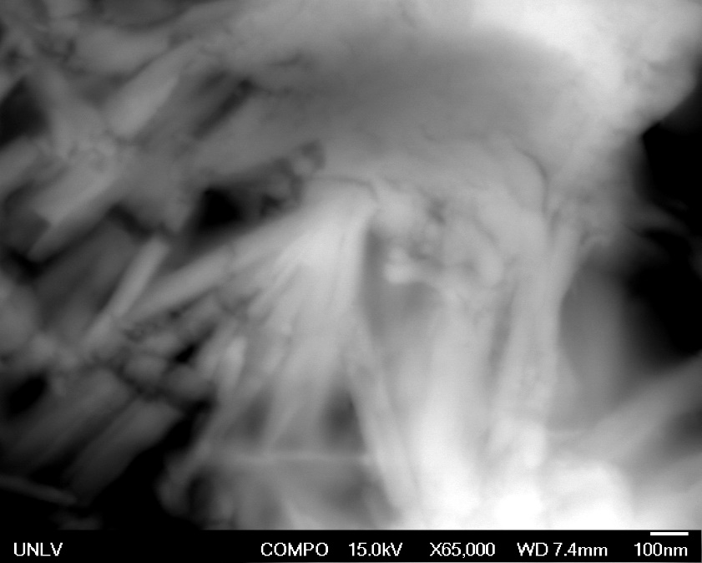
Electron Imaging:
DSM-200
Massive amalgamations
Individual micronodules
Hollow spheres
Nano-fibers
**Fe-rich clay matrix**
1μm
10μm
200nm
10μm

Slide 7
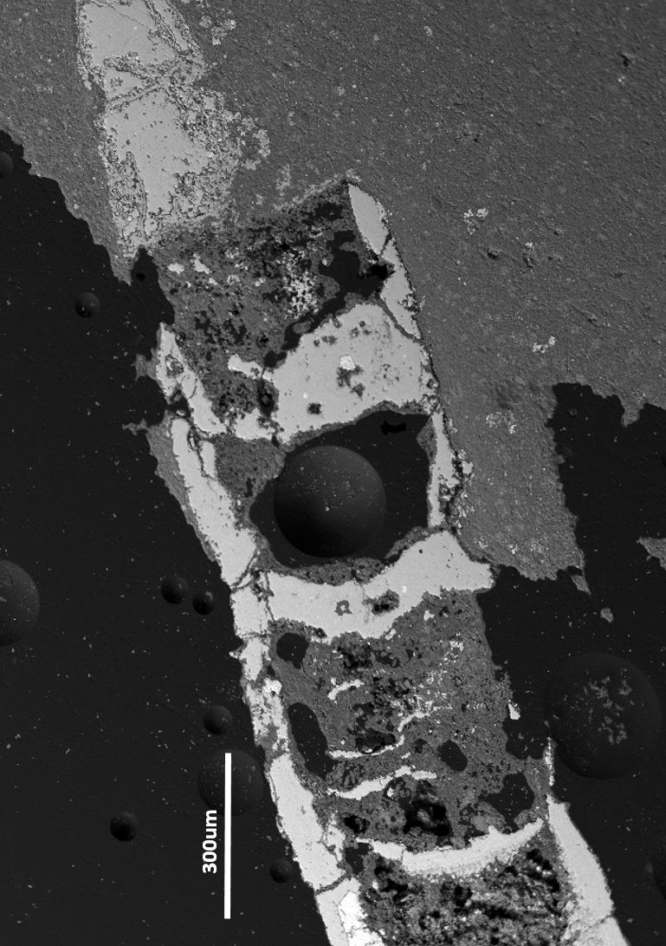
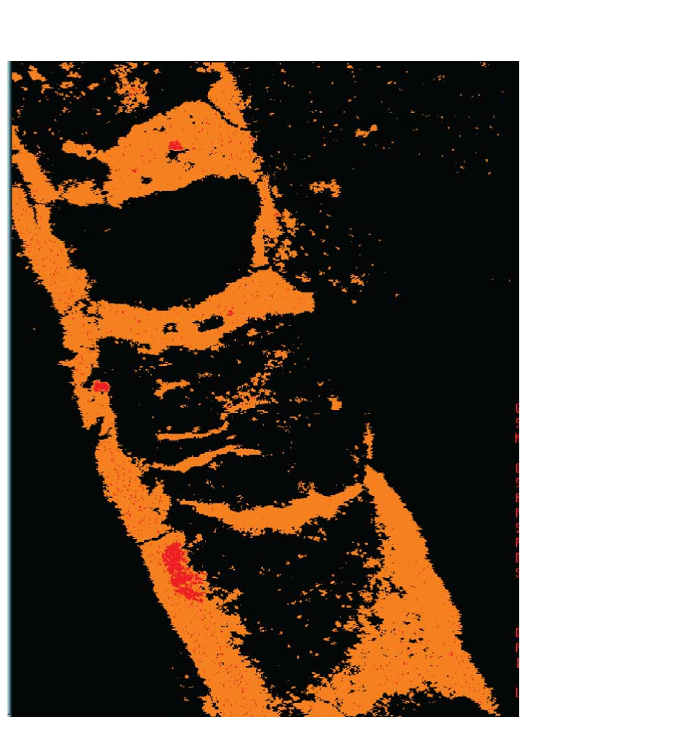
Results:
DSM-300
Nearly complete lack of Fe-rich clays
Abundant Fe Oxides
Fe Oxide

Slide 8
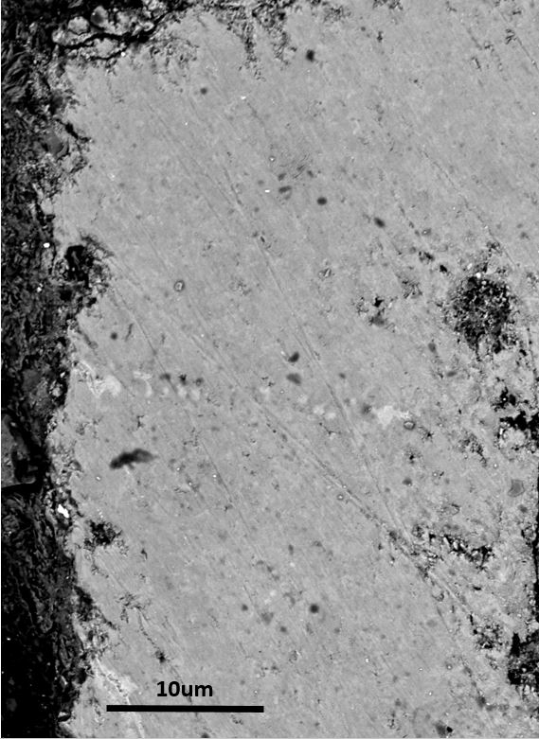
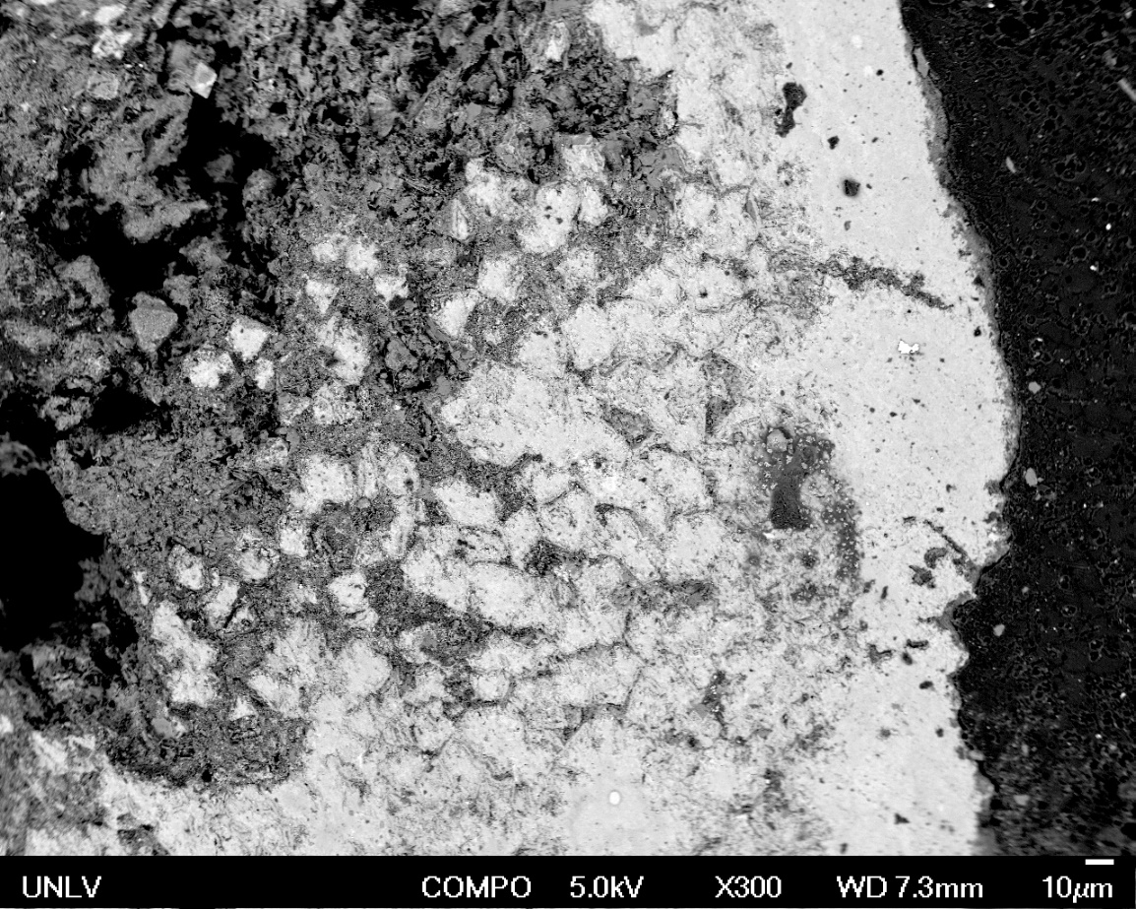
Electron Imaging:
DSM-300
30μm

Slide 9
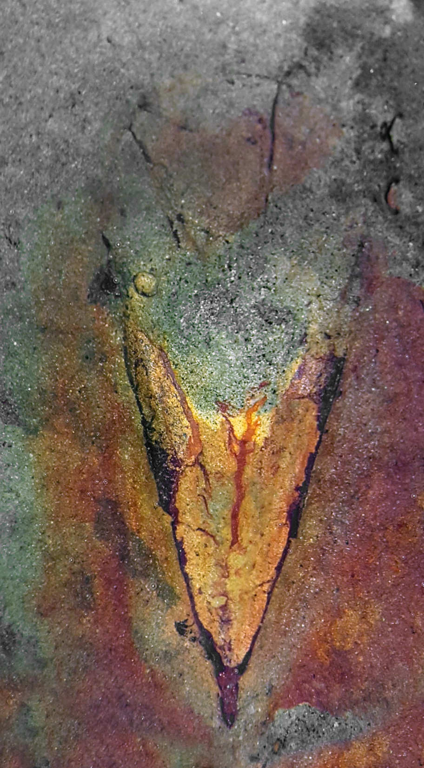
Electron Imaging:
Hyolith
Remnant pyrite cores
Iron oxide rims and amalgamation
Fe-rich clay matrix

Slide 10

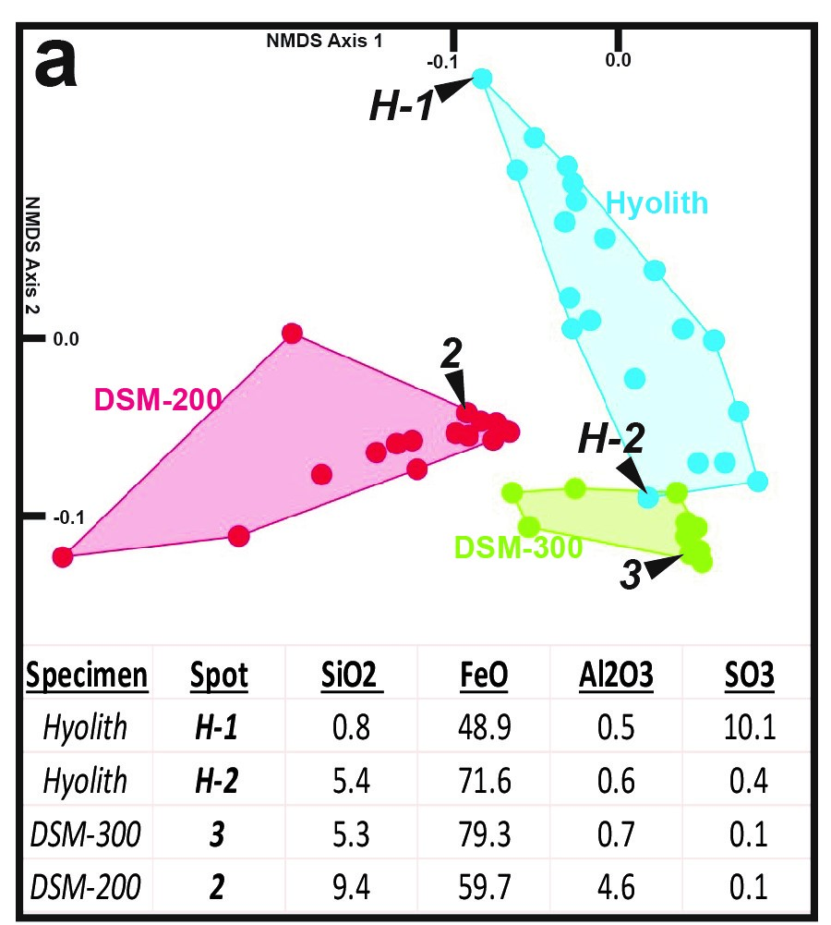
Microprobe Data Analysis
Hyolith oxidation evident in downward trend from pyrite (H-1) to Fe oxyhydroxide (H-2)
DSM-300 points cluster at the end of pyrite oxidation trend
DSM-200 outside of pyrite oxidation trend
S-Fe correlation
  DSM 300 R²= -.78
  Hyolith R²= -.72
  DSM 200 R²= .07

Slide 11
Raman Spectroscopy
HAEMATITE
DSM-300
GOETHITE
DSM-200

Slide 12
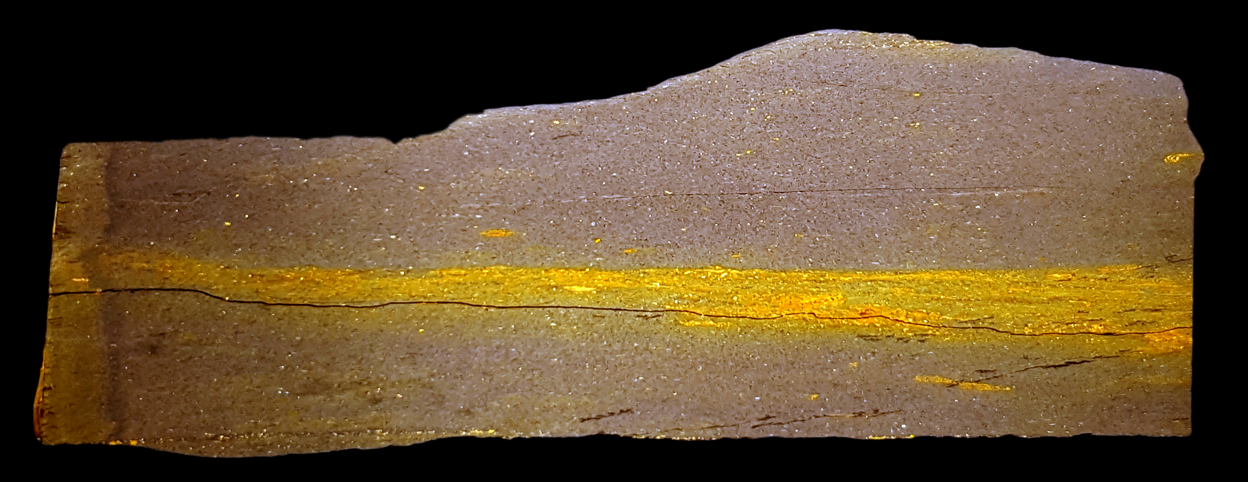
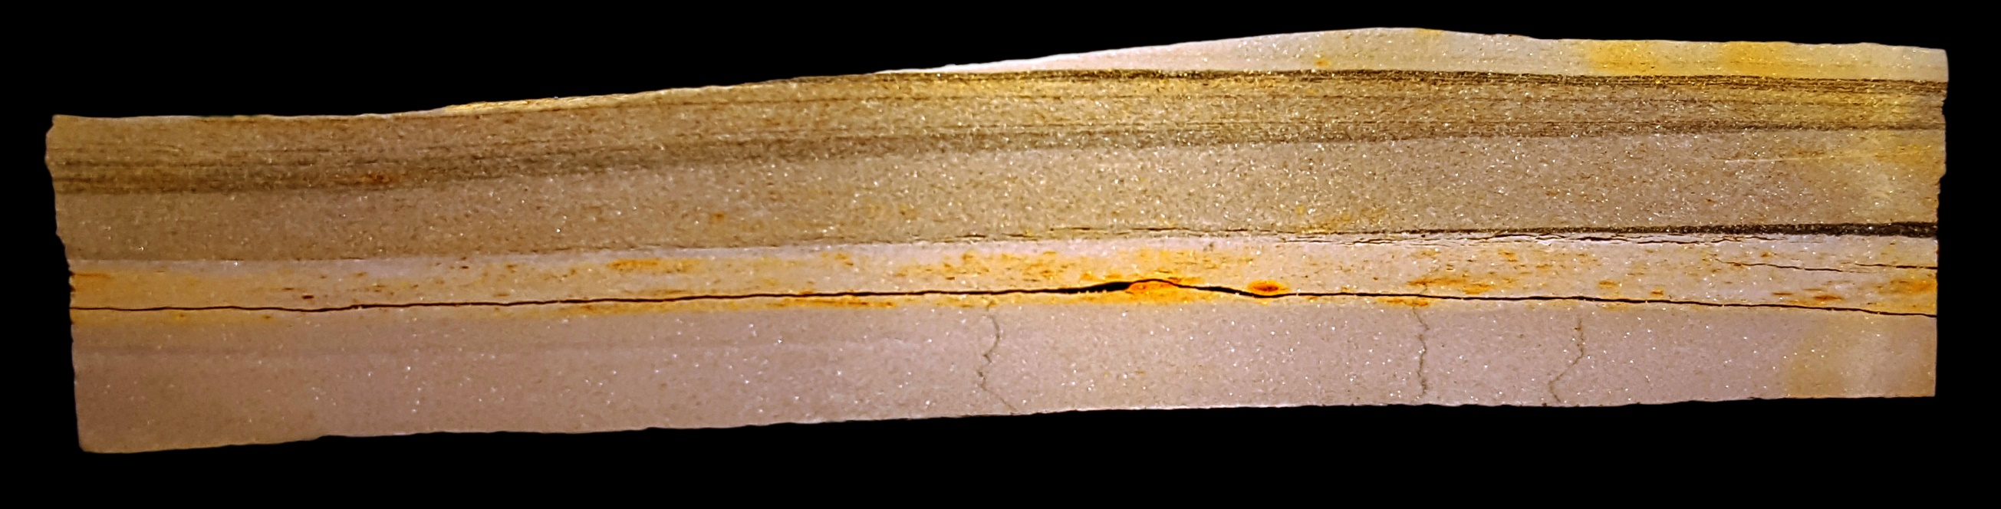
Host-Rock Characterization
Facies 1
Facies 2
Horizon
Fossil
1cm

Slide 13
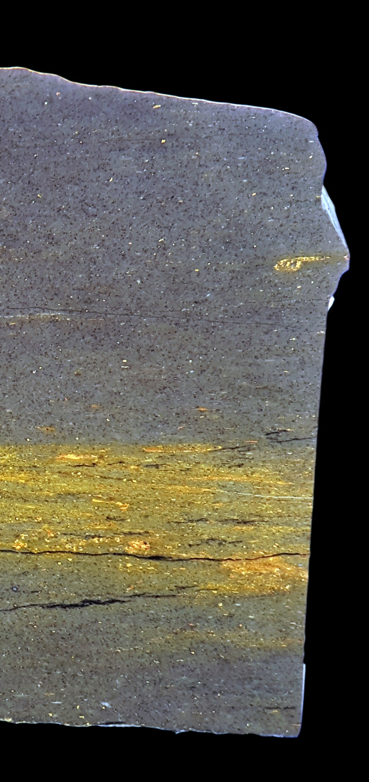
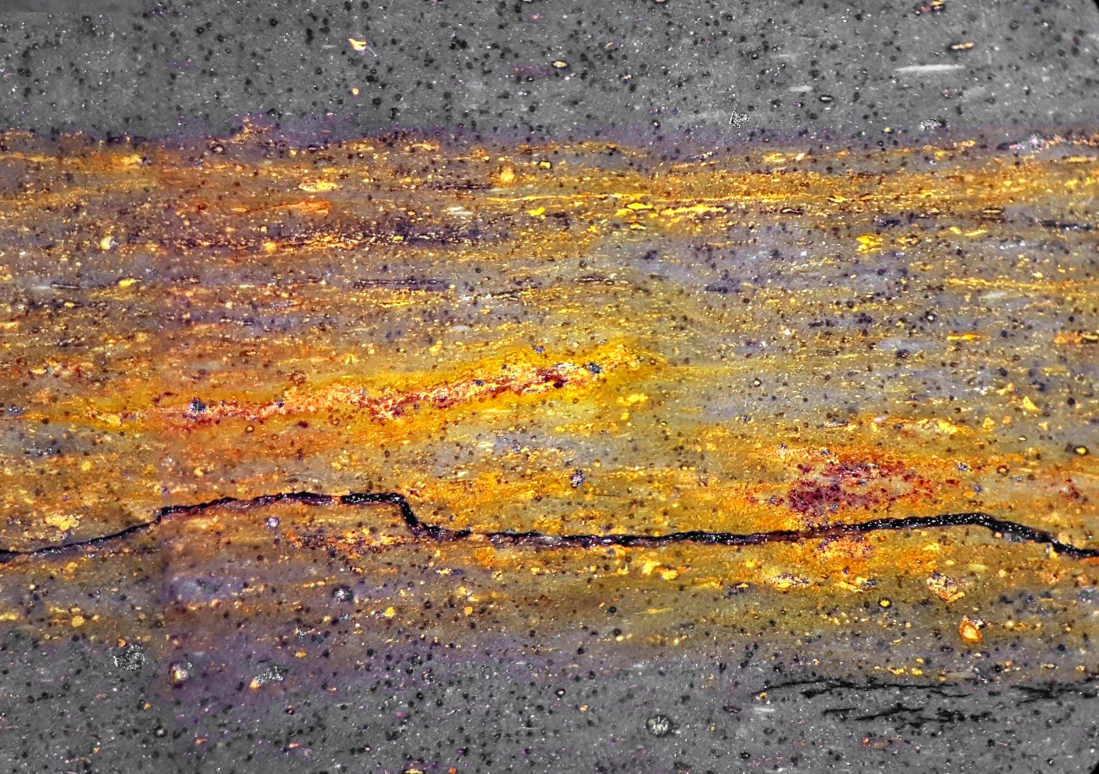
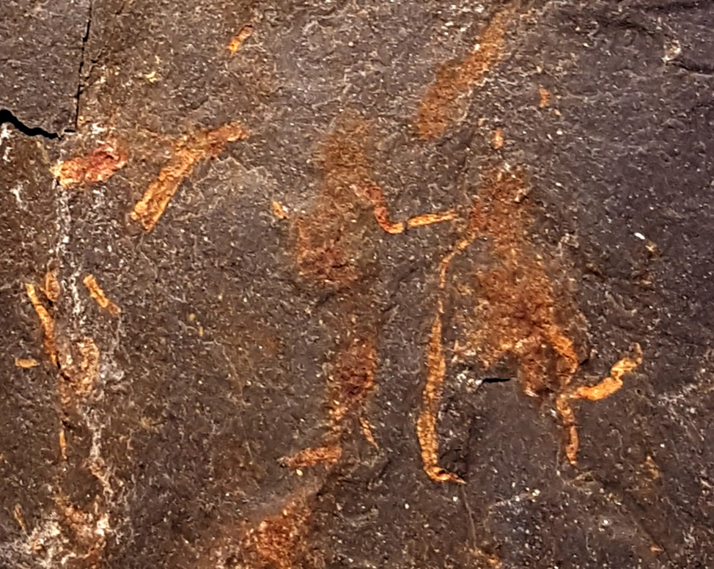
Facies 1
Consistent sedimentation
Very abundant fossils
Low preservational quality
Diffuse 2-D mineralization

Slide 14
Facies 1
Abundant mineralization patches throughout sediment

Slide 15
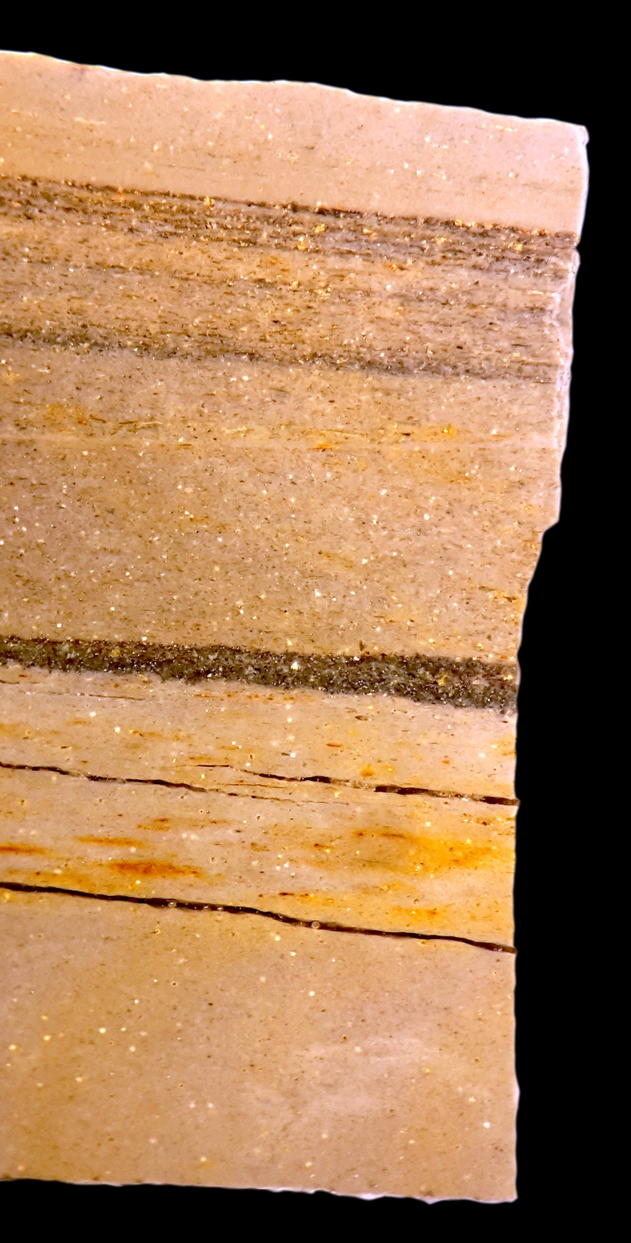
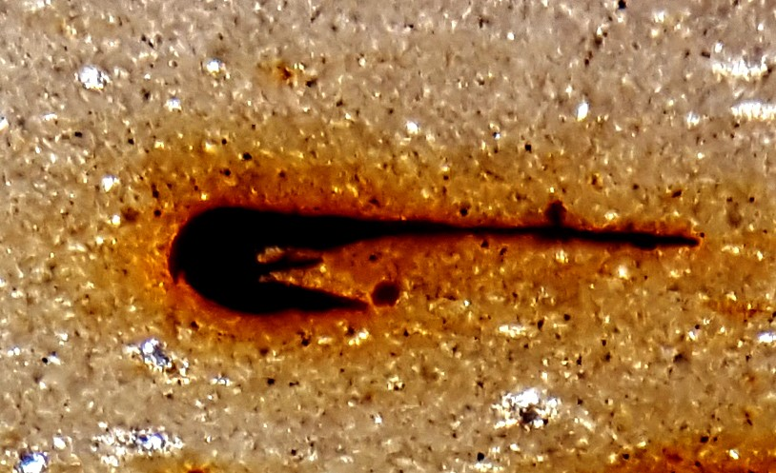
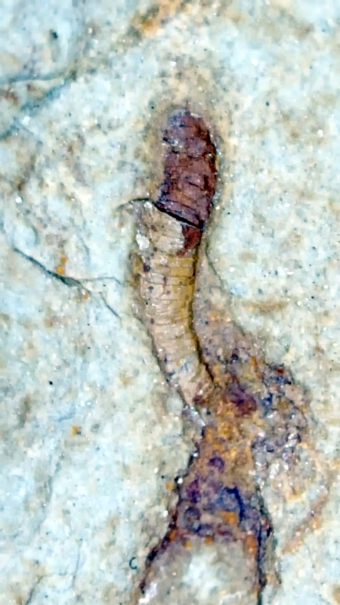
Facies 2
Changes in sedimentation
Sparse fossils
Highly localized, 3-D mineralization

Slide 16
Facies 2
Sparse mineralization throughout sediment

Slide 17
Microaerophilic Zone:
Fe Oxidizing Bacteria (FeOB)
Sediment Microbial/Redox Zonation Model (Schiffbauer et al. 2014)
Microaerophilic Zone straddling the Oxic-Anoxic boundary
  FeOB proliferate
  Outcompete abiotic Fe oxidation
Wide variety of organo-mineral structures and Fe-organominerals are known to be created within this environment

Slide 18
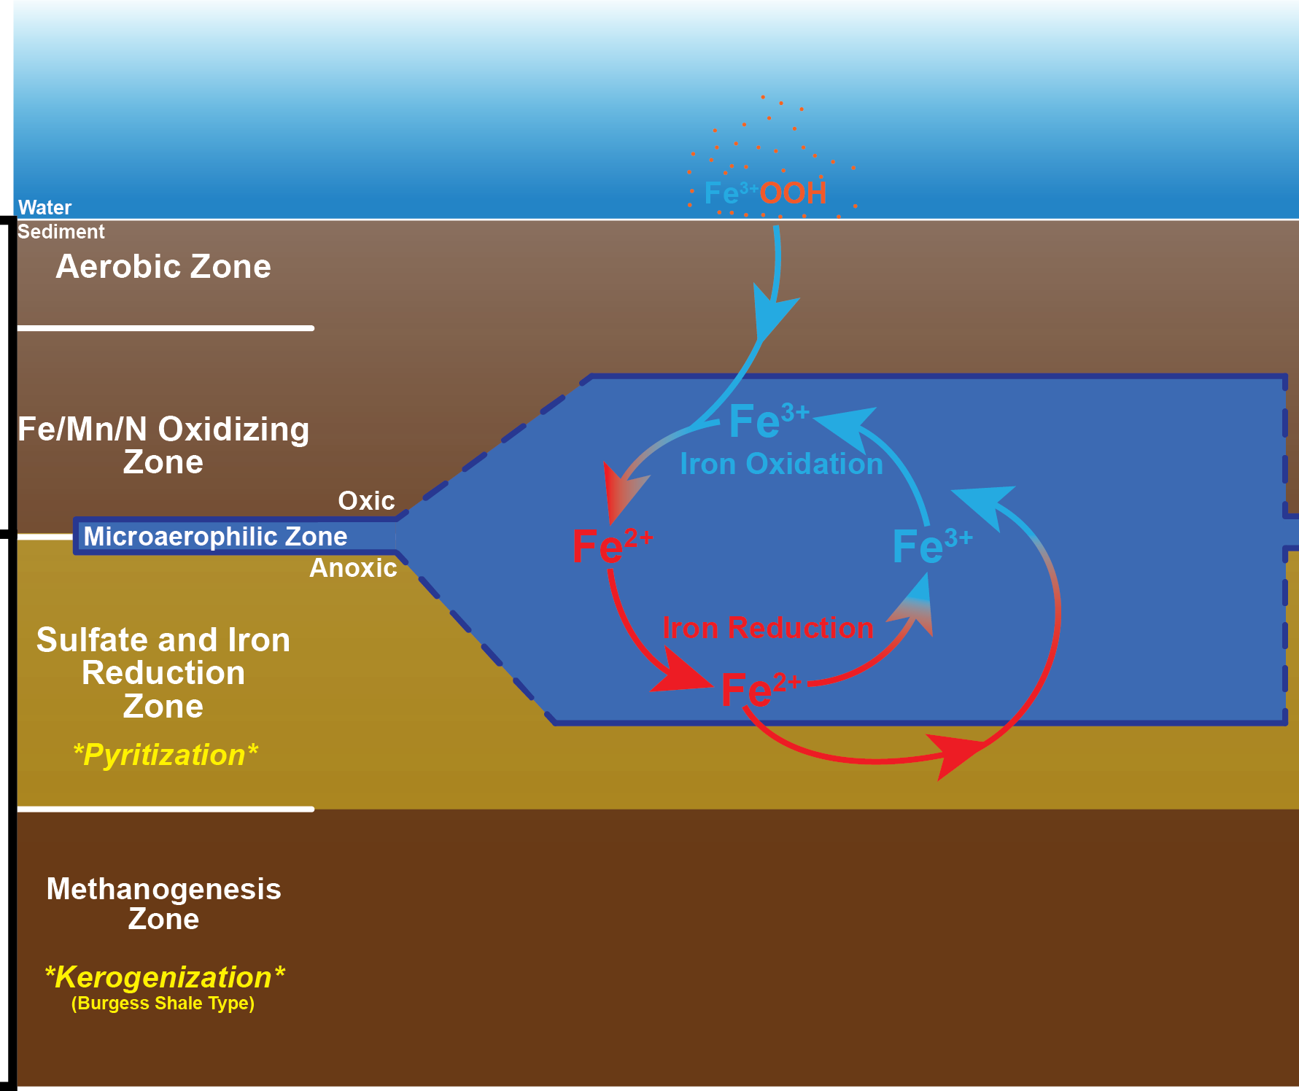
Taphonomic
Model
Dynamic Cycling Fe²⁺ and Fe³⁺
Concentrated around the microaerophilic zone
  Oxidation above
  Reduction below
  Both occurring within
Diffusion from above and below
Oxic
Anoxic

Slide 19
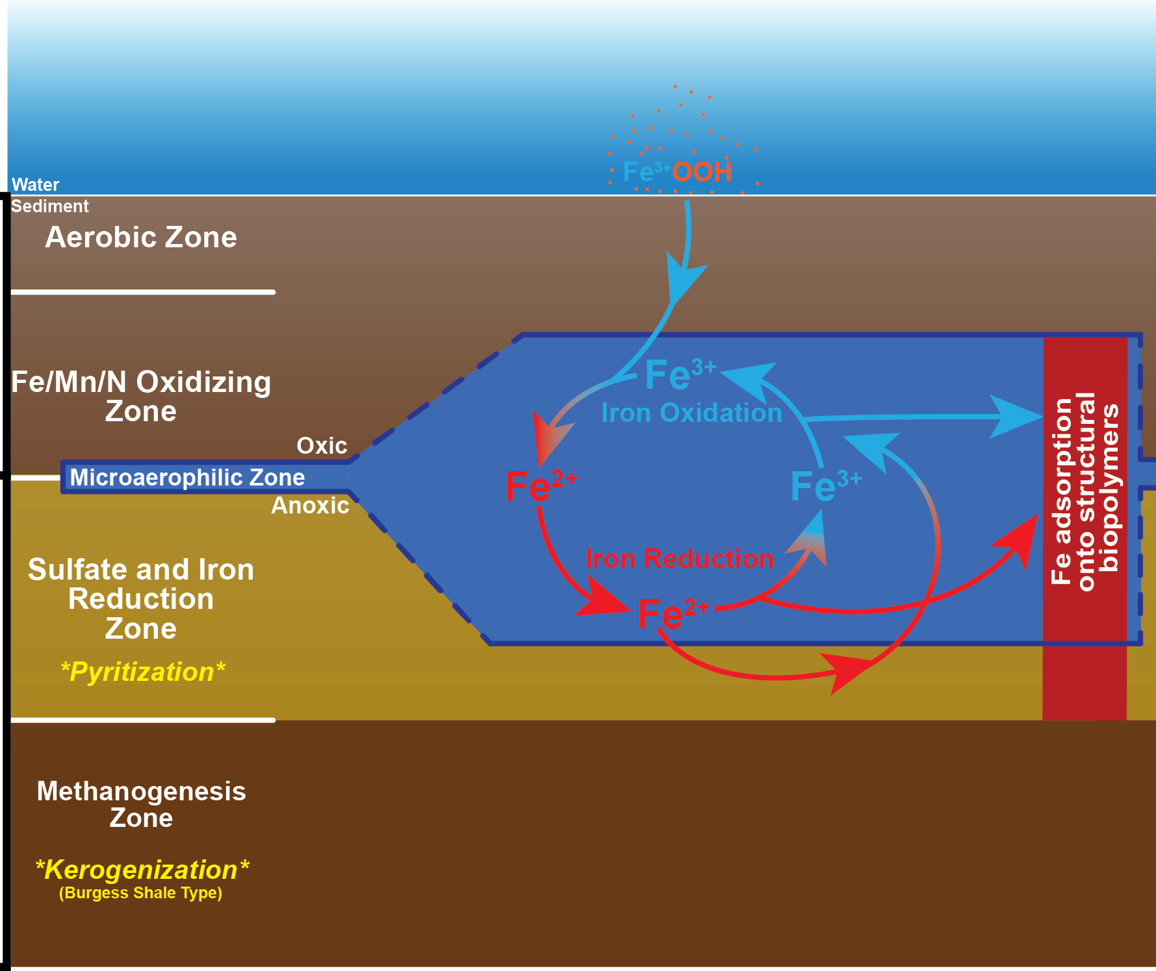
Taphonomic
Model
Abundance of Fe²⁺ and Fe³⁺ due to the constant pool renewal
Fe adsorption onto structural biopolymers likely concentrated here
Oxic
Anoxic

Slide 20
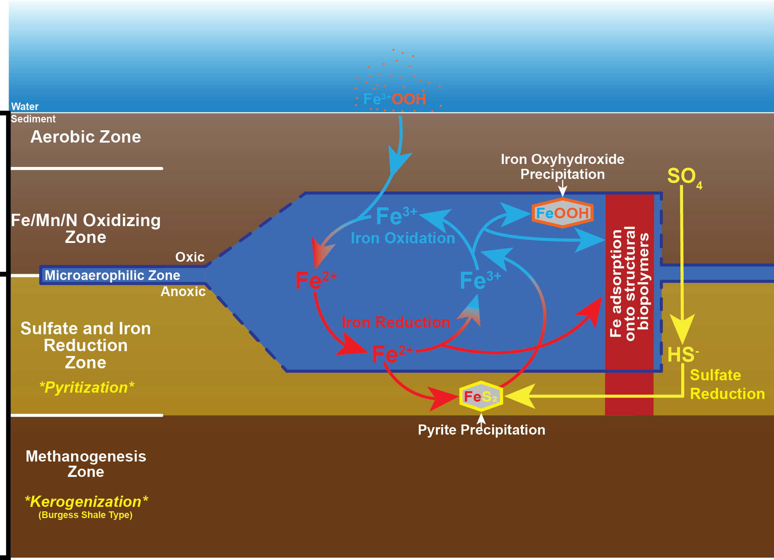
Mineralization
Fe Oxyhydroxide precipitation after Fe oxidation
Pyrite and pyrite precursor precipitation after Fe and sulfate reduction
Kerogenization and clay authigenesis occurring lower in the Methanogenesis zone
Oxic
Anoxic

Slide 21
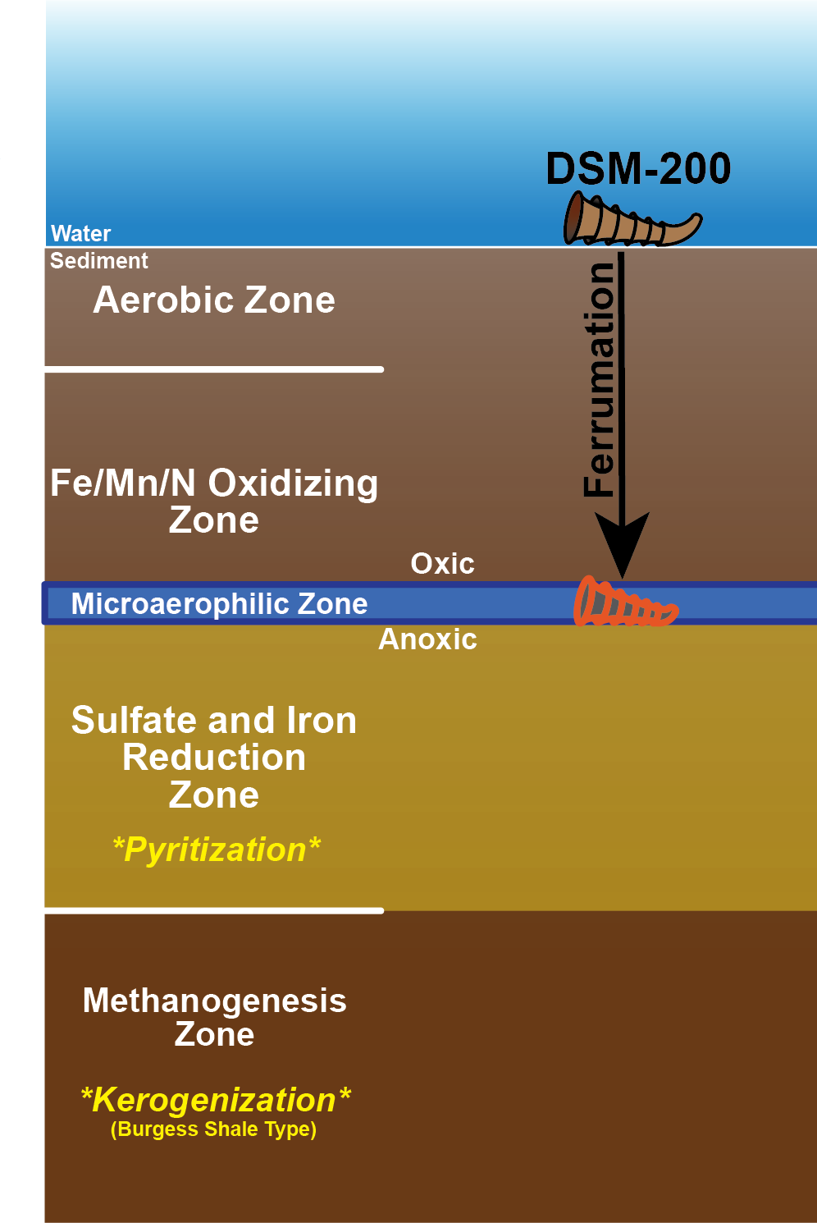
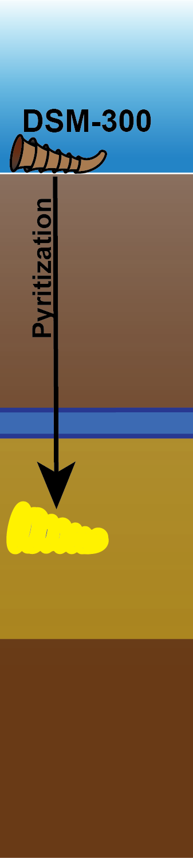
Preservation of DSM-300: Pyritization
Goethitization
Goethitization
Similar composition to pyritized hyolith
Replication of soft-tissues through pyritization
Oxic
Anoxic

Slide 22
Preservation of DSM-200: Goethitization
Rapid Post-depositional sedimentation rate to allow quick burial into Microaerophilic zone
FeOB proliferate within the tube using labile tissues as organic fuel while oxidizing Fe
Early Fe adsorption reduces decay of tube walls and provides nucleation sites
  Iron-rich clays
  Iron Oxyhydroxide
Goethitization
Oxic
Anoxic

Slide 23
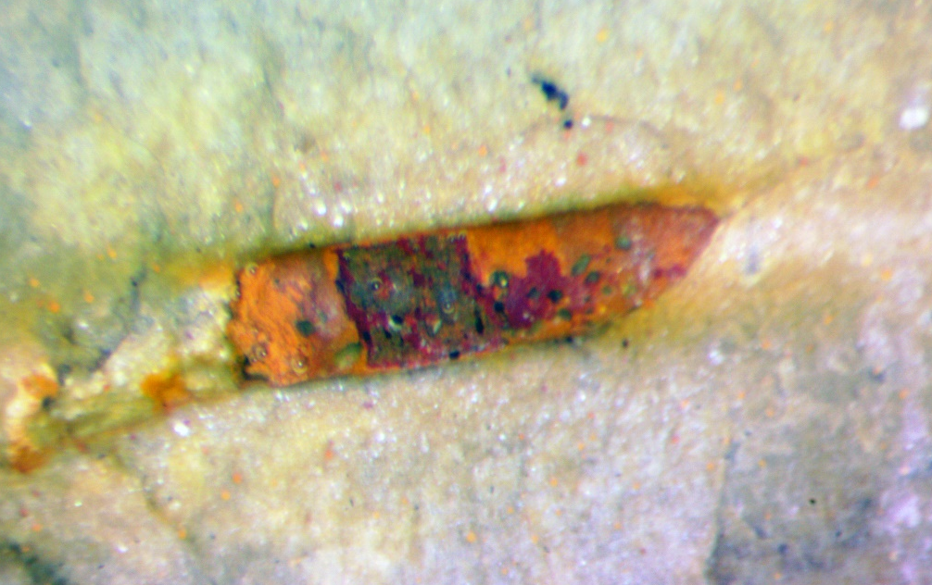
Organo-Mineral Structure
1mm
100μm

Slide 24
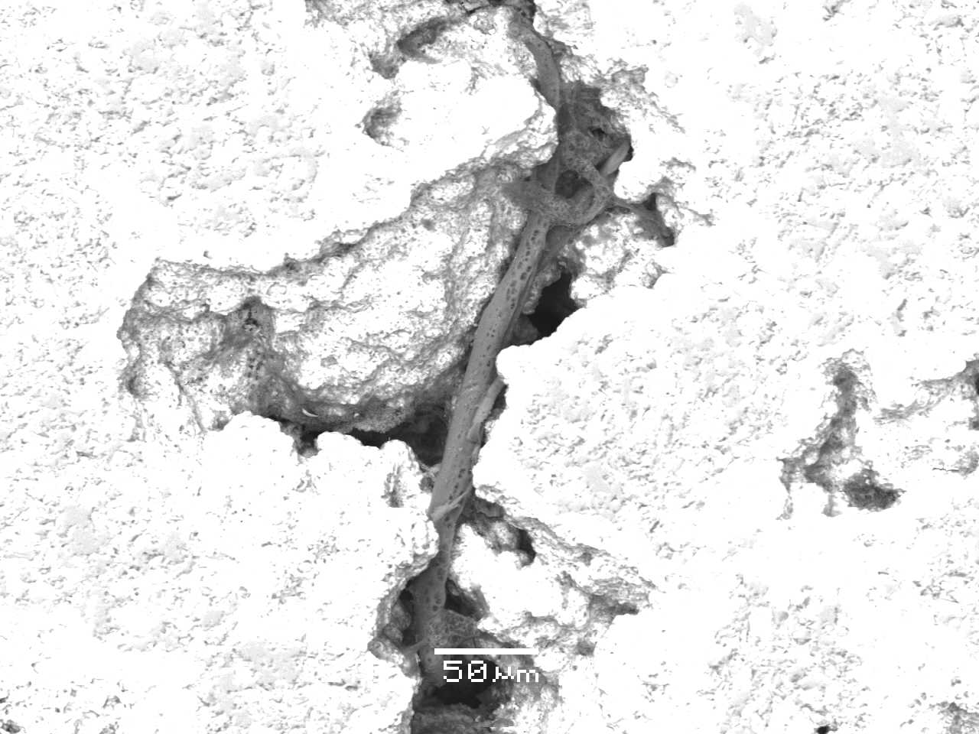
Organo-Mineral Structure
Found within mineralized cavity
Dehydrated Extracellular Polysaccharide (EPS) ???
Mineralization within organic matrix
Raman Spectroscopy confirmed both organic matter and Fe mineral phase

Slide 25
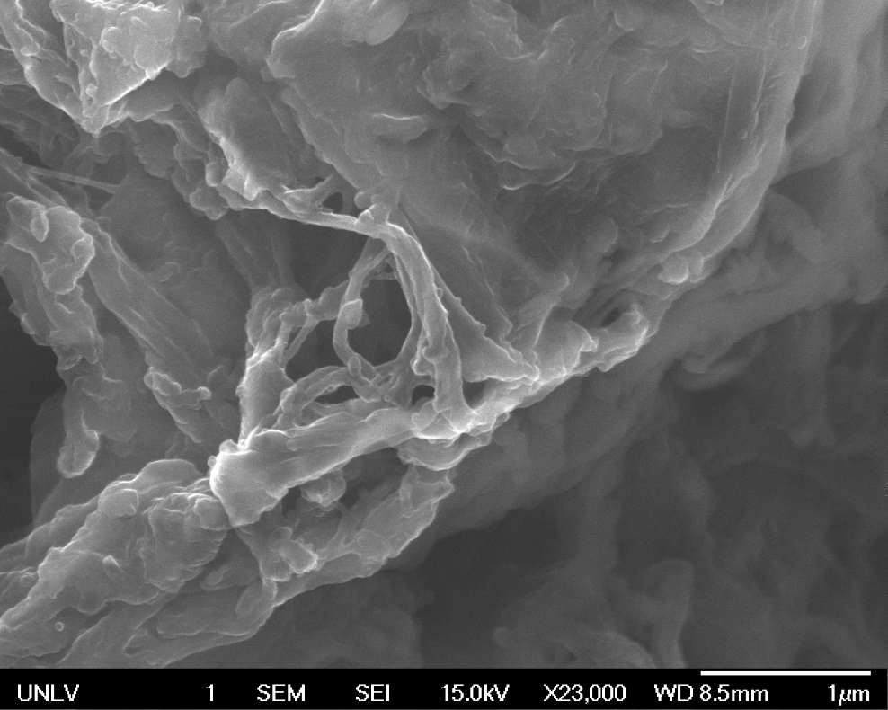
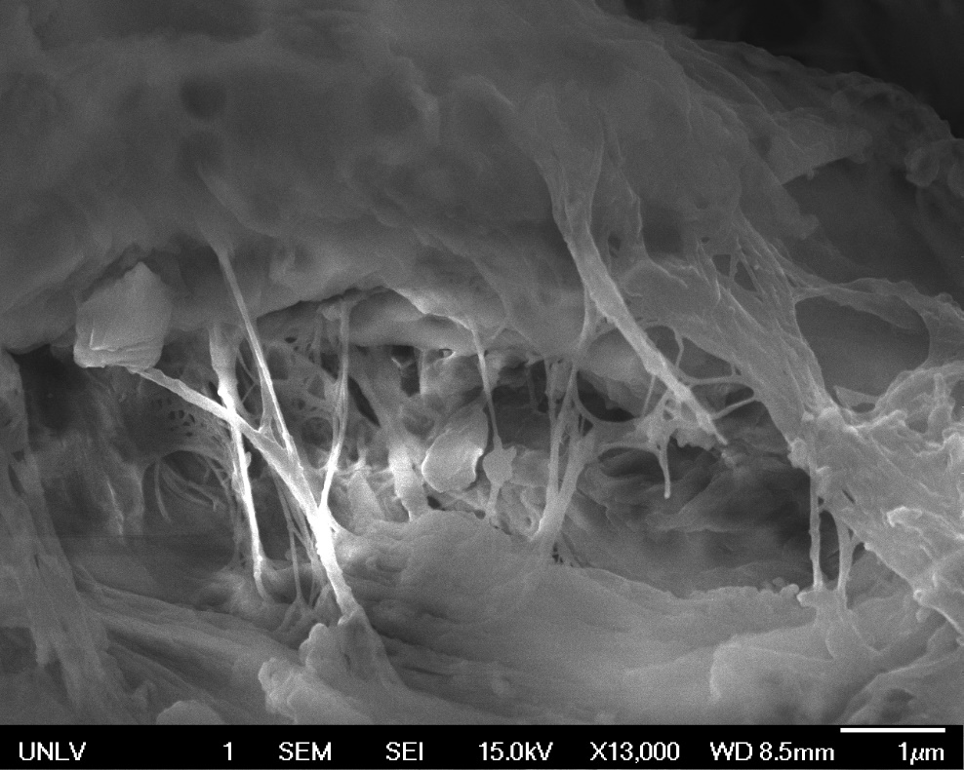
Organo-Mineral Structure
Found within mineralized cavity
Dehydrated Extracellular Polysaccharide (EPS) ???
Mineralization within organic matrix
Raman Spectroscopy confirmed both organic matter and Fe mineral phase

Slide 26
Organo-Mineral Structure
Found within mineralized cavity
Dehydrated Extracellular Polysaccharide (EPS) ???
Mineralization within organic matrix
Raman Spectroscopy confirmed both organic matter and Fe mineral phase

Slide 27
Organo-Mineral Structure
Found within mineralized cavity
Dehydrated Extracellular Polysaccharide (EPS) ???
Mineralization within organic matrix
Raman Spectroscopy confirmed both organic matter and Fe mineral phase

Slide 28
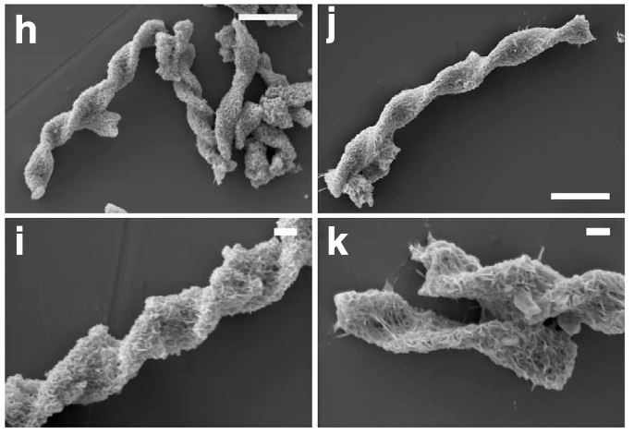
Organo-Mineral Structure
Broadly similar to twisted stalk structures
  Also form from microbial Fe-OXIDATION
  Also form in MICROAEROPHILIC environments
Picard et al. 2015

Slide 29
Conclusions
Goethitization: soft-tissue replication through the direct precipitation of goethite and iron-rich aluminosilicates during the metabolic activity of FeOB within microaerophilic environments
Burgess Shale taphonomic gradient
  Goethitization-Pyritization-Kerogenization
  Inclusive understanding of mineralization pathways to exceptional preservation
*Goethitization*

Slide 30

Acknowledgments
Stephen M. Rowland & Minghua Ren- UNLV
Dean Smith & Salamat Ashkan-UNLV Laser Lab
Emmy Smith- Smithsonian
James Hagadorn- Denver Museum of Natural History
James Schiffbauer, Gretchen O’neil, Tara Selly- University of Missouri
Funding
  GSA Student Research Grant

