Slide 1



Soil Pollution from Informal Recycling of Used Lead Acid Battery (ULAB) in Bangladesh
M. Aziz Hasan¹, Arif M. Sikder², M.Lutful Kabir¹, M. Hasnat Jaman¹, M. Riaz Uddin¹, M. Hashibur Rashid¹, Asma Akter¹,
Xin-cheng Liu³and Drew McCartor³
¹Department of Geology, University of Dhaka, Dhaka 1000, Bangladesh
²Centre for Environmental Studies, Virginia Commonwealth University, Richmond, VA 23284-3050, USA
³Pure Earth, New York, NY 10115,USA

Slide 2
Toxic Sites Identification Program (TSIP) in Bangladesh
The program is implemented in Bangladesh by the Department of Geology, University of Dhaka in May 2016 with technical and financial support from Pure Earth (formerly known as Blacksmith Institute), a Non-profit organization based in New York.
Objectives of TSIP
Identify point-sources of toxic pollutants like lead, arsenic, chromium, cadmium mercury etc.;
Migration/distribution of toxic pollutants in the surrounding environment such as soil and water bodies;
Pathways by which the pollutants may enter human bodies such as dermal contact, inhalation and ingestion.

Slide 3
TSIP-Initial Site Screening (ISS) method
Interview local people;
Divide the source and its surrounding areas (about 300m) into sectors based on land-use type;
Surface soil samples from each sector:
Composite sample - 10 to15 samples collected from a sector and mixed together, and targeted samples – single sample collected from one or two target area of the sector.
Water samples: Surface water and groundwater where available;
Collect evidences (photographs) of migration and pathways of pollutants;
Chemical analyses of the collected samples (XRF for soil and ICP-OES for water)

Slide 4
Used Lead Acid Battery (ULAB) Recycling sites
147 sites have so far been screened (active and abandoned sites);
About 1500 soil samples (composite and targeted) have been collected and analyzed (elemental composition) using portable XRF (Niton XL3t 950) at the Geology Department, Dhaka University and selected samples were analyzed further by PANanalytical Epsilon 3X in VCU;
More than 400 water samples are also collected and sent to laboratory for analysis (toxic/trace elements) using ICP-OES at the CES, VCU;

Slide 5
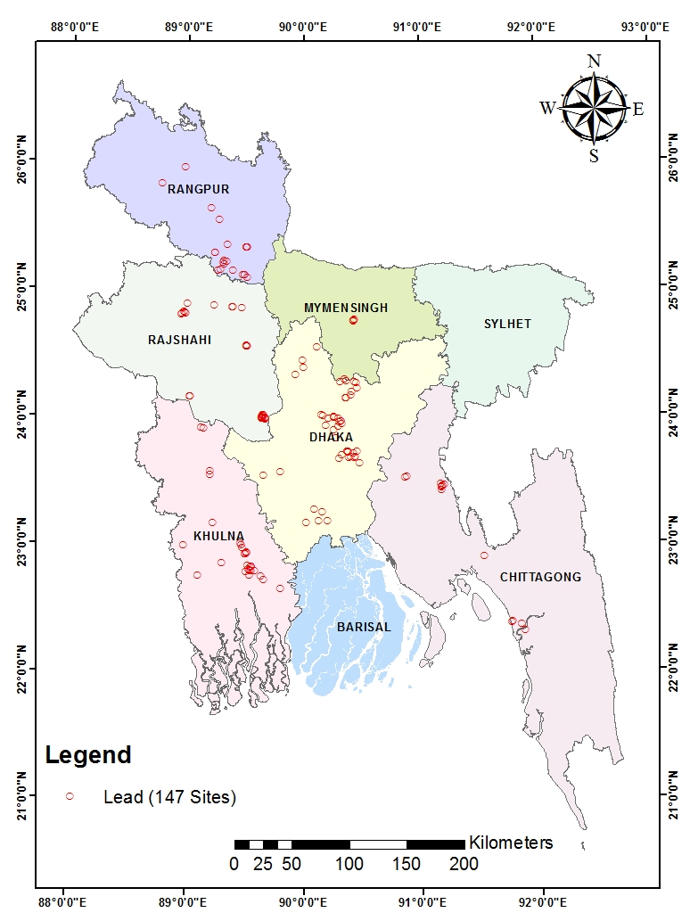
Screened ULAB Recycling Sites in Bangladesh

Slide 6
Informal (Artisanal) ULAB Recycling Activities
Breaking batteries manually to remove lead plates,
Sorting lead plates, and
Smelting lead in open coal-fired kilns (pits).

Slide 7
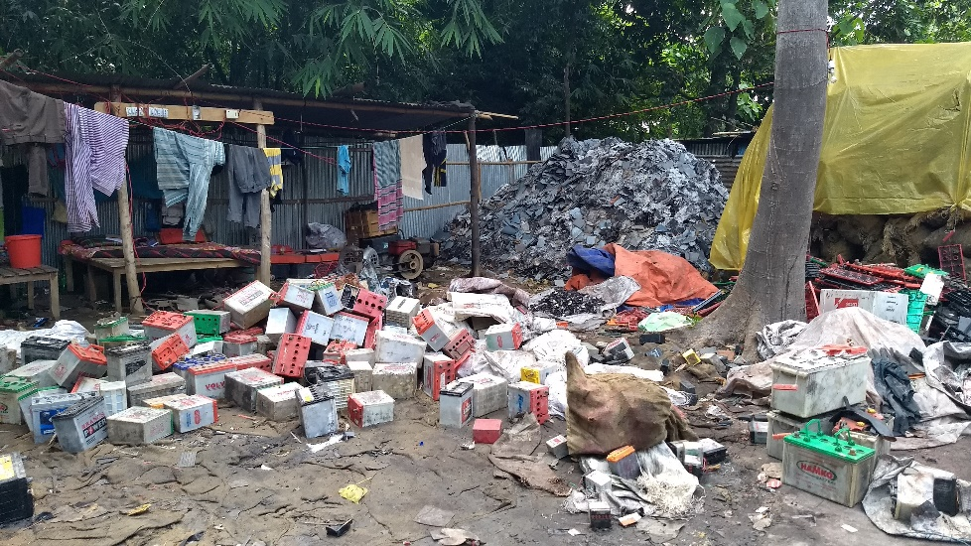
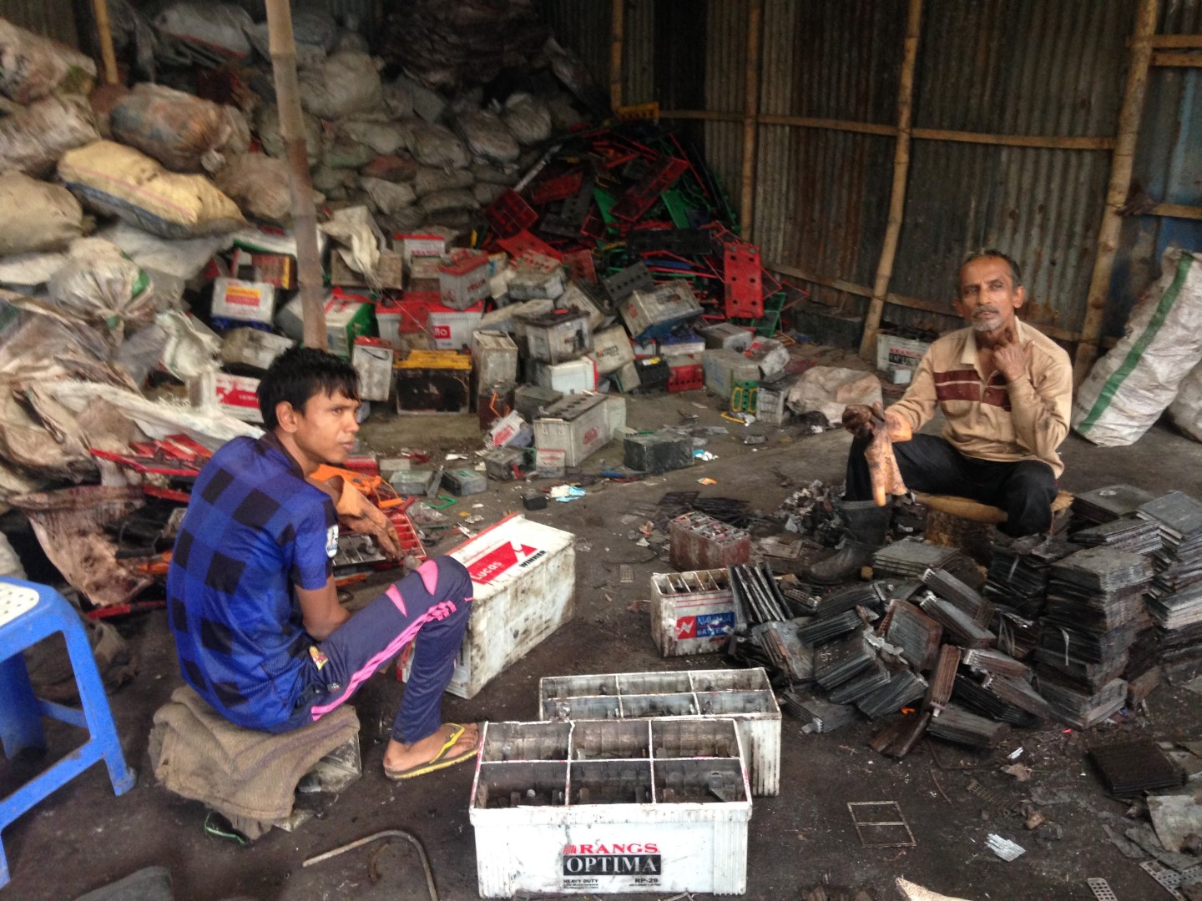
Breaking to open used batteries manually

Slide 8
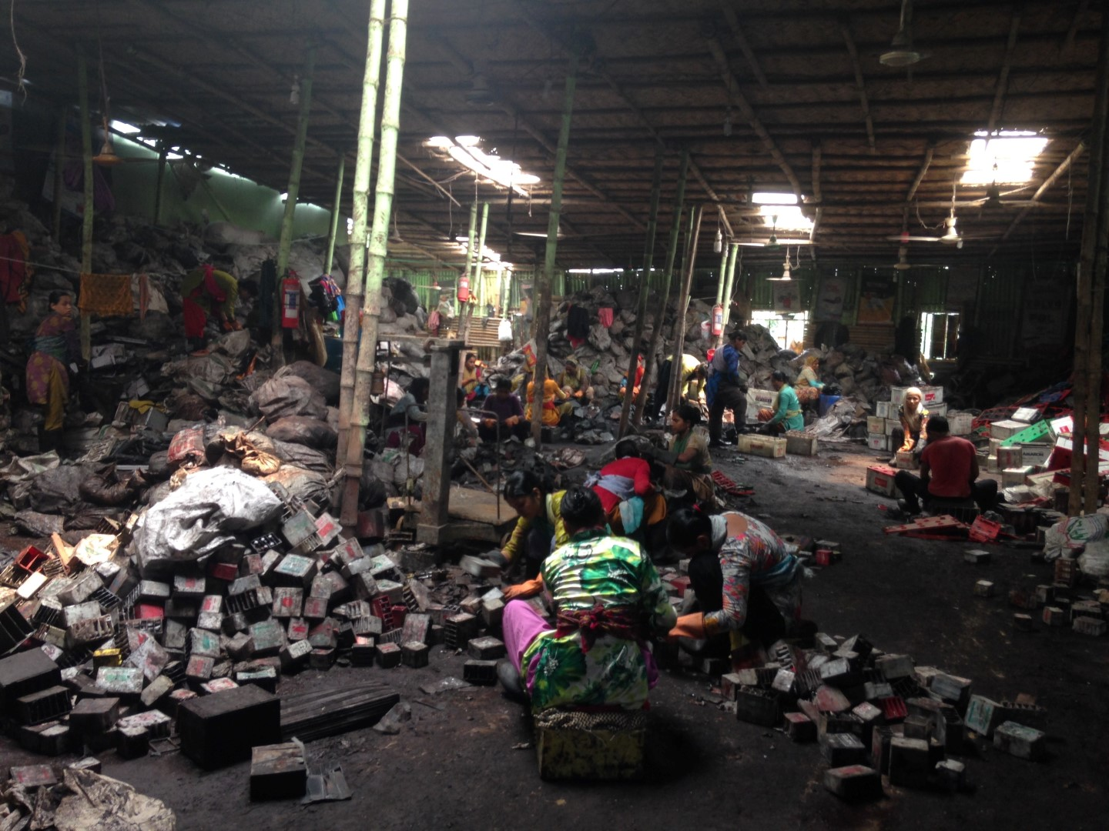
Breaking batteries and sorting lead plates

Slide 9
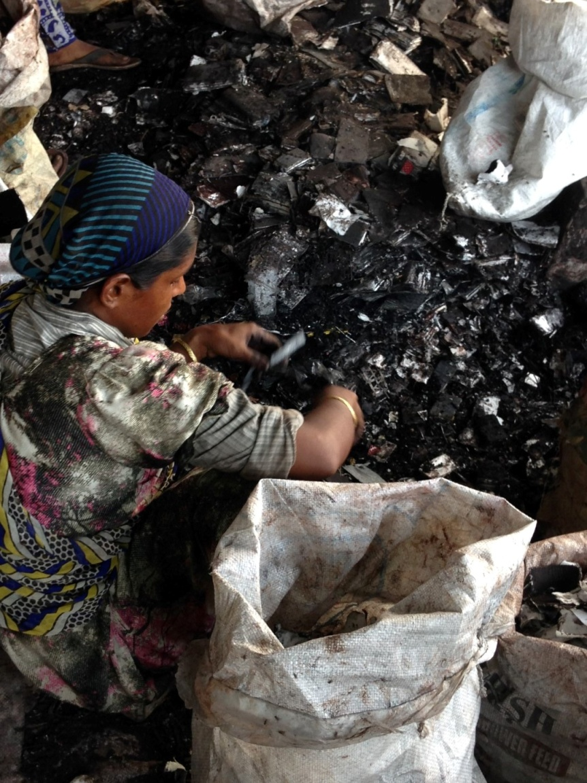
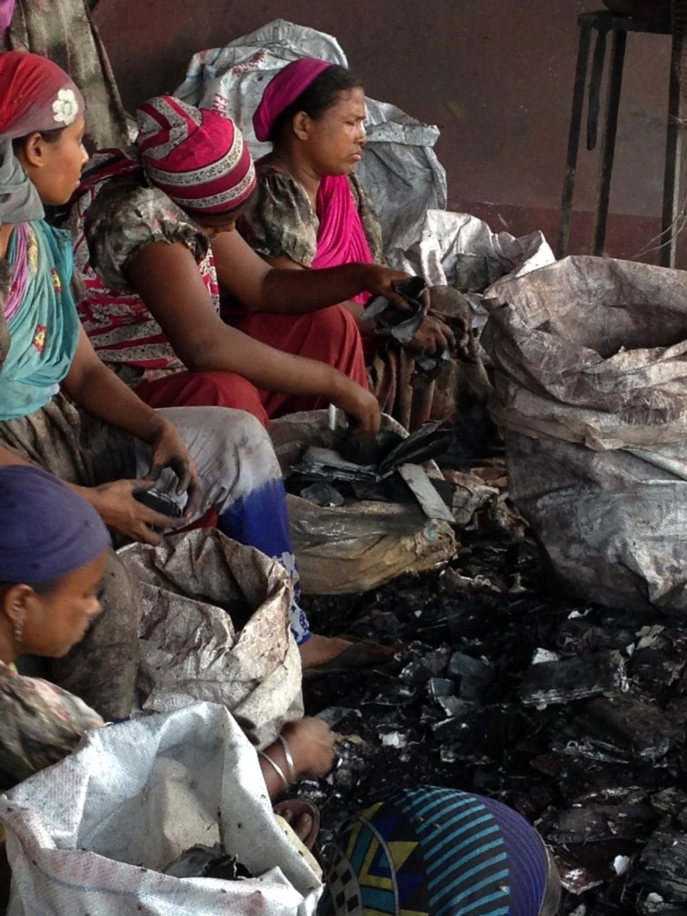
Sorting lead plates in sacks for smelting

Slide 10
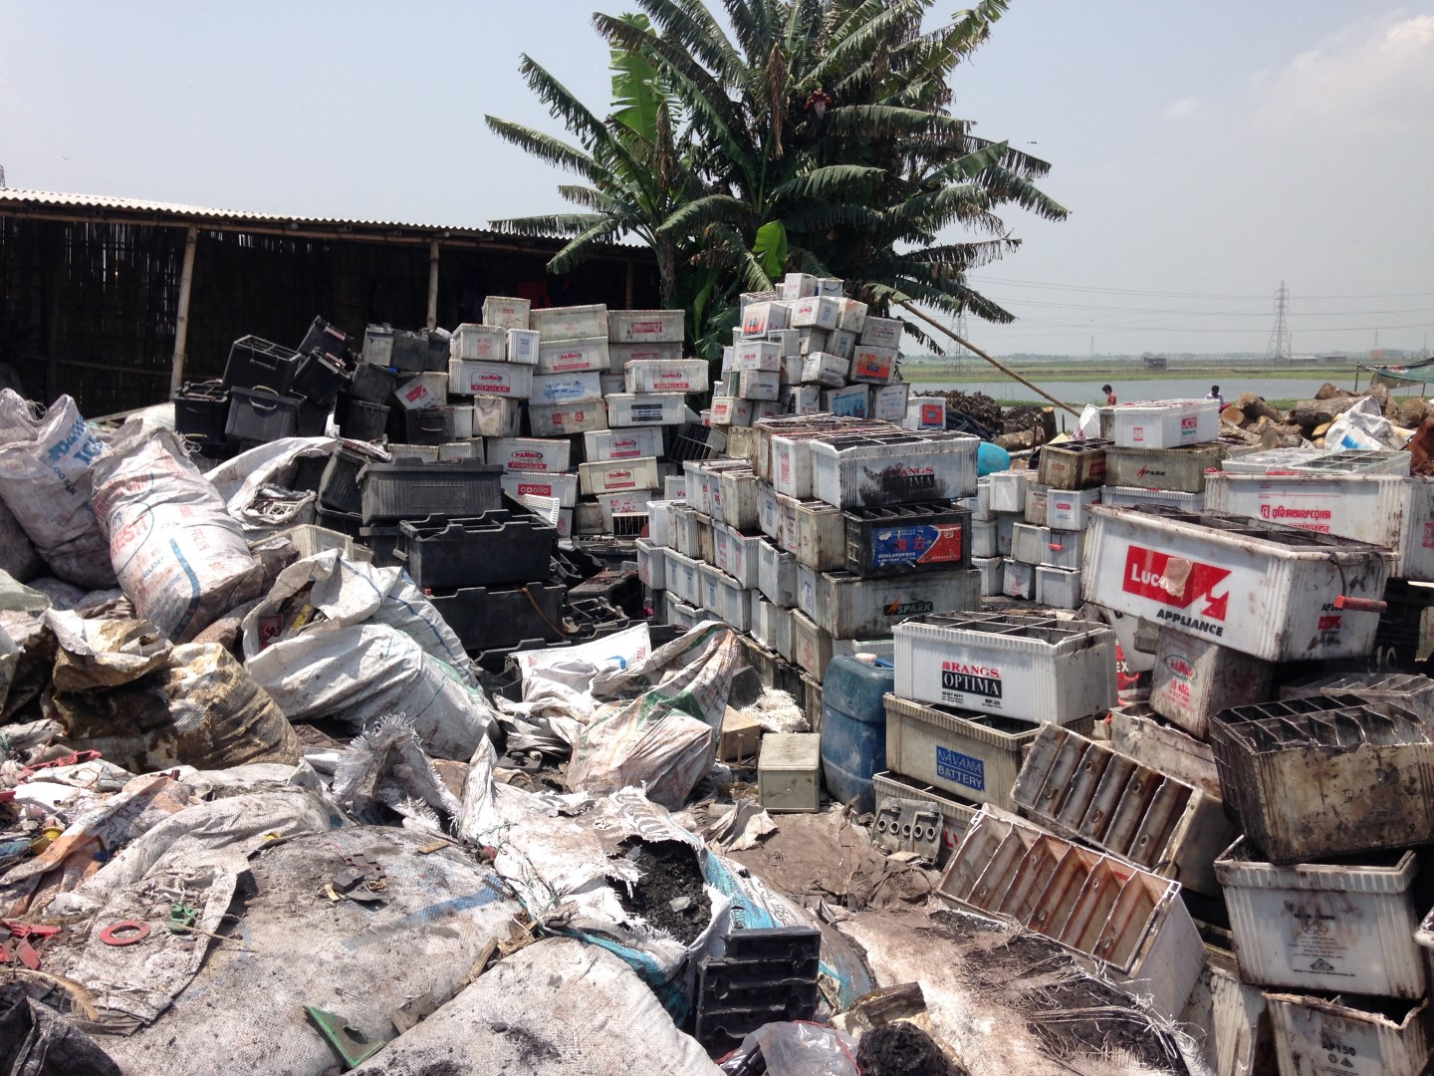
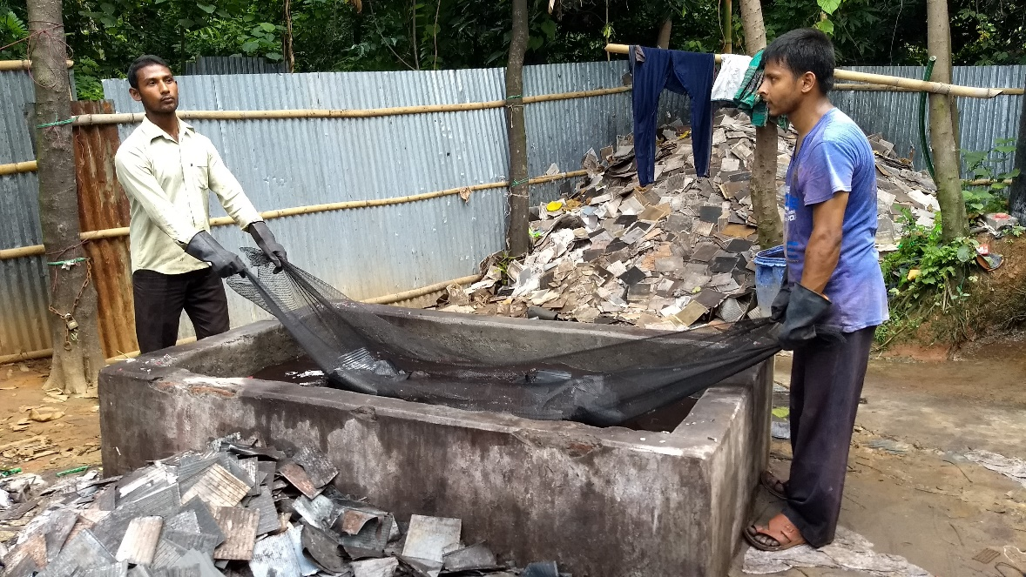
Empty battery casings are stacked in open air in a recycling site

Slide 11
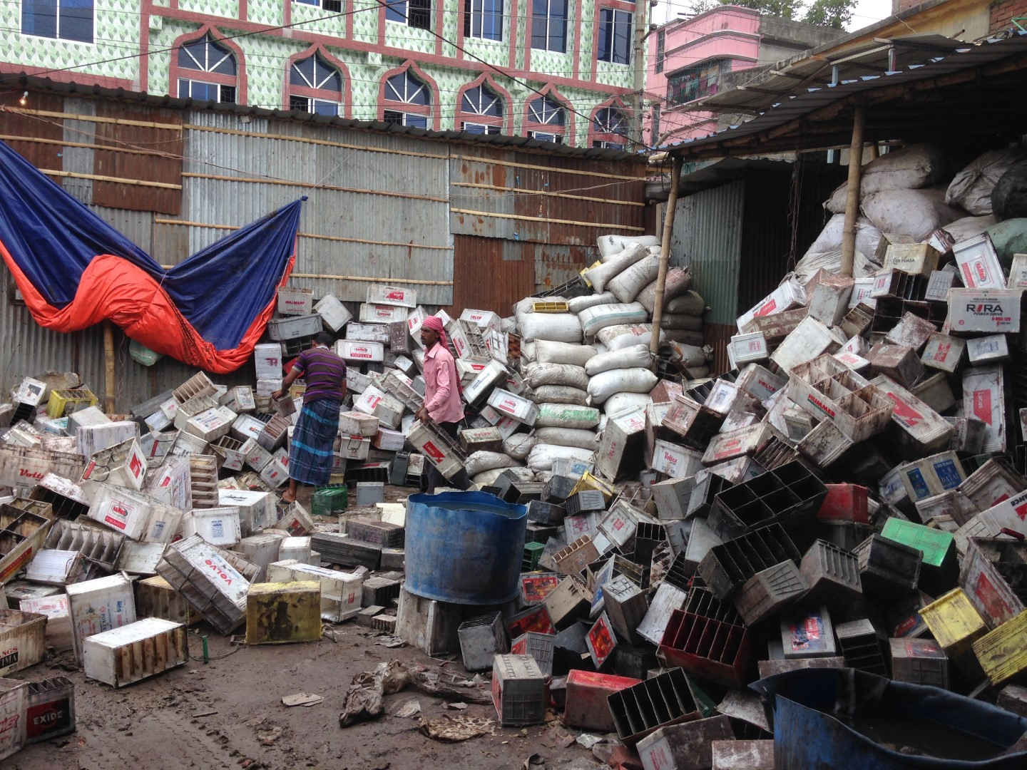
ULAB recycling (breaking) site in a residential area

Slide 12
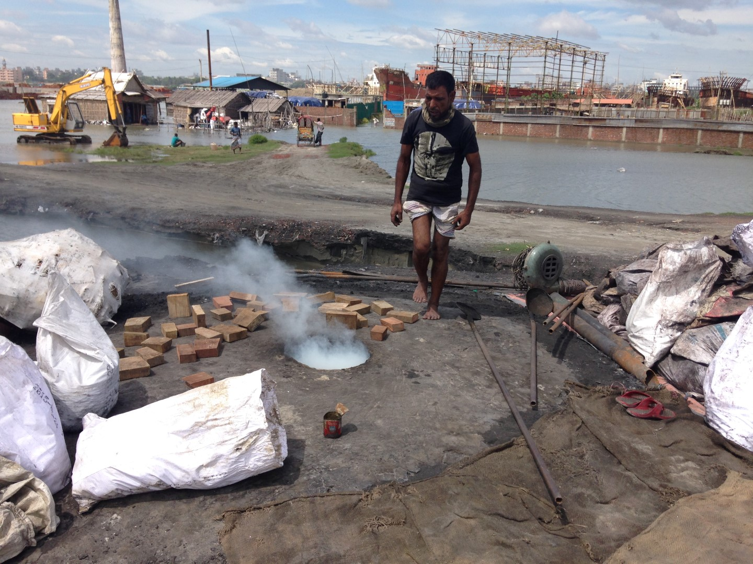
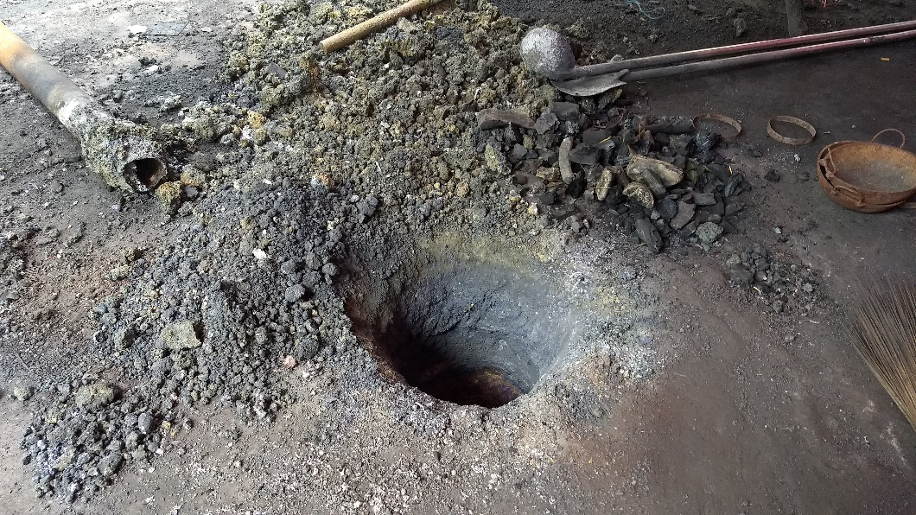
A lead smelting site by the Buriganga River
A smelting kiln (pit)

Slide 13
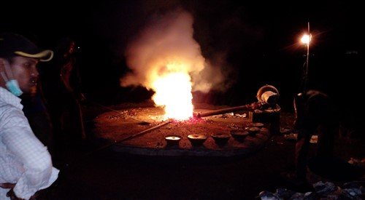
Lead smelting using coal-fired kiln in open air

Slide 14
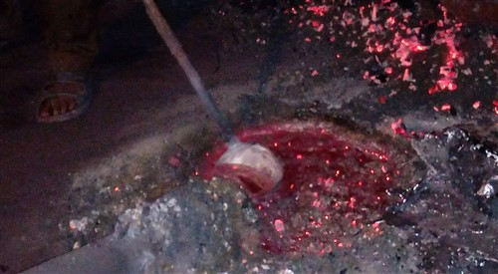
Collection of the melted lead from the kiln (pit)

Slide 15
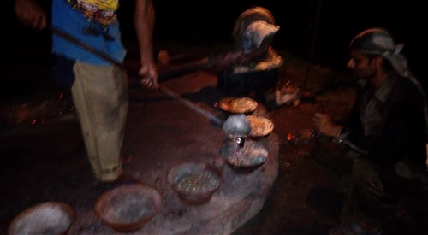
Pouring the lead-melt in molds

Slide 16
Maximum Recommended Concentrations
used for Identification of Toxic Sites
Toxic Pollutant | Soil |  |  | Water
 | Residential (ppm) | Agricultural (ppm) | Industrial (ppm) | Drinking (ppb) | Fishing (ppb) | Irrigation/ Bathing/ Washing (ppb)
Pb | 400( EPA) | 400 (EPA) | 1200 (EPA) | 10 (WHO) | 10 (CAN) | 200 (CAN)
As | 12(CAN) | 12(CAN) | 12 (CAN) | 10 (WHO) | 50(CAN) | 100 (WHO)
Cd | 14 (CAN) | 1.4(CAN) | 192 (CAN) | 3 (WHO) | 0.2 (CAN) | 10 (WHO)
Cr | 220 (CAN) | 220 (CAN) | 2300 (CAN) | 50 (WHO) | 50 (CAN) | 8 (CAN)

Slide 17
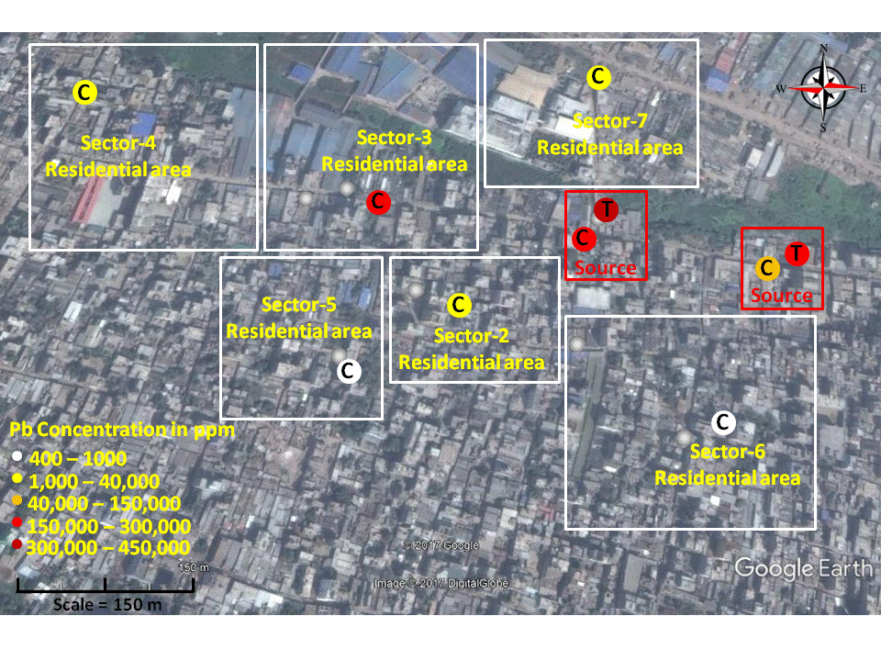
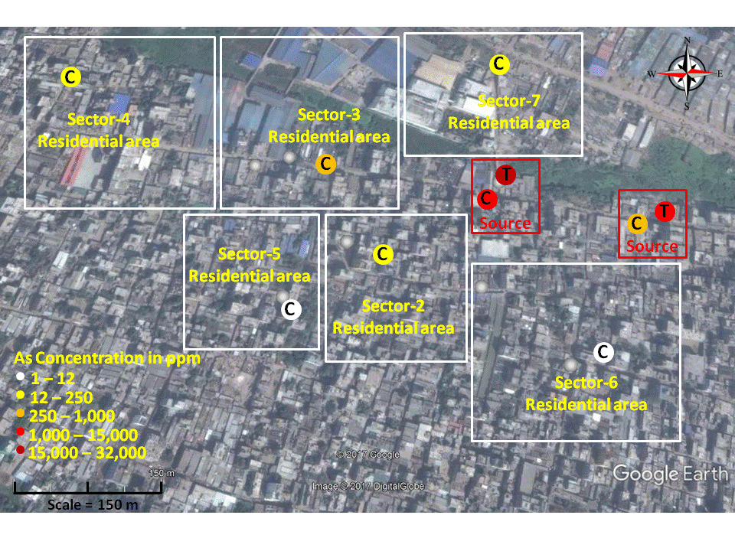
Soil pollution from ULAB site in a urban area
C - Composite samples, T – Targeted samples
Pb concentration in soil
As concentration in soil

Slide 18
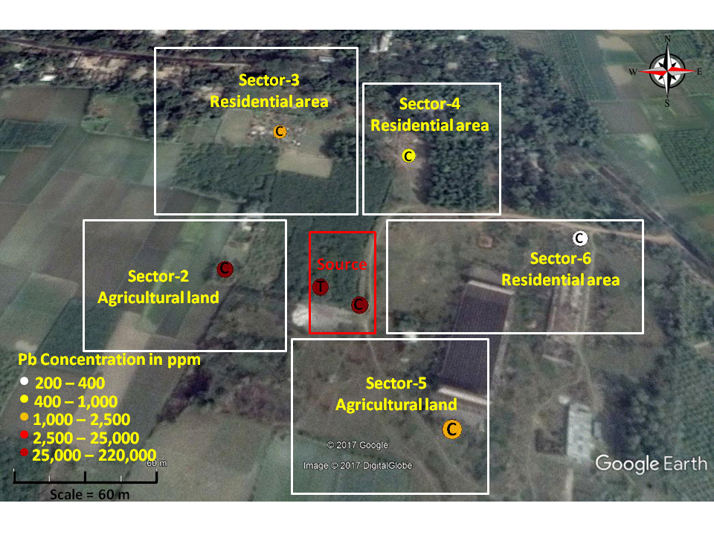
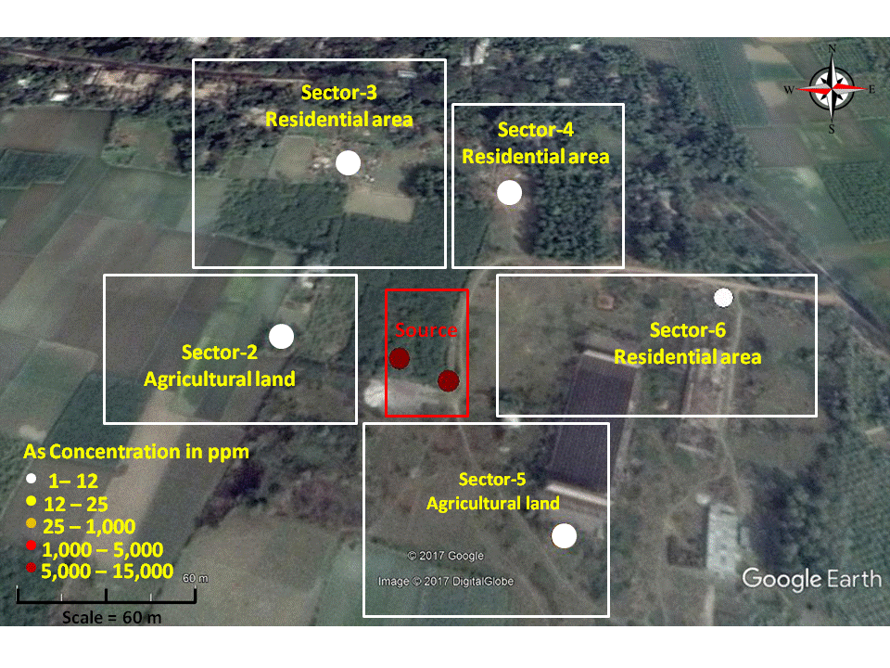
Soil pollution from ULAB site in a rural area
C - Composite samples, T – Targeted samples
Pb concentration in soil
As concentration in soil

Slide 19
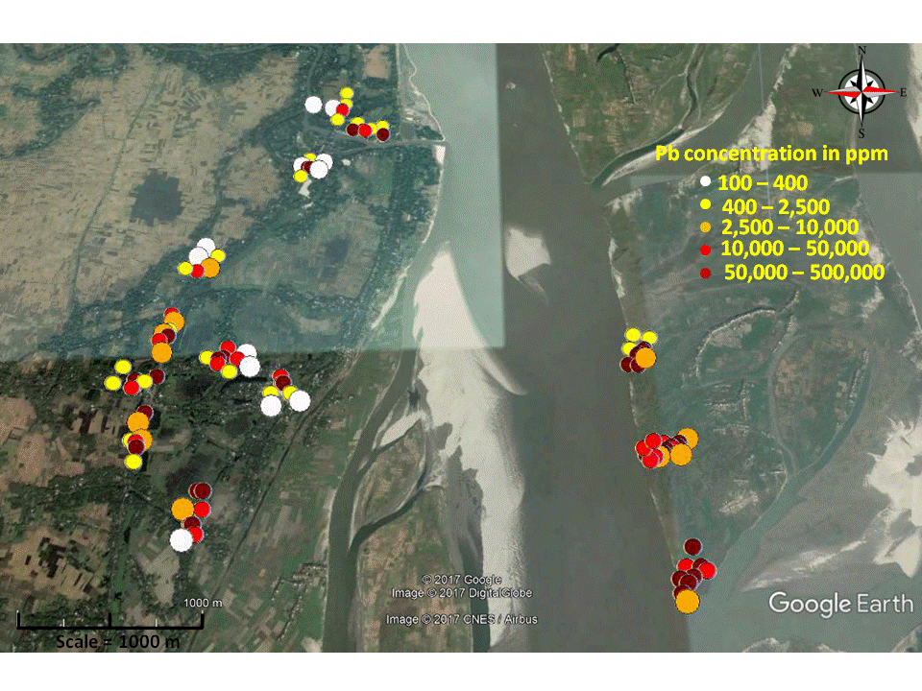
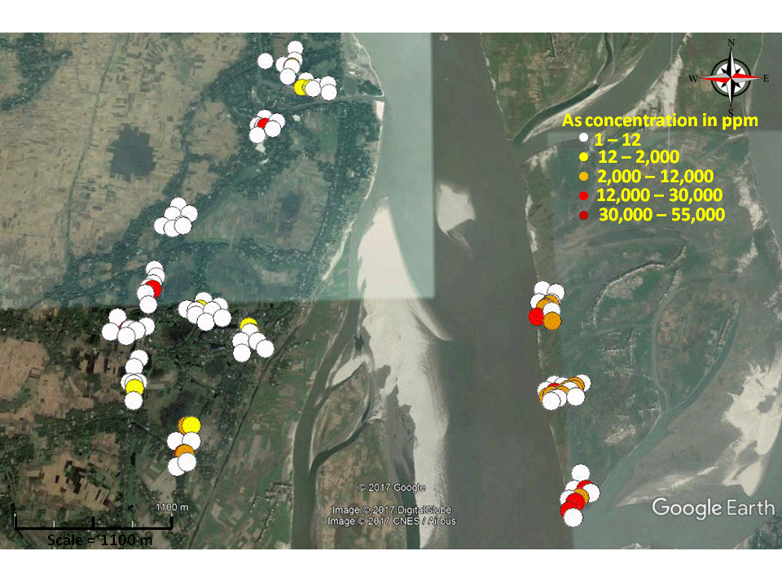
Soil pollution from ULAB site in an island (sand bar) of Jamuna River
Sand bar
Jamuna R..
Sand bar
Jamuna R.
Pb concentration in soil
As concentration in soil

Slide 20
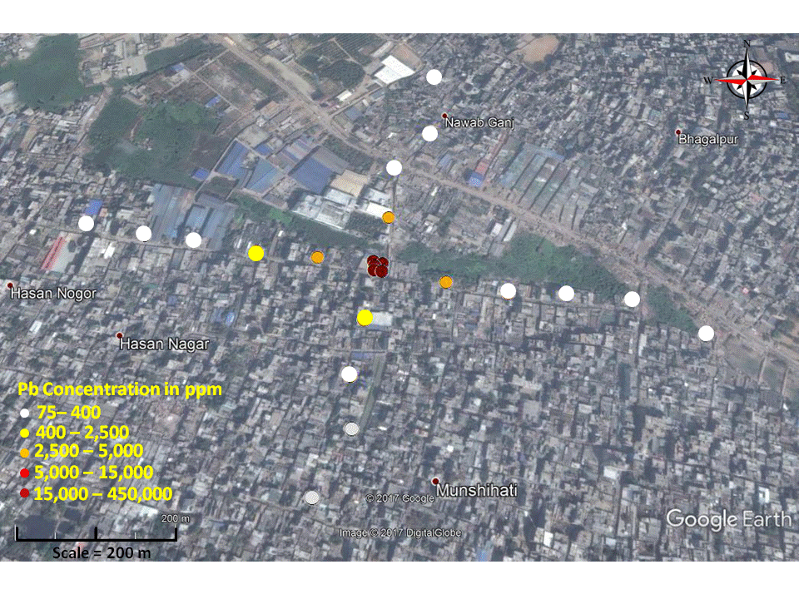
Spread of lead in soils at 100m interval at a recycling site

Slide 21
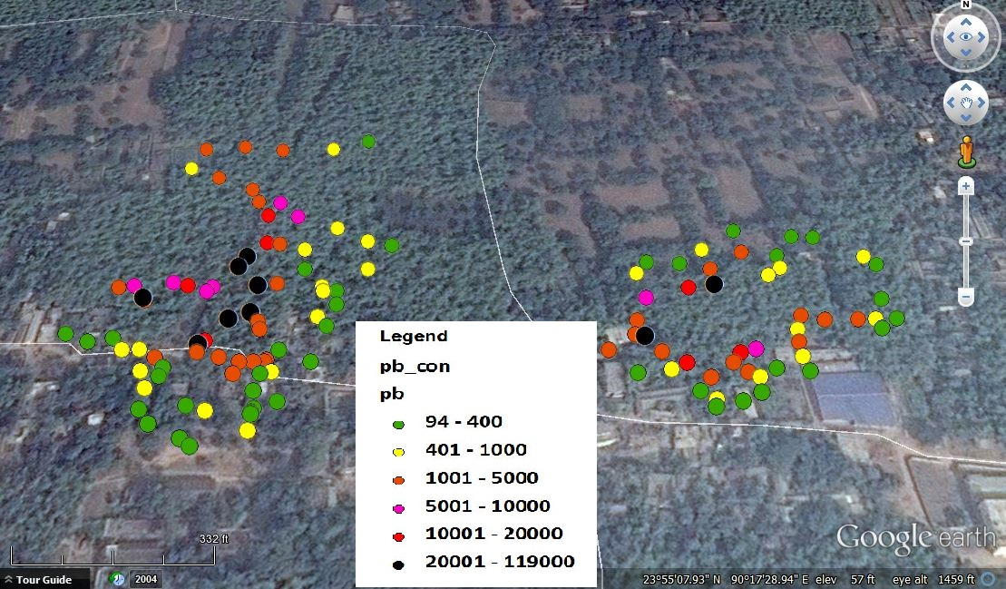
Soil XRF mapping at two abandoned recycling sites
in ppm

Slide 22
Comparison of result of XRF analysis: Portable vs Benchtop
Soil of ULAB recycling site
Laboratory XRF
Laboratory XRF
Portable XRF
Portable XRF
Pb concentration in ppm
As concentration in ppm
Laboratory XRF
Laboratory XRF
Portable XRF
Portable XRF
Cr concentration in ppm
Cd concentration in ppm

Slide 23
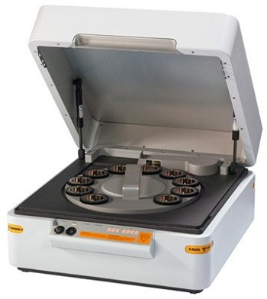
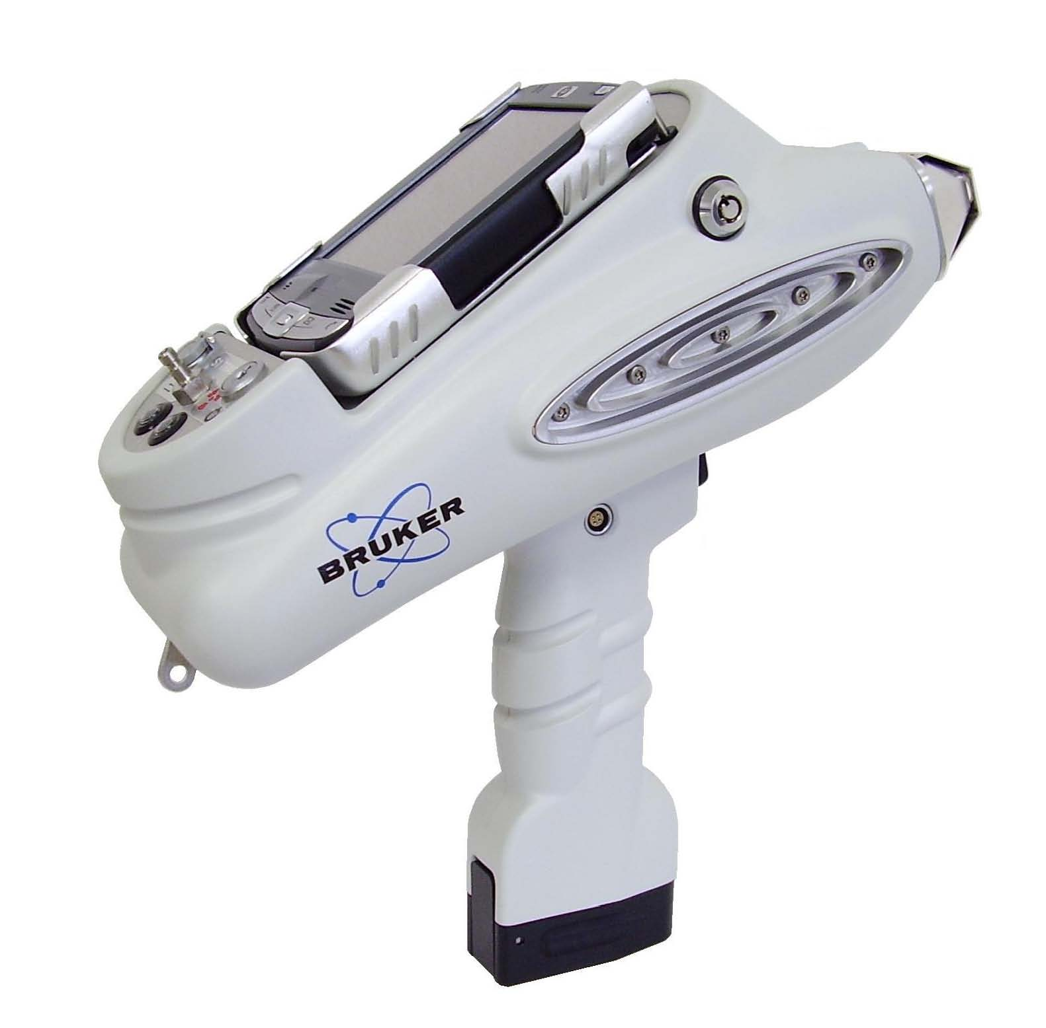
Why the difference is so big?

Slide 24
Conclusions
Soils in the residential and agricultural lands around (200-300 m) the ULAB recycling sites are found with very high concentration (400 to several thousand ppm) of lead;
Arsenic is found as the second pollutant in most of the sites together with cadmium and chromium;
High concentrations of lead in the residential and agricultural soils are likely to expose people in the area particularly children to lead toxicity through ingestion/inhalation/dermal contact.

Slide 25

Thanks!

