Slide 1
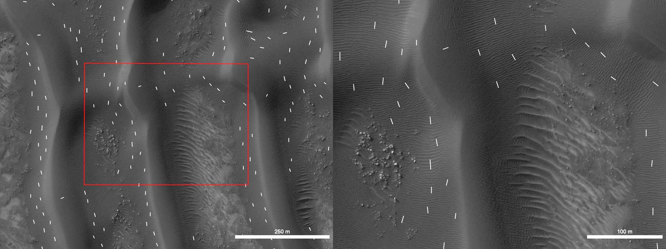
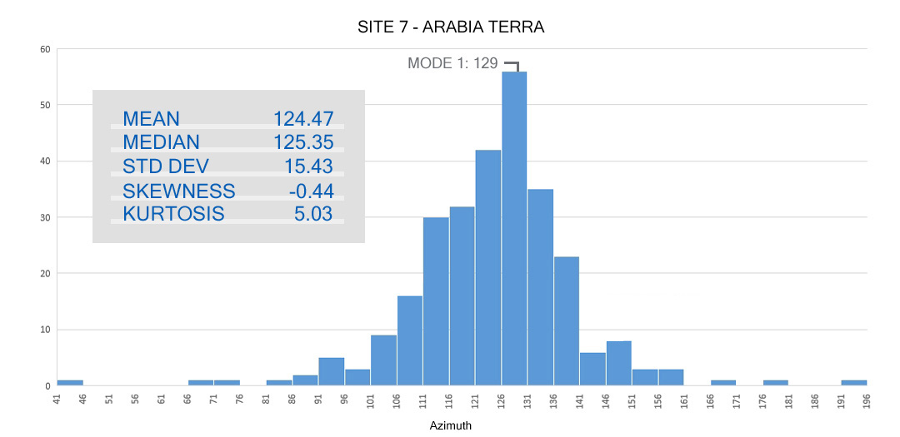
Ripple Orientations on Martian Dunes
Document Diverse Wind Flow Patterns
James R. Zimbelman, Molly B. Johnson, Jennifer O’Brien
Center for Earth and Planetary Studies, National Air and Space Museum
Smithsonian Institution, Washington, DC 20013-7012

Slide 2
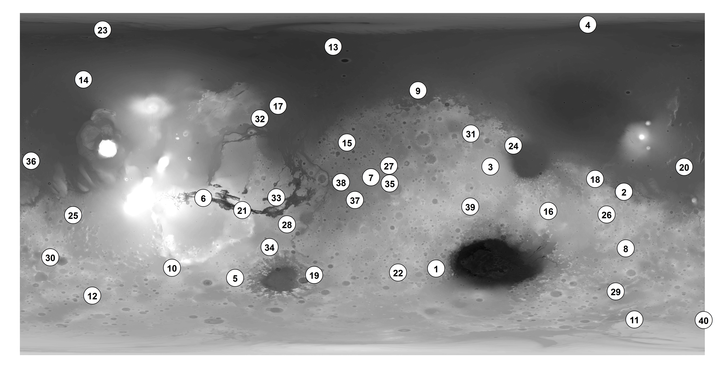
40 study sites were examined; 7 with JMARS, 33 with ArcGIS
Here we present results from the first 7 locations, measured using JMARS software
MDAP grant NNX12AJ38G

Slide 3
Ripples Mapping Procedure
- Only Small Dunes (small or no slip face)
- Avoid places near slip face, if present
Avoid places with superposed ripples
Draw line perpendicular to crest,
(crests of three adjacent ripples)

Slide 4
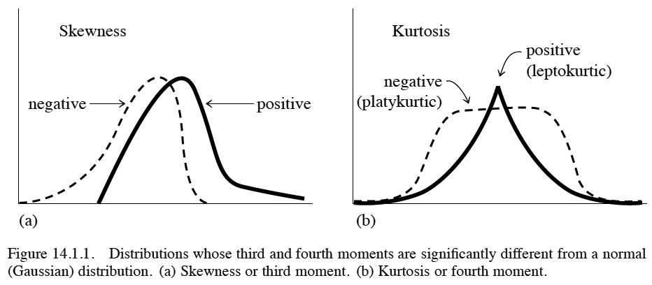
Statistical ‘Moments’ of a Distribution
“Moments are the sums of the integer powers of the values”
Mean – First moment; value around which clustering occurs
Variance – Second moment; ‘width’ or ‘variability’ around mean
(Standard Deviation is square root of the variance)
Skewness – Third moment; degree of asymmetry around mean
Kurtosis – Fourth moment; ‘peakedness’ or ‘flatness’ relative to
a normal (Gaussian) distribution (K=3)
Median – value for which larger and
smaller values are equally probable
Mode – value where distribution is
a maximum
Numerical Recipes in C: The Art of Scientific Computing, 1992, Cambridge Univ. Press, pp 610-615.

Slide 5
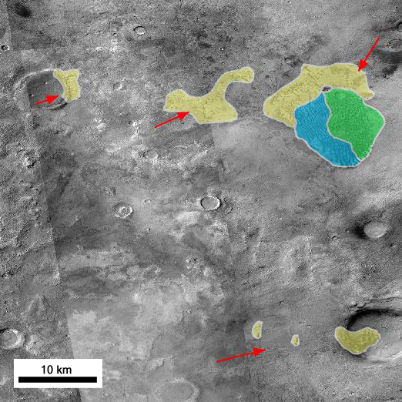
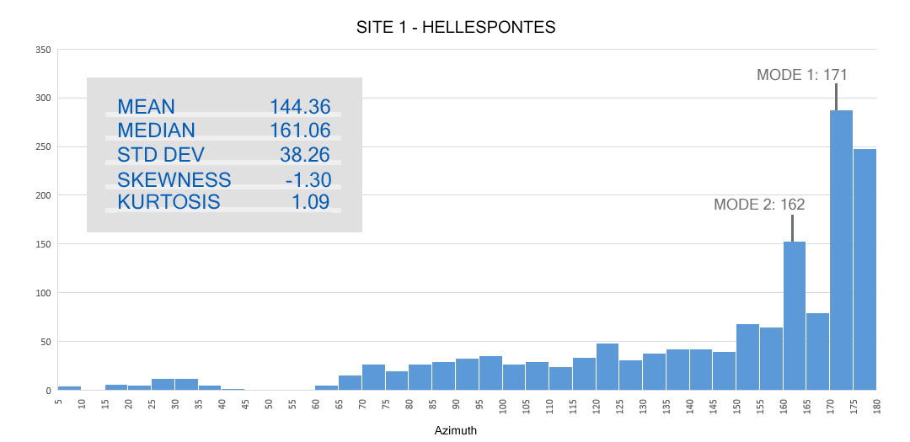
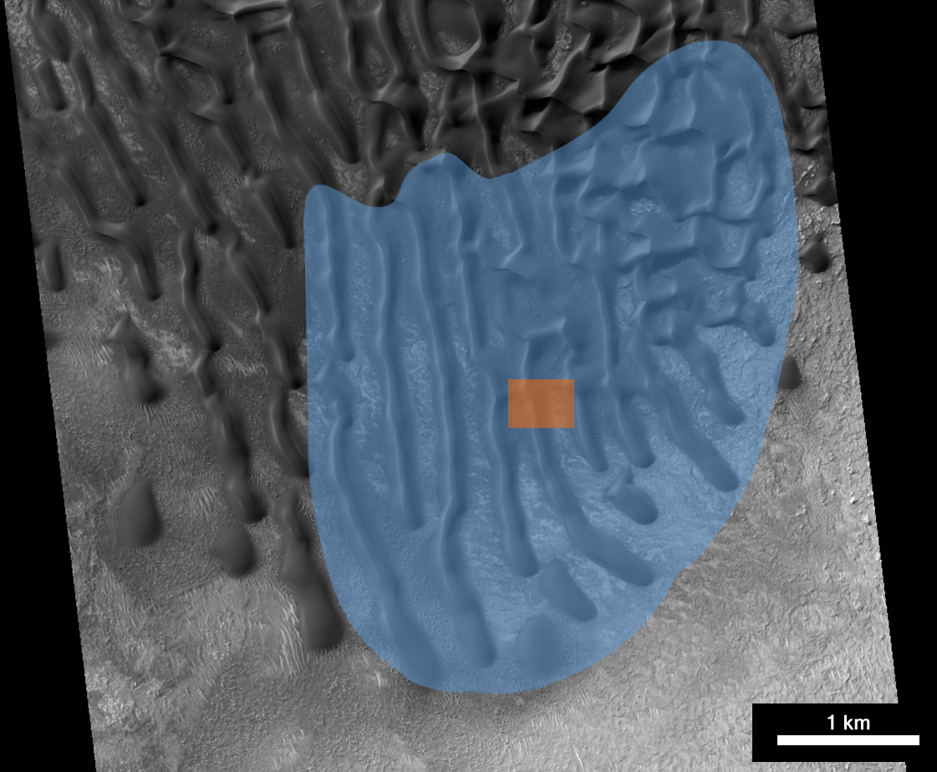
1 – Hellespontes
n = 1493
Weak bimodal, with
pronounced wing
Longitudinal,
(transverse)
Regional map by Y. Ku (CTX images)
HiRISE frame PSP_007633_1350, 44.86 S, 38.80 E
Notes:
In Gamboa Crater (CTX, transverse; HiRISE, longitudinal). Blue – Transverse Ridge

Slide 6
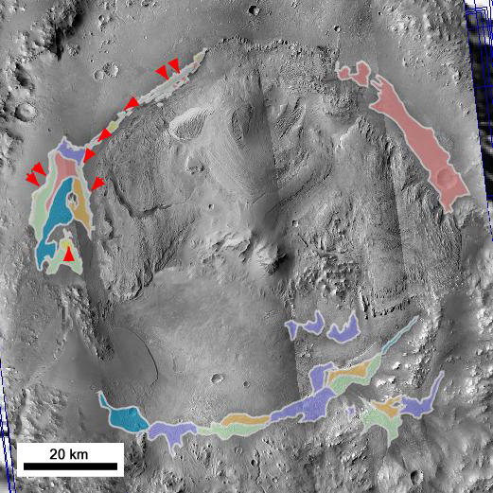
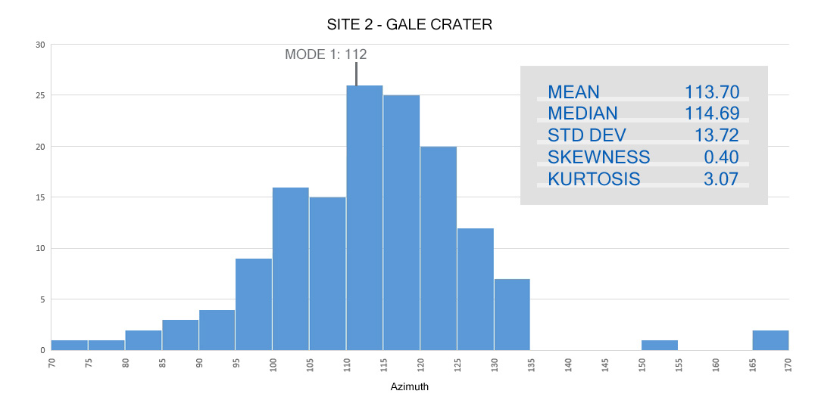
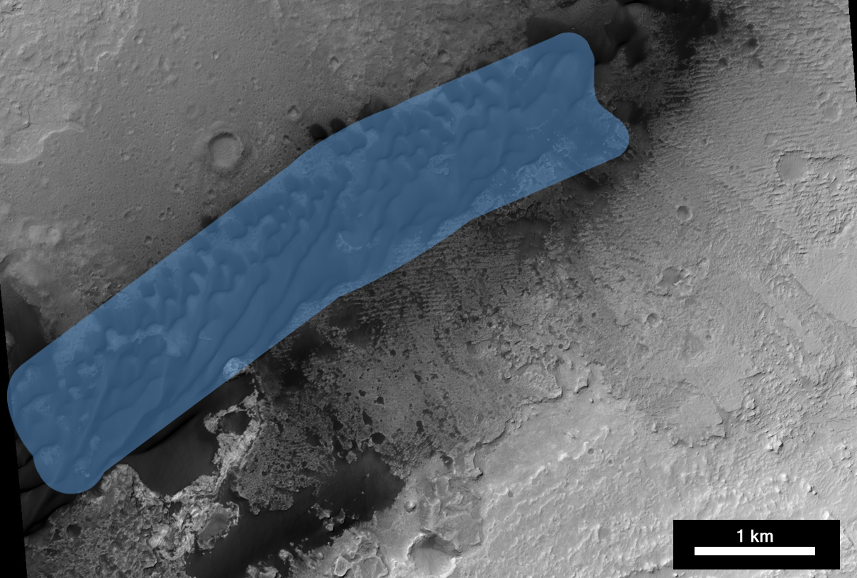
2 - Gale Crater
n = 144
Unimodal
Longitudinal,
barchanoid
Regional map by Y. Ku (CTX images)
HiRISE frame PSP_009571_1755, 4.46 S, 137.50 E
Notes:
Grey – Unknown; HiRISE, Barchanoid Ridge

Slide 7
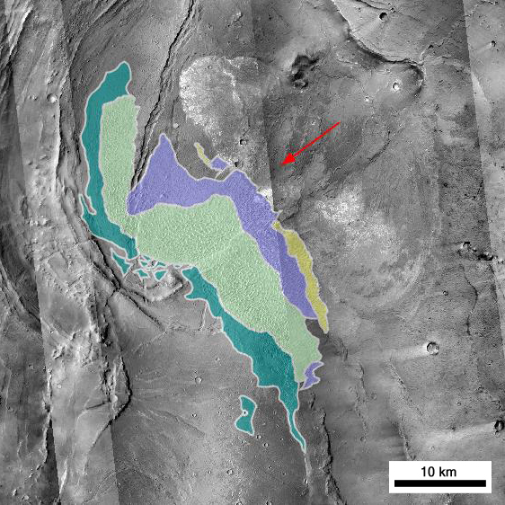
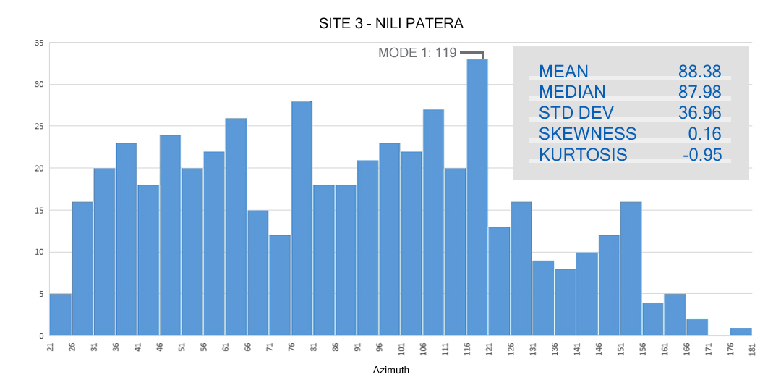
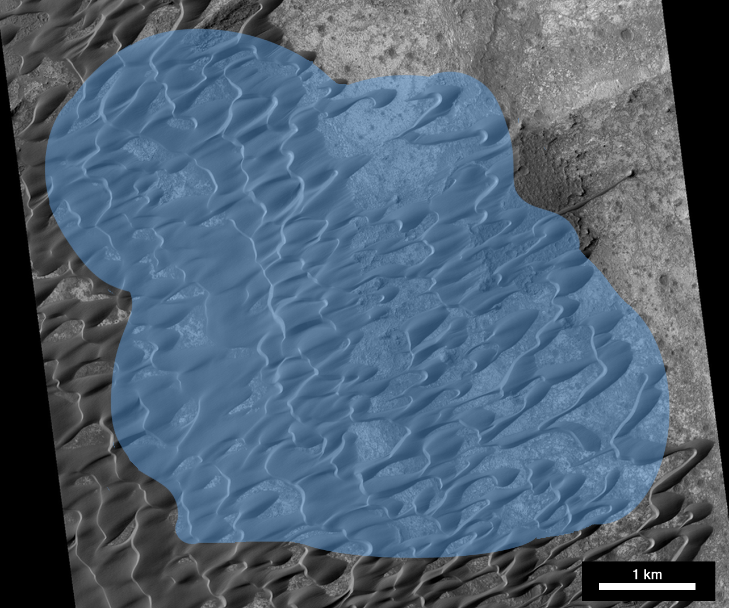
3 - Nili Patera
n = 507
Non-modal,
(nearly random)
Barchan,
barchanoid ridge
Regional map by Y. Ku (CTX images)
HiRISE frame PSP_017762_1890, 8.78 N, 67.32 E
Notes:
Green – Barchanoid Ridge; Purple – Elongate Barchanoid

Slide 8
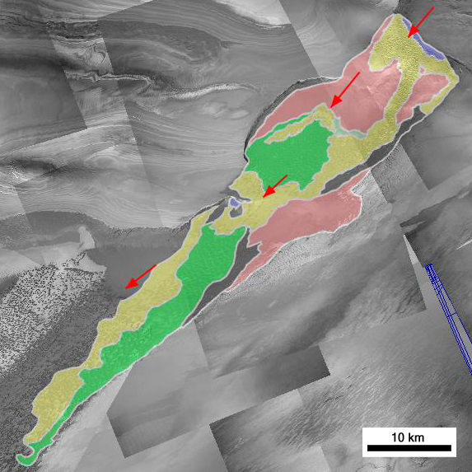
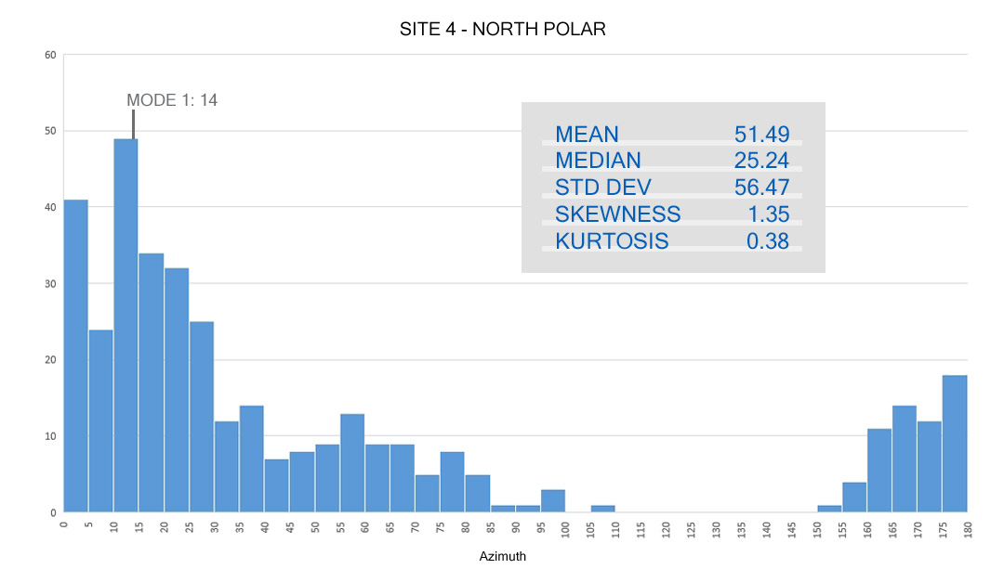
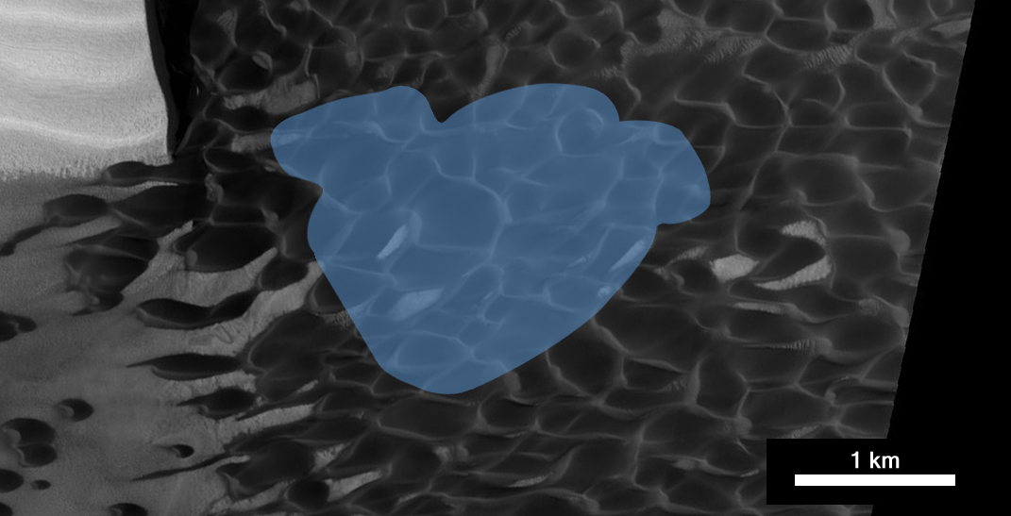
4 - North Polar Erg
n = 370
Unimodal,
with wing
Barchanoid
Regional map by Y. Ku (CTX images)
HiRISE frame PSP_010019_2635, 83.51 N, 118.54 E
Notes:
Green – Barchanoid Ridge

Slide 9
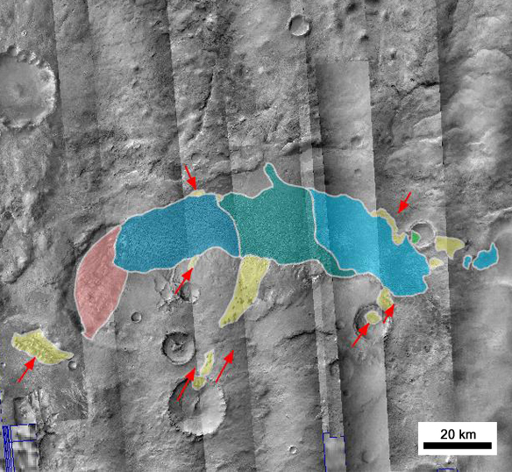
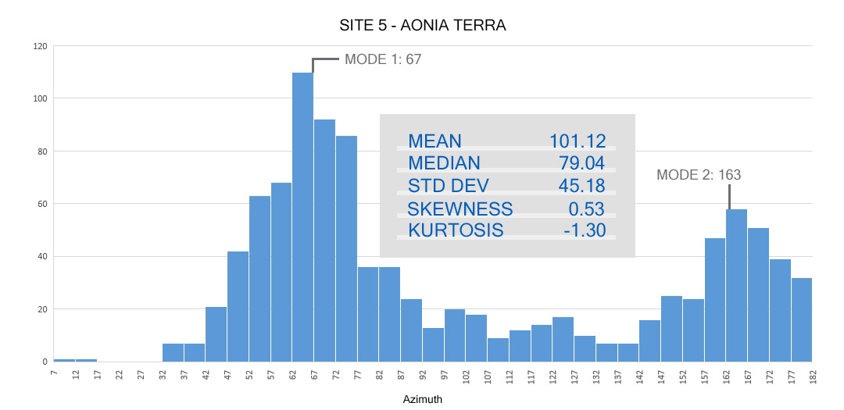
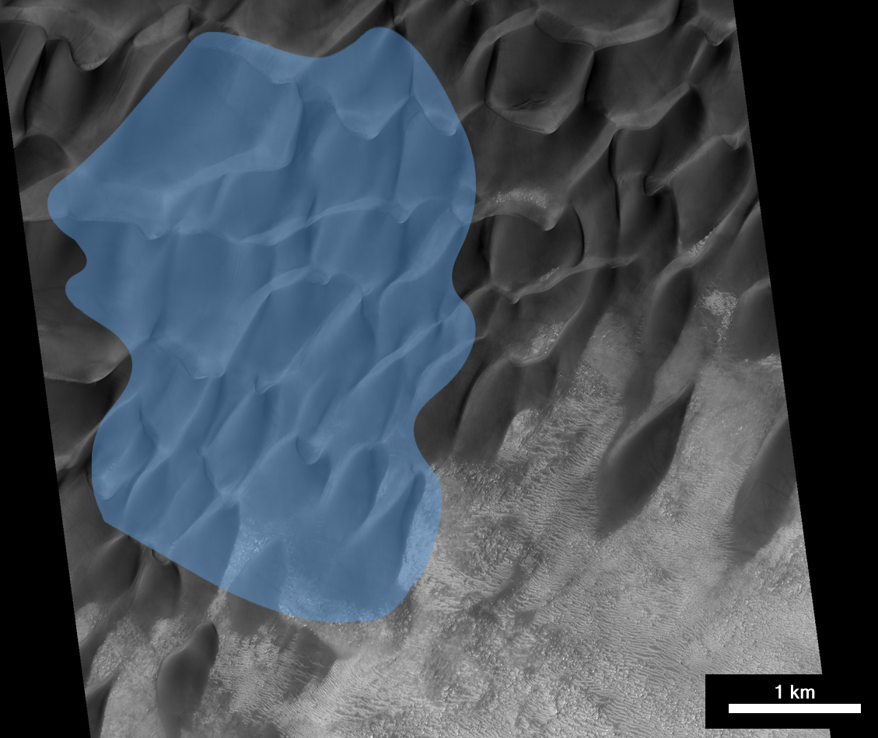
5 - Aonia Terra
n = 1112
Bimodal, with
wing
Transverse
Regional map by Y. Ku (CTX images)
HiRISE frame ESP_013785_1300, 49.80 S, 293.10 E
Notes:
Blue – Transverse ridge

Slide 10
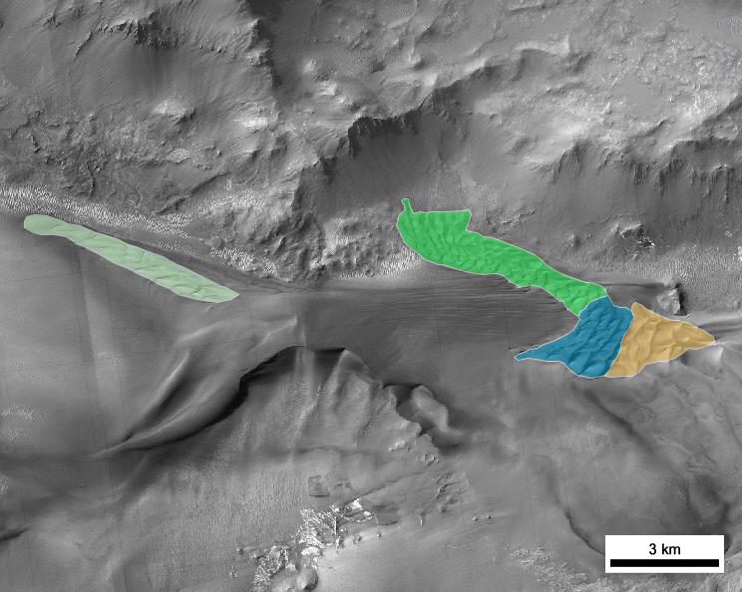
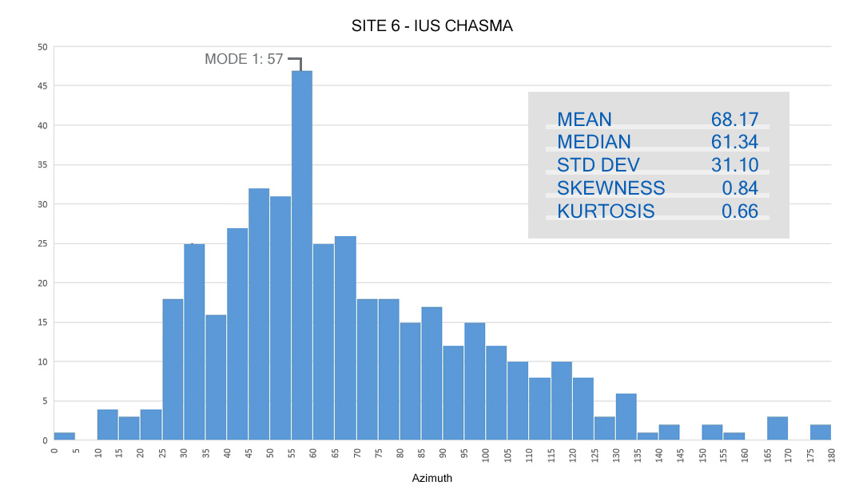
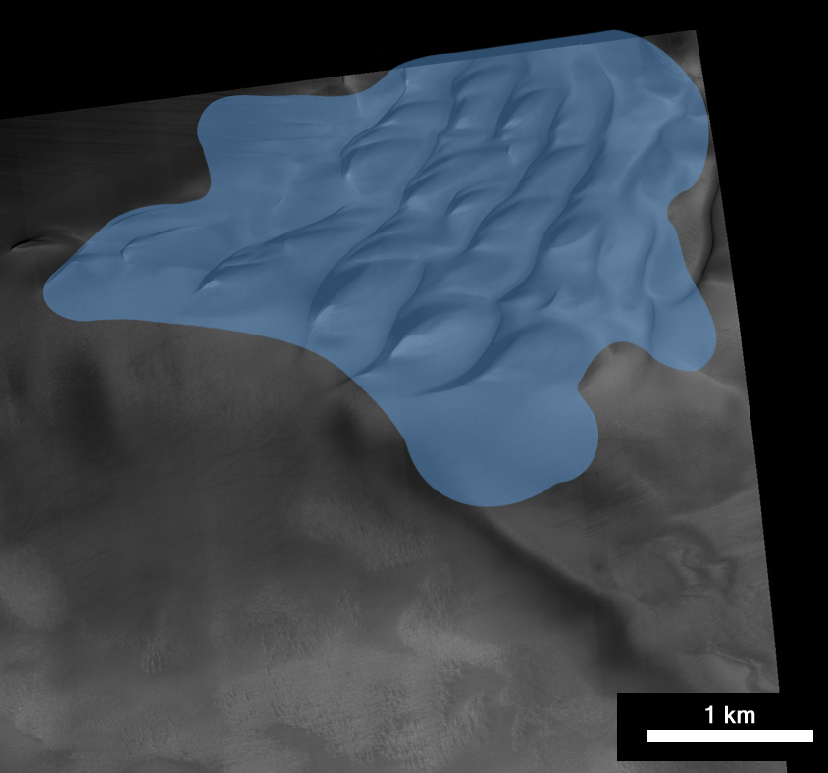
6 - Ius Chasma
Regional map by Y. Ku (CTX images)
n = 422
Unimodal, with
pronounced wing
Transverse ridge
HiRISE frame ESP_027341_1720, 7.72 S, 276.39 E
Notes:
Green – Barchanoid rRdge; Blue – Transverse Ridge

Slide 11
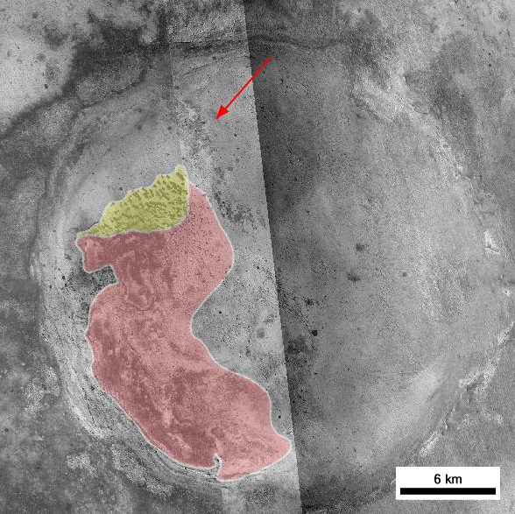
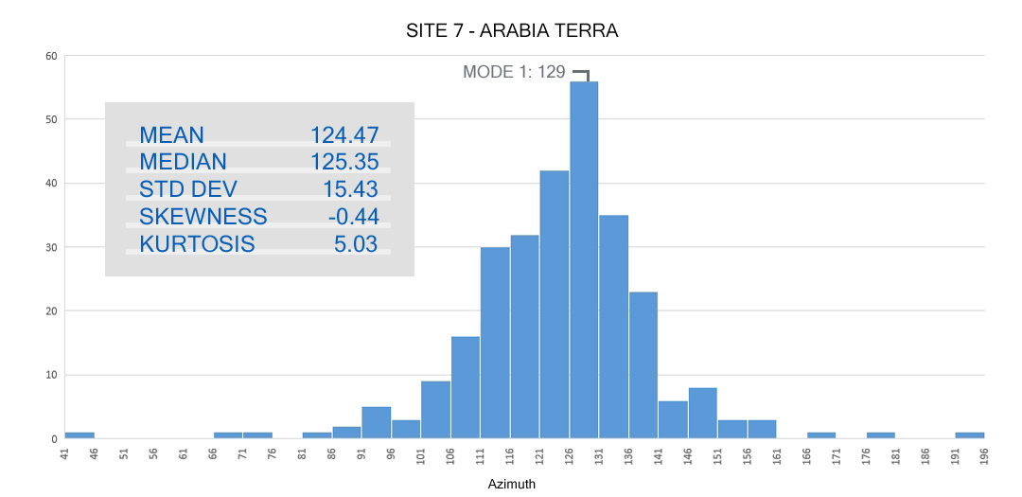
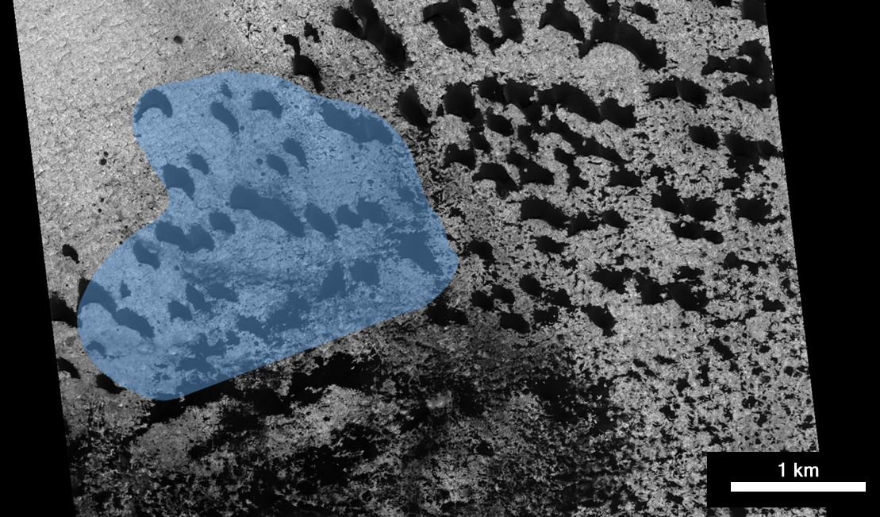
7 - Arabia Terra
n = 279
Unimodal, with
wings
Barchan
Regional map by Y. Ku (CTX images)
HiRISE frame ESP_016459_1830, 3.12 N, 4.55 E
Notes:
Yellow – Barchan; Light Red-Pink – Sand Sheet / Sand Patch

Slide 12
Conclusions
Three ‘classes’ of ripple orientation:
unimodal, bimodal, and ‘random’
No association with regional setting,
elevation, dune type
Dune surface slope direction may be
a factor in orienting surface wind

