Slide 1
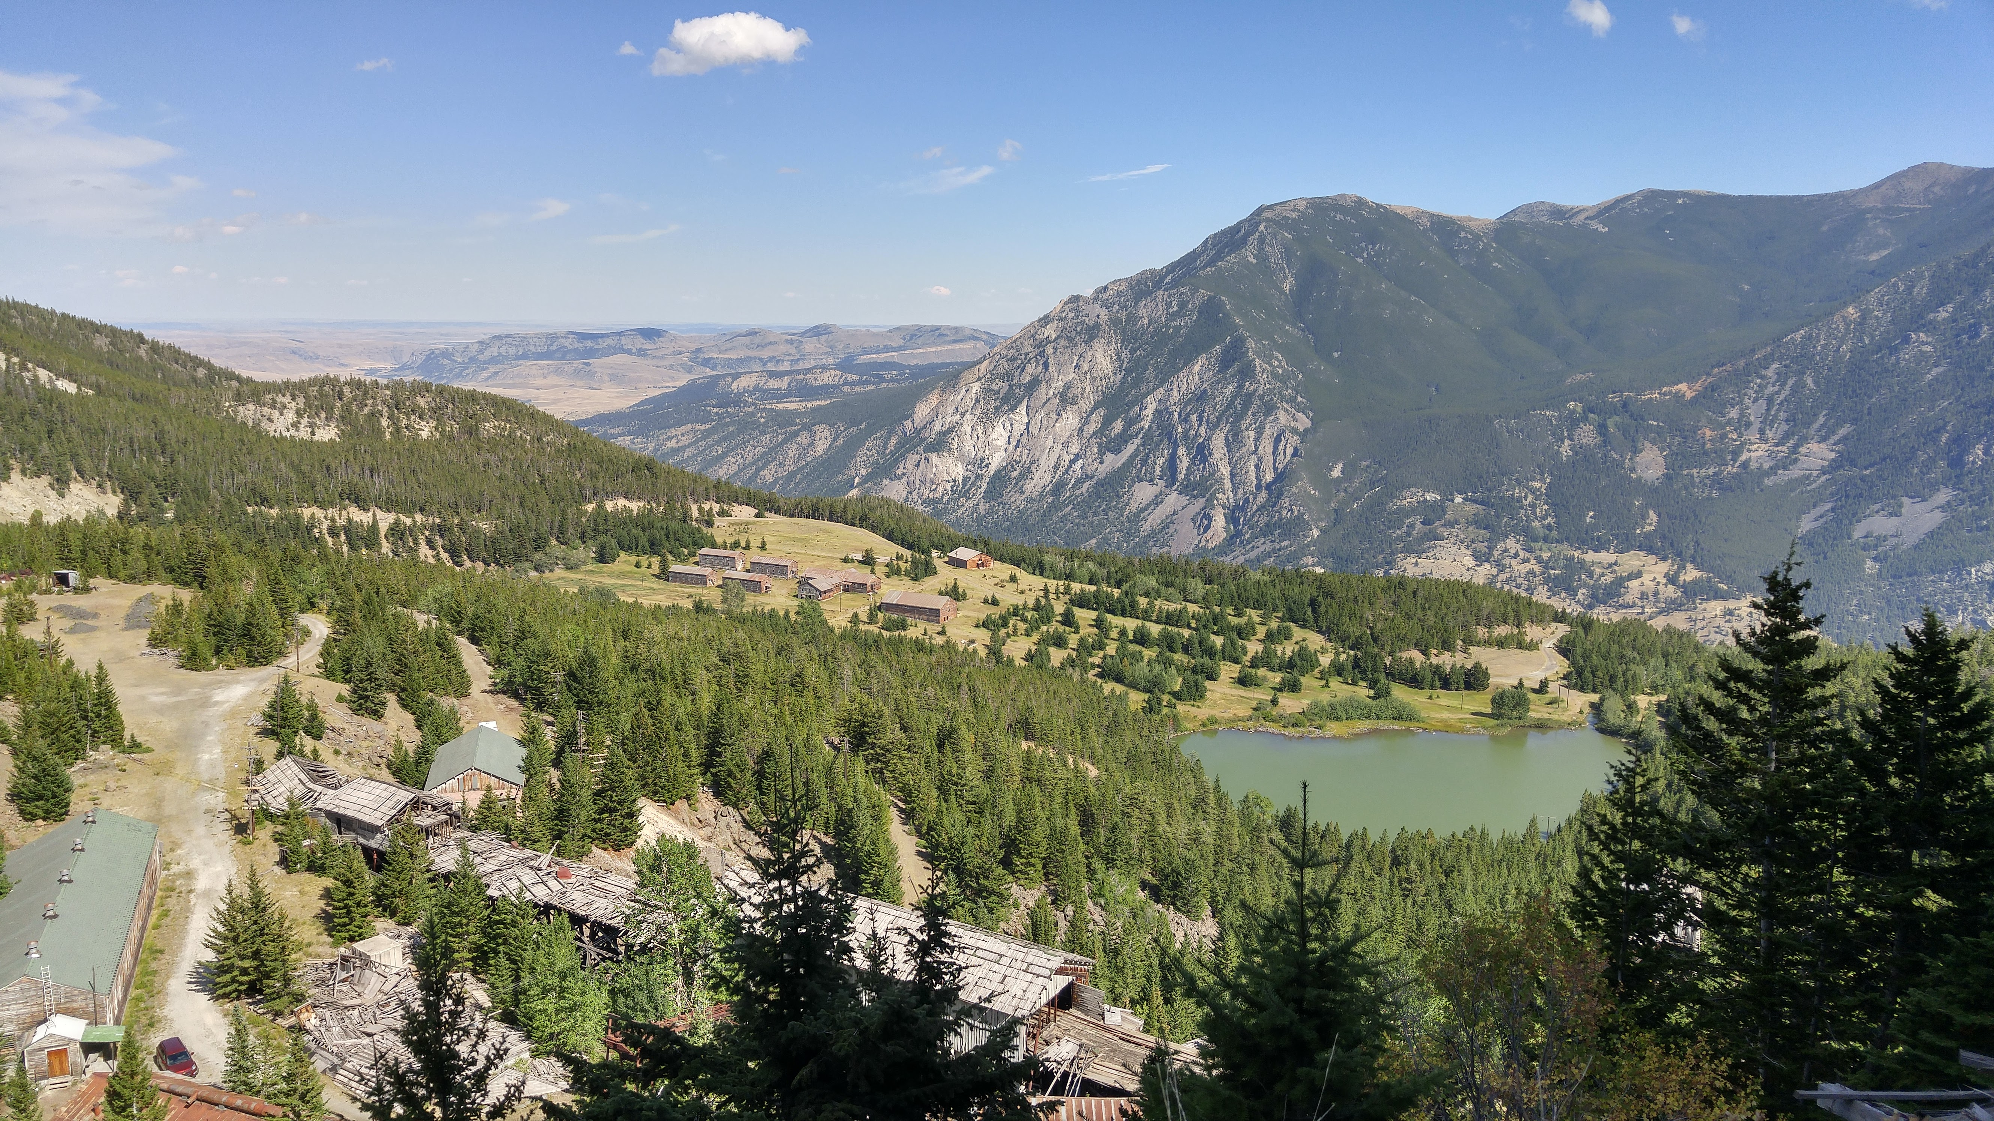

Possible parent magma and origin of layering for the Peridotite zone, Stillwater Complex, Montana, USA
Chris Jenkins & James Mungall
G & H chromite ore
Mouat Lake Camp, Mountain View area

Slide 2
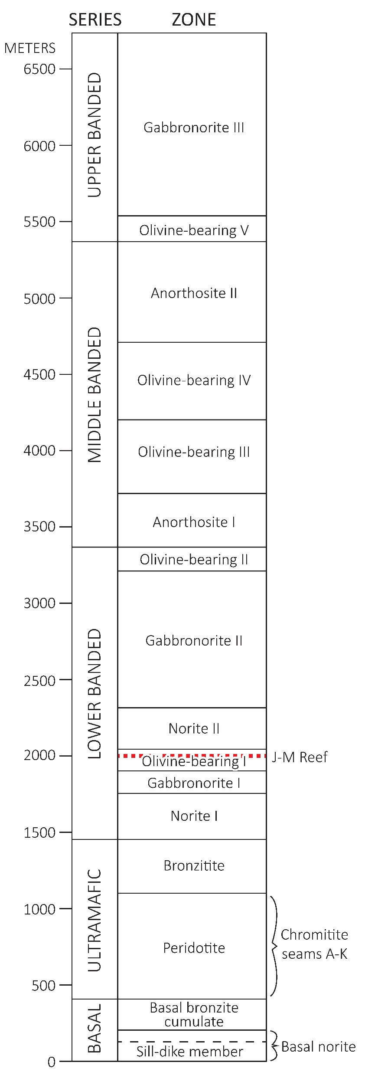
Notes:
North-northwest trending layered intrusion along the northern flank of the Beartooth Mountains in south-west Montan.
The complex outcrops over ~35 km and has a maximum thickness of ~6 km.
The layering can be cm thick (for example the famous inch-scale doublet layers along the Mountain View road) to hundreds of meters thick (AnI and ANII in the Middle banded series.
Some of the layers have been correlated for the length of the complex based

Slide 3
Selected drill hole
Modified from Jackson et al. (1954) and Page and Nokleberg (1974).
Notes:
Which direction is this DDH trending. I believe it’s south-southeast but I should double check.

Slide 4
Stillwater parent magmas
Heteradcumulates (i.e. trapped liquid + cumulus phases ≠ parent)
Diabasic rocks (Peoples 1932, Hess 1960, Jackson 1971)
Basal series fine-grained sills & dikes
  Zientek (1983), Helz (1985, 1995)
  Most popular: A mixture of Group 2 high-Mg gabbronorite and Group 3 mafic norite
Theoretical parental magmas calculated from mineral chemistry
  Raedeke (1979), Lambert & Simmons (1987, 1988)

Slide 5
Bushveld U-type magmas
U-type magmas
  High-MgO (9-19%), high SiO₂ (>52%), and low TiO₂ (<1%) (Barnes, 1989)
  Parental magmas to ultramafic cumulates?
  Residual liquid after forming ultramafic cumulates?
Contaminated komatiites
  Barnes, 1989; Lambert, 1994; Barnes et al., 2010; Eales and Costin, 2012; Mungall and Brenan 2014; Wilson, 2015; Mungall et al., 2016

Slide 6
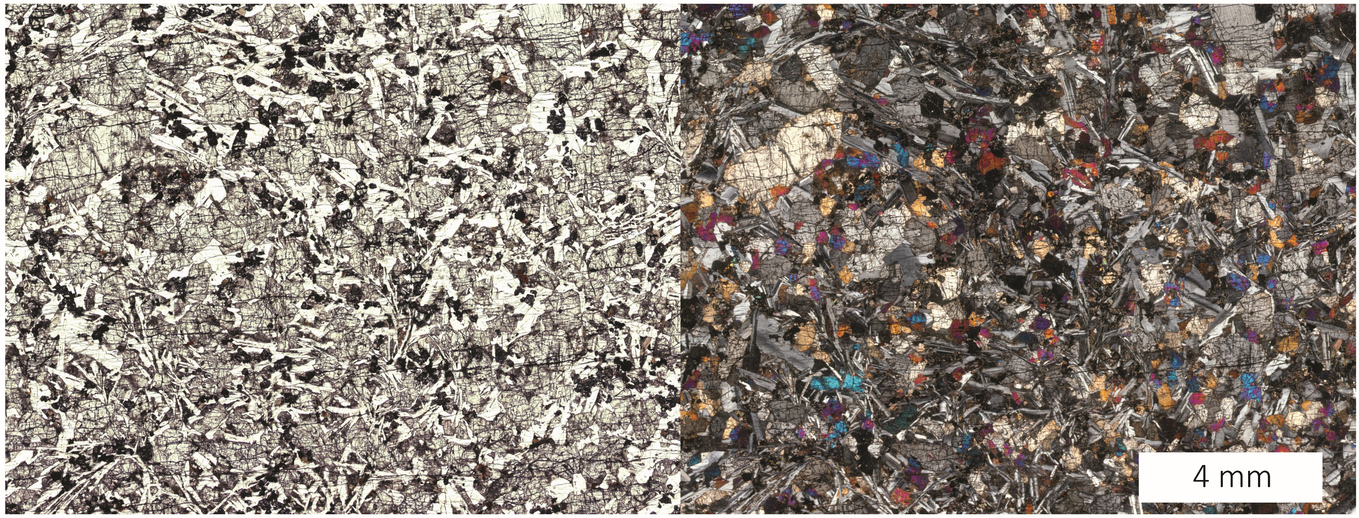
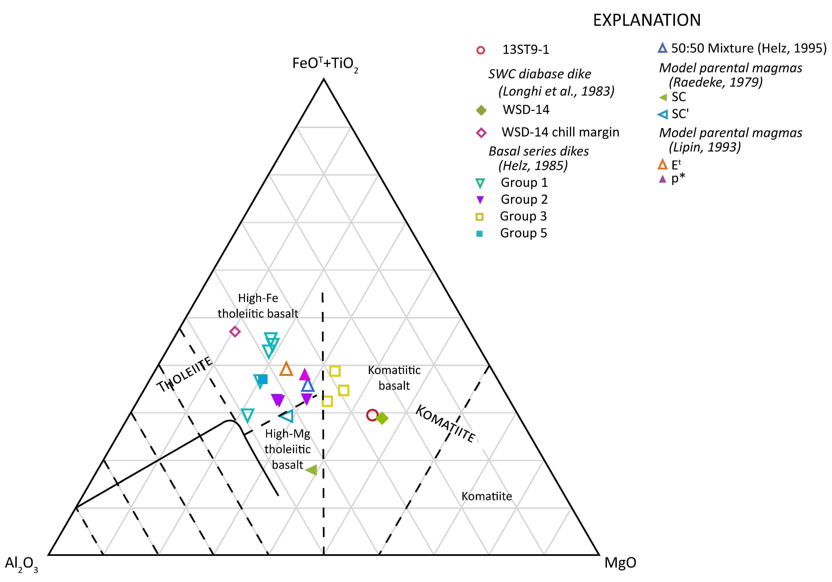
SiO₂ | 52.46
TiO₂ | 0.55
Al₂O₃ | 9.68
FeO* | 10.21
MnO | 0.18
MgO | 16.16
CaO | 8.17
Na₂O | 1.61
K₂O | 0.60
P₂O₅ | 0.07
Cr₂O₃ | 0.30
High-Mg bronzite-rich dike, Mountain View area
previously investigated by Longhi et al. (1983)
Notes:
Why did Longhi dismiss these rocks?
His experiements didn’t yield the observed liquidus sequence in the Ultramafic cumulates
The plagioclase is not anorthitic enough to match the measured plagioclase in the complex.
He was also able to sample a chilled margin along the edge of this dike and observed the 84% groundmass and 14% phenocrysts suggesting that the dike was largely phenocryst free. He did observe that the relatively low Mg# in olivine suggests some accumulation had likely occurred.
The texture is intergranular to subophitic.

Slide 7

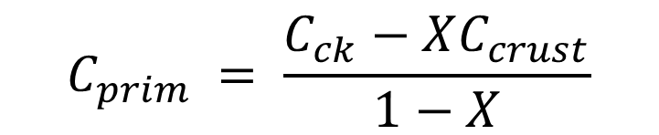
Contaminated komatiite?
Mungall et al. (2010):
Possible contaminants?
  Wyoming Province TTG
  Iron formation
  Metasedimentary rocks
As much as 50% contamination
  Mungall (2007)
(1)
$$C_{ck}=XC_{crust}+\left(1−X\right)C_{prim}$$
Rearranging:
$$C_{prim }= \frac{C_{ck}−XC_{crust}}{1−X}$$
(2)
X is the fraction of model crustal contaminant in the mixture

Slide 8
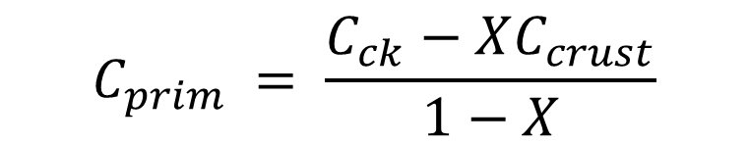
Crust
$$C_{prim }= \frac{C_{ck}−XC_{crust}}{1−X}$$
High-Mg
dike
21% crustal contamination
of model granodiorite (20%)
+ iron formation (1%)
Komatiite
Notes:
REE studies of orthopyroxene from the ultramafic series led Lambert to come up with a field of likely parental magmas that are enriched in LREE.

Slide 9
Measured chromite
Measured + model olivine
Model LLD + proposed parents
Measured bulk rock chromite-bearing olivine cumulates
A+B+C≈D
olivine (Fo_{84.5}-₈₇)
chromite (Cr#=0.55-0.63)

Slide 10
Chromitite formation
Magma mixing model
  Evolved liquid at f, mixed with primitive liquid at a
  Mixing drives the bulk composition to c
    Through the chromite-only field
  For SWC: More primitive relative to evolved
    Hybrid returns to curved cotectic
  Chromitites formed without mechanical sorting
Increase in fO₂
Increase in pressure
(1) Cotectic olivine-chromite (oC)
(2) Chromite-only (cC)
(3) Cotectic olivine-chromite (oC)
3
2
1
Muskox Intrusion cyclic units
Irvine, 1977

Slide 11
Cotectic olivine to chromite ~100:1 (Barnes, 1998)
Olivine to chromite in DDH MV89-551 averages >100:9 up with to 80 vol% chromite
Notes:
In the magma mixing models that we’ve discussed here. The mixture of the hybrid magma pushes the liquid into the chromite-only field resulting in the monomineralic layer of chromitite. Then, the liquid should return back to the chromite-olivine cotectic. If that is the case, then we should see a good amount of olivine-cumulates with cotectic proportions of chromite and olivine
Measured B, G, and H chromite cumulates, olivine cumulates, and olivine-chromite cumulates from the MV88-1, MV89-551, and MV89-550 DDHs

Slide 12
Mechanical sorting—kinetic sieving
Dais Layered Intrusion, Antarctica (Marsh, 2004)
  Coarse-grained orthopyroxene & fine-grained plagioclase
Bushveld Complex
  Viscous particle segregation during slumping (Maier et al., 2013; Forien et al., 2015)
Phenocryst-rich magma & turbulent/laminar flow regime
  Phenocryst-rich magma from underlying staging chamber (Eales & Costin, 2012)
  Magmas carrying suspended load of chromite crystals formed the UG2 (Mondal & Mathez, 2007)

Slide 14
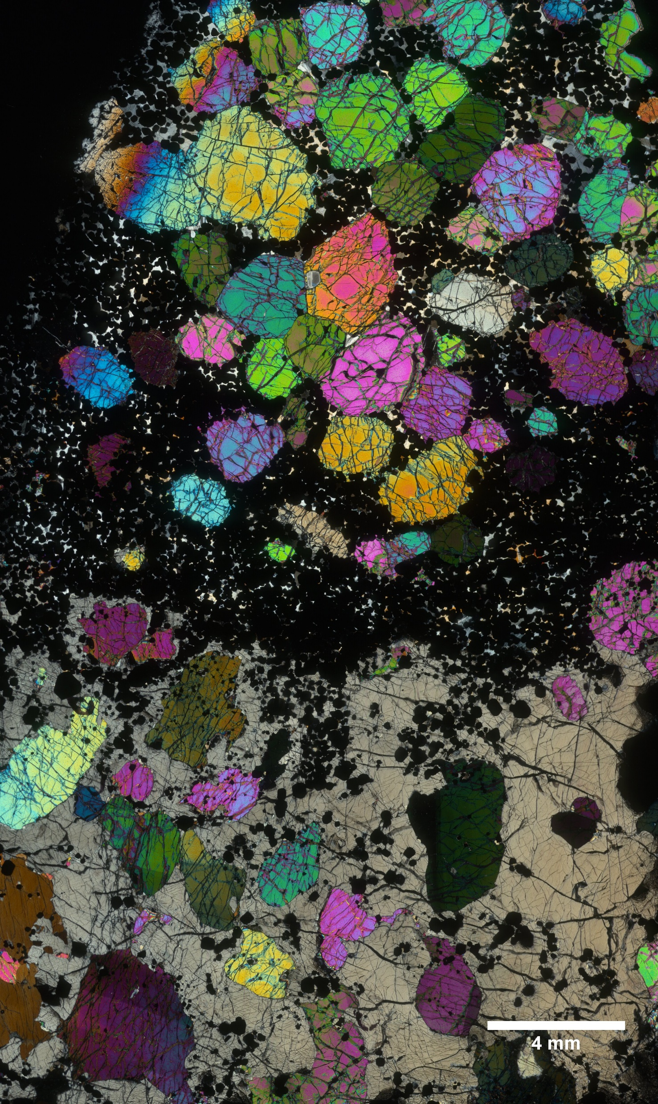
Do textures support this model?
HW G chromitite

Slide 15
Take-aways
Propose a possible parental magma to the ultramafic cumulates in the PZ
  Contaminated komatiite
  High-Mg dike representative of liquid + solids after contamination
Kinetic sieving—mechanical sorting of cumulus minerals

Slide 16
Acknowledgements
Dr. Roger Cooper
Dr. Mike Zientek, Dr. Carol Finn, Niki Wintzer, Heather Parks and more with the U.S. Geological Survey
Society of Economic Geologists Foundation
  SEG Canada Graduate Fellowship

