Slide 1

Arthur Lakes’ 1878 Map of the
Florissant Fossil Beds, Colorado
Herbert W. Meyer
National Park Service
Florissant, Colorado USA
GSA Annual Meeting, Seattle, October 23, 2017

Slide 2
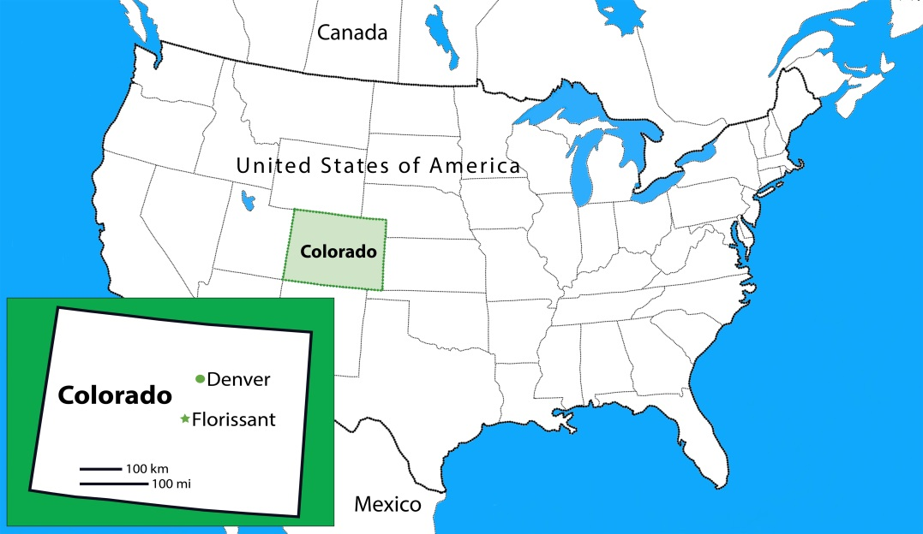
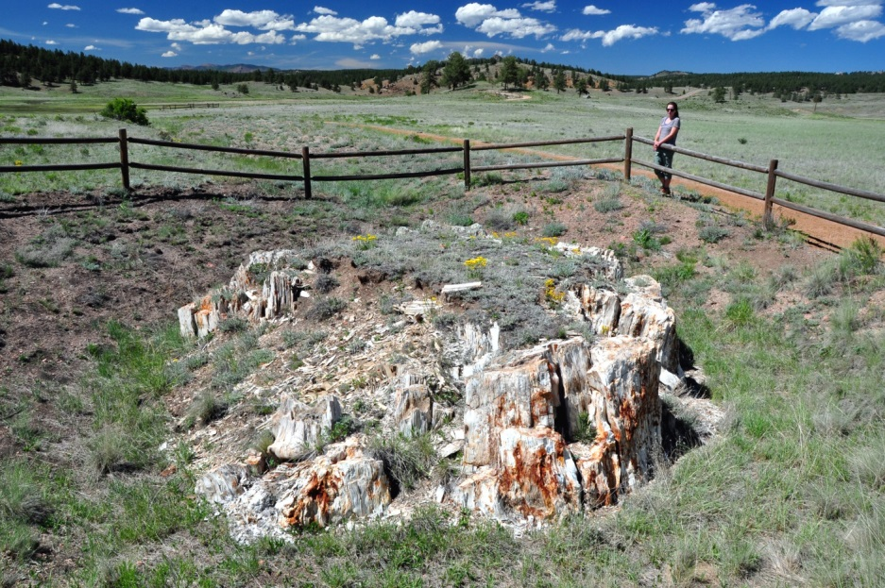
Florissant fossil beds, Colorado

Slide 3
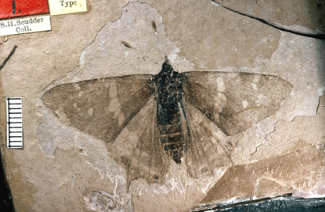
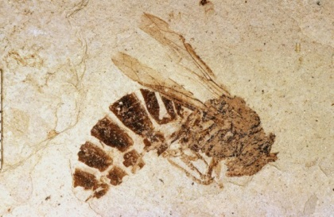
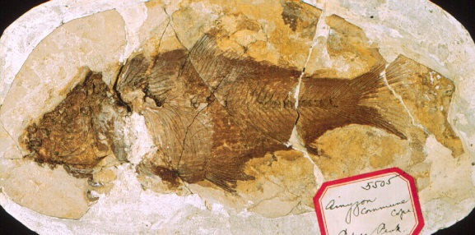
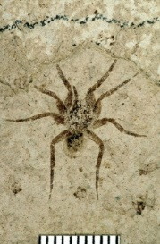
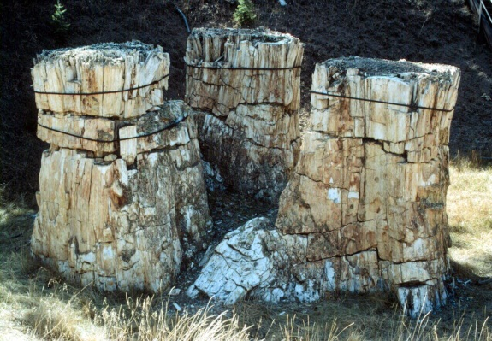
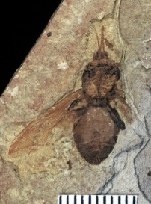
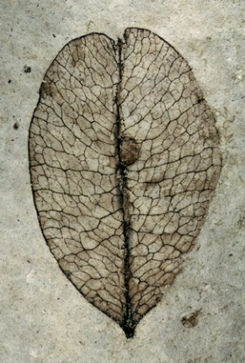
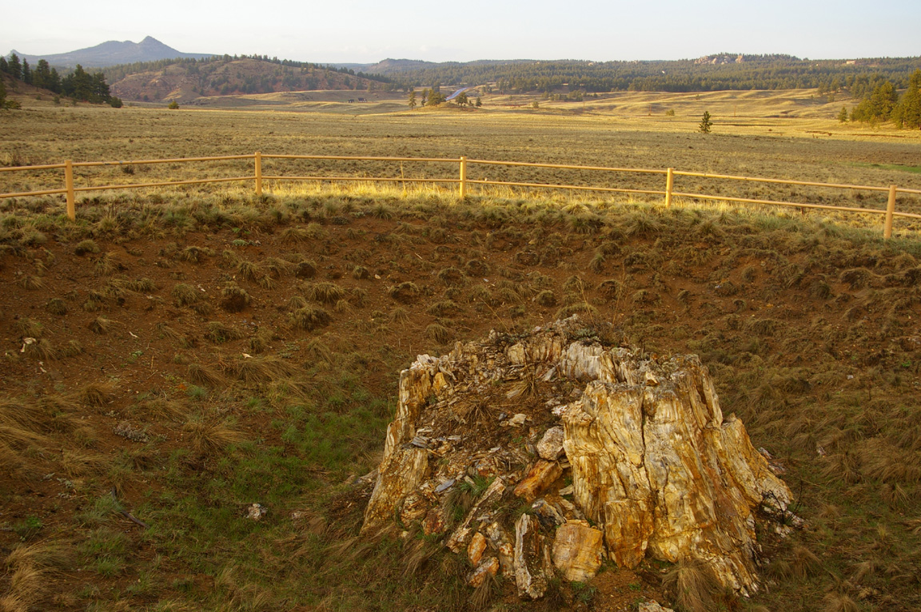
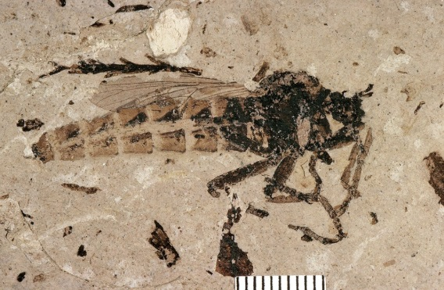
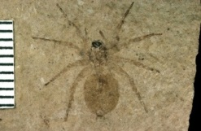
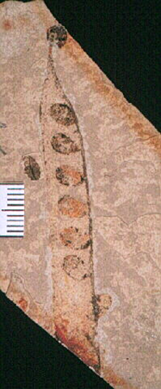
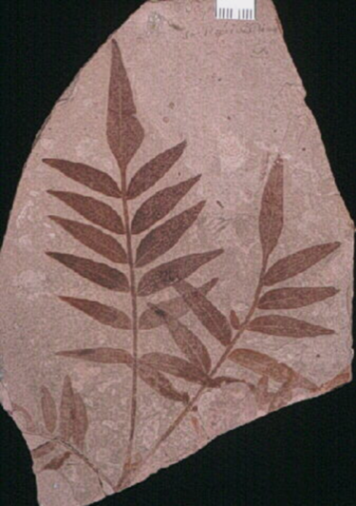
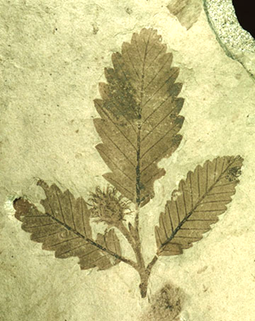
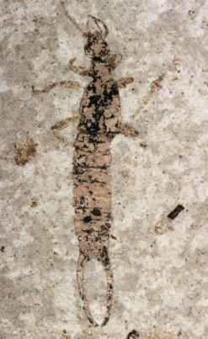
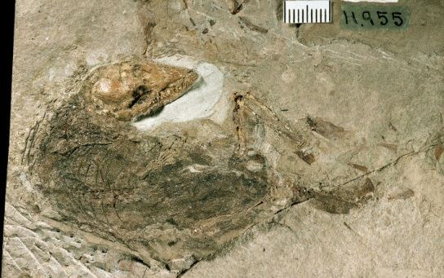
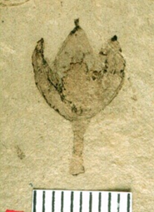
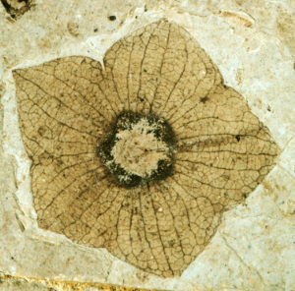
The Fossils of Florissant
The Fossils of Florissant
  Insects Spiders Plants Fish Birds Mammals
  Insects Spiders Plants Fish Birds Mammals

Slide 4
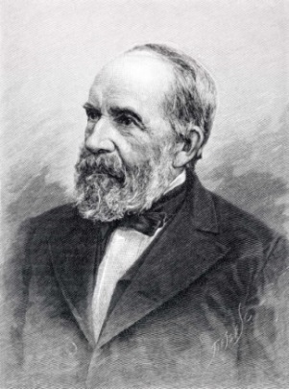
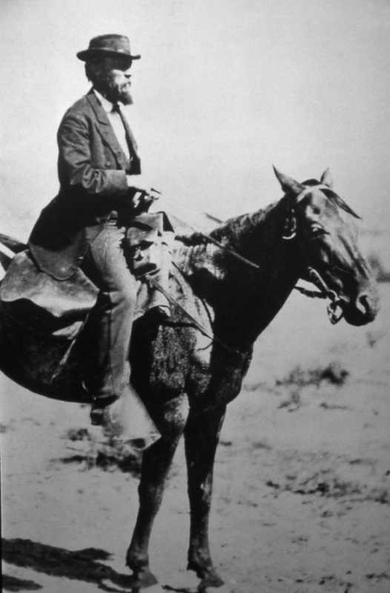
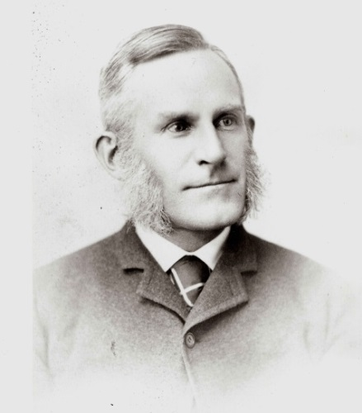
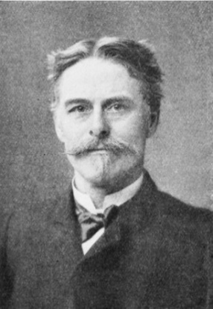
The Hayden Survey’s Florissant work – 1873 and later
The Boss
The Geologist
The Paleontologists
L. Lesquereux
A.C. Peale
S.H. Scudder
F.V. Hayden
E.D. Cope

Slide 5
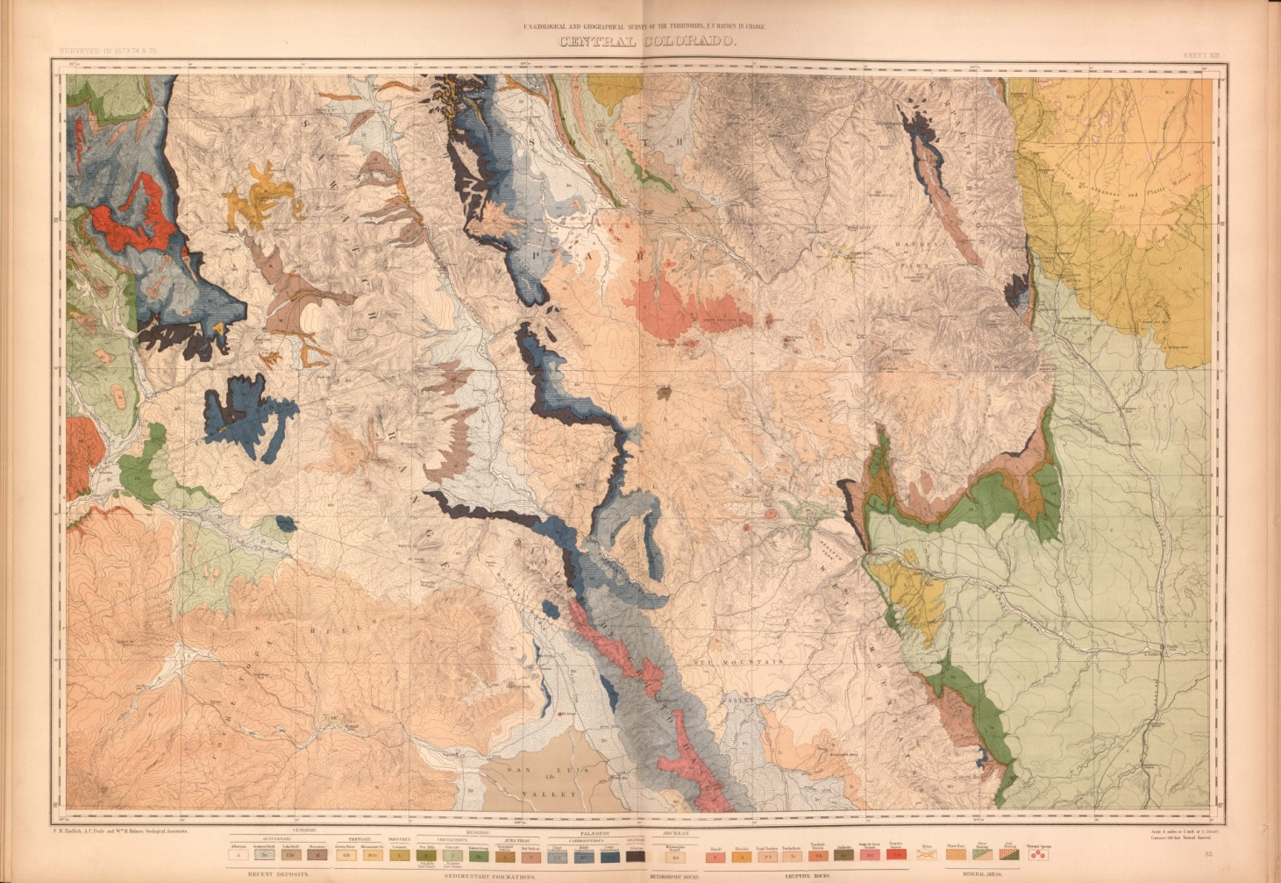
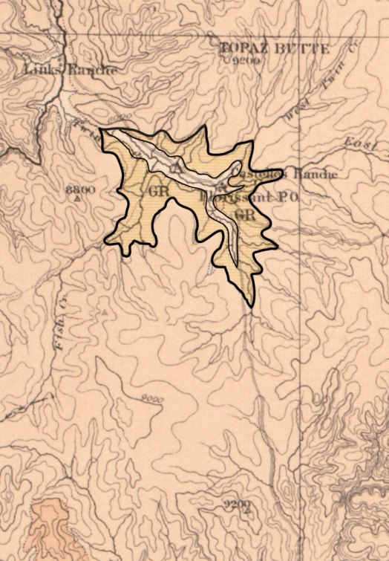
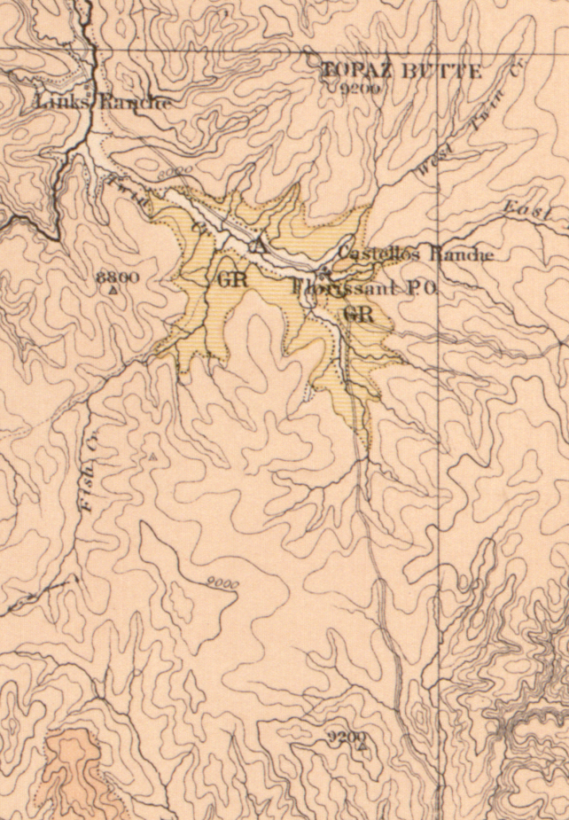
Hayden Survey’s 1877 “Central Colorado” map
1:253,440 (1” = 4 mi.)
1º15’ lat. x 2º30’ long.

Slide 6
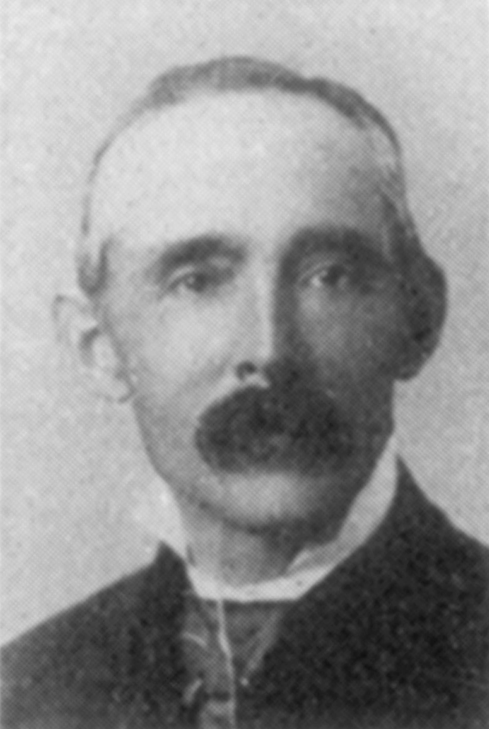
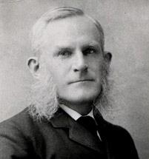
The Field Expedition of 1877
Arthur Lakes leads Samuel Scudder to Florissant
  Hayden Survey paleoentomologist Samuel Scudder from Cambridge, Mass. made arrangements with Colorado geologist Arthur Lakes for an expedition to Florissant to collect modern and fossil insects.
Arthur Lakes
Samuel Scudder

Slide 7
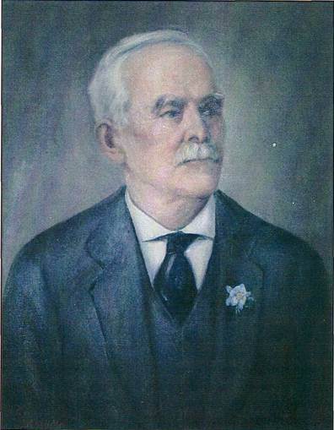
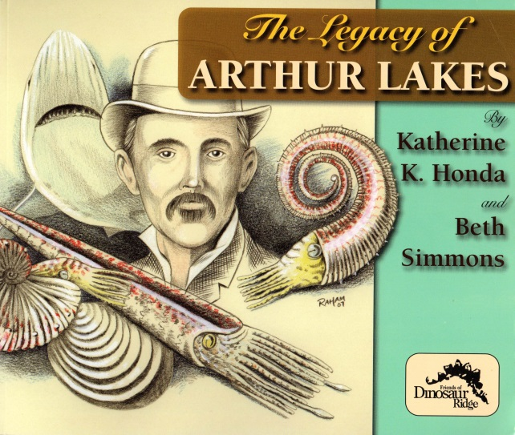
Who was Arthur Lakes?
1844 (England) – 1917 (Canada). U.S. citizen.
“Father of Colorado Geology”
Naturalist, geologist, paleontologist, minister, lecturer, journalist, author, collector, miner, artist, and illustrator
Made significant collections of fossils, especially dinosaur discoveries for O.C. Marsh
Professor at (now) Colorado School of Mines
The Legacy of Arthur Lakes, Honda and Simmons 2009

Slide 8
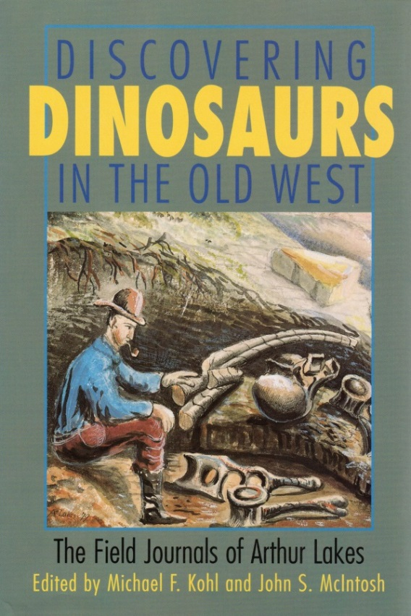
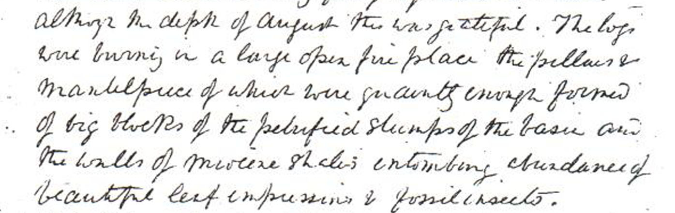
The Field Journals of Arthur Lakes
Two Field Journal Notebooks
  Documents his scientific adventures in the “Old West”
  Smithsonian Institution Archives
  Published transcription by Kohl 1997, as Discovering Dinosaurs in the Old West: The Field Journals of Arthur Lakes

Slide 9
The Field Expedition
Arthur Lakes leads Samuel Scudder to Florissant
  August 8, 1877
  Departed Golden, Colorado
  “I went to meet [Scudder] in Denver…. I procured a couple of horses at the rate of a dollar a day.”
Arthur Lakes
Samuel Scudder

Slide 10
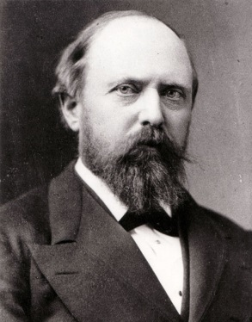

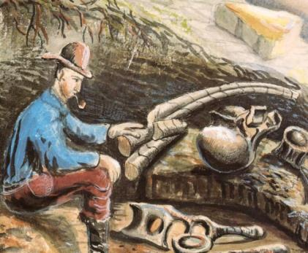
Dinosaurs or bugs?
  August 9, 1877
  “A telegram from Marsh arrived desiring [me] to go at once to Cañon City to secure a fossil saurian lately discovered there from the hands of Professor Cope who was trying to get it. I could not break my engagement with Professor Scudder and so went on our journey.”
O.C. Marsh
E.D. Cope
The “Bone Wars”

Slide 11
The journey across South Park to Florissant
  Rode for several days traveling through South Park
  Scudder collected many modern insect specimens

Slide 12
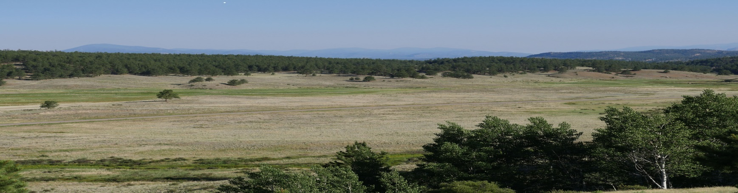
Over the pass and into the Florissant valley
  “We halted on the crest of a hill overlooking the park to bid farewell to this beautiful scene only to turn around and behold one equally sublime… Towards nightfall we descended into a depression among the hills with light grey shales … showing we were approaching the skirts of an old lacustrine deposit among the granite hills.” - A. Lakes, August 17, 1877

Slide 13
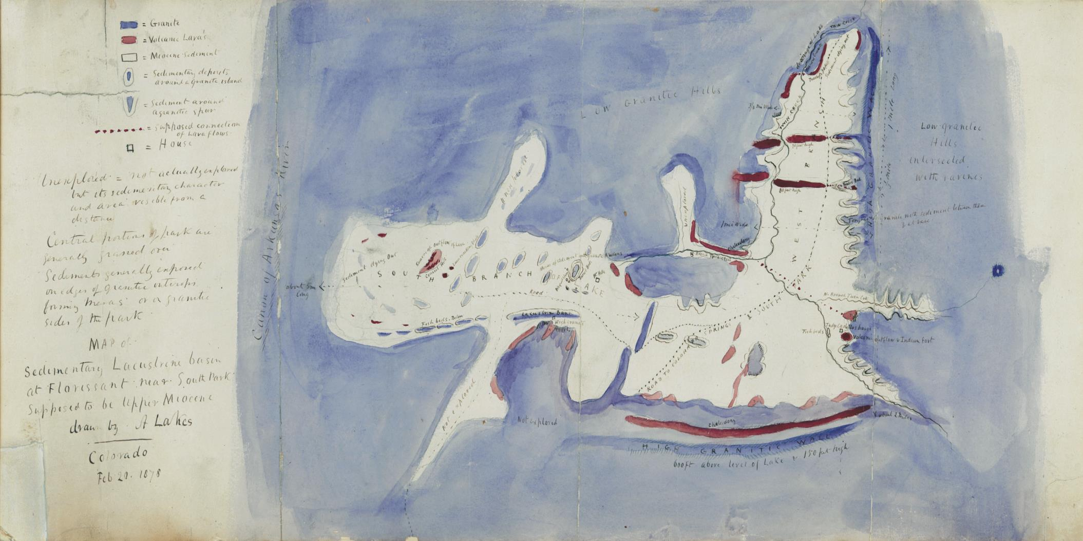
“Map of Sedimentary Lacustrine basin at Florissant near South Park, Supposed to be Upper Miocene, drawn by A Lakes, Colorado, Feb 20. 1878”
6 months later, back in Golden, Lakes makes the map

Slide 14
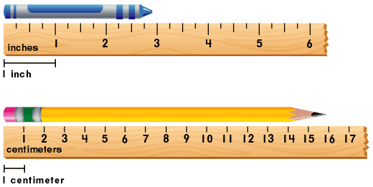
“Map of Sedimentary Lacustrine basin at Florissant near South Park, Supposed to be Upper Miocene, drawn by A Lakes, Colorado, Feb 20. 1878”
Map Scale
1 in. = 0.35 mi.
1 cm = 0.22 km
1:22,000 (approx.)
1 mile
1 kilometer
Map Dimensions
11 in. x 25.5 in.
(65 cm x 28 cm)

Slide 15
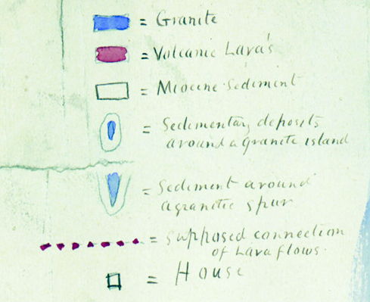
“Map of Sedimentary Lacustrine basin at Florissant near South Park, Supposed to be Upper Miocene, drawn by A Lakes, Colorado, Feb 20. 1878”
= Granite
= Volcanic Lavas
= Miocene Sediment
= Sedimentary deposits around a
granitic island
= Sediment around a granitic spur
= Supposed connection of lava flows
= House

Slide 16
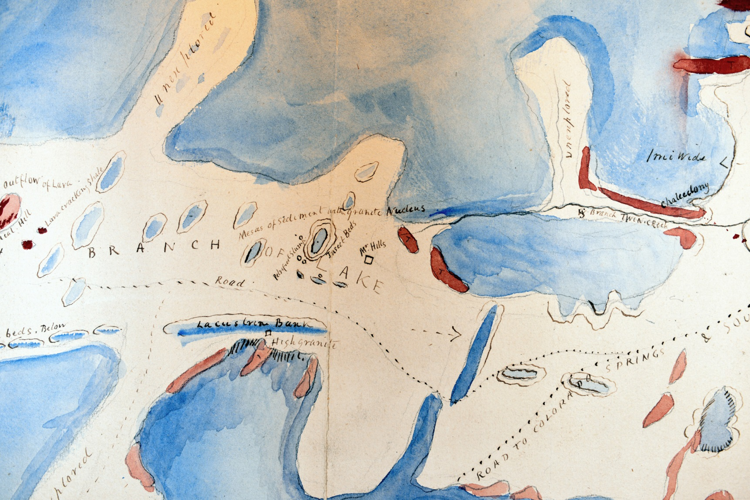
Watercolor brush strokes

Slide 17
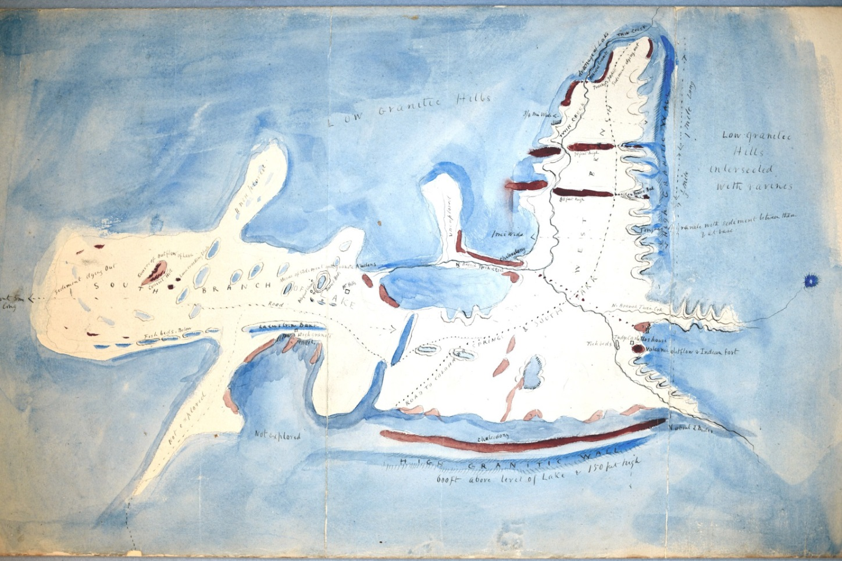
Lakes maps the lake: Ancient Lake Florissant
  “The southern entrance of the lake is about five miles long and two to three in width with many little bays and inlets on either side, … and little islet mesas of fine shale capped with trachyte…. The walls or slopes of the primeval lake are formed of red granite traversed by outbursts of trachyte.”
  - A. Lakes
“Unexplored” inlets of the lake
“Low Granitic Hills”
“Drainage of Lake”
“Lacustrine Bank”
“High Granitic wall 600 ft above level of lake”

Slide 18
Mapping paleontological sites
  August 19, 1877
  “We started to explore the locality known as the Petrified Stumps, celebrated for these gigantic petrified trees as well as for the beautiful fossil impressions of insects.”
  - A. Lakes
“Insect Beds”
“Peales bed”
“Fish beds”
“Petrified stump”
“Fish beds”

Slide 19
Mapping cultural features
  “We rode into our destination of Castello’s hospitable ranch… A half hours ride took us to Mr. Hill’s house and to the mesa whence so many insects had been taken.”
  - A. Lakes
“Mr Hills”
“Indian fort”
“Judge Castellos house”

Slide 20

Detail of the northern area

Slide 21
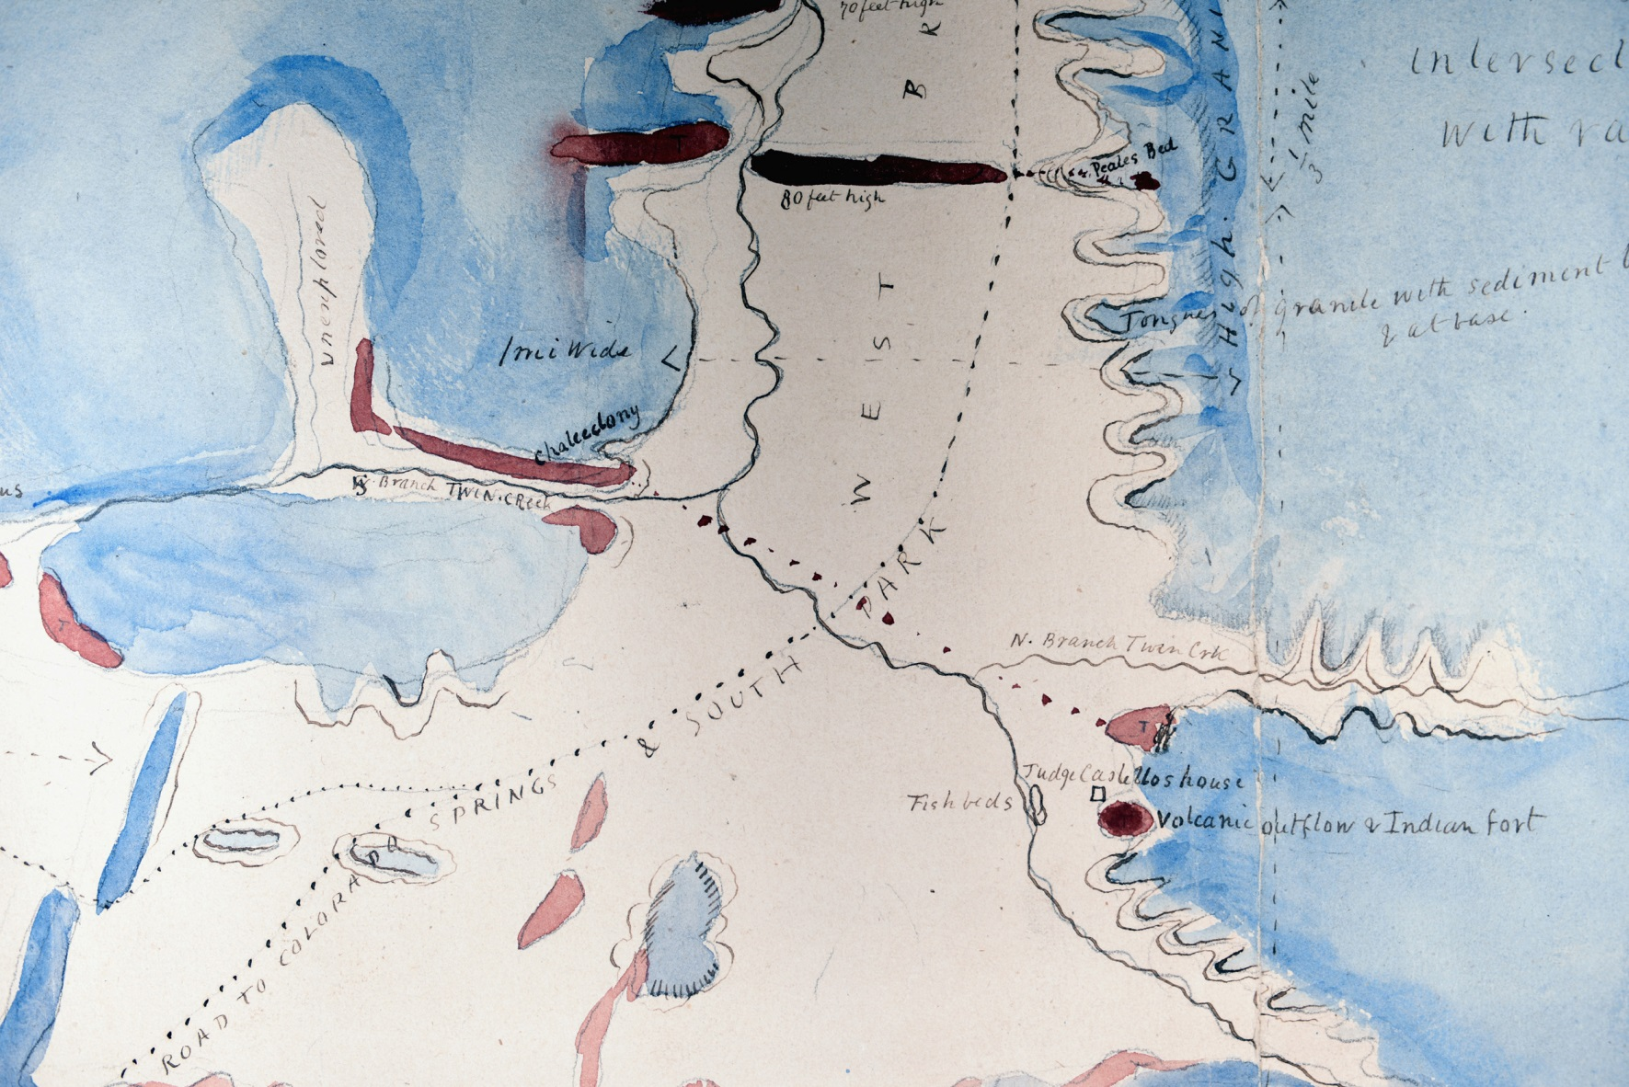
Peale’s Bed
Tongues of granite
Road
Volcanic outflow
& Indian fort
Fish Beds
Judge Castello’s house (Florissant town)

Slide 22
Detail of the central area

Slide 23
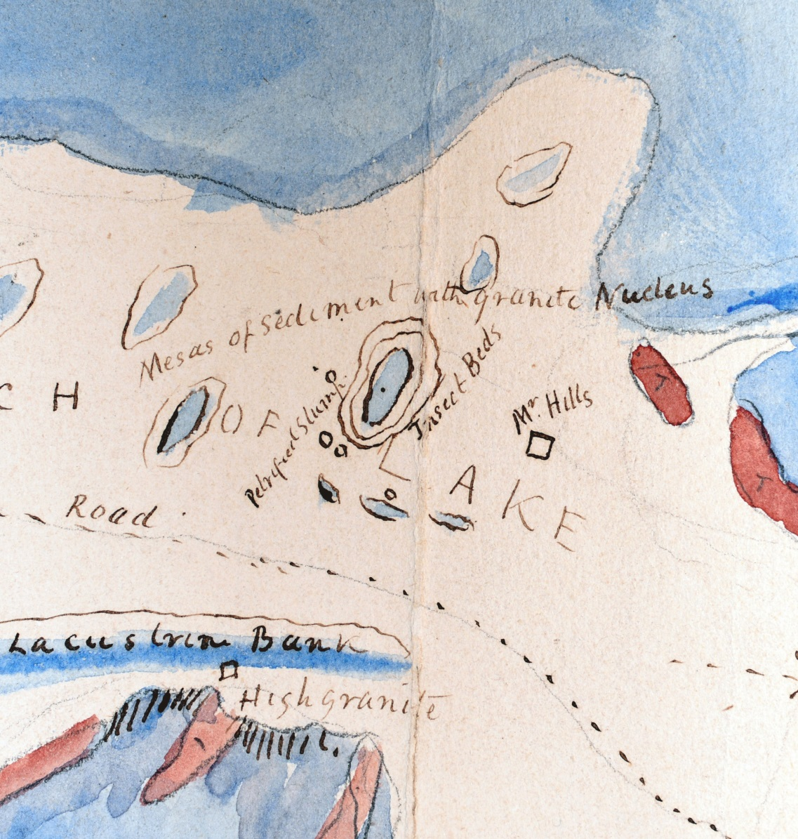
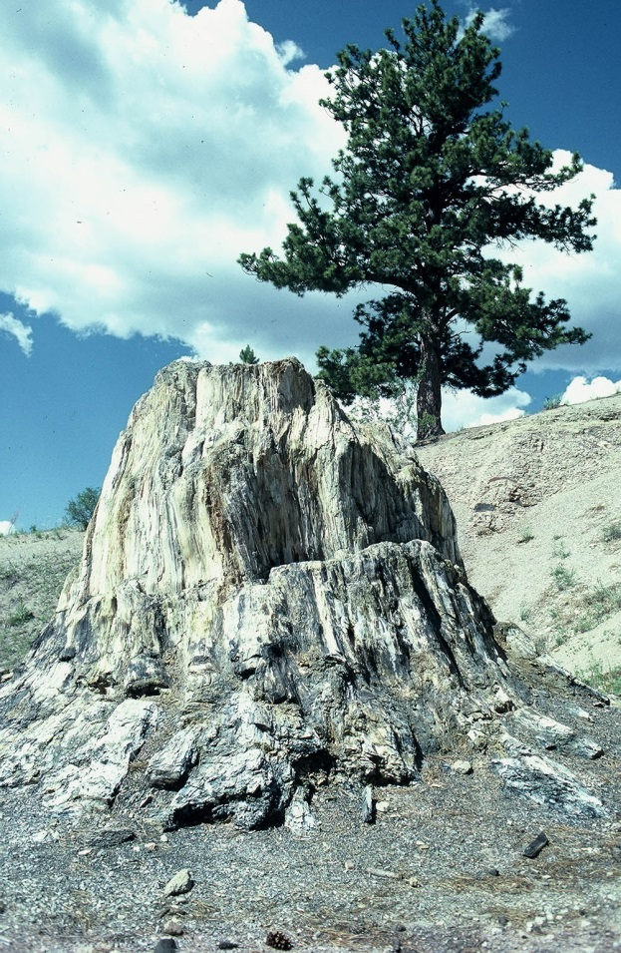
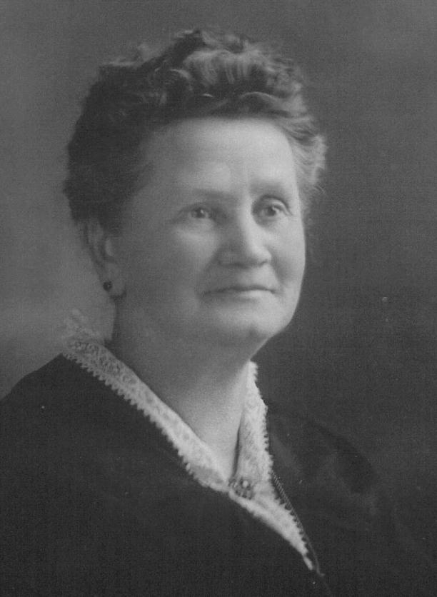
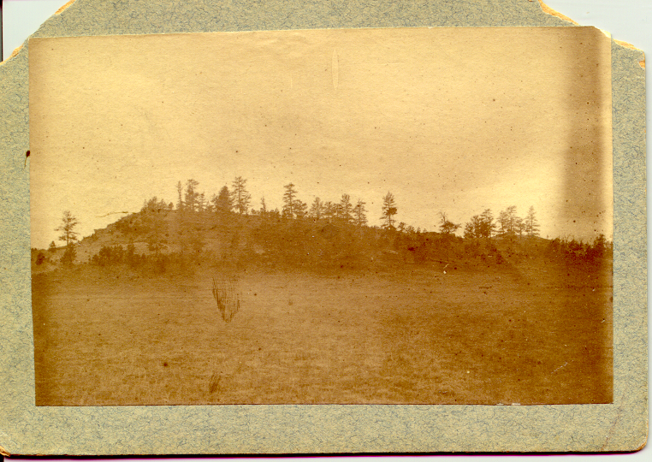
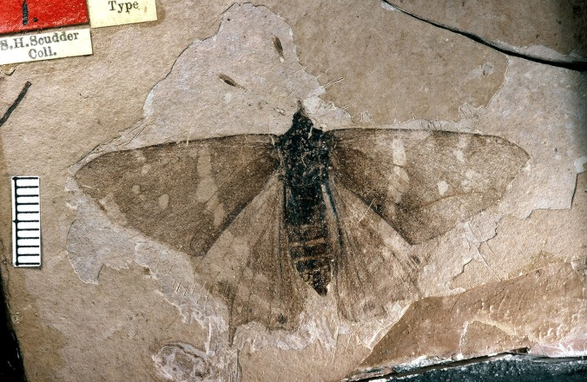
Insect Beds
  August 18, 1877
  “Prof. Scudder went over to Hill’s ranch to see about some fossils Mrs. H. had been collecting for him… He came back reporting the Hills had boxes upon boxes full of fine paper shales covered with the impressions of most perfect insects.”
Hills house
Prodryas persephone Scudder 1878
“Hill where most of the insect specimens were obtained”
Taken by Scudder’s son, ca. 1882
Petrified stump
Homesteader Charlotte Hill

Slide 24
Where’s my horse?
  Scudder’s lost horse
  “Prof S who had let his horse graze whilst he went to examine something came back and found his horse gone. Three hours were spent in a weary hunt all over the country… We were just giving up when I found the horse quietly grazing behind a rock a few feet from where it had been left.”
  - A. Lakes, August 20, 1877

Slide 25
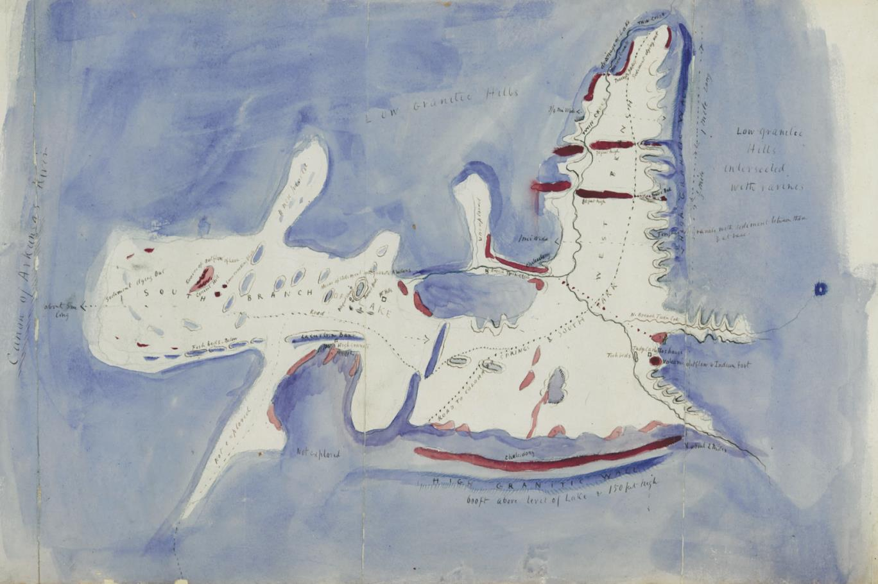
North

Slide 26
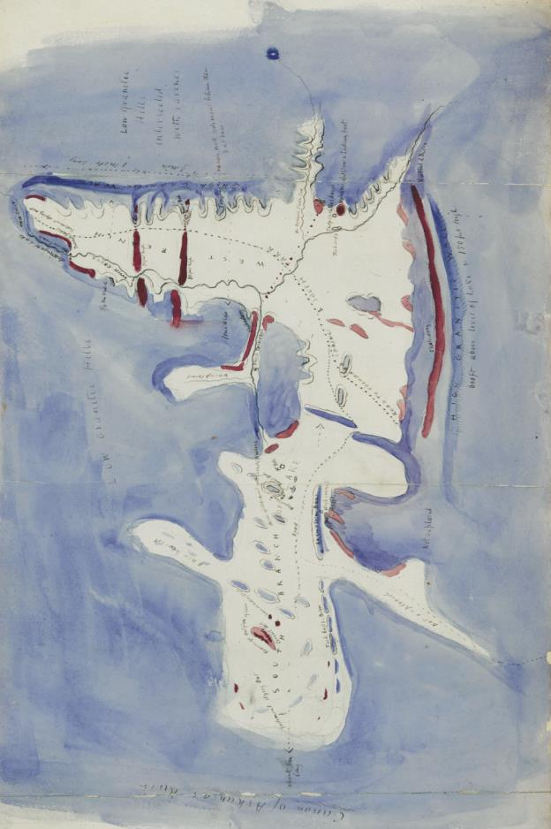
North

Slide 27
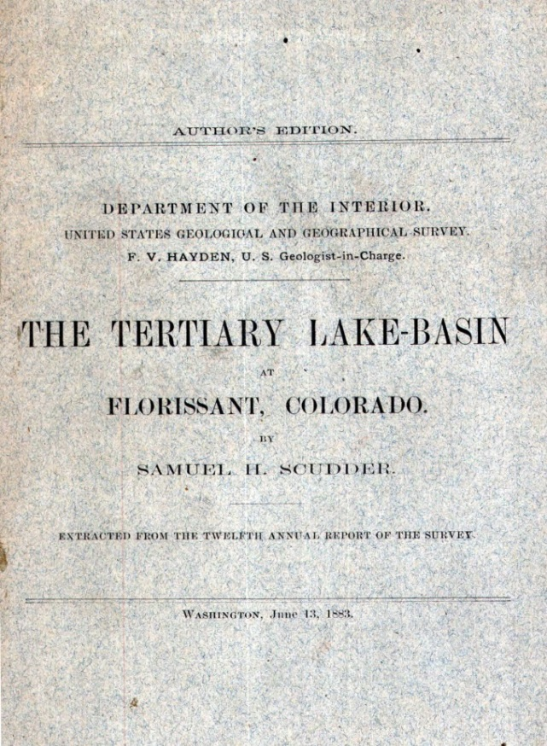
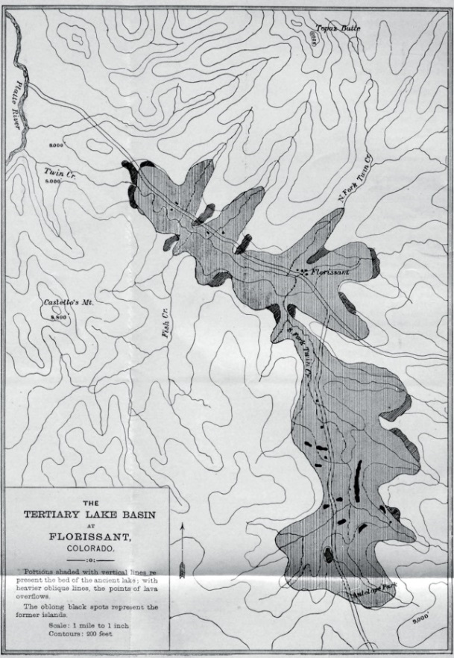
Scudder’s 1881 version of the map
  “Mr. Lakes studied the geology of the district … and the first part of this paper should be considered our joint production.”

Slide 28











Evolution of the Florissant Geologic Map
National
Monument
area only
Hayden Survey
1877
Lakes
1878
Scudder
1881
Cross
1894
Wobus and Epis
1978
Evanoff
1992
Hayden
Peale

Slide 29



Contemporary Lithostratigraphy
  Florissant Formation (= “Miocene sediment” of Lakes)
    Six informal units
    Lacustrine, fluvial, and volcanic
    Upper Eocene (34 Ma)
  Wall Mountain Tuff (= “Volcanic Lavas” of Lakes)
    Welded tuff
    Upper Eocene (37 Ma)
  Pikes Peak Granite (= “Granite” of Lakes)
    Proterozoic (1.08 Ga)

Slide 30

Significance of the Map
Association with scientists of the Hayden Survey
Good correlation with journal notes
First large scale map of the Florissant area
First map to indicate boundaries of local rock units
Provides paleogeographic reconstruction of the lake
Documents locations of early fossil collecting sites
Documents the location of Charlotte Hill’s house

Slide 31



Ownership of the map 1878 to 2017
Lakes made the map for Samuel Scudder
It was in Scudder’s personal library
Harvard Professor Frank Carpenter purchased Scudder’s library from the Boston Society of Natural History in 1944
Carpenter donated the map to the National Park Service in 1988
It is now cataloged in the collection at Florissant Fossil Beds National Monument
Prof. Frank M. Carpenter
FLFO Paleontology Collections

Slide 32

Florissant Fossil Beds National Monument
Established in 1969
Includes the central area of Lakes’ map
NPS boundary
(Approximate)

Slide 33

Acknowledgements
Conni O’Connor Lindsay Walker
Sarah Allen
Notes:
Add FLFO Friends logo

