Slide 1





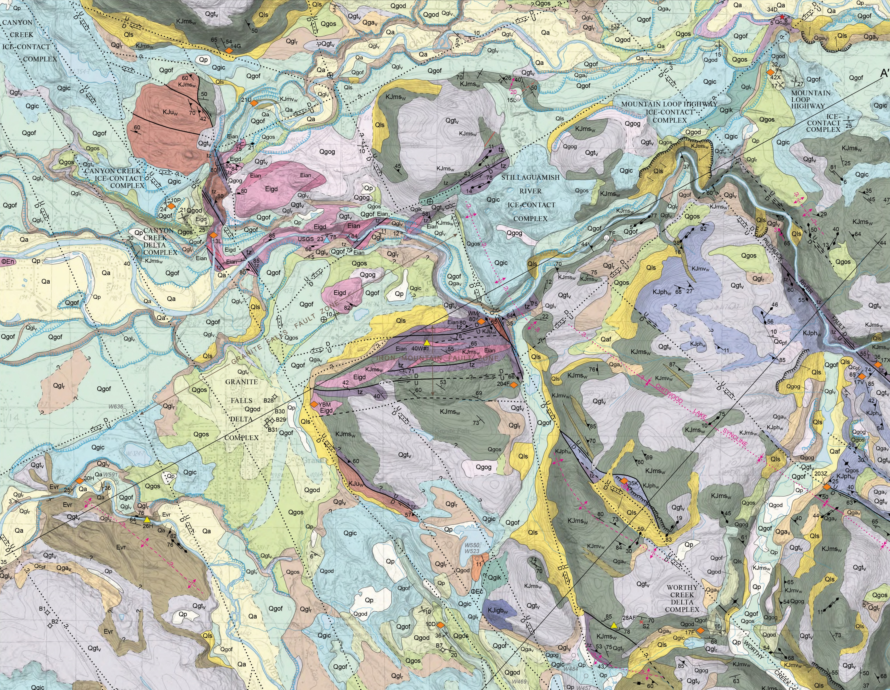
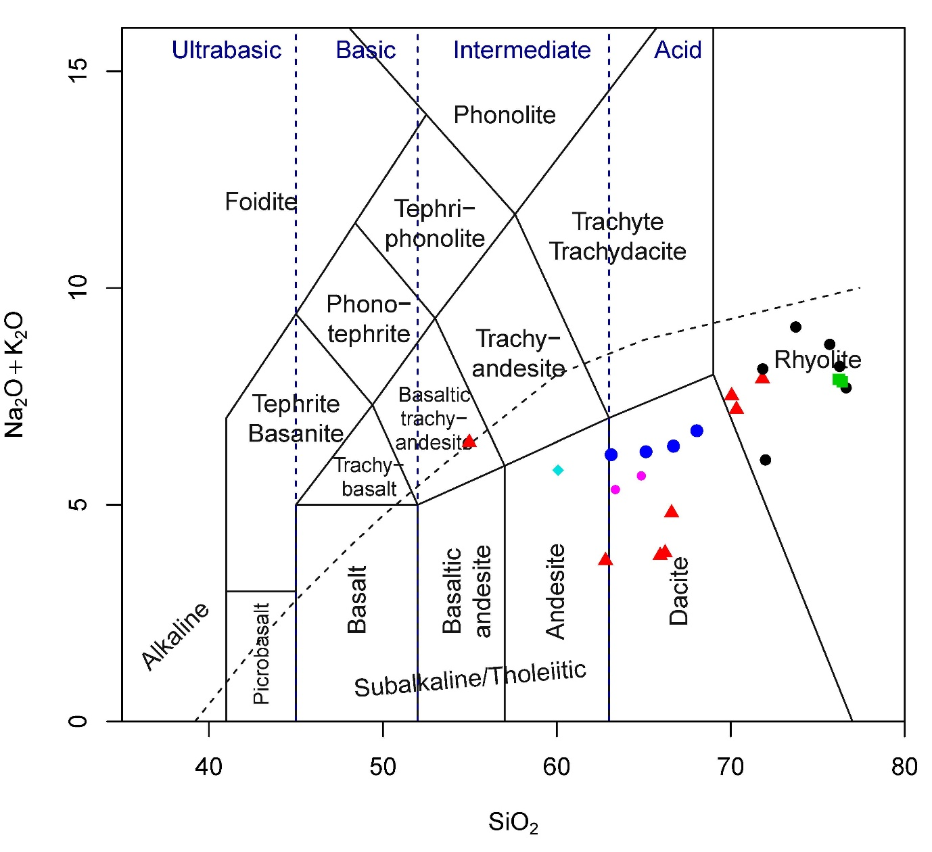
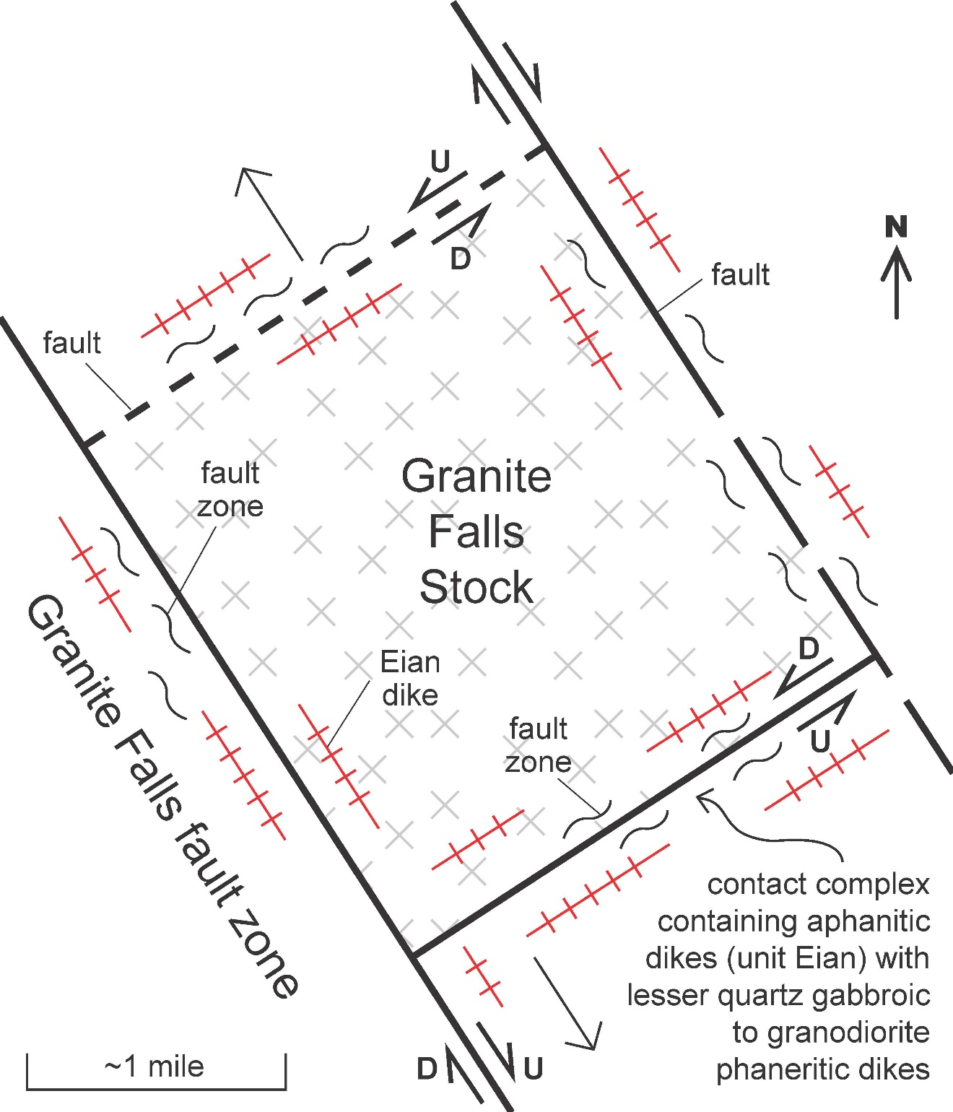
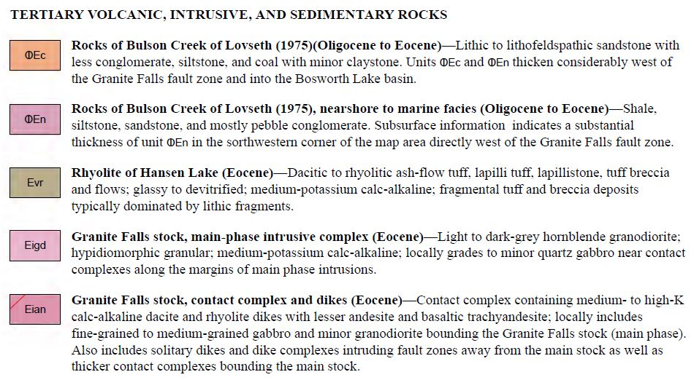
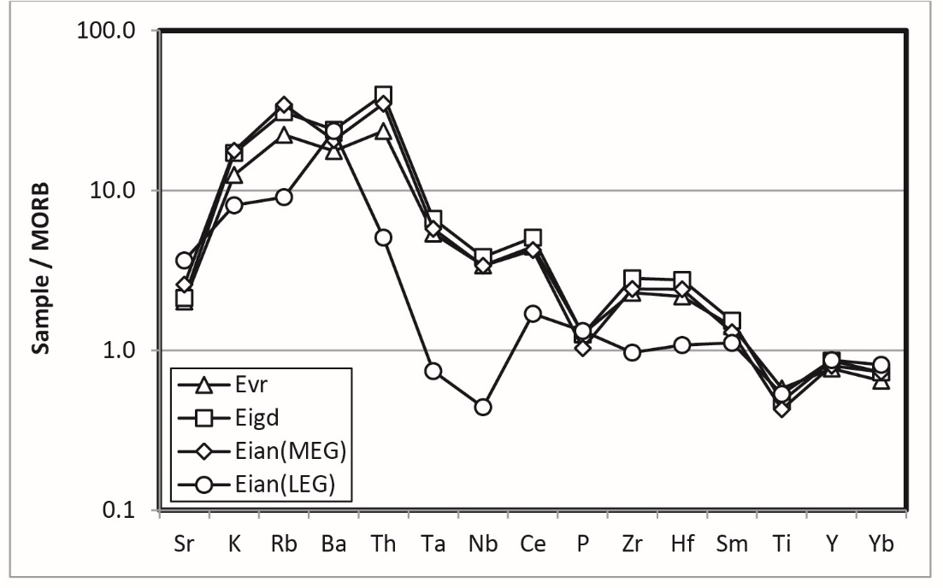
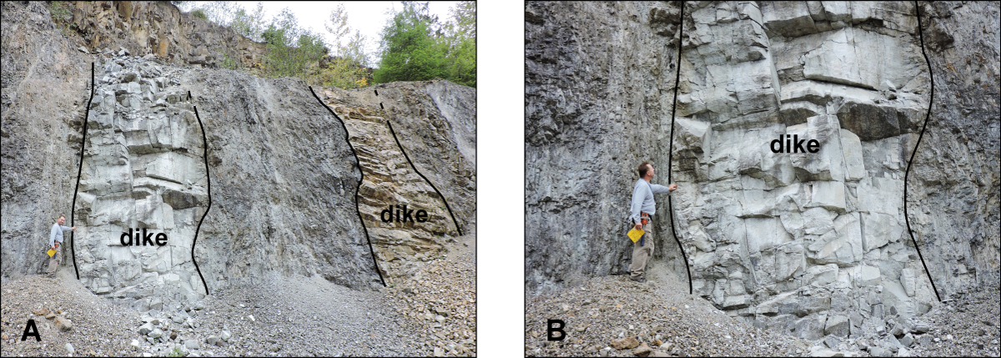
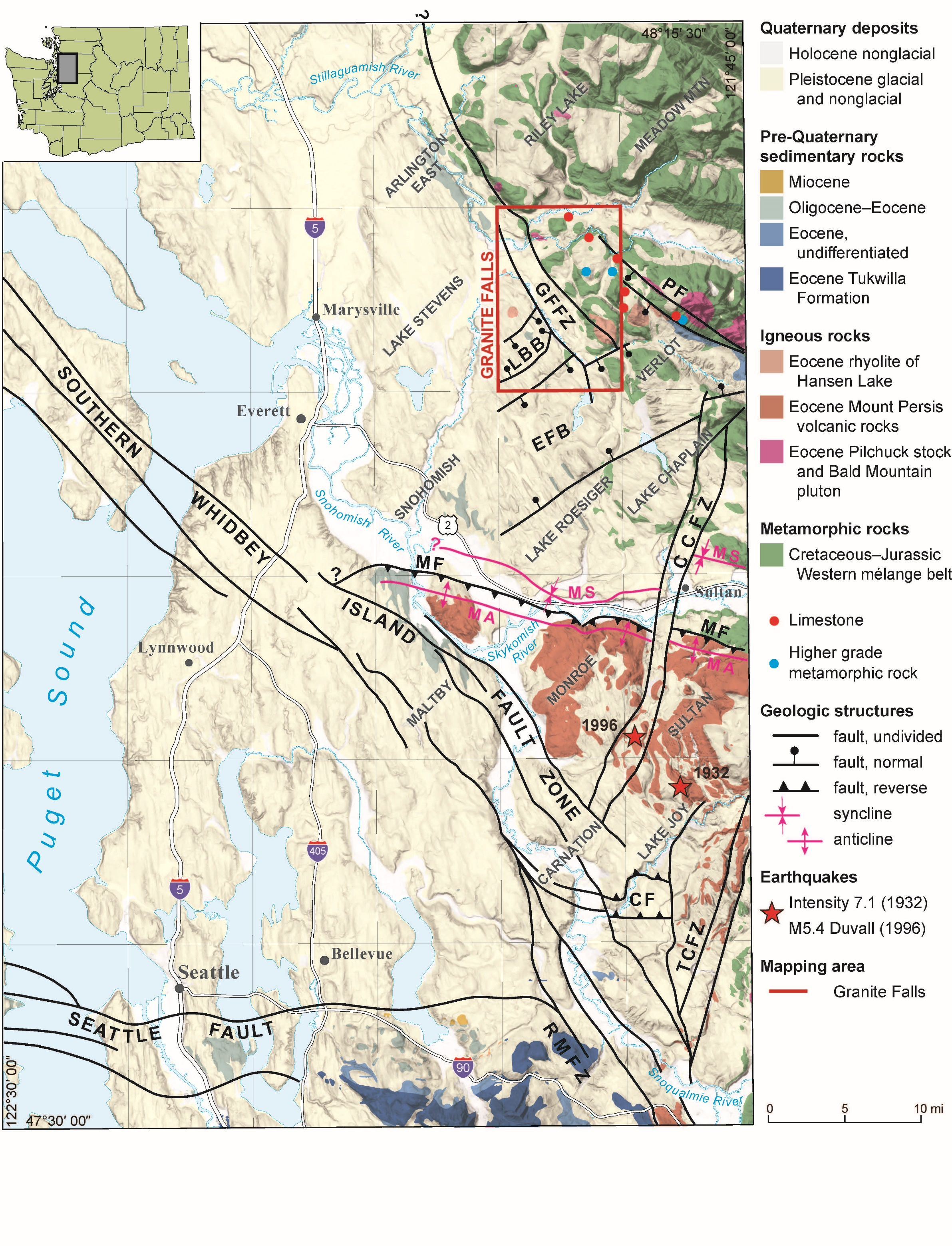
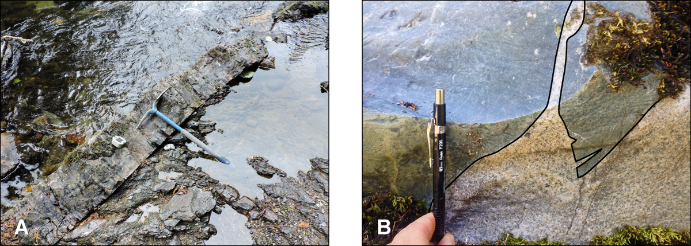
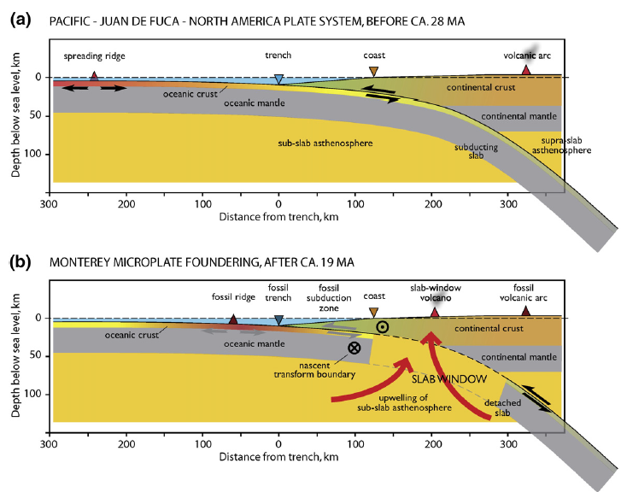
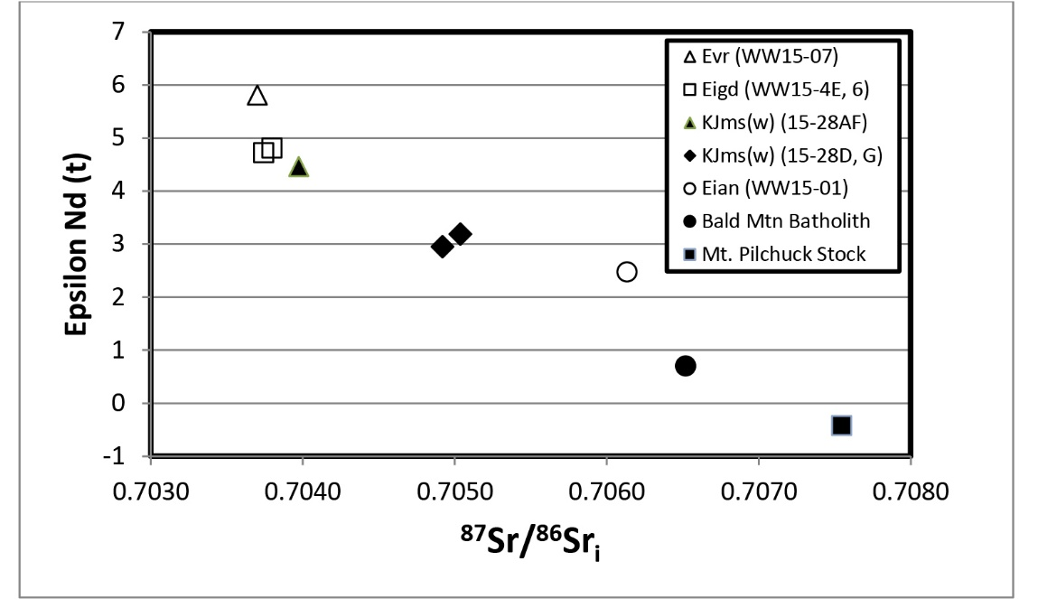
GRANITE FALLS STOCK AND THE HANSEN LAKE RHYOLITE—A HISTORY OF SYN-TECTONIC EOCENE MAGMATISM AND UPLIFT IN THE PILCHUCK RIVER VALLEY DURING REGIONAL TRANSTENSION, SNOHOMISH COUNTY, WASHINGTON
_{ABSTRACT}
Joe D. Dragovich¹, Jeffrey H. Tepper², James H. MacDonald³, Jr., S. Andrew DuFrane⁴, Megan L. Anderson⁵, Curtis J. Koger⁶, Skyler P. Mavor⁷, Glenn T. Thompson³, and Michael P. Eddy⁸
Our new mapping, U-Pb zircon dating, geochemistry, and isotope information shows that ~43–50 Ma igneous bodies in the Pilchuck Valley preserve a history of Eocene syn-tectonic intrusion and uplift during regional transtension. The Bald Mountain Pluton (BMP), Mount Pilchuck Stock (MPS), and Granite Falls Stock are mesozonal to epizonal intrusions in the Pilchuck River valley whose emplacement was controlled by bounding faults (Fig 1). The ~43 Ma Granite Falls rhyolite exposed directly south of Granite Falls (Fig. 2 and full quadrangle map to the right of this poster) is an extrusive equivalent of the metaluminous ~44–45 Ma Granite Falls Stock. The Hansen Lake rhyolite and S-type BMP and MPS constitute a slightly older ~49 Ma comagmatic package preserved to the east in the upper Pilchuck River valley (Fig. 1). The contact complex bordering the Granite Falls Stock main phase consists of intermediate to felsic aphanitic to porphyritic dikes, and mafic to intermediate, medium-grained intrusive bodies (Figs. 3-5). Early dikes are contact metamorphosed by later intrusions.
The contact complex and main Granite Falls Stock syn-tectonically intruded into conjugate ENE and NNW trending fault zones that bound the stock and controlled magmatic emplacement paths (Fig. 4). In this “pull-apart basin” intrusive model, space was created by dilation across conjugate NE-trending transtensional faults and NW-trending transpressional to transtensional faults (Fig. 7). Geochronologic constraints, geochemistry, and field relations suggest that diking generally accompanied intrusion of the 44 Ma Granite Falls Stock during NNW-SSE directed regional transtension.
Geothermobarometry and mapping indicate the Bald Mountain Pluton and Mount Pilchuck Stock crystalized at depth (4.5–5.4 kb) whereas the Granite Falls Stock was shallowly emplaced (0.7 kb) and fed the Granite Falls rhyolite and contact complexes of the Granite Falls Stock. This suggests >5 km to perhaps as much as 10 km of mid-Eocene uplift along the Pilchuck River Fault, a regional fault mapped north of the Granite Falls Stock, Hansen Lake Rhyolite and Granite Falls rhyolite (Fig. 1). This combination of mid-Eocene extension, uplift, and crustal melting in a forearc setting support Farallon Slab breakoff following the Siletzia accretion, all being responses to hot asthenosphere upwelling through a gap in the slab (Fig.8).
Transtensional Pull Apart Basin’ Model for the Eocene Intrusive Rocks of the Granite Falls Stock
Granite Falls Stock
Figure 5. Total alkali versus silica diagram (LeBas and others, 1986) illustrating the diversity of igneous rocks from the Granite Falls Quadrangle. Major element data for the Bald mountain pluton (black circles) and Mount Pilchuck stock (green squares) are from Campbell (1991). Unit Eian dikes (red triangles), Eigd Granite Falls Stock granodiorite (blue circles), Evr rhyolite flows (pink circles), and KJmv_{w} WMB basement rocks (diamond).
Granite Falls rhyolite
Figure 2. Northern half of the Granite Falls 7.5-minute quadrangle. A separate full map of the quadrangle is shown to the right is shown to the right of this poster. See Figure 1 red box for quadrangle location regionally.
Figure 7. Structural Model. Cross-cutting faulted and intrusive age relationships indicate both a syn-tectonic and co-magmatic intrusive history for the contact complex (CC) and Granite Falls Stock (GFS) stock intrusive bodies. The CC and GFS syn-tectonically intruded into conjugate ENE and NNW trending fault zones that bound the GFS and controlled magmatic emplacement paths. In this the “pull-apart basin” intrusive model space was created by dilation across conjugate NE-trending transtensional faults and NW-trending transpressional to transtensional faults. An extensional tectonic model fits with the observation of contemporaneous regional sedimentary basins and is consistent with the observation that the Eocene intrusive rocks in the Pilchuck Valley are largely to completely bounded by faults.
This model explains these key observations:
similar 43-45 Ma ages of the andesite dikes, Granite Falls rhyolite, and GFS main phase,
dikes intrude faults but are cut again by later faults of the Granite Falls and Iron Mountain fault zones,
the GFS intruded the CC dikes (Fig. 4), but dikes also cut the main stock, and
the more-felsic andesite dikes are geochemically and isotopically similar to the GFS (Fig. 5, 6A-6B).
Figure 6A. MORB-normalized spider diagram showing LILE enrichments and Ta-Nb depletions characteristic of subduction-related magmas. Plotted values are averages for each unit. Note the close similarity of patterns for units Eigd, Evr, and Eian (MEG), suggestive of a common origin. Trace element and isotopic geochemistry of dikes suggest they were mostly generated from the same melt source as the nearby Granite Falls Stock (Figs. 5 and 6B).
Figure 3. Dacitic porphyritic dikes (unit Eian) intruding faulted Western mélange belt metasedimentary rocks (unit tz). The most prominent dike (sample 15-40W#1), gave a U-Pb date of 43.95 ±0.44 Ma.
From McCrory et al (2009)
Figure 8. Tectonic Framework
As Siletzia approached the Cascadia trench (~52 Ma) subduction slowed, leading to rollback of the Farallon slab.
The docking of Siletzia (~50 Ma) terminated subduction and resulted in slab break off beneath what is today central Washington.
Upwelling of asthenospheric mantle through the slab tear resulted in production of basaltic magmas as well as elevated heat flow. Manifestations of increased magmatism and heat flow between ~50 – 45 Ma included crustal melting (.g., S-type Mt. Pilchuck and Bald Mountain plutons) and crustal uplift.
Eocene Uplift
The presence of primary muscovite in the ~49 Ma Bald Mountain and Mt. Pilchuck plutons indicates crystallization at P > 4 kb. Phengite and amphibole thermobarometry on these plutons (Thompson et al., this meeting) also yields mid-crustal pressures. In contrast, the younger (44-45 Ma) Granite Falls stock and Hansen Lake Rhyolite were emplaced near or on the surface.
These results suggest 10-15 km of crustal uplift occurred between ~49 – 44 Ma (~0.25 cm/yr). This suggests substantial vertical offset on the Pilchuck River fault (PF on Fig. 1), which runs between the older and younger units.
Figure 4. Contact relations of unit Eian. A) Porphyritic dike cross cutting sheared meta-argillite in the Western mélange belt (unit KJms_{w} in Fig. 2). This exposure is in the Pilchuck River in the SE portion of the quadrangle. It is one of a family of dikes mapped along the Pilchuck River directly south of the Carpenter Creek fault (CCF) and within the northernmost part of the Explorer Falls basin. These Eocene dikes trend east-northeast and we hypothesize are related to Eocene extension (Fig. 7). B) Well exposed intrusive relationship between the Granite Falls Stock (unit Eigd) main phase granodiorite and contact complex (dark rock bounded by black line); this outcrop is part of a series of exceptional rock exposures in the South Fork Stillaguamish River. Granodiorite of the Granite Falls Stock intrudes aphanitic country rock of unit Eian. However, because we also observed dikes intruding the stock we broadly envision a comagmatic history for these ~44–45 Ma intrusive bodies. We postulate a syn-tectonic intrusive history during regional Eocene transtension for these igneous bodies because the dikes in the contact complex intrude faults and then are again faulted locally by the faults bounding Eocene igneous bodies (Fig. 7).
Figure 6B. Sr-Nd isotopic compositions. Note the similarity of Eigd and Evr samples. High εNd(t) and low ⁸⁷Sr/⁸⁶Sr values of KJms meta-argillites preclude their being the source for the Pilchuck and Bald Mountain plutons. WMB volcanic metasedimentary rock could be the Eigd/Evr source. We suspect that the structurally deep KJms meta-arkosic metasedimentary rocks are the source for the “S-type” Bald Mountain and Mount Pilchuck plutons.
Figure 1. Simplified regional tectonic map of the central Puget Lowland and Cascade Range foothills showing the Granite Falls 7.5-minute quadrangle (red rectangle). With this study, we extend the Explorer Falls basin (EFB) from the south and southeast into the Granite Falls quadrangle and add the Bosworth Lake Basin (LBB). The EFB is bound by the Three Lakes Hill fault on the south and the Carpenter Creek fault on the north. The Pilchuck River fault (PF) has substantial vertical offset. The PF, LBB and EFB are likely originally Eocene extensional structures that controlled the emplacement of Eocene igneous rocks, but now preserve Paleogene to Pleistocene basin sediments in the Pilchuck River valley.
Acknowledgements/Coauthor Contact Information
This geologic map was funded in part by the U.S. Geological Survey (USGS) National Cooperative Geologic Mapping Program under award no. G15AC00248. ¹Associated Earth Sciences, Inc., 1552 Commerce Street, Suite 102, Tacoma, WA 98402, jdragovich@aesgeo.com; ²Department of Geology, University of Puget Sound, Tacoma, WA 98416, ³Marine & Ecological Sciences, Florida Gulf Coast University, 10501 FGCU Blvd South, Ft. Myers, FL 33965, ⁴Earth and Atmospheric Sciences, University of Alberta, 1-26 Earth Science Building, Edmonton, AB T6G 2E3, Canada, ⁵Geology Department, Colorado College, 14 E. Cache La Poudre St, Colorado Springs, CO 80903, ⁶Associated Earth Sciences, Inc., 911 5th Ave., Suite 100, Kirkland, WA 98033, ⁷Department of Geosciences, Colorado State University, 1401 Campus Delivery, Ft. Collins, CO 80523, ⁸Department of Geosciences, Princeton University, Princeton, NJ 08544

