Slide 1



Energetics both promote and limit aquatic mammal gigantism
William Gearty¹, Craig R. McClain², and Jonathan L. Payne¹
¹Department of Geological Sciences, Stanford University
²Louisiana Universities Marine Consortium
@willgearty

Slide 2
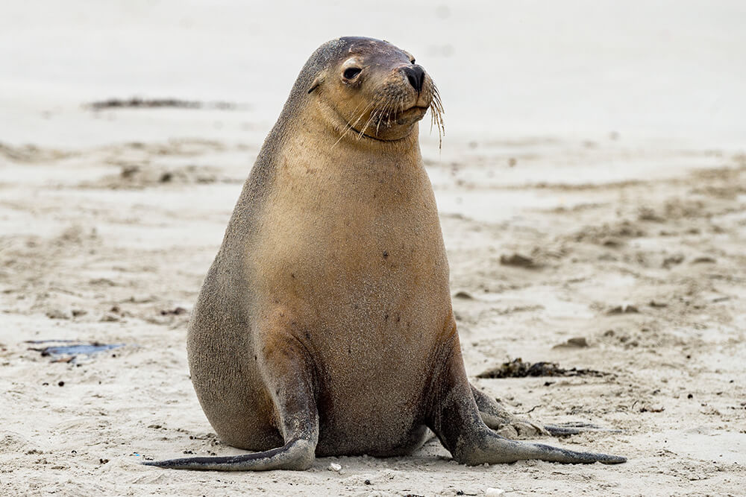
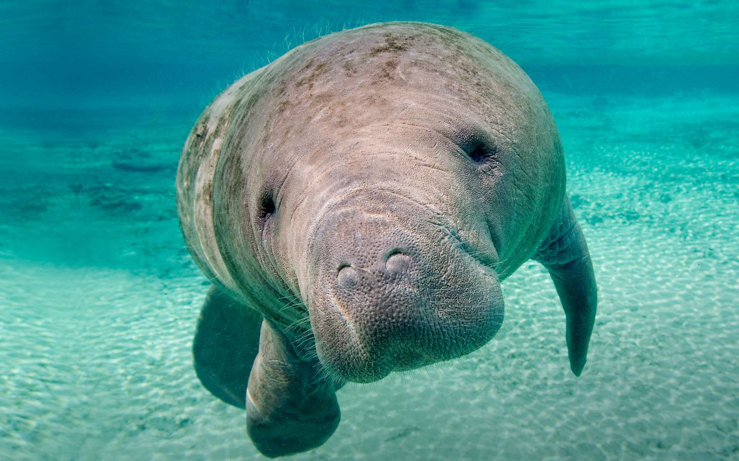
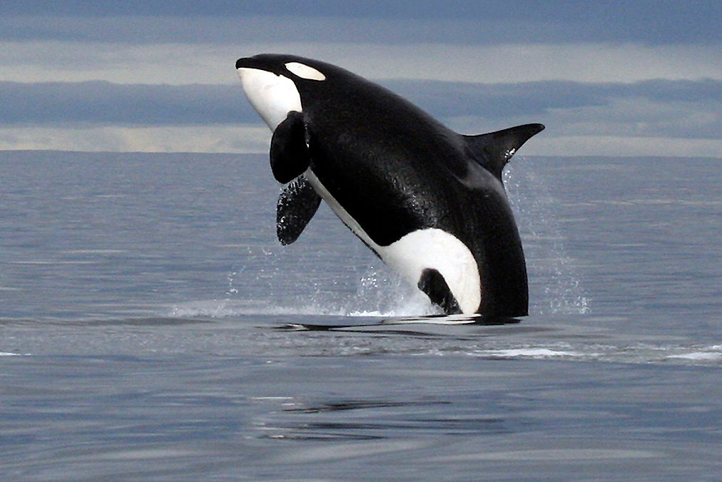
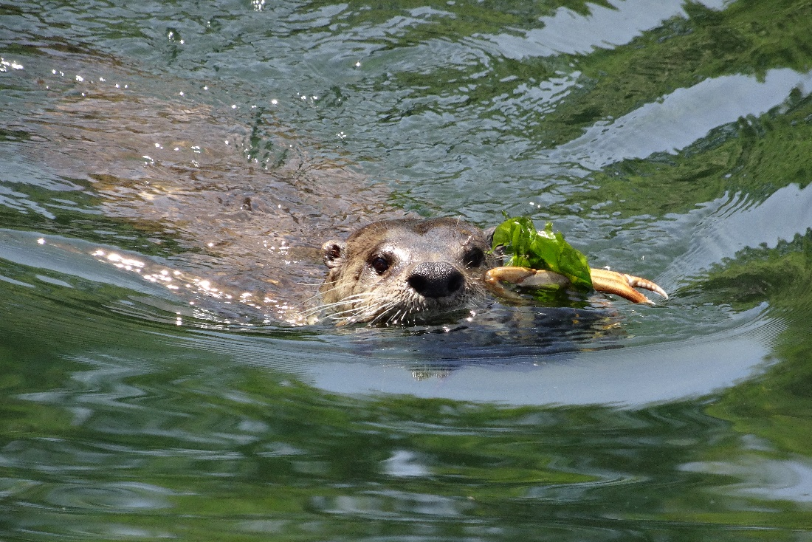

Slide 3
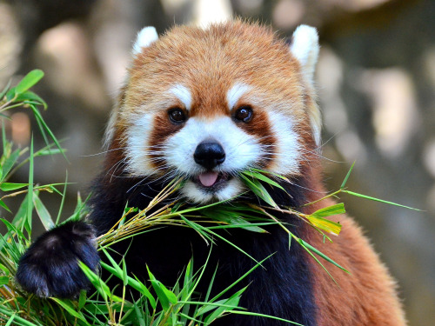
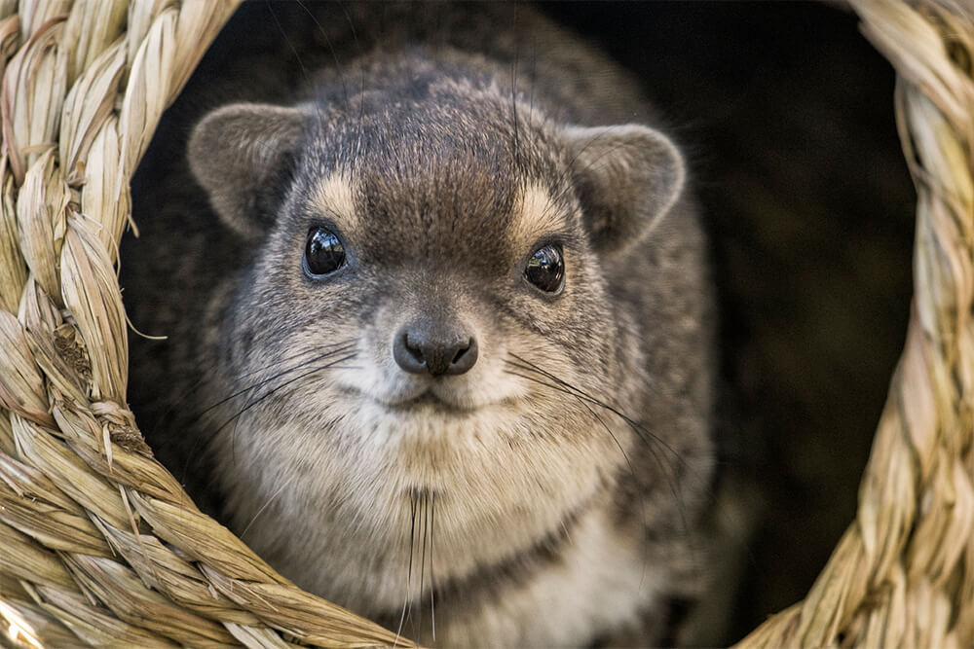
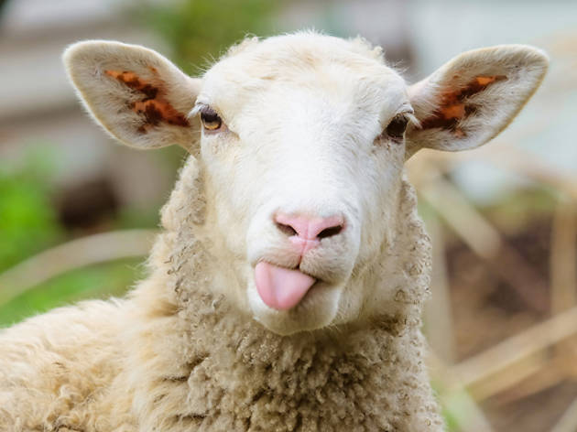
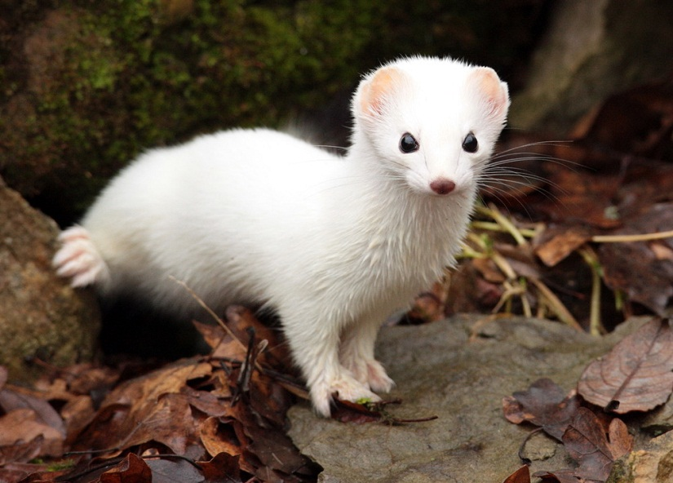

Slide 4
Lots Of Reasons To Be bigger in water
Diet
More habitat area
More food availability
Neutral buoyancy/easier locomotion
Thermoregulation

Slide 5
Lots Of Reasons To Be bigger in water
Diet
More habitat area
More food availability
Neutral buoyancy/easier locomotion
Thermoregulation
Which of these actually drove This increase in body size?

Slide 6
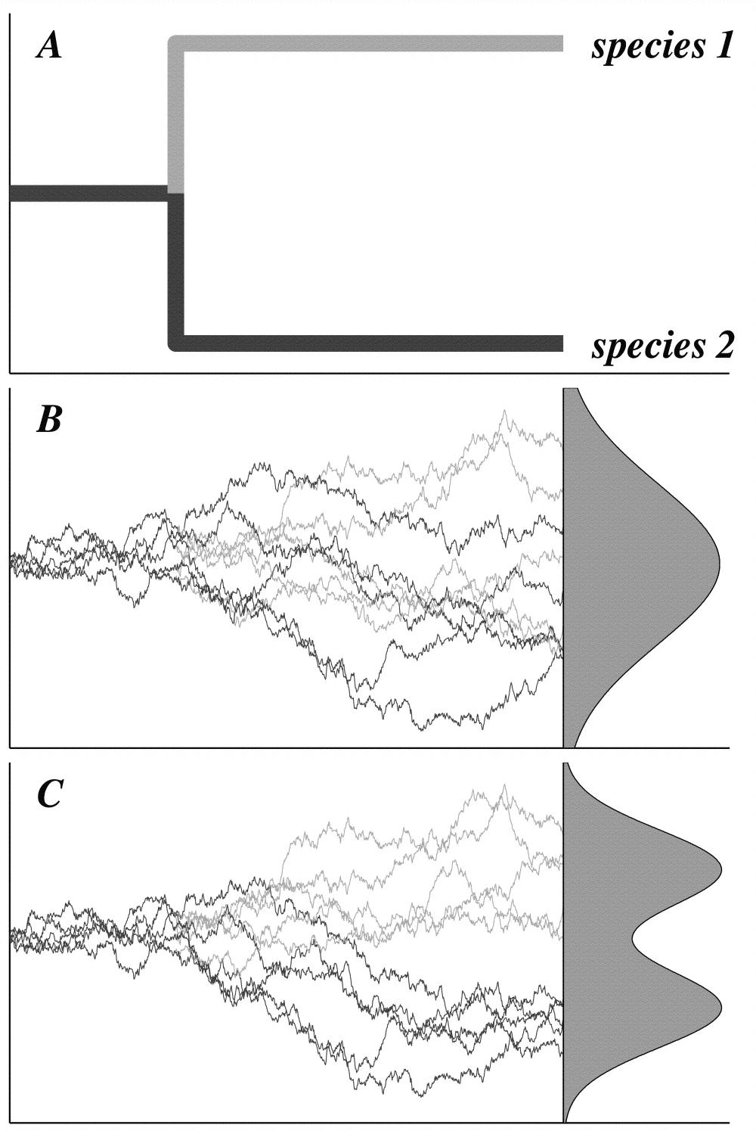
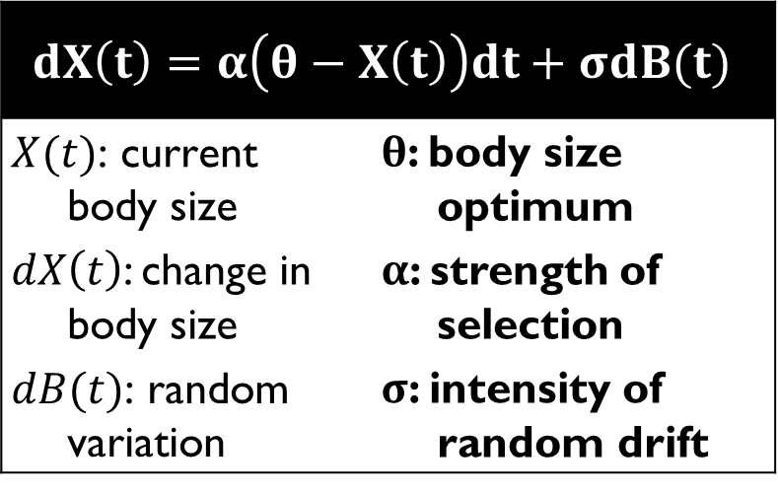
We Can Model Evolution…
σ₁
$$dX\left(t\right)=α\left(θ−X\left(t\right)\right)dt+σdB(t)$$
$$X(t)\text{: }\text{current} \text{body} \text{size}$$ | $θ$: body size optimum
$dX\left(t\right)$: change in body size | $α$: strength of selection
$$dB(t)\text{: }\text{random} \text{variation}$$ | $σ$: intensity of random drift
Brownian Motion
(random evolution)
α₁, α₂ = 0
σ₂
σ₁, α₁
θ₁
Ornstein-Uhlenbeck
Process
(adaptive evolution)
θ₂
σ₂, α₂
Butler and King 2004, Am. Nat.

Slide 7
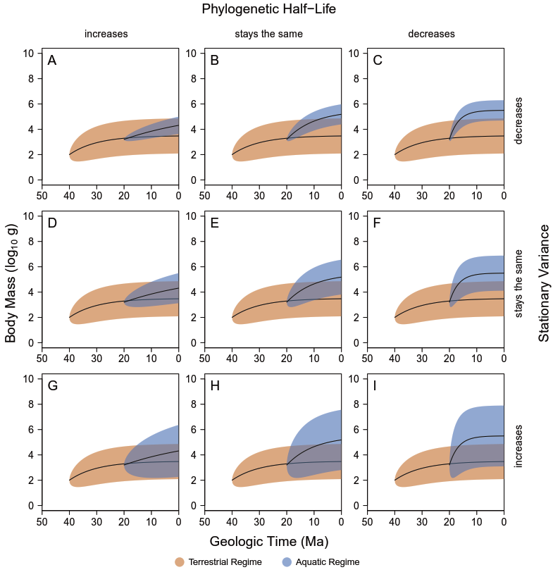
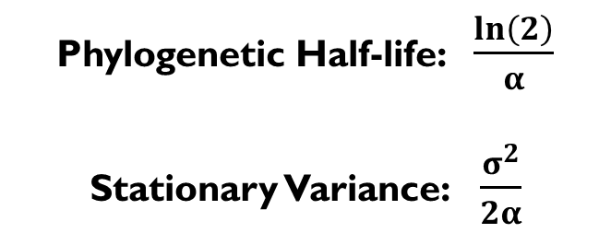
Then we can compare the Model results to the predictions of the different hypotheses
Phylogenetic Half-life: $\frac{ln\left(2\right)}{α}$
Stationary Variance: $\frac{σ^{2}}{2α}$
Gearty et al., in review

Slide 8
neutral buoyancy
Modified from Gearty et al., in review

Slide 9
neutral buoyancy
protein availability
Modified from Gearty et al., in review

Slide 10
neutral buoyancy
protein availability
habitat area
Modified from Gearty et al., in review

Slide 11
neutral buoyancy
protein availability
habitat area
diet?
Modified from Gearty et al., in review

Slide 12
thermoregulation
neutral buoyancy
protein availability
habitat area
diet?
Modified from Gearty et al., in review

Slide 13
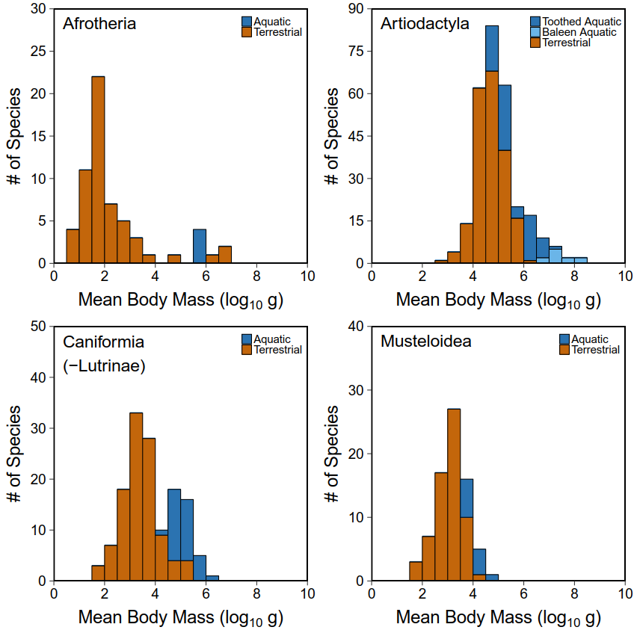
the Data
  Body masses of 3832 living mammal species
    PanTHERIA (Jones et al. 2005)
    MOM (Smith et al. 2003)
    Heim et al 2015
    Primary literature
    Kate Lyons
  Habitat codings
    Global Biodiversity Information Facility
    Primary literature

Slide 14
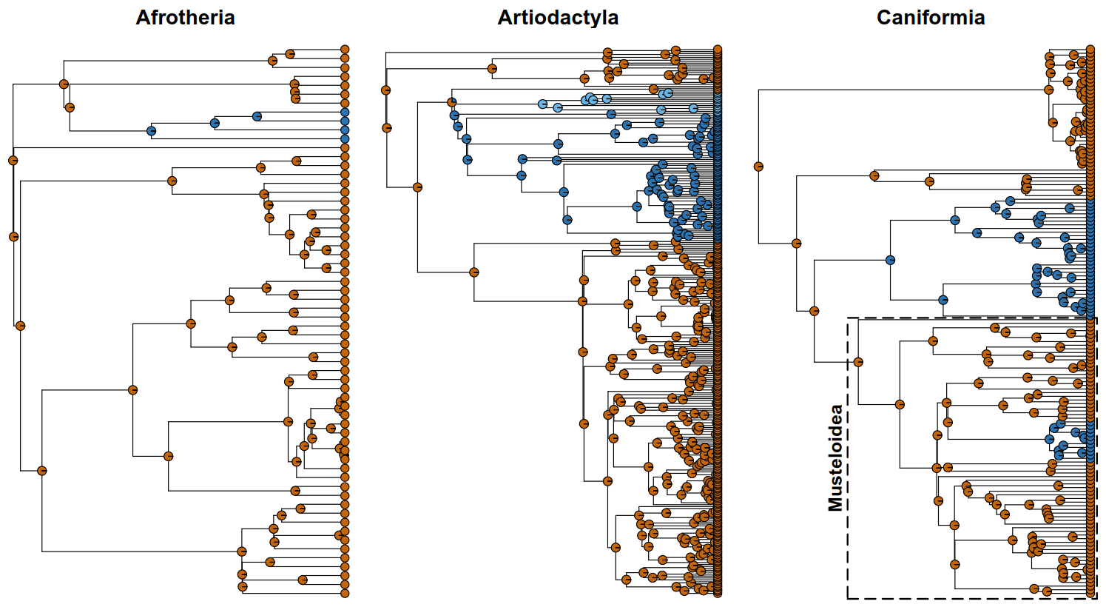





the Data
Supertree from Bininda-Emonds et al. 2007

Slide 15
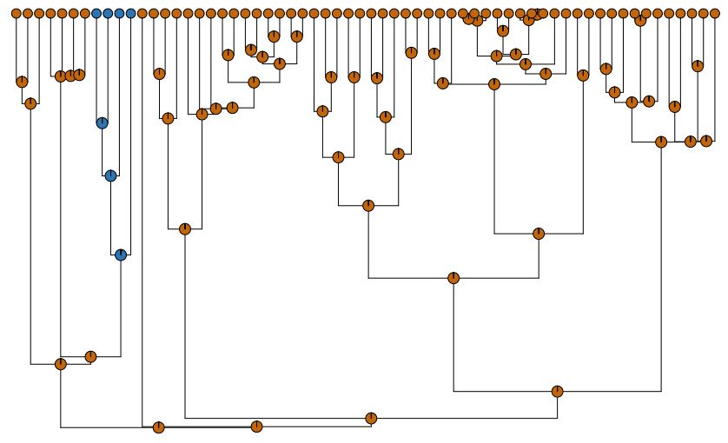
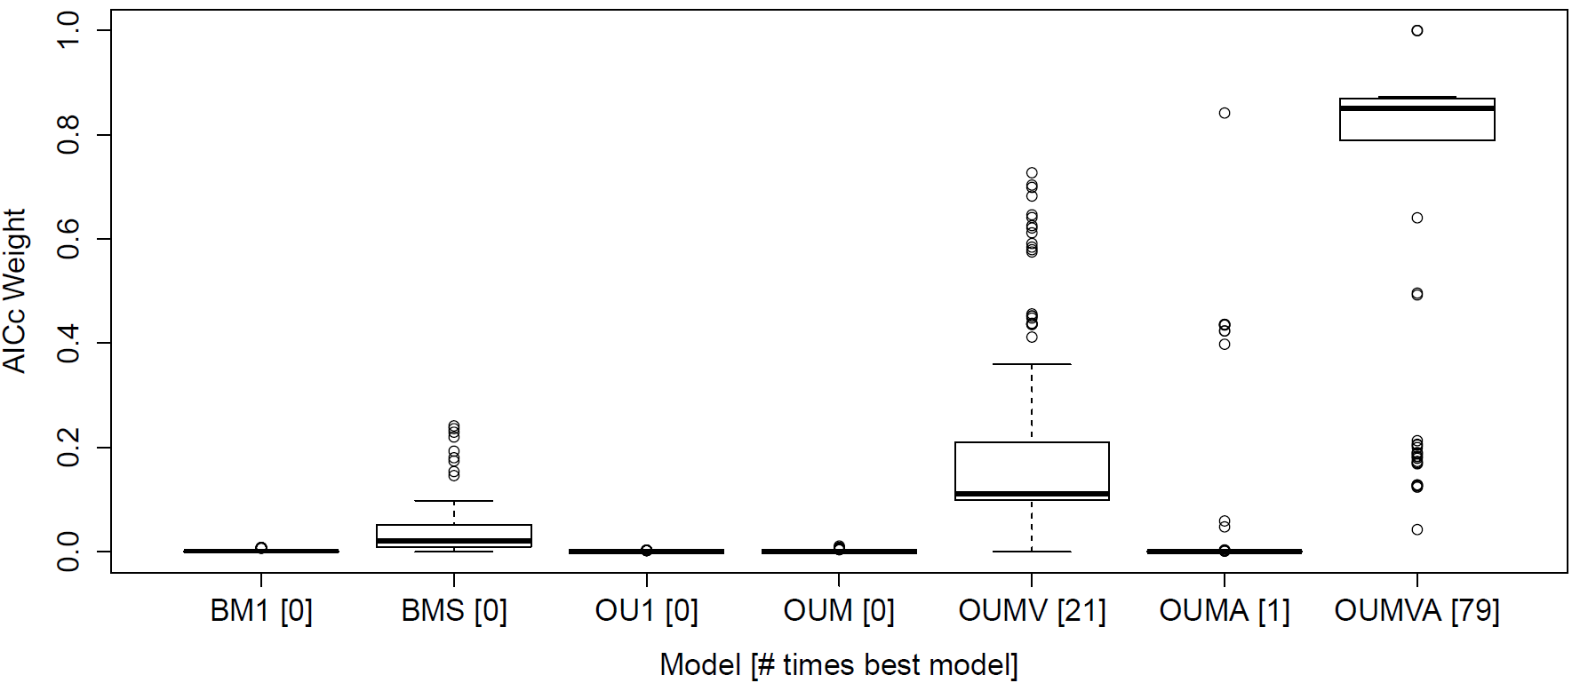
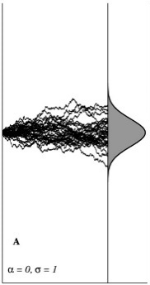

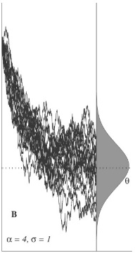

The Method
x100
OUwie
P A R A M E T E R
E S T I M A T E S
σ
α
θ

Slide 16
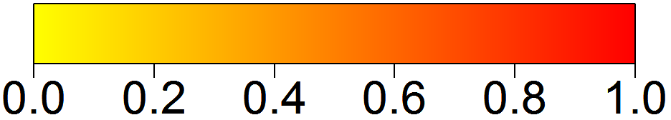
Land and Water Impose Different Selective Pressures…Usually
least support
most support
AIC_{c} Weights | BM₁ | BM_{S} | OU₁ | OU_{M} | OU_{MV} | OU_{MA} | OU_{MVA}
Afrotheria | 0.00 | 0.03 | 0.00 | 0.00 | 0.29 | 0.00 | 0.45
Artiodactyla | 0.00 | 0.00 | 0.00 | 0.09 | 0.32 | 0.23 | 0.11
Caniformia [- Lutrinae] | 0.03 | 0.15 | 0.01 | 0.05 | 0.30 | 0.02 | 0.44
Musteloidea | 0.15 | 0.27 | 0.06 | 0.04 | 0.06 | 0.12 | 0.21
Non-adaptive regime(s)
Single adaptive regime
Different terrestrial and aquatic adaptive regimes

Slide 17
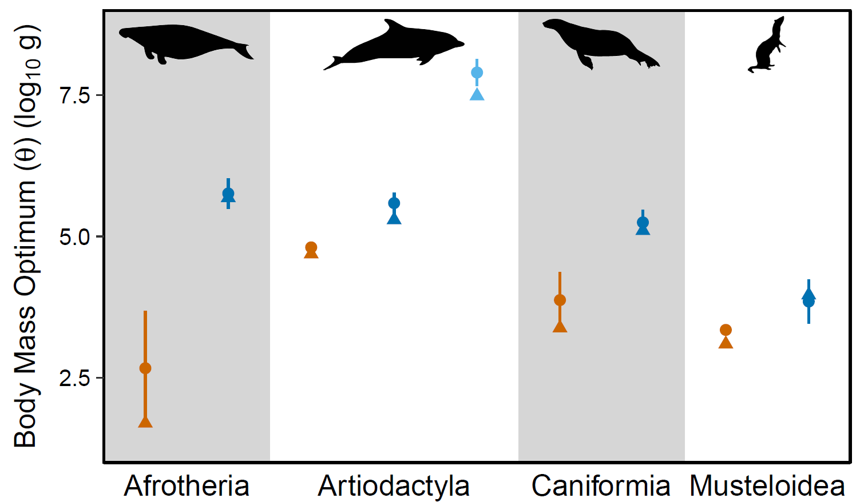
Yup, they get bigger...
Gearty et al., in review

Slide 18
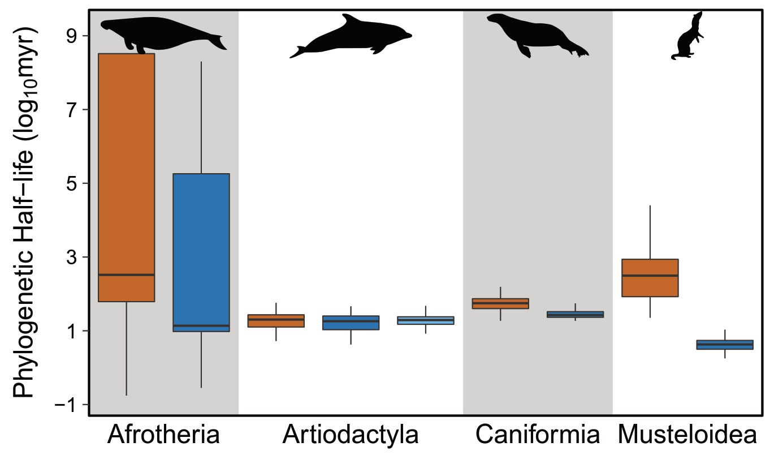
…With Equal or Stronger Selection…
Gearty et al., in review

Slide 19
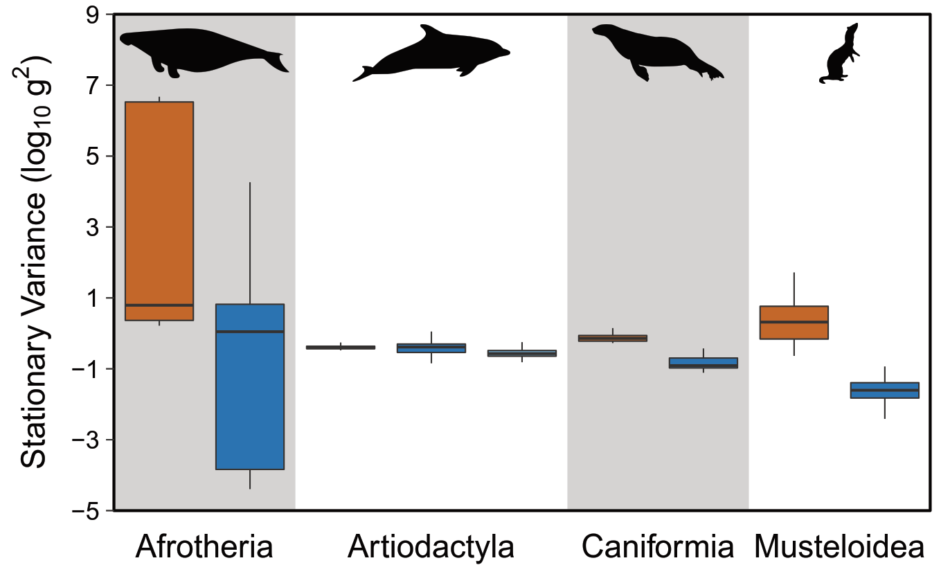
…and Equal or less variance
Gearty et al., in review

Slide 20
thermoregulation
neutral buoyancy
protein availability
habitat area
diet?
Gearty et al., in review

Slide 21
thermoregulation
neutral buoyancy
protein availability
habitat area
Gearty et al., in review

Slide 22
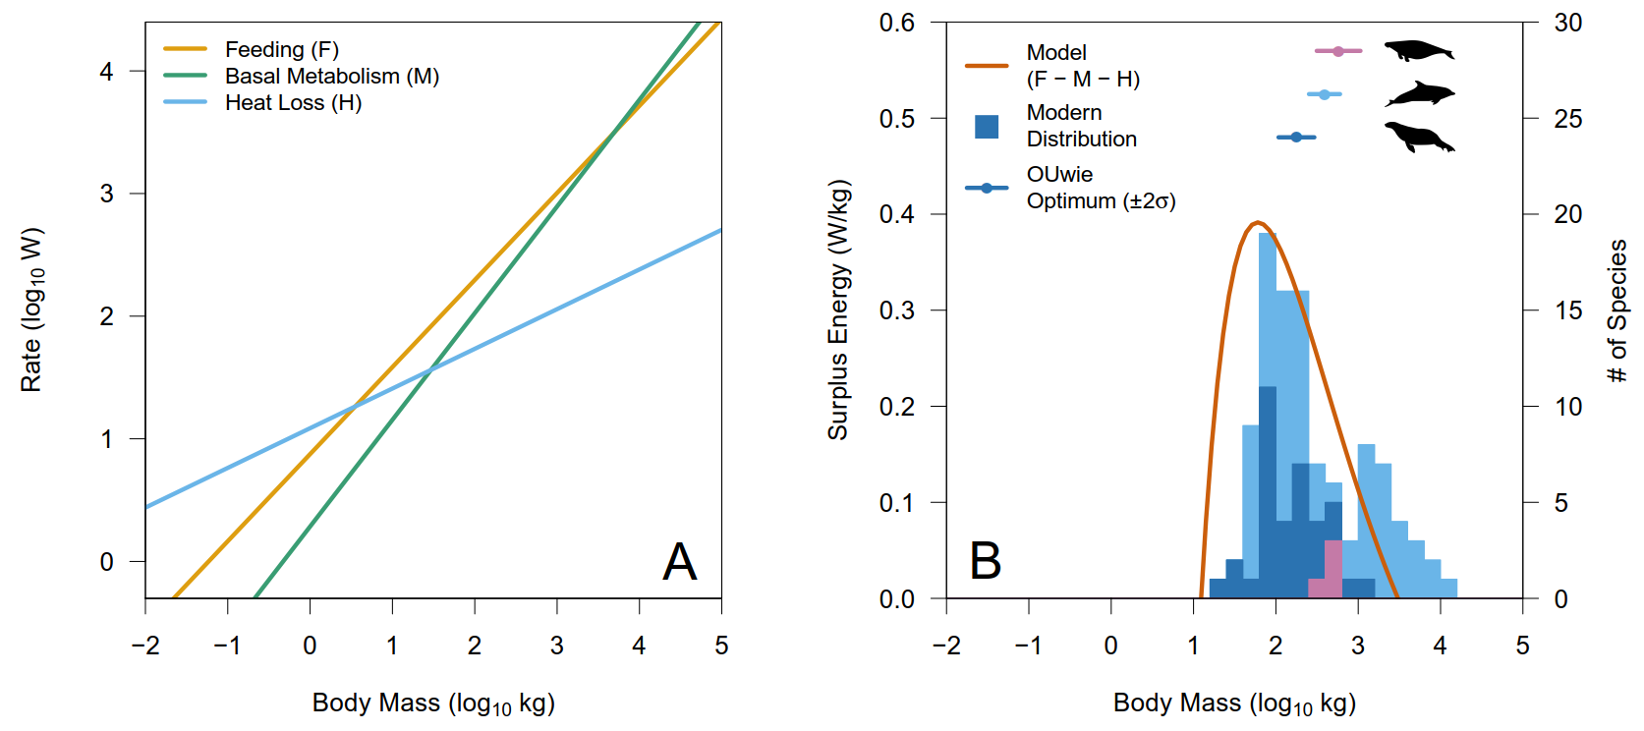
Thermoregulation?
Gearty et al., in review

Slide 23
Thermoregulation?
Gearty et al., in review

Slide 24
Conclusions
3 out of 4 mammal groups living in aquatic environments have larger optimal body sizes than their terrestrial counterparts
Results suggest the existence of a body size attractor (~500 kg) that has been discovered independently by these three aquatic clades
Increased selection and decreased variation exclude most hypotheses as reasons for driven body size increases, except for thermoregulation
Physiological cost function modelling supports thermoregulation as the driver of body size increases and feeding as the limiter of further body size increases, resulting in the constraint about the body size attractor

