Slide 1
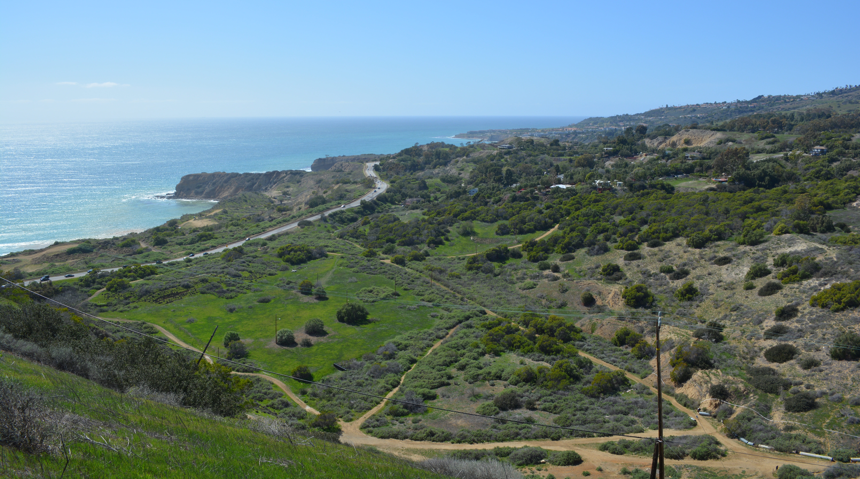
Slow Landslide Identification using InSAR to Update the California Landslide Inventory on the Palos Verdes Peninsula
El Hachemi Bouali, Thomas Oommen, and Rüdiger Escobar-Wolf
Michigan Technological University
The Geological Society of America 129th Annual Meeting T242: Current Trends in Landslide Monitoring: New Techniques, Methods, Successes, Failures, and Case Studies I The Conference Center, Skagit 5 22 October, 2017 @ 2:30 PM

Slide 2
Objective
To update the California Landslide Inventory with extremely slow landslides, defined as 4 mm/year < |Velocity| < 16 mm/year¹.
Extremely slow slides may be imperceptible without proper instrumentation.
Some structural damage may occur over a relatively long period.
Palos Verdes Peninsula is prone to landslides (and other natural hazards).
Thus, we wish to demonstrate a remote sensing-based approach to update a preexisting landslide inventory, with the final output being an inventory that includes previously unmapped landslides which can be verified through targeted field inspection in a landslide life-cycle management program.
¹Cruden & Varnes 1996

Slide 3
Study Site
Figure 1
Tectonic & Natural Hazard Activity
Regional uplift – 13 wave-cut marine terraces located above sea level¹
Two major faults – Palos Verdes and Cabrillo
Landslides – Palos Verdes Hills Landslide Complex (PVHLC); Altamira Shale (Monterey Frm)²
Translational Slides
Seaward-Dipping Beds
Bentonite Clay
¹ Kayen et al. 2002
² Merriam 1960; Vonder Linden & Lindvall 1982; CRPV 2012

Slide 4
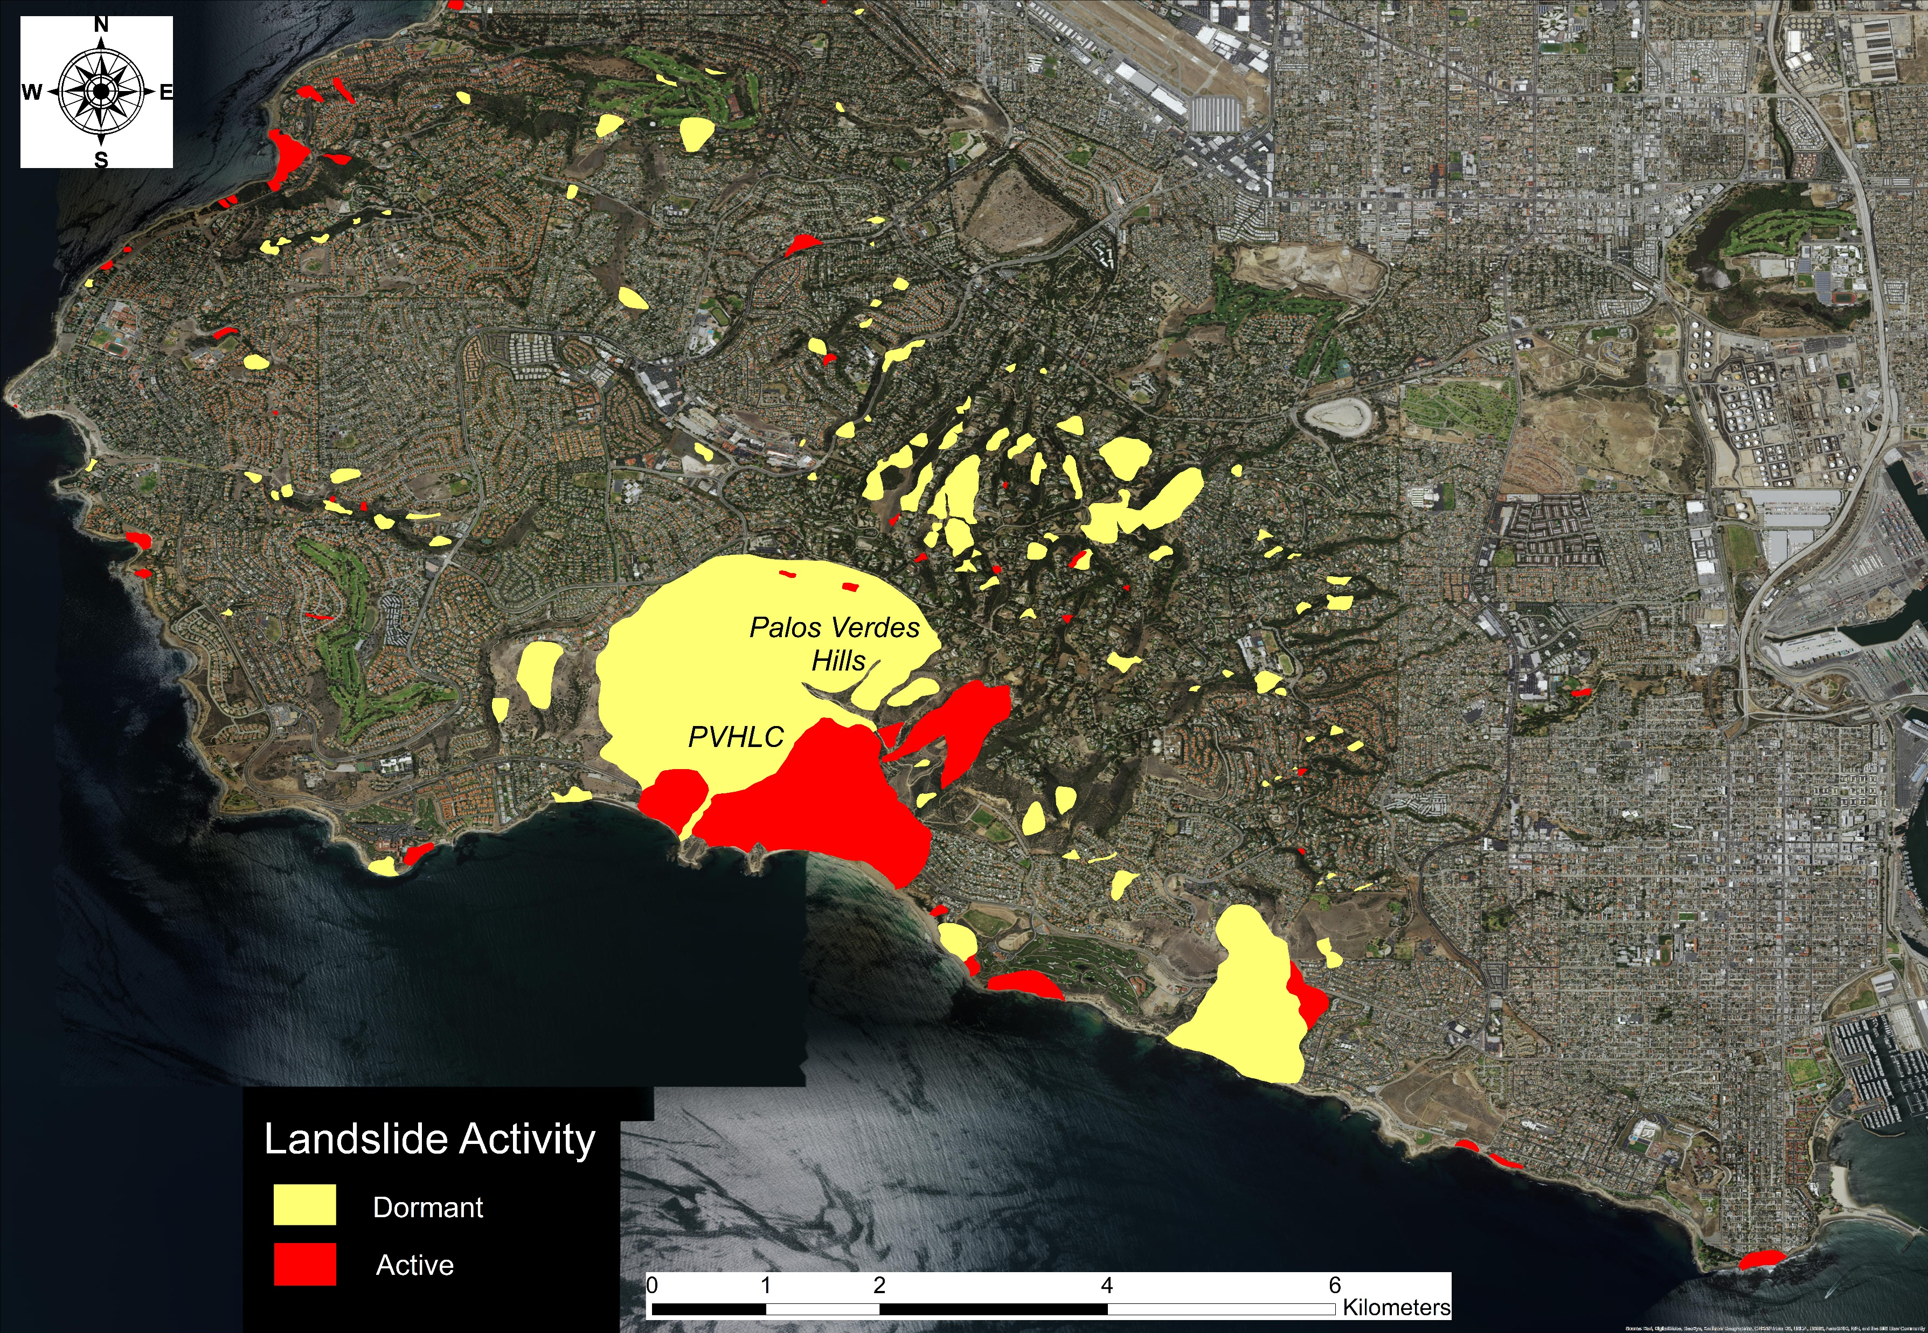
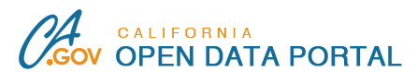
Data: California Landslide Inventory
California Department of Conservation
https://data.ca.gov/dataset/california-landslide-inventory
An inventory of mapped landslides for the State of California.
Database includes landslides mapped by California Geological Survey and others over the past 50 years.
Figure 2

Slide 5
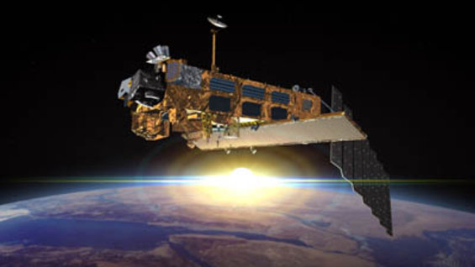

Data: Satellite Radar Imagery
ENVISAT
COSMO-SkyMed
Frequency = 5.331 GHz
Wavelength = 5.6 cm
Line-of-Sight: 21°, N85°W
Resolution = 20 m
34 Radar Images
11 Nov 2005 – 14 Oct 2010
Frequency = 9.6 GHz
Wavelength = 3.1 cm
Line-of-Sight: 27°, N85°W
Resolution = 3 m
40 Radar Images
19 Jul 2012 – 27 Sep 2014

Slide 6

Methodology
Persistent Scatterer Interferometry
“…a branch of interferometry at exploits point scatterers, with strong radar backscatter, over a long time period to provide a phase history of the point target over time.” – ESA Interferometry User Guide
Phase Change → Displacement
$$d=\frac{1}{2}λ\left(\frac{φ}{2π}\right)$$
Coherence
Number of PS points > 4
1
Average Velocity ≥ 4 mm/yr
2
Slope Angle
> 5°
3
Slope Aspect in Proper Direction
4
Criteria
Justification from Literature
¹Bianchini et al. 2013
²Cruden & Varnes 1996
³Calabro et al. 2010
⁴Merriam 1960
InSAR Landslide Inventory
Final Landslide Inventory
California Landslide Inventory
Figure 3

Slide 7
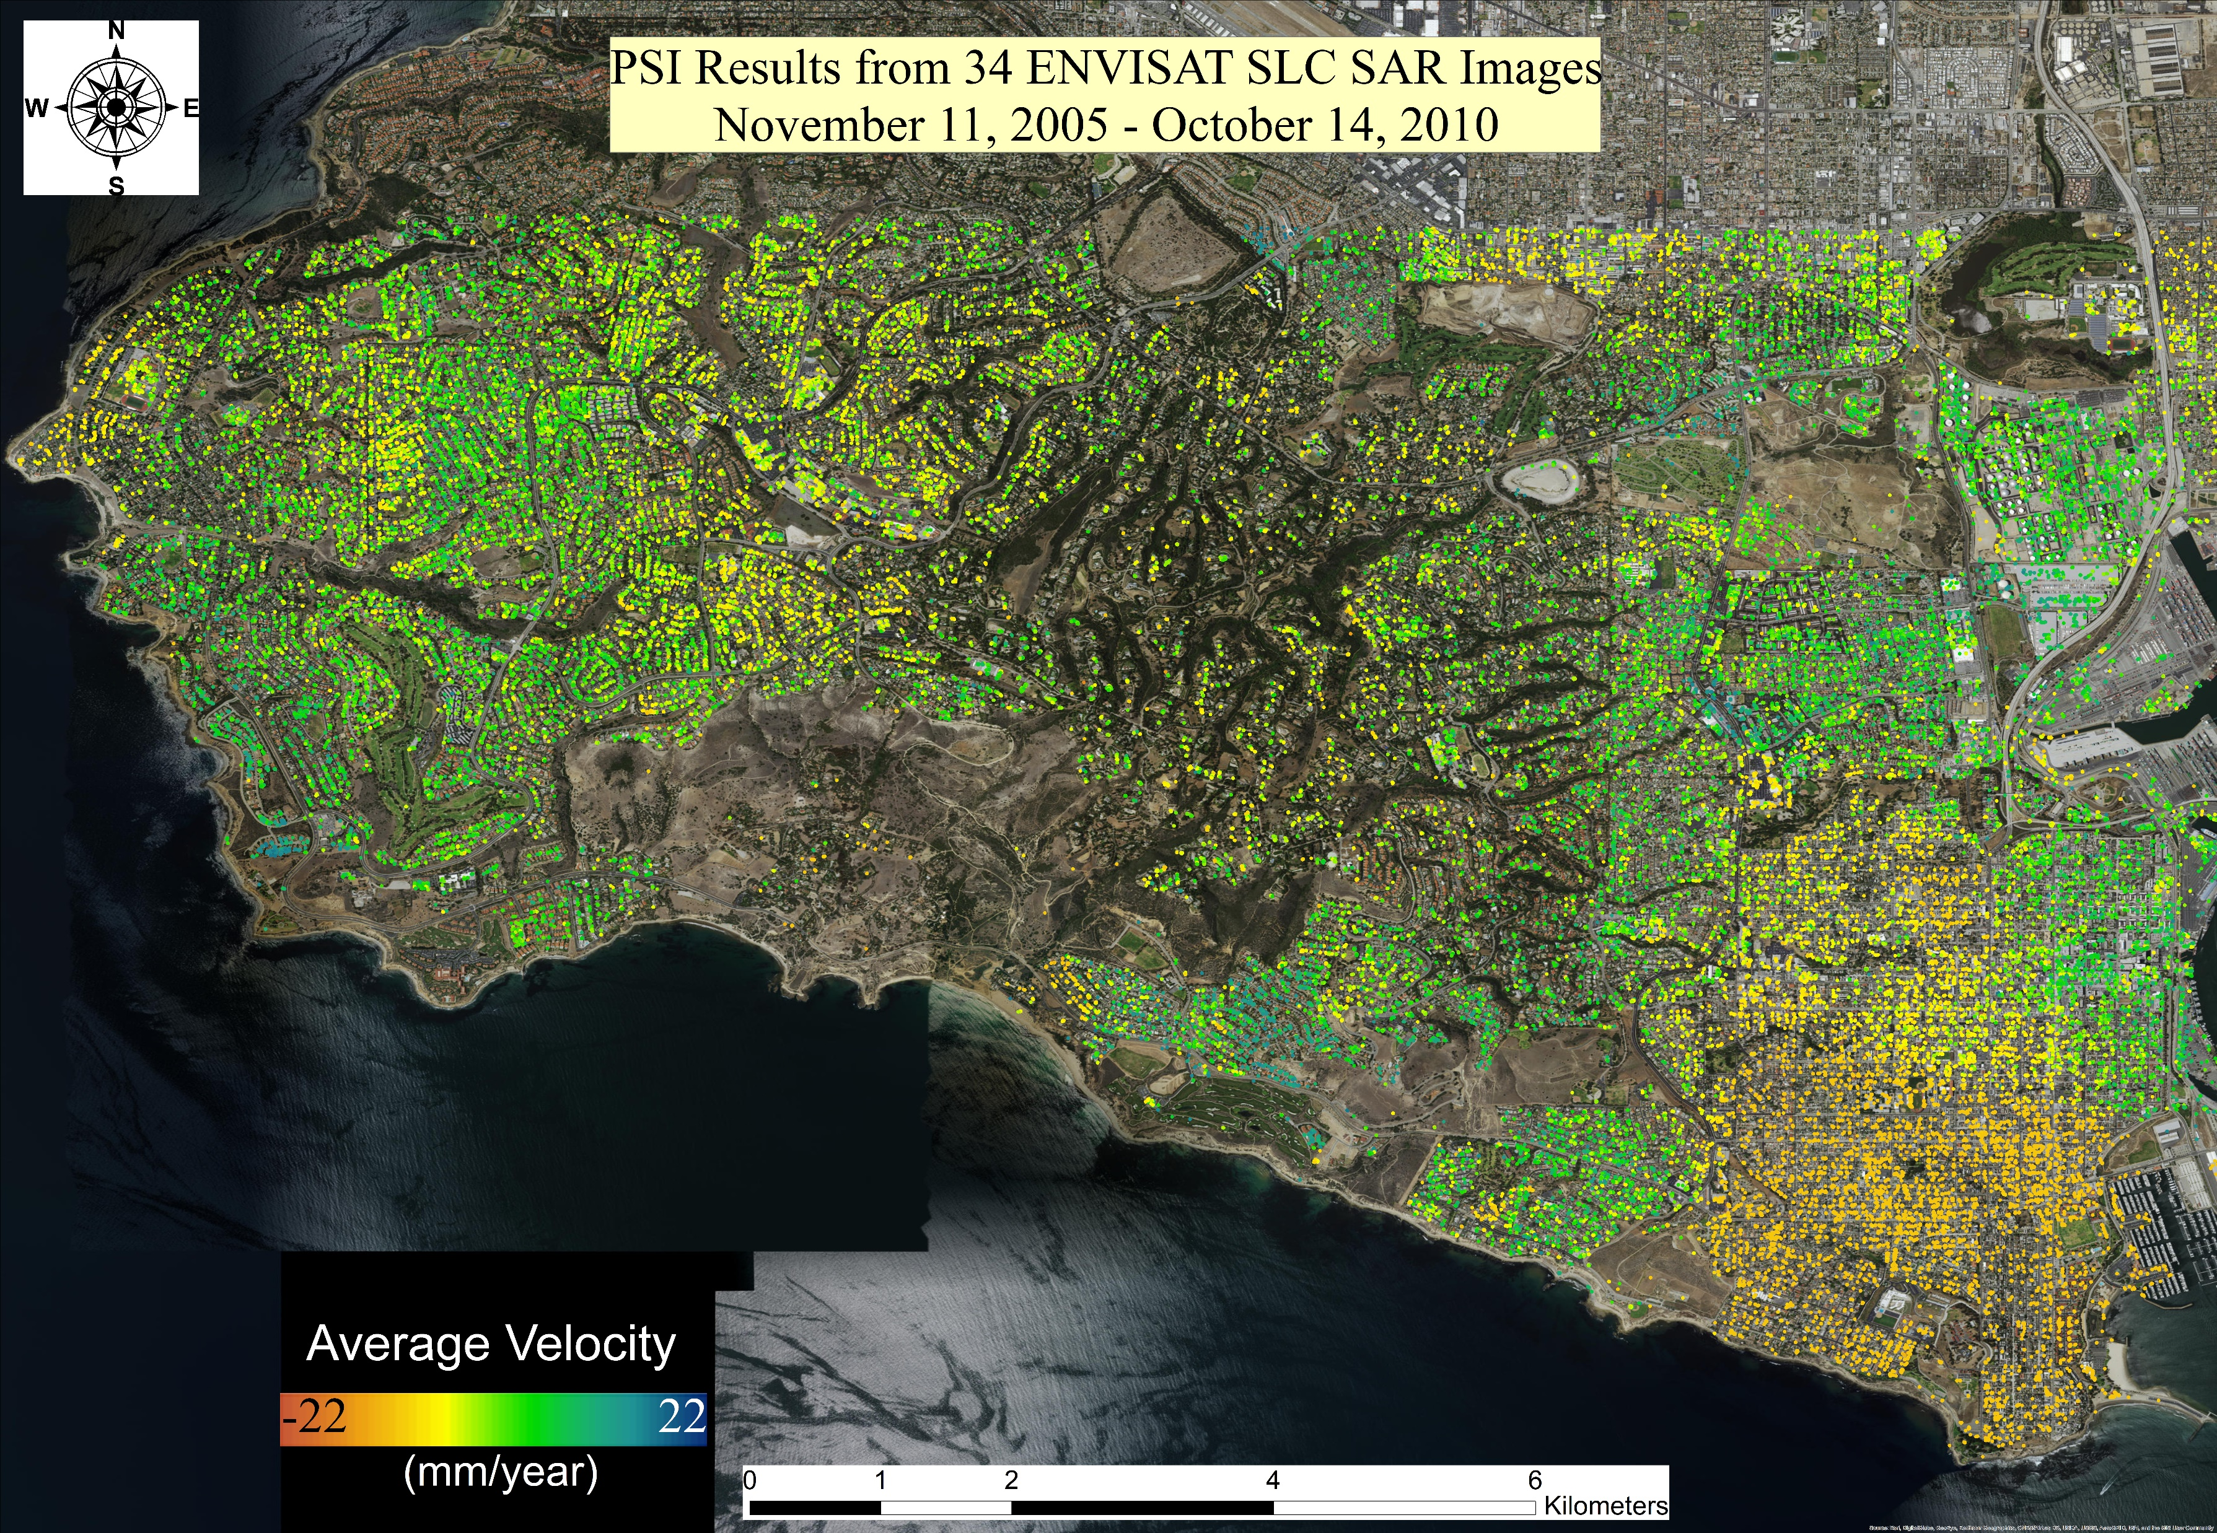
Results: ENVISAT PSI
PVHLC
Figure 4

Slide 8
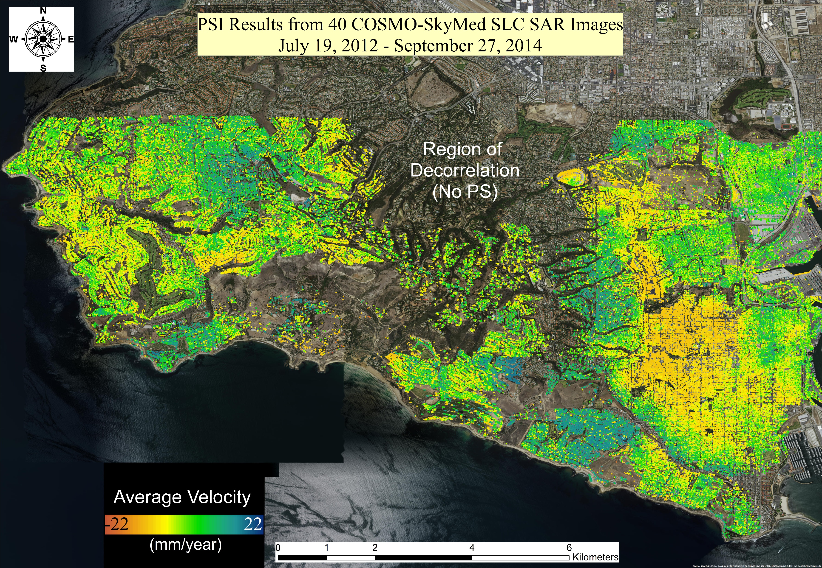
Results: COSMO-SkyMed PSI
PVHLC
Figure 5

Slide 9
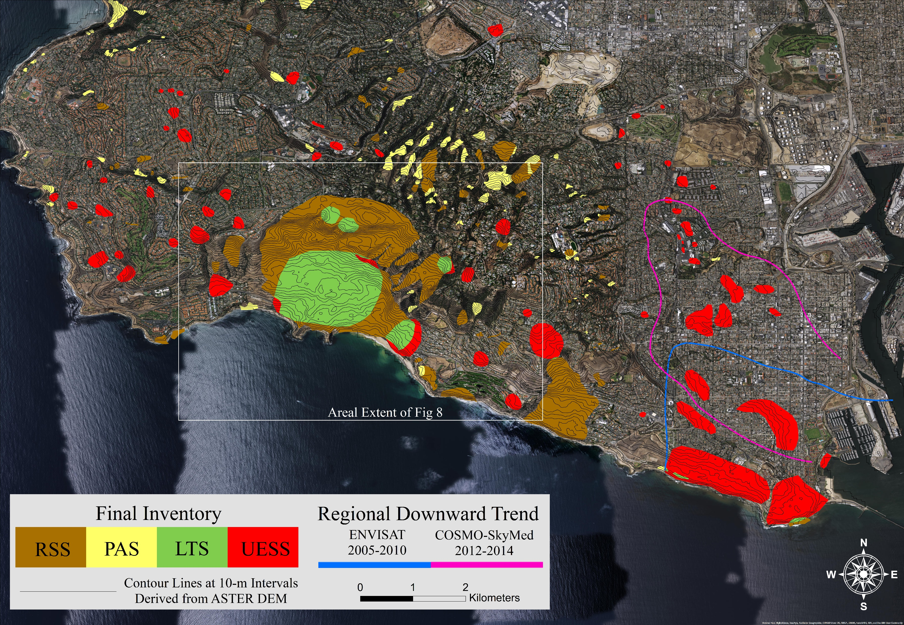
Results: Final Landslide Inventory
Figure 7
68 RSS Relatively Stable Slopes
Historic/Dormant Slides
PS |V| < 4 mm/year
114 PAS Potentially Active Slides
Active
No PS Available
14 LTS Long Term Slides
Active
PS|V| > 4 mm/year
67 UESS Unmapped Extremely
Slow Slides
Not Previously Mapped
PS|V| > 4 mm/year
PVHLC

Slide 10
Results: Final Landslide Inventory
III. LTS Long Term Slides
Area = 271,720 m²
Slide Thickness > 15 m
Max. Slope = 24.96°
Stable PS = 155
Unstable PS = 531
Max. V = -10.34 mm/year
Max. V Dir. = 220°
Location of Max. V = Head
Originally Mapped in 1998

Slide 11
Discussion
PSI Limitations for Landslide Mapping
PSI Advantages for Landslide Mapping
Inherent to the Technique
Deformation measurements limited to line-of-sight direction
Not all landslides will be visible
Most likely not measuring actual landslide displacement (oblique)
Dense vegetation causes temporal decorrelation
Rapid deformation (d > λ/2 between two images) causes temporal decorrelation
Low cost/benefit ratio
1 mm/year accuracy (w/ ample images)
Large satellite image archive (1992-present)
Excels in urban areas or locations with anthropogenic structures
Remote sensing > Traditional mapping
High PSI Density
PSI deformation measurements not limited to infrastructure
Traditional fieldwork cannot be performed as well under infrastructure (e.g., buildings, roads, etc.)

Slide 12
Conclusion
Objective: Update California Landslide Inventory with extremely slow landslides.
InSAR Landslide Inventory: created using PSI
Final Landslide Inventory: 263 mapped slides (of various states of activity)
68 Relatively Stable Slopes
114 Potentially Active Slides
14 Long Term Slides
67 Unmapped Extremely Slow Slides
Future Task: Conduct fieldwork to investigate these previously unmapped slides for preventative maintenance and monitoring.

Slide 13
Acknowledgements
Funding provided by NASA Earth and Space Science Fellowship (proposal: 16-EARTH16F-0086)
European Space Agency provided ENVISAT data (proposal ID 82169) and COSMO-SkyMed data (proposal ID 31684).
California Geological Survey and California Department of Conservation provided GIS layers of the California Landslide Inventory.
Digital Elevation Models provided by JPL, NASA, and the USGS.
Background images in Figures 2, 4, 5, and 8 provided by the USGS, NASA, Google, and Digital Globe.

Slide 14

Thank You
Contact Information
El Hachemi Bouali eybouali@mtu.edu
Michigan Technological University 1400 Townsend Drive Houghton, MI 49931
Please feel free to inquire about research, references, and opportunities for collaboration.

