Slide 1
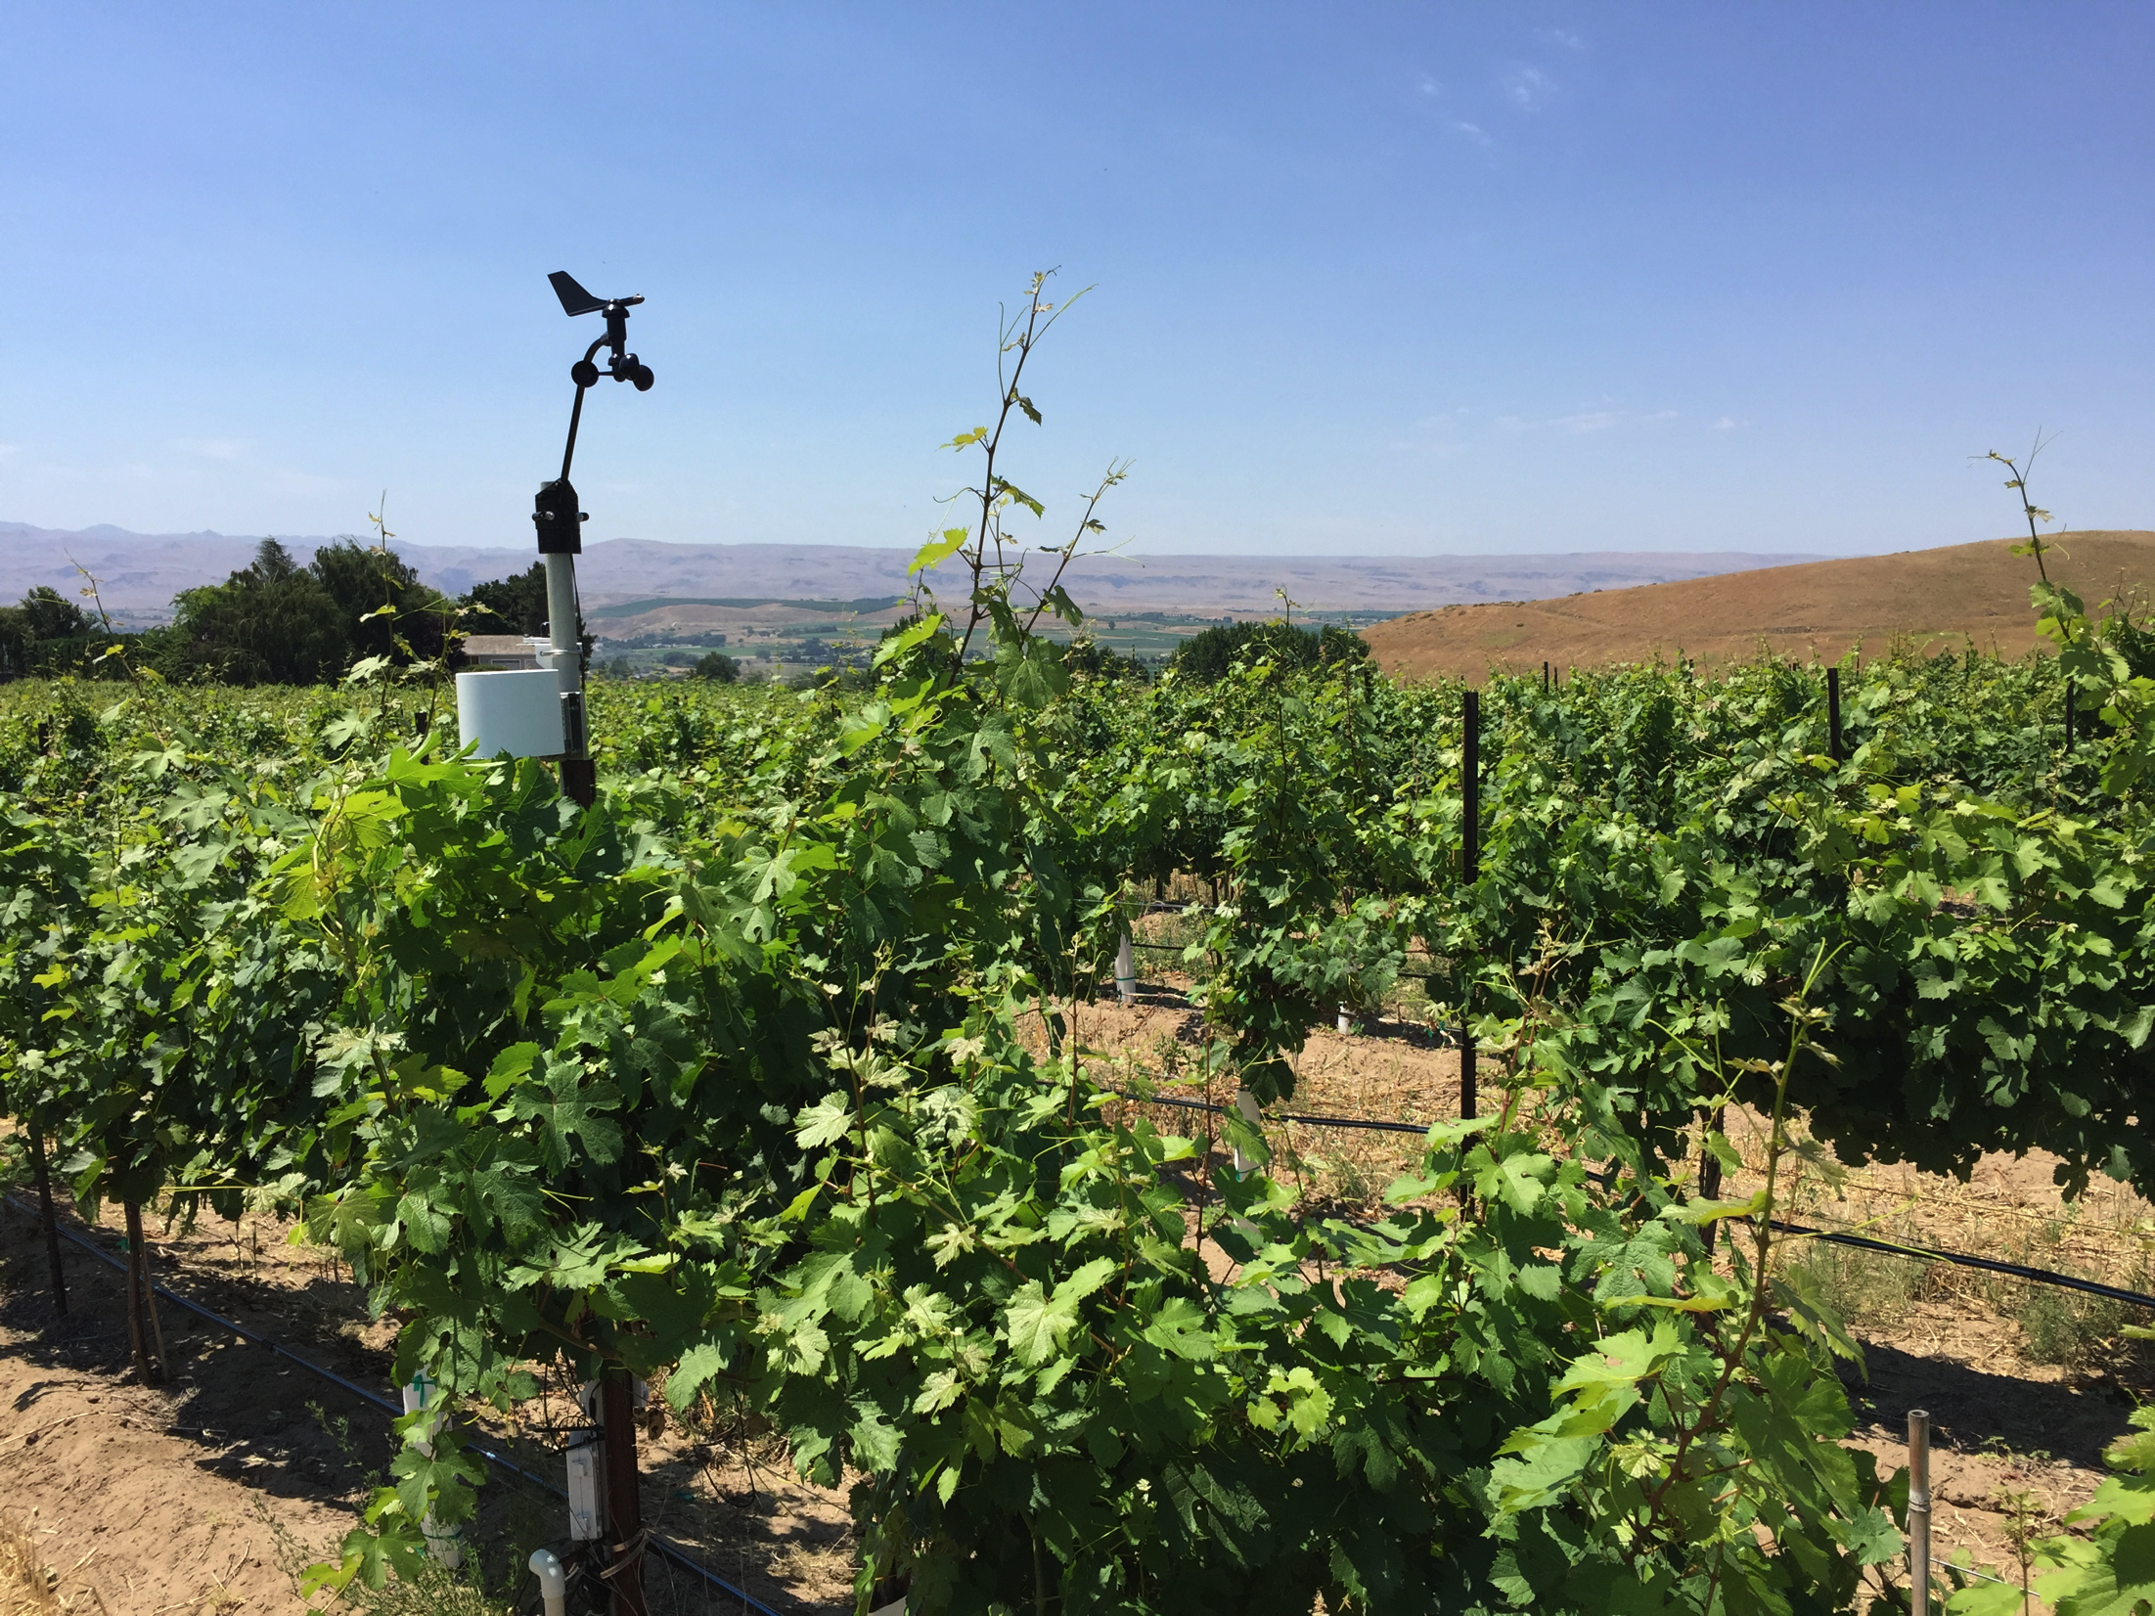

INSIGHTS INTO TERROIR FACTORS,
SUNNYSLOPE DISTRICT,
IDAHO
David Wilkins, Boise State University
Alan Busacca, Vinitas Consultants, LLC

Slide 2
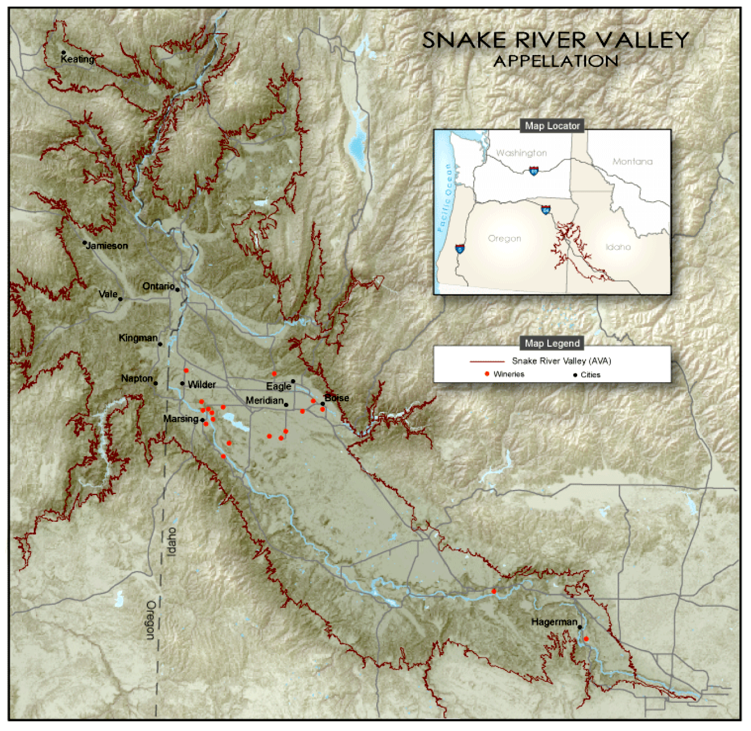
Snake River Valley AVA Regional Setting
SW Idaho & E. Central Oregon
Defined by extent of ancient Lake Idaho
1,040m contour
21,500 km²
Elevations from 550m to 1040m; median of 880m
SRV AVA yuge in total area but most vineyards in 1/25th of AVA
Focus of Study – characterize soil and climate terroir of Sunnyslope District

Slide 3
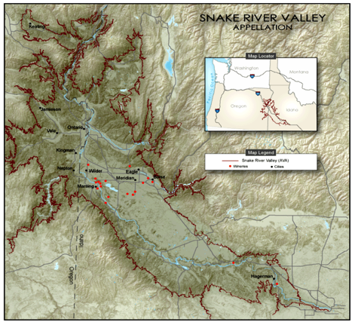
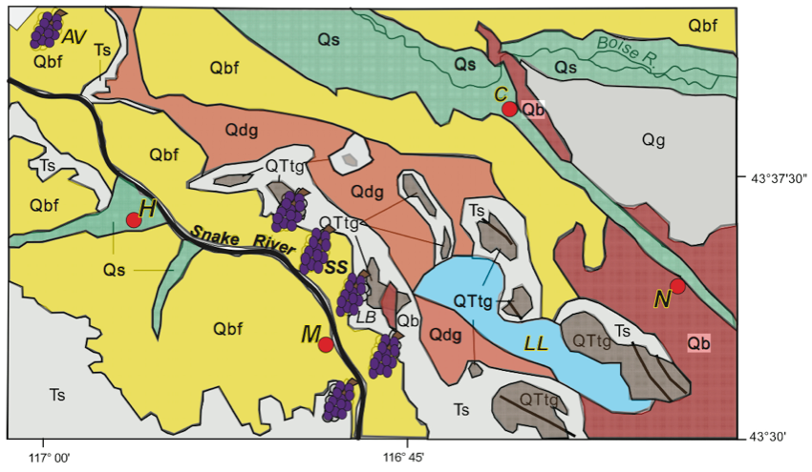
Geologic and Geomorphic Underpinnings -
Sunnyslope (SS) Wine District
2 Ma -5 Ma river terraces
  Tenmile - QTtg
  Deer Flat - Qdg
Interfluve between Boise and Snake rivers
Terraces provide
  substantial local relief
  cold air drainage
  variable aspects
More recent volcanics (Qb)
Soils from windblown loess and sand over a variety of older deposits
Bonneville Flood source of parent material at lower elevation vineyards
Interfluve

Slide 4
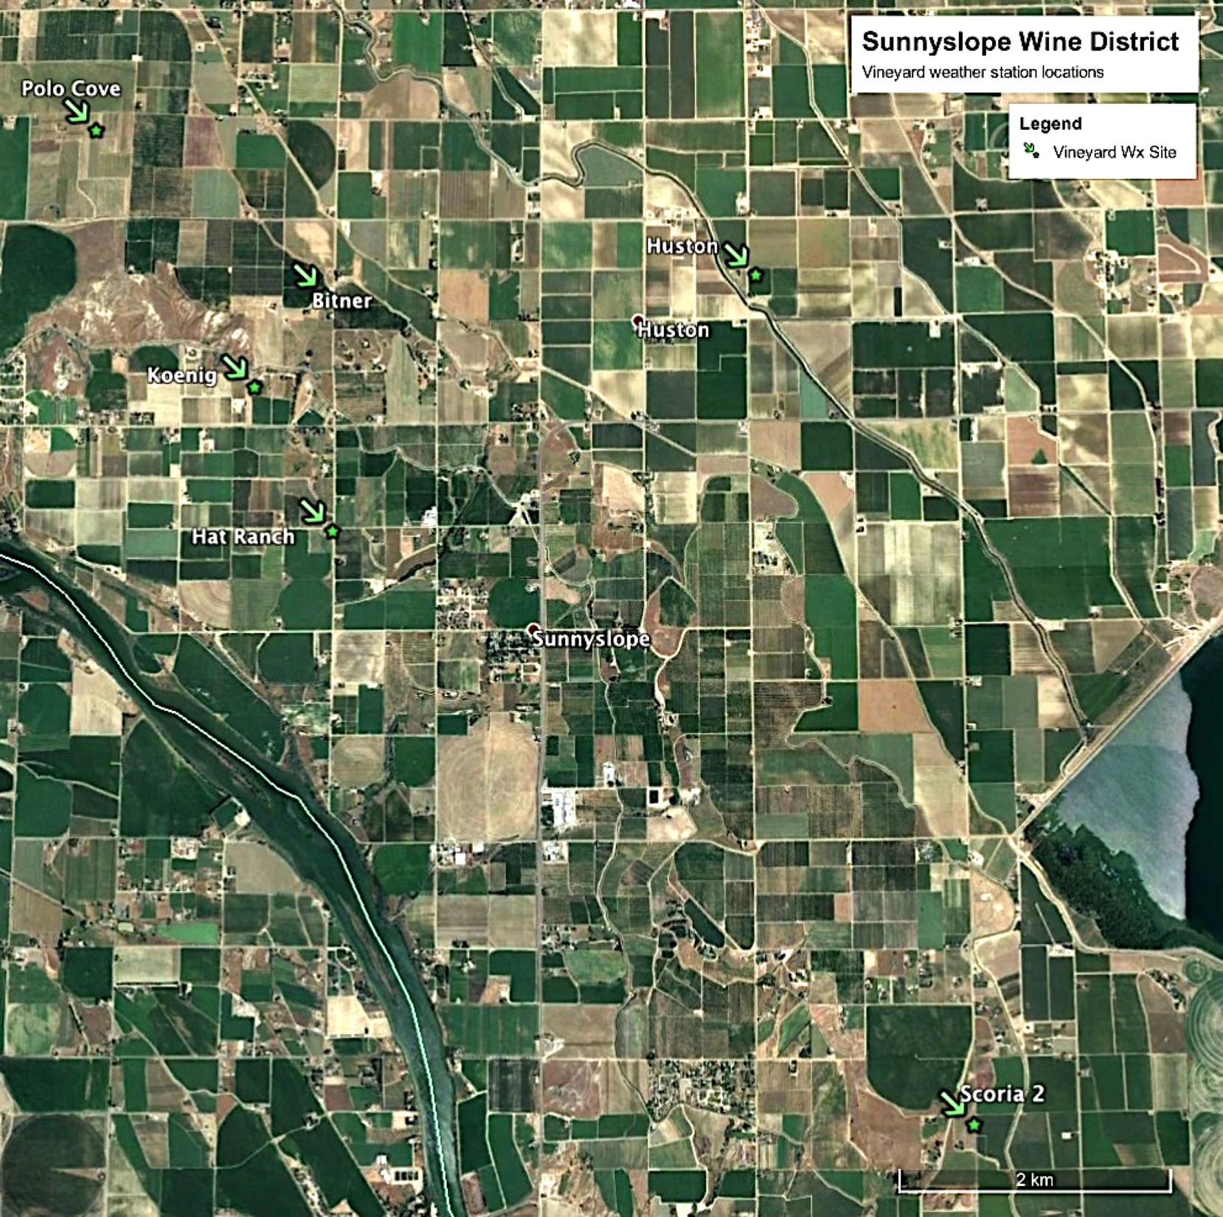
800m
780m
760m
Interfluve
740m
BF
715m
Snake R.
675m
High Terrace Break
800m

Slide 5
Sunnyslope Project 2015-…
Focus on terroir characteristics
Vineyard-scale soil characterization and collecting long-term weather data
Objectives
  characterize soils and meso-scale climate variability over the Sunnyslope District
  improve understanding of terroir characteristics of current vineyards
  provide guidance and measurement data for future vineyards
Two-pronged approach
  Soils investigation
  Weather and climate data network

Slide 6
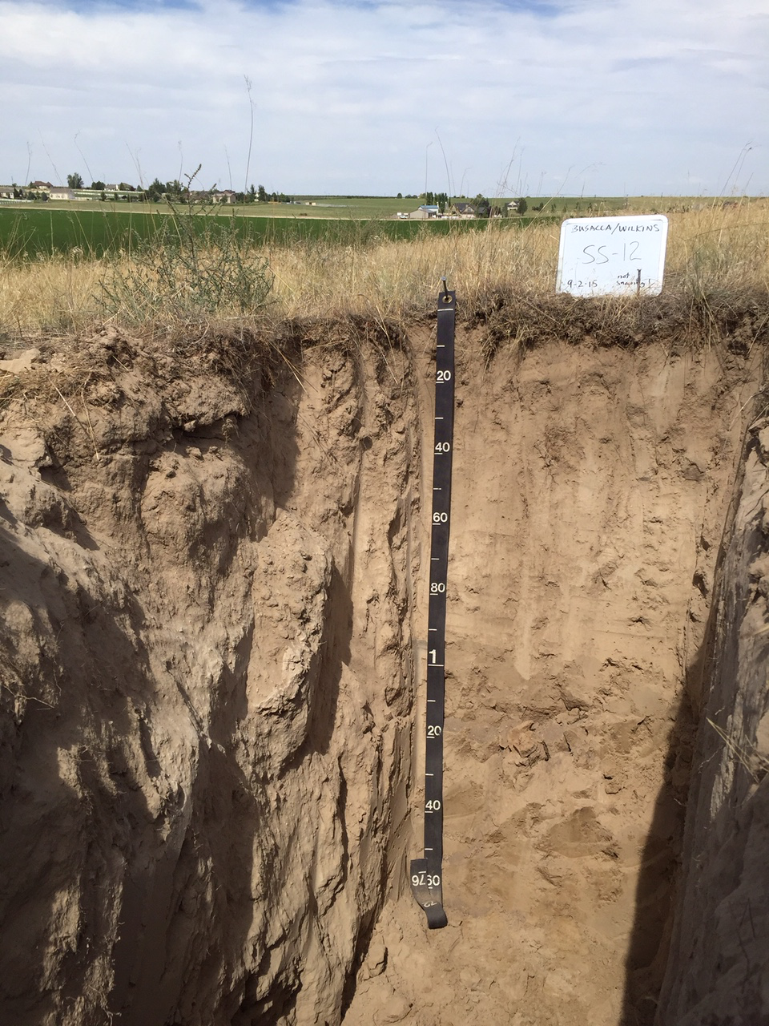
Soil Study
A
Backhoe pits excavated to 1.5-2.5m at 15 vineyard sites
Soil field profile description with photographs and notes
Correlated observed soil to named soil series if possible
Sampled for physical and chemical properties
Objective – begin to develop database of key soils
Bw
Bk
Bwgb

Slide 7
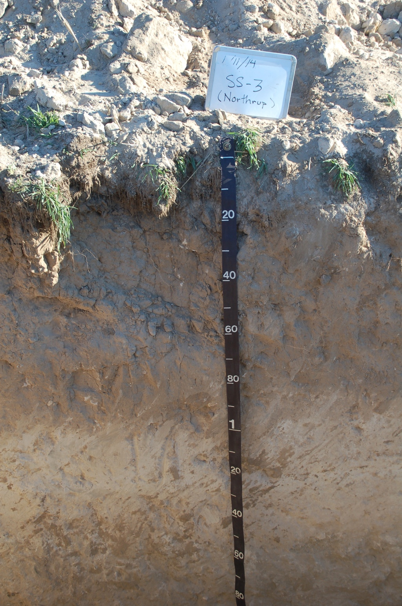
Soil Types
Feltham Variant with a Cemented Pan
Type 3
Type 1:
  simple, uniform profile
  single parent material
  no restrictive pan n=5
Type 2:
  2 or more strongly contrasting parent material textures
  no restrictive pan n=2
Type 3
  simple profile
  single parent material (more or less)
  with a restrictive pan n=3
Type 4:
  complex, polygenetic profile
  2 or more episodes of soil development
  buried paleosol hardpan n=5

Slide 8
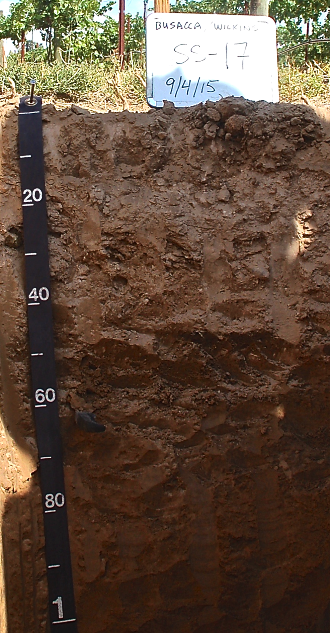
Soil Types
Type 4
90% of soil horizons
  sandy loam, loamy sand, sand or silt loam textures
  well to excessively well drained
  all had <20% clay, many had <5%
Based on Soil Survey
  ~12 of the 15 soils were expected to be simple, uniform profiles with no root or water restrictions
However, our investigation showed that 8 of 15 soils have Type 3 and Type 4 profiles with root and water restricting hardpans and complex pedostratigraphy
  Soil complexity much greater than previously known: this new awareness can play an important role in design of future vineyards, variety selections, planting density, trellising and training, etc.

Slide 9
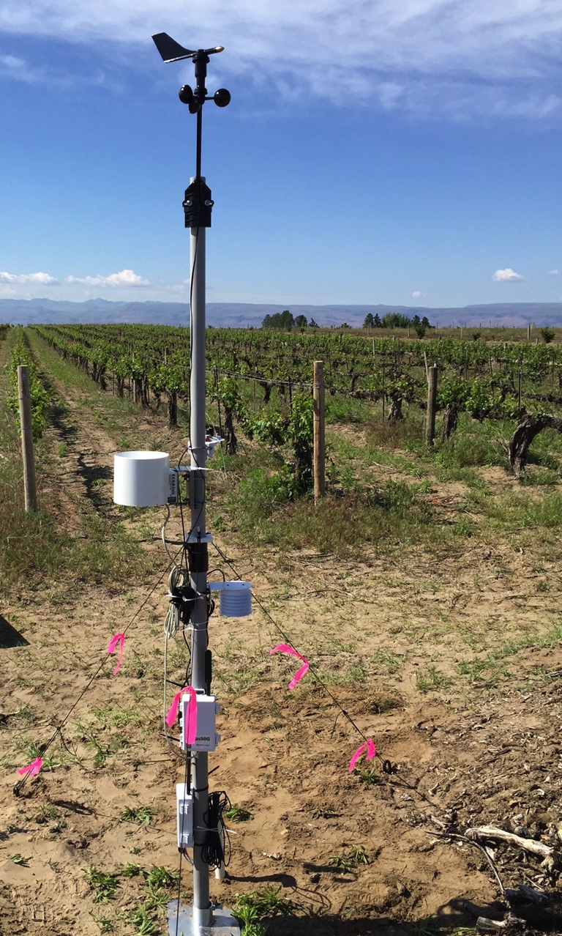
Weather and Climate
Ten sites in existing/planned vineyards
  Eight in Sunnyslope (w/in 5 km radius)
  Six sites illustrated this talk
Above ground weather instruments
  wind, RH, insolation, precipitation, temperature
  derived GDD, VPD, ETo, wind run
Soil sensors
  temperature and moisture
  variable depths (15-50 cm)
  dry sites (background) and in vineyard row (irrigated)

Slide 10
800m
760m
780m
740m
715m
Snake R.
675m
Sunnyslope
Weather Stations
800m

Slide 11
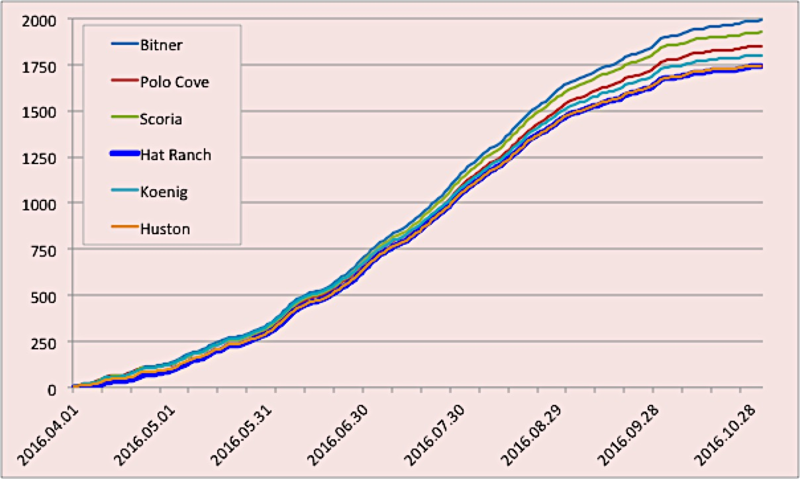
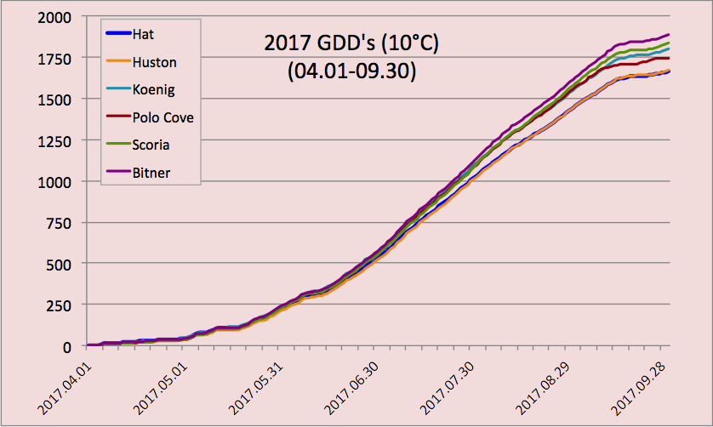
Two Years of Degree Day Data
Growing seasons 2016 and 2017
  Clear distinction between sites
  Consistent order of cooler to warmer sites between years
  Surprisingly wide range of heat units vineyards separated by only a few km
2016 GDDs (10°C)
(04.01-10.31)
 | Hat | Huston | Koenig | Polo Cove | Scoria | Bitner
093016 ytd | 1668 | 1671 | 1725 | 1764 | 1840 | 1890
093017 ytd | 1667 | 1671 | 1800 | 1744 | 1835 | 1889

Slide 12
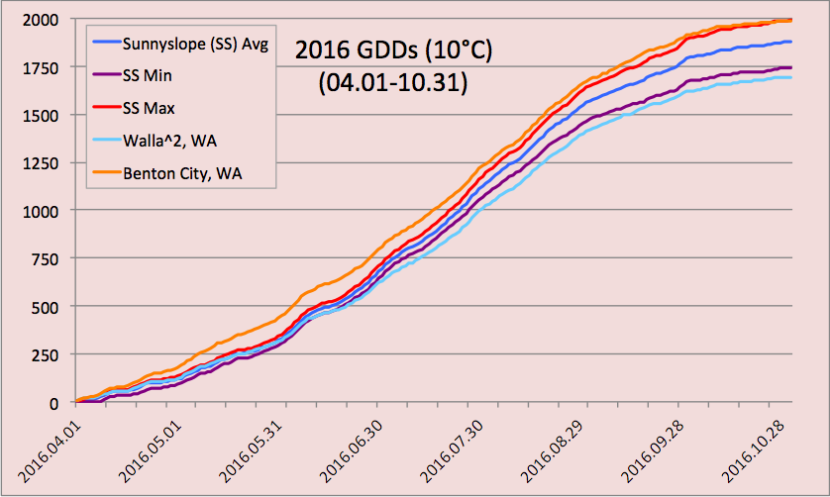
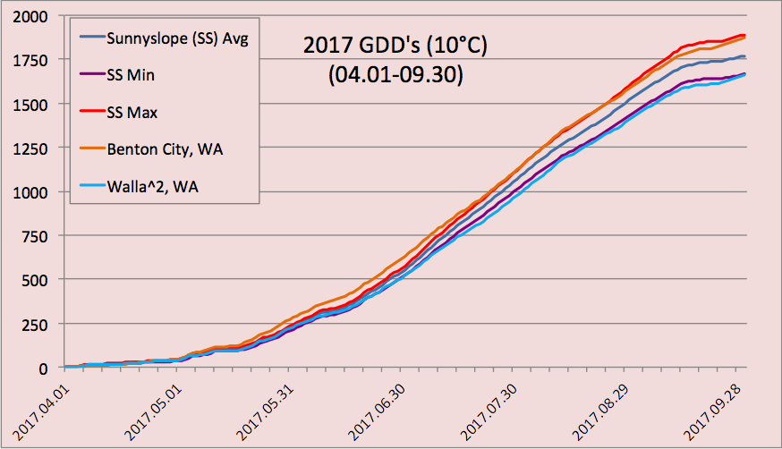
Regional Comparisons
SS compared to Benton City (Red Mountain) and Walla Walla in Washington
SS and WW lag early compared to RM reflected by later bud break
SS warm sites catch up and are as warm as RM by end of season – similar veraison dates
 | SS Avg | Benton City | Walla^2
093016 ytd | 1760 | 1911 | 1616
093017 ytd | 1768 | 1870 | 1658

Slide 13
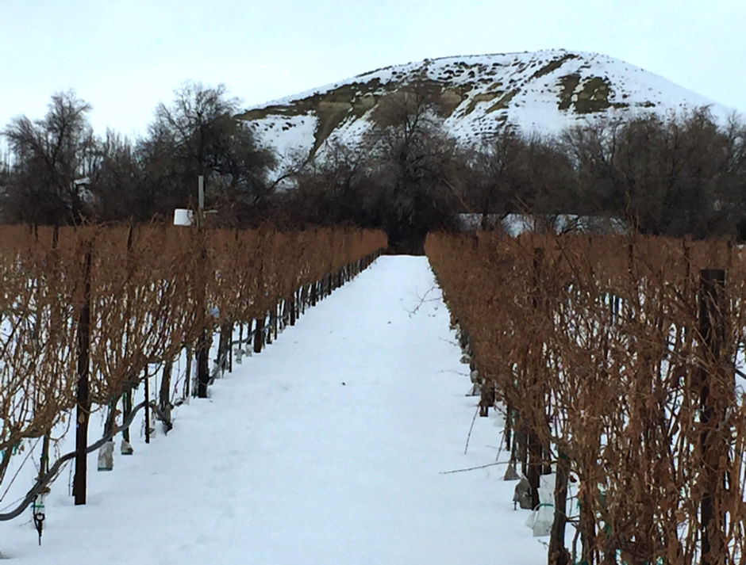
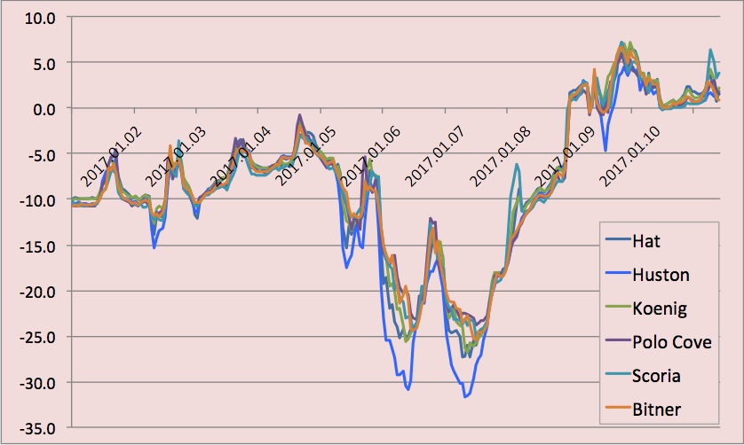
Cold Vulnerability
Deep freeze over two nights in Jan. 2017
Sites with steeper slope, better air drainage had warmer temps
Coldest temps (-31C) at highest elevation Huston site
  nearly flat site in interfluve
  very poor cold air drainage
  resulted in extreme cold

Slide 14
Summary and Next Steps
Summary
  Project identified large variation in soils AND climate over short distances
    Message – trust but verify soil survey data
  Soil data, moisture sensors, and Wx sensors aid growers in deficit irrigation management
  Meso-scale climates influenced by differences in elevation and slope creating large differences in air drainage
Next Steps
  Expand network to include other vineyard clusters in Snake River, Lewis-Clark Valley AVAs
  Integrate Wx data into WRF model being developed for Idaho vineyards

Slide 15
Acknowledgements
Funding provided by USDA/ISDA Specialty Crop Block Grant Program, with in kind matches and support by
  Boise State University
  Ron Bitner
  Jai Jaiprakash (Synchronexus)
  NNU

Slide 16
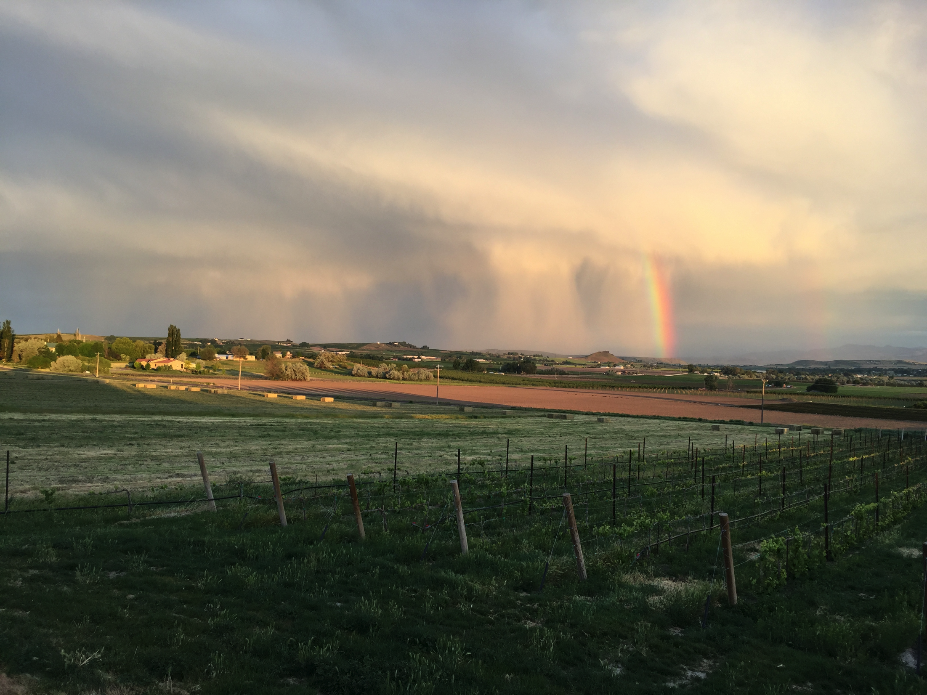
Questions?

Slide 17
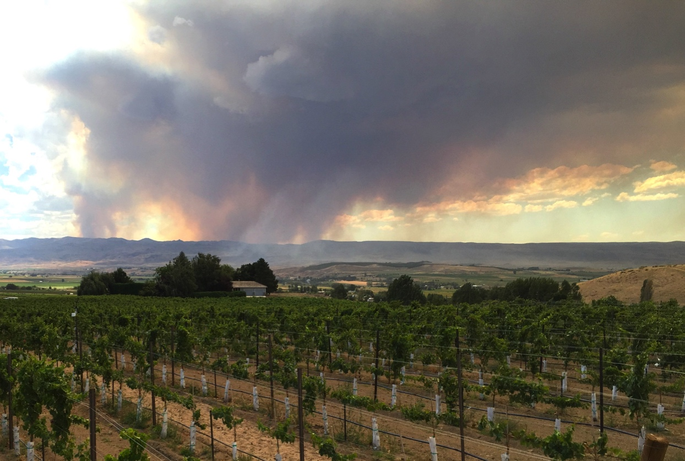
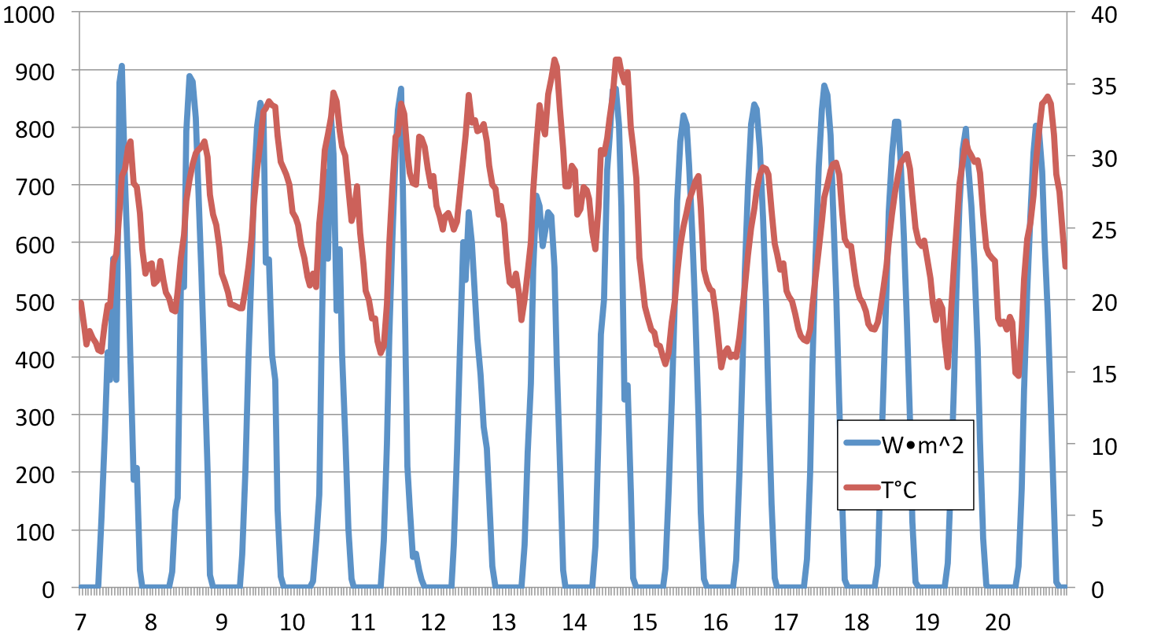
Regional Fire and Smoke
reduced insolation (~25% less compared to prior and following days
increased night T°C (5-10°C more than prior and following days)
similar patterns observed for other fire events.
T°C
w/m²
Aug.

