Slide 1
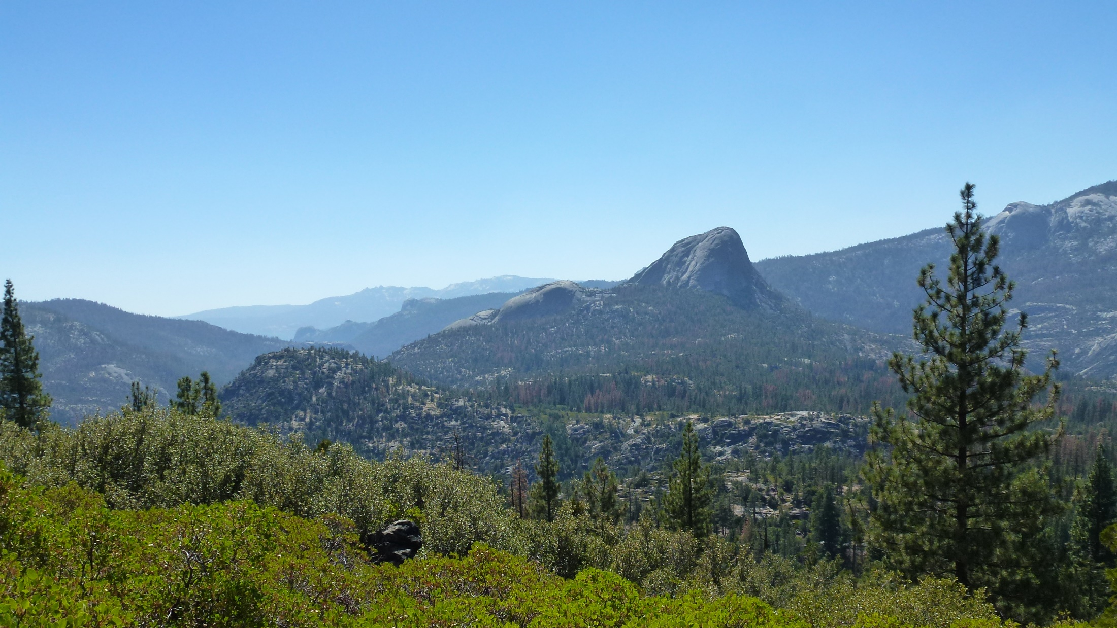



Constraining the timing and magnitude of deglaciation in the drainage basins of Mono Creek and the South Fork of the San Joaquin River, central Sierra Nevada Mountains (USA)
Richard Becker - University of Wisconsin-Madison
Aaron Barth - University of Wisconsin-Madison
Shaun Marcott - University of Wisconsin-Madison
Basil Tikoff - University of Wisconsin-Madison

Slide 2
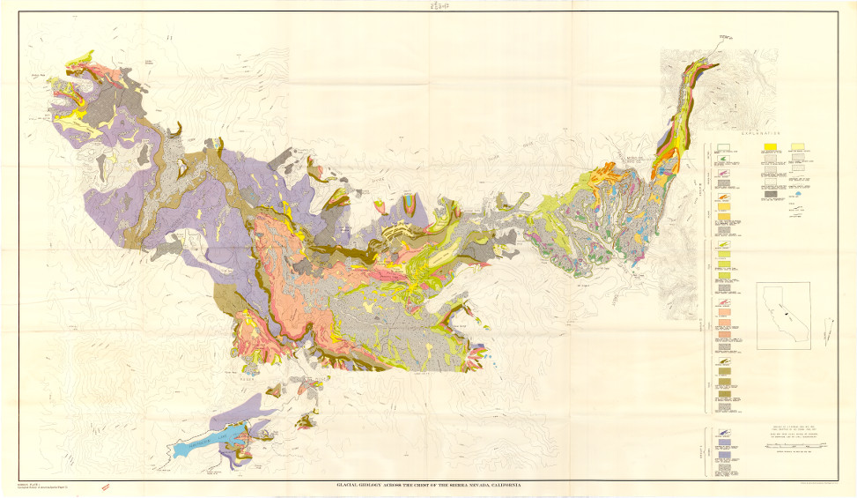
Birman (1964) Glacial Geology Across the Crest of the Sierra Nevada, California

Slide 3
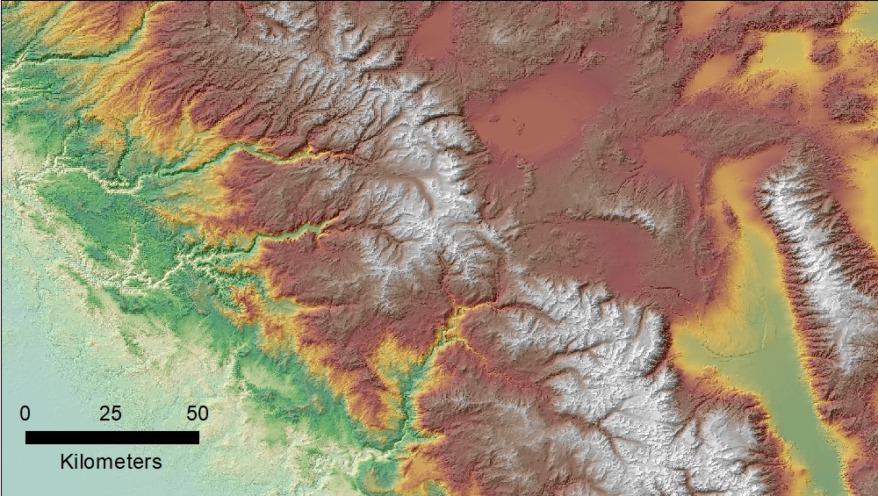
Mono Lake
Tuolumne
Meadows
Lee Vining
Mammoth Lakes
Yosemite Valley
Bishop
San Joaquin R.
Mono Creek
South Fork of…

Slide 4
Tuolumne
Meadows
Mono
Recesses

Slide 5
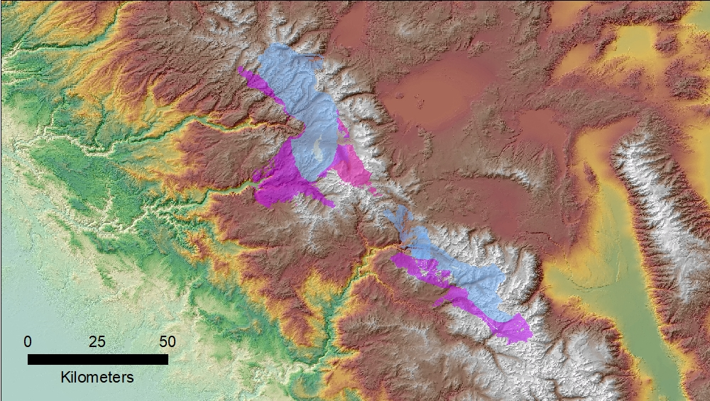
The bedrock geology is nearly identical.

Slide 6
The fracture patterns are different.

Slide 7
The geomorphology is different as well.

Slide 8
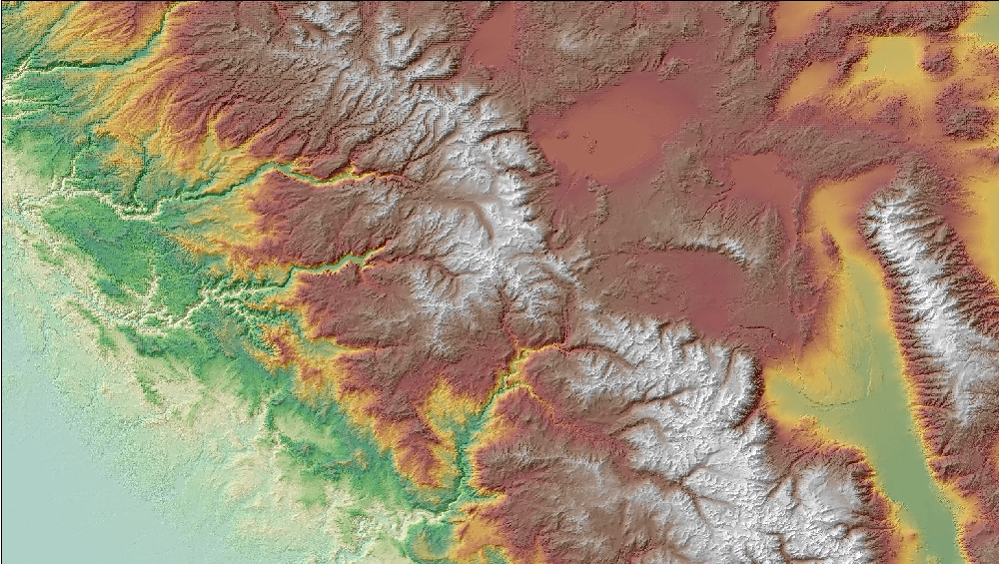
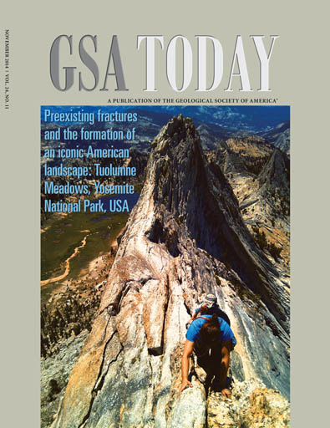

Slide 9
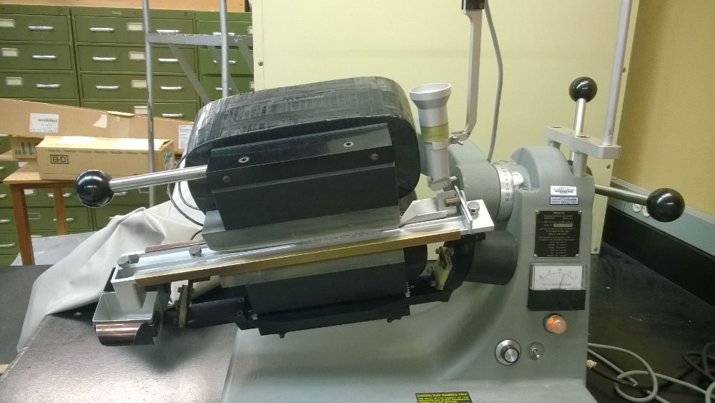
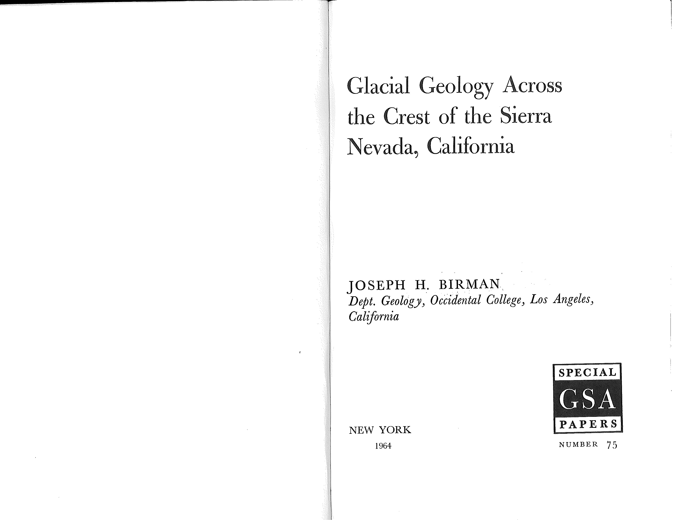

Slide 10
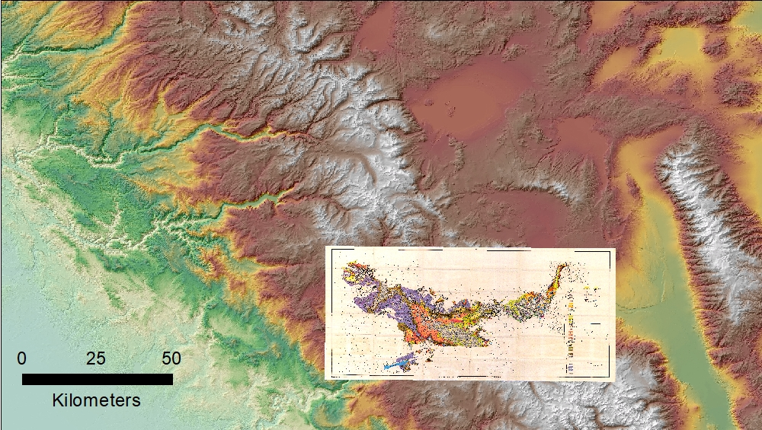

Slide 11
Birman (1964) Glacial Geology Across the Crest of the Sierra Nevada, California

Slide 12
Birman (1964) Glacial Geology Across the Crest of the Sierra Nevada, California
Tioga
Tenaya
Tahoe

Slide 13
Birman (1964) Glacial Geology Across the Crest of the Sierra Nevada, California
Birman (1964) Glacial Geology Across the Crest of the Sierra Nevada, California
Relative Weathering
Correlating with Blackwelder (1931)
Tioga
Tenaya
Tahoe
18.5 - 17.0 ka (Phillips et al., 2009)
18.8 ± 1.9 ka (2σ; Rood et al., 2011)
Tioga
Tenaya
Tahoe
165 - 135 ka (Phillips et al., 2009)
144 ± 14 ka (2σ; Rood et al., 2011)

Slide 14
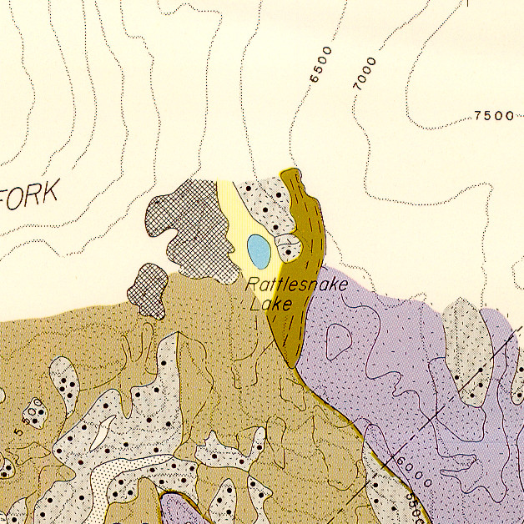
Birman (1964) Glacial Geology Across the Crest of the Sierra Nevada, California

Slide 15
Birman (1964) Glacial Geology Across the Crest of the Sierra Nevada, California
Birman (1964) Glacial Geology Across the Crest of the Sierra Nevada, California
Tioga
Tenaya
Tahoe
Tioga
Tenaya
Tahoe
MIS 4?

Slide 16
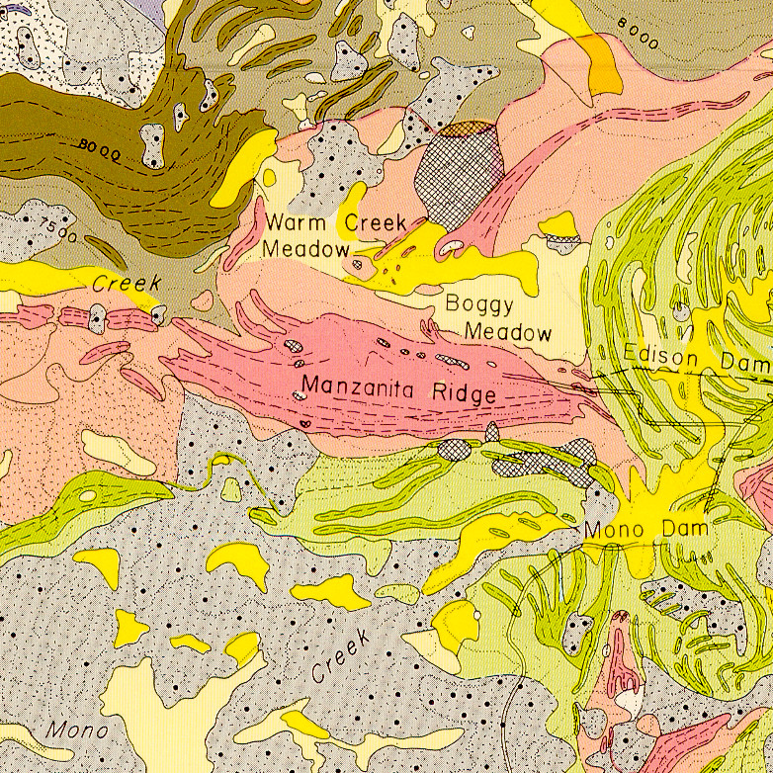
Birman (1964) Glacial Geology Across the Crest of the Sierra Nevada, California
Birman (1964) Glacial Geology Across the Crest of the Sierra Nevada, California
Tioga
Tenaya
Tahoe

Slide 17
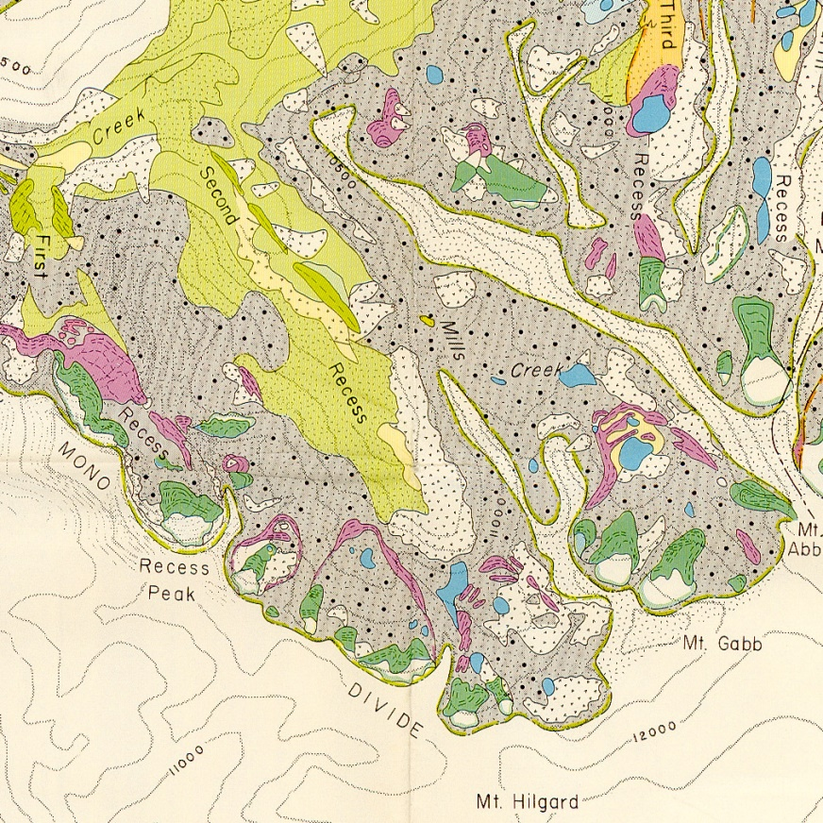
Birman (1964) Glacial Geology Across the Crest of the Sierra Nevada, California
Birman (1964) Glacial Geology Across the Crest of the Sierra Nevada, California
Tioga
Tenaya
Tahoe

Slide 18
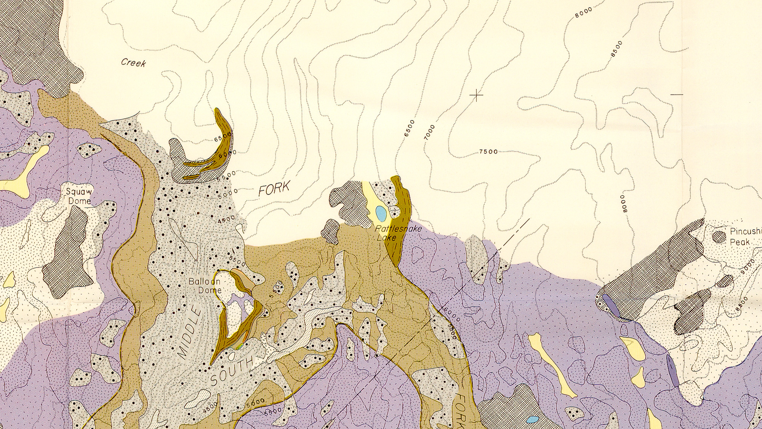
Ages ± 2σ internal
Lifton et al. (2014) scaling (“SA”)
no erosion, no snow
21.6 ± 1.0
22.6 ± 1.2
23.3 ± 1.2
23.4 ± 1.2
22.6 ± 0.6
180 m lower
22.6 ± 1.4
22.7 ± 1.2
22.7 ± 0.9
All 6 = 22.6 ± 0.5
Legend
Boulder
Bedrock
Vein-Quartz Clast
Weighted Average
rejected

Slide 19
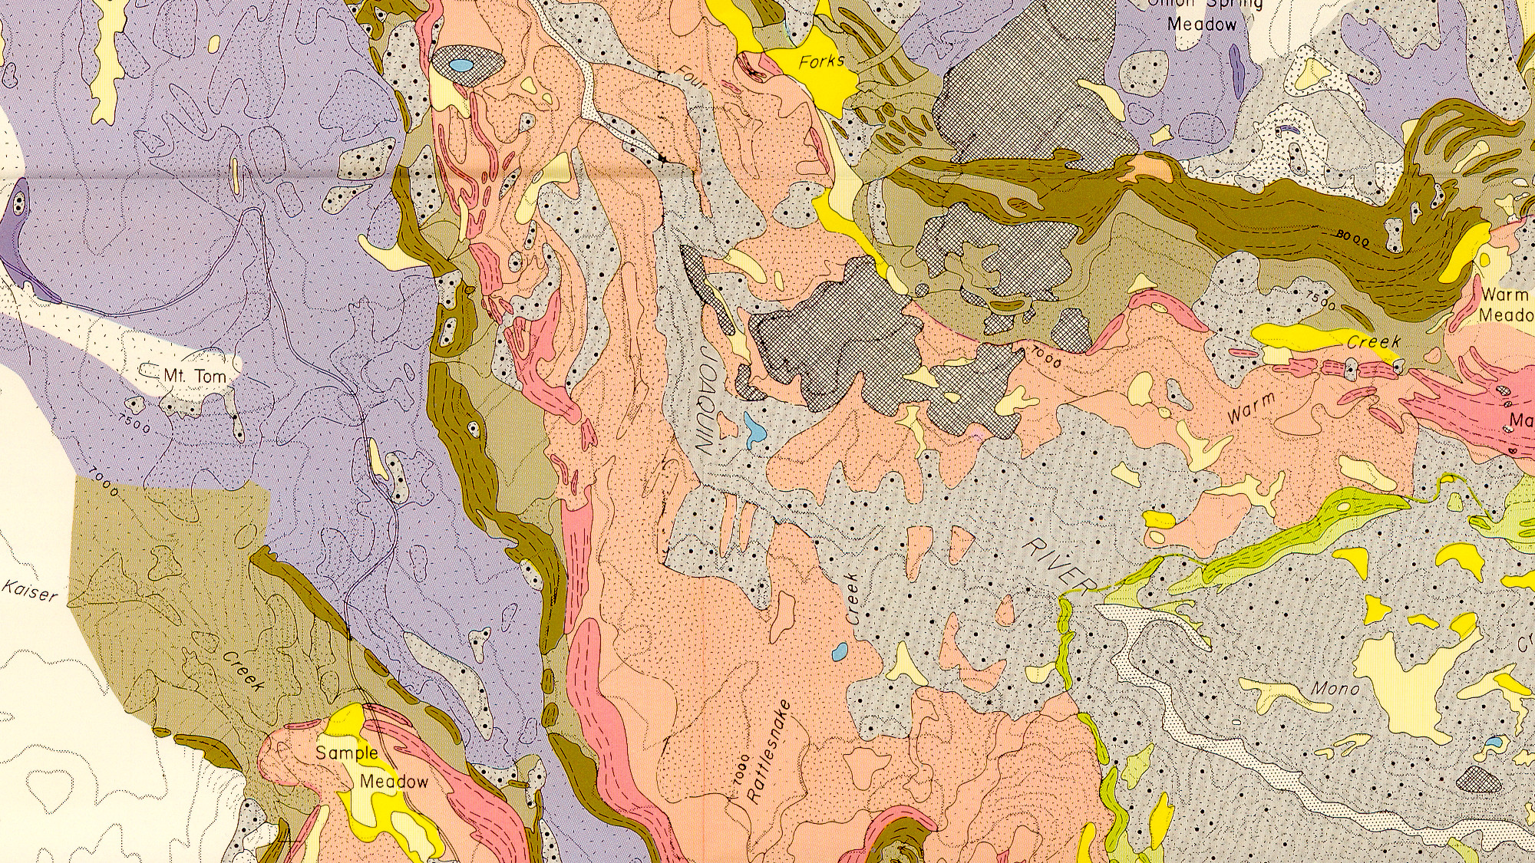
19.7 ± 1.4
21.5 ± 1.2
22.0 ± 1.4
23.5 ± 1.0
21.6 ± 2.7
19.7 ± 1.4
21.5 ± 1.2
22.0 ± 1.4
23.5 ± 1.0
22.5 ± 2.8
Dates indicate 40% ice-thickness loss at this location (~64% LGM glacier length)
~600 years after local LGM.
Legend
Boulder
Bedrock
Vein-Quartz Clast
Weighted Average
rejected

Slide 20
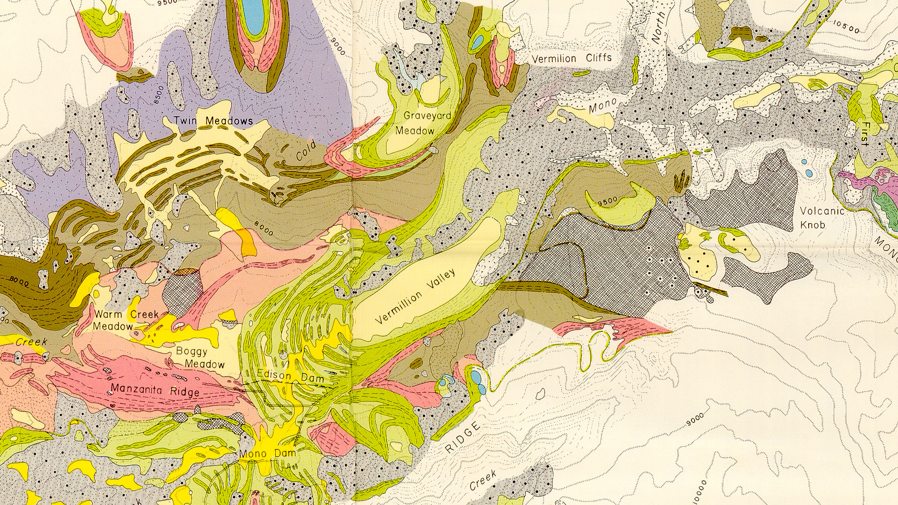
Manzanita Ridge, type location for Tenaya ice advance, bracketed between 22.6 ± 0.5 and 20.2 ± 1.6 ka.
Best Estimate = 21.4 ± 0.8 ka.
14.9 ± 0.8
15.8 ± 0.8
15.3 ± 0.6
16.3 ± 1.0
17.2 ± 0.8
17.5 ± 0.8
17.5 ± 0.8
17.8 ± 0.8
18.1 ± 0.8
17.5 ± 0.3
4.8 ± 0.4
19.3 ± 0.8
20.1 ± 0.8
19.7 ± 2.0
4 of 5 = 20.2 ± 1.6
19.6 ± 1.2
21.6 ± 1.0
20.5 ± 2.1

Slide 21
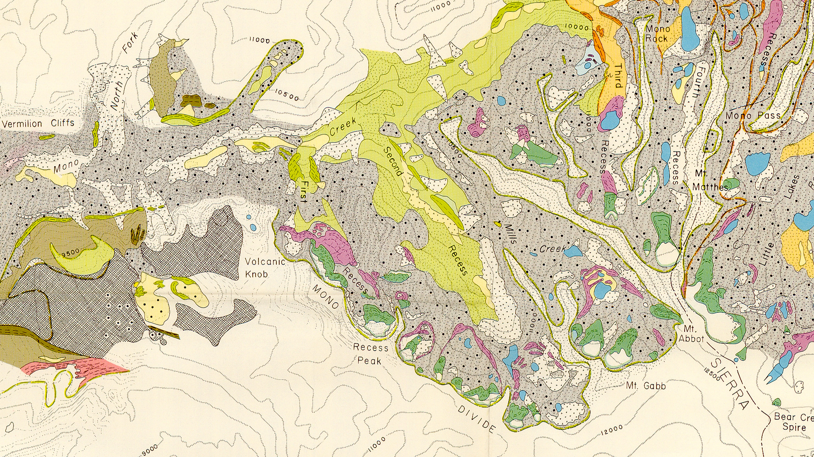
16.3 ± 1.0
17.2 ± 0.8
17.5 ± 0.8
17.5 ± 0.8
17.8 ± 0.8
18.1 ± 0.8
17.5 ± 0.3
10.4 ± 0.6
12.3 ± 0.6
12.6 ± 0.6
13.5 ± 0.8
13.9 ± 0.6
12.6 ± 1.6
10.4 ± 0.6
12.3 ± 0.6
12.6 ± 0.6
13.5 ± 0.8
13.9 ± 0.6
13.0 ± 1.2
~300 yr to retreat halfway
Legend
Boulder
Bedrock
Vein-Quartz Clast
Weighted Average
12.8 ± 0.6
13.1 ± 0.8
12.9 ± 0.5

Slide 22
Birman (1964) Glacial Geology Across the Crest of the Sierra Nevada, California
Birman (1964) Glacial Geology Across the Crest of the Sierra Nevada, California
“Tahoe” = Tioga
22.6 ± 0.5
Tenaya
21.4 ± 0.8
Tioga
Tenaya
Tahoe
Outer “Tioga”
20.2 ± 1.6
Recess Peak
13.0 ± 1.2
Inner “Tioga”
15.3 ± 0.6

Slide 23
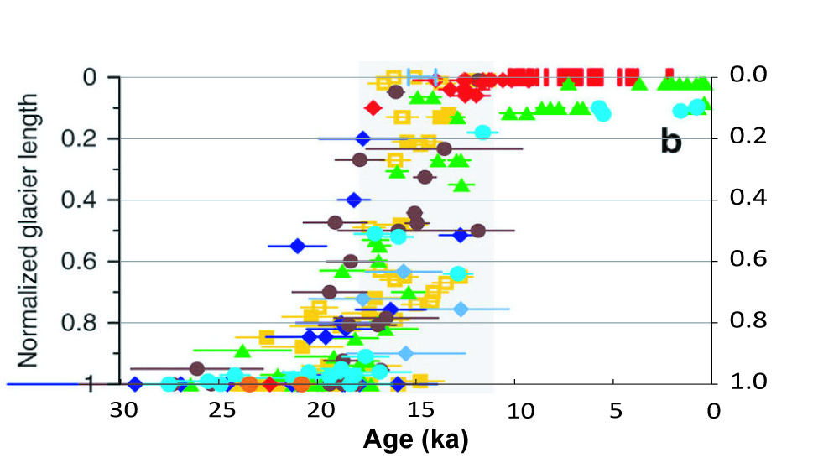
Normalized Glacier Length vs. Time
Shakun et al. (2015) Nature Communications, Fig. 2

Slide 24
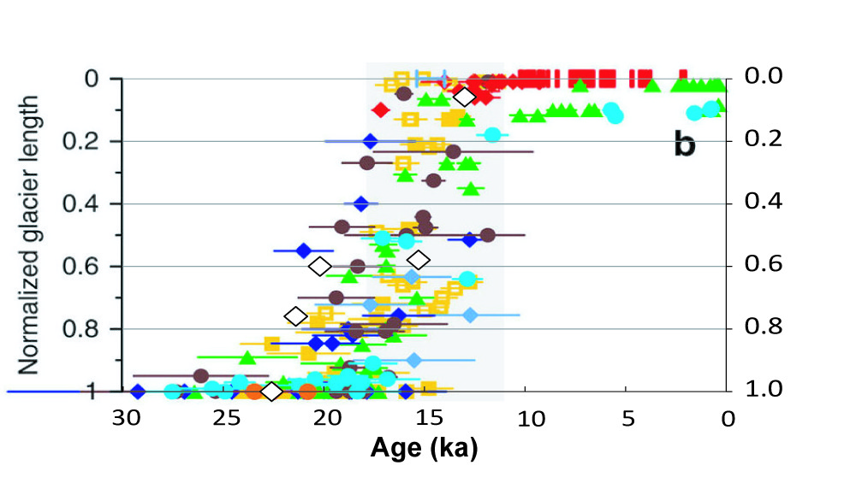
Normalized Glacier Length vs. Time
Shakun et al. (2015) Nature Communications, Fig. 2

Slide 25
Conclusions
Birman’s “Tahoe” is Tioga, 22.6 ± 0.5 ka.
The type location for the Tenaya ice advance is between 22.6 ± 0.5 and 20.2 ± 1.6 ka.
Compared to other glaciers, initial retreat of the South Fork glacier was relatively early.
The Mono Creek and South Fork glaciers were near ~60% of their LGM lengths for ~3-5 ka.
The Recess Peak advance has been dated to 13.0 ± 1.2 ka adjacent to its type location.

Slide 26
Acknowledgements
Sampling Permission: US Forest Service
Field Assistants: Mike Bahrmasel & Will Montz
Funding: NSF & PRIME Lab

Slide 27
Questions?

