Slide 1
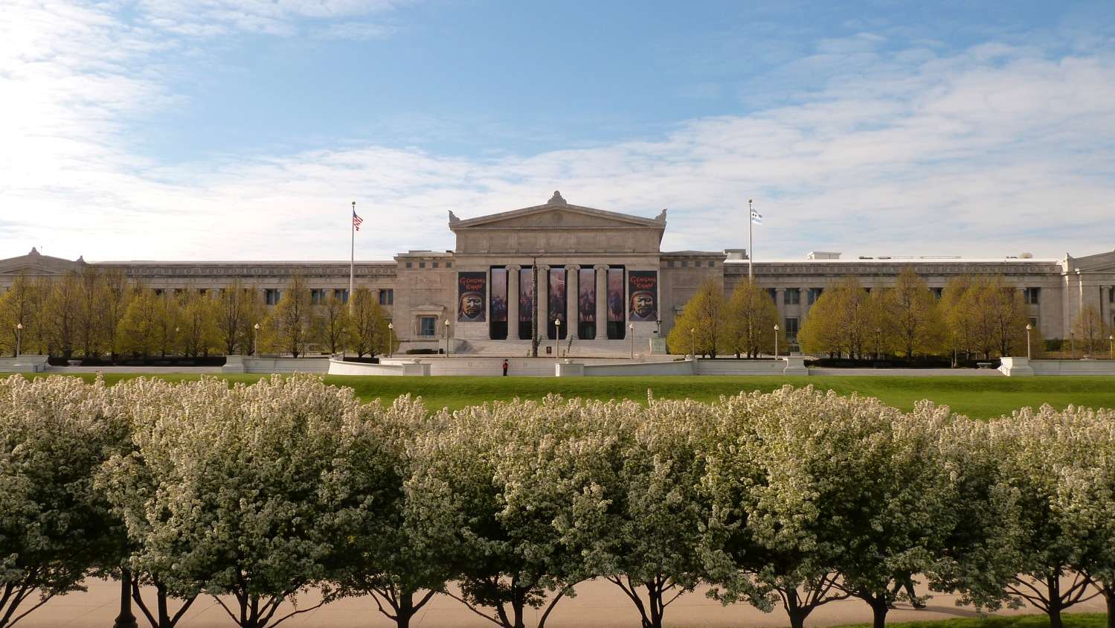
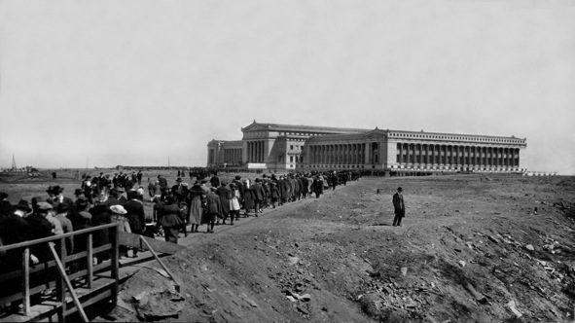
THE FIELD MUSEUM OF NATURAL HISTORY PROGRAMS:
MIXING NEW TECHNOLOGY WITH OLD COLLECTIONS
May 21st, 1921
By Paul Mayer
Fossil Invertebrate
Collections Manager

Slide 2
Introduction and History of Exhibits at the Field Museum
  Columbian World Exposition (5,000 specimens)
  Displays at old location 1894 to 1922 (5,000 specimens)
  New building exhibits 1922 to 1951 (~10,000 specimens)
  Geology Hall renovations 1951 to 1992 (1,339 specimens)
  Life over Time & Evolving Planet 1994 to Present (268 specimens)
New Technology Additions to Exhibits
  Videos, Digital rails, Computer programs
Outreach Programs
  Dozin with the Dinos, Members Night, Science Hub, Meet a Scientist, WeDigBio, Rock and Fossil Clubs
Social Media
  Virtual Silurian Reef / Ancient Oceans of the Midwest
  Facebook
  Twitter
  Apps
Interns and volunteers

Slide 4
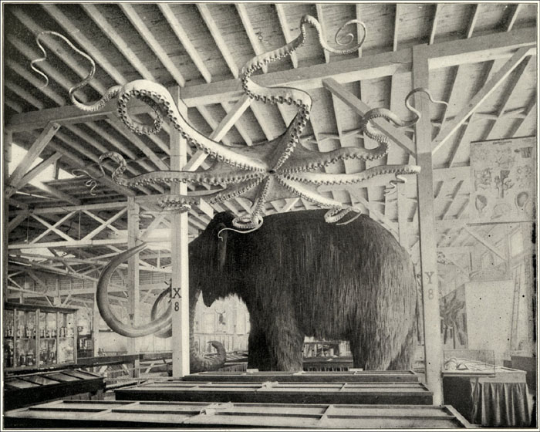
The Ward’s Natural Science Establishment display in the Anthropology Building
at the Chicago’s World Columbian Exposition 1893
The Field Museum, GN85075

Slide 5
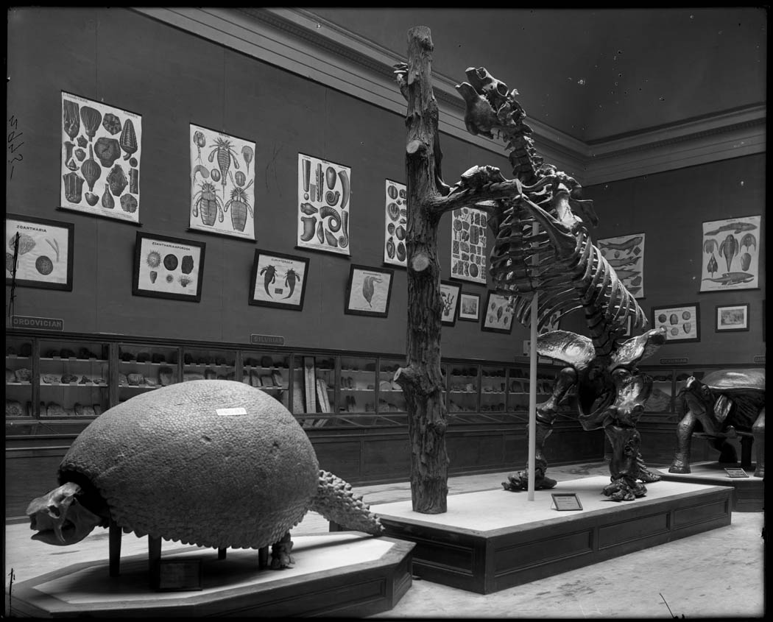
Hall 35
1895
The Field Museum, CSGEO2975, Photographer Charles Carpenter.

Slide 6
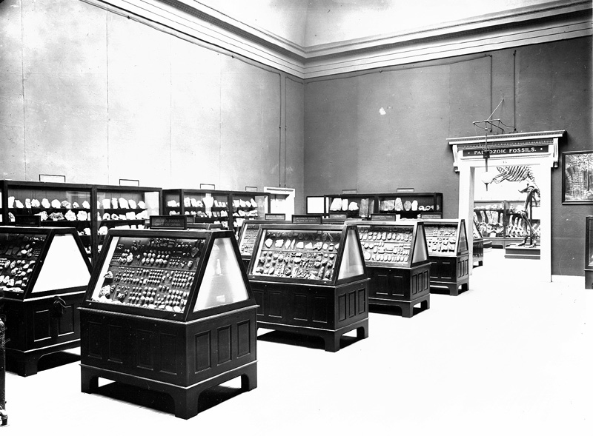
Hall 35
Paleozoic Fossils exhibit
1904
The Field Museum, CSGEO12694

Slide 7
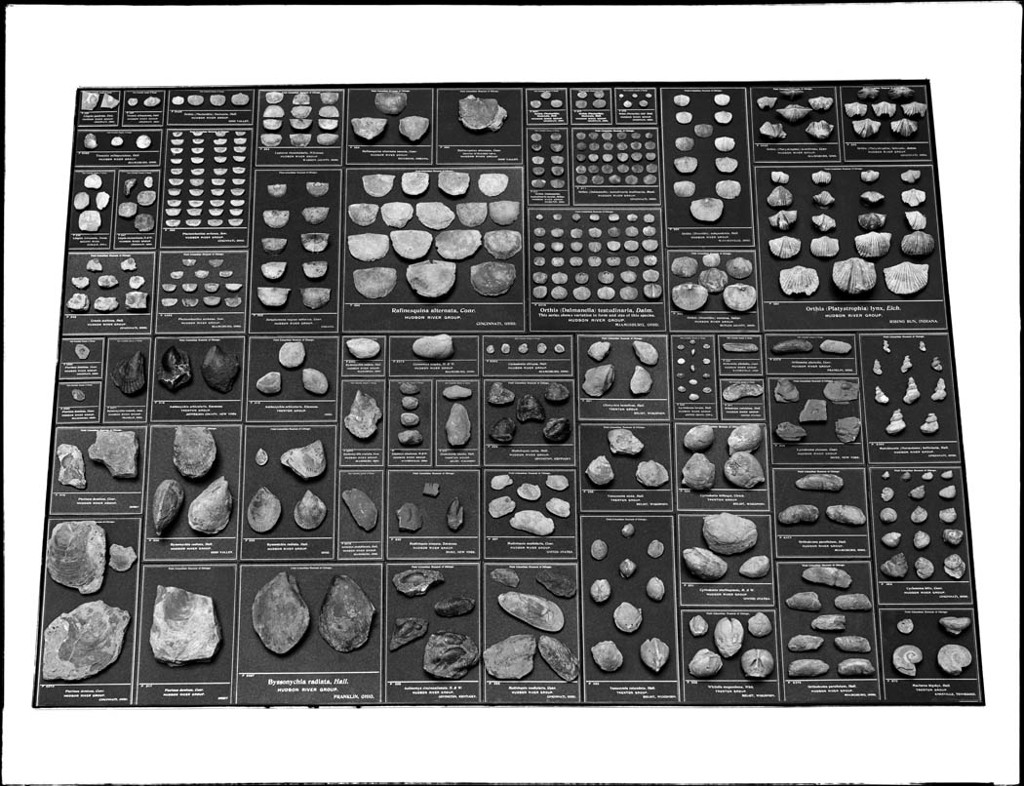
Hall 35 Display 1904
The Field Museum, CSGEO12695_A, Photographer Charles Carpenter.

Slide 8
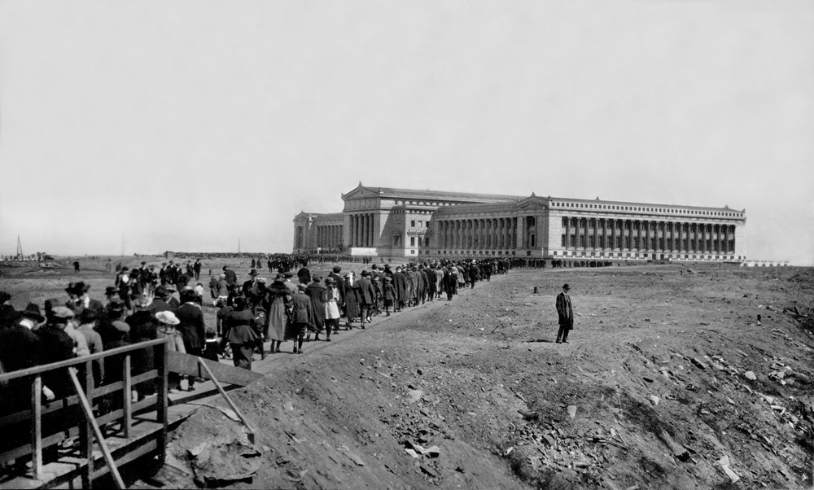
The Field Museum, CSGN44672, Photographer Charles Carpenter.
Opening Day crowds
Field Museum
May 21st, 1921

Slide 9
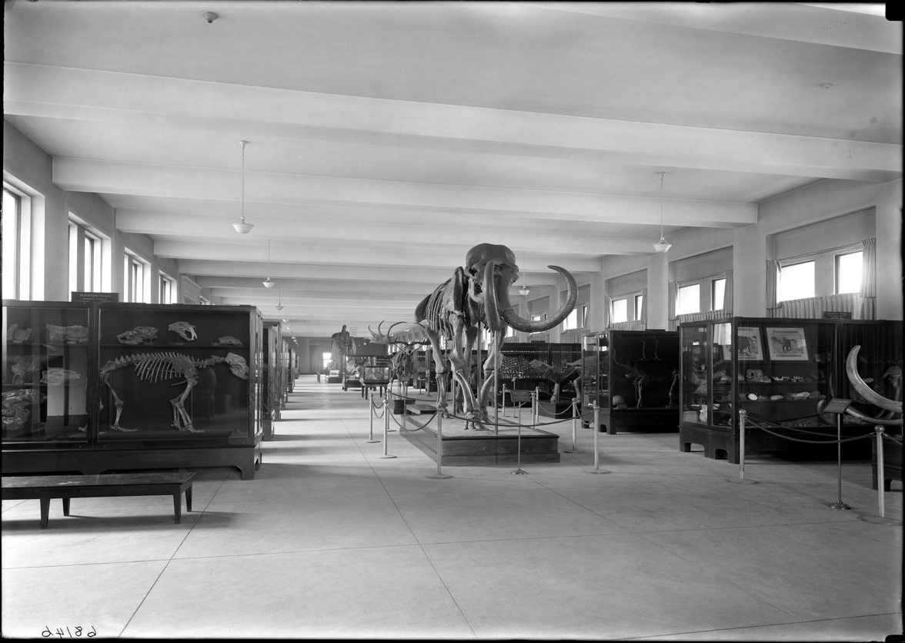
Hall 38 Paleontology, 1924
The Field Museum, CSGEO68146

Slide 10
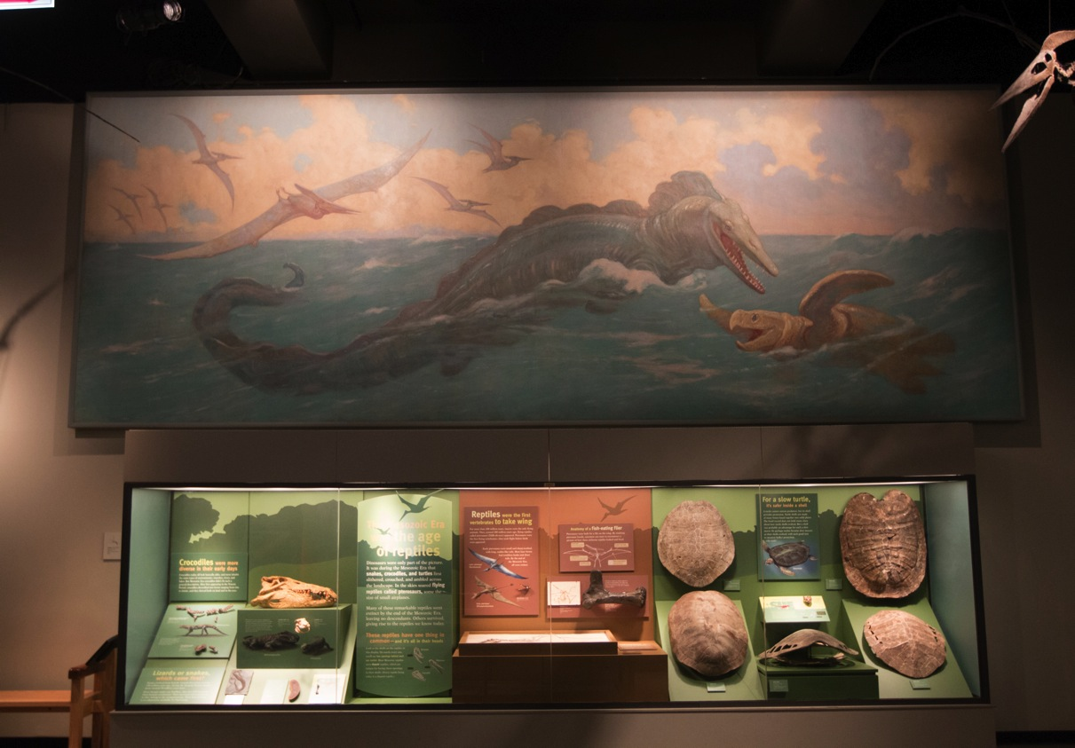
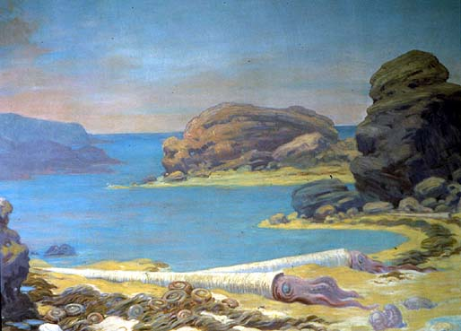
Charles Knight created
28 murals for the Field Museum from 1926 to 1931

Slide 11
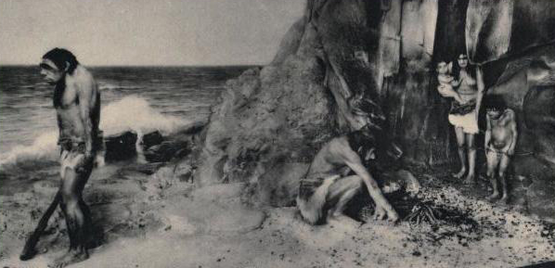
1933 Field Museum diorama showed a Neanderthal family in Gibraltar

Slide 12
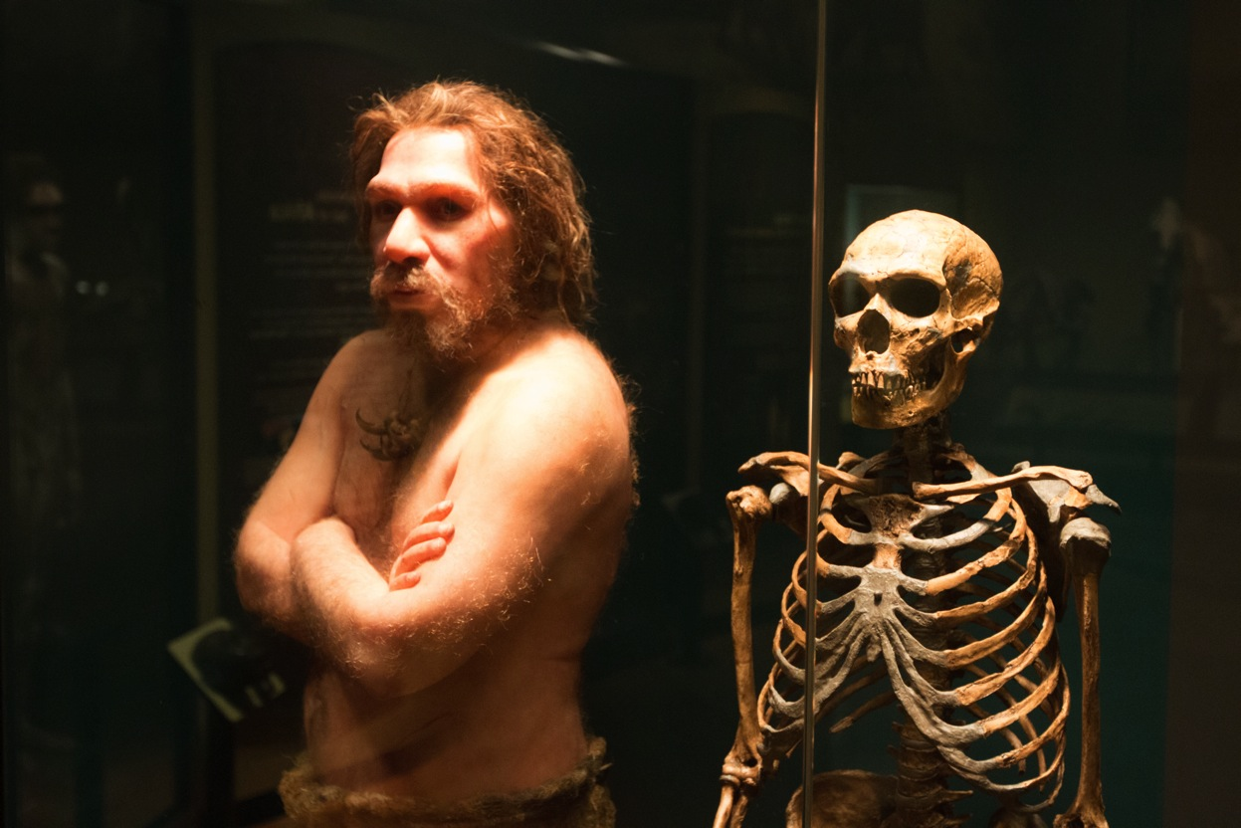
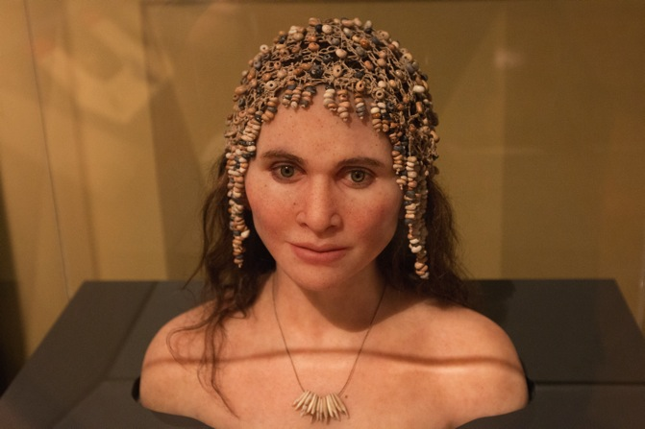
Elisabeth Daynès. Neanderthal and Magdalenian Woman Sculpture

Slide 13
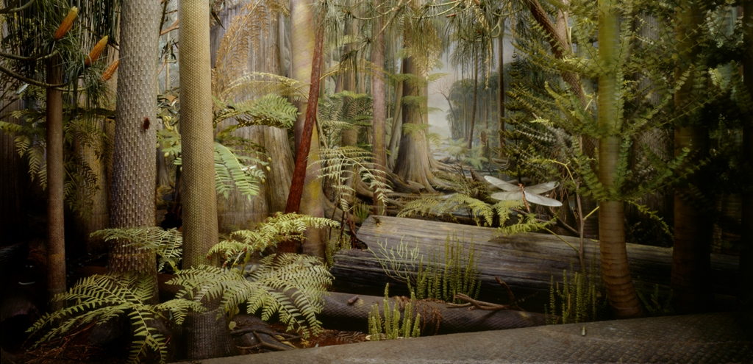
The Field Museum Carboniferous Forest Diorama
(Mazon Creek) 1929-1991
The Field Museum, GEO85637c, Photographer John Weinstein

Slide 14
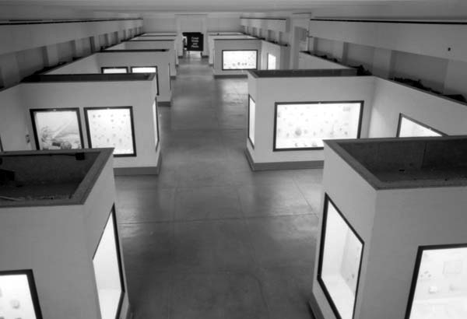
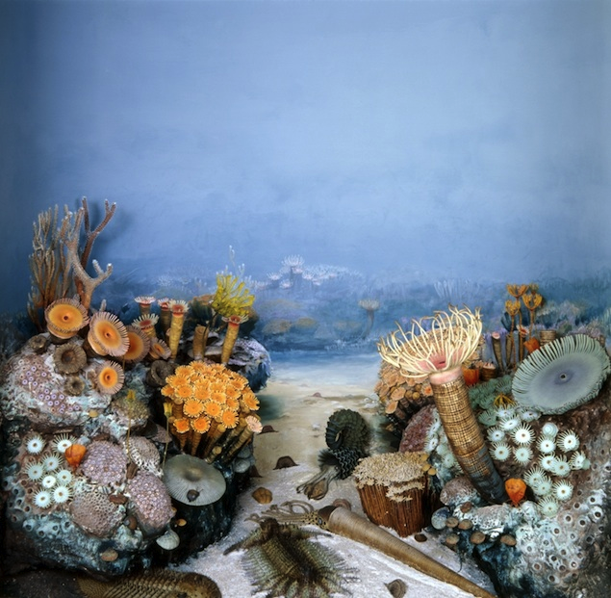
1951 Fossil Invertebrate Exhibit Renovation
Frederick J. V. Skiff Hall (Hall 37)
The Field Museum, GEO80821c, Photographer Ron Testa
The Field Museum, Photo GN85536_13
In total, 53 cases went into this exhibit displaying 1,339 fossil specimens. This was dramatically fewer fossils than previously displayed, but there was more interpretive material, explaining the meaning and importance of the fossils.
Next major remolding 1994.

Slide 15
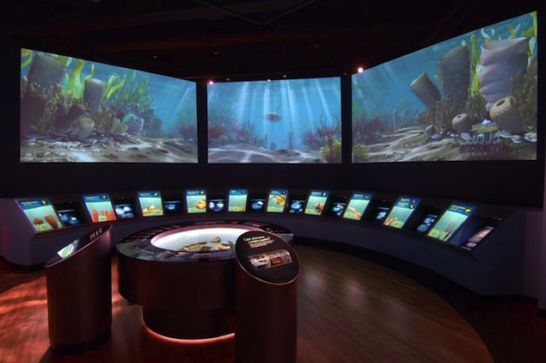
Life over Time 1994 - 2004
Evolving Planet 2004 - Present
More interpretation, less fossils
Today there are only 268 fossil invertebrates displayed in Evolving Planet.

Slide 16
Adding Technology to Tell the Stories of the Collections

Slide 17
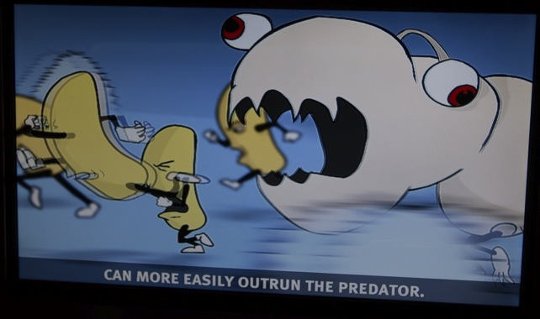
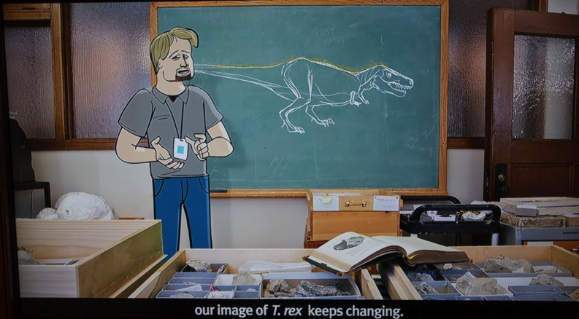
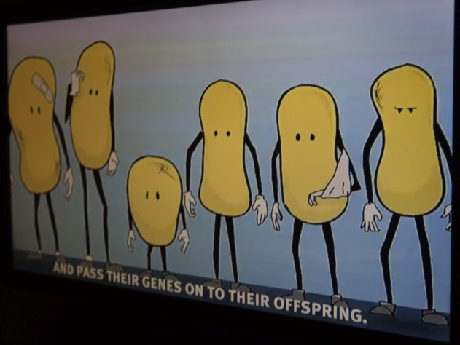
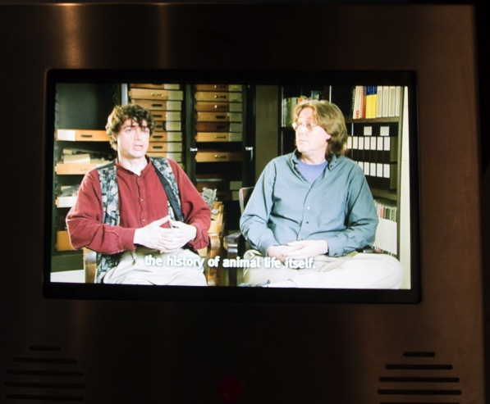

Slide 18
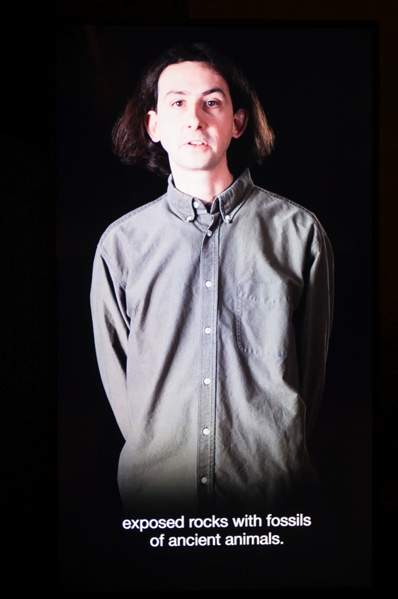
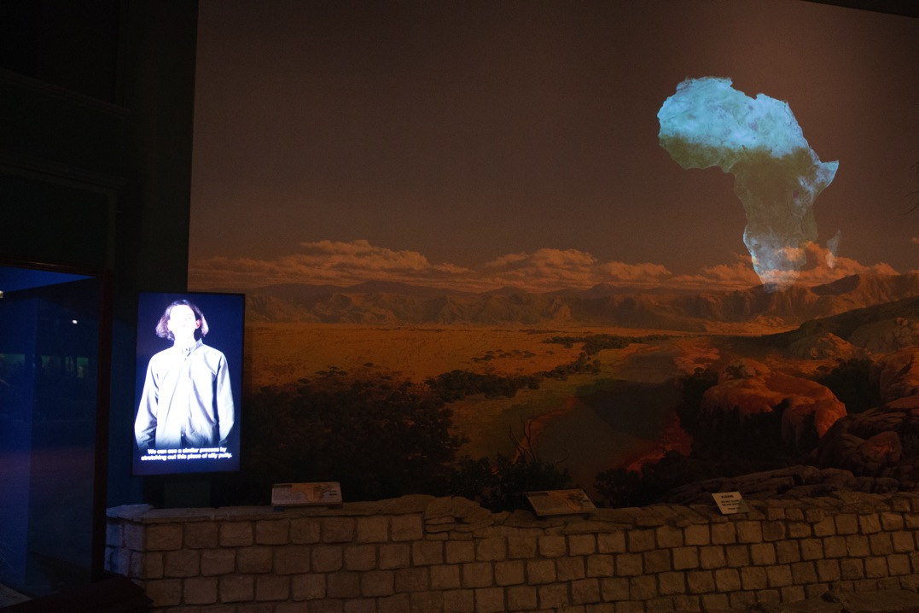

Slide 19
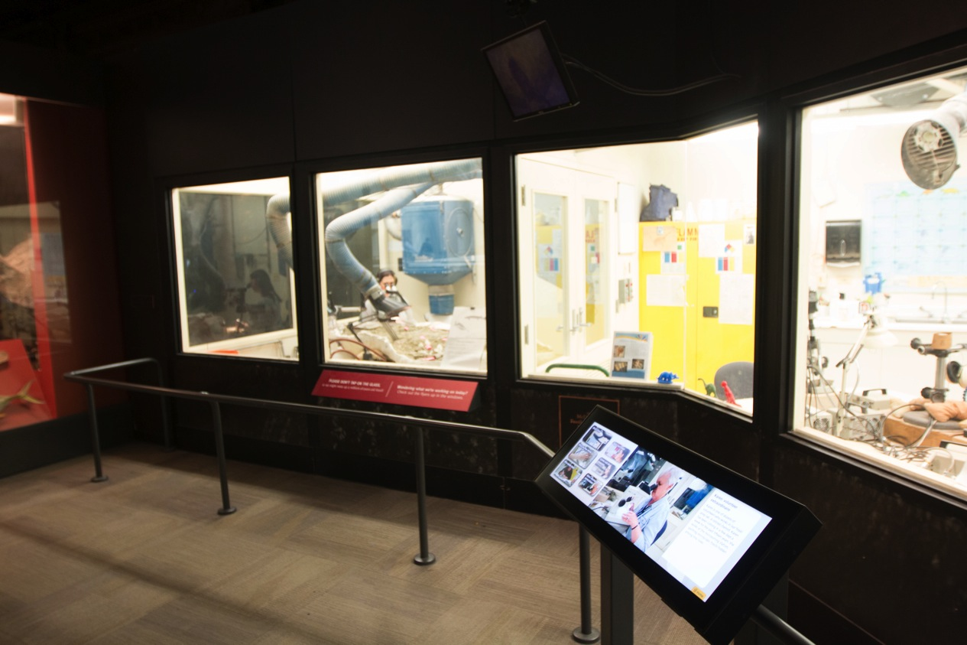

Slide 20
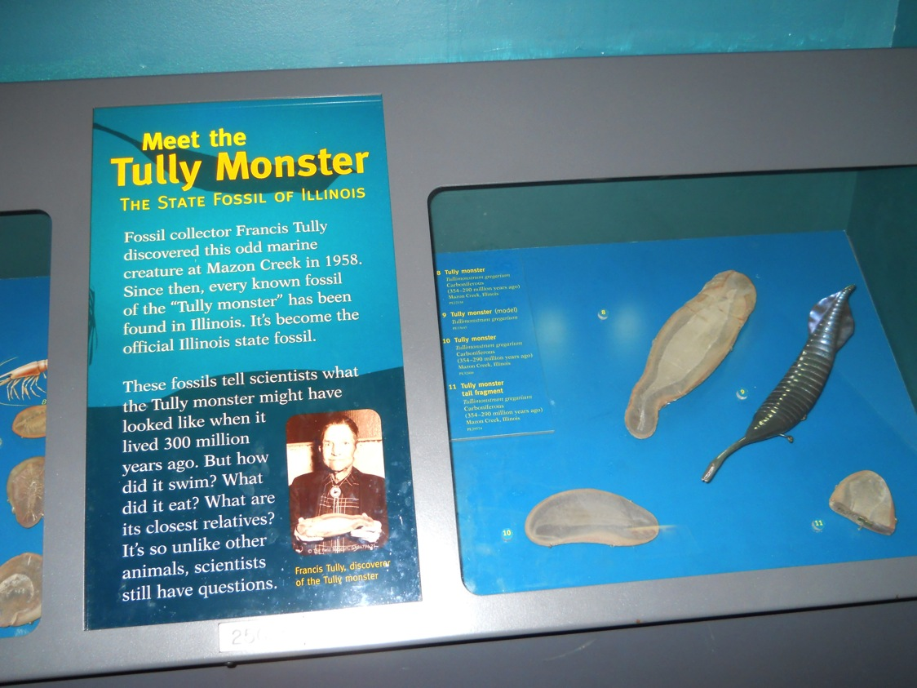

Slide 21
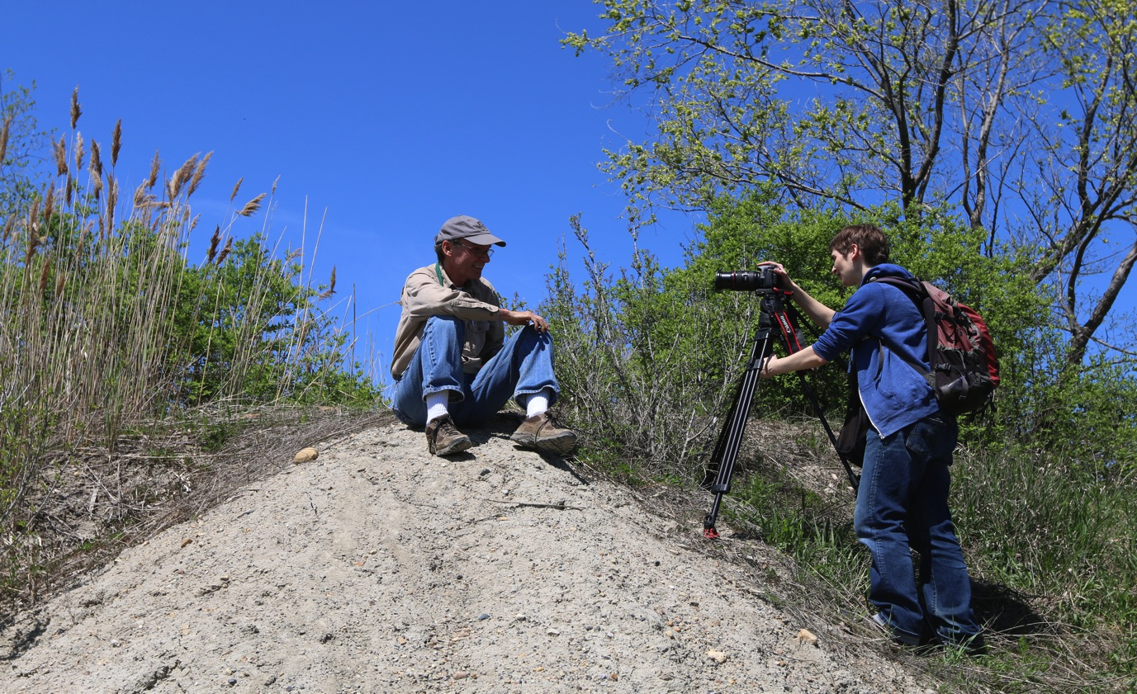

Slide 22
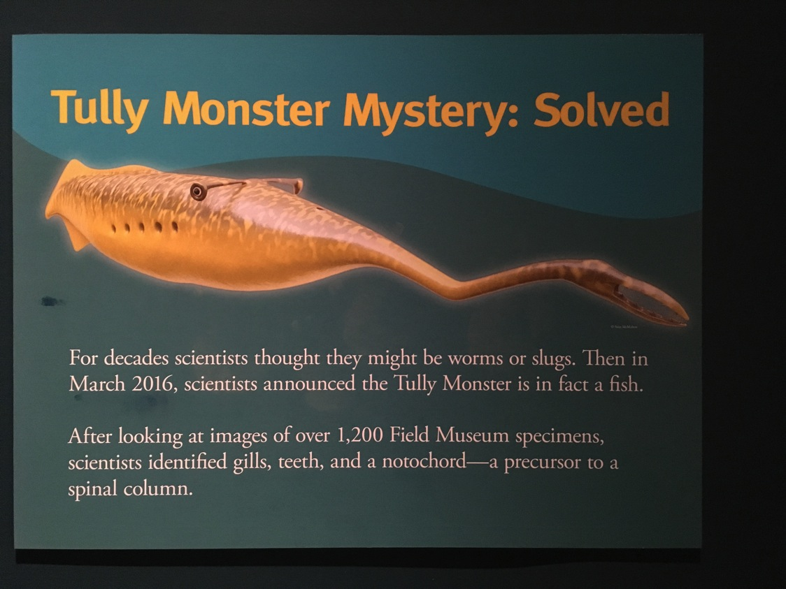

Slide 23
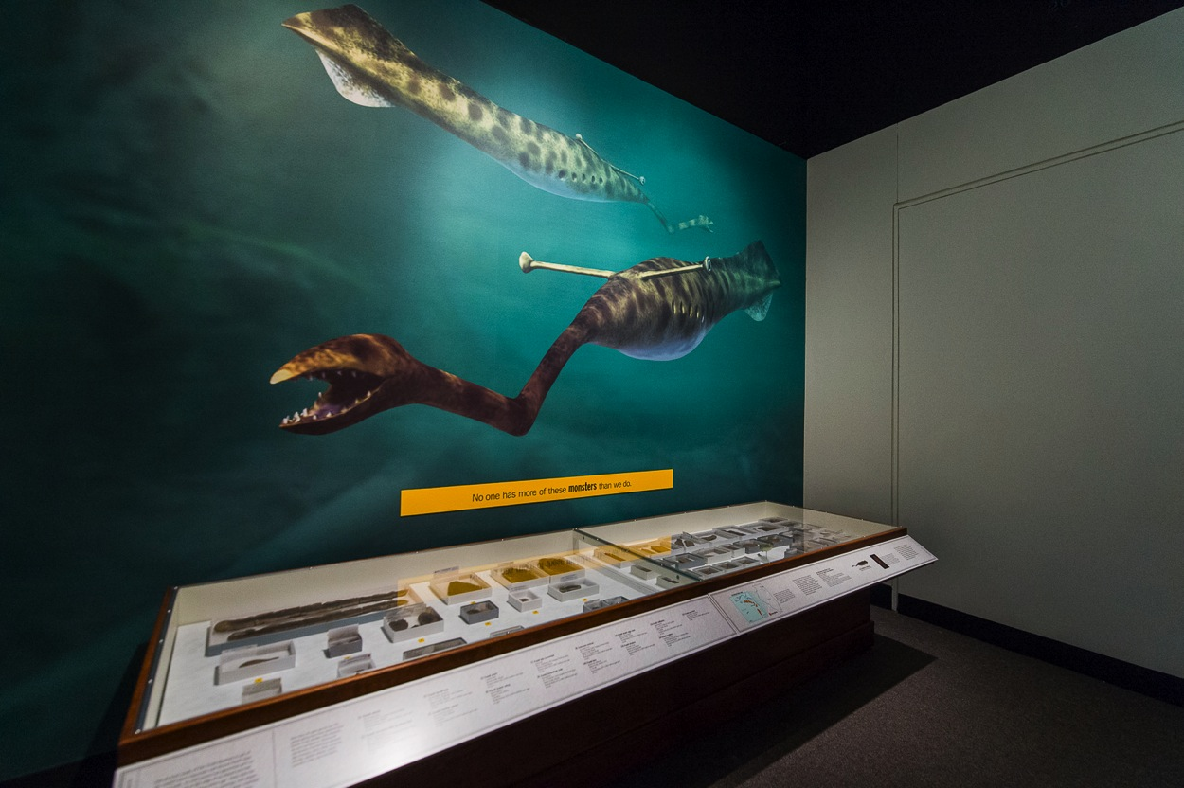
Tully Monster Display
in Specimens: Unlocking the Secrets of Life Special Exhibit

Slide 24
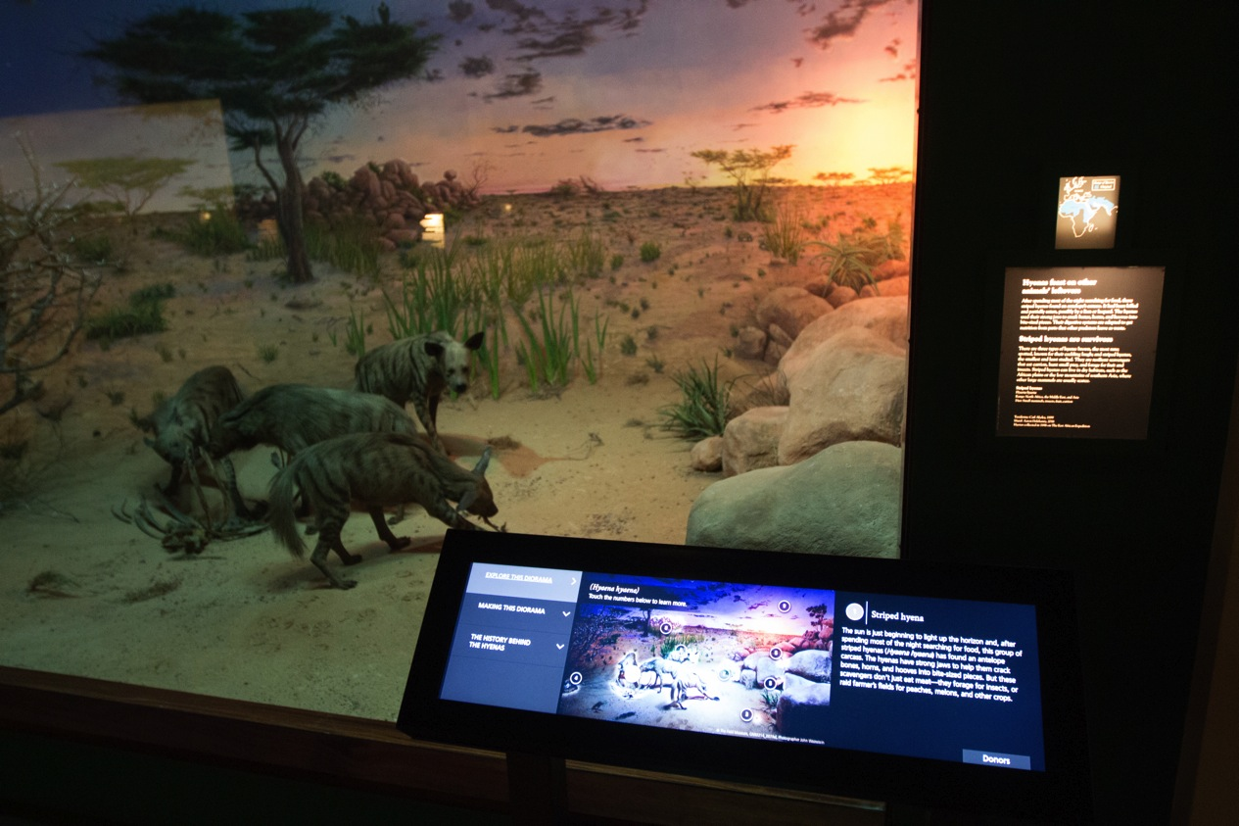
Project Hyena Diorama
Emily Graslie lead an Indiegogo funded project to create a new permanent diorama. It raised $155,165 with 1,811 donors.

Slide 25
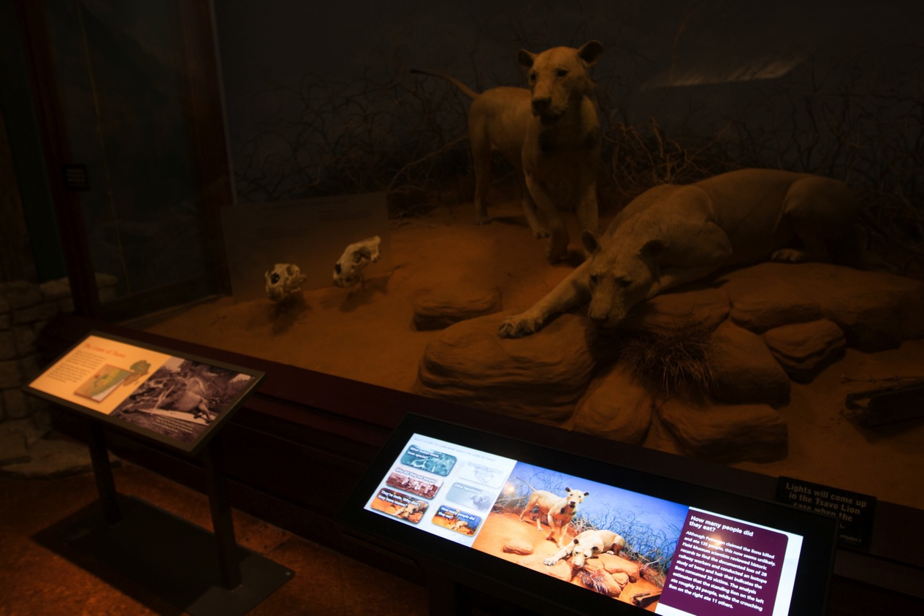
The Tsavo Lions
Digital Rails

Slide 26
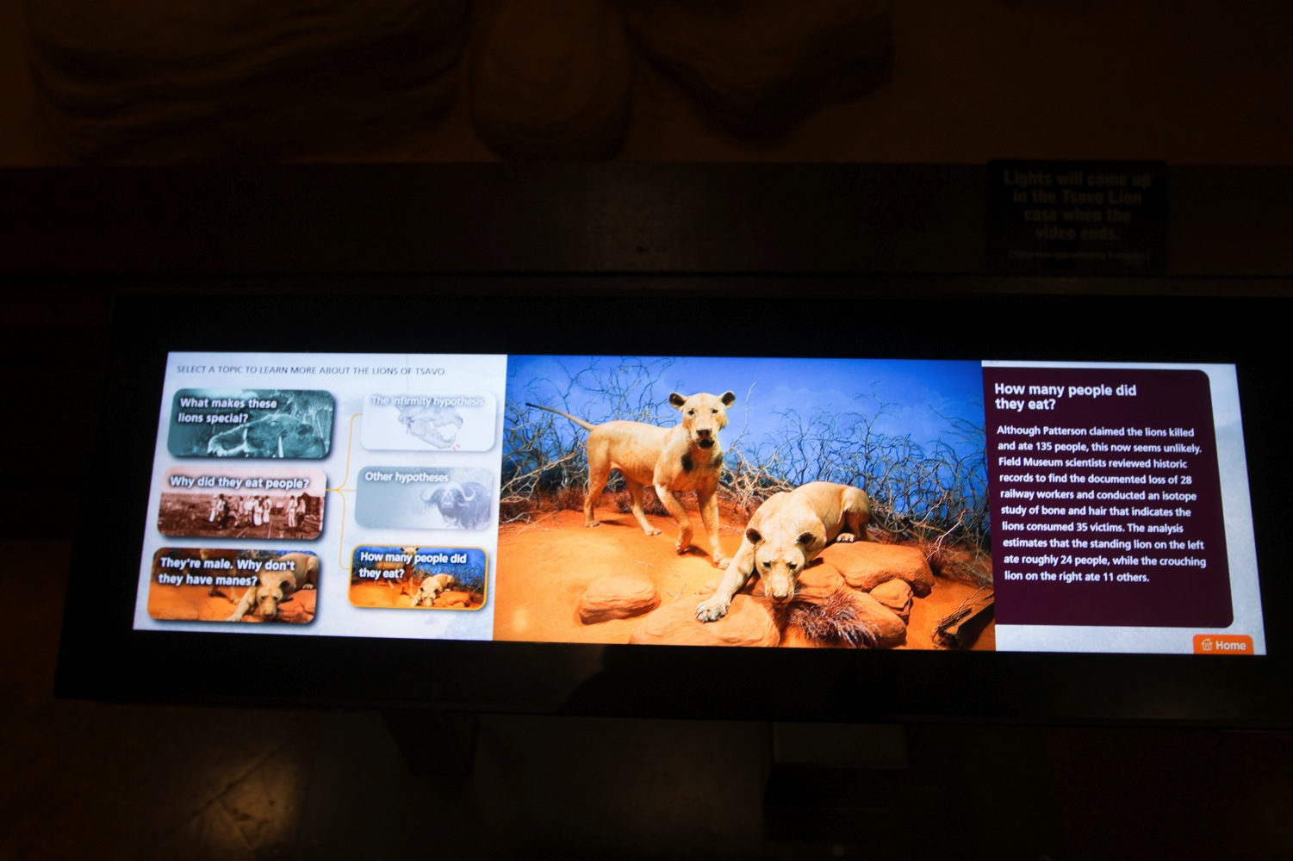
The Tsavo Lions
Digital Rails

Slide 27
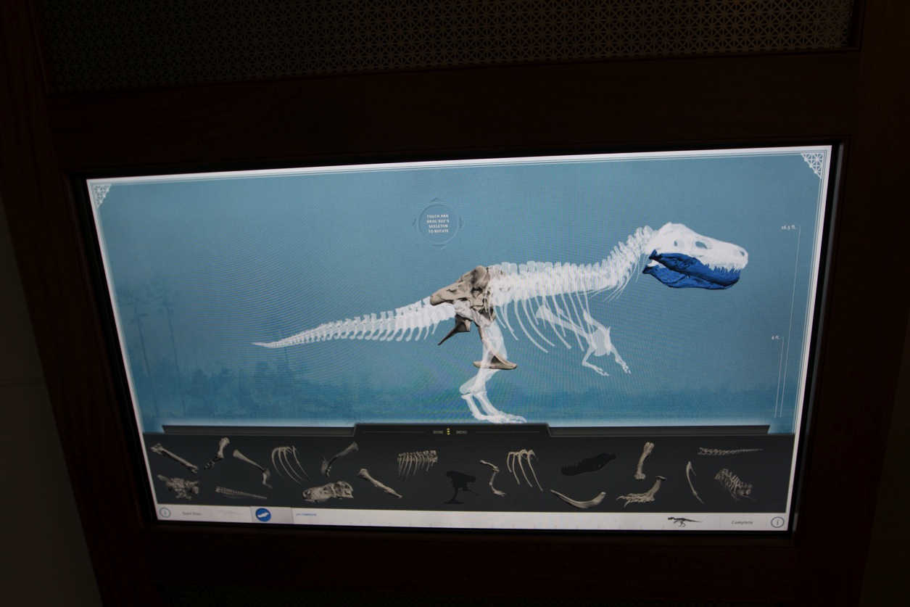
Computer Games

Slide 28
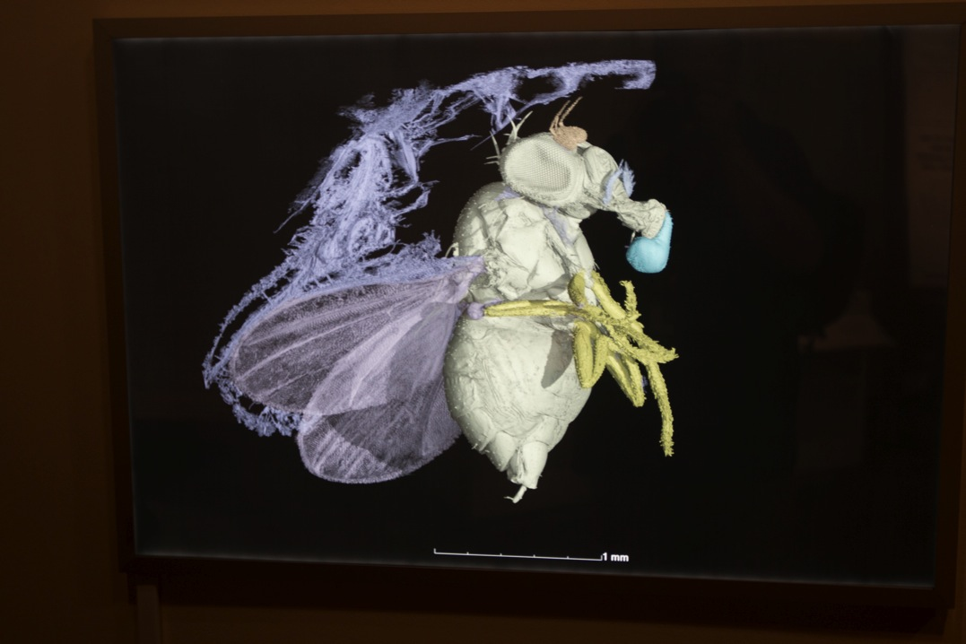
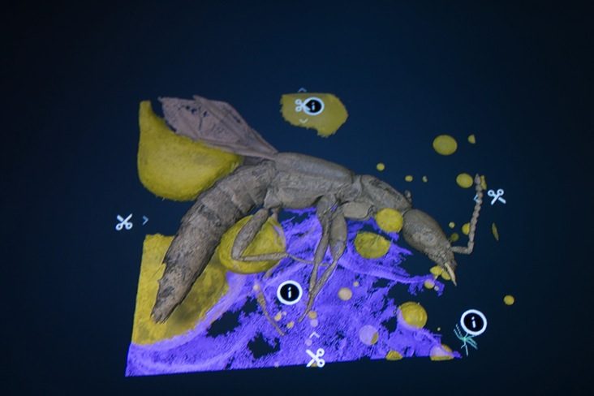
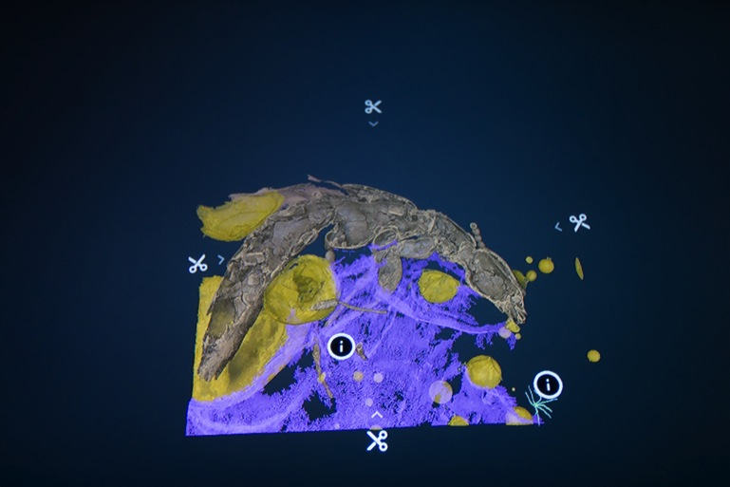
3D Objects
Specimens: Unlocking the Secrets of Life, an in-house special exhibit touting the importance of museum collections

Slide 29
Programs Promoting the Collections

Slide 30
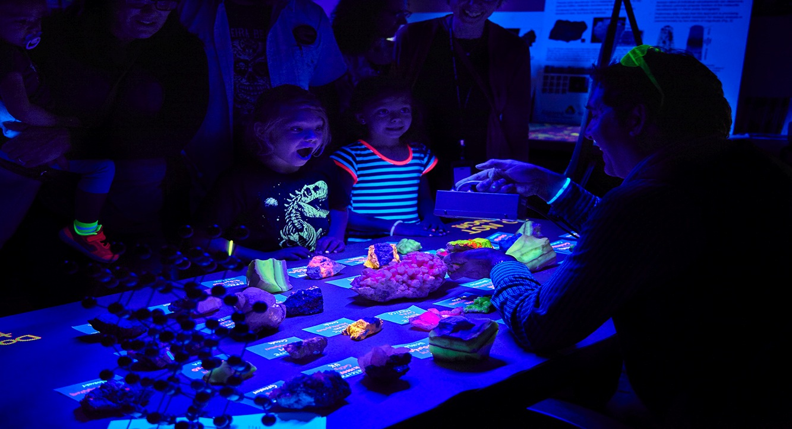
Members’ Nights

Slide 31
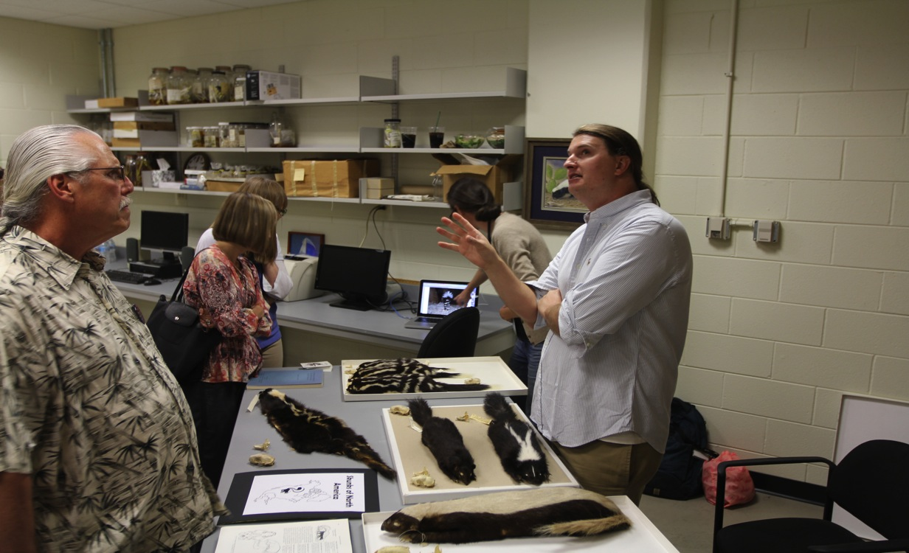
Members’ Nights

Slide 32
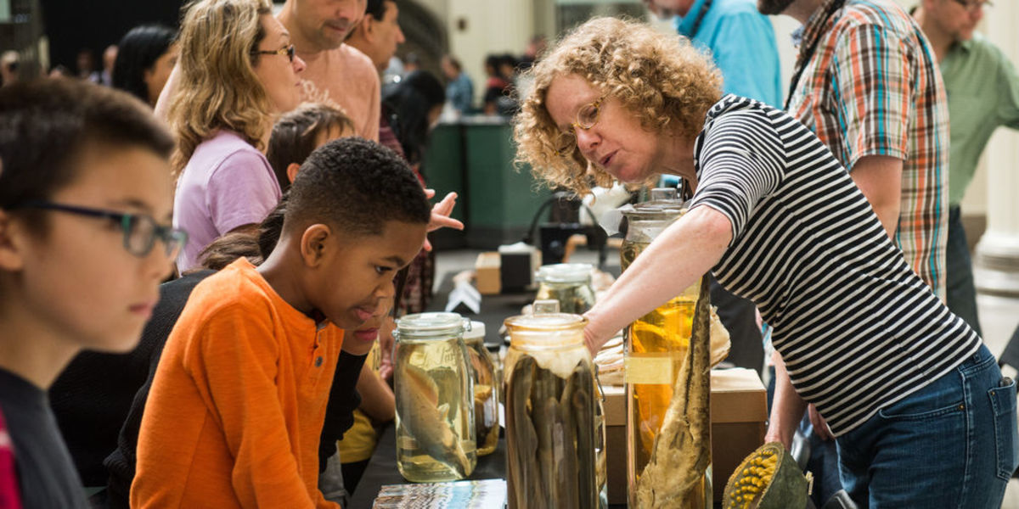
Fossil ID Day

Slide 33

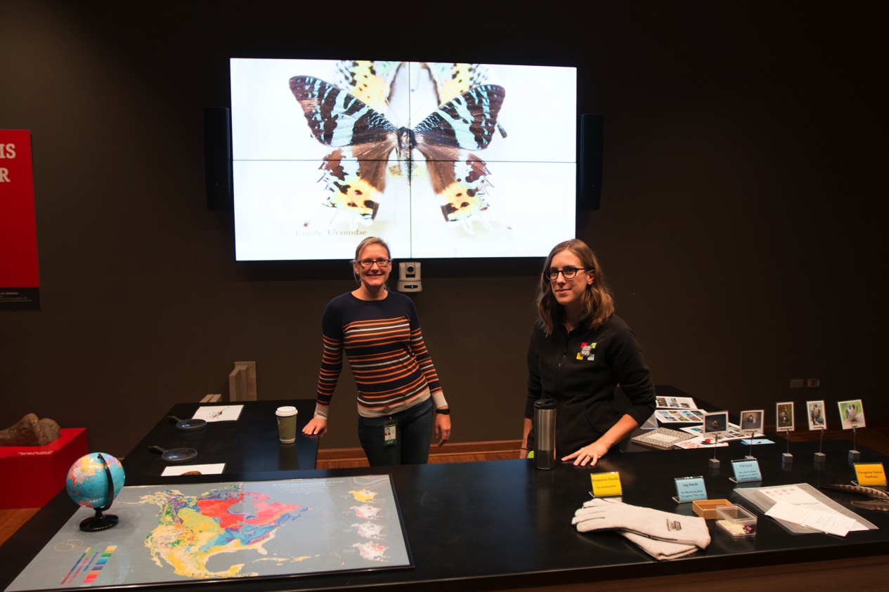
Science Hub

Slide 34
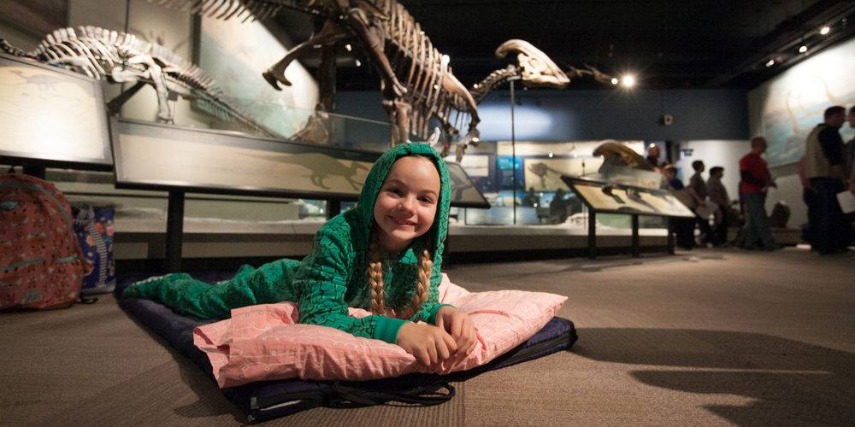
Dozin’ with the Dinos

Slide 35
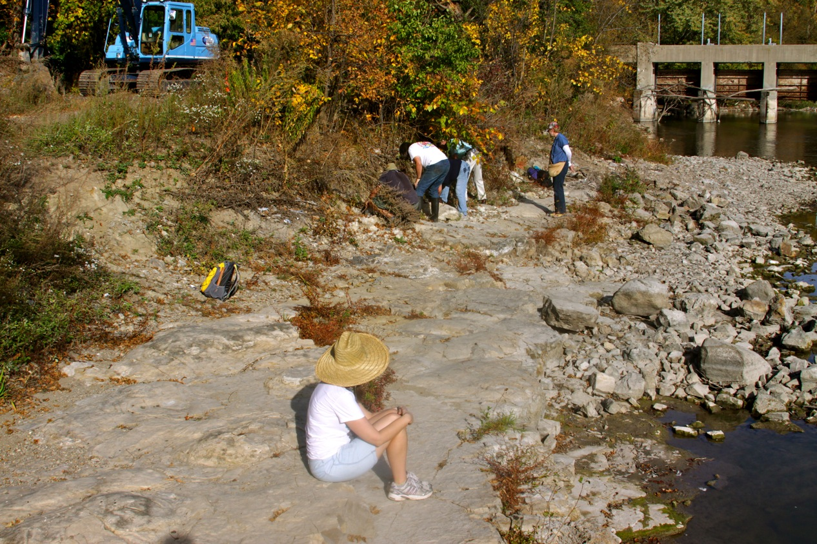
Field Trips

Slide 36
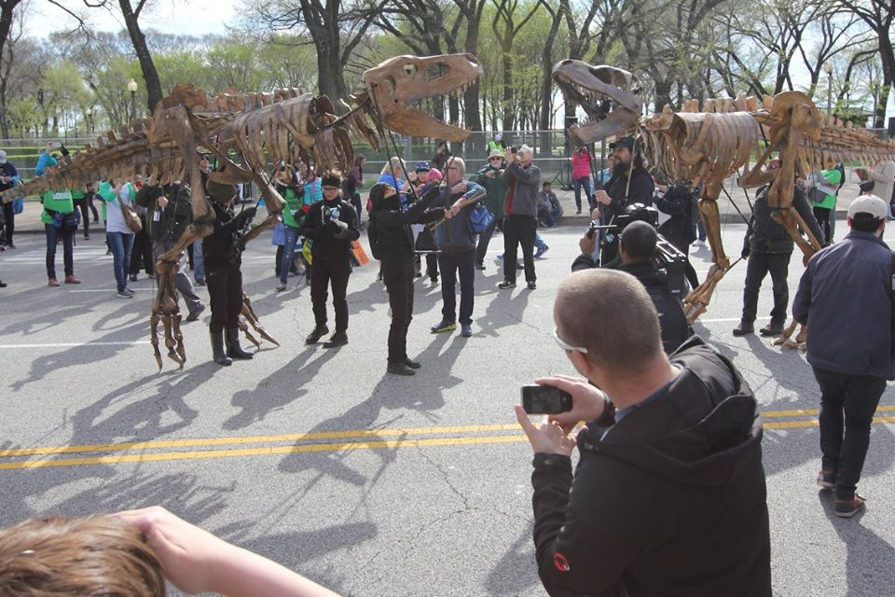
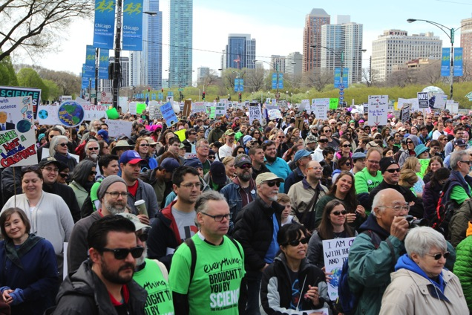
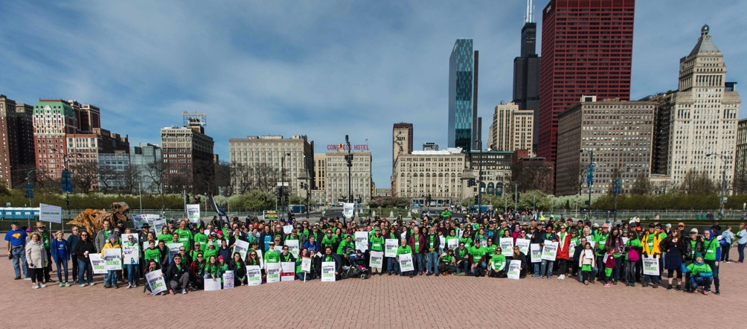
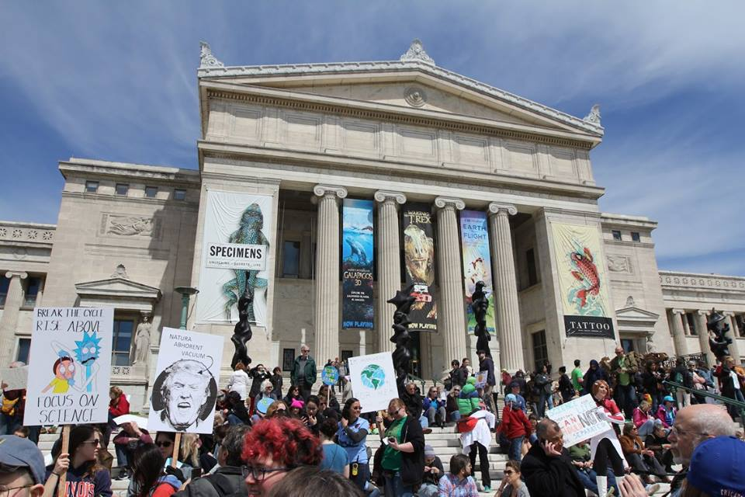
March for Science
April 22, 2017

Slide 37
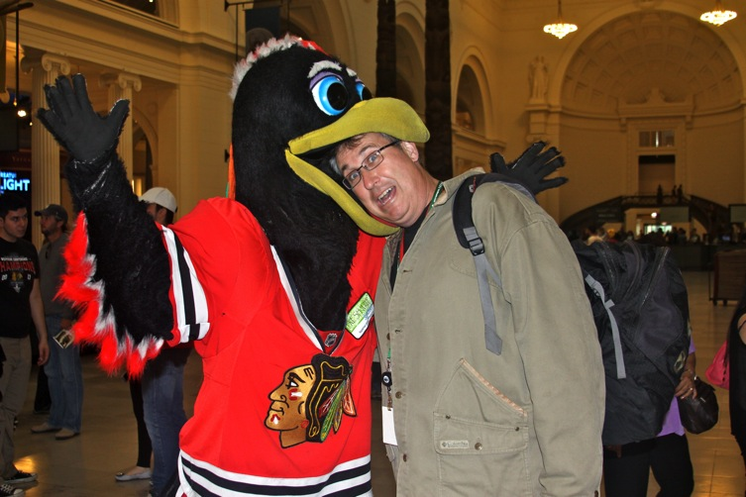
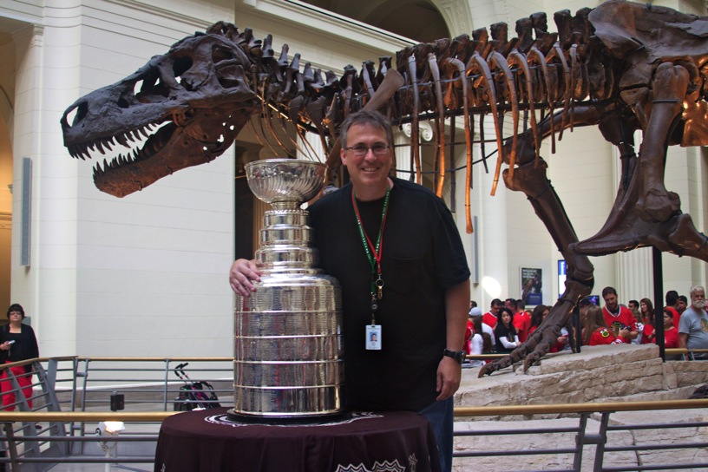
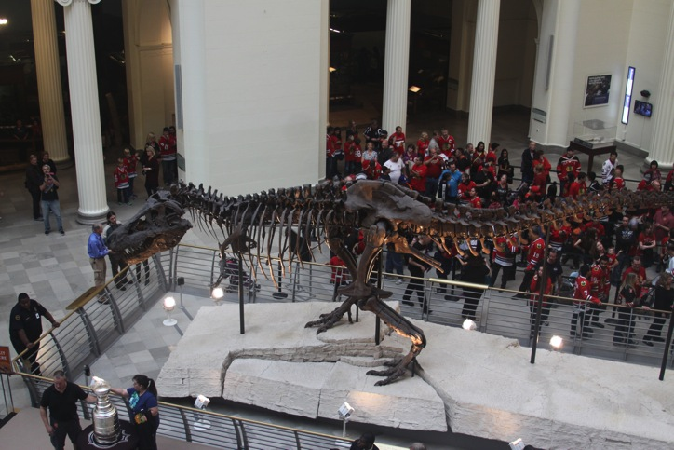
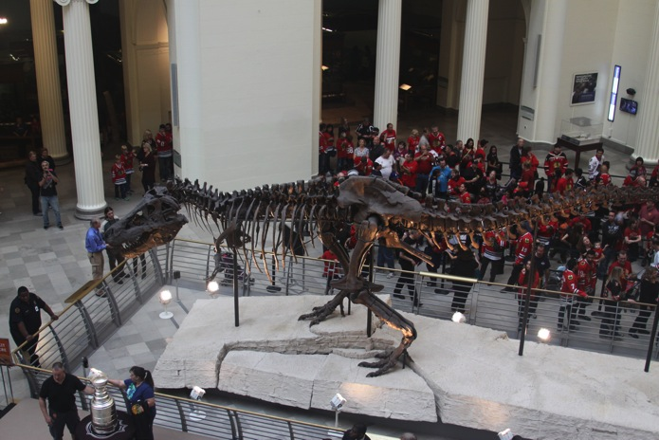
Stanley Cup Tour

Slide 38
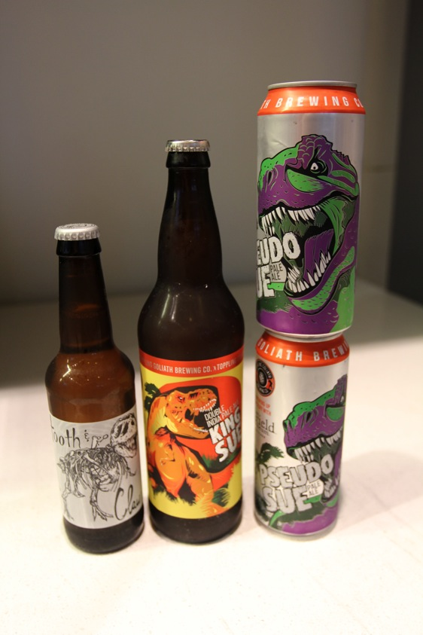

Cinema Science and Dinosaur Beer

Slide 39
Social Media Promoting the Stories of the Collections

Slide 40


Slide 41



Slide 42

Facebook Post
940 likes, 1,004 Shares
In comparison the Jurassic World teaser received 710 likes and 140 shares.
And its video 1,300 likes and 801 shares

Slide 43



Facebook

Slide 44




Field Museum Twitter

Slide 45


Apps

Slide 46
Volunteers and Interns
The Engine of Collections Management

Slide 47


High School interns: research projects, public presentations, and digitization

Slide 48


Undergraduate interns

Slide 49

Science Illustrator interns

Slide 50



Miranda Zimmerman’s Mazon Creek Esconites Polychaeta worm illustration

Slide 51


Volunteers

Slide 52


Talks and displays at rock and fossil shows and clubs

Slide 53

Volunteer Jack Wittry receiving the Strimple Awards

Slide 54


Citizen Scientists

Slide 55
Acknowledgements
Kate Webbink
Jack Wittry
Christopher McGarrity
Caitlin Kearney
Lucille Carver
Scott Lidgard
Carmen Soriano
Tim Nelson
Kurt Zahnle
Irene Broede
Karen Nordquist
Susan Mochel
Adam W. Ferguson
James Holstein
Mary Williams
Alex Layng
Nicole Karpus
Liza Connolly
Dana Kahn
Walker Weyland
Edmund Schweitzer
Jennifer Edginton
Lindsey Snyder
Heidi Rouleau
Megan Bradley
Marcy Krause
Peter Wagner
James Boone
John Weinstein
Patricia Burke
Sharon Grant
Peter Herbst
Ralph Kugler
Peter Sheehan
Rodney Watkins
Emily Graslie
Matthew Northey
Jochen Gerber
Kenneth Angielczyk
Pete Makovicky

