Slide 1






MAJOR STORM RISKS AND CLIMATE CHANGE, EMPOWERING COMMUNITY RESILIENCE
THROUGH APPLIED ASPECTS OF
GEOLOGY AND GEOGRAPHY
2014-2017 InTeGrate project:
Dr. Lisa Doner (presenter), Plymouth State University, NH
Dr. Patricia Stapleton, Worcester Polytechnic Institute, MA and Lorraine Motola, Metropolitan College of NY

Slide 2
Key characteristics of disaster-resilient communities:
Relevant hazards are recognized and understood
Communities at risk know when a hazard event is imminent
Individuals at risk are safe from hazards at home and work
Minimum disruption to life and economy after a hazard event
With rapid changes in the global climate system old paradigms of risk may no longer apply
** FEMA’s FIRM flood maps will become decreasingly accurate **
Community resilience increasingly depends on adapting to an uncertain level of risk especially from weather extremes

Slide 3
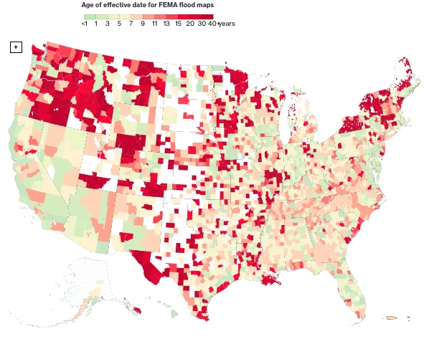
FEMA assesses flood risk for 22,000 communities
2017 Homeland Security report finds maps inaccurate for 9200 communities
Hardest hit by Harvey
Interval since last assessment too long
https://www.documentcloud.org/documents/4066233-OIG-17-110-Sep17.html

Slide 4
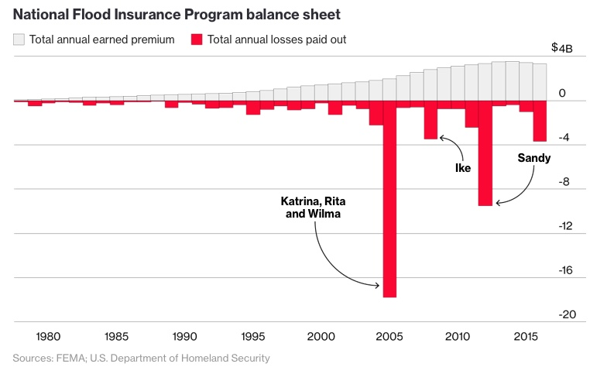
National costs of recovery high and not averaging-out over time
https://www.bloomberg.com/graphics/2017-fema-faulty-flood-maps/

Slide 5
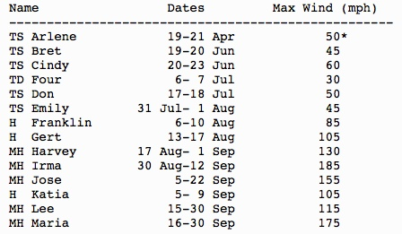
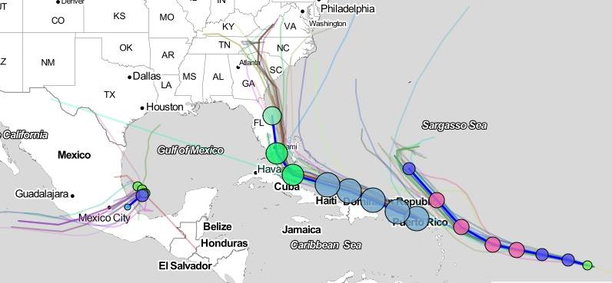
More relevant than ever
5 major land-falling hurricanes in Sept, 2017
Irma
Katia
Jose

Slide 6
Economic Impacts of 2017 September Hurricanes:
Estimated costs to US mainland areas of Harvey & Irma $300 billion,
Puerto Rico (Maria) & US Virgin Islands (Maria & Irma) $1 billion
Compare 2005: $200+ billion (in 2017 dollars)
source: DoDBuzz.com Oct 23, 2017
Longer Post-storm Impacts
    Disrupted business & unemployment
    Transportation and infrastructure damages
    Crop loss
    Increased fuel prices
    Property damage (cars lost: Sandy 250,000; Harvey 500,000)
Assessments still coming in …

Slide 7
2017
https://www.bloomberg.com/graphics/2017-fema-faulty-flood-maps/

Slide 8
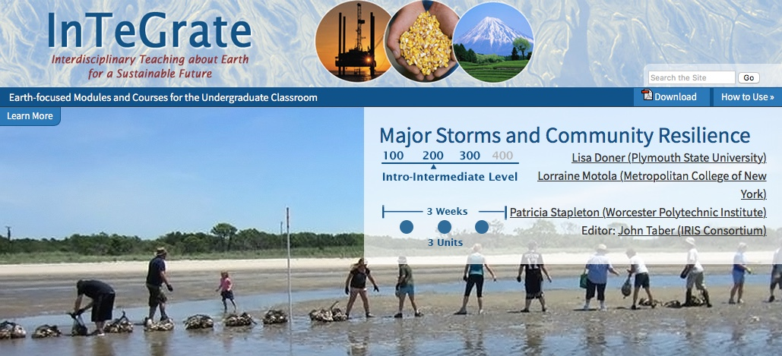
Our Module – Major Storms & Community Resilience
Aim - to create a populace well-informed about potential risks, mitigation and response strategies to major storm events, and to reduce individual and community demand for emergency measures.

Slide 9
Unit 1 - Basic understanding of natural systems, natural hazards and risk - especially geophysical systems
Unit 2 - Communication & response strategies before, during and after a disaster – local knowledge about community risks & capabilities
Unit 3 - Integration of knowledge, risk and awareness of social vulnerability – whole system plans for resilience

Slide 10
Unit 1 – Foundational Knowledge
Activities:
  Systems thinking instruction & concept map
  Probability and Hazards
  Case study of multi-hazard mitigation plan from local region
  Hazard Vulnerability Assessment
  Research on New Orleans hazards vs its Hazard Mitigation Plan
Readings:
  Vocabulary related to storms and storm systems (handout)
  Case study: New Orleans Hazard Mitigation Plan
  Fundamentals of Emergency Management (Lindell et al, 3 chs)
  FEMA Plan Review for Local Mitigation Plans

Slide 11
Unit 2 - Application of Concepts to Case Studies
Activities:
  Sea Level Rise & Coastal Resilience (online maps and map tools)
  Coastal Erosion Rates (rate of sediment supply vs beach erosion)
  Press Release and Peer Review (communication)
  Concept map revision
Readings:
  Case Study - Superstorm Sandy
    Superstorm Sandy: Hurricane Sandy Retrospective Analysis
    The Science Behind Superstorm Sandy's Crippling Storm Surge
    Superstorm Sandy Anniversary
  Case Study - 1993 winter’s Storm of the Century
    The Blizzard of '93: The Overview
    Blizzard of '93: Why Was It the Storm of the Century?
    Superstorm: Eastern and Central U.S., March 1993

Slide 12
Unit 3 - Culmination of Module in Town Hall Meeting
Activities:
  Talking Points Memo – revisions to local Hazard Mitigation Plan
  Press Release Revision (communication skills)
  Debris Removal Activity (benefits of re-using Sandy debris)
  Policy Paper – comprehensive local plan for major storms
  Town Hall Meeting (stakeholder perspectives)
  Peer Evaluations
Readings:
  Local Community Hazard Mitigation Plan
  Stakeholder and Partner Communication in Crisis and Emergency Risk Communication (Manual)
  Geological Society of America's Position Statement: Geoscience and Natural Hazards Policy
  Local HMP (specific to each local community)

Slide 13
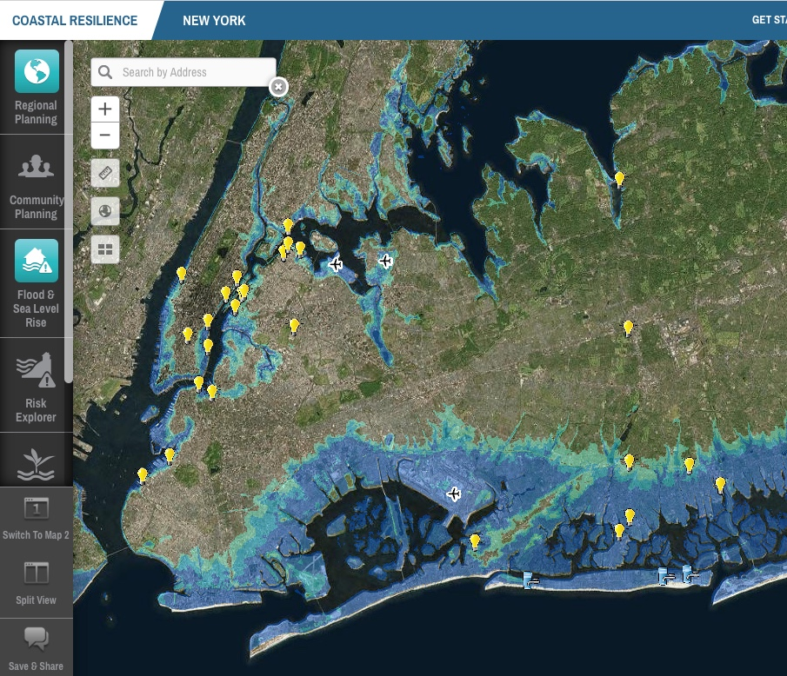
Example activity:
How many electric plants and water treatment stations are flooded (blue shaded areas)? What percentage of the regional total?
17 electric stations (68%), 3 water stations (100%)

Slide 14
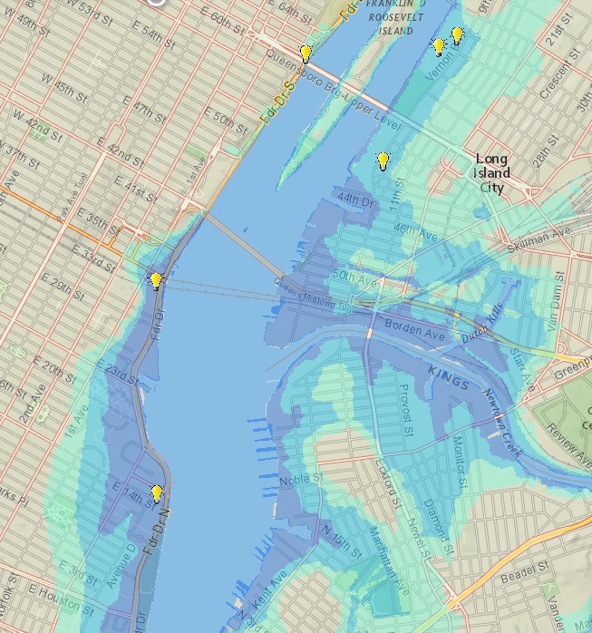
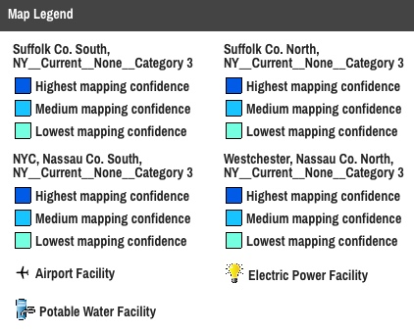
Zoomed in view
and legend

Slide 15
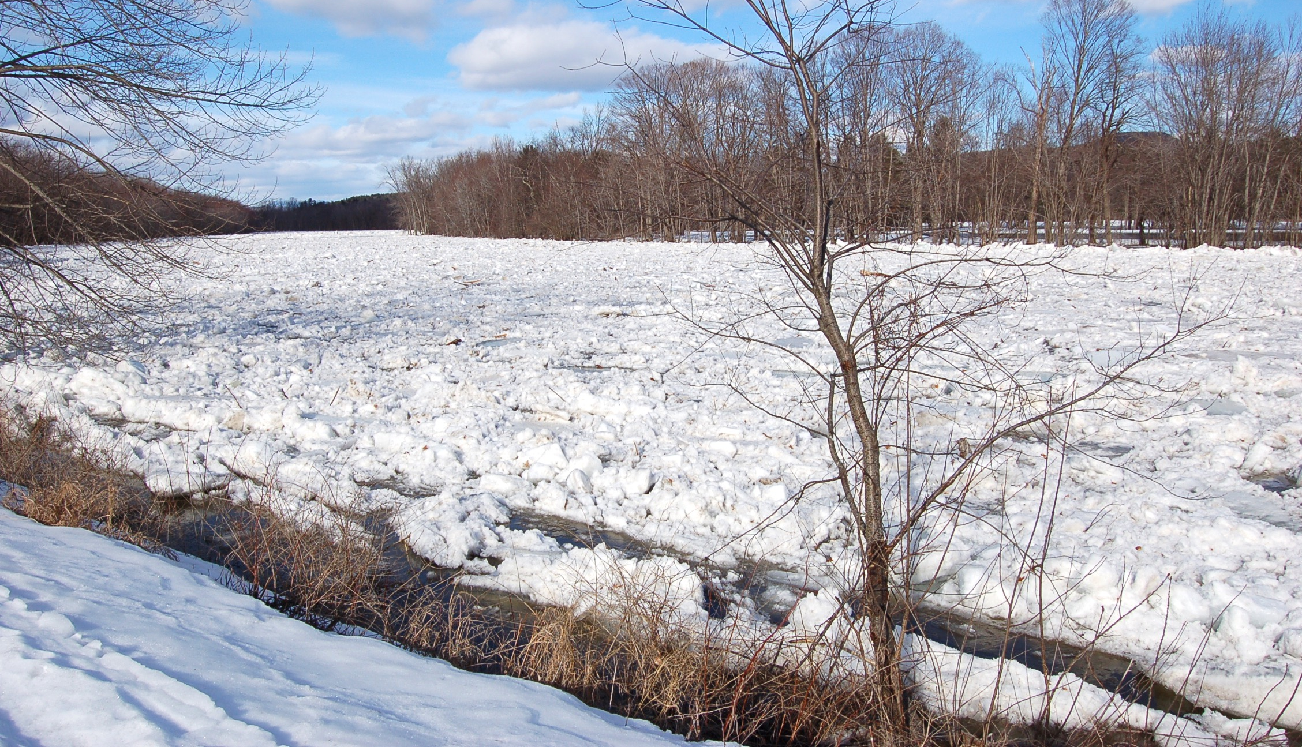
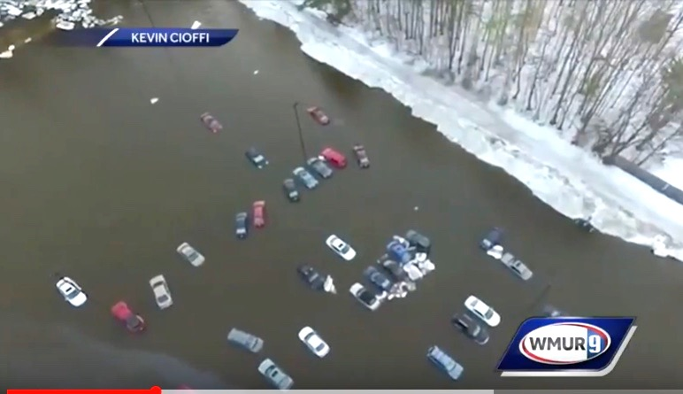
Local example for Unit 3: ice jam flood in Plymouth, NH
50 university student cars flooded in Feb 2017
first year students unfamiliar with local flood risks
event started on a clear Sunday morning at 7 am (students sleeping when need to move cars developed)
cars moved to this lot two days earlier because of mud issues in normal lot (typical spring thaw problem)
gaps in experience of emergency personnel – job transitions & K-12 spring break holiday slowed responses

Slide 16
Module evaluation:
Overall: Full module very intensive for 3 weeks – can be stretched out over a semester and mixed with other content.
Unit activities and readings can be used independently to supplement topics related to risk. Students who are unused to “active learning” perceived the work load as too high.
Instructor tips: Consider inviting guest “experts” to present disciplinary topics outside your area of expertise. I would invite our campus emergency manager to talk about risk. Social scientists might invite a geographer/geologist to teach the maps.
Non-science students show improved perception of complex interactions between social decisions and natural hazards.
Science students gain complexity in systems thinking, practice in use of data to make evidence-based decisions and in perception of applied science to broaden career choices.

Slide 17
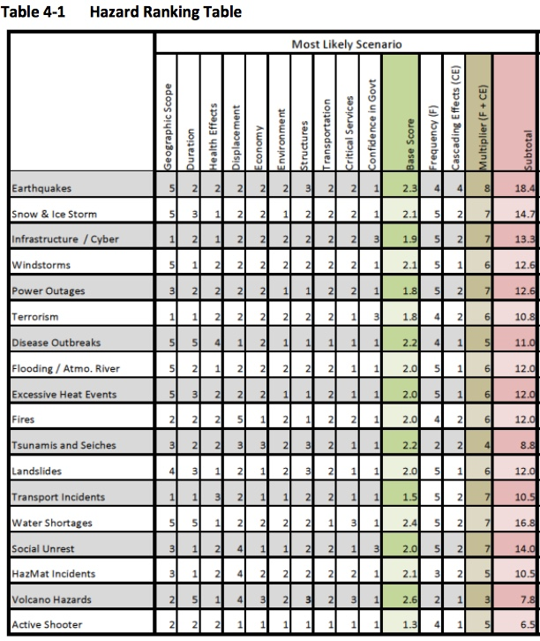
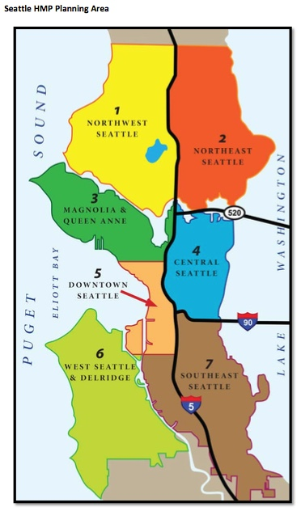
Stay calm and teach resilience!

