Slide 1
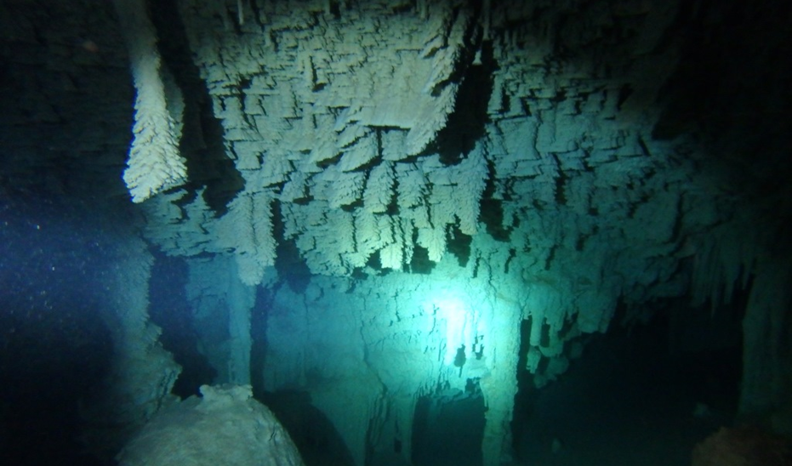


Re-evaluating Pleistocene Sea Level History and Speleogenesis in the Yucatan Peninsula:
U-Th dating of POS from Quintana Roo, Mexico
Aubri A. Jenson¹, Benjamin F. Schwartz^{1,2}, Yunxia Li^{3,4}, Yongli Gao³
¹Dept. of Biology, Texas State University, San Marcos, TX
²Edwards Aquifer Research and Data Center, San Marcos, TX
³Center for Water Research, Department of Geological Sciences,
University of Texas at San Antonio, San Antonio, TX
⁴Key Laboratory of Western China's Environmental Systems (Ministry of Education), College of Earth and Environmental Sciences, Lanzhou University, Lanzhou, China
Notes:
-Work is part of a dissertation in which I’m testing hypotheses concerning controls on speleogenesis in carbonate platforms.
-One of my methods is U-Th dating of Phreatic overgrowths of speleothems, and preliminary results show inconsistencies with assumptions of tectonic stability.
-seeks to resolve inconsistencies observed between speleothem dates and SL records
-suggests slow tectonic uplift may be occurring, challenging long-held assumptions of regional tectonic stability.
-has implications for interpretation of SL records as well as modes of speleogenesis acting at different locations relative to a migrating FW lens

Slide 2
Overview
Background
  Site location and history
  Caves in Quintana Roo
Speleogenesis
  Sea level and cave elevations
  Mixing vs Vadose origins
POS Evidence
  Water table elevations
  Surface lowering
Significance and Future work
Notes:
-Examine assumptions based on known geologic history and sea level records
-Discuss processes that control the elevation of cave development and where they form in the FW lens
-Evaluate results from POS samples that indicate caves are older than previously thought
-Consider implications for tectonic history and SL records, questions about speleogenesis

Slide 3
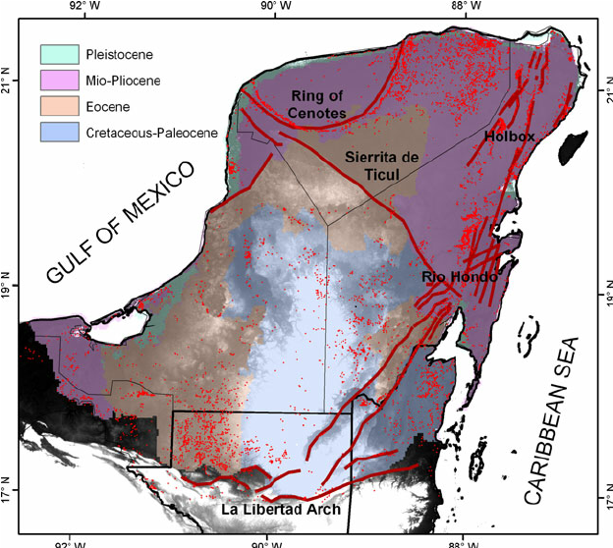
Bauer-Gottwein, 2011
Notes:
Study area is a 70m x 10km stretch of coastline in the north-eastern Yucatan Peninsula
Th YP is a Quaternary platform with 1km thick carbonate reef sequence of Miocene age, with Pleistocene deposits within 1km of the shoreline
Notable structural features include the Ring of Cenotes associated with the Chixilub impact crater 65ma, the Holbox fracture zone, a series of normal faults parallel to the island of Cozumel; and the Ticul fault to the south that creates a sub-unit within the Maya block.

Slide 4
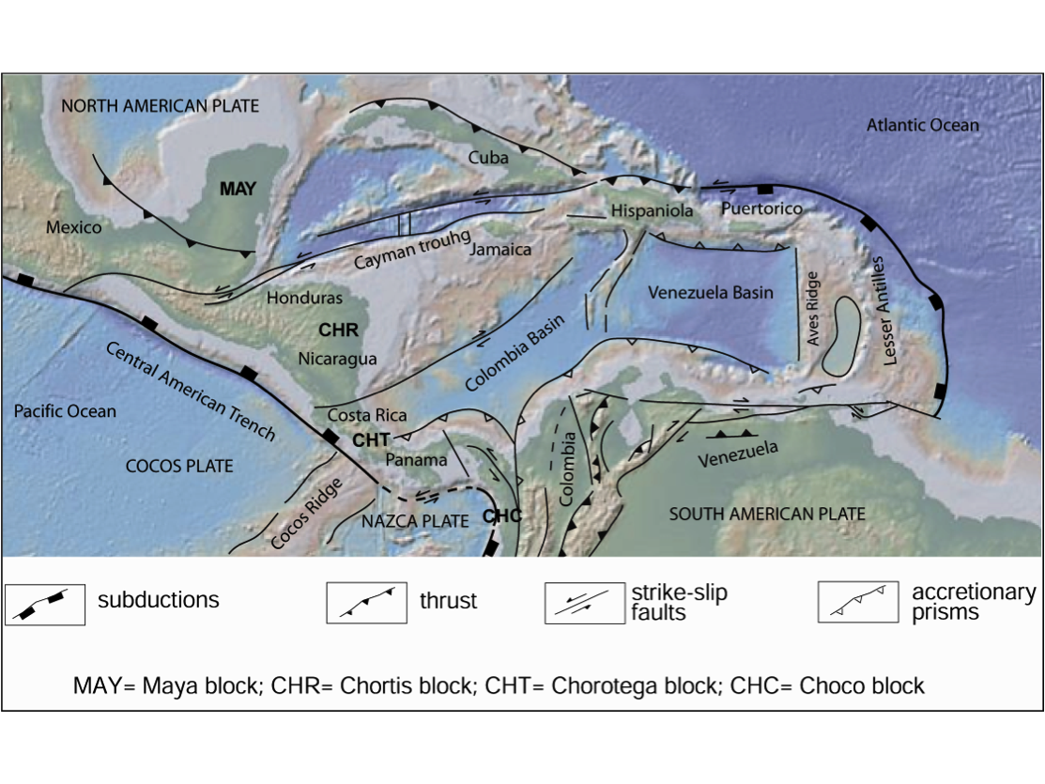
Giunta and Orioli, 2011
Notes:
- The Maya Block comprises the entire Yucatan peninsula and surrounding platform reef (Campeche bank)
Much of the tectonic history of the Caribbean region has been worked out from off-shore oil & gas exploration; work on Maya block has been focused on the southern boundary with the Chortis block, and very little has been on the northern portion (partly due to lack of outcrops)
The MB is thought to have been in place since the late Jurassic, and to have remained relatively stable into the Quaternary.
Stability since the late Pleistocene has been established by U-Th dates of corals.

Slide 5
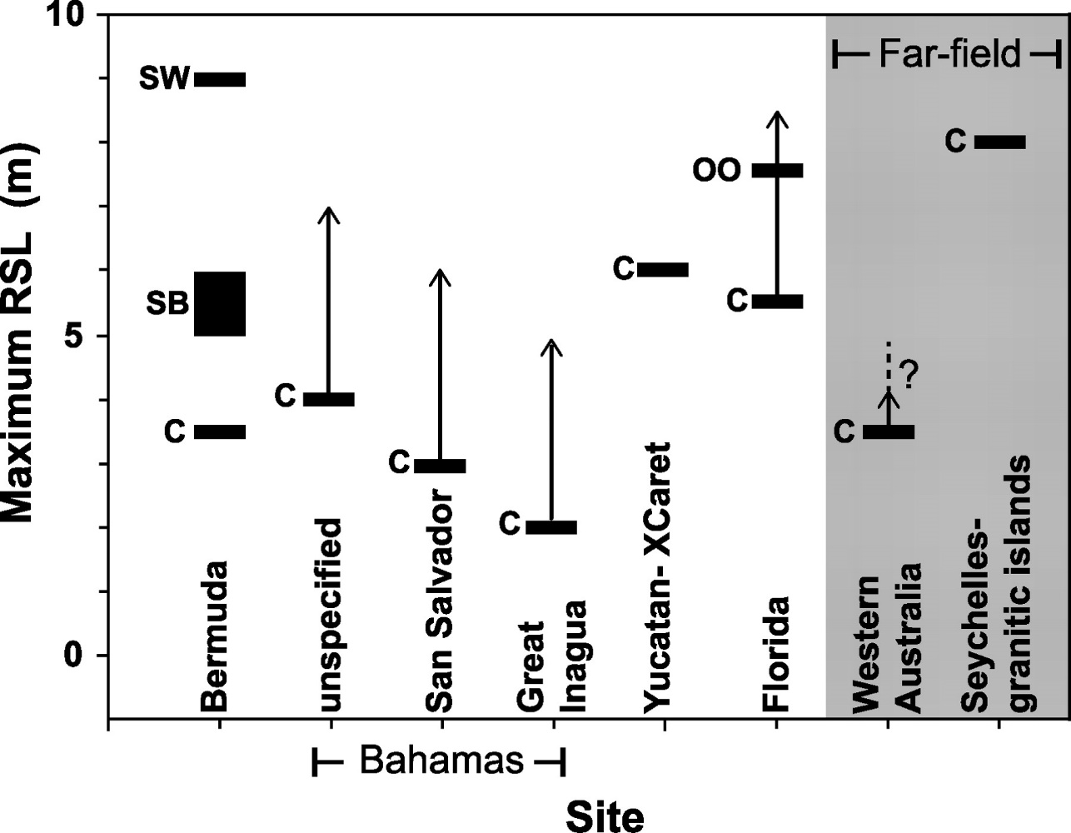
Pleistocene Coral
Dutton and Lambeck, 2012
Minimum values with range of depth for coral growth
Denudation not considered
Notes:
Coral collected from the north-eastern shoreline of the Yucatan peninsula suggests that highest sea levels experienced during the last SL highstand (125kya) were 6-8m above modern sea level. Arrows show estimated coral depth, based on modern conditions.
Uplift of other sites is measured against the elev of sites assumed to be stable, namely Florid and the Bahamas
Coral is a minimum indicator of SL. Depending on species, depth of up to 40m are possible (accuracy of 2m reported).
Denudation is not considered, which would remove older rock in the peninsula interior.
Benjamin: For the last comment line – be careful, because this assumes that there has been enough time for denudation to remove that much rock; something that is probably not the case for the very young deposits along the very edge of the coastline.

Slide 6
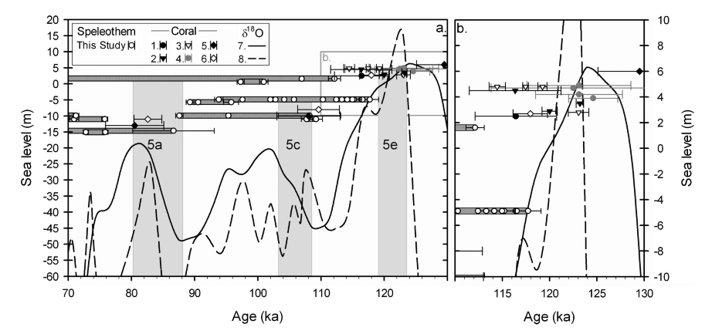
Pleistocene Speleothems
Moseley et al, 2013
Timing of SL change constrained by speleothems
Consistent with coral records
Notes:
- Speleothems provide a more precise measurement, since they constrain timing by “shutting off” when sea-level drops
- Samples collected from submerged caves up to ~20m below sea level
- Results agree with coral in that they are submerged during highstands and show growth during low stands

Slide 7
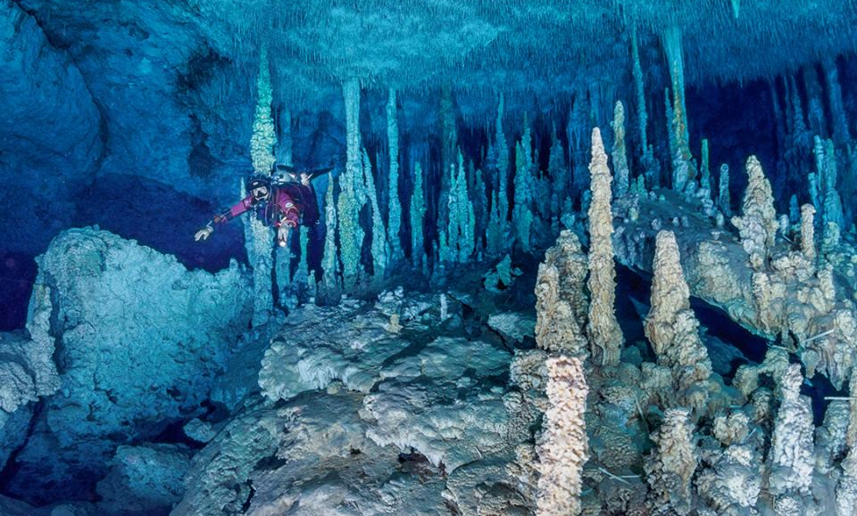
Surveyed underwater passage: 1,396 km (868mi)
Quintana Roo Speleological Survey, August 2017
Photo: Tom St. George
Notes:
Most speleothem dating studies have focused on stalagmites collected from submerged caves, and record growth from the Pleistocene when sea level was much lower than today and these caves were subaerially exposed.
Extensive exploration since the 1970s, but limited accessibility and bias toward shallow caves (within and above the modern mixing zone)

Slide 8
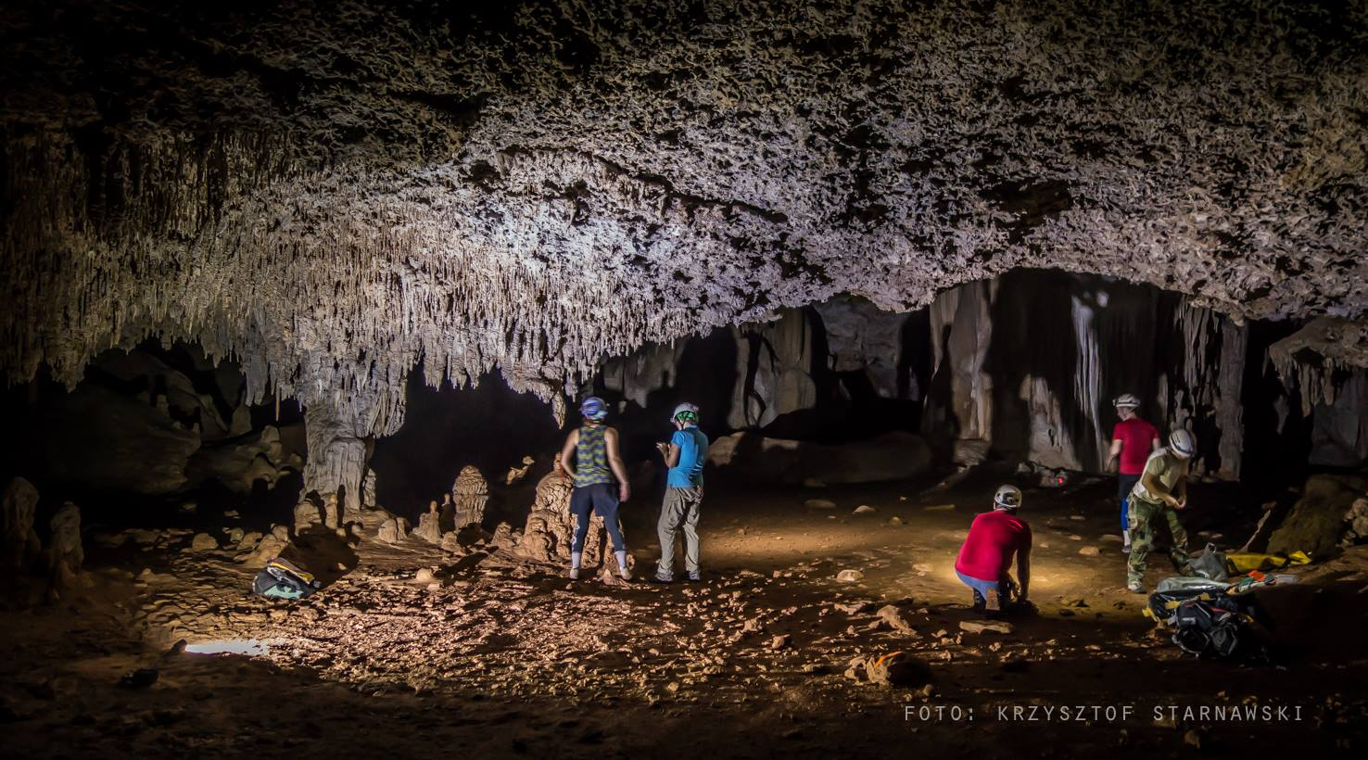
Surveyed dry passage: 292 km (181mi)
Quintana Roo Speleological Survey, August 2017
Notes:
Since 2010, extensive dry caves have been explored within 10km of the coastline.
These caves are potentially much older and may allow us to constrain the timing of sea-level change by dating formations that have been overprinted by phases of cave development during periods of subaerial exposure.
Notably, these caves are at or above modern sea level, some as high as 10-12m, which is higher than any past sea level

Slide 9
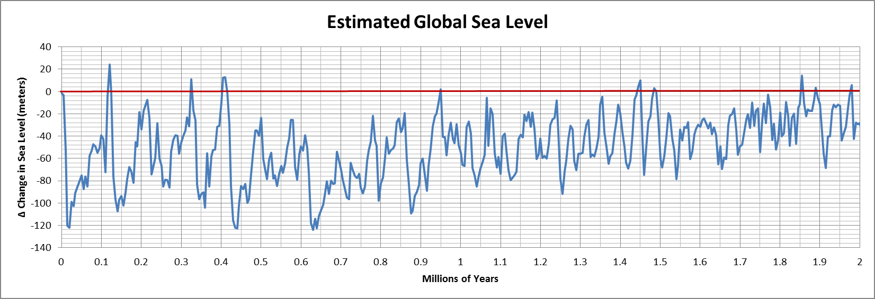
Data from Miller, 2005
Years Before Present
Mean Sea Level
Notes:
In the past 2 million years, sea level has mostly been much lower than today. Pleistocene high stand represents only a very small fraction of time, with some other brief high stands occurring earlier (and earlier than 2my)
If caves formed in the mixing zone, and the platform is stable, then the most extensive caves ought to be found deep at ~40m.
If uplift is occurring, then surface denudation must be occurring simultaneously to result in low elevation observed today

Slide 10
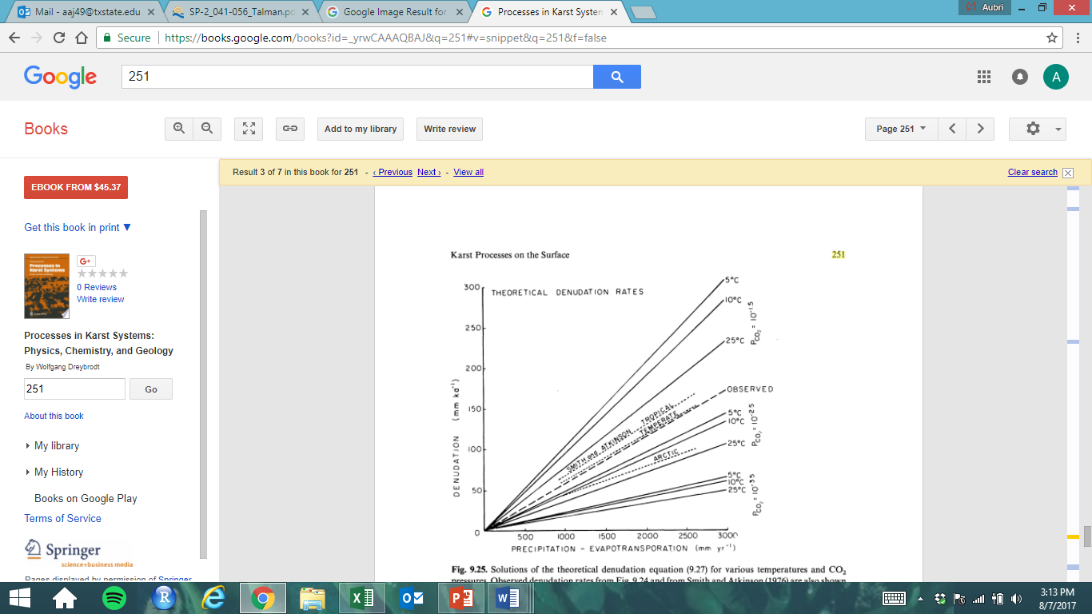
Surface Lowering Rates
White, 1984
Faster at low temperature
Increases with rainfall
Accelerated by pCO₂
Humid tropics ~200 mm/ky
Location | SL Rate (mm/ky) | Method | Source
Kikai jima, Japan | 205 | Pedestal | Matsukura, 2007
Aldabra atoll, Indian Ocean | 260 | Pedestal | Trudgill, 1976
Bikini atoll, Marshall Islands | 300 | Micro Erosion Meter | Revelle and Emery, 1957
Victoria, Australia | 300 | Micro Erosion Meter | Gill and Lang, 1983
Grand Cayman Island, Bahamas | 177 | Micro Erosion Meter | Spencer, 1985
 | 200 | Laboratory testing | White, 1984
 | 175 | Model estimates | Sheen, 2012
Notes:
-Surface denudation rates around the world have been measured directly using tablets, micro-erosion meters, and by estimating erosion of pedestal rocks.
-Sheen 2012 summarizes data from around the word and also modeled denudated rates based on temperature and available runoff
(Precipitation - Evapotranspiration).
-Dissolution rates are strongly CO2 dependent, and to a lesser extent, temperature dependent
- The northeast YP receives ~1500 mm/yr and denudation is likely 150-200 mm/kyr
Benjamin: For the location of modelling estimates, I would remove GA and PA. Otherwise people who don’t look closely might assume that there was a tropical denudation rate measured ni those places. Also, location is irrelevant for models.
I’ll see if I can track down that Mylorie paper, if you were not able to find it.

Slide 11
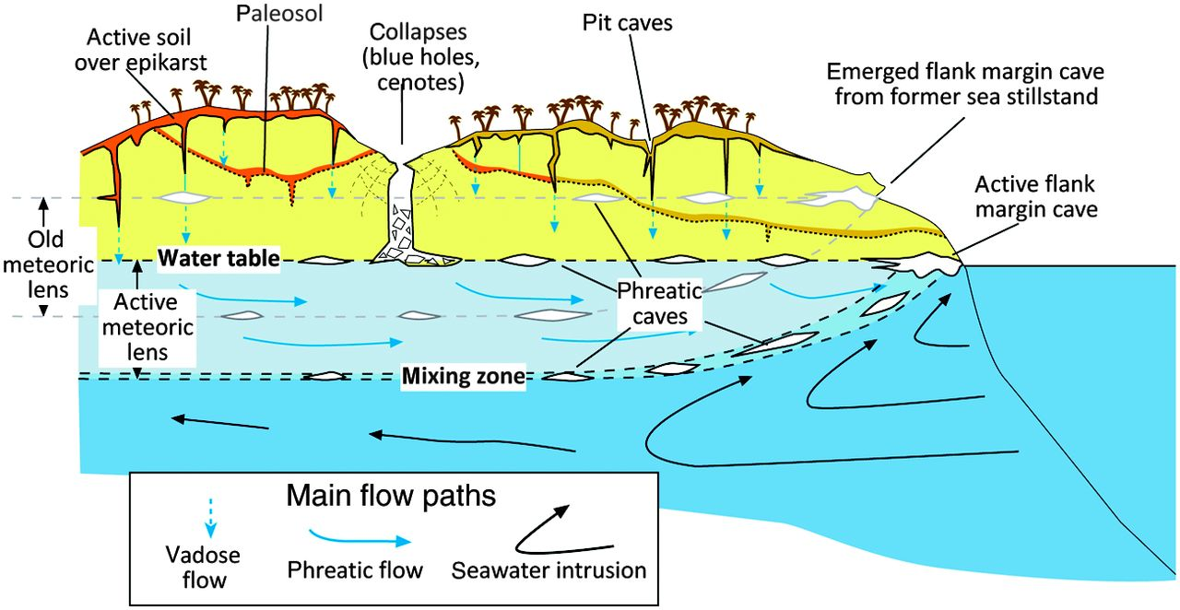
Hypotheses of Speleogenesis
GeoscienceWorld.org
Vadose origin
Follow water table gradient
Submerged by SL rise
Oldest caves eroded away by surface denudation
Mixing zone origin
Follow halocline
Formed very rapidly during high stands
Higher sea level max
Notes:
- Most caves in the vadose zone exhibit similar morphology to phreatic caves formed though mixing dissolution
- Generally assumed that caves formed at higher sea levels and were stranded when sea level dropped; collapse explained by loss of support by water table
- If caves formed in the mixing zone, they either formed very rapidly during higher sea levels, or they formed lower and have been lifted to their modern position
If caves formed where they are today, they must have formed incredibly rapidly or be very old.
We can date formations and compare results to sea level curves to constrain the timing of cave development and estimate their position relative to the water table
Benjamin – Is there no author for this figure? A website is awfully generic, and this figure has some very specific information. Try to track down the author or illustrator rather than just an online source.
Also, if caves can form so rapidly, why aren’t there MONSTER caves at lower elevations where FW/SW mixing zone elevation has been for much longer?

Slide 12
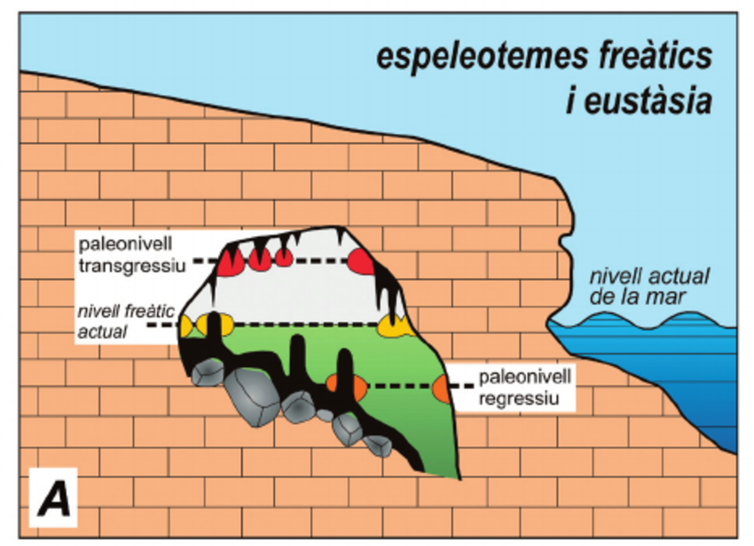
In
Phreatic Overgrowths on Speleothems and Sea Level
Highest
range
Out
Lowest range
Prior
High stand
Modern
Sea Level
Water
elevation
Prior
Low stand
Tuccimei et al., 2006
Notes:
POS provide very precise sea level proxies because they form at the water table where groundwater outgasses CO2 and precipitates calcite on existing formations. They grow relatively quickly, accumulating where water oscillates due to tidal and seasonal variations
U-Th dating can be used to date both the interior and exterior layers, constraining the time of deposition and providing a minimum age of the cave itself (not considering time to lithify and then dissolve passage volume).

Slide 13

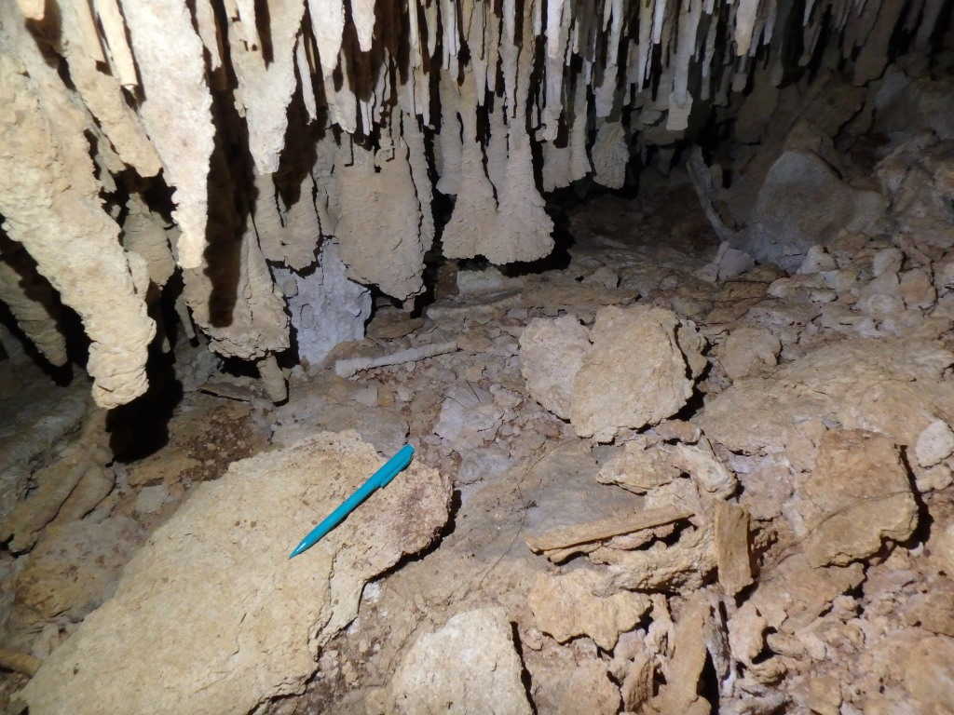
POS in Quintana Roo, MX
Lower water levels
Higher water levels
- Water table essentially equal to sea level (gradient 5-50cm/km)
- Precision to 10s of cm with tidal and seasonal fluctuation
- U-Th dating up to 600ka, +/- 10%
Notes:
Because the low GW gradient in the YP, the water table is essentially equivalent to sea level (5-50 cm/km).
POS below the modern water table represent prior low stands, and those above represent past high-stands
Datable by U-Th methods up to 600ka (both interior and exterior)
The POS in these photos are in Jaguar cave, one that has only been explored and mapped since 2013.

Slide 14
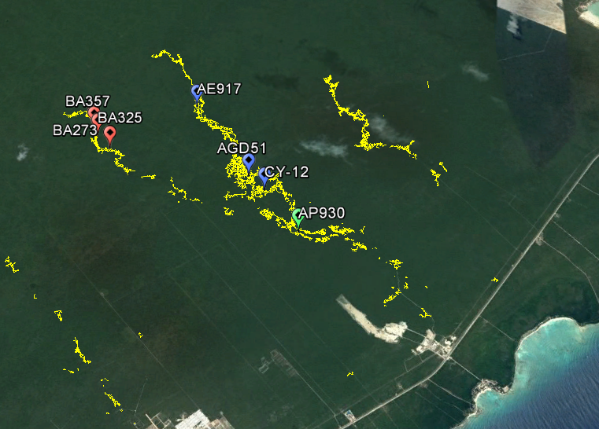
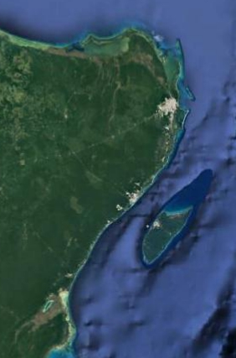
1 km
Notes:
- Near Paamul (see inset), dry caves extend inland up to 7km perpendicular to the shoreline, providing access to a cross section of the water table
- POS samples were collected from Jaguar and Solstice caves in 2016 for U-Th dating
- Samples were collected this August in a parallel cave, El Horno, and lab analysis is in progress. All samples are from above the modern water table.

Slide 15
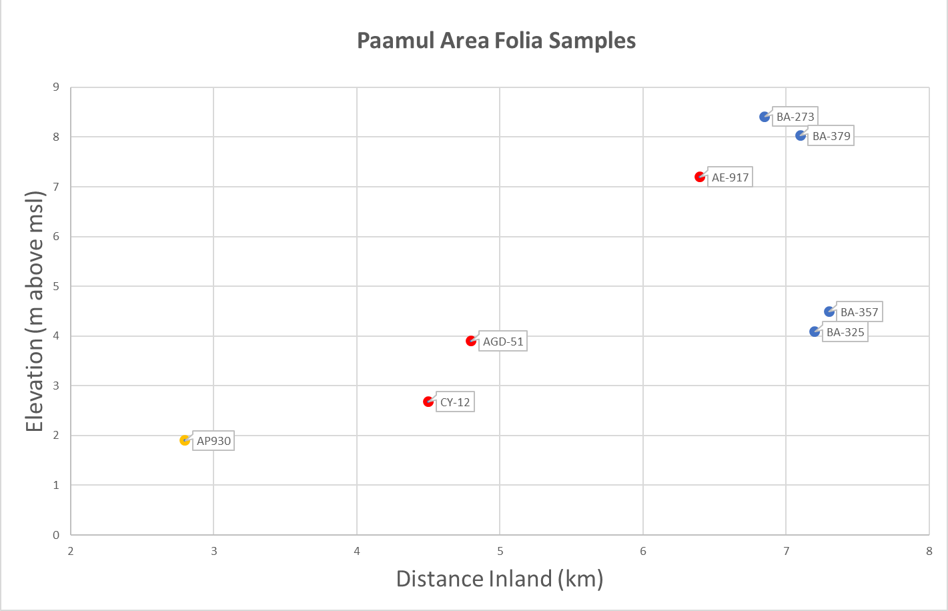
Sample Ages and Elevations above MSL
 | Sample | Age (ybp) | +/- yrs
CY-12 | out | 251,301 | 3,566
 | in | 337,960 | 6,486
CY-12b | out | 226,393 | 2,207
 | in | 317,789 | 5,682
AGD-51a | out | 236,361 | 1,898
 | in | 342,447 | 5,919
AGD-51b | out | 404,113 | 15,320
 | in | 646,106 | 124,936
AE-917 | out | 48,950 | 2,005
 | in | 252,147 | 2,279
AP-930a | out | 103.268 | 724
 | in | 110,275 | 740
AP-930b | out | 171,767 | 1,144
 | in | 212,449 | 2,153
Approx. water table
Notes:
Most samples were collected about 1m above the modern water table.
The youngest sample at 49ka is unusually high, and may represent a short-duration rapid high stand (compare Mallorca, 80ka)
The oldest sample was ~640ka, with surface denudation rates of 150mm/ky, these caves would have formed with 96m more overburden without uplift
Results agree with slow uplift at about the same pace as denudation

Slide 16
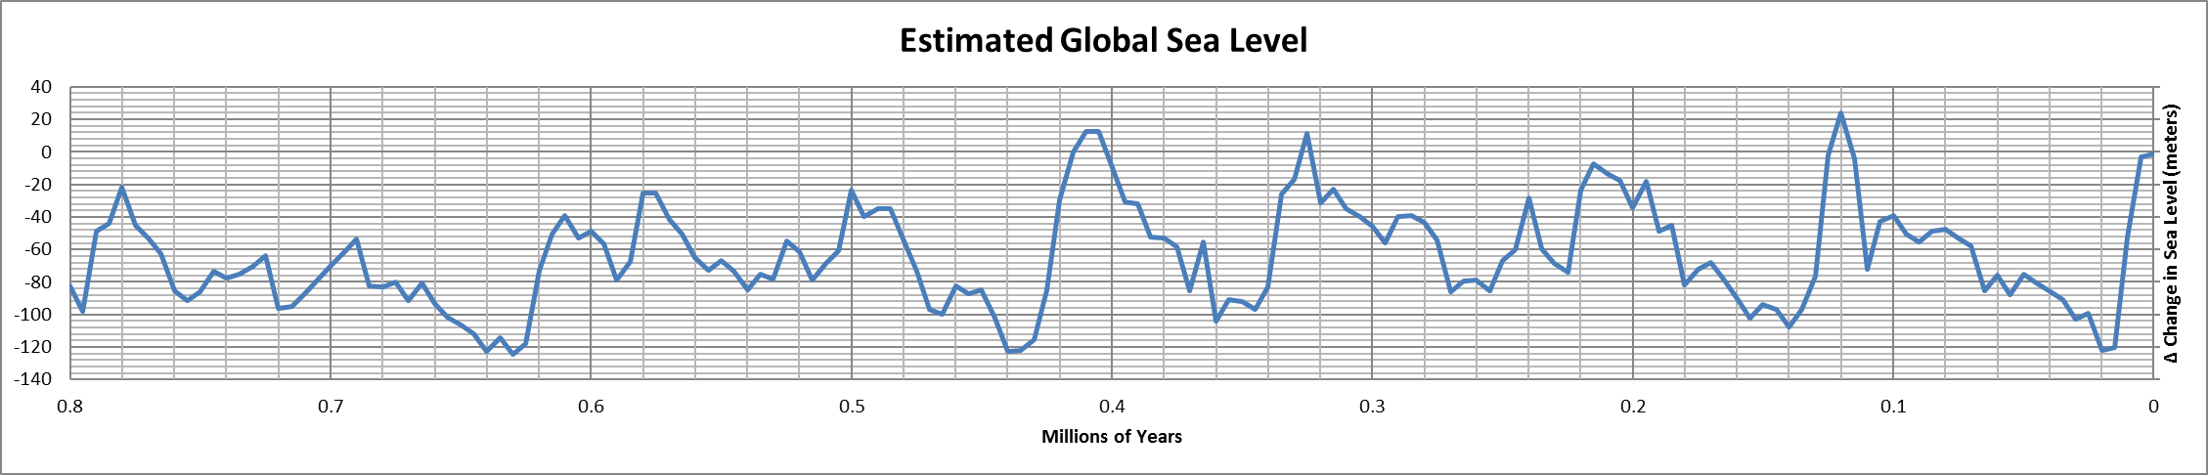
Significance
Miller, 2005
Richards, 2007
Tectonic history
Possible slow uplift ~150-180 mm/ky
Sea Level Records
Interpret data with uplift
Speleogenesis
Evaluate modes and rates
Notes:
The differences in age and elevation of POS suggest that the Yucatan peninsula is uplifting slowly, at a rate close to estimated surface lowering rates, which is necessary to maintain land above sea level. Differences in denudation rates due to rainfall distribution should be examined across the peninsula.
Sea level records are generally reliable, but POS provide a means to constrain the timing of high and low stands. Coral-based records may require some revision.
Caves are much older than previously thought, and could not have formed during brief high stands. Instead, these caves formed at lower elevations, likely in the mixing zone, and were lifted to their present position. Additional work will be required to establish the relative importance of different formation mechanisms.

Slide 17
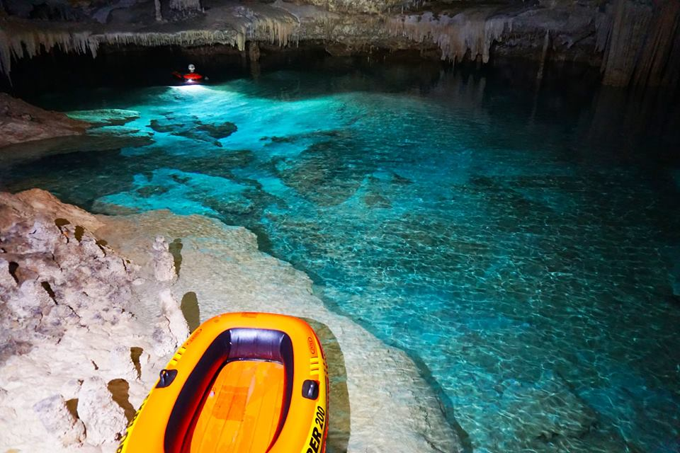

Acknowledgements
National Speleological Society
NASA Astrobiology Institute
UT Grotto and Paamul Grotto
Trish Beddows, Ed Mallon, Christine Lowe, Barbara Luke, Nick Banks, Peter Sprouse, and many other cavers…
Photo: Benjamin Schwartz

Slide 18
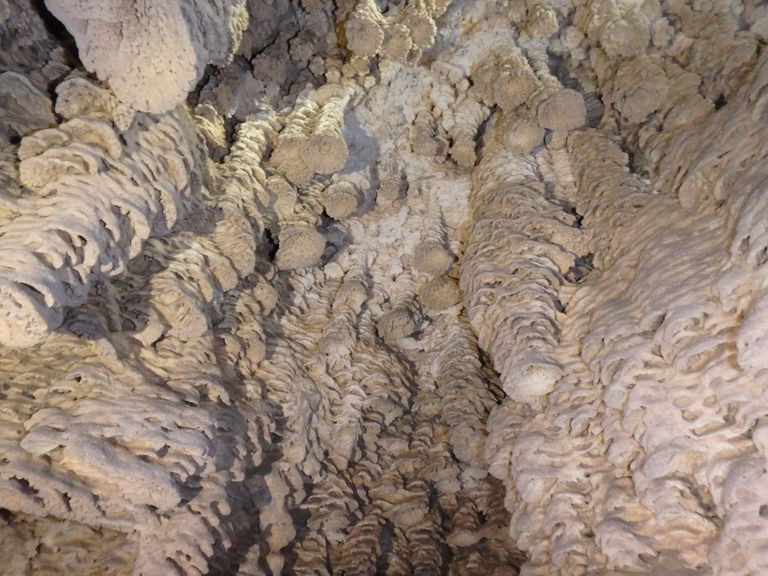
Questions?

Slide 19
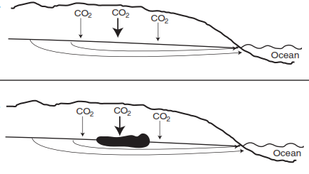
Vadose Mixing
CO₂ concentration increases with depth
  - Organic soil percolates down through fractures and oxidizes, increases dissolution potential
  Accelerated by tropical climate
  Results in mixing chambers at the surface of the water table
Gulley et al, 2015

Slide 20
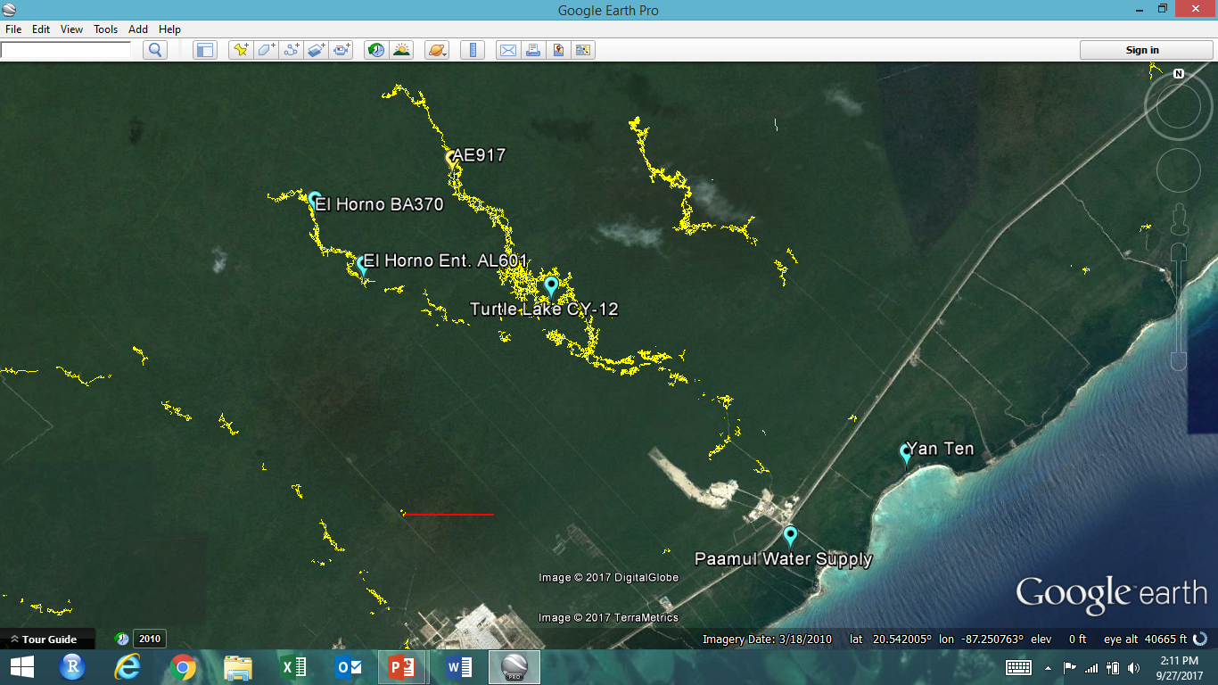
1 km

Slide 21
Meters above reference pt.
1cm water = 8.16m air
Water elevation relative to Sea Level
Surveyed elevation
above sea level

Slide 22
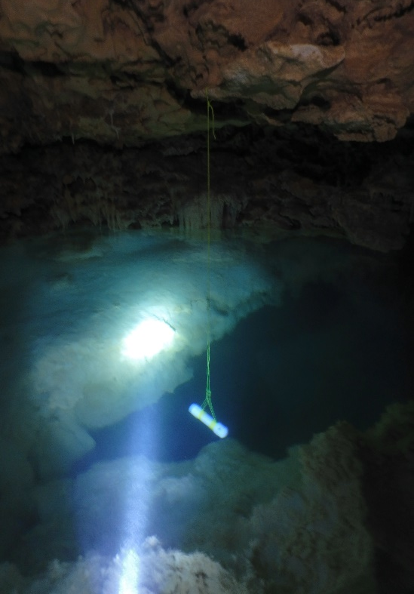
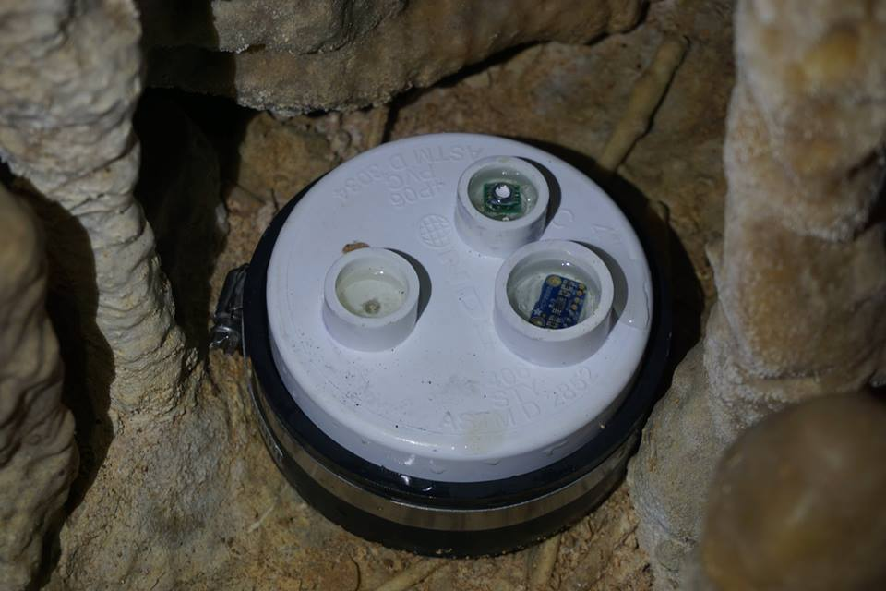
Hydraulic Gradient
Jan 2015- Aug 2017 at 30 min intervals
Both Schlumberger Divers and Cave Pearl DIY dataloggers
Average gradient 0.6m/km
Steeper gradient inland
Tidal signal delay of ~4 hrs
AE-917
Barometric Logger placement
CY-12
1.2m/km
Paamul
0.4m/km
6 km
4 km
0.5 km

Slide 23
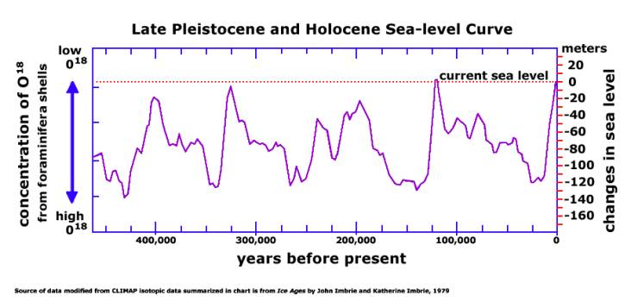
v
v
v
v
v
v
v
v
v

Slide 24
v
v
v
v
v
v
v
v
v
v

