Slide 1

Hill Annex Paleontology Project
Year four
John Westgaard, Steve Willging, Jason Korf

Slide 2
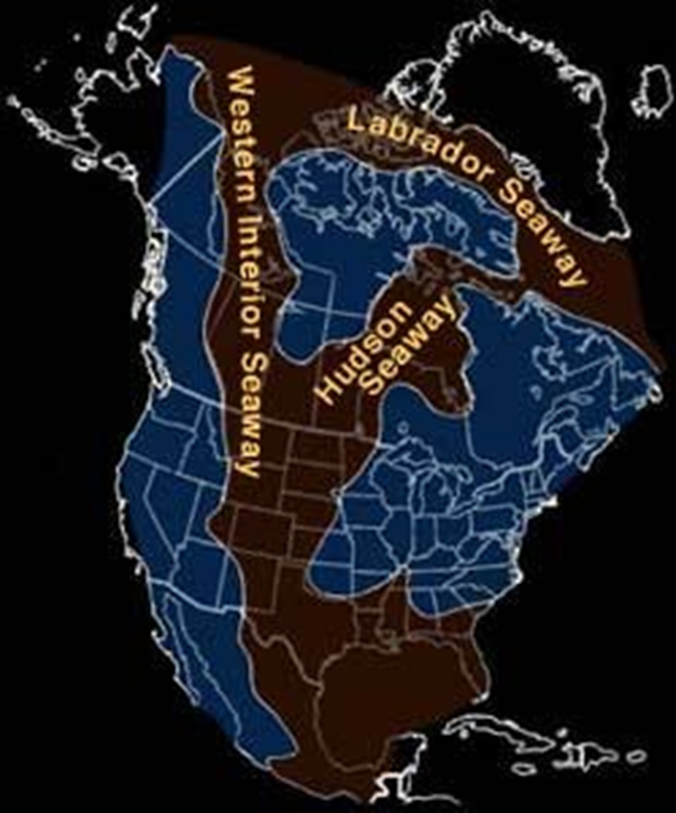
Project focus…
Research into the Cretaceous soils of Minnesota
  Better understand the scope of the historical content
  Preserve new evidence
  Expand known content of ancient environment
Public Outreach – Community Engagement
  Become voice to change perception
  Offer programming to interested groups
  Grow informal learning connections

Slide 3
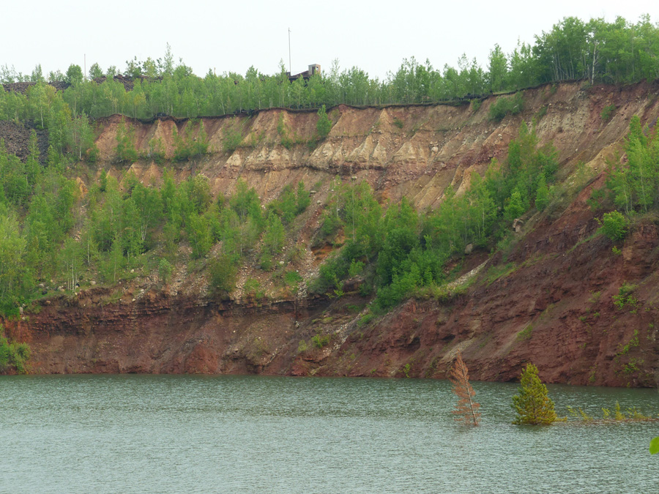
2014 to today….
Hill Annex Paleontology Project ( HAPP )
Started in 2014
All volunteer endeavor
Offering some of our insights
and experience

Slide 4
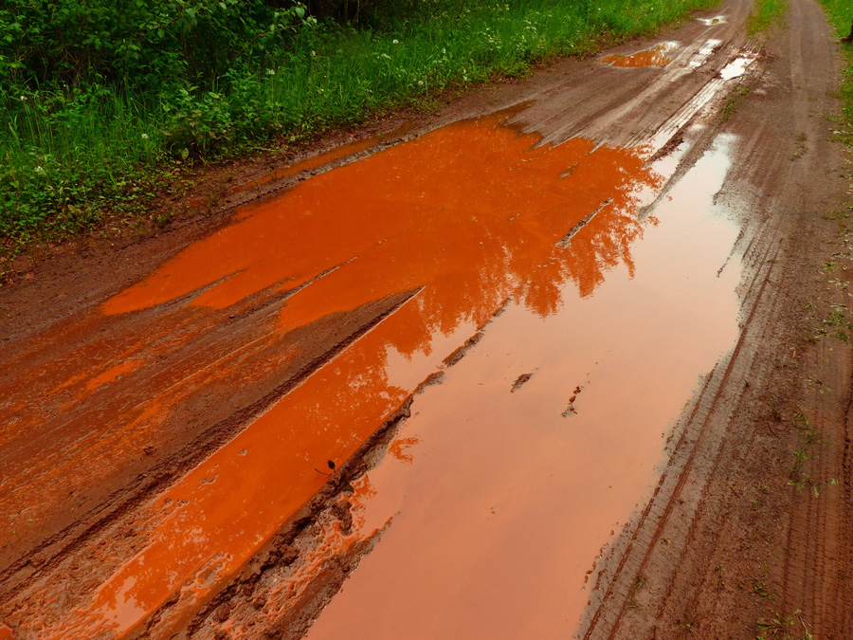
Outline:
Institution Collaboration
Volunteerism
Outreach & Engagement
Informal Stem
Social Media
Fundraising
Collection Management
Publication
Personal Challenges
Acknowledgments

Slide 5
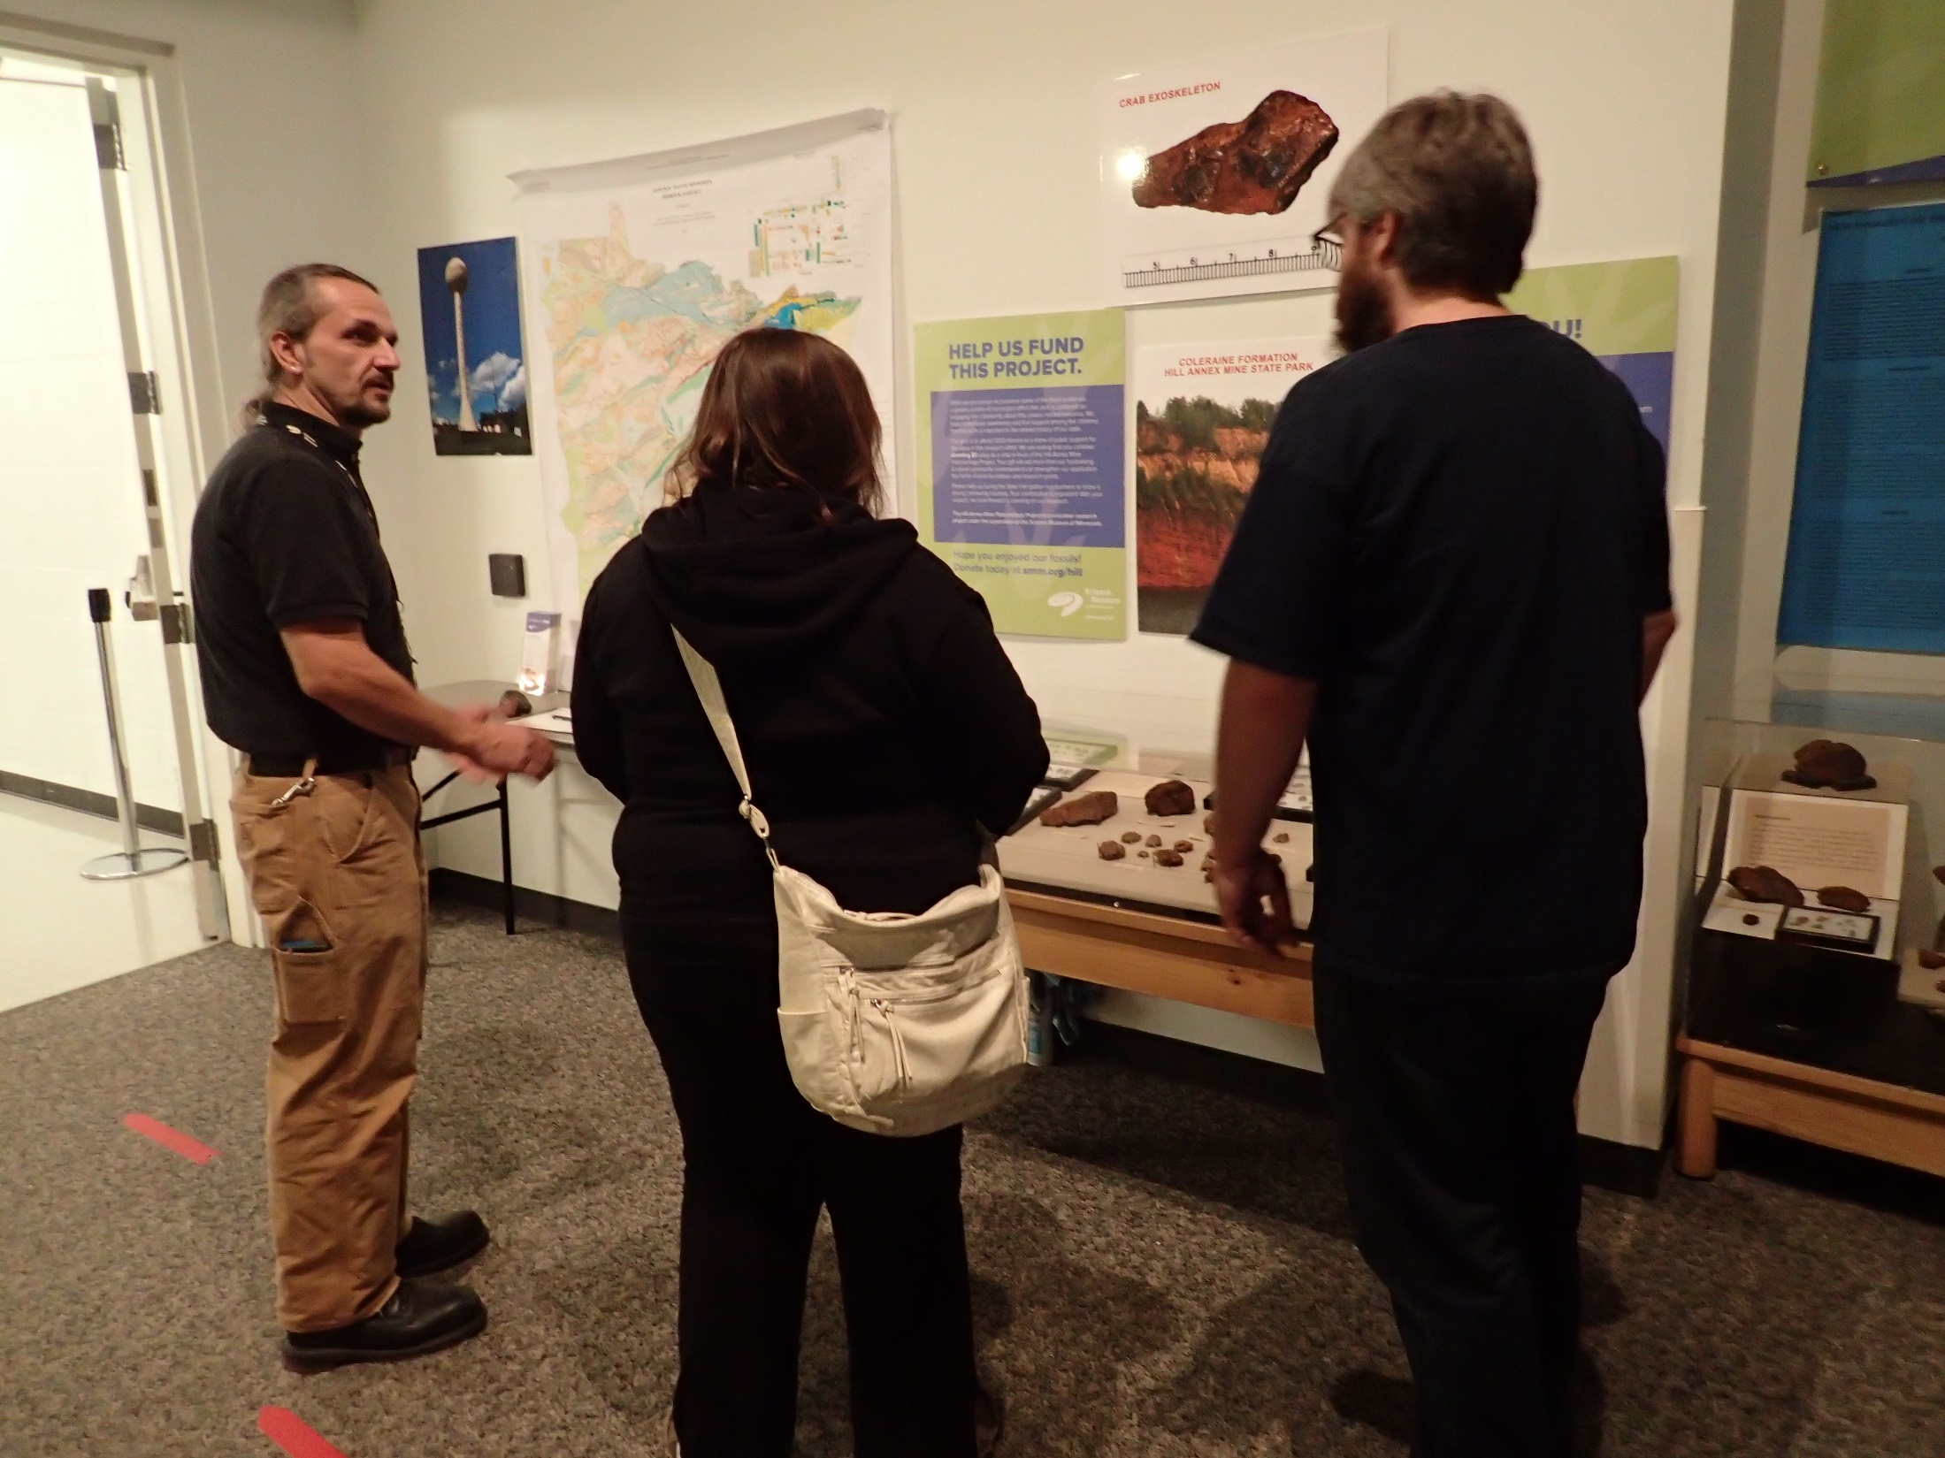
Institutions
Science Museum of Minnesota (SMM)
  Project started under supervision of Bruce Erickson – Fitzpatrick Chair of Paleontology (emeritus)
  Still main web presence ( smm.org/hill )
  Remains supporting partner
Minnesota Department of Natural Resources (DNR)
  Host of main collection site: Hill Annex Mine State Park
  Continuing partner and largest outreach host
  Resources on geology and drill core research
Minnesota Discovery Center (MDC)
  NEW host partner
  Local to primary search area - Minnesota’s Mesabi Iron Range
  Focus of new Natural History collection
myFOSSIL.org
  Recent supporter and open community resource
  Sponsor of HAPP conference attendance
  Professional development workshops – Scientist / Teacher collaborations

Slide 6
Institutions
Advisory group:
  Academic and professional resources available as support structure
    Illinois State University
    University of Minnesota
    Macalester College, Saint Paul, MN.
    Minnesota Geological Survey
    Minnesota Department of Natural Resources – Lands & Minerals Division
  Other institution contacts for specimen analysis
Field visitations:
  University of Wisconsin – Superior historical geology class
  Indiana – Purdue- Fort Wayne University geology field trip
  Bemidji State University Earth Sciences field trip

Slide 7
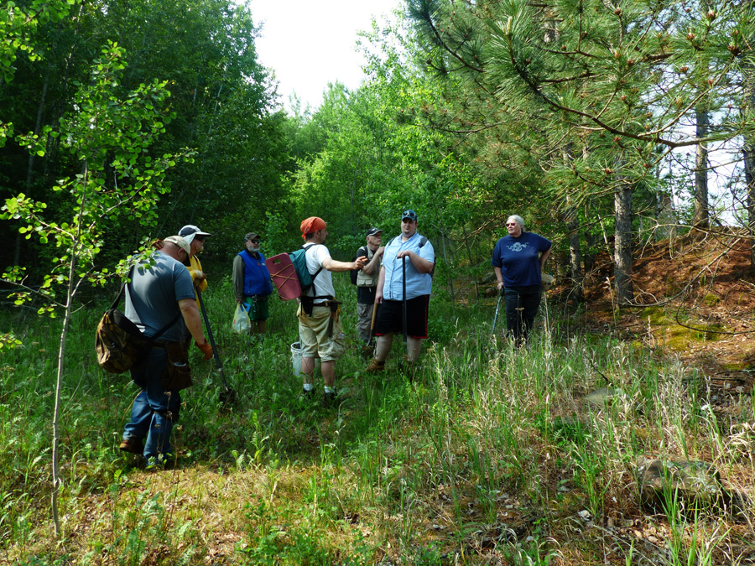
Volunteerism
Need for a Team !
HAPP started by volunteers
Early field trips for SMM Paleontology gallery volunteers
Annual offerings of seasonal field work
Field crew of more than 3 dozen volunteers
  Four are geology/paleontology degree holders
  All working in NON degree fields
Grow to offer seasonal internships
Initiated Interpreter Program for state park host
Opportunities to share knowledge

Slide 8
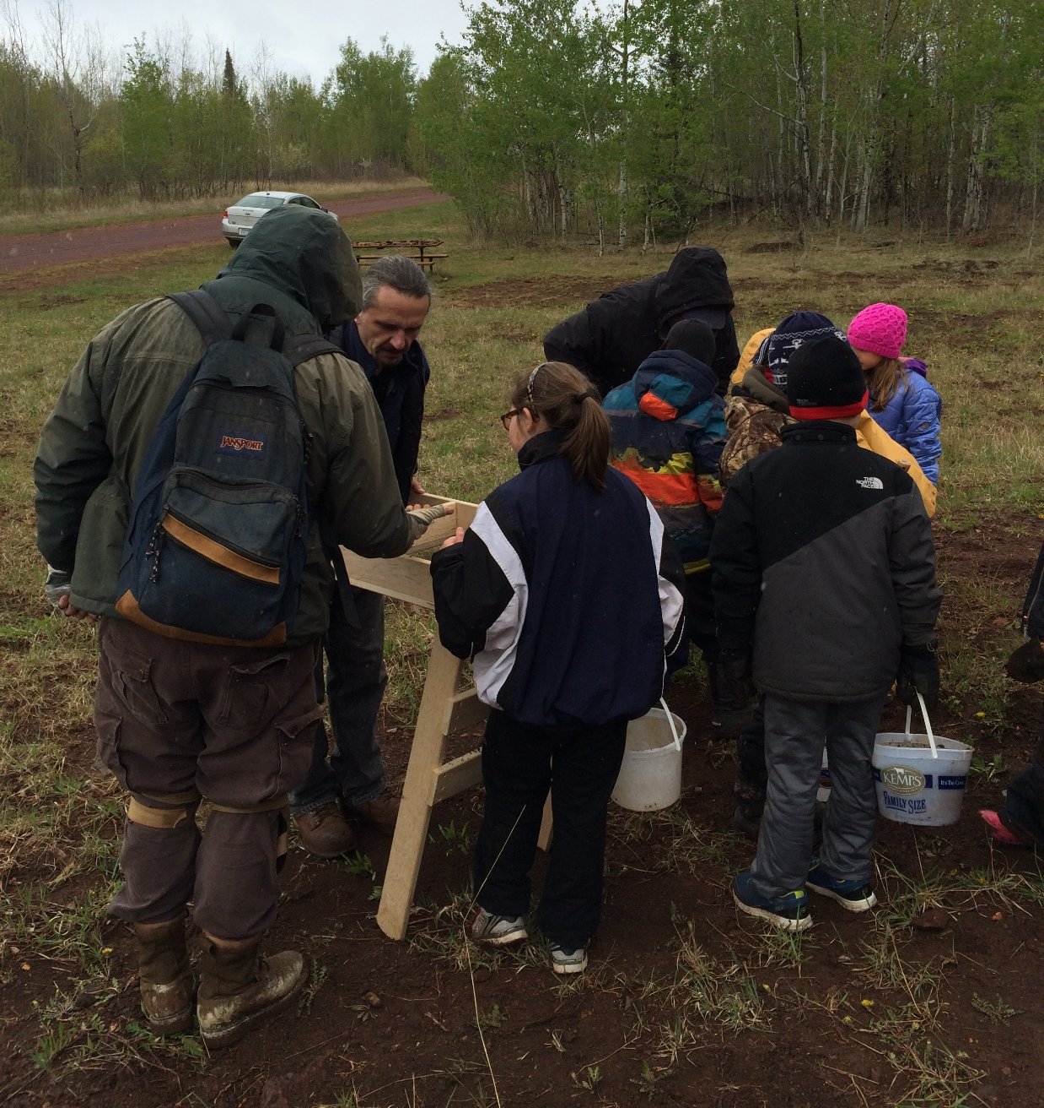
Outreach and Engagement
Major facet of the project focus
Initial interactions showed little knowledge of local fossils
Each interaction can be an informal STEM moment
Builds support
  New volunteers
  New donors
  New partners
Inspires inquiry and wonder!

Slide 9
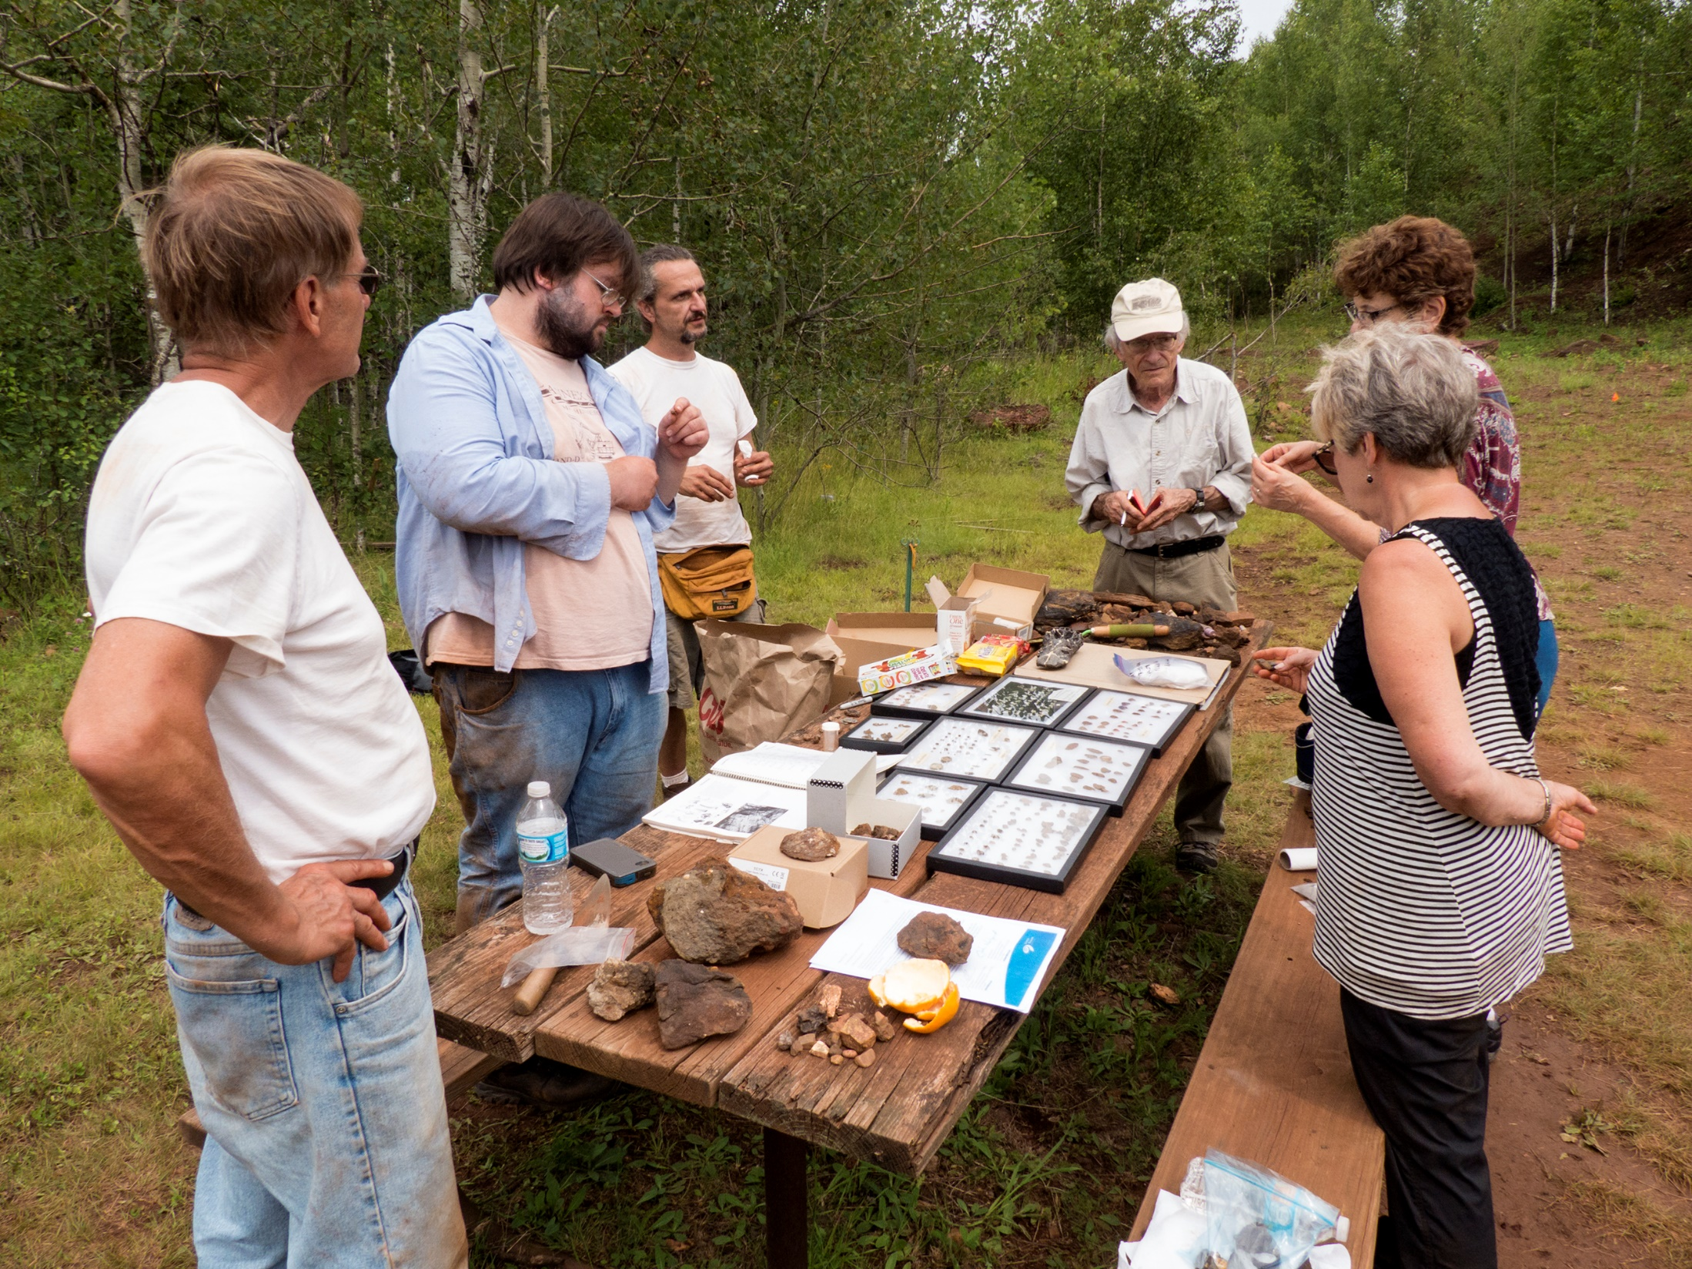
Informal STEM
Partners provide many opportunities for engagement
Science Museum of Minnesota
  Research Hall Open Houses
  Fossil Day celebrations
  Paleontology gallery fossil kits
Department of Natural Resources
  Fossil interpretation with park visitors
  State Fair invites
Minnesota Discovery Center
  Family Discovery Days
  Iron Range Science and Engineering Festival
  New exhibit hall additions
  Future: field trips, class visits, teacher kits

Slide 10
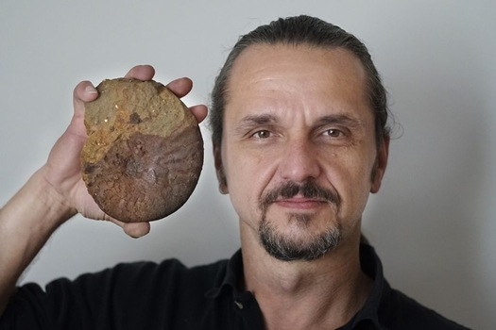
Social Media
More Social and Media than Social Media
Limited access
  Webpage smm.org/hill
  Newletter
  Youtube
Long period of indecision
Mostly traditional media… paper, radio, television
  State Fair exhibitions
New host… New Options!
  Future… new website and online collection access
  Embracing Social Media forms

Slide 11
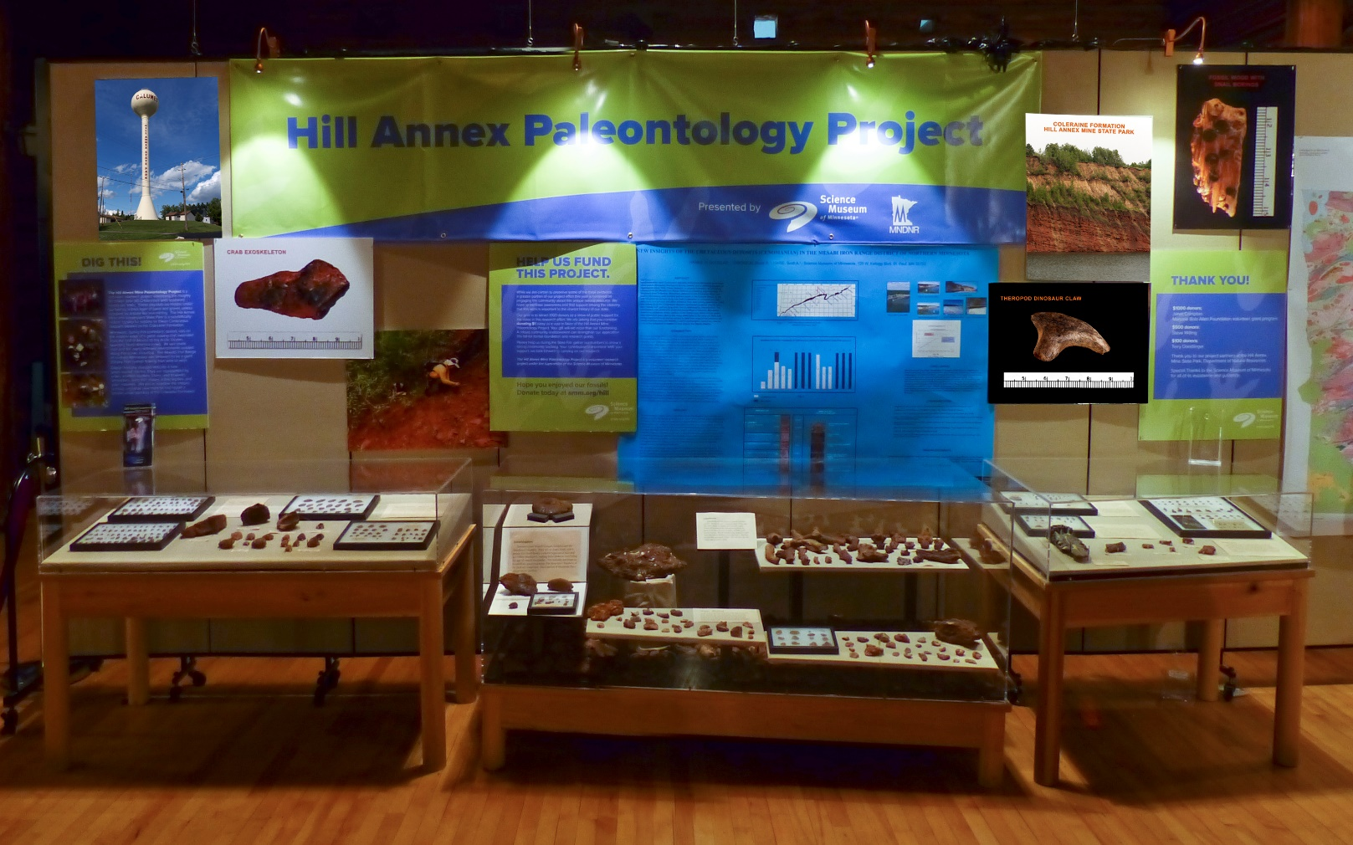
Minnesota State Fair 2015 display

Slide 12
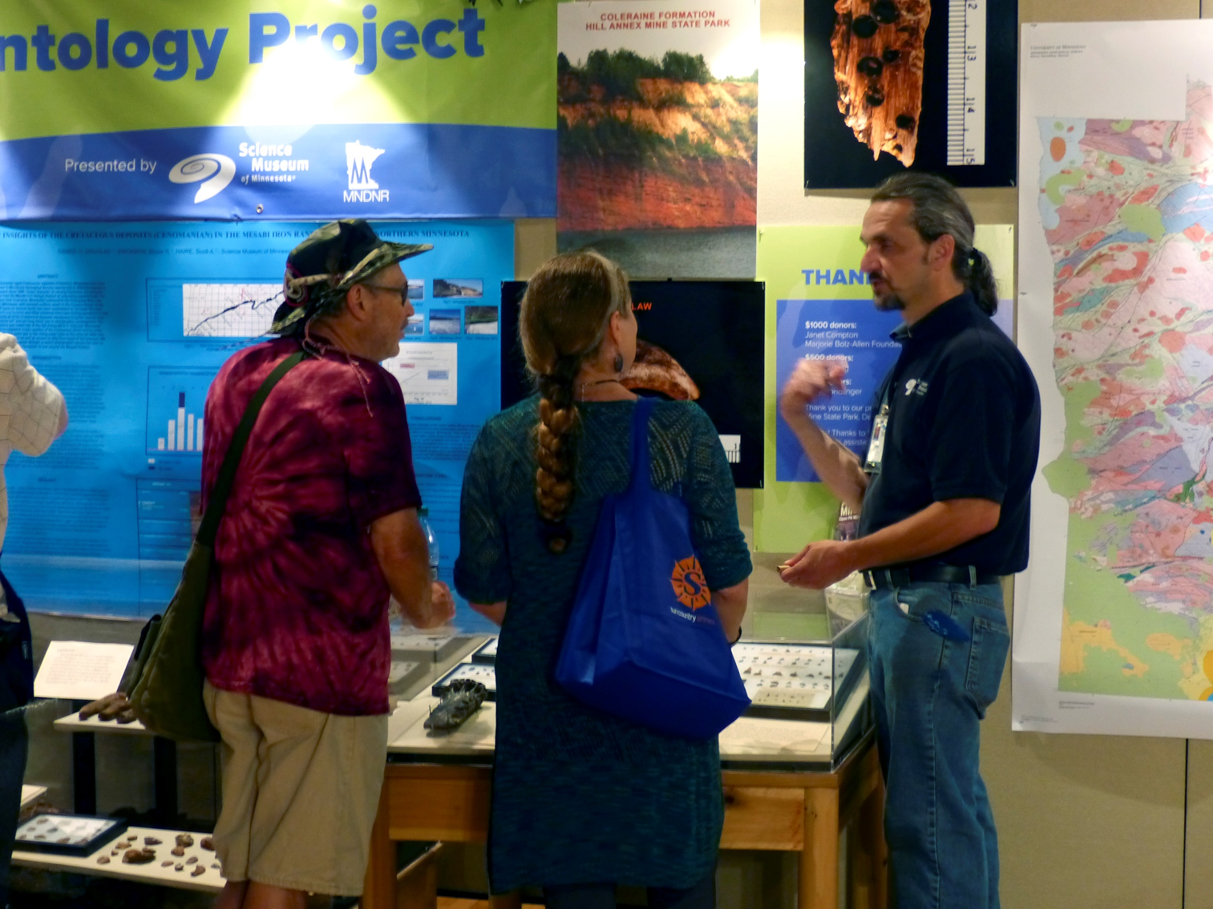
Fundraising
First dollars in 2015 on Marjorie Bolz-Allen Volunteer grant $1200
  SMM in-house program for volunteer projects
Science Museum of Minnesota allowed HAPP open soliciting
  Authentication of Support letter
  Developed a few annual supporters
Other MBA grants followed
  2015 SMM Paleo lab microscope upgrades
  2016 State Fair grant
  2016 Paleo gallery – Cretaceous MN volunteer kit
Minnesota Discover Center changes
  Capital outlay for new Lab space
  Strategic Funding Plan development
  Donor match system (with threshold)
Stay fiscally THRIFTY !
always will find constraints to your budget

Slide 13
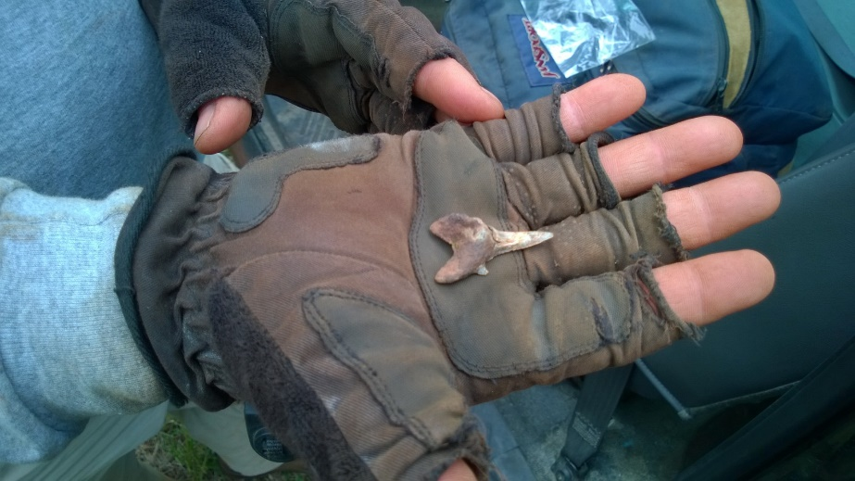
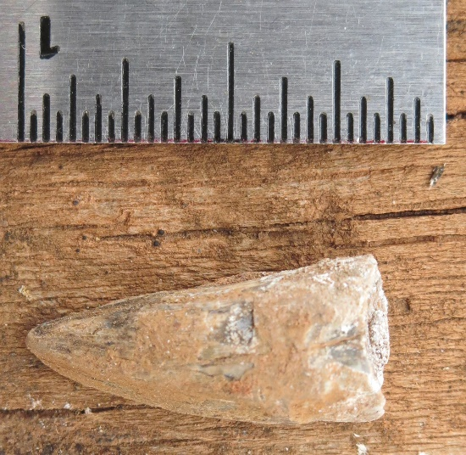
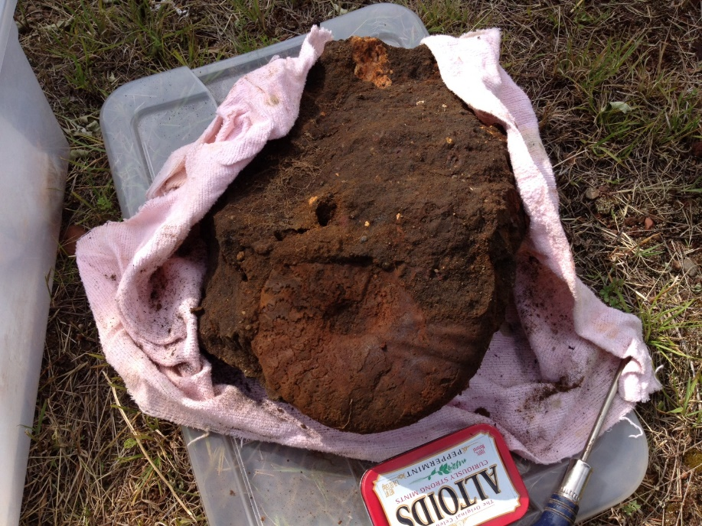
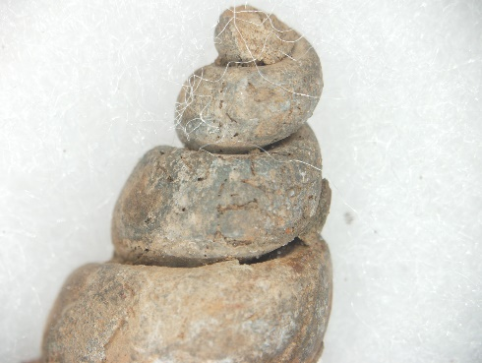
Collection Management
Inaugural plan shared new fossil collections
  Science Museum of Minnesota Paleontology – first review
    6 official SMM accessions from HAPP
  Develop field collection for HAPP to utilize
  Augment fossil display at Hill Annex Mine State Park
  New MBA grant: SMM Paleo gallery Cretaceous MN fossil kit
Private donations
Other entities interested in temporary exhibitions
New Host - New Plan Minnesota Discovery Center
  Developing Lab space to process field collection
  Start NEW Natural History focus in collecting: Paleontology
  Future exhibition to become regular attraction
  More than 5000 fossils part of current HAPP collection

Slide 14
Publication
Something to grow into…
Geological Society North-Central Regional Conferences since 2015
  Posters and Project updates
Future publication on selected fossil finds in progress
Long timeline with part time basis effort
Opportunities for institution or intern collaborations

Slide 15
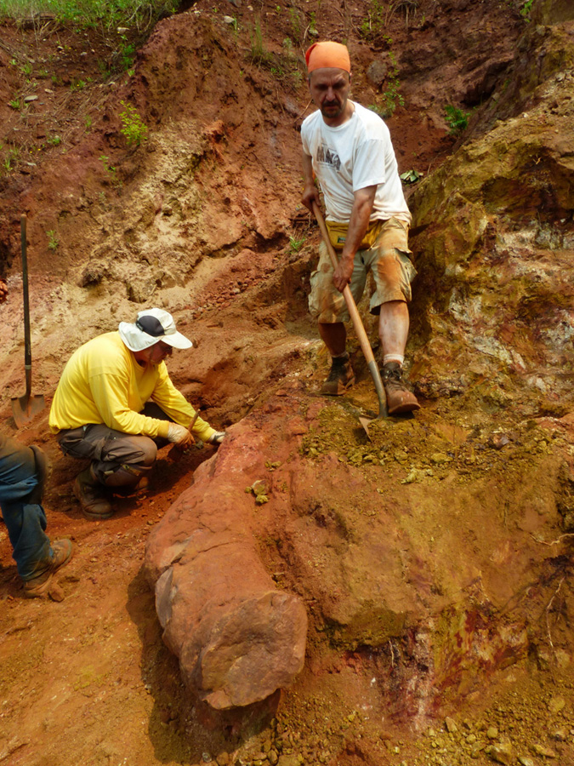
Personal Challenges
Many things to challenge your plans
Jack of all Trades
  Need to manage many facets
  Admin, Recruiting, Budgets, Logistics, Grant writing, etc.
Institution timelines and priorities
  Leadership transitions (SMM President and Paleontologist)
  Economic factors
Stay Flexible!
  New opportunities may arise. Alternate approaches more useful.
Self-Determination
  Stick to your Vision ! Life will challenge your dream

Slide 16
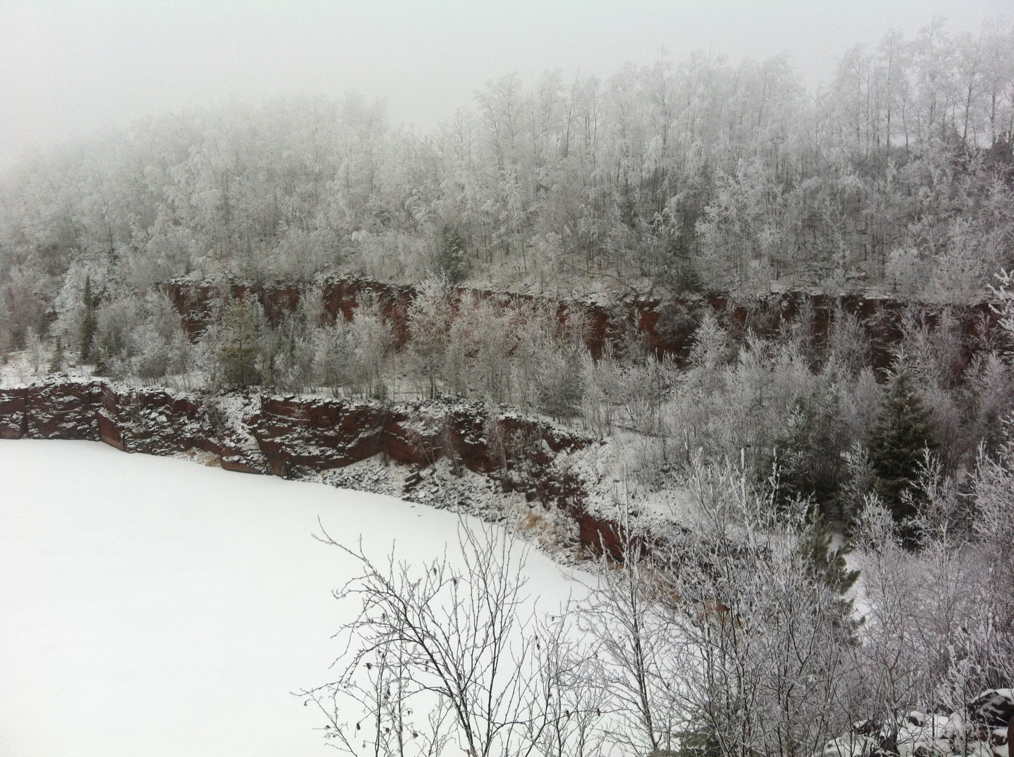
Credits
Thank you to all our supporters and partners
Brought to you in part by myFOSSIL.org
Kudos to our Field Crew volunteers!
The Marjorie Bolz-Allen Volunteer grant program
Our private supporting donors
Photos: Mark Ryan Amitycreek.com
Field Crew
Paleo Art: Nathan Rogers

Slide 17
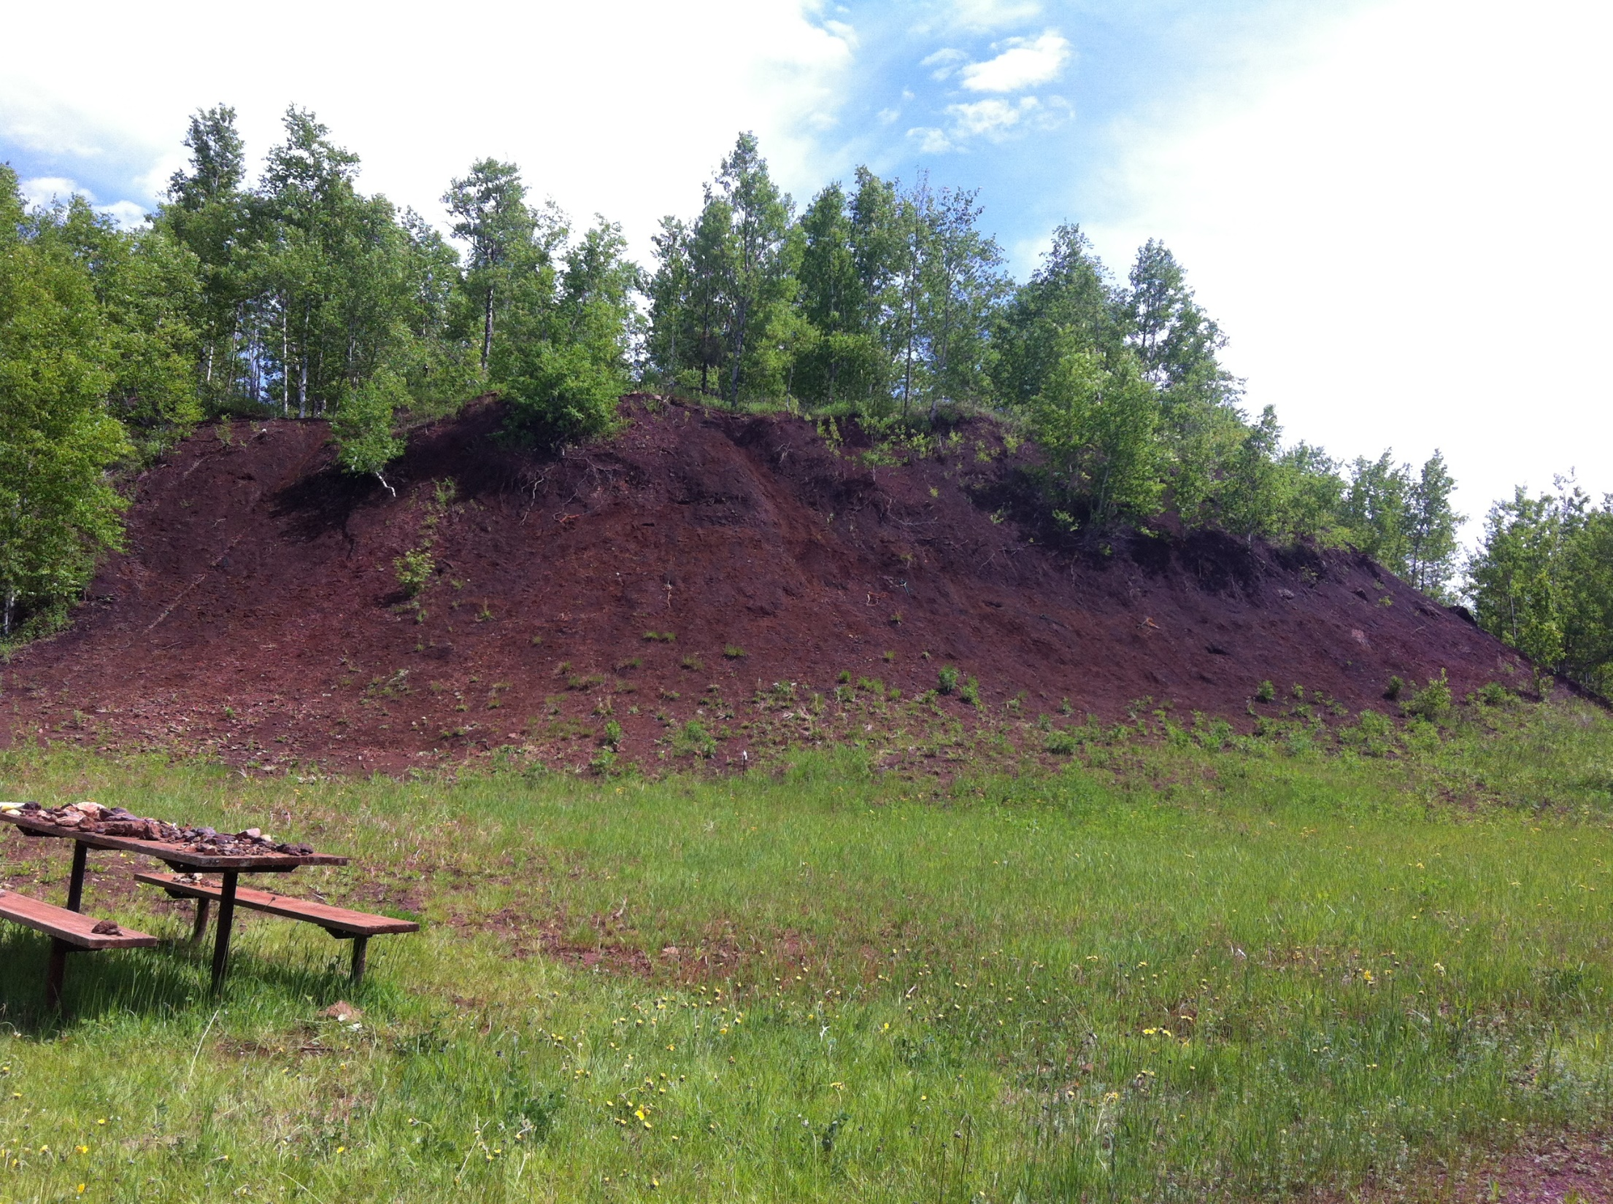







THANK YOU !
Hill Annex Paleontology Project
SMM.org/hill
John Westgaard jwestgaard@smm.org

