Slide 1
How Can CUREs Be Best Implemented to Meet Programmatic Learning Goals and Degree Requirements?
Session No: 334 T110. Engaging Students through Course-Based Undergraduate Research Experiences (CURE) across the Geoscience Curriculum
Wednesday, 25 October 2017
Kristen St. John, Liz Johnson, Steve Baedke, Steve Leslie, and Shane McGary
Department of Geology and Environmental Science
James Madison University
stjohnke@jmu.edu

Slide 2
Presentation Outline
What the Research Tells us about CUREs
JMU Geology and Environmental Science Department
  Programmatic Learning Goals
  Degree Requirements [esp. Research Requirement]
  Where do UREs and CUREs Currently Fit into the Curriculum?
  Example CURE Courses
  Benefits and Costs Summary
  Alternative Model for how CUREs Could Fit into the Curriculum

Slide 3
What the Research Tells us about CUREs
Undergraduate Research Experiences (UREs): engage students in research practice:
  Generate original results
  [Situate research in context of prior (published) work]
  Relevant problems of interest
  Collaborate/work in teams
  Iterative process
  Develop technical skills
  Reflective practice
  Communicate results
  Mentorship and student ownership
[Modified from] National Academies of Sciences, Engineering, & Medicine. (2017). Undergraduate Research Experiences for STEM Students: Successes, Challenges, and Opportunities.
UREs
Apprentice Model
CUREs
1+ student(s) work with an individual/small group of established scientists on a research problem, typically outside of the classroom.
A cohort of students in a research project [with established scientist(s)] as part of a formal academic experience.

Slide 4
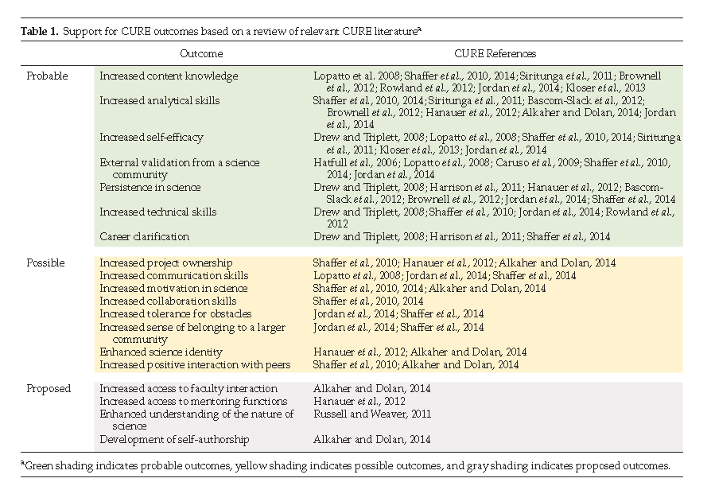
What the Research Tells us about CUREs
Corwin et al., 2015. Modeling Course-Based Undergraduate Research Experiences: An Agenda for Future Research and Evaluation, CBE—Life Sciences Education.
Increased content knowledge
Increased analytical skills
Increased self-efficacy
External validation from science community
Persistence in science
Increased technical skills
Career clarification
Probable
Outcomes

Slide 5
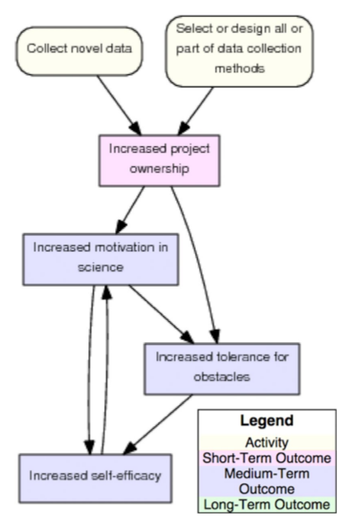
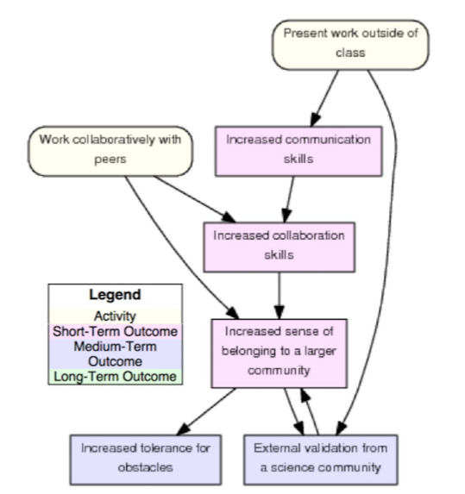
What the Research Tells us about CUREs
Pathway Models representing hypotheses of how CURE outcomes are achieved (Corwin et al, 2015).
Knowledge and Skill Model
Ownership Model
Communication and Collaboration Model

Slide 6
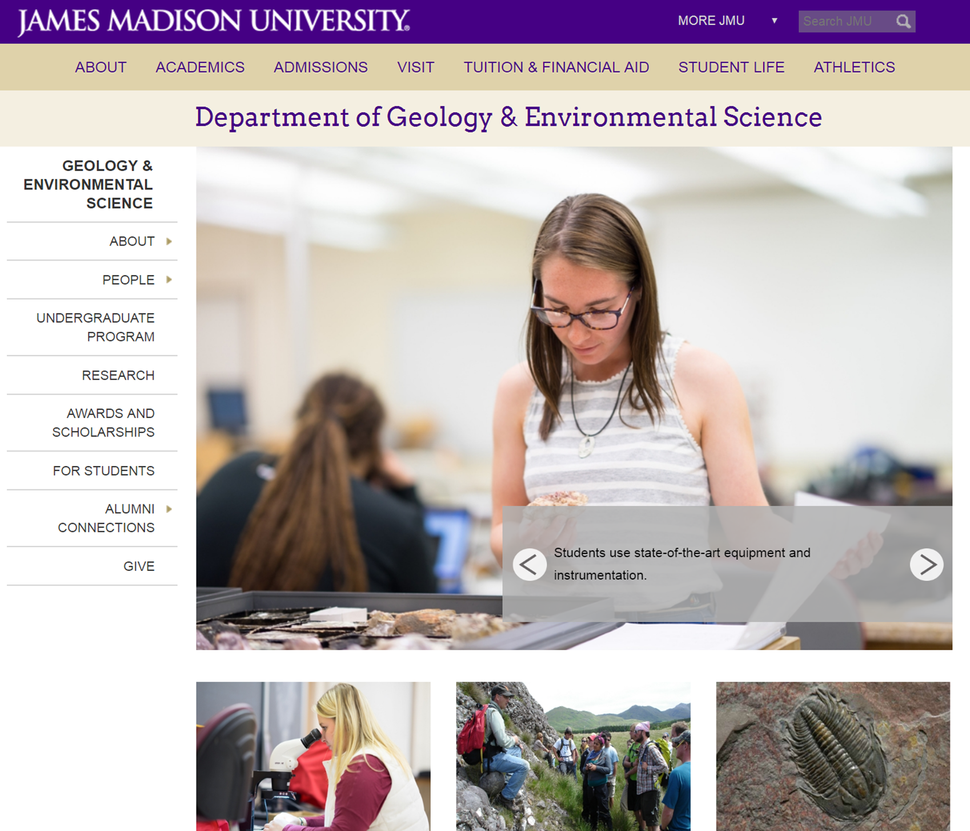
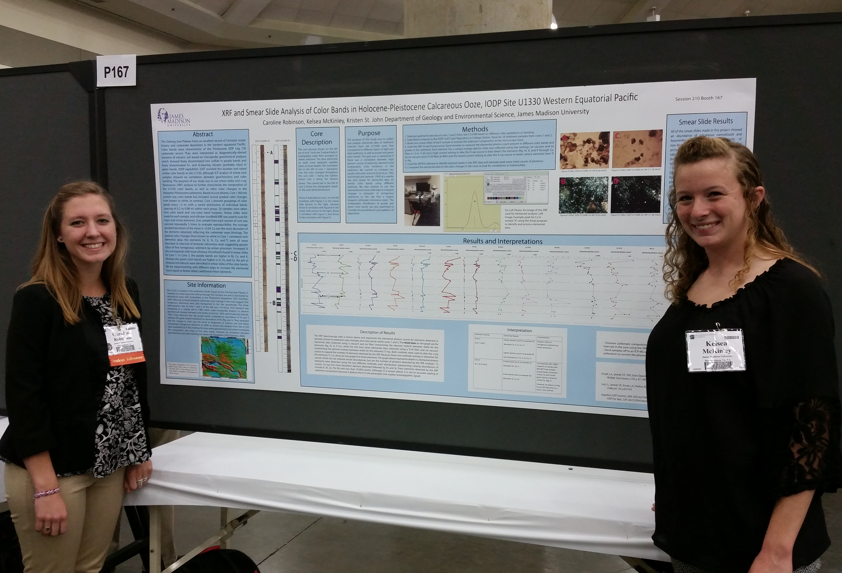
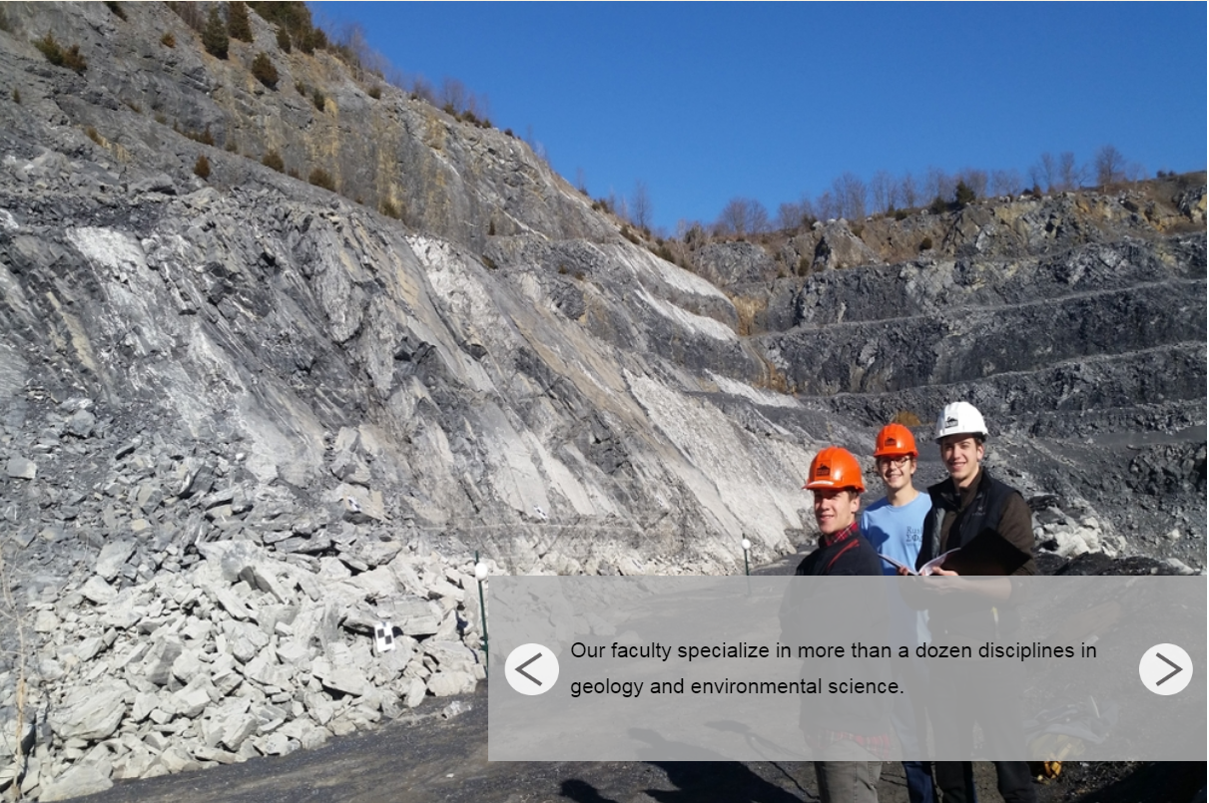
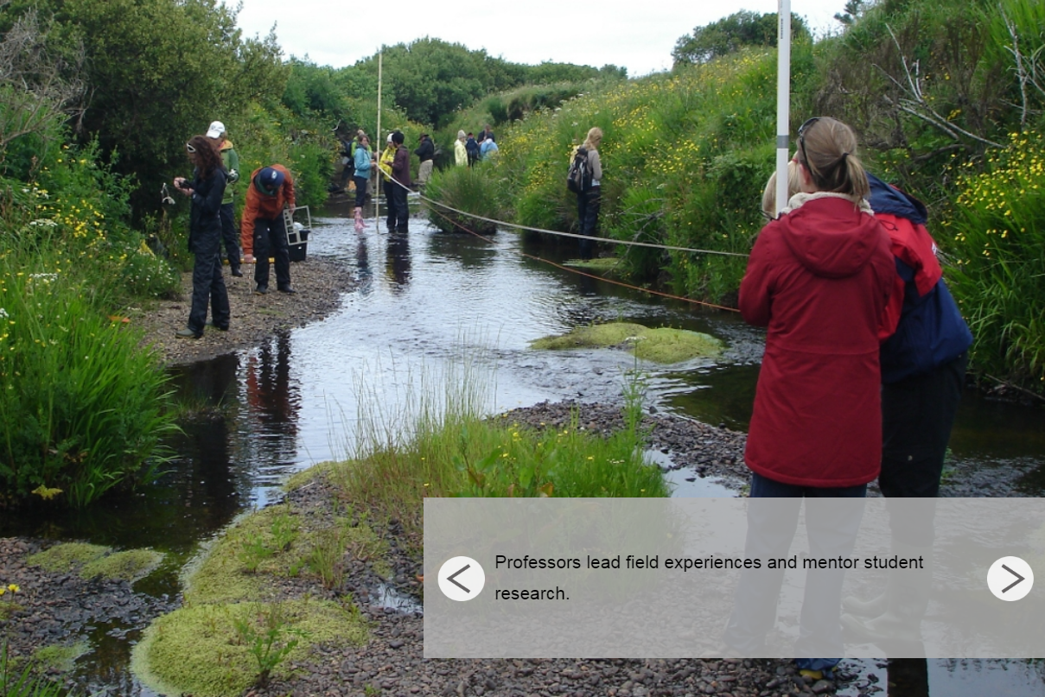
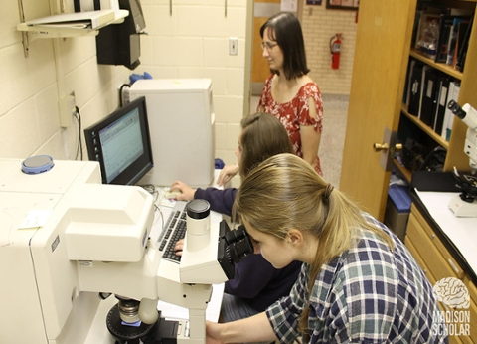
JMU Dept of Geology and Environmental Science
~120 majors
<
>
<
The department sponsors students to present research at national conferences.
>
_{v}
_{v}
Students use state-of-the-art equipment and instrumentation

Slide 7
JMU Dept of Geology and Environmental Science:
Programmatic Mission
From the Dept Academic Program Review (APR) [i.e., Self-Study] Report, 2015
Unit Mission: Serve three vital needs of the students at JMU | Target Populations | [Program] Goals
(a) Prepare geoscience students to enter the workforce directly at the professional level and for graduate work. | B.S. Geology students B.A. Earth Science students | Educate geologists and Earth system scientists to pursue careers in fundamental research, and/or help solve the increasingly complex practical problems humans are face with today and in the future. Enrich and develop faculty and student research. Increase the number of STEM majors and STEM graduates to increase the STEM workforce.
(b) Provide quality preparation for prospective teachers of Earth Science and general science at the K-12 levels. | B.A. Earth Science students with secondary education (SEED) minors IDLS students | Alleviate the critical shortage of qualified Earth Science teachers in the Commonwealth and larger region. Develop meaningful and sustainable relationships with the constituents at JMU interested in K-12 science education.
(c) Promote life-long learning and provide insights into Earth processes and human-environment interactions. | General Education students | Prepare and education an enlightened citizenry.

Slide 8
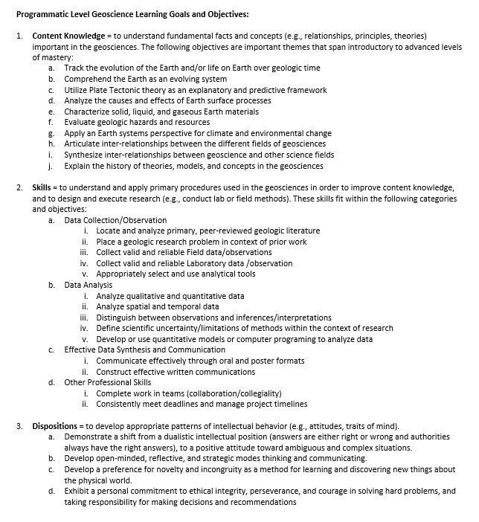
JMU Dept of Geology and Environmental Science:
Programmatic Learning Goals
Approach program reflection and revision using the
Backward Design model (Wiggens and McTighe, 2012, Understanding by Design)
Content Knowledge
Programmatic Learning Goals and Objectives
Skills
Dispositions
From the Dept Academic Program Review (APR) [i.e., Self-Study] Report, 2015

Slide 9
JMU Dept of Geology and Environmental Science
Programmatic
Learning Goals
Skills | Objectives
Data Collection/ Observation | Locate and analyze primary, peer-reviewed geologic literature Place a geologic research problem in context of prior work Collect valid and reliable Field data/observations Collect valid and reliable Laboratory data /observation Appropriately select and use analytical tools
Data Analysis | Analyze qualitative and quantitative data Analyze spatial and temporal data Distinguish between observations and inferences/interpretations Define scientific uncertainty/limitations of methods within the context of research Develop or use quantitative models or computer programing to analyze data
Effective Data Synthesis and Communication | Communicate effectively through oral and poster formats Construct effective written communications
Other Professional Skills | Complete work in teams (collaboration/collegiality) Consistently meet deadlines and manage project timelines
Skills
Important in Research
From the Dept Academic Program Review (APR) [i.e, Self-Study] Report, 2015

Slide 10
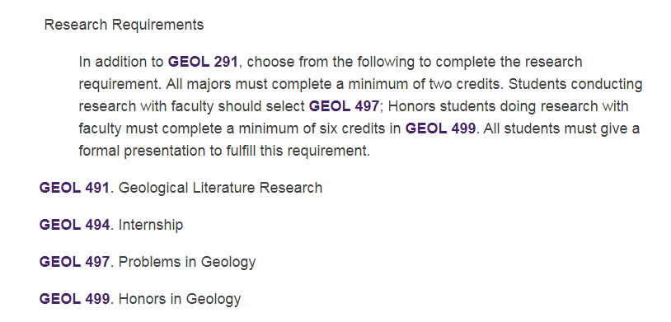
JMU Dept of Geology and Environmental Science: Degree Requirements
Geowriting and Communication
= Individual Student Research
v
From the 2017 JMU Course Catalog and Degree Requirements

Slide 11
JMU Dept of Geology and Environmental Science:
Where do UREs and CUREs Currently Fit into the Curriculum?
Meeting the research degree requirement | Apprentice Model | CURE
19XX to 2010 | 3-credits of Individual Research
2010 to present | 2-credits of Individual Research | 1-credit course: Geowriting and Communication
Challenge:
inefficient way to mentor some common
(non-content area specific) research skills
+

Slide 12
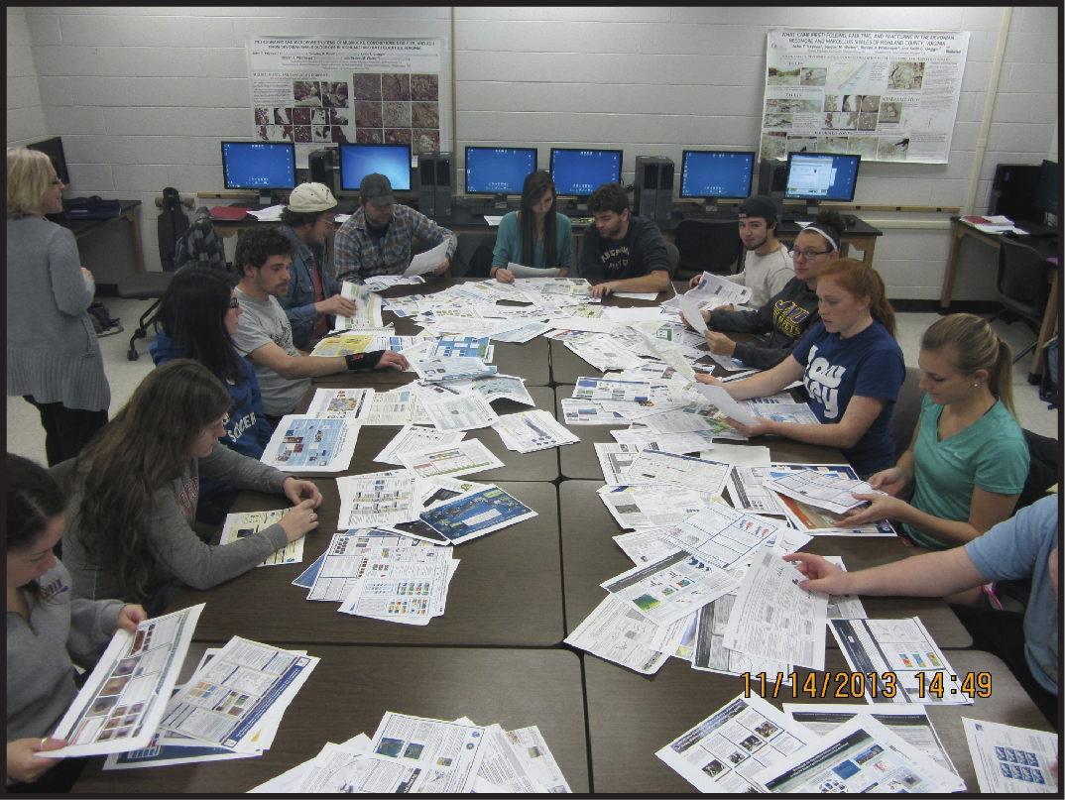
JMU Dept of Geology and Environmental Science:
Required CURE course: Geowriting and Communication
1-credit, meets 1x/week
Team-taught
Capped at 20 students
Learning Objectives: Students should be able to:
construct effective resumes and cover letters;
locate primary literature resources using the JMU library system;
critically read and evaluate peer‐reviewed papers;
identify the parts of an abstract and write meaningful and informative abstracts;
identify the parts of a proposal and write a research proposal;
use accepted styles of referencing in bibliographies;
understand the structure and format of scientific poster presentations and PowerPoint presentations;
effectively present scientific research through oral and poster presentations; and
be self-sufficient in learning software techniques needed to create presentations.
Students examining mini-posters from AGU in preparation for designing their own posters in Adobe Illustrator.

Slide 13
JMU Dept of Geology and Environmental Science:
Required CURE course: Geowriting and Communication
Learning Objectives: Students should be able to:
construct effective resumes and cover letters;
locate primary literature resources using the JMU library system;
critically read and evaluate peer‐reviewed papers;
identify the parts of an abstract and write meaningful and informative abstracts;
identify the parts of a proposal and write a research proposal;
use accepted styles of referencing in bibliographies;
understand the structure and format of scientific poster presentations and PowerPoint presentations;
effectively present scientific research through oral and poster presentations; and
be self-sufficient in learning software techniques needed to create presentations.
UREs: engage students
in research practice:
  Generate original results
  [Situate research in context of prior (published) work]
  Relevant problems of interest
  Collaborate/work in teams
  Iterative process
  Develop technical skills
  Reflective practice
  Communicate results
  Mentorship and student ownership
√
√
√
√
√

Slide 14
JMU Dept of Geology and Environmental Science:
Where do UREs and CUREs Currently Fit into the Curriculum?
Meeting the research degree requirement | Apprentice Model | Partial-CURE
19XX to 2010 | 3-credits of Individual Research
2010 to present | 2-credits of Individual Research | 1-credit course: Geowriting and Communication
+
Are the research-related programmatic learning goals being met in other ways, but are not represented in the current degree requirements?

Slide 15
JMU Dept of Geology and Environmental Science
Programmatic
Learning Goals
Skills | Objectives
Data Collection/ Observation | Locate and analyze primary, peer-reviewed geologic literature Place a geologic research problem in context of prior work Collect valid and reliable Field data/observations Collect valid and reliable Laboratory data /observation Appropriately select and use analytical tools
Data Analysis | Analyze qualitative and quantitative data Analyze spatial and temporal data Distinguish between observations and inferences/interpretations Define scientific uncertainty/limitations of methods within the context of research Develop or use quantitative models or computer programing to analyze data
Effective Data Synthesis and Communication | Communicate effectively through oral and poster formats Construct effective written communications
Other Professional Skills | Complete work in teams (collaboration/collegiality) Consistently meet deadlines and manage project timelines
Skills
Important in Research:
Skills also obtained in
current upper level elective courses via CUREs
in conjunction with gaining content-specific knowledge.

Slide 16
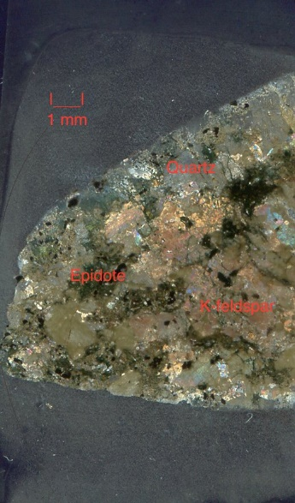
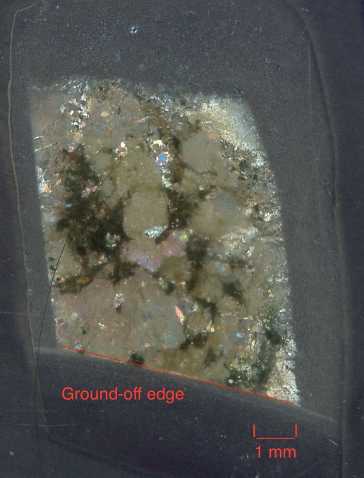
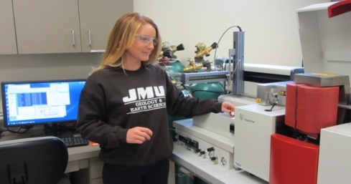
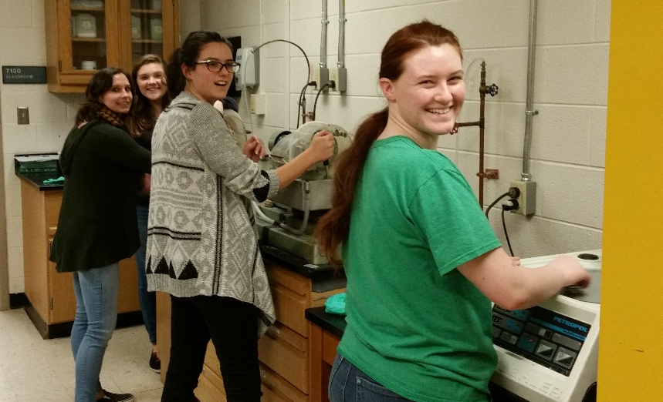
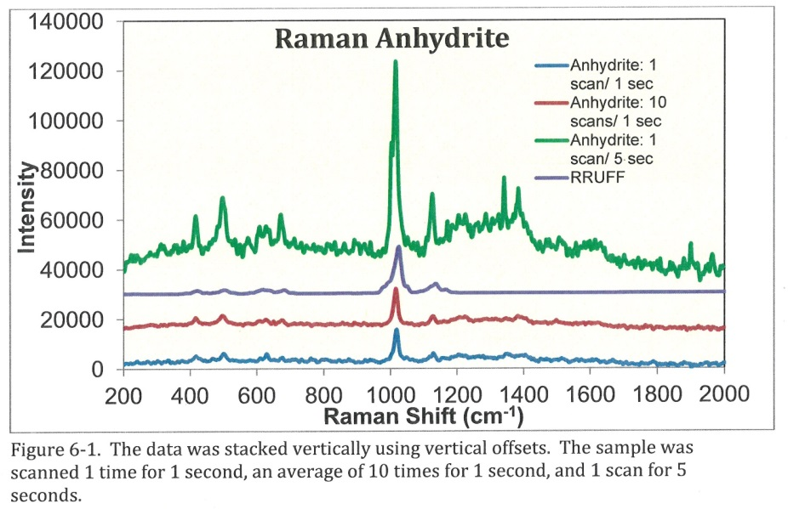

JMU Dept of Geology and Environmental Science
CURE (or partial-CURE) courses
Example 1: Laboratory Techniques in Geology
Figure 1. (a) Completed thin section after being polished thin. (b) First attempt at a thin section, ground off by the thin section grinder.
Instructional material development supported by an NSF-grant:
Collaborative Research: Open Access Blended Learning Modules for Teaching Laboratory Methods: Developing Scientific Skills for Undergraduates (PI Liz Johnson).

Slide 17
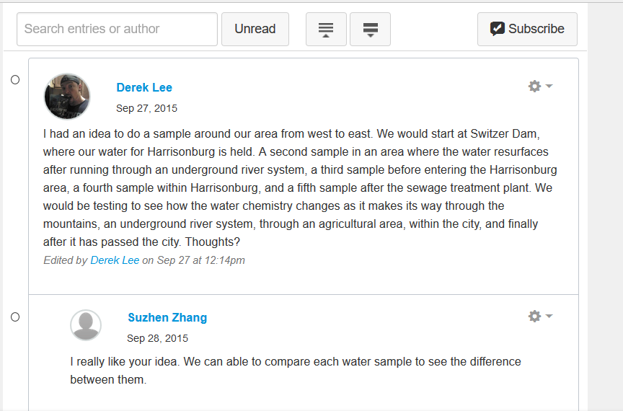
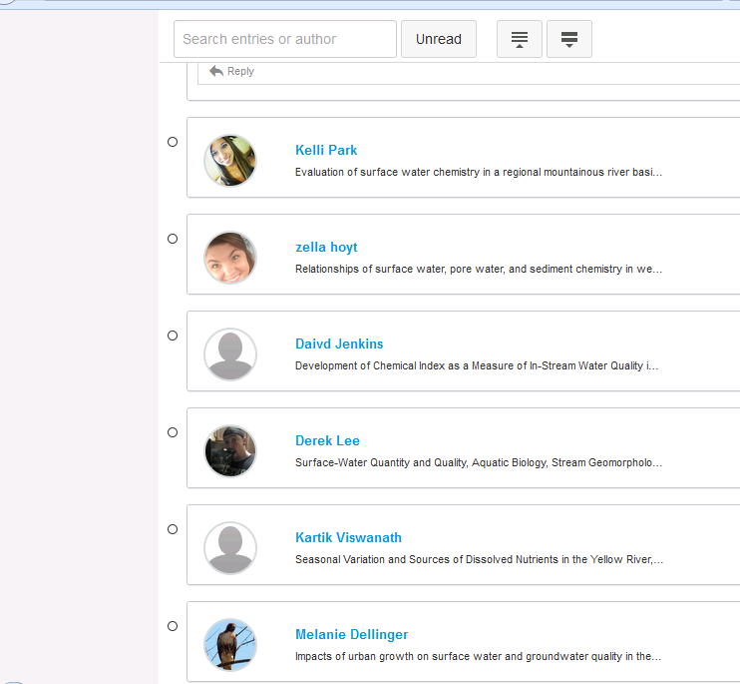
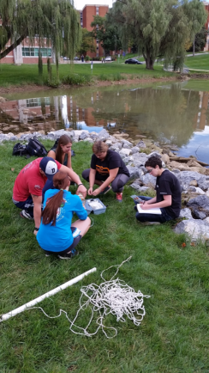
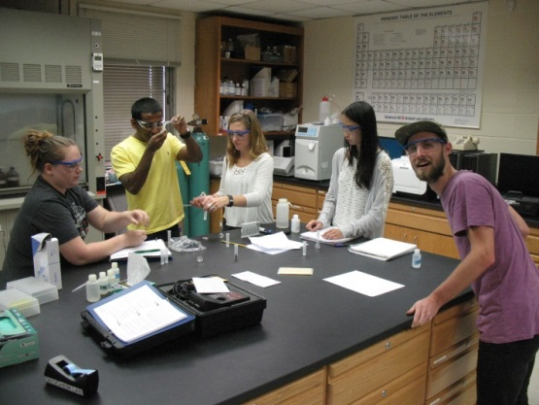
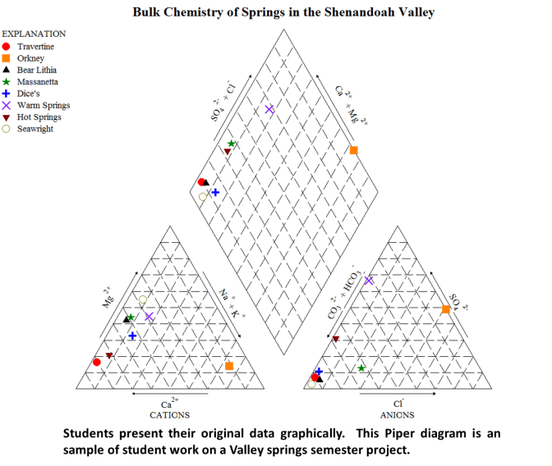
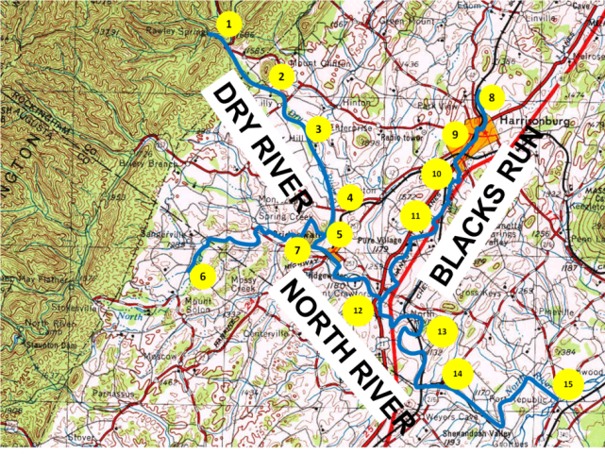
JMU Dept of Geology and Environmental Science
CURE (or partial-CURE) courses
Example 2: Aqueous Geochemistry “Lab”
Students use Canvas discussions to identify a research topic for the semester, decide samples locations, share relevant papers discovered during literature review, and discuss and interpret data.
Students work in groups of 2-5 to collect field samples and conduct lab work.
Students peer review each others work, then work together to present their findings. They either write a final report, or prepare a GSA style poster, detailing their work during the semester and their conclusions.

Slide 18
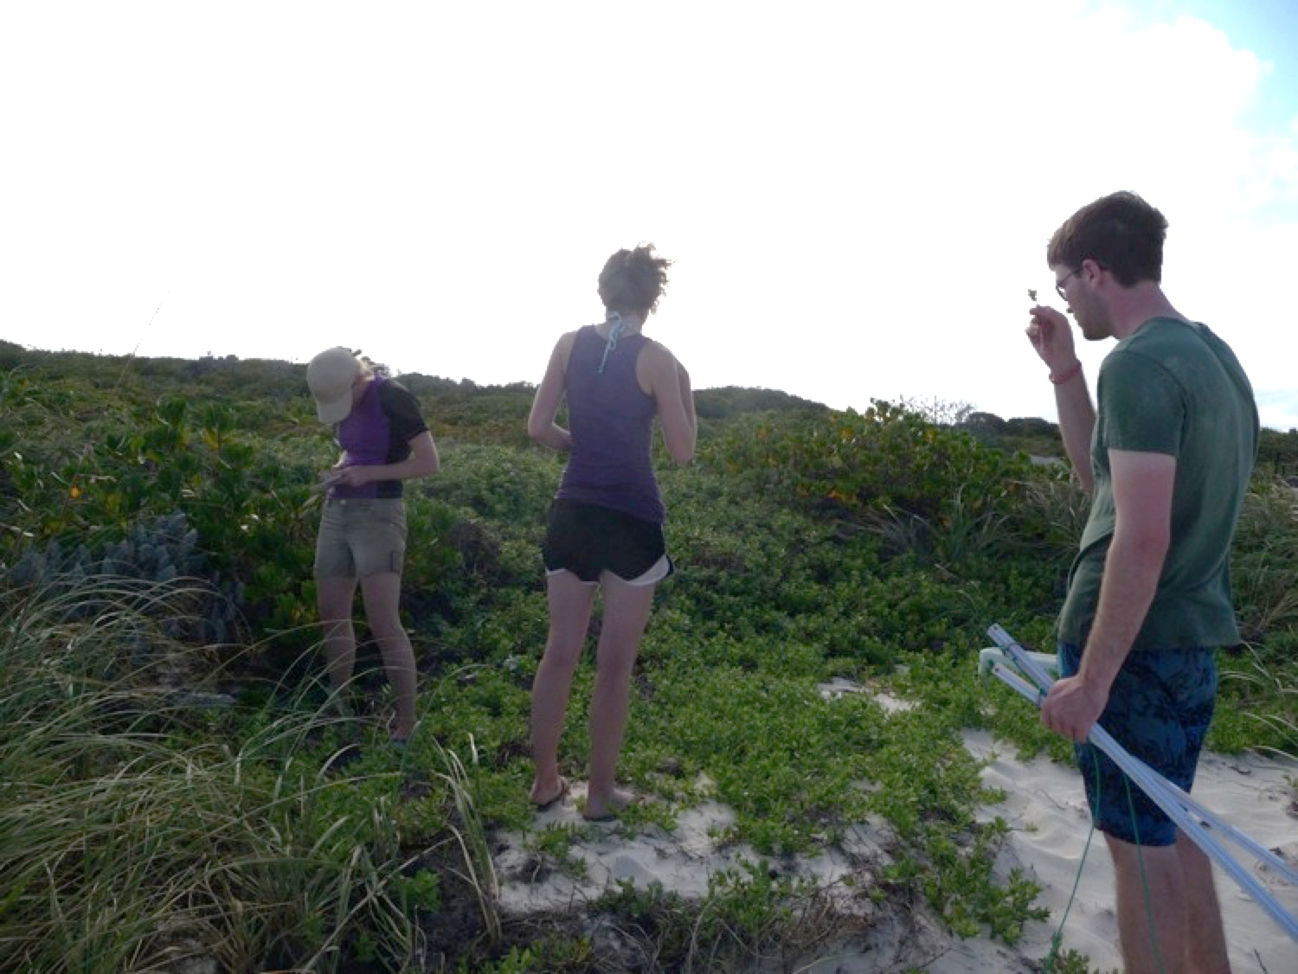
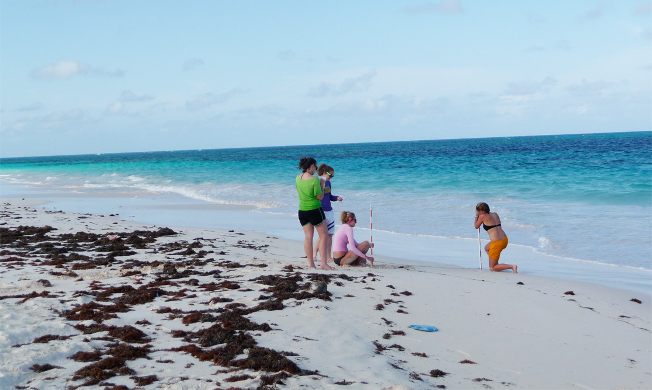
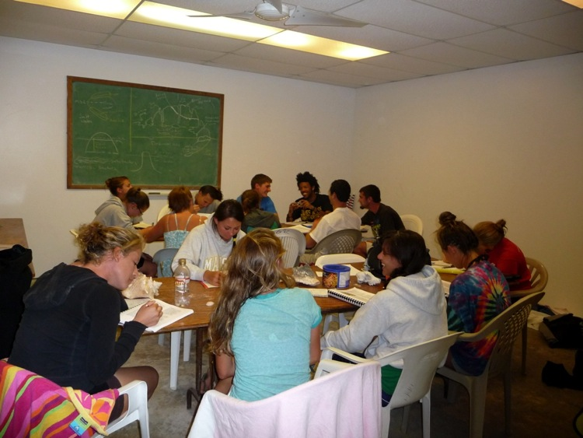
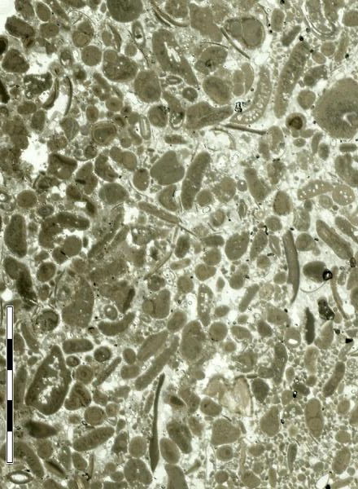
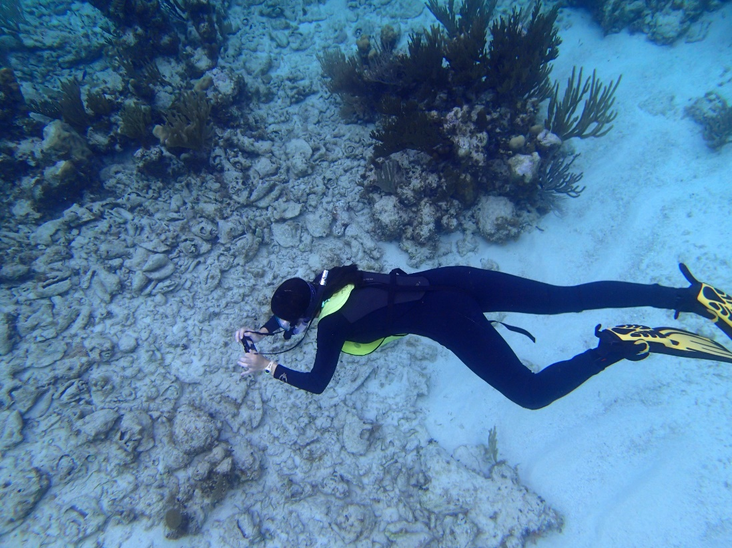
JMU Dept of Geology and Environmental Science
CURE (or partial-CURE) courses
Example 3: Geology and Ecology of the Bahamas
Work in teams, collect data and construct a field guide to the Geology and Ecology of San Salvador Island and propose follow-up research.

Slide 19
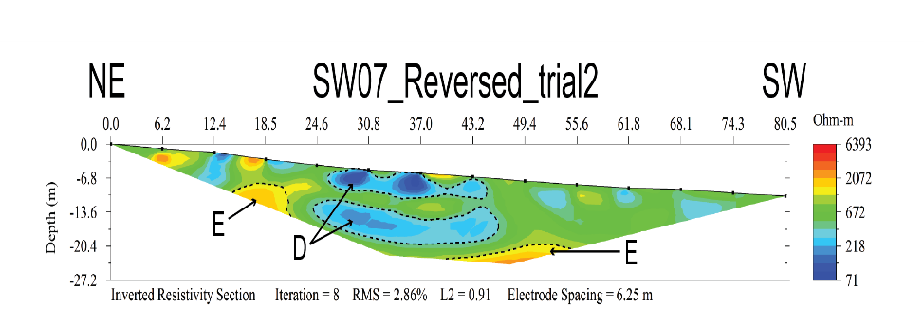
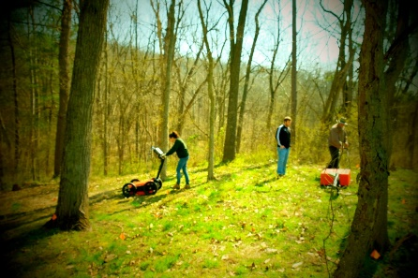
JMU Dept of Geology and Environmental Science
CURE (or partial-CURE) courses
Example 4: Field Geophysics
GPR inversion model of subsurface near a historical
farmhouse owned by JMU, showing electrical conduits
and water pipes.
Course work
Resistivity inversion model of water flow near a
karstic swale feature
Undergraduate research
students collecting GPR
data at Corhaven Slave
Cemetery in Quicksburg,
VA. (Photo courtesy of
Sarah Kohrs)
Post-course
Individual Student Research
Resistivity inversion models of data collected by undergraduate
research students at Grand Caverns, VA., showing caverns, water
flow patterns and perched aquifers, and water table below the
Caves (Figure by Jacob Gochenour) (submitted, 2017)
Location of buried enslaved persons at Belle Grove Plantation
Slave Cemetery, established by undergraduate research students
using GPR (Figure by Michelle Proulx) (in prep, 2018)

Slide 20
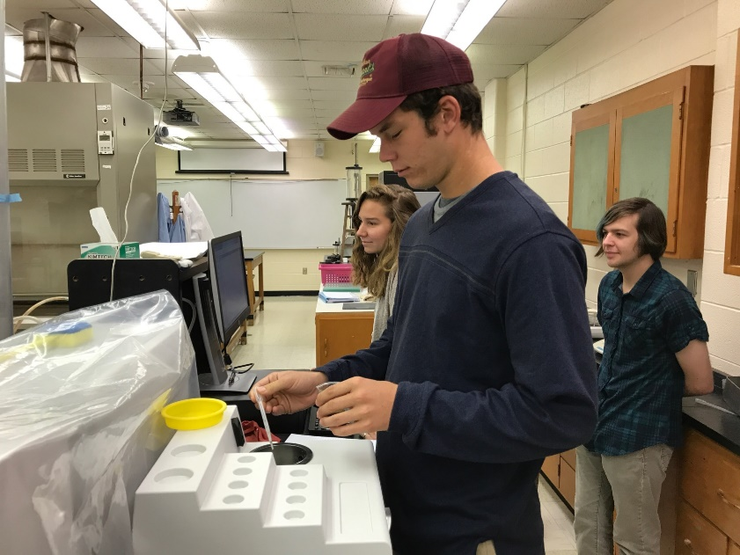
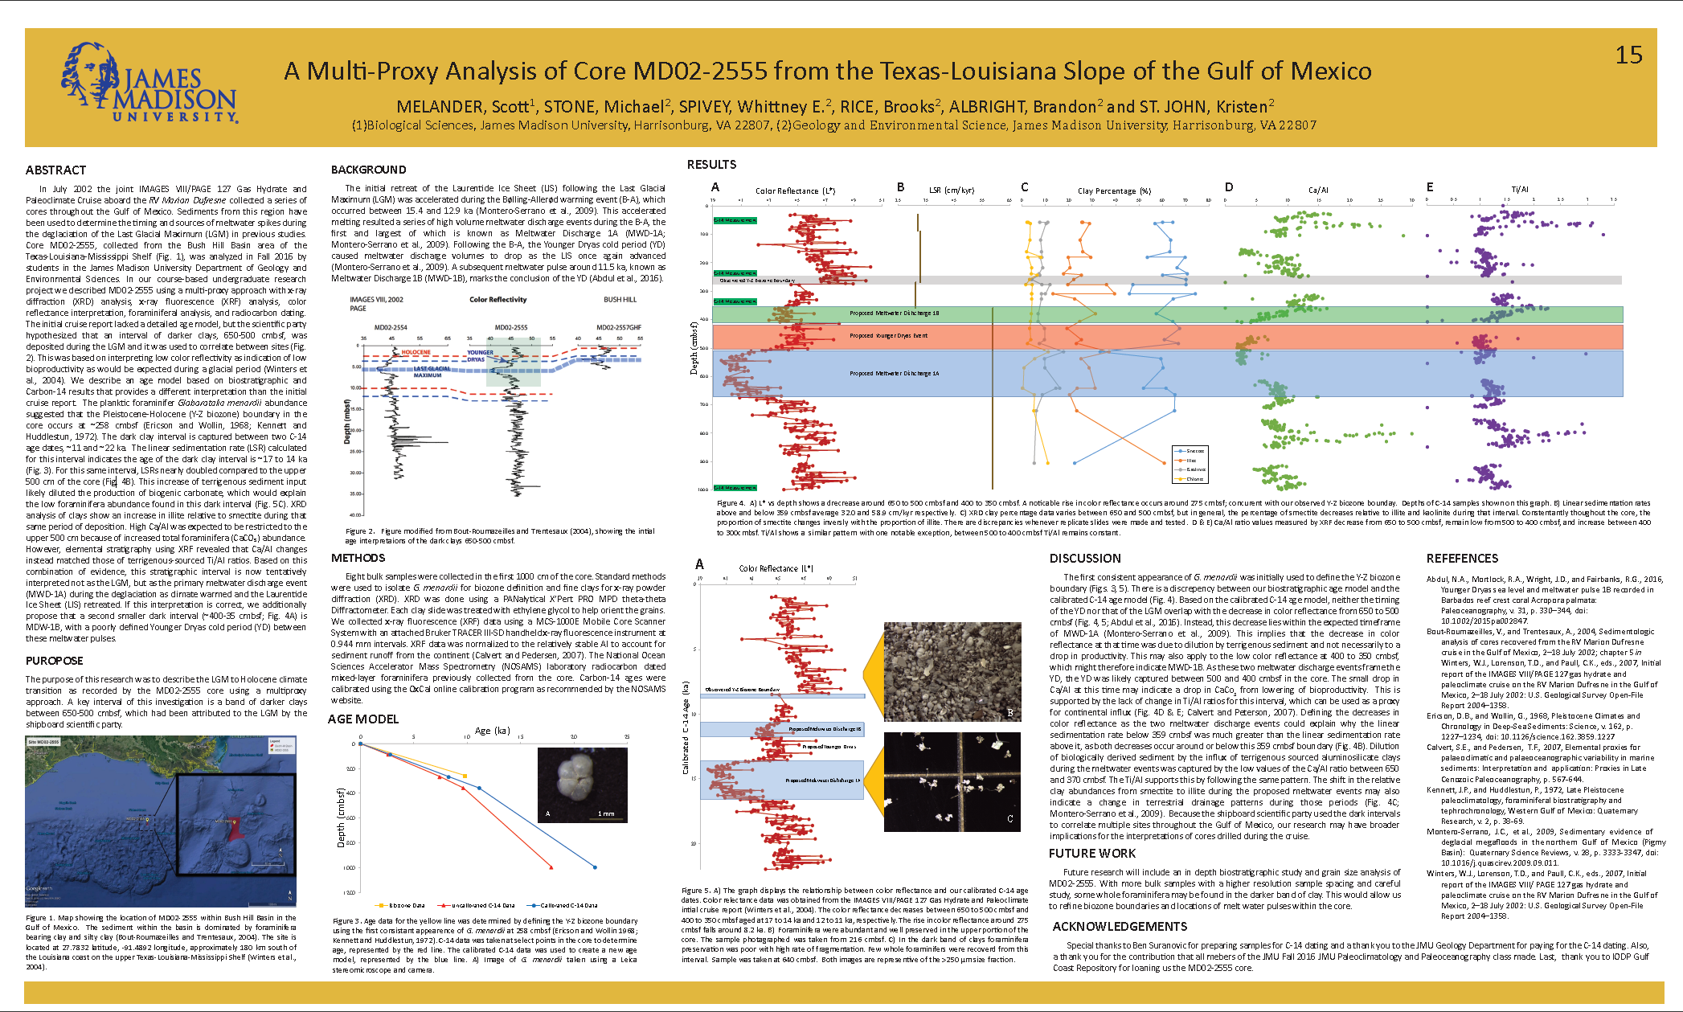
JMU Dept of Geology and Environmental Science
CURE (or partial-CURE) courses
Example 5: Paleoceanography & Paleoclimatology
Fall 2017 students doing grain size analysis to test hypotheses posed by last year’s class
Spring 2017 SE GSA poster presentation by Fall 2016 course students

Slide 21
JMU Dept of Geology and Environmental Science
CURE (or partial-CURE) courses: Faculty Observed Costs and Benefits
Benefits
Costs
Students’ earlier identification of potential individual research topics.
Students better prepared for the required individual research.
Higher quality of individual research presentations.
Greater analytical (critical thinking) skills(?)
Greater breadth of technical skills.
Increase in the number of students who do research in areas (and with faculty) they didn’t before.
Increase in the number of students who apply and are admitted to graduate school in specific research areas.
Curriculum argument for new analytical instrumentation purchases.
Much more time-intensive for faculty than teaching a “regular” course.
Trade offs: course embedded research means more “global material” not covered.
Small class size (5 to 16 students).
Time-intensive, hands-on, collaborative nature of this class is not of interest to all students.
$$ (e.g., travel, instrumentation)
Increased risk that analytical equipment breaks.
Administrative hurdles: How to count faculty time? As teaching or research?

Slide 22
JMU Dept of Geology and Environmental Science
CURE (or partial-CURE) courses:
Summary of Faculty Observed Costs and Benefits
UREs: engage students
in research practice:
  Generate original results
  [Situate research in context of prior (published) work]
  Relevant problems of interest
  Collaborate/work in teams
  Iterative process
  Develop technical skills
  Reflective practice
  Communicate results
  Mentorship and student ownership
These upper level elective courses partially or fully meet the expectations of Undergraduate Research Experiences (UREs).
√
(√)
√
√
√
√
√
(√)
√

Slide 23
JMU Dept of Geology and Environmental Science:
Recall: Where do UREs and CUREs Currently Fit into the Curriculum?
Are the research-related programmatic learning goals being met in other ways, but are not represented in the current degree requirements?
Meeting the research degree requirement | Apprentice Model | Partial-CURE
19XX to 2010 | 3-credits of Individual Research
2010 to present | 2-credits of Individual Research | 1-credit course: Geowriting and Communication
+
YES

Slide 24
JMU Dept of Geology and Environmental Science
Alternative Model for how CUREs Could Fit into the Curriculum
Perhaps starting in 2018?
Meeting the research degree requirement | Partial-CURE | Upper level CURE elective | Apprentice Model
Option 1 | 1-credit course: Geowriting and Communication |  | 2-credits of Individual Research
Option 2 | 1 credit course: Geowriting and Communication | Upper level CURE elective (3 to 4 elective credits +1 credit towards research) | 1-credit of Individual Research (focus on presentation)
+
+
+

Slide 25
JMU Dept of Geology and Environmental Science
Opportunities for Program-Level Geo Ed Research
Knowledge and Skill Model
Ownership Model
Test the Corwin et al (2015) Pathways Models?
As a program:
Quantify Short-Term Outcomes and Measure Medium-Term Outcomes

