Slide 1
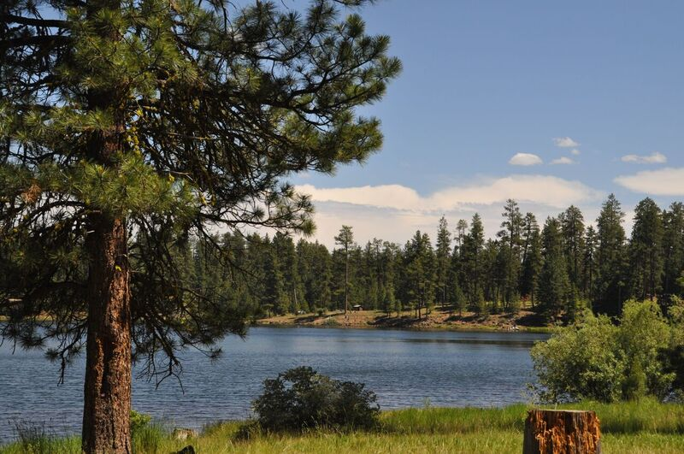
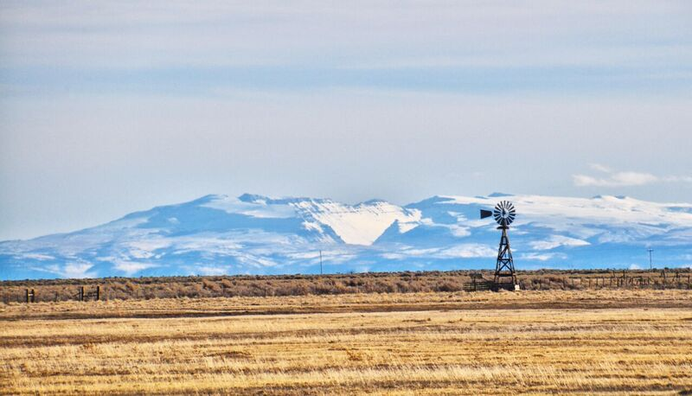
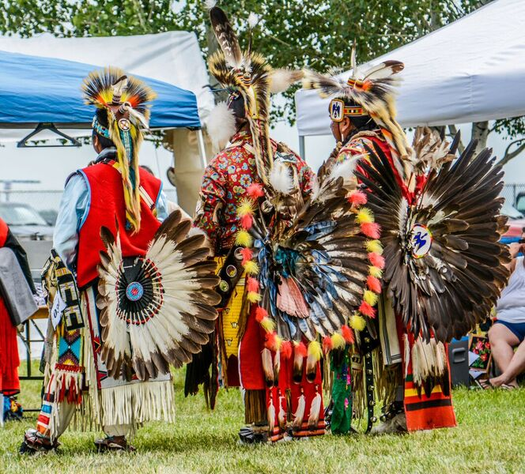
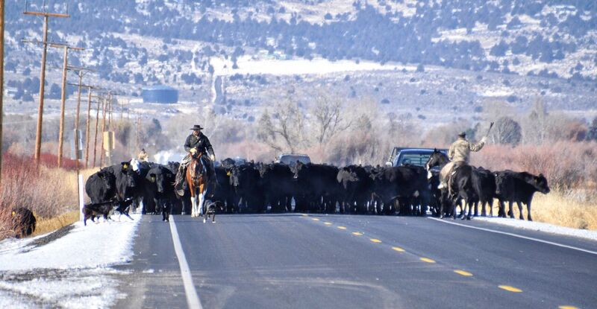
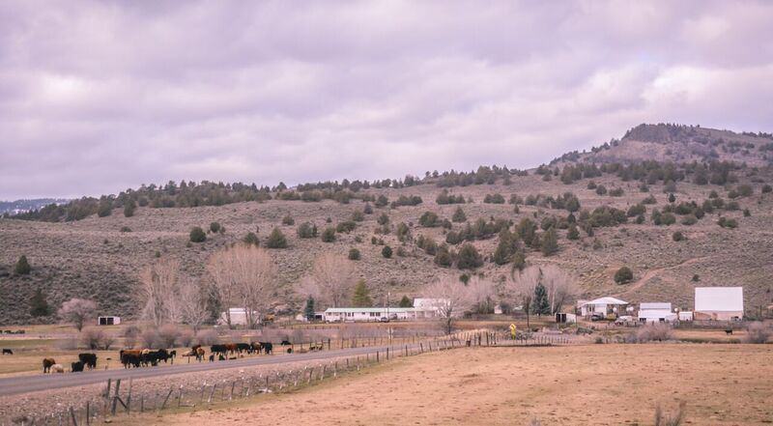
NGSS IN MULTI-GRADE CLASSROOMS: EXPERIENCES FROM RURAL EASTERN OREGON
Michael L. Cummings and Richard C. Hugo, Department of Geology, Portland State University
Connie Robbins, Crane Union High School District 1J, Crane, OR
Carolyn Koskela, Frenchglen School District 16, Frenchglen, OR
Linda Pelroy, Slater Elementary School, Harney County School District 3, Burns, OR
Karla Neuschwander, Double-O School District 28, Hines, OR
Photo by Andi Harmon
Abstract
Multi-grade classroom teachers must simultaneously guide multiple students of varying age through NGSS-disciplinary core ideas, science and engineering practices, and crosscutting concepts. A particular challenge is scaffolding curriculum over as many as eight years so that each student experiences no gaps and minimal redundancy. Our University/School Partnerships project includes 22 rural school districts: ten K-8 districts have two-room schools and seven K-12 districts have multi-grade classrooms. Our project developed a four-year repeating framework for multi-grade classrooms to support the progression of scientific knowledge all students must master to be successful in high school. The overall approach is to present lesson sequences organized by disciplinary core ideas and highly differentiated by depth of the core idea and level of science and engineering practice. The framework integrates NSTA Quick-Reference Guides to the NGSS for Elementary and Middle School, Proficiency Scales for the New Science Standards by Marzano and Yanoski, and websites that support NGSS. Objectives were created for scope and sequence units for disciplinary core ideas and guidelines for implementing standards at grade levels with lesson planning and activities. Work has been completed for “year one” of the four-year framework and, particularly for two-room districts, work is progressing for years 2, 3 and 4. A workshop introduced teachers to the framework and provided opportunity to explore units and tailor the framework to various multi-grade configurations in partnership districts. Classroom implementation and development of assessment strategies are supported through the Oregon Science Project of the Oregon Department of Education and Eastern Oregon University.
Photo by Andi Harmon
Oregon participation in NGSS
In March, 2013, Oregon joined the consortium of states adopting the Next Generation Science Standards in K-12 classrooms. The Oregon Science Project started in 2017 to support teachers during implementation of the standards and to prepare students for the first year of state-wide testing in the 2018-2019 school year.
Project History
The project is one component of a proposal funded through the U.S. Department of Education University/School Partnerships Title II-A Improving Teacher Quality Program. Twenty-two school districts in eastern Oregon formed the partnership with Portland State University.
Goals and Objectives of our partnership
1. Support multi-subject, multi-grade instruction in geographically isolated districts.
2. Encourage and support integration of cross cutting concepts from mathematics and English language arts with science and engineering design.
3. Provide access to technologies and the PD needed to integrate appropriate technologies in classroom instruction.
4. Foster learning communities across districts that support teachers at different stages of career and in new work assignments.
5. Provide ongoing, just-in-time PD and resources to support high-context, authentic science projects in- and across-districts.
6. Provide experiences for teachers in the practices of science and the development and use of models in scientific inquiry.
A challenge facing teachers in this project can be summarized by the following question.
How does a 4th grader learn science with an 8th grader?
The School Districts
Low population density and large geographic area (Table 1) encouraged creative approaches to professional development tailored to the strengths of districts. Among the 22 partner districts are 8 independent K-8 districts in Harney County, each with its own school board, that send students to Crane Union High School District. At Crane Union, many students live in dormitories during the four-day school week and return home to ranches for the weekend. If enrollment is great enough, these independent K-8 districts are configured with two classrooms, one for grades K-3 and one for grades 4-8. This project was initiated to provide a framework for teachers in these districts to implement NGSS
without gaps in student knowledge,
minimal redundancy,
prepare all students in the independent K-8 districts to enter Crane Union High School with a common background in science.
This poster presents how we propose to address the situation in the independent K-8 districts in Harney County. However, multi-grade classrooms are common in 17 of the 22 districts in our partnership.
Photo by Andi Harmon
Table 1: K-8 districts of Harney County
2017-2018 District size
enrollment square miles
Harney County SD #4 87 2119
Drewsey SD #13 8 378
Pine Creek SD #5 9 294
Frenchglen SD #16 3 2283
South Harney SD #33 14 1708
Suntex SD #10 13 1283
Double-O SD #28 3 223
Diamond SD #7 6 630
Harney County High SD #1J 54 8918
Photo by Andi Harmon
Photo by Andi Harmon

Slide 2
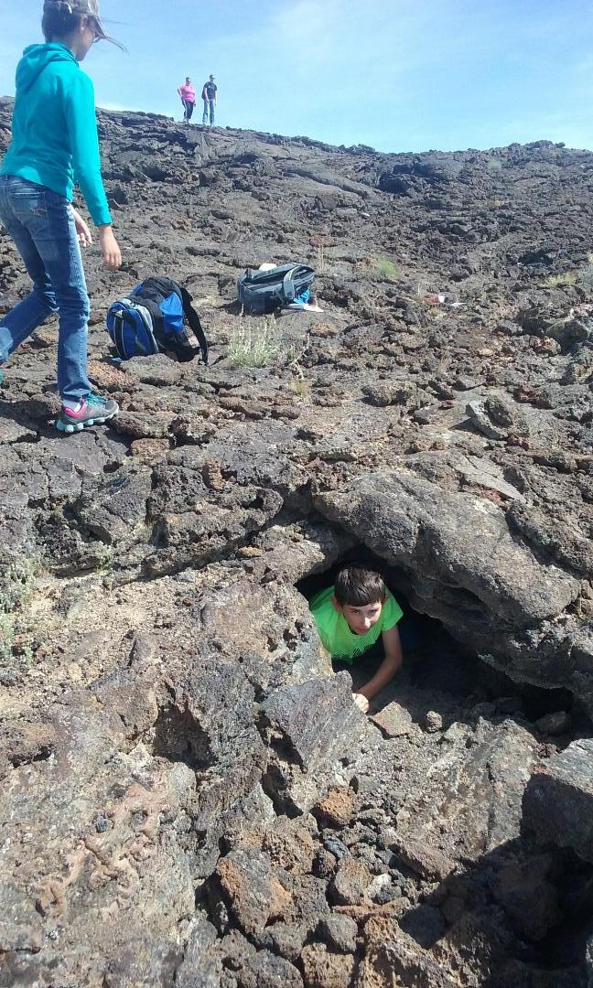
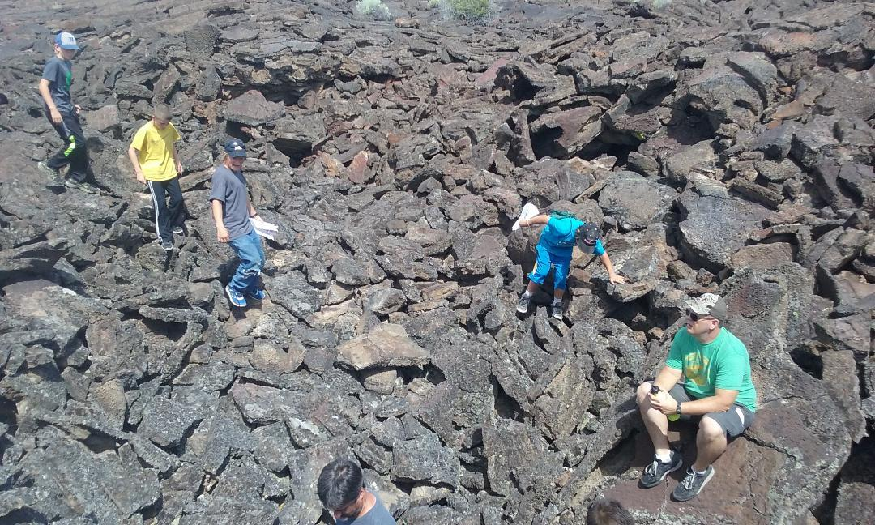
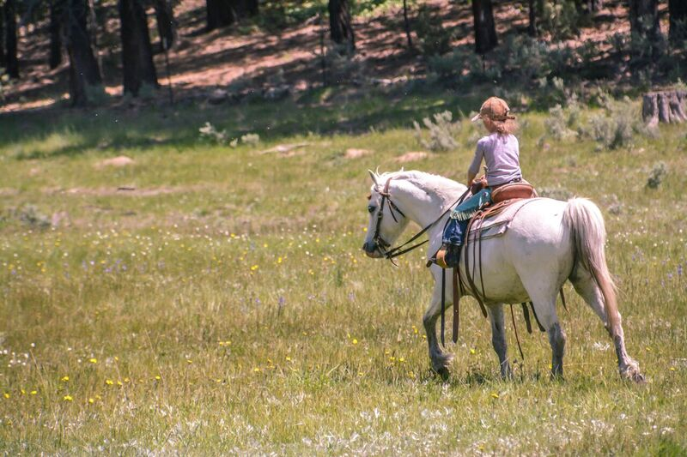
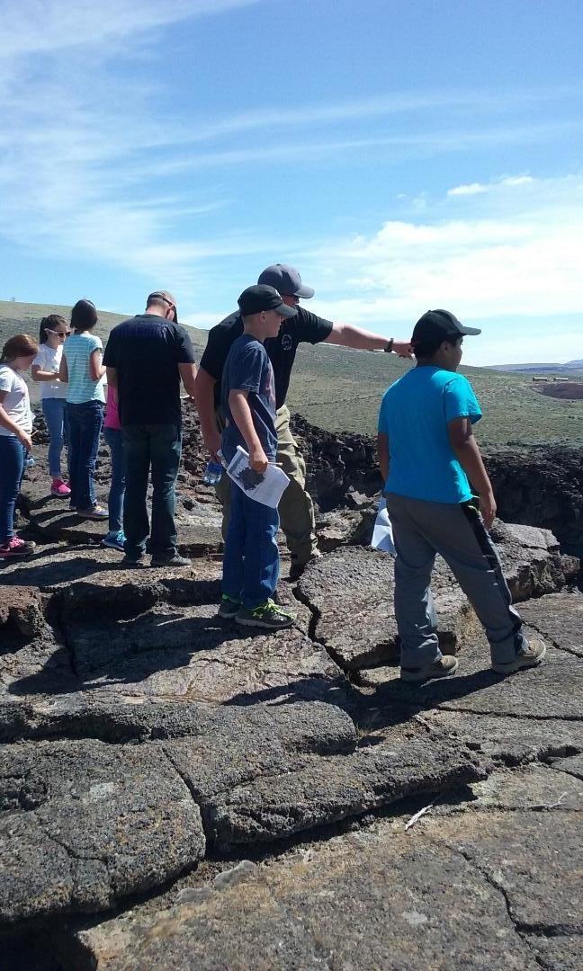
Michael L. Cummings cummings@pdx.edu
Richard C. Hugo hugo@pdx.edu
Connie Robbins robbinsc@harneyesd.k12.or.us
Carolyn Koskela koskelac@harneyesd.k12.or.us
Linda Pelroy pelroyl@harneyesd.k12.or.us
Karla Neuschwander neuschwk@harneyesd.k12.or.us
Example K-3 Unit with Proficiency Scale
NGSS IN MULTI-GRADE CLASSROOMS
YEAR ONE Grade K-3 Earth and Space Science The Solar System: Seasons
Unit: (1-ESS1-2): Make observations at different times of year to relate the amount of daylight to the time of year. (for example, use observations—firsthand or from media—to make relative comparisons of the amount of daylight in the winter to the amount in the spring or fall). NGSS Suggested Phenomena: The days are getting longer! How do we know that summer is coming? Time-lapse seasons with sounds of the seasons A Year on Planet Earth (video) |  |  |  | Class activities More information on phenomenon
Score 4.0 (Knowledge application lessons) | The student will: Develop a model of the relationship between the Earth, Sun, and Moon. |  |  | Examples of ways to create model; clay, paper mache, pencil & paper, etc. | Specific topics/ lesson plans
 | Score 3.5 |  | In addition to score 3.0 performance, partial success at score 4.0 content
Score 3.0 (practicing and deepening lessons) | The students will: Make observations at different times of year to relate the amount of daylight to the time of year. |  |  | Compare the amount of daylight in winter to the amount in spring/fall. Draw shadows on the side walk to notice how the position of the sun moves. Children’s book: Next Time You See a Sunset Anchor chart of earth’s movement around the sun to show seasons Seasons Chart Anchor chart of rotate vs. revolve of the earth Rotate vs. Revolved
 | Score 2.5 |  | No major errors or omissions regarding score 2.0 content, and partial success at score 3.0 content
Score 2.0 (direct instruction lessons) | The students will: Recognize or recall specific vocabulary: comparison, daylight, fall, observation, spring, summer, sun’s position, sun’s size, sunrise, sunset, winter, and year. Make and record observations of the amount of sunlight at different times of the year. |  |  | Download an app on the iPad such as Sunset & Rise Share a picture model of the entire solar system with emphasis on the connection Earth has to it, the sun, and the moon. Sunset and Shadows Chapter 19 from ­Even More Picture-Perfect Science Lessons, K-5 Using the books Twilight Comes Twice by Ralph Fletcher & Next Time You See a Sunset by Emily Morgan
 | Score 1.5 | Partial success at score 2.0 content and major errors or omissions regarding score 3.0 content
Score 1.0 | With help, partial success at score 2.0 content and score 3.0 content
 | Score 0.5 | With help, partial success at score 2.0 content and score 3.0 content
Score 0.0 | Even with help, no success
NGSS in the multi-grade classroom website: https://sites.google.com/a/pdx.edu/multigrade-ngss/home
Project Timeline
Core group meets September 2016
Study Marzano and NSTA books
Present K-3 and 4-8 NGSS framework at K-8 workshop
November 2016
Develop scope and sequence of lessons
Find lessons that support scope and sequence
October 2016- July 2017
Year 1 ready for implementation July 2017
Workshop to roll out year 1 to partner districts
August 2017
ZOOM sessions start with Oregon Science Project
September 2017
Year 2 completed for implementation
Projected for August 2018
Total Implementation completed in 2020-2021
Curriculum Scope and Sequence
Crosscutting Concept |  | Year 1 | Year 2 | Year 3 | Year 4
Universal concepts: Patterns Scale, Proportion, and Quantity Cause and Effect | Matter and Energy K-3
 | Matter and Energy 4-8
 | Systems, Change, and Stability K-3
 | Systems, Change, and Stability 4-8
 | Structure and Function K-3
 | Structure and Function 4-8
Legend
Electric and Magnetic Forces:
3-PS2-3, 3-PS2-4
Energy Conservation and Energy Transfer: Sunlight
K-PS3-1, K-PS3-2
Information Technologies: Communication over a distance
1-PS4-4
Forces and Interactions: PUSH PULL
K-PS2-1 , K-PS2-2, 3-PS2-1 , 3-PS2-2
Electromag Radiation: Light
1-PS4-2 1-PS4-3
States of Matter: Melting and Freezing
2-PS1-4
Waves: Sound
1-PS4-1
Water and Earth’s Surface: Water (States of Matter)
2-ESS2-3
(from K-3 year 4)
Matter and Energy: Survival of Organisms
K-LS1-1, 2-LS2-1
Weathering and Erosion: Wind and Water
2-ESS2-1
Structure and Properties of Matter
2-PS1-1, 2-PS1-2, 2-PS1-3
Forces/Interactions: Newton’s Law
4-PS3-3, MS-PS2-1, MS-PS2-2
Energy Definitions: Potential/Kinetic Energy
4-PS3-1, MS-PS3-1, MS-PS3-2
Information Technologies: Information Transfer
4-PS4-3 , MS-PS4-3
Gravity: Mass and Direction
5 -PS2-1, MS-PS2-4
Energy Conservation and Transfer: Kinetic Energy
4-PS3-2, 4-PS3-4, ,MS-PS3-3, MS-PS3-4, MS-PS3-5
Information Processing: Senses
4-LS1-2, MS-LS1-8
(from K-3 year 4)
Electric and Magnetic Forces: Strength of Forces
MS-PS2-3, MS-PS2-5
Waves: Water- Properties of Waves
4-PS4-1, MS-PS4-1, MS-PS4-2
YEAR ONE Grade 4-8 Earth and Space Science The Solar System: Cycles of Solar Systems
Unit: (5-ESS1-2): Represent data in graphic displays to reveal patterns of daily changes in length and direction of shadows, day and night, and the seasonal appearance of some stars in the night sky. NGSS (MS-ESS1-1): Develop and use a model of the earth-sun-moon system to describe the cyclic patterns of lunar phases, eclipses of the sun and moon, and seasons. NGSS (MS-ESS1-2): Develop and use a model to describe the role of gravity in the motions within galaxies and the solar system. NGSS (MS-ESS1-3): Analyze and interpret data to determine scale properties of objects in the solar system. NGSS Suggested Phenomena: Solar and/or lunar eclipses-How do the cyclic patterns of planetary bodies affect human observations of season, lunar phases, and eclipses? |  |  |  | Class activities More information on phenomenon Information on Solar Eclipse: https://eclipse2017.nasa.gov/
Score 4.0 (Knowledge application lessons) | The student will: Use the model to create an explanation of how the patterns affect observable patterns of lunar phases, eclipses of the sun and moon, and seasons. |  |  |  | Specific topics/ lesson plans
MS-ESS1-1 | Score 3.5 |  | In addition to score 3.0 performance, partial success at score 4.0 content
Score 3.0 (practicing and deepening lessons) | The student will: Use a model to describe the role of gravity in the motions within galaxies and the solar system. Include gravity as the force holding the solar system together. They will also analyze and interpret data to determine scale properties of objects in the solar system. Include space-based telescopes and space craft to determine similarities and differences among objects in the solar system. Create a model of the Earth-sun-moon system to describe patterns of lunar phases, eclipses of the sun and moon, and seasons. They will include the accuracy of size and distance to each planet and the relationship between the earth and moon and tilt of the axis. Represent data to show patterns of daily changes in length and direction of shadows, day and night, and seasonal appearance. |  |  | Students will study and learn about the role of gravity and orbits within the solar system. They will analyze and interpret data from objects in the solar system. http://phet.colorado.ed/en/contributions/view/3401 http://phet.colorado.ed/en/contributions/view/3566 Use books to help with this unit. Eclipse by Phillips Harrington and Total Solar Eclipse 2017 by Marc Nussbaum. Students will build hole cameras to observe the 2017 eclipse in August 2017. They will also build a Earth-sun-moon system to use in understanding eclipses, seasons, and the size and distances to each planet and relationships to all things in the solar system. Explore lunar and solar eclipses via a 3-D Modeling Design Task: http://static.nsta.or/files/ss1602_30.pdf
 | Score 2.5 |  | No major errors or omissions regarding score 2.0 content, and partial success at score 3.0 content
Score 2.0 (direct instruction lessons) 5-ESS1-2 | The student will: Recognize or recall vocabulary: Earth’s axis, Earth’s orbit, position in the sky, lunar phase, solar eclipse, elliptical orbit, meteor and asteroid movement patterns, scale property, planet composition, atmosphere, orbit radius Describe the lunar phases, lunar and solar eclipse, and how the seasons are created Describe the role of gravity in the motions within galaxies and the solar system Describe the scale properties of various objects in the solar system Review the solar system and plot data to reveal patterns of daily changes in length and direction of shadows, day and night, and seasonal appearances of stars in the night sky. They should also see patterns in the position and motion of the Earth with respect to the sun and stars. |  |  | The teacher will: Have students note length of shadows at different times of day to show times of day. They will also note sunrises and sunsets to determine seasons and the axis of the Earth. They will use a star chart to note visibility of stars at different times of the year. They will identify the relationships between sunrises and sunsets in creating shadows and solstices based on Earth’s axis. They will organize data to find similarities in the motion of the sun simulator and the rotating sky: http://astro.unl.edu/naap/motion3/motion3.html NSTA activities for Score 2
 | Score 1.5 | Partial success at score 2.0 content and major errors or omissions regarding score 3.0 content
Score 1.0 | With help, partial success at score 2.0 content and score 3.0 content
 | Score 0.5 | With help, partial success at score 2.0 content and score 3.0 content
Score 0.0 | Even with help, no success
Electromag Radiation: Sight
4-PS4-2
Structure and Properties of Matter
5-PS1-1, 5-PS1-3, MS-PS1-1
(from 4-8 year 4)
Matter/Energy in Organisms: Photosynthesis and Cellular Respiration.
5-LS3-1, 5-LS1-1, MS-LS1-6, MS-LS1-7
States of Matter: Building Blocks of Matter
MS-PS1-4
Conservation of Matter
5-PS1-2 MS-PS1-5
Photo by Linda Pelroy
Matter and Energy in Ecosystems: Food Chains
5-LS2-1, MS-LS2-3
Weathering and Erosion:
4-ESS2-1
Chemical Reactions:
5-PS1-4, MS-PS1-2, MS-PS1-3, MS-PS1-6
(from K-3 year 4)
The Solar System: Seasons
1-ESS1-2
Weather and Climate:
K-ESS2-1, 3-ESS2-1, 3-ESS2-2
Earth’s History: Dynamic Earth
2-ESS1-1
The Universe and Stars: Patterns of Celestial Bodies
1-ESS1-1
Natural Hazards: Severe Weather
K-ESS3-2, 3-ESS3-1
Plates Tectonics: Land Forms
2-ESS2-2
Ecosystem Dynamics: Diversity of Life/Habitats
2-LS4-1
Fossils: Common Ancestry
3-LS4-1
Relationships in Ecosystems: Animal behavior
2-LS2-2, 3-LS2-1
Biogeology : Changing the Environment
K-ESS2-2
Natural Resources: Living in the Environment
K-ESS3-1
(from K-3 year 4)
Humans and Earth Systems: Human Impact
K-ESS3-3
(from 4-8 year 4)
The Solar System: Cycles of Solar System
5-ESS1-2, MS-ESS1-1, MS-ESS1-2, MS-ESS1-3
Global Climate Change
MS-ESS3-5
Water and Earth’s Surface: Water Cycle
5-ESS2-2, MS-ESS2-4
Fossils: History of Life on Earth
MS-LS4-1
The Universe and Stars: Distances
5—ESS1-1
Weather and Climate: Causes
MS-ESS2-5, MS-ESS2-6
Earth Systems: Dynamic Earth
5-ESS2-1, MS-ESS2-2
Humans and Earth Systems: Human Impact
5-ESS3-1, MS-ESS3-3
Plates Tectonics: Earth’s Features and Evidence
4-ESS2-2, MS-ESS2-1, MS-ESS2-3
Relationships in Ecosystems; Patterns of Interactions
MS-LS2-2
Earth’s History: Rock Formations
4-ESS1-1, MS-ESS1-4
Humans/Ecosystems: Biodiversity, Ecosystem Services
MS-LS2-5
Ecosystem Dynamics: Populations and Ecosystems
MS-LS2-1, MS-LS2-4
Natural Resources: Living in the Environment
4-ESS3-1, MS-ESS3-1, MS-ESS3-4
(from K-3 year 4)
Growth and Development of Organisms: Life Cycles
1-LS1-2, 3-LS1-1
Structure and Function: Animal/plant Mimicry
1-LS1-1
Inheritance of Traits: Similarities in Species
1-LS3-1, 3-LS3-1
Adaptations: Environmental
3-LS4-3, 3-LS4-4
Photo by Andi Harmon
Variation of Traits: Diversity of Species
3-LS3-2
Natural Selection: adaptations species
3-LS4-2
(from 4-8 year 4)
Growth and Development of Organisms: Reproduction and Growth
MS-LS1-4, MS-LS1-5
Structure and Function: Body Systems
4-LS1-1, MS-LS1-3
Natural Selection: Evolution
MS-LS4-5, MS-LS4-4
Cell Theory: Parts, Cells and Functions
MS-LS1-1, MS-LS1-2
Adaptation: Evolution MS-LS4-6
*review traits
Natural Hazards: Effects on Humans
4-ESS3-2, MS-ESS3-2
Inheritance: Reproduction/Genetic Probability
MS-LS3-2
Evidence of Common Ancestry: Common Ancestry
MS-LS4-2, MS-LS4-3
Variation of Traits: Gene Mutation
MS-LS3-1
Physical Science Unit
Block of conceptually similar
4-8 unit that conceptually follows a unit offered the previous year in K-3
Earth Science Unit
units offered in
Unit that follows one offered the previous year in the same age bracket
Life Science Unit
the same year
Year 1 unit that follows a Year 4 unit
Year 4 unit that precedes a Year 1 unit
Any Unit with Engineering component
References
Marzano, R. J., Yanoski, D. C., & Paynter, D. E., (2016). Proficiency scales for the new science standards. Bloomington, IN: Marzano Research. ISBN: 978-0-9903458-9-3
NGSS Hub. (2014). Retrieved August, 2017, from National Science Teachers Association website: http://ngss.nsta.org/Default.aspx
NGSS Lead States. (2013). Next Generation Science Standards: For states by states. Retrieved 2017, from http://www.nextgenscience.org/get-to-know
* is a registered trademark of Achieve. Neither Achieve nor the lead states and partners that developed the Next Generation Science Standards were involved in the production of this product, and do not endorse it.
Willard, T. (Ed.). (2015). The NSTA Quick-Reference Guide to the NGSS. Arlington, VA: NSTA Press. ISBN: 978-1-941316-13-9
Photo by Linda Pelroy

