Slide 1
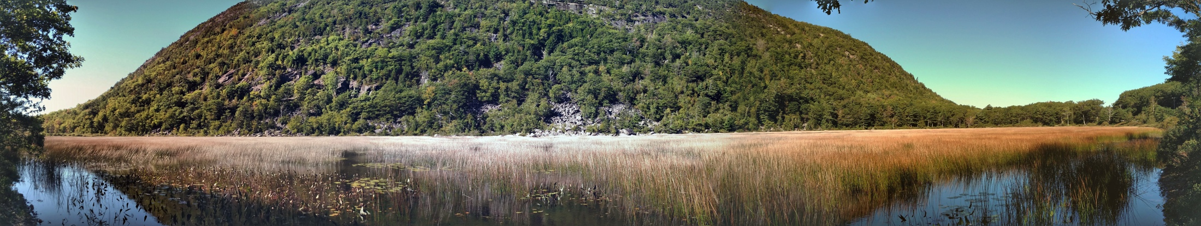




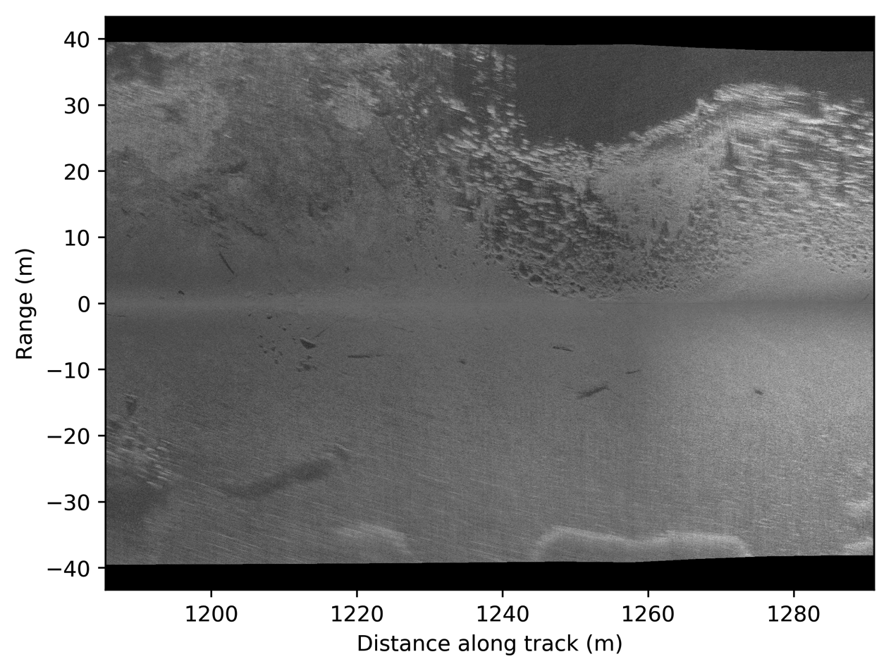
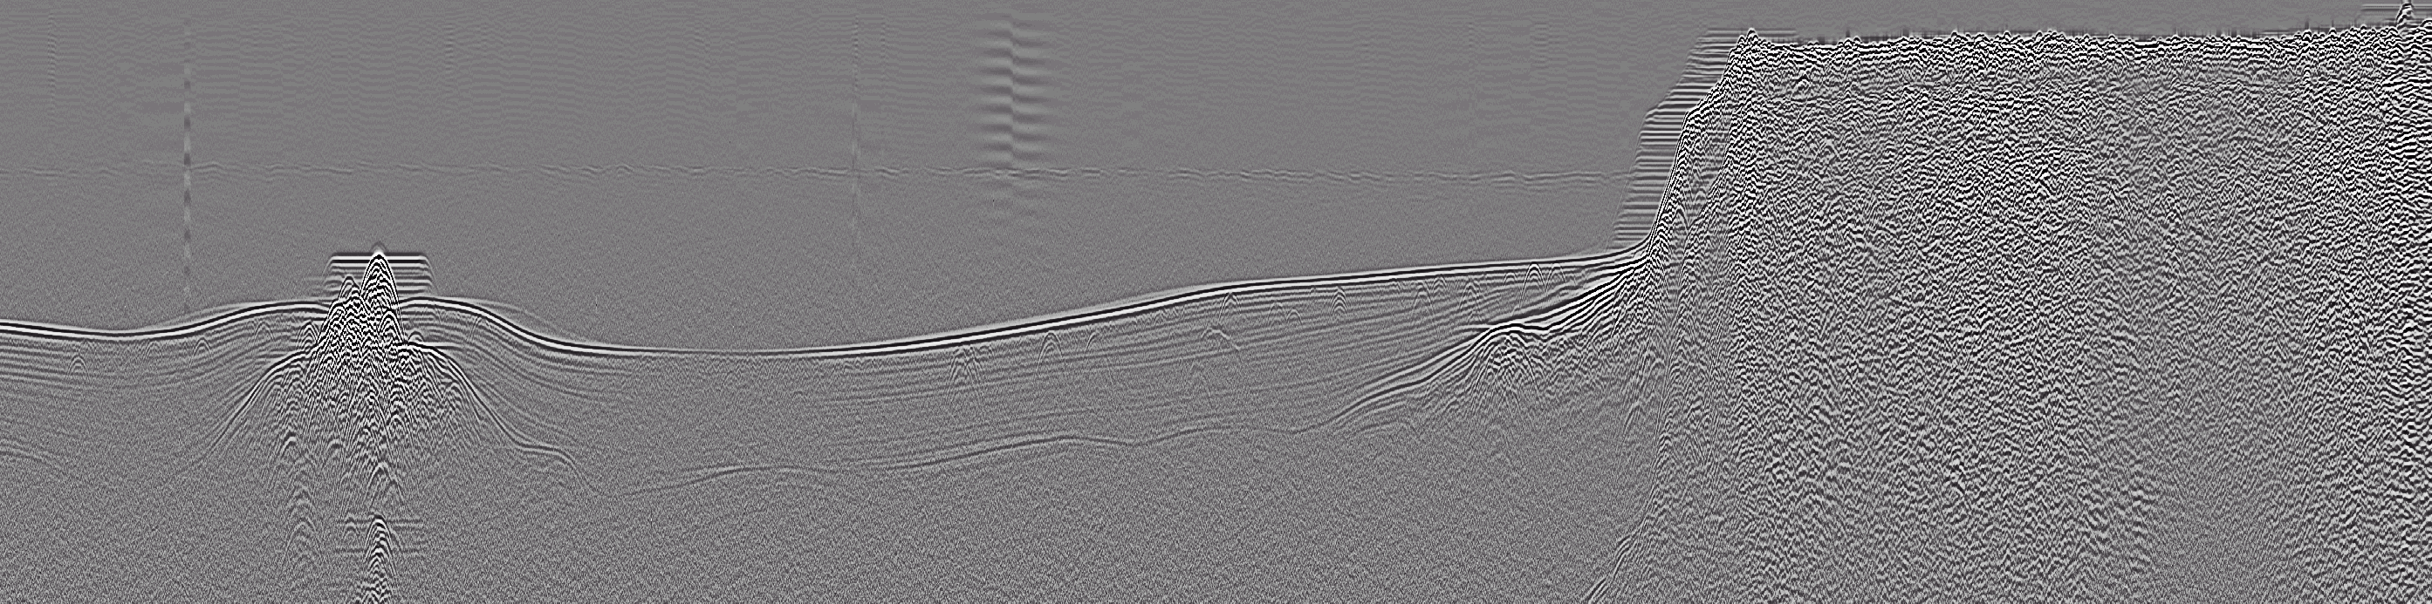
Investigating Holocene lacustrine sedimentation in New England using ground-penetrating radar and sidescan sonar
Seth Campbell^{1,2}, Ian Nesbitt¹, Steven Arcone², Sean Smith¹
¹ University of Maine, Orono, ME
² US Army Cold Regions Research and Engineering Laboratory, Hanover, NH

Slide 2
Key Point:
Lake sediments are not always uniformly deposited
Overview GPR Sidescan Setting Results Future

Slide 3
What are we looking for?
Total sediment volume
  Geophysics can help constrain error
  Resolve complex stratigraphy such as in Davis and Ford (1982) (Arcone, 2013)
Overview GPR Sidescan Setting Results Future

Slide 4

What are we looking for?
Total sediment volume
  Geophysics can help constrain error
  Resolve complex stratigraphy such as in Davis and Ford (1982) (Arcone, 2013)
Water
Till and/or bedrock
Gyttja
Inorganic fines
Overview GPR Sidescan Setting Results Future

Slide 5
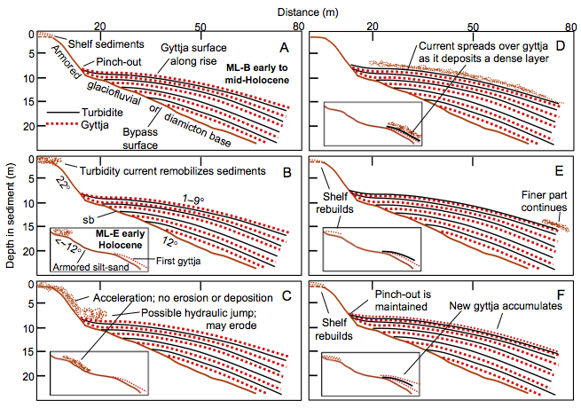
What are we looking for?
Total sediment volume
  Geophysics can help constrain error
  Resolve complex stratigraphy such as in Davis and Ford (1982) (Arcone, 2013)
Overview GPR Sidescan Setting Results Future

Slide 6
What are we looking for?
Total sediment volume
  Geophysics can help constrain error
  Resolve complex stratigraphy such as in Davis and Ford (1982) (Arcone, 2013)
Ultimately: Rates & Dates!
  Periodic rate
    Post-glacial
    Anthropogenic
  Bulk sediment yield rate
Overview GPR Sidescan Setting Results Future

Slide 7
Questions
What is the Holocene sedimentation rate in Penobscot Wshd / Maine / N. E.?
Do Holocene and Anthropocene rates differ?
Hypotheses:
  Rates in Maine ≈ low
  Humans have influence
Overview GPR Sidescan Setting Results Future
Notes:
Maine and New England in general
Analyzing the imprinting of industrial revolution influence on sedimentation through the building of dams and deforestation of watersheds
- How does changing the trapping efficiency and sediment supply characteristics influence lacustrine sedimentation rates?

Slide 8
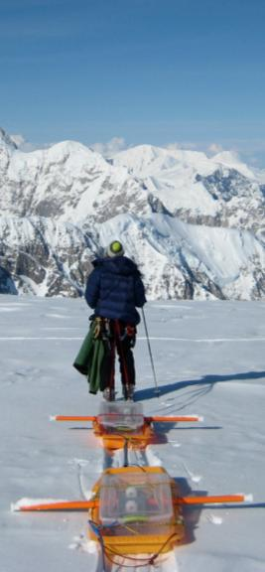
Ground Penetrating Radar – The Basics
Computer
Receiver
Transmitter
Tow
Person
-
+
Surface (ice, water)
Shallow
Sled
L1
Transmitter
Electrical
Contrast
L2
Receiver
Depth
Deep
L3
Data Recorder
Bedrock
System Operator
L4
Overview GPR Sidescan Setting Results Future
Notes:
- TWTT and amplitude denotes gradient in electrical contrast
- Conductivity = bad

Slide 9
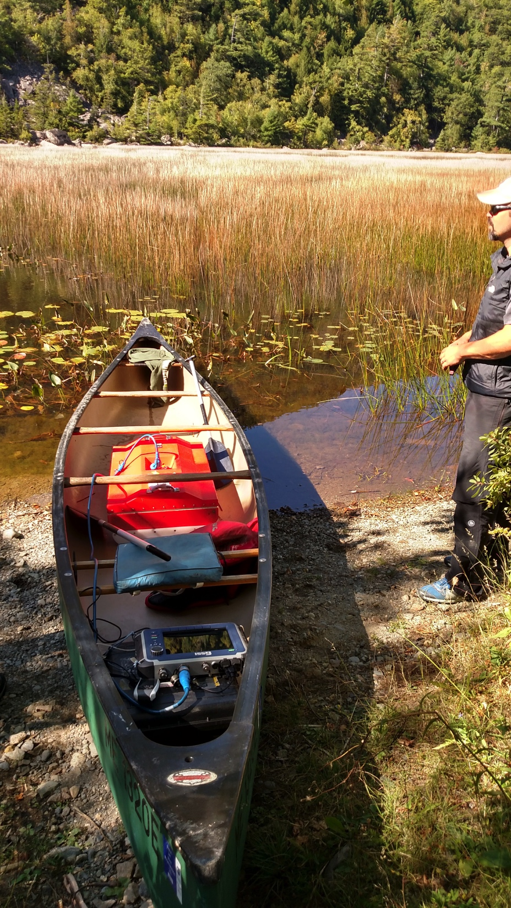
Lake GPR in Practice
Key points:
Water conductivity
Gas / organics
Overview GPR Sidescan Setting Results Future

Slide 10
Lake GPR in Practice
3207 100 MHz antenna
SIR 4000 field computer
Key points:
Water conductivity
Gas / organics
RADAN 7
or conversion to HDF5 / SEG-Y
github.com/iannesbitt/readgssi
Overview GPR Sidescan Setting Results Future

Slide 11
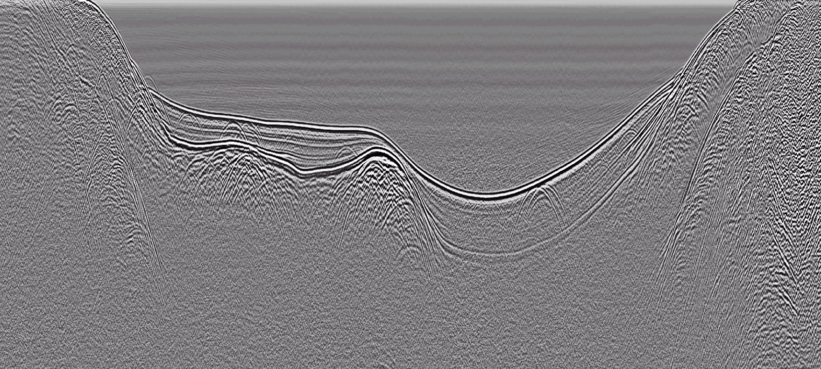
320
240
Ground Penetrating Radar – Data
200
Distance (m)
40
160
280
360
5
120
10
1500
Water
80
1250
15
Depth (ns)
Depth (m)
1000
20
Sediments
750
25
500
Till/Bedrock
1750
30
0
250

Slide 12
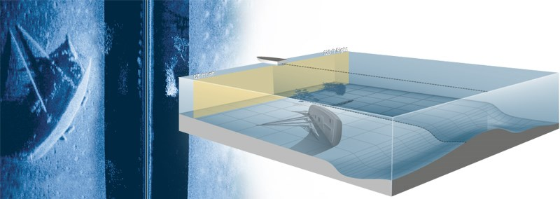
Sidescan Sonar – The Basics
Key points:
Brightness = reflectivity
Texture changes
https://www.humminbird.com/Category/Technology/Side-Imaging/ (accessed 2017-10-04)
Overview GPR Sidescan Setting Results Future
Notes:
On a lake that’s not so filled with organics,
Reflectivity may indicate:
- Hardness
- Angle of incidence

Slide 13


Sidescan Sonar – The Basics
Key points:
Brightness = reflectivity
Texture changes
https://www.humminbird.com/Category/Technology/Side-Imaging/ (accessed 2017-10-04)
Buscombe et al. (2016)
github.com/dbuscombe-usgs/pyhum
999ci HD SI Combo
Overview GPR Sidescan Setting Results Future
Notes:
On a lake that’s not so filled with organics,
Reflectivity may indicate:
- Hardness
- Angle of incidence

Slide 14
Sidescan Sonar – Data
Shoreline
Till
Boat Track
Woody debris
Fine-grained sediment
Till
Overview GPR Sidescan Setting Results Future

Slide 15
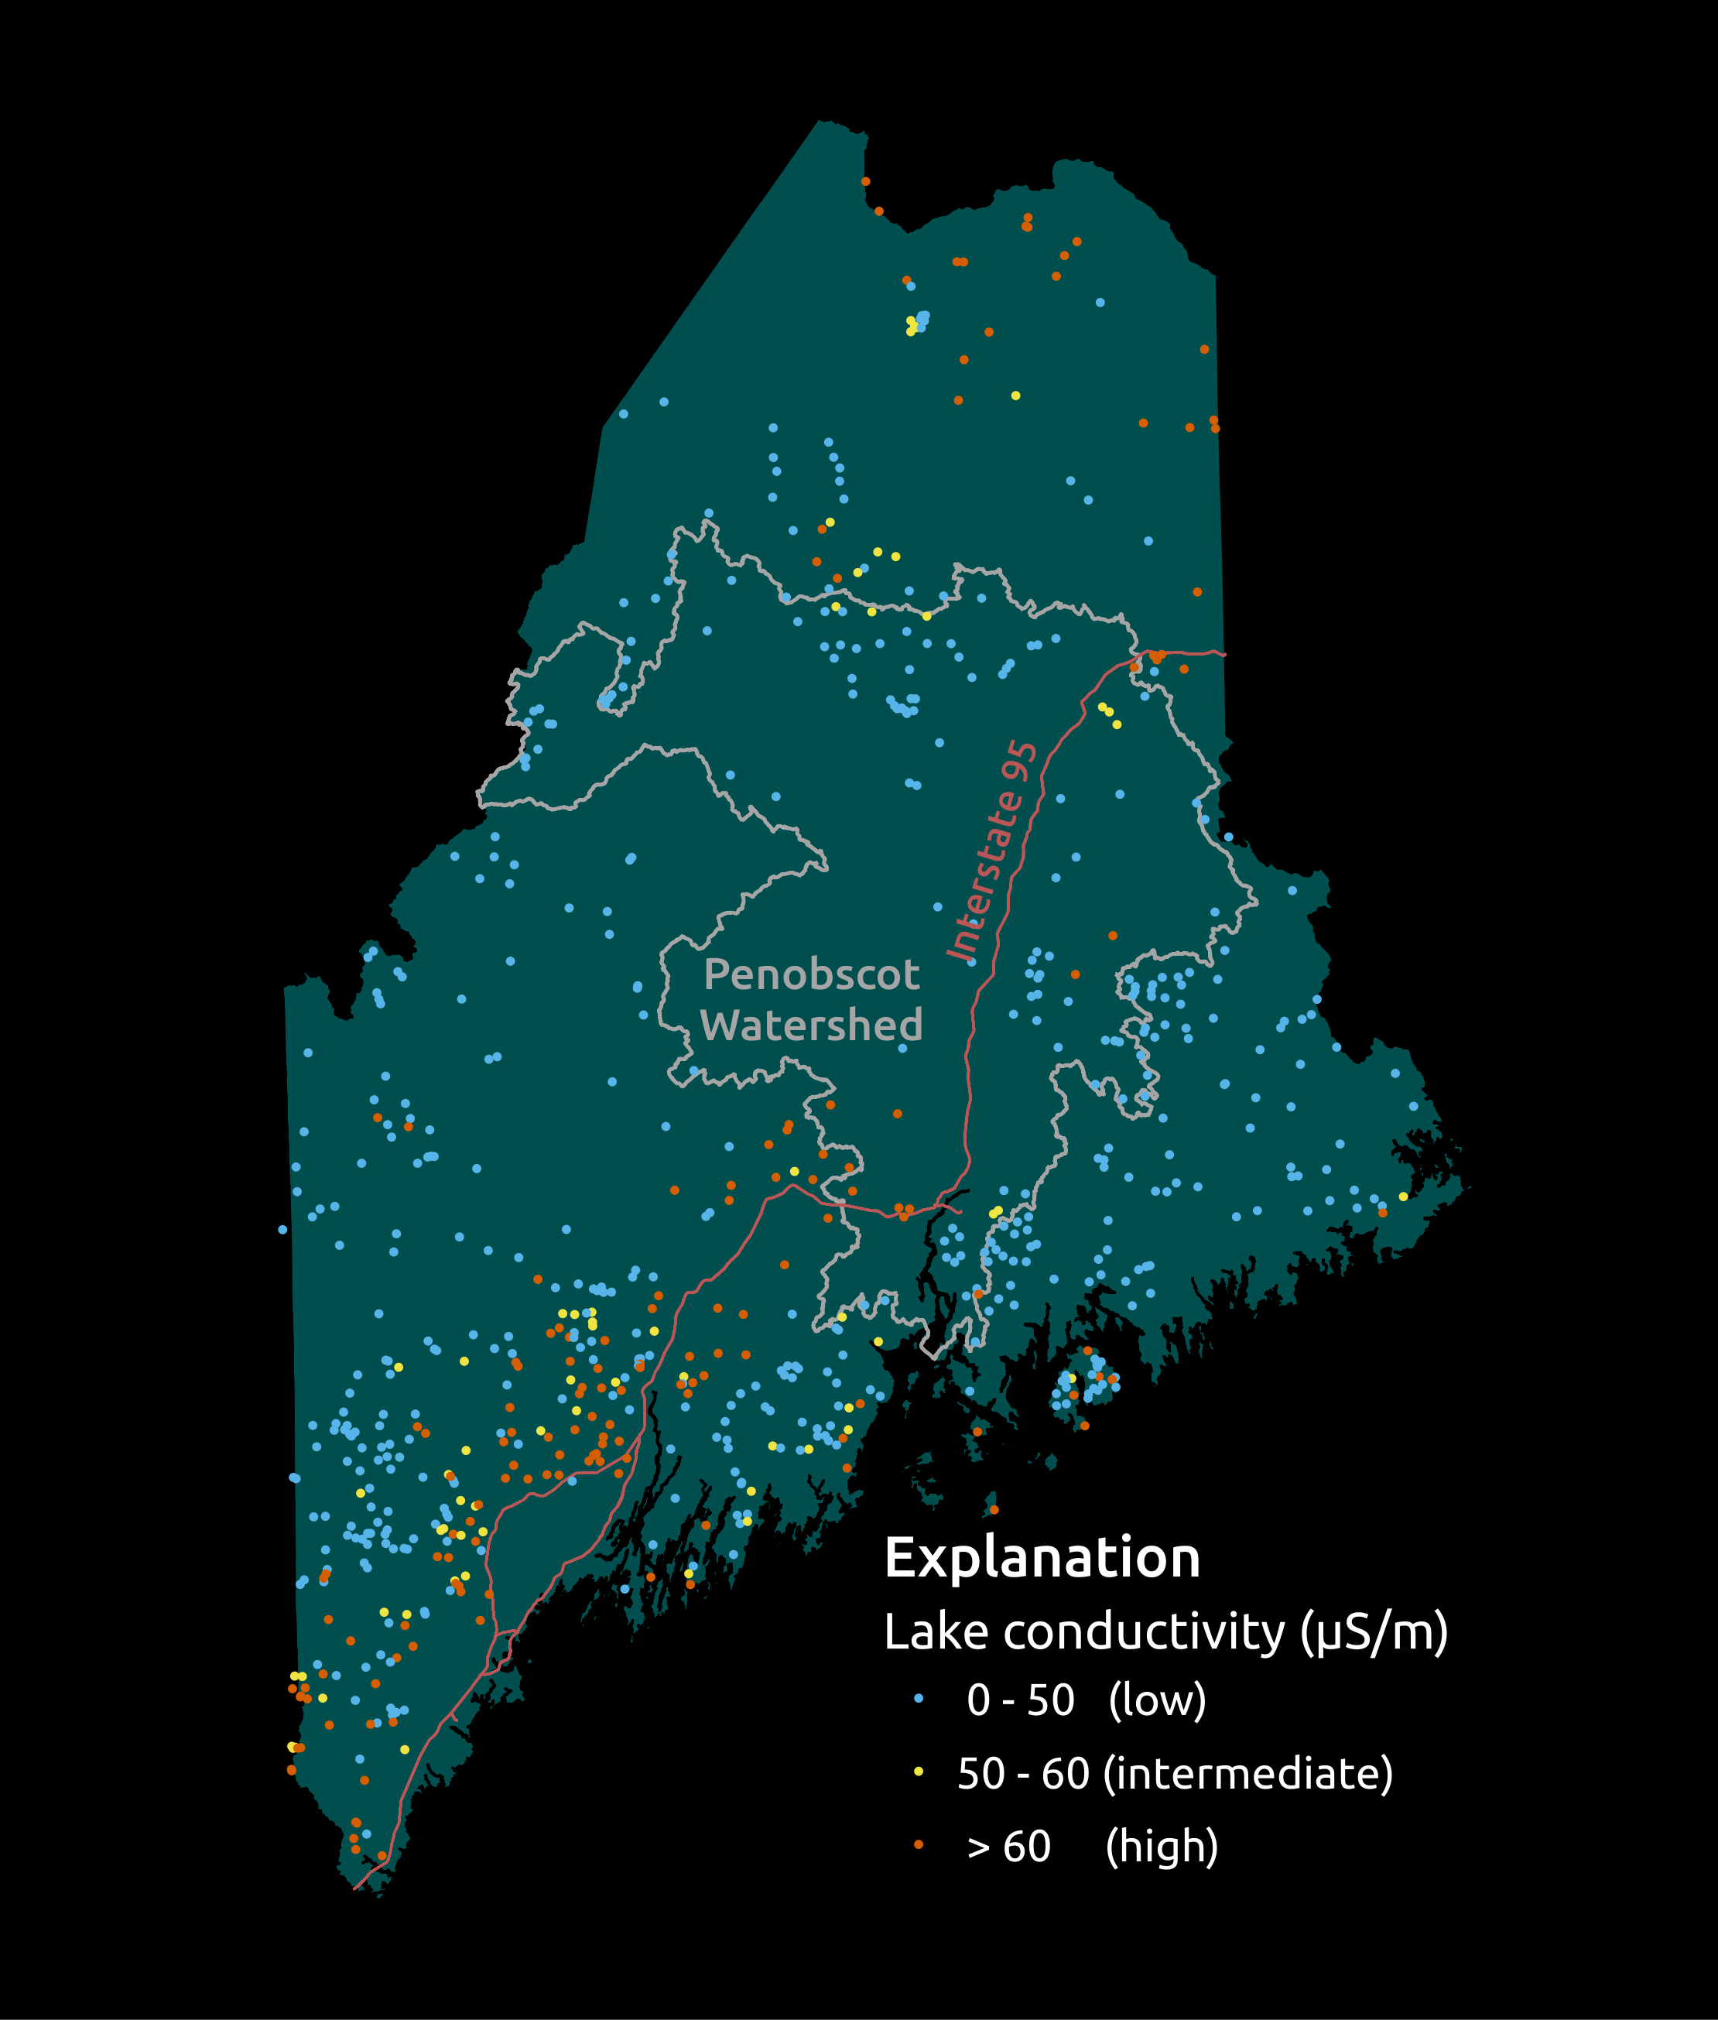
Setting - Conductivity
Key point:
Influence of development
Overview GPR Sidescan Setting Results Future

Slide 16
Setting - Conductivity
Key point:
Transect through deglaciation
Overview GPR Sidescan Setting Results Future

Slide 17
Results locations
Kingsbury Pond, ME
South Pond, NH
Overview GPR Sidescan Setting Results Future
Notes:
Just going to show a couple of results

Slide 18
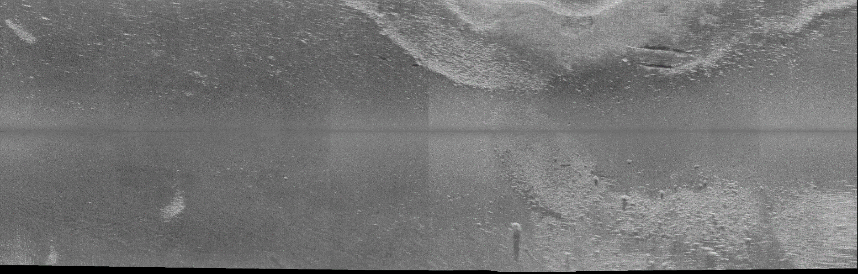
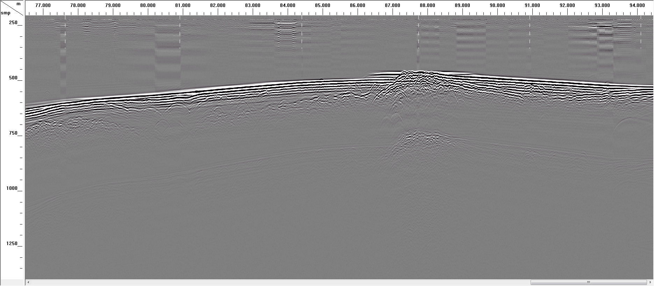
Key Points:
Post-glacial E & D - Anthropogenic/Post-industrial E & D
+30
Pre-dam shoreline
+20
+10
Boat Track
0
Range (m)
-10
Till
-20
Fine-grained sediment
-30
Pre-dam shoreline
Distance (m)
0
50
100
150
200
0
Water
Till
2.5
Fine-grained sediment
Depth (m)
5.0
7.5
Multiple
Distance along track (m)
Overview GPR Sidescan Setting Results Future
Notes:
Difference between soft and hard sediments
Evidence of dam
Challenge of this study (and why GPR and sidescan are important) is disentangling shoreline remobilization from actual basin yield
Applied a background removal filter (FIR)

Slide 19
Key Points:
Volume vs. point measurement for sedimentation rate
Selecting core sites
Source to Sink E&D Studies since LGM, industrial influence
Overview GPR Sidescan Setting Results Future

Slide 20
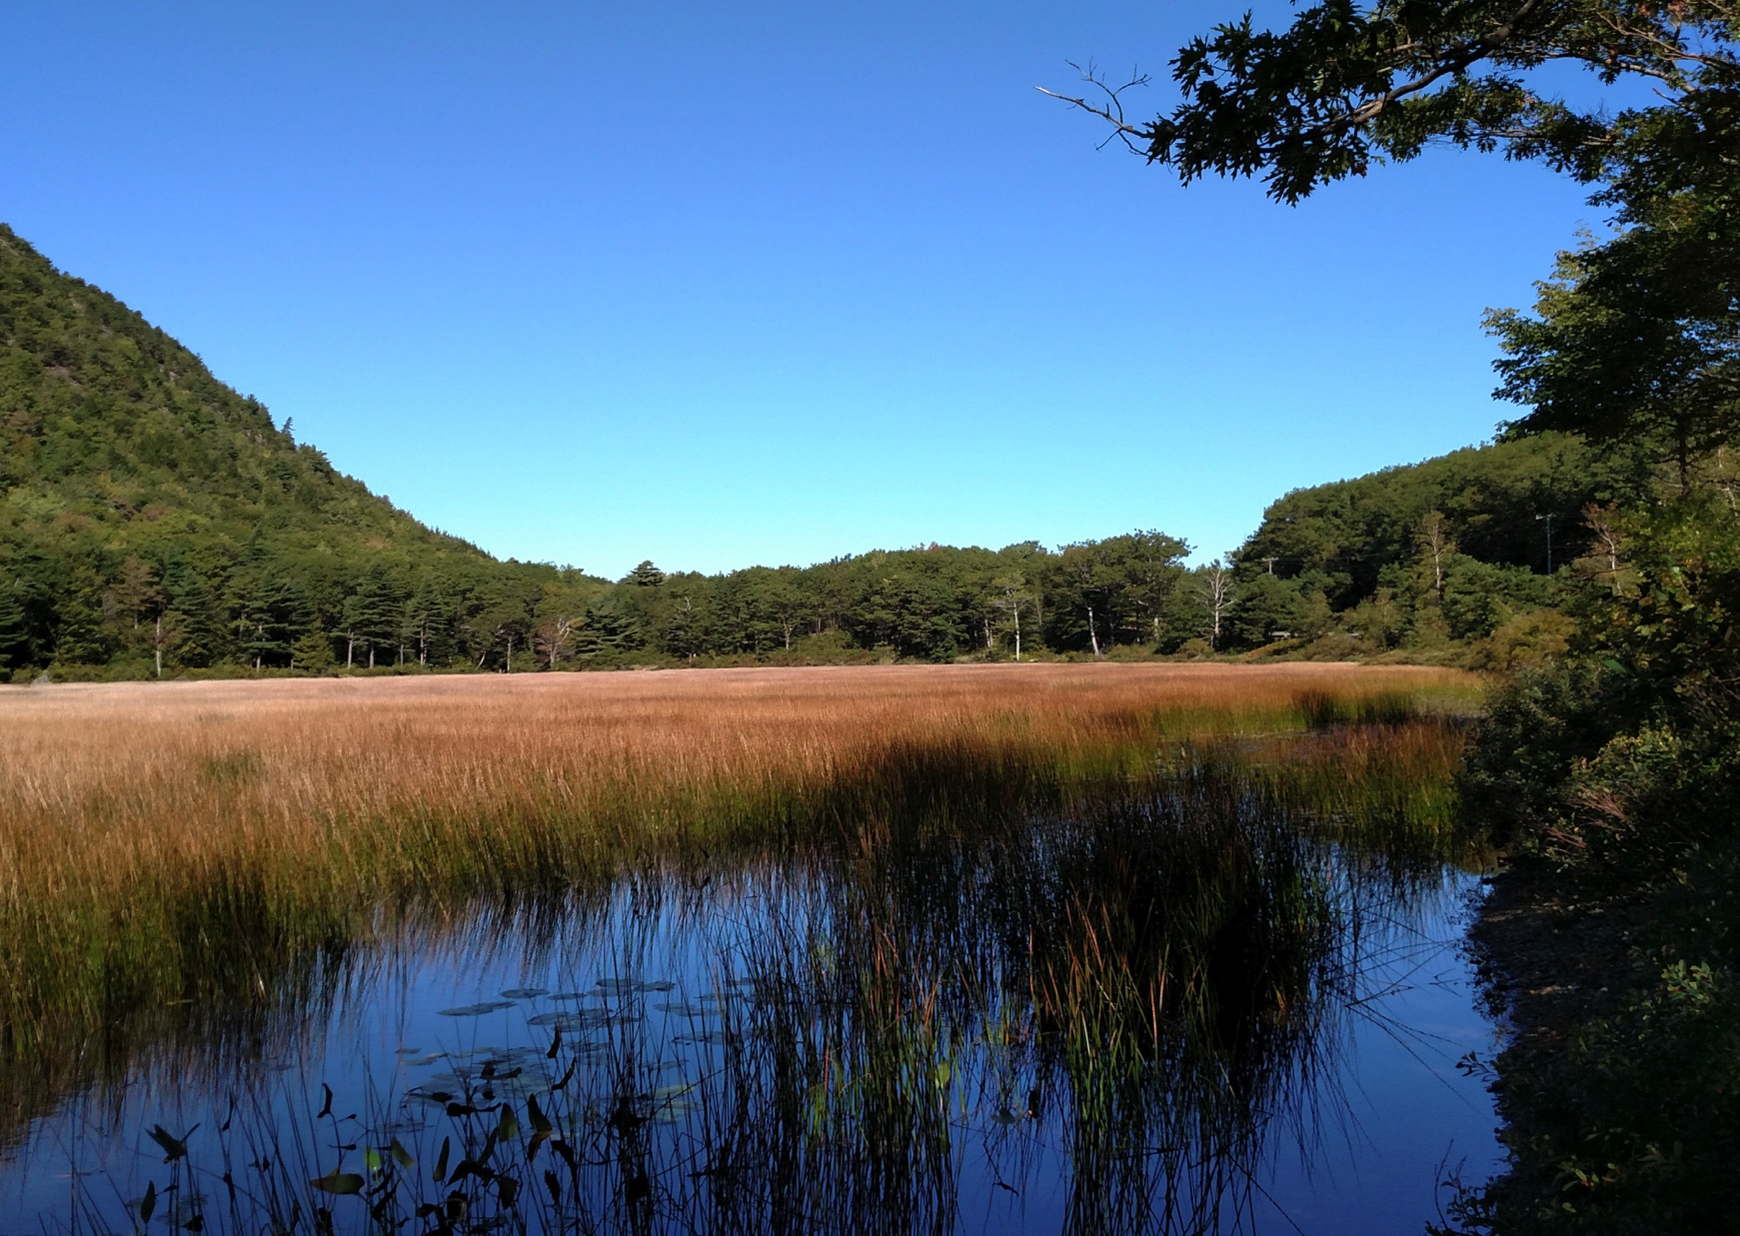
Acknowledgements
US Park Service
Senator George J. Mitchell Center for Sustainability
Andrew Newcomb
Brenda Hall
David Dethier
Christopher Dorion
Stephen Norton
Katherine Allen
Cody Barnett
Overview GPR Sidescan Setting Results Future

Slide 21
Questions?
Overview GPR Sidescan Setting Results Future

Slide 22
References
Arcone, S.A., 2013, GPR Profiles of Mirror Lake, NH: Exceptional Signal Penetration in Low Conductivity Water and Subbottom Sedimentation, in American Geophysical Union, Fall Meeting 2013,.
Arcone, S.A. Sedimentary architecture beneath lakes subjected to storms: Control by turbidity current bypass and turbidite armouring, interpreted from GPR images: Sedimentology,.
Borns, H.W., Doner, L.A., Dorion, C.C., Jacobson, G.L., Kaplan, M.R., Kreutz, K.J., Lowell, T. V., Thompson, W.B., and Weddle, T.K., 2004, The deglaciation of Maine, U.S.A., in Developments in Quaternary Science, v. 2, p. 89–109, doi: 10.1016/S1571-0866(04)80190-8.
Buscombe, D., Grams, P.E., and Smith, S.M., 2016, Automated Riverbed Sediment Classification Using Low-Cost Sidescan Sonar: Journal of Hydraulic Engineering, v. 142, p. 1–7, doi: 10.1061/(ASCE)HY.1943-7900.0001079.
Davis, M.B., and Ford, M.S. (Jesse), 1982, Sediment focusing in Mirror Lake, New Hampshire: Limnology and Oceanography, v. 27, p. 137–150, doi: 10.4319/lo.1982.27.1.0137.
Johnson Outdoors Marine Electronics Inc, 2017, Humminbird Side Imaging:, https://www.humminbird.com/Category/Technology/Side-Imaging/ (accessed October 2017).
Smith, S.M., and Wilcock, P.R., 2015, Upland sediment supply and its relation to watershed sediment delivery in the contemporary mid-Atlantic Piedmont (U.S.A.): Geomorphology, v. 232, p. 33–46, doi: 10.1016/j.geomorph.2014.12.036.
Overview GPR Sidescan Setting Results Future

Slide 24
320
240
200
Distance (m)
40
160
280
360
5
120
10
1500
Water
80
1250
15
Depth (ns)
Depth (m)
1000
20
Sediments
750
25
500
Till/Bedrock
1750
30
0
250

Slide 25
South Pond – NH
Depth

Slide 26
South Pond – NH
Thickness

Slide 27
South Pond – NH
Uncertainty

